Slide 1

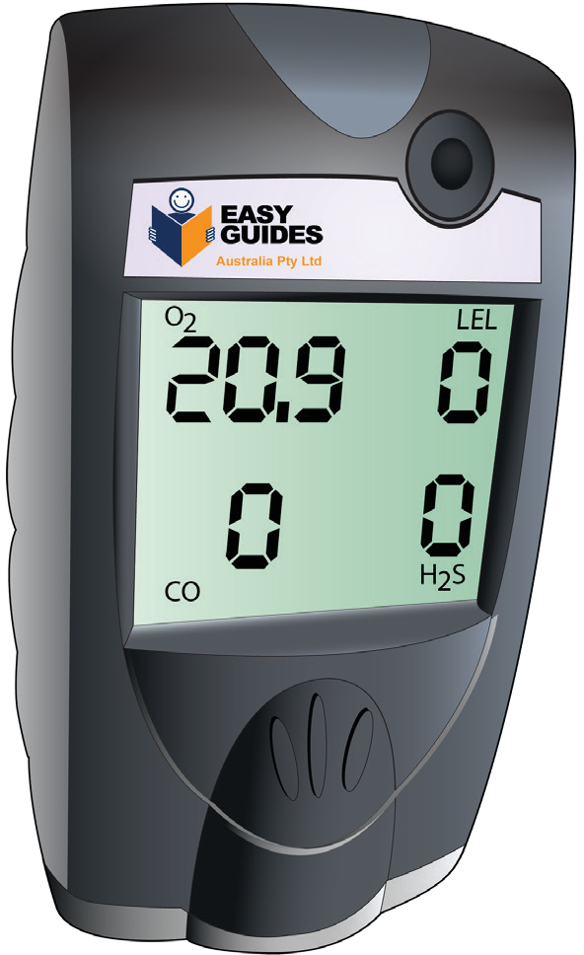

LEARNER GUIDE
Training support material for:
MSMWHS217
Gas test atmospheres
Produced by:
Picture based. Plain English. Learning made easy.

Slide 2

Prepare for gas testing
PLAN AND PREPARE TO USE HAND AND POWER TOOLS
Element 1

Slide 3

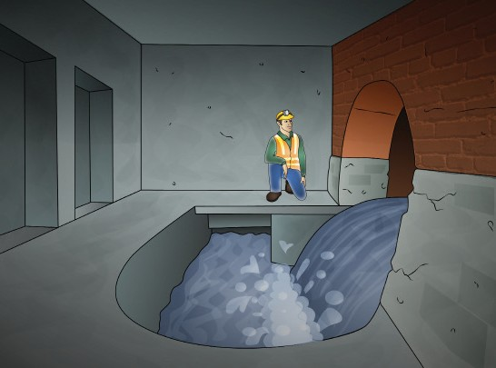
PC 1.1 PREPARE FOR GAS TESTING
Question 1. You are preparing for gas testing. How do you find out the type of gas/atmosphere to be tested?
Consult safety data sheets (SDS): Safety Data Sheets (SDS), sometimes referred to as Material Safety Data Sheets (MSDS), provide information about the hazardous chemicals used in your workplace.
These sheets include details about the chemical composition of substances, potential hazards, and recommended safety measures. Refer to the SDS for any materials you will be working with.
Talk to supervisors or safety personnel: Communicate with your supervisor or safety personnel responsible for the work area. They may have knowledge of the specific hazards associated with the task and can provide guidance on the gases or atmospheric conditions that need to be monitored.
Talk to safety personnel.
Assess the work environment: Visually assess the work environment to identify potential sources of gas emissions or atmospheric hazards. Look for equipment, processes, or materials that could release gases or create unsafe conditions.
Review industry standards and regulations: Consult relevant industry standards and occupational health and safety regulations that apply to your work. These standards often outline requirements for gas testing in specific situations. Ensure compliance with these standards.
Check the work environment.
Continued next slide...

Slide 4
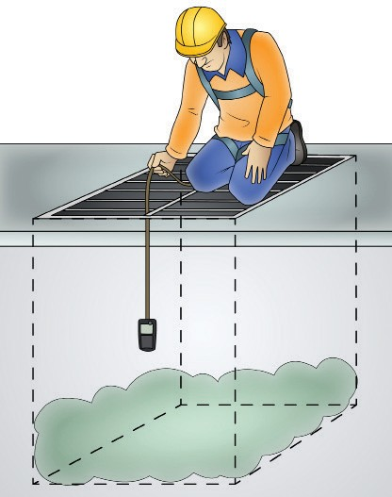

PC 1.1 PREPARE FOR GAS TESTING
Continued from last slide...
Consider the nature of the task: Think about the nature of the task you are performing. Different tasks may involve different hazards. For example, welding or chemical processing may involve the release of specific gases, while confined spaces may have unique atmospheric conditions that require testing.
Review work orders and job instructions: Check any work orders or job instructions related to the task or project you are working on. These documents often specify the types of gases or atmospheric conditions that need to be tested for as part of the job.
Use gas detection equipment.
Seek expert advice: If you are unsure about the specific gases or atmospheric conditions to be tested, seek guidance from safety experts, industrial hygienists, or environmental consultants. They can provide expertise in identifying potential hazards and recommending appropriate monitoring measures.
Use gas detection equipment: If necessary, use gas detection equipment such as gas monitors or detectors to assess the actual conditions in the work area. These devices can measure the concentration of gases in real-time and help identify any unexpected hazards.
Check work instructions.

Slide 5
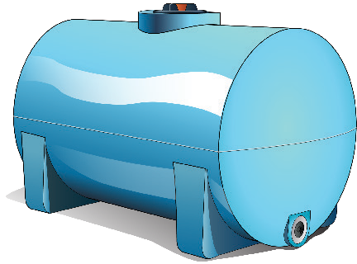

PC 1.1 PREPARE FOR GAS TESTING
Question 2. what are some typical gases you might find in confined spaces?
Oxygen (O2): Oxygen levels in confined spaces can vary, and in some cases, there may be a deficiency (oxygen levels below 19.5%) or enrichment (oxygen levels above 23.5%), both of which can be hazardous.
Hydrogen sulfide (H2S): This toxic gas is often found in sewers, manholes, and areas with organic materials undergoing decomposition. It has a foul odor at low concentrations but can be deadly at higher levels.
Water storage tanks.
Methane (CH4): Methane is a flammable gas commonly found in confined spaces associated with natural gas, sewage, and agricultural facilities.
Carbon monoxide (CO): Carbon monoxide is a colourless, odorless, and highly toxic gas that can be present in confined spaces with combustion sources, such as furnaces and engines.
Ammonia (NH3): Ammonia can be found in refrigeration systems and industrial settings, and it is both irritating and potentially hazardous to human health.
Ducts..
Continued next slide...

Slide 6
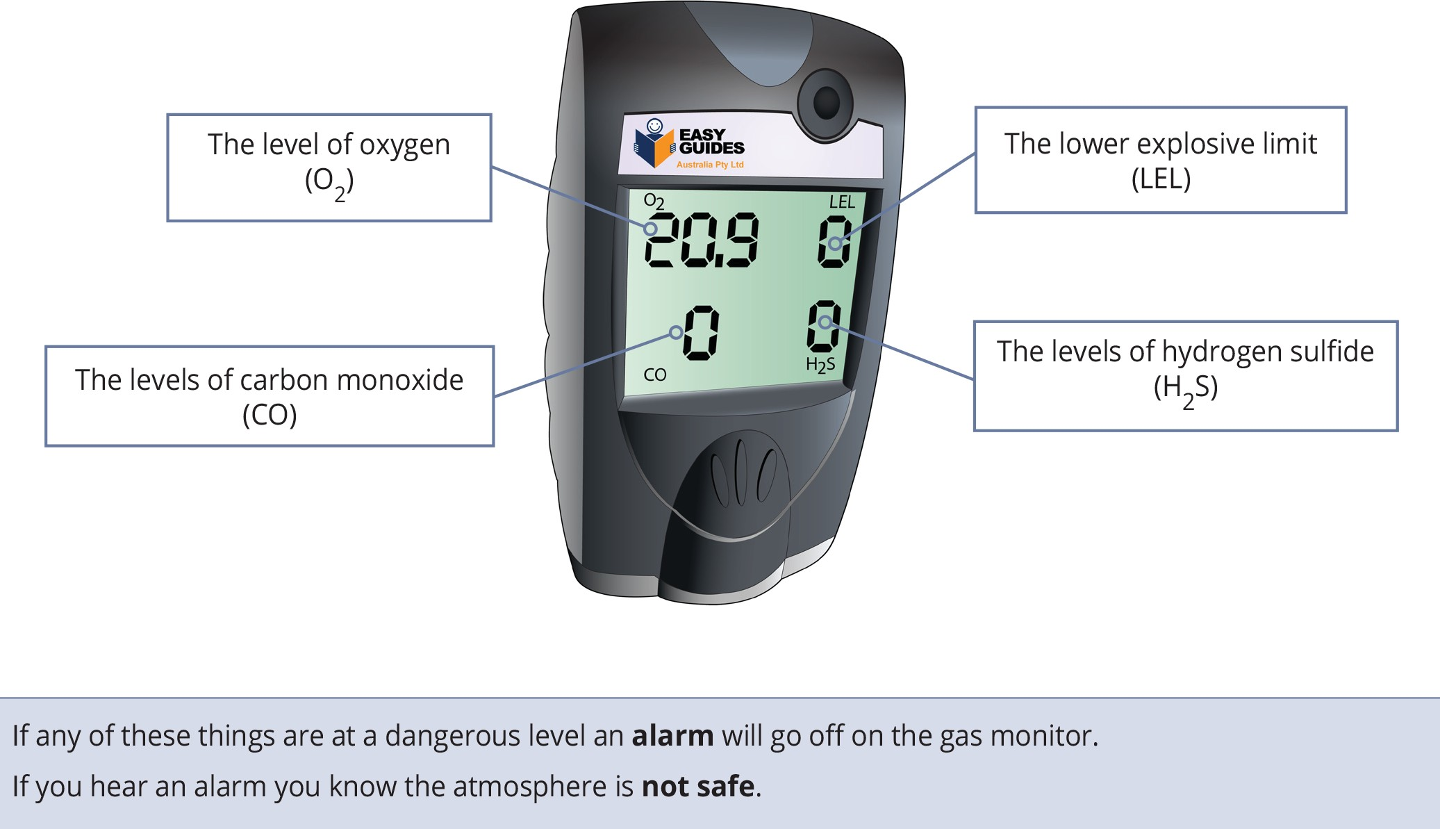
PC 1.4 PLAN AND PREPARE TO USE HAND AND POWER TOOLS
Question 10. What are the four dangers a gas monitor tests for?

Slide 7

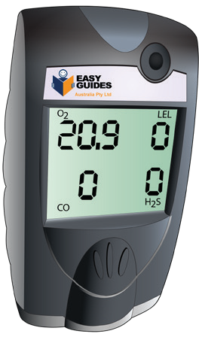
PC 1.5 PLAN AND PREPARE TO USE HAND AND POWER TOOLS
Question 11. You are preparing for gas testing. How can you implement hazard control measures and use appropriate personal protective equipment (PPE)?
Identify and assess hazards: Understand the type of gases you’ll be testing for and their potential risks.
Assess the testing environment, including confined spaces, tanks, pipelines, or
other areas where gas may accumulate.
Develop a written plan: Create a detailed gas testing plan that outlines procedures, responsibilities, and safety measures.
Identify safe entry and exit procedures for confined spaces, including rescue
plans.
Develop a written plan.
Select the right equipment: Choose appropriate gas detection
equipment based on the specific gases you expect to encounter.
Ensure that gas detectors are properly calibrated and maintained.
Establish safe work practices: Implement proper isolation and lockout/ tagout procedures to prevent the release of hazardous gases.
Establish safe work practices and procedures for gas testing, including who
can perform the testing and under what conditions.
Ventilation: If possible, ensure adequate ventilation in the testing area to dilute and disperse any hazardous gases.
Choose the right gas detection equipment.
Continued next slide...

Slide 8
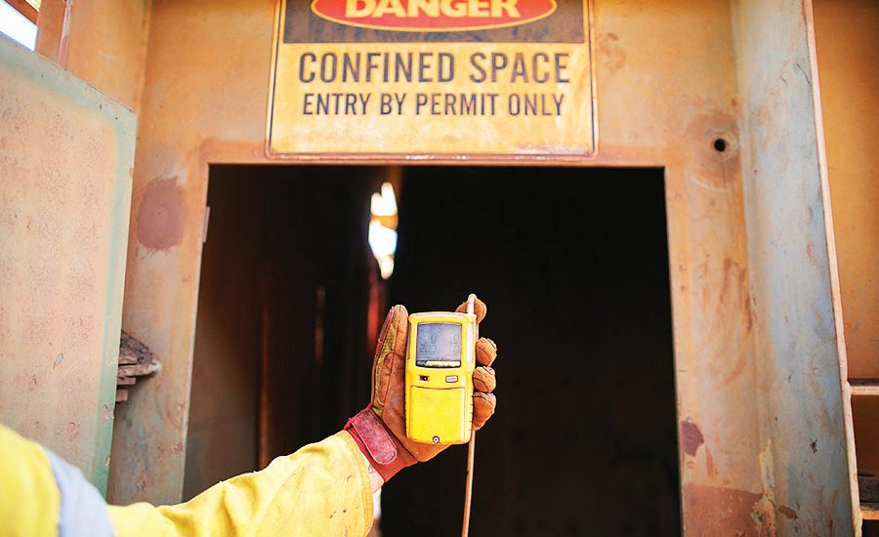
test gas
TEST GAS
Element 2

Slide 9
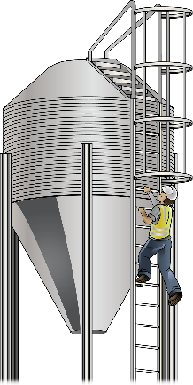
PC 2.1 TEST GAS
Question 15. You are using gas testing equipment. What permit might you need?
Confined space entry permit: If you are using gas testing equipment to assess the atmosphere inside confined spaces (such as tanks, silos, sewers, or underground tunnels), you may need a confined space entry permit. .
Hazardous work permit: In some industrial environments where exposure to hazardous gases is a risk, a hazardous work permit may be required.
Environmental monitoring permit: If you are conducting gas testing related to environmental monitoring or emissions control, you might need a permit from environmental regulatory agencies to ensure compliance with emission standards and environmental protection regulations.
Construction or demolition permit: Gas testing equipment may be used on construction sites or during demolition to ensure the safety of workers. Depending on local regulations, you might need specific permits for these activities.
Research or laboratory permits: In a research or laboratory setting, you might need permits related to the handling and testing of gases, especially if you are dealing with hazardous or controlled substances.
Occupational safety permits: Occupational safety permits or licenses may be necessary in some regions, particularly if you are conducting gas testing as part of occupational health and safety procedures.
You may need a permit to check the
atmosphere inside a confined space.

Slide 10
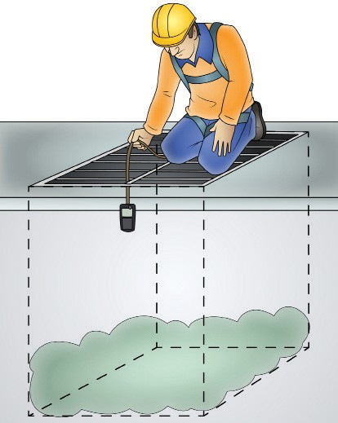
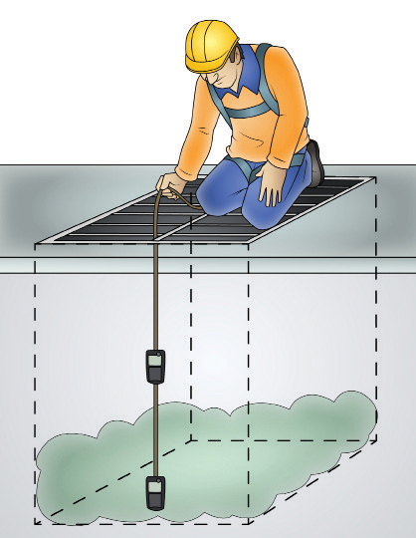
PC 2.1 TEST GAS
Question 16. How do you use gas testing equipment to test gas as needed?
Select the appropriate gas detection equipment: Choose the right gas detector for the type of gases you expect to encounter. Some detectors are specific to particular gases, while others can detect a range of gases.
Calibration and pre-check: Before each use, ensure that the gas detection equipment is properly calibrated according to the manufacturer’s instructions. Calibration verifies that the instrument is accurately measuring gas concentrations.
Perform a pre-check of the equipment to confirm that it is functioning correctly.
Check the battery, sensors, alarms, and display.
Set baseline readings: In a clean and safe environment (an area free from the target gases), turn on the gas detector and allow it to establish baseline readings. These readings serve as a reference point for detecting changes in gas levels.
Properly wear personal protective equipment (PPE): Before conducting any testing, ensure that you and your team are wearing the appropriate PPE, including respiratory protection, gloves, eye protection, and any other necessary gear based on the potential hazards.
Test gas at different heights. Some gases may be heavier or lighter than air.
Sampling strategy: Determine the appropriate sampling strategy based on the specific conditions and gas being tested. This may involve using a handheld gas detector to sample the air at different locations or using a fixed
Continued next slide...

Slide 11
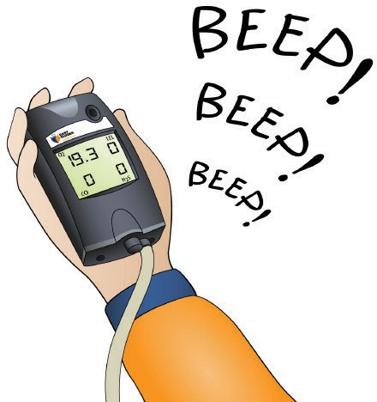
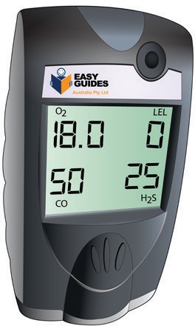
PC 2.1 TEST GAS
Continued from last slide...
Interpret and monitor readings: Pay close attention to the gas detector’s readings. If gas levels exceed safe limits or alarm thresholds, take immediate action, which may include evacuating the area or implementing safety measures.
Continuous monitoring: In some situations, continuous monitoring may be necessary. In this case, keep the gas detector operating throughout the work to provide real-time data on gas levels.
Record data: Document all gas testing activities, including the date, time, location, gas concentrations, and any actions taken in response to the readings.
Wear PPE for hazards.
Post-testing procedures: After gas testing is complete, turn off the gas detection equipment, properly clean and store it, and ensure that it is ready for the next use.
Emergency response plan: Be prepared to respond to any emergencies or abnormal readings, following the established emergency response plan.
Regular maintenance and calibration: After each use, follow the manufacturer’s guidelines for maintenance and calibration to keep the equipment in good working condition.
You may need to continually check readings..

Slide 12
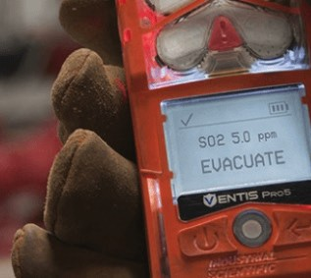
PC 2.2 TEST GAS
Question 17. You are using gas testing equipment. How do you interpret and report readings?
Take baseline readings: Before entering a potentially hazardous area, take baseline readings to establish the initial gas levels. These readings will serve as a reference point for comparison.
Continuous monitoring:
While in the area, continuously monitor gas levels. Pay attention to changes in readings, as sudden spikes or decreases can be indicative of a problem.
Record and report readings:
Record gas readings at regular intervals or whenever significant changes occur. Ensure that your report includes the following information:
Pay attention to changes in readings. There may be a problem.
Date and time of the readings.
The specific location or area where the readings were taken.
The type of gas detected.
The gas concentration in parts per million (ppm) or other relevant units.
Any alarms triggered and the actions taken in response.
Any environmental factors that might affect the readings (e.g.
temperature, humidity).

Slide 13
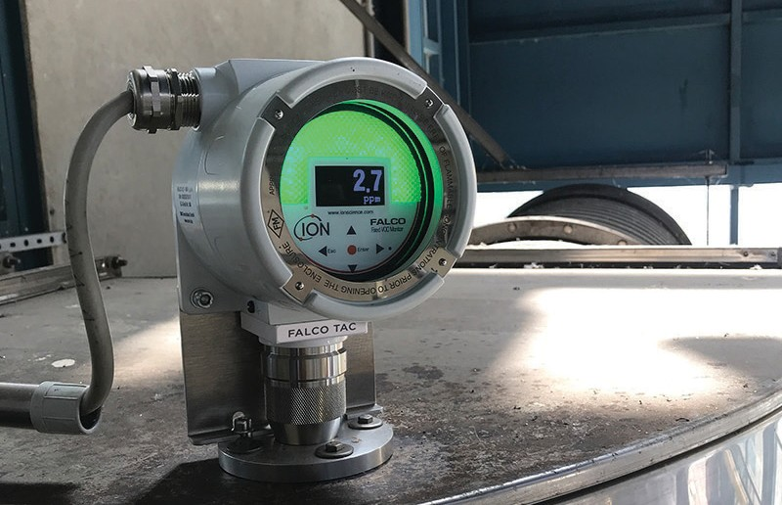
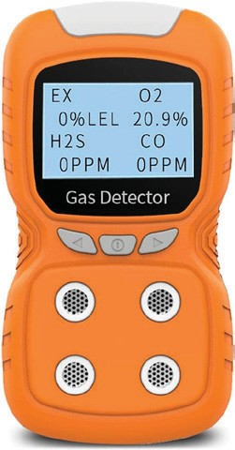
PC 2.3 TEST GAS
Question 18. How do you continuously monitor gas levels?
Here are some common methods for continuous gas level monitoring:
Fixed gas detection systems:
Fixed gas detectors are installed in specific locations where gas hazards are anticipated. These systems continuously monitor gas levels and provide real-time data.
Fixed gas detectors can be connected to alarms, control systems, or data loggers to provide immediate alerts when gas levels exceed predefined thresholds.
They are commonly used in industrial settings, such as refineries, chemical
plants, and manufacturing facilities.
Fixed gas detector.
Portable gas monitors with data logging:
Portable gas monitors can be worn by personnel entering potentially hazardous areas. These monitors continuously sample the air and log gas concentration data over time.
Data can be retrieved and analysed after monitoring is complete, providing a historical record of gas levels.
Some portable monitors can also transmit data in real-time to a central control room.
Portable gas detector.
Continued next slide...

Slide 14
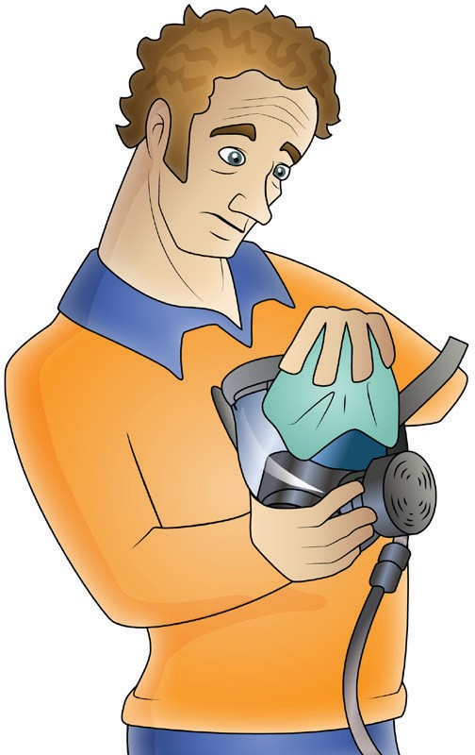
maintain equipment
Element 3

Slide 15
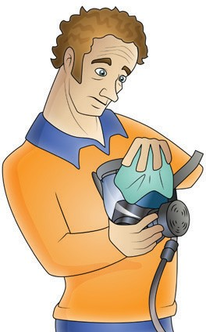
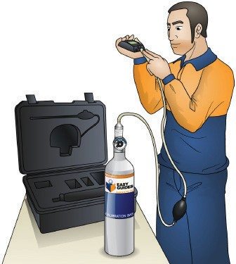
PC 3.1 MAINTAIN EQUIPMENT
Question 21. How do you clean gas testing equipment according to procedures?
Safety precautions:
Before starting any maintenance, ensure the equipment is turned off, and any
gas sources are disconnected.
Inspect for damage:
Examine the equipment for any visible damage, such as cracks, dents, or loose parts. If you find any damage, address it according to the manufacturer’s instructions or your organization’s maintenance procedures.
Clean external surfaces:
Wipe down the external surfaces of the equipment with a clean, dry cloth to remove dust, dirt, and contaminants. Use a damp cloth with mild detergent if necessary, but avoid getting the interior wet.
Clean external surfaces with a clean, dry cloth.
Calibration gas cylinder:
If your gas testing equipment requires calibration, ensure that the calibration gas cylinder is clean and in good condition. Secure it properly.
Sensor cleaning (if applicable):
If your equipment has gas sensors, consult the manufacturer’s guidelines for cleaning and maintaining the sensors. Some sensors may require periodic cleaning with specific cleaning solutions.
Make sure that the calibration cylinder is clean and in good condition.

Slide 16
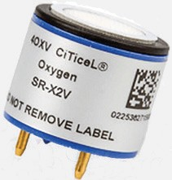
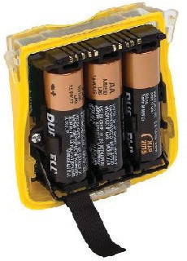
PC 3.1 MAINTAIN EQUIPMENT
Question 22. How do you maintain gas testing equipment according to procedures?
Calibration:
Gas testing equipment, especially portable gas detectors, may require regular calibration to ensure accurate readings. Follow the manufacturer’s recommended calibration schedule and procedure. Calibration typically involves exposing the device to a known concentration of the gas it measures and adjusting it if the readings are not accurate.
Sensor replacement (if applicable):
Some gas detectors have replaceable sensors with a limited lifespan. Follow the manufacturer’s guidelines for sensor replacement when they reach their end of life or start to malfunction.
Use a sensor replacement if possible.
Battery maintenance:
Check and maintain the batteries in your equipment as per the manufacturer’s
recommendations. Ensure they are charged and functioning correctly.
Leak testing:
Periodically perform leak tests to check for any gas leaks in the equipment. Follow manufacturer instructions for this procedure.
Make sure batteries are maintained.
Continued next slide...

Slide 17
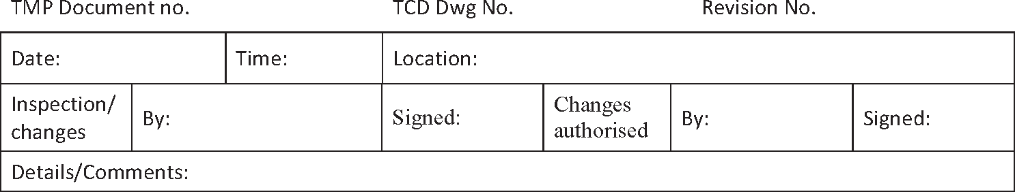
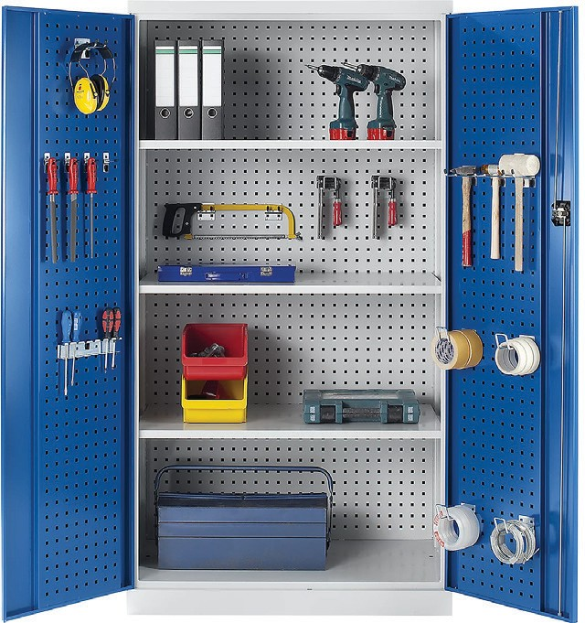
PC 3.1 MAINTAIN EQUIPMENT
Continued from last slide...
Record keeping:
Maintain detailed records of all maintenance activities, including calibration dates, sensor replacements, and any issues or repairs performed. This documentation is often required for compliance and quality assurance purposes.
Keep a record of maintenance activity.
Train personnel:
Ensure that personnel using the equipment are properly trained in its maintenance and use. This includes knowing how to perform routine checks and maintenance tasks.
Replace consumables:
Replace any consumable items, such as filters or hoses, based on the
manufacturer’s recommended schedules.
Store properly:
When not in use, store the gas testing equipment in a clean, dry, and controlled environment. Protect it from extreme temperatures, humidity, and physical damage.
Regular maintenance and cleaning of gas testing equipment are critical to ensure its accuracy and reliability in detecting gas concentrations.
Following manufacturer recommendations and your organization’s procedures is essential for the safety of personnel and the integrity of the testing process.
Store the gas testing equipment in a clean, dry, and controlled environment.

Slide 18
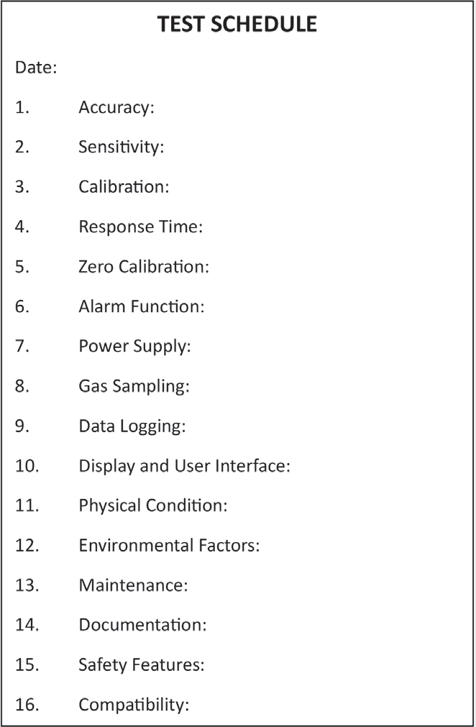
PC 3.4 MAINTAIN EQUIPMENT
Question 25. How would you maintain records of tests and results in accordance with procedures?
Document test procedures:
These procedures are often provided by the manufacturer and may include guidelines for testing, calibration, and maintenance.
Test Schedule:
Have a regular testing schedule based on the equipment’s requirements and workplace policies. Record the planned test dates in a schedule or calendar to make sure tests are not overlooked.
Test results form:
This form should include fields for essential information, such as the date,
equipment details, test conditions, and results.
Identification:
Clearly identify the equipment by name, model, and serial number in the records. This helps track and differentiate between different pieces of equipment, especially in larger facilities.
Test environment:
Record information about the test environment, including factors like temperature, humidity, and atmospheric pressure. These conditions can impact the equipment’s performance.
Record test schedule.
Continued next slide...

Slide 19
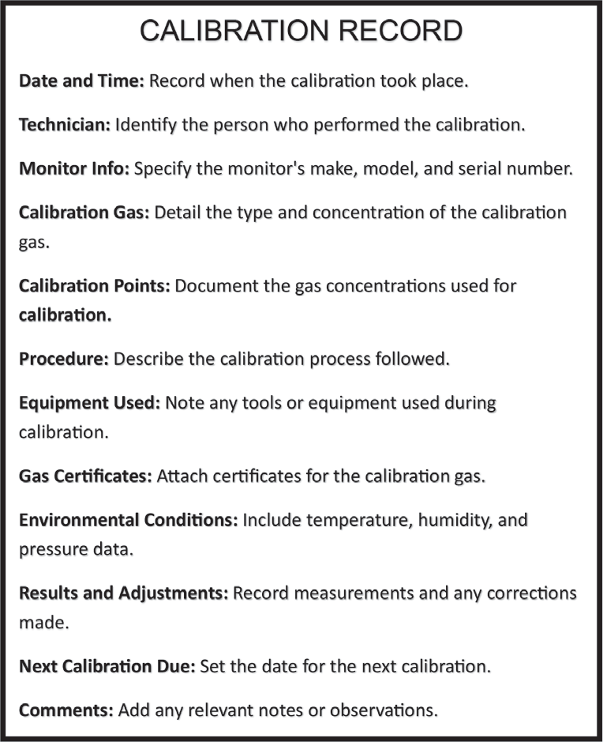
PC 3.4 MAINTAIN EQUIPMENT
Continued from last slide...
Test data:
Record the data from each test, including readings, measurements, and any deviations from expected values. Be precise and consistent in your data entry.
Calibration information:
If the equipment requires calibration, document calibration dates, gas concentrations used, and the results of the calibration process. Attach calibration certificates to the records if applicable.
Maintenance actions:
Include information about any maintenance actions taken during or after testing. This may involve sensor cleaning, calibration, or adjustments.
Errors or issues:
If any errors, malfunctions, or issues are encountered during testing, document them in detail. This information is valuable for troubleshooting and corrective actions.
Calibration record.
Authorised signatures:
Have the records signed and dated by authorized personnel. These signatures indicate that the tests were conducted according to procedures and provide accountability.
Continued next slide...

Slide 20

PC 3.4 MAINTAIN EQUIPMENT
Continued from last slide...
File organization:
Establish a systematic way to organize and store test records. Consider using a digital document management system or physical folders to keep records accessible and well-organised.
Retention period:
Be aware of the retention period required by your organization’s policies or relevant regulations. Test records may need to be retained for a specific duration, often for compliance and auditing purposes.
By maintaining accurate and well-organized records of tests and results, you contribute to the equipment’s reliability, safety, and compliance with industry standards and regulations. These records are invaluable for identifying trends, troubleshooting issues, and ensuring that the gas monitoring equipment functions as intended.
Keep records..

