Slide 1
Electrotechnology Health and Safety Induction
Apply Occupational Health and Safety regulations, codes and practices in the workplace UEECD0007
Learner Guide
Edition 1

Slide 2
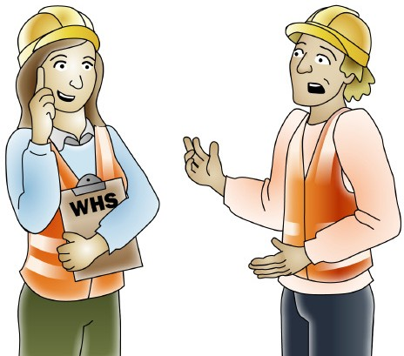
Contents
Performance Criteria Index....................................................................................4
Workplace health and safety in the electrotechnology industry.............................5 Aims of electrotechnology health and safety induction..........................................6
T1 Workplace health and safety laws ...........................................................7
T2 Work hazards, emergencies and controls .............................................19 T3 Manual handling ....................................................................................75
T4 Chemicals in the workplace...................................................................79
T5 Working safely at heights ......................................................................83
T6 Confined spaces....................................................................................91
T7 How hazards affect people ....................................................................95
T8 Working safely with electricity..............................................................101
T9 First aid and CPR ................................................................................107
Acknowledgements ........................................................................................... 111

Slide 3
Workplace health and safety laws
T1
The basic legal requirements covering occupational health and safety in the workplace encompassing:
underlying principles of OH&S
general aims and objectives of the relevant state or territory legislation relating to OH&S
employer and employee responsibilities, rights and obligations
major functions of safety committees and representatives
powers given to Occupational Health and Safety Inspectors
housekeeping and potential hazards in relation to improper housekeeping
selecting appropriate personal protective equipment (PPE) given hazardous situations

Slide 4
Legal requirements covering occupational Health and Safety in the workplace
‘Workplace health and safety laws’
WHS/OHS requirements are outlined in Acts, Regulations, Codes of Practice and Australian Standards.
WHS/OHS Acts
‘WHS/OHS Acts’ are laws that explain how to improve health and safety in the workplace. For example: Model National WHS Act, June 2011.
Regulations
‘Regulations’ explain specific parts of the Act. For example: Part 4.3 – Confined Spaces, Part 4.4 – Falls.
Codes of Practice/Compliance Codes
‘Codes of practice’ are practical guidelines on how to comply with (meet the rules of) legislation. For example: Managing electrical risks in the workplace Code of Practice - April 2012.
Australian Standards
‘Australian Standards’ are work guidelines that set the minimum accepted performance or quality for a specific hazard, process or product. For example: AS/NZS 3760:2010 In Service Safety Inspection and Testing of Electrical Equipment
Examples of WHS/OHS legislative requirements:
Duty of care
Construction industry WHS/OHS standards and guidelines
Licences, tickets or certificates of competency
Health and safety officers/representatives, committees and supervisors
National Code of Practice for Induction Training for Construction Work
WHS/OHS and welfare Acts and Regulations
Safety codes of practice.
It is important that you know about these legislative requirements and how they affect the work that you do. These laws, regulations and guidelines are in place to make your worksite a safe place to work. They are there to protect you and the workers around you, and will help you understand your legal responsibility for WHS/OHS.

Slide 5
Electrotechnology industry WHS/OHS standards and codes
Guidelines are created to maintain a minimum level of quality for the electrotechnology industry.
Here are some common examples of Australian Standards:
AS/NZS 3760:2010
In Service Safety Inspection and Testing of Electrical Equipment
AS/NZS 3012:2010
Electrical installations - Construction and Demolition sites
AS/NZS 60335.2.25:2002
Household and similar electrical appliances - Safety
- Particular requirements for microwave ovens, including combination microwave ovens (IEC 60335- 2-25 Ed 5.2, IDT)
Managing electrical risks in the workplace Code of Practice - April 2012
Your trainer may show you a copy of the 'Managing electrical risks in the workplace Code of Practice - April 2012' and give you a short summary of its contents.
Other Codes of Practice include:
National Code of Practice for Induction for Construction Work
Electrical Code of Practice
WHS Act and Regulations
Laws that describe how to make your workplace a healthy and safe place to be.
Safety codes of practice
Guidelines on how to carry out a task safely and in accordance with WHS laws.

Slide 6
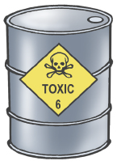
Basic Principles of Risk Management
Hazard versus risk: What’s the difference?
The constantly changing nature of construction work sets it apart from other types
of work. Different hazards and risks emerge constantly–sometimes instantly.
Co-ordinating risk management is made more difficult by the stop and start nature
of a construction project, high turnover of workers and temporary workplaces. These features contribute to the high levels of risk in the industry.
A hazard is any thing or any situation which could injure or harm you.
In other words, it is anything that can hurt you.
hazad
A risk is the chance of a hazard causing injury or harm.
In other words, how likely it is that somebody or something may be harmed by the hazard.
risk

Slide 7
1.1 Work area access permits are obtained from appropriate personnel according to established procedures
‘Get the right permits for the work you will be doing.’
You need a permit to do some types of work. This is usually because the type of work, or the site has special hazards you need to know about. By using a permit system, the employer (boss) can make sure that the person who is doing the work is properly trained and knows about the hazards.
Here are some types of work that you may need a permit to do:
electrical
cold or hot work
excavation
vehicle entry
minor repairs
working at heights
confined space
increased hazard
other relevant permits.
Different sites may have different rules about the types of permits you need. It is important you check which permits you need with your supervisor (boss) before you start work.

Slide 8
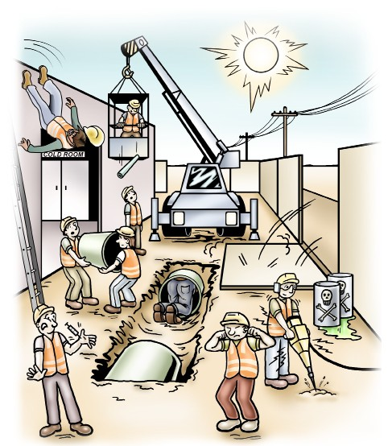
3.1 Hazards are identified and control measures implemented and monitored through
active participation in the consultation process with employer and other employees
Hot working environment ultraviolet (UV) radiation
Working at heights
Traffic and mobile plant
Electrical safety
Cold working environment
Unplanned collapse
Manual handling
Hazardous substances and dangerous goods
HIV and other infectious diseases
Confined spaces
Excavations including trenches
Plant and equipment
Noise
You will see a number of these hazards while working in construction. Each of them carries a
risk of harm to yourself and others so it is important that you check for these hazards regularly and know what to do if you find them.

Slide 9
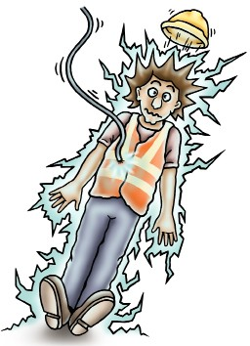
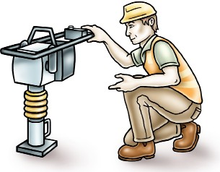
Electrical hazards
Make sure you report any electric shocks or short circuits.
Z
All electrical equipment must be checked, tested and tagged
by a qualified person who has completed an approved course.
For example, in Victoria you can get the qualification from the
Chief Electrical Inspector.
!
AP

Slide 10
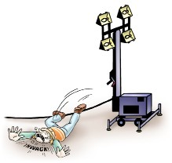
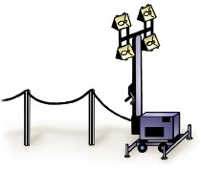
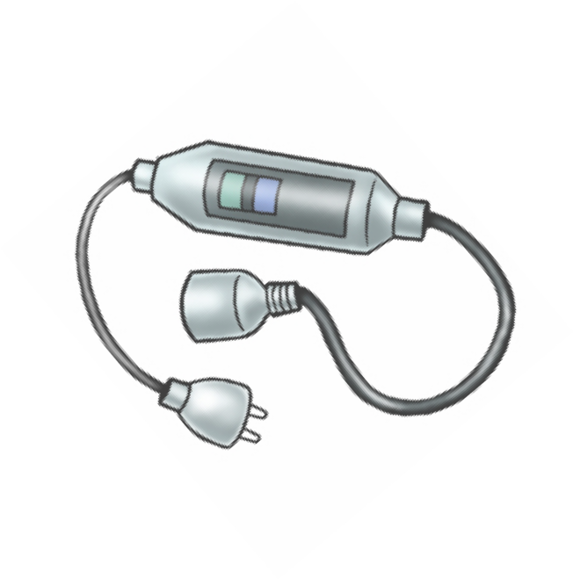
Electrical hazards – continued
Any faulty equipment should be tagged and isolated (removed/stored) to stop anybody from using it.
Make sure any electrical leads are suspended well off the ground to avoid any tripping hazards or damage to leads.
You can do this by using electrical lead hooks or stands.
Electrical equipment should be earthed. Portable equipment must have a portable earth leakage circuit breaker.
All electrical equipment should be routinely inspected.

