Slide 1

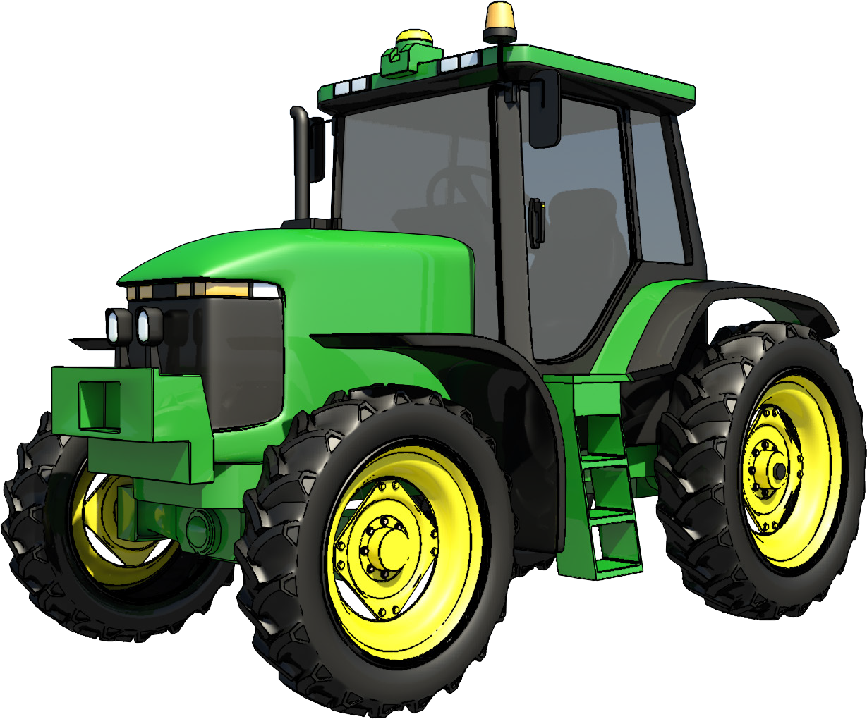

LEARNER GUIDE
Tractor
Training support material for:
RIIMPO315E
Conduct tractor operations
TICKET
Produced by:
Picture based. Plain English. Learning

Slide 2
Introduction to tractor

Slide 3
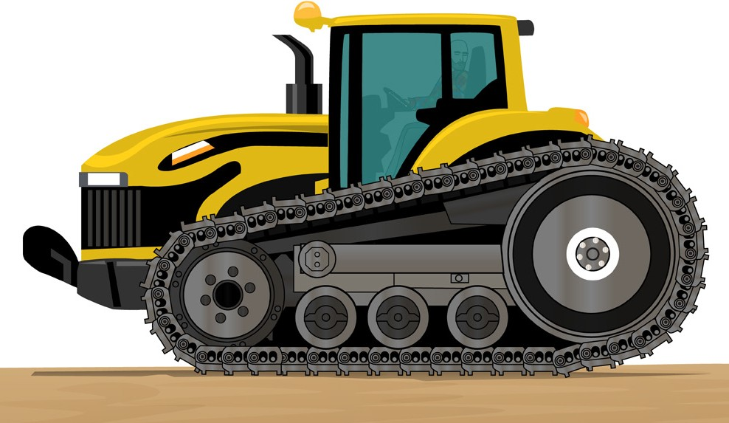
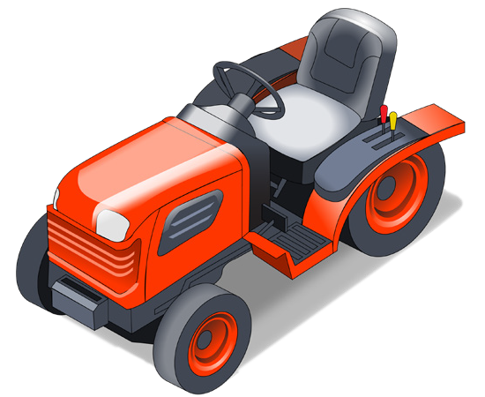
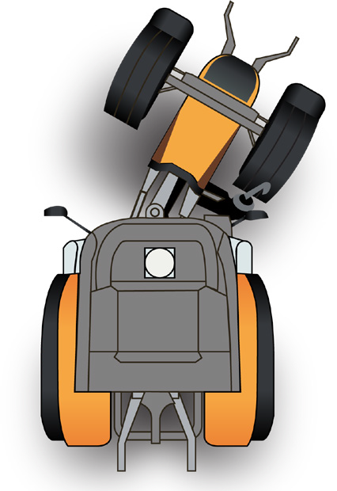
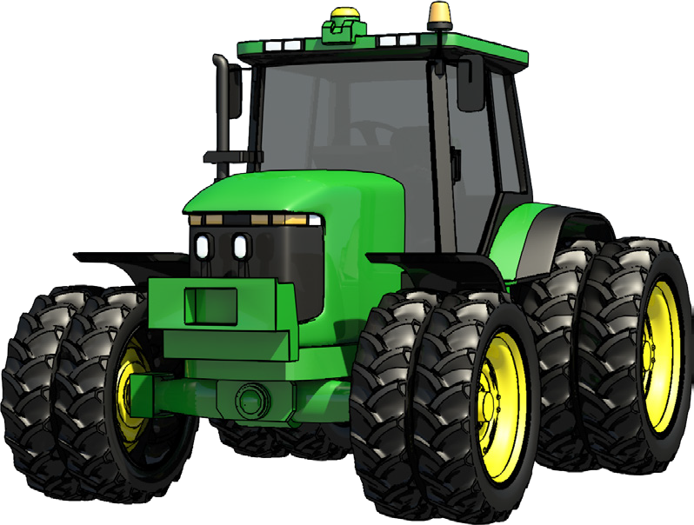
PC 1.6
INTRODUCTION TO TRACTOR
Tractor examples
Rigid wheeled tractor | Tracked tractor
Articulated tractor | Dual wheeled tractor

Slide 4
PC 1.6
INTRODUCTION TO TRACTOR
Parts of a tractor
Flashing safety light
Falling object protective structure (FOPS)
Climate control cabin
Roll over protective structure (ROPS)
Exhaust
Engine cover
Steering wheel
Engine
Seat
Grill
Headlights
Rim
Counter weight
Rear axle
Rear tyre
Front tyre
Steps
Front axle
Rim
Platform

Slide 5

Plan and prepare for tractor operations
Element 1

Slide 6

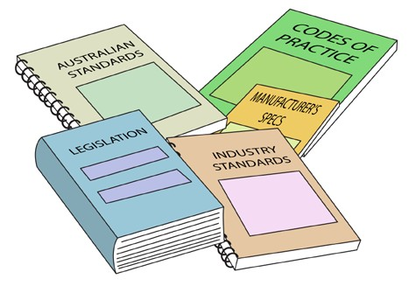
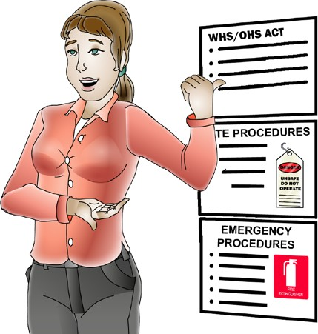
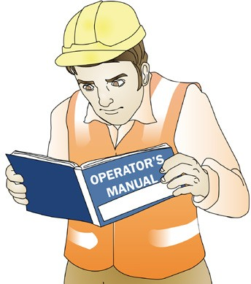
PC 1.1
PLAN AND PREPARE FOR TRACTOR OPERATIONS
Australian standards For example: AS2958 Earthmoving machinery AS2153 Tractors and machinery for agriculture and forestry | Worksite rules, policies and procedures The rules, policies and procedures of the company you are working for or the site you are working on should be made available by the employer during site induction. You could also speak to your supervisor or human resources department to get this information.
Guidance notes For example: Guide to the model WHS Act Formwork and falsework guidance material Check what’s available from your state or territory regulator. | Operator’s manual The manufacturer’s guidelines and the tractor’s specifications can be found in the operator’s manual. It includes information about: Start up and shut down procedures Maintenance requirements and schedules Correct and safe operation Safety requirements.

Slide 7

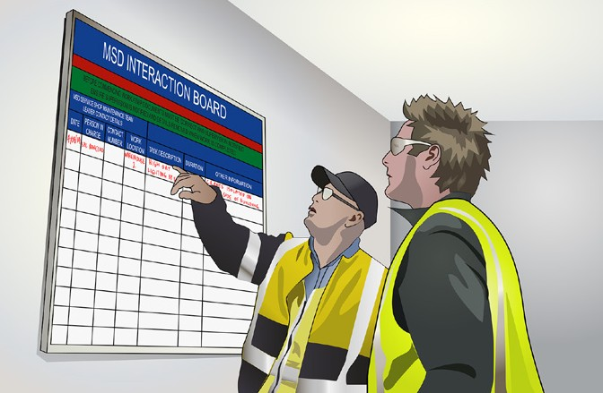
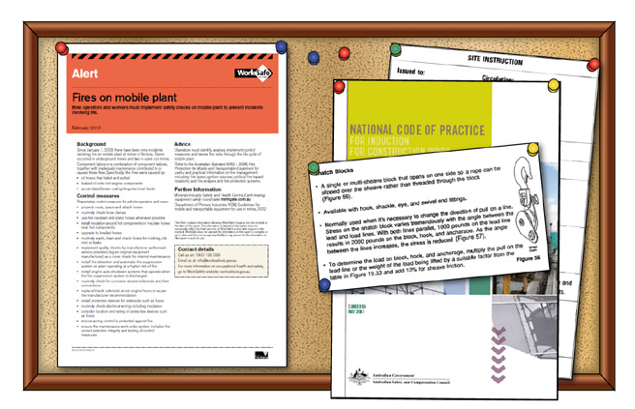


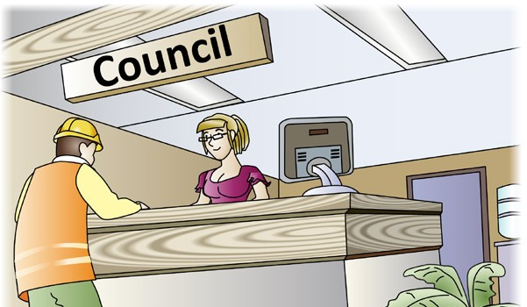
Work instructions
PC 1.2 PLAN AND PREPARE FOR TRACTOR OPERATIONS
Work instructions are important so workers know what needs to be done, how it is to be done and when they need to do it.
This allows work to be completed in a way that is safe, efficient, compliant and meets quality requirements.
Work instructions include things like:
Verbal, written and graphical instructions | Signage, work schedules and plans | Work bulletins, memos and maps
Safety data sheets (SDS) | Quality requirements | Instructions issued by authorised organisations or external personnel.

Slide 8
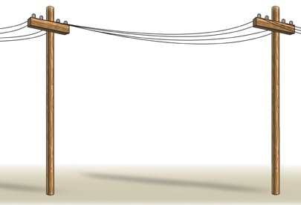
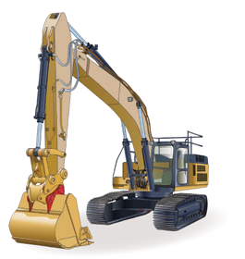


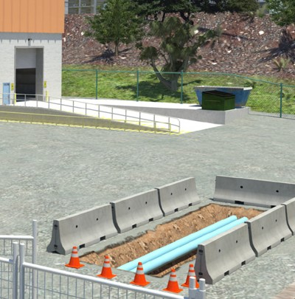
PC 1.3
PLAN AND PREPARE FOR TRACTOR OPERATIONS
Plan for safety
It is a good idea to have an operational plan before
you start work.
Your plan should show that you have thought about:
Above eye level
Check for obstructions, buildings, and anything else above eye height.
How to do the job
What needs to be done first
Workplace rules and procedures
Hazards and risks (including environmental hazards and risks)
Equipment and resources needed to do the job.
Inspect the site
You should inspect the work area for hazards and risks daily before starting work.
A good rule is to check:
At eye level
Look for other machines, people and obstructions that may be in the path where you want to work.
Below eye level
Check the surface of the ground. Check for boggy ground or any other obstructions that might interfere with the safe operation of the tractor.
Above eye level
At eye level
Below eye level.
Continually monitor
Just because you inspected your work area for hazards and risks at the start of the day, it does not mean new hazards and risks won’t arise throughout the day.
Always be aware of what is happening around you.

Slide 9
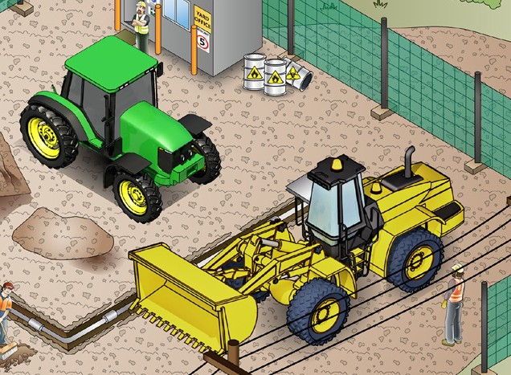
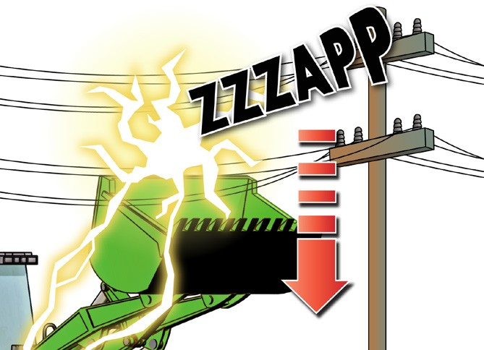
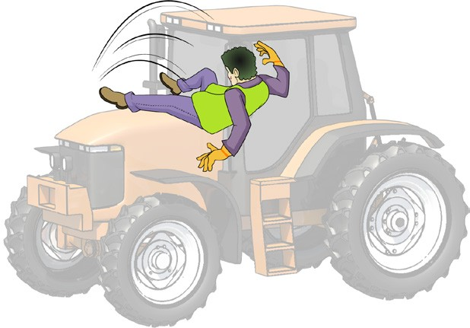
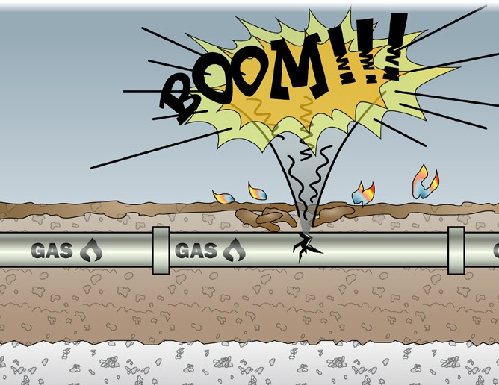
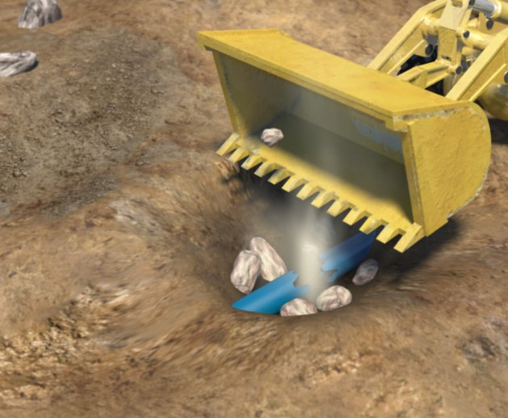
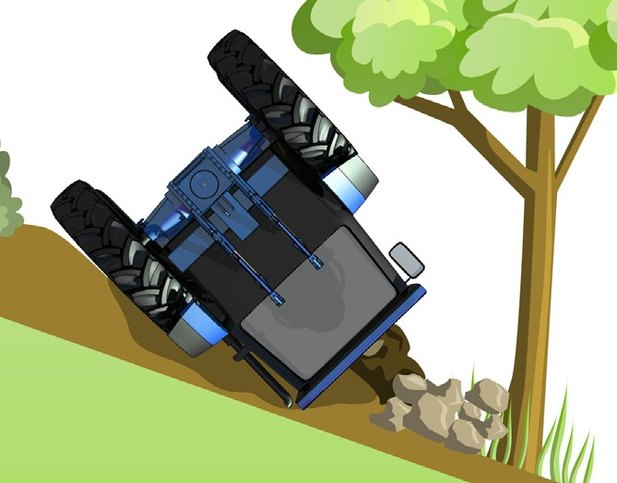
Tractor hazards and risks
PC 1.3 PLAN AND PREPARE FOR TRACTOR OPERATIONS
It is important to check for hazards before you start work. Some common hazards and risks with tractor work are:
Falls from the tractor | Traffic and other mobile plant | Overhead or underground power
Underground gas lines | Water and sewage piping | Roll overs

Slide 10
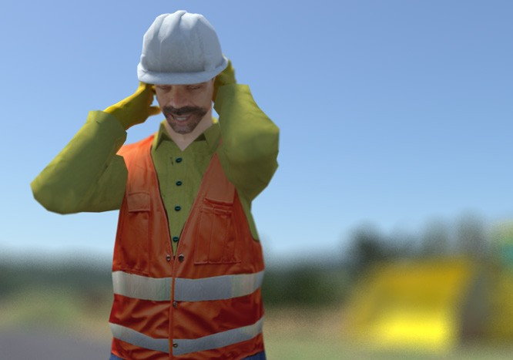
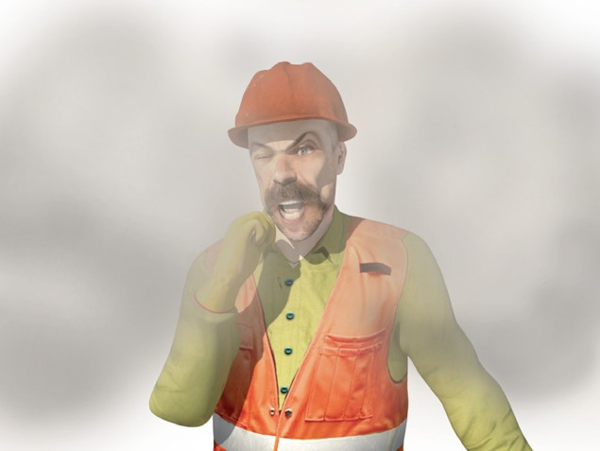
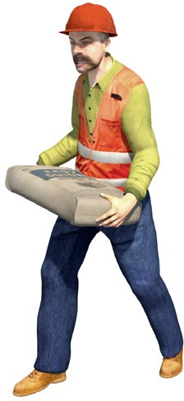
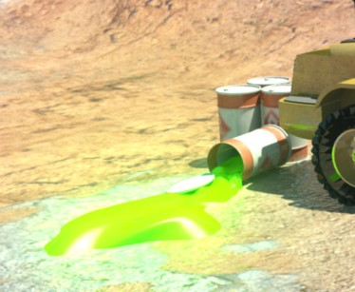
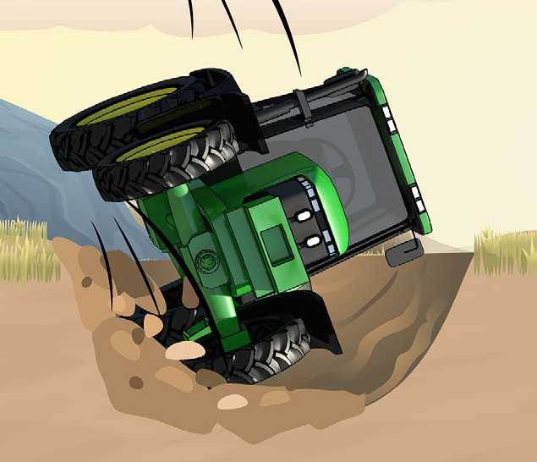

PC 1.3
PLAN AND PREPARE FOR TRACTOR OPERATIONS
Tractor hazards and risks (continued)
Noise | Dust | Manual handling
Contaminated soil | Falling into trenches or excavations | UV rays (radiation) from working in the sun

Slide 11
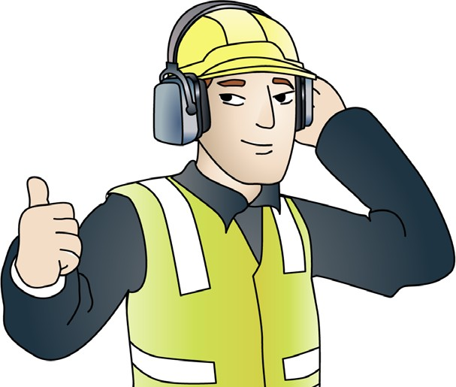
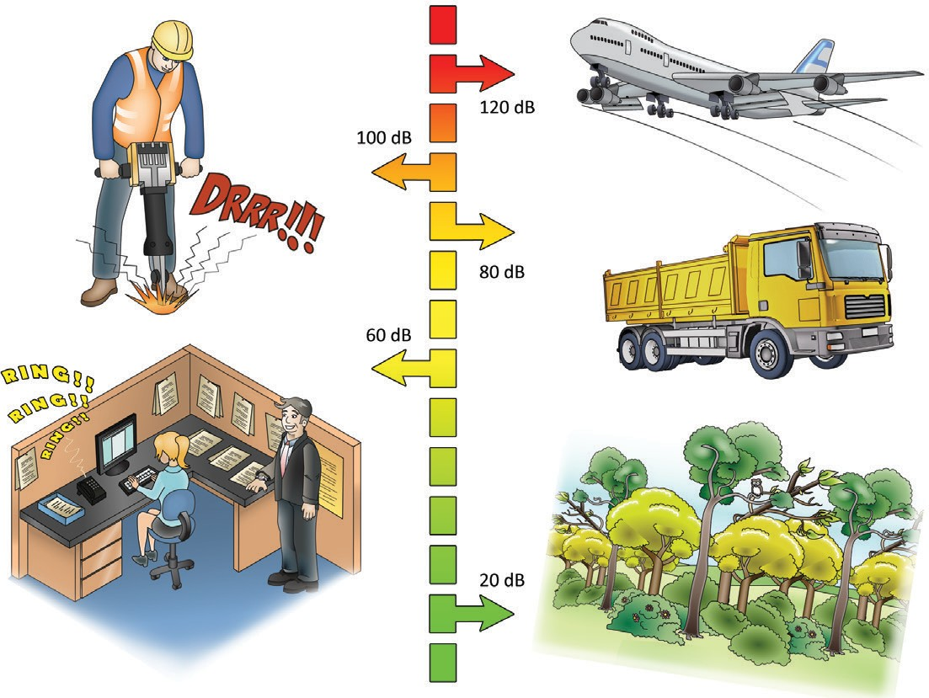
Decibel levels of common sounds
PC 1.3 PLAN AND PREPARE FOR TRACTOR OPERATIONS
You must wear hearing protection when operating tractors.
This is important because 8 hours of noise at 85 db (decibels), or noise
levels of 140 db even briefly can permanently damage your hearing.
Hearing loss is:
Slow
Painless
Irreversible.
Levels of noise
Here are some examples of levels of noise in
different environments.
A forest has about 20 db of noise
In an office there might be around 60 db
Standing outside a truck generates about 80 db
A jackhammer generates around 100 db
A jet taking off generates about 120 db

Slide 12

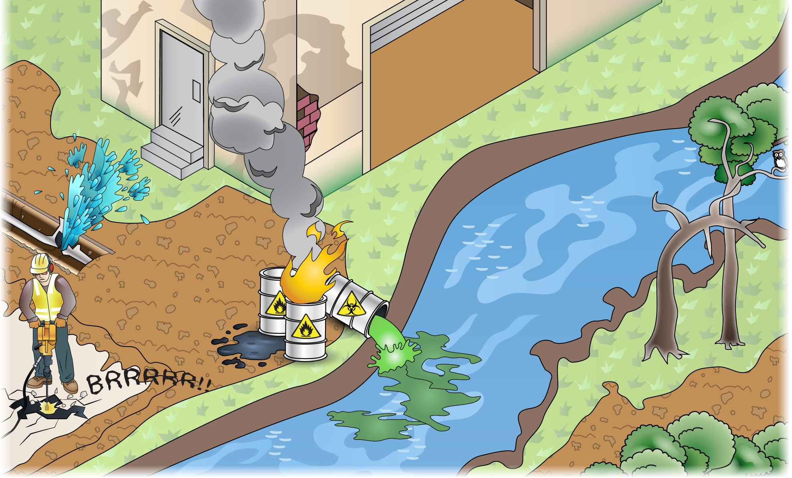
Environmental protection requirements
PC 1.3 PLAN AND PREPARE FOR TRACTOR OPERATIONS
Sometimes the environment can be damaged by work which is done. The worksite may have an Environmental Management Plan (EMP) in place.
The EMP is a plan that is developed for the worksite to identify all the environmental hazards and give information on how they must be controlled so the environment is protected. The plan also makes sure the site is complying with environmental legislation including the correct disposal of rubbish and waste products.
Some environmental issues that need to be considered include:
Waste management and clean up
Air pollution
Asbestos
Water quality protection
Underground services
Fire
Fuel and oil spills
Soil damage and erosion
Damage to plants and trees
Chemicals and hazardous substances
Noise, vibration and dust

Slide 13
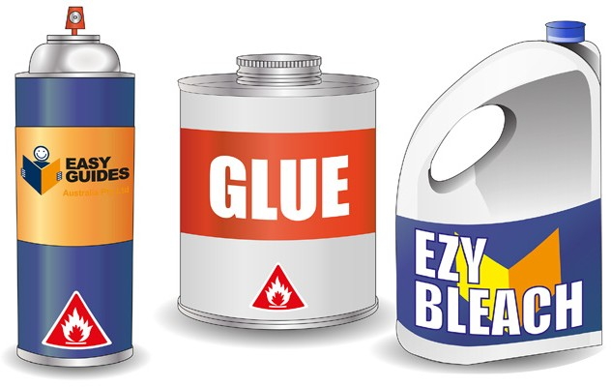
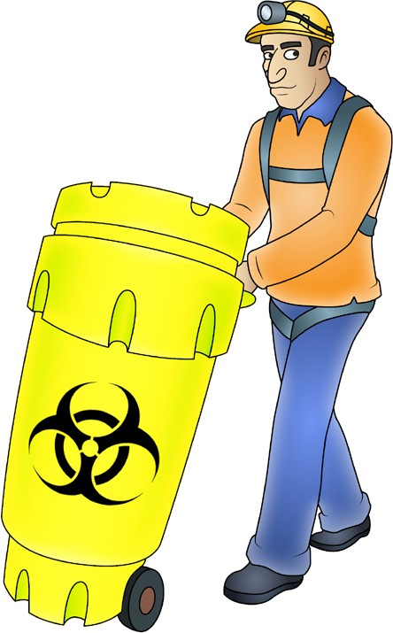


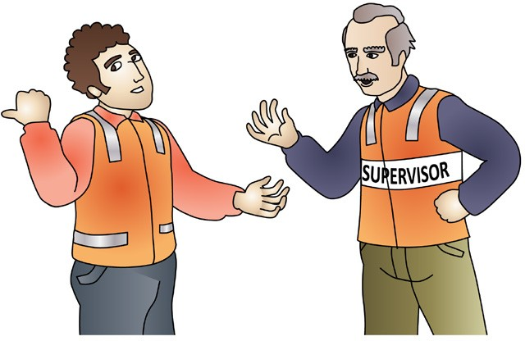
Chemicals and solvents
PC 1.3 PLAN AND PREPARE FOR TRACTOR OPERATIONS
Chemicals should always be labelled so that you can easily tell what chemical you are working with.
Chemicals should be stored in a safe place where someone cannot accidentally come into contact with them.
Always check the Safety data sheet (SDS) before handling any chemicals.
Safety data sheet (SDS)
The SDS must be provided to and understood by any person using chemicals in the workplace. | The SDS will tell you how to safely handle the chemicals and what PPE to wear. | If you are not sure: Put the chemicals in a safe, isolated area Talk to your supervisor.

Slide 14

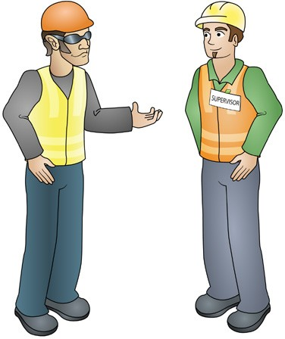

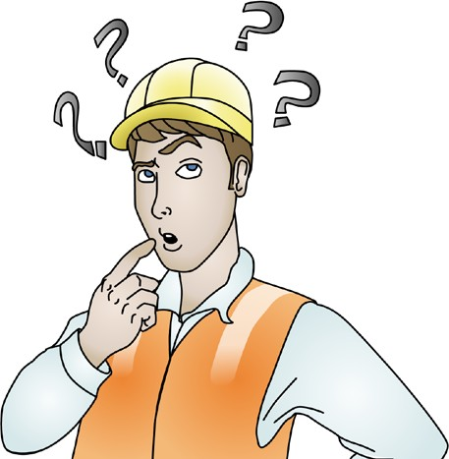
PC 1.3
PLAN AND PREPARE FOR TRACTOR OPERATIONS
Health and safety reports and forms (continued)
Check with your supervisor | Raise any safety concerns
See your supervisor once you have filled out the necessary reports and forms to make sure you are safe to go ahead and begin work. Some forms will require your supervisor to sign off on the details of the job. | Raise any safety concerns that you have with your supervisor or health and safety representative by talking to them or put it in writing.
Fatigue
Tight deadlines and lost time due to poor weather conditions can be some of the reasons workers do long or rotating shifts. This can lead to fatigue which can be a significant hazard.
Fatigue can lead to a worker having:
Managing fatigue
Sleep is the only effective long term strategy to prevent and manage fatigue.
While tired muscles can recover with rest, the brain can only recover with sleep.
The most beneficial sleep is a good night’s sleep taken in a single continuous period.
Lack of concentration
Slow reaction times
Confusion
Increased errors.

Slide 15
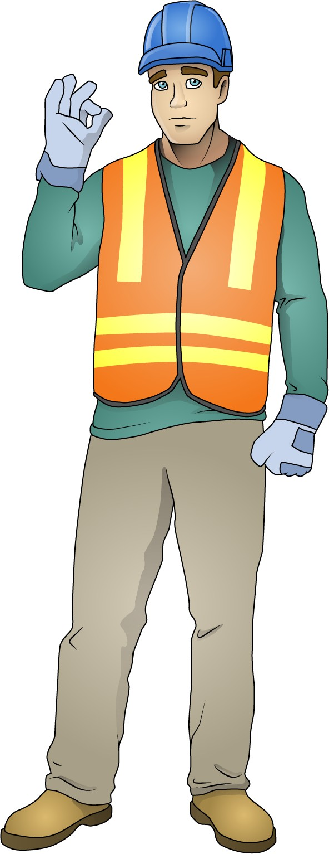

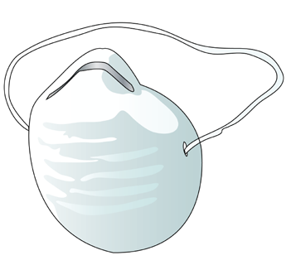



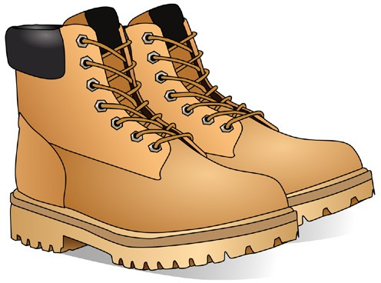


Personal protective equipment (PPE)
PC 1.4 PLAN AND PREPARE FOR TRACTOR OPERATIONS
The best way to make the workplace safe is to take away hazards altogether. But often you can’t do this. This is where Personal Protective Equipment (PPE) can help.
PPE is clothing or equipment worn on the body to help protect you from hazards. PPE will not take away the risk of harm altogether, but it will help keep you safe. Wear the PPE for the job you are doing.
Here are some examples of PPE:
Safety vest
Dust mask
Hard hat
Safety gloves
Long sleeved top
Ear muffs
Boots that cover the whole foot
Safety glasses/goggles, Sunglasses
Long pants
Sunscreen

Slide 16
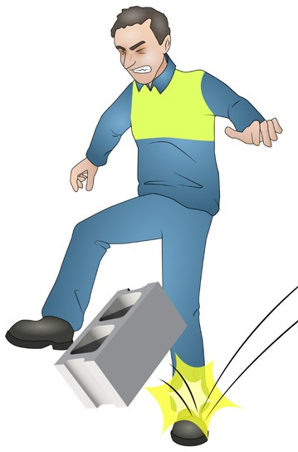
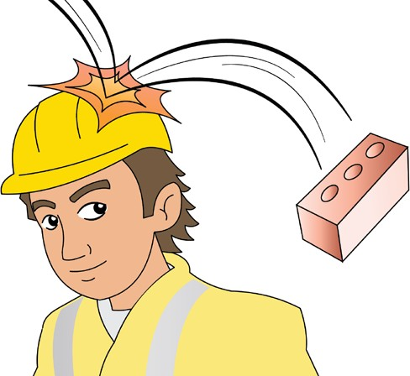
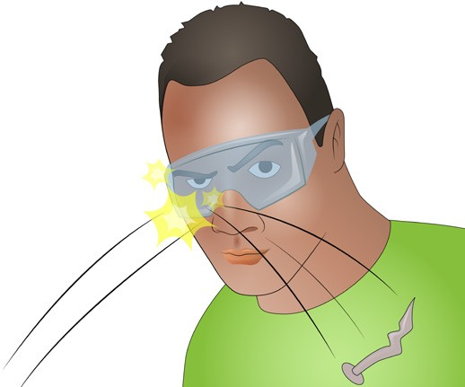
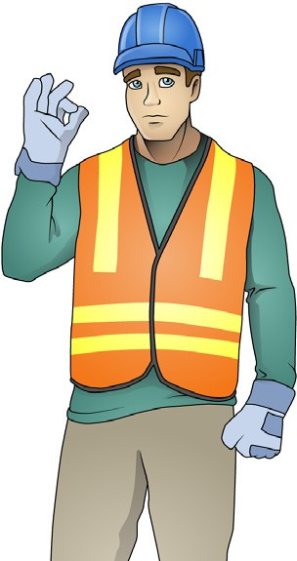
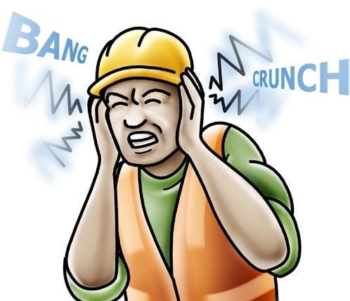
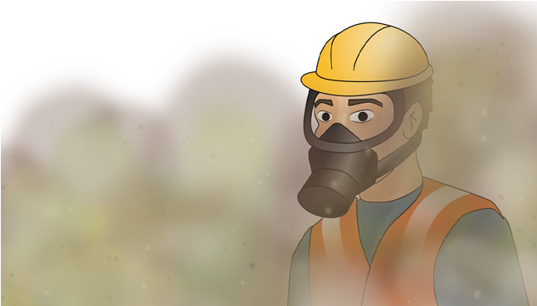
PC 1.4 PLAN AND PREPARE FOR TRACTOR OPERATIONS
PPE examples
These are examples of how personal protective equipment can protect you and your work mates.
Safety shoes or boots should be worn. It is important that your footwear is safe and the right type for the work you do and the conditions you work in. | Safety helmet or hard hat can protect your head from falling objects. | Safety glasses, goggles or a face shield can protect your eyes from harmful objects.
Respiratory equipment can stop you from breathing in harmful substances such as gasses, dust or other contaminants. | Earmuffs or earplugs should be worn whenever there is a chance of noise causing loss of hearing. | Safety gloves should be worn to help prevent cuts, burns and abrasions. Gloves will also stop hazardous materials getting into your body through your skin.

Slide 17
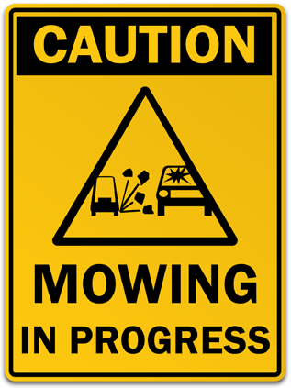
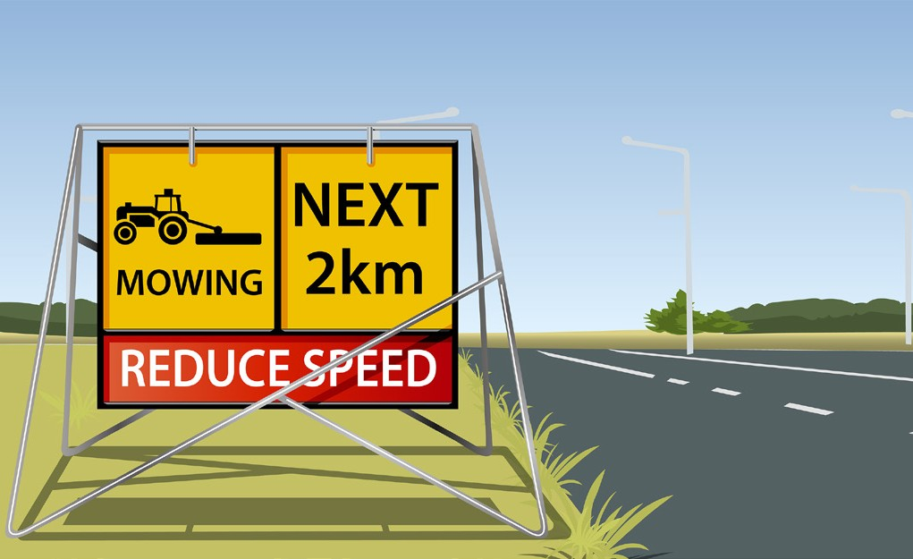
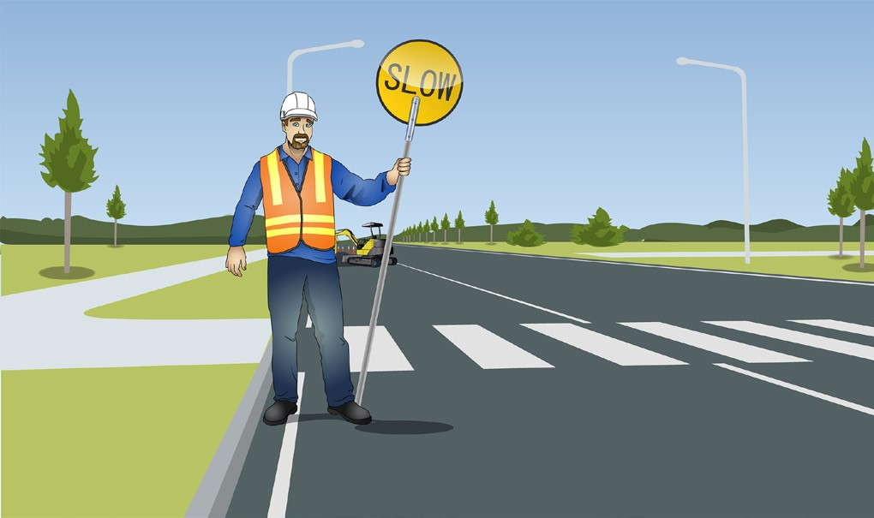
PC 1.5
PLAN AND PREPARE FOR TRACTOR OPERATIONS
Traffic management plan (TMP)
When working with the tractor there might be a time when you will need to use traffic management signs. Signage will be needed to warn traffic of the potential hazard. | Hazardous circumstance Under certain hazardous circumstances a qualified traffic controller might be needed to: Place traffic signs Control traffic
It helps keep the site safe for you and for others. For example, a tractor may be used to mow grass alongside a road. | Lower speed limits. A general rule of thumb is that if the existing traffic speed is altered then a qualified traffic controller will be needed.

Slide 18
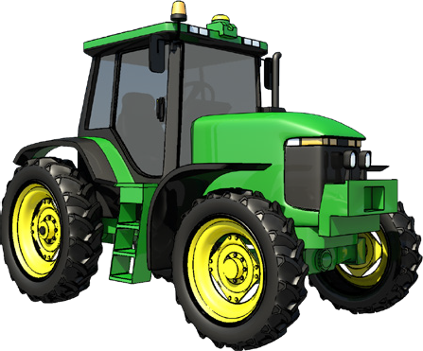
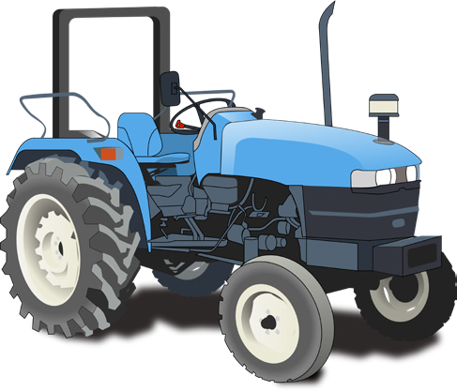
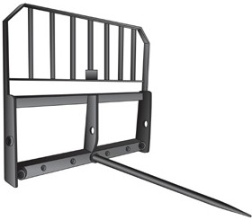
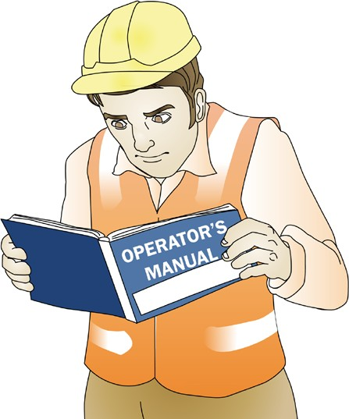
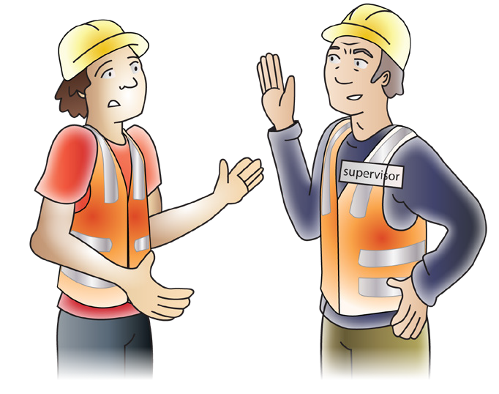
Check equipment and attachments
PC 1.6 PLAN AND PREPARE FOR TRACTOR OPERATIONS
You must show that you know how to check the equipment or the attachments you will be using on the tractor.
When checking the tractor’s attachments look for any wear or damage that will affect the use and operation of
the attachment.
Always follow the instructions in the manufacturer’s operating manual about the:
All attachments will have their own list of items to check. You need to be familiar with these from the operator’s manual instructions.
If in doubt, ask an experienced person.
Tractor
Attachments
Equipment being used.

Slide 19

Check the 3-point hitch/linkage
PC 1.6 PLAN AND PREPARE FOR TRACTOR OPERATIONS
The main benefit of the 3-point hitch/linkage system is to transfer the weight of an implement to the drive wheels of the tractor. This gives the tractor more usable traction than it would otherwise have, with the same power, weight, and fuel consumption.
The 3-point hitch/linkage is used for fixing attachments onto the tractor.
Each hitch/linkage has attachment holes for attaching implements
The implement has posts that fit through the holes
The implement is secured by placing a pin on the end of the posts
Lifting rod (left)
Lifting rod (right)
Top link
PTO
Lower lifts
Lower lifts
Locking pin
Locking pin

