Slide 1
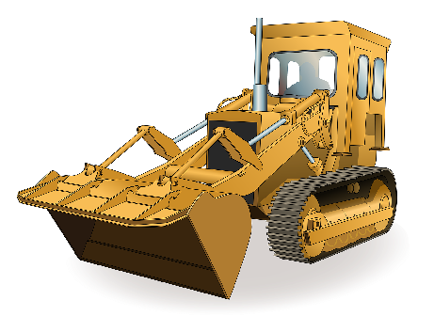
LEARNER GUIDE
Tracked Front End Loader
Training support material for: RIIMPO322F (Tracked)
Conduct civil construction tracked front end loader operations
Produced by:

Slide 2
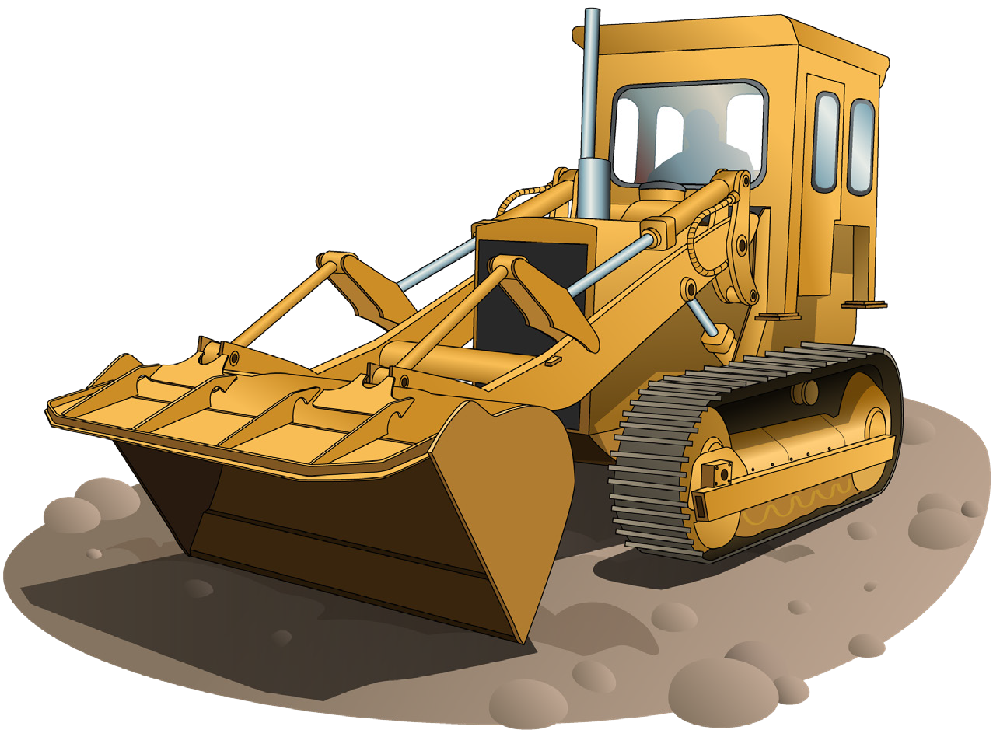
Introduction to Tracked Front End Loaders

Slide 3
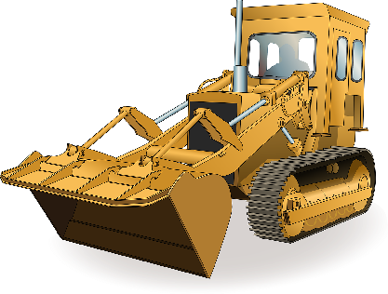
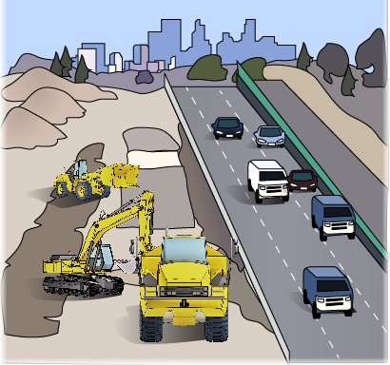
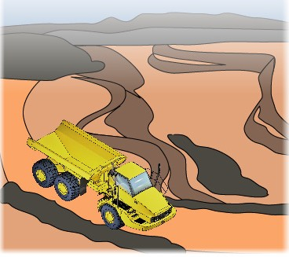
What do you use a front end loader for?
INTRODUCTION TO TRACKED FRONT END LOADERS
Agriculture – farming
Construction
Clean up
Moving dirt/rocks etc
Can use for lifting purposes
What industries do you use a front end loader in?
Civil construction
Mining

Slide 4
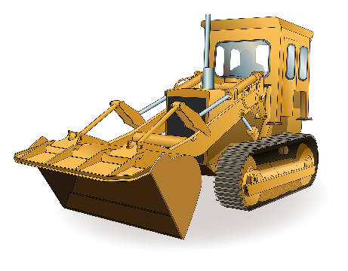
An example of a tracked front end loader
INTRODUCTION TO TRACKED FRONT END LOADERS
A tracked front-end loader is a type of machine that has a front mounted square wide bucket connected to the end of two booms (arms) to scoop up loose material such as dirt, sand or gravel and move it from one place to another without pushing the material across the ground.
A tracked front end loader is commonly used to move material from ground level and deposit it into an awaiting dump truck, stockpile or into an open trench excavation.
Front end loaders also come in wheeled models (refer RIIMPO321D Conduct civil construction wheeled front end loader operations).
Dump cylinder
Operators cabin
Tilt link
Lift cylinder
Bucket
Tracks
Lift arm

Slide 5
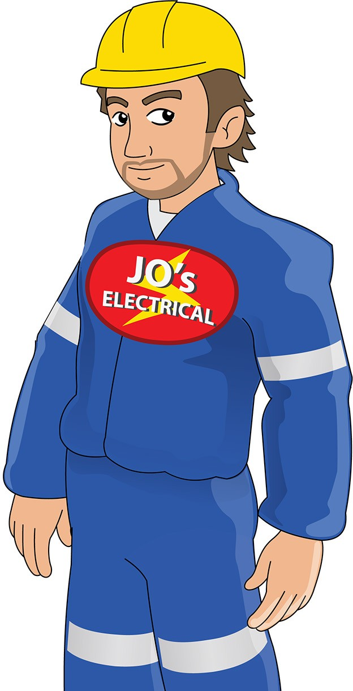
Who has duty of care?
PC 1.1 INTRODUCTION TO TRACKED FRONT END LOADERS
You have a duty of care. So does anyone who has something to do with the worksite. Duty of care applies to:
Employers/persons conducting a business or undertaking (PCBU). This includes managers, manufacturers/suppliers, importers, designers, inspectors, etc.
Workers. This includes employees, contractors and sub-contractors, employees of labour hire companies, outworkers, volunteers, etc.

Slide 6
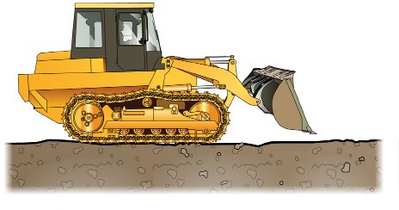
Earthmoving site hazards
PC 1.3 GENERAL INFORMATION
z
Checking for underground services
You should always check where services are before you start work. You may phone ‘Dial before you dig on 1100’. You may look at the site plan or talk to your supervisor. You may need to look at the location of pits and meters to get an idea of where the services run. You may need to check with the local council or service company. You may even need to get underground detection equipment.
If you hit a service line, contact the provider immediately. You may need to organise to get the service disconnected while a
qualified person fixes the problem.
You can sometimes tell there are services below by the types of ground. Some services are surrounded by a different type of soil, rock or sand.
You may notice that the soil is looser,
or does not match the soil around where you are digging. There may be a line of tape alerting you to the services.
If you suspect there are services underground, stop working. Check the ground. You may need to excavate the area by hand, or dig in another area.
z
z

Slide 7
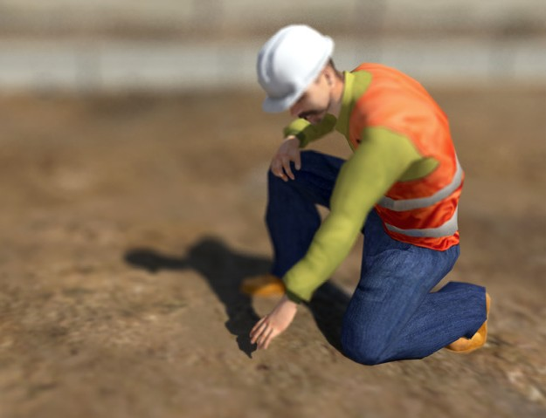
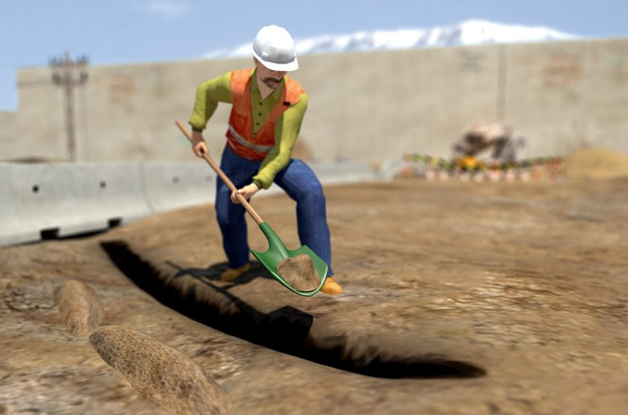
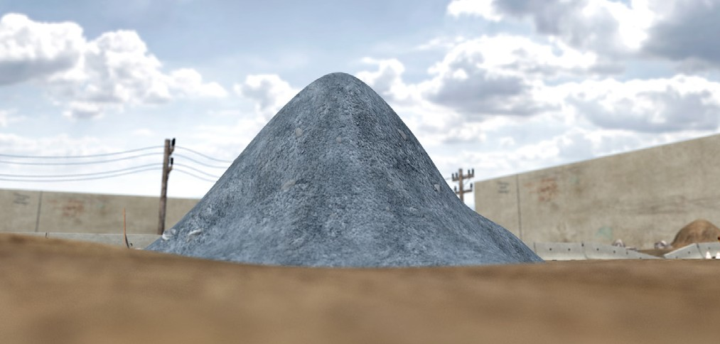
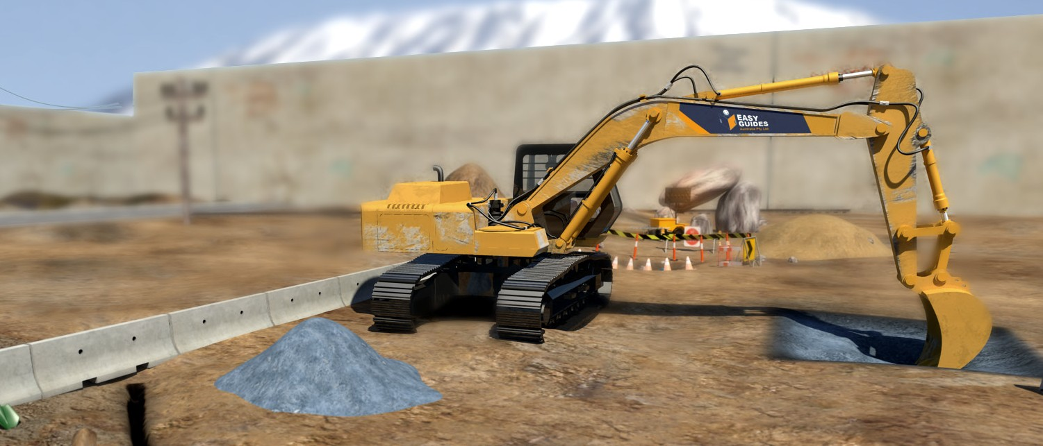
Operating techniques
PC 1.2 GENERAL INFORMATION
Building a stockpile
A stockpile is a pile of material (soil, sand, rock, etc) that you use for earthmoving work. You must choose a good location for your stockpile. If you choose the wrong location, your stockpile could get washed away or become dirty (mixed with other materials).
z
If you can, choose an area of well drained, firm level ground. | You should set up drainage so that rainwater does not cause the stockpile to wash away or slide.
Make sure the stockpile is close to the area you are working. You don’t want to drive too far to work with the stockpile. | Make sure you have clear access to the stockpile.
z
z
z
z

Slide 8
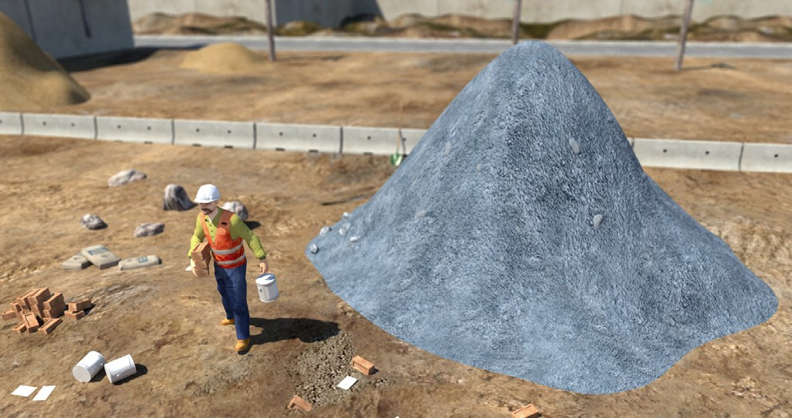
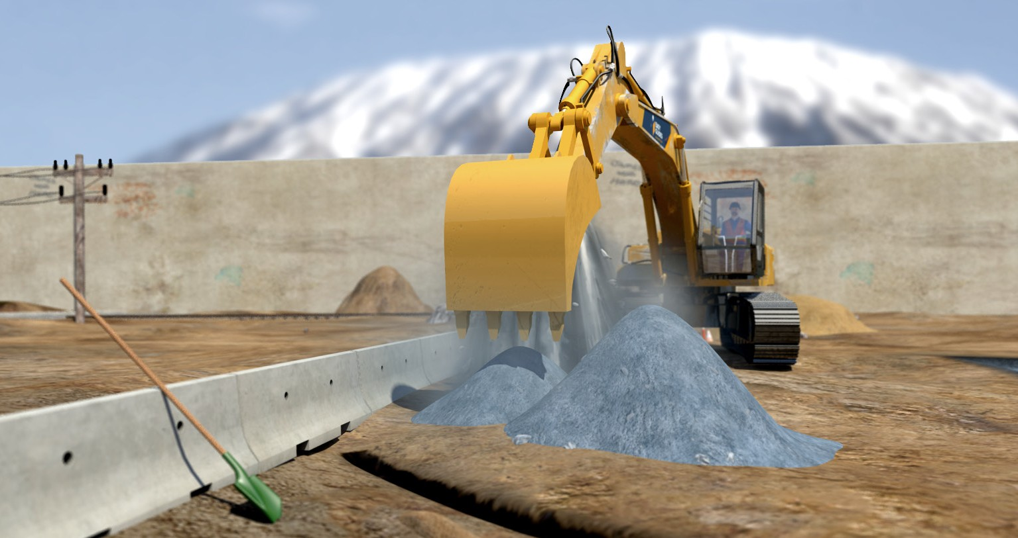
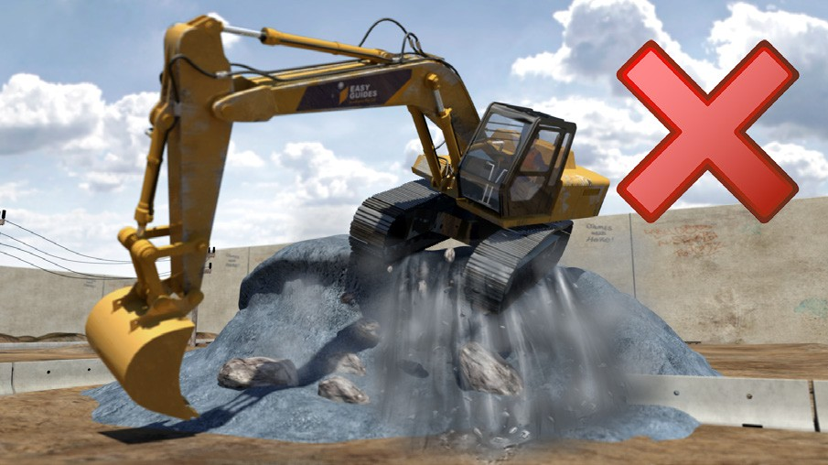
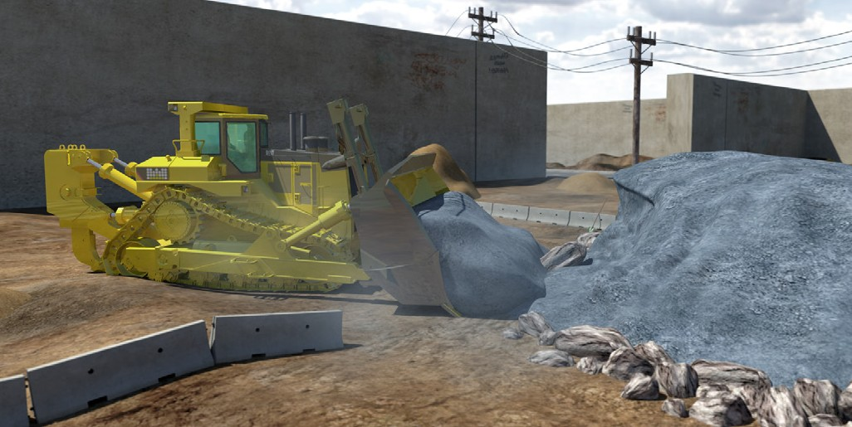
PC 1.2
GENERAL INFORMATION
Building a stockpile (continued)
Clear the area of any rubbish or debris, so it doesn’t get mixed in the stockpile. | When you fill out a stockpile, start by filling the area closest to the back of the stockpile area.
Don’t work too close to the edge of the stockpile as it could give way. | Keep filling out the stockpile one row at a time or by dozing material to the correct position on the stockpile.
z
z
z
z

Slide 9
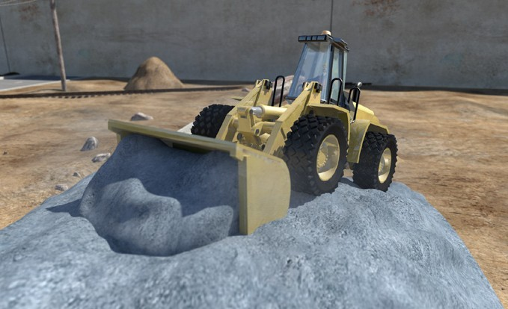
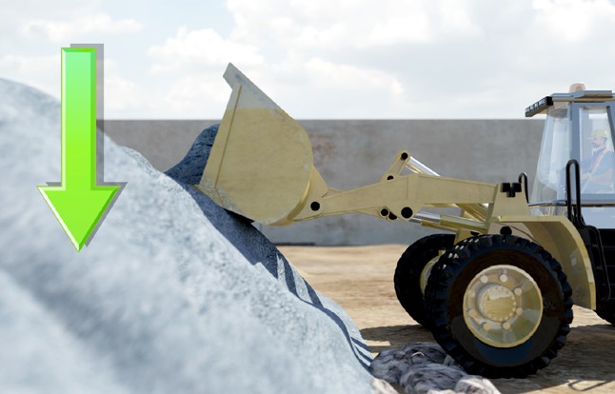
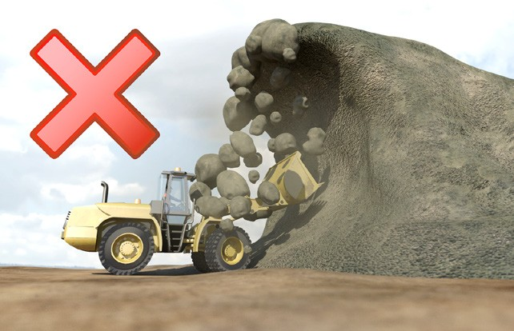
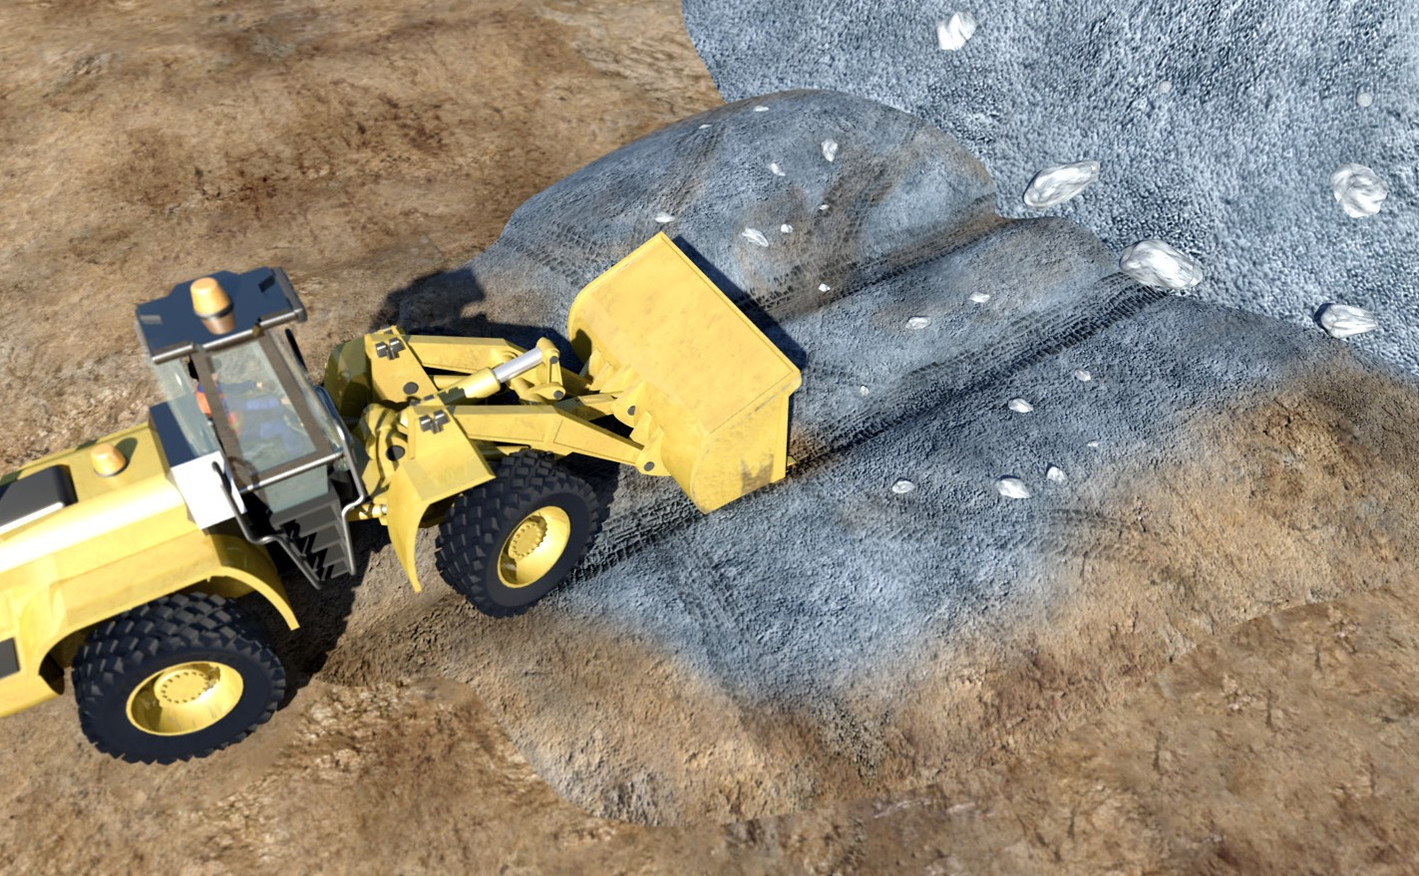
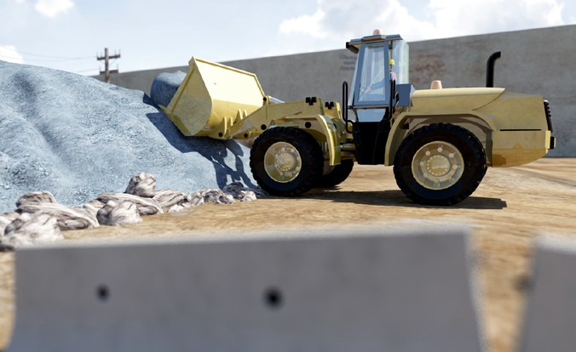
PC 1.2
GENERAL INFORMATION
Operating techniques
Taking from a stockpile
When you take from a stockpile, try and work neatly. | Take from the top, working down in layers. | Do not undercut the stockpile. It might collapse on you.
You may need to maintain the stockpile by neatening it up. | To do this, you push material up that has been spread out. Keep the loading area clean and level.
z
z
z
z
z

Slide 10
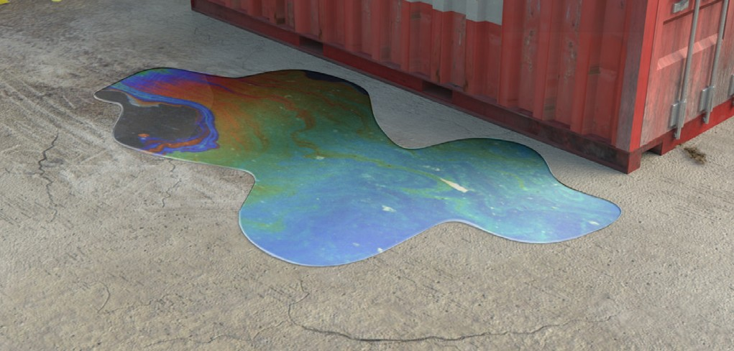
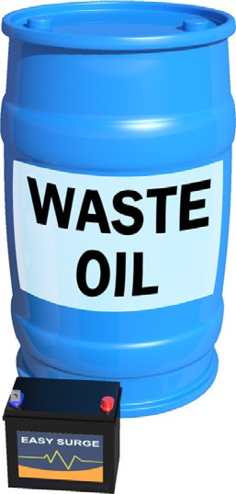
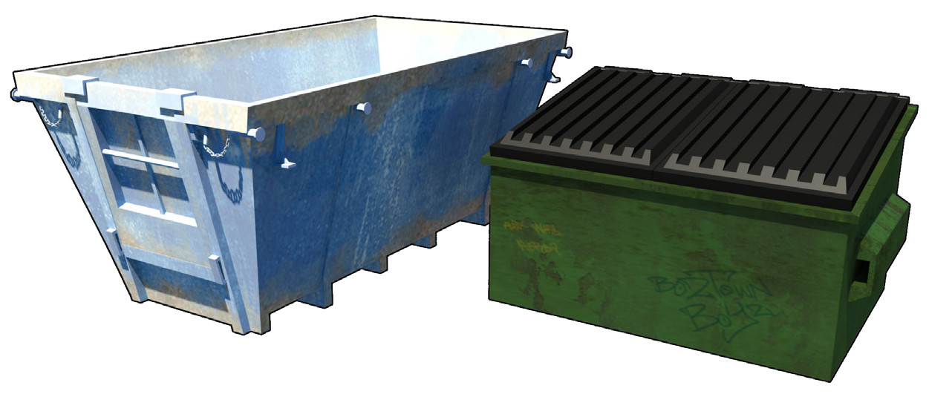
PC 1.3
GENERAL INFORMATION
Environmental management plan (EMP)
The environmental management plan (EMP) tells you important things about the environment at the worksite. It explains how the work you are doing could damage the environment. The possibility that you will cause this damage is called the environmental risk. | The EMP tells you what you must do so you do not damage the environment. It tells you how to work in a way that reduces damage to the environment.
The EMP also tells you how the worksite meets all environmental protection laws and what to do with waste.
z
z
z

Slide 11
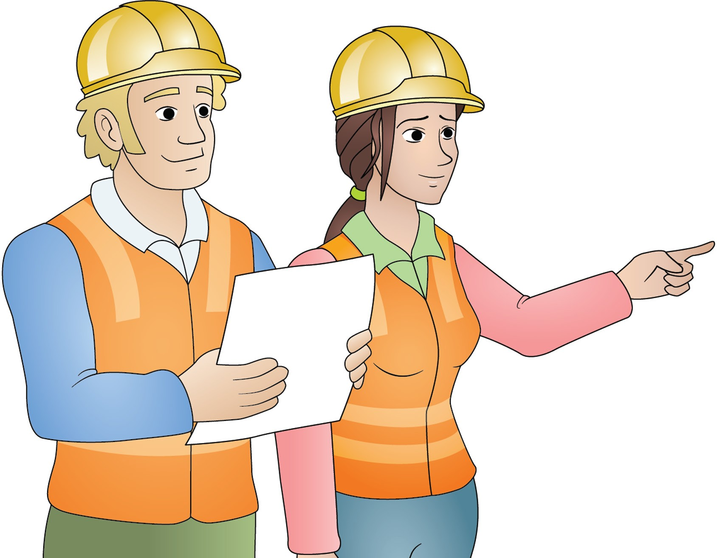
Plan and prepare for tracked front end loader operations
Element 1

Slide 12
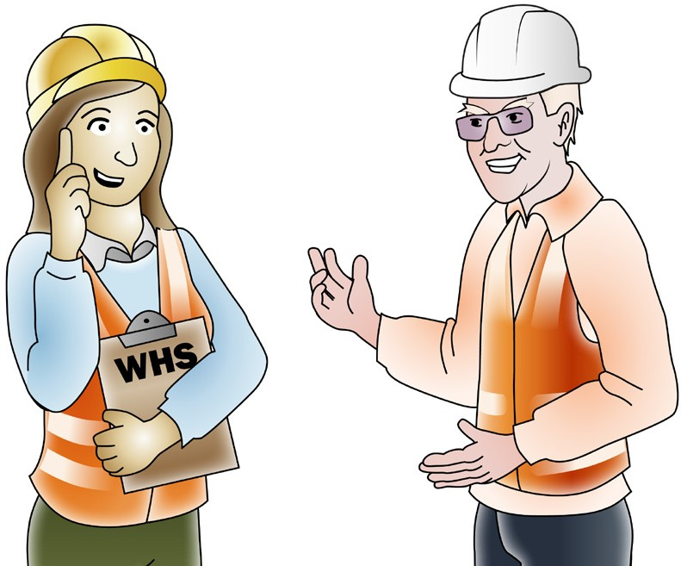
Work Health & Safety Legislative Requirements
PC 1.1 PLAN AND PREPARE FOR TRACKED FRONT END LOADER OPERATIONS
z
‘Laws to keep your workplace safe’
WHS/OHS requirements are outlined in Acts, Regulations, Codes of Practice and Australian Standards.
WHS/OHS Acts
‘WHS/OHS Acts’ are laws that explain how to improve health and safety in the workplace.
For example: Model National WHS Act, June 2011. WHS has the same meaning as OHS in this document.
Regulations
‘Regulations’ explain specific parts of the Act.
For example: Part 4.3 – Confined spaces, Part 4.4 – Falls.
Codes of Practice/Compliance Codes
‘Codes of Practice’ are practical guidelines on how to comply with (meet the rules of) legislation. For example: HAZARDOUS MANUAL TASKS Code of Practice, 23rd December 2011.
Australian Standards
‘Australian Standards’ are work guidelines that set the minimum accepted performance or quality
for a specific hazard, process or product.
For example: AS 2550 – Cranes, hoists and winches – safe use set.
z
z
z
z

Slide 13
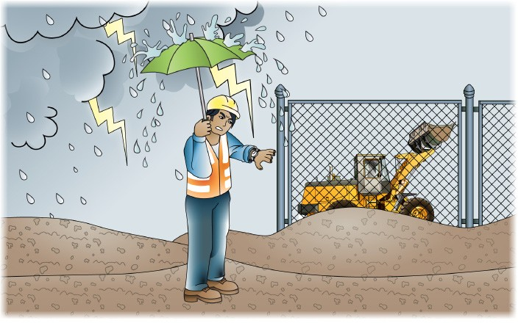
PC 1.2
PLAN AND PREPARE FOR TRACKED FRONT END LOADER OPERATIONS
QUESTION 10
What do the job’s work instructions explain?
Work instructions explain:
z
z
What to do in unexpected situations like bad weather
What the job is
Where the job is
z
z
z
How to do the job safely
How long the job will take
What tools and equipment you need
How to do the job from start to finish
z
z
z
z

Slide 14
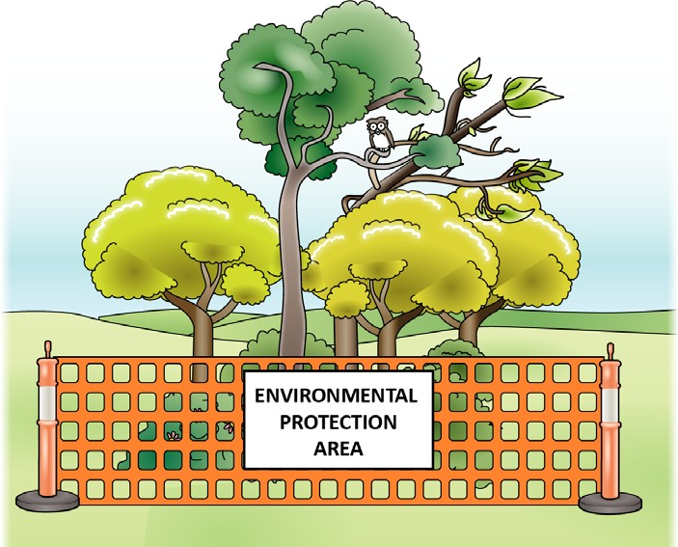
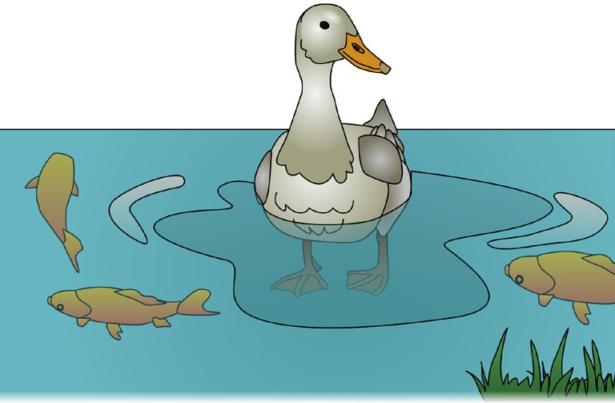
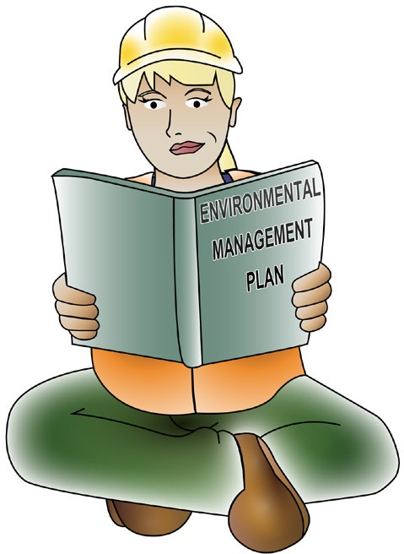
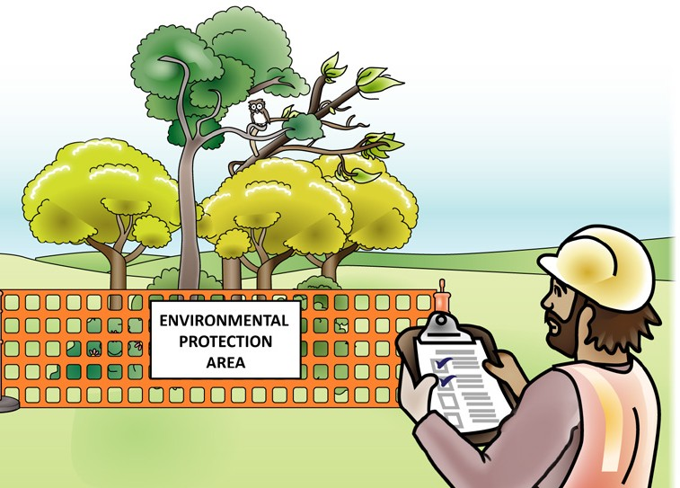
PC 1.3
PLAN AND PREPARE FOR TRACKED FRONT END LOADER OPERATIONS
QUESTION 11
What does the environmental management plan (EMP) tell you?
Possible risks to the environment on the worksite | How to work in a way that reduces damage to the environment
How the worksite meets all environmental protection laws | Who is responsible for what?
z
z
z
z
z

Slide 15
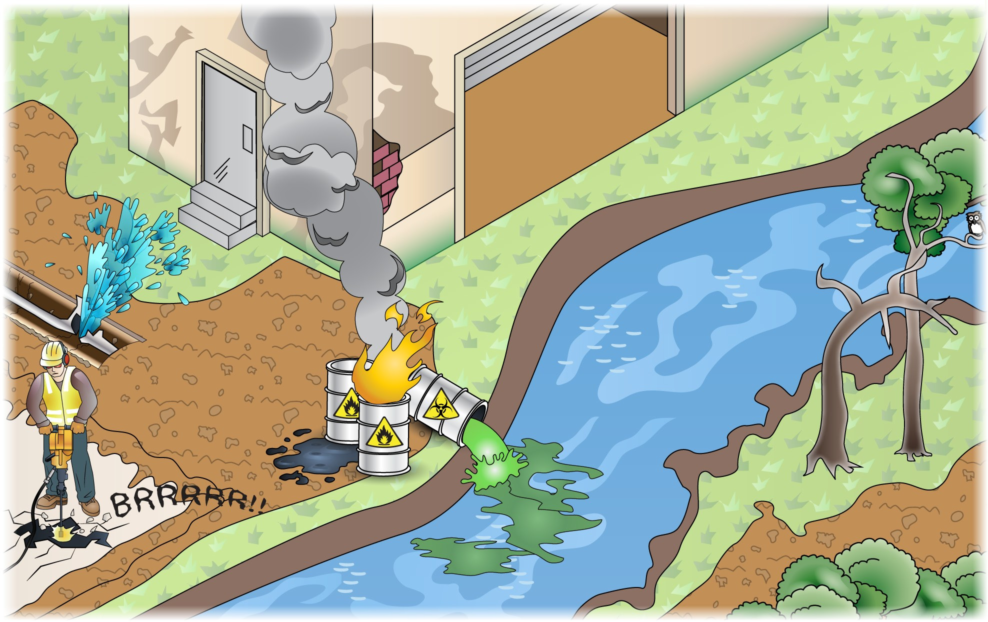
PC 1.3
PLAN AND PREPARE FOR TRACKED FRONT END LOADER OPERATIONS
QUESTION 12
What environmental challenges should you be careful of when working?
z
Asbestos from old buildings
z
Confined spaces
z
Damage to underground services
z
Air pollution
z
Fire
z
Damage to plants and trees
z
Noise
z
Waste management
z
Soil damage and erosion
Leaking fuels
z
z

