Slide 1


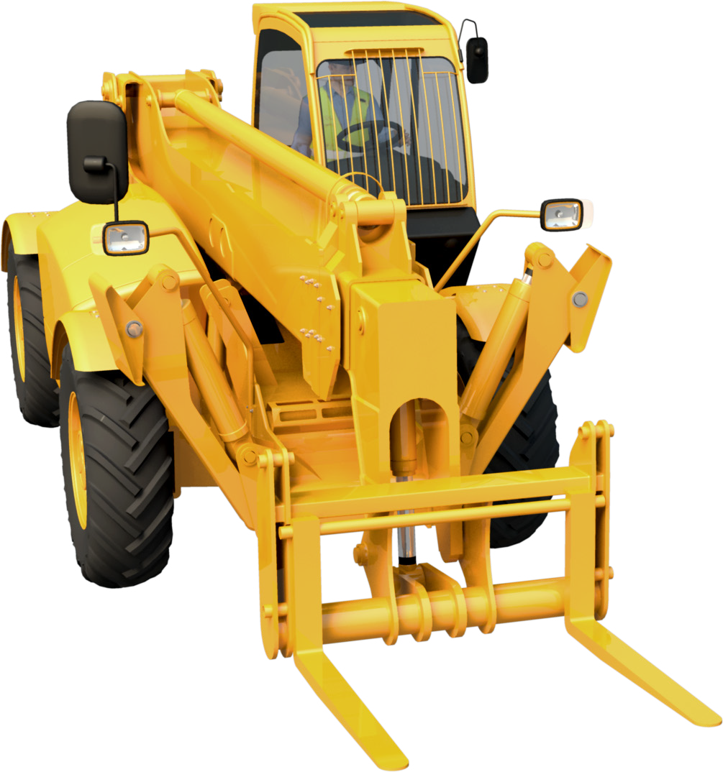

LEARNER GUIDE
Telescopic Materials Handler
RII COMPETENCY
Training support material for:
RIIHAN309F –
Conduct telescopic materials handler operations
Produced by:
Includes practical training tasks

Slide 2
Contents
How to use this guide
Language – Literacy – Numeracy (LLN)
Acknowledgements Introduction to telehandlers General information
4
5
7
9
13
17
31
49
69
115
121
125
129
131
137
146
154
Chapter 1
Chapter 2
Chapter 3
Chapter 4
Chapter 5
Chapter 6
Chapter 7
Chapter 8
Chapter 9
Chapter 10
Plan and prepare for work Identify and control hazards Check and monitor equipment Operate/use equipment
Shut down and store equipment Maintain equipment Housekeeping
Record keeping Relocate equipment Attachments
Practical training tasks Operating record

Slide 3

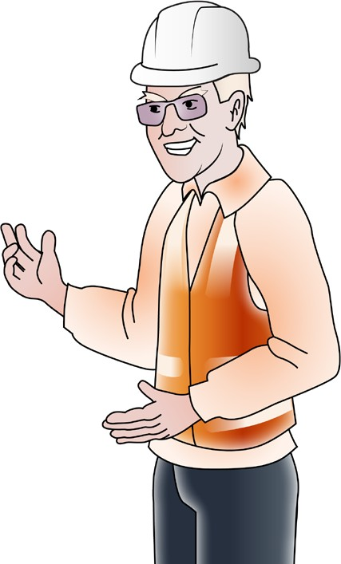
Language – Literacy – Numeracy (LLN)
TAELLN411 Address adult language, literacy and numeracy skills
LANGUAGE – LITERACY – NUMERACY (LLN)
Why LLN matters?
The unit TAELLN411 Address adult language, literacy and numeracy skills describes the skills and knowledge a vocational trainer or assessor requires to identify language, literacy and numeracy (LLN) skill requirements for training in the work environment. The aim is to use resources and strategies that meet the needs of the learner group.
The LLN unit applies to individuals who teach, train, assess and develop resources.
Easy Guides training materials have been developed around LLN principles
James Tennant, Managing Director of Easy Guides Australia Pty Ltd has completed the LLN unit as well as a MA (TESOL) Masters of Arts degree in teaching speakers of other languages.
James taught as a Workplace language and literacy (WELL) teacher in industry where he gained knowledge and experience for adapting training to a wide range of learners.
James’ qualifications and experience have been embedded into the Easy Guides training materials making them unique in their field.
3

Slide 4

LLN core skills – customising training
LANGUAGE – LITERACY – NUMERACY (LLN)
The Australian Core Skills Framework (ACSF) provides a detailed description of each of the five core skills
which help people to participate effectively in our society.
The core skills are:
Learning | Reading | Writing | Oral Communication | Numeracy
Trainers can use knowledge of the core skills of their learners to adjust their training program. For example, a learner may be high in oral communication but low in writing.
For such learners, training materials could:
be written in simple, plain English
use pictures and diagrams to explain concepts
use bullet points or tables instead of long paragraphs
explain difficult words that students might need to know.
Easy Guides has built many of these LLN learning strategies into their training materials.
4

Slide 5
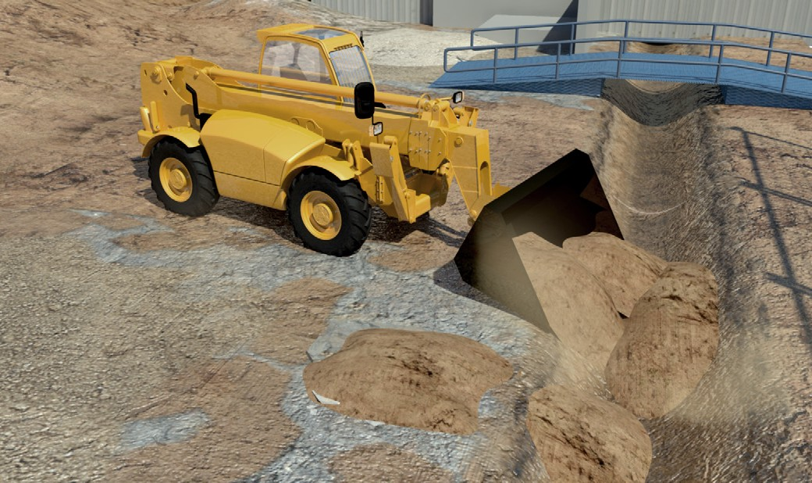
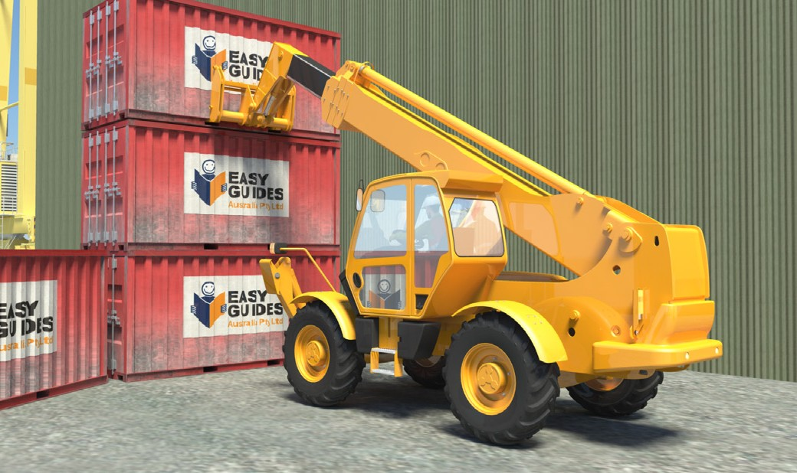
What is a telehandler?
INTRODUCTION TO TELEHANDLER
Telescopic materials handlers are often called telehandlers. They are a wheeled machine with lots of uses. You usually use them for lifting and placing loads. They have many attachments.
If you change the attachment, you can change how you use the machine. You can use them as an elevating work platform (EWP), general-purpose earthmover, or crane.
Telehandlers have a telescopic boom, which you can lift, extend and tilt. They have a carriage at the end of the boom. You can quickly fit different attachments to the carriage.
Some telehandlers also have stabilisers. They help keep the machine steady during lifting work.
Telehandlers come in different sizes with different lifting capacities.
You can drive telehandlers on public roads, but they must be registered and roadworthy.
5

Slide 6
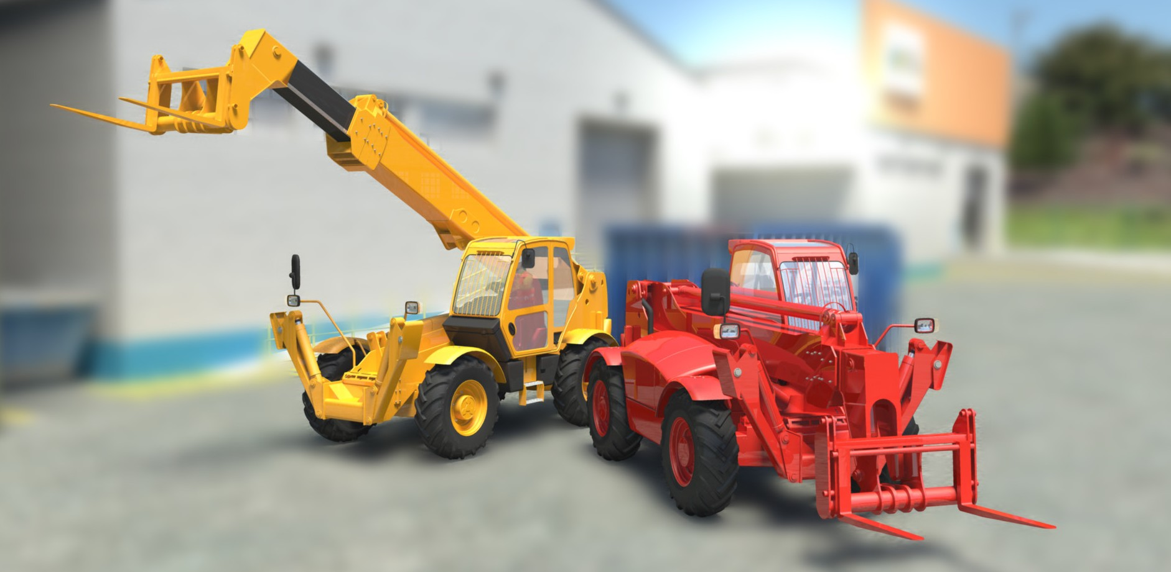
PC 1.6
INTRODUCTION TO TELEHANDLER
Names for telehandlers
Telehandlers are known by different names including:
Telescopic materials handler
Multi-purpose handler
Multi-purpose tool carrier
Telescopic forklift.
6

Slide 7
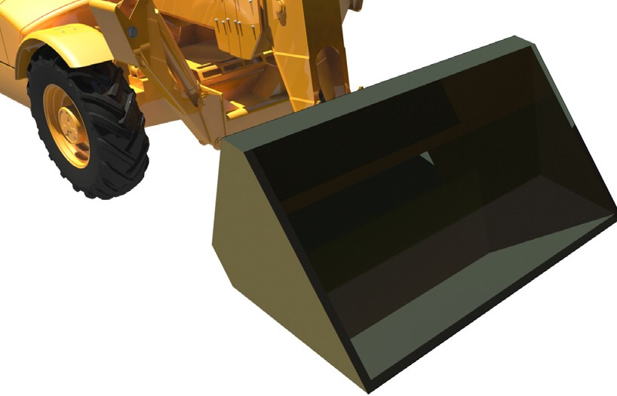
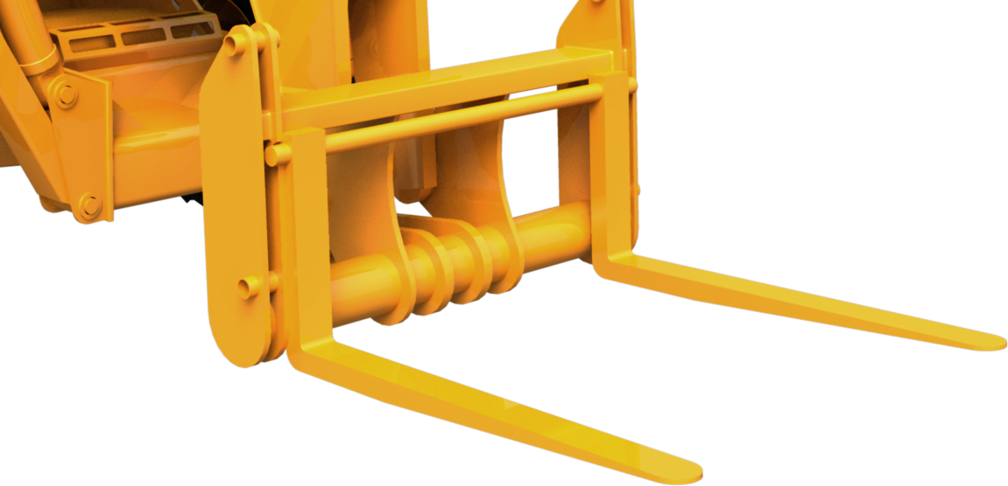
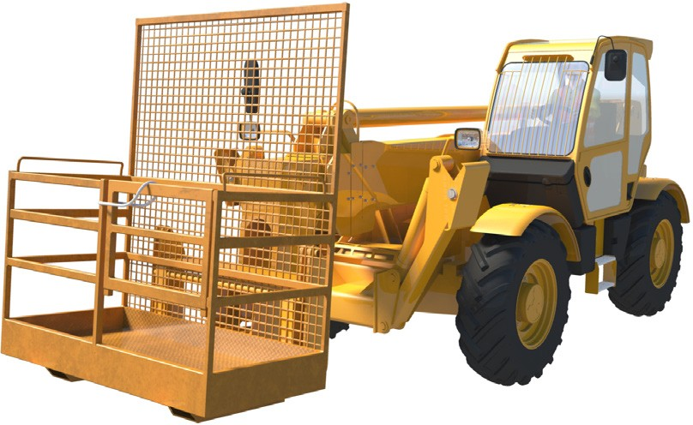
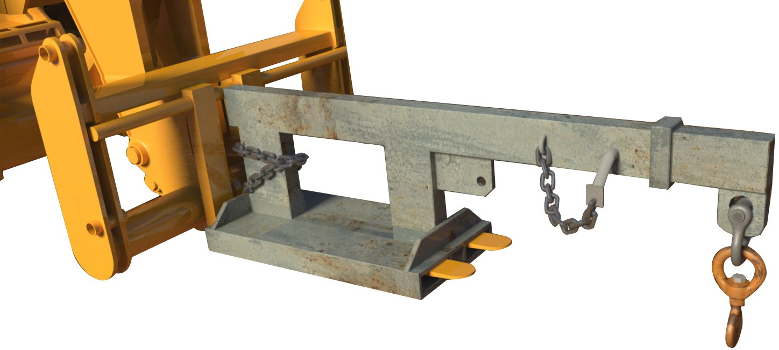
PC 4.1
INTRODUCTION TO TELEHANDLER
Telehandler attachments
The attachment you choose depends on the job you are doing and the load you are lifting. The attachment must be authorised (allowed) for use with the telehandler you are driving. Check with the manufacturer if you are not sure.
Lifting attachments include:
Forks | Buckets
Fixed and telescopic jibs, lifting block and hooks | Work platform baskets
7

Slide 8
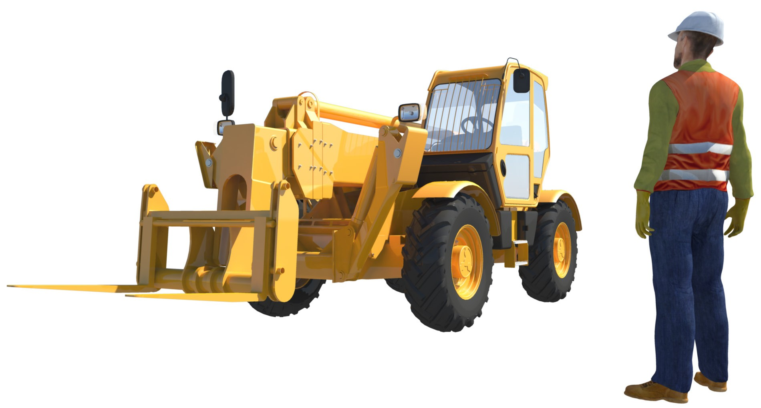
Identify and control hazards
Chapter 2
©© EEaassyyGGuuiiddeessAAuussttrraalliiaa PPttyy.. LLttdd..
8

Slide 9
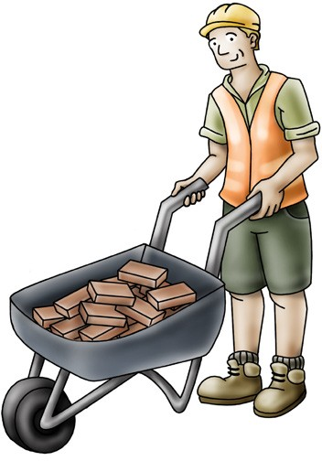
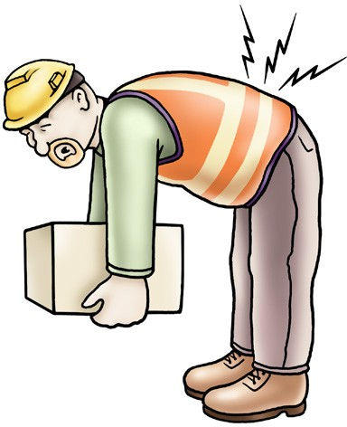
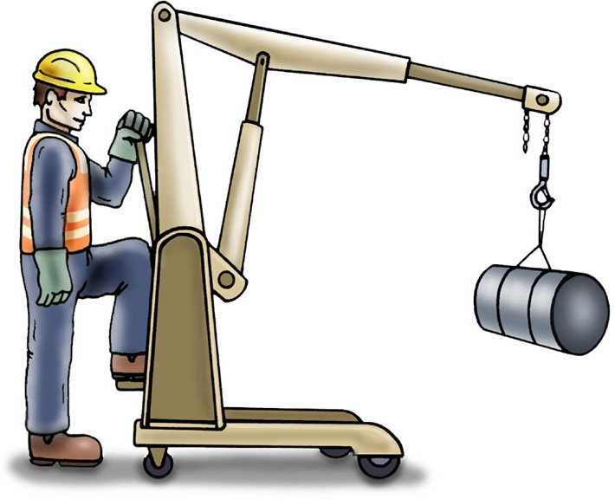
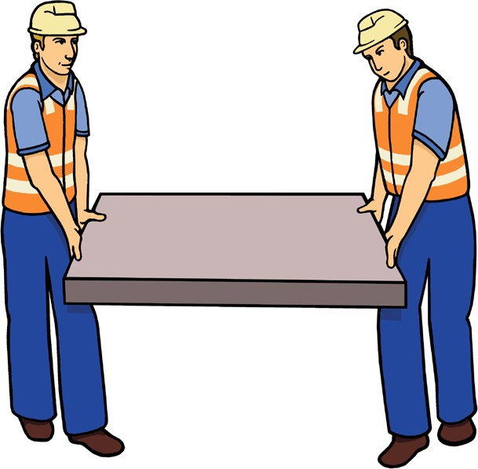
PC 1.3
IDENTIFY AND CONTROL HAZARDS
Manual handling
Manual handling is any activity where you use force to: lift lower push pull carry or move a load. | Any manual handling activity that is done incorrectly can result in injuries such as muscle strain and back and neck injuries. Manual handling injuries are very serious and can stop you enjoying things you like doing. For example, playing sport or walking the dog.
Before you start any manual handling activity, check to see if there are any mechanical aids or equipment that you can use to make the job safer and easier. | If the load is big, heavy or an awkward shape get someone to help you move it.
©© EEaassyyGGuuiiddeessAAuussttrraalliiaa PPttyy.. LLttdd..
9

Slide 10




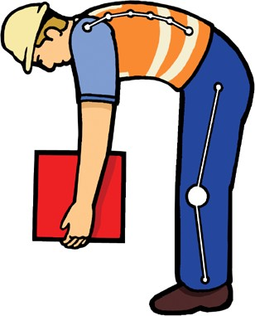




PC 1.3
IDENTIFY AND CONTROL HAZARDS
Manual handling (continued)
When lifting – Bend your legs, keep your back straight. | When carrying – Keep your back straight. | When shifting – Move your feet.
©© EEaassyyGGuuiiddeessAAuussttrraalliiaa PPttyy.. LLttdd..
10

Slide 11


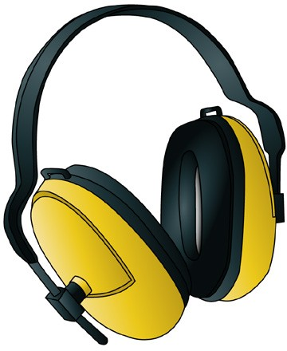

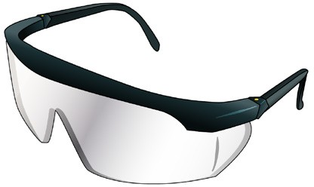

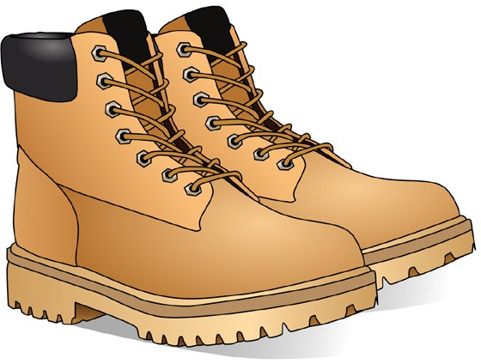
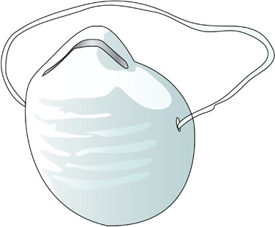
PC 1.4
IDENTIFY AND CONTROL HAZARDS
Personal protective equipment (PPE)
Steel cap boots
High visibility safety vest
Hearing protection
Hard hat
Goggles/glasses
Gloves
Dust mask
Sunscreen
Here are some examples of what personal protective equipment (PPE) you might need to use.
©© EEaassyyGGuuiiddeessAAuussttrraalliiaa PPttyy.. LLttdd..
11

Slide 12





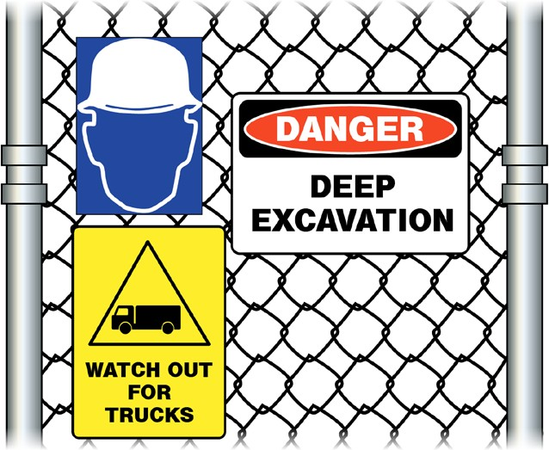


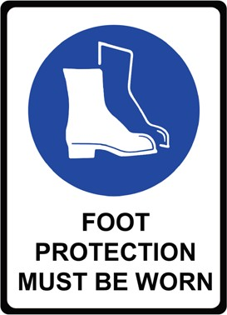
PC 1.5, 5.2
IDENTIFY AND CONTROL HAZARDS
Signs
Signs are used around the workplace to identify dangerous or hazardous areas. Signs are also used to give you instructions on what to do to protect yourself and others.
As the telehandler operator you may need to place signs warning people to stay out of your work area. Some examples include:
Warning signs such as danger high voltage or Instruction signs for traffic control or PPE requirements
underground services
©© EEaassyyGGuuiiddeessAAuussttrraalliiaa PPttyy.. LLttdd..
12

Slide 13
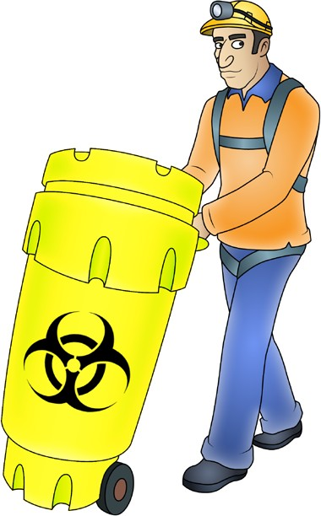

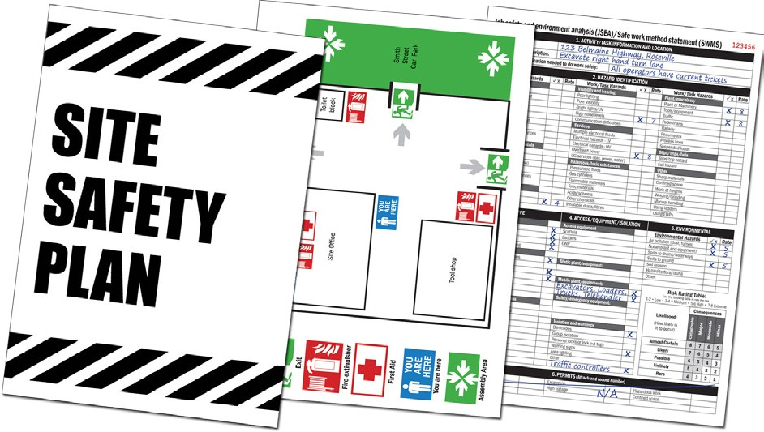
PC 1.1
IDENTIFY AND CONTROL HAZARDS
Chemicals and solvents
Chemicals should always have a label, so that you can easily tell what you are working with. They should be stored in a safe place where nobody may accidentally come in contact with them.
Always check the safety data sheet (SDS) before handling any chemicals.
An employer must provide an SDS to a person using chemicals in the workplace. They must make sure the person using the chemical knows how to read and understand the SDS.
If you are not sure about a chemical, put the chemicals in a safe, isolated area and talk to your supervisor.
Safety plan
The safety plan may tell you things like:
How to use tools and equipment safely
How hazards and risks need to be controlled
Emergency procedures
Emergency exits and assembly areas
What PPE to wear
Safe areas to park machinery.
13

Slide 14
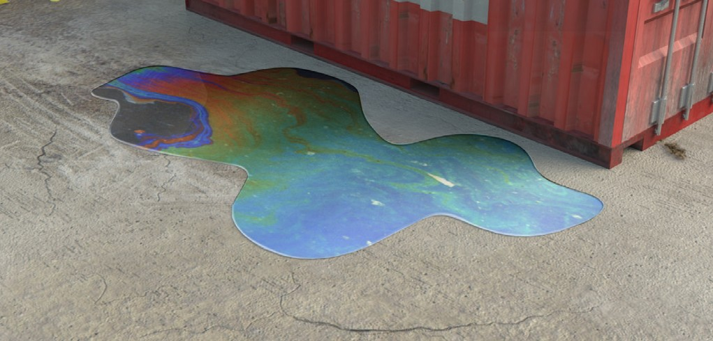

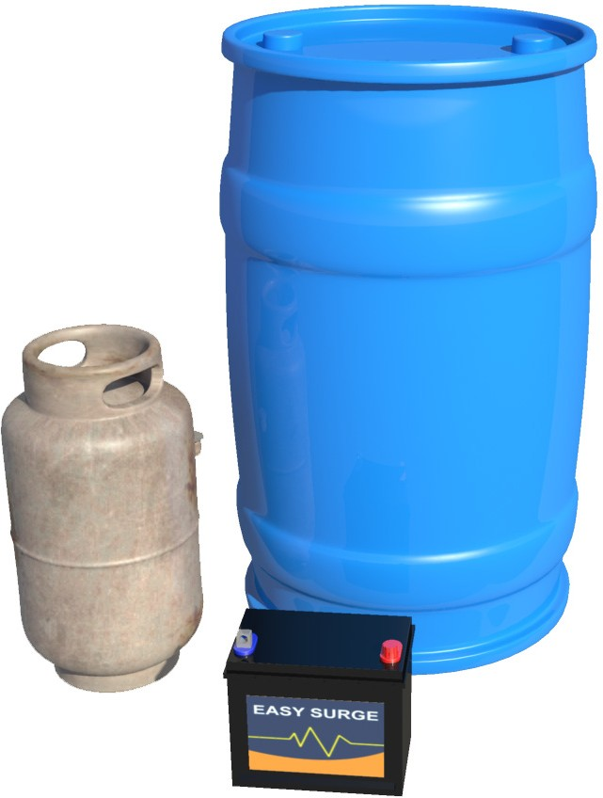
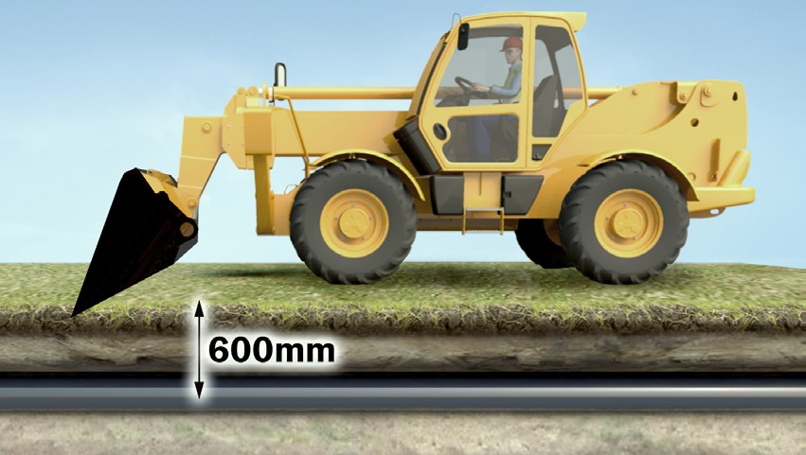
PC 1.1
IDENTIFY AND CONTROL HAZARDS
Environmental management plan (EMP)
The Environmental management plan (EMP) tells you important things about the environment at the worksite. It explains how the work you are doing could damage the environment. The possibility that you will cause this damage is called the environmental risk. | The EMP tells you what you must do so you do not damage the environment. It tells you how to work in a way that reduces damage to the environment.
How the worksite meets all environmental protection laws and what to do with waste. | Where underground services are located. For example you should keep clear of underground gas lines, water lines and service lines.
14

Slide 15

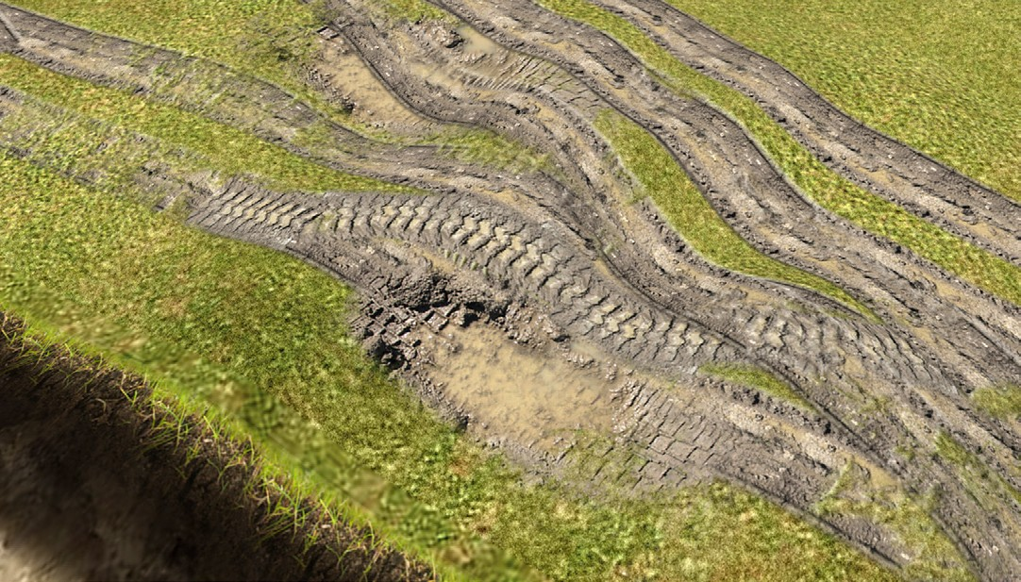
PC 1.1
IDENTIFY AND CONTROL HAZARDS
How can you control the environmental risk? (continued)
Example 2:
Risk: Cause: Control:
Noise.
Engine noise from heavy machinery.
Work on site to be carried out between 7 am and 6 pm.
Example 3:
Risk: Cause: Control:
Loss of topsoil.
Driving across a paddock or over vegetation.
Go around the paddock even if it increases the time the job takes.
©© EEaassyyGGuuiiddeessAAuussttrraalliiaa PPttyy.. LLttdd..
15

Slide 16
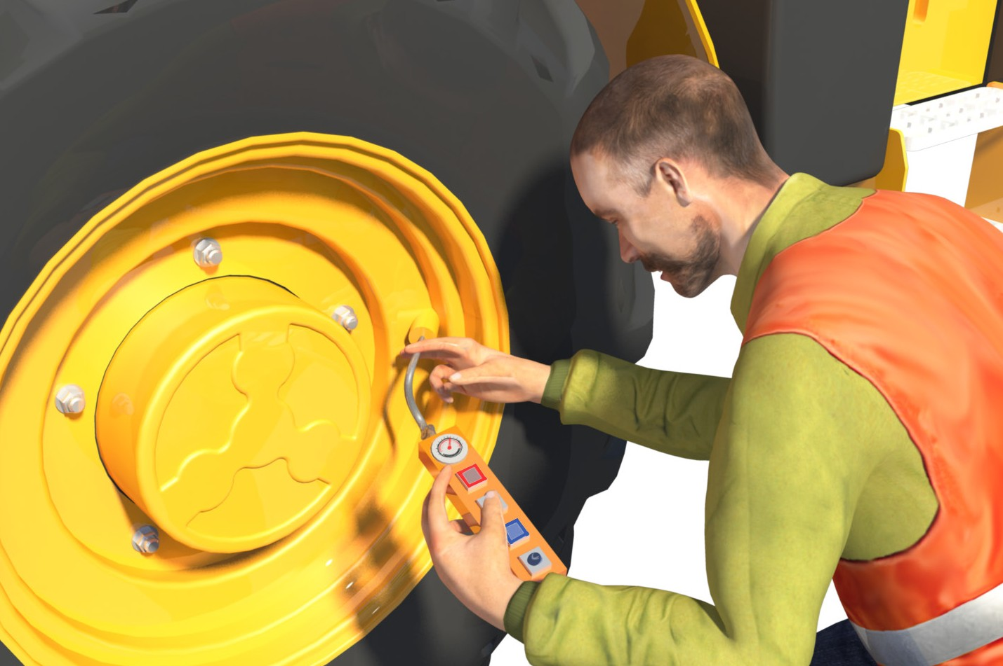
Check and monitor equipment
Chapter 3
16

Slide 17
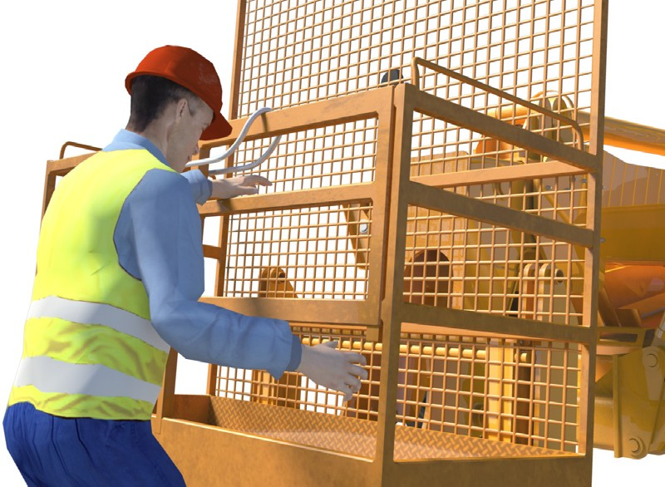

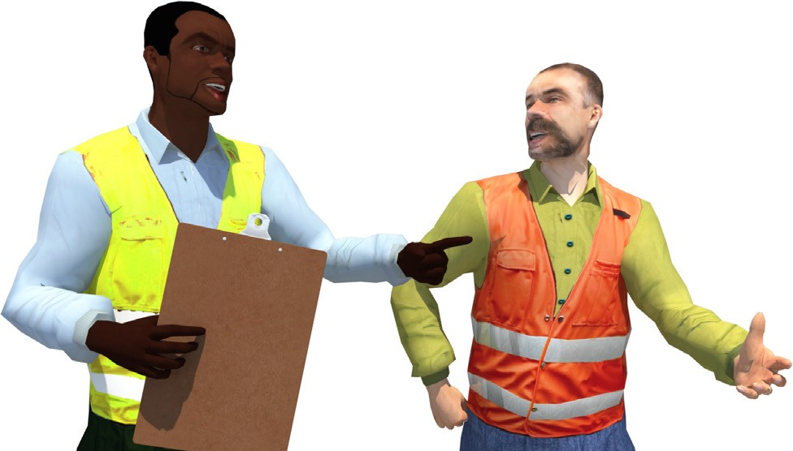
PC 2.2
CHECK AND MONITOR EQUIPMENT
Select plant, tools and equipment
Before you start the job, make sure the telehandler is the right one for the job. It must have the capacity to lift the load. Also the boom must have the reach to safely place the load at the height required. The attachment must be compatible with (match) the telehandler.
Before beginning work, select the tools and equipment you will need. Check all the tools and equipment to make sure they aren’t damaged or faulty. Check if there are any missing parts, cracks, or warps.
Report faults
If you find faults, tell your supervisor so the equipment can be repaired or replaced. You should tag out the faulty equipment if your workplace allows it.
If it can’t be repaired, throw it away.
Do not work with faulty equipment.
17

Slide 18
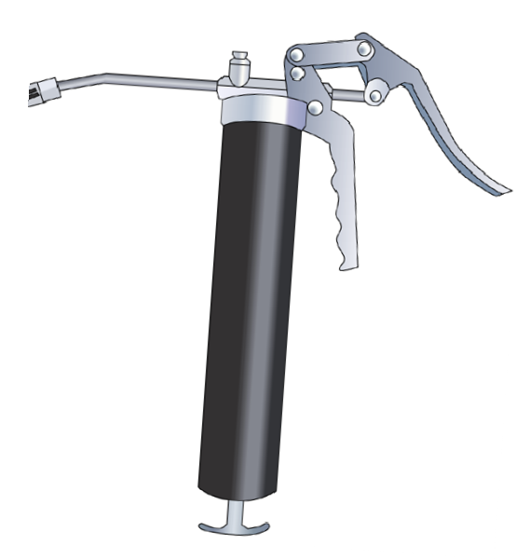
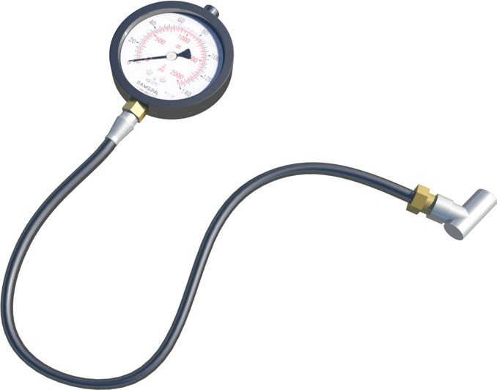
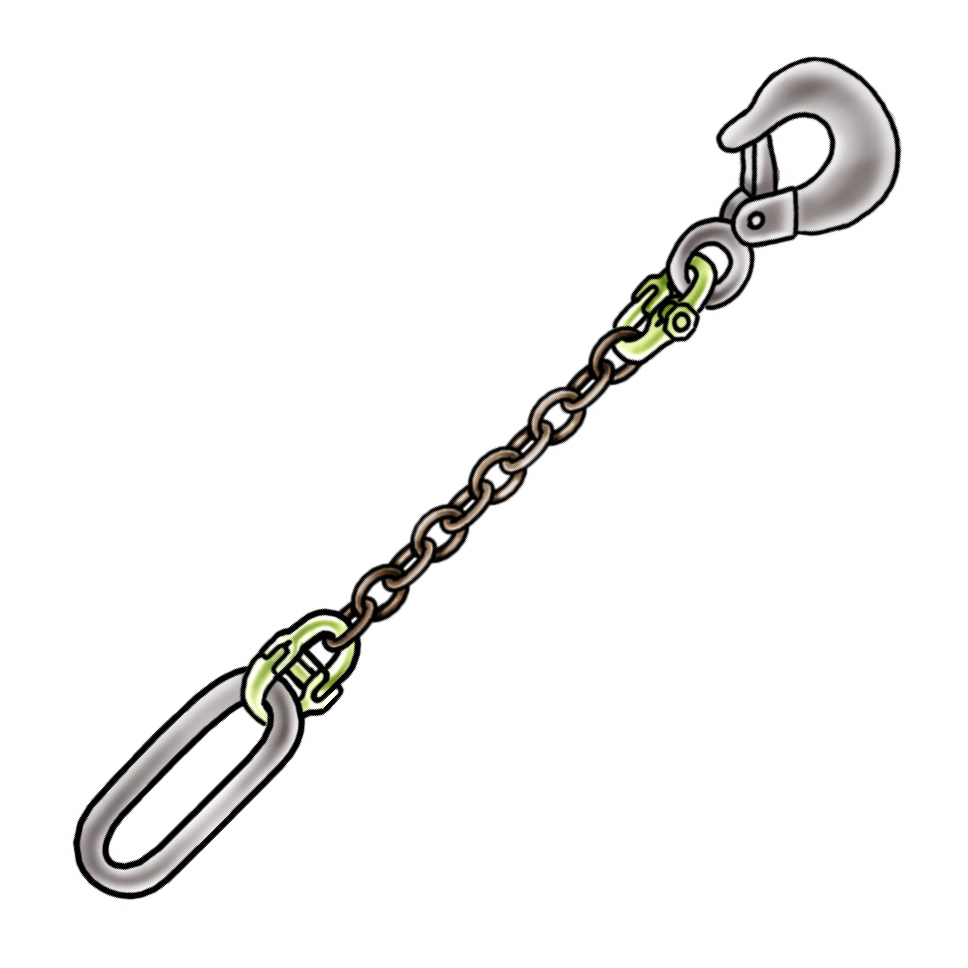
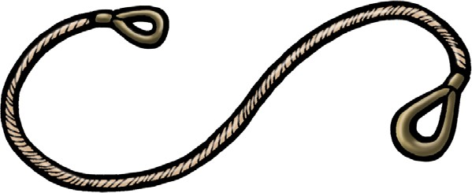
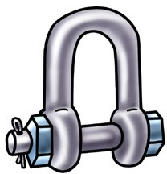
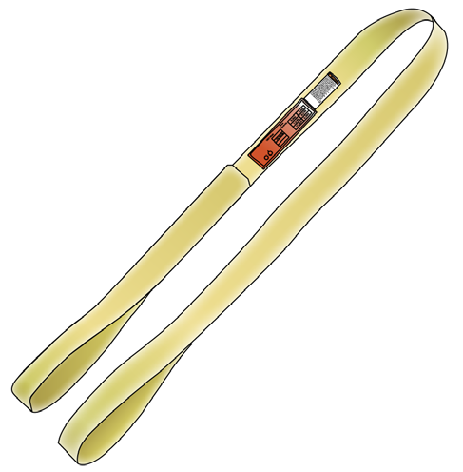
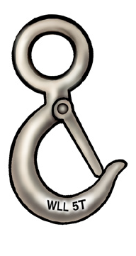
PC 1.6
CHECK AND MONITOR EQUIPMENT
Tools and equipment (continued)
Maintenance equipment
Grease gun
Tyre pressure gauge
Lifting equipment
Slings
Chains
Shackles
18

Slide 19
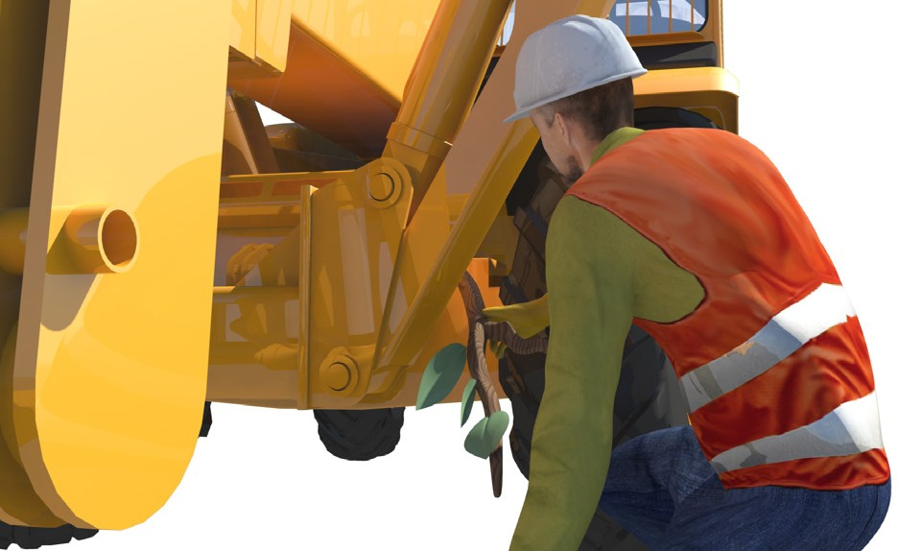
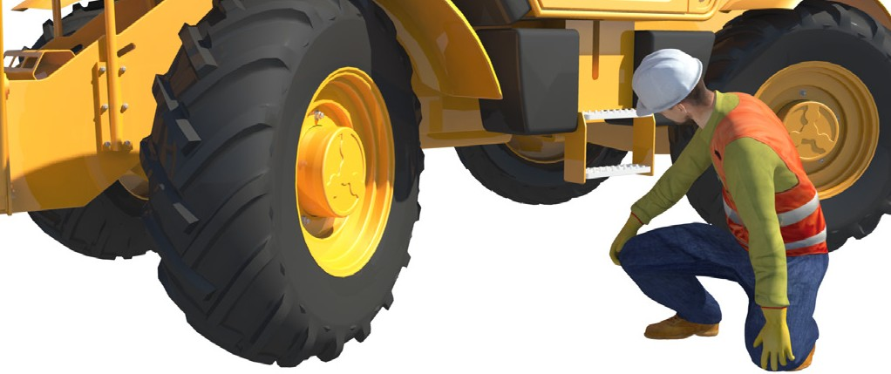
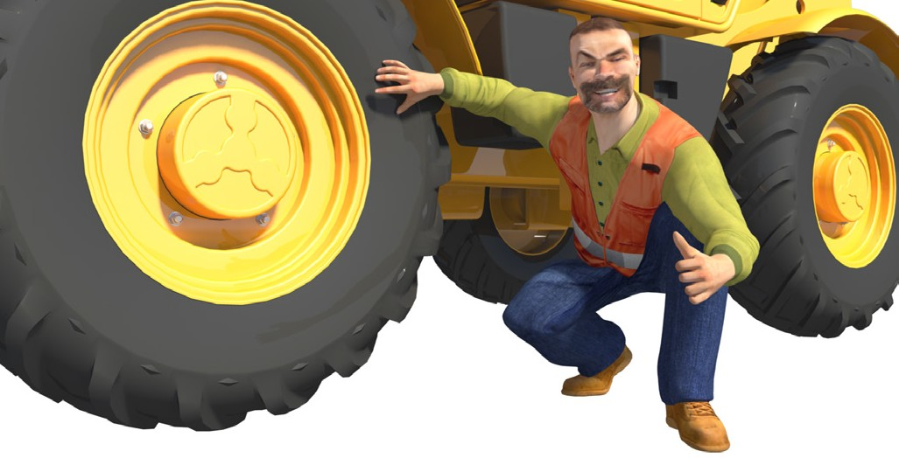
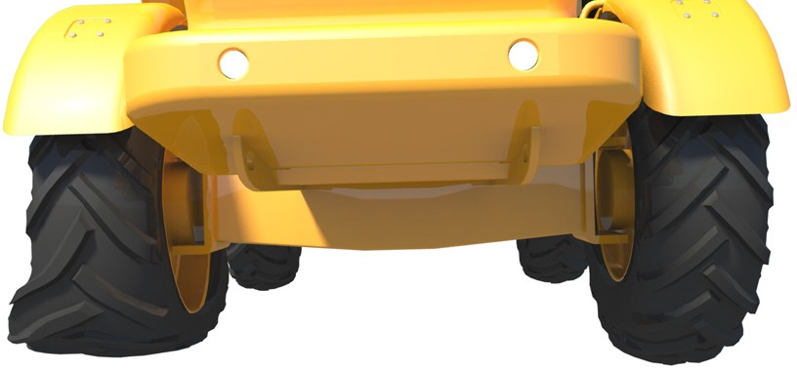
PC 2.1
CHECK AND MONITOR EQUIPMENT
Pre-start checks
Before you start, walk around the vehicle. Check under the vehicle – look for any obvious oil or fluid leaks. Never use your hands to check for leaks – use a piece of paper or cardboard. | Look for any debris that has been caught under the vehicle.
Tyre condition – no cuts or abrasions on treads or tyre sides. Also make sure wheel nuts aren’t loose. | The valve caps should be in place. Double check the tyre pressure if the tyre looks like it has less pressure than the other tyres. The tyres should always be at proper pressure. If they are not, you risk tipping over.
19

Slide 20
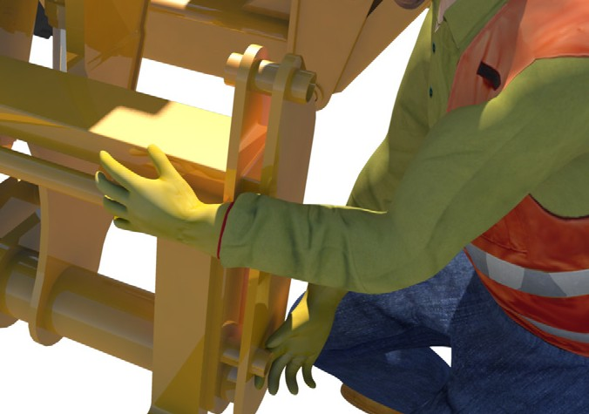
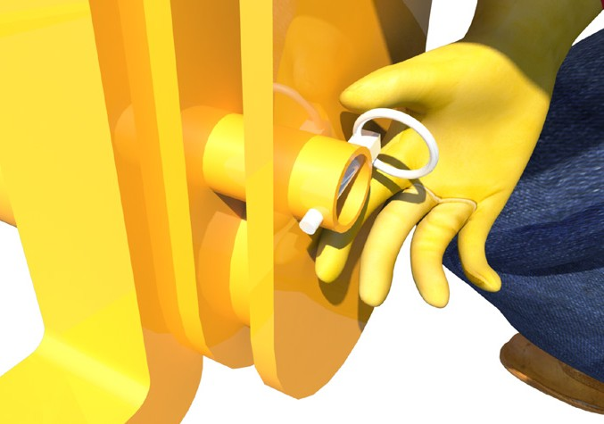
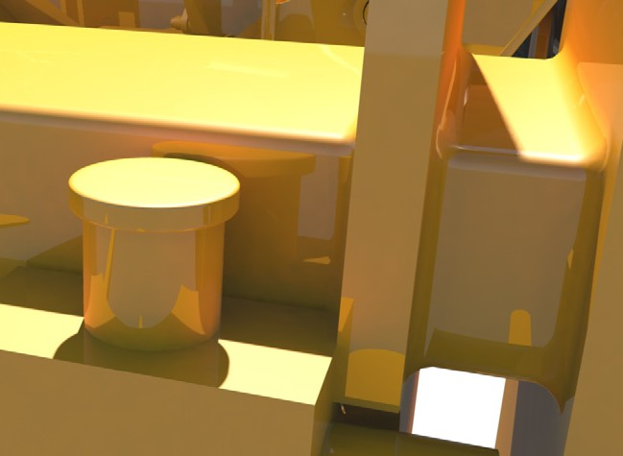
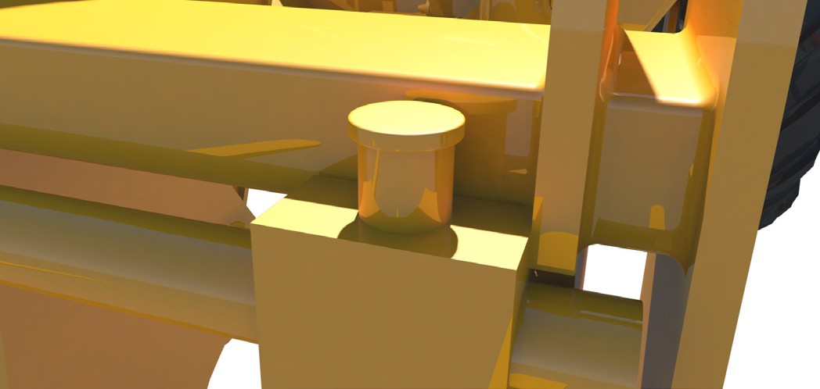
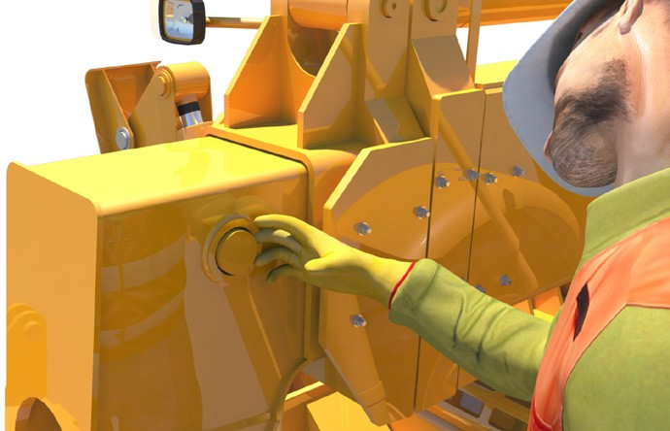
PC 2.1
CHECK AND MONITOR EQUIPMENT
Pre-start checks (continued)
Attachment locating bar – It should be secure. | Make sure all locking pins are in place. |  | Tyne locating pins – Should be in place and working.
Carriage – Make sure there is no physical damage to the carriage. Also look for any unusual wear. |  | The main carriage pins should be in place. Also check locating pins on all cylinders. Make sure there’s no obvious loose movement around the pins.
20

Slide 21
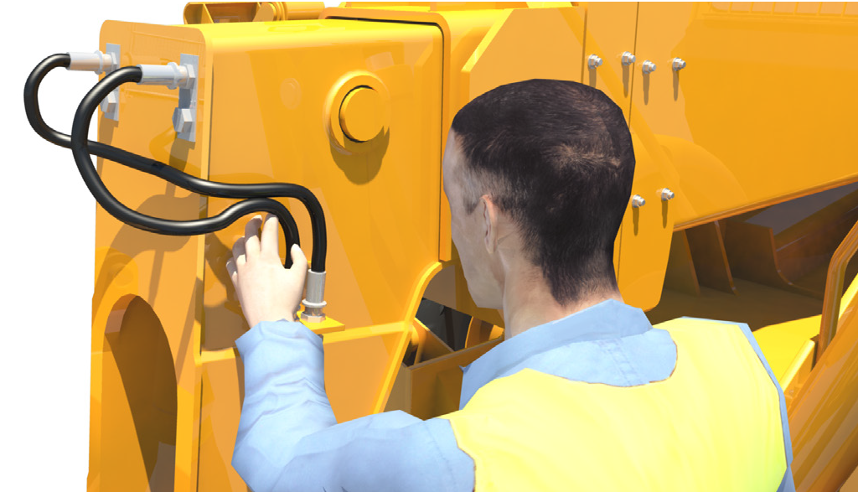
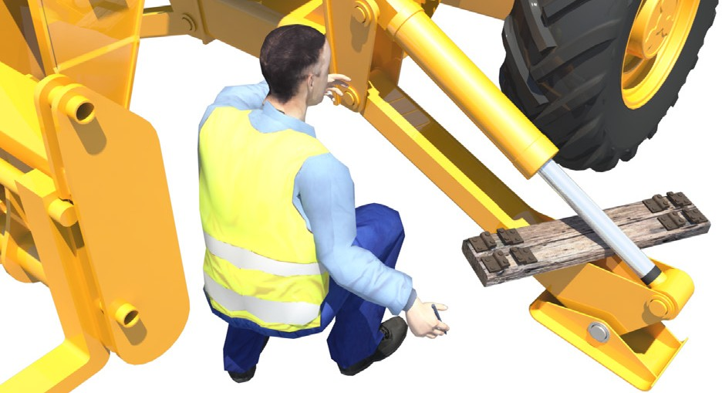
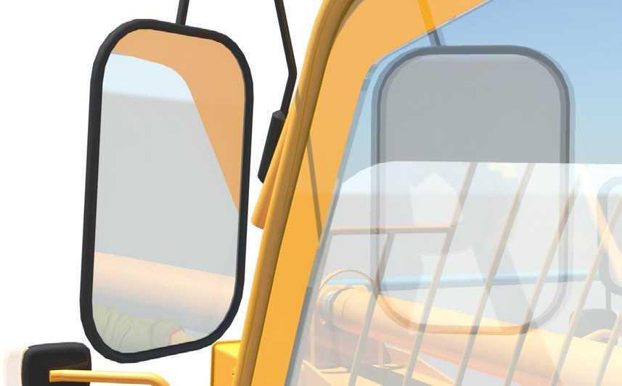
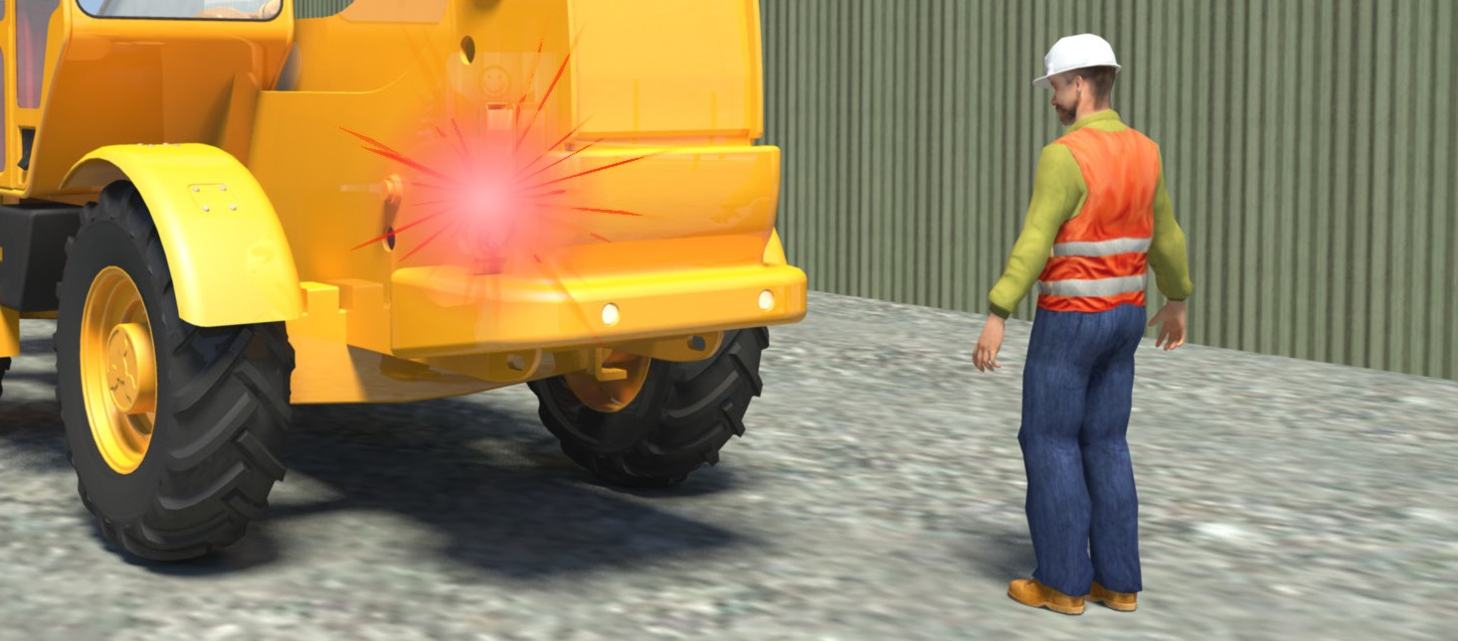
PC 2.1
CHECK AND MONITOR EQUIPMENT
Pre-start checks (continued)
Hoses – Should not be leaking or damaged. | Stabilisers – Make sure there are no crushed lines or debris caught in the stabilisers.
Mirrors and windows – Must be clean; not cracked or broken. | Lights – Ask someone to help you check that all lights are working.
21

Slide 22





PC 2.1
CHECK AND MONITOR EQUIPMENT
Inside the cabin
When you are doing pre-start checks from inside the cabin, keep the handbrake lock secured during these checks:
The view through windows and in mirrors must be clear. | You should be able to read and understand decals in the cabin.
The operator’s manual should be in the cabin and should match the telehandler model. The seat adjustments should work properly. | The logbook needs to be up-to-date and filled out correctly. There must also be a load chart which can be used by the driver in normal operating position.
22

Slide 23



PC 2.1, 2.2
CHECK AND MONITOR EQUIPMENT
Check under the bonnet
When you open the bonnet always make sure you securely replace all caps opened. When you’ve finished, firmly lock the bonnet
back in place. You should check the following:
Oil – Make sure engine oil and transmission oil are not too high or low. | Coolant – Check coolant levels as long as the engine isn’t hot.
Air filter – Check the air filter or air filter indicator. Check belts are tight (if they can be seen).
23

Slide 24



PC 2.1, 2.2
CHECK AND MONITOR EQUIPMENT
Start-up checks
Make sure all controls are working before starting work on the site. Find a clear area so you can safely test all controls, attachments and movements.
Some machines have one joystick for all functions; others have two controls.
Also some machines have a total joystick lockout, which stops all functions from moving.
You must understand how the machine you are using works.
24

Slide 25




PC 2.2
CHECK AND MONITOR EQUIPMENT
Hydraulic functions
The first thing to check after start-up is the hydraulic functions.Test raise and lower the boom. Listen for unusual noises that could mean a problem. | Make sure the boom angle indicator is working.
Test that the tilt lockout will work. When switched on it stops the carriage and attachment being tilted. | Also check the tilt controls can be used to tilt the tynes or other attachment. To avoid damaging the machine, the attachment should be raised off the ground when testing the forward tilt.
25

