Slide 1
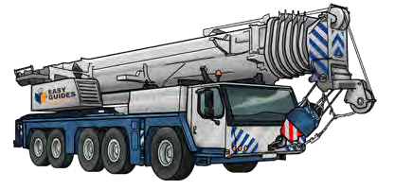
SLEWING MOBILE CRANE
SAFETY AND LICENCE GUIDE
Training support material for:
TLILIC0015
Licence to operate a slewing mobile crane
(Over 100 tonnes)
Produced by:
Picture based. Plain English. Learning made easy.

Slide 2
Introduction to Slewing Mobile Crane (over 100 tonnes)

Slide 3
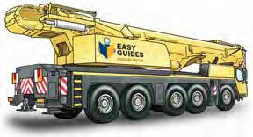
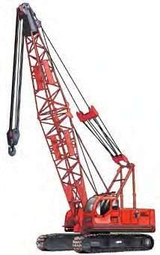
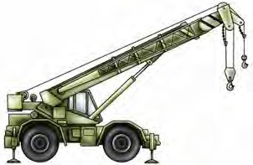
What is a slewing mobile crane
INTRODUCTION TO SLEWING MOBILE CRANE (over 100 tonnes)
A slewing mobile crane is a powered crane which features a boom or jib that can slew from front to back. The crane is mounted on a vehicle.
Slewing mobile crane | Crawler crane
Rough terrain slewing crane
This learner resource does not cover front-end loader, backhoe, excavator or similar equipment when configured
(arranged or set up) for crane operations.

Slide 4
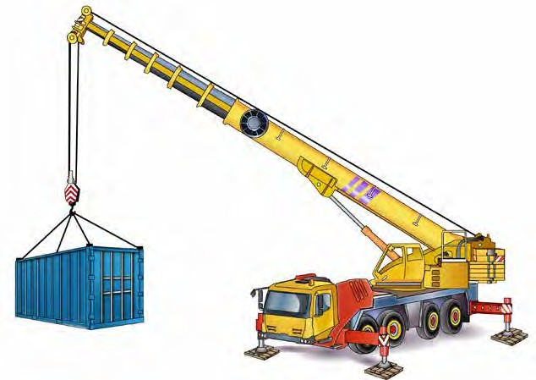
Parts of a slewing mobile crane
INTRODUCTION TO SLEWING MOBILE CRANE (over 100 tonnes)
Head sheave
Running rope
Hoist rope
Boom or jib
Hook block
Winch
Hook
Counter weight
Operators cabin
Drivers cabin
Rear outrigger
Jack
Front outrigger
Outrigger beam
Pigstyed packing

Slide 5
Element 1 – Plan work / task

Slide 6
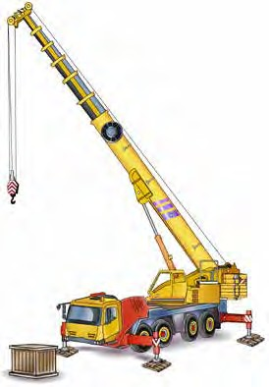
Set up the crane for the task
PC 1.1 ELEMENT 1 — PLAN WORK/TASK
The configuration (set up) of the crane determines how much you can lift.
Set up the crane so the load will never be more than the Safe working load (SWL) of the crane.
Setting up the crane includes:
Positioning the boom/jib over the load correctly
– boom length and radius
Working out the centre of gravity
Looking at the load chart to see if the crane can support the load
Checking the rated capacity of the crane
Setting up the counterweights to keep the crane balanced.
Note:
A licenced dogger is responsible for selecting, inspecting and setting up the lifting gear.

Slide 7
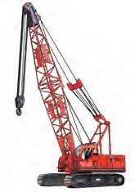
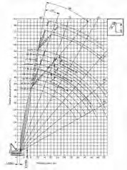
PC 1.1
ELEMENT 1 — PLAN WORK/TASK
Plan the lift
This section covers the kinds of planning you will do before moving the load.
Including:
Working out the weight of the load
Choosing the crane
Reading load charts
Planning the path you’ll take
Checking ground conditions.
Identify and estimate the weight of the load
Make sure you know the weight of the load you are to lift.
Before you move a load, find out its weight and size.
Think about how different types of loads will affect your crane.

Slide 8
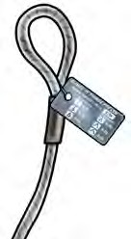
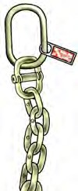
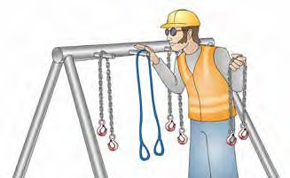
PC 1.3
ELEMENT 1 — PLAN WORK/TASK
Safe working load (SWL)/
Working load limit (WLL) of lifting gear
To find out the Safe working load (SWL) of lifting gear:
Check lifting equipment
Lifting equipment must be checked before use.
Using faulty or damaged lifting equipment could result in the load being damaged or falling from height while it is being moved.
A licenced dogman or rigger is responsible for selecting and checking the lifting gear.
As the crane operator you are responsible for making sure this has been done.
Check the tag
Check to see if it is marked on the sling
Calculate the load yourself.
A sling tag must show:
Working load limit
Reeve factors
Angle factors.
Sling tag

Slide 9
Element 2 – Prepare for work / task

Slide 10
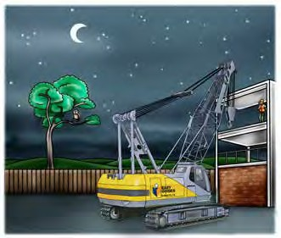
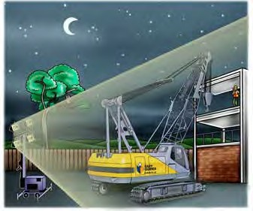
Too dark
PC 2.2 ELEMENT 2 – PREPARE FOR WORK/TASK
You must be able to see clearly. Ask your boss to have the area properly lit up. They may need to set up temporary lighting while you work.
Hazard
If the work area is dark or dimly lit you might not be able to see clearly.
Control
Use extra lighting such as portable lamps, or try to find a
brighter area if you can.

Slide 11
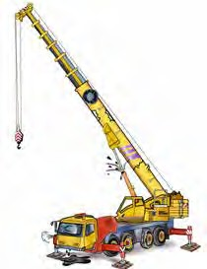
Check the crane
PC 2.4 ELEMENT 2 – PREPARE FOR WORK/TASK
This section is about checking the crane for problems and what to do if you find any problems. It covers visual checks, signs and labels, pre-operational checks, crane controls, checking the logbook, starting the crane, post-start checks and recording and reporting faults.
Visual check
Make sure you have a look around the slewing mobile crane before you use it. See if the crane and lifting equipment are in a safe working condition and are right for the job before you lift any loads. A faulty crane could cause an accident and injure or kill you or your workmates.
Some examples of checks you should do are:
Crane operator
As the crane operator, you are responsible for inspecting the crane.
If you think someone has tampered with the crane, you must report this problem to your supervisor or some other authorised person immediately.
The crane owner and workplace security may also need to be informed.
If someone has mucked about with the crane, report the fault to your supervisor.
Check for bends, twists and cracks in the boom (signs of defects)
Broken windscreen (could indicate vandalism)
Fluid leaks
Damaged tyre

Slide 12
Element 3 – Perform work / task
12

Slide 13
PC 3.1
ELEMENT 3 – PERFORM WORK/TASK
Introduction to load charts
This book covers all four slewing mobile crane capacities. You only need to read the sections relevant to the licence you are studying.
Load chart
All cranes have their own load chart. The load chart gives information about the load capacity of the crane in a given
configuration (set up). The cranes capacity changes depending on how the crane is set up.
Configuration The configuration of the crane includes things like: The outrigger set up (if applicable) The length and angle of the main boom Operating radius Maximum line load and winch capacity Fly jib and hook attachments. | Important information Other important information may include: Limitations of boom angles Operational conditions. For example wind speed. | Crane set-up A load chart refers to a crane that is set up: According to manufacturers specifications On firm, level ground In ideal weather conditions With outriggers/stabilisers fully extended (where applicable) Tyres correctly inflated and in good condition. Read all of the information on the load chart.
13

Slide 14
How to read a load chart
PC 3.1 ELEMENT 3 – PERFORM WORK/TASK
To calculate the maximum load you can safely lift, there are some basic rules for all load charts. Look at the following
Load chart X, which is for a 20 tonne hydraulic crane.
Follow the steps:
Outriggers
Choose the outrigger set up. This will help you know which section of the load chart to look at. For this example, look at the Without outriggers on the chart. The crane is set up to mobile on rubber.
Boom length
Choose the length of the boom. This will help you know which column to look at. In this example, we’ll use a boom length of 14.06 metres.
Operating radius
Choose the operating radius. This will help you know which row to look at. For this example we’ll use 4.30 metres.
Round up to 4.50 metres.
Capacity
Read down the boom length column and across the operating radius row. This is the capacity (WLL) of the crane. In this example it is 5200 kg.
Hook block/s
The weight of the hook block/s is part of the load. Deduct the weight from the capacity. These weights are on the load chart. In this example, deduct 200 kg for a 3 sheave
hook block.
Jib weight
The weight of the jib (fly), either fitted or stowed, is part of
the load and may be a deduction from the capacity.
This information is on the load chart. In this example, we can’t use the jib because we are not using outriggers.
Line (hoist rope)
Look at the hoist rope reeving to work out how many parts of line (hoist rope) you need to support the load. In this example, the load being lifted is 5 tonnes. The hoist rope has a capacity of 3340 kg which is less than 5 tonnes so you need 2 lines to safely lift the load.
Jib configuration
Find the information about the load capacity of the different jib configurations. This information is in the Jib load
ratings-kgs on the bottom right-hand side of the chart. With jib offset the crane has more capacity, but the jib is meant to give you more lifting height. Some load charts will have information on auxiliary jibs and their limitations.
14

Slide 15
READING LOAD CHARTS
For Cranes over 100 Tonnes
Main boom in 360O work area - rated crane loads in kilograms (KGs)
Powered boom lengths in metres
Radius (M)
Load Chart -
43
46
49
52.5
55.5
Operating
Radius (M)
34
36
40.5
KGs
KGs
KGs
4.00
100 Tonne (A)
Operating
KGs
KGs
KGs
KGs
KGs
5.00
4.00
5.50
WARNING
5.00
6.00
1.
Boom backstops are required
5.50
7.00
for all boom lengths.
6.00
8.00
2.
Gantry must be in a raised
9.00
position for all operating
7.00
10.00
NOTE: Please read the other ‘Reading Load Charts’ section before reading this section.
conditions.
8.00 80 22,900
22,900 79
22,800
3.
Boom inserts must be arranged
9.00 78 23,000 78
19,600 78 19,500 78 19,400
as shown in the ‘Boom Insert
10.00 76 19,800 76
19,700 77
15,200 76 15,100 76 15,000 78 14,900 77 14,800 78 14,700 12.00
Arrangement Chart’.
15,300 75
12,300 74 12,200 74 12,100 76 12,000 75 11,900 76 11,800 14.00
4.
Mid-point suspension (centre
12.00 73 15,400 74
12,400 72
9,900 73
9,800 74
9,700 16.00
hitch) required when boom
14.00 69 12,500 71
10,300 68
10,200 71 10,100 71 10,000 74
8,300 70
8,200 71
8,100 18.00
length is 55.5m or longer.
16.00 65 10,400 67
8,700 64
8,600 67
8,500 67
8,400 71
7,100 66
7,000 67
6,900 20.00
5.
Safe loads depend up on
18.00 61 8,800 63
7,400 63
7,300 63
7,200 67
6,200 62
6,050 63
5,900 22.00
ground conditions, boom
20.00 57 7,600 59
7,500 60
6,400 59
6,300 63
5,200 59
5,050 24.00
length, radius of operation and
6,600 58
6,500 59
5,500 59
5,350 58
4,350 26.00
proper handling. All of which
22.00 53 6,700 55
5,700 57
5,600 57
4,650 56
4,500 57
must be taken into account
24.00 49 5,900 51
5,800 56
5,000 55
4,900 55
4,800 57
4,150 54
4,000 55
3,850 28.00
by the user.
26.00 44 5,200 47
5,100 54
4,500 53
4,400 53
4,300 55
3,500 53
3,350 30.00
6.
Standard boom hoist reeving is
28.00 35 4,700 42
4,600 51
3,900 50
3,800 53
3,650 52
3,000 50
2,850 32.00
12 parts line.
30.00 31 4,200 33
4,100 48
4,000 50
3,400 47
3,300 50
3,150 49
2,650 47
2,450 34.00
7.
Ratings are based on crawler
3,600 43
3,500 47
3,000 47
2,850 46
2,150 36.00
extended to a fulcrum point.
32.00
29
34
3,200 42
3,100 42
2,550 41
2,350 42
Crawler frames must be
2,800 33
2,700 42
1,950 33
1,750 38.00
fully extended for all crane
34.00
30
2,900 33
2,400 29
2,300 33
2,150 32
1,350 40.00
operations.
36.00
29
1,900 29
1,750 28
1,550 29
8.
For main boom ratings, with jib
38.00
erected not shown, use rating
40.00
for next longer boom.
15

Slide 16
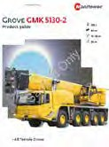
Introduction to load charts
PC 3.1 FOR CRANES UP TO 100 TONNES –
ELEMENT 3 – PERFORM WORK/TASK
Load chart
All cranes have their own load chart. They should be in place and readable. The load chart gives information about the load
capacity of the crane in a given configuration (set up). The cranes capacity changes depending on how the crane is set up.
Configuration The configuration of the crane includes things like: The outrigger set up (if applicable) The length and angle of the main boom Operating radius Maximum line load and winch capacity Fly jib and hook attachments. © Easy Guides Australia Pty. Ltd. | Important information Other important information may include: Limitations of boom angles Operational conditions. For example wind speed. 224 | Crane set-up A load chart refers to a crane that is set up: According to manufacturers specifications On firm, level ground In ideal weather conditions With outriggers/stabilisers fully extended (where applicable) Tyres correctly inflated and in good condition. Read all of the information on the load chart. May not be reproduced

Slide 17
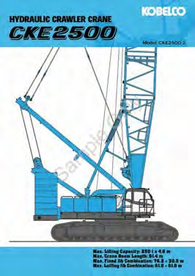
READING LOAD CHARTS OVER 100T
Introduction to load charts
All cranes have their own load chart. The load chart gives information about the load capacity of the crane in a given
configuration (set up). The crane’s capacity changes depending on how the crane is set up.
The configuration of the crane includes:
the outrigger set up
the length and angle of the main boom
maximum line load and winch capacity
fly jib and hook attachments.
Other important information can include:
specific limitations of boom angles
operational condition such as wind speed.
Read all of the information on the load chart.
17

Slide 18
Element 4 –
Pack up
18

Slide 19
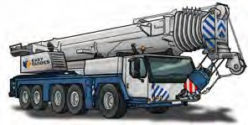
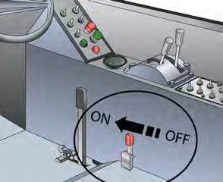
PC 4.1, 4.3
ELEMENT 4 – PACK UP
Shut down and pack up
This part of the book is about how to shut down, pack up and put away equipment.
It covers:
Stow boom/jib and equipment
Stow your boom as shown in the manufacturer’s instructions or
the specifications.
Remove any lifting parts from the boom and securely attach them to the correct position on the vehicle.
Stowing and securing equipment
Using motion locks
Shutting down the crane
Post-operational checks.
Apply motion locks and brakes
Check that you have turned on all motion locks and brakes.
19

Slide 20
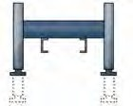
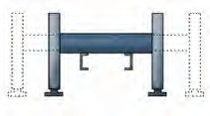
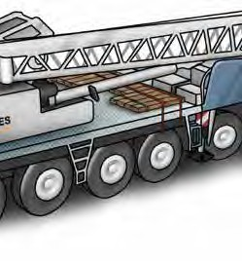
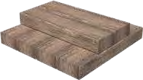
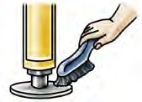
PC 4.4
ELEMENT 4 – PACK UP
Stow and secure outriggers/stabilisers
Check that outriggers/stabilisers are stored safely for travel.
To secure and stow outriggers you should:
Stow and secure plates and packing
Secure all packing properly and safely.
Use straps or ties to hold packing timbers down.
1. Use the controls to raise the outrigger footplates. | 2. Use the controls to retract the outriggers.
3. Pack up the packing timbers. | 4. Clean steel plates.
20

