Slide 1
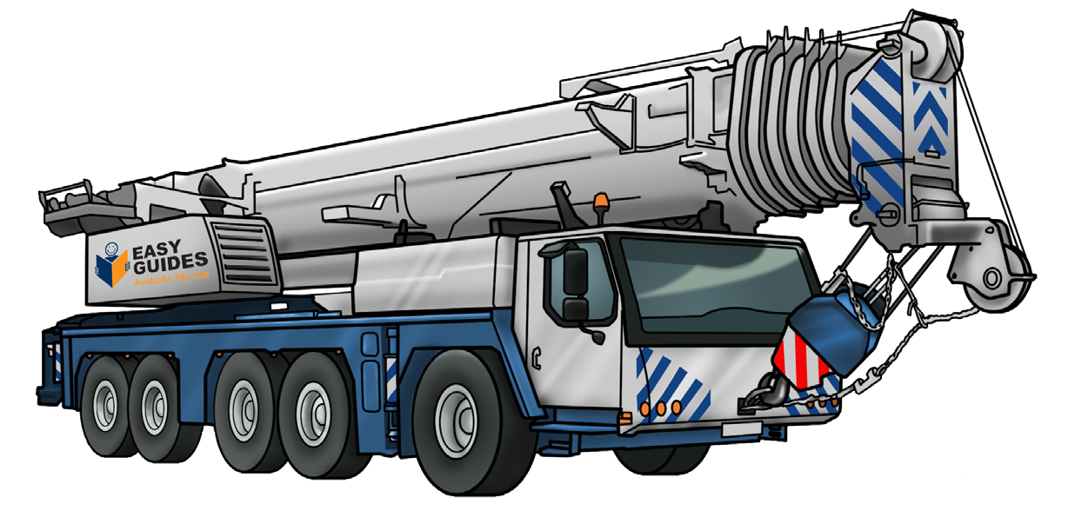

SLEWING MOBILE CRANE (60T)
SAFETY AND LICENCE GUIDE
Training support material for:
TLILIC0013
Licence to operate a slewing mobile crane
(up to 60 tonnes)
Produced by:

Slide 2
Introduction to Slewing Mobile Crane (up to 60 tonnes) 7
High Risk Licensing and the Law
11
Element 1 – Plan work / task
25
Element 2 – Prepare for work / task
107
Element 3 – Perform work / task
179
Reading Load Chart – for cranes up to 60 tonnes
227
Element 4 – Pack up
249

Slide 3
Introduction to Slewing Mobile Crane (up to 60 tonnes)

Slide 4
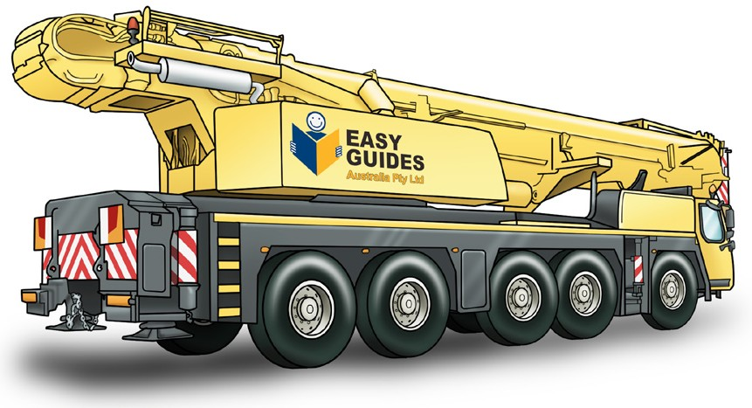
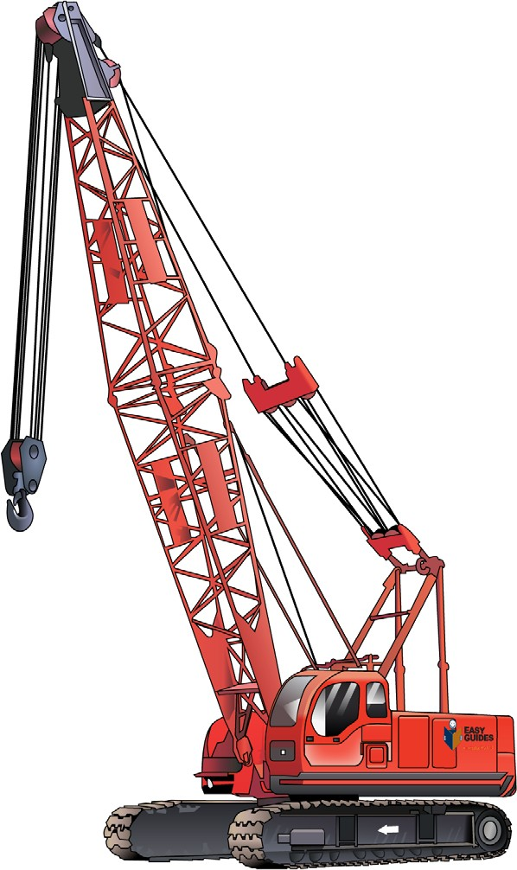
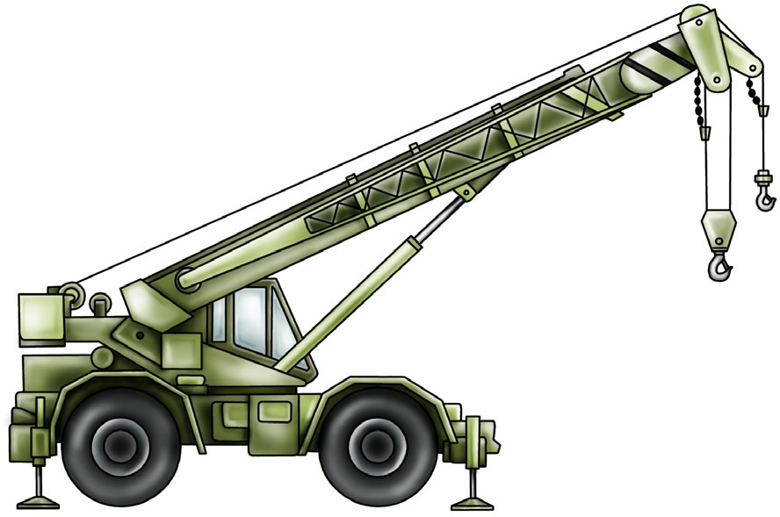
What is a slewing mobile crane
INTRODUCTION TO SLEWING MOBILE CRANE (up to 60 tonnes)
A slewing mobile crane is a powered crane which features a boom or jib that can slew from front to back. The crane is mounted on a vehicle.
Slewing mobile crane Crawler crane
Rough terrain slewing crane
This learner resource does not cover front-end loader, backhoe, excavator or similar equipment when configured
(arranged or set up) for crane operations.

Slide 5
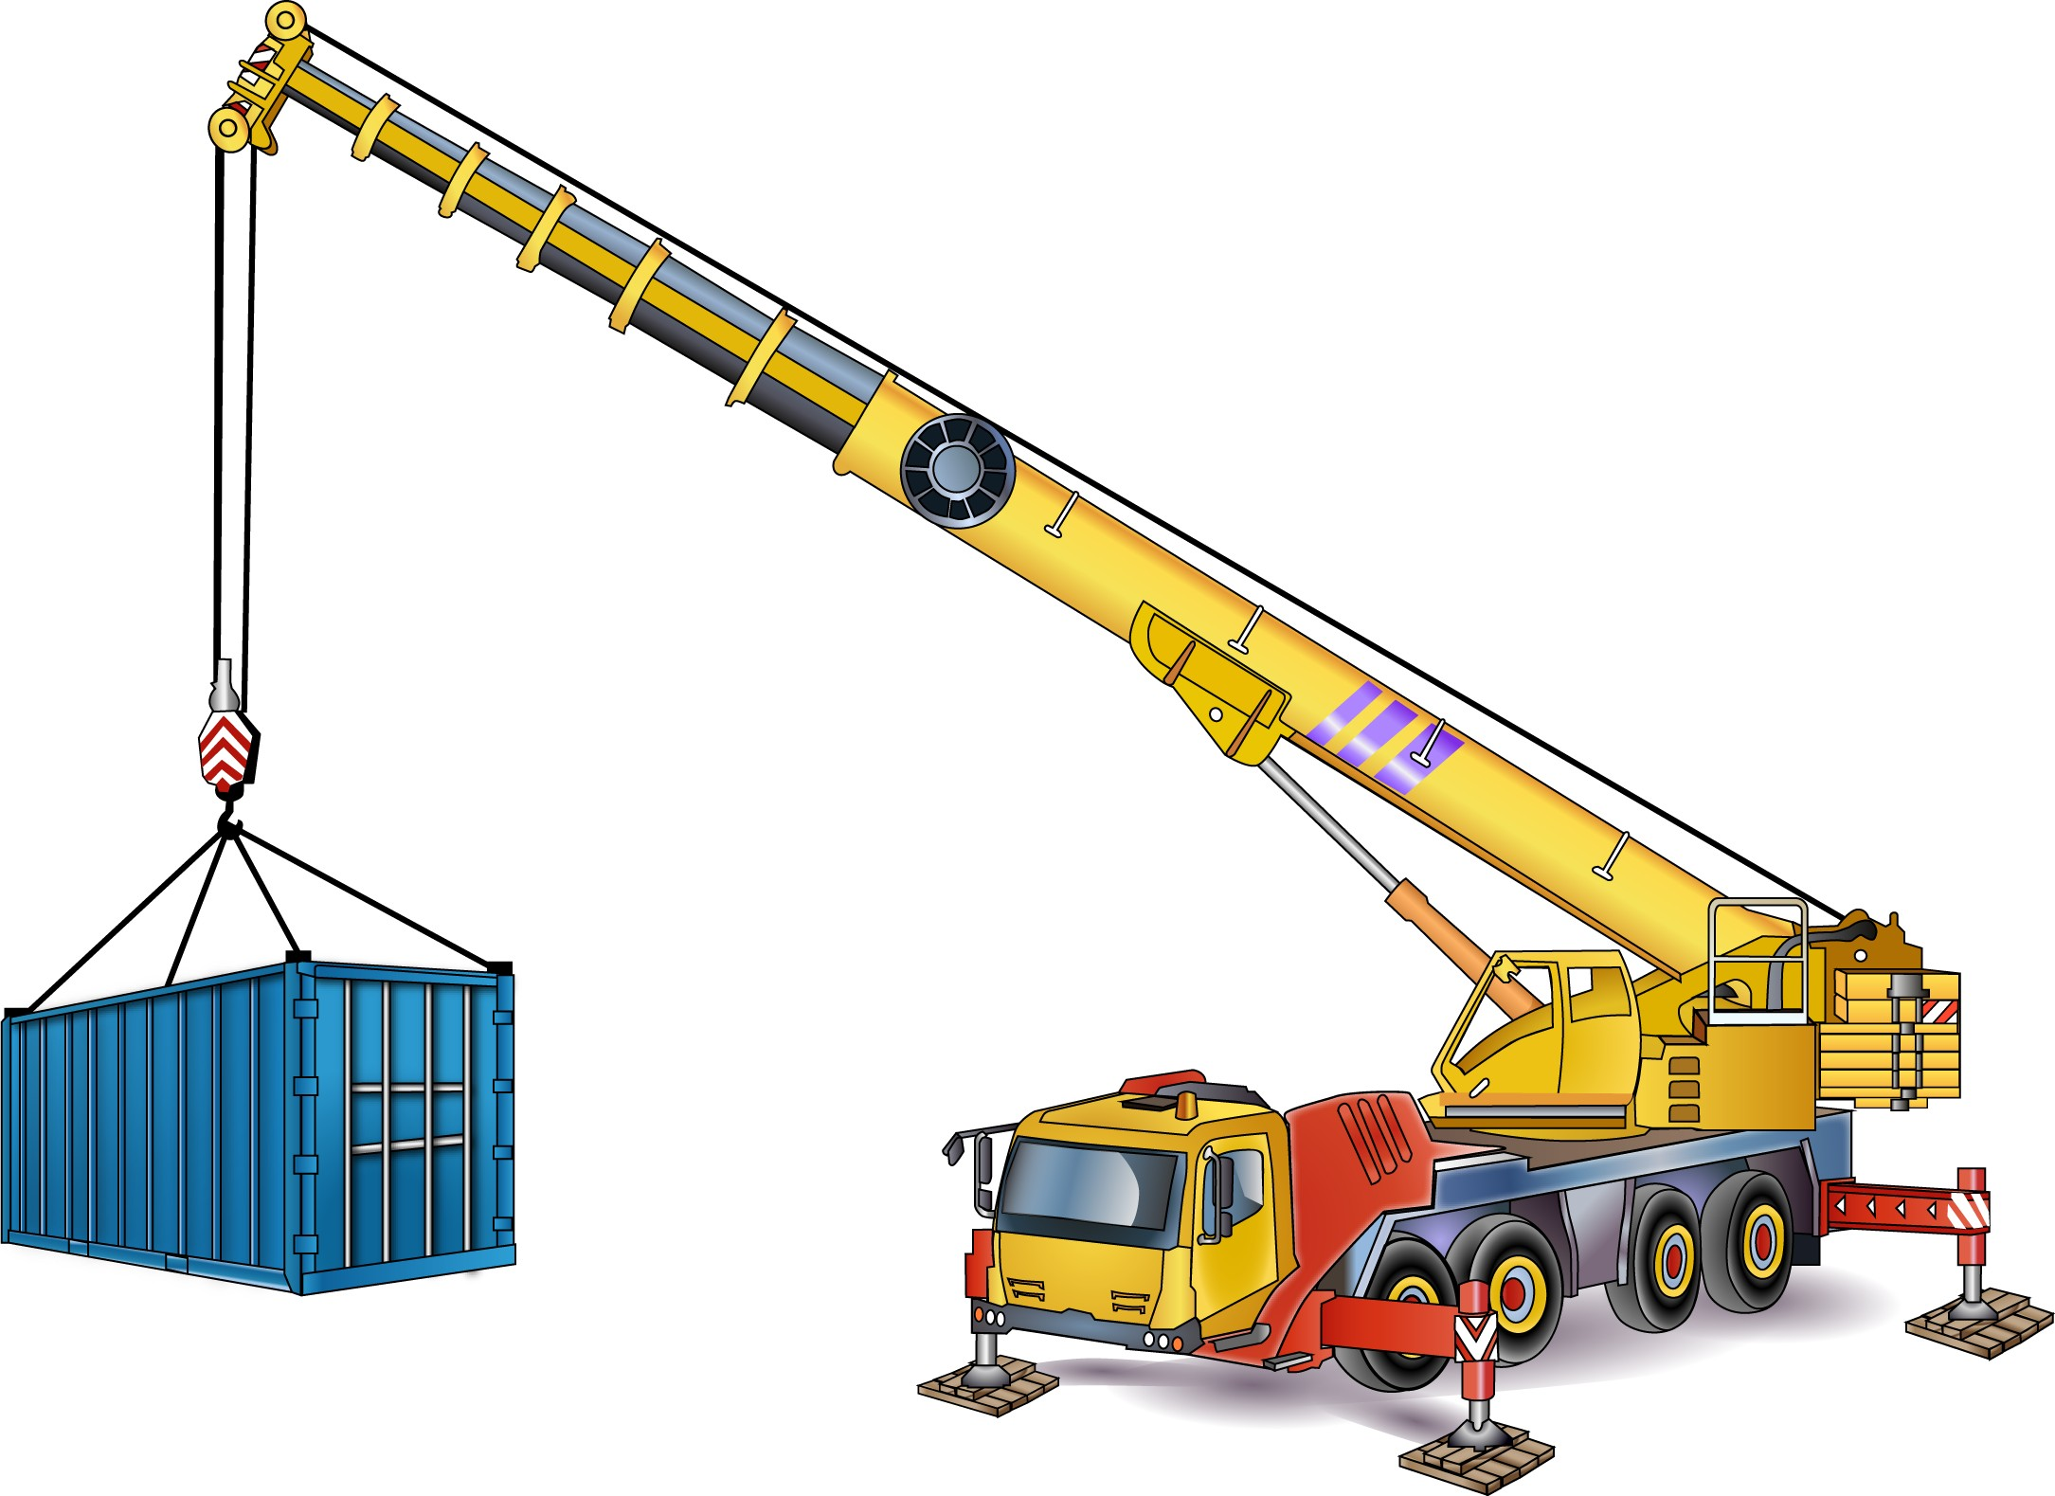
Parts of a slewing mobile crane
INTRODUCTION TO SLEWING MOBILE CRANE (up to 20 tonnes)
Head sheave
Running rope
Hoist rope
Boom or jib
Hook block
Winch
Hook
Counter weight
Operators cabin
Drivers cabin
Rear outrigger
Jack
Front outrigger
Outrigger beam
Pigstyed packing

Slide 6
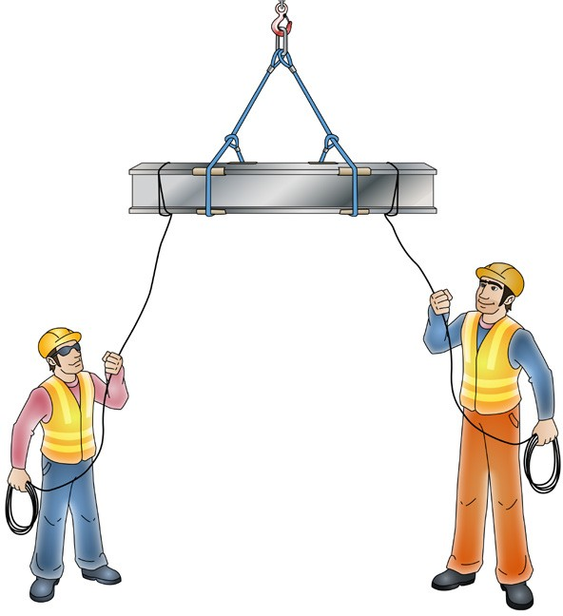
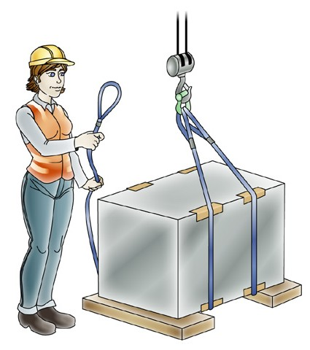
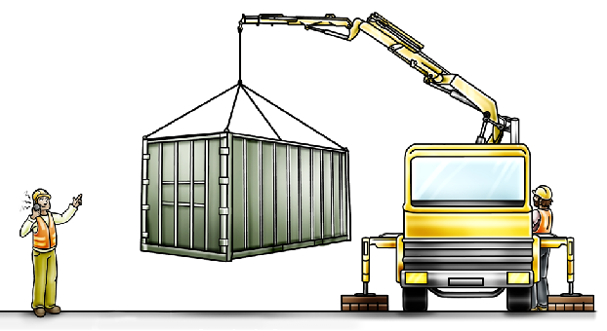
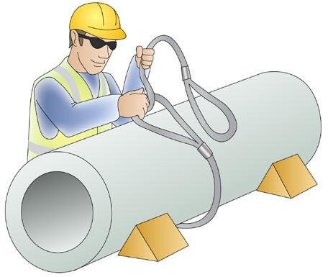
What is a dogger/dogman?
INTRODUCTION TO SLEWING MOBILE CRANE (up to 20 tonnes)
The crane operator must work closely with a dogman (dogger). The dogman is responsible for:
Selecting and inspecting lifting gear/equipment
Slinging loads
Guiding/directing a crane operator in the movement of a load
Working out the weight of a load
Working out the best ways to sling a load
Working with the crane operator to make sure the crane is right for the job.
You must hold the correct licence or be enrolled in a course with an RTO and under the supervision of a licenced dogman to perform any of the tasks listed above.
In this book the term dogger or dogman also means rigger.

Slide 7
High Risk Licensing and the Law

Slide 8
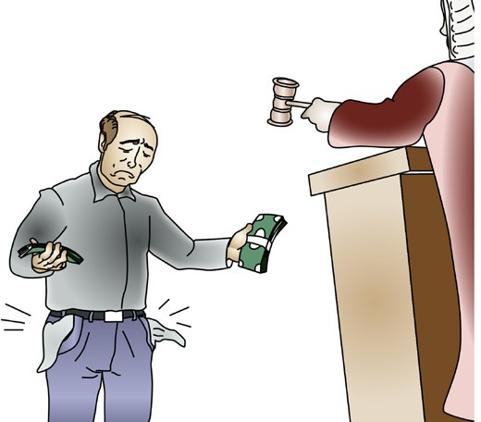
PC 1.1
HIGH RISK LICENSING AND THE LAW
Duty of care
Duty of care means your legal responsibility to ensure the safety and well being of others who could be affected by your actions.
Duty of care applies to:
Worker’s duty of care
By law, as a worker you must:
take care of your own health and safety
take care of the health and safety of other people in the workplace because of the things you do or forget to do
Employers/persons conducting a business or undertaking (PCBU)
‘Workers’ which includes people who are:
– employees
Do your best to follow workplace, health and safety (WHS) / Occupational health and safety (OHS) requirement from your PCBU/employer
Don’t misuse anything provided at the workplace for WHS / OHS either deliberately or recklessly.
Do not do work if you believe a hazard would be a serious risk to your health or safety.
contractors
sub-contractors
outworkers
employees of labour hire companies
volunteers
Managers
Designers
Importers
Suppliers
Inspectors.
Penalties
If you are a PCBU/employer or worker, the government can
fine or even imprison you for failing your duty of care.
PCBU’s/Employer’s duty of care
By law, as an employer you must:
provide a workplace that is safe and without risk to health or safety to people
provide information and training so that work will be done safely
provide safe plant, equipment and structures
put systems in place to work safely
provide ways to make sure plant, structures and substances are used, handled and stored safely.
make sure facilities are in good condition
Note: PCBU means employer in this publication

Slide 9
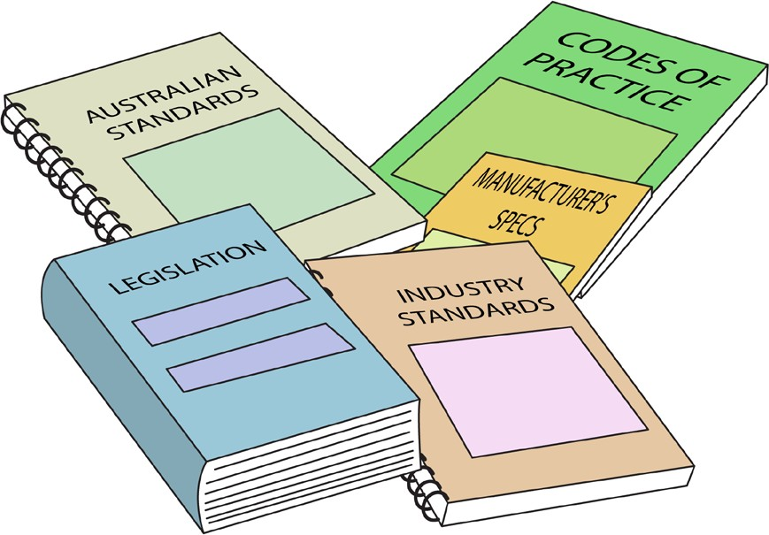
OHS / WHS Guidelines, instructions and people
HIGH RISK LICENSING AND THE LAW
Before operating the crane you must be aware of any guidelines, instructions and people for the crane you will be operating and for crane operation in general at the workplace.
The types of documents you may need to refer to include:
Manufacturers instructions such as an operator’s manual
Safe work or job procedures
Specific workplace policies and procedures
OHS / WHS workplace representatives
Plans by managers
Codes of practice
Guidelines for the safe operation of forklifts and attachments
WHS /OHS policy
Health and Safety Acts and Regulations (OHS/WHS)
These can be found at www.safeworkaustralia.com or
on your state/territory Health and Safety Regulators website.
Australian and industry standards
You can search for standards at www.standards.org.

Slide 10

National Vocational Education and Training (VET) Licensing Pathway
HIGH RISK LICENSING AND THE LAW
Introduction
In April 2006 at a meeting of Council of Australian Governments (COAG) all states and territories approved a ‘National Standard for Licensing Persons Performing High Risk Work’.
“This National Standard recognises the importance of quality training as an underpinning principle in providing skilled workers, and that the most effective form of training is a combination of informal and formal training methods. It requires training and assessment to be undertaken by Registered Training Organisations (RTOs).”
National licensing system

Slide 11
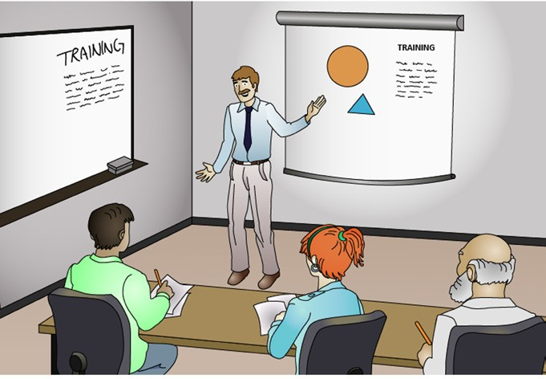
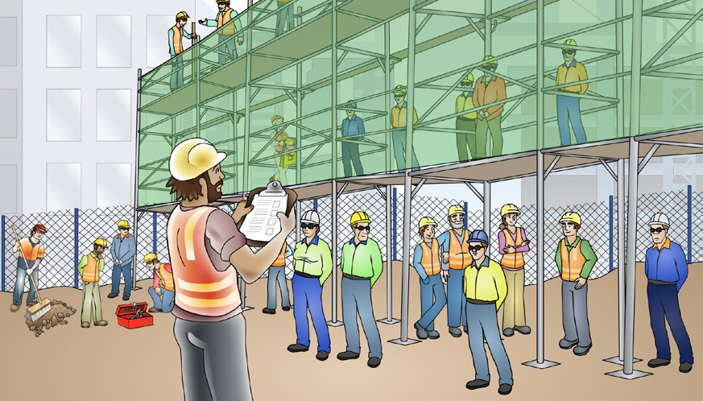
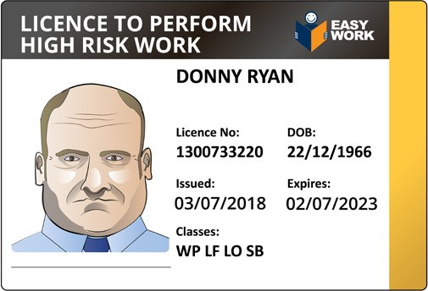
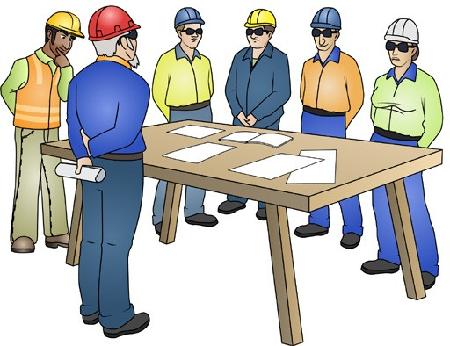
Doing high risk work without a licence
HIGH RISK LICENSING AND THE LAW
You can do high risk work without holding a licence if:
You are enrolled for the relevant licence with a registered training organisation (RTO).
You are being supervised at work by a person with that high risk licence.
Evidence of competency
Your employer may ask you for written evidence before you can do high risk work. You should show your employer:
Your licence, OR
Other evidence that you are training for the licence with a registered training organisation.

Slide 12
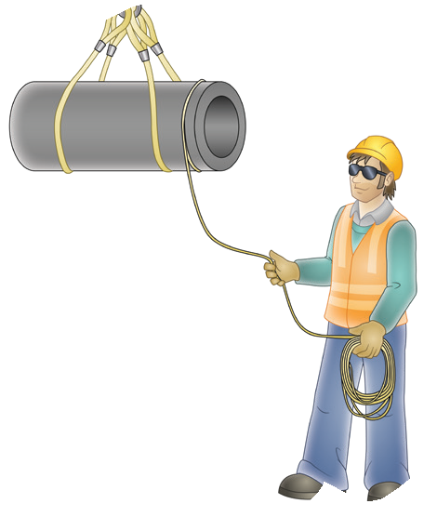


Maintaining competence
HIGH RISK LICENSING AND THE LAW
Once you have a high risk work licence you need to keep experienced and up to date (maintain competent and current skills). If you are no longer competent, you must not do high risk licence work (even if you have a licence).
You must:
Retrain to become competent again or
Give your licence back to the Health and Safety Regulator.
For example, this dogger has been in a desk job for several years and has not kept up his experience.
He will need to retrain before doing any dogging work or he should hand his licence back to the regulator.

Slide 13
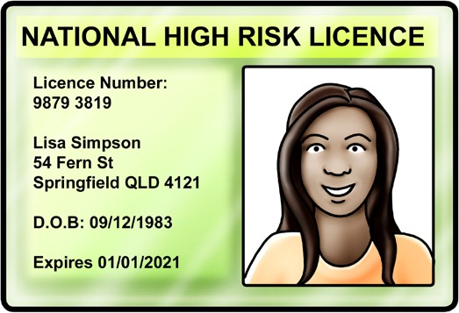
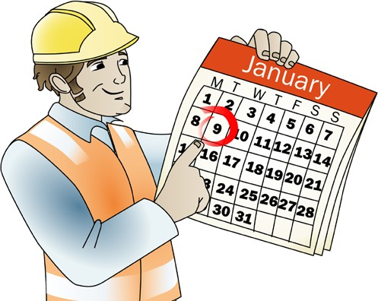
Renewing your high risk work licence
HIGH RISK LICENSING AND THE LAW
You must renew your high risk work licence every 5 years.
Your licence must be renewed within 12 months of the expiry date (24 months in WA). The regulator may send you a reminder just before the expiry date, so you must keep your details up to date with them.
To renew your licence you need to:
complete paperwork
provide a passport size photo
provide the correct types of identification
pay a fee.
You may be required to sign a declaration saying you are still competent and your skills are current.
It is your responsibility to renew your licence before it expires.
If your licence is not renewed within 12 months of the expiry date, your existing licence cannot be renewed. You will need to complete another course and licence assessment with a registered training organisation (RTO) to be able to apply for a new licence.
DO NOT FORGET
You must renew your high risk work licence every 5 years. Set yourself a reminder before the due date.
If you change your address remember to notify the issuing authority of your high risk work licence.

Slide 14
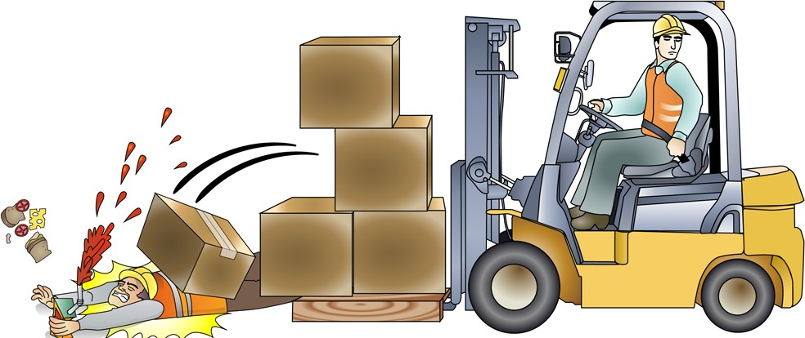

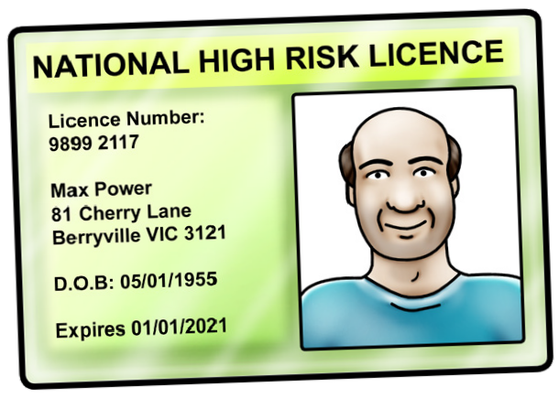
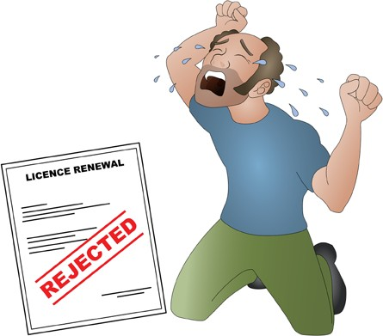
Your legal responsibility when doing high risk work
HIGH RISK LICENSING AND THE LAW
Work carefully
Look after your own health and safety.
You must also make sure that your work does not harm the health and safety of others.
You must be careful the whole time you are doing high risk work
Penalties for working unsafely
You may not be able to renew your licence
You may have your licence suspended or cancelled
You may have to do your high risk licence test again to make sure you can do the work safely and competently.
You may be prosecuted and have to go to court.
You may not be able to get your licence renewed.
CANCELLED

Slide 15

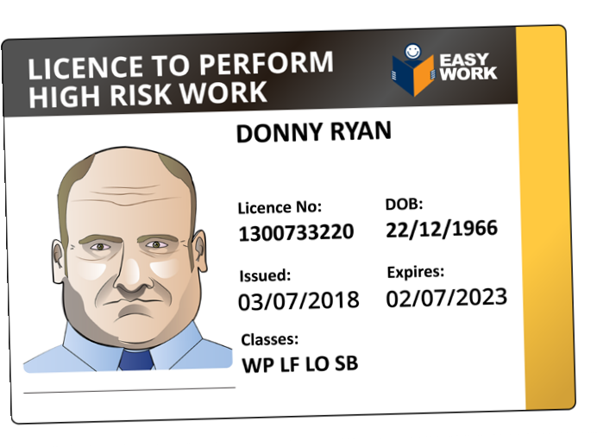
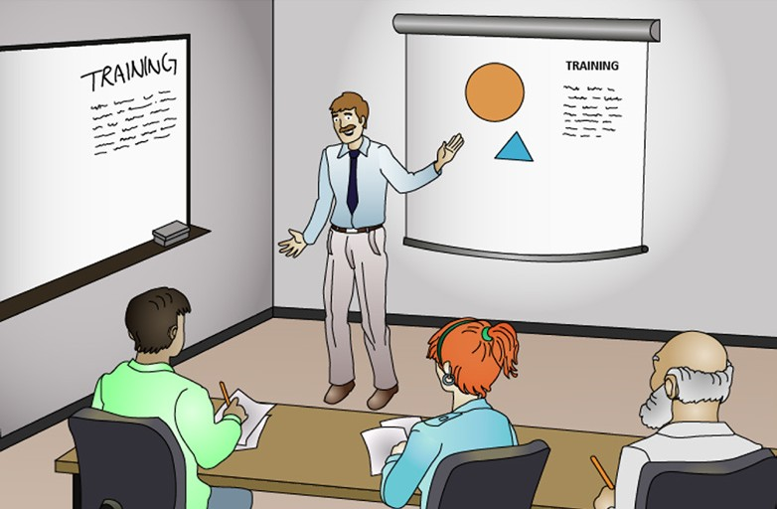
HIGH RISK LICENSING AND THE LAW
QUESTION 1 Can I do high risk work if I don’t have a licence? | Yes, but only if you are enrolled in a course with a Registered training organisation (RTO) for the licence you need and supervised by someone with a licence for the class of high risk work you are doing. Note: Your PCBU/employer will not let you do high risk licence work if he or she believes you are not competent.
QUESTION 2 Your employer might ask you to show evidence of competency before you can do high risk work. What evidence might you need to show? | You might need to show your employer your high risk licence. | You might need to show your employer that you are training with a Registered training organisation (RTO) to get the licence.

Slide 16
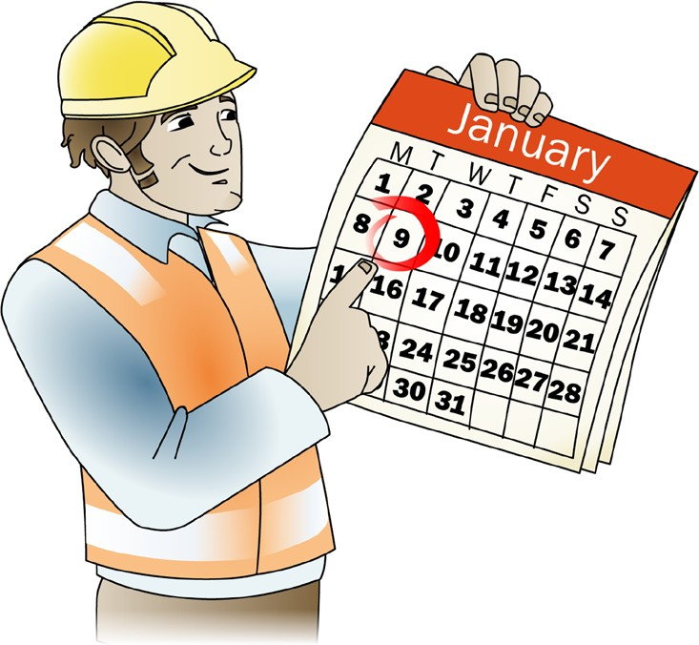
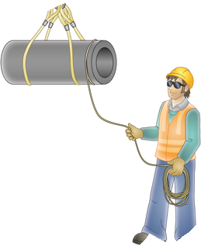


HIGH RISK LICENSING AND THE LAW
QUESTION 3
You have passed your high risk work licence test. You must now apply for your photo ID high risk work licence. You must submit the Statement of Attainment or Satisfactory Assessment from your Registered training organisation (RTO) or assessor.
How many days do you have to put this application in?
60 days!
DON’T LEAVE IT TOO LATE!
QUESTION 4
Once you have a high risk work licence you need to keep experienced and up to date (competent).
Can you use your high risk work licence if you are no longer experienced and up to date?
No. If you are no longer competent, you must not do high risk licence work (even if you have a licence).
You must retrain to become competent or give back your licence to the
WHS Regulator.
For example, this dogger has been in a desk job for several years and has not kept up experience.

Slide 17
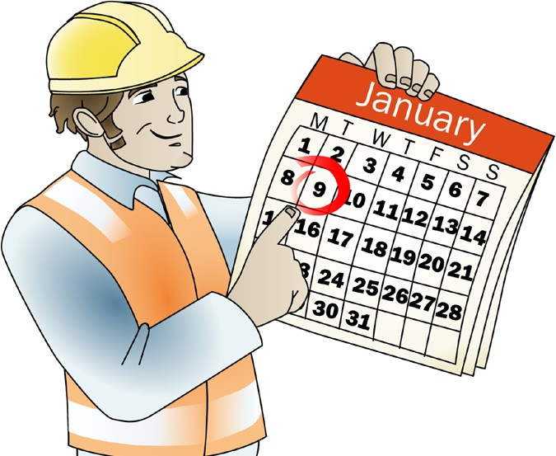

HIGH RISK LICENSING AND THE LAW
QUESTION 5
You need to renew your high risk work licence every 5 years.
You must renew your licence within 12 months of the renewal date.
What will happen if you don’t renew your licence within 12 months of the date it expires?
Note: In Western Australia this period is 24 months.
You won’t be able to renew your licence. You will need to get a new licence.
You will need to do a course with a Registered training organisation (RTO) then apply for a new licence.
While training you could do high risk work but you must be supervised by someone with a licence for the high risk work you are doing.
DO NOT FORGET – Set yourself a reminder before the due date
QUESTION 6
What is your legal responsibility when using a high risk work licence?
Work carefully. Look after your own health and safety. You must also make sure that your work does not harm the health and safety of others.

Slide 18
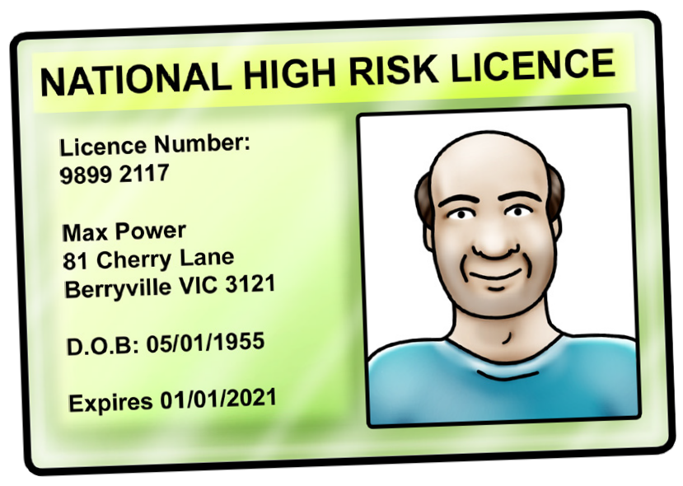

HIGH RISK LICENSING AND THE LAW
QUESTION 7 | You may have your licence suspended or cancelled.
You can be punished (penalised) for not doing high risk licence work safely. There are a number of things that a health and safety regulator, for example WorkSafe/ WorkCover, can do. What might the punishment be?
 | You may not be able to renew your licence.
 | You may have to do your high risk licence test again to make sure you can do the work safely and competently.
CANCELLED

Slide 19
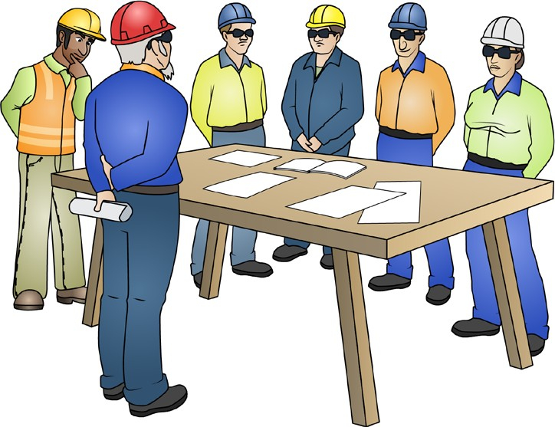

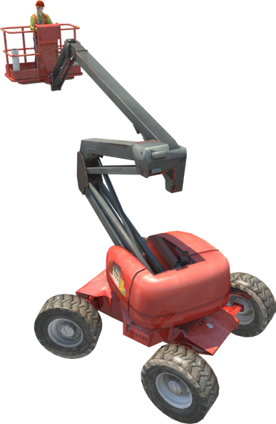
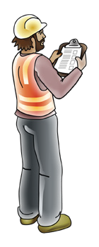
PC 2.1
HIGH RISK LICENSING AND THE LAW
QUESTION 4 | Your employer needs to provide you with information and training about the unfamiliar EWP.
You have got your High Risk Work Licence to operate a slewing mobile crane. You are going to work using an unfamiliar slewing mobile crane. What must your employer do before you use the unfamiliar mobile slewing crane?
 | Your employer needs to provide you with instruction and supervision using the unfamiliar EWP.

Slide 20
Element 1 – Plan work / task

