Slide 1
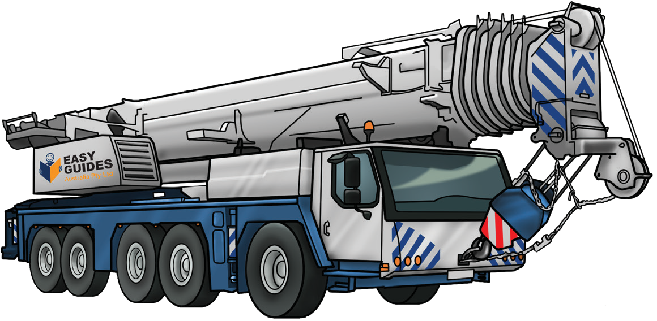

SLEWING MOBILE CRANE
(up to 20 tonnes)
SAFETY AND LICENCE GUIDE
TLILIC0010
Licence to operate a slewing mobile crane
(up to 20 tonnes)
Introduction to
Slewing Mobile Crane
(up to 20 tonnes)
High Risk Licensing and the Law
ELEMENT 1
Plan work/task
ELEMENT 2
ELEMENT 3
READING
ELEMENT 4
Prepare for work/task
Perform work/task
LOAD CHART
Pack up
For cranes
up to 20 tonnes
© Copyright Easy Guides Australia
Edition 1: Version 1 - May 2019

Slide 2
Introduction to Slewing Mobile Crane (up to 20 tonnes)
Home

Slide 3
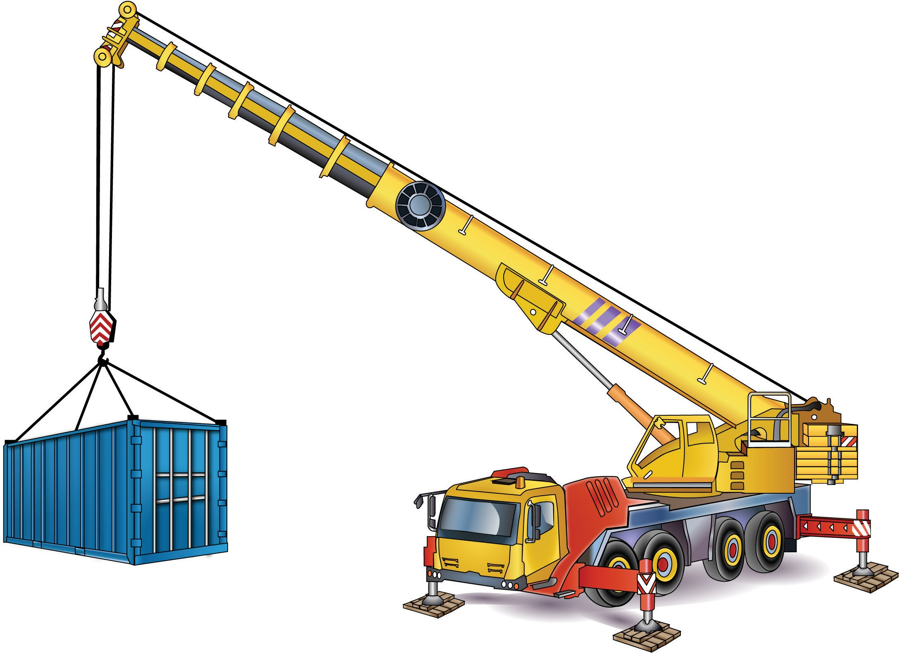
Parts of a slewing mobile crane
INTRODUCTION TO SLEWING MOBILE CRANE (up to 20 tonnes)
Head sheave
Running rope
Hoist rope
Boom or jib
Hook block
Winch
Hook
Counter weight
Operators cabin
Drivers cabin
Rear outrigger
Jack
Front outrigger
Outrigger beam
Pigstyed packing

Slide 4
Element 1 – Plan work / task
Home

Slide 5
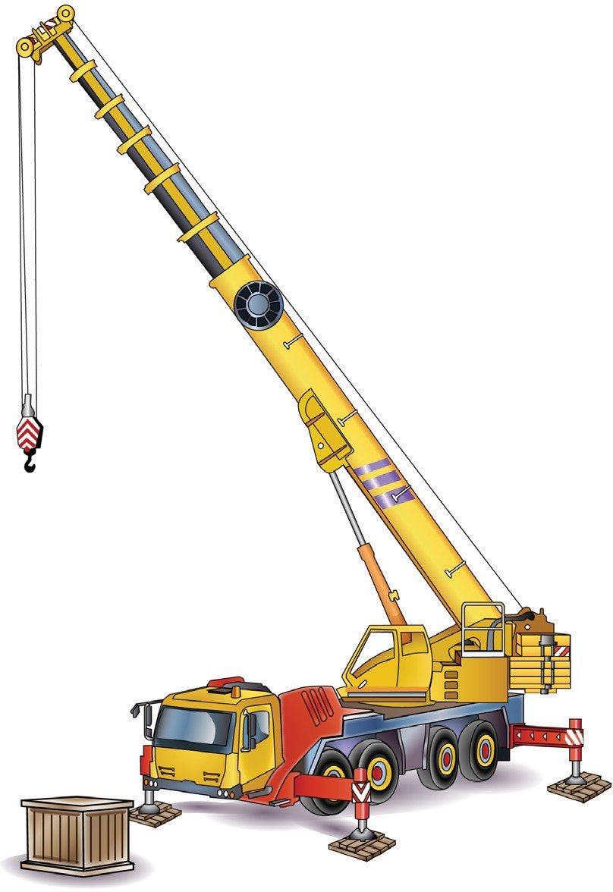

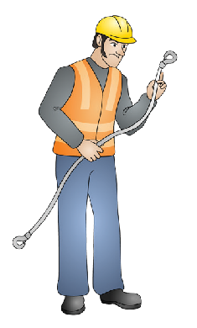
Set up the crane for the task
PC 1.1 ELEMENT 1 — PLAN WORK/TASK
The configuration (set up) of the crane determines how much you can lift.
Set up the crane so the load will never be more than the Safe working load (SWL) of the crane.
Setting up the crane includes:
Positioning the boom/jib over the load correctly
– boom length and radius
Working out the centre of gravity
Looking at the load chart to see if the crane can support the load
Checking the rated capacity of the crane
Setting up the counterweights to keep the crane balanced.
Note:
A licenced dogger is responsible for selecting, inspecting and setting up the lifting gear.

Slide 6
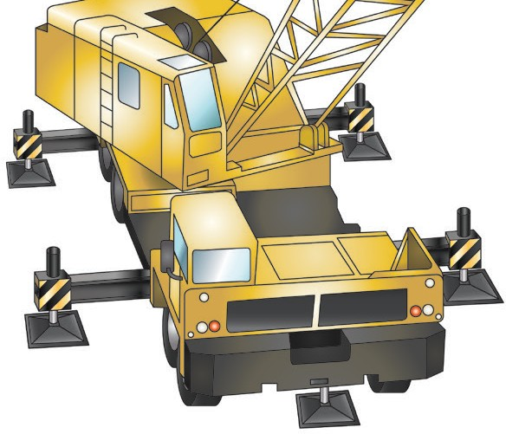
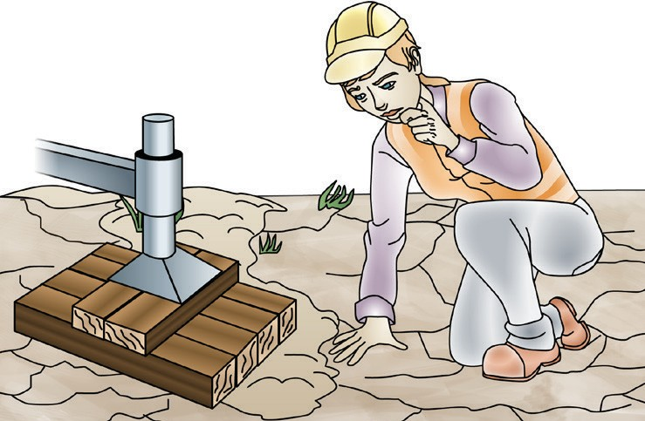

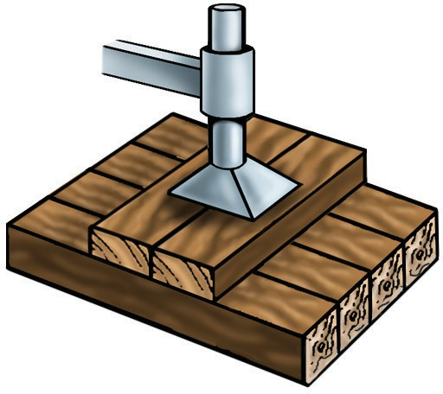
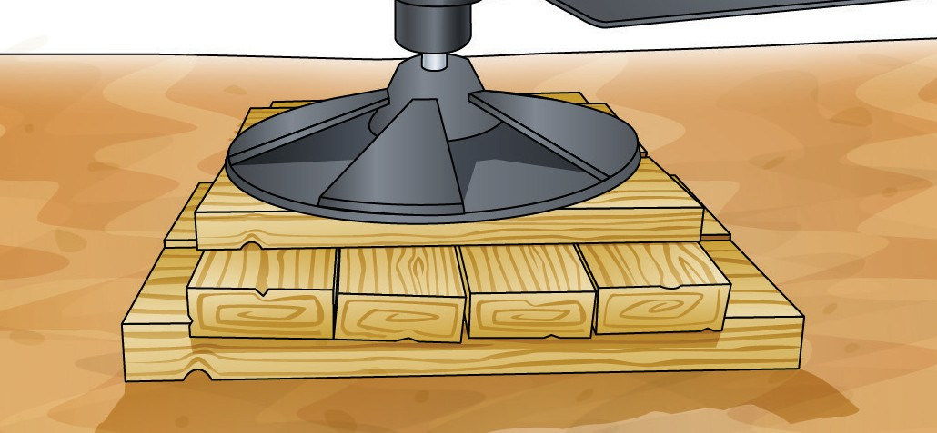
Outriggers and packing
PC 1.2 ELEMENT 1 — PLAN WORK/TASK
Outriggers (which can also be called stabilisers) are beams or legs that extend out from a crane, helping to keep it stable. Packing is placed under the outriggers to distribute the weight of the crane and load. Outriggers should always be used in accordance with the manufacturers instructions.
Some important things to remember when setting up and packing outriggers are:
Outriggers should be fully extended (if possible) | Make sure the ground is firm and can bear the load
Packing must cover as much area as possible to distribute load | The packing should be made of hardwood and free from any defects.

Slide 7
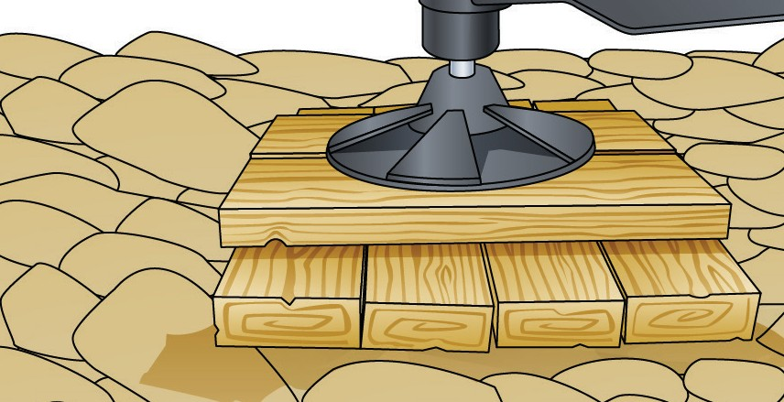
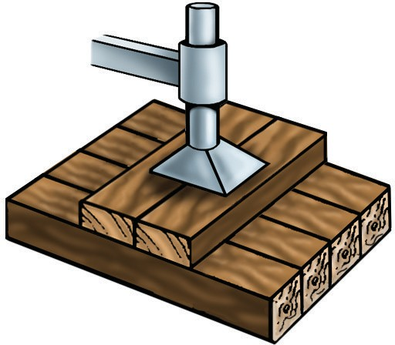
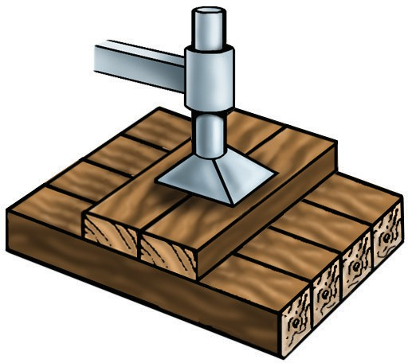
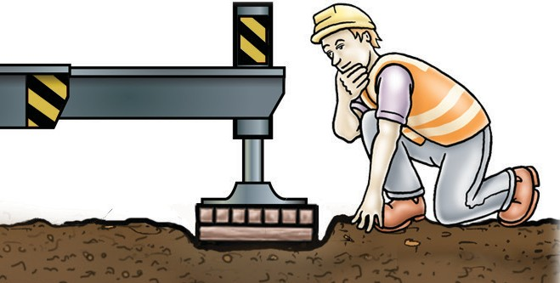
PC 1.2
ELEMENT 1 — PLAN WORK/TASK
Outriggers and packing (continued)
The base layer of packing should be closely laid and at least 75 mm thick 75 mm minimum | The packing should be pigstyed. This means each layer is at right angles (90° degrees) to the next. 90º
The top layer of packing must be at right angles to the direction of the outrigger beam and at least 200 mm wide. Outrigger beam 90º 200 mm wide | Packing, outriggers and jacks should be checked regularly during an operation.

Slide 8

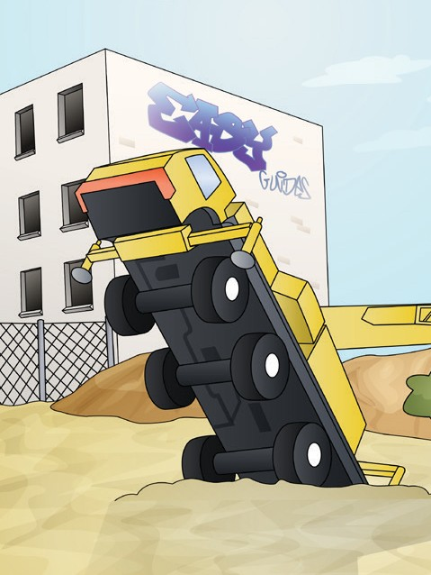

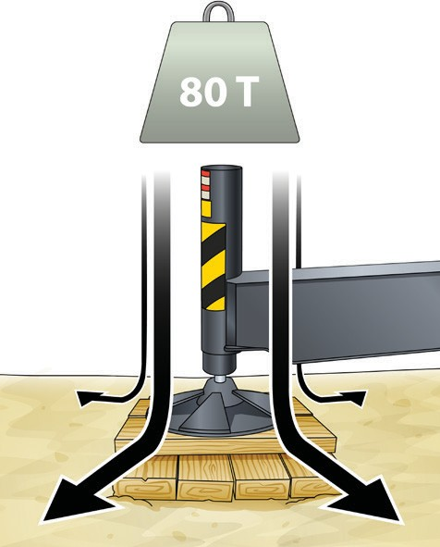
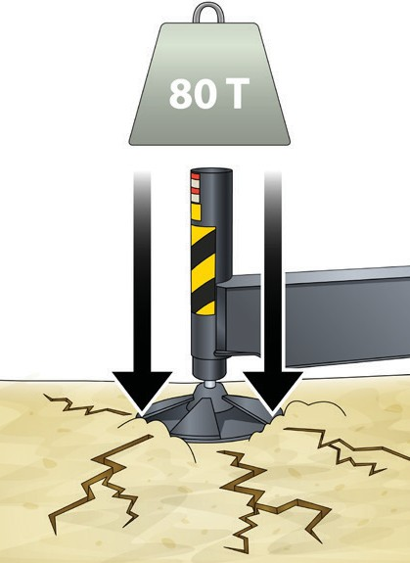

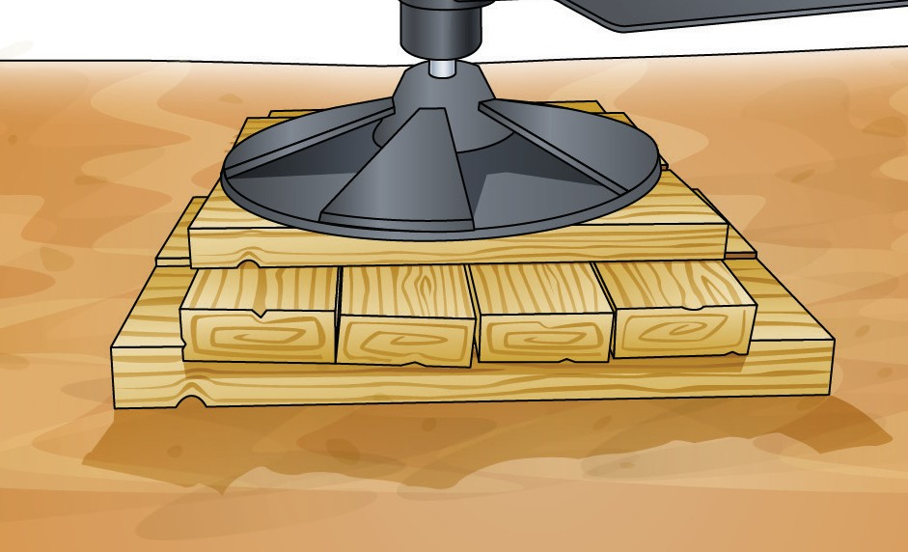
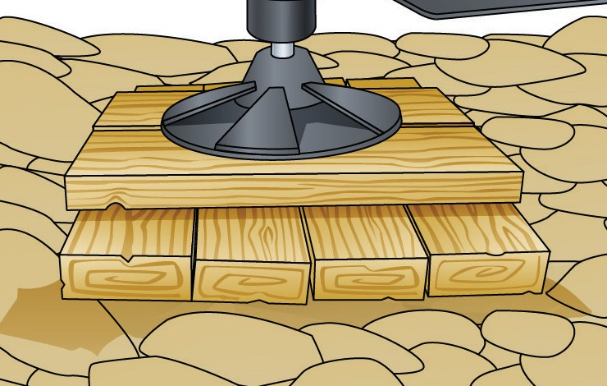
Why you need packing
PC 1.2 ELEMENT 1 — PLAN WORK/TASK
You must use packing under the outriggers. Each outrigger takes some of the weight of the crane and the load. Packing spreads that weight over a larger area. The packing must cover as much area as possible to distribute the load. This makes the crane more stable.
Packing spreads the weight
No packing
If you do not use packing the outriggers could sink and the crane could tip over.
How soil types affect packing
The type of ground you are working on changes how much packing you need.
For example, if you need to set up on soft clay you will need more packing than if you are setting up on shale or rock.

Slide 9
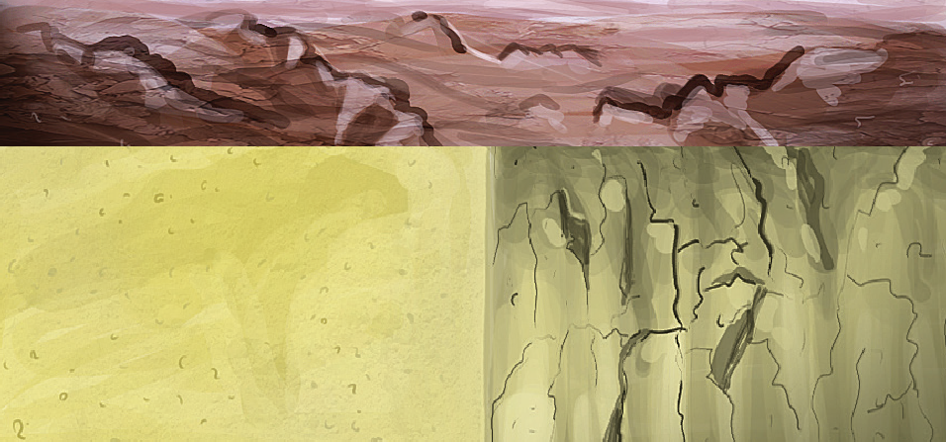
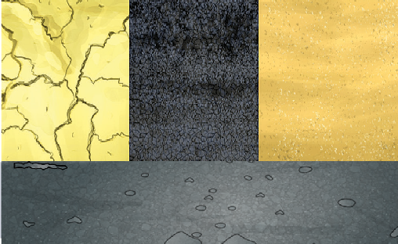
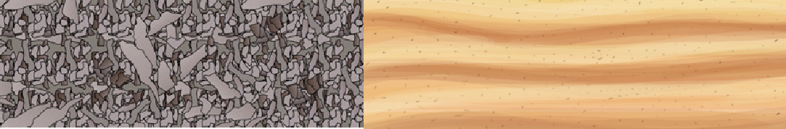

Bearing capacity of different types of ground
PC 1.2 ELEMENT 1 — PLAN WORK/TASK
You should assess if the soil type is able to support the crane. Different soil types have different load bearing pressures and these should be considered when choosing packing for outriggers. The pressure a certain type of ground can take is called its bearing capacity. Different ground types have different bearing capacities.
This table shows the different types of ground and their bearing capacity from weakest to strongest.
Ground type | Maximum bearing capacity PMAX (Tonnes per m²) | Sample of soils
Wet clay
Less than 10
Loose sand
10
Soft clay (dry)
10
Stiff clay (dry)
20
Compacted sand
20
Asphalt
20
Compacted gravel (with up to 20% sand)
40
Shale rock and sandstone 80
Hard rock 200
Unsure? If you are unsure what condition the ground is in, use the lowest bearing capacity or get an engineer to work it out.

Slide 10
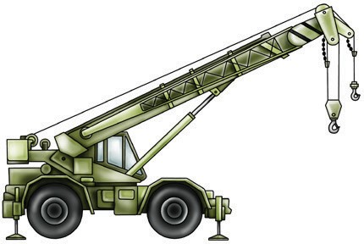
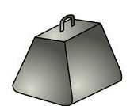
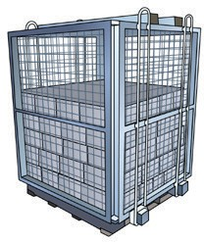
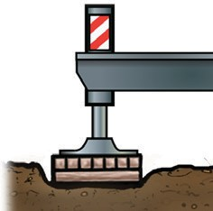
PC 1.2
ELEMENT 1 — PLAN WORK/TASK
Packing formula
To calculate the area of packing needed in square metres you must know:
The cranes mass (Cm)
The loads mass (L) • The bearing pressure of the soil (PMAX).
(Cm + L) × 0.65
In this formula:
Cm =
L =
Area =
PMAX
Crane mass Load
Soil bearing pressure
OR
Area = (Cm + L) × 0.65 ÷ PMAX
PMAX =
Remembering this formula
It is much easier to understand this formula if you know what each part of the formula does.
Find the load on each outrigger
You should start by working out the top section. This part works out how much weight each outrigger will support.
This is calculated on 65% of the total load.
+
× 0.65 =
(Crane mass + Load weight) × 0.65 = Amount of weight on 1 outrigger
For example, if the crane weights 8 tonnes and the load weighs 2 tonnes:
8 t + 2 t = 10 t
(Cm + L) × 0.65
10 × 0.65 = 6.5 t
6.5 tonnes
Area =
Each outrigger will support
PMAX (Soil bearing pressure)

Slide 11
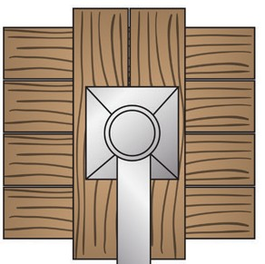
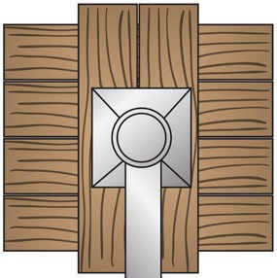
PC 1.2 ELEMENT 1 — PLAN WORK/TASK
Convert m² to find the dimensions of the packing pad
Now you know how many square metres of packing you need. If you need to calculate the measurements of the packing pad to use you simply square root the square metres.
Note:
0.465 m or 465 mm is an uncommon size so the 465 mm is rounded up to a common size of 500 mm × 500 mm
0.2166
= 0.465 metres Minimum packing size = 0.465 m × 0.465 m
Round up the size = 500 mm × 500 mm
_{m}2
SIZE
=
SIZE
Square root of 0.2166 = 0.465 m
You would round this up to use a packing pad 500 mm × 500 mm

Slide 12
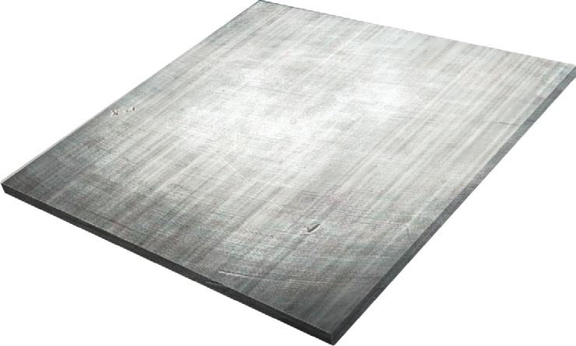
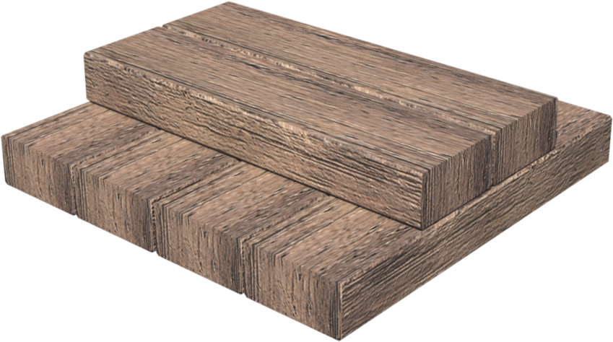
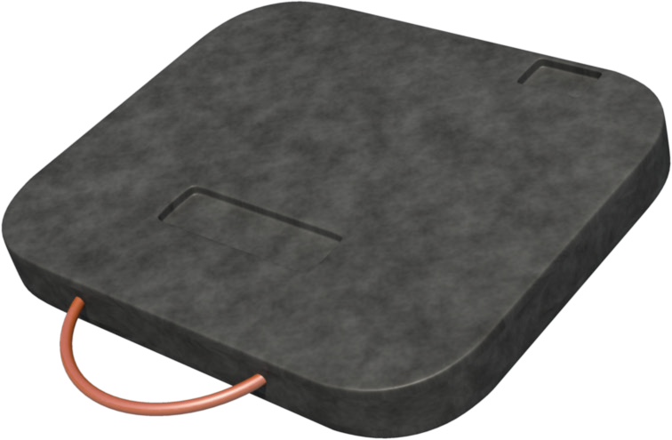
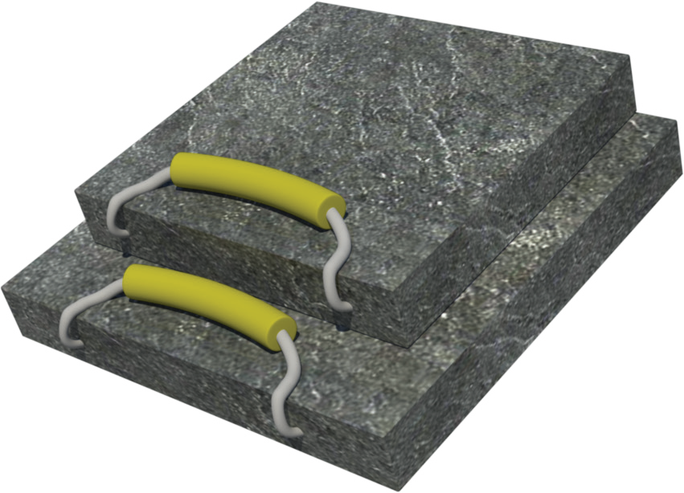
PC 1.2
ELEMENT 1 — PLAN WORK/TASK
Types of packing
Types of packing you may use include:
Steel plates | Hardwood packing
Sleeper mats | Concrete rafts
Packing is placed under the outriggers to distribute the weight of the crane and load.

Slide 13
PC 1.3
ELEMENT 1 — PLAN WORK/TASK
Common weights
Shown here are the weights of some common materials.
1 cubic metre of water 1 metric tonne (1000 litres = 1000 kg)
1 cubic metre of earth 1.9 metric tonnes
1 cubic metre of clay 1.9 metric tonnes
1 cubic metre of dry beach sand 2 metric tonnes
1 cubic metre of concrete 2.4 metric tonnes (2400 kgs)
1 cubic metre of coal ash 0.8 (8/10) of a metric tonne
25 bags of cement (40 kg each) 1 metric tonne
1000 common bricks 4 metric tonnes
1 cubic metre of steel 7.85 metric tonnes (7850 kgs)
1 cubic metre of copper 9 metric tonnes
1 cubic metre of lead 11.4 metric tonnes

Slide 14
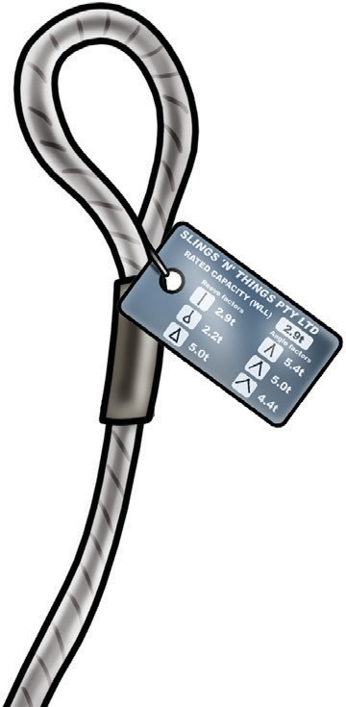
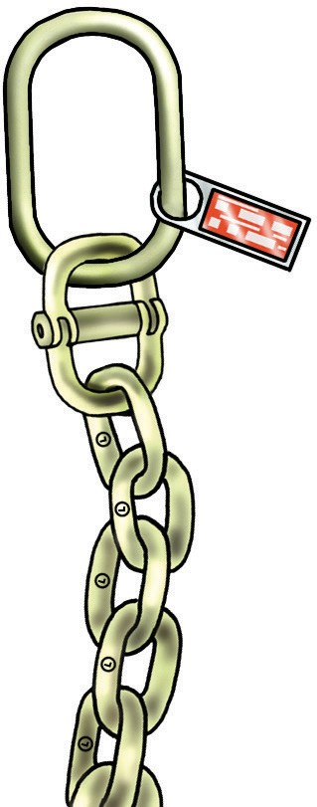
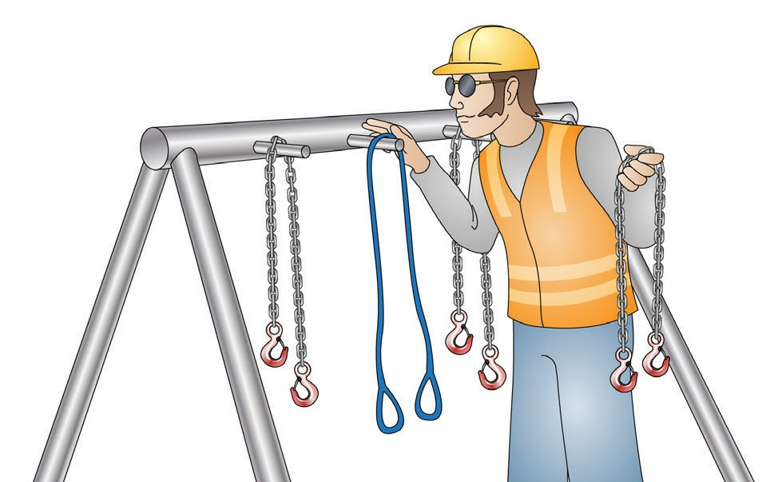
PC 1.3
ELEMENT 1 — PLAN WORK/TASK
Safe working load (SWL)/
Working load limit (WLL) of lifting gear
To find out the Safe working load (SWL) of lifting gear:
Check lifting equipment
Lifting equipment must be checked before use.
Using faulty or damaged lifting equipment could result in the load being damaged or falling from height while it is being moved.
A licenced dogman or rigger is responsible for selecting and checking the lifting gear.
As the crane operator you are responsible for making sure this has been done.
Check the tag
Check to see if it is marked on the sling
Calculate the load yourself.
A sling tag must show:
Working load limit
Reeve factors
Angle factors.
Sling tag

Slide 15
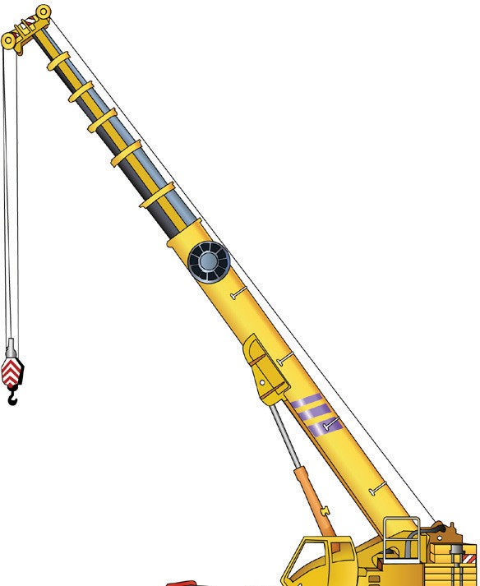
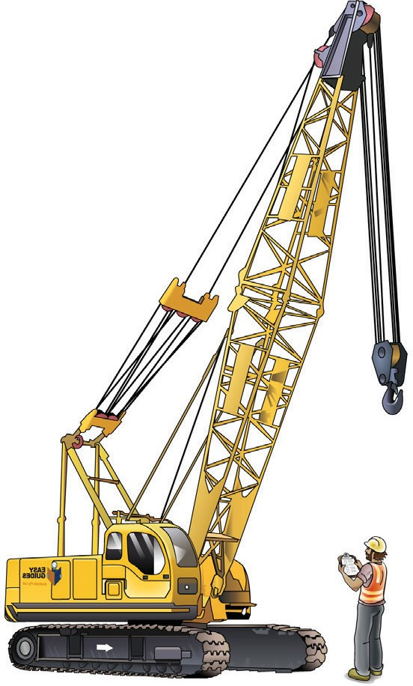
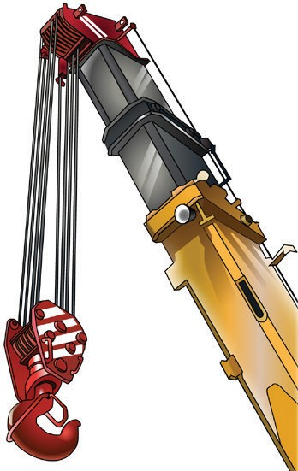
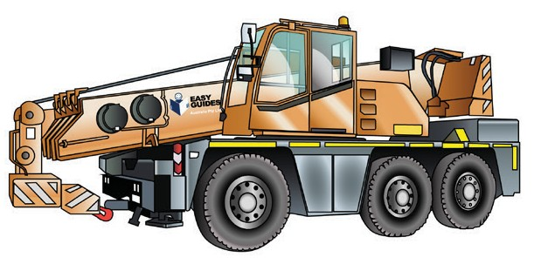
PC 1.3
ELEMENT 1 — PLAN WORK/TASK
Choosing the right crane
Booms
A slewing mobile crane has a telescopic boom that can:
Make sure the crane is the right size for the work area
Check the crane’s lifting capacity to make sure it can lift the load
Make sure the crane is appropriate for the site and weather conditions
The crane is the correct type for the job. For example a slewing or non-slewing crane.
Extend out
Retract in

Slide 16
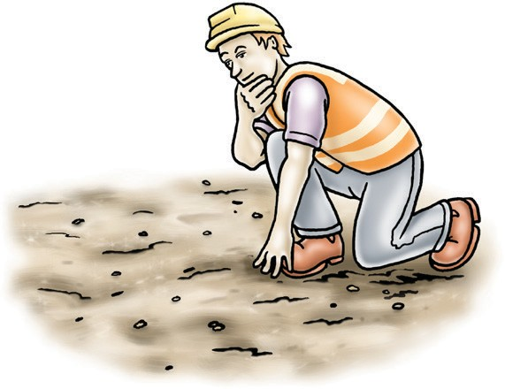
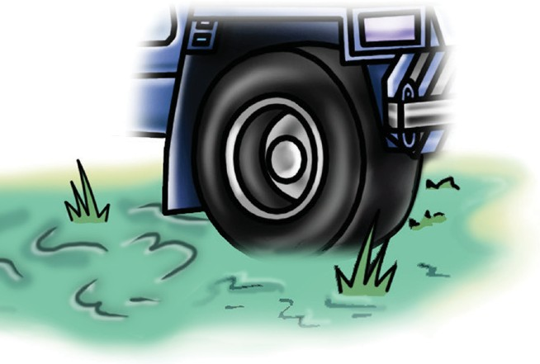
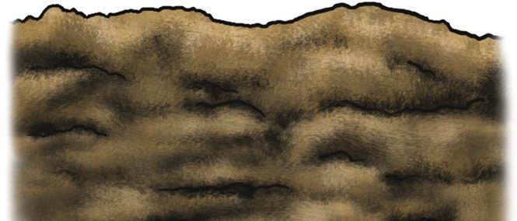
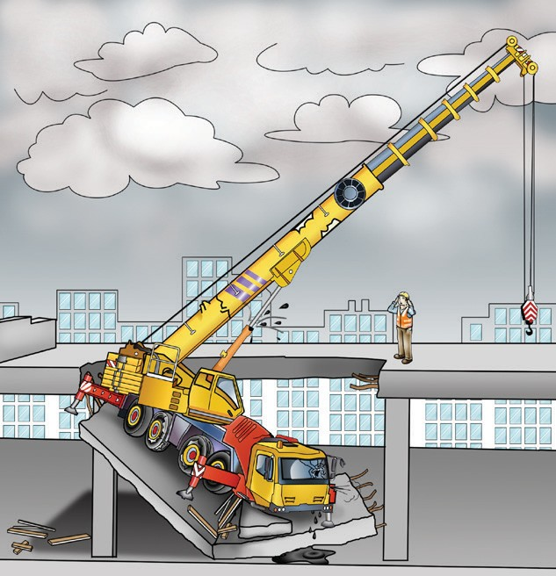

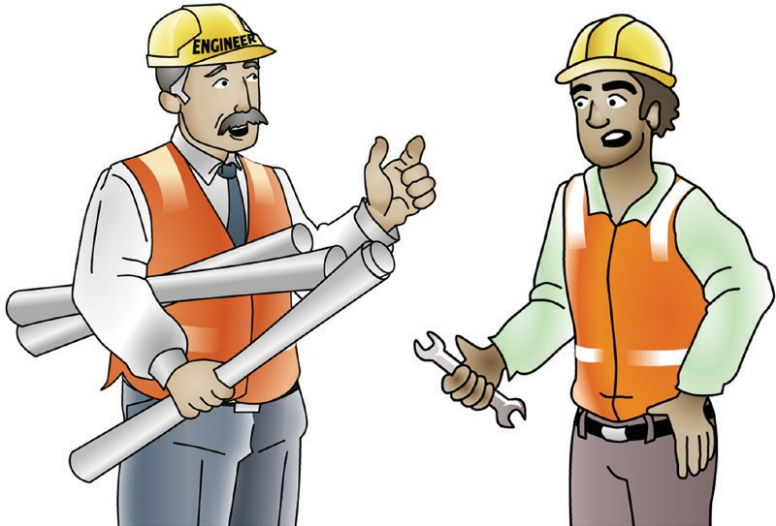
Check your planned route
PC 1.4 ELEMENT 1 — PLAN WORK/TASK
Check your planned route before you move the load. Look out for unusual or difficult surfaces in your path of movement.
For example:
Check the ground type Bumpy ground Soft or wet ground
Be careful of
suspended floors
Talk to the engineer

Slide 17
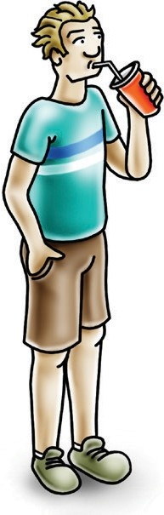
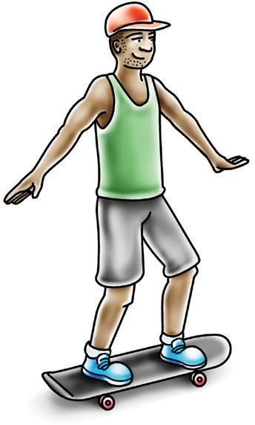
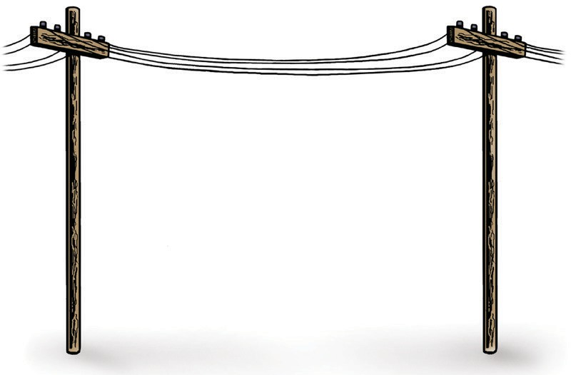
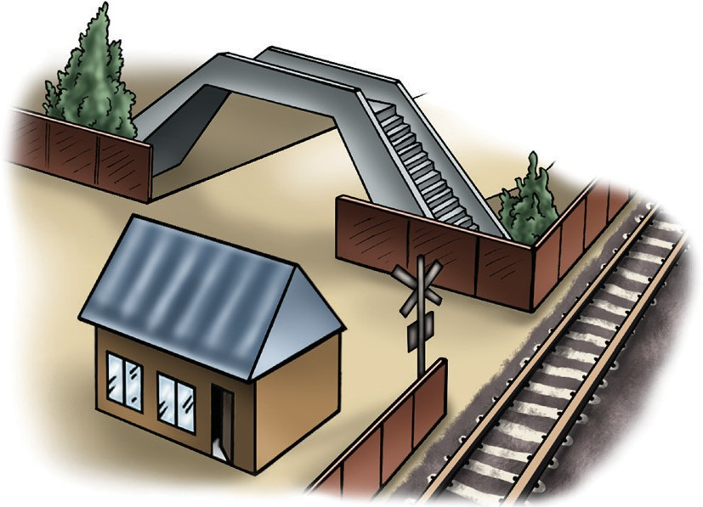
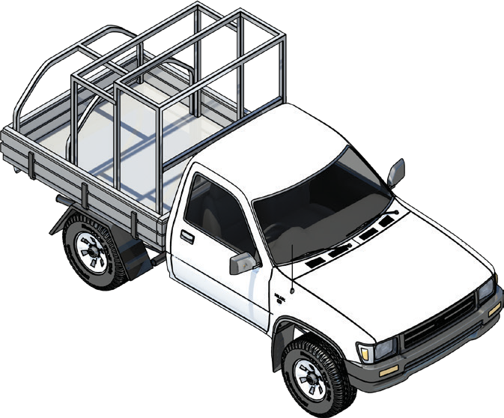
PC 1.4
ELEMENT 1 — PLAN WORK/TASK
Check your planned route (continued)
Look out for obstacles or obstructions that might get in your way. For example:
Powerlines | People
Buildings | Vehicles and other plant

Slide 18



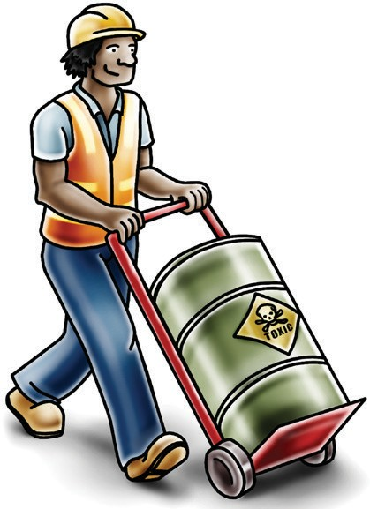



PC 1.5
ELEMENT 1 — PLAN WORK/TASK
Prepare for hazards
Hazard | Risk | Control
A hazard is anything that can harm you or others while you work. | A risk is the chance of a hazard injuring or hurting a person. | A control is what you can do to stop the hazard from hurting or killing someone.
 | In other words, what is the chance of the hazard hurting you?

Slide 19
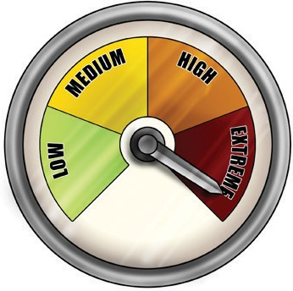
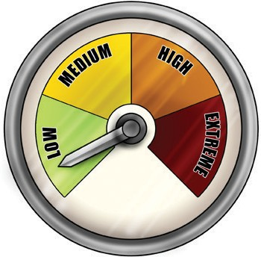



PC 1.5
ELEMENT 1 — PLAN WORK/TASK
Assess the risk (risk assessment)
You need to identify (know) the worksite’s hazards before you start work.
Look for hazards. When you find a hazard, you need to work out two things:
How dangerous is the hazard?
How likely (risky) is it that the hazard will hurt someone?
For example, you find a very dangerous hazard but the risk of it hurting someone is low. Because the danger is high, you need to find a way to control it.
Use the risk assessment and control form (example over page) and the hierarchy of hazard control to help you.
If in any doubt talk to:
How dangerous?
How likely?
WHS/OHS representatives or safety officers | Your supervisor or team leader | Workmates

Slide 20



Hierarchy of hazard control details
PC 1.5, 2.2 ELEMENT 1 — PLAN WORK/TASK
The Hierarchy of hazard control gives you six ways to control or prevent a hazard (meaning danger) in the workplace. Start with trying the first way (elimination) to control or prevent a hazard. If that doesn’t work, try the second one. Keep trying until you find the best way to control or prevent the hazard. For example:
1. Elimination (remove) | 2. Substitution (use something else) | 3. Isolation (keep apart)
If you can, remove the hazard. To do this, change the way you work or the equipment you use — the best way to control a hazard. For example, remove dangerous materials from the work area. | If you are unable to remove the hazard, use something else. For example, use a pallet cage to lift a pallet of bricks instead of lifting the pallet without a cage. | Put up barriers or fencing around the hazard to lower the risk of damage or harm. You call this restricting or preventing access to the hazard. Keep people and equipment away from the hazard. For example, put up barriers, gantries or fencing to keep people out. This will reduce the risk of hazard.

Slide 21

PC 1.5, 2.2
ELEMENT 1 — PLAN WORK/TASK
Personal Protective Equipment (PPE)
Safety glasses or goggles
PPE is clothing or equipment worn on the body to protect you from hazards.
PPE will not take away the risk of harm altogether, but it will help
keep you safe.
Safety helmet
or hard hat
Ear muffs or ear plugs
Respiratory equipment
Dust mask, half face respirator or full face respirator
High visibility clothing
Safety vest, hi-vis shirt or hi-vis jumpsuit
Long sleeved shirt
Lanyard
Safety gloves
Insulated
Safety harness
Long pants
Safety shoes
Rubber soled, fully enclosed foot, may be steel capped to protect the toes

Slide 22

PC 1.5
ELEMENT 1 — PLAN WORK/TASK
Identifying workplace hazards
Workplace hazards need to be identified before you start work.
Take a good look at your workplace and decide if anything could possibly cause injury to you or anyone else in the area.
Above eye level
You should check above eye level for:
powerlines
other overhead services
buildings
trees
surrounding structures and facilities
other obstructions
bridges.
Zones/areas to check for hazards:
Ground to eye level
You should check around eye height for:
other equipment
machinery/plant
people
pedestrians
things in the path of travel
insufficient lighting
weather conditions
dangerous materials
surrounding structures
facilities
other obstructions.
Ground level (and below)
You should check the ground to see if:
the surface is stable and level
there is debris or rubbish in the way
the surface is strong enough to support the weight of any equipment or materials
if there are any open trenches or recently
filled trenches/excavations
unstable ground
underground services
suspended slabs.

