Slide 1
EASY GUIDE
Shiftwork
Managing Your Fatigue
Industry Training Resources

Slide 2
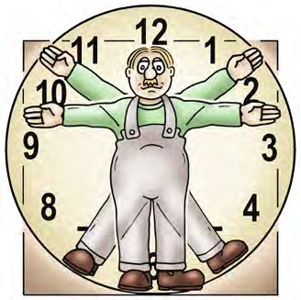
Introduction –
Your body and shiftwork
2

Slide 3
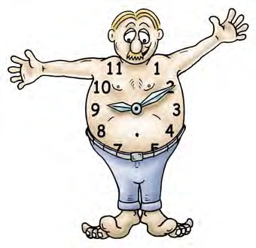
The human body is made to be active and awake during the day and asleep at night.
INTRODUCTION – YOUR BODY AND SHIFTWORK
IDENTIFY OHS LEGISLATIVE REQUIREMENTS
This is guided by an internal body clock in the brain called circadian rhythms.
Daily body rhythms control the:
sleep-wake cycle
heart rate
digestion
body temperature
memory
mood
performance.
As a shiftworker you work against your body clock. You are often expected to work when your body clock tells you to sleep.
3

Slide 4
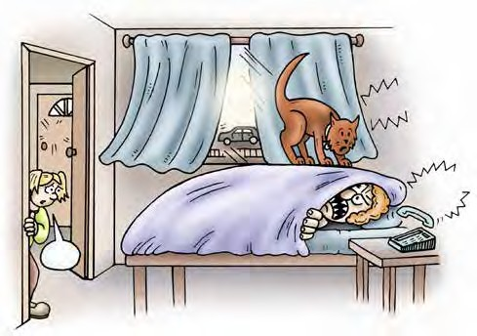
As a shiftworker your sleep time is when most people are awake. People may phone you during their daytime forgetting that this is your sleep time!
INTRODUCTION – YOUR BODY AND SHIFTWORK
IDENTIFY OHS LEGISLATIVE REQUIREMENTS
You may need to attend family and social occasions like birthdays, weddings, barbecues and so on during your sleep time.
You may feel you are in a state of ‘jet lag’ as both your body rhythm and sleep time are out of step with others.
As you can see, being a shiftworker is difficult. You are faced with disruptions to your body clock and sleep patterns as well as increased pressures on your family and social life.
4

Slide 5
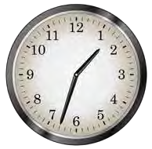
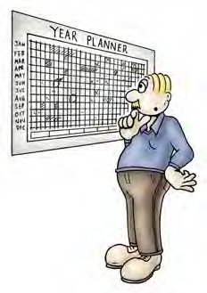
Planning your sleep time
5

Slide 6
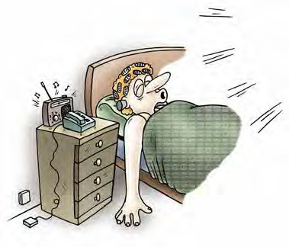
PLANNING YOUR SLEEP TIME
IDENTIFY OHS LEGISLATIVE REQUIREMENTS
10 Tips to get a good daytime sleep
TIP
1
Keep your bedroom QUIET
Use ear plugs
Turn off mobile phone
Unplug the telephone or turn down the volume on the answering machine
Disconnect door bells
Put the radio on with the volume low, or use a fan as ‘white noise’ to block out outside noises
Install double glazing on your bedroom windows to reduce outside noise.
BANG! CRASH!
BEEP BEEP!

Slide 7
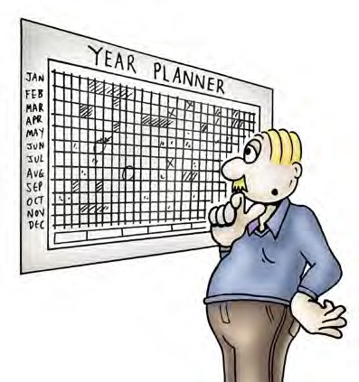
IDENTIFY OHS LEGISLATIVE REQUIREMENTS
PLANNING YOUR SLEEP TIME
TIP
9
PLAN your sleep
If you can, plan family and social events around your sleep
Try to pick times so that you don’t have to give up your sleep
You’ll be more fun to be around if you’re well rested.

Slide 8
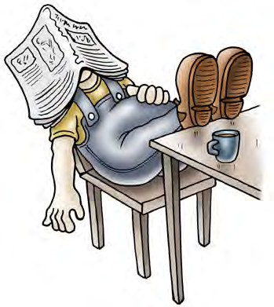
IDENTIFY OHS LEGISLATIVE REQUIREMENTS
PLANNING YOUR SLEEP TIME
TIP
10
Take naps
Short naps can make up for lost sleep.
If you can take naps, you may find that you can make up for lack of sleep by taking a nap either before or after sleep loss.

Slide 9
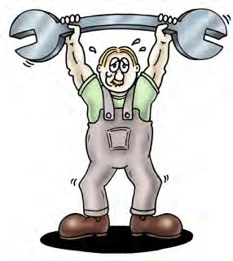
Health and fitness

Slide 10
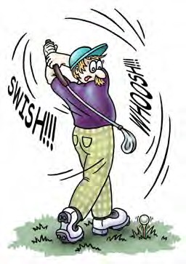
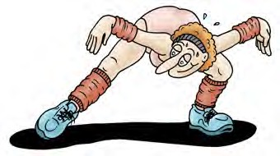
Here are some ideas to help keep you fit ...
HEALTH AND FITNESS
IDENTIFY CONSTRUCTION HAZARDS AND CONTROL MEASURES
Try a sport you can do on your own. For example, walking, running, cycling, swimming or golf.
Use a gym. Some are open 24 hours.

Slide 11
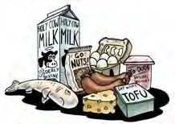
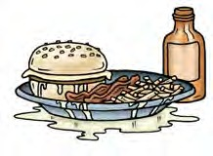
Diet - do’s and don’ts

Slide 12
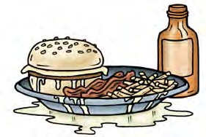
Diet do’s and don’ts summary ...
DIET – DO’S AND DON’TS
IDENTIFY CONSTRUCTION HAZARDS AND CONTROL MEASURES
DO
DON’T
have a heavy meal right before bed
eat fried, fatty, spicy and hard-to- digest foods later in the day
go to bed hungry
rush your meals.
try and have regular meal times
eat breakfast soon after waking
eat foods high in protein for the first
and second meals of the day
eat foods high in carbohydrates for the third meal of the day
drink less before going to bed
eat plenty of fresh fruit and vegetables.

