Slide 1
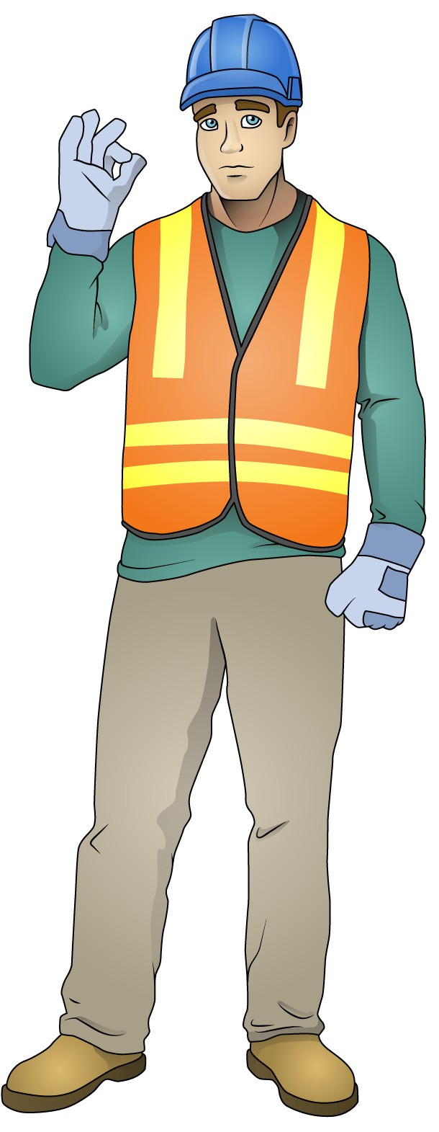
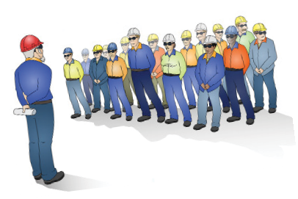
LEARNER GUIDE
Training support material for:
RIIWHS201E
Work safely and follow WHS policies and procedures
Workplace
Policy and Procedures
Produced by:

Slide 2
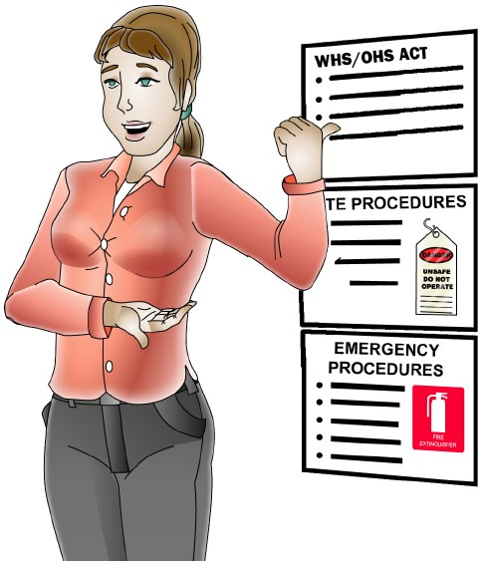
Access and apply site safety procedures

Slide 3
PC 1.1 ACCESS AND APPLY SITE SAFETY PROCEDURES
What are work requirements?
A work requirement is a statement that outlines the work that needs to be done.
Example of a work requirement statement;
Dig a trench at Site 123243A Unit 4 / 18 Floriston Road Boronia.
Lay asphalt down from eastern freeway Warragal, City of Warragual / police road to Hight Street
Boronia turn off.
Load and unload a plant 10 tonne excavator from Warragal, City of Warragual depo to Site 123243A Unit 4 / 18 Floriston Road Boronia 5day hire..
Requirements
Who would write a work order?
Generally your supervisor or someone in authority would write a work order.
The work order or work that needs to be done can be broken down into smaller parts like a job or job plan.
Example of work order description;
Dig a trench at Unit 4 / 18 Floriston Road Boronia on the property to make an inground pool.
Lay asphalt down from mile marker 17 to 23 or before Boronia turn off, lanes 1 and 2 to be closed off for the laying of turf and lane 3 open for traffic.
Easy Guides Aust Pty Ltd Address: 19 Floriston Rd Boronia VIC 3155
Phone: 1300 733 220
email address: admin@easyguides.com.au
Worker order as- Harry Styles – M 1300 006 001
signed to:
Other works on call Super Man – M: 1800 007 000
WORK ORDER / Work Plan
Site Supervisor
Joe Black
Super Mobile
0400 911 911
CLIENT NAME
CLIENT PHONE CLIENT EMAIL
Joe Bloggs
ORDER NUMBER
CUSTOMER ID
WO-019
0421 123 456
C123
a@hotmail.com
ORDER RECEIVED BY
1/1/2022
ORDER DATE
2/1/2022
EXPECTED START DATE
6/1/2022
EXPECTED END DATE
31/1/2022
WORK AUTHO- RIZED BY | James Tennant | SIGNATURE | James Tennant
WORK DESCRIPTION ADDITIONAL COMMENTS | Erect a Fence around site ABC123 18 Floriston Road Boronia VIC 3155 to create a work zone or exclusion zone for the general public for site works. Need a gate for truck to come in and out of site.
 | Need gravel laid for crane and trucks to enter site this can be done at al later stage if need be but however if can be done on same day this would be good.
Supervisor
SERVICE AND LABOR DESCRIPTION |  | HOURS | RATE | AMOUNT
Meeting |  | 0.5 | 35 | 35
Source all documents and permits |  | 0.5 | 300 | 150
measurements |  | 1 | 35 | 35
Dig holes |  | 4 | 35 | 140
Excess dirt digger 1 |  | 2 | 35 | 70
Excess dirt digger 2 |  | 2 | 35 | 70
Post 1 pole in dirt person 1 |  | 2 | 35 | 70
Fill hole with dirt person 2 |  | 2 | 35 | 70
Brace each Hole |  | 1 | 35 | 70
 | Total Hour | 8 | LABOR TOTAL | 710
PARTS AND MATERIALS DESCRIPTION
QUANTITY
PRICE PER UNIT
AMOUNT
Poles
1000
1000
3
1
1
0.50
5.00
200
1000.00
500 .00
15.00
200
468.70
1000
Pegs
Paint
Swing Door
Gravel, Cubic meters = length x width x depth
46.87 cm3
10
Long load truck dimensions 12.5 meters by 2.5 meters.
12.5 x 2.5 x 1.5 meters = 46.875 m3
Wire fence mesh – 1000 meters
1000
1
MATERIAL TOTAL 2683.7
WORK ORDER COMPILED BY
Joe Black
enter tax rate
SUBTOTAL | $ 3393.7
TAX RATE % TOTAL TAX OTHER TOTAL | 10%
 | $ 339.37
 | $3733.07
CLIENT APPROVAL NAME AND TITLE APPROVING PARTY SIGNATURE DATE OF APPROVAL | Joe Bloggs
 | James Tennant
 | 11/12/2021
enter other cost

Slide 4
What is a Job or Job plan?
PC 1.1 ACCESS AND APPLY SITE SAFETY PROCEDURES
A job or job plan is a break down of a work order, that identity’s the tasks that are needed to be performed and the resources and time allocation for completion of a work order. Each task, that is created, creates a set of work instructions for a worker to perform.
Example of a task or work instructions;
Task 1. Close lane 1 off,
Task 2. Close land 2 off,
Task 3. Get Scraper to tear up bitumen,
Task 4. Get roller to compact ground,
Task 5. Get turf machine to lay turf.
What is the purpose of a Job Plan?
A job plan confirms that you, as the worker, understands the work requirements given to you by your supervisor.
Task No | Progress
 | 1/02/2022 |  | 2/02/2022
Task 1 |  |  | 100%
Task 2 |  | 25%
Task 3 |  |  |  | 50%
Work Requirements
Easy Guides Aust Pty Ltd
Address: 19 Floriston Rd Boronia VIC 3155
Phone: 1300 733 220
email address: admin@easyguides.com.au
Worker order as- Harry Styles – M 1300 006 001
signed to:
Other works on call Super Man – M: 1800 007 000
Site Supervisor Joe Black Super Mobile
CLIENT NAME Joe Bloggs ORDER NUMBER
CLIENT PHONE 0421 123 456 CUSTOMER ID
CLIENT EMAIL a@hotmail.com ORDER RECEIVED BY ORDER DATE 2/1/2022 EXPECTED START DATE 6/1/2022
Job Plan Work Summary For Work: (Work Order - WO-019)
Date | Tasks | Personnel | Equipment / Material | Qty | Documents and Permits | Duration | Start Date | End Date | Price
2/1/2022 | Task 0. Have meeting with supervi- sor to discuss work order. | Supervisor, Harry Styles |  |  |  | 30 min / 0.5 hrs | 2/1/2022 | 2/1/2022 | $35,$35
6/1/2022 | Task 1 – Measure and mark fence post positions as per plans | Harry Styles Super Man | Spray Can – Pink, Green, Blue Pegs 1000, Line Tape Measure / Digital |  |  | 1hr | 6/1/2022 | 6/1/2022
 |  |  | Pegs | 1000 |  |  |  |  | $1
 |  |  | Tape | 1 |  |  |  |  | $10
 |  |  | Line | 1 |  |  |  |  | $5
2/1/2022 | Task 2– Check area for under- ground s | Local Council / Supervisor |  |  | Underground line document report | 3 days | 2/1/2022 | 5/1/2022 | $35
6/1/2022 | Task 3 – Dig post holes using post hole digger | Harry Styles | Post Hole Digger |  |  | 4 hrs | 6/1/2022 | 6/1/2022 | $35
6/1/2022 | Task 4 – Remove excess dirt from holes using spade | Harry Styles Superman | Spade Pick | 2 2 |  | 4hrs | 6/1/2022 | 6/1/2022 | $35
6/1/2022 | Task 5 – Place one fence post in each hole | Harry Styles | Poles | 1000 |  | 4hrs | 6/1/2022 | 6/1/2022 | $1 $35
6/1/2022 | Task 6 – Rape fence mesh around pole stumps | Harry Styles Superman | Wire fence mesh Wire Cutters and Mesh Ties | 1000 |  | 4hrs | 6/1/2022 | 6/1/2022 | $1 $35, $35
6/1/2022 | Task 7 – Level and brace each post, fill holes with dirt/cement mix and compact area around post. | Harry Styles Superman | Dirt / Cement Mix |  |  | 4hrs | 6/1/2022 | 6/1/2022 | $35, $35
6/1/2022 | Wait for delivery of gravel |  | Gravel |  |  | 8 hrs | 6/1/2022 | 6/1/2022 | $35
6/1/2022 | Task 8. Level out section of property for gravel to be dumped for drive way | Harry Styles Superman | Shovel Spade |  |  | 2 hrs | 6/1/2022 | 6/1/2022 | $10, $35,$35
6/1/2022 | Task 9. Secure Site after all work done | Harry Styles | Pad Lock and key |  |  | 0.5 hrs | 6/1/2022 | 6/1/2022 | $35
WORK ORDER / Work Plan
0400 911 911
WO-019
C123
1/1/2022
31/1/2022
EXPECTED END DATE
WORK AUTHO- RIZED BY | James Tennant | SIGNATURE | James Tennant
WORK DESCRIPTION | Erect a Fence around site ABC123 18 Floriston Road Boronia VIC 3155 to create a work zone or exclusion zone for the general public for site works. Need a gate for truck to come in and out of site.
ADDITIONAL COMMENTS | Need gravel laid for crane and trucks to enter site this can be done at al later stage if need be but however if can be done on same day this would be good.
SERVICE AND LABOR DESCRIPTION | HOURS | RATE | AMOUNT
Meeting | 0.5 | 35 | 35
Source all documents and permits | 0.5 | 300 | 150
measurements | 1 | 35 | 35
Dig holes | 4 | 35 | 140
Excess dirt digger 1 | 2 | 35 | 70
Excess dirt digger 2 | 2 | 35 | 70
Post 1 pole in dirt person 1 | 2 | 35 | 70
Fill hole with dirt person 2 | 2 | 35 | 70
Brace each Hole | 1 | 35 | 70
Total Hour | 8 | LABOR TOTAL | 710
PARTS AND MATERIALS DESCRIPTION | QUANTITY | PRICE PER UNIT | AMOUNT
Poles | 1000 | 1 | 1000.00
Pegs | 1000 | 0.50 | 500 .00
Paint | 3 | 5.00 | 15.00
Swing Door | 1 | 200 | 200
Gravel, Cubic meters = length x width x depth Long load truck dimensions 12.5 meters by 2.5 meters. 12.5 x 2.5 x 1.5 meters = 46.875 m3 | 46.87 cm3 | 10 | 468.70
Wire fence mesh – 1000 meters | 1000 | 1 | 1000

Slide 5
National Work Health and Safety (WHS) Laws
PC 1.2 ACCESS AND APPLY SITE SAFETY PROCEDURES
The model WHS Act was finalised in June 2011. At the time of printing for this guide, Victoria were the only states/territories to have not adopted the act. The laws include a model WHS Act, model health and safety regulations, model codes of practice and a National Compliance and Enforcement Policy.
These can be found at www.safeworkaustralia.gov.au.
States and Territories using the model WHS Acts
Northern Territory
Queensland
New South Wales
Australian Capital Territory
South Australia
Tasmania
Western Australia
NT
QLD
WA
SA
Adopted March 2022
NSW
States not using the WHS laws
Victoria still follows the OHS Act.
The OHS Act and regulations can be found on the
regulators website.
ACT
Not yet adopted
VIC
TAS
* Information shown in this diagram is current as of April 2017

Slide 6
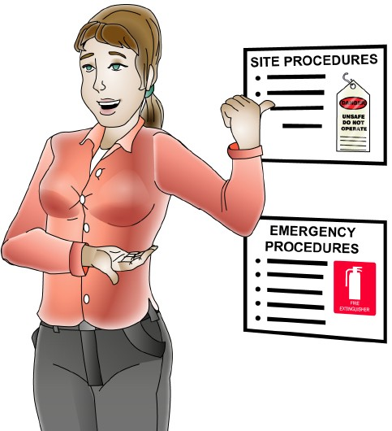
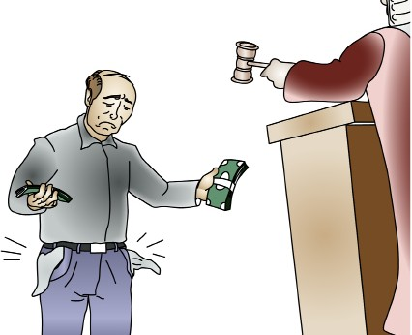
Worker’s (employee’s) duty of care
PC 1.2 ACCESS AND APPLY SITE SAFETY PROCEDURES
PCBU’s (employer’s) duty of care
By law, as a PCBU you must do everything reasonably practical to provide a workplace that is safe and without risk to health.
You must instruct and train your workers to work safely. You must do so in a way that is easy for your employees
to understand.
While at work, a worker must:
Take reasonable care for his or her own health and safety
Take reasonable care that his or her acts or omissions do
not adversely affect the health and safety of other persons
Follow workplace health and safety procedures and policies
Do not do work if you believe a hazard would be a serious risk to your health or safety.
Penalties
If you are a PCBU/employer or worker, the government can fine or even imprison you for failing your duty of care.

Slide 7
Signs and symbols
PC 1.3 ACCESS AND APPLY SITE SAFETY PROCEDURES
There are a lot of signs and symbols that are placed around work sites. It is important that the meaning of these signs is understood and the directions they give are followed.
Safety signs are made to an Australian standard (AS1319) which means their colour, design, shape and size all have to
meet the standard.
Safety signs sit in a number of different categories
Mandatory signs White with a blue circle containing an image. These signs give an instruction that you that you MUST follow. | Prohibition signs White background with a symbol inside a red circle with a slash. These signs tell you what you MUST NOT do. | Warning signs Yellow background with a black triangle around a hazard symbol. These signs warn of a hazard or hazardous situation that should not be life threatening

Slide 8
PC 1.3 ACCESS AND APPLY SITE SAFETY PROCEDURES
Signs and symbols (continued)
Dangerous goods
Dangerous goods are organised into differant classes depending
on what they are.
Some classes have a number of sub classes.
For more information refer to the
Australian Code for the Transport of Dangerous Goods by Road or Rail (ADG Code)
Globally Harmonized System (GHS)
The Globally Harmonized System of classification and labelling of chemicals (GHS) have become mandatory under the model work health and safety laws from 1 January 2017.
For more information refer to your
State/Territory Work Health and Safety regulator

Slide 9
PC 1.2, 1.1 ACCESS AND APPLY SITE SAFETY PROCEDURES
QUESTION 5
As a worker on a construction site, you are responsible for following workplace policies and procedures to maintain workplace health and safety standards.
How do we confirm that people have followed work place policy and procedures in the work place?
A training deceleration statement that follows a policy and procedures document and, in some cases, in a risk assessment control form OR obtain a signature that work has been carried out.
Workplace
Policy and Procedures
Implementation Plan
Control option | Associated activities | Resources required | Person(s) responsible | Proposed implementation date | Sign off and date | Scheduled review date
Review Are control measures in place? Yes No Why not? Are controls preventing or Yes No Why not? minimising the risk? Are there any new problems Yes No What are they? with the risk?
QUESTION 6
What document do you create to confirm work requirements that your supervisor has given to you in the work place?
Circle the Correct Answer.
Choices to choose from:
Work order
Requirements document
Job plan or a job plan work summary document
Job Plan Work Summary
Tasks | Personnel | Equipment / Material | Qty | Documents and Permits | Duration | Start Date | End Date | Price
Task 0. Have meeting with supervi- sor to discuss work order. | Supervisor, Harry Styles |  |  |  | 30 min / 0.5 hrs | 2/1/2022 | 2/1/2022 | $35,$35
Task 1 – Measure and mark fence post positions as per plans | Harry Styles Super Man | Spray Can – Pink, Green, Blue Pegs 1000, Line Tape Measure / Digital |  |  | 1hr | 6/1/2022 | 6/1/2022
 |  | Pegs | 1000 |  |  |  |  | $1
 |  | Tape | 1 |  |  |  |  | $10
 |  | Line | 1 |  |  |  |  | $5
Task 2– Check area for under- ground s | Local Council / Supervisor |  |  | Underground line document report | 3 days | 2/1/2022 | 5/1/2022 | $35
Task 3 – Dig post holes using post hole digger | Harry Styles | Post Hole Digger |  |  | 4 hrs | 6/1/2022 | 6/1/2022 | $35
Task 4 – Remove excess dirt from holes using spade | Harry Styles Superman | Spade Pick | 2 2 |  | 4hrs | 6/1/2022 | 6/1/2022 | $35
Task 5 – Place one fence post in each hole | Harry Styles | Poles | 1000 |  | 4hrs | 6/1/2022 | 6/1/2022 | $1 $35
Task No | Progress
 | 1/02/2022 |  | 2/02/2022
Task 1 |  |  | 100%
Task 2 |  | 25%
Task 3 |  |  |  | 50%
Correct Answer: c. Job plan or a job plan work summary document

Slide 10
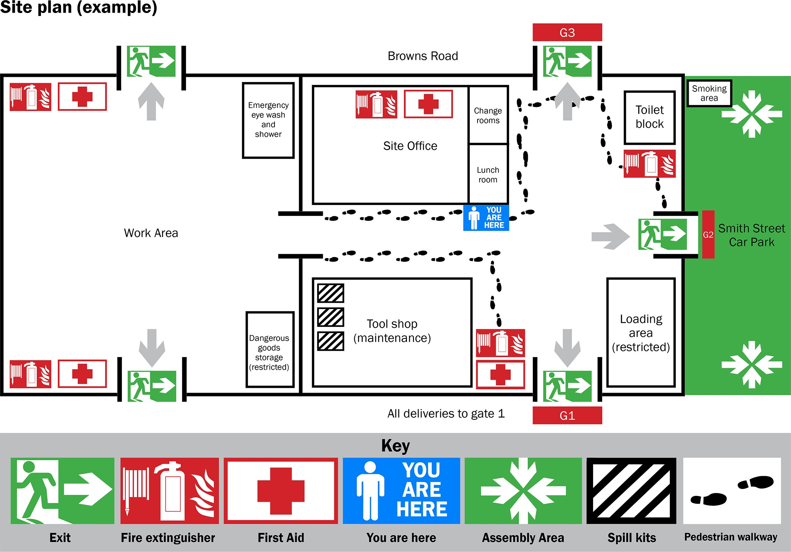
PC 1.3 ACCESS AND APPLY SITE SAFETY PROCEDURES
QUESTION 7 A site plan is a diagram of the worksite showing where all the important areas are. Identify some of the things you might find marked on the plan. | Answer may include but is not limited to: Location of first aid facilities/equipment Location of fire fighting and emergency response equipment Emergency exits and evacuation assembly points Location of site office Restricted areas Location of amenities, for example toilets, washing facilities etc.
QUESTION 8 | Mandatory signs inform you of something you MUST do. | Prohibition signs inform you of something you MUST NOT do.
What is the difference between a mandatory sign and a prohibition sign?

Slide 11
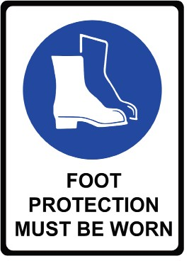
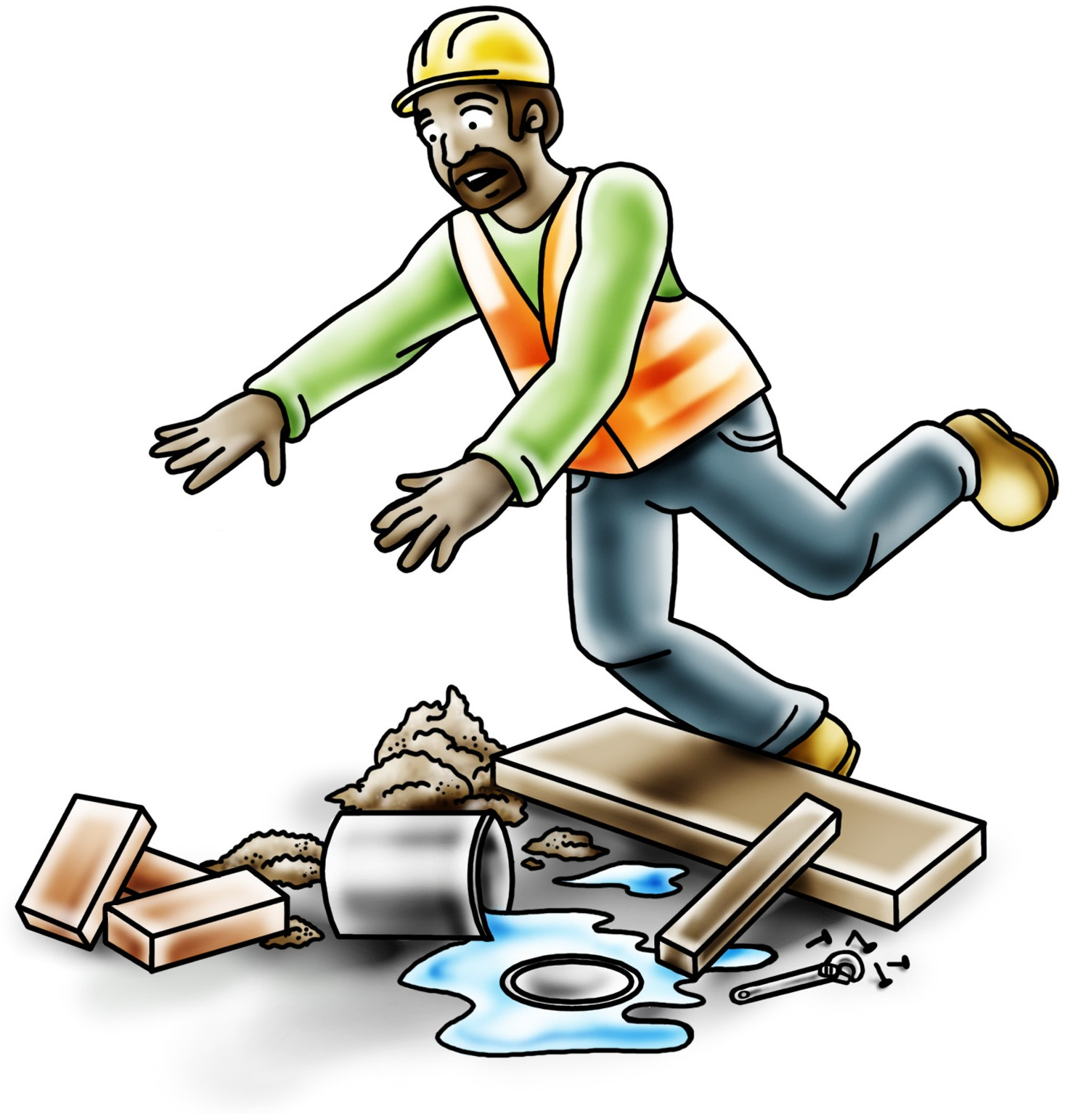
PC 2.1, 2.2 APPLY PERSONAL SAFETY MEASURES
QUESTION 11 How do you know what PPE is required to be worn on a worksite or for a particular task? | Check the policies, procedures and rules for the work site Look for signs indicating what you need to wear.
QUESTION 12 What are the reasons for maintaining a clean, tidy | Prevent hazards Protect workers from incidents and accidents Meet environmental requirements.
and safe work area?

Slide 12
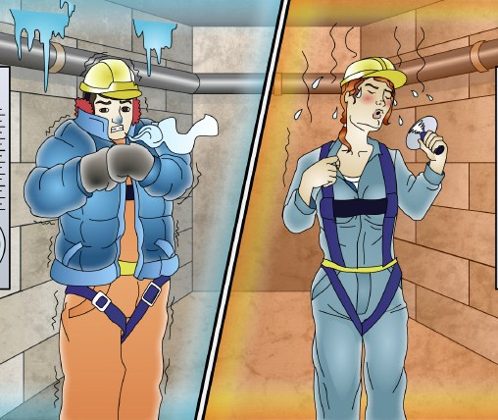
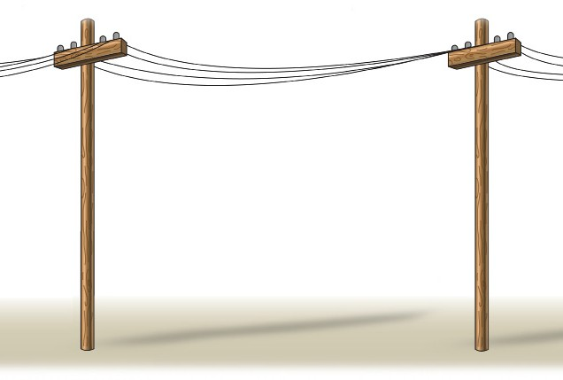
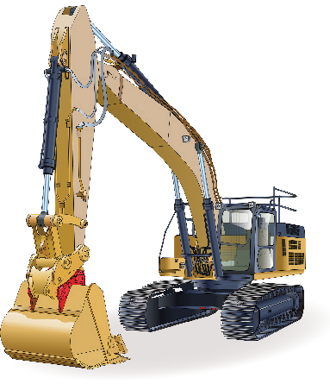
PC 4.1, 4.2 MAINTAIN PERSONAL WELLBEING
QUESTION 28 | Answer may include but is not limited to:
A persons well-being could be described as their comfort, health and happiness. There are various situations in the workplace that can affect a person’s well-being. | Heat stress Hypothermia Horseplay Mental stress Fatigue Communicable diseases.
Identify some things that pose a risk to a persons personal well being.
QUESTION 29 | You should check: Above eye level (in the air) At eye level Below eye level (on the ground) | Above eye level At eye level Below eye level
Workers should inspect their work area for hazards and risks daily before starting work.
Where should you check for hazards?

