Slide 1
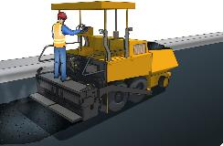
LEARNER GUIDE
Hand spread asphalt
Training support material for:
RIICBS202E
Hand spread asphalt
Produced by:

Slide 2
Contents
Hand spread asphalt
Introduction to hand spread asphalt The basics of road construction
5
6
18
26
116
133
145
Element 1
Element 2
Element 3
Prepare to hand spread asphalt Spread asphalt
Clean Up
Additional Notes

Slide 3
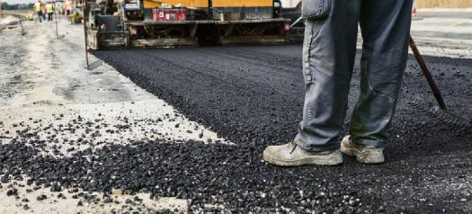
Hand spread asphalt

Slide 4
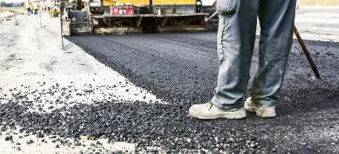
Introduction to hand spread asphalt
PC 1.1, 1.2 INTRODUCTION TO HAND SPREAD ASPHALT
What is compliant?
Hand spread asphalt refers to the manual application of asphalt mixtures by workers in civil construction. It involves physically spreading and shaping the asphalt to create road surfaces, parking lots, or other paved areas.
This method is used when precise control over the asphalt application is required, particularly in smaller or more intricate areas where large machinery may not be practical.
Workers typically use various hand tools, such as shovels, rakes, and lutes, to distribute the asphalt evenly and ensure it adheres properly to the underlying surface.
Hand spreading asphalt requires skilled labor and is commonly used for finishing touches, repairs, or small-scale paving projects where precision and attention to detail are essential.
"Compliant" refers to the state of conforming to or meeting a set of rules, regulations, standards, or specifications.
In the context of hand spreading asphalt in civil construction, being compliant means that the work activities align with the,
established guidelines,
safety protocols,
and project specifications,
ensuring that they meet the required standards and regulations.

Slide 5
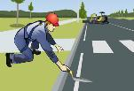
What type of work would a person that does hand spreading asphalt do in civil construction?
PC 1.1, 1.2 INTRODUCTION TO HAND SPREAD ASPHALT
A person who performs hand spreading of asphalt in civil construction typically works on tasks related to the manual application and distribution of asphalt materials to create and maintain road surfaces, pavements, or other construction projects. Here are the key responsibilities and associated types of work for this role:
Surface Preparation: Before asphalt application, workers prepare the surface by cleaning, repairing, and ensuring proper drainage.
This may involve removing debris, filling cracks and potholes, and grading the
surface to the desired level.
Handling Asphalt Material: Hand spreaders are responsible for handling, mixing and transporting the hot mix asphalt (HMA) material to the work site.
They coordinate with delivery trucks to ensure a steady supply of asphalt.
Handling Asphalt Material
Hand Spreading: The primary task of a hand spreader is to manually distribute the
HMA onto the prepared surface.
They use shovels, rakes, lutes, or other hand tools to achieve the desired thickness and even distribution of the asphalt material.
Hand Spreading
Hand spreading is particularly important in areas where automated paving equipment cannot reach or where precise placement is required.
Edging: Hand spreaders are responsible for creating clean and well-defined edges
along the asphalt surface.
Edging
They use hand tools to shape the edges and ensure they meet project
specifications.
...CONTINUES ON NEXT PAGE

Slide 6
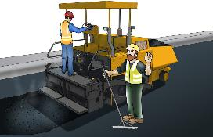
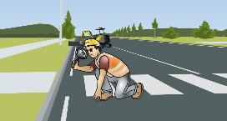
What type of work would a person that does hand spreading asphalt do in civil construction?
PC 1.1, 1.2 INTRODUCTION TO HAND SPREAD ASPHALT
...CONTINUED FROM PREVIOUS PAGE
Working with Paver Operator: Hand spreaders work in coordination with the operator of the asphalt paver. They guide the paver along designated paths, ensuring proper alignment and movement. This collaboration helps achieve a seamless transition between hand-spread and machine-laid sections.
Surface Finishing: After spreading the asphalt, workers may use hand tools, such as lutes and rakes, to achieve a smooth and even surface. They create uniform joints, edges, and transitions for a professional finish.
Compaction: Hand spreaders may assist in the compaction process to eliminate air voids and achieve the required density in the asphalt layers, using equipment like rollers or plate compactors.
Working with Paver Operator
Cleanup: After the asphalt is laid, hand spreaders are responsible for cleaning and maintaining their tools and equipment. They also assist in the proper disposal of excess asphalt material and debris.
Quality Control: Hand spreaders monitor the thickness, grade, and overall quality of the asphalt during the spreading process. They ensure that the asphalt meets project specifications and quality standards.
Quality Control

Slide 7
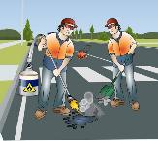
PC 1.1, 1.2 INTRODUCTION TO HAND SPREAD ASPHALT
QUESTION 1 What does the term "hand spread asphalt" refer to in civil construction? | It involves: The automated application of asphalt mixtures using specialized machinery. The manual application of asphalt mixtures by workers. The use of asphalt in gardening and landscaping. The production of asphalt mixtures in a factory setting. Answer: b. The manual application of asphalt mixtures by workers.
 | Possible types of work in hand spreading asphalt in civil construction could do? Planting trees and shrubs in the work area. Managing office paperwork and documentation. Distributing asphalt evenly with hand tools and ensuring proper compaction. Supervising the installation of electrical wiring on the construction site. Answer: c. Distributing asphalt evenly with hand tools and ensuring proper compaction.
QUESTION 2 What are the types of work that a person in hand spreading asphalt in civil construction do?

Slide 8
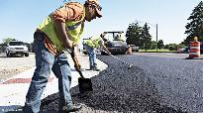
PC 1.1, 1.2 INTRODUCTION TO HAND SPREAD ASPHALT
QUESTION 3 What are some of the tasks that a person might perform when hand spreading asphalt in civil construction? | When hand spreading asphalt in civil construction, the following tasks are typically performed by a worker? Choose all the correct tasks of a hand spread asphalt worker would do. Material handling Pouring and spreading Leveling and smoothing Edge work Heat management Working with the paver operator
 | Answer: All of the above (a. Material handling, b. Pouring and spreading, c. Leveling and smoothing, d. Edge work, e. Heat management, f. Working with the paver operator).
QUESTION 4 | Arrange the layers in an asphalt pavement structure from bottom to top.
Choose the correct sequence of the different layers in asphalt. | Subbase, Surface Course, Wearing Course, Base Course, Subgrade Subgrade, Base Course, Subbase, Surface Course, Wearing Course Base Course, Subbase, Subgrade, Surface Course, Wearing Course Subgrade, Subbase, Base Course, Surface Course, Wearing Course
 | Answer: d. Subgrade, Subbase, Base Course, Surface Course, Wearing Course

Slide 9
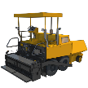
PC 1.1, 1.2 THE BASICS OF ROAD CONSTRUCTION
QUESTION 9
What are the basics of Road Constructions?
stake
A surveyor will out the site.
An excavator or dozer removes the trees, shrubs and other plants and levels the area.
A borrow pit may be dug out for storage of material or for drainage.
An excavator or dozer may create division blocks to divert water away and create drainage channel.
A front end loader or dozer shapes the road base. This helps smooth out the surface ready for grading.
The water truck wets down the ground to help soil to bond.
The grader grades the road to produce a much smoother surface.
A roller or compactor then compacts the road. This breaks up lumps and smooths the surface out.
Trucks then deliver subbase. Haul trucks or tip trucks sometimes tip the subbase, and front end loaders spread it.
Fill in the blanks to Complete the sentences.
Missing Words:
stake
levels
3. subbase
4. compacted
5. binder course
6. surface course
7. paver
levels
subbase
compacted
Several of are laid. The subbase is and tested.
Once the subbase is at the right thickness and is compacted properly, trucks deliver the course road base. The road base is built up in many layers
If asphalt is being laid, more layers will go on top of the road base. There will be an asphalt base course, then a ______________, and finally, a
_______________ which a will lay down.
A roller or compactor then compacts the road. This breaks up lumps and smooths the surface out.
Binder course
surface course
paver

Slide 10
Prepare to hand spread asphalt
PREPARE TO HAND SPREAD ASPHALT
Element 1

Slide 11
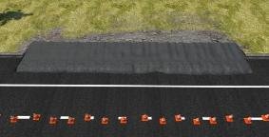
Calculations
PC 1.1 PREPARE TO HAND SPREAD ASPHALT
Working out how much material you need
The work plan has an area which is 4 metres × 20 metres that must be covered by a layer of road base of 150 mm depth.
How many square metres of road base are to be laid? How many cubic metres of road base will you need?
Step 1:
To work out the square metres, multiply the Length (L) by the Width (W).
L × W = Square metres
4 m × 20 m = 80 square metres
This can also be written as: 80 m² or 80 square metres
Step 2:
Convert the layer thickness from millimeters to metres.
To do this divide the layer thickness by 1000
150 mm ÷ 1000 = 0.15 m
Step 3:
Multiply the square metres by the layer thickness to get the cubic metres.
80 square metres × 0.15 m
= 12 cubic metres
This can also be written as: 12 m³ or 12 cubic metres
Answer:
There are 80 square metres of road base to be laid.
You will need 12 cubic metres to cover the area to 150 mm depth.

Slide 12
PC 1.1 PREPARE TO HAND SPREAD ASPHALT
QUESTION 12 Calculate how much material is required to cover a spread at least 5m2 of asphalt and over 50mm thick, with a asphalt mixture density (or weight) of 2.5 tons per cubic meter. | Step 1: Calculate the volume (in cubic meters) using the formula: Volume (in cubic meters) = Area (in square meters) x Thickness (in meters) Given: Area to be covered = 5m² Thickness of the asphalt = 50mm (which is 0.05 meters)) Volume = 5m² x 0.05m = 0.25 cubic meters So, you need 0.25 cubic meters of asphalt material Step 2: Convert the volume to tons based on the specific weight (or density) of the asphalt mixture. The formula for this conversion is: Tons = Volume (cubic meters) x Specific Weight (tons per cubic meter) Tons = 0.25 cubic meters x 2.5 tons per cubic meter = 0.625 tons So, you would need approximately 0.6 tons of asphalt material to cover an area of at least 5m² with asphalt over 50mm thick, assuming a specific weight (density) of 2.4 tons per cubic meter for the material.
QUESTION 13 Calculate the density for a compacted base course layer in road construction from the following scenario information. | Density is calculated by dividing the mass by the volume: Density = Mass / Volume Density = 10,000 kg / 8 m³ = 1,250 kg/m³ So, in this example, the density of the compacted base course is 1,250 kg/m³. low density high density
Scenario Description: Mass of the compacted base course = 10,000 kg Volume of the compacted base course = 8 m³

Slide 13
Guide to using a hand shovel when hand spreading asphalt - (techniques)
PC 1.1 PREPARE TO HAND SPREAD ASPHALT
When spreading asphalt with a hand shovel in civil construction, it's important to follow proper techniques to
ensure safety, efficiency, and quality results. Here are the recommended steps and tips:
1. Position and Stance
1.1 Stand Firm: Ensure you have a stable and balanced stance with your feet shoulder-width apart. This helps with stability and control.
Stand Firm
1.2 Face Forward: Stand facing the direction you want to spread the asphalt. Avoid turning your body while shoveling.
Scooping and Lifting
Proper Angle: Hold the shovel with both hands and push the blade into the asphalt pile. Angle the blade slightly to help scoop the asphalt effectively.
2.2 Use Your Legs: When lifting the loaded shovel, bend your knees and use your leg muscles rather than your back to reduce strain and minimize the risk of injury.
Scooping and Lifting
2.3 Controlled Load: Avoid overloading the shovel with asphalt. It's better to take smaller, manageable loads to maintain control.
Controlled Load

Slide 14
Communication techniques and systems
PC 1.1 PREPARE TO HAND SPREAD ASPHALT
The following are some ways you can communicate with the pave operator using hand signals, that you might find in a company’s
policy and procedures on how to communicate with a Paver Operator.
Policy And Procedures On How To Communicate With A Paver Operator.
Thumbs Up
Thumbs Up: Used to signal that everything is okay and to continue with the current operation.
Thumbs Down: Indicates the need to stop or halt the operation immediately.
Pointing: Point in a specific direction to indicate
which way the paver should move.
For example, pointing to the left or right can instruct the operator to steer the paver in that direction.
Flat Hand Held Out: Signifies that the paver should maintain its current position or speed. Hand Waving Downward: A downward motion with your hand indicates that the paver should lower the screed or take it closer to the surface for paving.
Hand Waving Upward: An upward motion instructs the paver to raise the screed or lift it higher above the surface.
Circular Motion: Rotating your hand in a circle signifies that the paver should increase or decrease speed, with the direction of rotation indicating whether to speed up or slow down.
Thumbs Down
Hand Signals
Pointing Left / Right move
Flat hand out / stay in current position and or speed
Hand waving downward
Hand waving upward
Circular Motion / change speed
...CONTINUES ON NEXT PAGE

Slide 15
Hazards and Risks
INTRODUCTION TO HAND SPREAD ASPHALT
PC 1.3 PREPARE TO HAND SPREAD ASPHALT
What are hazards and risks?
The constantly changing nature of construction work sets it apart from other types of work. Different hazards and
risks emerge constantly—sometimes instantly.
Co-ordinating risk management is made more difficult by the stop and start nature of a construction project, high turnover of workers and temporary workplaces. These features contribute to the high levels of risk in the industry.
Hazard
A hazard is any thing or any situation which could injure or harm you.
In other words, it is anything that can hurt you.
Risk
A risk is the chance of a hazard causing injury
or harm.
In other words, how likely it is that somebody or something may be harmed by the hazard.

Slide 16
Assessing the risk involved — risk assessment
INTRODUCTION TO HAND SPREAD ASPHALT
PC 1.3 PREPARE TO HAND SPREAD ASPHALT
Likelihood How likely is it to happen? |  | CONSEQUENCES: How severely it hurts someone (if it happens)
 |  | Insignificant (no injuries) | Minor (first aid treatment only; spillage contained at site) |  | Moderate (medical treatment; spillage contained but with outside help) | Major (extensive injuries; loss of production) |  | Catastrophic (death; toxic release of chemicals)
Almost certain — expected in most circumstances |  | 3 High | 3 High |  | 4 Acute | 4 Acute |  | 4 Acute
Likely — will probably occur in most circumstances |  | 2 Moderate | 3 High |  | 3 High | 4 Acute |  | 4 Acute
Possible — might occur at some time |  | 1 Low | 2 Moderate |  | 3 High | 4 Acute |  | 4 Acute
Unlikely — could occur at some time |  | 1 Low | 1 Low |  | 2 Moderate | 3 High |  | 4 Acute
Rare — may occur, only in exceptional circumstances |  | 1 Low | 1 Low |  | 2 Moderate | 3 High |  | 3 High
Risk Score and Statement
4 |  | 3 |  |  | 2 |  |  | 1
Acute |  | High |  | Moderate |  |  | Low
Act now — URGENT Do something about the risks immediately. Requires immediate attention. | Highest management decision is required urgently. |  |  | Follow management instructions. |  |  | OK for now. Record and review if any equipment/ people/materials/ work process or procedure changes.
After you have identified a hazard you need to assess the level of risk associated with the hazard.
You may need to talk to other workers or health and safety consultants to get enough information to assess and lower the risk.
Risk assessment is made up of three elements
Probability –
How likely is it that the hazard will cause harm?
Consequence –
How much harm could it do?
Frequency –
How often could people be harmed by it?

Slide 17
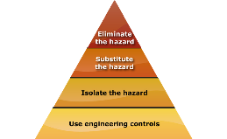
INTRODUCTION TO HAND SPREAD ASPHALT
PC 1.3 PREPARE TO HAND SPREAD ASPHALT
QUESTION 29 | 1. Elimination: If possible, 2. Substitution: Use a safer | 3. | Isolation: Stop access
The hierarchy of hazard control is a list of controls you can use to lower the danger from a hazard on the worksite. What are the six (6) levels in the hierarchy of hazard control from the first choice to the last choice? | remove (take away) method if you can’t remove the hazard. the hazard. |  | to the hazardous (dangerous) area.
 | 4. Engineering Control 5. Administrative Practices: | 6. | Personal Protective
 | Measures: Reduce the time the worker |  | Equipment (PPE):
 | Change the tools, is exposed to the hazards by |  | Use PPE as your
 | equipment or environment using training, job rotation, |  | last line of defense.
 | to make it safer. the timing of jobs, etc.
 | Memory aid: Every Saturday I Eat A Pie

Slide 18
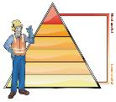
INTRODUCTION TO HAND SPREAD ASPHALT
PC 1.3 PREPARE TO HAND SPREAD ASPHALT
Question 30
What is a Hazard?
What is a Risk?
What is a Hazard?
The likelihood of an incident occurring.
A potential source of harm or danger that exists.
The process of assessing safety measures.
The presence of safety equipment.
Answer: b. A potential source of harm or danger that exists.
What is a Risk?
A potential source of harm or danger.
The likelihood of an incident occurring.
A hazard-free environment.
A safety measure in place for job
Answer: b. The likelihood of an incident occurring.
Question 31
While hand spreading asphalt in a construction project, what is the hazard and associated risk?
Identify a hazard and risk when hand spreading asphalt from the following statements of choice, choose the correct statement:
Hazard: Wearing appropriate personal protective equipment (PPE)
Risk: Heat stress due to the PPE
Hazard: Hot asphalt material
Risk: Burns or skin injuries from contact with the hot asphalt
Hazard: Effective communication with the paver operator
Risk: Increased efficiency and safety
Hazard: Maintaining a clean work area Risk: Improved visibility for workers
Answer: b. Hazard: Hot asphalt material, Risk: Burns or skin injuries from contact with the hot asphalt.

Slide 19
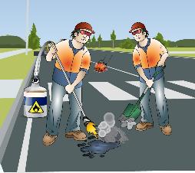
Spread asphalt
Element 2

Slide 20
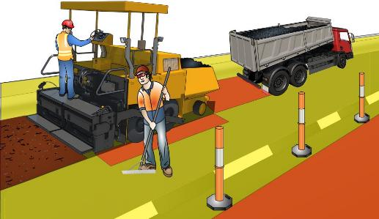
Working around a paver while hand spreading asphalt
PC 2.1 SPREAD ASPHALT
Conduct hand asphalt spreading in close but safe proximity to the paver, maintaining clear communication and awareness of surrounding hazards.
Unsafe areas can include zones where heavy machinery operates and remains outside the operator's line of sight. The following red zones are areas that are un safe to operate.
Danger Zone
Safe Zone

