Slide 1
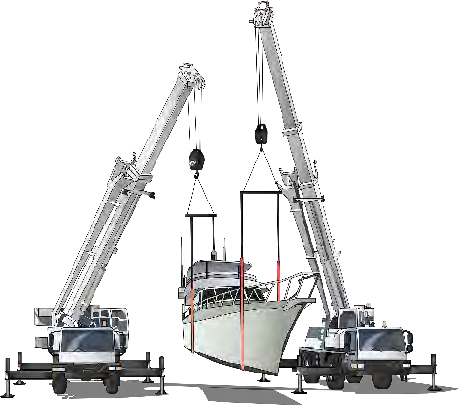
RIGGING INTERMEDIATE SAFETY & LICENCE GUIDE
Training support material for:
CPCCLRG3002
Licence to perform rigging
intermediate level

Slide 2
Contents
How to use this guide
Language – Literacy – Numeracy (LLN) Acknowledgements
Introduction to intermediate rigging High risk licensing and the law
4
5
7
9
11
17
45
51
85
111
133
Element 1
Element 2
Element 3
Element 4
Element 5
Plan Task
Select and inspect equipment Set up task
Undertake intermediate rigging activities Complete Task
Test yourself – Learning tasks

Slide 3
About this guide
HOW TO USE THIS GUIDE
The guide is a follow-up to your formal training.
Like all Easy Guides, this one uses plain words and pictures to help you remember what you learned in your formal training. So you can pass your test — and get your licence.
Good luck from the team at Easy Guides Australia Pty Ltd.
Note: This guide does not use the same wording as the Safe Work Australia Assessment Instrument. This Instrument cannot be shown to the learner before the test.
Easy Guides training materials have been developed around Language – Literacy – Numeracy (LLN) principles.
How to use this guide
Use it in hard copy
This guide helps you prepare for the test at the end of the course. Study it carefully, and then ask a friend to help you practise. They can ask you each question, and then you give the answer. Writing down the answers can also help you remember them. This also helps you see what you still need to learn. Good luck!
Or use it on screen
This guide also comes in a multimedia presentation, so you can use it on your computer or screen. The multimedia presentation is just like the guide and has exactly the same questions with the same short words and easy-to-understand pictures.
Trainers can use the multimedia presentation in class to help learners discuss questions. The trainer first shows the question and asks if anyone knows the answer. Next, the trainer will show the answer and discuss it with the learners.
4

Slide 4
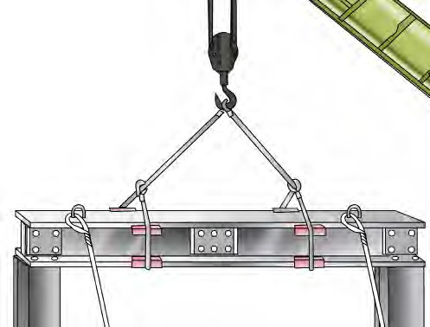
Introduction to intermediate
rigging

Slide 5
What is intermediate rigging?
INTRODUCTION TO INTERMEDIATE RIGGING
Intermediate rigging covers all the work done by riggers at the basic level, and also includes:
Rigging of cranes
Rigging of conveyors
Rigging of dredges and excavators
Rigging tilt slabs
Demolition work
Dual crane lifts.
Intermediate rigging includes using mechanical load shifting equipment to move, place or secure a load. It also involves using plant, equipment or part of a structure/building to set up and dismantle cranes and hoists.
Prerequisite
CPCCLRG3001
Licence to perform rigging basic level
A valid licence for basic rigging (RB)

Slide 6
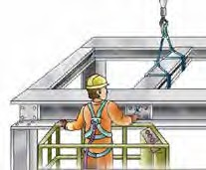
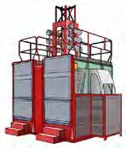
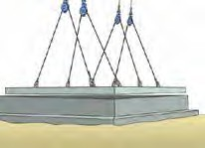
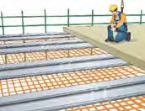
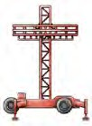
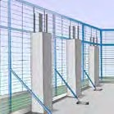
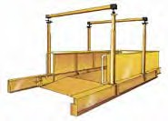
INTRODUCTION TO INTERMEDIATE RIGGING
An intermediate rigger can also perform work usually done by a dogger or basic rigger (continued)
Rigging work involving:
Structural steel erection |  | Hoists |  | Pre-cast concrete members of a structure
Safety nets and static lines | Mast climbing work platforms |  | Perimeter safety screens and shutters |  | Cantilevered crane loading platforms

Slide 7
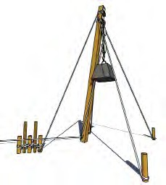
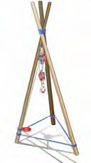
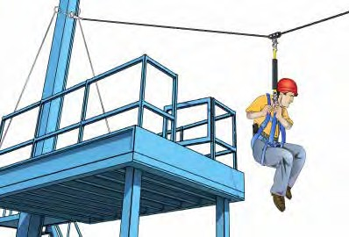
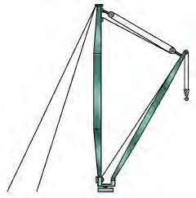
INTRODUCTION TO INTERMEDIATE RIGGING
An intermediate rigger cannot perform any rigging work involving any of the following.
Gin poles | Shear legs
Flying foxes and cable ways | Guyed derricks and structures

Slide 8
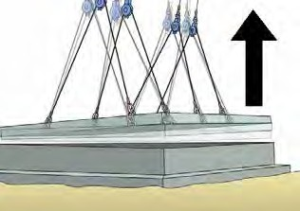
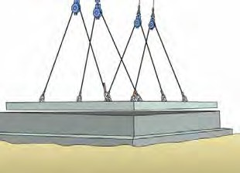
PC 3.4 SET UP TASK
Safety factors Safety factor is a margin included in calculations to _{Jerking crane} allow for conditions on the job. _{during lift} Things that might affect the safety factor include: Strength of material used to manufacture equipment or materials Work method. For example, jerking the crane during a lift will increase the required safety factor.
QUESTION 3.4 (A) You need to lift a pre-cast panel from its casting bed. What is the risk? | Suction can cause an increase in the dead load of the panel. If the tilt-up panel is sticking to the casting surface the dead load must be increased by 40% to allow for the effect of suction.
84

Slide 9
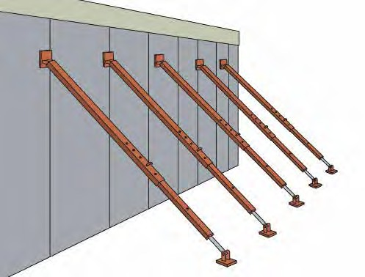
undertake intermediate rigging
activities
Element 4
95

Slide 10
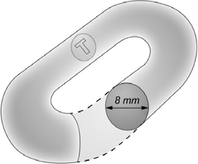
PC 4.1 UNDERTAKE INTERMEDIATE RIGGING ACTIVITIES
QUESTION 4.1 (G) Demolition rigging involves felling columns, walls and towers by pulling them over. What is the minimum diameter of: Flexible steel wire rope (FSWR) used for felling Grade 80 chain used for felling? | Felling FSWR must have a minimum diameter of 12 mm 12 mm diameter 12 mm
 | Felling grade 80 chain must have a minimum diameter of 8 mm
100

