Slide 1


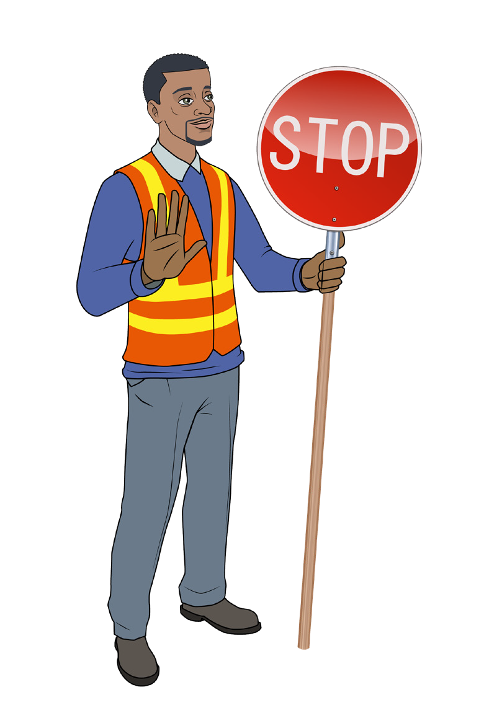


TRAFFIC MANAGEMENT LEARNER GUIDE
Training support material for:
RIIWHS205E
Control traffic with a stop-slow bat
Produced by:

Slide 2
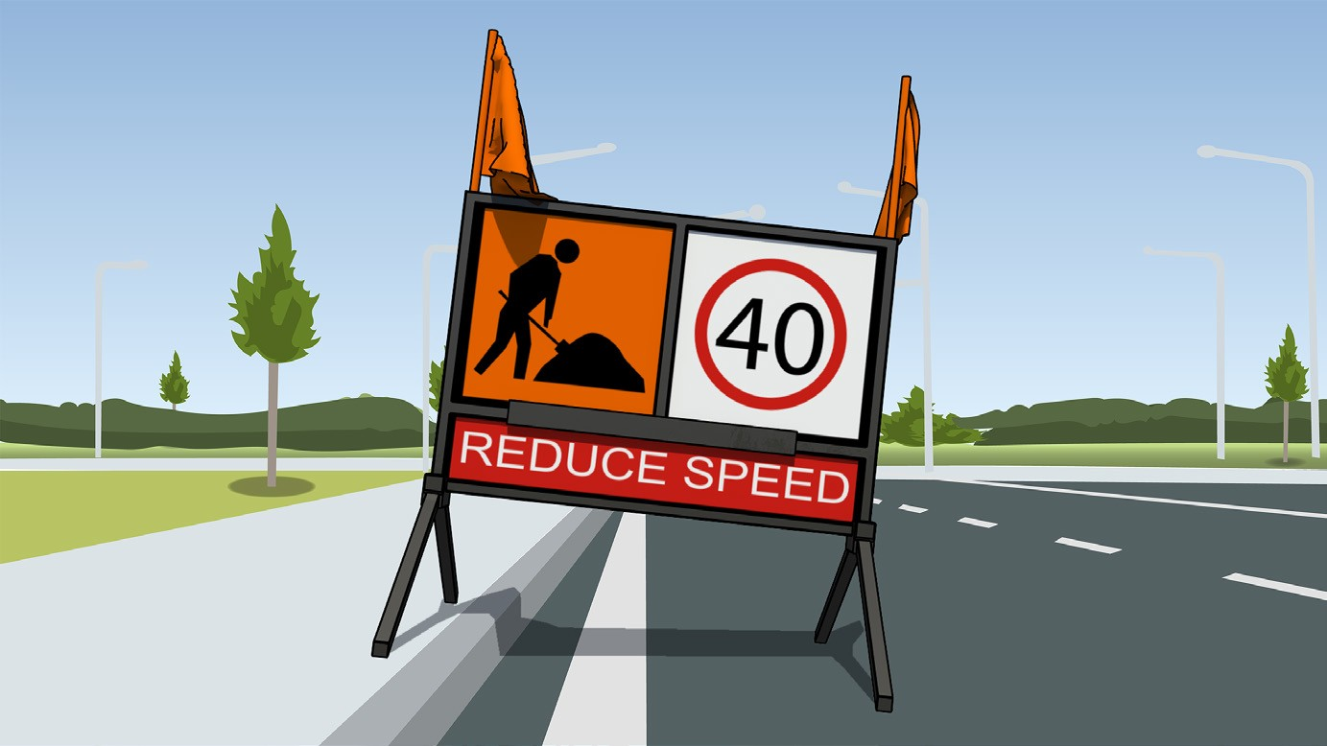
Introduction

Slide 3

PREPARE TO CONTROL TRAFFIC

Slide 4
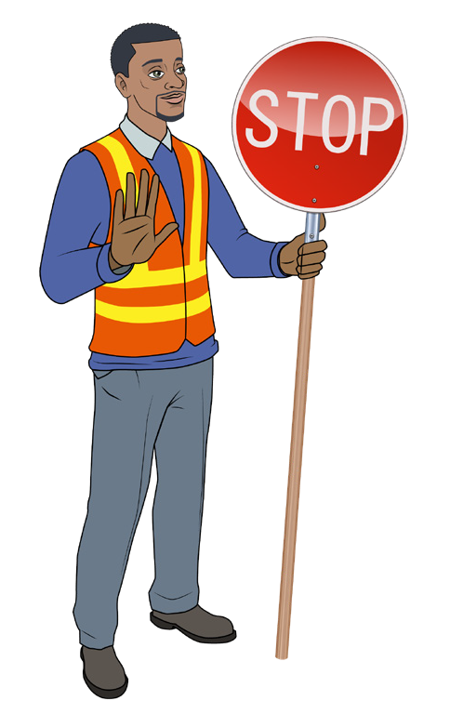
PC 1.1, 1.3
PREPARE TO CONTROL TRAFFIC
Safety requirements
Personal protective equipment (PPE)
Depending on the situation, traffic controllers must wear appropriate high visibility clothing which meets AS/NZS 4602 for class:
“D” (day)
“N” (night) or,
“D/N” (day and night)
Hi-visibility clothing must be worn at all times while working in or next to traffic. This includes traffic at worksites, in quarries and on construction haul roads.
During the day (in well lit conditions), traffic controllers must wear class “D” hi-visibility clothing. Clothing may include vests, jackets, polo shirts or overalls and must:
Be either red-orange or yellow in color (Class “F” fluorescent material)
Comply with AS/NZS4602
Display the company name
Be clean and in good condition
Be correctly worn and done up at all times.

Slide 5
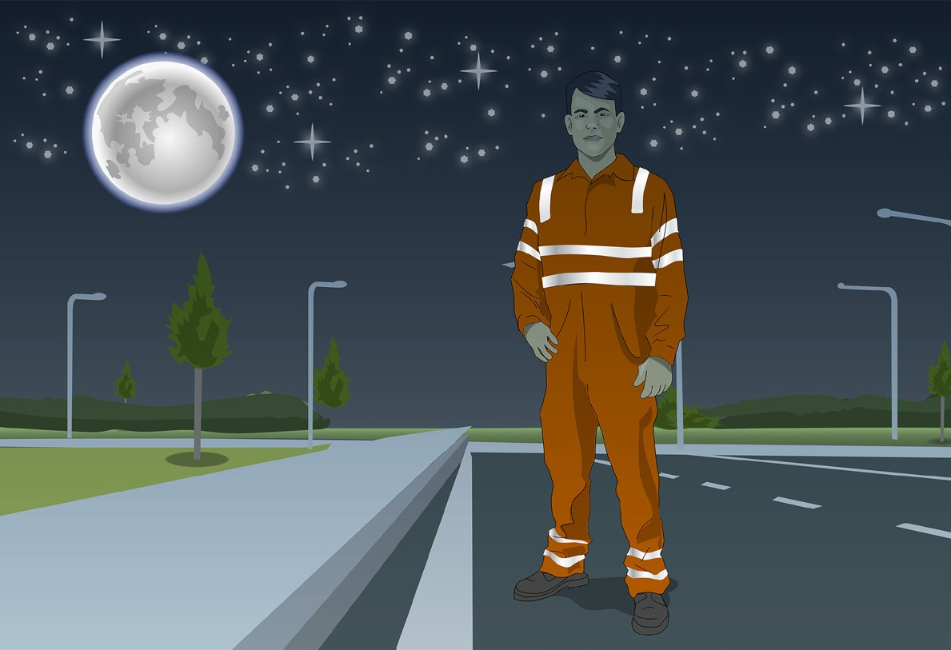
PC 1.1, 1.3
PREPARE TO CONTROL TRAFFIC
Personal protective equipment (continued)
When working at night time (in poor light or under artificial lighting) or when working day/night in combination, fluorescent clothing meeting or exceeding AS/NZS4602 for night use class “N” or day/night use class “D/N” must be worn.
The clothing must:
Be either red-orange or yellow in color (Made from Class “R” retroreflective material)
Comply with AS/NZS4602 (Class “N” night or “D/N” day/ night use)
Contain retroreflective material, preferably hoops on the body arms and legs
Display the company name
Be clean and in good condition
Be correctly worn and done up at all times.
Wet weather clothing (e.g rain jackets, pants) should be made from waterproof material which is as close to the required colors
and retroreflectivity (refer to standards) as possible. Retroreflective material should be capable of reflecting in wet or dry conditions.
Retroreflective = Reflects light

Slide 6
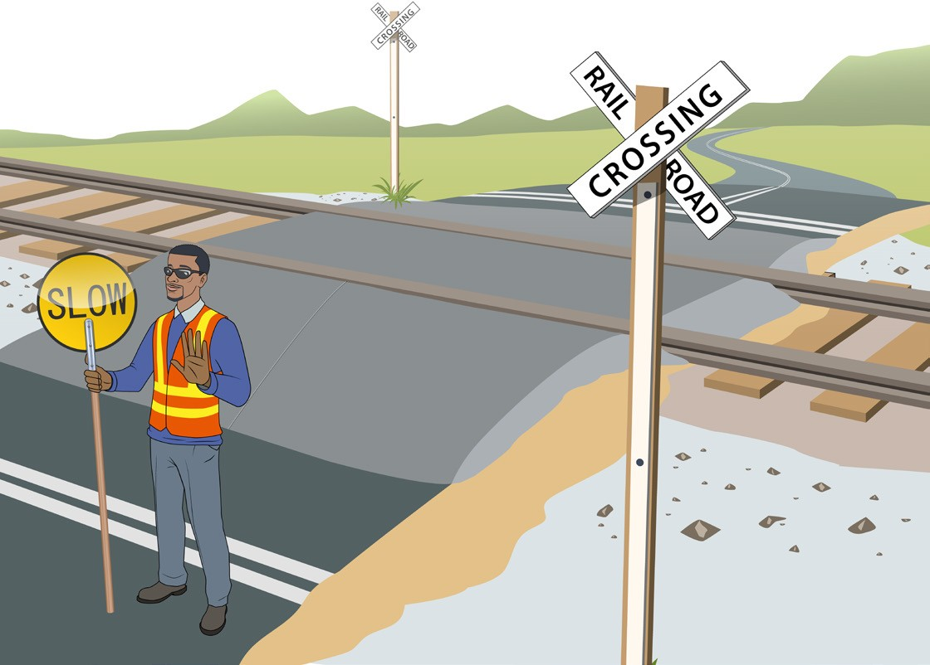

PC 1.1, 1.3
PREPARE TO CONTROL TRAFFIC
Personal protective equipment (continued)
If traffic control is needed near a train track, rail reserve, level crossing or boom gate there may be special rules that need to be followed. Check with the local state/territory rail authority and the traffic management authority for any special rules.
For example in Victoria:
Traffic controllers must wear hi-visibility clothing that meets AS/NZS 1906.4 and AS/NZS 4602
Hi-visibility clothing must be of the color “special purpose orange”
Clothing, hats (including safety hats) or carried objects that are red or green in color are not allowed as these colors have special meanings in railway system operations, signalling and safe work procedures and may cause confusion.
Work is not allowed within 3 metres of the nearest train track without the necessary safe working qualifications
Safety footwear and if necessary eye protection must be worn when working in the danger zone.
3 metres

Slide 7
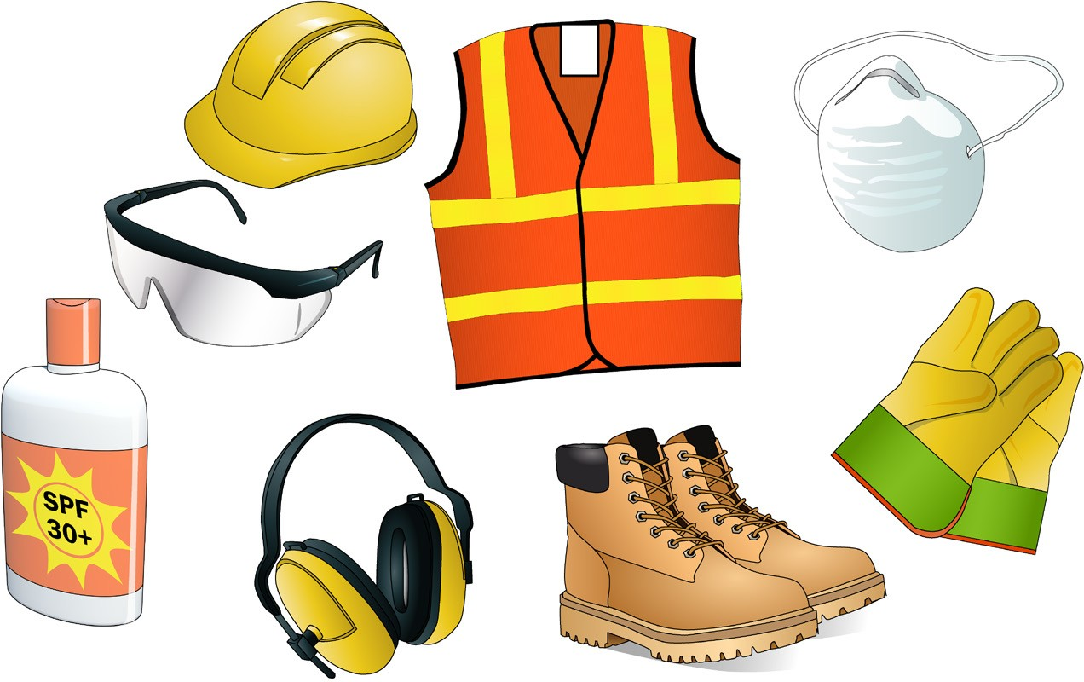
PC 1.1, 1.3 PREPARE TO CONTROL TRAFFIC
Personal protective equipment (continued)
As a minimum traffic controllers must also wear safety footwear which meets Australian Standards. The work site rules will also tell you any other personal protective equipment which must be worn.
This may include:
Safety vest
Hard hat
Dust mask
Safety glasses
Safety gloves
Sunscreen
Safety footwear
Hearing protection
Note: Traffic controllers should also consider wearing wide brimmed hats, sunglasses, long sleeved tops and pants when working in the sun. Detachable brims with neck flaps can be used if a hard hat must be worn.

Slide 8
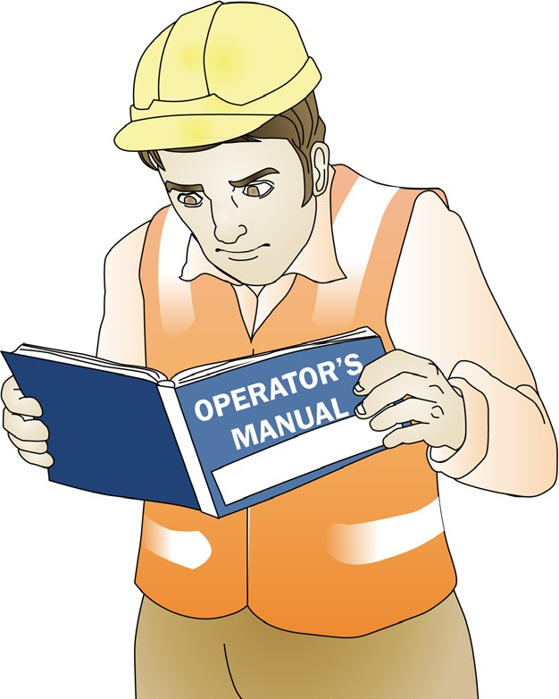
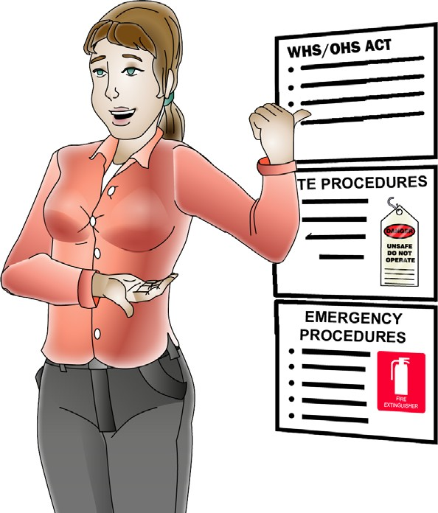
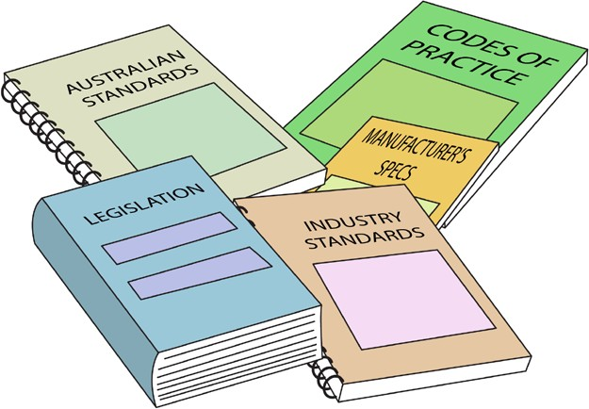
Work instructions
PC 1.2 PREPARE TO CONTROL TRAFFIC
Work instructions are important so workers know what needs to be done, how it is to be done and when they need to do it. This allows work to be completed in a way that is safe, efficient, compliant and meets quality requirements.
Work instructions include things like:
Compliance information | Company policies and procedures | Manufacturers guidelines and specifications

Slide 9


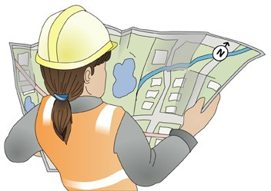
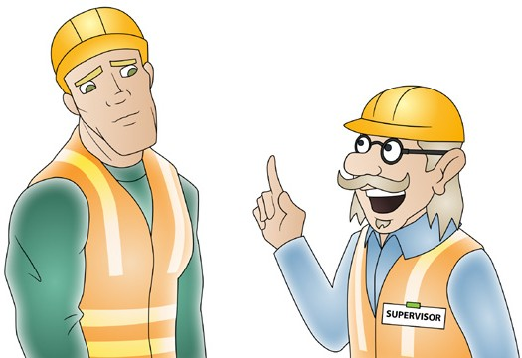
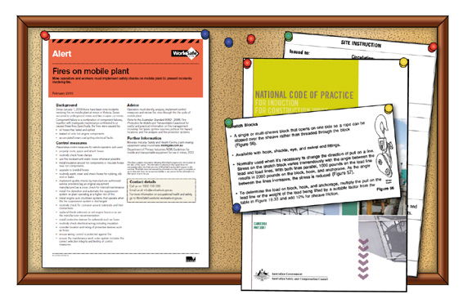
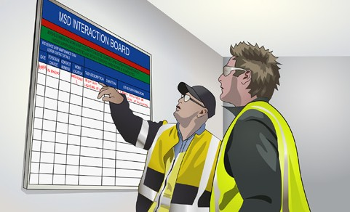
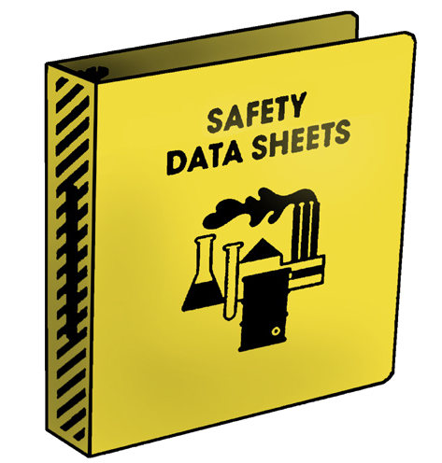

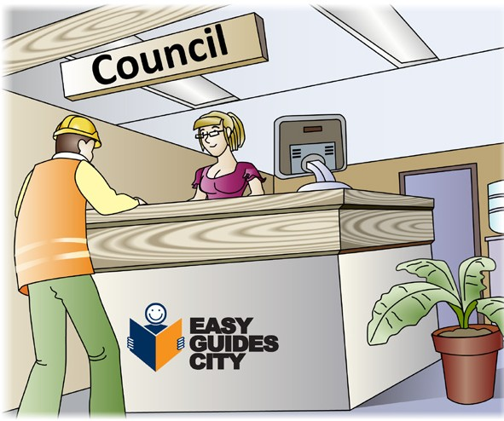
PC 1.2
PREPARE TO CONTROL TRAFFIC
Work instructions (continued)
Verbal, written and graphical instructions | Signage, work schedules and plans | Work bulletins, memos and maps
Safety data sheets (SDS) | Quality requirements | Instructions issued by authorised organisation or external personnel.

Slide 10
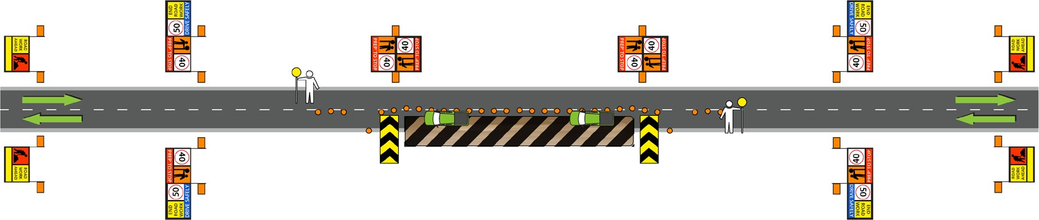
PC 1.2
PREPARE TO CONTROL TRAFFIC
Traffic management plan (TMP)
The road safety act requires any person conducting works on or near a road to have a traffic management plan in place. The traffic management plan must be prepared by a qualified person. The TMP contains the Traffic Guidance Scheme (TGS), worksite hazard assessment (eg: SWMS) and details of the location, nature and duration of the work. The traffic controller should review the TMP before starting work so they know what to do and how to do it.
The traffic management plan may include information about:
The safety of workers and the public
The overall strategy for the management of traffic
The arrangment of traffic control devices
The arrangment and number of traffic controllers
Emergency access (for workers and emergency services vehicles)
Unusual hazards or specific job requirements (eg: nearby schools, access to shops).
Traffic guidance scheme (TGS)
The TGS is a diagram which shows where temporary signs and traffic control devices (including the traffic controller) must be placed to warn traffic and guide it through, past or around a work area or temporary hazard so work can be carried out safely. The traffic guidance scheme (TGS) is part of the traffic management plan (TMP).

Slide 11

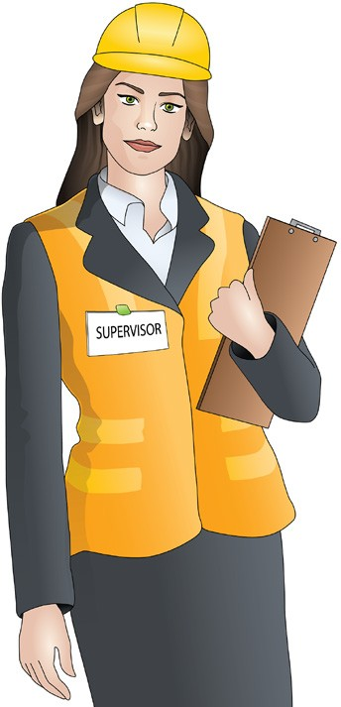

Duty of Care Obligations under the WHS/OHS Act
PC 1.3 PREPARE TO CONTROL TRAFFIC
Note:
The following information is based on the new WHS Act. If your state is not using the new Act, you should refer to the Occupational Health & Safety (OHS) Act.
‘The national WHS Act sets out the legal responsibilities that apply to persons conducting a business or undertaking (PCBU) and workers to make sure the workplace is as safe and healthy as possible.’
PCBUs (employer/workplace manager) and workers (employees) both have a duty of care responsibility to make sure the workplace is a healthy and safe place to be. A ‘worker’ includes people who are employees, contractors, sub-contractors, outworkers, employees of labour hire companies and volunteers.
The workplace must also not harm the health or safety of visitors or people nearby.

Slide 12
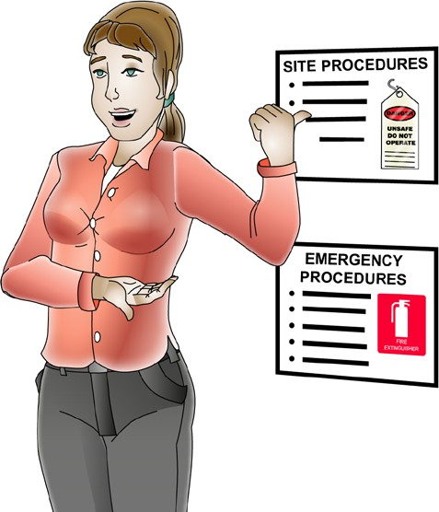
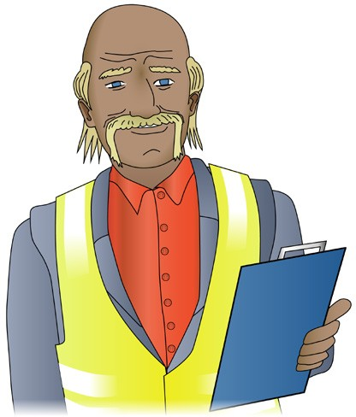
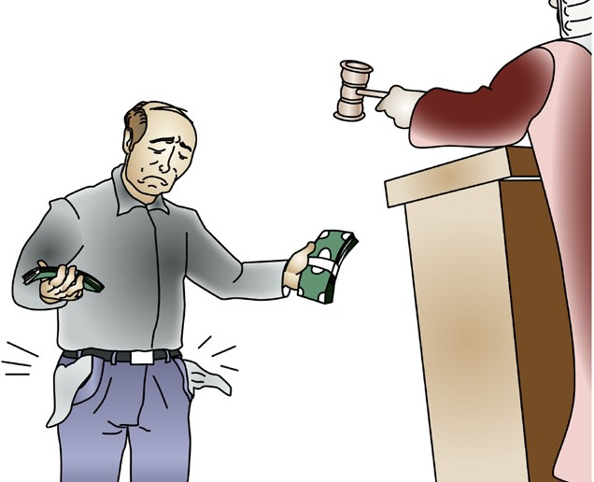
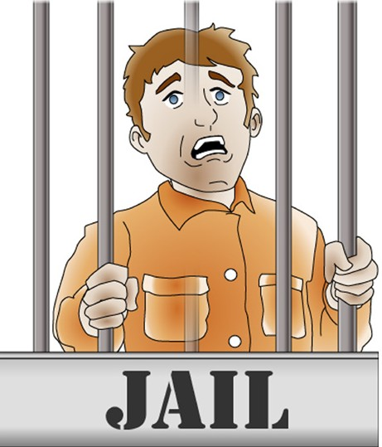
PC 1.3
PREPARE TO CONTROL TRAFFIC
Worker’s (employee’s) duty of care
By law, as a worker you must take care of your own health and safety — and the health and safety of other people in the workplace.
You must also:
PCBU’s (employer’s) duty of care
By law, as a PCBU you must do everything reasonably practical to provide a workplace that is safe and without risk to health.
You must instruct and train your workers to work safely.
You must do so in a way that is easy for your employees to understand.
Do your best to follow reasonable safety instructions from your PCBU/employer (boss)
Follow workplace health and safety procedures and policies
Do not do work if you believe a hazard would be a serious risk to your health or safety.
Penalties
If you are a PCBU/employer or worker, the government can fine or even imprison you for failing your duty of care.

Slide 13

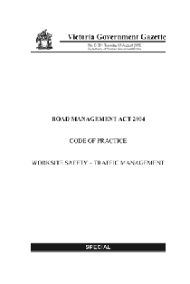
Compliance
PC 1.3 PREPARE TO CONTROL TRAFFIC
There are documents called compliance documents that traffic controllers need to know about. These documents tell you what you must do to work safely and legally as a Traffic Controller.
The following are all examples of the types of compliance documents that are important for a Traffic Controller to know about:
Legislation
Road Management Act
Road Safety Act
Occupational Health and Safety Act or Work Health and Safety Act
Occupational Health and Safety Regulations or Work Health and Safety regulations
Road Safety (Traffic Management) Regulations
These documents can be found at www.comlaw.gov.au
Codes of practice (for example)
Code of Practice for Worksite Safety – Traffic Management
Traffic management for works on roads code of practice
Note: Check with the state/territory regulator for the relevant compliance documents in your state/territory.

Slide 14

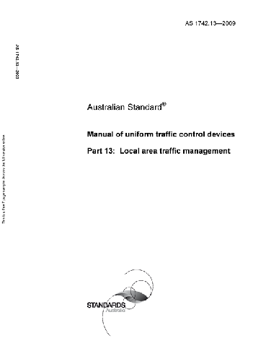
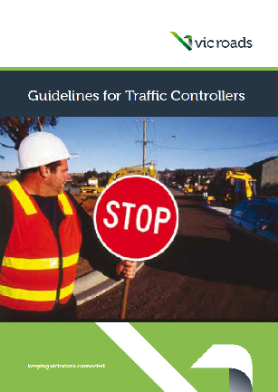
PC 1.3
PREPARE TO CONTROL TRAFFIC
Compliance (continued)
Australian standards
Australian Standard AS1742: Manual of Uniform Traffic Control Devices
Australian Standard AS4602: High visibility safety garments
Australian Standard AS1906: Retroreflective materials and devices for road traffic control purposes.
These documents can be found at www.saiglobal.com
Worksite rules and procedures
The rules, procedures and policies of the company you are working for or the site you are working at should be made
available during site induction or from your supervisor.
Guidance notes
Guidelines for traffic controllers
Traffic controller handbook
(Check what’s available from your state or territory roads regulator).

Slide 15
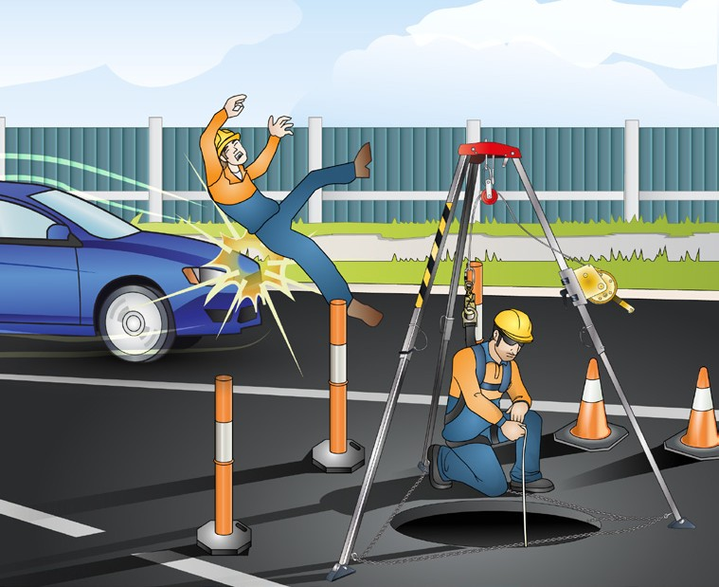

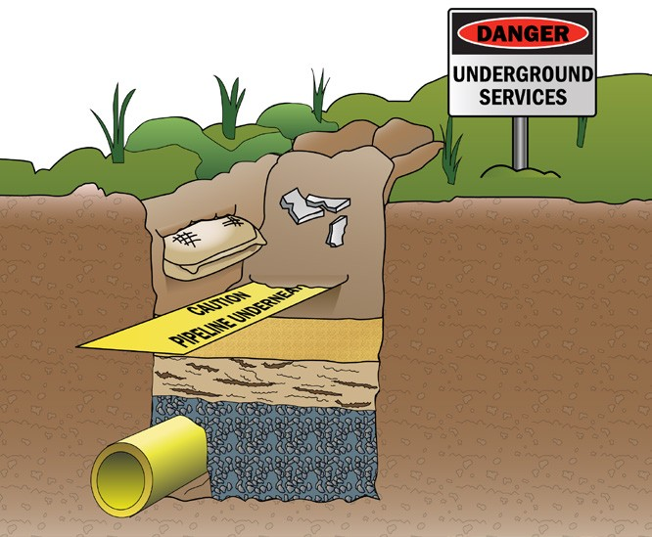
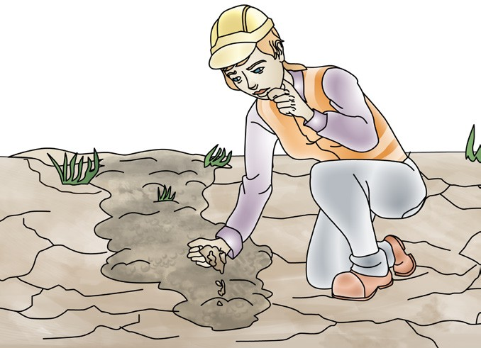
PC 1.3
PREPARE TO CONTROL TRAFFIC
Hazard identification
There are a lot of hazards on construction sites that you need to be aware of. Hazards can cause accidents and injuries. Hazards need to be identified before you can start work so they can be controlled.
Hazards can include things like:
Uneven/unstable ground | Trees | Pits and underground services

Slide 16
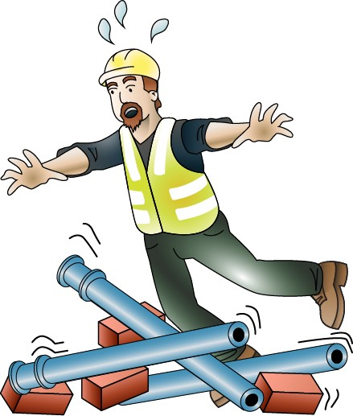
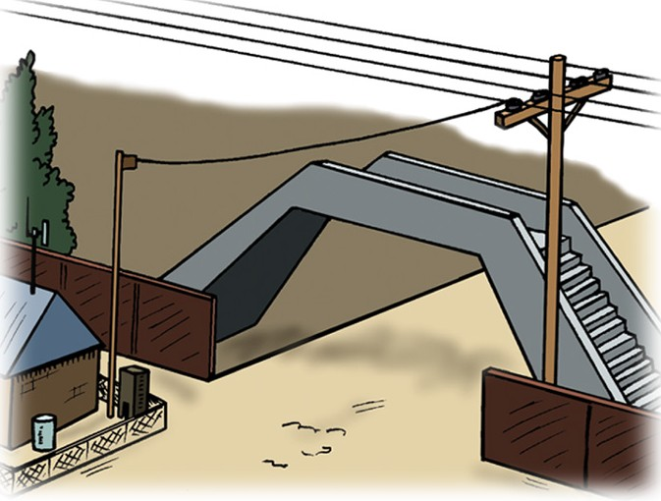
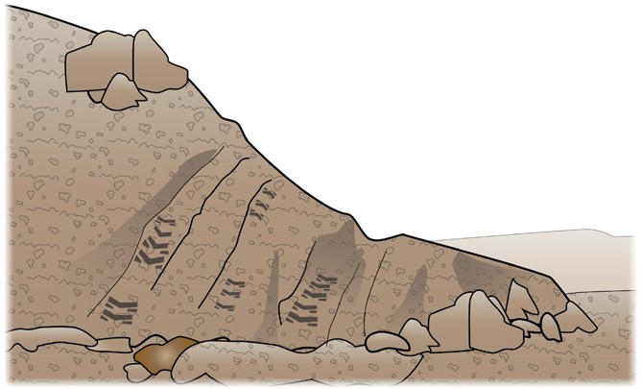
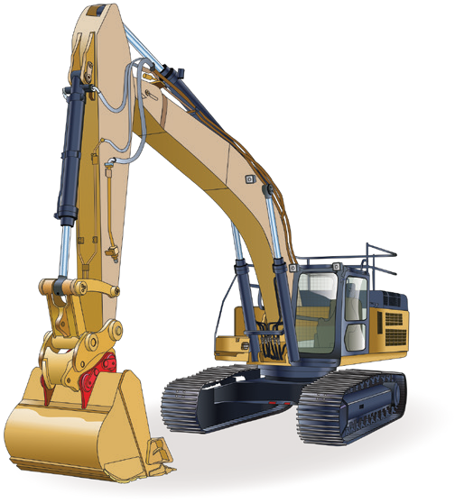
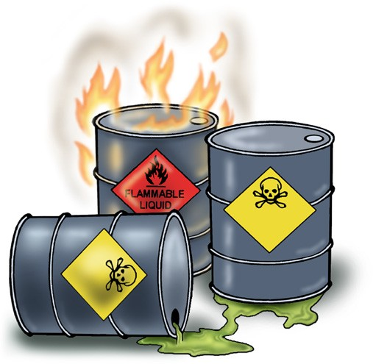
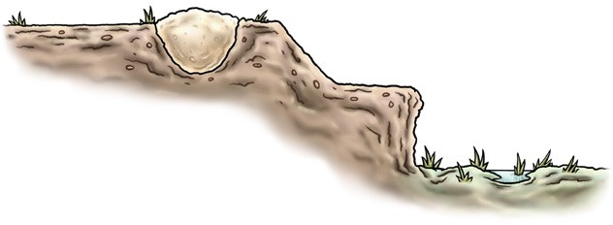
PC 1.3
PREPARE TO CONTROL TRAFFIC
Hazard identification (continued)
Overhead services and bridges | Trip hazards and obstructions | Embankments and dirt mounds
Plant and machinery | Fire and hazardous materials | Cuttings

Slide 17
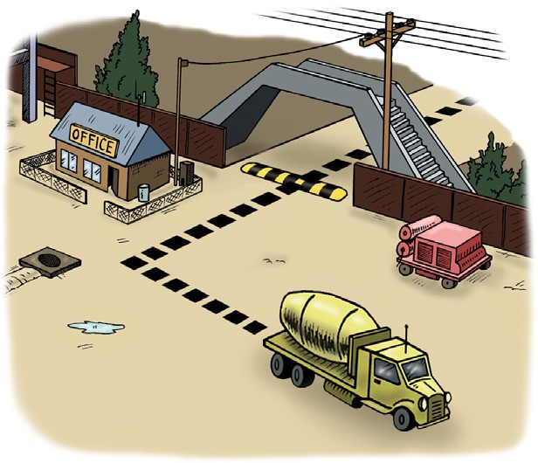
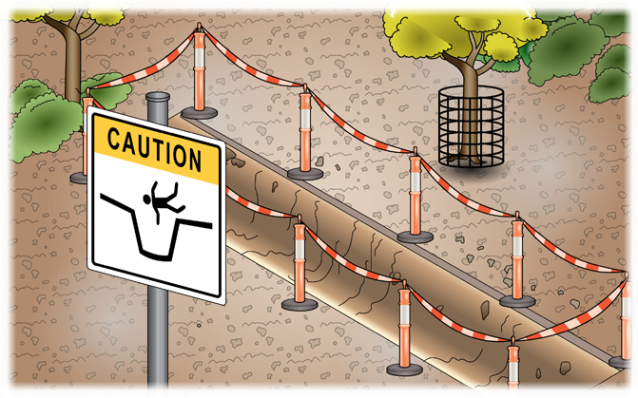
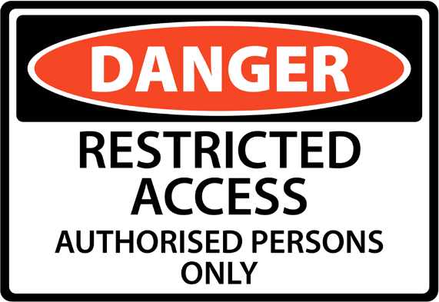
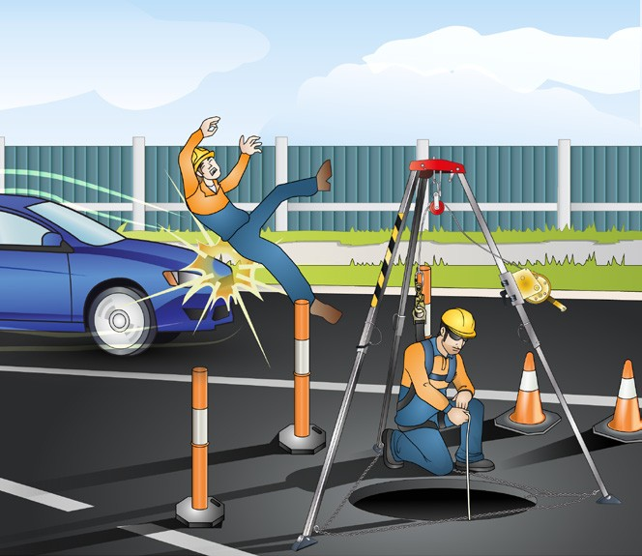
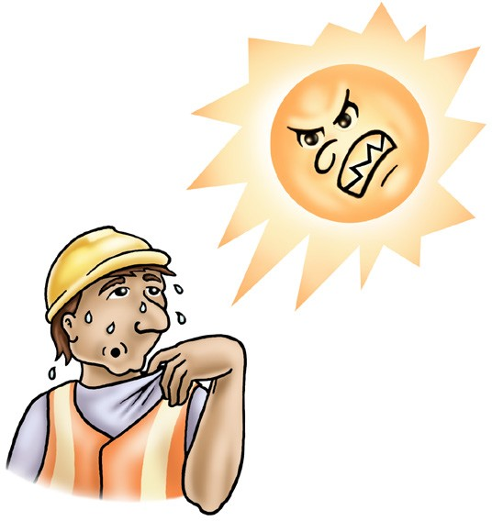
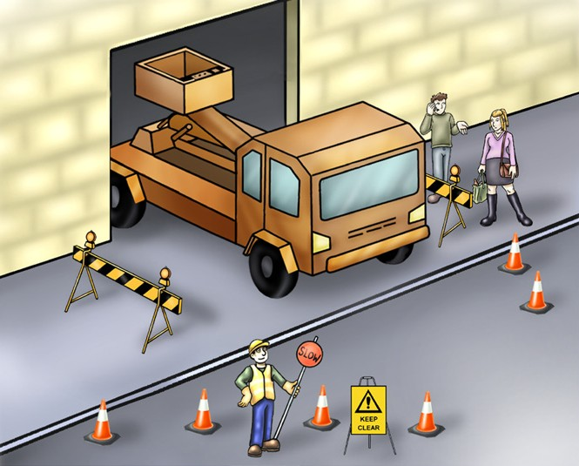
PC 1.3
PREPARE TO CONTROL TRAFFIC
Hazard identification (continued)
Surrounding buildings, structures and facilities | Excavations and recently filled trenches | Restricted access barriers
Pedestrians and other personnel | Vehicle traffic | Weather conditions

Slide 18

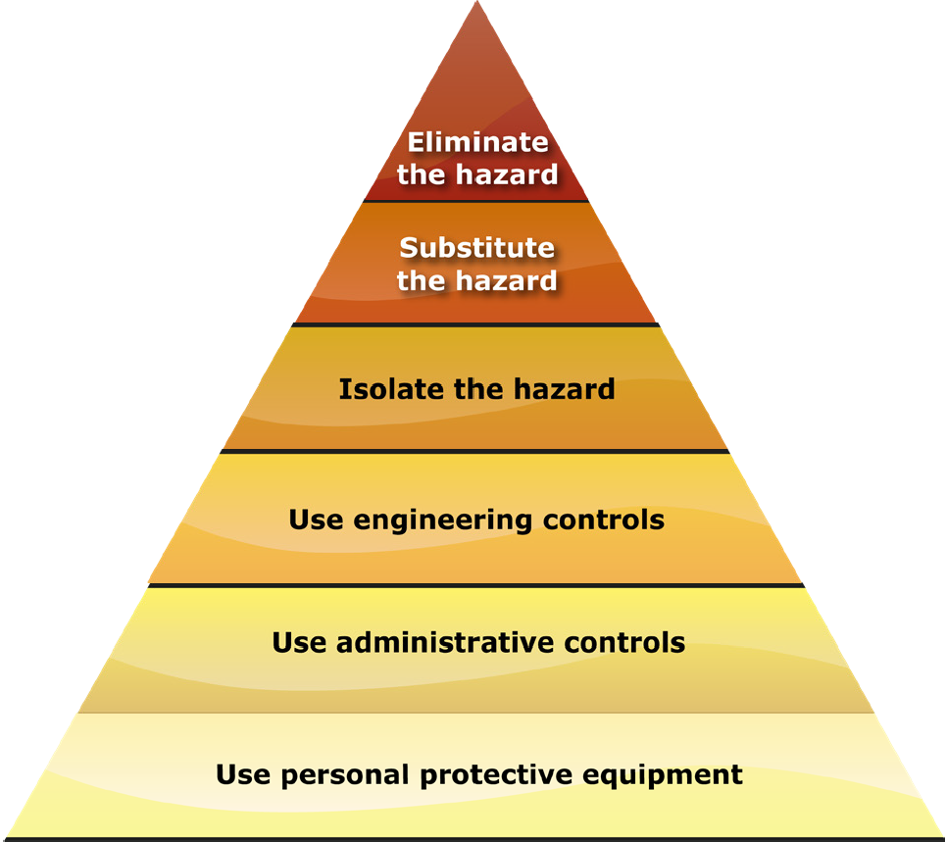

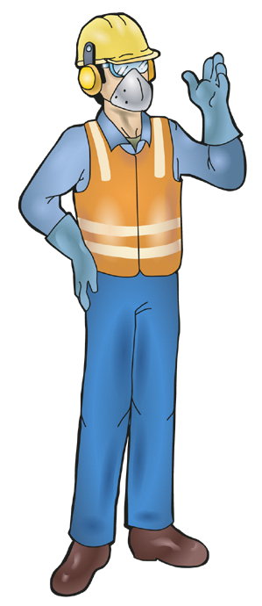
Hierarchy of Hazard Control
PC 1.3 PREPARE TO CONTROL TRAFFIC
Once hazards have been found on the worksite, controls need to be put in place to make them safe. The Hierarchy of Hazard Control is a list of controls you can use when deciding how to control a hazard.
There are six (6) levels in hierarchy of hazard control from the first choice (best way to control the hazard) to the last choice (there may be better controls than this one on its own).
Elimination:
eg: Road closures, detours.
Substitution:
eg: Sidetracks.
Isolation:
eg: Safety barriers, lane closures.
Engineering control measures:
eg: Portable traffic signals, vehicle mounted attenuators.
Administrative practices:
eg: Signs, speed reductions, police presence.
Personal protective equipment (PPE)
eg: Hi-visibility clothing, safety boots, sun protection.
You can use the following acronym to help you remember the steps in the hierarchy of hazard control:
Every Saturday I Eat a Pie

Slide 19
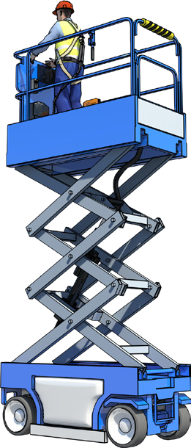
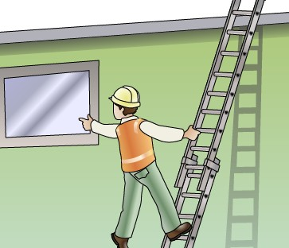
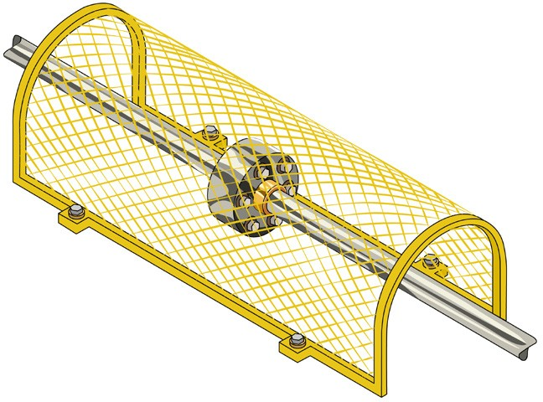
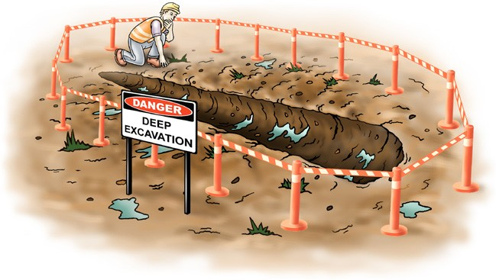



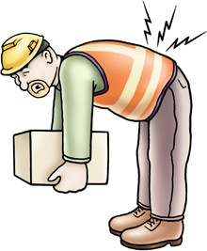
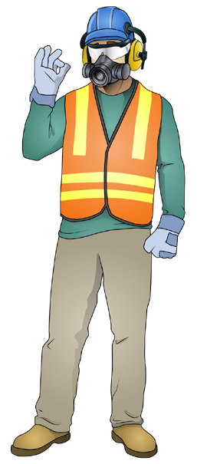
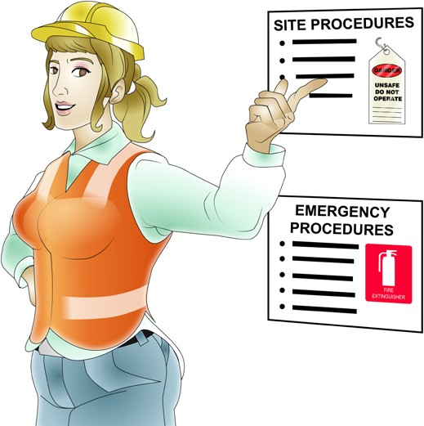
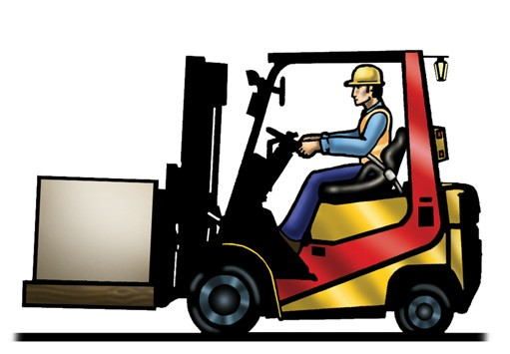

PC 1.3
PREPARE TO CONTROL TRAFFIC
Hazard controls
Some of the ways hazards can be controlled include:
Placing barriers and signs | Using a safer type of equipment | Guarding machinery and equipment
Using a safer way to do things | Reading and following safety procedures | Wearing Personal protective equipment (PPE)

Slide 20

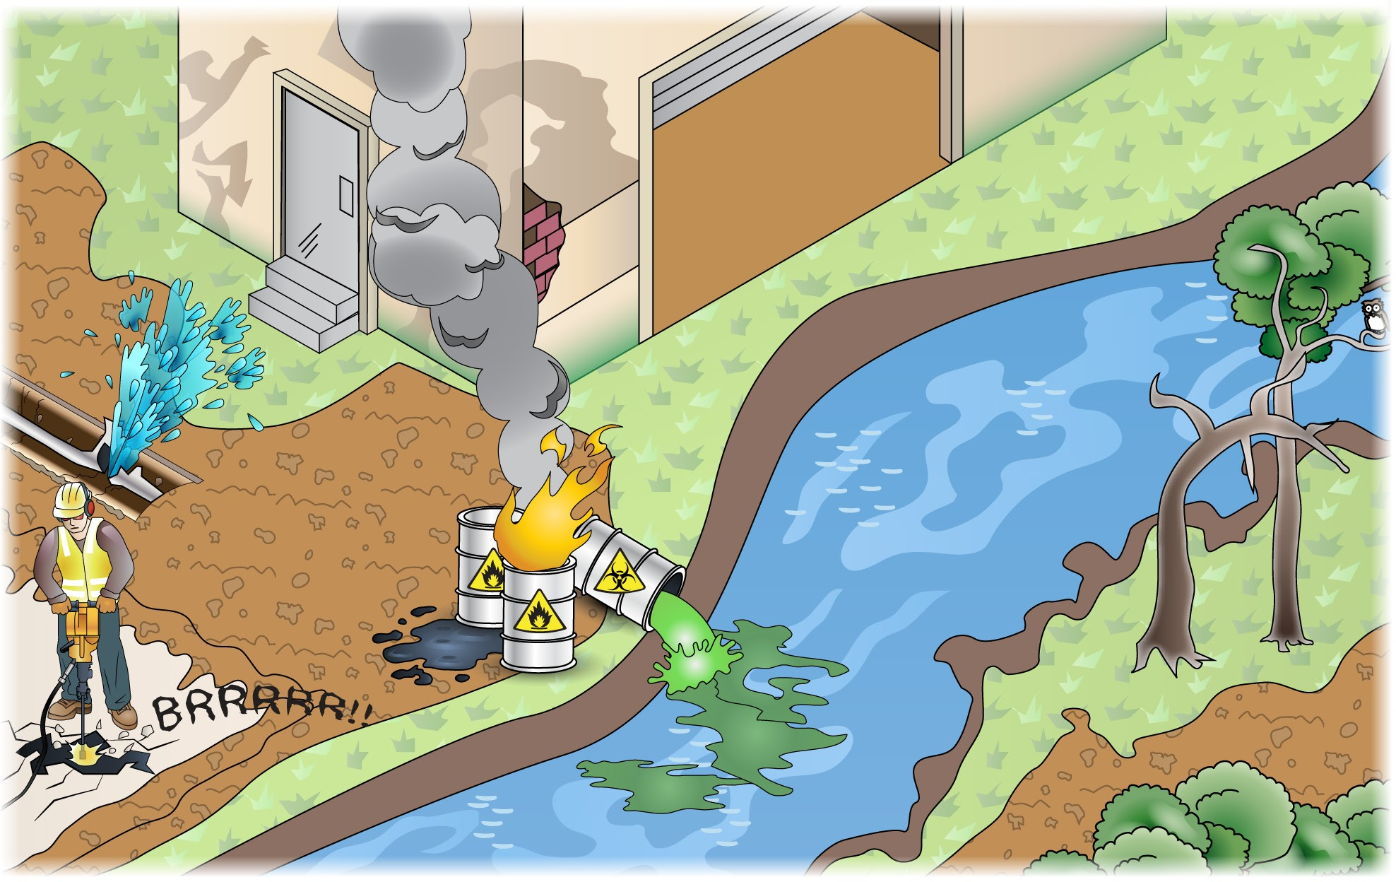
Environmental protection requirements
PC 1.3 PREPARE TO CONTROL TRAFFIC
Sometimes the environment can be damaged by work which is done. The worksite may have an Environmental Management Plan (EMP) in place. The EMP is a plan that is developed for the worksite to identify all the environmental hazards and give information on how they must be controlled so the environment is protected. The plan also makes sure the site is complying with environmental legislation including the correct disposal of rubbish and waste products.
Some environmental issues that need to be considered include:
Air pollution
Waste management and clean up
Asbestos
Underground services
Fire
Water quality protection
Chemicals and hazardous substances
Noise, vibration and dust
Damage to plants and trees
Soil damage and erosion

