Slide 1

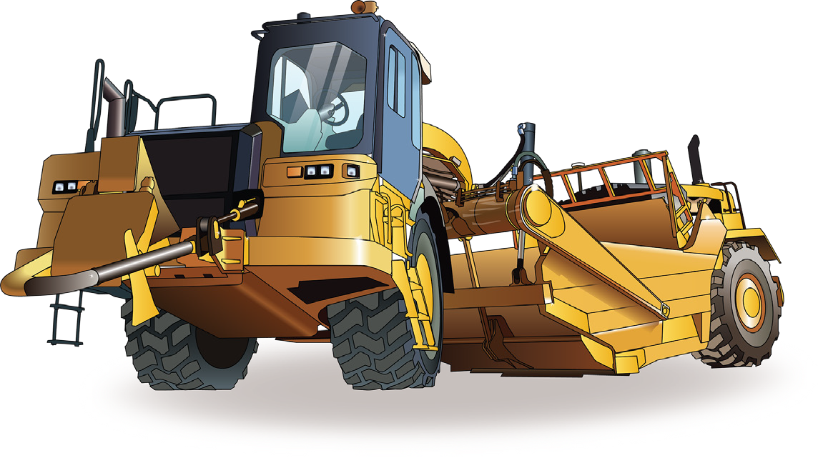

LEARNER GUIDE
Scraper
TICKET
Training support material for:
RIIMPO325E
Conduct civil construction scraper operations
Produced by:

Slide 2

PC 1.6
INTRODUCTION TO SCRAPERS
An example of a scraper
Hydraulics
Goose neck
Cab
Ejector
Yoke
Hook
Bowl
Bail
Push pad cushion
Apron
Blade/cutting edge
Tractor
Engine

Slide 3

Plan and prepare for scraper operations
Chapter 1

Slide 4
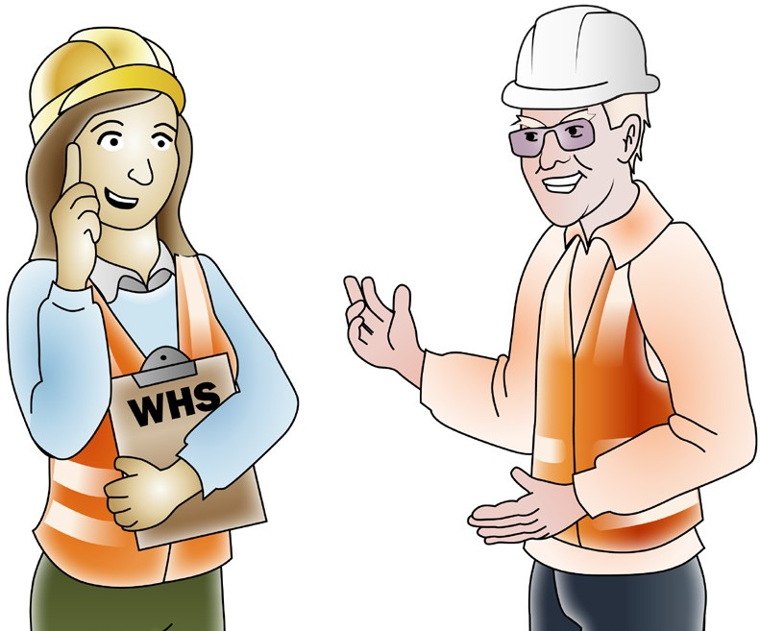
Work Health & Safety Legislative Requirements
PC 1.1 PLAN AND PREPARE FOR SCRAPER OPERATIONS
‘Laws to keep your workplace safe’
WHS/OHS requirements are outlined in Acts, Regulations, Codes of Practice and Australian Standards.
WHS/OHS Acts
‘WHS/OHS Acts’ are laws that explain how to improve health and safety in the workplace.
For example: Model National WHS Act, June 2011. WHS has the same meaning as OHS in this document.
Regulations
‘Regulations’ explain specific parts of the Act.
For example: Part 4.3 – Confined spaces, Part 4.4 – Falls.
Codes of Practice/Compliance Codes
‘Codes of Practice’ are practical guidelines on how to comply with (meet the rules of) legislation. For example: HAZARDOUS MANUAL TASKS Code of Practice, 23rd December 2011.
Australian Standards
‘Australian Standards’ are work guidelines that set the minimum accepted performance or quality
for a specific hazard, process or product.
For example: AS 2550 – Cranes, hoists and winches – safe use set.

Slide 5
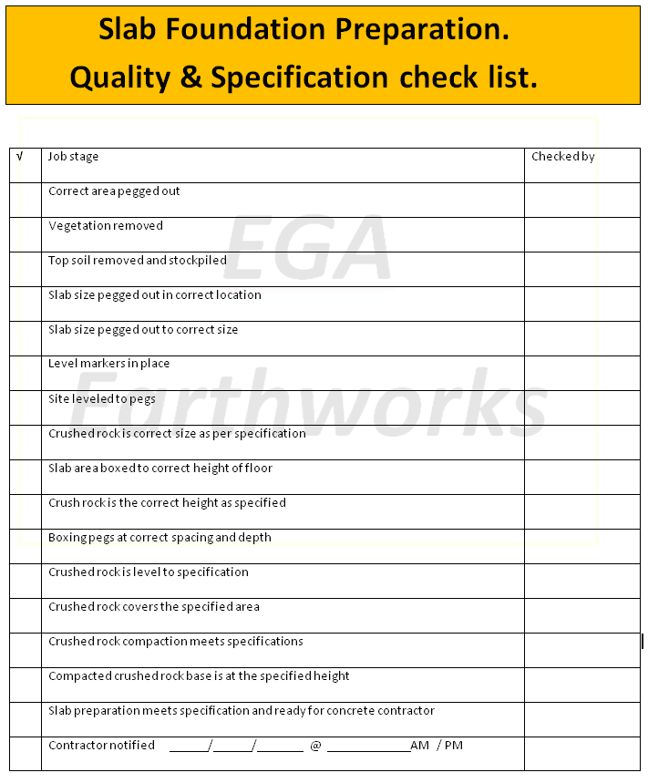

PC 1.1, 1.2
PLAN AND PREPARE FOR SCRAPER OPERATIONS
QUESTION 1 What are quality requirements? | The quality requirements tell you the standards you must meet when doing earthmoving work. They tell you what you need to do and how to do it to satisfy the customer. You may need to follow Codes of Practice, regulations, national standards etc.

Slide 6




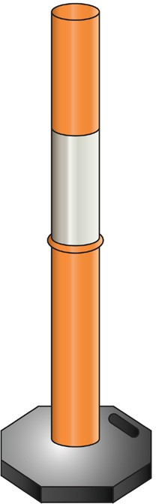

PC 1.5
PLAN AND PREPARE FOR SCRAPER OPERATIONS
QUESTION 2
What equipment may be used in a traffic control plan?
Stop/slow bats | High visibility vests | Radios
Barricades | Cones | Bollards

Slide 7


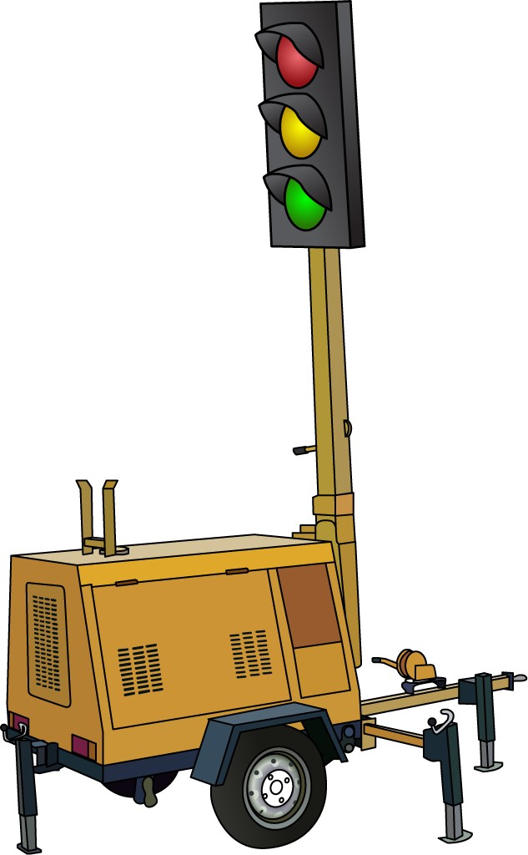

PC 1.5
PLAN AND PREPARE FOR SCRAPER OPERATIONS
QUESTION 3
What signs may be used in
a traffic control plan?
Speed limit signs | Warning signs
Arrow boards | Portable traffic signals

Slide 8

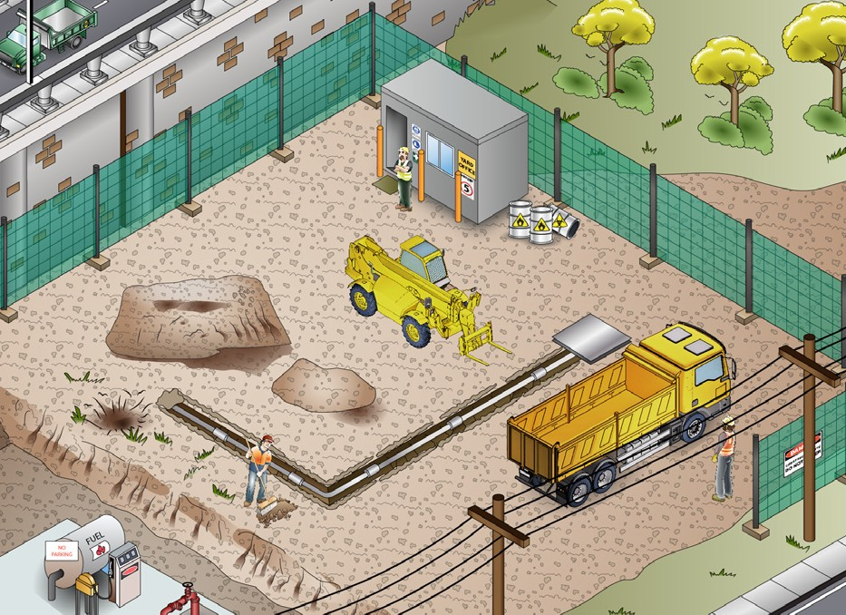
PC 1.1, 1.8
PLAN AND PREPARE FOR SCRAPER OPERATIONS
QUESTION 4 What kinds of information do you need before starting work? | Plans – what you need to do Specifications – rules and details about the job Operational details – how you will do the job Quality requirements of the job – the standards you are expected to meet.
QUESTION 5 When planning your job, why do you need to know what other people are doing on site? | To make sure you will not get in the way of other jobs being done To make sure you know what others are doing near where you must work.

Slide 9
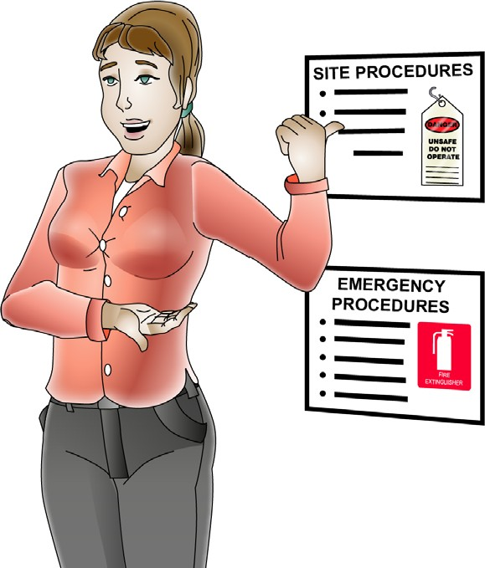

PC 1.1, 1.2
PLAN AND PREPARE FOR SCRAPER OPERATIONS
QUESTION 6 What are some examples of documentation you should read before doing earthmoving work? | WHS/OHS Act Regulations Codes of Practice Australian Standards (AS 2598-1995 Earth-moving machinery) Manufacturer’s specifications Operator’s manual for your machine Site requirements and procedures Company policies and procedures for Employment and workplace relations, Equal opportunity and disability.
QUESTION 7 Why should you check the operator’s manual before using earthmoving equipment? | The operator’s manual tells you how to operate your machine. The manual also tells you about maintenance (how to keep your machine working well).

Slide 10

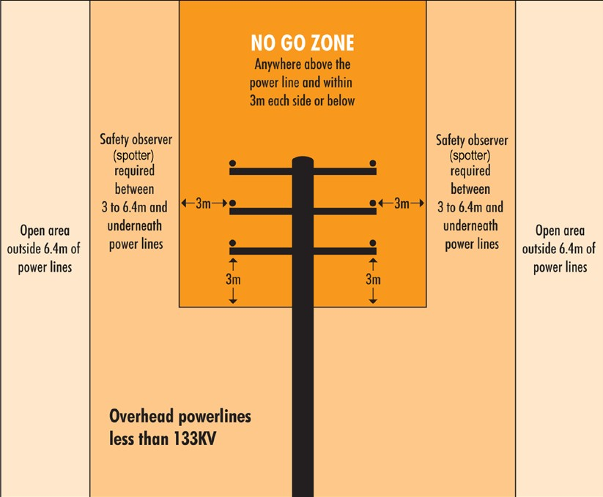
PC 1.1
PLAN AND PREPARE FOR SCRAPER OPERATIONS
QUESTION 8
What do codes of practice explain?
Codes of practice are practical guidelines on how to comply or follow the rules in legislation/laws.
For example:
A traffic management code of practice will tell you all the rules a traffic controller must follow. For example, a traffic controller must have a zero percent blood/ alcohol concentration/reading while performing traffic control duties.
QUESTION 9
What do Australian Standards explain?
Australian standards are work guidelines that set the minimum accepted performance or quality for a specific hazard process or product.
For example:
AS2550.1-2011—Powerline distances
This standard tells you the distances you can safely work near powerlines on poles and towers.

Slide 11
Job safety and environment analysis (JSEA) or Safe work method statement (SWMS)
PC 1.3, 2.6 PLAN AND PREPARE FOR SCRAPER OPERATIONS
These forms help you plan for the work you will do. It is very important you fill these out before you start work. They help you
work out the tools, equipment and PPE you need to do the job safely. All workplaces should have these types of forms.
Example:
Job safety and environment analysis (JSEA)/Safe work method statement (SWMS)
123456
PC 1.3, 1.4, KE 11 1. ACTIVITY/TASK INFORMATION AND LOCATION
Location/Project: |  | 123 Belmaine Highway, Roseville
Activity or Task Description: |  | Load spoil from excavation right hand turn lane
Competency/Qualification needed to do work safely: |  |  |  |  | All operators have current tickets
2. HAZARD IDENTIFICATION
Location/Area Hazards |  |  | Rate | Work/Task Hazards |  |  | Rate | Work/Task Hazards |  | Rate
Area |  |  |  | Visibility and hearing |  |  |  | Plant/machinery |  | 8
Entry or exit is difficult |  |  |  | Poor lighting |  |  |  | Plant or Machinery | 
Engulfment/entrapment |  |  |  | Poor visibility |  |  |  | Tools/equipment |  | 8
Work at heights |  |  |  | Bright lights/UV |  |  | 7 | Traffic | 
Confined space |  |  |  | High noise levels |  |  |  | Pedestrians
Remote location |  |  |  | Communication difficulties |  |  |  | Railway
Rescue could be difficult |  |  |  | Services |  |  |  | Pneumatics
Temperature extremes |  |  |  | Multiple electrical feeds |  |  |  | Process lines
Hazardous/Toxic substances (attach SDS) |  |  |  | Electrical hazards - LV |  |  |  | Suspended loads
 |  |  |  | Electrical hazards - HV |  |  | 8 | Slips/trips/falls
Gasses/oxygen/chemicals |  |  |  | Overhead power |  |  |  | Slips/trip hazard
Poisonous gas/es |  |  |  | UG services (gas, power, water) |  |  |  | Fall hazard
Explosive/flamable gas |  |  |  | Hazardous/toxic substances |  |  |  | Other
Oxygen levels (high or low) |  |  |  | Pressurised fluids |  |  |  | Sharp materials
Inhalable dusts/fibres |  |  |  | Gas cylinders |  |  |  | Confined space
Hazardous/toxic substances (attach SDS) |  |  |  | Flammable materials |  |  |  | Work at heights
 |  |  |  | Toxic materials |  |  |  | Welding/Grinding
Exposure |  |  |  | Acids/solvents |  |  |  | Manual handling
Heat/Cold |  |  | 4 | Other chemicals |  |  |  | Using ladders
Sunlight/ Radiation |  |  |  | Inhalable dusts/fibres |  |  |  | Using EWPs

Slide 12
PC 1.3, 2.6 PLAN AND PREPARE FOR SCRAPER OPERATIONS
Job safety and environment analysis (JSEA) or Safe work method statement (SWMS) (continued)
3. PPE |  | 4. ACCESS/EQUIPMENT/ISOLATION |  | 5. ENVIRONMENTAL
Hands, feet and body |  | Access equipment |  | Environmental Hazards |  |  |  | Rate
Gloves: (type)............................. |  | Scaffold |  | Air pollution (dust, fumes)
Safety boots |  | Ladders |  | Noise (plant and equipment) |  |  |  | 5
Long sleeves/pants |  | EWP |  | Spills to drains/waterways |  |  |  | 5
High visibility vest/clothing |  |  |  | Spills to ground
Head and face |  |  |  | Soil erosion
Safety glasses/sun glasses |  | Static plant/equipment: |  | Hazard to flora/fauna
Full face shield |  |  |  | Other:
Hearing protection
Hard hat |  | Mobile plant/equipment: |  | Risk Rating Table: Use the fo | llowing table to rate the risk.
Dust gas mask |  | Excavators, Loaders, Trucks, Machine |  | • 1-2 = Low • 3-4 = | Medium
Breathing apparatus |  |  |  | • 5-6 = High • 7-8 = | Extreme
Welding face shield |  | Safety/emergency equipment:
Fall protection and access
Safety harness
Fall protection equipment
Fall arrest equipment |  | Isolation and warnings | 
Other: |  | Barricades
 |  | Group isolation
 |  | Personal locks or lock out tags
 |  | Warning signs
 |  | Area lighting
 |  | Other: | 
 |  | Traffic controllers



Likelihood: (How likely is it to occur) | Consequences
 | Catastrophic | Major | Moderate | Minor
Almost Certain | 8 | 7 | 6 | 5
Likely | 7 | 6 | 5 | 4
Possible | 6 | 5 | 4 | 3
Unlikely | 5 | 4 | 3 | 2
Rare | 4 | 3 | 2 | 1

6. PERMITS (Attach and record number)
Hot work |  | Excavation |  | Hazardous work
Access to work area |  | High voltage |  | Confined space
N/A

Slide 13
PC 1.3, 2.6 PLAN AND PREPARE FOR SCRAPER OPERATIONS
Job safety and environment analysis (JSEA) or Safe work method statement (SWMS) (continued)
Job safety and environment analysis (JSEA)/Safe work method statement (SWMS)
123456
7. JOB STEPS, HAZARDS AND CONTROLS
Step (No.) | Job Step (Describe each step) | Hazard/Environmental Issue | Risk Rating (Before control) | Control | Risk Rating (after control)
1 | Set up traffic control | Traffic in busy intersection | 8 | Barriers and flag person supplied by ABC Traffic. | 1
 |  | Noise of traffic and plant | 7 | Hearing protection must be worn at all times. | 1
 |  | Sunlight | 4 | Long sleeve pants, tops, hard hats with visor and sunglasses. | 1
2 | Unload excavator from float | Excavator sliding on ramps | 5 | Pedestrian exclusion zones 1.5 x excav. height. Operator wear seat belt. | 3
3 | Excavate turn lane | Powerlines overhead | 8 | Power will be isolated. This must be confirmed before starting. | 1
4 | Load tip truck | Location of tip truck and drivers while loading. | 8 | Traffic controllers will direct drivers where to safely park. Drivers must remain in truck while being loaded. | 1
5 | Load excavator on float
 |  | Dust and noise | 5 | Noise restrictions limit work to between 9am-5pm. Water truck available to reduce dust if needed. | 2
 |  | Spills to ground | 5 | Pre-op checks on excavator before work. Spills kit on site if needed. | 2

Slide 14
PC 1.3, 2.6 PLAN AND PREPARE FOR SCRAPER OPERATIONS
Job safety and environment analysis (JSEA) or Safe work method statement (SWMS) (continued)
8. CONSULTATION AND WORKER OFF
By putting my signature below I confirm that I have attended a briefing and understand and will comply with all environmental and safety issues, as described in this JSEA/SWMS. I have reviewed and will comply with all necessary paperwork including permits, SDS, isolation plants etc.
Name | Signature | Date | Name | Signature | Date
Dick Osborne | Dick Osborne | 2/4
Paul Williams | Paul Williams | 2/4
Jason Tennant | Jason Tennant | 2/4
Amanda Jones | Amanda Jones | 2/4
9. FINAL APPROVAL/SIGN OFF
 | Name | Signature | Date
Approved by: | Mark Alabaster | Mark Alabaster | 2/4/14
Approved by: | Duncan Morton |  | 2/4/14
Customer/Client | N/A
Duncan Morton

Slide 15
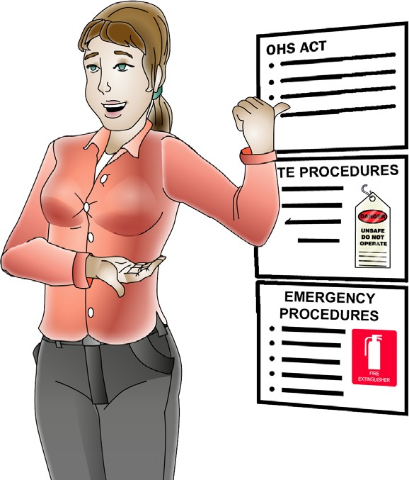
PC 1.1
PLAN AND PREPARE FOR SCRAPER OPERATIONS
QUESTION 10
What are the National Work Health (WHS) and Occupational Health and Safety (OHS) Acts about?
The Acts explain how to keep your workplace safe and healthy. They explain what you need to do to meet your duty of care.
For example:
You must make sure you do earthmoving work in a way that won’t put yourself or others at risk. You must use earthmoving equipment according to instructions.
Note:
Check your state requirements as Acts may vary from state to state
QUESTION 11
Under WHS/OHS laws, what are your responsibilities while working?
You must work in a way that is safe. You must not risk the health and safety of yourself or others.

Slide 16

PC 1.1
PLAN AND PREPARE FOR SCRAPER OPERATIONS
Where to find WHS information
You can check these websites for more information about workplace health and safety. The National WHS Act started in some states/territories on January 1, 2012.
QLD Workplace Health and Safety
www.justice.qld.gov.au
NT WorkSafe
www.worksafe.nt.gov.au
WA WorkSafe
www.worksafe.wa.gov.au
NSW WorkCover
www.workcover.nsw.gov.au
SA SafeWork
www.safework.sa.gov.au
ACT WorkCover
www.ors.act.gov.au/workcover
You can read more about the new WHS Act at www.safeworkaustralia.gov.au
VIC WorkCover Authority
www.vwa.vic.gov.au
TAS Workplace Standards
www.wst.tas.gov.au

Slide 17
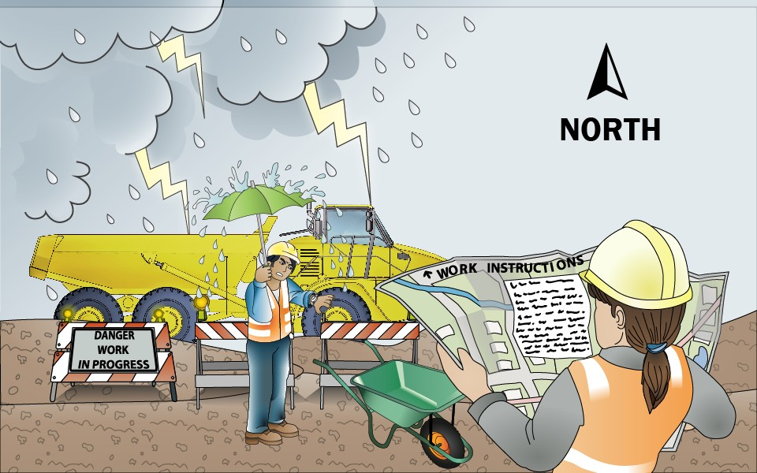
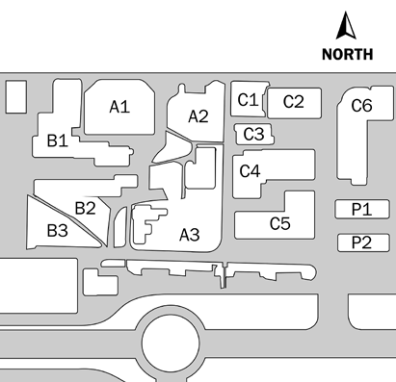
PC 1.2
PLAN AND PREPARE FOR SCRAPER OPERATIONS
QUESTION 12
What do the job’s work instructions explain?
Work instructions explain:
What to do in unexpected situations like bad weather
What the job is
Where the job is
How to do the job safely
How long the job will take
What tools and equipment you need
How to do the job from start to finish

Slide 18
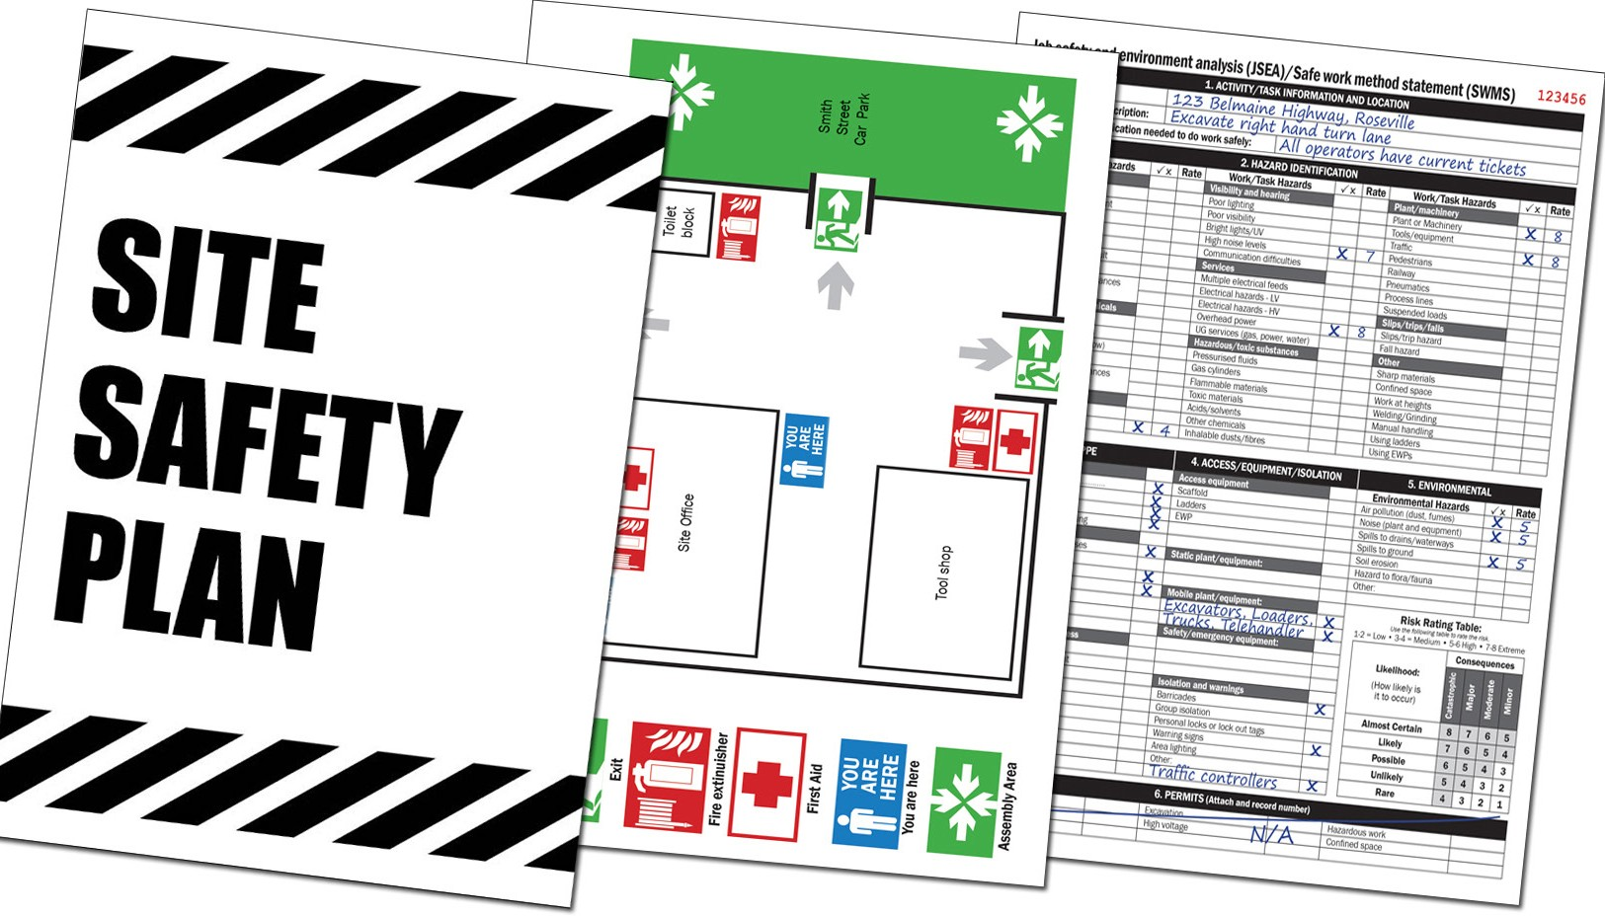
PC 1.7
PLAN AND PREPARE FOR SCRAPER OPERATIONS
Safety plan
The safety plan may tell you things like:
How to use tools and equipment safely
How hazards and risks need to be controlled
Emergency procedures
Emergency exits and assembly areas
What PPE to wear
Safe areas to park machinery
Site evacuation.

Slide 19




PC 1.7
PLAN AND PREPARE FOR SCRAPER OPERATIONS
Safety plan (continued)
Site evacuation plan — Example
Browns Road
Site Office
Toilet block
Exit
Fire extinguisher
YOU ARE HERE
Smith Street Car Park
First Aid
YOU ARE HERE
You are here
Tool shop
Assembly Area

Slide 20

PC 1.1
PLAN AND PREPARE FOR SCRAPER OPERATIONS
QUESTION 13
What does the safety plan tell you?
The safety plan tells you how the worksite intends to meet all the safety rules. It tells you:
What personal protective equipment (PPE) to wear
...CONTINUES ON NEXT PAGE

Slide 21
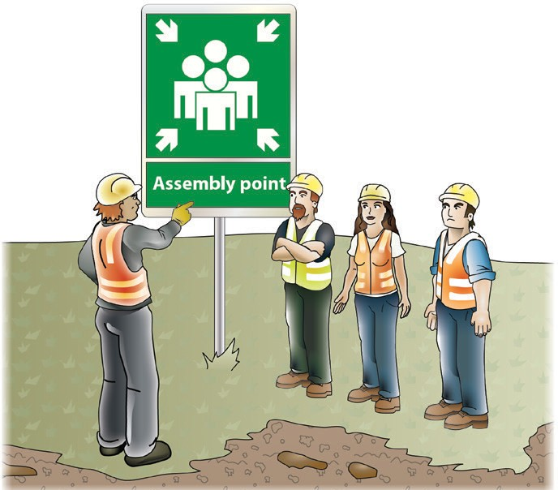
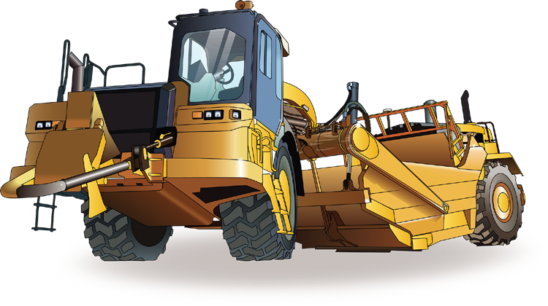
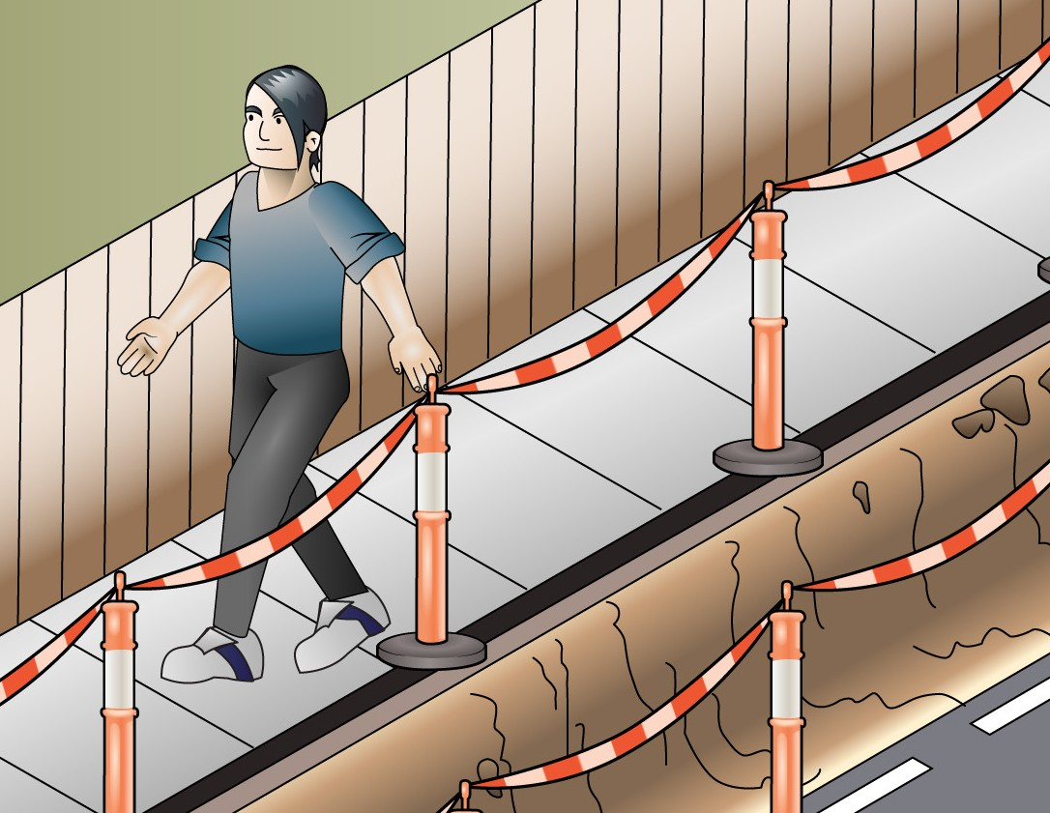
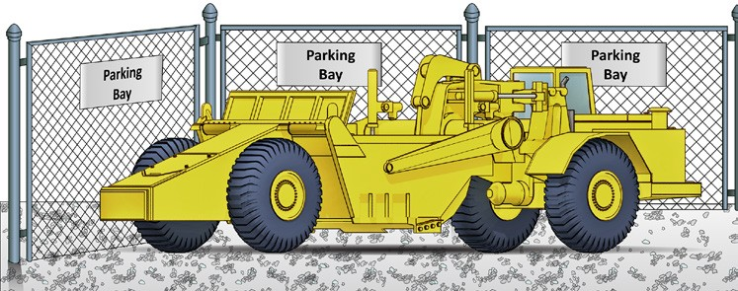
PC 1.7
PLAN AND PREPARE FOR SCRAPER OPERATIONS
QUESTION 13
How to use tools, plant and equipment safely | Emergency procedures and exits
How to park safely and where to park | Control hazards and risks
...CONTIN
UED FROM PREVIOUS PAGE
What does the safety plan tell you?

Slide 22
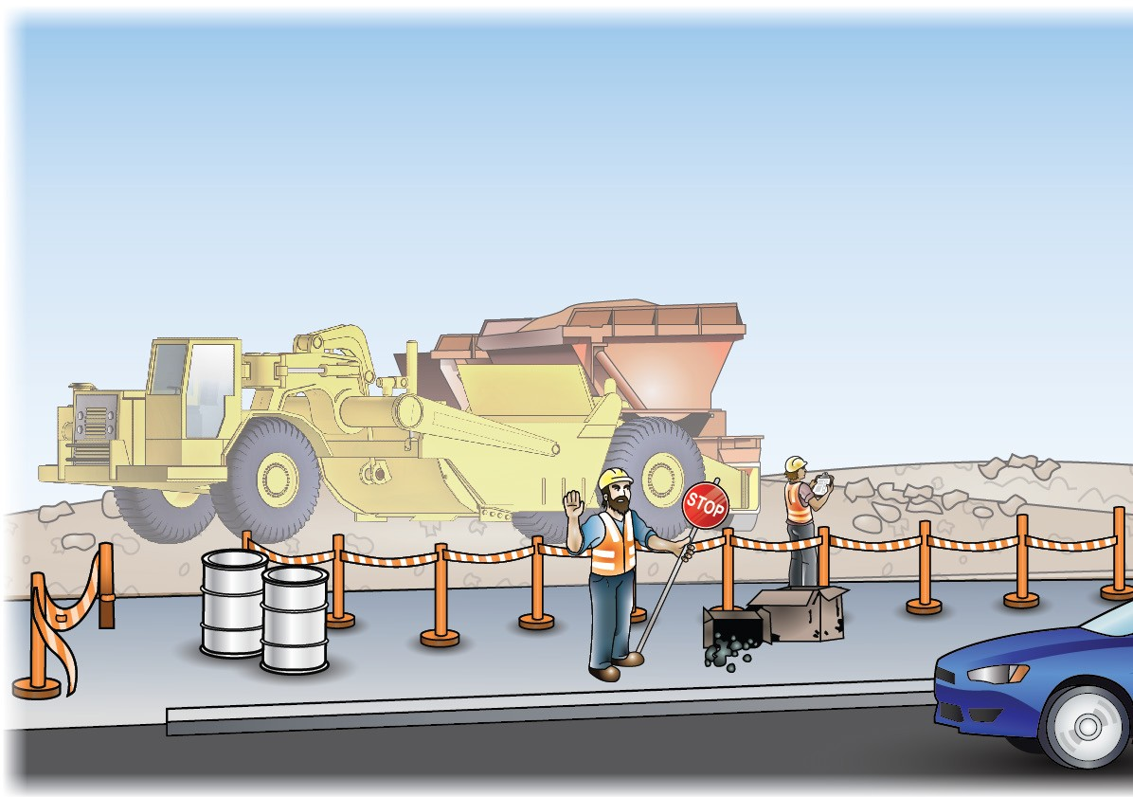
PC 1.5
PLAN AND PREPARE FOR SCRAPER OPERATIONS
QUESTION 14 | It tells you how to control vehicles in and around the worksite. It helps keep the site safe for
What does the traffic management plan (TMP) | you and others. You may require a traffic control licence in your state or territory.
tell you?

Slide 23
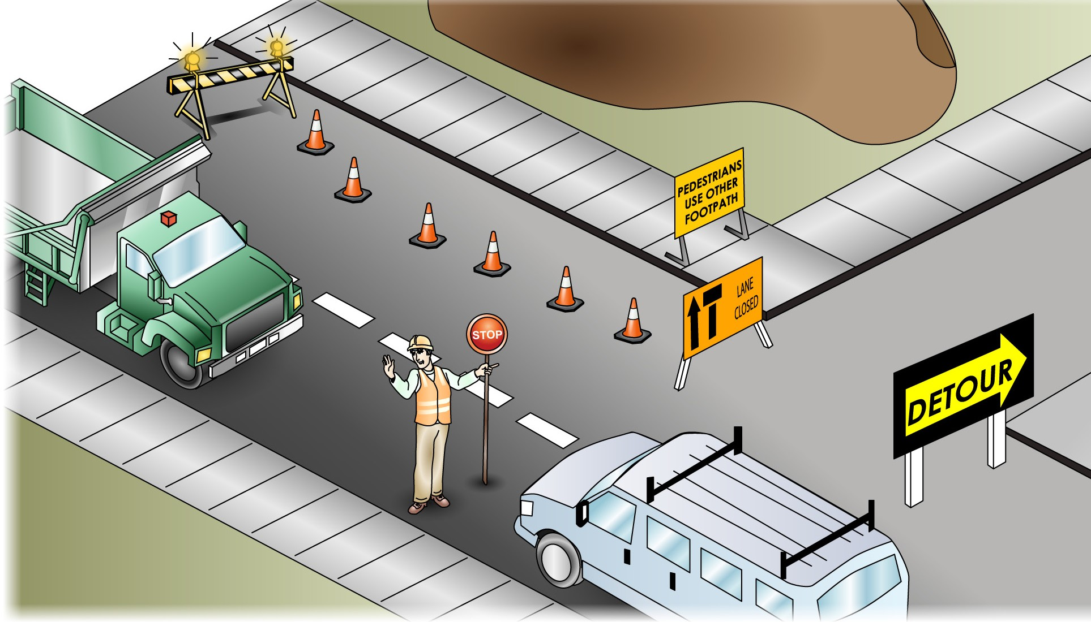
PC 1.5
PLAN AND PREPARE FOR SCRAPER OPERATIONS
QUESTION 15
What can you do to control
traffic in and around
a worksite?
You can:
Use flashing lights
Close footpaths nearby
Put up barricades or witches hats
Close roads or one or two lanes of a road
Put up warning signs
Set up detours
Use a traffic control person (to control traffic on a public road, you must be a qualified traffic controller)

