Slide 1


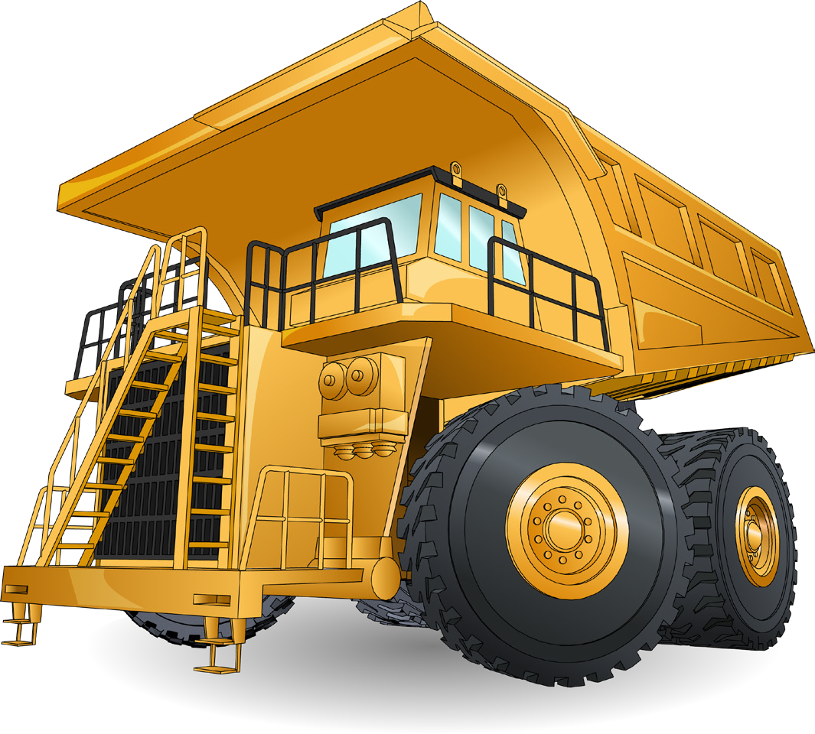

LEARNER GUIDE
Rigid Haul Truck
TICKET
Training support material for:
RIIMPO338E
Conduct rigid haul truck operations
Produced by:

Slide 2
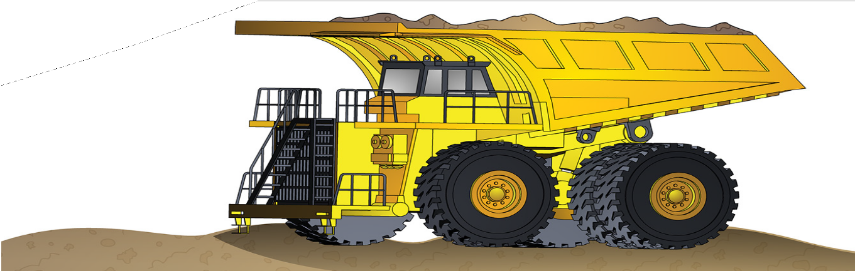
Introduction to Rigid Haul Truck

Slide 3
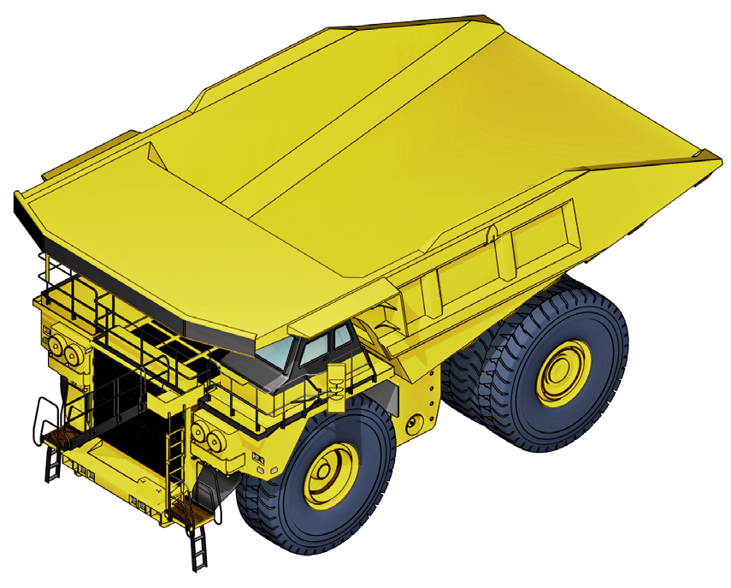
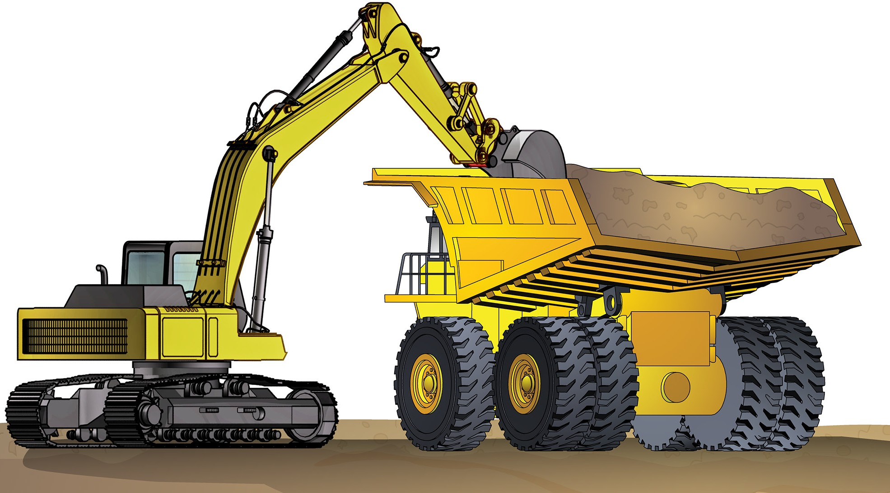
Introduction to rigid body haul truck
INTRODUCTION TO RIGID HAUL TRUCK
This guide covers rigid body haul trucks. A haul truck is a machine you use to carry materials from one place to another. You can load a haul truck with a number of machines including excavators and loaders.
The large mining haul trucks can weigh over 500 tonnes. Rigid haul trucks covered in this guide are off-highway trucks such as diesel-mechanical, diesel electric and rigid body.
Rigid haul trucks have a rigid body.
Rigid for this truck means:
The chassis does not articulate.
The truck is steered by the front wheels pivoting on each end
of the front axle, similar to the steering of a family car.

Slide 4
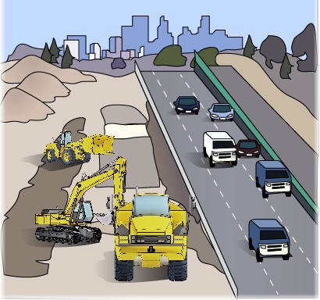
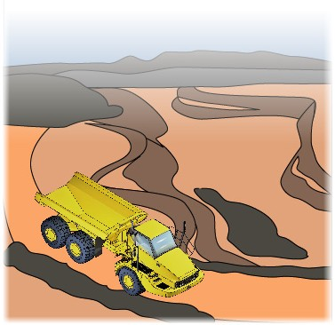
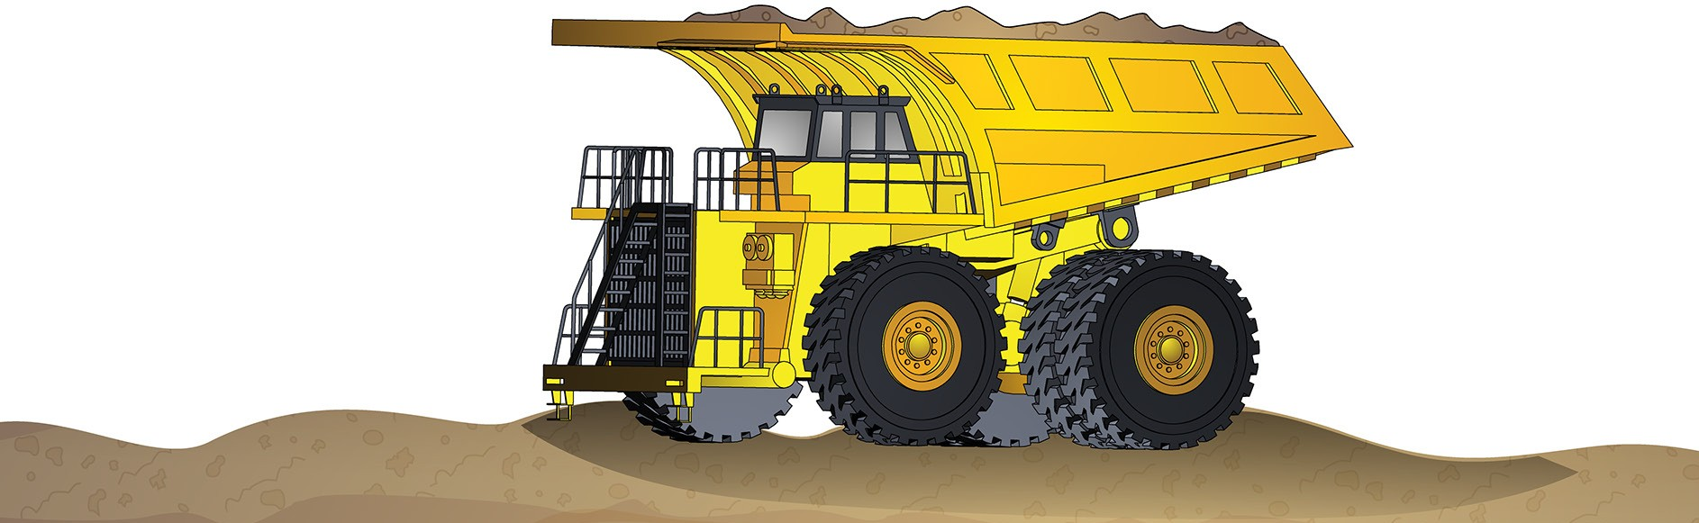
What industries do you use a rigid haul truck in?
INTRODUCTION TO RIGID HAUL TRUCK
Civil construction
Coal mining
Extractive industries
Metalliferous mining

Slide 5
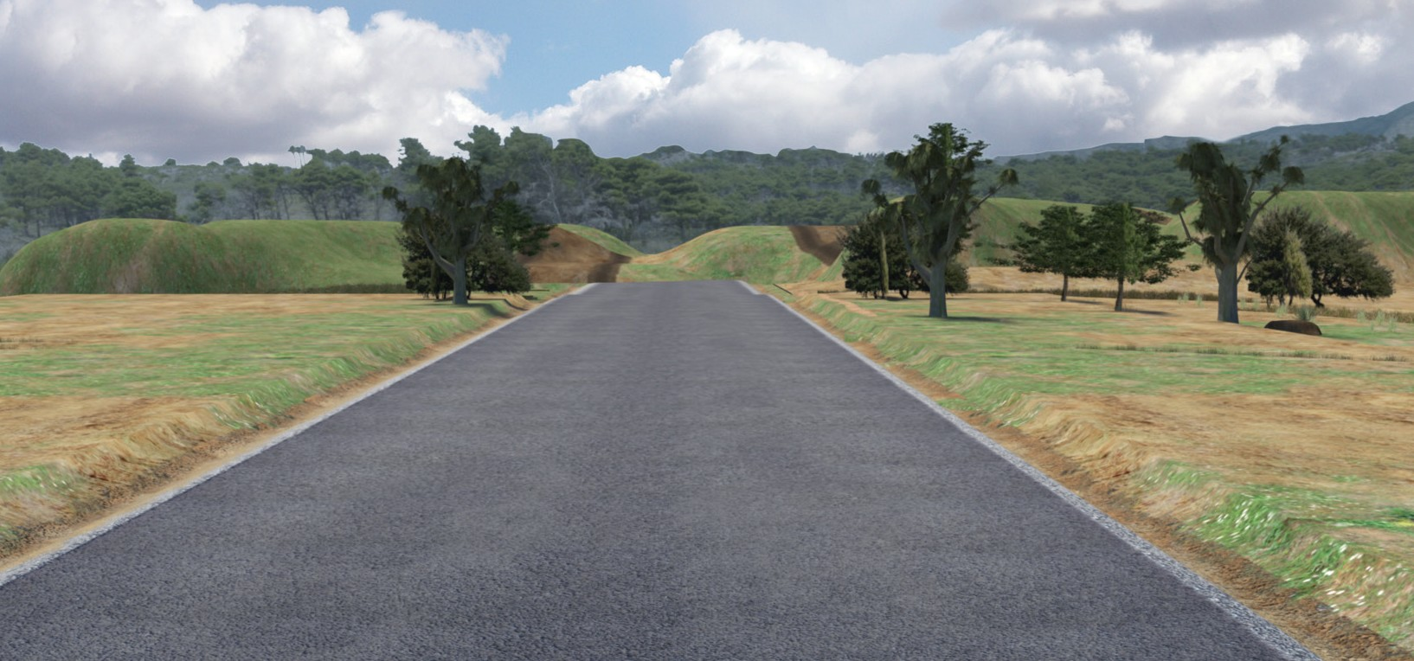
The basics of road construction

Slide 6
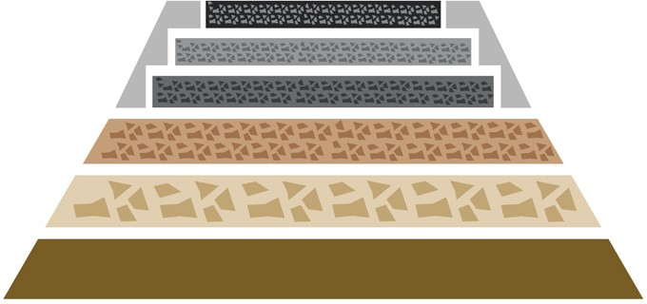
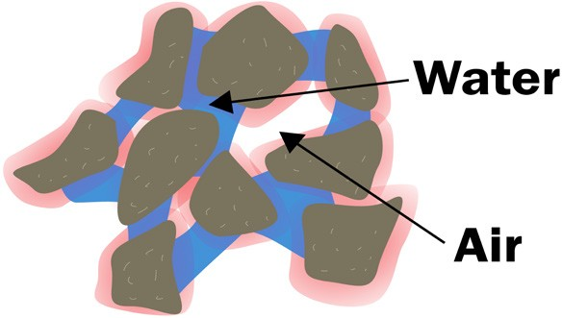
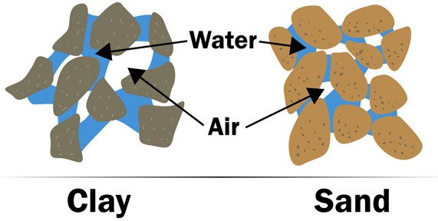
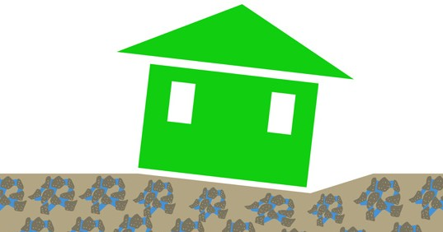
THE BASICS OF ROAD CONSTRUCTION
Principles of soil technology for civil works
One of the most important jobs you will do, as a machine operator, is to help lay foundations. Foundations are the base for roads, railway lines, swimming pools and buildings. If you do not have a solid foundation, you cannot build something solid on top of it. | In civil construction, moisture content means how much water is in a soil, rock, aggregate or road base. Moisture is very important in earthmoving. Moisture affects the weight of soils. It makes soils swell, and it also affects the handling properties of the soil. Handling properties means how easy or hard it is to work with that soil.
All soils usually contain moisture. How much moisture the soil has depends on many things. The weather, drainage, and the soil’s ability to hold water all affect the moisture in a soil. Retention properties mean how much water a soil can hold. Different soils can hold different amounts of water. Sometimes you can treat a soil to change its moisture content. To do this you mix a chemical with the soil. | Different types of soils can cause problems with foundations. Wet, boggy soil can cause foundations to sink. That is why it is important to make sure water can run or drain from the site. It is also important that the foundation is built up to the right level. You can sometimes treat wet boggy soil with lime. Lime helps dry out the soil, and helps it ‘clump’ together.

Slide 7
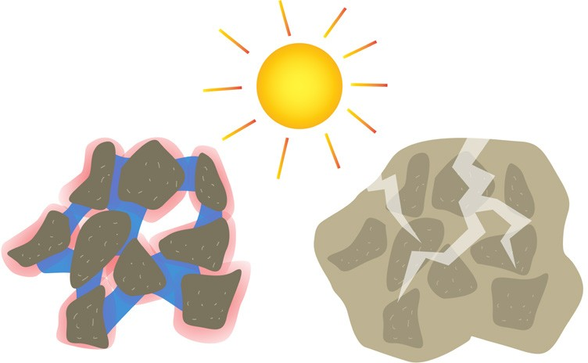
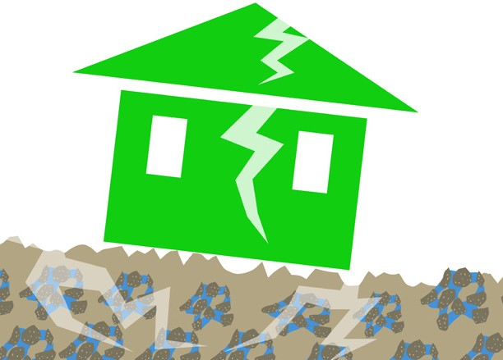
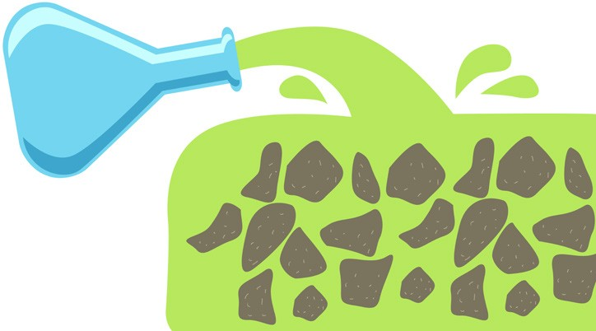
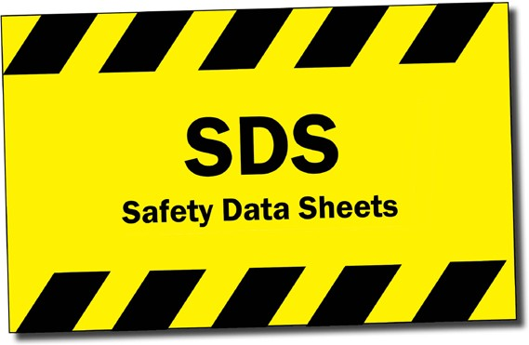
THE BASICS OF ROAD CONSTRUCTION
Principles of soil technology for civil works (continued)
Clay soils can also cause problems under foundations. This is because clay attracts water. When this happens, the clay expands and swells. Later, when it is hot and sunny, the water dries up and the clay cracks. | Over time, this swelling (expanding) and cracking (while shrinking) can warp your foundations. This can cause cracks and potholes in roads, cracked walls or ceilings in buildings, or swimming pools to crack and leak.
You can treat clay soils with chemicals that stop clay from attracting water. Once you treat the clay, you can compact it. This makes a much better foundation that won’t swell and crack as much. | Before you use any chemicals, you must make sure they are safe. Check the safety data sheet (SDS) to find out how to safely use, store and handle the chemical. Check the site’s environmental management plan. If you are not sure about using a chemical, talk to your site supervisor.

Slide 8
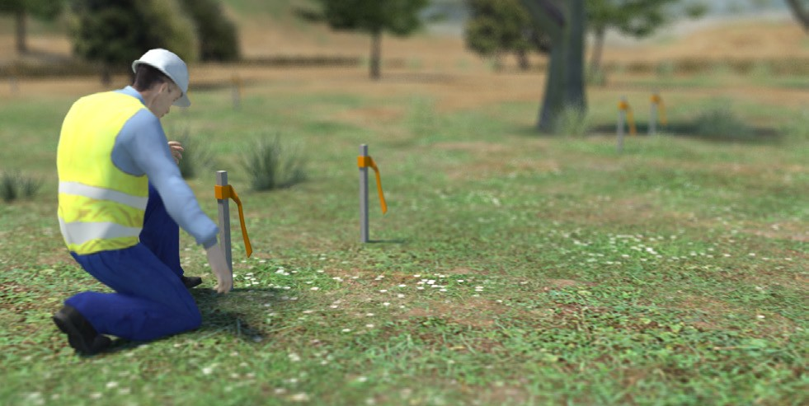
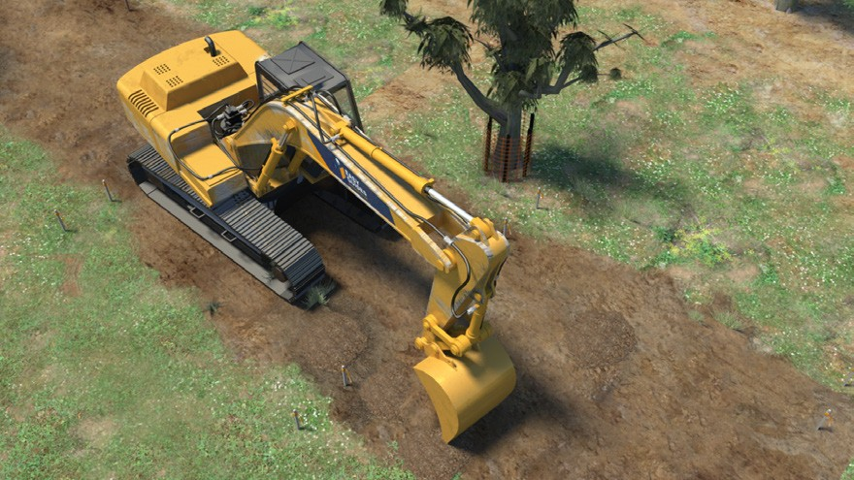
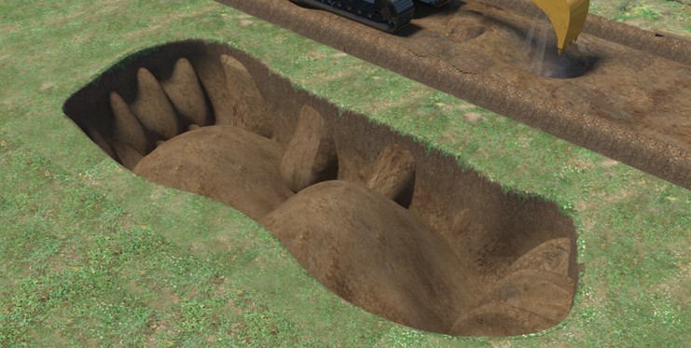
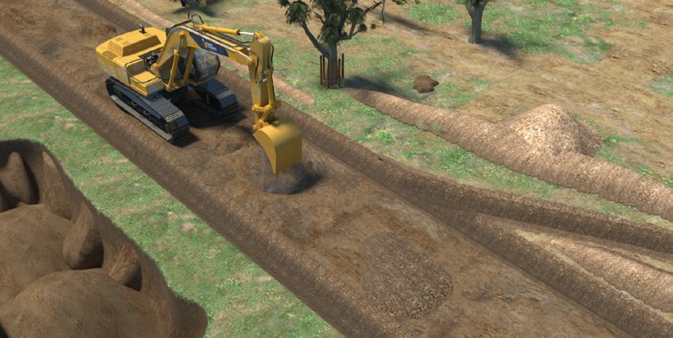
PC 1.2
THE BASICS OF ROAD CONSTRUCTION
The basics of road construction
A surveyor will stake out the site according to the site plan. The stakes mark where the road will go and any drains or pits, which will help to drain water away from the road area. | An excavator or dozer removes the trees, shrubs and other plants and levels the area. Some trees may be protected with padding or fencing.
Sometimes contractors may use a borrow pit (also called a sand box). A borrow pit is an area where soil, sand or gravel (material) is dug out to be used in another area. Sometimes the borrow pit will become the drains, or water catchment areas at the end of the work. | The excavator or dozer may use material from the borrow pit to build up low areas in the road. They may also build up diversion blocks. Diversion blocks divert water away from the road and into drains.

Slide 9
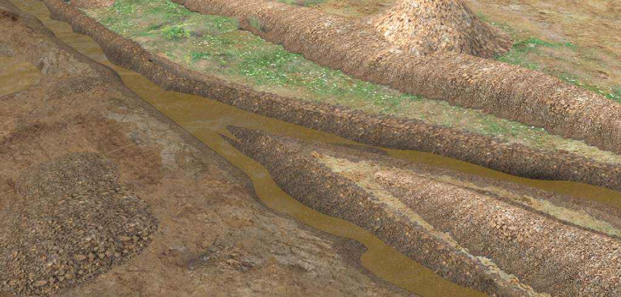
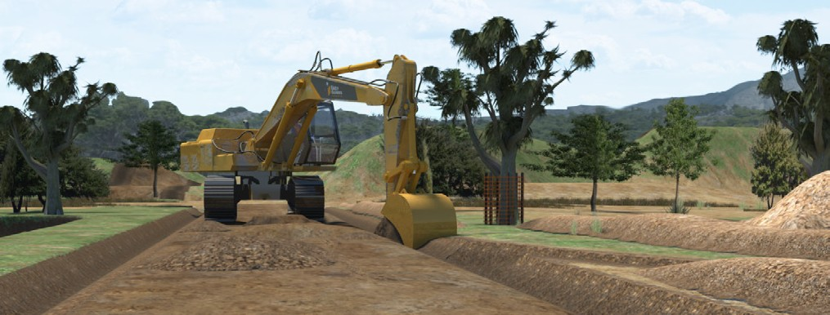
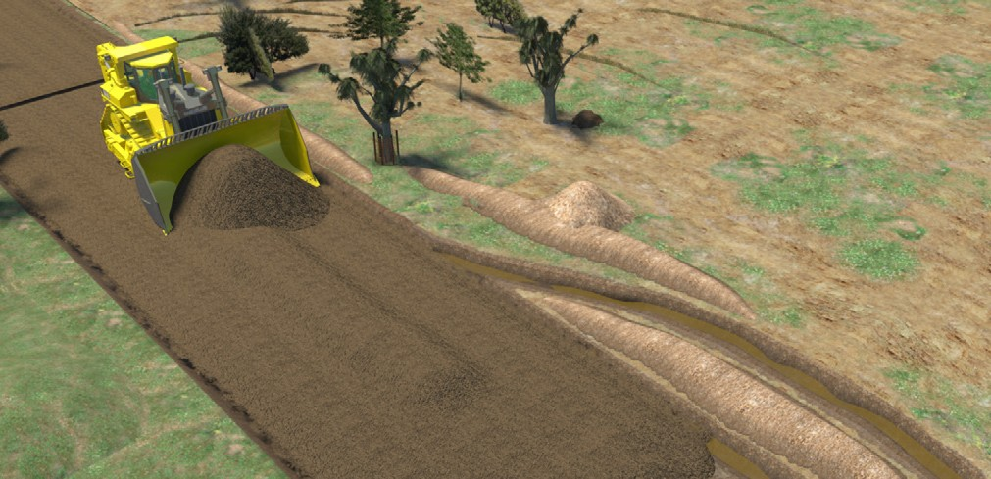
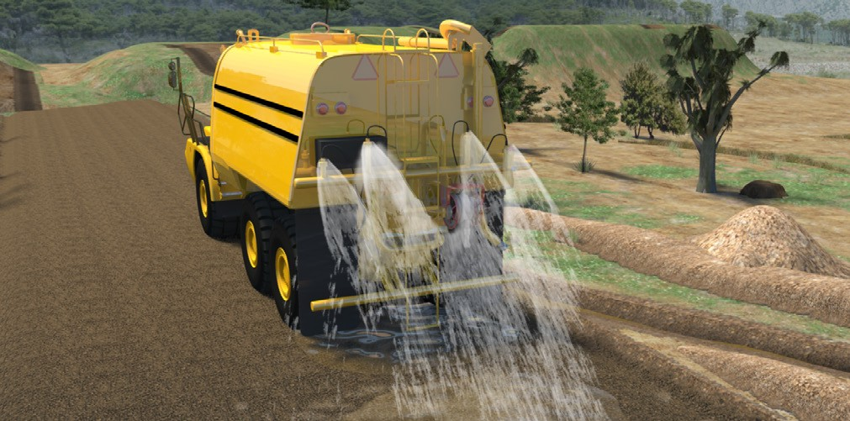
PC 1.2
THE BASICS OF ROAD CONSTRUCTION
The basics of road construction (continued)
As the operator shapes the ground, they will usually create drainage at the sides of the road area. They will also make sure there is enough fall (scope) on the road so that water drains away from the road. | Drains are installed to help take water away from the worksite.
A front end loader or dozer shapes the road base. This helps smooth out the surface ready for grading. | A water truck may wet down the ground. This helps the soil to bond.

Slide 10
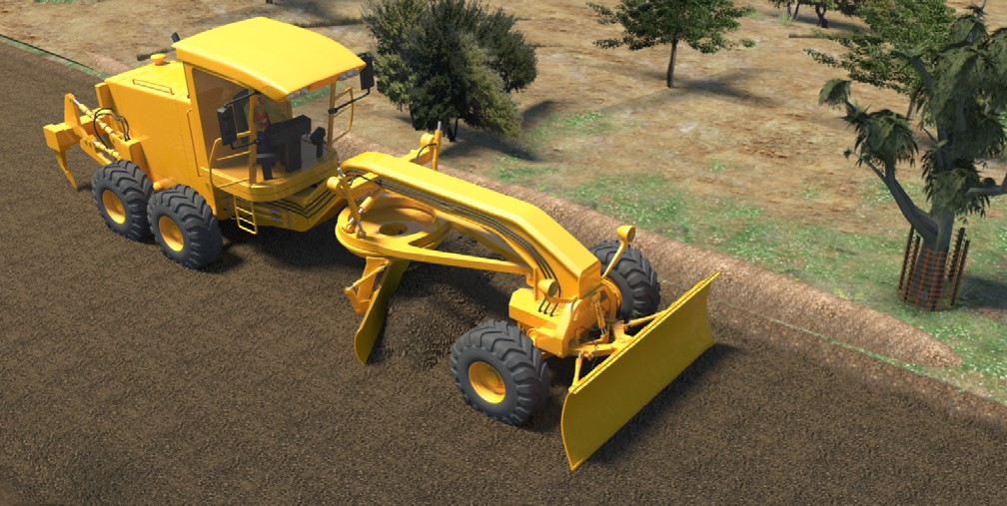
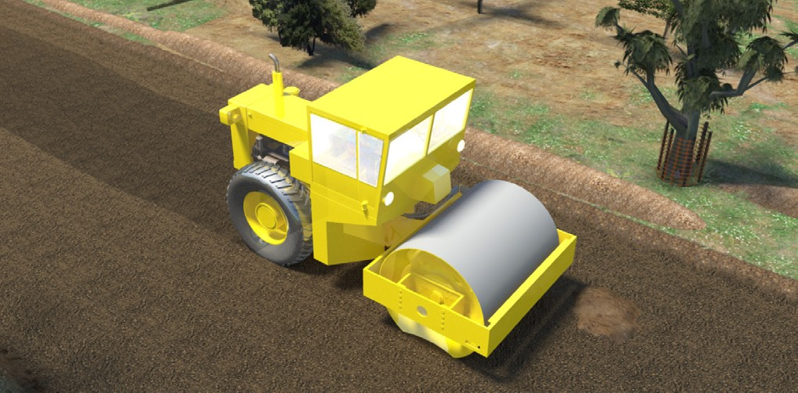
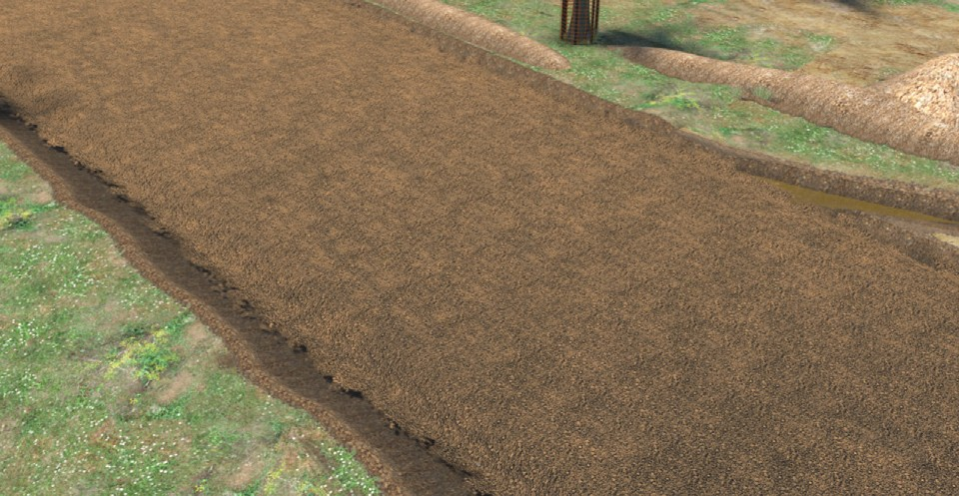
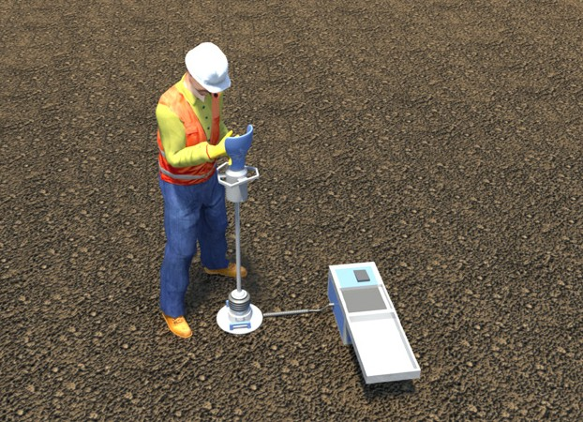
PC 1.2
THE BASICS OF ROAD CONSTRUCTION
The basics of road construction (continued)
The grader grades the road to produce a much smoother surface. | A roller or compactor then compacts the road. This breaks up lumps and smooths the surface out.
A site supervisor or roller operator tests the compaction. Sometimes they will use a deflectometer or penetrometer. Some rollers/compactors can test the compaction as they drive. | Many layers of the ground material are built up. This is called the subgrade. Each layer is compacted and tested.

Slide 11
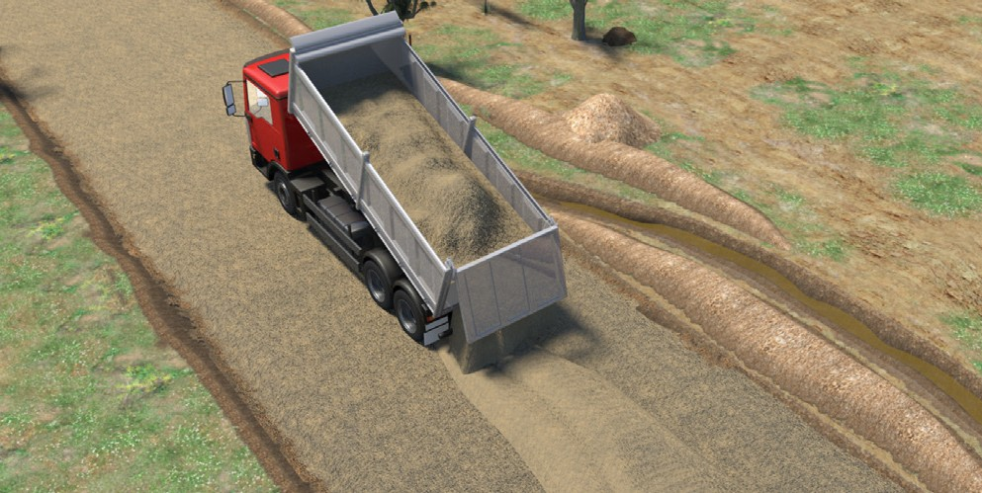
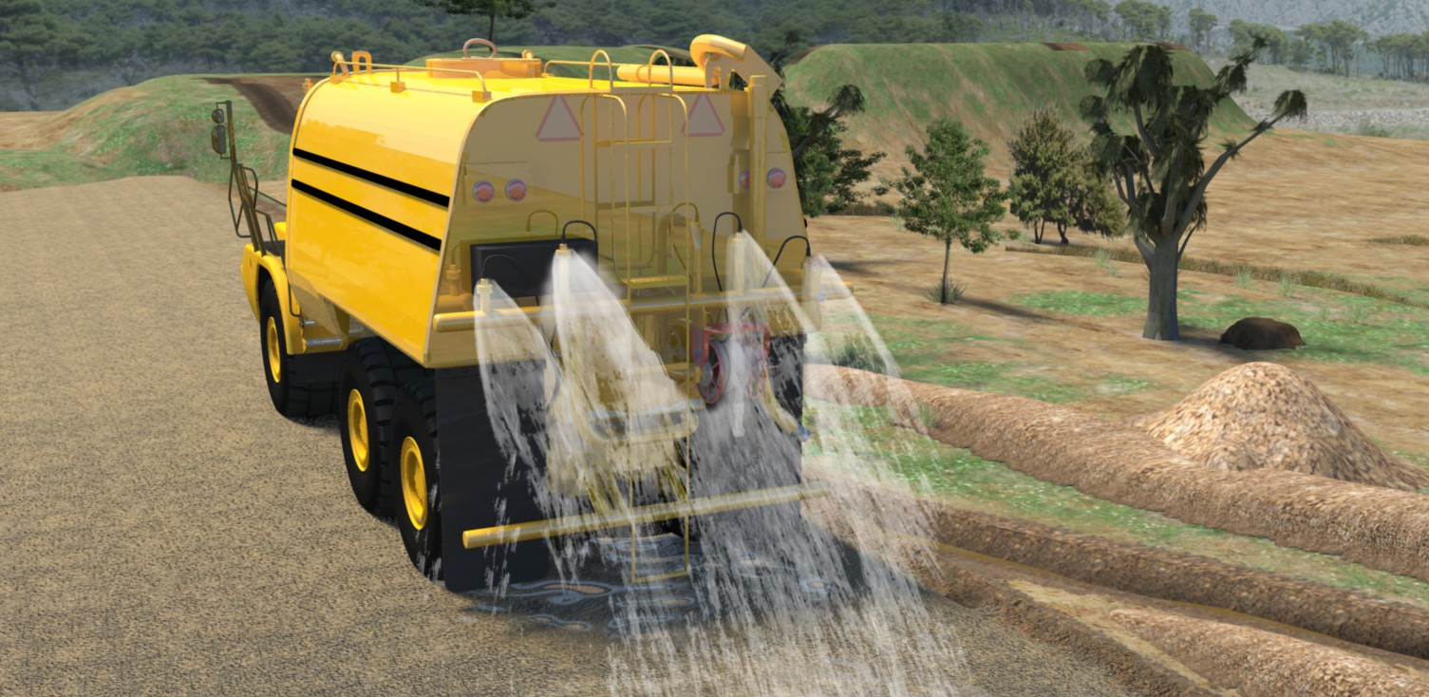
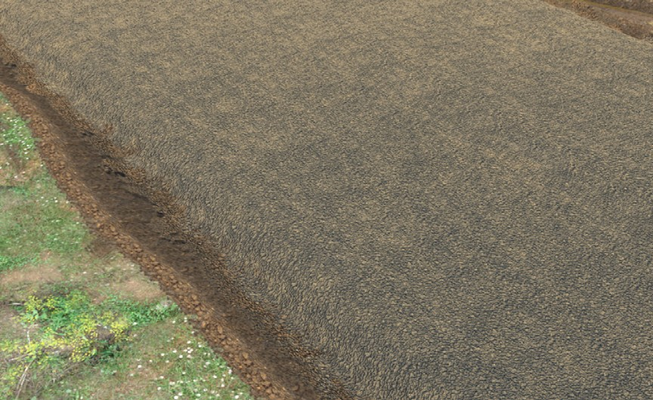
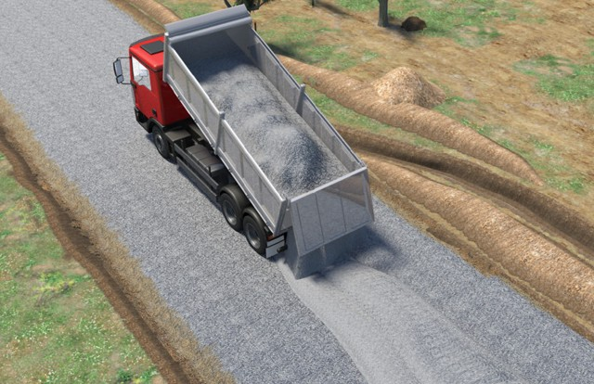
PC 1.2
THE BASICS OF ROAD CONSTRUCTION
The basics of road construction (continued)
Trucks then deliver subbase. Haul trucks or tip trucks sometimes tip the subbase, and front end loaders spread it. | A water truck may spray water on the subbase to help the soil bond. This makes the particles stick together and make it compact better.
Several layers of subbase are laid. The subbase is compacted and tested. | Once the subbase is at the right thickness and is compacted properly, trucks deliver the course road base. The road base is built up in many layers. Water trucks may wet down the road base if it helps the roller/compactor compact the base.

Slide 12
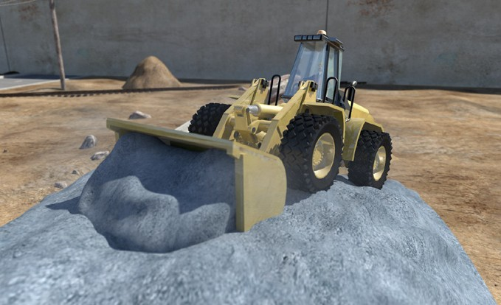
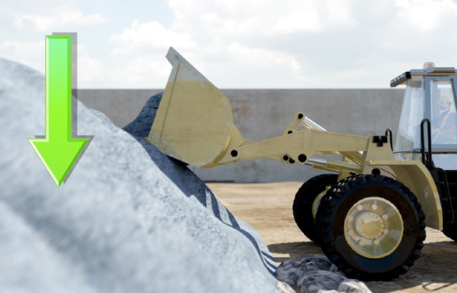
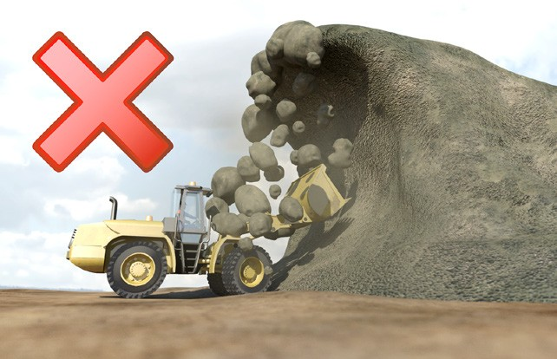
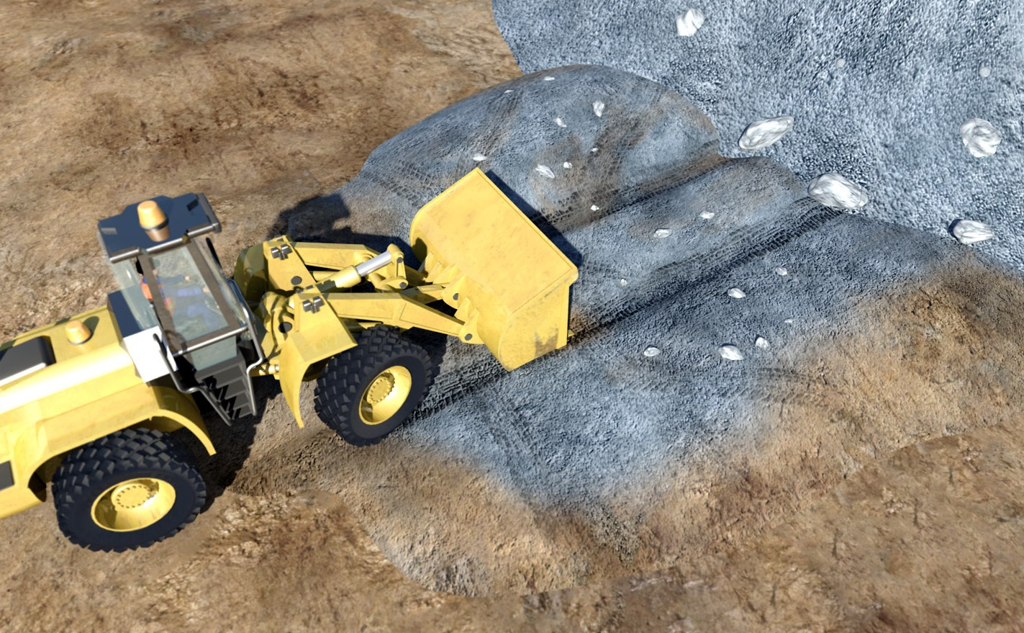
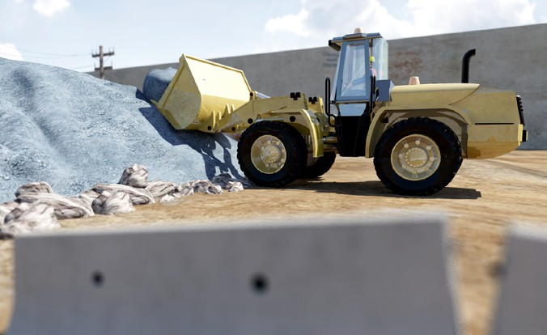
PC 1.2
THE BASICS OF ROAD CONSTRUCTION
Operating techniques
Taking from a stockpile
When you take from a stockpile, try and work neatly. | Take from the top, working down in layers. | Do not undercut the stockpile. It might collapse on you.
You may need to maintain the | To do this, you push
stockpile by neatening it up. | material up that has been spread out.
 | Keep the loading area clean and level.

Slide 13
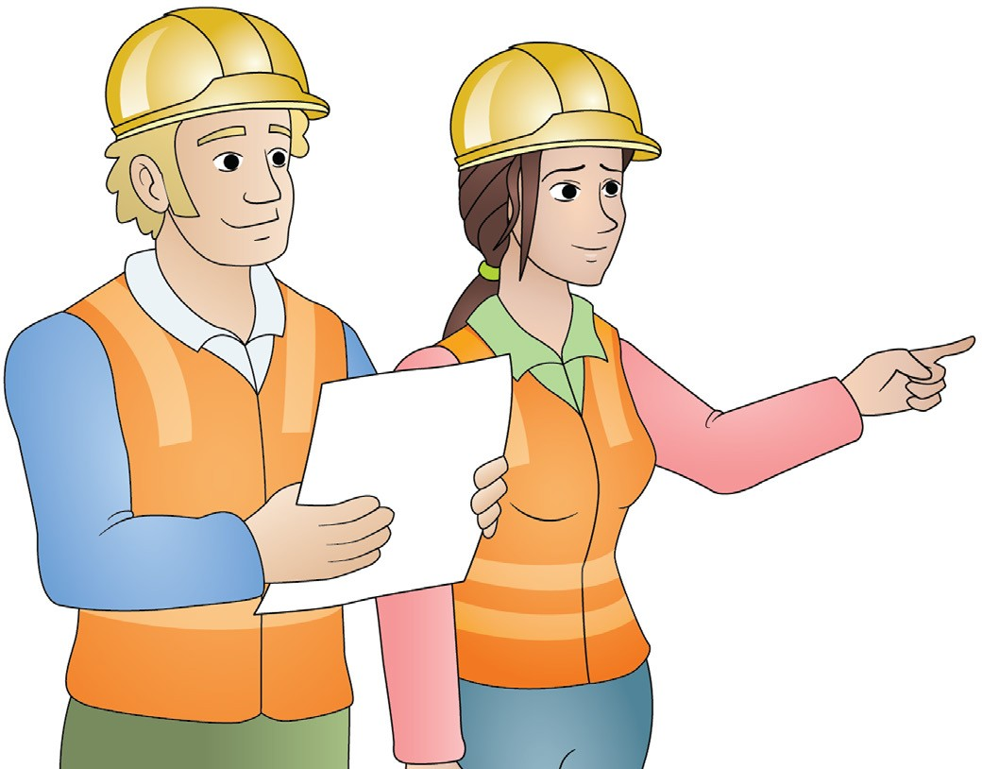
Plan and prepare for rigid haul truck operations
Element 1

Slide 14
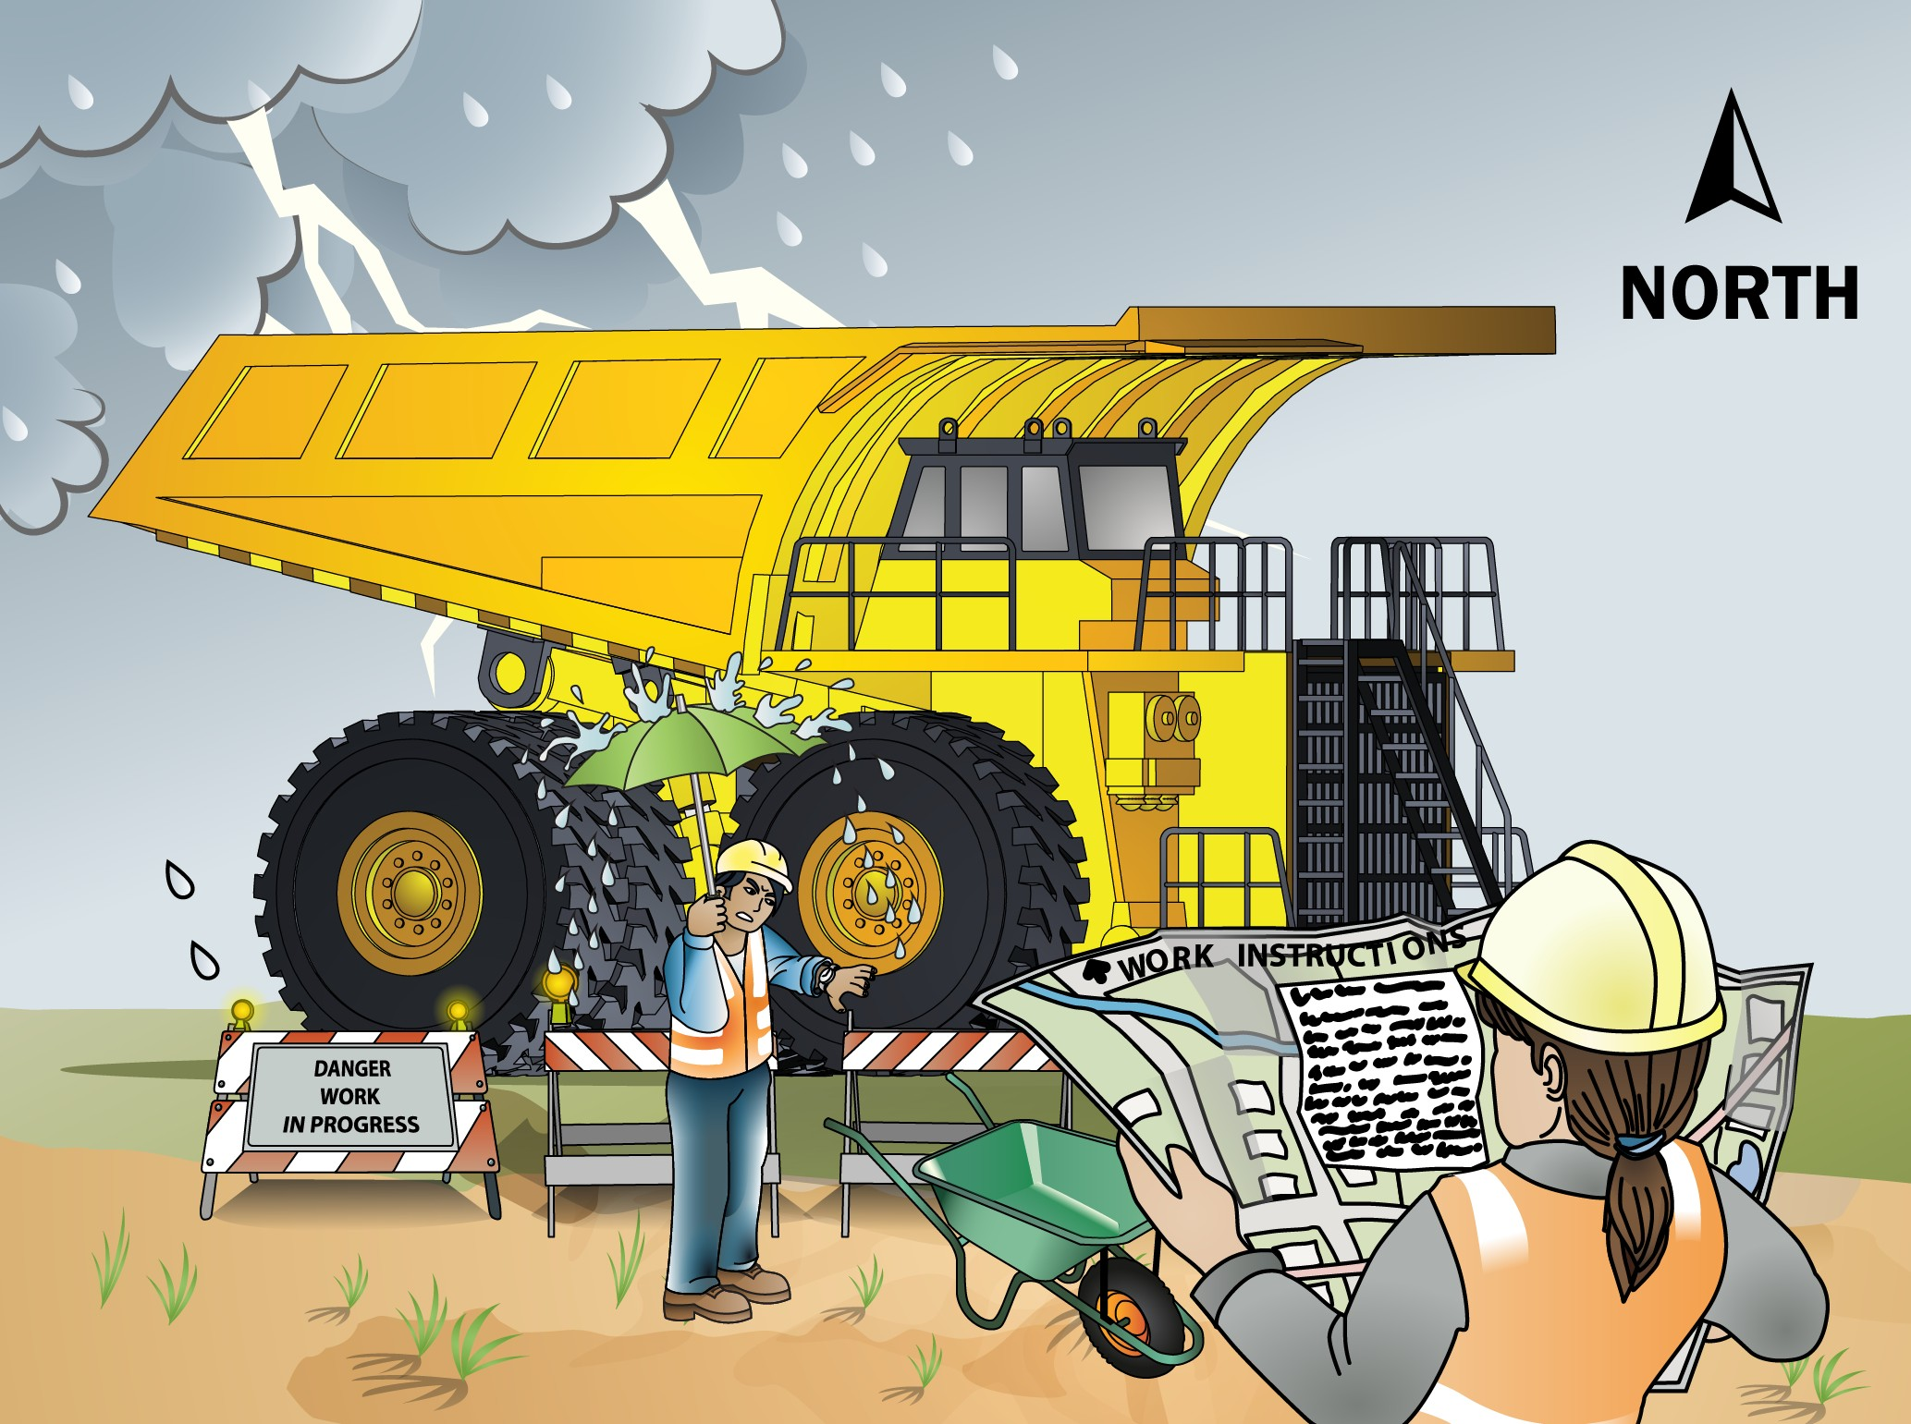
PC 1.2
PLAN AND PREPARE FOR RIGID HAUL TRUCK OPERATIONS
QUESTION 11
What do the job’s work instructions explain?
Work instructions explain:
What to do in unexpected situations like bad weather
What the job is
Where the job is
How to do the job safely
How long the job will take
What tools and equipment you need
How to do the job from start to finish

Slide 15
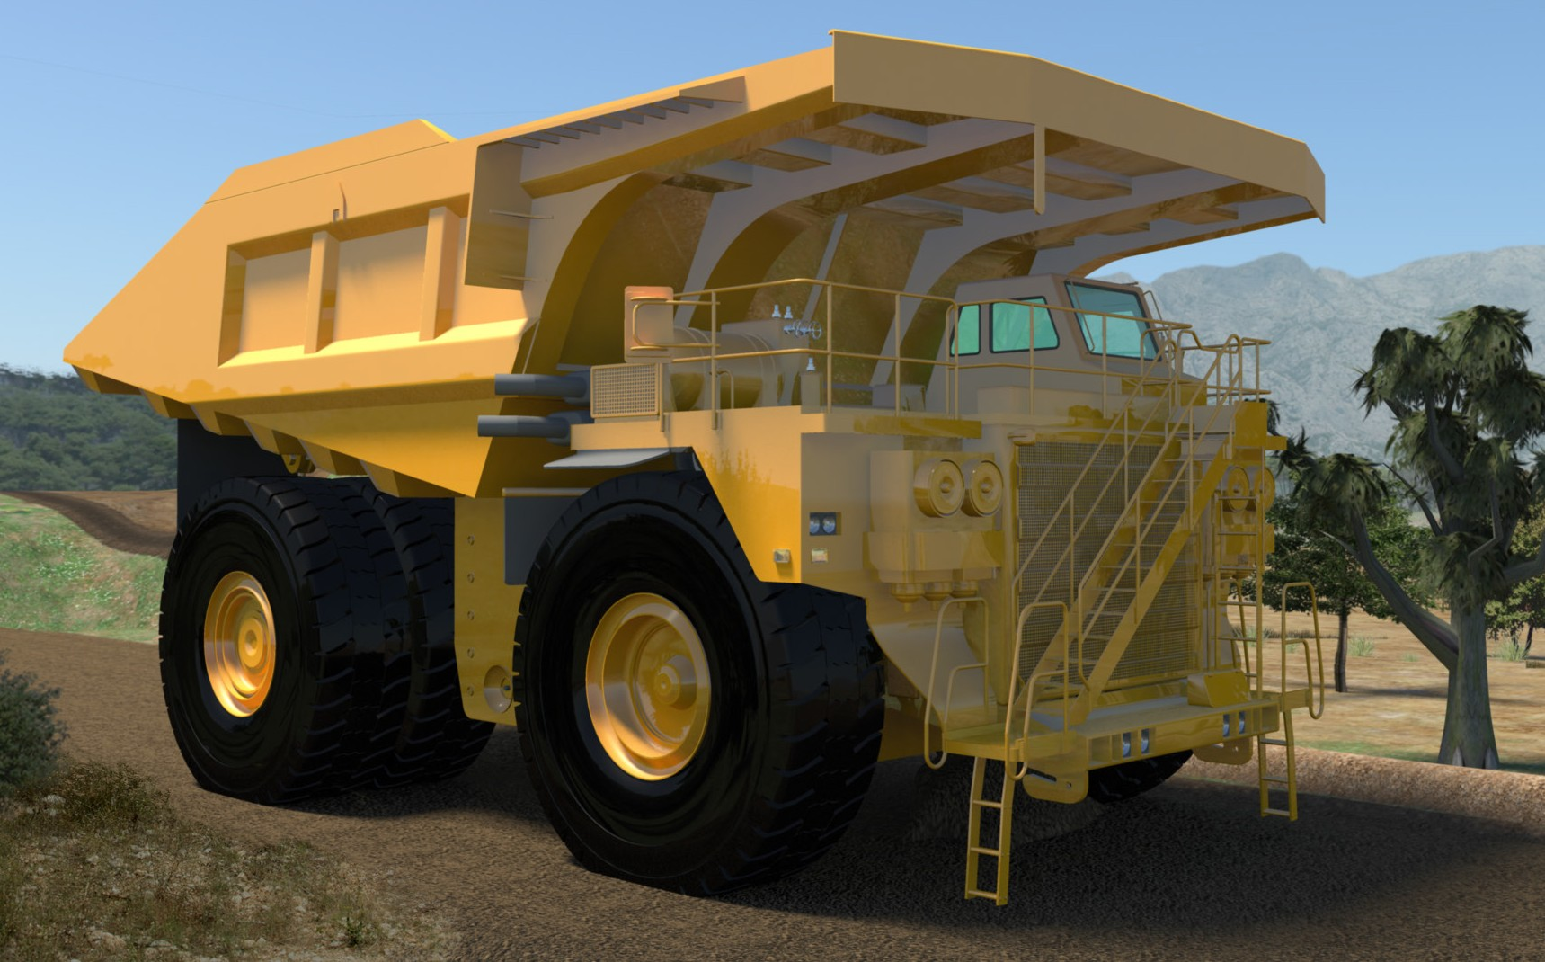
Earthmoving site hazards
PC 1.3 PLAN AND PREPARE FOR RIGID HAUL TRUCK OPERATIONS
Checking for underground services
You should always check where services are before you start work. You may phone ‘Dial before you dig on 1100’. You may look at the site plan or talk to your supervisor. You may need to look at the location of pits and meters to get an idea of where the services run. You may need to check with the local council or service company. You may even need to get underground detection equipment.
If you hit a service line, contact the provider immediately. You may need to organise to get the service disconnected while a
qualified person fixes the problem.
You can sometimes tell there are services below by the types of ground. Some services are surrounded by a different type of soil, rock or sand.
You may notice that the soil is looser,
or does not match the soil around where you are digging. There may be a line of tape alerting you to the services.
If you suspect there are services underground, stop working. Check the ground. You may need to excavate the area by hand, or dig in another area.

Slide 16
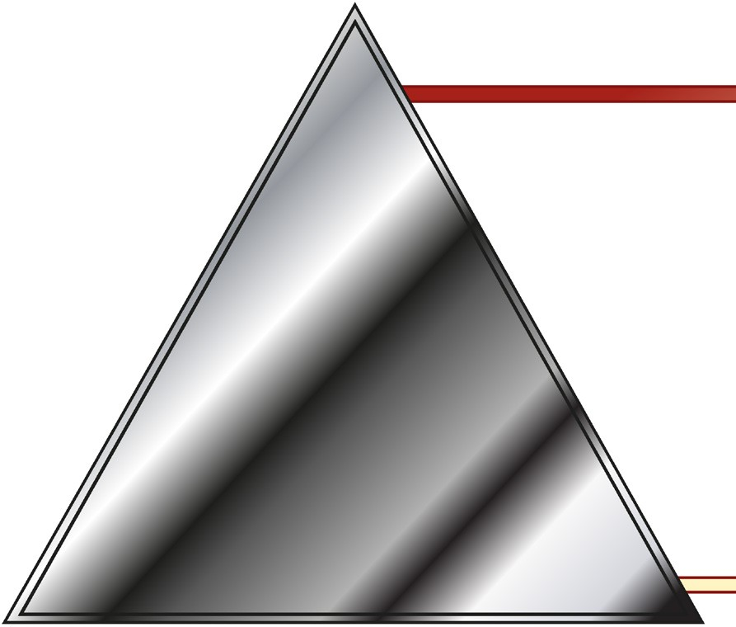
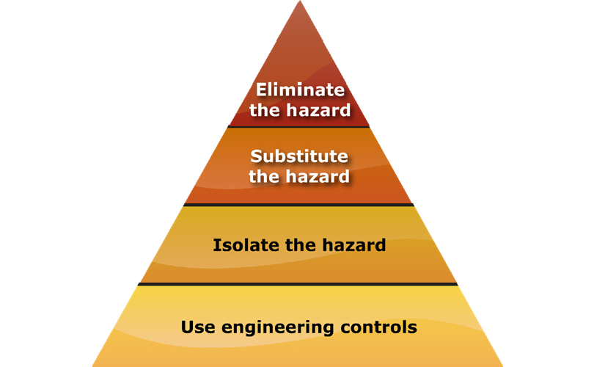
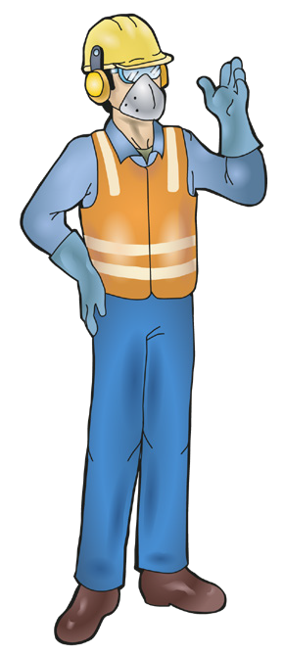
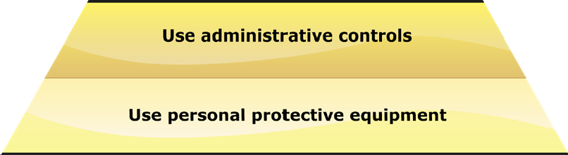
PC 1.3
PLAN AND PREPARE FOR RIGID HAUL TRUCK OPERATIONS
QUESTION 13
The hierarchy of hazard control is a list of controls you can use to lower the danger from a hazard on the worksite.
What are the six (6) levels in the hierarchy of hazard control from the first choice to the last choice?
1. Elimination: If possible, remove (take away)
the hazard.
2. Substitution: Use a safer method if you can’t remove the hazard.
3. Isolation: Stop access to the hazardous (dangerous) area.
4. Engineering Control Measures:
Change the tools, equipment or environment to make it safer.
5. Administrative Practices: Reduce the time the worker is exposed to the hazards by using training, job rotation, the timing of jobs, etc.
6. Personal Protective Equipment (PPE): Use PPE as your last line of defence.
Memory aid: Every Saturday I Eat A Pie

Slide 17
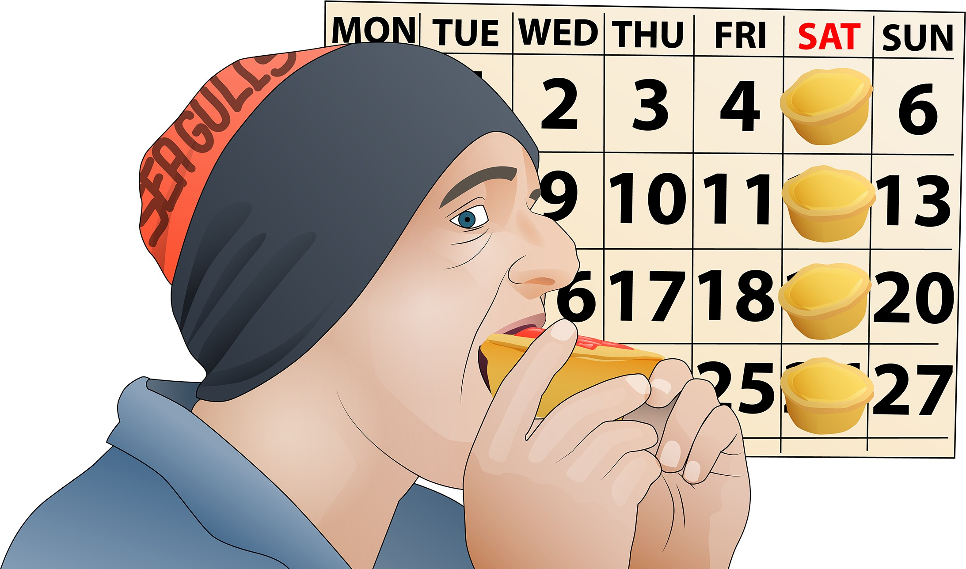
PC 1.3 PLAN AND PREPARE FOR RIGID HAUL TRUCK OPERATIONS
How to remember the Hierarchy of Hazard Control
You can use the following acronym (an abbreviation formed from the initial components in a phrase) to help you remember the steps in the hierarchy of hazard control.
Every Saturday I Eat a Pie
E Every
Eliminate
S Saturday
Substitute
I
I
Isolate
E Eat
Engineering
A a
Administration
P Pie
PPE

Slide 18
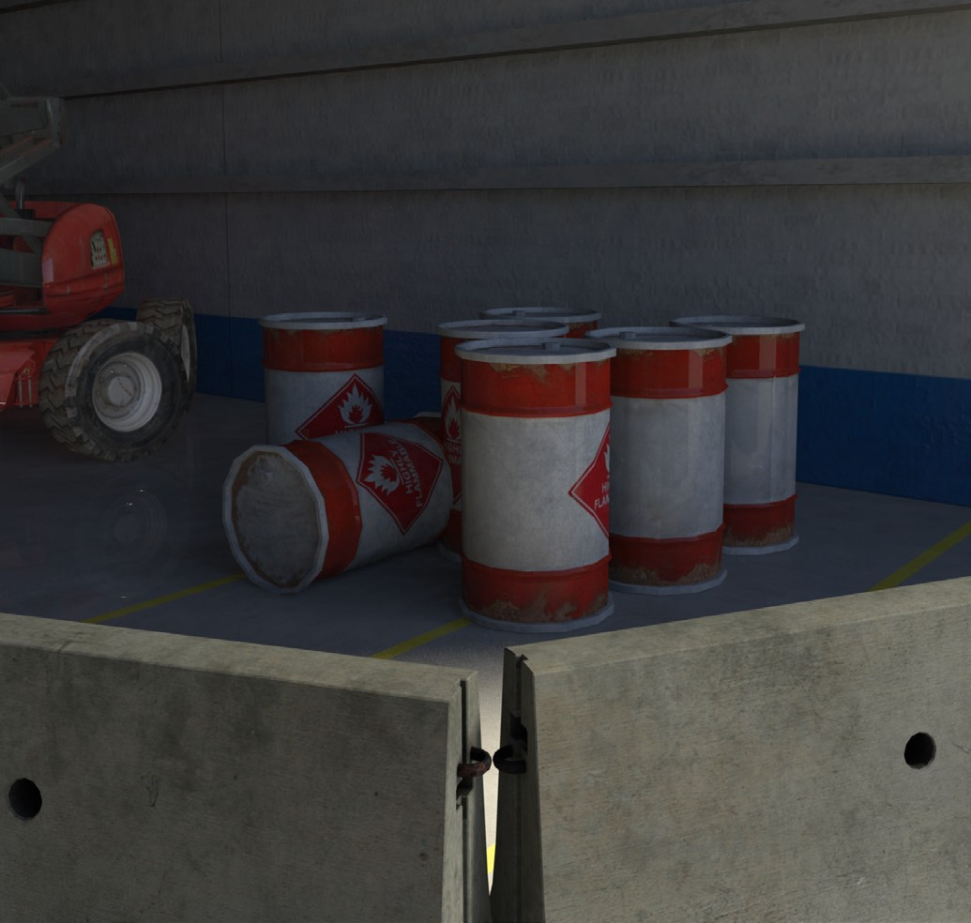
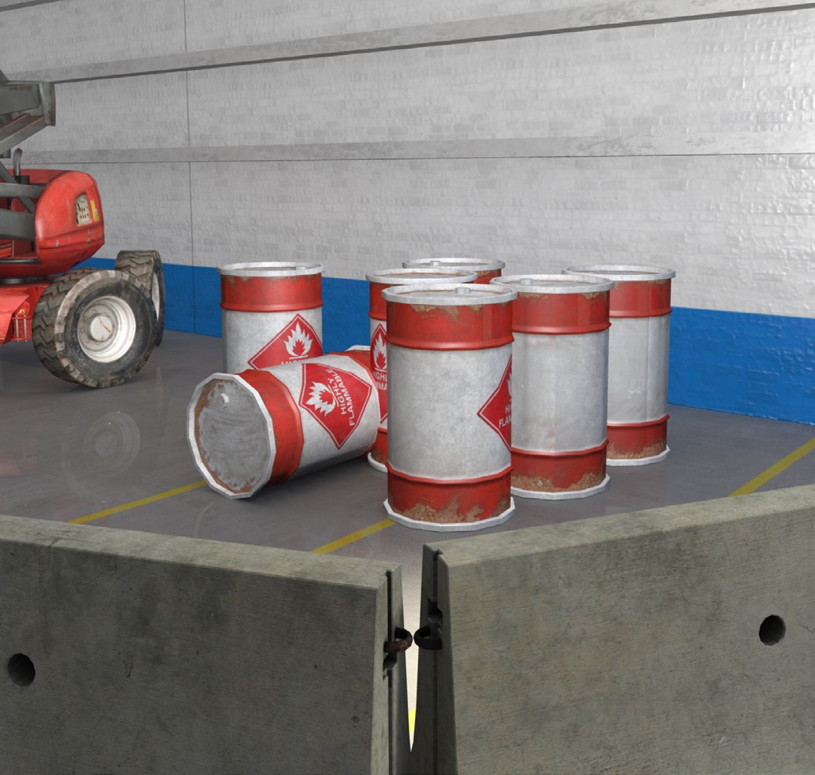


Hazard controls
PC 1.3 PLAN AND PREPARE FOR RIGID HAUL TRUCK OPERATIONS
You must set up hazard controls before you start work, or as soon as you find a hazard.
For example, if you find an area that’s too dark, you need to set up good lighting before you begin work.

Slide 19
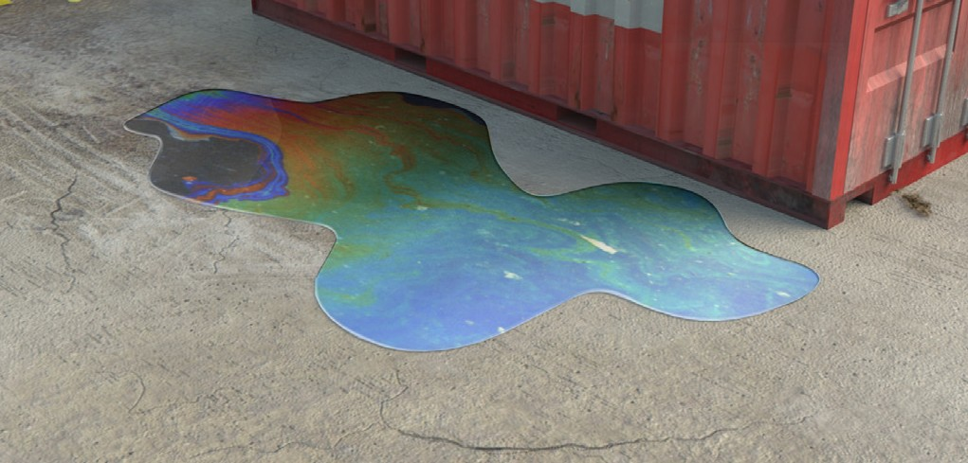
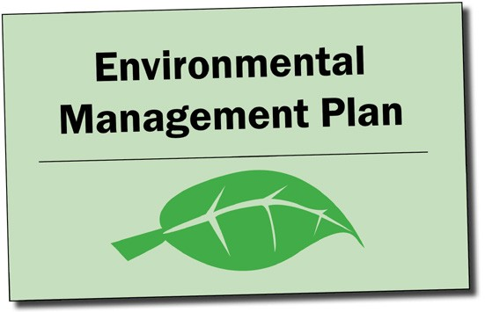
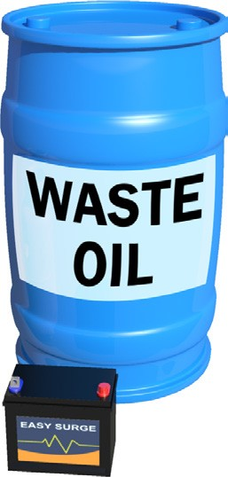

PC 1.3 PLAN AND PREPARE FOR RIGID HAUL TRUCK OPERATIONS
Environmental management plan (EMP)
The environmental management plan (EMP) tells you important things about the environment at the worksite. It explains how the work you are doing could damage the environment. The possibility that you will cause this damage is called the environmental risk. | The EMP tells you what you must do so you do not damage the environment. It tells you how to work in a way that reduces damage to the environment.
The EMP also tells you how the worksite meets all environmental protection laws and what to do with waste.

Slide 20



PC 3.4
LOAD, HAUL AND DUMP MATERIALS
QUESTION 104
You need to make sure the machine is safe to use for the next person.
What post-operational checks do you do after you’ve finished using the haul truck?
Check your manual. Some examples may include:
Refuel ready for next use
All fluid checks (once the
truck has cooled down)
Wheel nut torque
Any structural damage
Any fluid leaks
20

