Slide 1
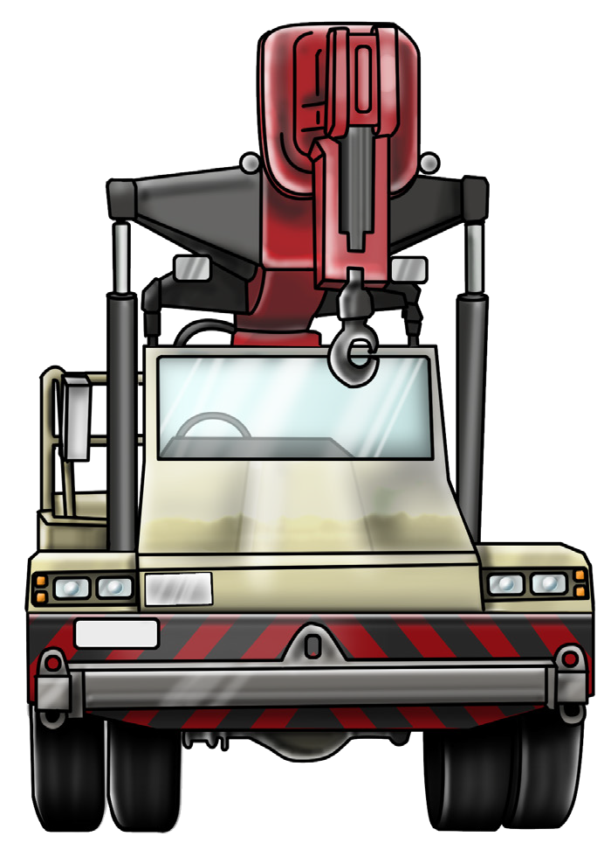

NON-SLEWING MOBILE CRANE SAFETY AND LICENCE GUIDE
Training support material for:
TLILIC0008
Licence to operate a non-slewing mobile crane
(Greater than 3 tonnes capacity)
Produced by:

Slide 2

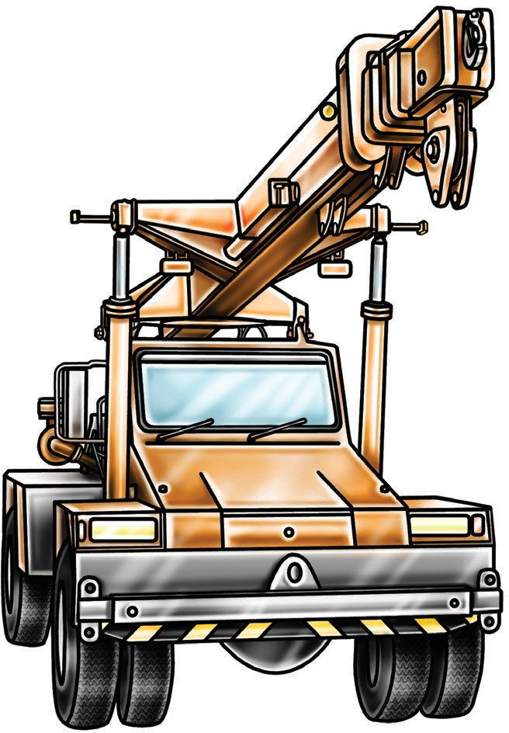
Introduction to non-Slewing Mobile
2

Slide 3
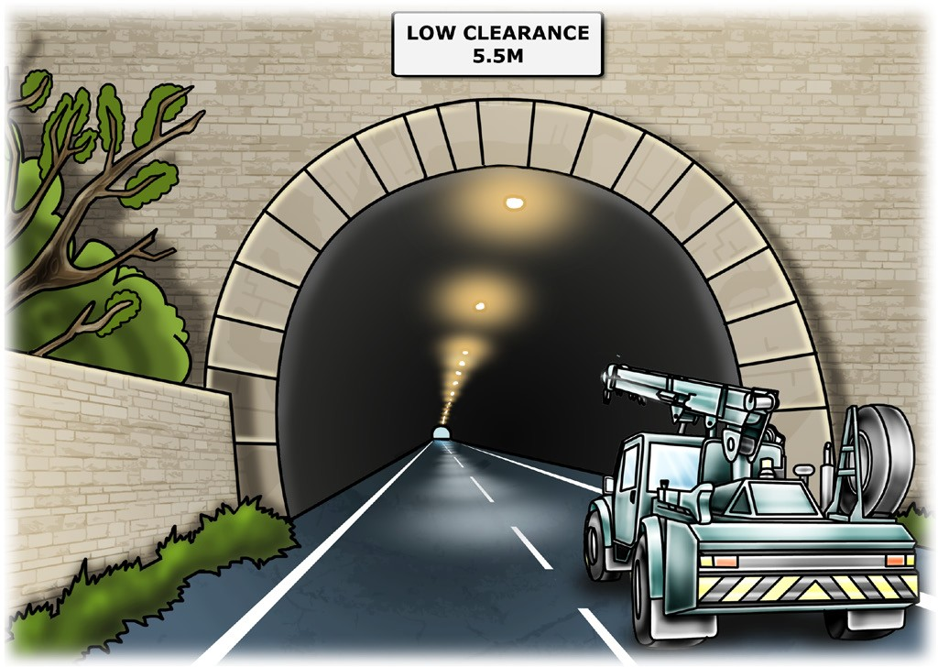
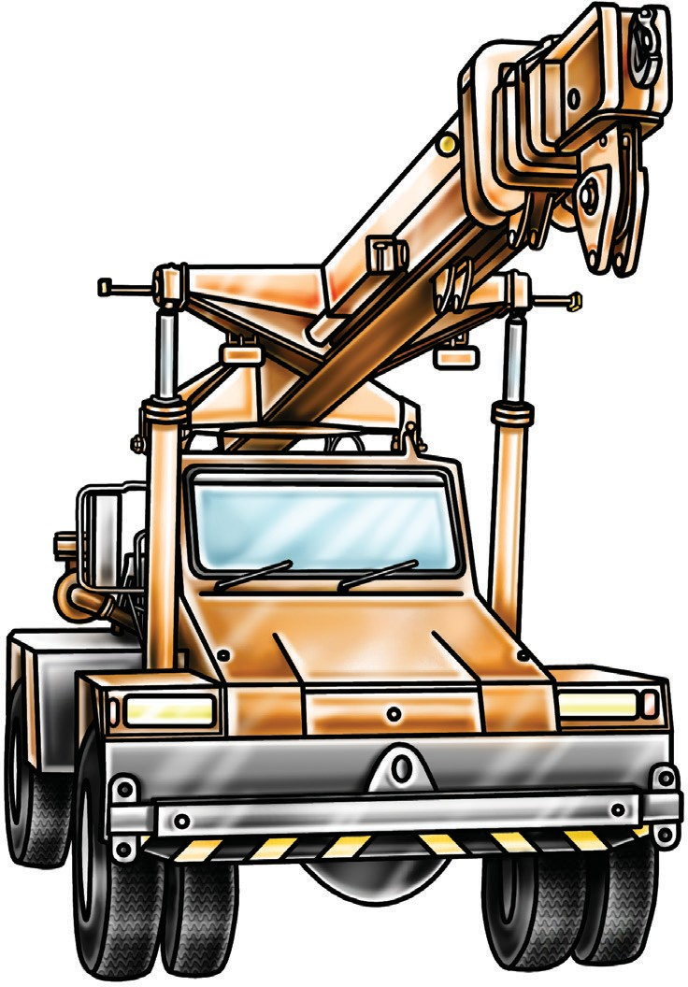
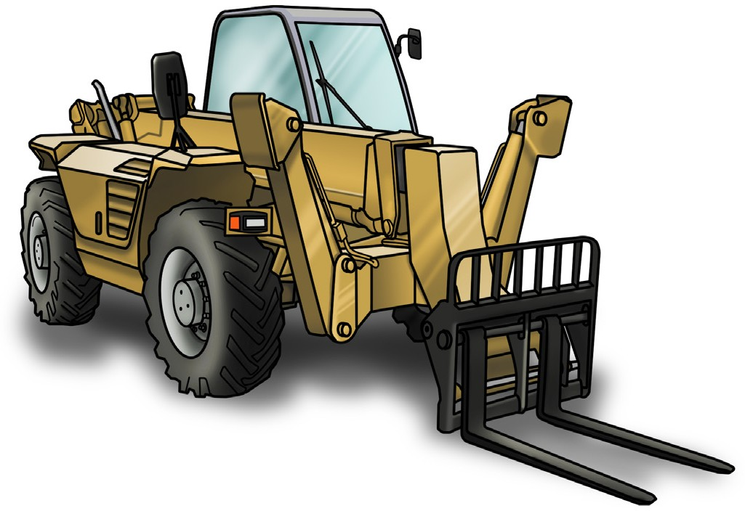
PC 1.3
INTRODUCTION TO NON-SLEWING MOBILE CRANE
What is a non-slewing mobile crane?
A non-slewing mobile crane is a powered crane which features a boom or jib that does not slew.
The boom can only luff up and down and telescope in and out.
The crane is mounted on a vehicle.
In some states a telescopic handler is classed as a non-slewing crane
3

Slide 4
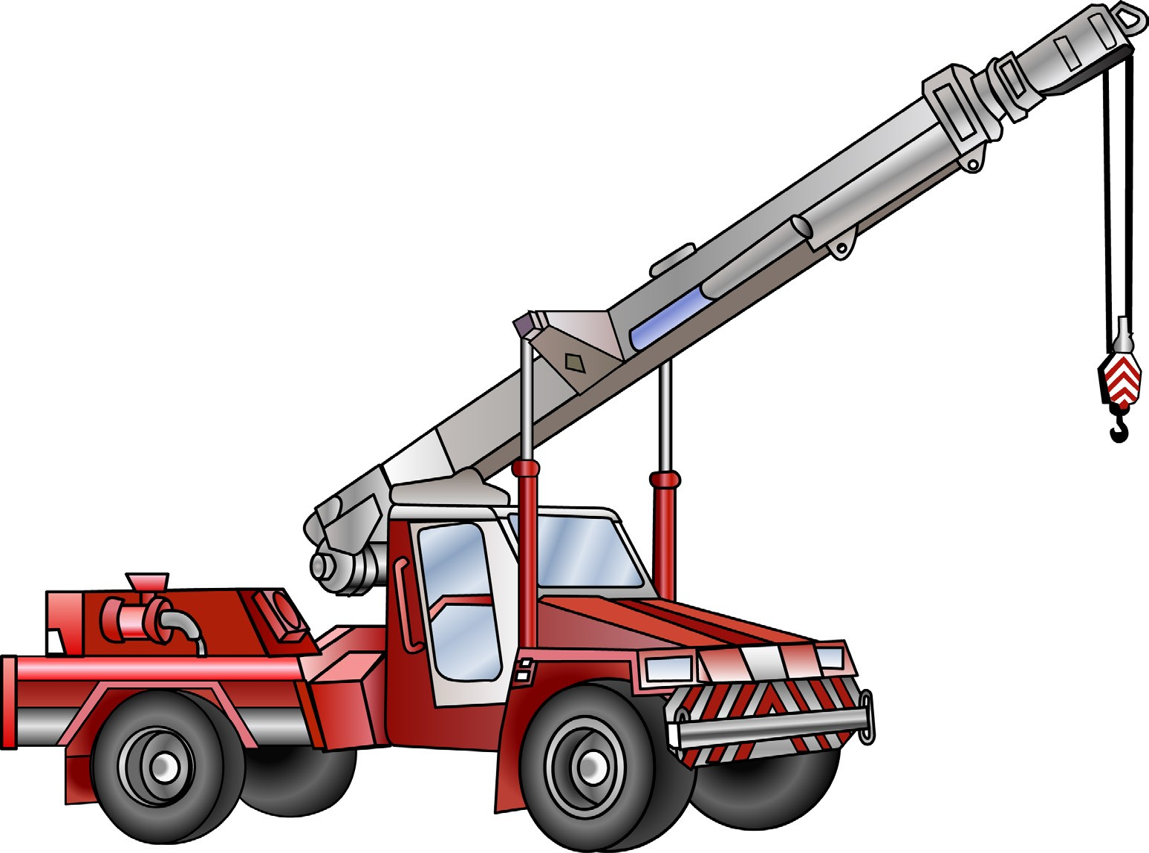

PC 1.3
INTRODUCTION TO NON-SLEWING MOBILE CRANE
Parts of a non-slewing crane
Boom extensions
Head sheave
SWL marking
Anti two block switch
Main boom
SWL
Running rope
Hook or
slinging points
Engine
air intake
Hook block
Rope winch drum
Hook
SWL for
hook block
Lift cylinder
Engine
cover
Spreader bar in
transport position
Counter
weight
Front wheel
Articulation point and steering cylinders
Rear wheel
4

Slide 5

PLAN WORK
Plan work / task
Element 1
5

Slide 6
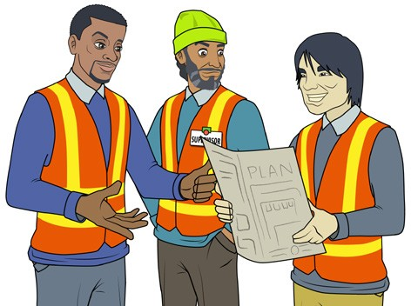
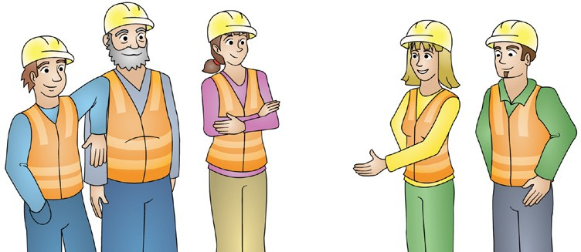
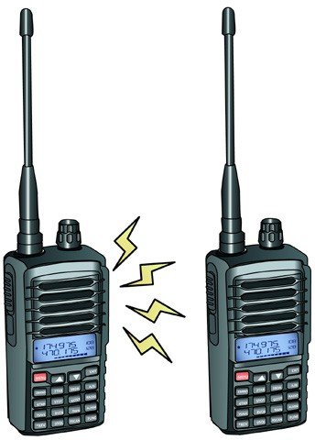
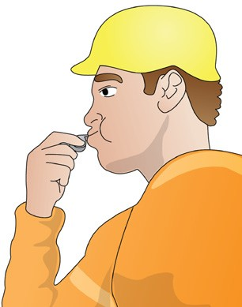
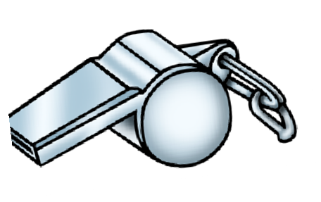
Communication
PC 1.7 PLAN WORK
You can communicate many different ways. Sometimes the type of communication method depends on the non-slewing mobile crane that you will be working with and the worksite. You must choose the best communication method for the job.
Make sure you listen to information and ask questions if you do not understand what you have been told. You can communicate in many different ways. Examples of types of communication:
Speaking, listening, asking questions This is very important because it helps you understand how to do your job safely. | Toolbox meetings Toolbox meetings are like small staff meetings that provide important information.
Two-way radios These are common on worksites. If you are using them, always make sure they are working properly before you start the job. Check the batteries have enough charge and check you have the right channel to communicate with your workmates. | Whistle Whistles can be used when the operator and other workers are both in and out of sight.
6

Slide 7
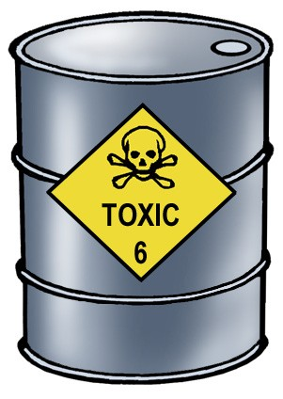
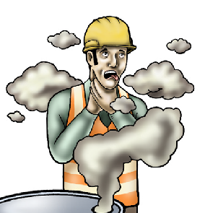
PC 1.5
CHAPTER 1 – PLAN WORK/TASK
PLAN WORK
Hazard versus risk
What is the difference?
Different hazards and risks emerge constantly—sometimes instantly.
Hazard
A hazard is any thing or any situation which could injure or harm you.
In other words, it is anything that can hurt you.
Risk
A risk is the chance of a hazard causing harm such as injury, illness or even death.
In other words, how likely it is that somebody or something may be harmed by the hazard.
7

Slide 8
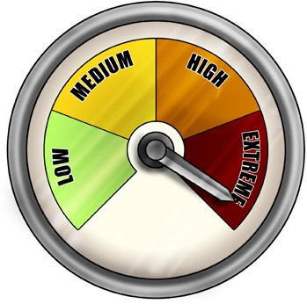
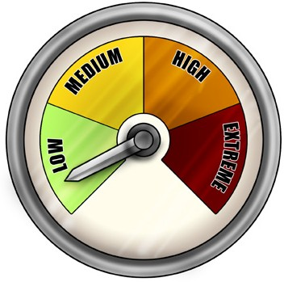
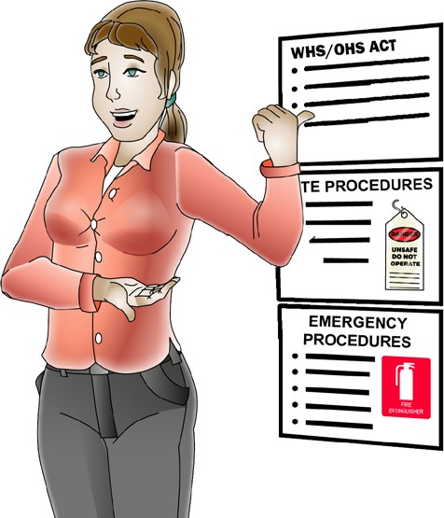
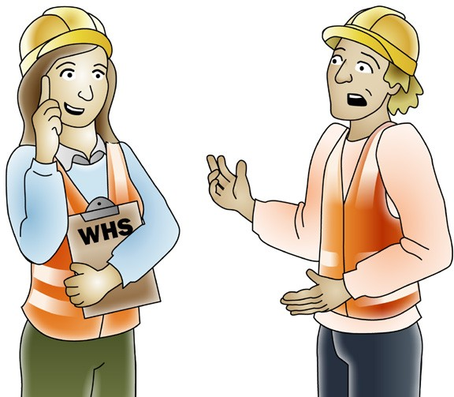
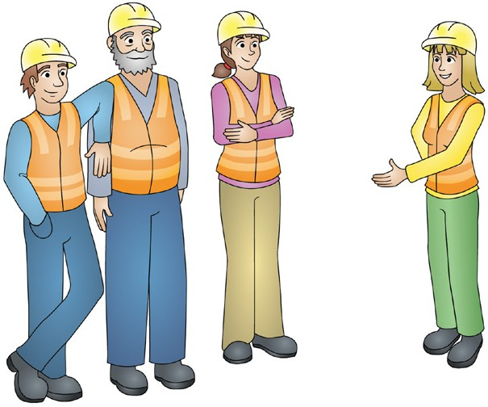
PPCC11.5.5
PLAN WORK
Assess the risk (risk assessment)
You need to identify (know) the worksite’s hazards before you start work. Look for hazards. When you find a hazard, you need to work out two things:
How dangerous is the hazard?
How likely (risky) is it that the hazard will hurt someone?
For example, you find a very dangerous hazard but the risk of it hurting someone is low. Because the danger is high, you need to find a way to control it.
Apply risk control measures BEFORE starting or as soon as you find a hazard while you are working. Make sure policies or procedures are
How dangerous?
How likely?
WHS/OHS representatives, committee members or safety officers | Your supervisor or team leader. Managers in charge of the job. Engineers (if available). | Workmates
8

Slide 9
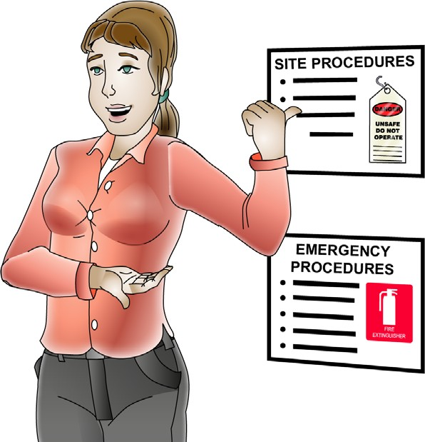
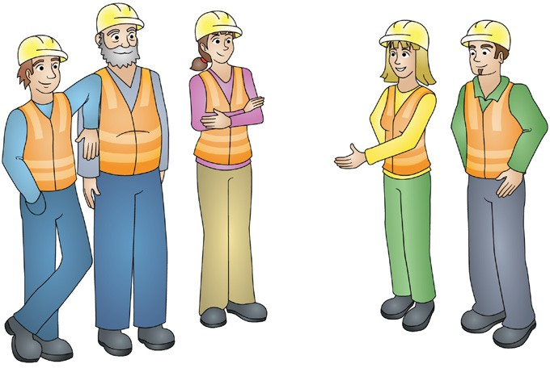
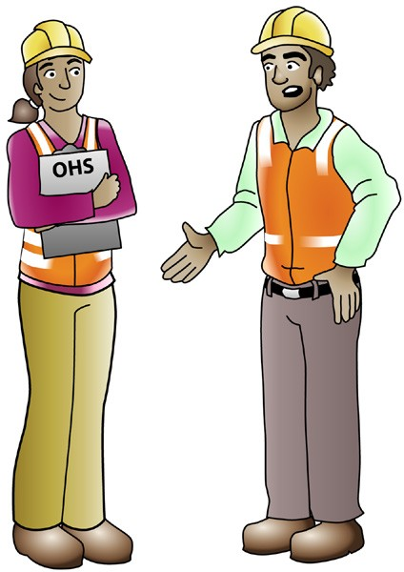
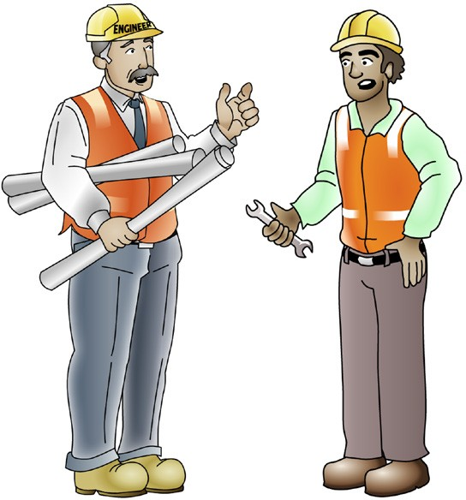
PC 1.1, 1.5, 2.2
PLAN WORK
QUESTION 9
Who should you talk to about site hazards before you start the job?
Your supervisor or manager | Workmates
WHS/OHS representatives or safety officer | Site engineers
9

Slide 10
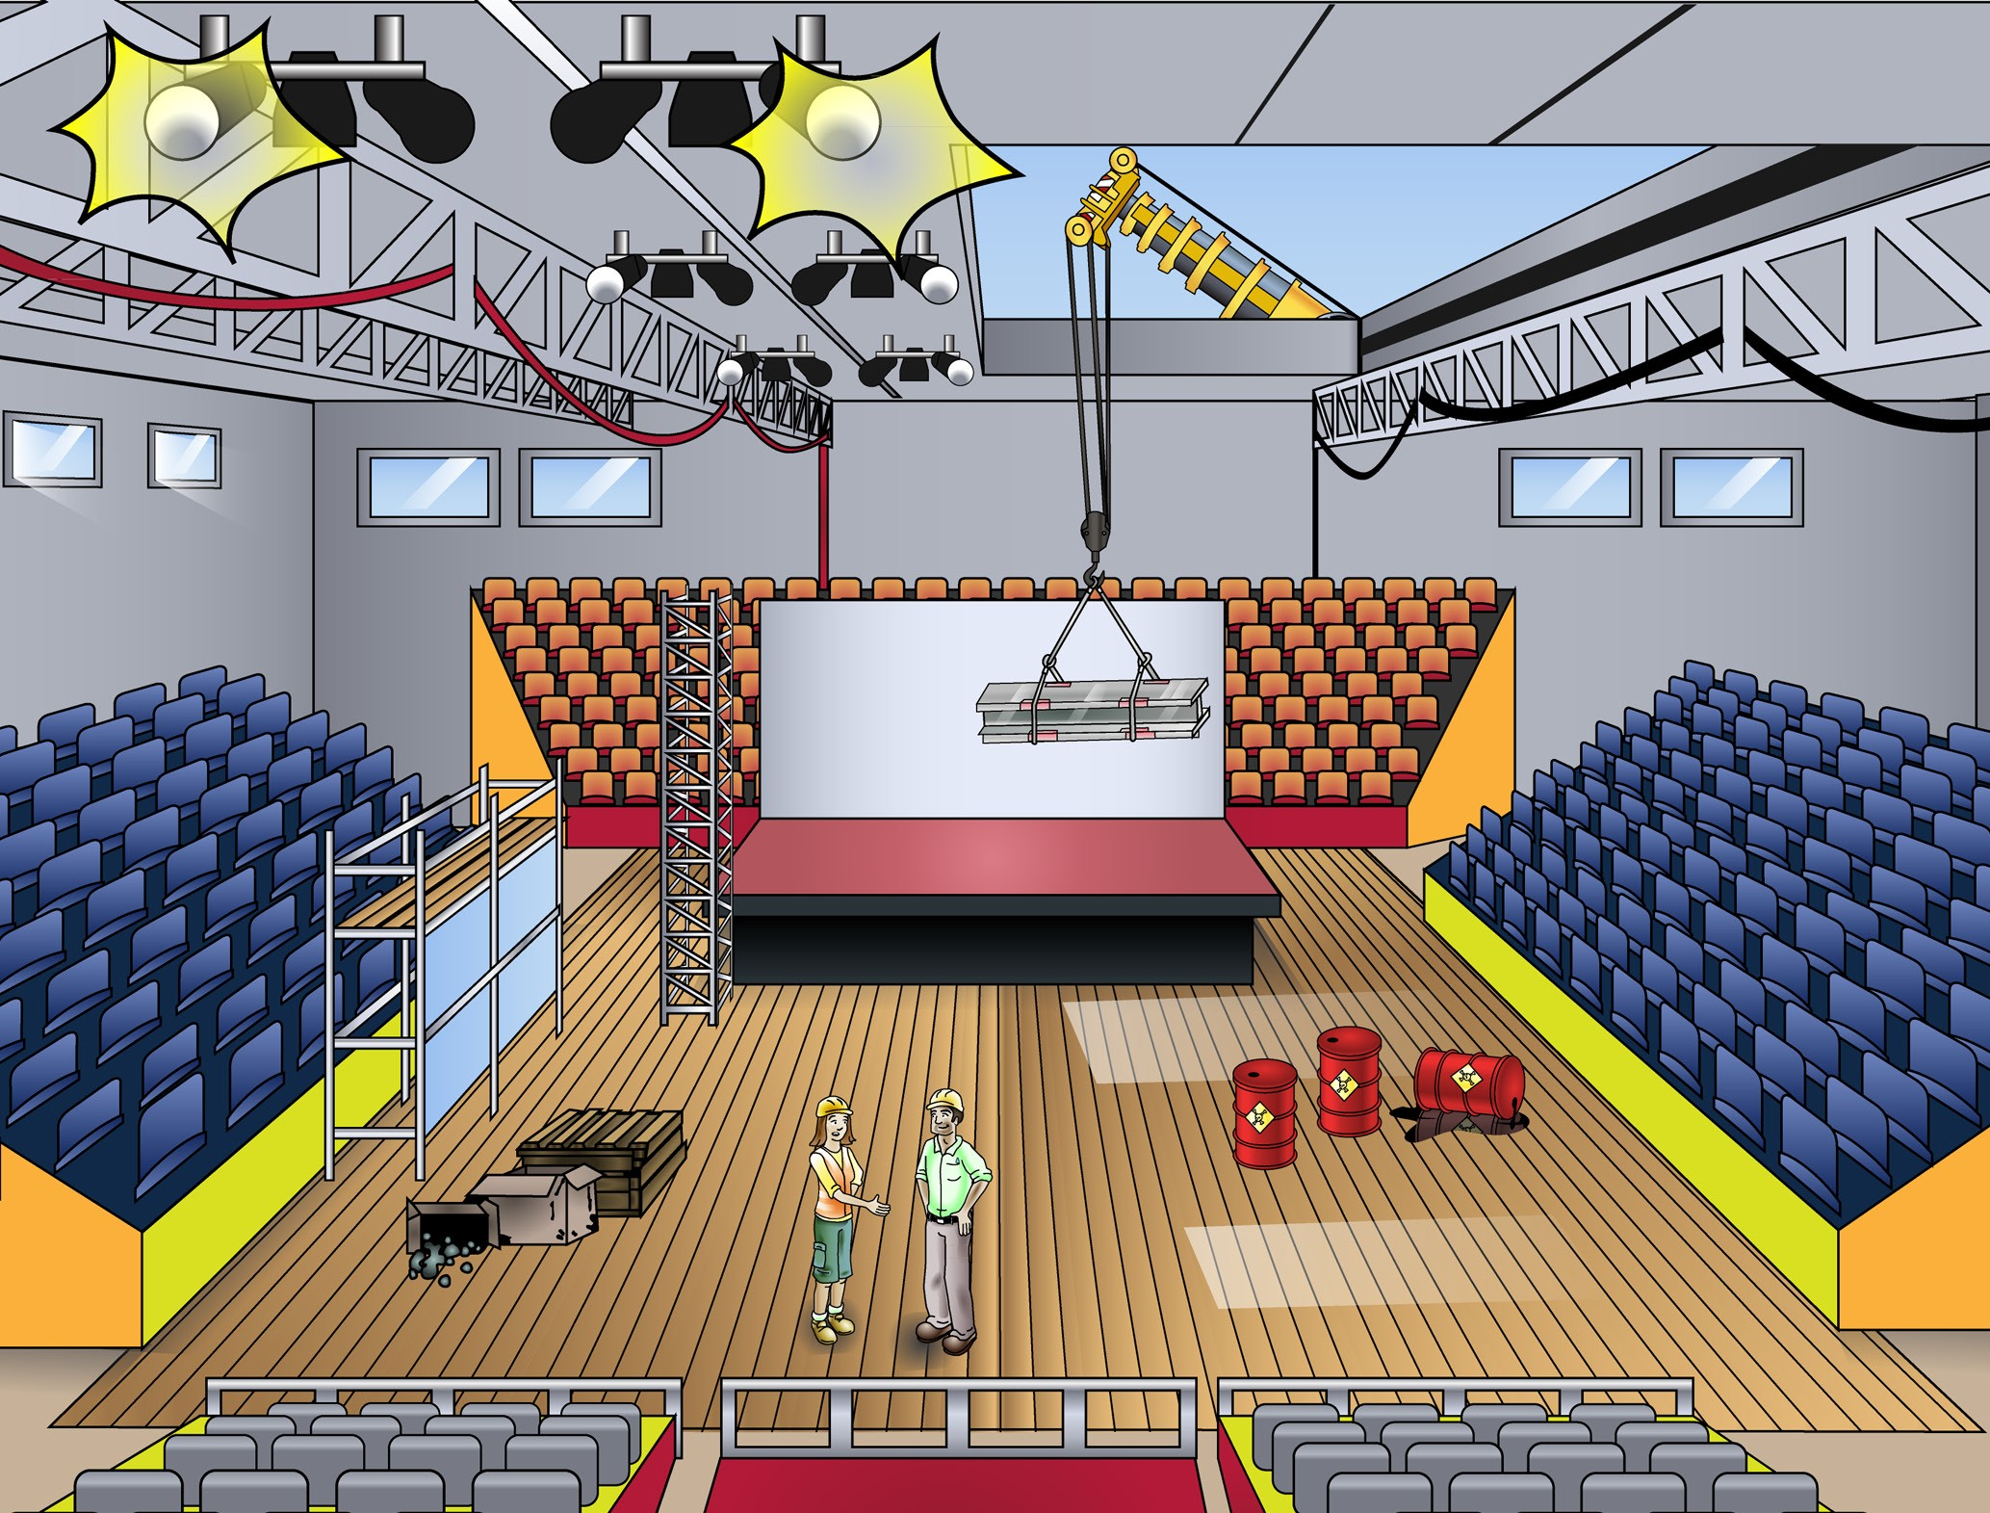
PC 1.5
PLAN WORK
QUESTION 10
You have arrived on site and you are about to start using the crane. There are hazards (dangers) you might run into when using the crane.
What are some examples of hazards that you must plan for?
Possible indoor hazards
Overhead services such as
electricity or phone lines
There may not be enough lighting
Entry and exit points
Structures
Facilities
Dangerous materials such as chemicals
Poor ‘housekeeping’
causing obstructions
People
...CONTINUES ON NEXT PAGE
10

Slide 11
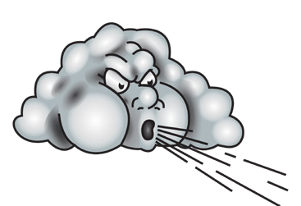
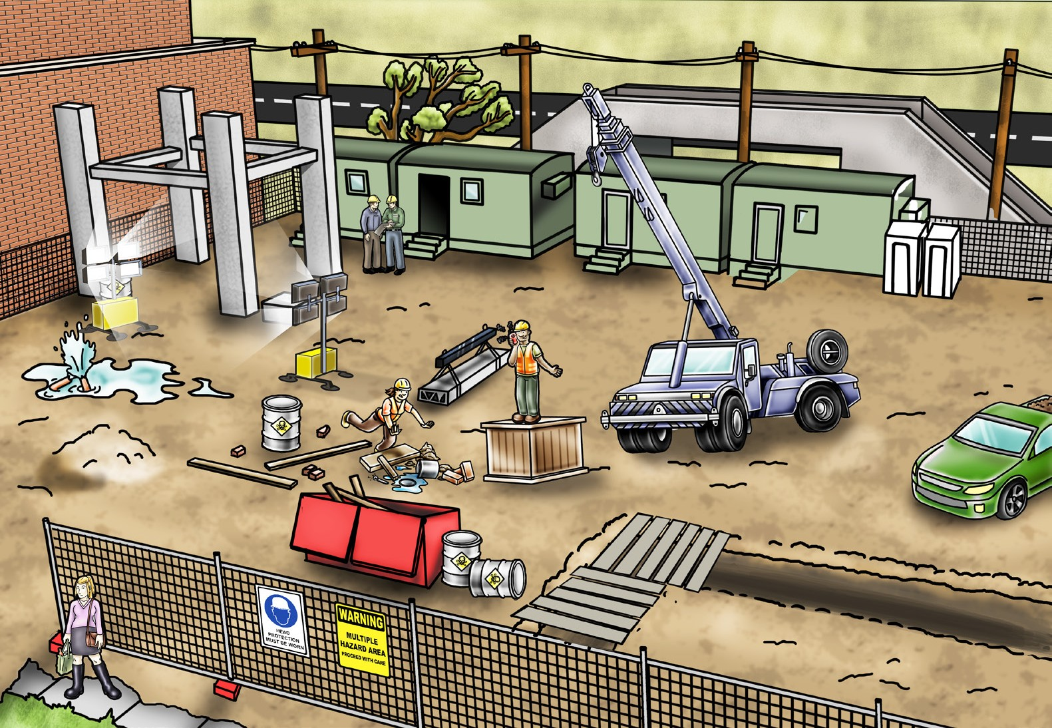
PC 1.5
PLAN WORK
QUESTION 10
Possible outdoor hazards
Wind, lightning or rain
...CONTINUED FROM PREVIOUS PAGE
Surrounding buildings
or obstructions
You have arrived on site and you are about to start using the crane. There are hazards (dangers) you might run into when using the crane.
What are some examples of hazards that you must plan for?
Trees
Powerlines
Bridges
Lighting
People
Facilities
Underground services
Unstable ground
Tripping hazards
Open trenches/ excavations
Pedestrians
Hazardous
materials
Non weight
bearing surfaces
Vehicles/other mobile plant/traffic
Other obstructions that you may have to direct a load past or over
11

Slide 12
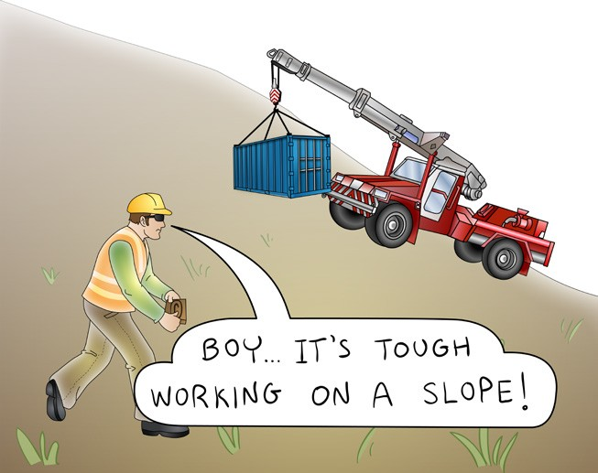
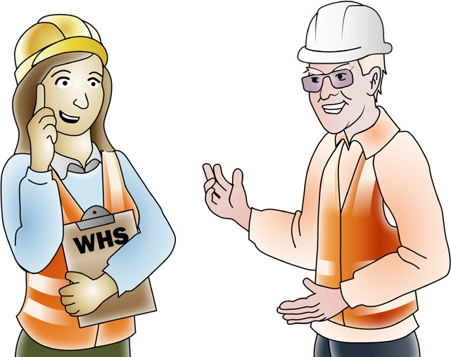
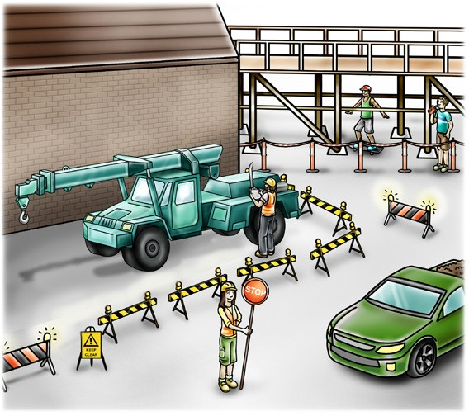
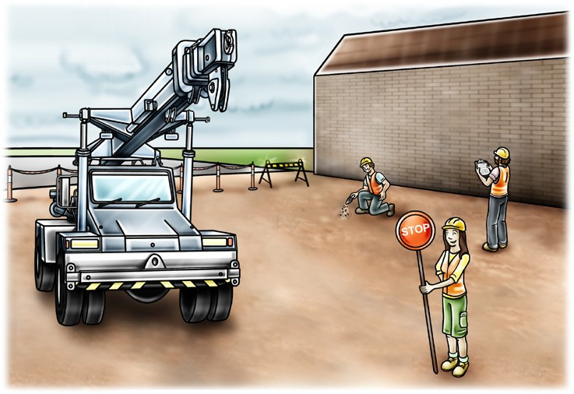
PC 1.1
PLAN WORK
QUESTION 11
You’ve already planned for site hazards.
What other things do you plan for before using the crane?
Some things to plan for are:
What the task requires you to do.
Safe and appropriate
communication methods.
How will you get in and out of the site?
Where will you use the crane?
...CONTINUES ON NEXT PAGE
12

Slide 13
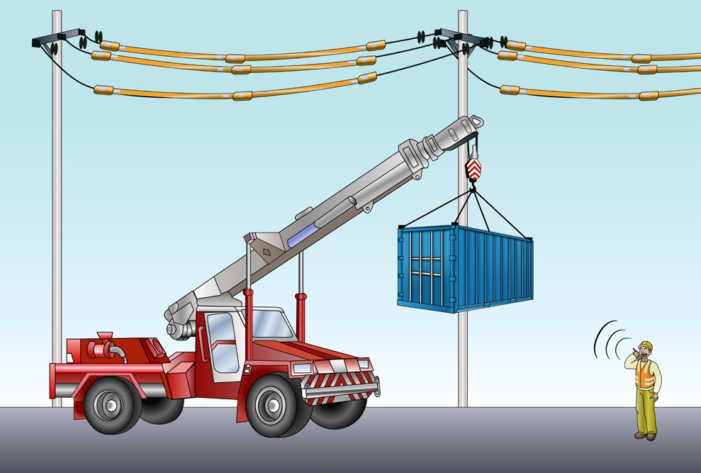
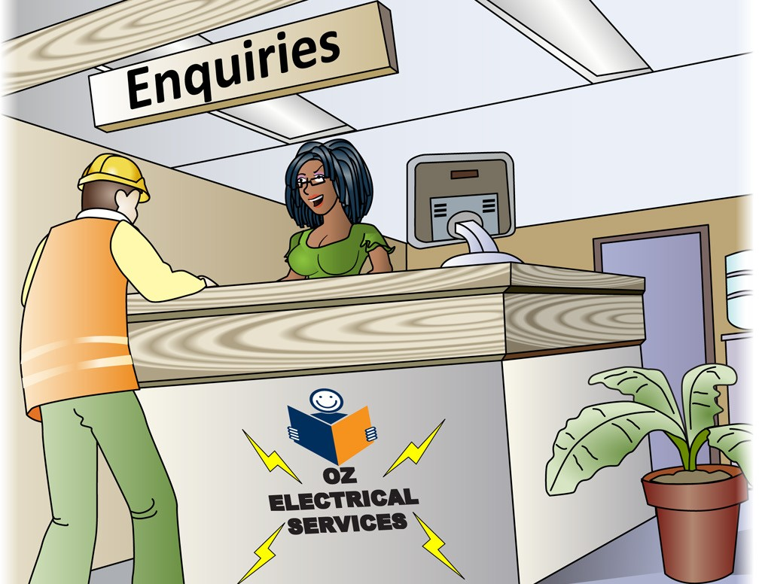
PC 1.5, 2.2
PLAN WORK
QUESTION 13
You are working near powerlines. Working near powerlines is very
dangerous and can kill you.
What are the minimum safe distance rules you must follow?
The minimum safe distance rules you must follow can be different for each state/territory.
For example, only some use
a spotter.
A spotter is someone who helps you work closer to powerlines.
Most states and territories use
Australian Standard AS 2550.1
Spotter
QUESTION 14
Who could you talk to if you need to find out the voltage of overhead powerlines?
Your local power supply company
responsible for the electric lines.
13

Slide 14
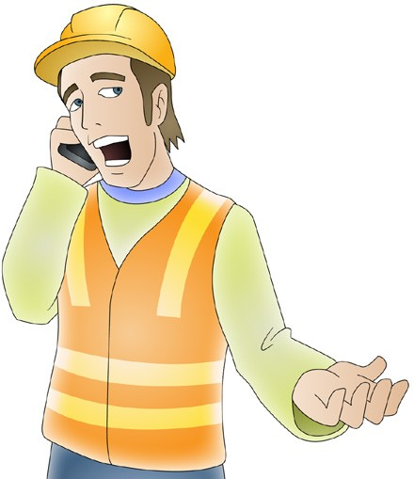
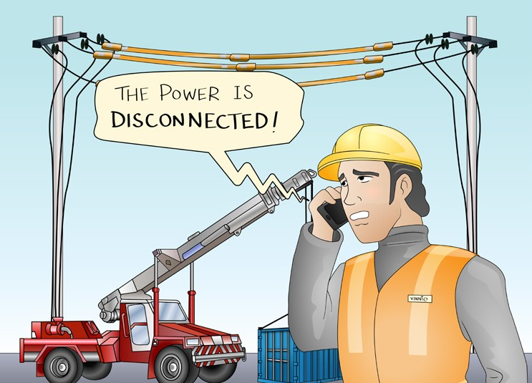
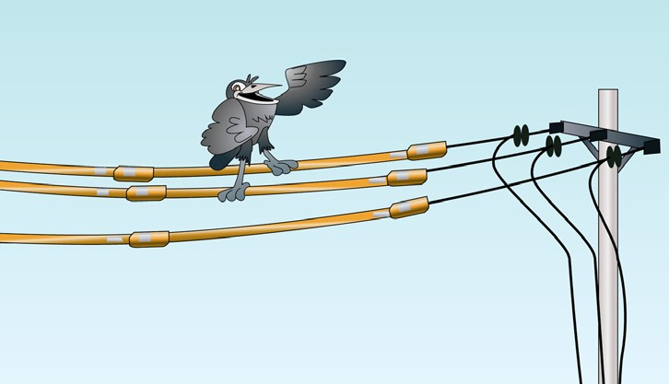
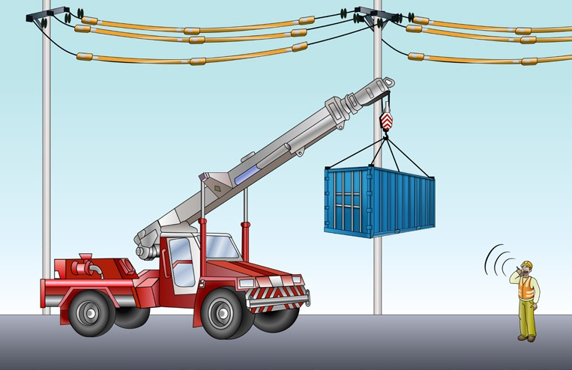
PC 1.5, 2.2
PLAN WORK
QUESTION 15
What are some ways you can work closer to electric power lines than the minimum distances allowed?
You might be able to get access permit from the electricity supply authority. They will provide help with working safely. | Where possible, the power company may be able to turn off (disconnect) the power supply.
If you can’t get the power turned off, the electrical supply authority will need to cover t These powerlines have been insulated | Use a spotter in the exclusion zone if you are allowed to in your state/territory. Spotter
he electric lines with insulation.
14

Slide 15
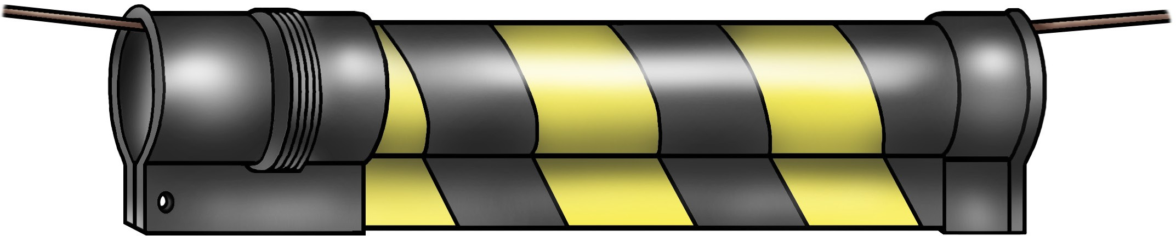
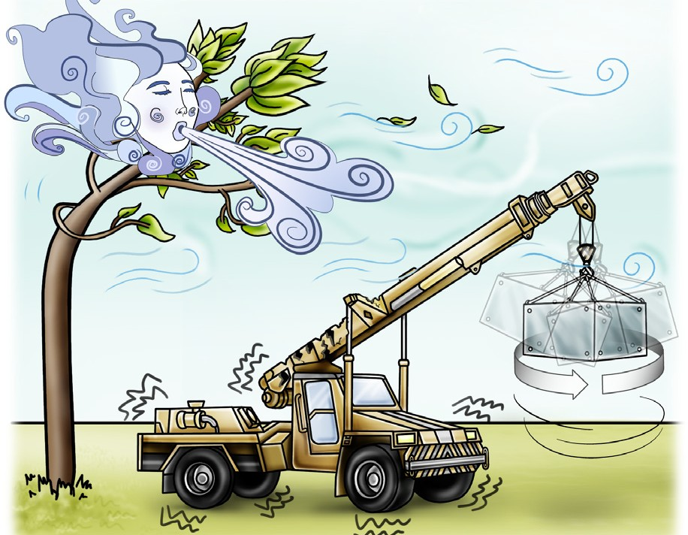
PC 1.5, 2.2, 2.9
PLAN WORK
QUESTION 16
Tiger tails are black and yellow pipes that hang off powerlines.
What are they for?
Tiger tails are a warning device. They make powerlines easier to see.
QUESTION 17
A crane is moving a load
on a windy day.
What hazards can the wind cause?
The load
could swing
The crane could be damaged
The crane could be damaged
The crane could become unstable
The load could spin
15

Slide 16
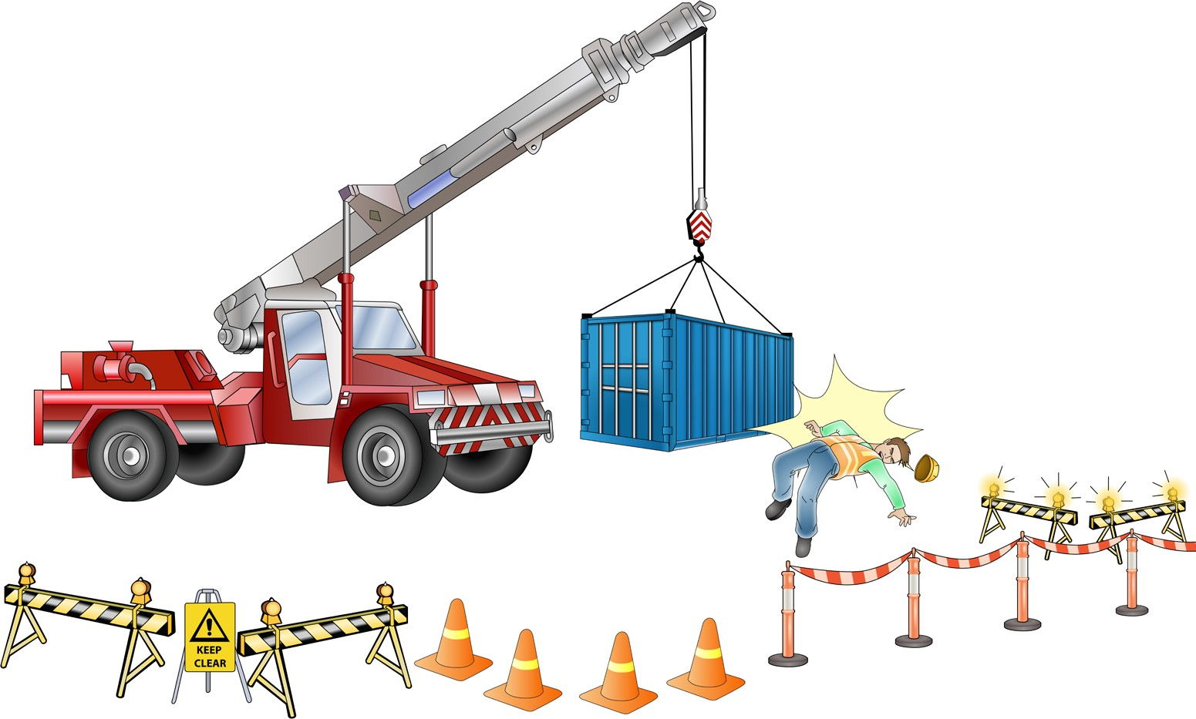

PC 1.5, 2.2
PLAN WORK
QUESTION 18
What hazards (dangers) are there if you work near (the radius) of the outriggers or chassis
of a non-slewing crane?
The crane or load could hit or crush you. You should stay outside the exclusion zone.
Exclusion zone
16

Slide 17
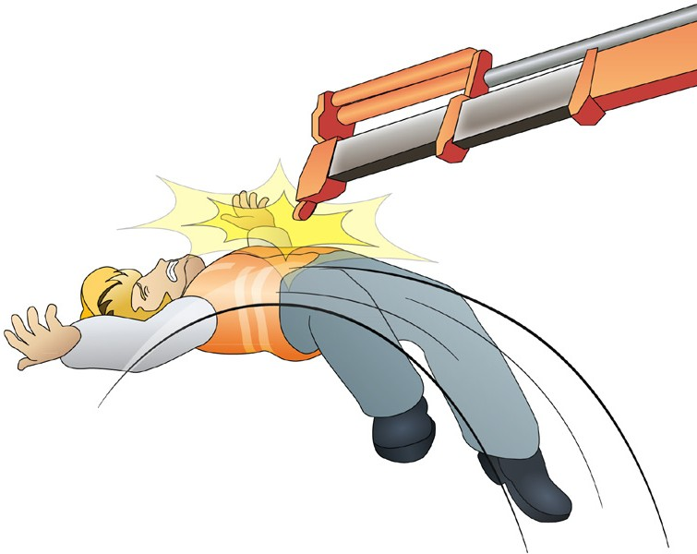
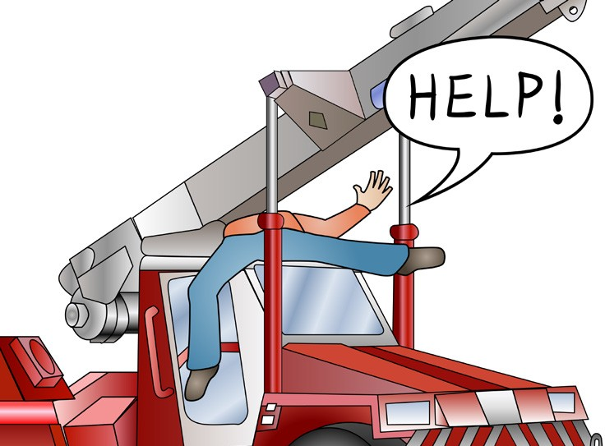

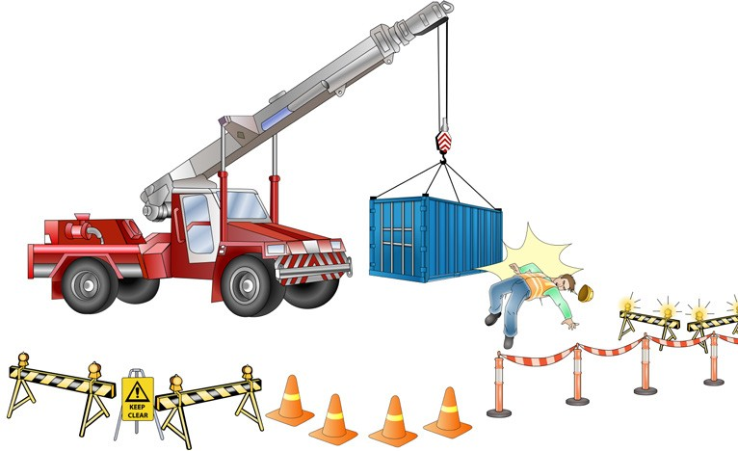

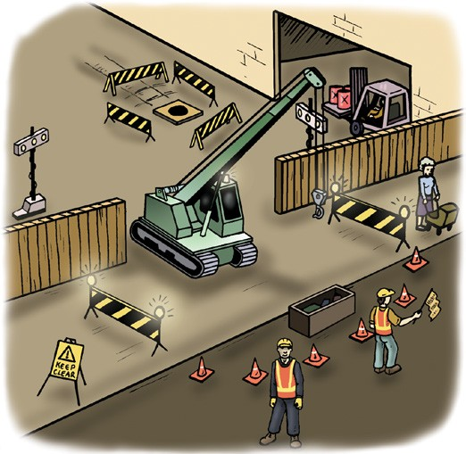
PC 1.5, 2.2
PLAN WORK
QUESTION 19
The crane operator is folding the boom so he can drive the crane.
What hazards (dangers) do you need to think about in the cranes operating radius or reach?
How can you control the hazards?
Hazard: You could be caught in the boom and trapped. | Hazard: You could be hit by the boom.
Hazard: You could be hit by the load. | Control: Use exclusion zones to keep people out of the area where they could be injured or killed.
17

Slide 18
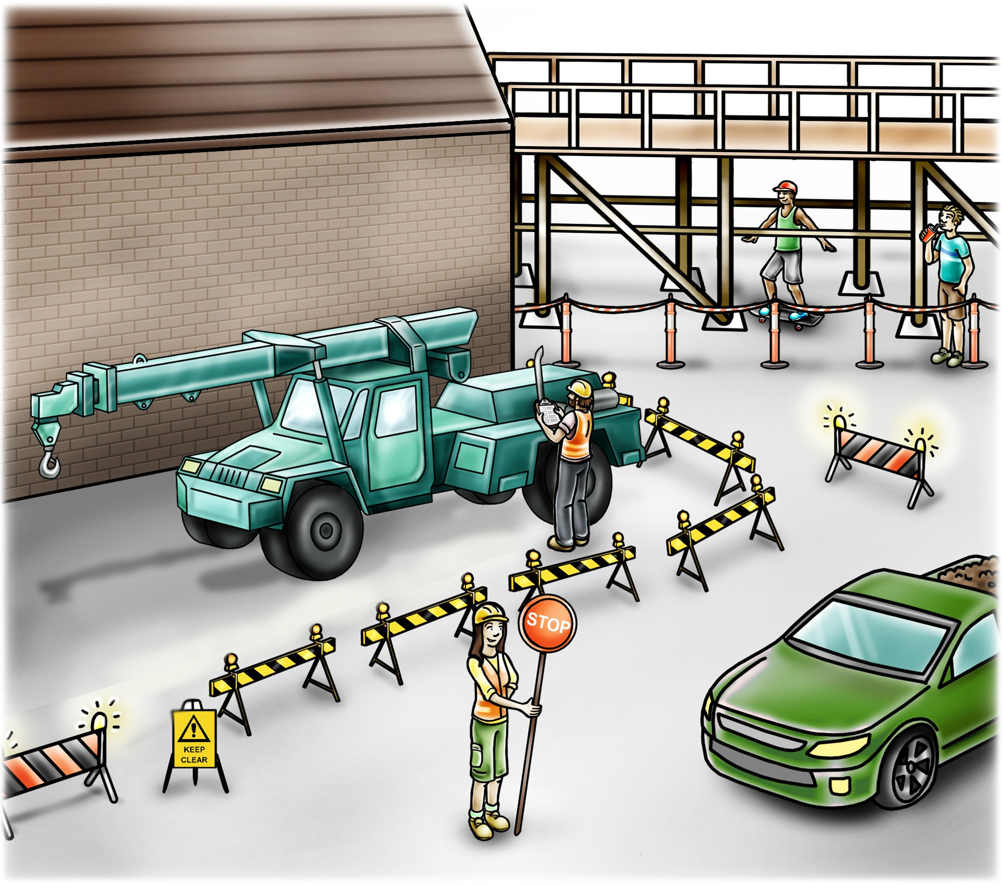
PC 1.6, 2.2
PLAN WORK
QUESTION 21
What hazard controls can you use for vehicles or plant on the job?
Some methods you can use are:
Flashing yellow hazard lights to warn people
Vehicle exclusion zone
Barriers
A flag person to control the traffic
Warning signs
18

Slide 19
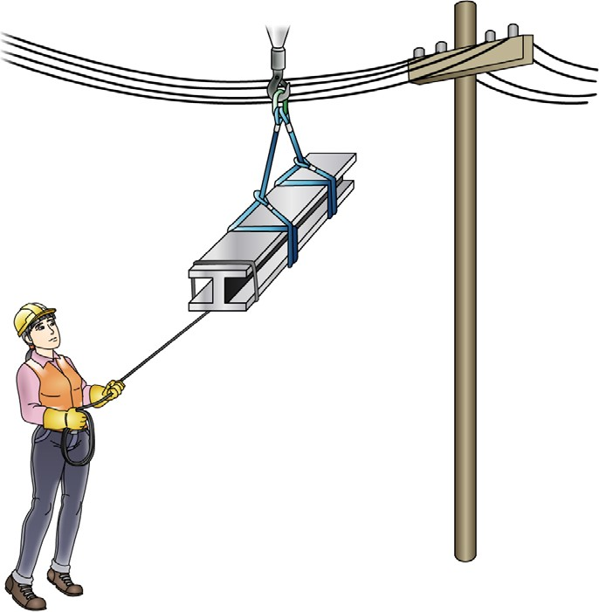


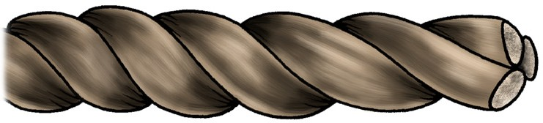
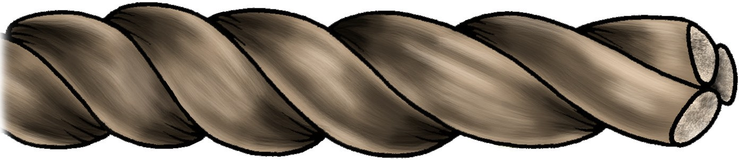
PC 1.5, 2.2
PLAN WORK
QUESTION 22
You are working near powerlines.
What kind of tagline should you use?
You need to use a dry, non-conductive rope. Dry non-conductive rope does not conduct electricity. Keep the rope dry so that electricity cannot travel through the water in the rope.
Dry natural fibre rope
QUESTION 23
What is the minimum diameter (thinnest)
non-conductive rope you
can use as a tagline?
What does it need to be made of?
It needs to be dry non-conductive rope, dry natural fibre rope or dry natural rope that is at least 16 mm thick.
16 mm
19

Slide 20
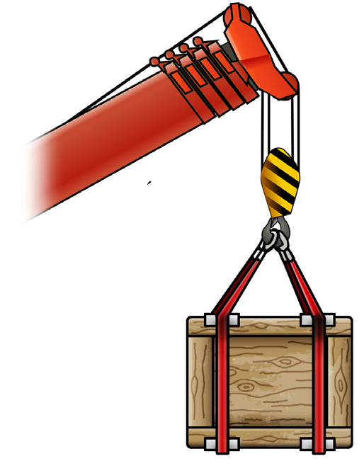
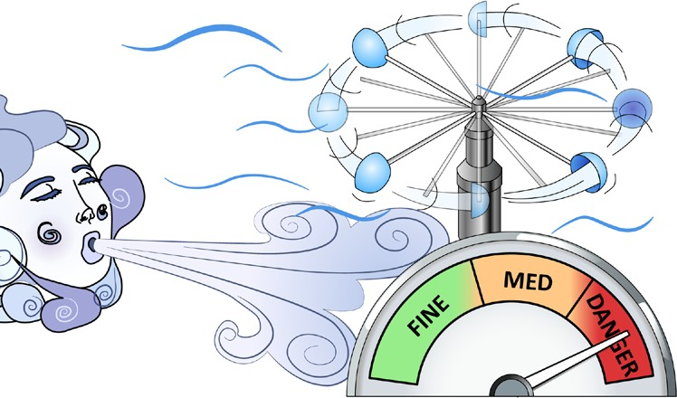

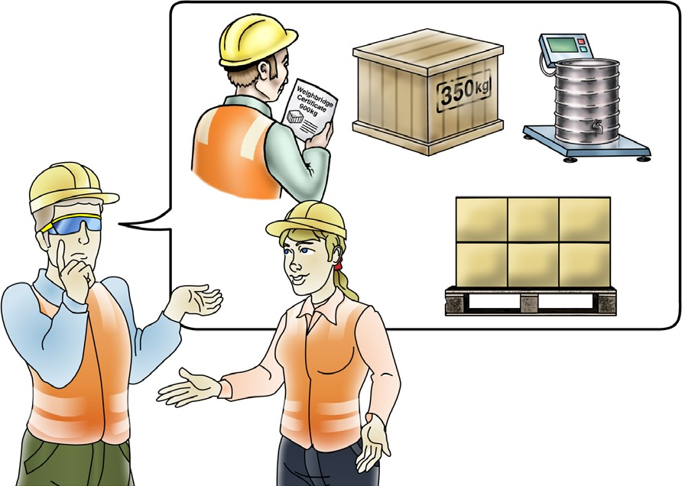
PC 1.5, 2.2, 2.9
PLAN WORK
QUESTION 24 You are operating the crane and the wind speed increases. What should you do? | Stop work if it becomes unsafe, or the wind is over the maximum wind velocity. Check the manufacturer’s specifications for the crane. | Bring the load down and make it safe.
QUESTION 25 Whose job is it to find out the weight of the load you will lift? | Someone who has a dogging or rigging licence. Usually it will be the dogger in charge of slinging the load. Dogger
20

Slide 21
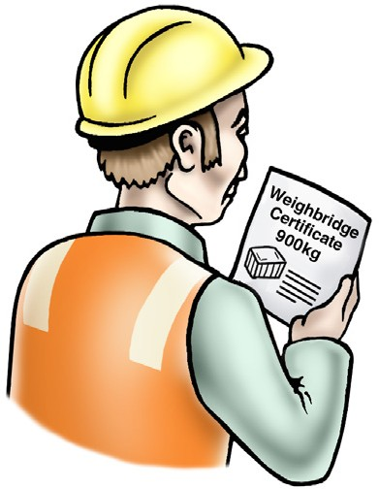



PC 1.3
PLAN WORK
QUESTION 26
You need to move a load.
How can you find out the loads weight?
You can find the weight by:
Checking the weighbridge note, consignment note, or other information. | Calculating the weight of the load. For example: 10 × 20 kg + 15 kg = 215 kg 15kg
Weighing the load | Reading the weight marked on the load.
21

