Slide 1

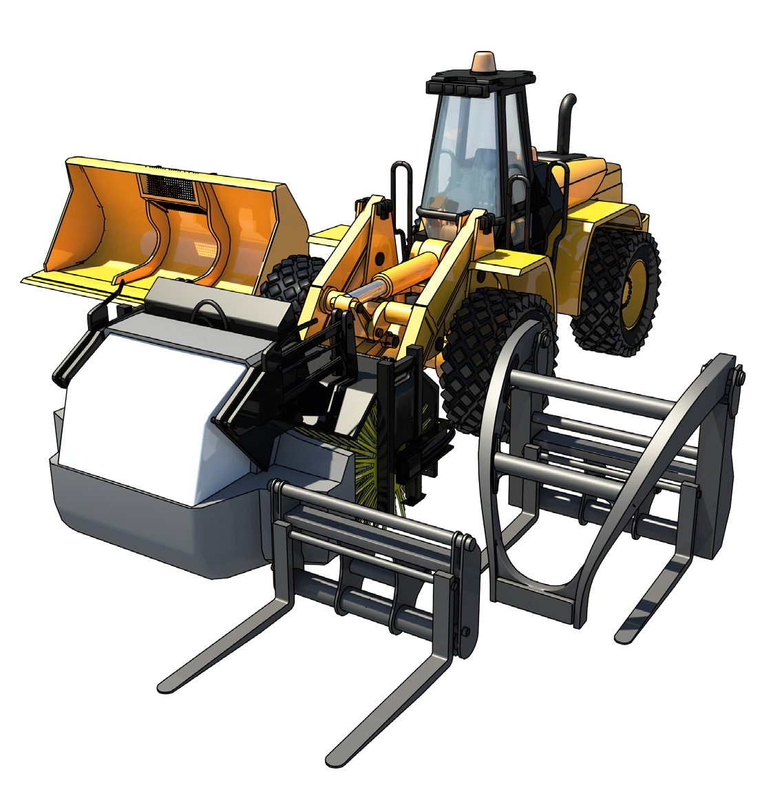

LEARNER GUIDE
Integrated Tool Carrier
RII COMPETENCY
Training support material for:
RIIHAN311F
Conduct operations with integrated tool carrier
Produced by:

Slide 2
Contents
How to use this guide
Language – Literacy – Numeracy (LLN) Acknowledgements
Introduction to integrated tool carrier General information
Plan and prepare for integrated tool carrier operations Lift and move load
Complete operations
Select, remove and fit attachments
4
6
8
9
15
57
107
159
179

Slide 3
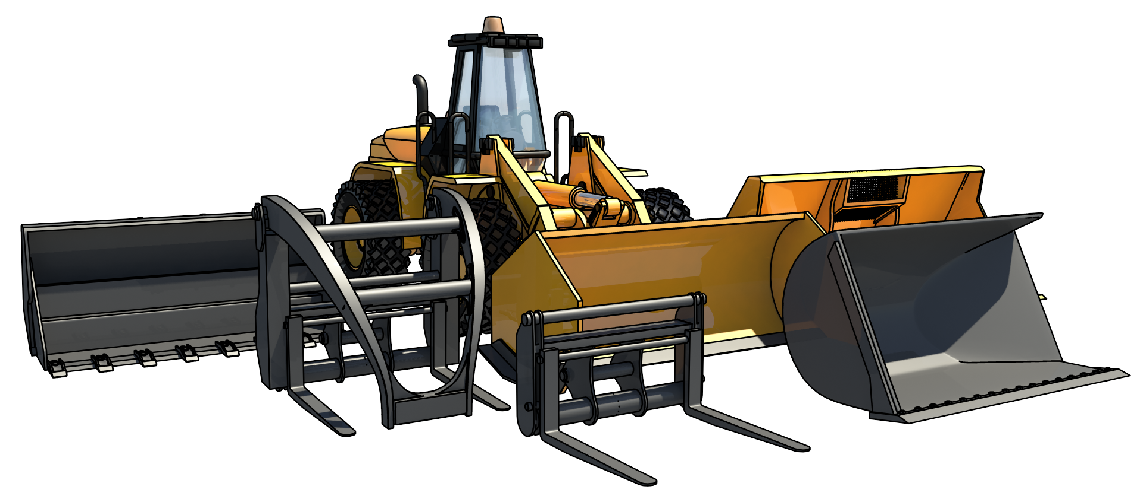
Introduction to Integrated tool carrier

Slide 4
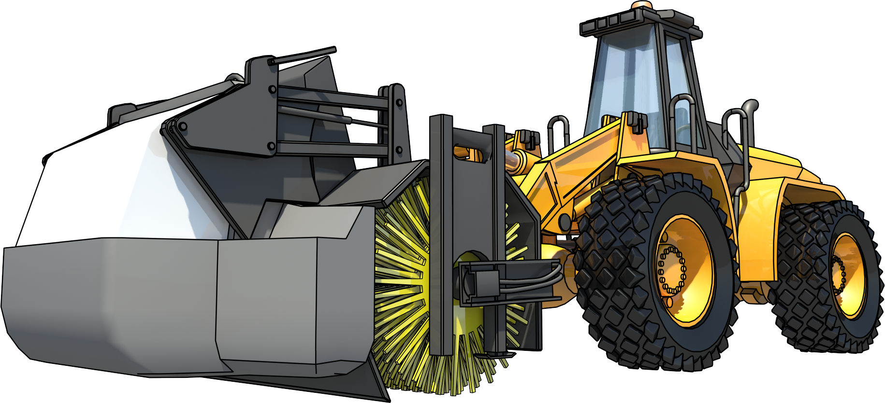
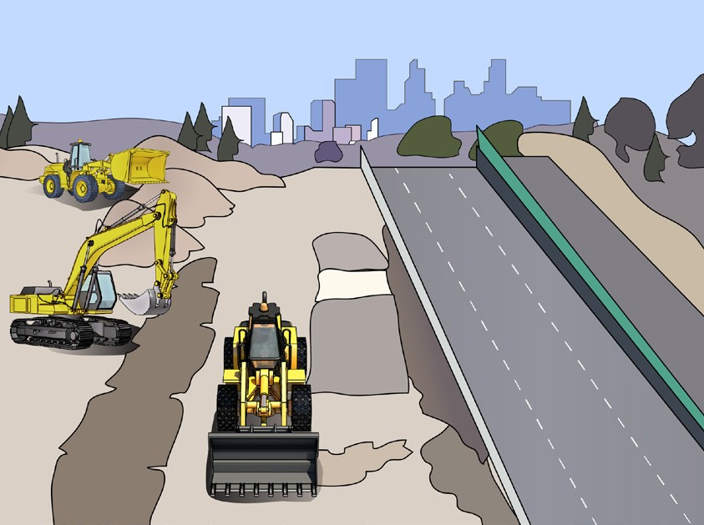
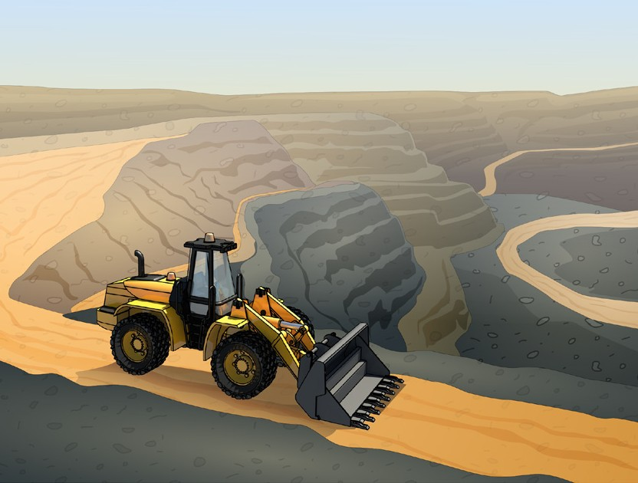
What do you use an integrated tool carrier for?
PC 1.5 INTRODUCTION TO INTEGRATED TOOL CARRIER
Mining
Construction
Clean up
Moving dirt/rocks etc
Agriculture – farming
Forestry
Can use for lifting purposes
What industries do you use an integrated tool carrier in?
Civil construction • Mining

Slide 5
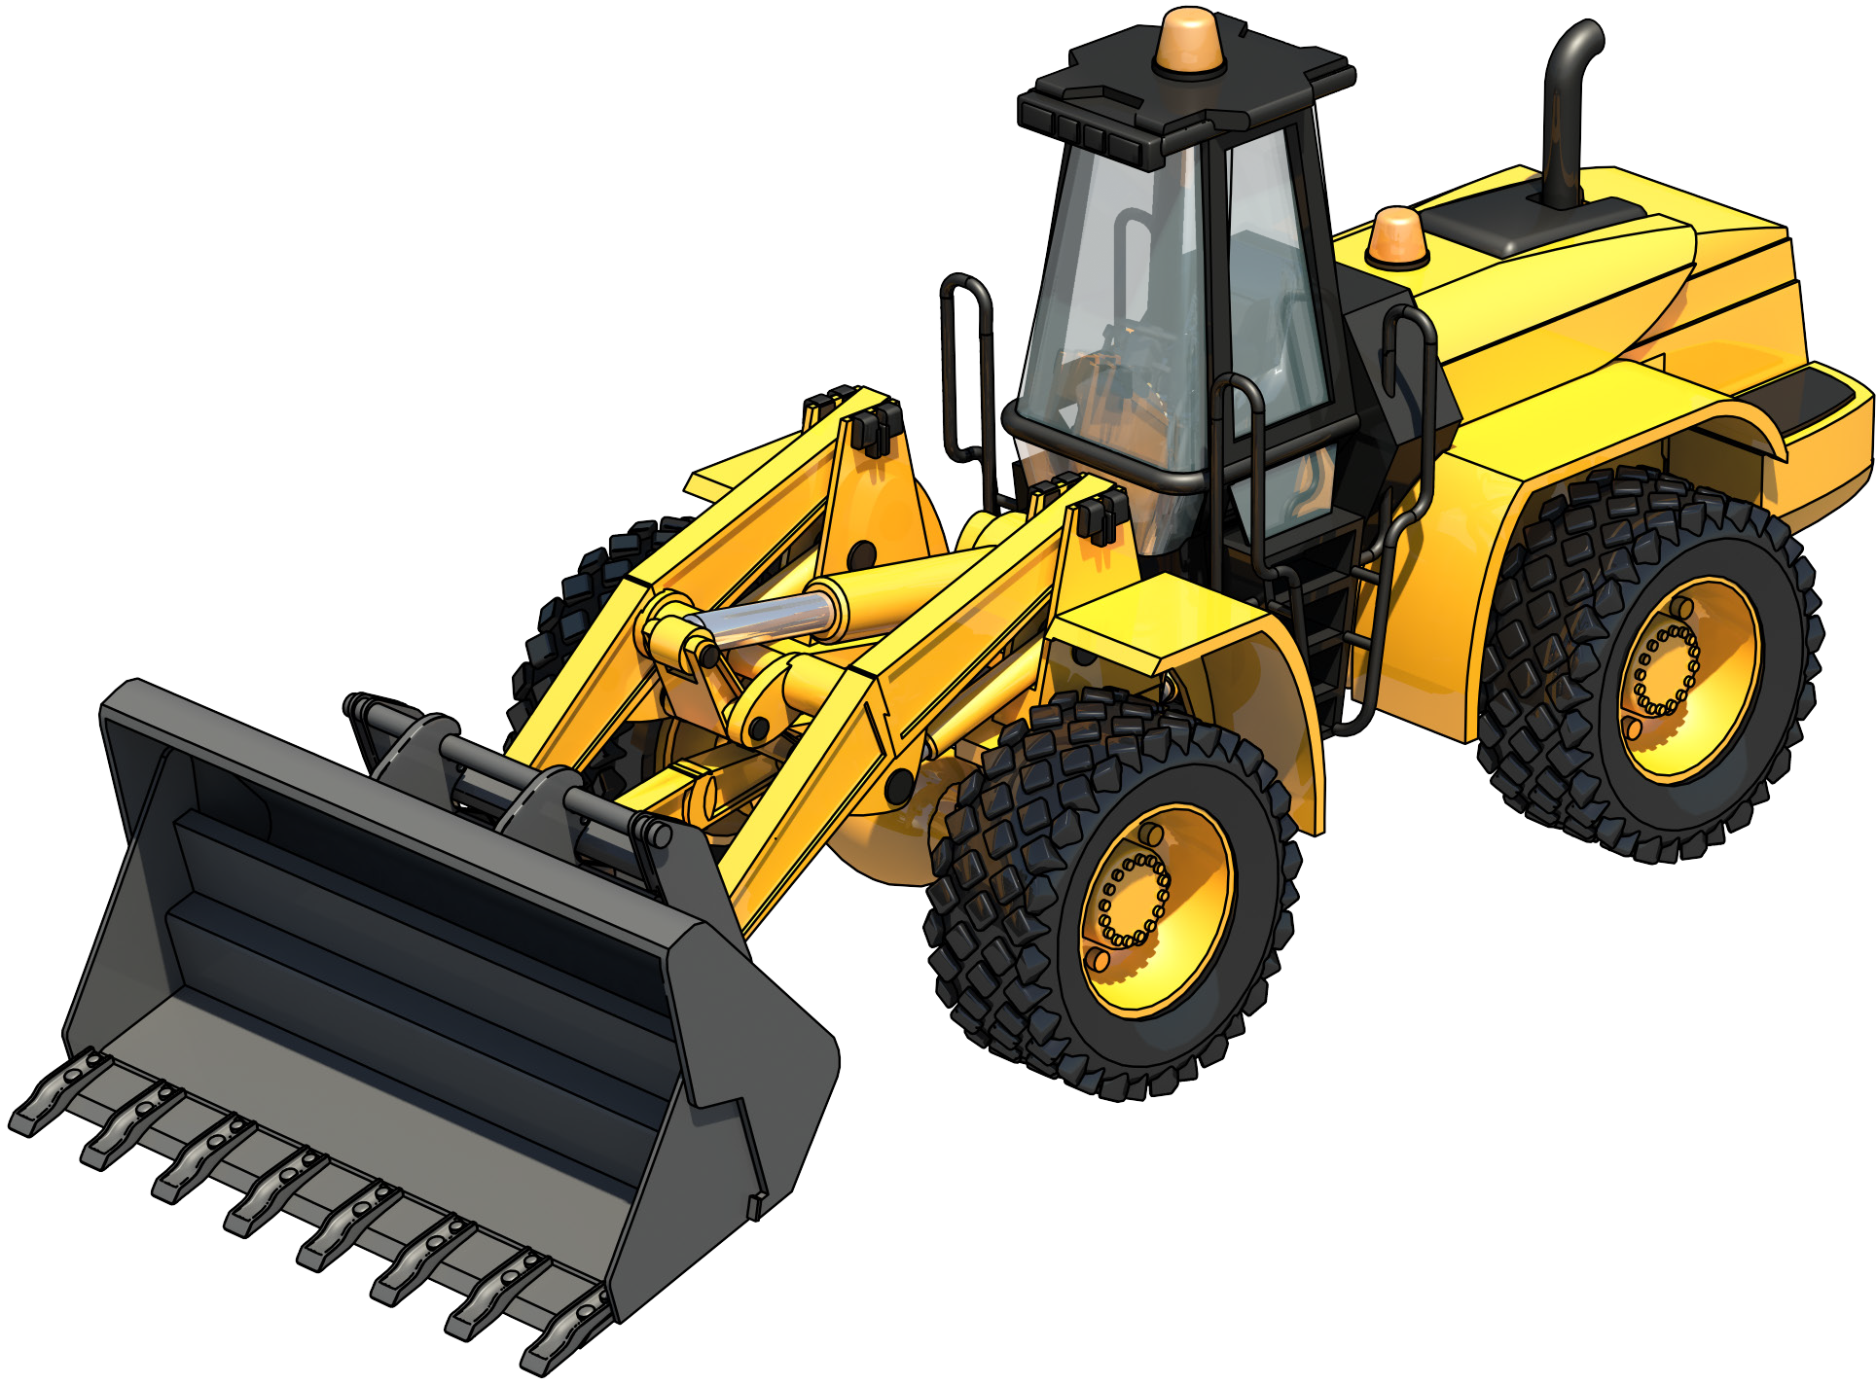
Example of an integrated tool carrier (ITC)
PC 1.5 INTRODUCTION TO INTEGRATED TOOL CARRIER
An integrated tool carrier (ITC) is a machine similar to a front end loader which has a quick release mechanism on the lift arms which allows the fast changing of various attachments without the need for hand tools or special equipment.
Tilt cylinder
Tilt link
Bucket attachment
Rear wheel
Lift cylinder
Lift arm
Front wheel

Slide 6
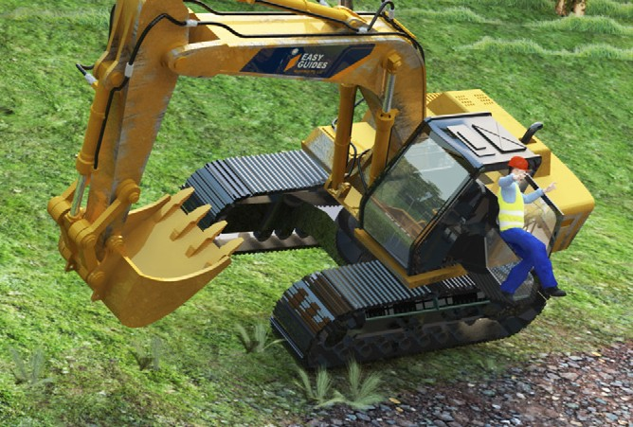
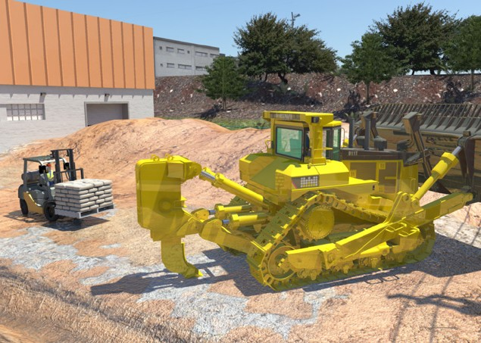
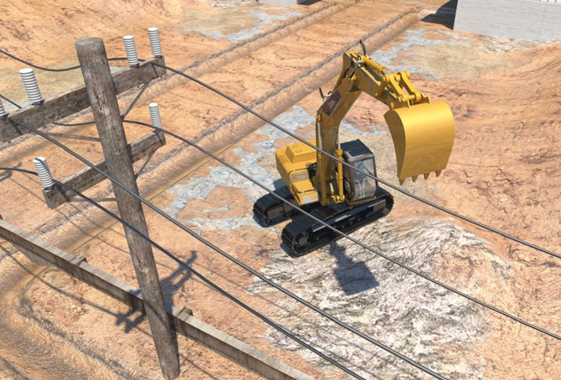
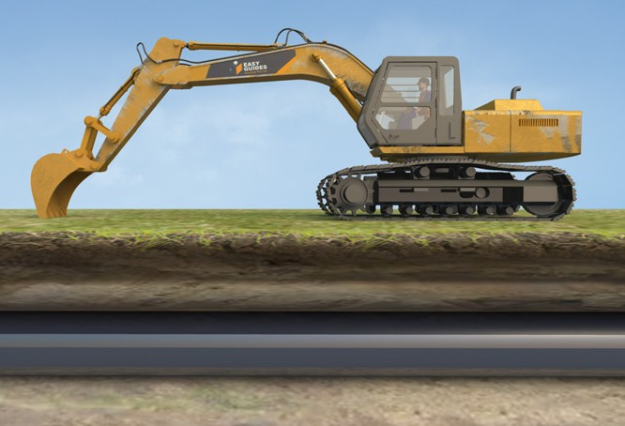
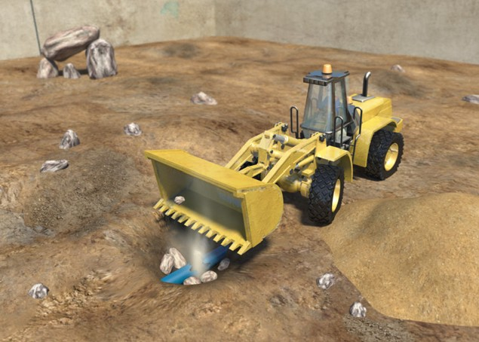
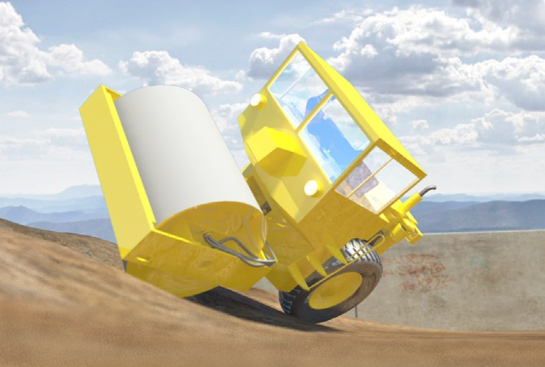
PC 1.4
GENERAL INFORMATION
Earthmoving hazards and risks
The most common hazards and risks with earthmoving work are:
Falls from plant or machinery | Traffic and other mobile plant | Overhead or underground power
Underground gas lines | Water and sewage piping | Rollovers

Slide 7
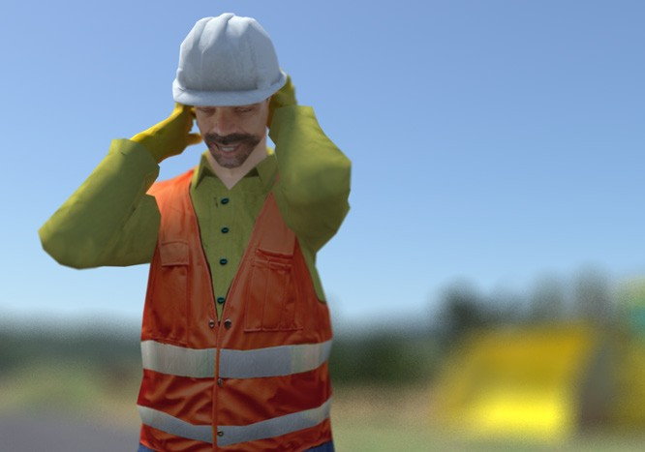

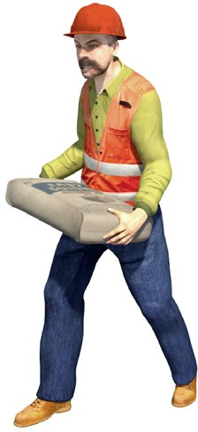
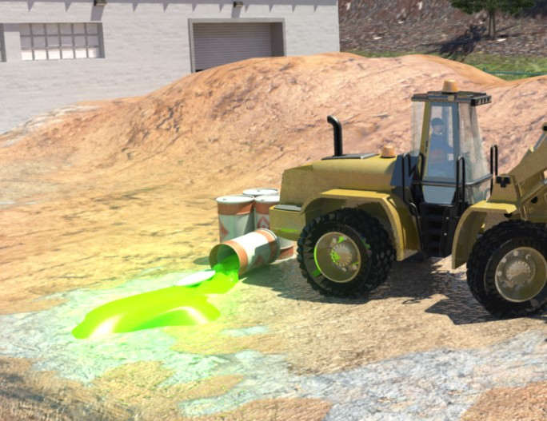
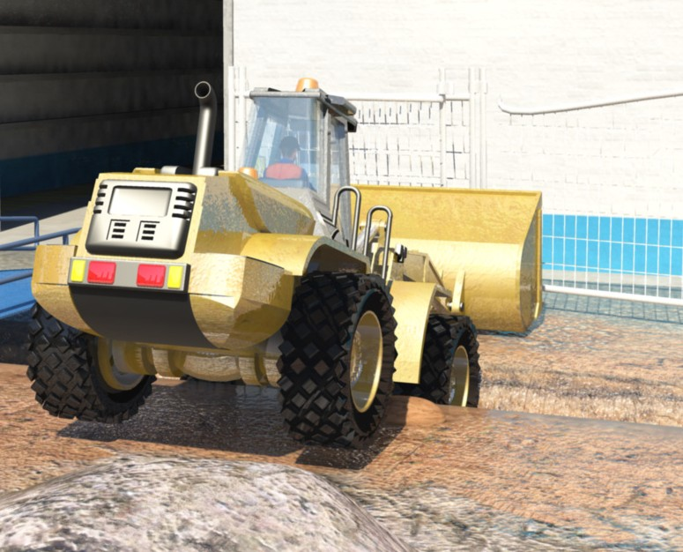

PC 1.4
GENERAL INFORMATION
Earthmoving hazards and risks (continued)
Noise | Dust | Manual handling
Contaminated soil | Falling into trenches or excavations | UV rays (radiation) from working in the sun

Slide 8



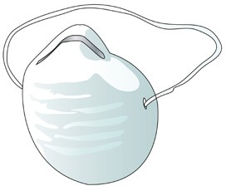


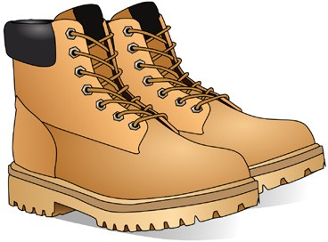
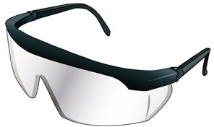
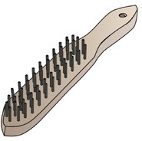


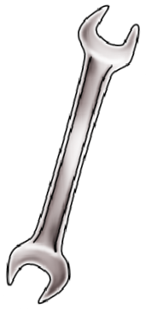
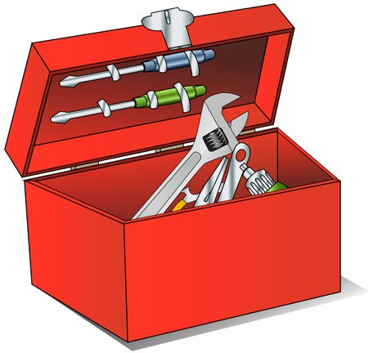
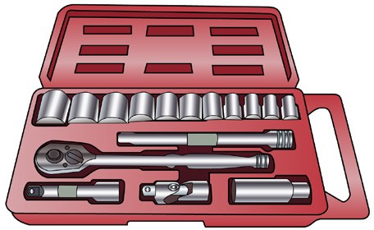

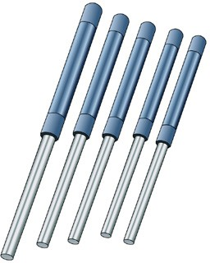
PC 1.5
GENERAL INFORMATION
Tools and equipment
Here are some typical tools and equipment you might need.
Personal protective equipment (PPE)
Steel cap boots
High visibility safety vest
Hearing protection
Hard hat
Goggles/glasses
Gloves
Dust mask
Sunscreen
Hand tools
Shovel and levels
Socket sets
Screwdrivers or wrenches
Wire brush
Spanners

Slide 9

Plan and prepare for integrated tool carrier operations
Element 1

Slide 10
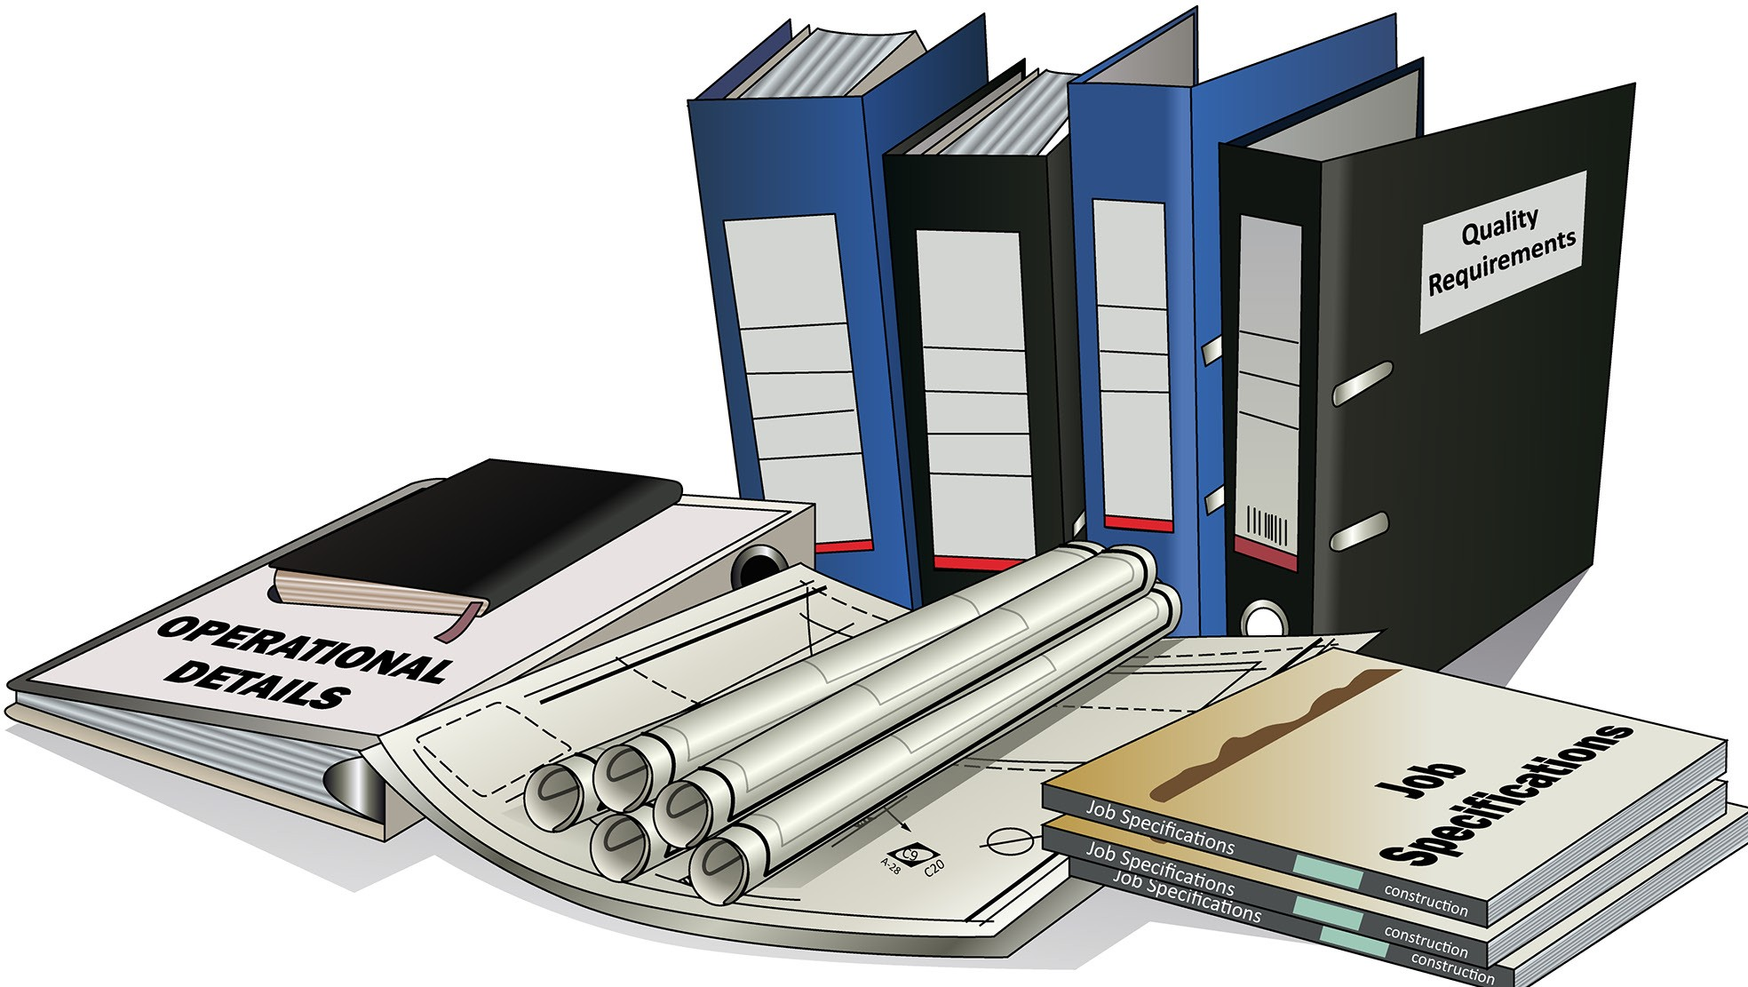
PC 1.2
PLAN AND PREPARE FOR INTEGRATED TOOL CARRIER OPERATIONS
QUESTION 7 | Plans – what you need to do
What kinds of information | Specifications – rules and details about the job
do you need before starting work? | Operational details – how you will do the job Quality requirements of the job – the standards you are expected to meet.

Slide 11
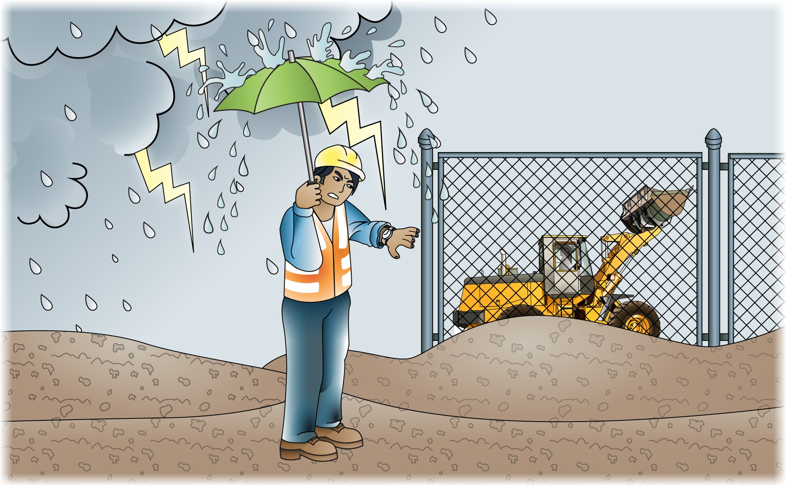
PC 1.2
PLAN AND PREPARE FOR INTEGRATED TOOL CARRIER OPERATIONS
QUESTION 9
What do the job’s work instructions explain?
Work instructions explain:
What to do in unexpected situations like bad weather
What the job is
Where the job is
How to do the job safely
How long the job will take
What tools and equipment you need
How to do the job from start to finish

Slide 12
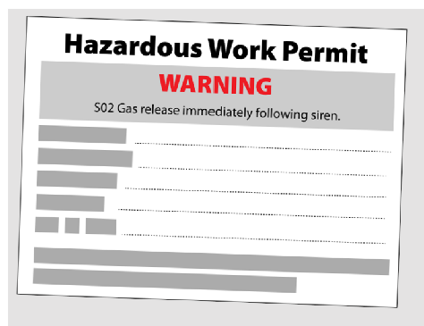
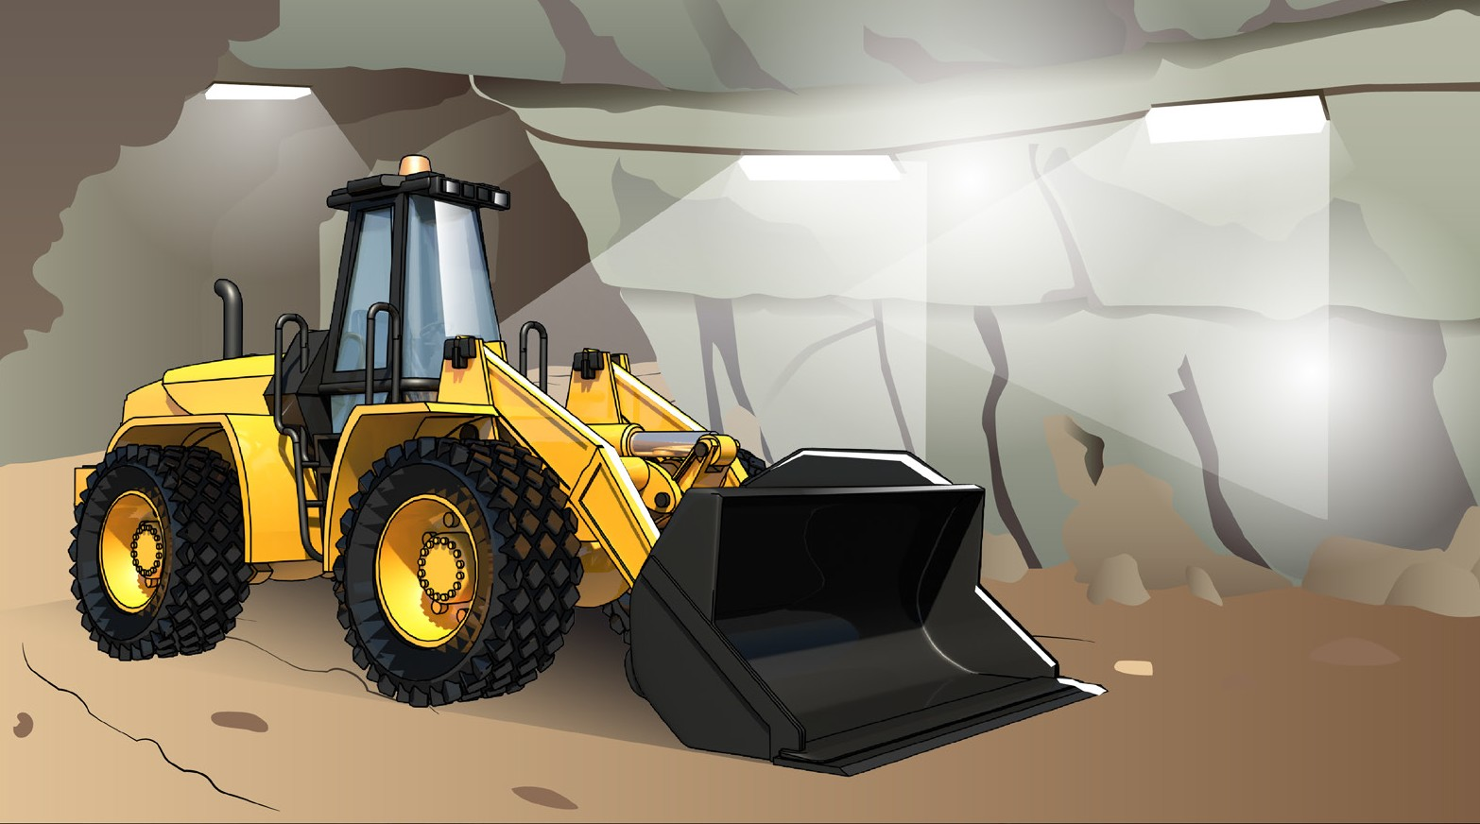
PC 1.4
PLAN AND PREPARE FOR INTEGRATED TOOL CARRIER OPERATIONS
QUESTION 10
You will be working in a hazardous area.
What type of permit might you need to get?
You may need to get a hazardous work permit.

Slide 13
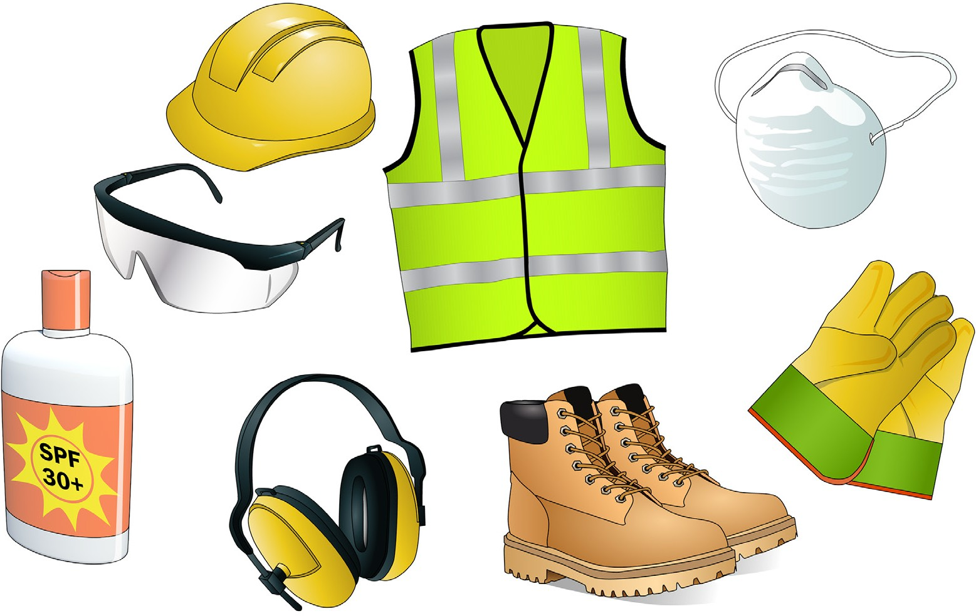
PC 1.3, 1.7
PLAN AND PREPARE FOR INTEGRATED TOOL CARRIER OPERATIONS
QUESTION 11
What does the safety plan tell you?
The safety plan tells you how the worksite intends to meet all the safety rules. It tells you:
What personal protective equipment (PPE) to wear
...CONTINUES ON NEXT PAGE

Slide 14



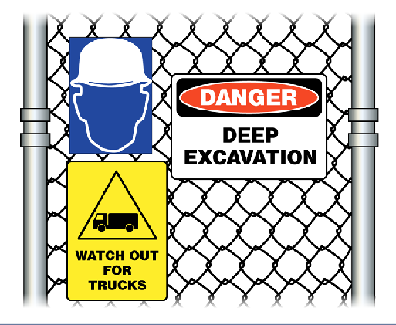



PC 3.2
PLAN AND PREPARE FOR INTEGRATED TOOL CARRIER OPERATIONS
QUESTION 24
Where do you put up warning signs?
Near underground services | Near dangerous places
In places you need to control traffic | On the site fencing
14

Slide 15
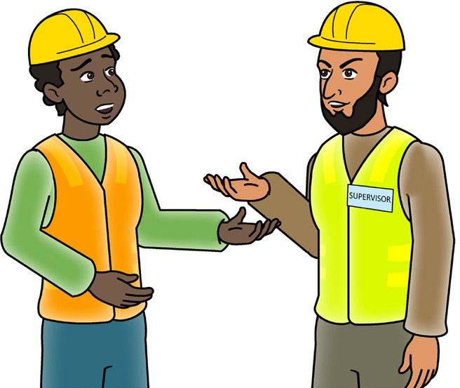

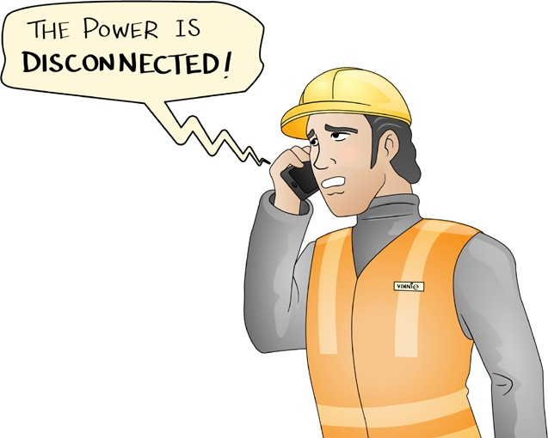
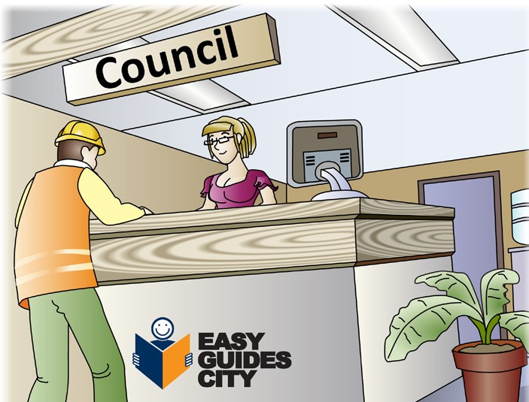
PC 1.4
PLAN AND PREPARE FOR INTEGRATED TOOL CARRIER OPERATIONS
QUESTION 29
Who can you ask about underground services on the worksite?
You can:
Ask your site supervisor | Call 'Dial Before You Dig' on 1100 as a guide to services location only. Ask a specialist consultant to check the site.
Ask the local supply authority (for example, the electricity, gas or water company). | Check the council maps for the site
15

Slide 16
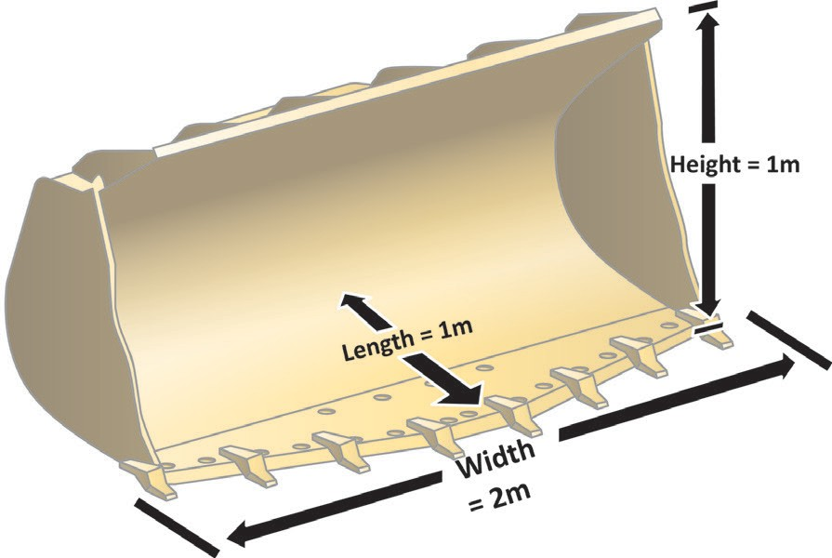
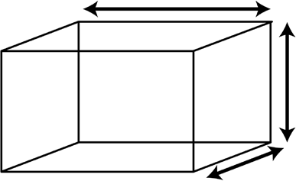
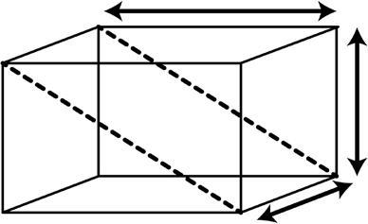
PC 1.2
LIFT AND MOVE LOAD
QUESTION 56
How do you find out the
cubic capacity of the bucket?
Capacity = L × W × H
2
Length
Height
Width
Cubic capacity of cube = L × W × H
Length
Height
Width
Cubic capacity of bucket = L × W × H ÷ 2
Cubic capacity is ÷ 2 because of the shape of the bucket (a triangular prism, or half of a rectangle)
16

Slide 17
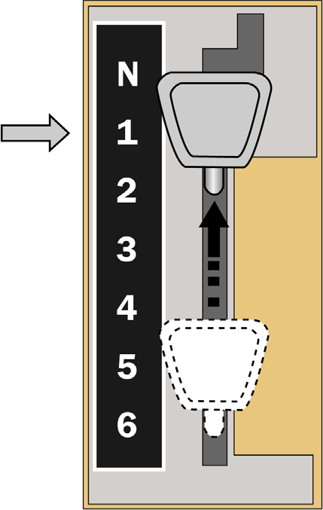
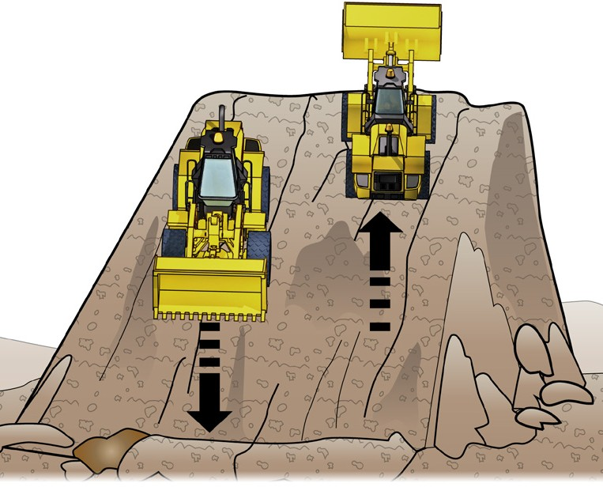
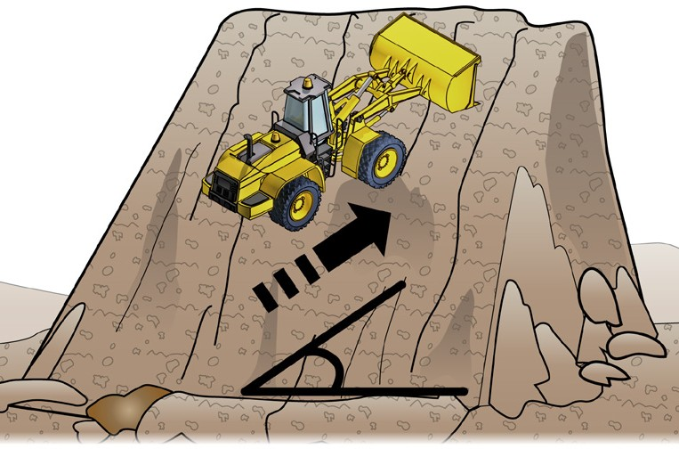
PC 2.3
LIFT AND MOVE LOAD
QUESTION 57 When travelling down a steep slope, which gear do you use? | Use the lowest gear you can. Change into low gear before you drive on the slope. For example:
QUESTION 58 Which way should you travel when driving on sloping ground? | Go straight up or down the hill, not at an angle.
17

Slide 18
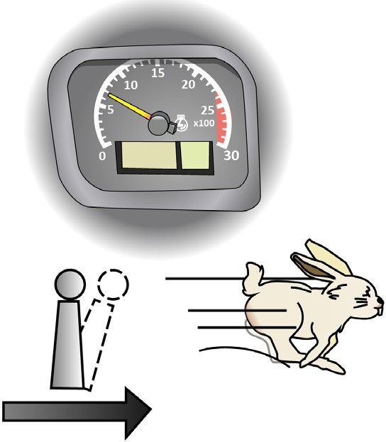
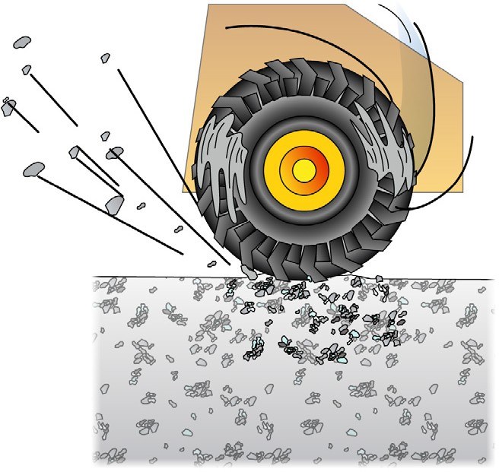

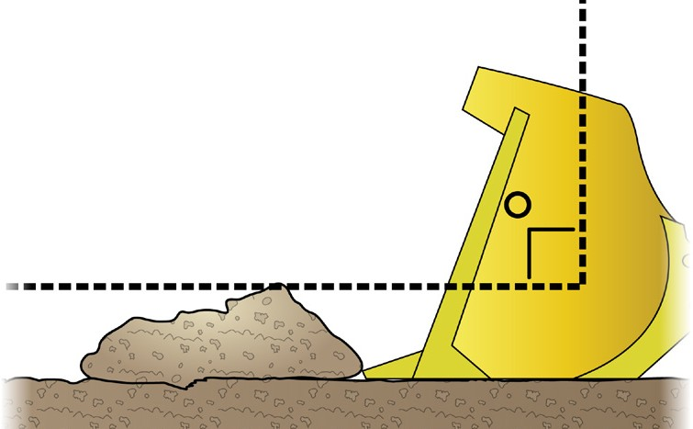
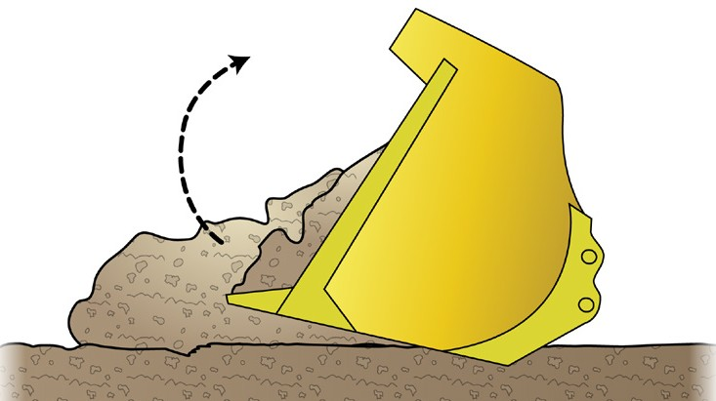
PC 2.3, 2.4
LIFT AND MOVE LOAD
QUESTION 62
What steps do you take to safely pick up, move, and dump materials with a bucket?
1. Build up engine RPM and correct speed. Try not to spin the wheels.
2. Make sure the bucket is at the right level and angle. | 3. Crowd the bucket upwards while moving forward.
 | ...CONTINUES ON NEXT PAGE
18

