Slide 1


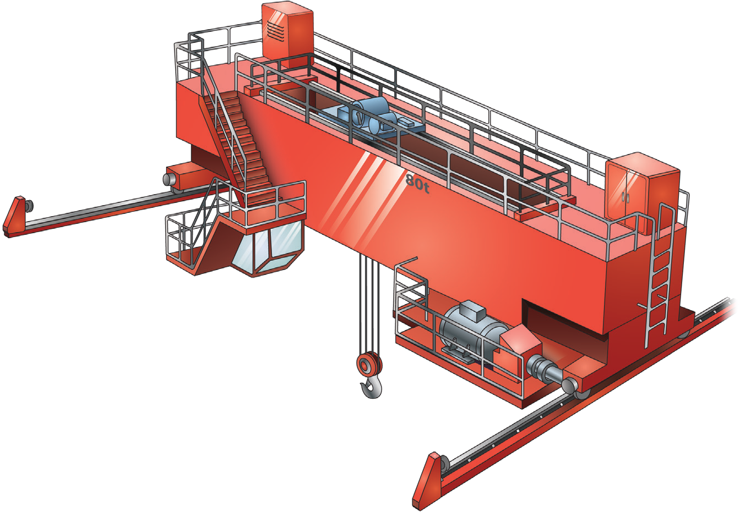

Bridge and gantry Crane
SAFETY AND LICENCE GUIDE
Training support material for:
TLILIC0006
Licence to operate a bridge and gantry crane
Produced by:

Slide 2
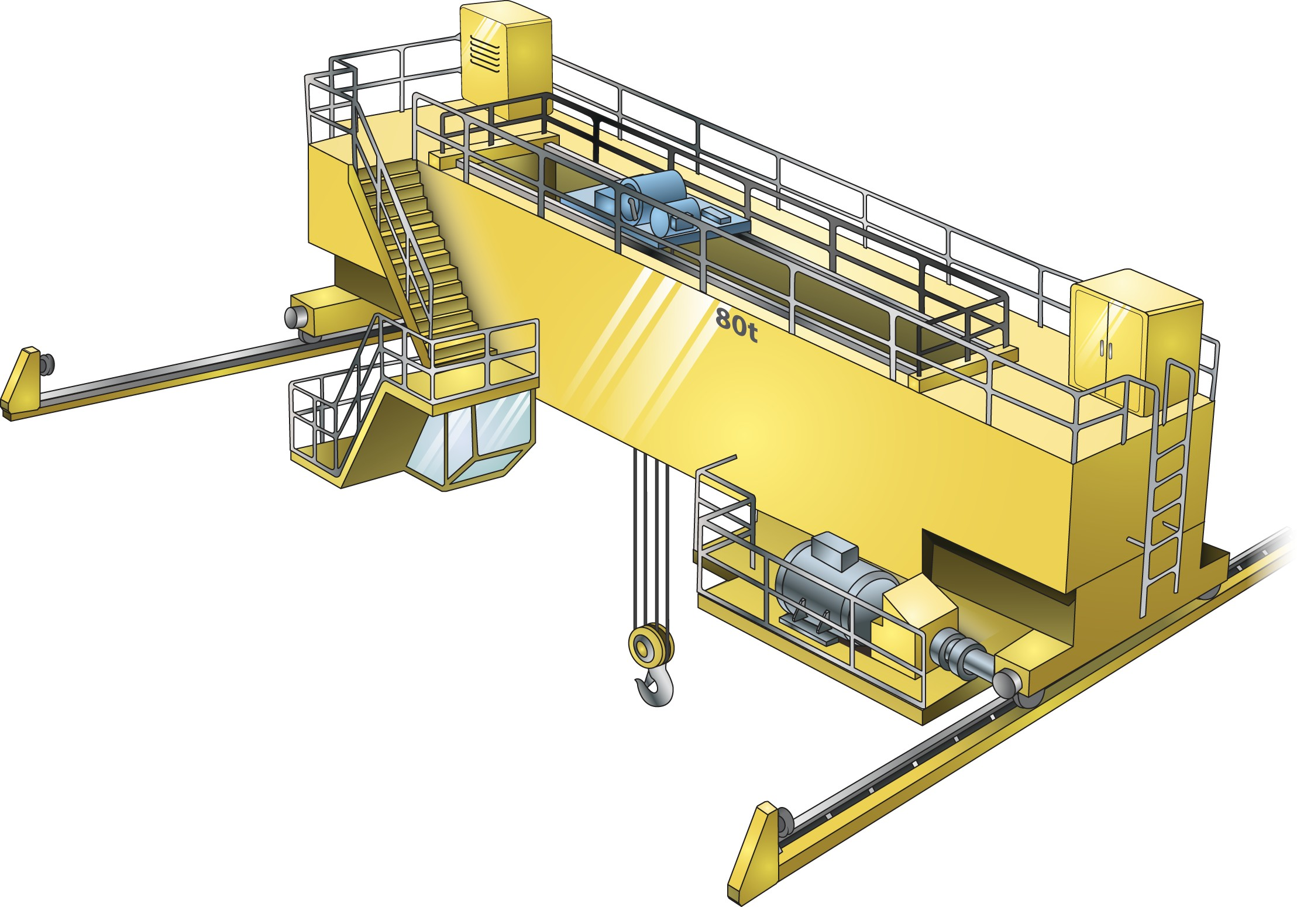

Parts of a bridge crane
INTRODUCTION TO BRIDGE AND GANTRY CRANE
Resistor banks
Crab
Control panel
Bogeys
SWL
Beam bridge
Drivers cabin
Hoist block
Rails
End stop
2

Slide 3
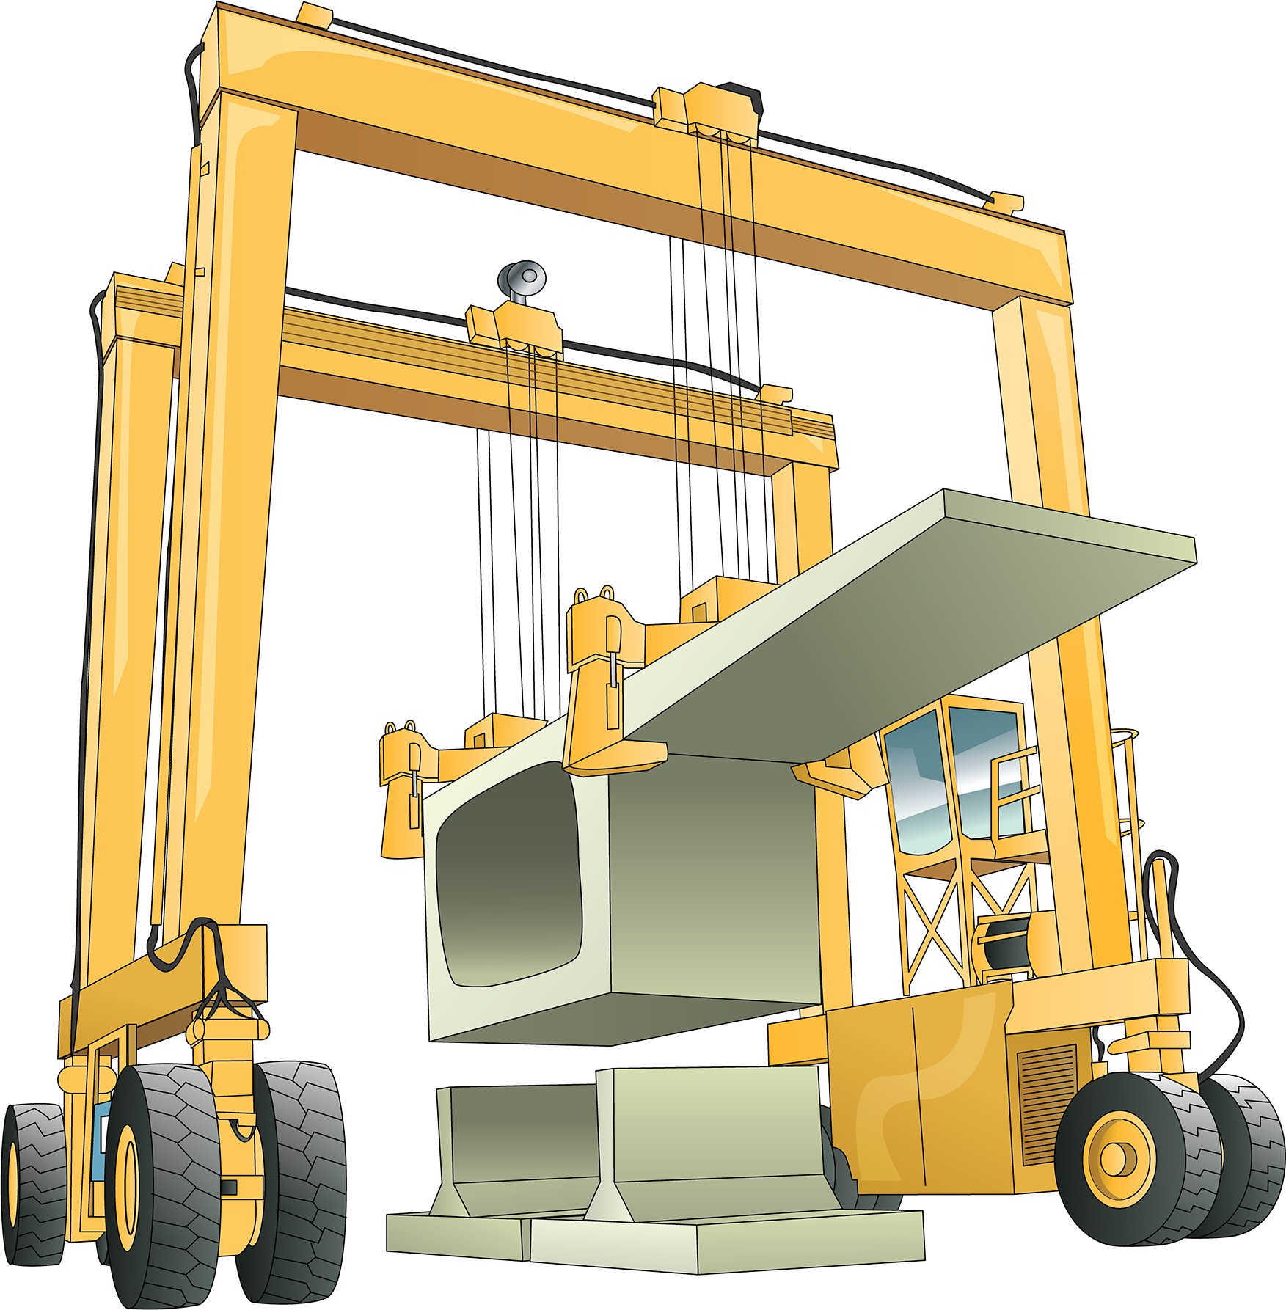
What is a gantry crane?
INTRODUCTION TO BRIDGE AND GANTRY CRANE
A gantry crane has a bridge beam
which is supported by legs
The legs are mounted on carriages which move along supporting surfaces or deck levels
They have a crab with at least one hoisting mechanism which moves from side to side across the bridge
Gantry cranes are used in factories and outdoor areas including railway and shipping yards
3

Slide 4
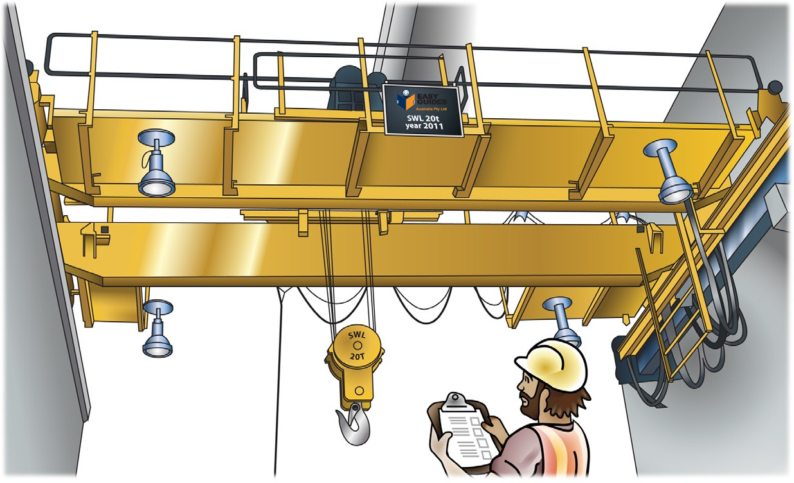
Conduct routine checks
Chapter 2

Slide 5
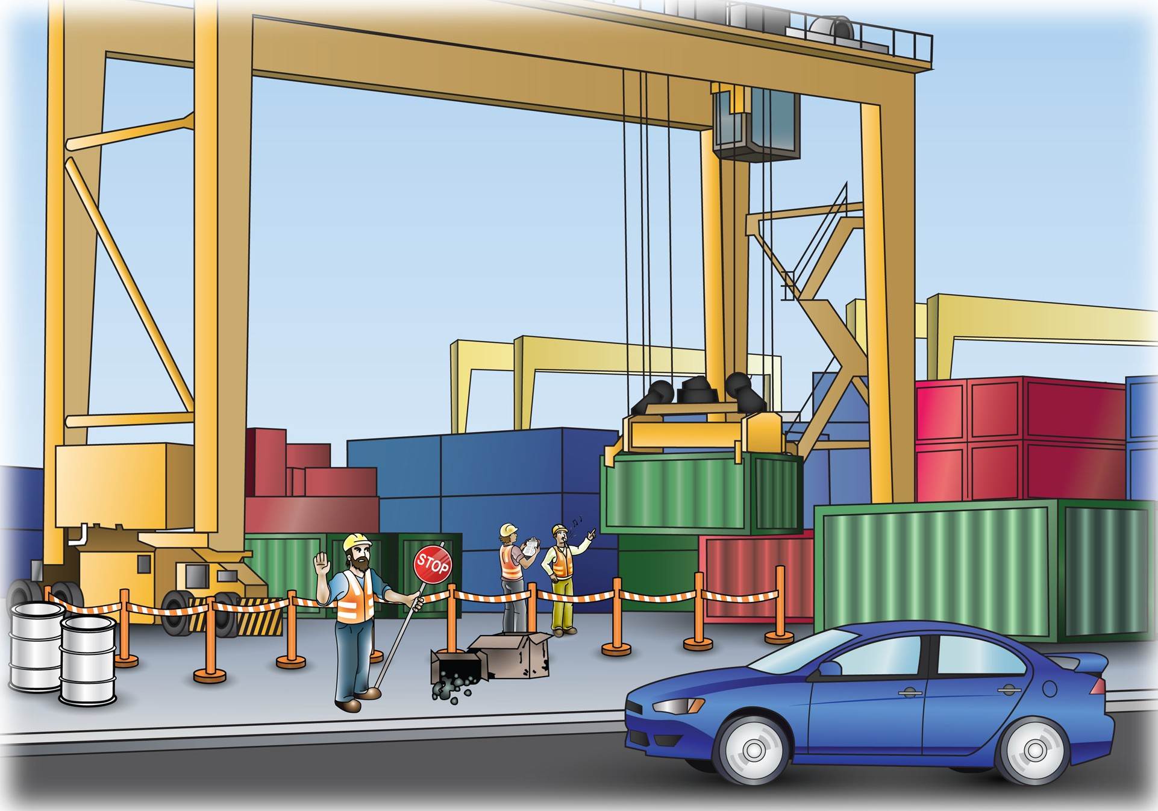
PC 1.5, 2.2
CONDUCT ROUTINE CHECKS
QUESTION 35 | Before you start working. If a hazard arises after you have started work, stop immediately and put controls in place.
When do you put your
hazard (risk) controls in
place?

Slide 6
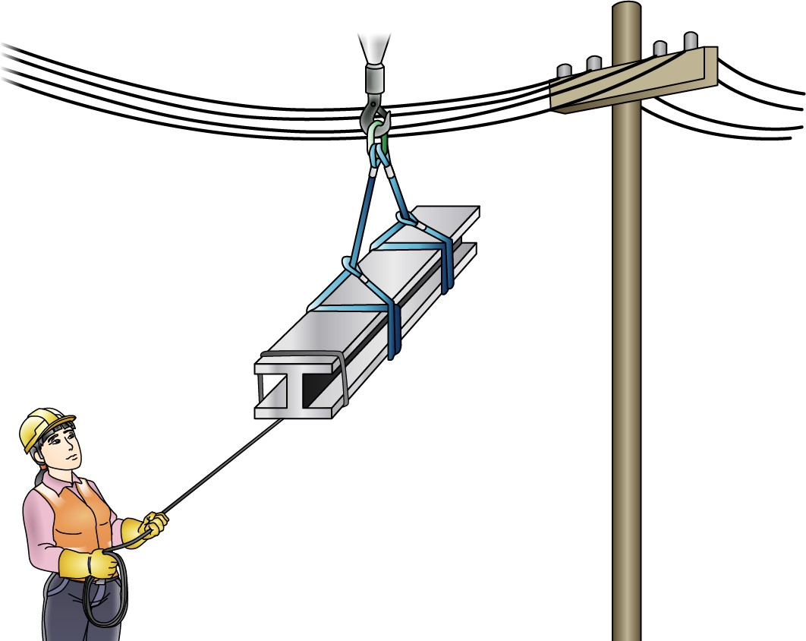
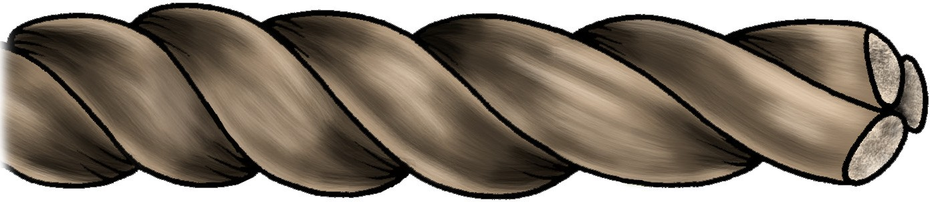
PC 3.5
CONDUCT ROUTINE CHECKS
QUESTION 36 What type of tagline do you use when you work near powerlines? | Non-conductive rope
QUESTION 37 What is the smallest tagline you can use? | 16 mm 16 mm

Slide 7

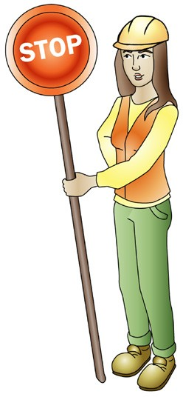

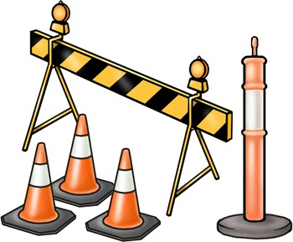
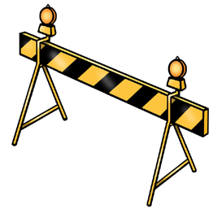
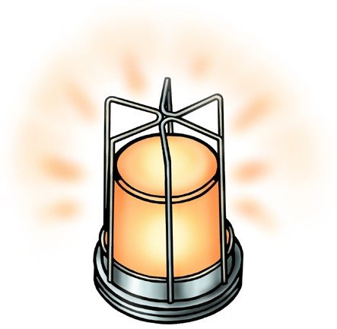
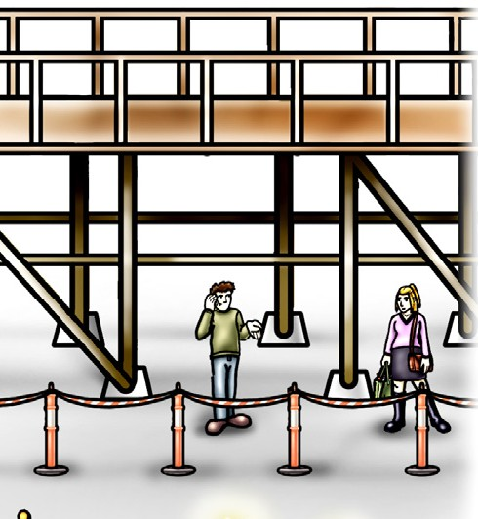

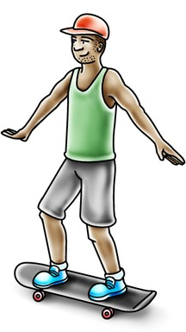
PC 1.6
CONDUCT ROUTINE CHECKS
QUESTION 38
How do you control the movement of vehicles, mobile plant or people on site?
Warning signs and barriers | Flag person | Traffic controls such as witches hats
Flashing yellow hazard lights to warn people | Scaffolding or a gantry to protect people walking by | Pedestrian/vehicle exclusion zones.

Slide 8
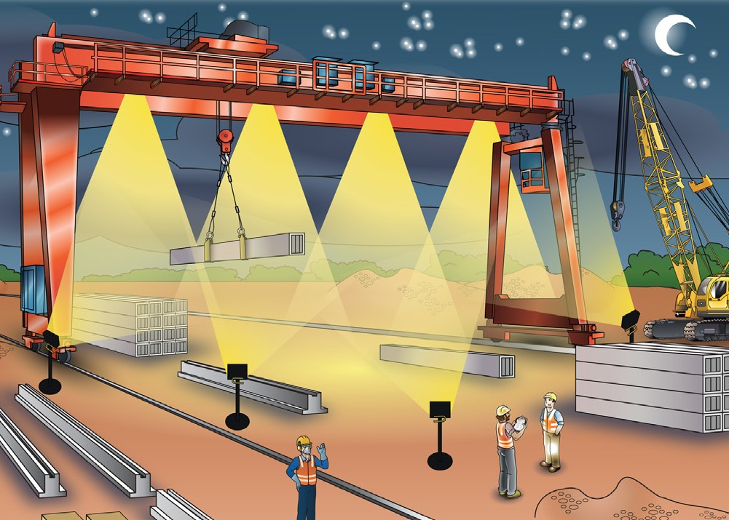
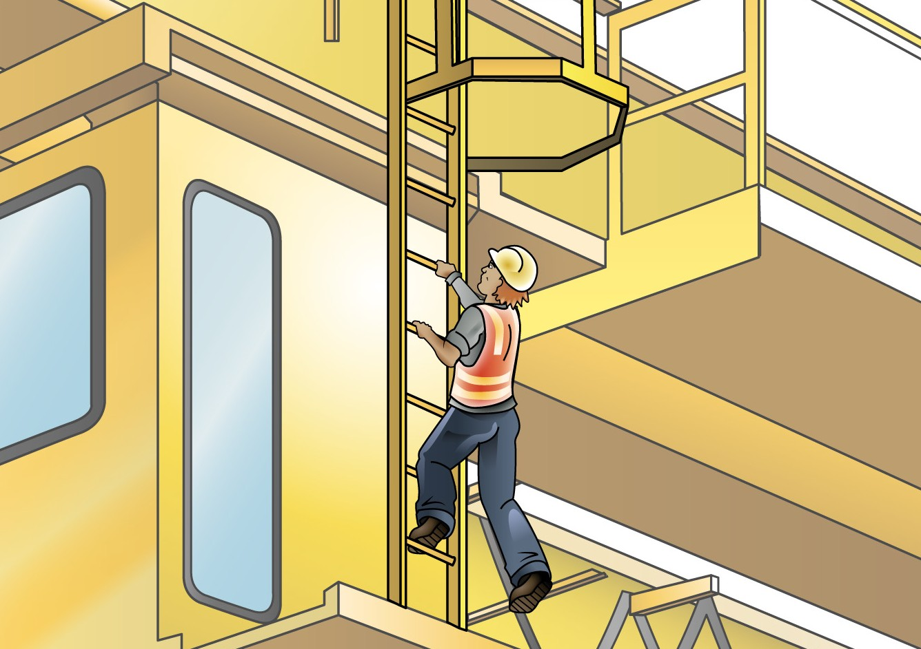


PC 2.9, 2.3
CONDUCT ROUTINE CHECKS
QUESTION 39 What do you need when working in the dark? | You need enough light to work safely. If the work area is dark, you need extra lighting.
QUESTION 40 | Make sure the crane is parked correctly.
How do you safely access the crane’s cabin? | Use three (3) points of contact. For example, two hands and one foot or two feet and one hand.

Slide 9
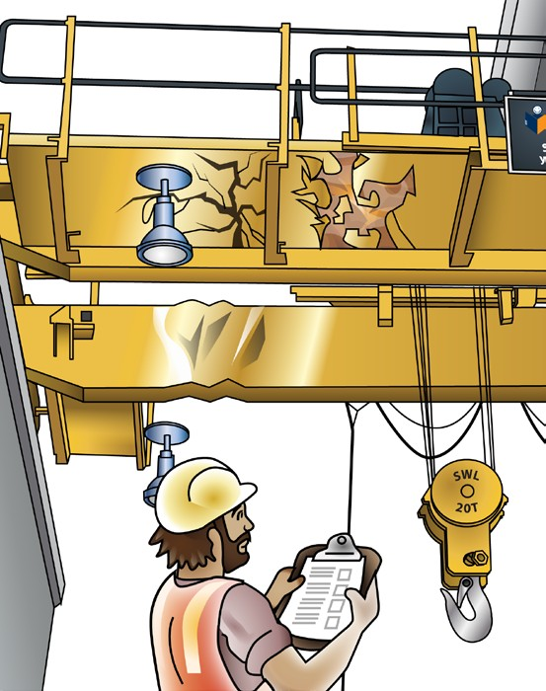
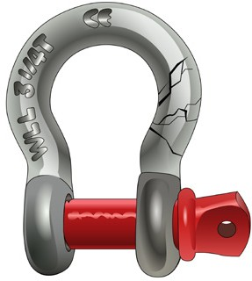


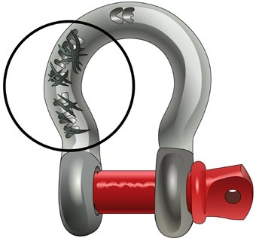
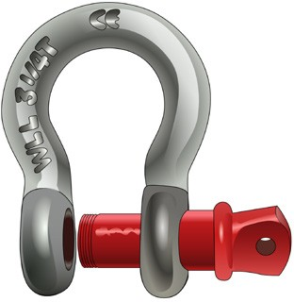

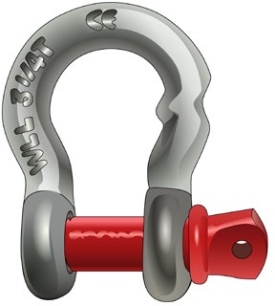

PC 2.4
CONDUCT ROUTINE CHECKS
QUESTION 41 What are some examples of obvious defects on a crane? | Cracks in the structure or welds. Bends or twists (or both) in the structure. Visible rust – especially from welds or joints. Paint flaking. Bolts that are loose.
QUESTION 42 | Chips or cracks | Can’t read the working load limit
What sort of damage would |  | (WLL) marking
mean that shackles are
not safe to use for lifting?
 | Pin defects – | Bends or twists
 | wrong pin
 | pin is missing
 | pin won’t screw in.
• stretched pin

Slide 10
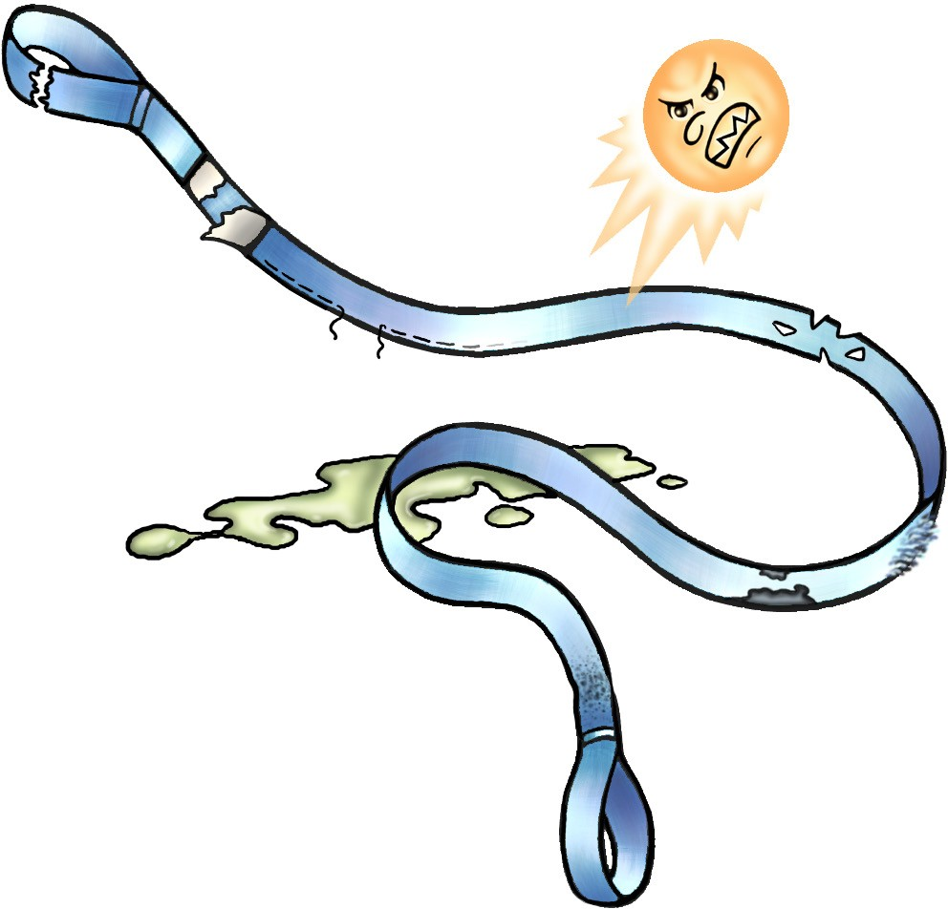
PC 2.4, 2.5
CONDUCT ROUTINE CHECKS
QUESTION 62
Name some problems that make a synthetic sling unsafe to use.
Damaged eyes, terminal
attachments or end fittings
Damage from heat the sun or chemicals
Stitching is damaged
Any visible damage at all
The label/tag is missing,
damaged or you can’t read it
Wear and tear or burns on the inside
Nylon sling has contacted acid or alkaline
Wear and tear or abrasions (rub marks)
on the outside
Polyester sling has contacted paint, coal tar or paint stripper
Damaged sleeve

Slide 11
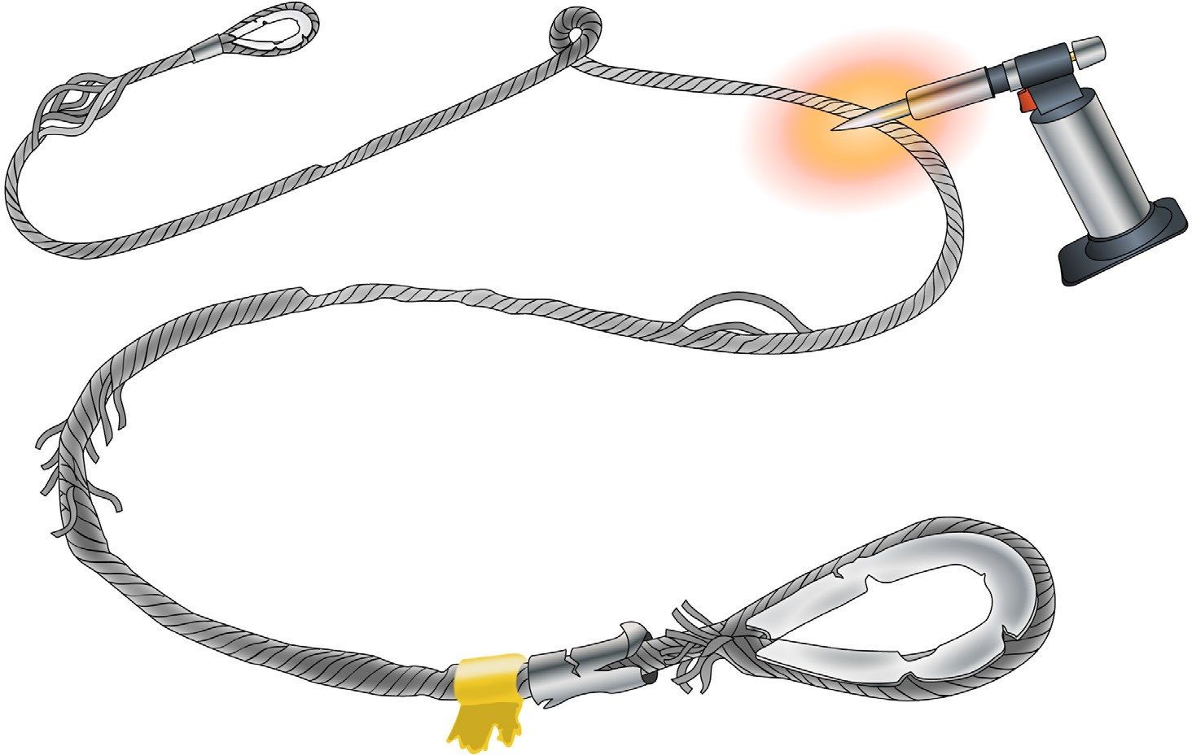

PC 2.4, 2.5
CONDUCT ROUTINE CHECKS
QUESTION 63
Name some problems that stop you from using a flexible steel wire rope (FSWR) for lifting.
Knots in the rope
Ferrule is damaged
Core is collapsed
Heat damage
Loose strands
(bird-caging)
Abrasions
Strands are squashed or stuck
Stretching
More than 10% wear
More broken wires than are allowed
High strands
Splice is damaged
Damage to eyes
Loose and springy wires
caused by rust or corrosion
Bends or cracks
Thimble is damaged
The SWL or WLL is unreadable

Slide 12
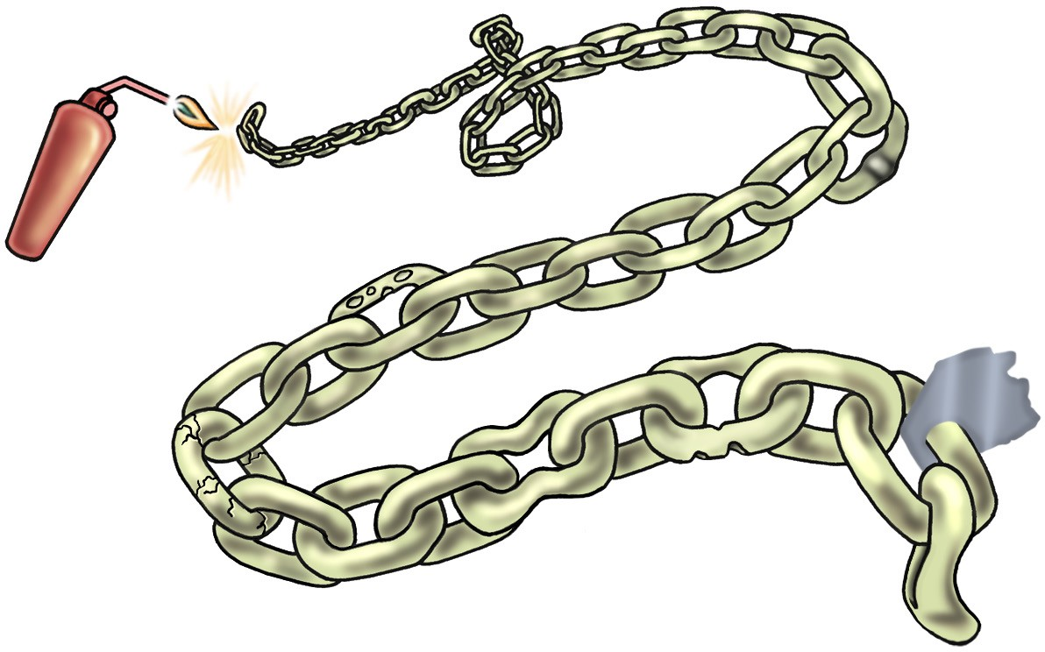
PC 2.4, 2.5
CONDUCT ROUTINE CHECKS
QUESTION 64
Name some problems that stop you from using a lifting chain for lifting.
Heat damage
Twisted, kinked or knotted
Locked or stretched chain links
Pitting and or rust
Link has more than 10% wear in the diameter
Gouge marks or cuts
Cracks or spot welds
The label/tag is missing, damaged or you
can’t read it

Slide 13
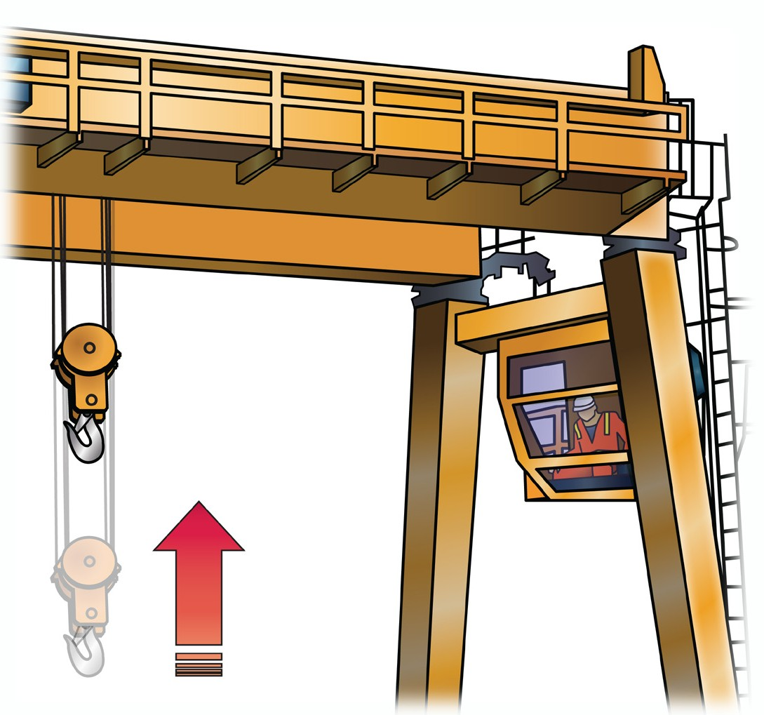
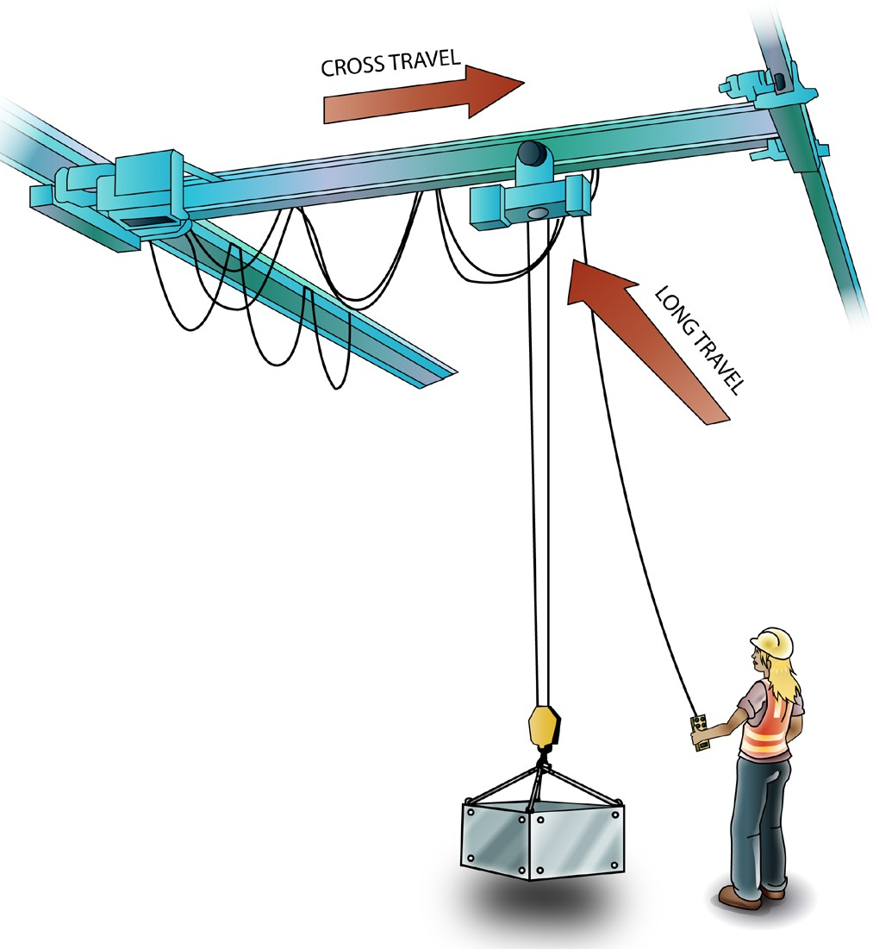
Test the movements
PC 2.7 CONDUCT ROUTINE CHECKS
Test the crane’s movements to make sure everything works and the crane can do all of its movements to full capacity.
The movements you test are:
Cross travel (crabbing)
Test the cross travel control and move the crab along
the runway. Go all the way to both end stops.
Long travel
Test the long travel control and move the crane along the rail. Go all the way to both end stops.
Hoist
Lower and raise the hoist block. This will also test the hoist limit switch.
Grab rotation
Some cranes have an extra movement that lets the grab assembly turn 360 degrees.

Slide 14
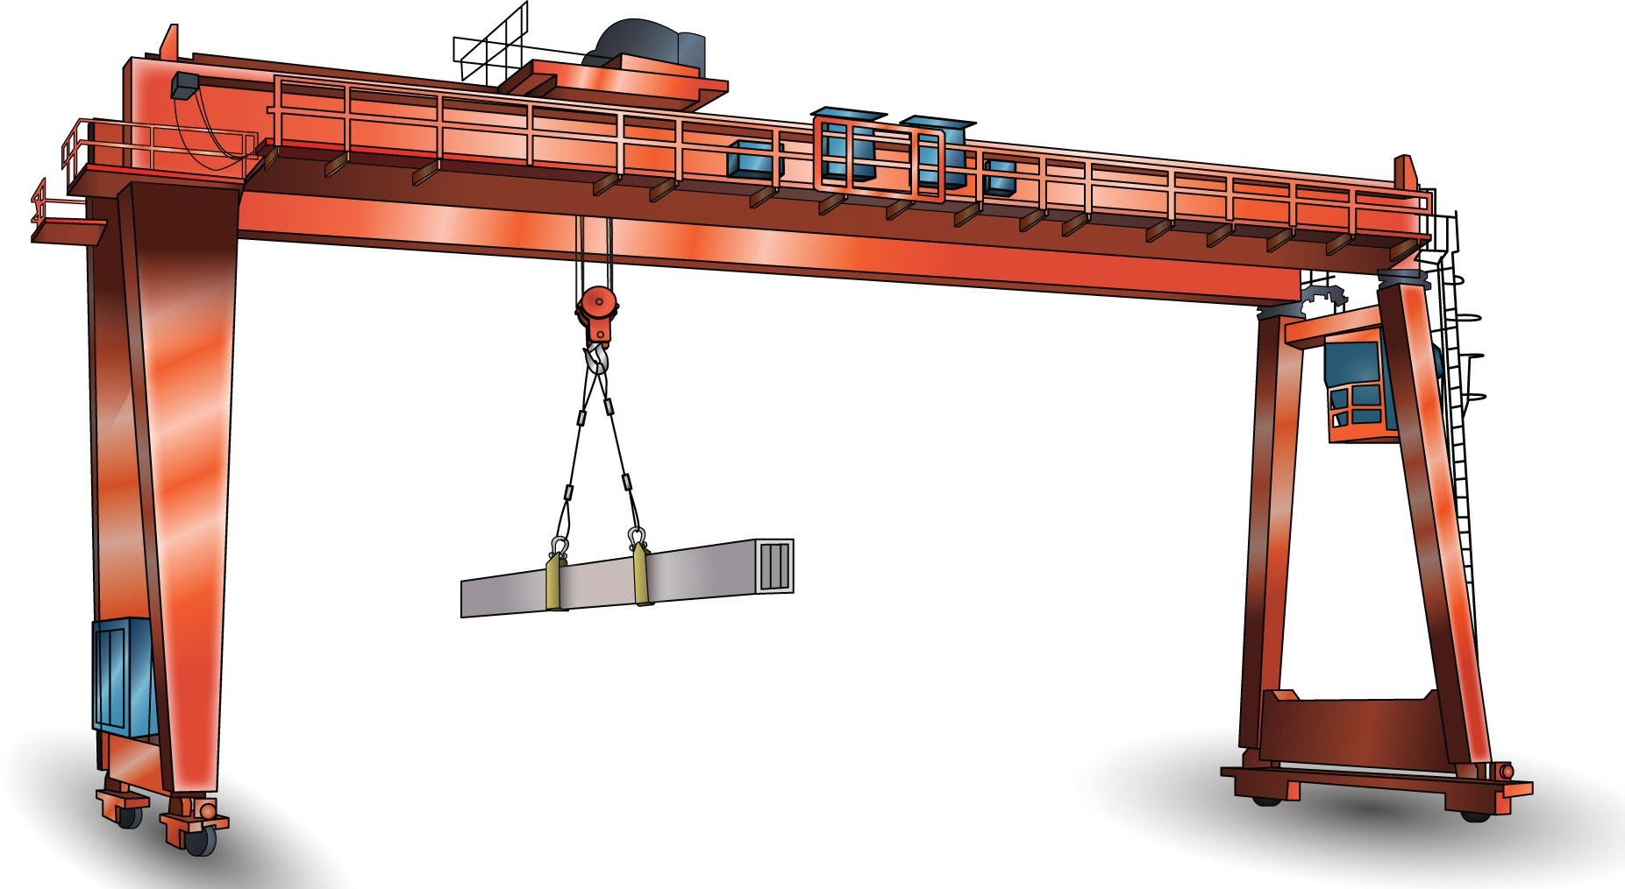
Transfer loads
Chapter 3

Slide 15
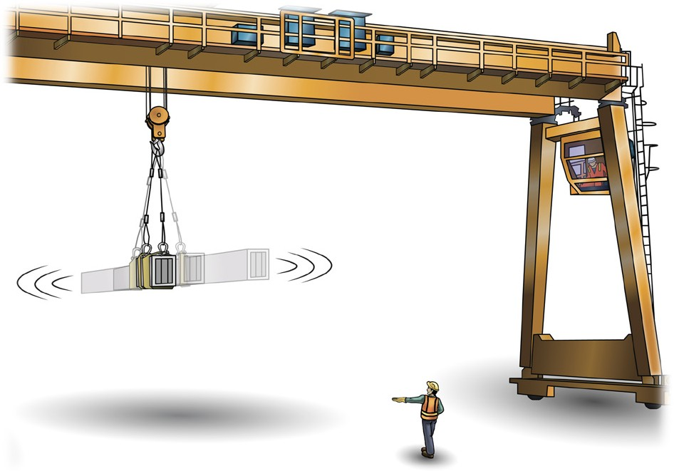

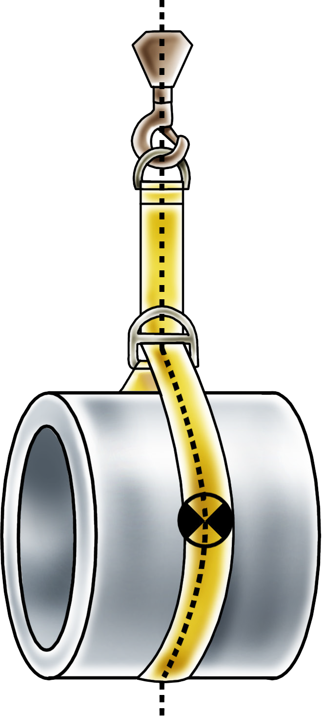
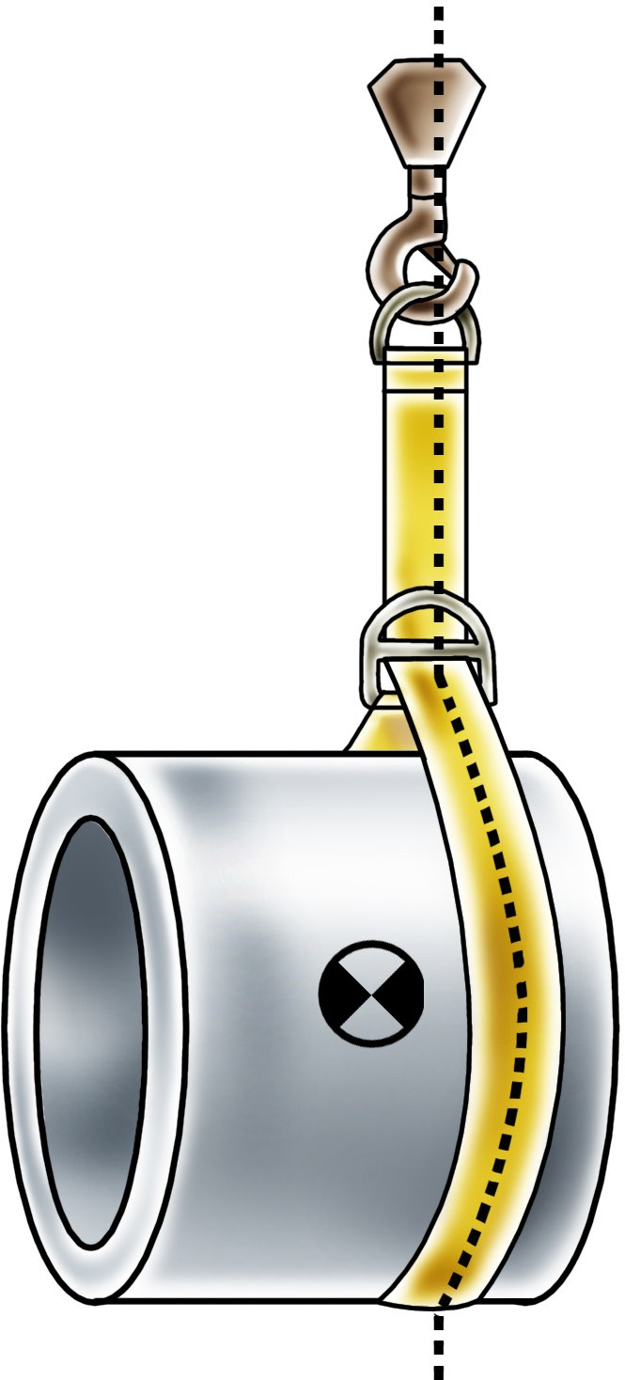

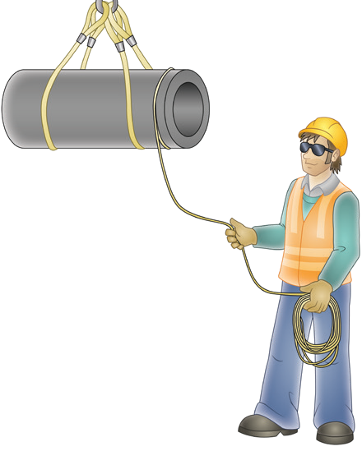
PC 3.2
TRANSFER LOADS
Position the hoist block
You use the hoist block for raising and lowering the hook.
The block might have one or more sheaves.
Position the hoist block over the load’s centre of gravity.
When the hoist block is set up properly it reduces the risk of
load swing, damaging the crane, or overloading the crane.
If required, a dogger can help you set up and position the hoist block.
Centre of gravity

