Slide 1


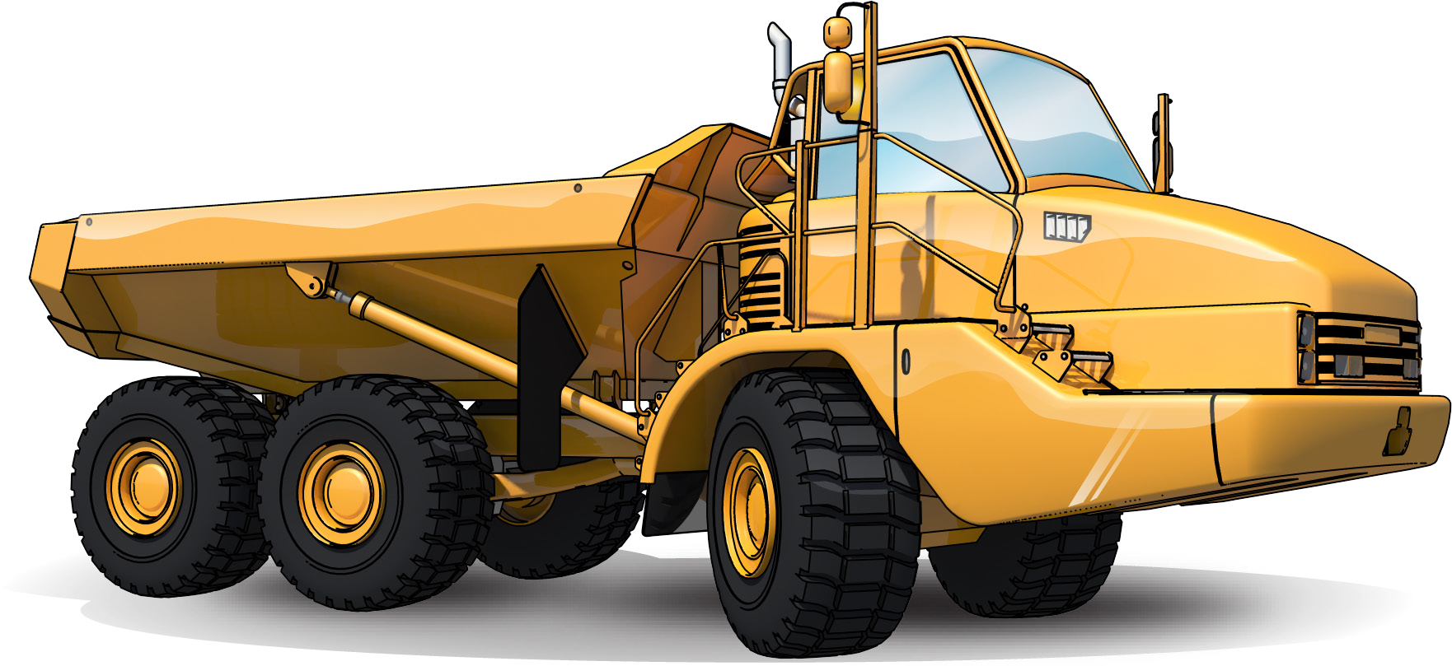

Articulated
Haul Truck
LEARNER GUIDE
TICKET
Training support material for:
RIIMPO337E
Conduct articulated haul truck operations
Produced by:

Slide 2

INSTRUCTIONS TO VIEW POWERPOINT
This PowerPoint presentation is currently in ‘Edit mode’.
This means you can edit it and make changes.
To view the PowerPoint you need to click your mouse on Slide Show at the top of the screen. You can then watch from the beginning or the Current Slide.

Slide 3
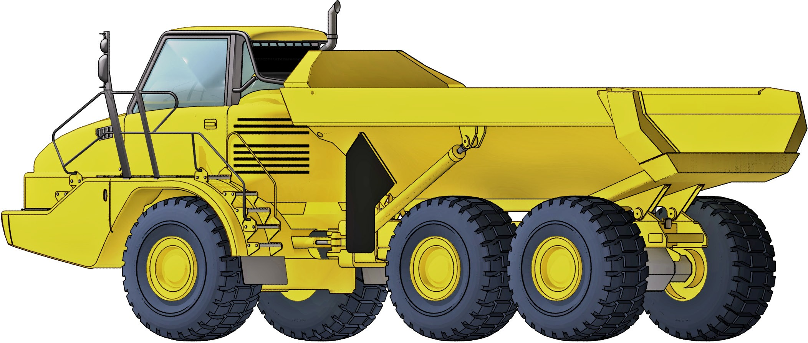
Introduction to Articulated Haul Truck

Slide 4
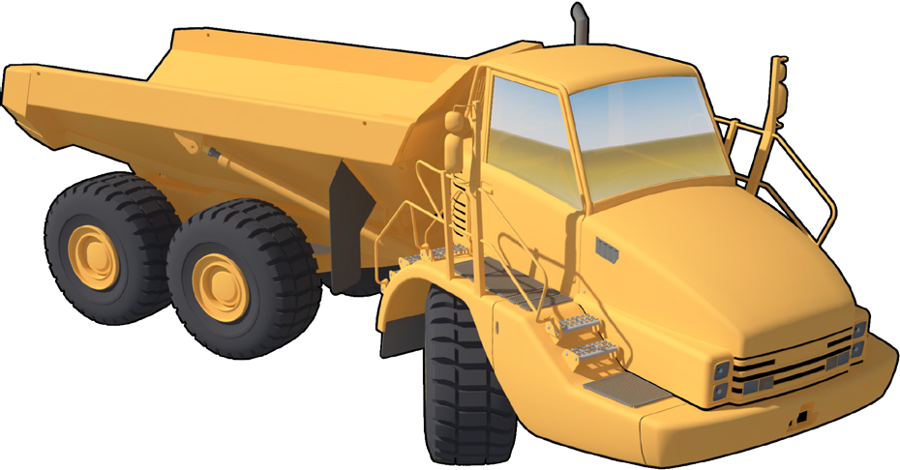
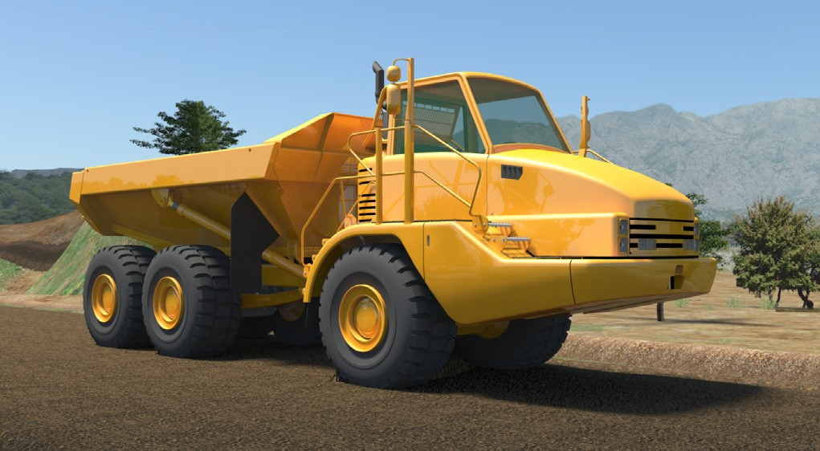
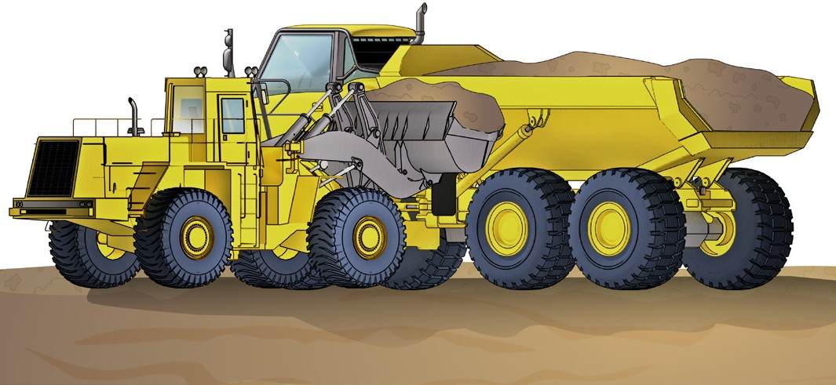
PC 1.1
INTRODUCTION TO ARTICULATED HAUL TRUCK
Introduction to articulated haul truck
An articulated haul truck is a large heavy uty type of haul truck used to transport loads over rough terrain and carry materials from one place to another.
The haul truck is built to handle rough slopes and slippery conditions. It has four-wheel or all-wheel drive and the truck steers by the cab and front axle pivoting separate from the load body and rear wheels. For example, to steer to the right, the engine, cab and front axle would pivot to the right.
You can load a haul truck with a number of machines including excavators and loaders.
Articulated haul trucks covered in this guide are off-highway trucks and diesel-powered mechanical drive.

Slide 5
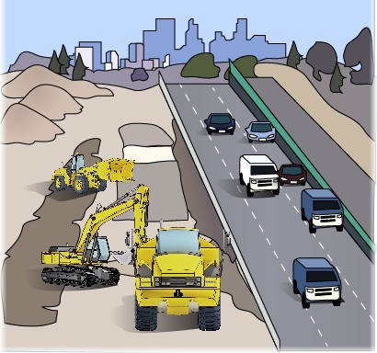
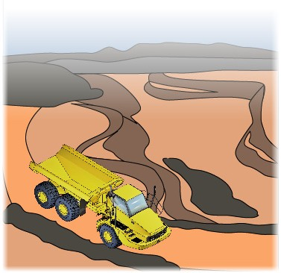
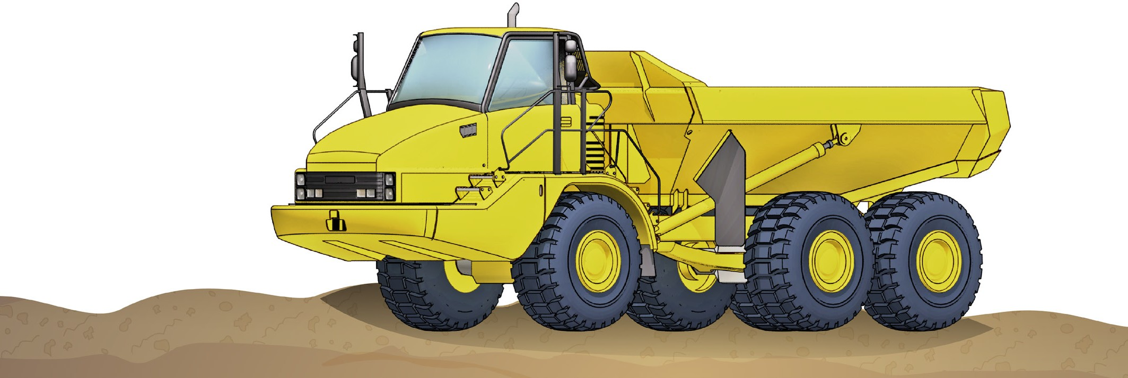
What industries do you use an articulated haul truck in?
PC 1.2 INTRODUCTION TO ARTICULATED HAUL TRUCK
Civil construction
Coal mining
Extractive industries
Metalliferous mining

Slide 6
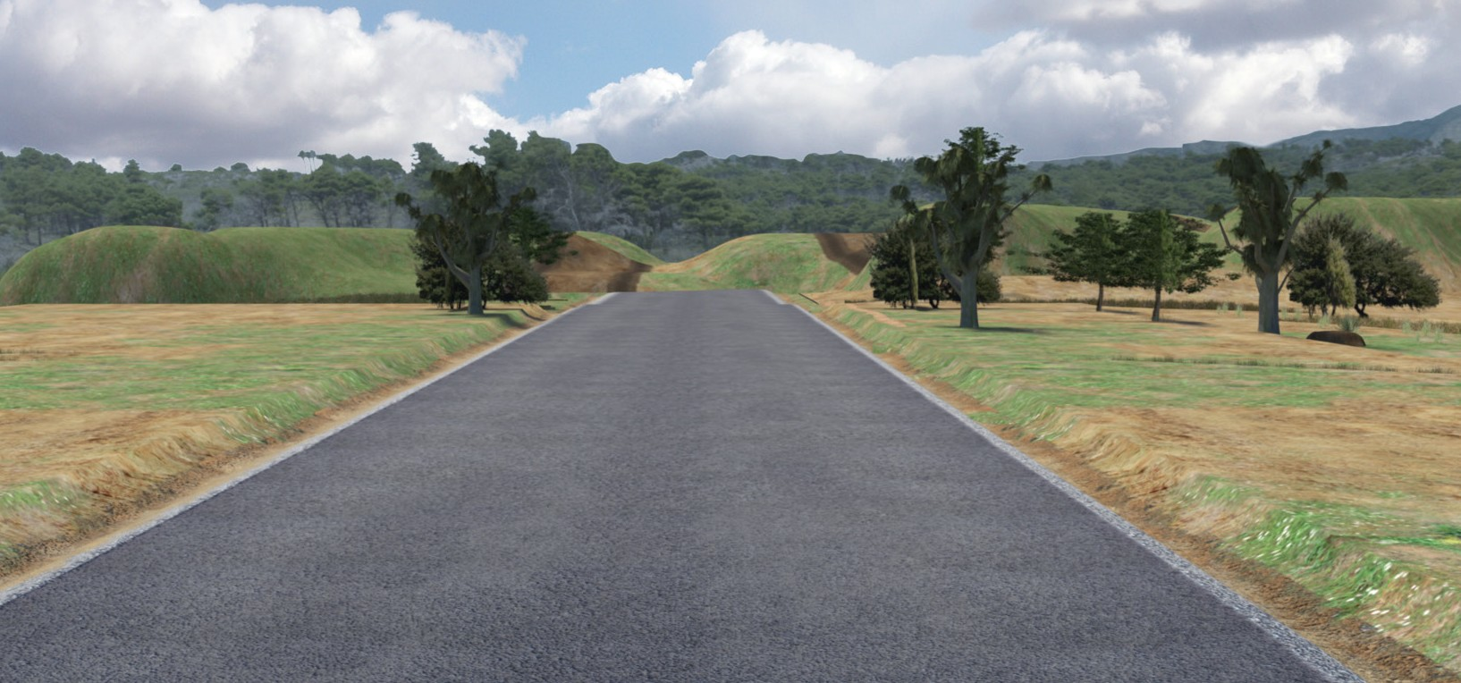
The basics of road construction

Slide 7
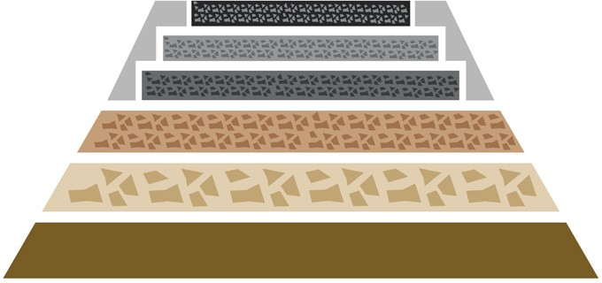
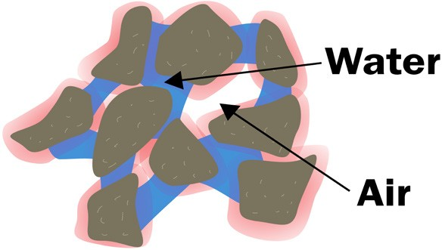
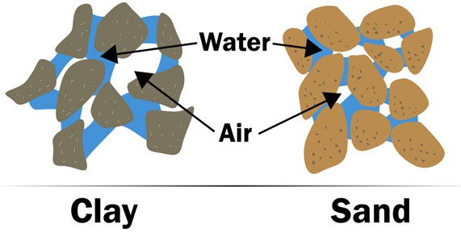
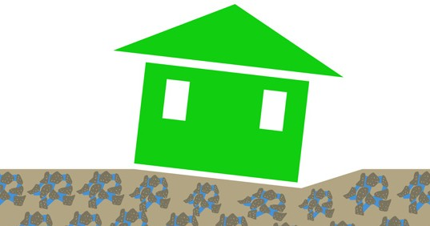
PC 1.2
THE BASICS OF ROAD CONSTRUCTION
Principles of soil technology for civil works
One of the most important jobs you will do, as a machine operator, is to help lay foundations. Foundations are the base for roads, railway lines, swimming pools and buildings. If you do not have a solid foundation, you cannot build something solid on top of it. | In civil construction, moisture content means how much water is in a soil, rock, aggregate or road base. Moisture is very important in earthmoving. Moisture affects the weight of soils. It makes soils swell, and it also affects the handling properties of the soil. Handling properties means how easy or hard it is to work with that soil.
All soils usually contain moisture. How much moisture the soil has depends on many things. The weather, drainage, and the soil’s ability to hold water all affect the moisture in a soil. Retention properties mean how much water a soil can hold. Different soils can hold different amounts of water. Sometimes you can treat a soil to change its moisture content. To do this you mix a chemical with the soil. | Different types of soils can cause problems with foundations. Wet, boggy soil can cause foundations to sink. That is why it is important to make sure water can run or drain from the site. It is also important that the foundation is built up to the right level. You can sometimes treat wet boggy soil with lime. Lime helps dry out the soil, and helps it ‘clump’ together.

Slide 8

Plan and prepare for articulated
haul truck operations
Chapter 1

Slide 9
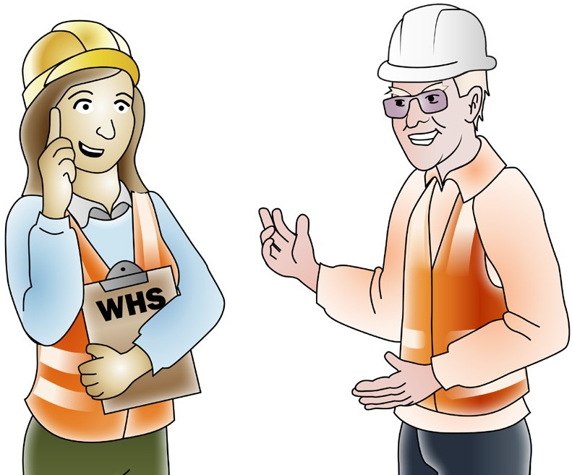
Work Health & Safety Legislative Requirements
PC 1.1 PLAN AND PREPARE FOR ARTICULATED HAUL TRUCK OPERATIONS
‘Laws to keep your workplace safe’
WHS/OHS requirements are outlined in Acts, Regulations, Codes of Practice and Australian Standards.
WHS/OHS Acts
‘WHS/OHS Acts’ are laws that explain how to improve health and safety in the workplace.
For example: Model National WHS Act, June 2011. WHS has the same meaning as OHS in this document.
Regulations
‘Regulations’ explain specific parts of the Act.
For example: Part 4.3 – Confined spaces, Part 4.4 – Falls.
Codes of Practice/Compliance Codes
‘Codes of Practice’ are practical guidelines on how to comply with (meet the rules of) legislation. For example: HAZARDOUS MANUAL TASKS Code of Practice, 23rd December 2011.
Australian Standards
‘Australian Standards’ are work guidelines that set the minimum accepted performance or quality
for a specific hazard, process or product.
For example: AS 2550 – Cranes, hoists and winches – safe use set.

Slide 10

Where to find WHS information
PC 1.1 PLAN AND PREPARE FOR ARTICULATED HAUL TRUCK OPERATIONS
You can check these websites for more information about workplace health and safety.
QLD Workplace Health and Safety
www.justice.qld.gov.au
NT WorkSafe
www.worksafe.nt.gov.au
WA WorkSafe
www.worksafe.wa.gov.au
NSW WorkCover
www.workcover.nsw.gov.au
SA SafeWork
www.safework.sa.gov.au
ACT WorkCover
www.ors.act.gov.au/workcover
You can read more about the new WHS Act at www.safeworkaustralia.gov.au
VIC WorkCover Authority
www.vwa.vic.gov.au
TAS Workplace Standards
www.wst.tas.gov.au

Slide 11
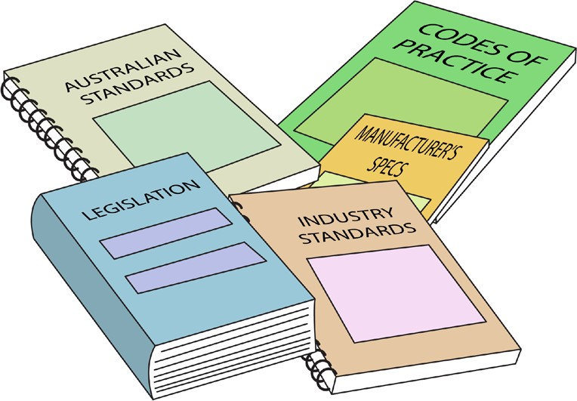
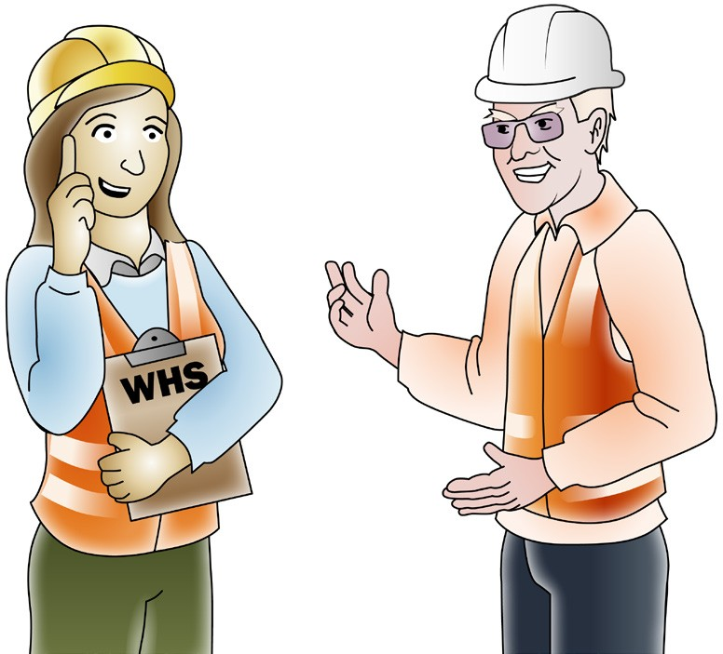
PC 1.1
PLAN AND PREPARE FOR ARTICULATED HAUL TRUCK OPERATIONS
QUESTION 1
What are the National Work Health (WHS) and Occupational Health and Safety (OHS) Acts about?
The Acts explain how to keep your workplace safe and healthy. They explain what you need to do to meet your duty of care.
For example:
You must make sure you do earthmoving work in a way that won’t put yourself or others at risk. You must use earthmoving equipment according to instructions.
Note:
Check your state requirements as Acts may vary from state to state
QUESTION 2
Under WHS/OHS laws, what are your responsibilities while working?
You must work in a way that is safe. You must not risk the health and safety of yourself or others.

Slide 12
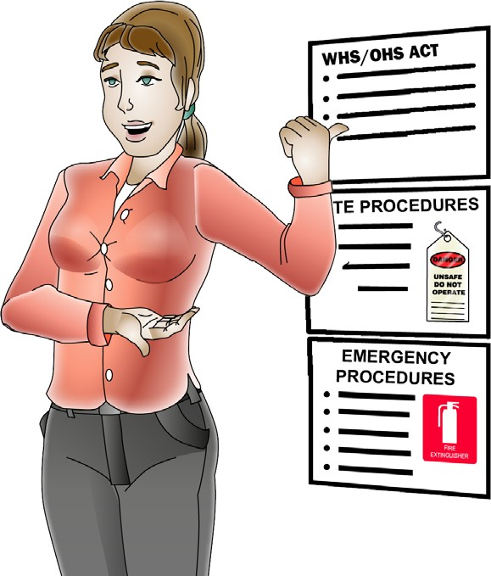
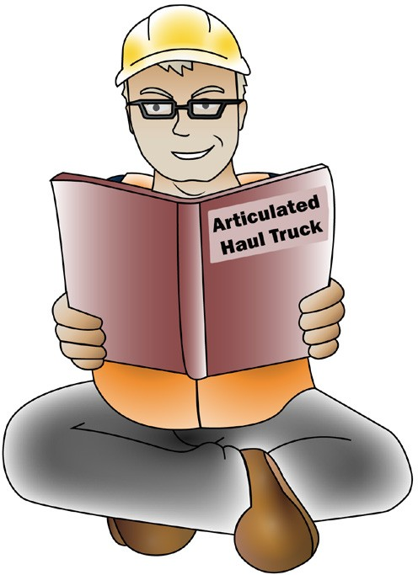
PC 1.1
PLAN AND PREPARE FOR ARTICULATED HAUL TRUCK OPERATIONS
QUESTION 3 | WHS/OHS Act Regulations Codes of Practice Australian Standards (AS 2598-1995 Earth-moving machinery) Manufacturer’s specifications Operator’s manual for your machine Site requirements and procedures Company policies and procedures for Employment and workplace relations, Equal opportunity and disability.
What are some examples of documentation you should read before doing earthmoving work?
QUESTION 4 | The operator’s manual tells you how to operate your machine.
Why should you check the operator’s manual before using earthmoving equipment? | The manual also tells you about maintenance (how to keep your machine working well).

Slide 13
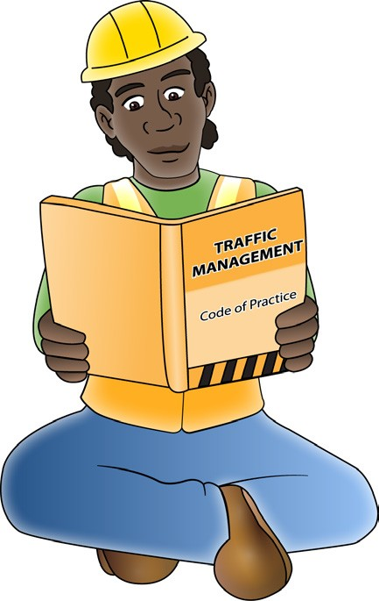
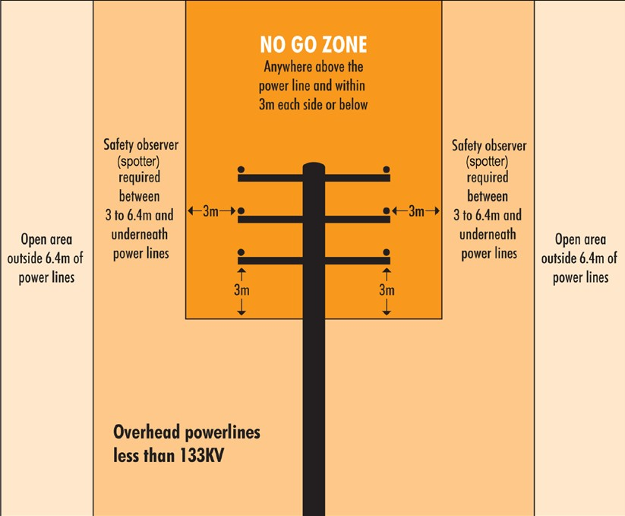
PC 1.1
PLAN AND PREPARE FOR ARTICULATED HAUL TRUCK OPERATIONS
QUESTION 5
What do codes of practice explain?
Codes of practice are practical guidelines on how to comply or follow the rules in legislation/laws.
For example:
A traffic management code of practice will tell you all the rules a traffic controller must follow. Such as a traffic controller must have a zero percent blood/ alcohol concentration/reading while performing traffic control duties.
QUESTION 6
What do Australian Standards explain?
Australian standards are work guidelines that set the minimum accepted performance or quality for a specific hazard process or product.
For example:
AS2550.1-2011—Powerline distances
This standard tells you the distances you can safely work near powerlines on poles and towers.

Slide 14
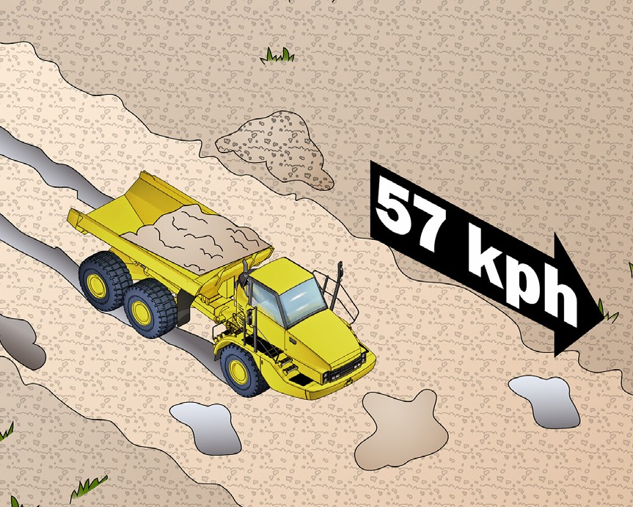
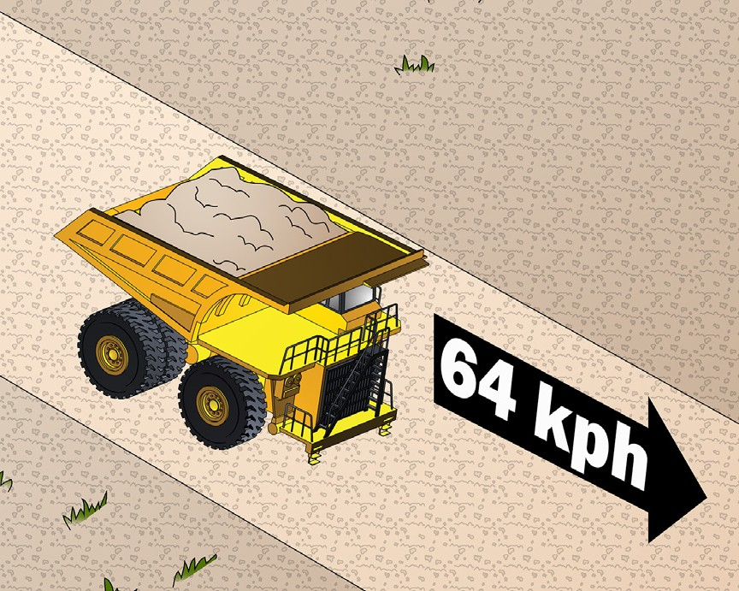
PC 1.2
PLAN AND PREPARE FOR ARTICULATED HAUL TRUCK OPERATIONS
QUESTION 7 When would you choose an articulated haul truck? | You choose an articulated haul truck when you will haul loads over muddy or soft ground. Because they are 4 or 6-wheel drive, they have good traction. You can use an articulated haul truck when you have a small load to haul. An example of an articulated haul truck: Volvo A40GFS can carry 39 tonnes and has a top speed of 57 kilometres per hour.
QUESTION 8 When would you choose a rigid haul truck? | You choose a rigid haul truck when you'll have a heavier or larger load. They are best for long hauls as they can travel quickly on flat or down hill haul roads. Check the site procedures to find out the maximum speed limit on your site. An example of a rigid haul truck: Komatsu 960E can carry 327 tonnes and has a top speed of 64 kilometres per hour.

Slide 15

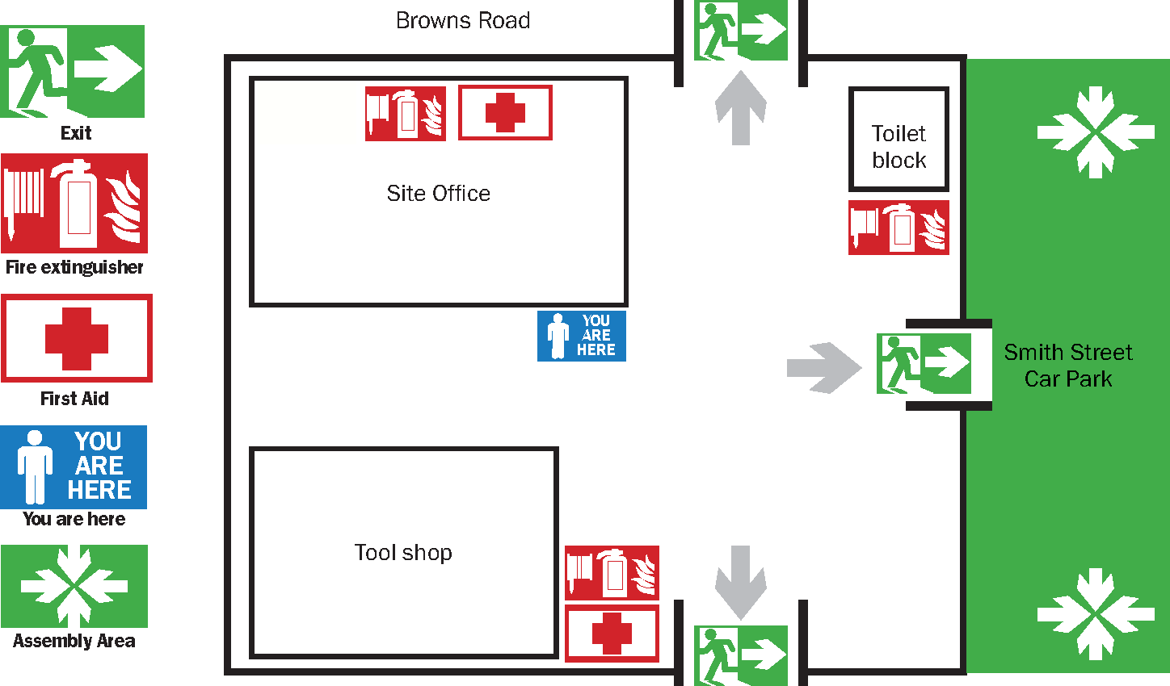
Worksite requirements
PC 1.2 PLAN AND PREPARE FOR ARTICULATED HAUL TRUCK OPERATIONS
Examples of documents your employer should provide include:
Safety plan for the site
Emergency procedures, for example, a site evacuation plan
Environmental management plan for the job.
Emergency evacuation plan
Many worksites have an emergency evacuation plan which is displayed on the notice board.
You should make sure you know how to interpret this plan. For example, start by looking for a ‘You are here’ sticker on the plan drawing. Note how nearby areas are shown on the plan. Then work out where the emergency exit is – on the plan and in real life.

Slide 16
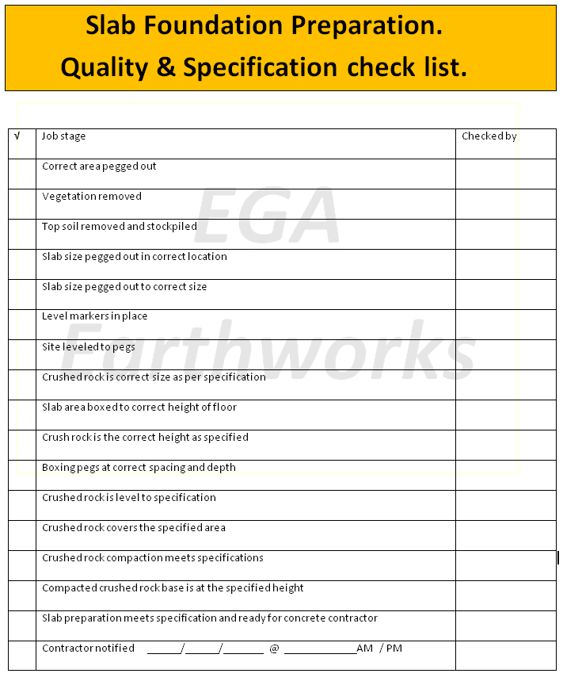

PC 1.2
PLAN AND PREPARE FOR ARTICULATED HAUL TRUCK OPERATIONS
QUESTION 9 What are quality requirements? | The quality requirements tell you the standards you must meet when doing earthmoving work. They tell you what you need to do and how to do it to satisfy the customer. You may need to follow Codes of Practice, regulations, national standards etc.

Slide 17

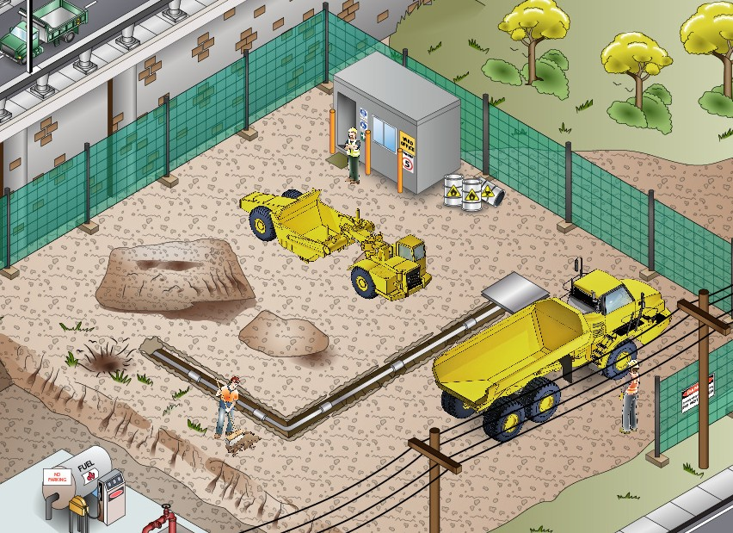
PC 1.2, 1.6
PLAN AND PREPARE FOR ARTICULATED HAUL TRUCK OPERATIONS
QUESTION 10 What kinds of information do you need before starting work? | Plans – what you need to do Specifications – rules and details about the job Operational details – how you will do the job Quality requirements of the job – the standards you are expected to meet.
QUESTION 11 When planning your job, why do you need to know what other people are doing on site? | To make sure you will not get in the way of other jobs being done To make sure you know what others are doing near where you must work.

Slide 18
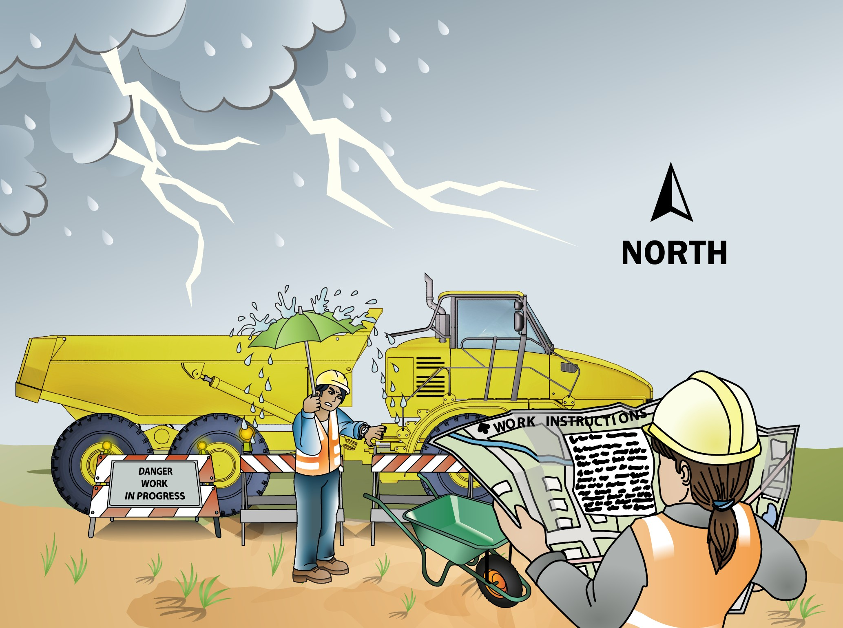
PC 1.2
PLAN AND PREPARE FOR ARTICULATED HAUL TRUCK OPERATIONS
QUESTION 12
What do the job’s work instructions explain?
Work instructions explain:
What to do in unexpected situations like bad weather
What the job is
Where the job is
How to do the job safely
How long the job will take
What tools and equipment you need
How to do the job from start to finish

Slide 19
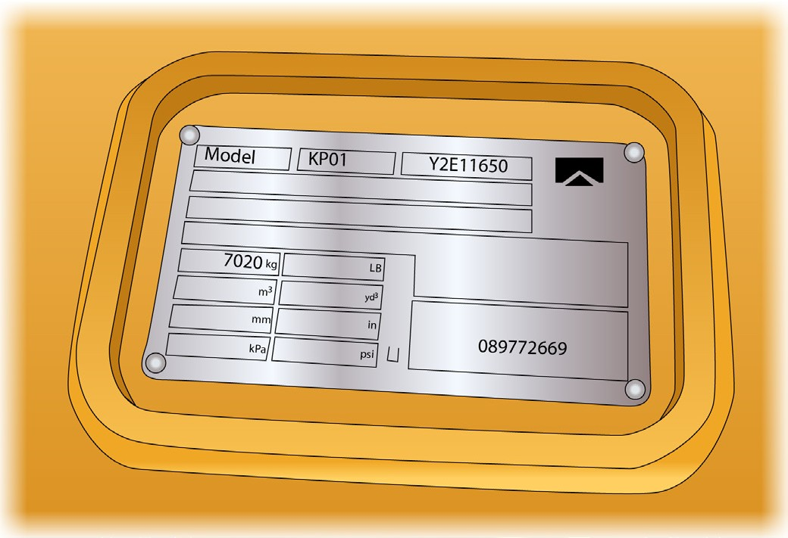
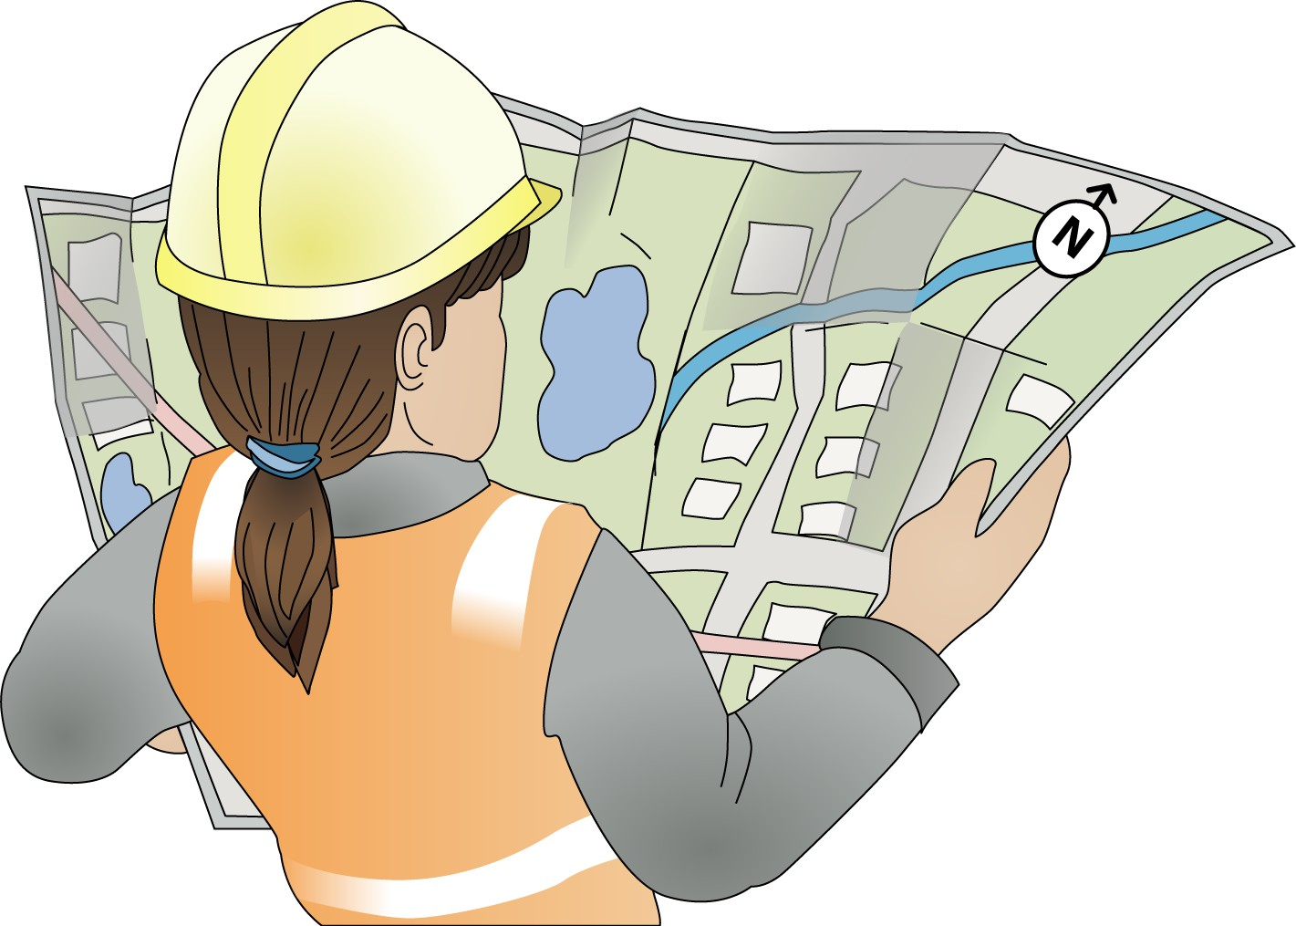
PC 1.1, 1.2
PLAN AND PREPARE FOR ARTICULATED HAUL TRUCK OPERATIONS
QUESTION 13 How do you find out the limits and capacity of the haul truck? | Ask your employer, check the operator’s manual and check the data or load plates inside the cabin.
QUESTION 14 Which plans do you follow so you know how to do the job properly? | The site’s standard operating procedures and/or work instructions.

Slide 20
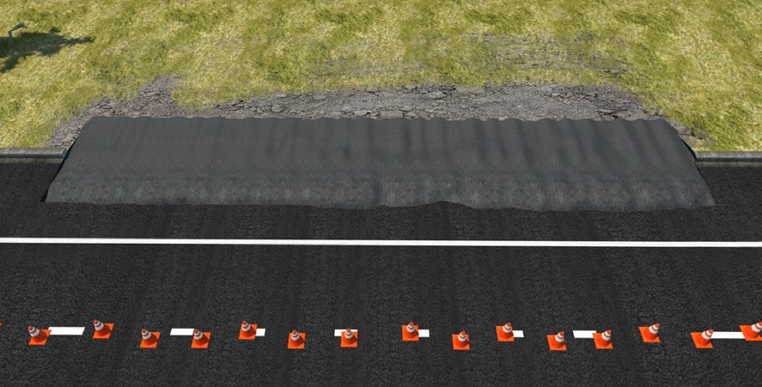
PC 1.2
PLAN AND PREPARE FOR ARTICULATED HAUL TRUCK OPERATIONS
Calculations
Working out how much material you need
The work plan has an area which is 4 metres × 20 metres that must be covered by a layer of road base of 150 mm depth.
How many square metres of road base are to be laid? How many cubic metres of road base will you need?
Step 1:
Work out the square metres
To work out the square metres, multiply the Length (L) by the Width (W).
L × W = Square metres
4 m × 20 m = 80 square metres
This can also be written as: 80 m² or 80 square metres
Step 2:
Convert millimetre thickness to metres
Convert the layer thickness from millimetres to metres.
To do this divide the layer thickness by 1000
150 mm ÷ 1000 = 0.15 m
Step 3:
Work out the square metres
Multiply the square metres by the layer thickness to get the cubic metres.
80 square metres × 0.15 metres
= 12 cubic metres
This can also be written as: 12 m³ or 12 cubic metres
Answer:
There are 80 square metres of road base to be laid.
You will need 12 cubic metres to cover the area to 150 mm depth.

Slide 21
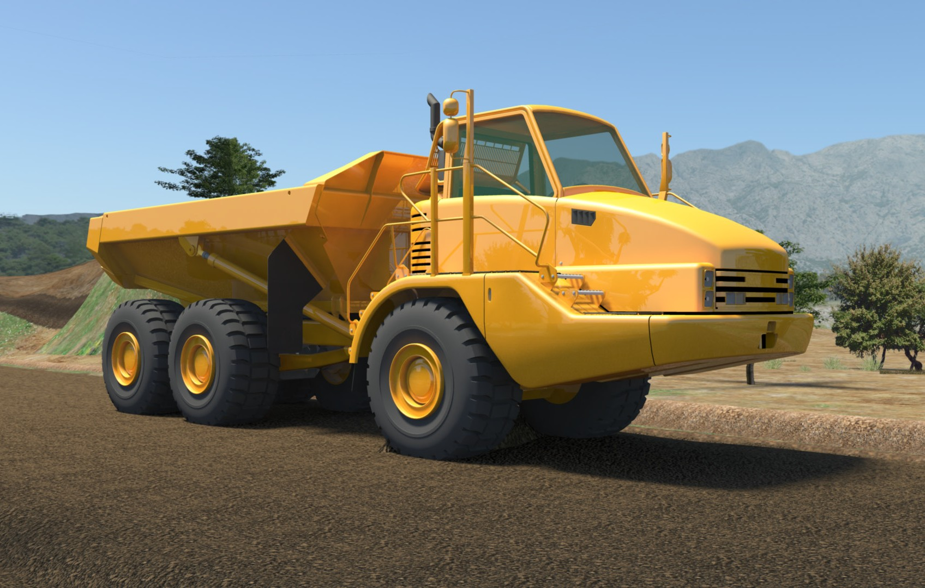
Earthmoving site hazards
PC 1.3 PLAN AND PREPARE FOR ARTICULATED HAUL TRUCK OPERATIONS
Checking for underground services
You should always check where services are before you start work. You may phone ‘Dial before you dig on 1100’. You may look at the site plan or talk to your supervisor. You may need to look at the location of pits and meters to get an idea of where the services run. You may need to check with the local council or service company. You may even need to get underground detection equipment.
If you hit a service line, contact the provider immediately. You may need to organise to get the service disconnected while a
qualified person fixes the problem.
You can sometimes tell there are services below by the types of ground. Some services are surrounded by a different type of soil, rock or sand.
You may notice that the soil is looser,
or does not match the soil around where you are digging. There may be a line of tape alerting you to the services.
If you suspect there are services underground, stop working. Check the ground. You may need to excavate the area by hand, or dig in another area.

Slide 22
Job safety and environment analysis (JSEA) or Safe work method statement (SWMS)
PC 1.3, 1.4 PLAN AND PREPARE FOR ARTICULATED HAUL TRUCK OPERATIONS
These forms help you plan for the work you will do. It is very important you fill these out before you start work. They help you
work out the tools, equipment and PPE you need to do the job safely. All workplaces should have these types of forms.
Example:
Job safety and environment analysis (JSEA)/Safe work method statement (SWMS)
123456
1. ACTIVITY/TASK INFORMATION AND LOCATION
Location/Project: |  | 123 Belmaine Highway, Roseville
Activity or Task Description: |  | Load spoil from excavation right hand turn lane
Competency/Qualification needed to do work safely: |  |  |  |  | All operators have current tickets
2. HAZARD IDENTIFICATION
Location/Area Hazards |  |  | Rate | Work/Task Hazards |  |  | Rate | Work/Task Hazards |  | Rate
Area |  |  |  | Visibility and hearing |  |  |  | Plant/machinery |  | 8
Entry or exit is difficult |  |  |  | Poor lighting |  |  |  | Plant or Machinery | 
Engulfment/entrapment |  |  |  | Poor visibility |  |  |  | Tools/equipment |  | 8
Work at heights |  |  |  | Bright lights/UV |  |  | 7 | Traffic | 
Confined space |  |  |  | High noise levels |  |  |  | Pedestrians
Remote location |  |  |  | Communication difficulties |  |  |  | Railway
Rescue could be difficult |  |  |  | Services |  |  |  | Pneumatics
Temperature extremes |  |  |  | Multiple electrical feeds |  |  |  | Process lines
Hazardous/Toxic substances (attach SDS) |  |  |  | Electrical hazards - LV |  |  |  | Suspended loads
 |  |  |  | Electrical hazards - HV |  |  | 8 | Slips/trips/falls
Gasses/oxygen/chemicals |  |  |  | Overhead power |  |  |  | Slips/trip hazard
Poisonous gas/es |  |  |  | UG services (gas, power, water) |  |  |  | Fall hazard
Explosive/flamable gas |  |  |  | Hazardous/toxic substances |  |  |  | Other
Oxygen levels (high or low) |  |  |  | Pressurised fluids |  |  |  | Sharp materials
Inhalable dusts/fibres |  |  |  | Gas cylinders |  |  |  | Confined space
Hazardous/toxic substances (attach SDS) |  |  |  | Flammable materials |  |  |  | Work at heights
 |  |  |  | Toxic materials |  |  |  | Welding/Grinding
Exposure |  |  |  | Acids/solvents |  |  |  | Manual handling
Heat/Cold |  |  | 4 | Other chemicals |  |  |  | Using ladders
Sunlight/ Radiation |  |  |  | Inhalable dusts/fibres |  |  |  | Using EWPs

