Slide 1

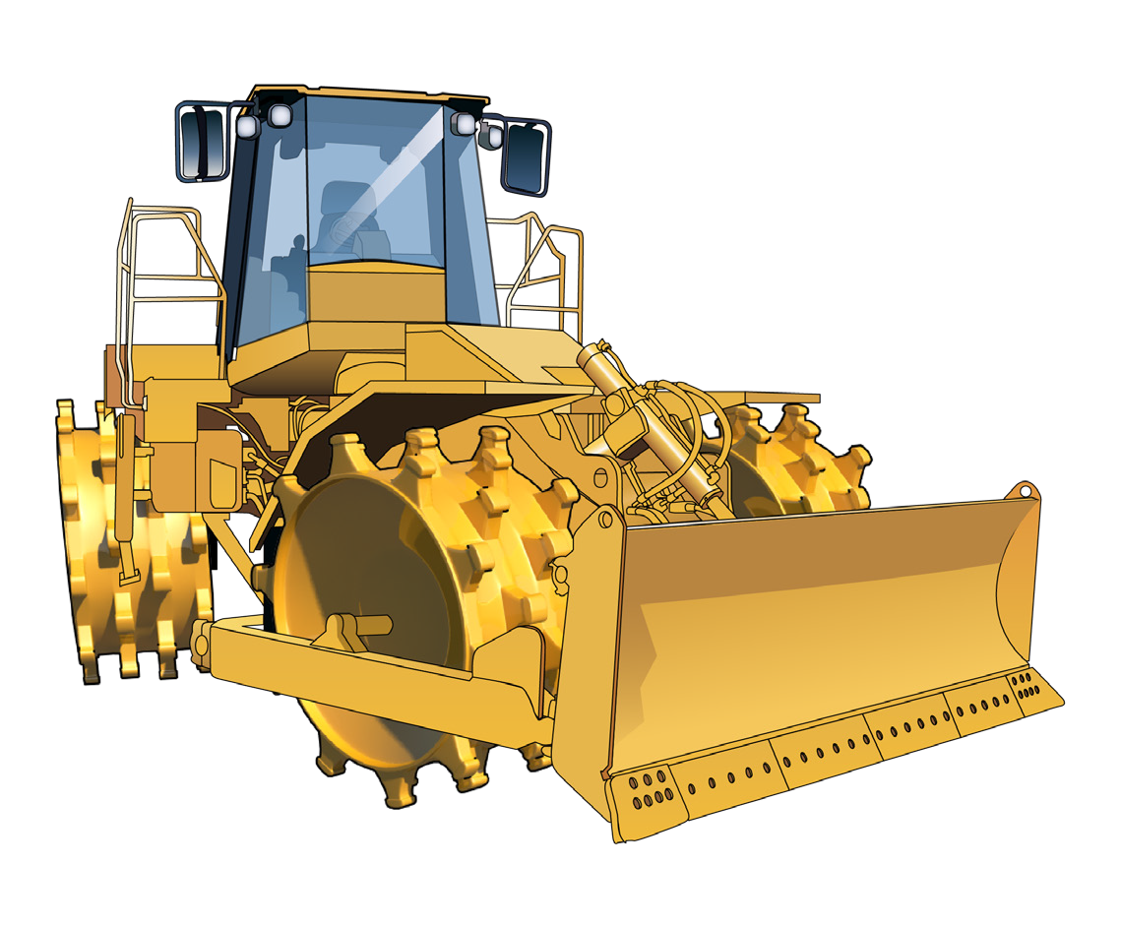

LEARNER GUIDE
Self-propelled Compactor
TICKET
Training support material for:
RIIMPO316E
Conduct self-propelled compactor operations
Produced by:

Slide 2
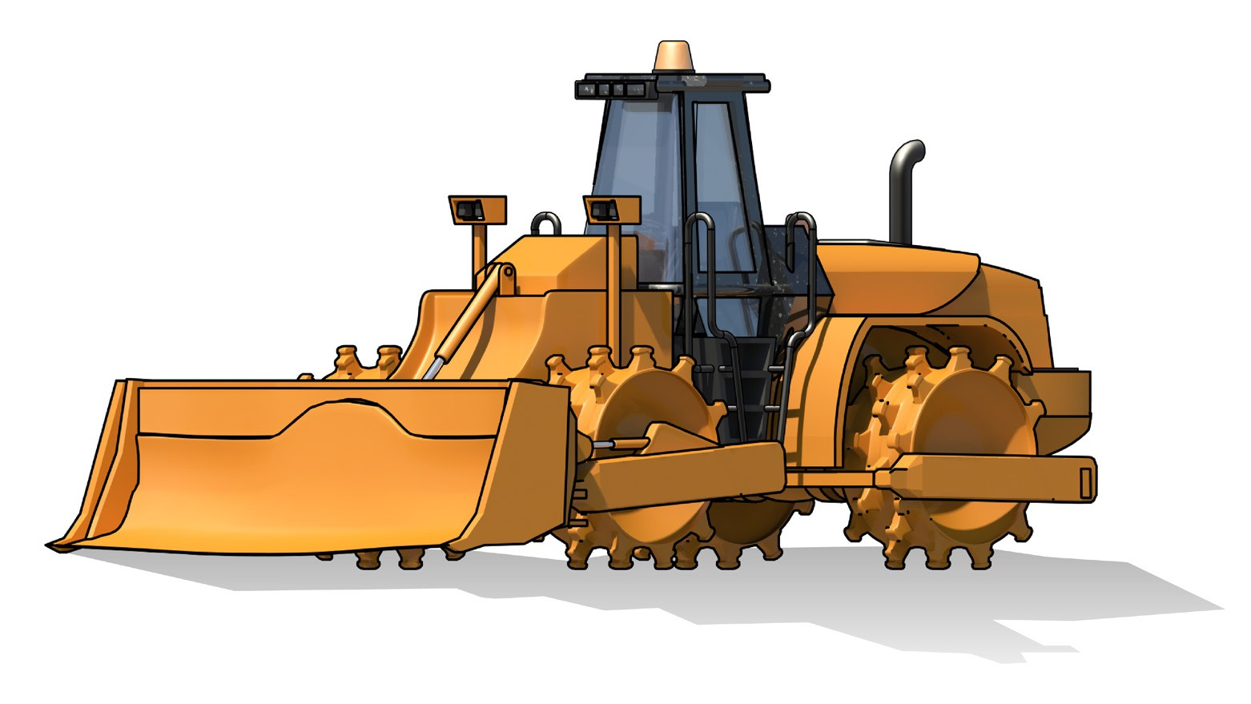
Introduction to Self-propelled Compactor

Slide 3
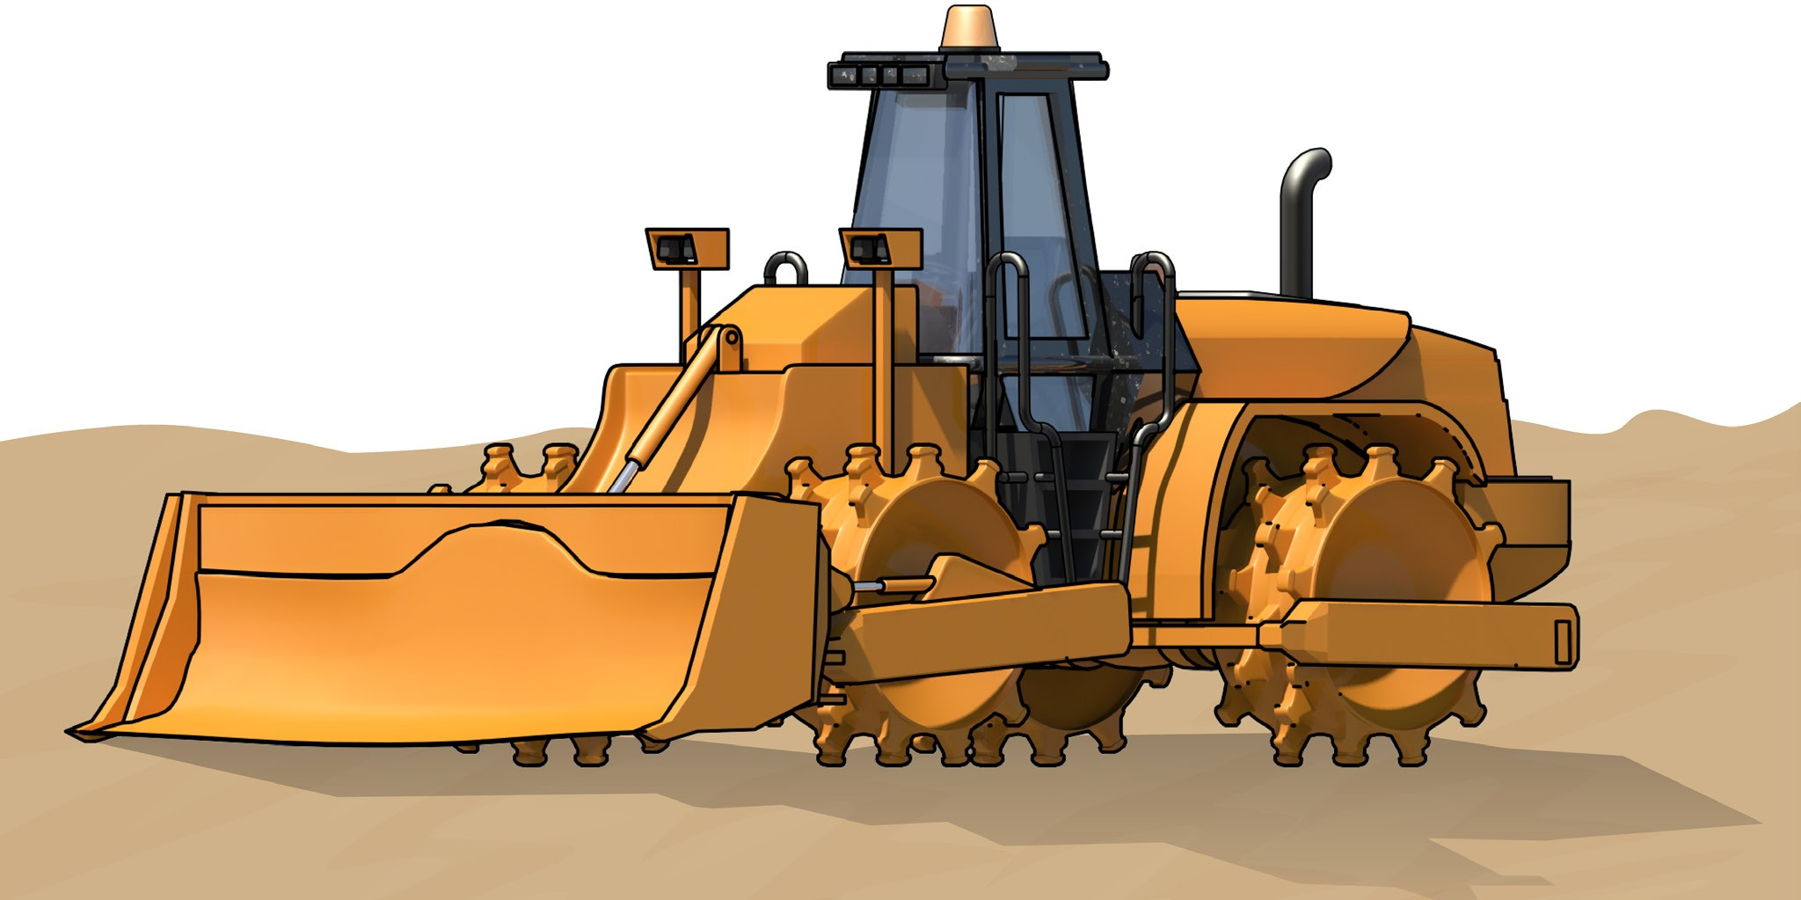
Introduction to self-propelled compactor
INTRODUCTION TO SELF-PROPELLED COMPACTOR
A self-propelled compactor is a self-propelled, tamping foot drum, wheeled machine, used to compact a variety of types of construction materials. It can operate at relatively high speeds and may have a dozer blade mounted on the front-end of the machine allowing for dozing, filling and compacting versatility. The tamping feet on the wheels of the machine may vary in size, shape and depth.
What industries do you use a self-propelled compactor in?
Civil construction

Slide 4
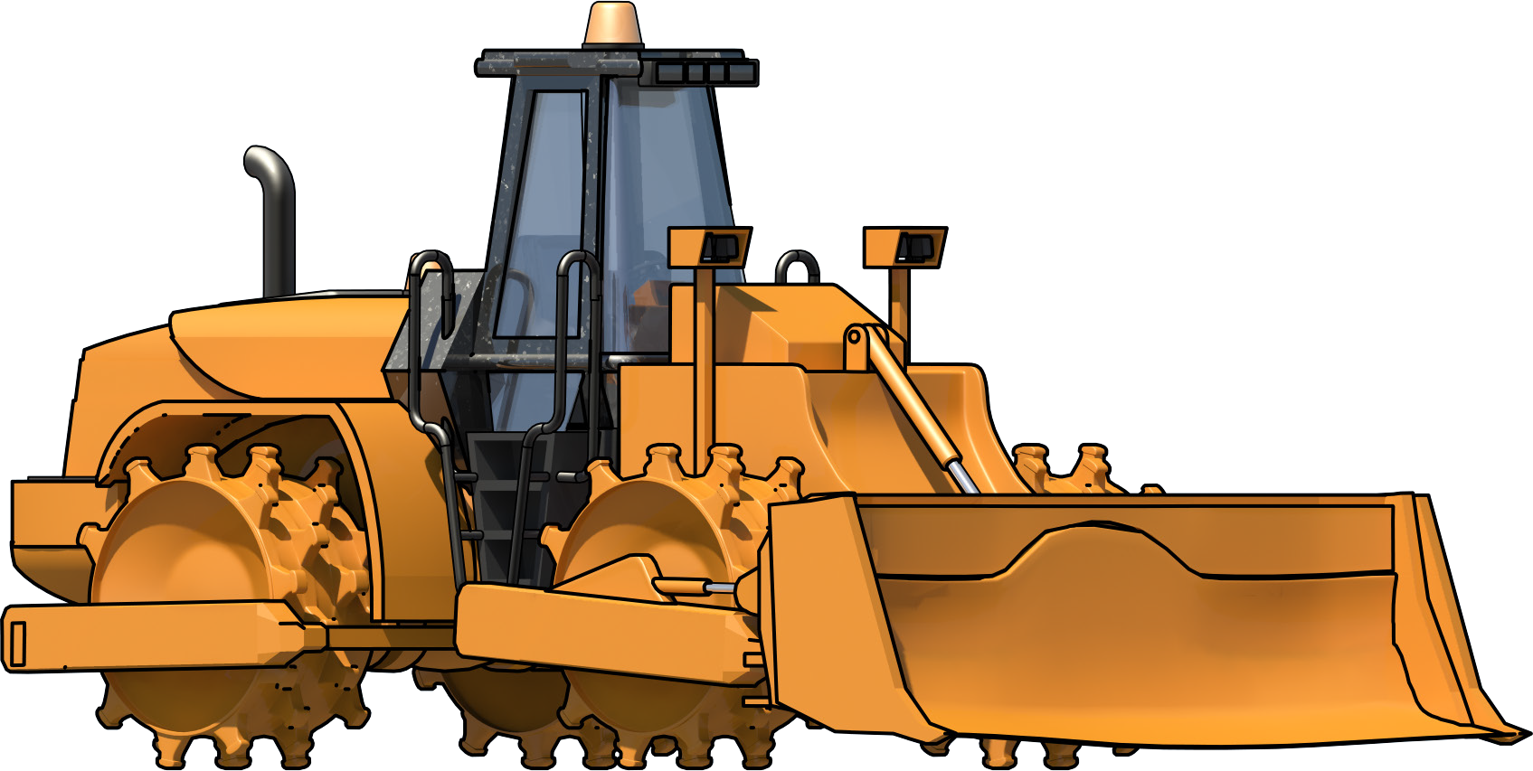
An example of a self-propelled compactor
INTRODUCTION TO SELF-PROPELLED COMPACTOR
Rollover protective structure (ROPS)
Cab
Engine
Sheepsfoot or tamping feet on the wheels
Dozer blade
Vibratory hydraulics

Slide 5
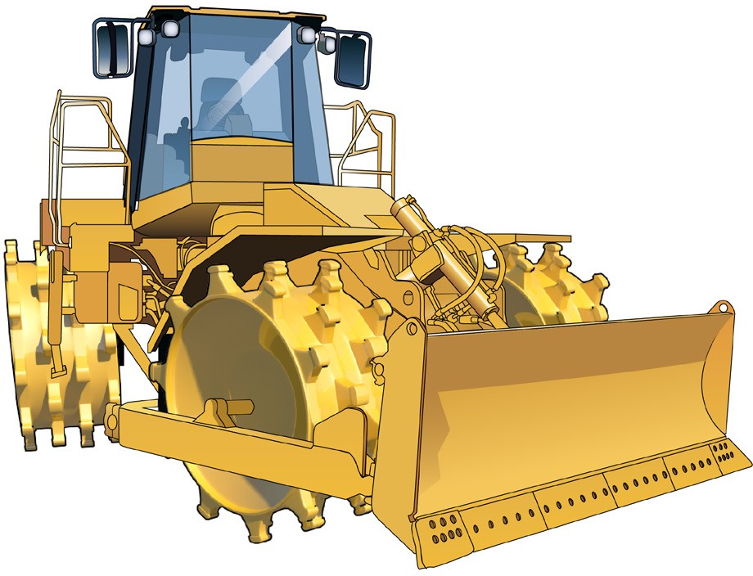
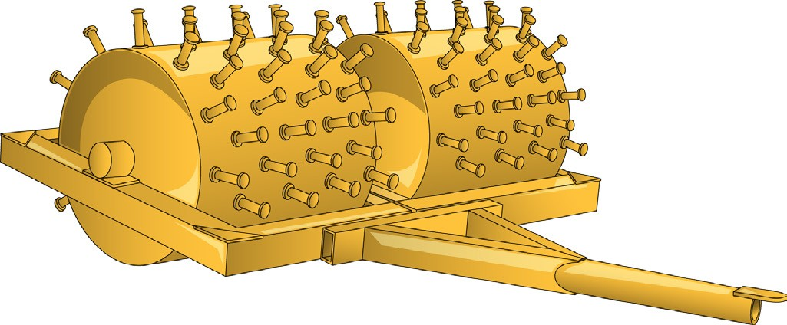
Self-propelled compactors
INTRODUCTION TO SELF-PROPELLED COMPACTOR
Four wheel (steel drum) articulated self-propelled compactor with dozer blade
Towed compactors
Single sheepsfoot drum compactor

Slide 6
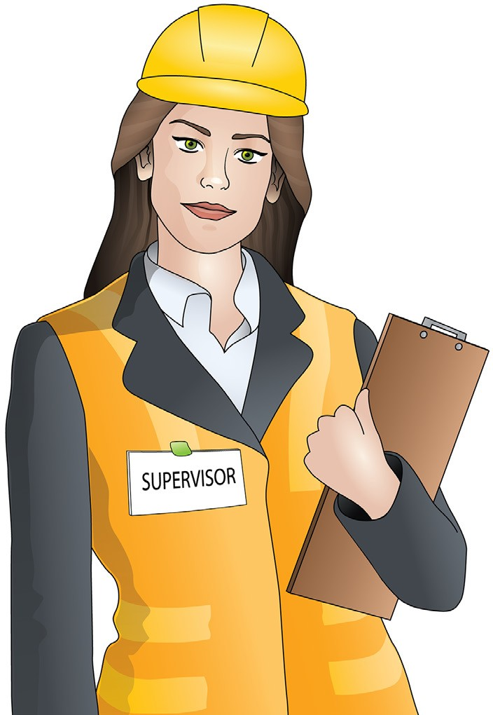
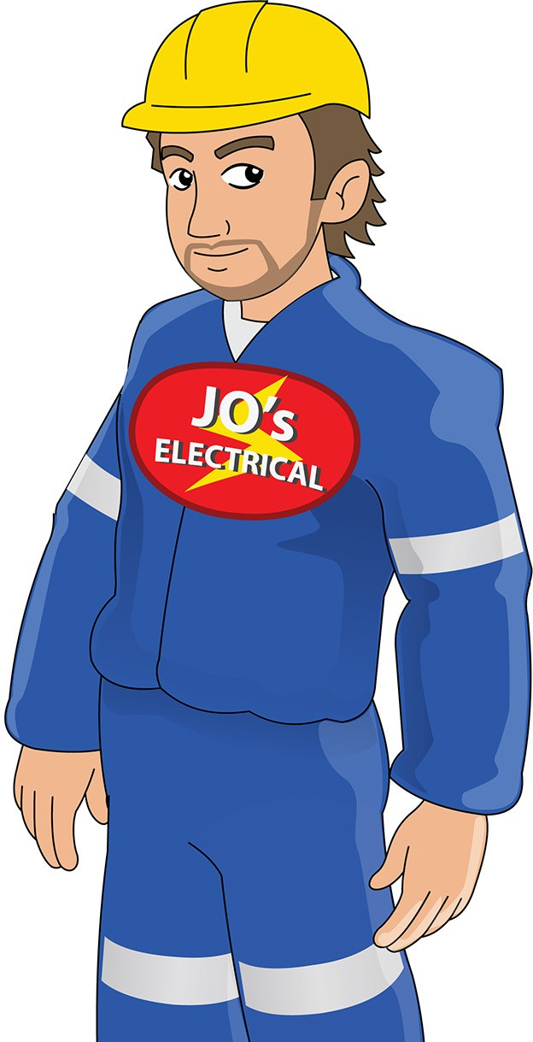
Who has duty of care?
PC 1.1 INTRODUCTION TO SELF-PROPELLED COMPACTOR
You have a duty of care. So does anyone who has something to do with the worksite.
Duty of care applies to:
Employers/persons conducting a business or undertaking (PCBU). This includes managers, manufacturers/suppliers, importers, designers, inspectors, etc.
Workers. This includes employees, contractors and sub-contractors, employees of labour hire companies, outworkers, volunteers, etc.

Slide 7
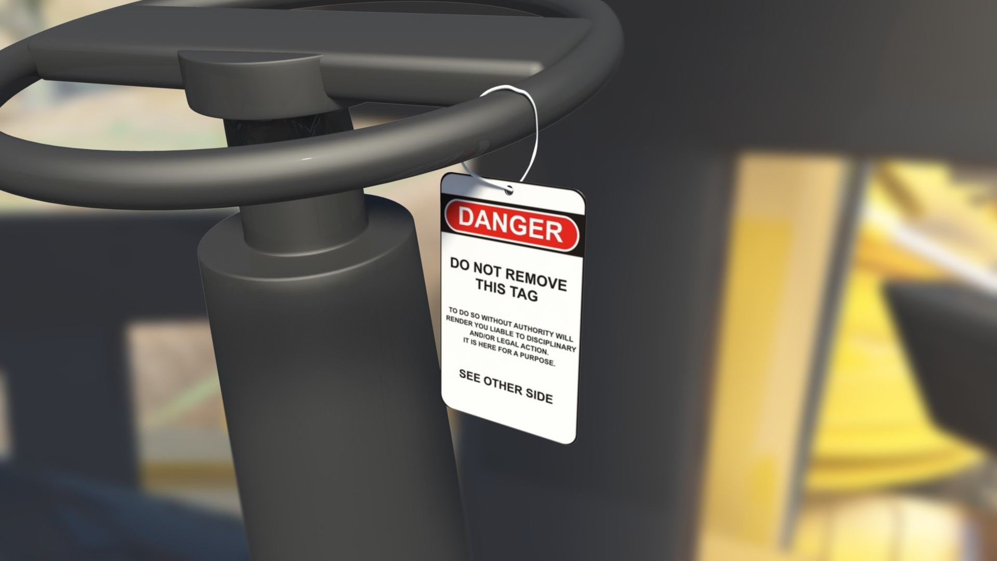
Worker’s duty of care
PC 1.1 INTRODUCTION TO SELF-PROPELLED COMPACTOR
As a worker you must take care of your own health and safety – and the health and safety of others at the workplace. You must not put your own or other people’s health and safety at risk.
Never work where you believe a hazard is a serious risk to your health and safety. You must also:
do your best to follow reasonable health and safety instructions from your boss (PCBU)
follow workplace health and safety policies and procedures
do not work where you believe a hazard would be a serious risk to your health and safety.

Slide 8
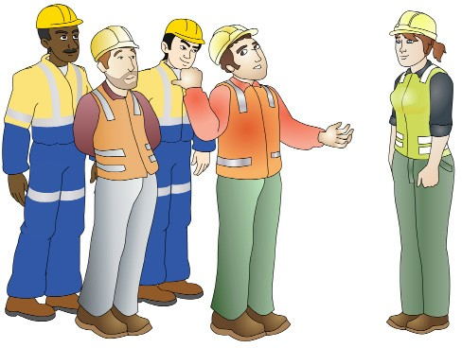
PCBU/Employer’s duty of care
PC 1.1 INTRODUCTION TO SELF-PROPELLED COMPACTOR
The PCBU must:
Provide a safe workplace
Train workers and make sure they know what to do on the job
Try to get rid of risks, or find ways to minimise risks
Tell workers about any hazards or risks. Workers must know what to do in an emergency.
Have a workplace safety plan. For example, workers should be trained in the use of fire fighting equipment and first aid equipment.
Penalties
If you are a PCBU/employer or a worker, the government can fine you or even imprison you for failing your duty of care.

Slide 9
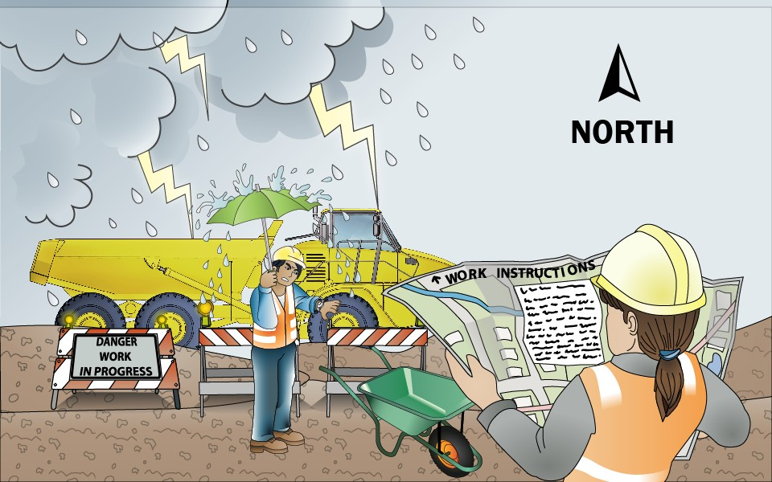
PC 1.2
PLAN AND PREPARE SELF-PROPELLED COMPACTOR OPERATIONS
QUESTION 6
What do the job’s work instructions explain?
Work instructions explain:
What to do in unexpected situations like bad weather
What the job is
Where the job is
How to do the job safely
How long the job will take
What tools and equipment you need
How to do the job from start to finish

Slide 10
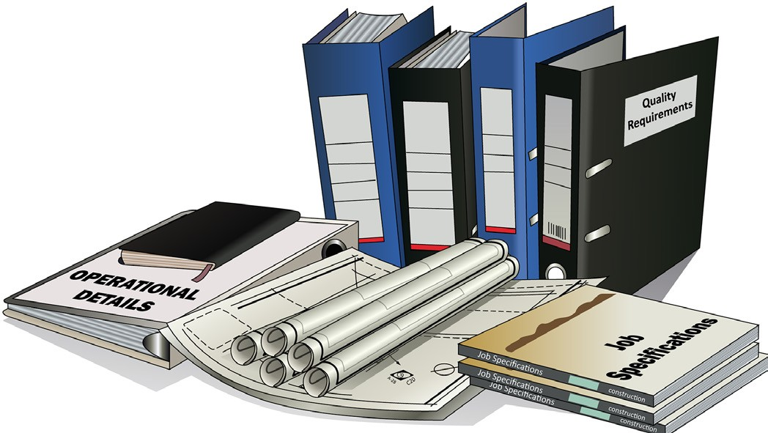
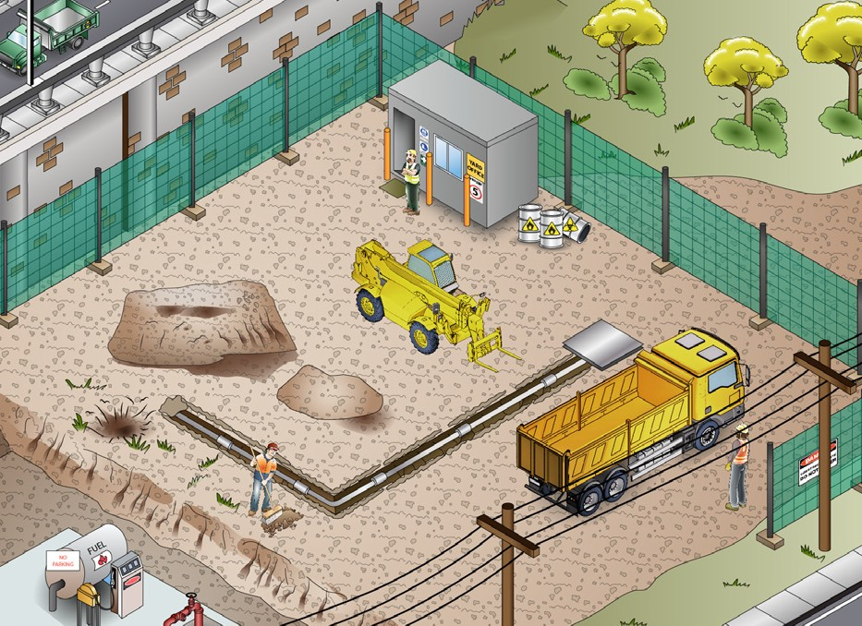
PC 1.1, 1.2
PLAN AND PREPARE SELF-PROPELLED COMPACTOR OPERATIONS
QUESTION 7 What kinds of information do you need before starting work? | Plans – what you need to do Specifications – rules and details about the job Operational details – how you will do the job Quality requirements of the job – the standards you are expected to meet.
QUESTION 8 When planning your job, why do you need to know what other people are doing on site? | To make sure you will not get in the way of other jobs being done To make sure you know what others are doing near where you must work.

Slide 11
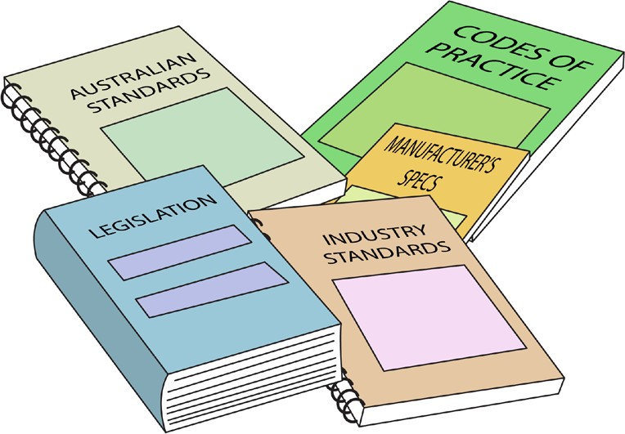
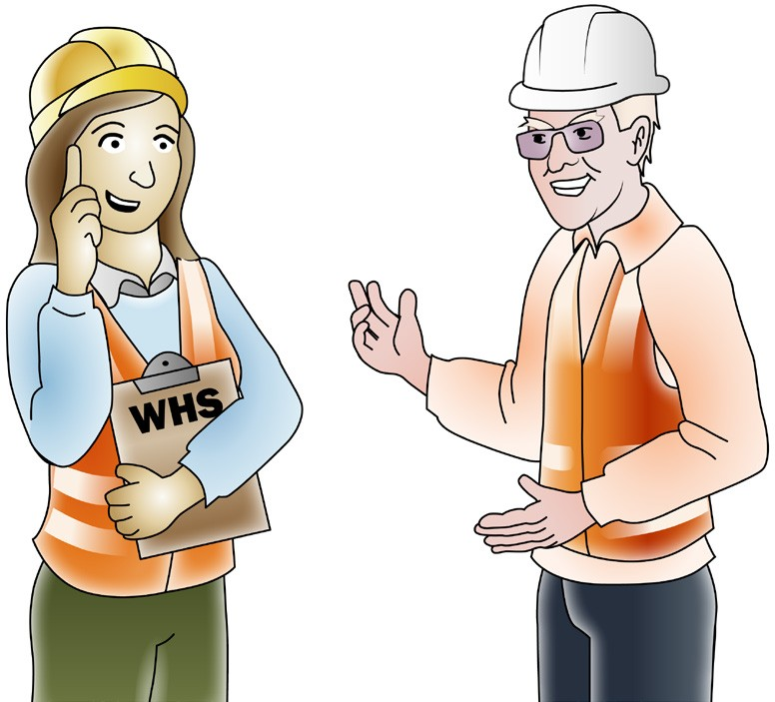
PC 1.1, 1.2
PLAN AND PREPARE SELF-PROPELLED COMPACTOR OPERATIONS
QUESTION 9
What are the National Work Health (WHS) and Occupational Health and Safety (OHS) Acts about?
The Acts explain how to keep your workplace safe and healthy. They explain what you need to do to meet your duty of care.
For example:
You must make sure you do earthmoving work in a way that won’t put yourself or others at risk. You must use earthmoving equipment according to instructions.
Note:
Check your state requirements as Acts may vary from state to state
QUESTION 10
You have a high risk work licence.
Under WHS/OHS laws, what are your responsibilities while working?
You must work in a way that is safe. You must not risk the health and safety of yourself or others.

Slide 12

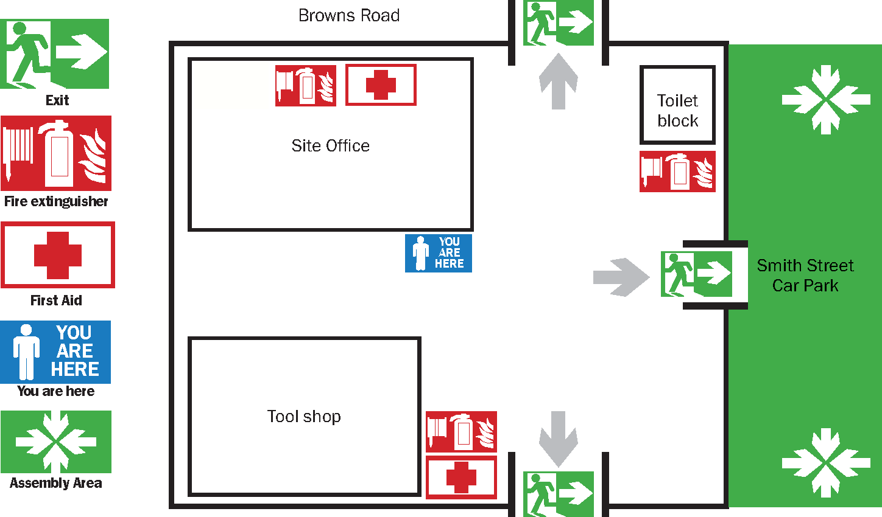
Worksite requirements
PC 1.2, 1.7 PLAN AND PREPARE SELF-PROPELLED COMPACTOR OPERATIONS
Examples of documents your employer should provide include:
Safety plan for the site
Emergency procedures, for example a site evacuation plan
Environmental management plan for the job.
Emergency evacuation plan
Many worksites have an emergency evacuation plan which is displayed on the notice board.
You should make sure you know how to interpret this plan. For example, start by looking for a ‘You are here’ sticker on the plan drawing. Note how nearby areas are shown on the plan. Then work out where the emergency exit is – on the plan and in real life.

Slide 13
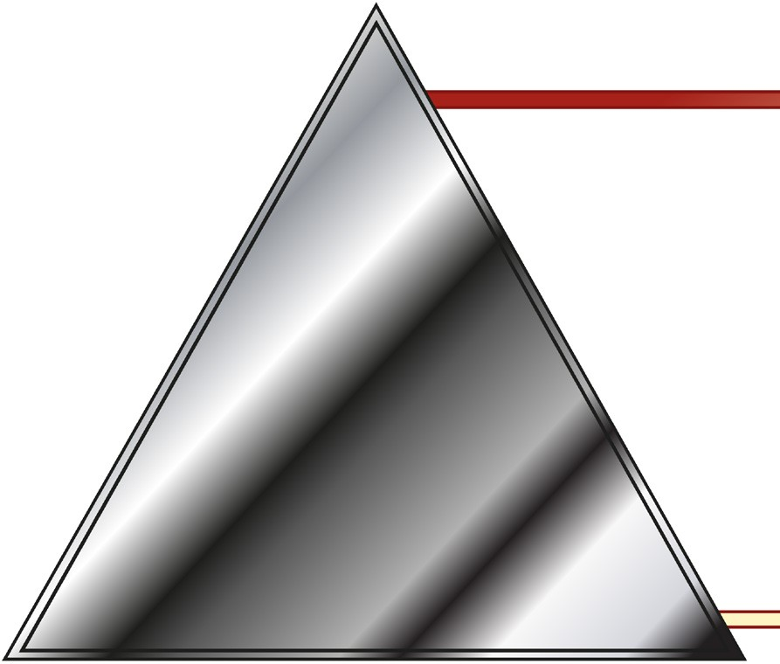
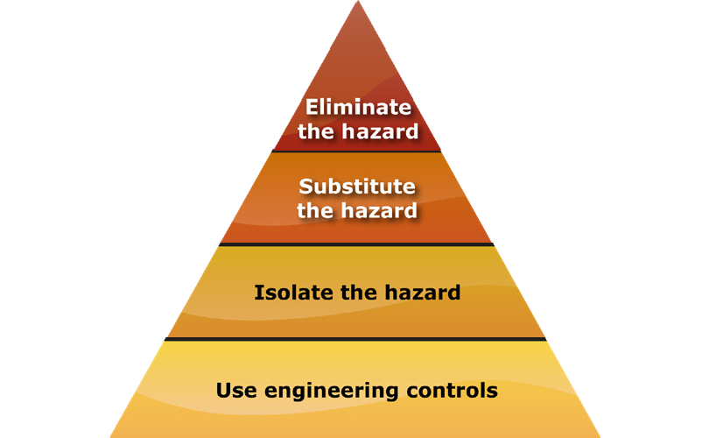
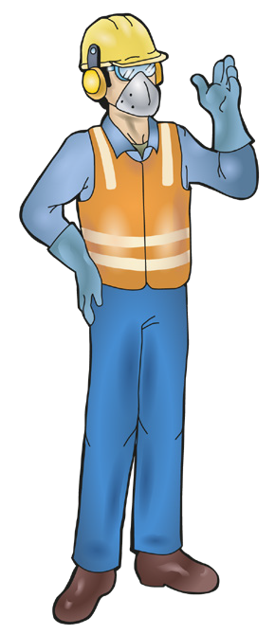
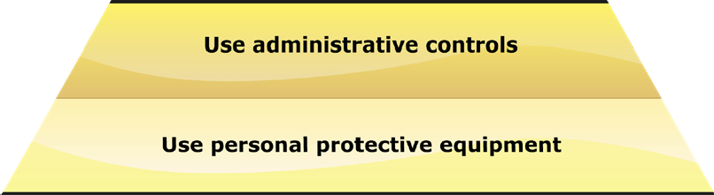
PC 1.3
PLAN AND PREPARE SELF-PROPELLED COMPACTOR OPERATIONS
QUESTION 11
The hierarchy of hazard control is a list of controls you can use to lower the danger from a hazard on the worksite.
What are the six (6) levels in the hierarchy of hazard control from the first choice to the last choice?
1. Elimination: If possible, remove (take away)
the hazard.
2. Substitution: Use a safer method if you can’t remove the hazard.
3. Isolation: Stop access to the hazardous (dangerous) area.
4. Engineering Control Measures:
Change the tools, equipment or environment to make it safer.
5. Administrative Practices: Reduce the time the worker is exposed to the hazards by using training, job rotation, the timing of jobs, etc.
6. Personal Protective Equipment (PPE): Use PPE as your last line of defence.
Memory aid: Every Saturday I Eat A Pie

Slide 14
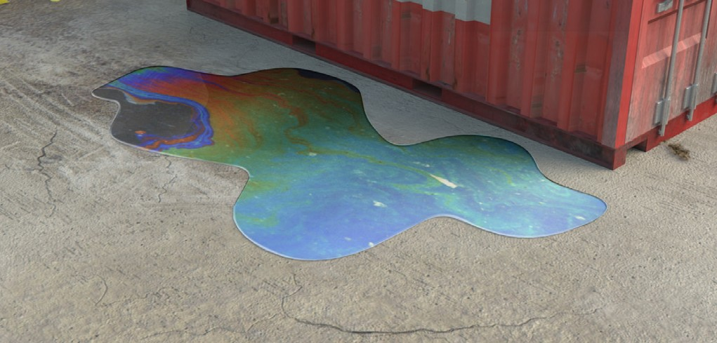

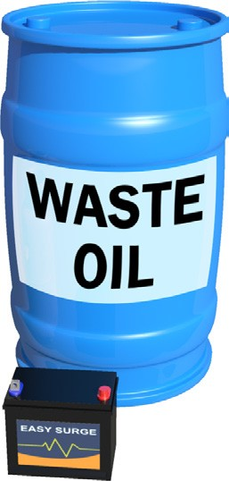
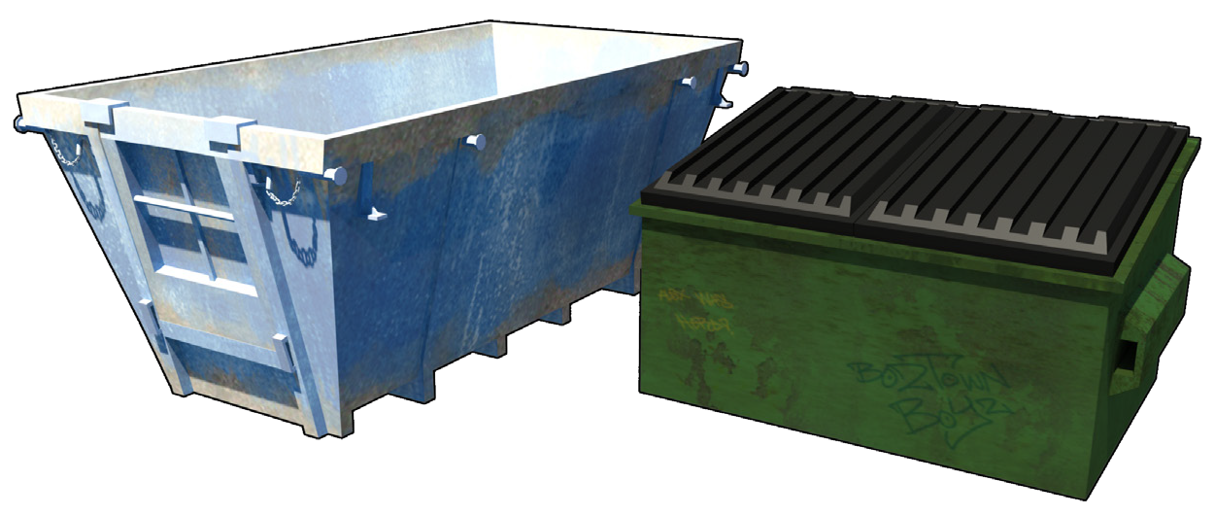
Environmental management plan (EMP)
PC 1.3 PLAN AND PREPARE SELF-PROPELLED COMPACTOR OPERATIONS
The environmental management plan (EMP) tells you important things about the environment at the worksite. It explains how the work you are doing could damage the environment. The possibility that you will cause this damage is called the environmental risk. | The EMP tells you what you must do so you do not damage the environment. It tells you how to work in a way that reduces damage to the environment.
The EMP also tells you how the worksite meets all environmental protection laws and what to do with waste.

Slide 15
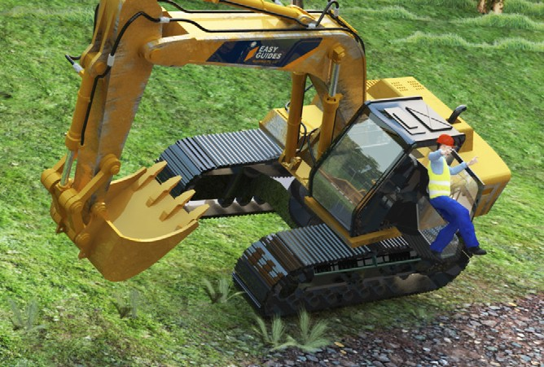
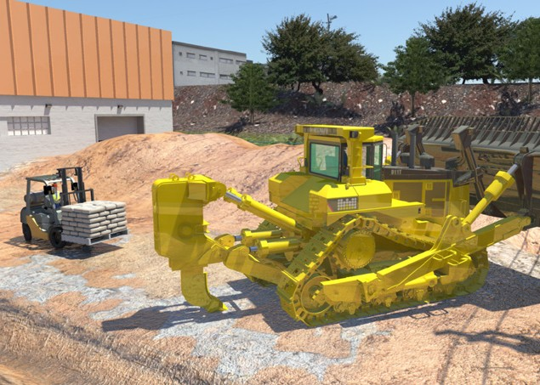
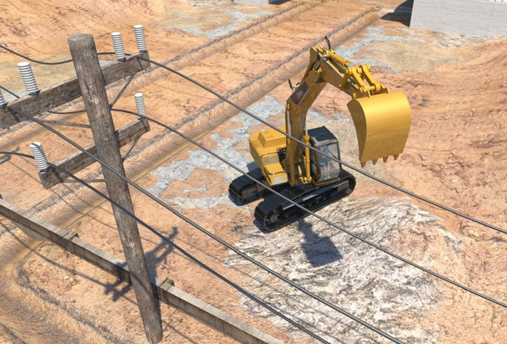
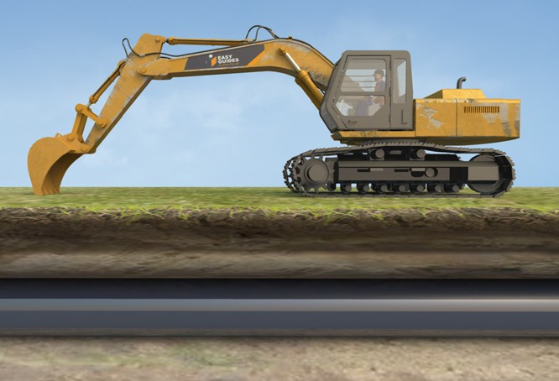
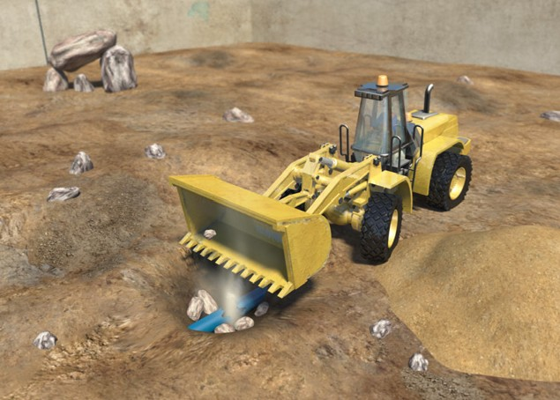
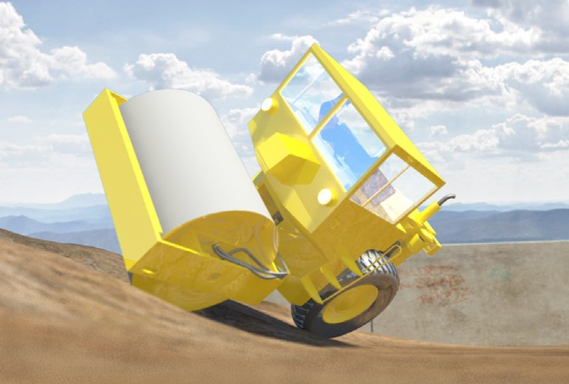
Earthmoving hazards and risks
PC 1.3 PLAN AND PREPARE SELF-PROPELLED COMPACTOR OPERATIONS
The most common hazards and risks with earthmoving work are:
Falls from plant or machinery | Traffic and other mobile plant | Overhead or underground power
Underground gas lines | Water and sewage piping | Rollovers

Slide 16
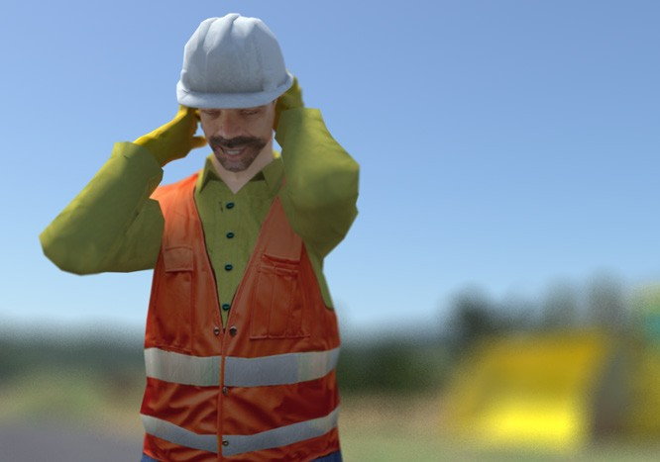
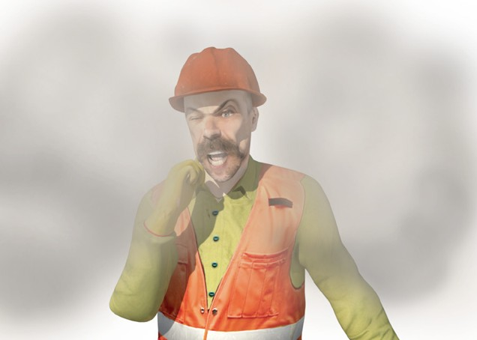
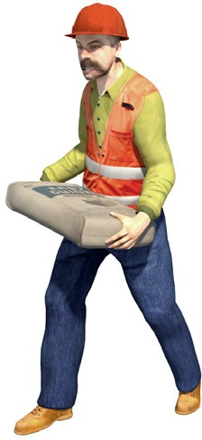
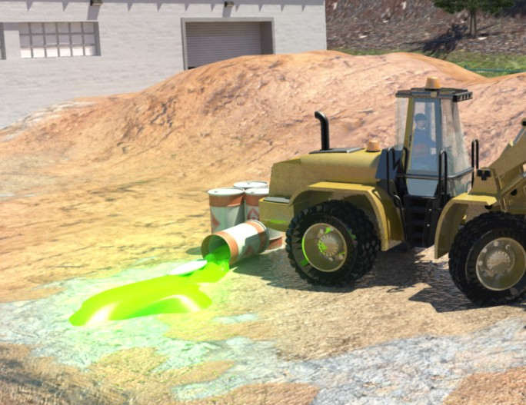
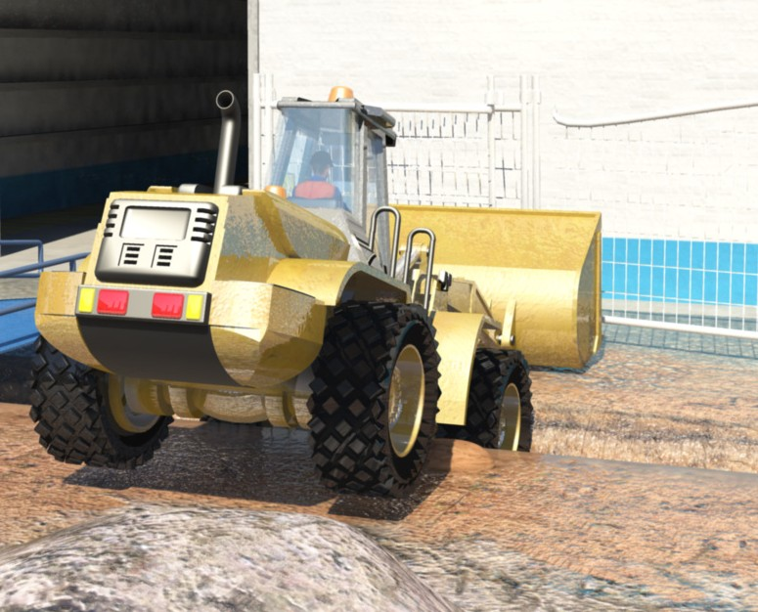
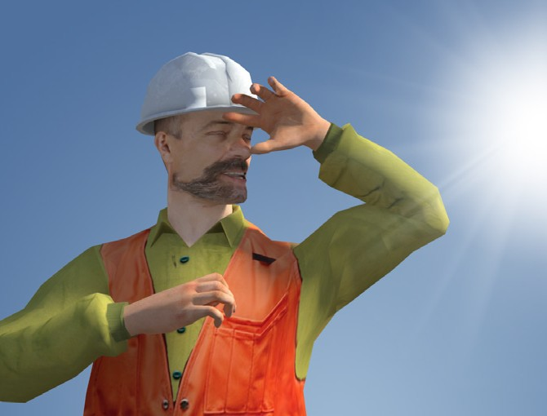
PC 1.3
PLAN AND PREPARE SELF-PROPELLED COMPACTOR OPERATIONS
Earthmoving hazards and risks (continued)
Noise | Dust | Manual handling
Contaminated soil | Falling into trenches or excavations | UV rays (radiation) from working in the sun

Slide 17
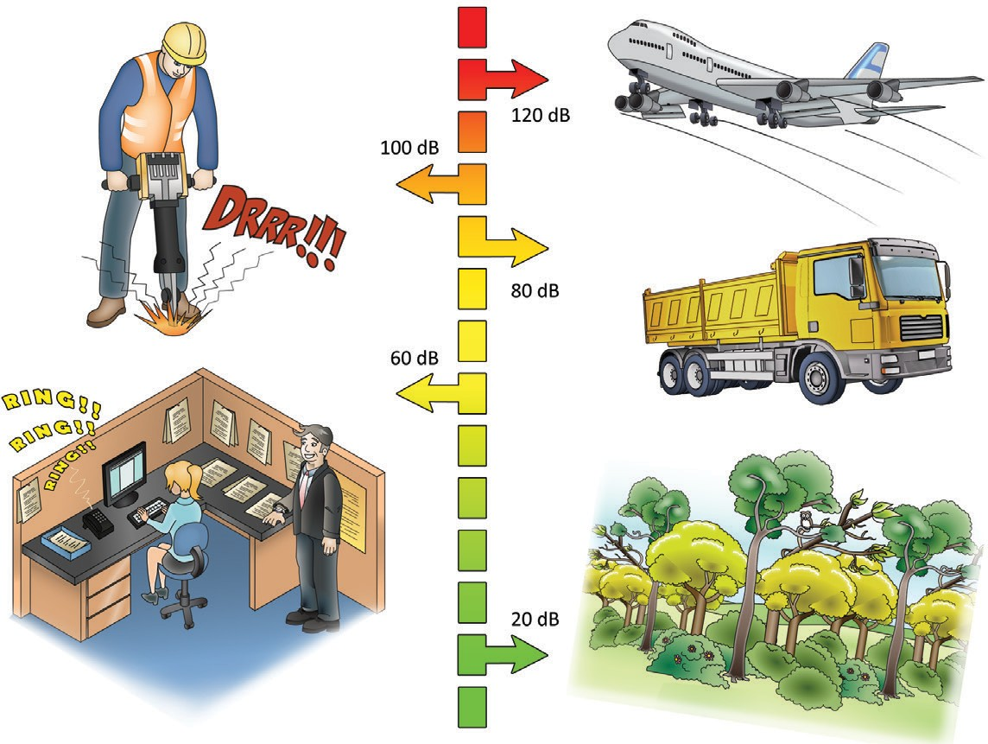
Decibel levels of common sounds
PC 1.3 PLAN AND PREPARE SELF-PROPELLED COMPACTOR OPERATIONS
You must wear hearing protection when operating heavy equipment. This is important because 8 hours of noise at 85 db (decibels),
or noise levels of 140 db even briefly can permanently damage your hearing.
Hearing loss is:
slow
painless
irreversible.
Here are some examples of levels of noise in different environments.
A forest has about 20 db of noise
In an office there might be around 60 db
Standing outside a truck generates about 80 db
A jackhammer generates around 100 db
A jet taking off generates about 120 db

Slide 18
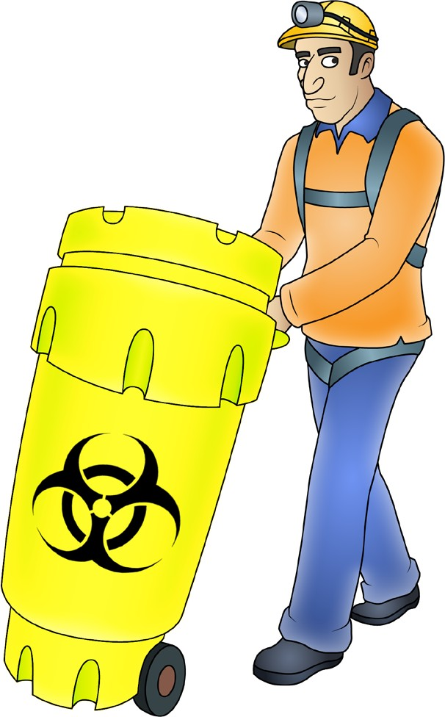

Chemicals and solvents
PC 1.3 PLAN AND PREPARE SELF-PROPELLED COMPACTOR OPERATIONS
Chemicals should always be labelled so that you can easily tell what chemical you are working with. Chemicals should be stored in a safe place where someone cannot accidentally come into contact with them.
Always check the Safety data sheet (SDS) before handling any chemicals.
The SDS must be provided to, and understood by, a person using chemicals in the workplace. The SDS will tell you how to safely handle the chemicals.
If you are not sure, put the chemicals in a safe, isolated area and talk to your supervisor.

Slide 19
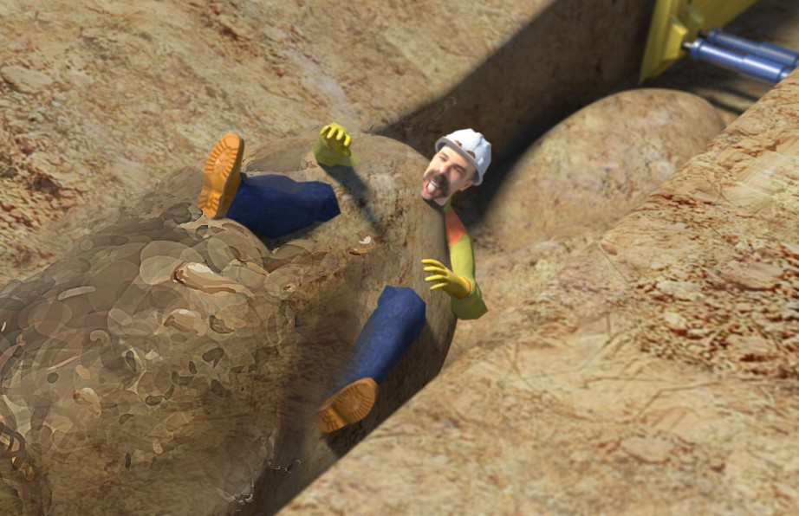
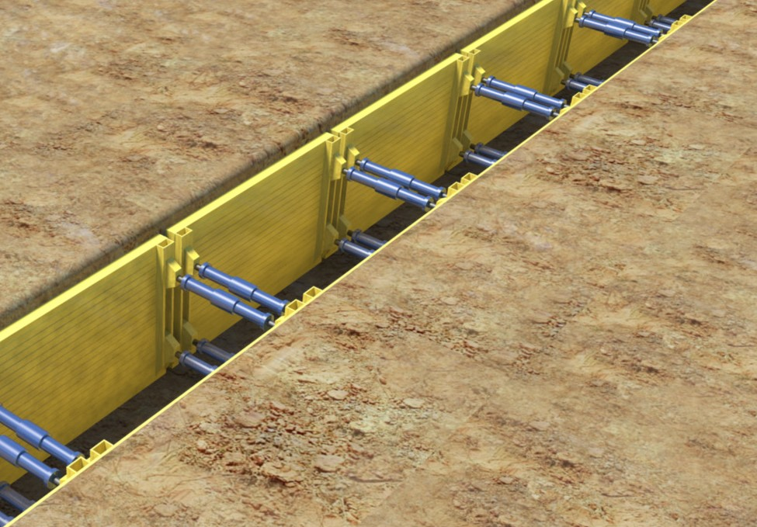
Safety around trenches
PC 1.3 PLAN AND PREPARE SELF-PROPELLED COMPACTOR OPERATIONS
There is a risk that a person could fall into an open trench or excavation on a worksite. People working in trenches are at risk of being crushed or trapped if the trench caves in.
You must try to reduce this risk. Isolation is a good way to reduce the risk. You could put up para-webbing, barriers or temporary fencing. You may put trench shields with guard rails.
Trench shields and shoring
If a trench is 1.5 metres deep or more you must use trench shields or shoring. You should use trench shields that have approved lifting points.
The shields weight must be permanently marked on the shield. If the shield does not have its weight marked, it must be rigged by a licenced dogger or rigger. The shoring must meet Australian Standard 4744: Steel shoring and trench lining equipment. It must also come with an instruction manual. You should secure a ladder for workers to get in and out of the trench.

Slide 20
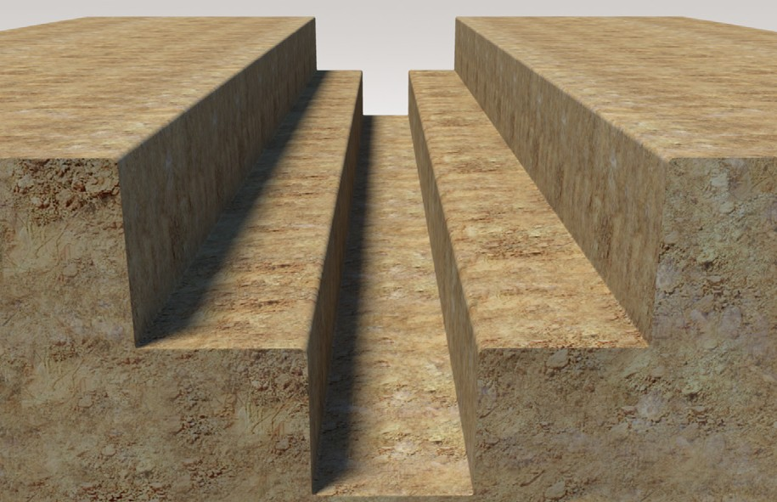
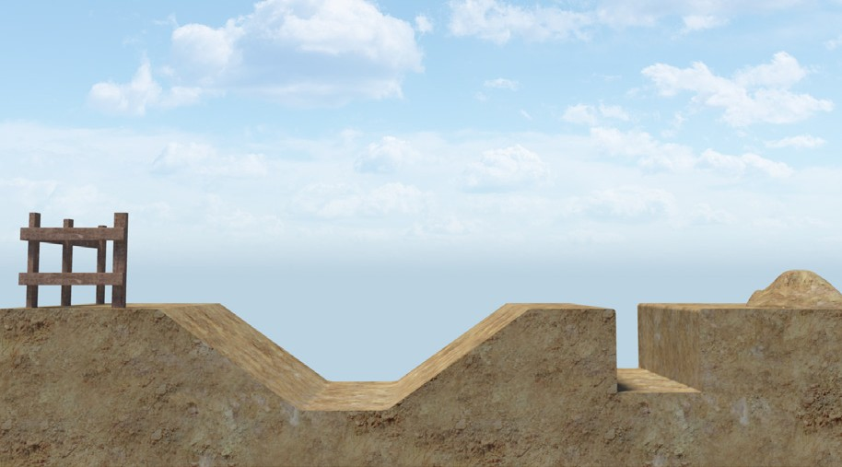
PC 1.3 PLAN AND PREPARE SELF-PROPELLED COMPACTOR OPERATIONS
Safety around trenches (continued)
Benching
Benching is where you cut levels in the soil to reduce the fall risk. For example, instead of having a single 2 metre trench, this area is excavated in two (2) levels. The first level is a 1 metre drop and is 3 metres wide. The second level is 1 metre × 1 metre.
Battering
Battering is where the edges of a trench are ‘tapered’ back on a gentle slope. Battering means that instead of a straight drop off, you have a more gentle slope. In this example, the drop off has been ‘battered’ back so the fall hazard is reduced.
Benching and battering reduce both the fall risk and the risk of collapse.

