Slide 1
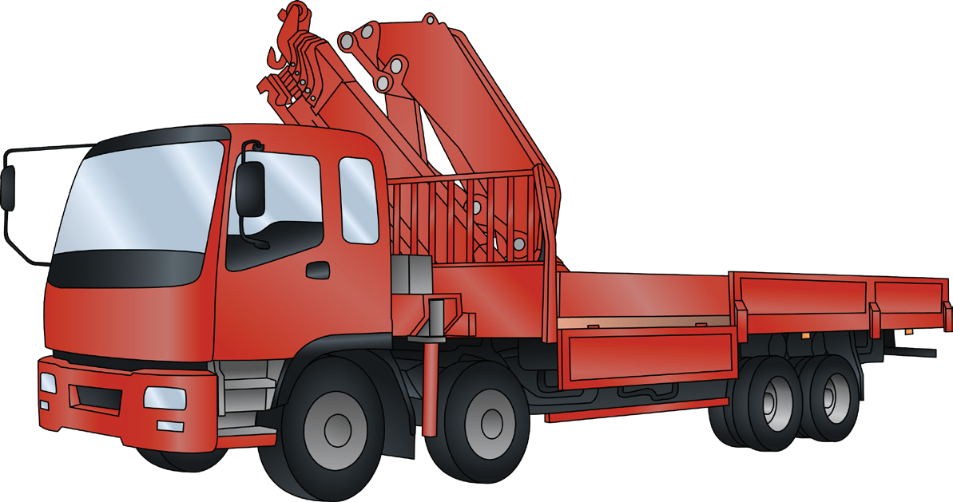
VEHICLE LOADING CRANE
SAFETY AND LICENCE GUIDE
Training support material for:
TLILIC0024
Licence to operate a vehicle loading crane
(capacity 10 metre tonnes and above)
Produced by:

Slide 2
Contents
About this guide
Introduction to vehicle loading crane High risk licensing and the law
4
5
11
15
91
183
213
Element 1
Element 2
Element 3
Element 4
Plan work / task Prepare for work / task Perform work / task Pack up

Slide 3
INTRODUCTION TO VEHICLE LOADING CRANE

Slide 4
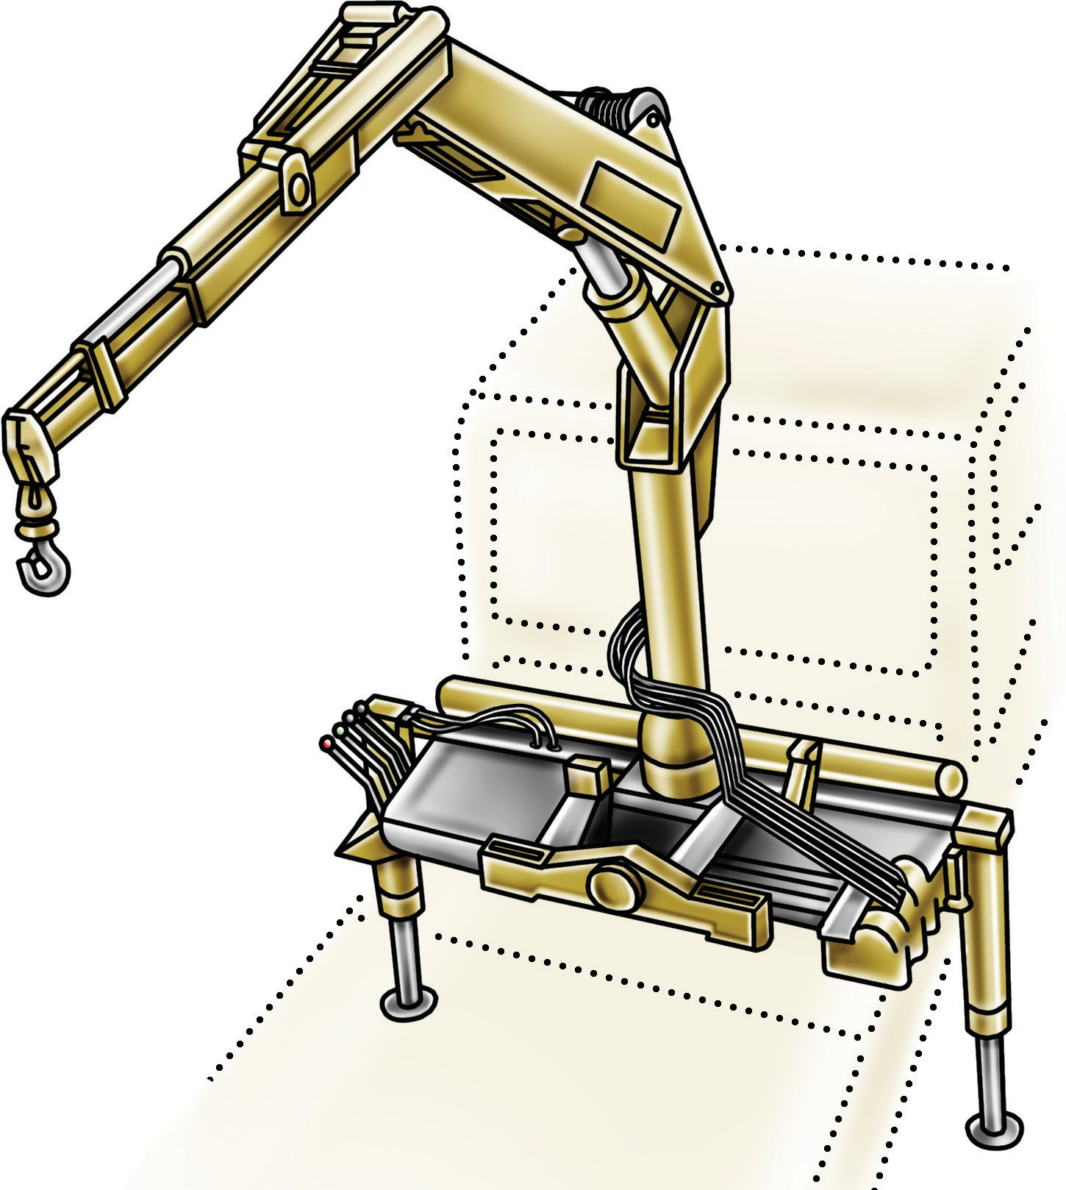
What is a vehicle loading crane?
INTRODUCTION TO VEHICLE LOADING CRANE
A vehicle loading crane is a crane which is mounted to a vehicle for loading and unloading. Vehicle loading cranes have hydraulic booms with power supplied from the vehicles engine through a PTO (power take off).
Winch
Extension cylinder
Lift cylinder
Booms
Hook
Mast
Slewing base
Controls
Outrigger/stabiliser legs

Slide 5
10 metre tonnes
PC 1.3 INTRODUCTION TO VEHICLE LOADING CRANE
A High Risk Work licence is needed when the vehicle loading crane has a capacity of 10 metre tonnes or more. The metre tonnage of a vehicle loading crane is a number which is worked out by multiplying the lifting capacity by the working radius of the boom for that lifting capacity.
To calculate 10 metre tonnes
MULTIPLY THE SWL × THE WORKING RADIUS FOR THAT SWL = METRE TONNES
from the centre line of slew to the centre line of hook. This calculation must be done for each Safe working load (SWL) on the load chart.
If any one calculation amounts to 10 metre tonnes lifting capacity or greater, the crane operator will require the appropriate High Risk Work Licence.
For example:
The load chart below indicates the crane can lift 1300 kilograms at 8.5 metres. 1300 kg × 8.5 m = 11,050
— as this is greater than 10,000 a HRW Licence is required to operate the crane.

Slide 6
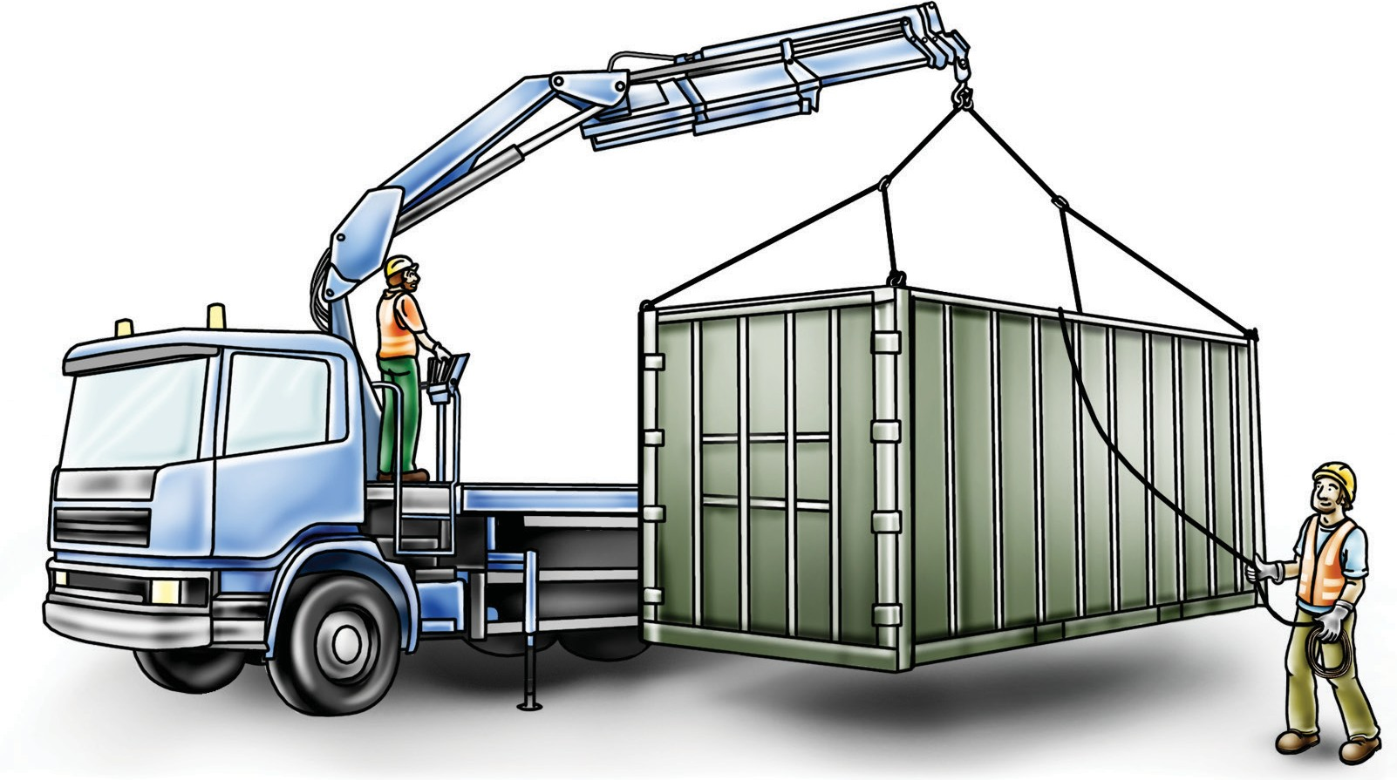
Does the operator of a VLC need a dogging licence?
INTRODUCTION TO VEHICLE LOADING CRANE
A dogging HRW Licence or one of the three rigging HRW Licences is required by:
Any person, other than a licenced VLC operator, who exercises judgment in the estimation of a load or selection of the slinging method and lifting gear when slinging a load on any VLC, or
Any person who directs any VLC operator in the movement of the load when the load is out of view of the crane operator.
To exercise judgment means:
Selecting the slinging method by considering the shape of the load
Selecting the lifting gear by determining the weight (its mass) and centre of gravity of the load, and
Inspecting the lifting gear to ensure it is not defective by considering its condition.
The vehicle loading crane HRW licence includes the application of load estimation and slinging techniques to move a load competently. Holders of a vehicle loading crane HRW licence can exercise judgment on the load and slinging method and select and inspect the lifting equipment when operating a vehicle loading crane.
The holder of a vehicle loading crane HRW licence cannot:
Exercise judgement or inspect lifting gear for any other class of crane unless they hold the relevant HRW licence
Operate the VLC if the load is out of view
Direct another VLC operator in the movement of a load when the load is out of the operators view.
For further information see the Safe Work Australia website – www.swa.gov.au

Slide 7
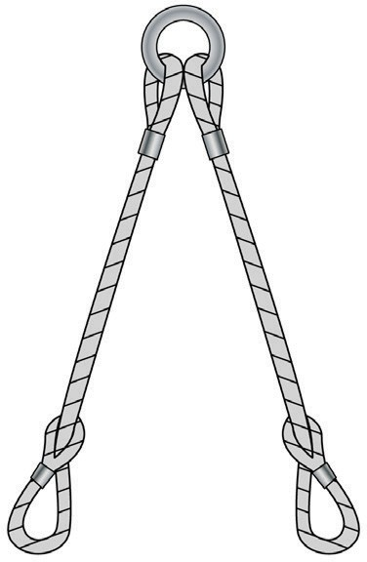
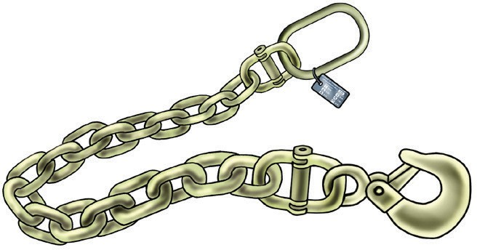
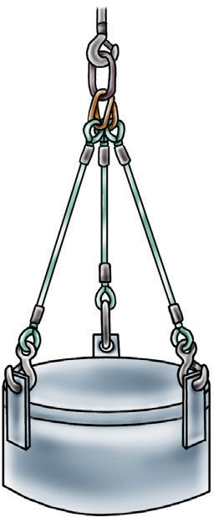
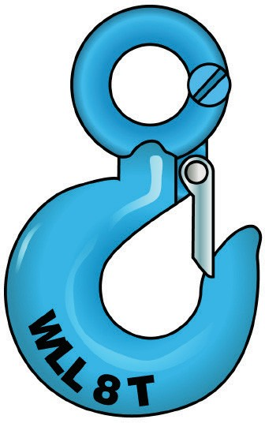
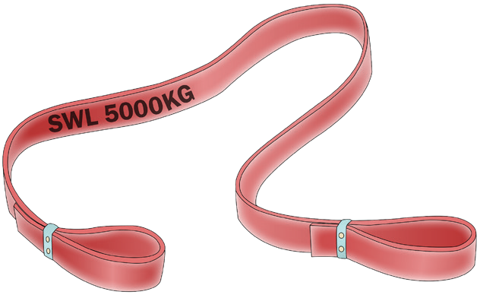
Lifting gear
PC 2.5 INTRODUCTION TO VEHICLE LOADING CRANE
As a VLC operator you will need to make use of many types of lifting gear including:
Fibre ropes | Wire ropes | Chain
Synthetic webbing slings | Multi-leg slings | Hooks

Slide 8
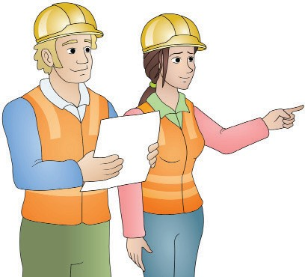
Plan work
Element 1

Slide 9
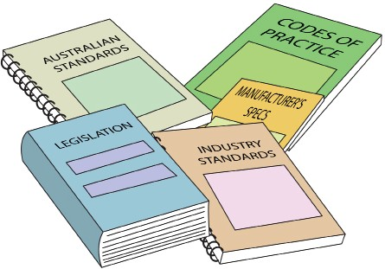
OHS / WHS Guidelines, instructions and people
PC 1.1 PLAN WORK
Before operating the crane you must be aware of any guidelines, instructions and people for the crane you will be operating and for crane operation in general at the workplace.
The types of documents you may need to refer to include:
Manufacturers instructions such as an operator’s manual
Safe work or job procedures
Specific workplace policies and procedures
OHS / WHS workplace representatives
Plans by managers
Codes of practice
WHS /OHS policy
Health and Safety Acts and Regulations (OHS/WHS)
These can be found at www.safeworkaustralia.com or
on your state/territory Health and Safety Regulators website.
Australian and industry standards
You can search for standards at www.standards.org.

Slide 10
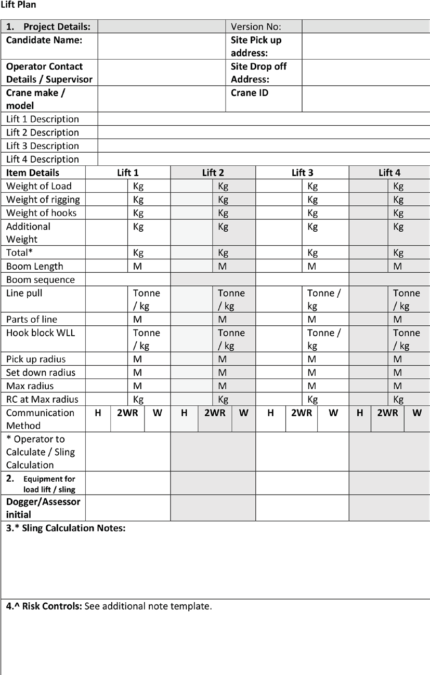
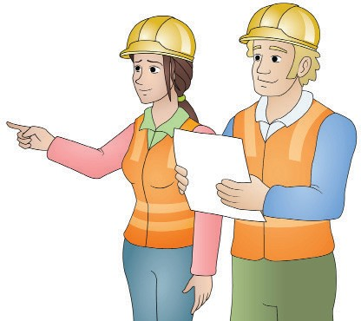
What is a lift plan?
PC 1.1 PLAN WORK
A lift plan is a document that outlines the size of a load, weight, dimensions, center of gravity, resources needed for lift, sling equipment list and a hazard risk assessment. The following is a sample template of a lift plan.
Crane lift plans are essentially overviews of safety risks that may occur and precautions that will be taken when completing the haul.
Crane lift plans look at the size and weight of the haul as well as
how far items are being moved and what sort of environment they are moving in.

Slide 11
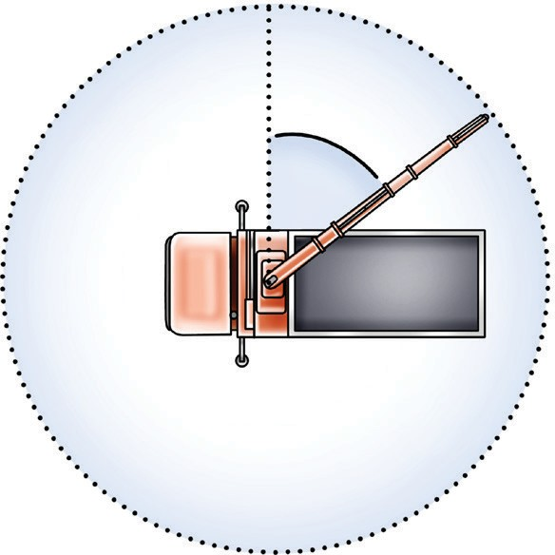
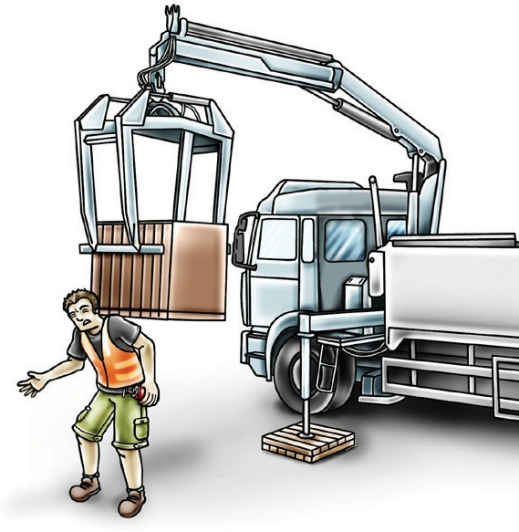
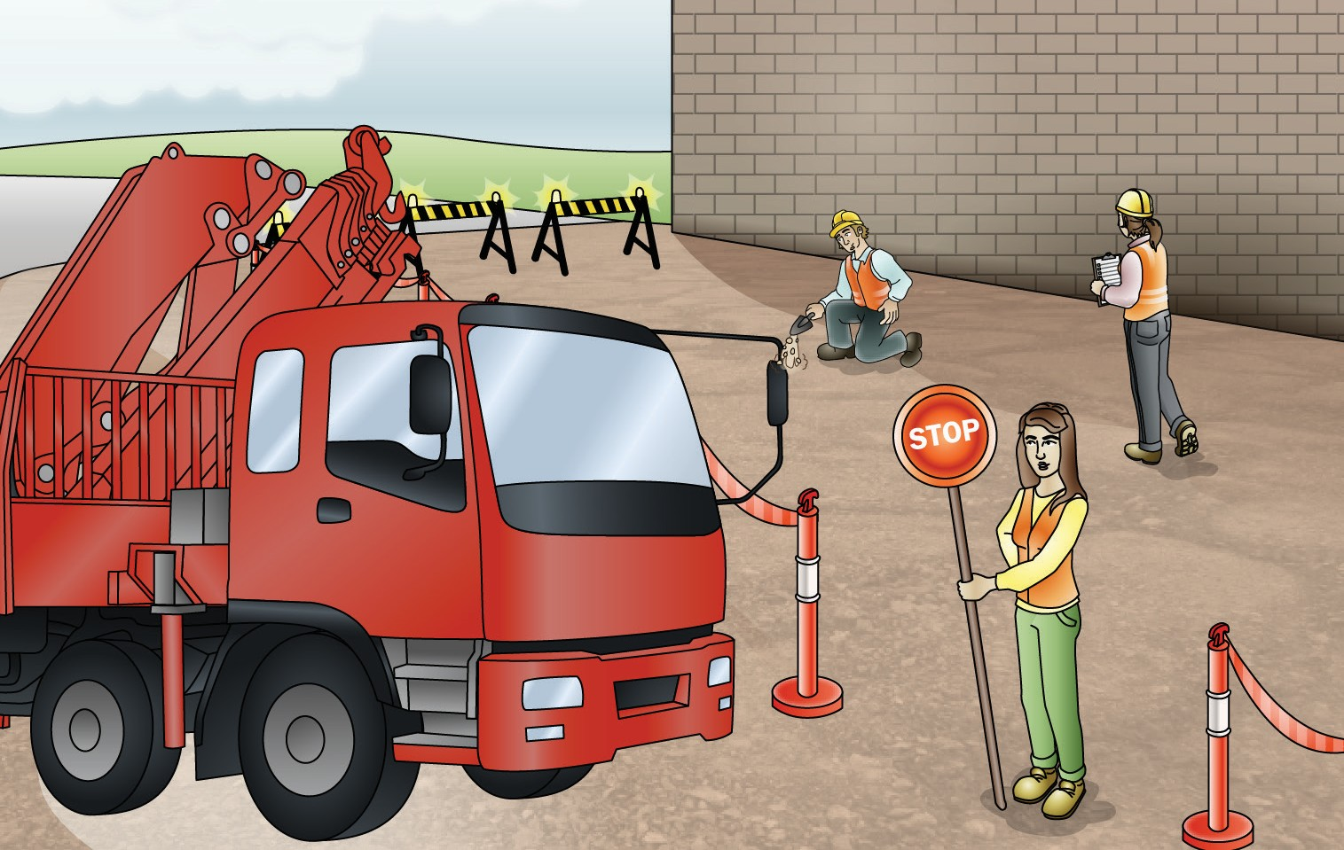
PC 1.1 PLAN WORK
QUESTION 2
You have some lifting jobs to do.
What should you think about and plan for?
Boom safe working radius Things that might get in your way
How you will get in (access) and out (egress) of the work area
...CONTINUES ON NEXT PAGE

Slide 12
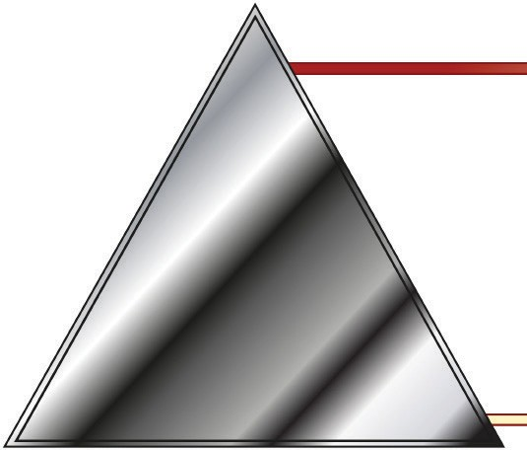
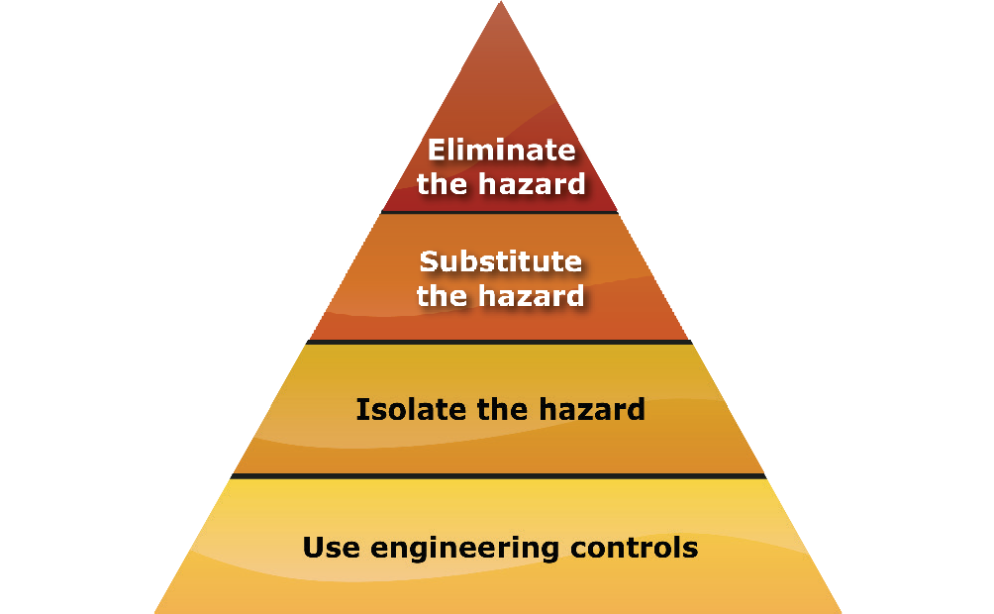
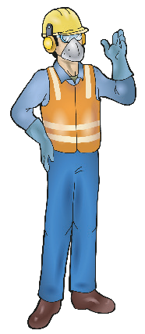
What is The Hierarchy of Hazard Control?
PC 1.5 PLAN WORK
The Hierarchy of Hazard Control is a list of controls that you can use to eliminate or lower the danger from a hazard in the workplace.
What are the six (6) levels in the hierarchy from first choice to the last choice?
Elimination:
If possible, remove (take away) the hazard.
Substitution:
Use a safer method if you can’t remove the hazard.
Isolation:
Stop access to the hazardous (dangerous) area.
Engineering control measures:
Change the tools, equipment or environment to make it safer.
Administrative practices:
Reduce the time the worker is exposed to the hazards by using training, job rotation, the timing of jobs, etc
Personal Protective Equipment (PPE):
Use PPE as your last line of defence.
Memory aid: Every Saturday I Eat A Pie

Slide 13
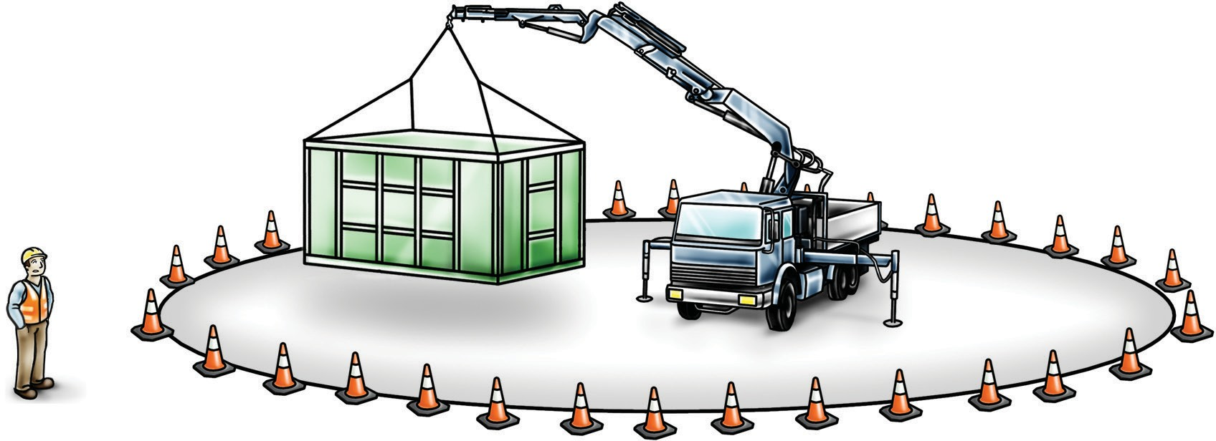
PC 1.5, 1.4 PLAN WORK
The risk to people working near the operating radius of your crane
You are working near people or other equipment.
What is the main risk for people in the operating radius, and how can you control it?
Hazard – someone might get hit or squashed by the crane when it is slewing.
Control – use exclusion zones (areas that are kept clear).

Slide 14
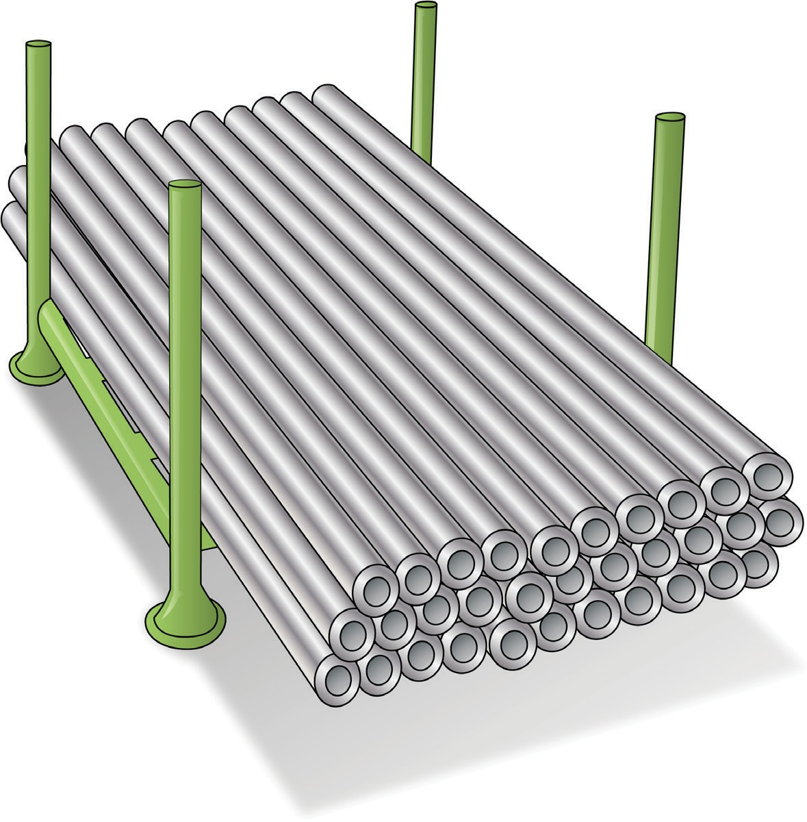
PC 1.3, 2.11 PLAN WORK
QUESTION 28
Work out the weight of a scaffolding stillage
loaded with 32 × 2 metre standards.
The tare of the stillage is 40 kg and each standard weighs 12 kgs.
...CONTINUES ON NEXT PAGE

Slide 15
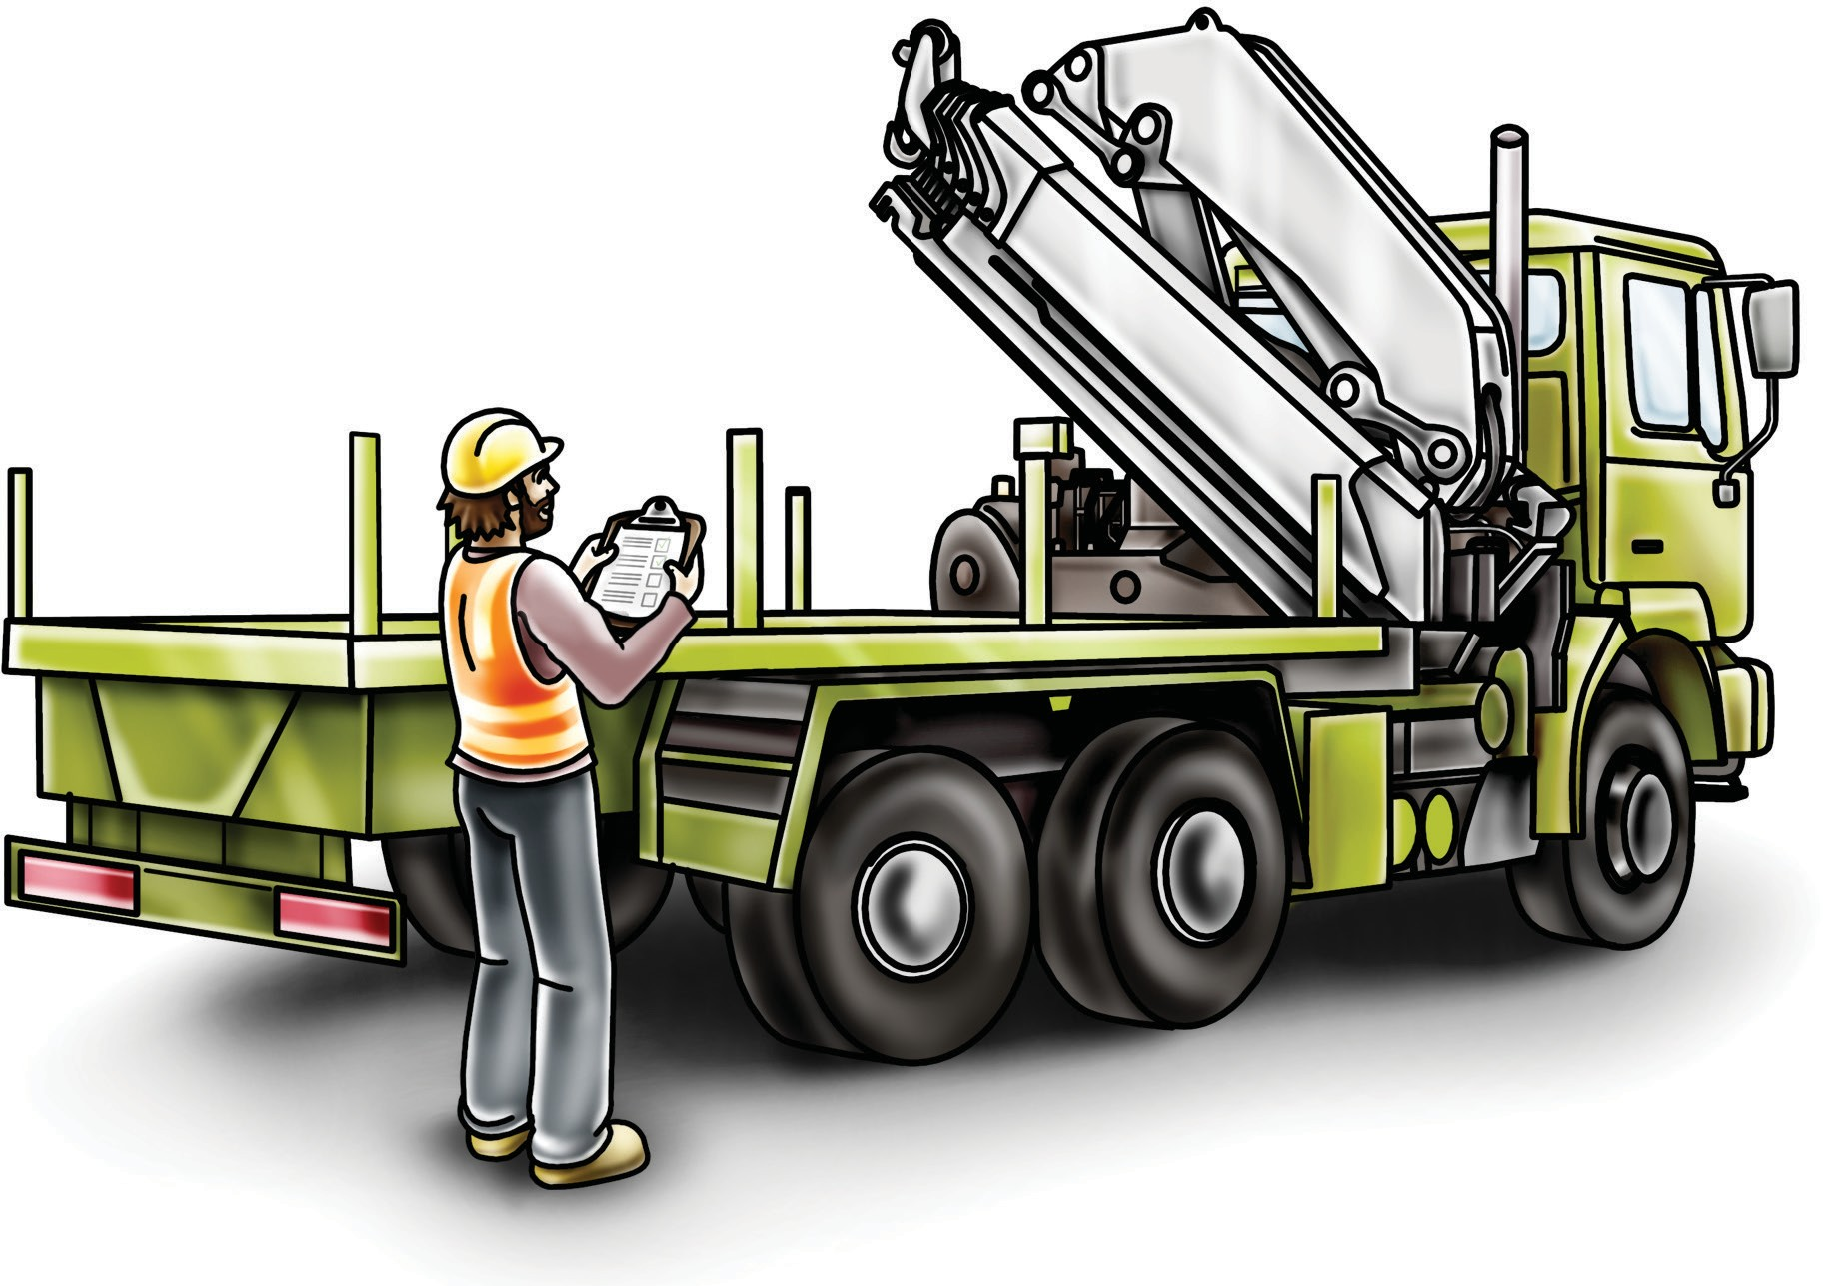
Prepare for work / task
Element 2

Slide 16
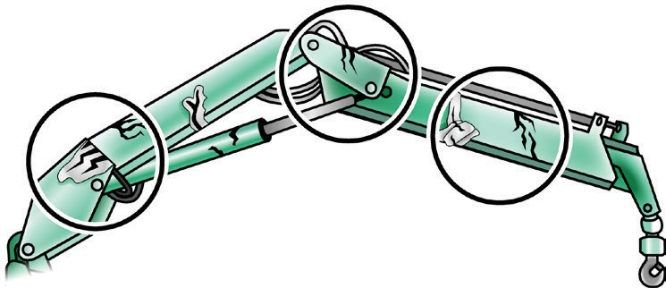
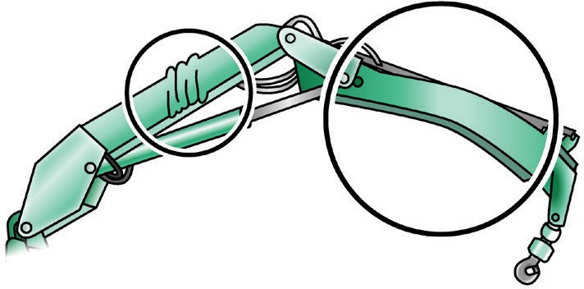
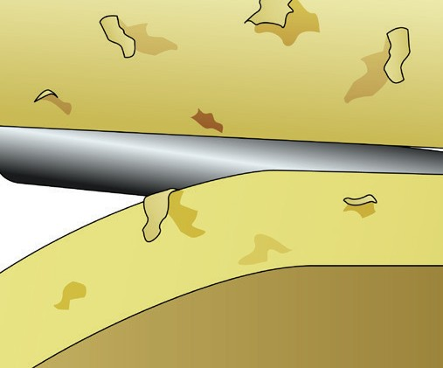
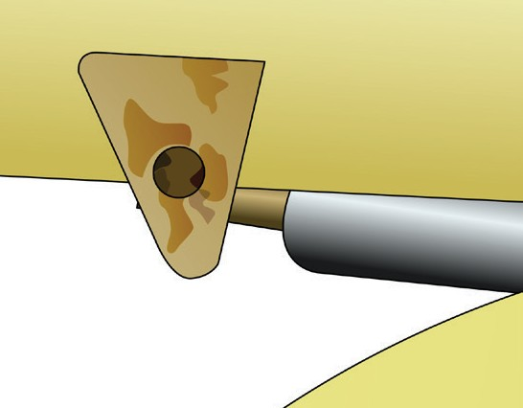
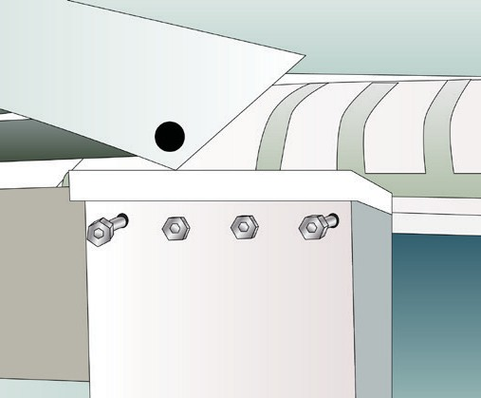
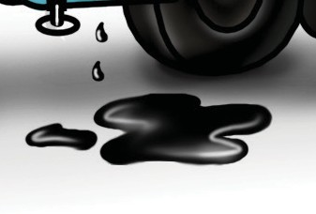
PC 2.4, 3.10 CONDUCT ROUTINE CHECKS
QUESTION 47
Name some defects you can easily see on a crane’s boom.
Cracked welds or metal in the boom or superstructure. | Twists or bends
Flaking paint | Rusty welds or joints
Loose bolts | Oil leaks

Slide 17
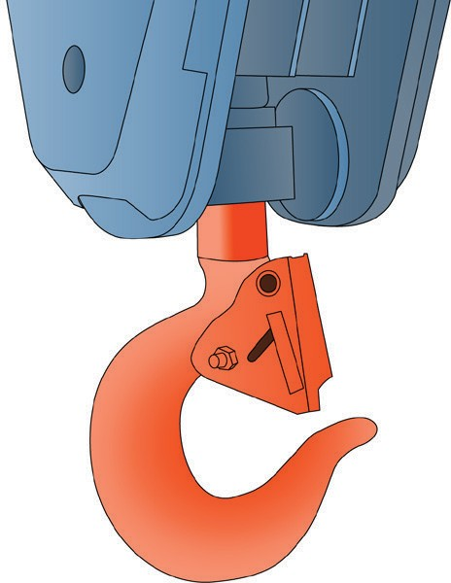
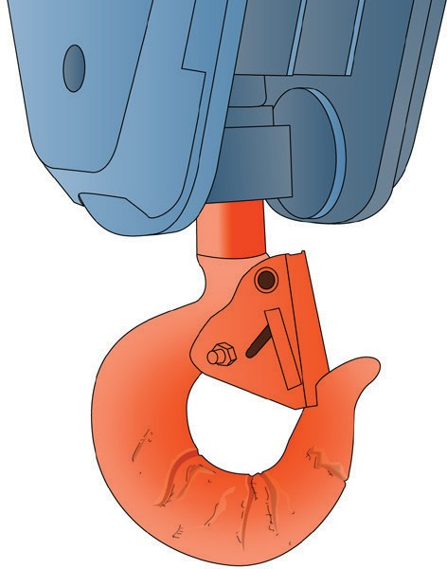
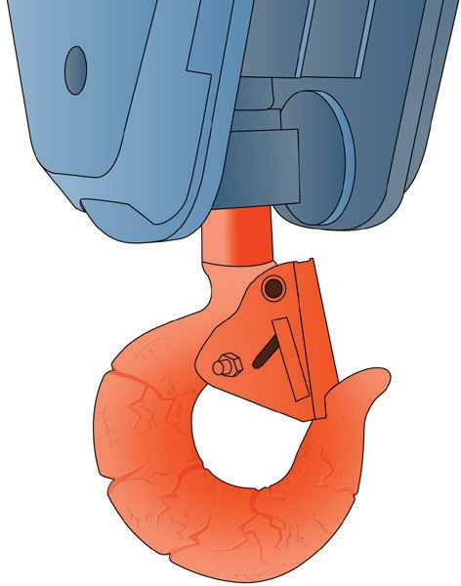
PC 2.4, 3.10 CONDUCT ROUTINE CHECKS
QUESTION 48
What are some defects that would make a hook unsafe to use?
Bill stretched (more than 5%)
Gouges and cuts (more than 10% wear)
Cracked or twisted hook
...CONTINUES ON NEXT PAGE

Slide 18
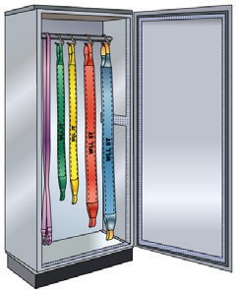
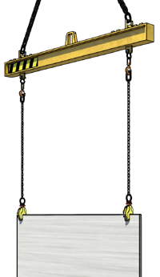
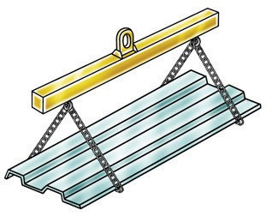
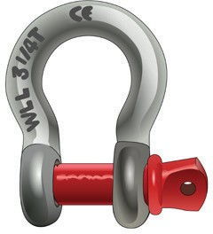
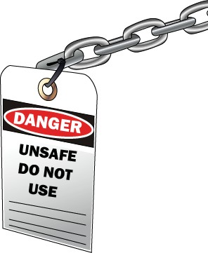
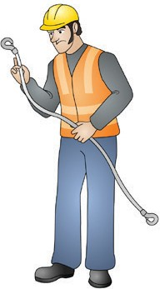
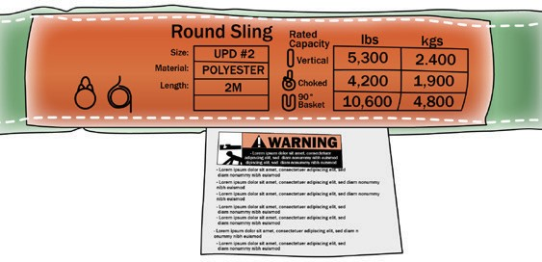
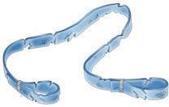
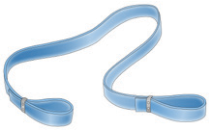
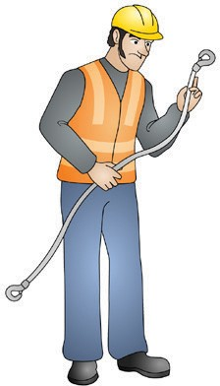
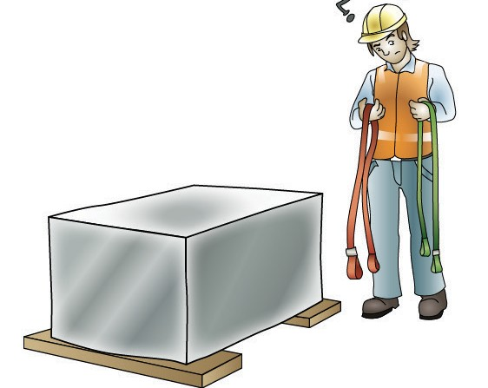
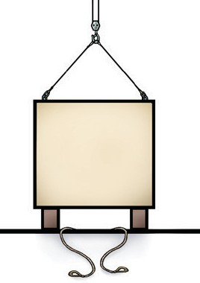
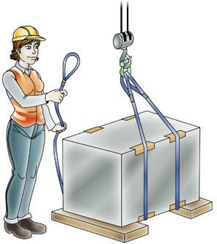
Lifting equipment and gear is prepared for safe use
PC 2.14 PREPARE FOR WORK / TASK
Gather sling equipment Lifting rings, shackles and eyebolts Beam and plate clamps Spreader and lifting beams
What would you do in preparation of lifting a load?
Wedges
Blacks
You would;
Gather equipment and gear
Inspect equipment tag information, other load lifting factors and inspect working condition of equipment
Layout load equipment and assemble
Inspect destination is setup to receive load (e.g. work blocks, wedges)
Do a test run.
Dunnage/packing

Slide 19
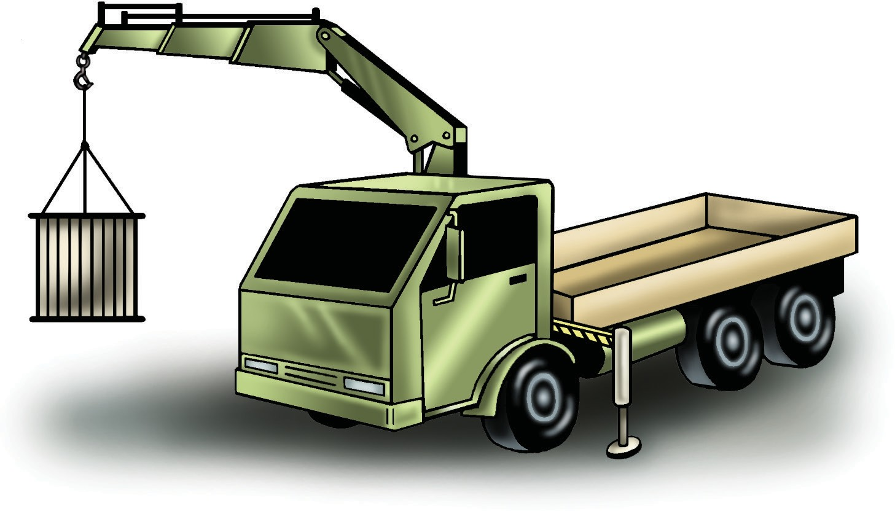
Perform work / task
Element 3

Slide 20
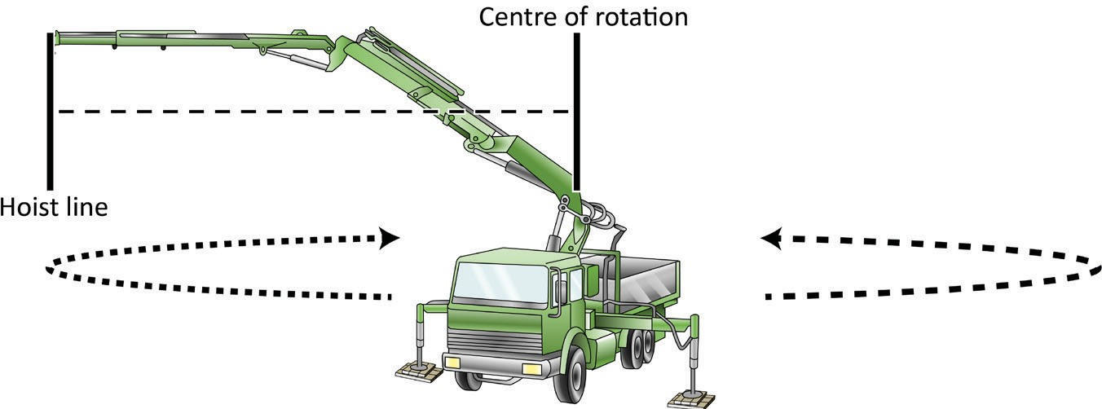
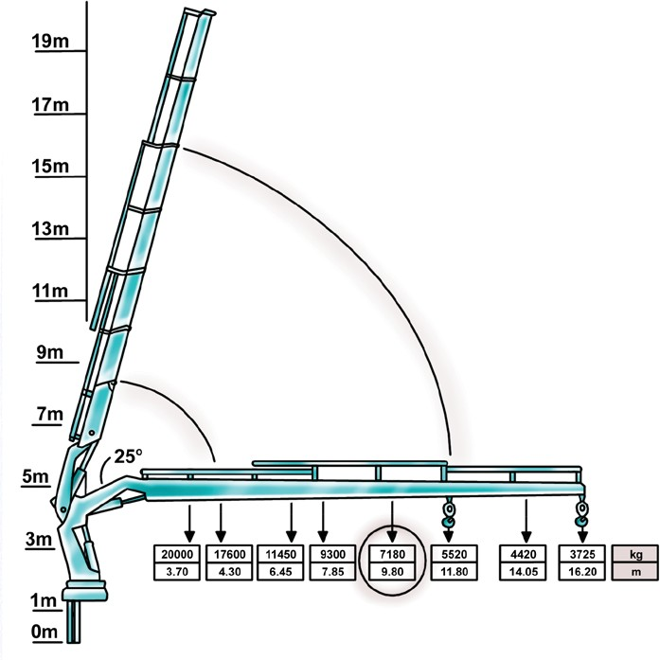
PC 3.1 TRANSFER LOADS
QUESTION 111
You are looking at the crane load chart.
What does operating radius show?
Note: When the operating radius is not shown on the load chart use the longer. This reduces the crane capacity.
The operating radius shows you the distance at which the crane can safely lift a known weight.
Centre of rotation
Hoist line
QUESTION 112
Name some things you will
find on a load chart.
The winch line pull
The crane’s rated capacity for different
configurations
The hook block’s mass/weight
Multiple rope fall capacities (eg. 2-fall and
4-fall hook block configurations)
Operating radius

Slide 21
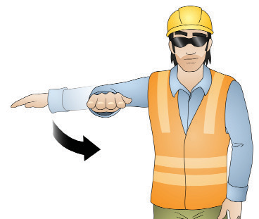
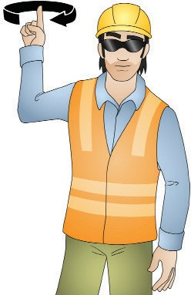
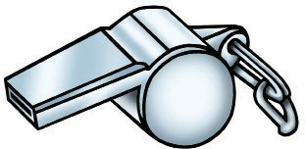
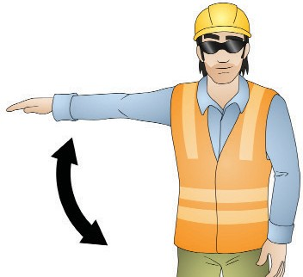
PC 3.7 TRANSFER LOADS
QUESTION 121
Some of the Australian Standard signals used in dogging are shown here.
What does each of these signals mean?
[Note: Signals may vary between worksites. You need to check.]
Hoisting raise Hoisting lower/down
Commonly used signal (not Australian Standard)
2 short
1 long
Luffing boom up
Luffing boom down
3 short
4 short
...CONTINUES ON NEXT PAGE

Slide 22
Pack up
SHUT DOWN AND SECURE CRANE
OFF
Element 4
ON

Slide 23
PC 4.1, 4.3 SHUT DOWN AND SECURE CRANE
QUESTION 134 | The manufacturer’s information or operator’s manual will tell you where and how to
The cranes boom and | stow and secure the crane boom, stabilisers/outriggers and equipment.
equipment must be stowed
and secured when you
finish the job.
How do you do this?

Slide 24
PC 4.2, 4.3 SHUT DOWN AND SECURE CRANE
QUESTION 135
When do you use motion locks and the park brake?
These should be used when you:
Shut down the crane
Leave the crane
Stop operations.
QUESTION 136
What are the steps for stowing
outriggers/stabilisers?
1. Raise up the footplate’s and retract (bring in) the outrigger beams.
2. Lock with the pin.
3. Clean the steel plates.

