Slide 1
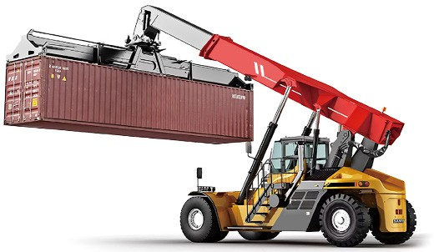
REACH STACKER
SAFETY AND LICENCE GUIDE
Training support material for:
TLILIC0011
Licence to operate a reach stacker
(greater than 3 tonnes
capacity)
Produced by:
Picture based. Plain English. Learning made easy.

Slide 2
Contents
Introduction to reach stackers
5
High risk licensing and the law
9
Plan work/task
21
Prepare for work/task
61
Perform work/task
87
Pack up
105

Slide 3
Introduction to REACH STACKERS

Slide 4
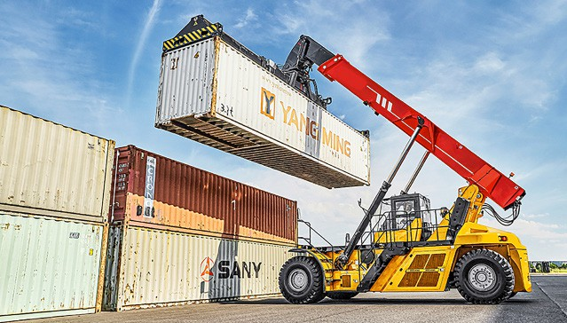
What is a reach stacker (container handler)?
INTRODUCTION TO REACH STACKER
A reach stacker is a type of heavy-duty machine used in ports and warehouses to lift and move large shipping containers. It has a long arm (or boom) that can extend and retract, allowing it to reach containers stacked several rows deep. The reach stacker picks up containers from ships or storage areas and stacks them in organised rows or moves them to trucks or trains for transportation. Essentially, it’s like a big, powerful reach stacker designed specifically for handling shipping containers.

Slide 5
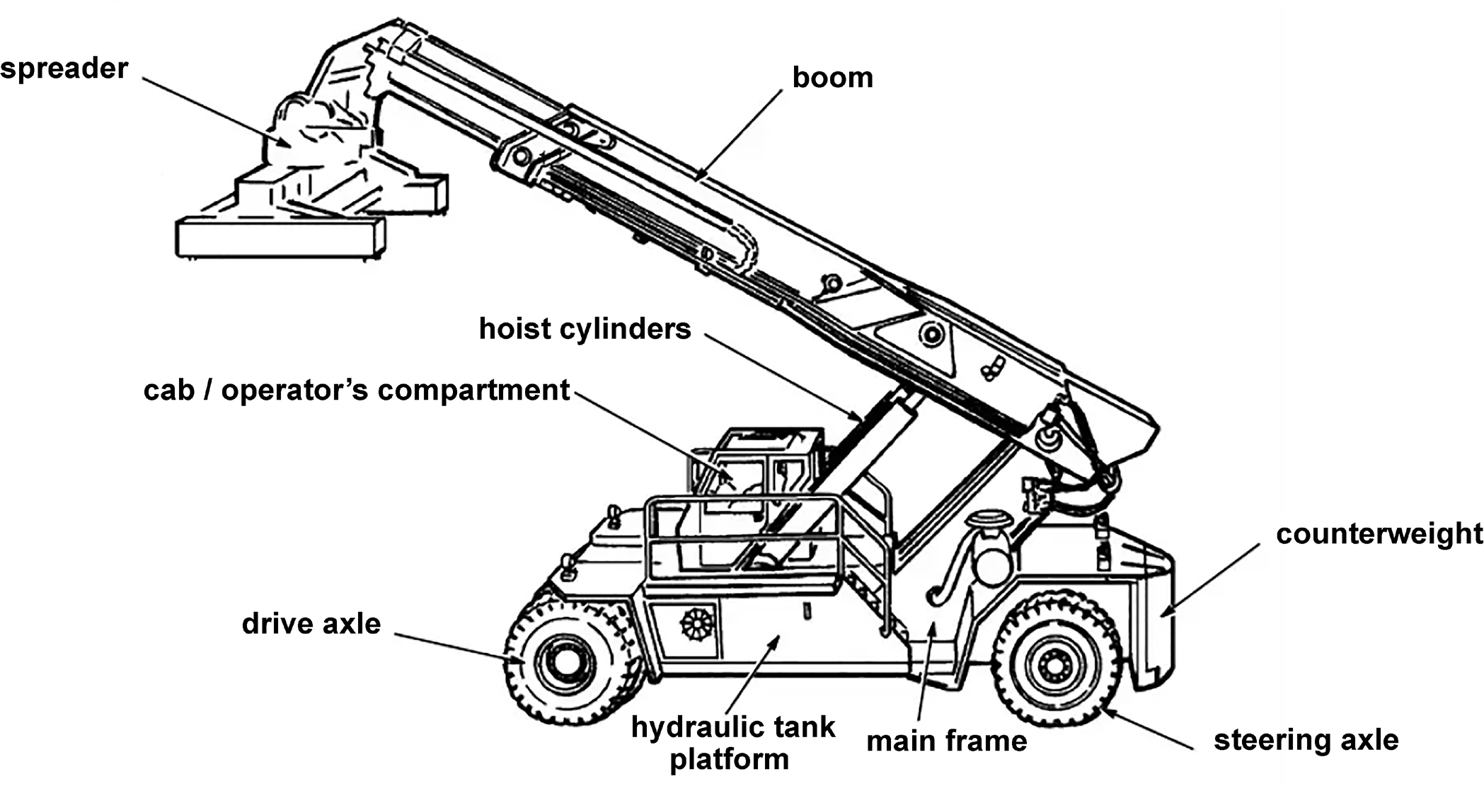
INTRODUCTION TO REACH STACKER
Parts of a reach stacker

Slide 6
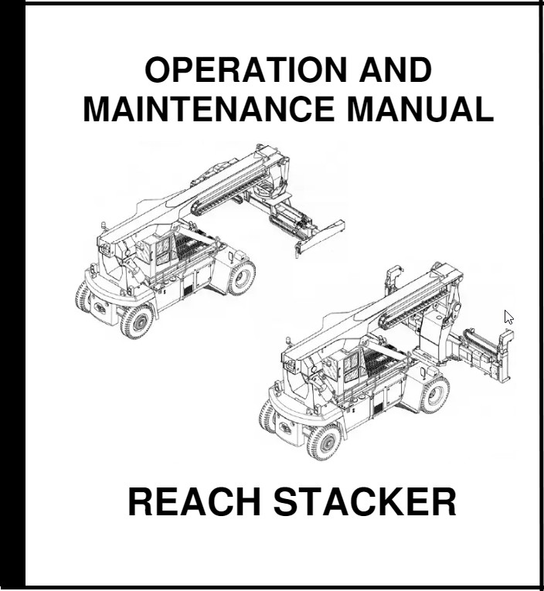
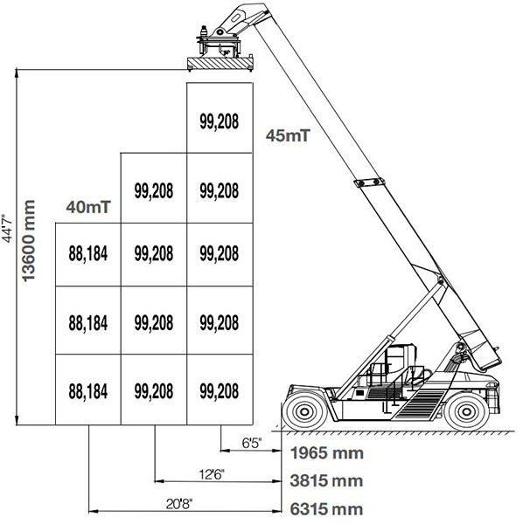
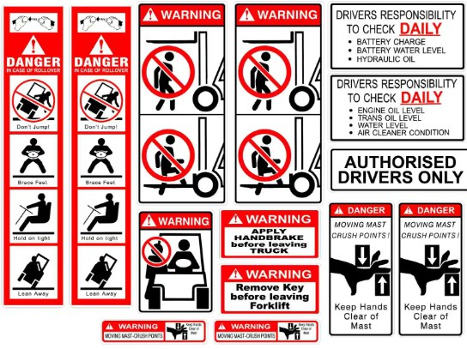
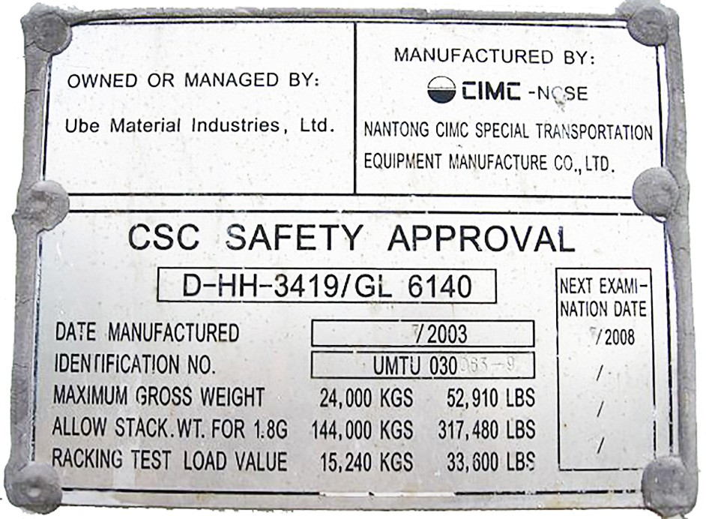
PC 1.1 INTRODUCTION TO REACH STACKER
You can find information about a reach stacker in the following places:
In the operator’s manual
On load charts
In manufacturer’s specification such as decals
Marked or labelled on the reach stacker

Slide 7
ELEMENT 1
Plan work/task

Slide 8
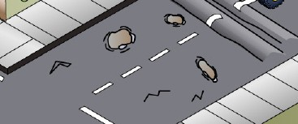
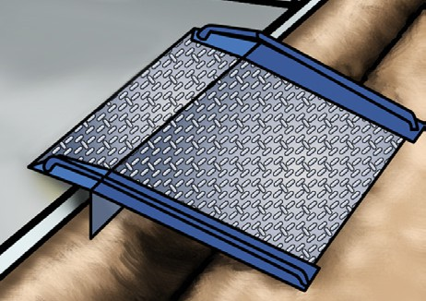
Inspect the operating surface
PC 1.2 CHAPTER 1 – PLAN WORK/TASK
ELEMENT 1 – PLAN WORK/TASK
It is important to inspect the operating surface for many reasons:
So you can identify any hazards that exist
To determine the suitability of the surface
So you can find out the best path for driving the reach stacker and moving and placing loads.
The operating surface can have an affect on the reach stackers stability and should be assessed before you start work. This will help you to decide if it creates a hazard as well as what will be the correct type of reach stacker to use. For example, if the surface is hard and flat such as concrete, a reach stacker fitted with solid tyres will be fine. However if you were working on a rough, uneven surface such as on a construction site, then a rough terrain reach stacker fitted with pneumatic tyres would be
Backfilled ground or covered trenches | Damaged or cracked bitumen or concrete and potholes | Hard compacted soil or soft soil
Railway tracks | Rough, uneven, sloping surfaces | Steel decks, ramps and grates

Slide 9
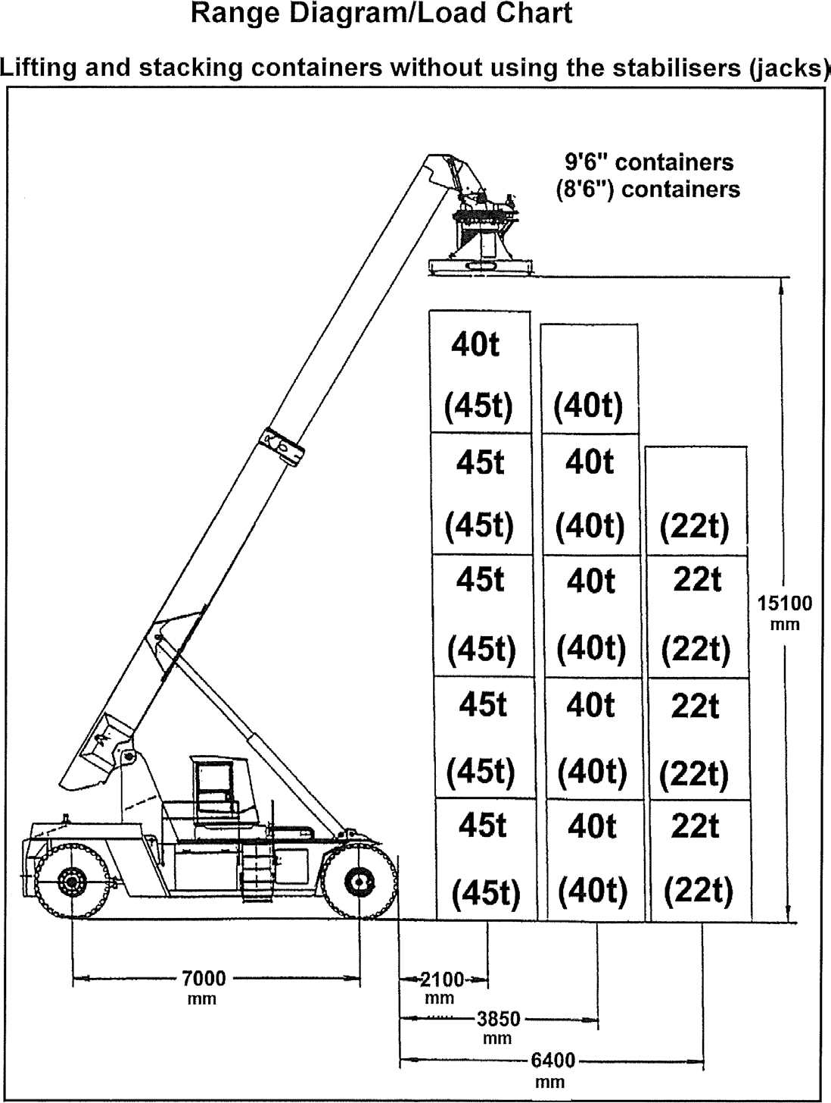
Reading a load chart
PC 1.3, 3.1 CHAPTER 1 – PLAN WORK/TASK
ELEMENT 1 – PLAN WORK/TASK
Examples of crane calculations
Example 1
The containers are 9’ 6” high. You need to move containers stacked 5 high and weighing 45t. What is the maximum allowable boom reach?
Answer: 2100 mm.
Example 2
The containers are 9’ 6” high. Each container weighs 40t. The boom reach is 3850 mm. What is the greatest height the containers can be stacked?
Answer: 4 containers high.
Example 3
The containers are 9’ 6” high. The maximum boom reach is 6400 mm. The containers cannot be stacked more than 4 high. What is the maximum weight you are allowed to lift?
Answer: 40T

Slide 10
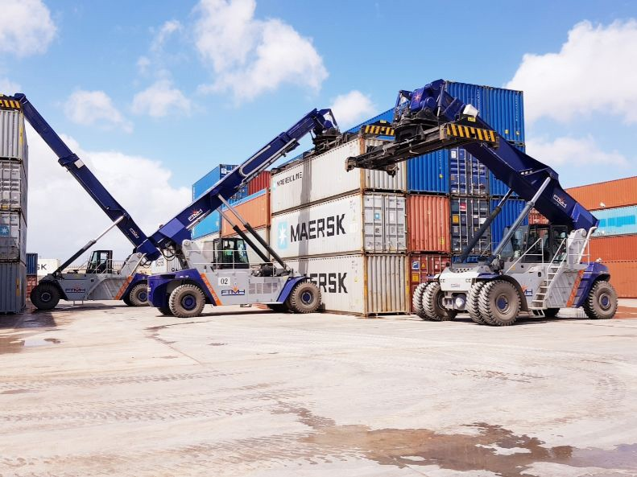
Path of travel
PC 1.4 CHAPTER 1 – PLAN WORK/TASK
ELEMENT 1 – PLAN WORK/TASK
Inspecting the work area also helps you to determine the most appropriate pathways for operating the reach stacker and for moving and placing loads.
When planning your path of travel you should consider some of the following things:
When should you sound the horn?
Will you need to reverse?
Where will you have to stop?
Where should you slow down?
What is the speed limit?
Are there places the reach stacker can’t go?
Where will there be pedestrians?
Is there a suitable area to place the load?

Slide 11
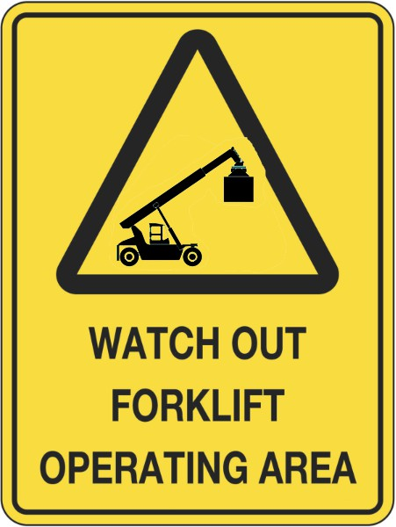
Risk control
PC 1.5 CHAPTER 1 – PLAN WORK/TASK
ELEMENT 1 – PLAN WORK/TASK
You should apply risk control measures:
before you start work
as soon as you spot a hazard while working.
Risk management is made up of the following five steps.
Identifying hazards.
Assessing the risk involved.
Talking and reporting to other workers.
Controlling the hazards to lower the risk.
Reviewing the action you have taken.

Slide 12
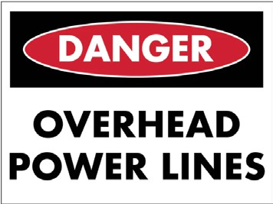
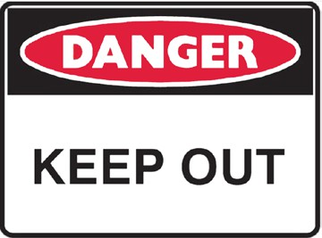
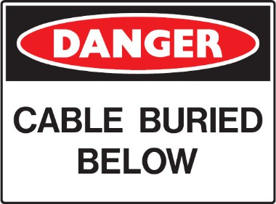
Check for hazards
PC 1.5 CHAPTER 1 – PLAN WORK/TASK
There are a lot of hazards and risks on work sites that you need to be aware of. Hazards can cause accidents, injuries and even death.
Hazards and hazard controls need to be considered when planning work. The work site should be inspected by looking for hazards and risks that exist:
Above eye level (in the air)
At eye level
Below eye level (on the ground).
You should always follow workplace procedures for conducting site inspections.
Above eye level (in the air)
At eye level
Below eye level (on the ground)

Slide 13
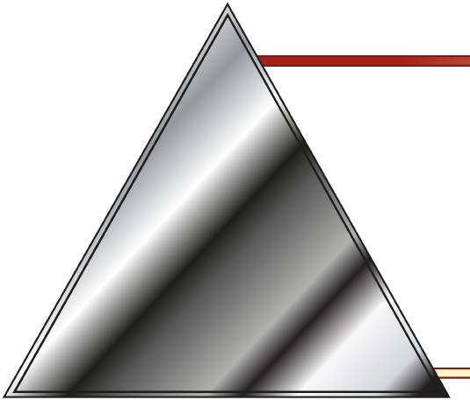
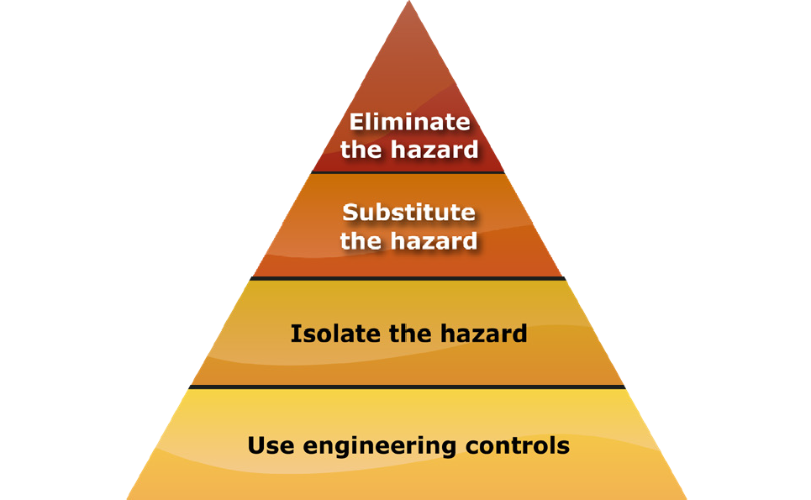
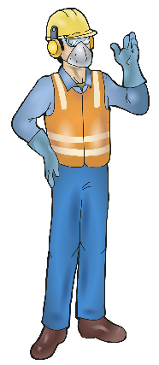
Hazard control
PC 1.5 CHAPTER 1 – PLAN WORK/TASK
When hazards are identified you must report them to the relevant people. You should report the control measures you will use for the hazard. Always follow workplace procedures for controlling hazards.
The Hierarchy of Hazard Control is a list of controls that you can use to eliminate or lower the danger from a hazard in the workplace. Make sure controls are set up before you start the job or as soon as you find a hazard.
These are the six (6) levels in the hierarchy from the first choice to the last choice.
Elimination:
If possible, remove (take away) the hazard.
Substitution:
Use a safer method if you can’t remove the hazard.
Isolation:
Stop access to the hazardous (dangerous) area.
Engineering control measures:
Change the tools, equipment or environment to
make it safer.
Administrative practices:
Reduce the time the worker is exposed to the hazards by using training, job rotation, the timing of jobs, etc.
6. Personal Protective Equipment (PPE):
Use PPE as your last line of defence.
Memory aid: Every Saturday I Eat A Pie

Slide 14
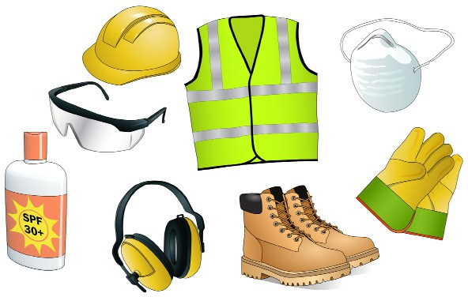
Personal Protective Equipment (PPE)
PC 1.5 CHAPTER 1 – PLAN WORK/TASK
The best way to make the workplace safe is to take away hazards altogether. But often you can’t do this. This is where Personal Protective Equipment (or PPE) can help.
PPE is clothing or equipment worn on the body to protect you from hazards. PPE will not take away the risk of harm altogether, but it will help keep you safe. These are some examples of PPE.
Hard hat
High visibility clothing
Dust mask
Safety glasses
Long sleeved
top
Long pants
Safety gloves
Sunscreen
Ear muffs
Safety shoes
Note: Before starting any work all PPE should be chosen and checked to make sure it is in good working order

Slide 15
CHAPTER 2
Prepare for work/task

Slide 16
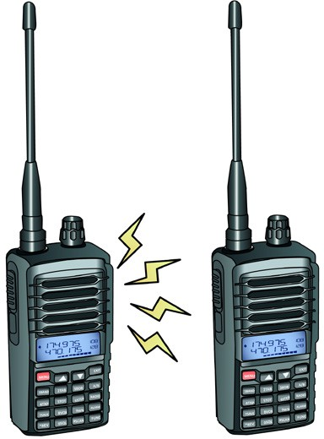
PC 2.2 CHAPTER 2 – PREPARE FOR WORK/TASK
ELEMENT 2 – PREPARE FOR WORK/TASK
Continued from previous page
Communication Protocols: Establish effective communication protocols between reach stacker operators, spotters, and other personnel working in the vicinity. Use two-way radios or hand signals to communicate instructions and warnings effectively.
Load Handling Practices: Train operators on proper load handling techniques, including weight limits, load distribution, and securing loads. Ensure that loads are stacked securely to prevent shifting during transport.
Emergency Response Preparedness: Develop and rehearse emergency response procedures for potential accidents or incidents involving reach stackers. This includes procedures for medical emergencies, equipment malfunctions, and evacuation protocols.
Decide how you will communicate
Environmental Considerations: Take into account environmental factors such as weather conditions and visibility when operating reach stackers.
Weather bureau forecasts and environmental conditions that could
impact operation include:
lightning
wind
water on ground
Ultra Violet (UV) exposure (sun glare)
Be ready for emergencies
Adjust operating practices accordingly to mitigate risks associated with
adverse conditions.

Slide 17
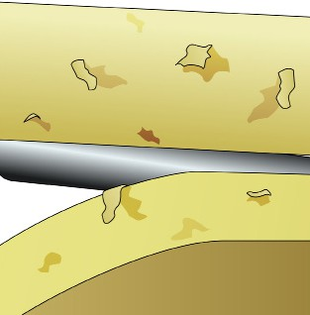
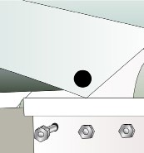
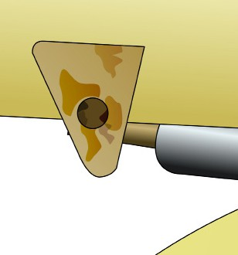
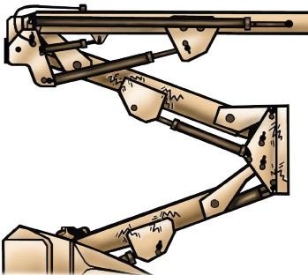
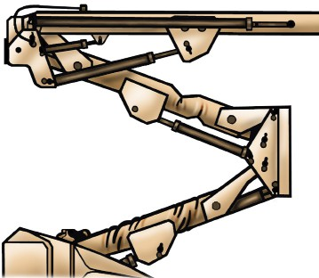
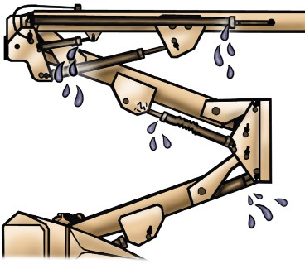
PC 2.4 PREPARE FOR WORK / TASK
ELEMENT 2 – PREPARE FOR WORK/TASK
Looking closely at the boom, you may be able to visually see some problems. Give some examples of defects you might find on the boom or superstructure. | Flaking paint | Loose bolts | Rusty welds or joints
 | Cracks in the boom, superstructure or welds | Twists or bends | Oil leaks

Slide 18
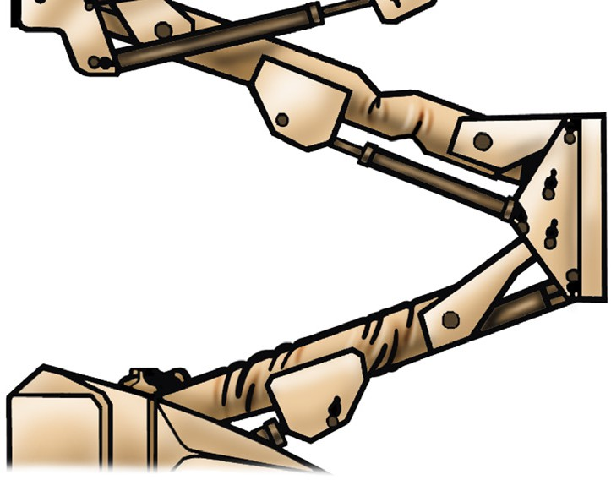
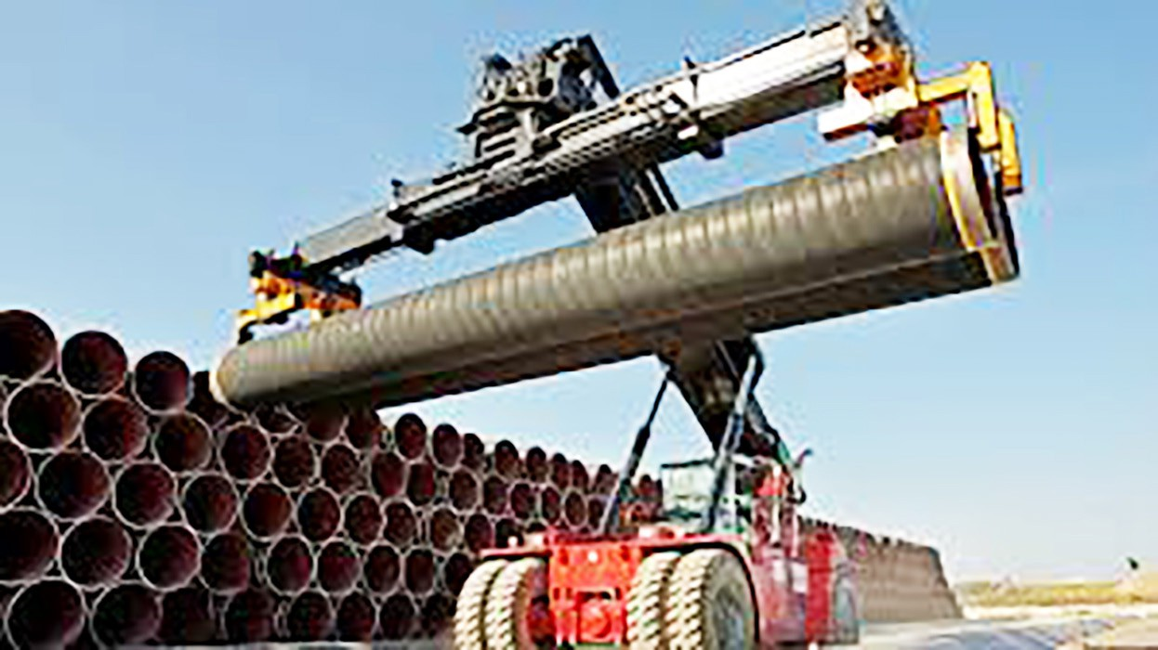
PC 2.4, 2.5 ELEMENT 2 – PREPARE FOR WORK/TASK
Pre-start checks continued...
Damage:
Check for any signs of damage on the reach stacker.
Boom:
Check for structural damage on the boom.
Reach stacker configuration:
The configuration will determine how much you can lift. Factors could include:
boom length
lift capacity
wheelbase
engine power
controls.

Slide 19
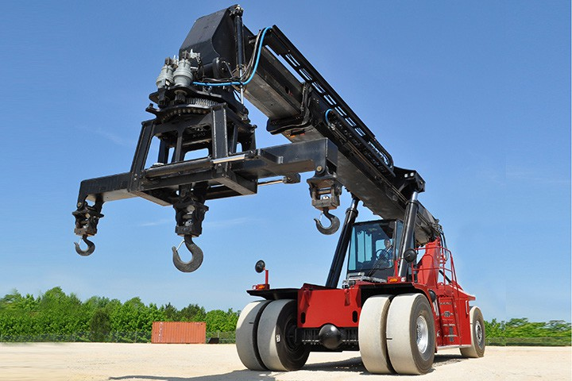
PC 2.6 ELEMENT 2 – PREPARE FOR WORK/TASK
Operational checks continued...
The spreader has a number of parts which should be checked before operating the reach stacker. These include:
Compliance plate - Tells you the manufacturer, model, serial number and capacity ratings.
Lifting lugs - Are typically used for attaching lifting slings or hooks to facilitate the lifting and handling of the machine.
Twist locks - Twist locks on a reach stacker are mechanisms used to securely lock shipping containers onto the spreader bars of the reach stacker.
Spreader - The primary function of the spreader is to securely grasp and lift shipping containers from the top corner fittings.
Side shift - AA side shift on a reach stacker refers to a feature that allows the operator to move the entire carriage or attachment horizontally along the length of the reach stacker’s boom or mast. This capability
enables the operator to adjust the position of the load relative to the reach stacker, providing more precise placement and alignment during handling operations.
Tilt cylinder - A tilt cylinder on a reach stacker is a hydraulic component that is responsible for controlling the tilting motion of the reach stacker’s attachment, typically the spreader or forks.
Rotating device - A allows the operator to rotate the entire spreader assembly, including the attached container or cargo, horizontally around a vertical axis.

Slide 20
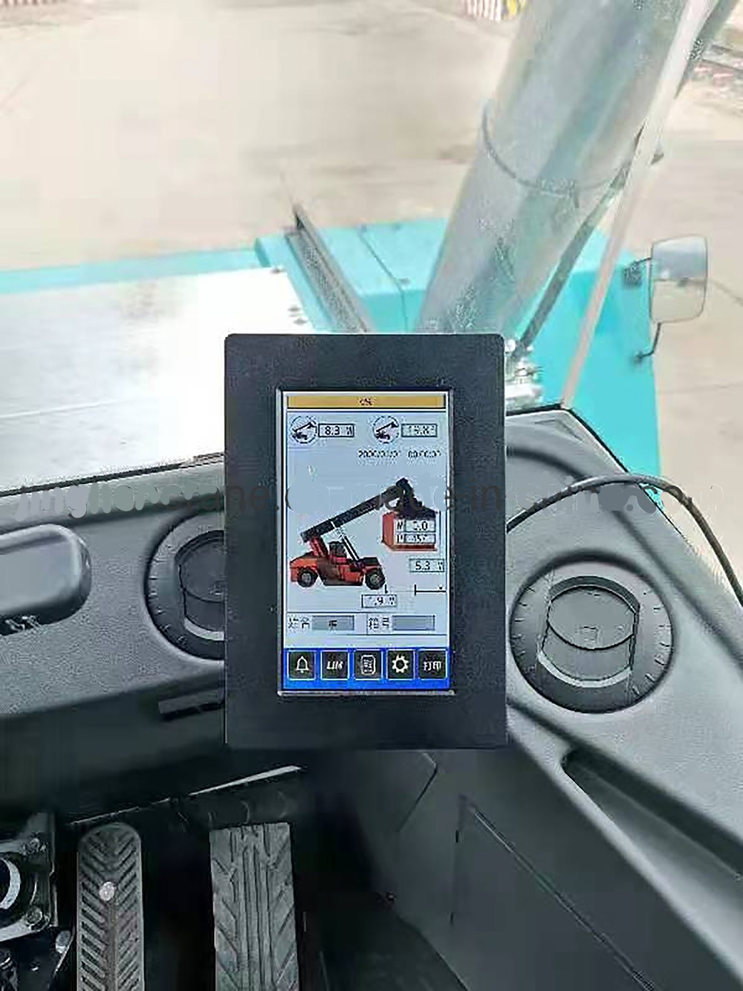
PC 2.6 ELEMENT 2 – PREPARE FOR WORK/TASK
Operational checks continued...
Check that the reach stacker’s computer / visual display is working accurately. You can do this by:
Check the load against a know weight.
Follow the manufacturer’s specifications for pre-
operational testing.
Compare the computer results compared to the load chart.

Slide 21
CHAPTER 3
Perform work/task

Slide 22
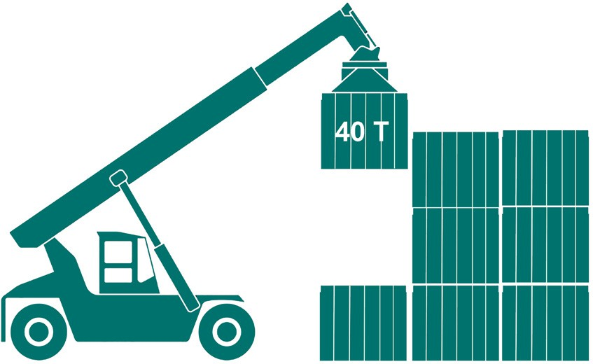
Maximum Rated Capacity (MRC)
PC 3.1 ELEMENT 3 – PERFORM WORK/TASK
MRC refers to the absolute maximum load or weight that a piece of equipment, such as a reach stacker, can handle as specified by the manufacturer.
It is determined based on engineering calculations, stress testing, and
compliance with safety standards.
MRC represents the maximum theoretical capacity of the equipment under ideal conditions, assuming perfect operation and no external factors affecting performance.
For example:
The reach stacker on-site has a maximum rated capacity of 45 tonnes. A large container weighing 40 tonnes needs to be moved from a storage area and loaded onto a waiting cargo ship. The reach stacker operator checks the weight of the container and confirms that it falls within the
reach stacker’s maximum rated capacity. The operator securely grips the container and lifts it off the ground.
Do not exceed the MRC
Upon reaching the cargo ship, the operator lowers the container into the designated spot on the ship’s deck, ensuring it is safely positioned and secured.
Throughout the entire operation, the reach stacker is working within its
maximum rated capacity of 45 tonnes.

Slide 23
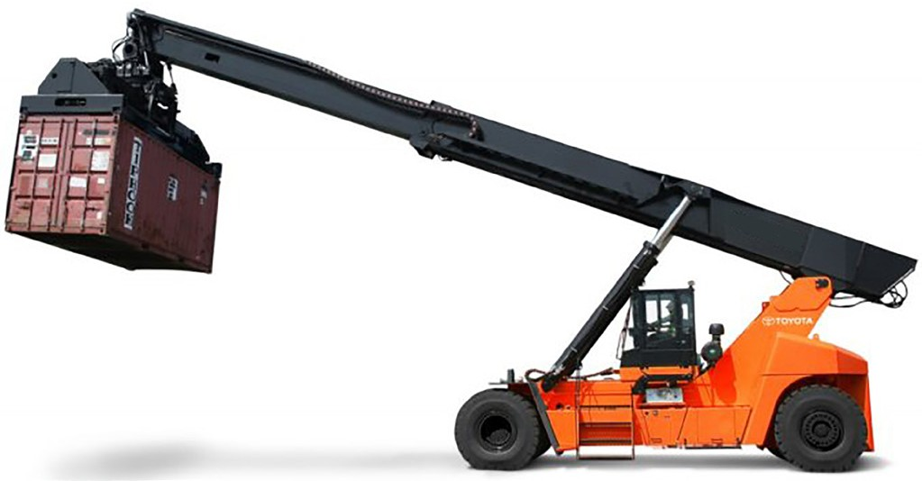
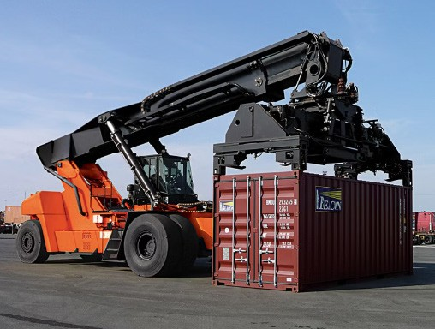
Position container spreader over container
PC 3.2, 3.3, 3.4 ELEMENT 3 – PERFORM WORK/TASK
Latch container spreader onto container
Container spreader is latched onto container and reach stacker is stabilised appropriately in accordance with safe work procedures
Position container spreader over container following directions from associated personnel (if applicable) in accordance with safe work procedures.
You need to make sure that:
the twist locks align with the corner castings.
you prevent damage to the container or spreader.
Align the corner castings when stacking containers because:
the container wall may collapse if you don’t.
the corner castings provide structural support for the
container.
Note: Twist locks are a type of mechanism used in container handling equipment, including reach stackers. They are designed to securely attach containers to the equipment

Slide 24
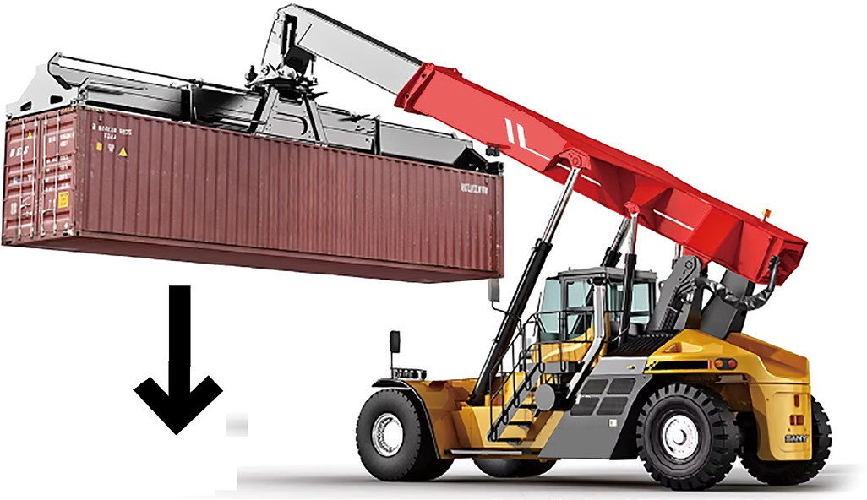
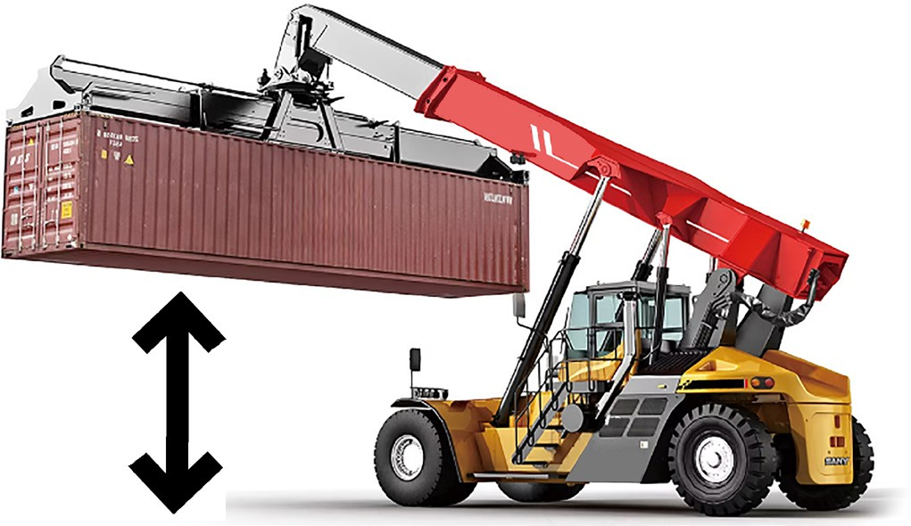
Do a test lift
PC 3.4, 3.5 ELEMENT 3 – PERFORM WORK/TASK
Finding a problem when you do a test lift
If you find a problem when doing a test lift you should lower the load and fix the problem. Do not continue until the problem has been fixed.
There are a number of reasons you should do a test lift. These include:
to make sure the load is stable.
to make sure the load is secure.
to make sure the reach stacker is stable.
to make sure the reach stacker’s controls are working
properly.
to check that the load is the right weight.
Using an articulated reach stacker
Some reach stackers are articulated. Operators should be aware of the maximum angle of articulation allowed for the reach stacker. Exceeding these limits can lead to tip-over accidents or damage to the equipment.

Slide 25
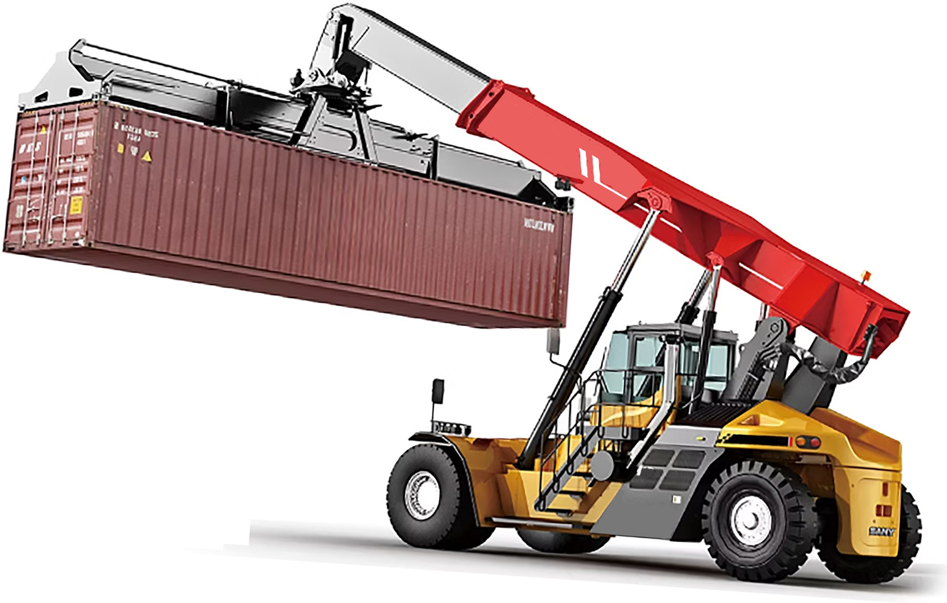
Travelling up a slope
PC 3.5 ELEMENT 3 – PERFORM WORK/TASK
You need to travel up a slope. To do this safely you need to do the following:
Check the rated capacity of the reach stacker.
Operate according to the load chart / manufacture’s
instructions.
watch your speed.
Look out for ground conditions such as smooth, slippery,
uneven etc.
Have the load face up the hill.

Slide 26
CHAPTER 4
Pack up

Slide 27
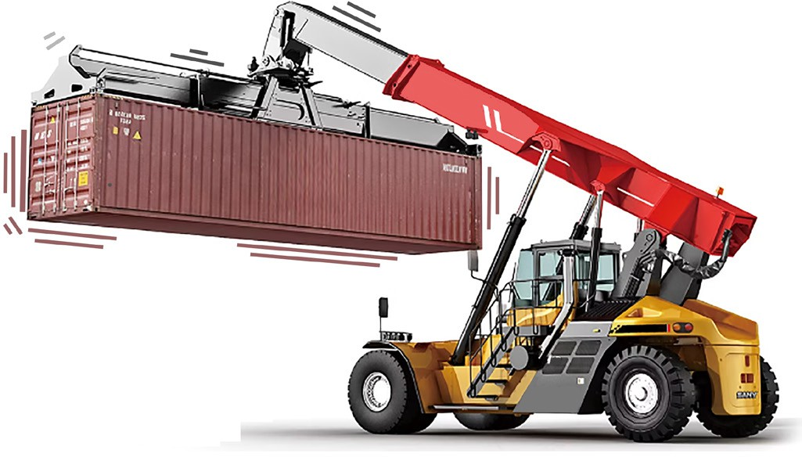
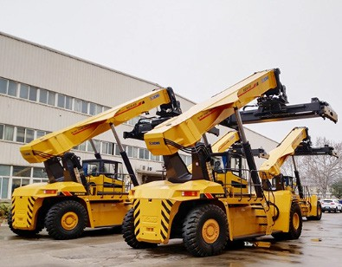
Do not leave loads suspended after shutdown
PC 4.1 CHAPTER 4 – PACK UP
ELEMENT 4 – PACK UP
Parking the reach stacker
You should park your reach stacker in a safe, set area suitable
for parking. For example:
You should not leave a load suspended from the spreader or attachment after shut down or when the reach stacker is
unattended. If you do this there is a risk of the load lowering, swinging or becoming unstable.
Choose a flat, firm surface.
Make sure there is enough space and visibility.
Use designated parking zones if available.
Keep away from hazards.
Engage the parking brake.
Follow company policies.

Slide 28
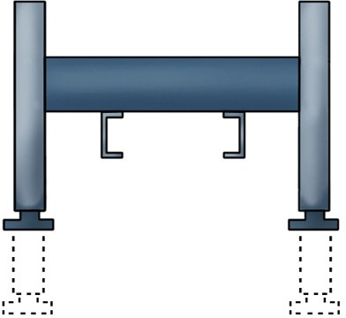
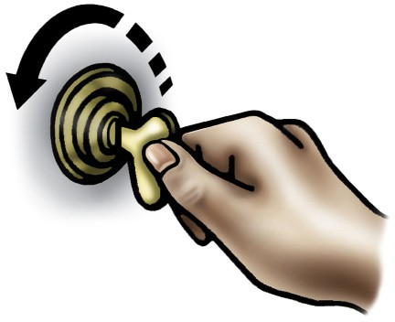
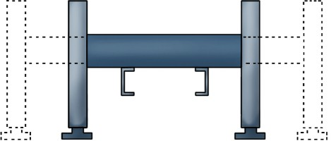
Raise and secure stabilisers
PC 4.3, 4.4 ELEMENT 4 – PACK UP
Park and shut down reach stacker
To park and shut down the reach stacker you should:
Make sure the reach stacker is parked on a level surface with the parking brake engaged.
Lift the boom slightly to relieve pressure on the
stabilizers.
If there are locking mechanisms, release them to allow the stabilizers to retract.
Use the control panel or levers to retract the stabilizers fully.
Check visually to ensure all stabilizers are securely
retracted.
Park on level ground.
Engage parking brake.
Lower boom.
Retract stabilizers.
Turn off engine.
Secure controls.
Perform visual inspection.
Lock doors and cab.

