Slide 1
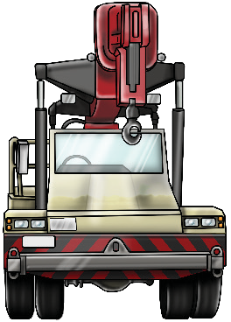
NON-SLEWING MOBILE CRANE SAFETY AND LICENCE GUIDE
Training support material for:
TLILIC0040
Licence to operate a non-slewing mobile crane
(Greater than 3 tonnes capacity)
Produced by:

Slide 2
CONTENTS
About this guide
4
Introduction to non-slewing mobile crane
5
High risk licensing and the law
Element 1 Plan work / task Element 2 Prepare for work / task Element 3 Perform work / task
9
15
81
207
Element 4 Prepare to drive an articulated mobile crane 247
Element 5 Drive an articulated mobile crane 255 Element 6 Pack up 271

Slide 3
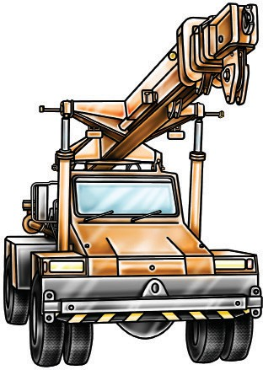
Introduction to Non-Slewing Mobile

Slide 4
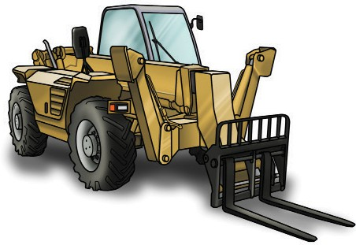
What is a non-slewing mobile crane?
PC 1.3 INTRODUCTION TO NON-SLEWING MOBILE CRANE
A non-slewing mobile crane is a powered crane which features a boom or jib that does not slew.
The boom can only luff up and down and telescope in and out. The crane is mounted on a vehicle.
In some states a telescopic handler is classed as a non-slewing crane
A non-slewing mobile crane is a type of crane that can lift and move loads but does not rotate or “slew” around a vertical axis. Instead, it typically has a fixed boom that can extend or retract, and it moves by rolling on wheels or tracks.
Articulated non-slewing mobile cranes have joints that allow the boom to bend, which enhances their versatility and maneuverability.

Slide 5
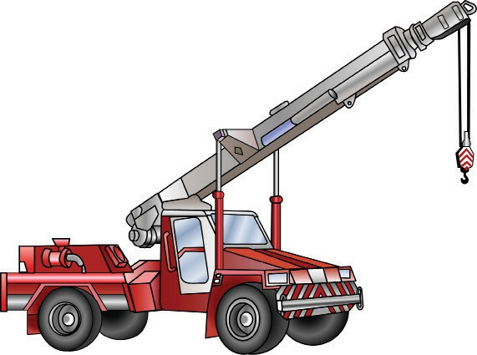
Parts of a non-slewing mobile crane
PC 1.3 INTRODUCTION TO NON-SLEWING MOBILE CRANE
Boom extensions
Head sheave
SWL marking
Anti two block switch
Main boom
SWL
Running rope
Hook or slinging points
Engine air intake
Hook block
Rope winch drum
Hook
SWL for hook block
Lift cylinder
Engine cover
Spreader bar in transport position
Counter weight
Front wheel
Articulation point and steering cylinders
Rear wheel

Slide 6
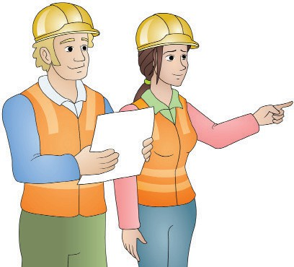
PLAN WORK
Plan work / task
Element 1

Slide 7
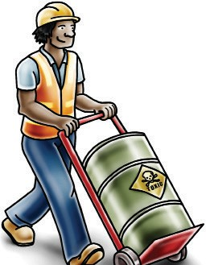
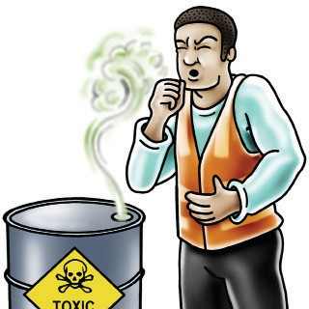
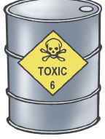
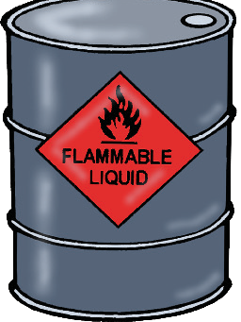
PC 1.1, 1.5 PLAN WORK
QUESTION 9. What is the difference between a hazard and a risk?
Different hazards and risks emerge constantly—sometimes instantly.
Hazard
A hazard is any thing or any situation which could injure or harm you.
In other words, it is anything that can hurt you.
Risk
A risk is the chance of a hazard injuring or hurting a person.
In other words, what is the chance of the hazard hurting you?
Control
A control is what you can do to stop the hazard from hurting or killing someone.

Slide 8
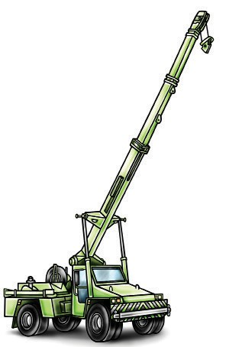
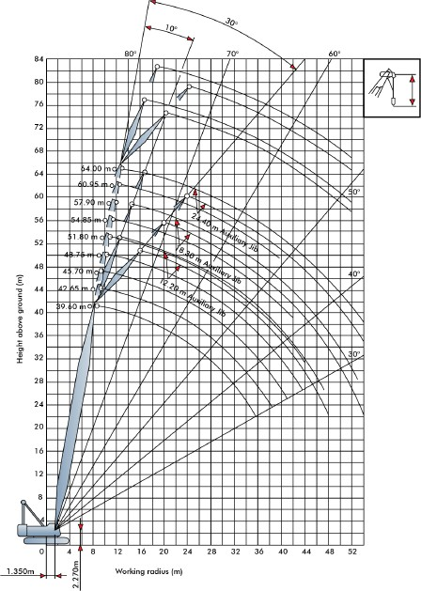
Plan the lift
PC 1.1 PLAN WORK
This section covers the kinds of planning you will do before moving the load. Including:
Identifying any hazards (dangers) at the site Working out the weight of the load Choosing the crane
Reading load charts Planning the path you’ll take Checking ground conditions.
Identify and estimate the weight of the load
Make sure you know the weight of the load you are to lift.
Before you move a load, find out its weight and size.
Think about how different types of loads will affect your crane.

Slide 9
PC 1.5 PLAN WORK
QUESTION 11. What are some common workplace hazards?
Above eye level
You should check above eye level for: powerlines
other overhead services buildings
trees
surrounding structures and facilities other obstructions
Workplace hazards need to be identified before you start work.
Take a good look at your workplace and decide if anything could possibly cause injury to you or anyone else in the area.
Zones/areas to check for hazards:
Ground to eye level
You should check around eye height for: other equipment
machinery/plant people pedestrians
things in the path of travel insufficient lighting weather conditions dangerous materials surrounding structures facilities
Ground level (and below)
You should check the ground to see if: the surface is stable and level
there is debris or rubbish in the way
the surface is strong enough to support the weight of any equipment or materials
if there are any open trenches or recently
filled trenches/excavations
unstable ground underground services

Slide 10
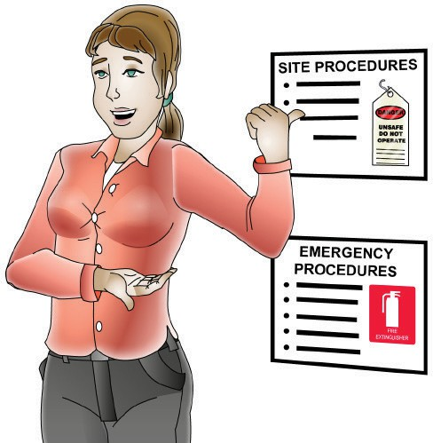
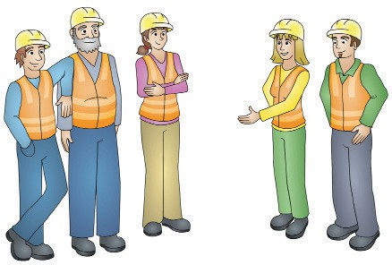
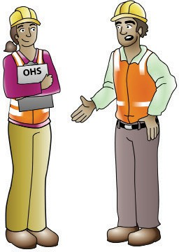
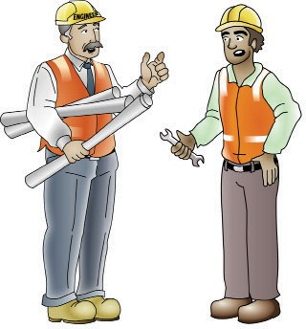
PC 1.1, 1.5, 2.1, 2.2 PLAN WORK
QUESTION 13 Who should you check with about site hazards before you start the job? | Your supervisor or manager | Workmates
 | WHS/OHS representatives or safety officer | Site engineers

Slide 11
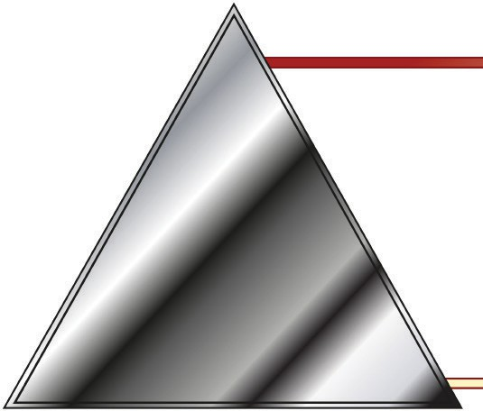
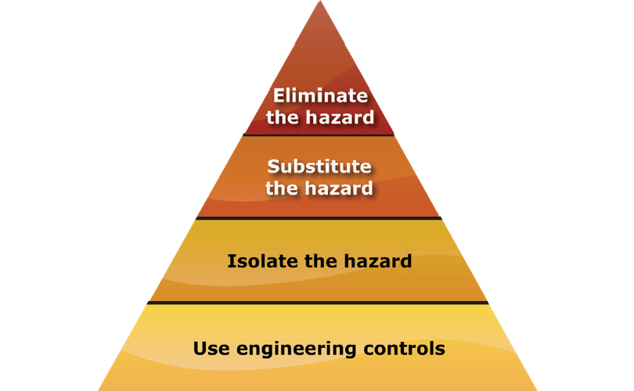
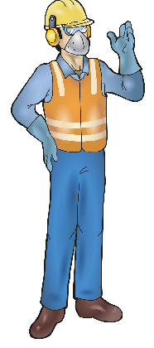
PC 1.5, 2.2 PLAN WORK
QUESTION 18. What is the Hierarchy of hazard control?
The Hierarchy of Hazard Control is a list of controls that you can use to eliminate or lower the danger from a hazard in the workplace. There are 6 levels in the hierarchy:
1. Elimination: If possible, remove (take away) the hazard.
2. Substitution: Use a safer method if you can’t remove the hazard.
3. Isolation: Stop access to the hazardous (dangerous) area.
4. Engineering Control Measures: Change the tools, equipment or environment to make it safer.
5. Administrative Practices: Reduce the time the worker is exposed to the hazards by using training, job rotation, the timing of jobs, etc.
6. Personal Protective Equipment (PPE): Use PPE as your last line of defence.
Memory aid: Every Saturday I Eat A Pie

Slide 12
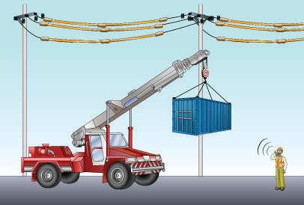
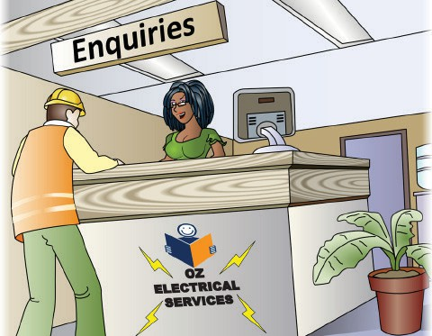
PC 1.5, 1.7, 2.2, 2.9 PLAN WORK
QUESTION 20
You are working near powerlines. Working near powerlines is very
dangerous and can kill you.
What are the minimum safe distance rules you must follow?
The minimum safe distance rules you must follow can be different for each state/territory.
For example, only some use a spotter.
A spotter is someone who helps you work closer to powerlines.
Most states and territories use Australian Standard AS 2550.1
Spotter
QUESTION 21
Who could you talk to if you need to find out the voltage of overhead powerlines?
Your local power supply company responsible for the electric lines.

Slide 13
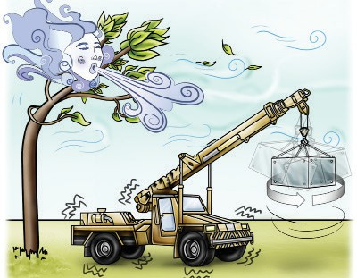
PC 1.5, 2.2, 2.9 PLAN WORK
QUESTION 24
A crane is moving a load on a windy day.
What hazards can the wind cause?
The crane could be damaged
The load could swing
The crane could become unstable

Slide 14
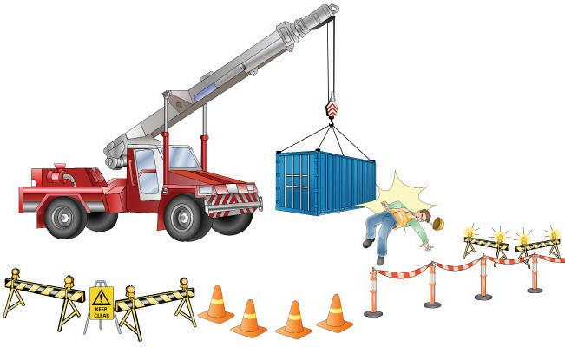
PC 1.5, 2.2 PLAN WORK
QUESTION 27
What hazards (dangers) are there if you work near (the radius) of the outriggers or chassis
of a non-slewing crane?
The crane or load could hit or crush you. You should stay outside the exclusion zone.
Exclusion zone

Slide 15
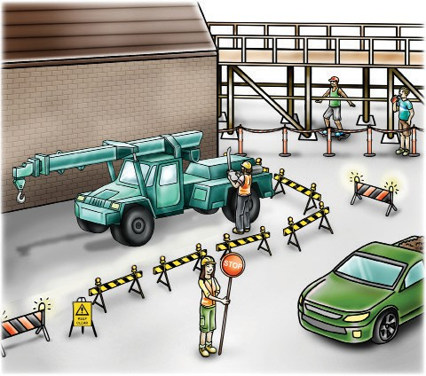
PC 1.6, 1.7, 2.2 PLAN WORK
QUESTION 29
What hazard controls can you use for vehicles or plant on the job?
Some methods you can use are:
Flashing yellow hazard lights to warn people
Vehicle exclusion zone
Barriers
A flag person to control the traffic
Warning signs

Slide 16
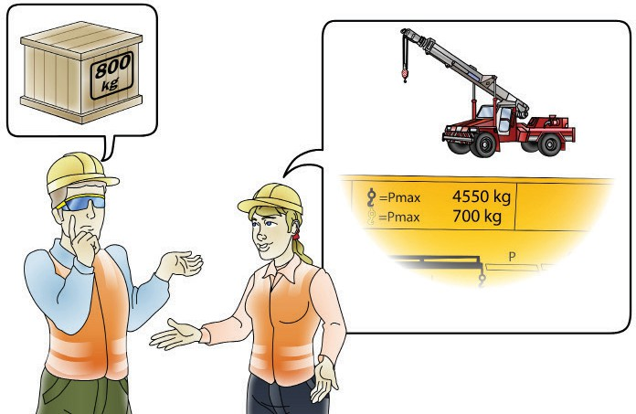
PC 1.3 PLAN WORK
QUESTION 35
Is it the crane operator’s job (responsibility) to know the weight of the load?
Yes. The dogger and the crane operator must communicate about the weight of the load and the crane’s capacity (the weight it can lift).
The crane operator needs to tell the dogger about the capacity and limitations of the crane.
Crane operator
Dogger

Slide 17
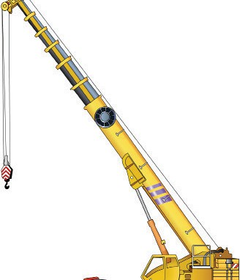
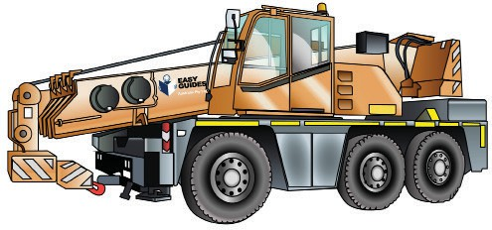
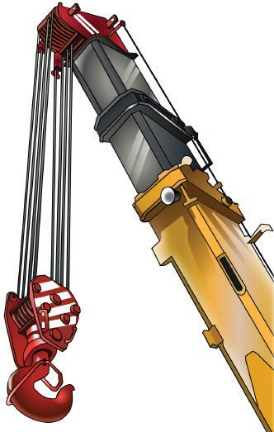
Booms
PC 1.2, 1.3, 1.9, 2.8 PLAN WORK
QUESTION 36. How do you know what crane to choose?
Make sure the crane is the right size for the work area
Check the crane’s lifting capacity to make sure it can lift the load .
Make sure the crane is appropriate for the site and weather conditions.
The crane is the correct type for the job. For example a slewing or non-slewing crane.
A non-slewing mobile crane has a telescopic boom that can:
Extend out
Retract in

Slide 18
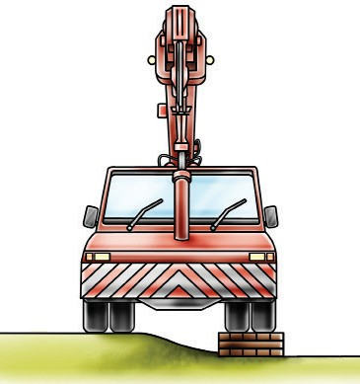
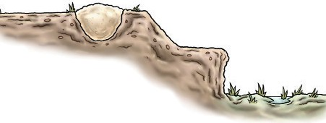
PC 1.1, 1.2 PLAN WORK
QUESTION 47. Why should you check for ground stability?
It is important that you check the ground condition. Make sure that the ground is firm and level to keep the crane stable while it
is moving the load.
Check the area for slopes (inclines) and drop-offs.
Any deviation to firm level conditions means that the rated capacity needs to be reduced according to the manufacturer’s information.
Articulation also requires the rated capacity to be reduced according to the manufacturer’s information.
You should check for recently filled trenches as the ground may be soft and the crane may sink while it is moving the load.

Slide 19
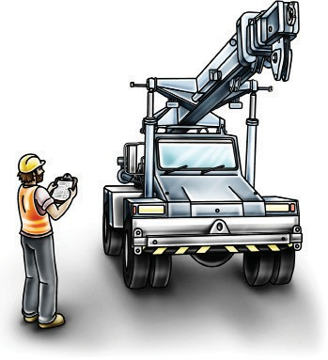
PREPARE FOR WORK / TASK
Prepare for work / task
Element 2

Slide 20
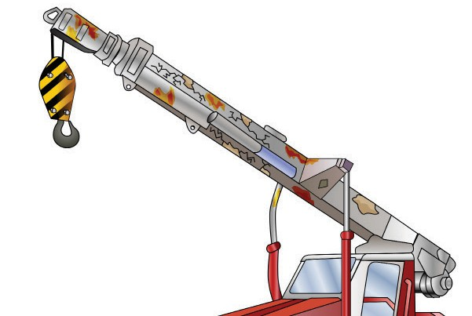
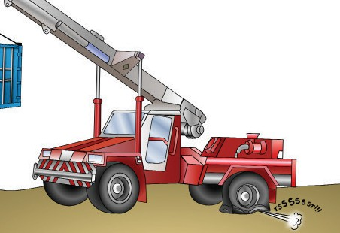
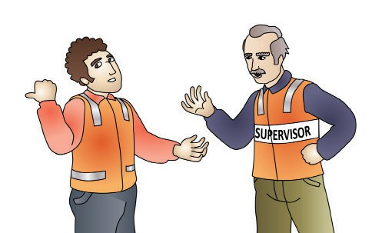
PC 2.1, 2.4, 2.7, 2.8 PREPARE FOR WORK / TASK
QUESTION 66. Why should you check the crane?
The following pages are about checking the crane for problems and what to do if you find any problems. It covers visual checks, signs and labels, pre-operational checks, crane controls, checking the logbook, starting the crane, post-start checks and recording and reporting faults.
Visual check
Make sure you have a look around the non-slewing mobile crane before you use it. See if the crane and lifting equipment are in a safe working condition and are right for the job before you lift any loads. A faulty crane could cause an accident and injure or kill
Some examples of checks you should do are:
Crane operator
As the crane operator, you are responsible for inspecting the crane.
If you think someone has tampered with the crane, you must report this problem to your supervisor or some other authorised person immediately.
The crane owner and workplace security may also need to be informed.
If someone has mucked about with the crane, report the fault to your supervisor.
Check for bends, twists and cracks in the boom (signs of defects)
Broken windscreen (could indicate vandalism)
Fluid leaks
Damaged tyre

Slide 21
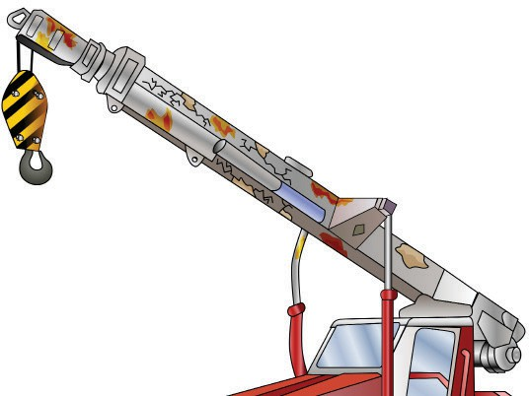
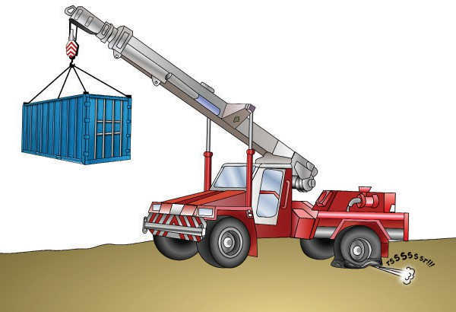
PREPARE FOR WORK / TASK
PC 2.2, 2.4, 2.7
QUESTION 69
You are inspecting the crane.
What are some defects you should look for on the boom or superstructure?
Rust on joints or welds
Cracked welds or metal
Loose or
missing bolts
Flaking paint
Bent pins
Twists or bends
Oil leaks
QUESTION 70
You are using a rubber tyre crane. Your crane’s tyres must be at the right pressure.
Why is this important?
Tyres that are low in pressure, flat or at different pressures can make the crane unstable.
Check the load chart to find the
correct tyre pressure for the crane.

Slide 22
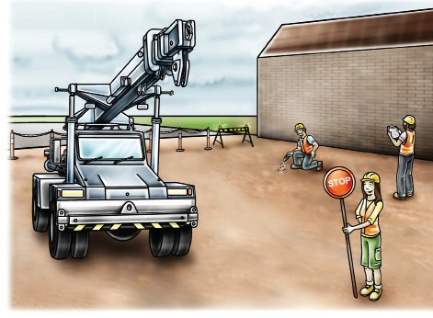
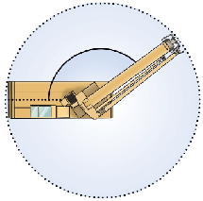
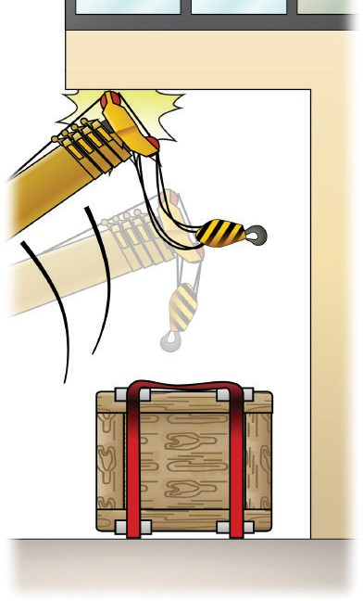
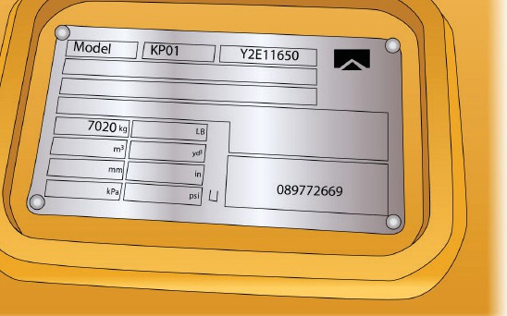
PC 2.2, 2.3, 2.4, 2.5, 2.6, 2.7, 2.8 PREPARE FOR WORK / TASK
QUESTION 71
You have some lifting jobs to do.
What kinds of things should you think about and plan for to do the job safely?
Some examples are:
How you will get in and out of the work area. How you will get in and out of the crane.
Boom safe working radius and reach. The working radius is the horizontal distance from a specified point on the crane to the hook.
The crane’s type and capacity
Pre-start and operational checks to identify any damage or defects before work starts
Boom deflection
...CONTINUES ON NEXT PAGE

Slide 23
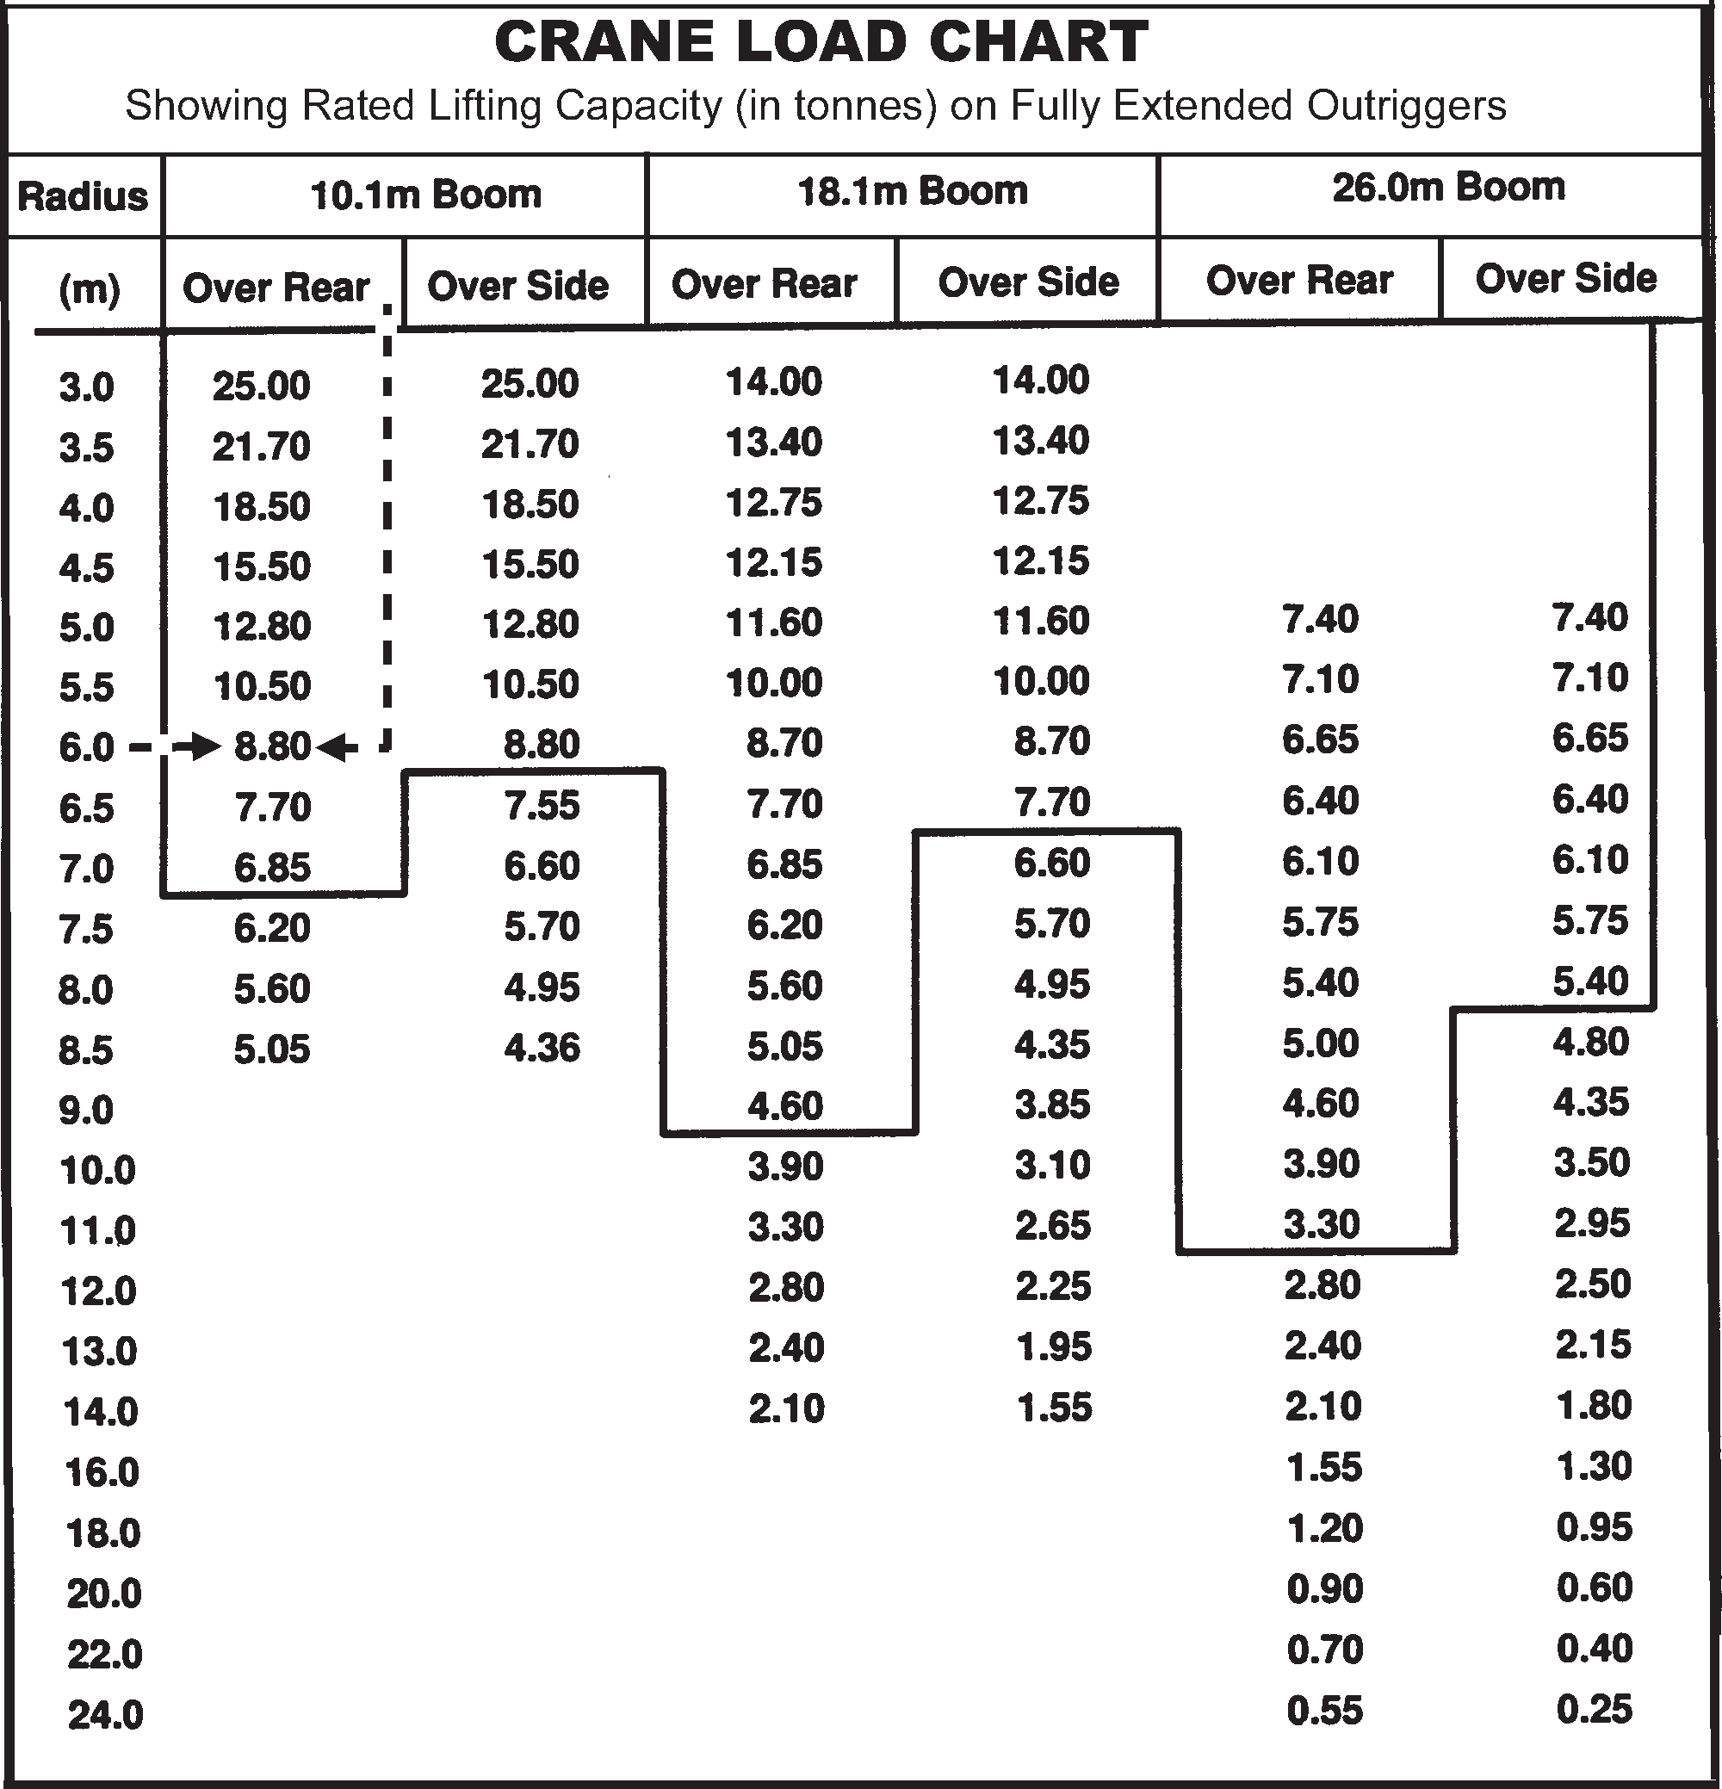
Range diagram
PC 2.5, 3.1 PREPARE FOR WORK / TASK
QUESTION 82. What is rated capacity?
The rated capacity is the maximum load weight a
crane can lift in different boom configurations.
The range diagram shows you the crane’s lifting
configurations and how to set up the crane properly.
It shows the;
range of boom lengths
boom radius
hook heights.
Example of a range diagram

Slide 24
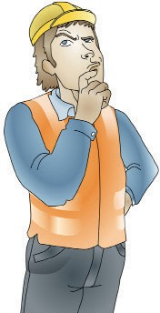
PC 2.5, 3.1 PREPARE FOR WORK / TASK
QUESTION 85
You are looking at the load chart. The chart has a thick black line near the middle.
What do the numbers above and below the line mean?
The numbers above the line tell you the structural strength of the crane. The numbers
below the line tell you how stable the crane is.
Structural strength
above line
Instability
below line

Slide 25
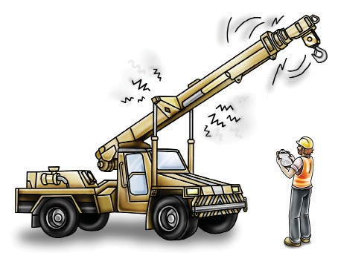
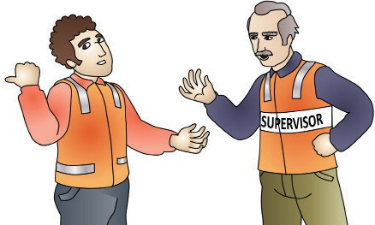
PC 2.7 PREPARE FOR WORK / TASK
QUESTION 93
You are starting your crane according to procedures (usually found in the operator’s manual).
What should you do if you hear any abnormal/ unusual noises?
If you hear unusual noises follow procedures. For example:
1. Stop working. | 2. Put a danger tag on the crane.
3. Record the problem in the logbook. | 4. Report the problem to a supervisor.

Slide 26
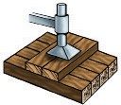
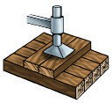
PC 2.5 PREPARE FOR WORK / TASK
QUESTION 103
What should the angle between the first (bottom) and second (top) layer of pigstying be?
The angle should be 90 degrees between layers of pigstying.
Outrigger
Top layer
90º
Bottom layer
90º

Slide 27
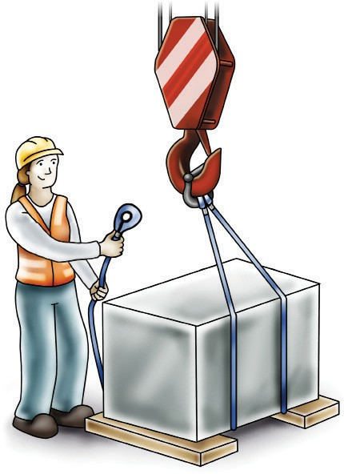
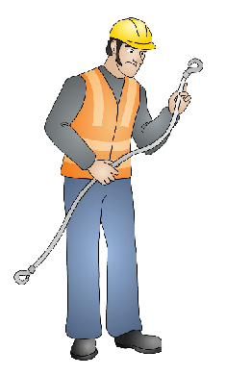
PC 2.5, 2.6, 2.7, 2.8, 2.10, 2.12, 2.13 PREPARE FOR WORK / TASK
QUESTION 105. How do you know how much a crane can lift?
The configuration (set up) of the crane determines how much you can lift.
Set up the crane so the load will never be more than the Safe working load (SWL) of the crane.
Setting up the crane includes:
Positioning the boom/jib over the load correctly – boom length and radius Working out the centre of gravity
Looking at the load chart to see if the crane can support the load Checking the rated capacity of the crane
Setting up the counterweights to keep the crane balanced.
Entering configuration data into the crane computer.
Note:
A licenced dogger is responsible for selecting, inspecting and setting up the lifting gear.

Slide 28
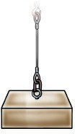
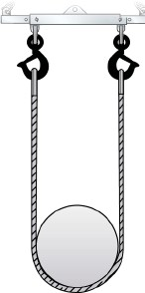
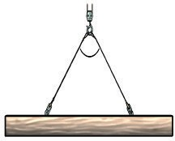
PC 2.11 PREPARE FOR WORK / TASK
QUESTION 148. What is slinging?
Slinging is the process of lifting or hanging and moving heavy objects using ropes, chains, or mechanical devices, to lighten a load.
Their are different types of ways to suspend or arrange (something), especially with a strap or straps, so that it hangs loosely in a particular position.
The following are methods of slinging loads or techniques you can use to lift a load;
Straight / Direct/ Vertical
Reeved / Choked
Basket
Angle Sling
Straight / Direct/ Vertical Sling
Reeve / Choke Hitch Rounded Load Sling
Rounded Basket Sling
2. sling with an angle
60°

Slide 29
PC 2.11 PREPARE FOR WORK / TASK
QUESTION 157
Calculate the maximum load of a sling when a 2 Leg angle sling configuration
is used with the following
specifications given?
Specifications
if load is 1000 kg
7m = L = Length of sling leg
5m = H = Height distance from pick point.
Formula:
=(Load Weight / No sling Legs) x (L / H)
Calculation is:
=(1000 kg / 2) x (7/5)
=500 kg x 1.4
= 700 kg per sling
7m
5m
1000 kg

Slide 30
PC 2.12, 3.3, 2.13 PREPARE FOR WORK / TASK
QUESTION 173. What is a tag line?
Tag lines are used to help control loads while they are being moved and to assist in landing the load safely. They are connected to the load using a clove hitch, rolling hitch or bowline.
Temporary connections
You may need to temporarily connect fibre ropes to loads to ensure stability during the move,
or to sling the load properly.
Use dry natural fibre ropes for tag lines, especially when operating near powerlines. Natural fibre ropes
do not conduct electricity and are safer to use as tag lines than synthetic fibre ropes.
Ropes used for tag lines should be at least 16 mm in diameter
16 mm
Note: If the synthetic fibre rope is wet, it may still conduct electricity and is
not safe for use around powerlines.
Bends and hitches
What is a clove hitch?
A clove hitch is widely used for starting rope lashings. It is commonly used when performing dogging and rigging. It is always finished with a half hitch.
It is unsafe for other purposes unless the end is secured with an additional half hitch.
1.
2.
3.

Slide 31
PERFORM WORK / TASK
Perform work / task
Element 3

Slide 32
PC 3.1 PERFORM WORK / TASK
QUESTION 179
To decide whether loads can be lifted you need to look at a lift plan.
What is a lift plan?
You can determine the rated capacity of a crane by checking the load chart.
Travel with load, forward
The following is some information that you might find in a lift plan.
Load 1. a load of >50% of the RC of the crane with a boom length of >75%, and
Load 2. a round load with a minimum diameter of 300 mm and minimum length of three m that requires a dogger to sling, and
Load 3. an asymmetrical load that requires a dogger to sling, and
Load 4. travelling with a load of stillage containing at least ten scaffolding standards or containing a load of steel pipes of equivalent weight that requires a dogger to sling and a boom length of <75%
asymmetrical load

Slide 33
PC 3.2 PERFORM WORK / TASK
QUESTION 180 | Communicate with other personnel, to make sure that the hook is directly under the load.
What are some ways that you can make sure the crane’s hook is safely positioned over the load? | Make sure that the chain hoist of the hook is not swinging when you place it over the load. Make sure that the hook shank and lower hook are in line with each other.

Slide 34
PC 3.4 PERFORM WORK / TASK
QUESTION 185
Why is it important to do a test lift?
To make sure:
The crane is working properly
The load is secure
The crane is stable
The load is stable
To check the weight of the load
QUESTION 186
You are doing a test lift and you have lifted the load just off the lifting plane (ground). You find there is a problem with the lift.
What do you need to check and do?
Check that the load is secure and balanced
Check that there are no loose parts hanging from the load
Check that there is nothing caught under the load.
NOW DO ANOTHER TEST LIFT.

Slide 35
PC 3.7 PERFORM WORK / TASK
QUESTION 193 | Hoisting raise 2 short | Hoisting lower/down Commonly used signal (not Australian Standard) 1 long
Some of the Australian
standard crane signals
used are shown here.
What does each of these
signals mean?
 | Luffing boom up 3 short | Luffing boom down
 |  | 4 short
 |  |  | ...CONTINUES ON NEXT PAGE

Slide 36
PERFORM WORK / TASK
Prepare to drive an articulated
mobile crane
Element 4

Slide 37
PC 4.1 PREPARE TO DRIVE AN ARTICULATED MOBILE CRANE
QUESTION 217
What should you do with any items on the cranes body?
You should make sure the items are safely restrained. Make sure any loose items are stored in storage areas.

Slide 38
PC 4.1, 4.3 PREPARE TO DRIVE AN ARTICULATED MOBILE CRANE
QUESTION 218. What steps should you follow when shutting down a crane?
1. Check the tyres are pumped 2. Unlock suspension for road travel. up and not damaged
3.Secure the outriggers. Use a locking device and put them in a travel position where there is no sideways movement.
4. Put loose things in storage area.
5. Turn off drives to hydraulic pumps, booms and outriggers. Put controls in the off position.
...CONTINUES ON NEXT PAGE

Slide 39
DRIVE AN ARTICULATED MOBILE CRANE
drive an articulated mobile crane
Element 5

Slide 40
PC 3.6 DRIVE AN ARTICULATED MOBILE CRANE
...CONTINUED FROM PREVIOUS PAGE
INDICATORS
Warning Lights:
Overload Indicator: Alerts when the load exceeds safe limits. Stability Warning: Signals if the crane is at risk of tipping.
Gauge Indicators:
Hydraulic Pressure Gauges: Monitor the hydraulic system’s pressure to ensure optimal performance.
Fuel Gauge: Indicates the amount of fuel remaining in the tank.
Operational Status Indicators:
Show the current operational mode (e.g., idle, lifting, traveling) and the status of various systems.
crane warning controls
USE AND IMPORTANCE
Proper use of controls and adherence to indicator warnings is critical for safe operation. Operators must be trained to respond appropriately to alerts.

Slide 41
PC 5.1 DRIVE AN ARTICULATED MOBILE CRANE
..CONTINUES FROM LAST PAGE
.
QUESTION 229
You are driving an articulated mobile crane. What are some safe driving strategies you can use?
Reversing
Check Surroundings: Before reversing, check for obstacles, people, and other vehicles.
Use Mirrors and Cameras: Utilize all available mirrors and cameras for a clear view.
Reverse Slowly: Move at a slow speed to allow for better control and reaction time.
Steering and Manoeuvring
Smooth Steering: Make gradual, smooth turns to avoid sudden shifts in the load.
Wide Turns: Plan for wide turns to accommodate the length of the crane and avoid collisions.
Use Proper Techniques: When turning, consider the rear end swing of the crane.

Slide 42
PC 5.3 DRIVE AN ARTICULATED MOBILE CRANE
QUESTION 231
What is meant by ‘one-handed steering techniques’?
In the context of operating an articulated mobile crane, “one-handed steering techniques” refer to steering the crane using only one hand on the controls. This usually involves:
Using a Single Control Lever: Many cranes have joystick or lever controls that allow operators to steer and maneuver the crane. One-handed steering means using just one of these controls to guide the crane.
Simplified Maneuvering: The technique is often used for precise movements or when operating in tight spaces where fine control is needed.
Overall, one-handed steering techniques help with ease of operation and precise control of the crane’s movements.

Slide 43
PREPARE TO DRIVE AN ARTICULATED MOBILE CRANE
Pack up
Element 6

Slide 44
PC 6.1 PREPARE TO DRIVE AN ARTICULATED MOBILE CRANE
QUESTION 236
What are the steps for stowing outriggers/ stabillisers?
The steps are:
1. Raise the footplates. | 2. Retract (bring in) the outrigger beams.
3. Lock with the pin. | 4. Clean the steel plates.

Slide 45
PC 6.4 PACK UP
QUESTION 237 | You should store the equipment somewhere that is clean, dry and undercover with good air flow. Keep equipment away from sunlight, UV or fluorescent lights, acids, chemicals, oils, dirt and grit. Keep clear of other machinery. Keep where rats and mice cannot damage the lifting gear. Always check the instructions that come with your equipment.
What is the correct way to store (put away) lifting equipment?
QUESTION 238 | Take down signs. Put away barriers and bollards. | Take down safety nets.
You have finished dogging work. What do you have to do with the hazard prevention equipment?

