Slide 1
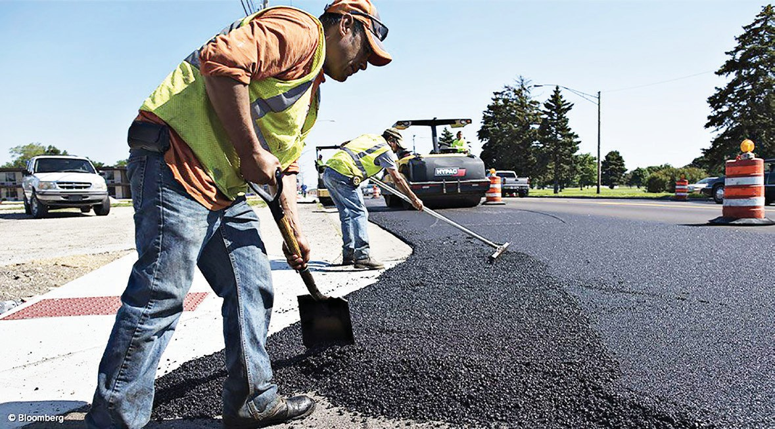
LEARNER GUIDE
Safely handle bituminous materials
TICKET
Training support material for:
RIICBS203E
Safely handle bituminous materials
Produced by:

Slide 2
Contents
Introduction to bituminous materials The basics of road construction
5
7
13
59
67
71
Element 1
Element 2
Element 3
Element 4
Prepare to safely handle bituminous materials Work safely with bituminous materials Demonstrate First Aid for bitumen burns Clean up

Slide 3
Prepare to safely handle bituminous materials
Element 1

Slide 4
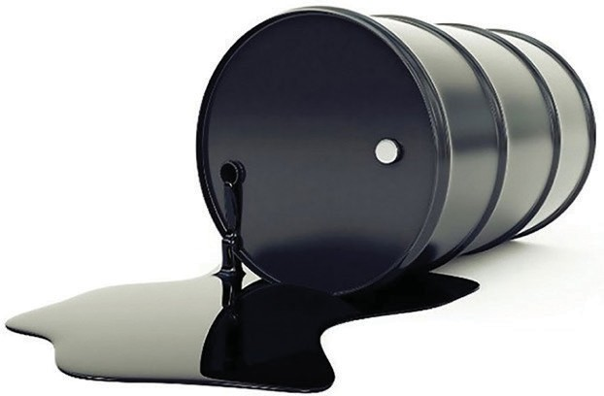
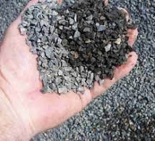
PC 1.1 PREPARE TO SAFELY HANDLE BITUMINOUS MATERIALS
Question 1. What is the difference between asphalt and bitumen?
Bitumen:
Bitumen is a naturally occurring or refined substance derived from petroleum. It is a thick, black, sticky, and viscous liquid or semi-solid material. Bitumen is the binding agent that holds the aggregates (such as crushed stone, sand, and gravel) together in asphalt pavement. It provides the adhesive and waterproofing properties that make asphalt effective as a road surface material. Bitumen is also used in various other applications, such as roofing, waterproofing, and industrial products.
Asphalt:
Asphalt refers to the mixture of aggregates and bitumen that is used in road construction and pavement. It is created by combining the aggregates with bitumen at specific temperatures to form a cohesive material. The asphalt mixture is then laid down in layers, compacted, and cooled to create a solid and smooth road surface. The term "asphalt" is often used to describe the finished product—the paved road or surface.
bitumen
In summary, bitumen is the sticky, black binder that holds the aggregates together, while asphalt is the composite material created by mixing bitumen and aggregates to create a durable road surface. The terms are related and often used interchangeably in everyday language, but they refer to different aspects of the asphalt pavement construction process.
asphalt

Slide 5
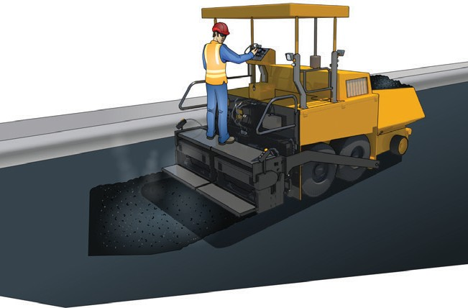
PC 1.1, 1.2 PREPARE TO SAFELY HANDLE BITUMINOUS MATERIALS
Question 6. What is an example of material calculations when working with bitumen?
Scenario:
We're tasked with constructing a 1-kilometer long, 4-meter wide asphalt road with a thickness of 5 centimeters. The project specifications call for an asphalt mix with 5% bitumen content by weight. We'll calculate the required amounts of bitumen and aggregates for this section of the road.
Bitumen quantity calculation:
To find the bitumen quantity, we first need to calculate the volume of asphalt needed: Volume = Length x Width x Thickness
Volume = 1000 meters x 4 meters x 0.05 meters = 200 cubic meters
Next, we convert the volume to weight using the specified bitumen content:
Bitumen Weight = Volume x Bitumen Content
Bitumen Weight = 200 m³ x 0.05 (5%) = 10 metric tons of bitumen.
Aggregate quantities:
The proportions of aggregates in the mix can vary, but let's assume a common mix with a 95% aggregate content by weight. We'll calculate the total weight of aggregates needed:
Aggregate Weight = Volume x (1 - Bitumen Content)
Aggregate Weight = 200 m³ x (1 - 0.05) = 200 m³ x 0.95 = 190 metric tons of aggregates
In this example, you would need 10 metric tons of bitumen and 190 metric tons of aggregates to construct the specified section of the road.

Slide 6
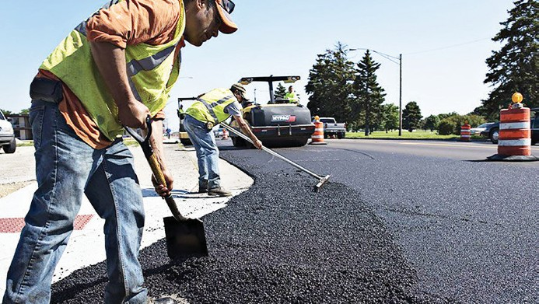
PREPARE TO SAFELY HANDLE BITUMINOUS MATERIALS
Continued from previous slide...
Smooth road surface:
Look at the road's surface. It should be smooth and even without any bumps.
Measure thickness and density:
Use tools to check how thick and dense the road is. It should meet the project's requirements.
Take samples:
Get samples from the road to check its quality. Compare the results with what the project needs.
Make sure the road surface is smooth and even.
Strength testing:
Test to see if the road can handle heavy vehicles without breaking.
Safety and the environment:
Follow safety rules and environmental guidelines during the work.
Keep records:
Keep a record of all the tests and actions done during the project.
Keep records of work done.

Slide 7
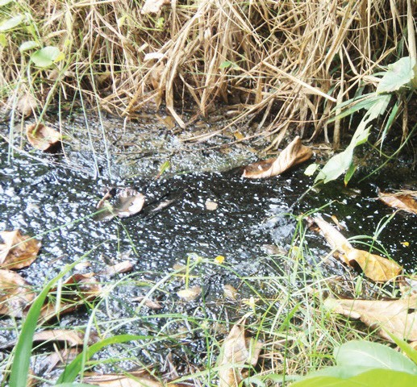
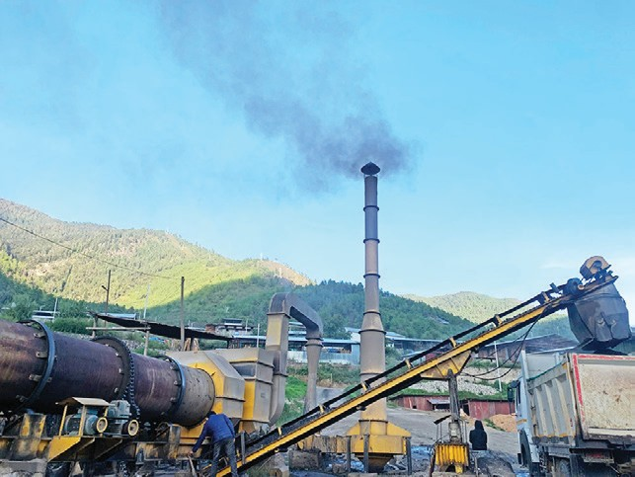
PC 1.3 PREPARE TO SAFELY HANDLE BITUMINOUS MATERIALS
Question 12. What are environmental issues when working with bitumen?
Water contamination: Improper handling can contaminate water sources, harming aquatic life and water quality.
Air pollution: Heating and processing release pollutants, impacting air quality and
health.
Habitat disruption: Construction can damage ecosystems and wildlife habitats.
Wildlife impact: Spills can harm animals that come into contact with contaminated
areas.
Soil contamination: Mishandling can lead to soil pollution, affecting land use and
quality.
Greenhouse gas emissions: Bitumen processes contribute to climate-changing emissions.
Waste generation: Bitumen activities produce waste, which if mismanaged, leads to pollution.
Spills and accidents: Accidental spills cause long-lasting harm to soil, water, and wildlife.
water contamination
greenhouse gas emissions

Slide 8
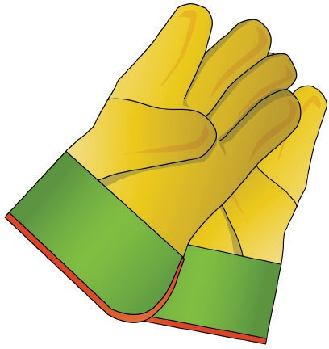
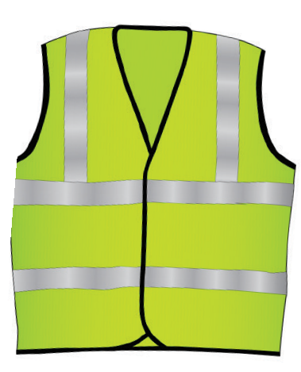
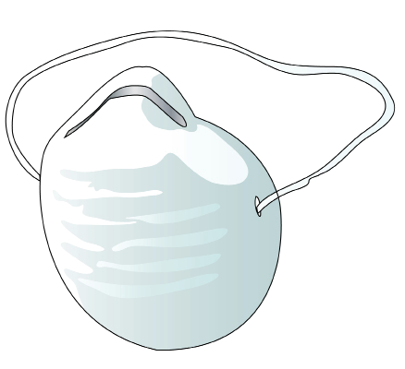
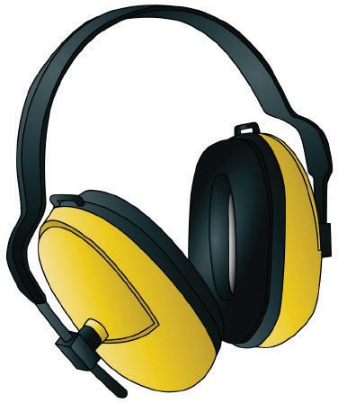
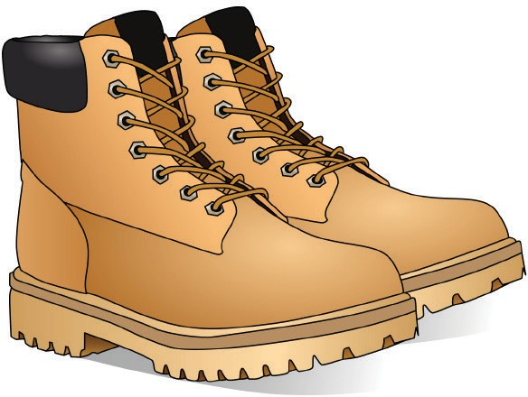
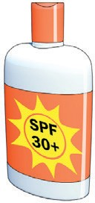
PC 1.4 PREPARE TO SAFELY HANDLE BITUMINOUS MATERIALS
Question 15. What PPE should you use when working with an bitumen?
Following are examples of PPE you might need to use when working with bitumen:
Hard hat
Hi-vis vest
Dust mask
Safety gloves
Long sleeved top
Ear muffs
Boots that cover the whole foot
Safety glasses/goggles, Sunglasses
Long pants
Sunscreen

Slide 9
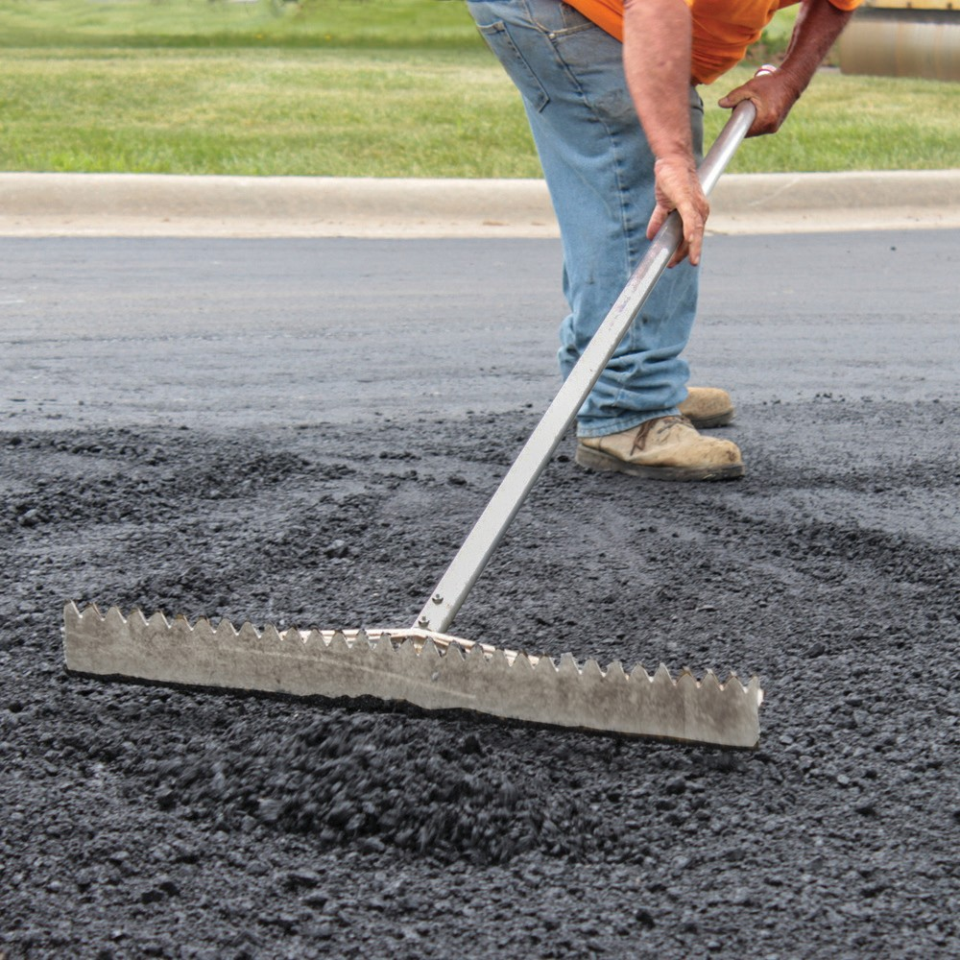
Work safely with bituminous materials
Element 2

Slide 10
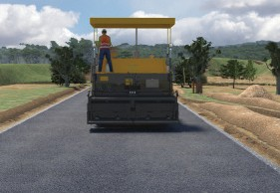
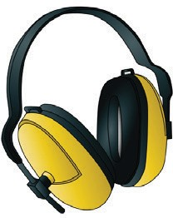
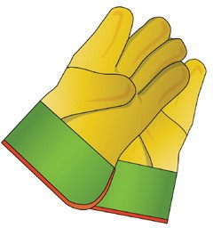
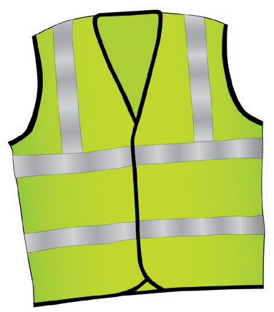
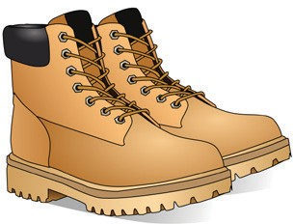
PC 2.2 WORK SAFELY WITH BITUMINOUS MATERIALS
Question 33. What would be an example of a work plan for working with bituminous materials?
Bituminous Material Work Plan - Road Construction
Objective:
Scope: To construct a bituminous road in [Location]. Goal: Ensure a durable and safe road surface.
Safety Measures:
All personnel must wear appropriate PPE. Regular safety briefings and hazard assessments. Emergency response procedures in place.
Materials and Equipment:
Bitumen (Type [specify]). Aggregates (Type [specify]).
Asphalt paver, roller, and compaction equipment. Necessary hand tools and safety equipment.
Timeline:
Phase 1 (Preparation): [Start Date] - [End Date]
Phase 2 (Asphalt Application): [Start Date] - [End Date] Phase 3 (Curing and Inspection): [Start Date] - [End Date]
Wear PPE.
Continued next page...

Slide 11
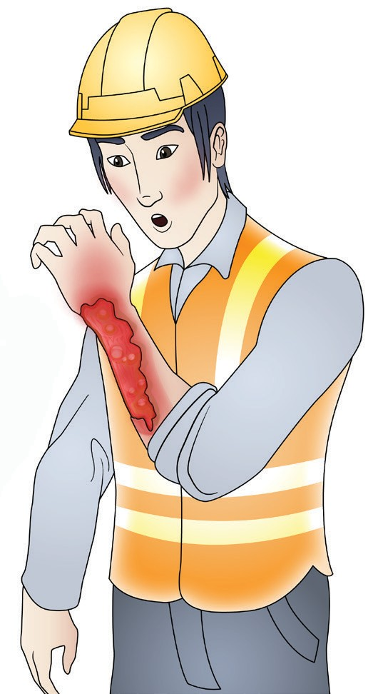
Demonstrate first aid for
bitumen burns
Element 3

Slide 12
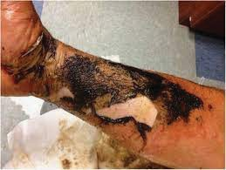
PC 3.1 DEMONSTRATE FIRST AID FOR BITUMEN BURNS
Question 35. What first aid should be done if someone gets a bitumen burn?
A bitumen burn, also known as an asphalt burn, can be a painful and potentially serious injury that occurs when hot bitumen (a thick, black, and sticky substance commonly used in road construction) comes into contact with the skin. Here are the steps to take for first aid if someone sustains a bitumen burn:
Remove the heat Source:
The first and most crucial step is to immediately remove the source of heat or bitumen from the affected area. This might involve gently brushing off any bitumen that is still in contact with the skin, taking care not to cause further damage or spread the hot material.
First aid is needed if someone gets a bitumen burn.
Cool the burn:
Use cool (not cold) running water to cool the affected area for at least 10-20 minutes. Do not use ice or very cold water, as it can further damage the skin. Cooling the burn helps to reduce pain and limit the depth of the injury.
Protect the area:
Cover the burn with a clean, non-stick dressing or a sterile, lint-free cloth to prevent infection. Do not use adhesive bandages or anything that might stick to the burn.
Use cool running water on the burn for 10 to 20 minutes..
Continued next slide...

Slide 13
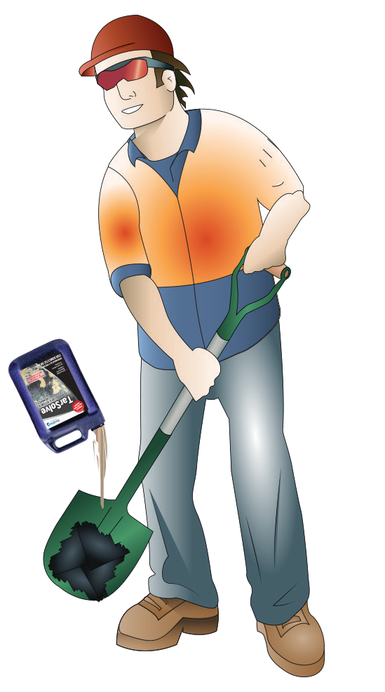
Clean up
Element 4

Slide 14
PC 4.1, 4.2 CLEAN UP
Question 37. You have been working with bitumen. What do you need to do to clear the work area and recycle materials?
Personal protective equipment (PPE):
Ensure that all workers are wearing appropriate personal protective equipment (PPE), including gloves, safety glasses, and protective clothing, to prevent exposure to bitumen and its fumes.
Cleanup and segregation:
Collect and segregate all materials used during the bitumen application, such as used brushes, rags, containers, and any waste materials.
Store bitumen-containing materials separately from other waste materials to
facilitate recycling or disposal.
Spill management:
In case of bitumen spills, use absorbent materials like oil absorbent pads or clay-based absorbents to clean up the spilled material.
Follow spill response procedures to minimize the environmental impact and ensure proper disposal of contaminated materials.
Recycling bitumen:
Bitumen can be recycled and reused in various ways, such as in asphalt production. Check local regulations and recycling facilities to determine the best way to recycle bitumen in your area.
Bituminous materials can be reheated, reprocessed, and incorporated into new asphalt mixtures.
Wear PPE when cleaning up.
Continued next slide...

