Slide 1


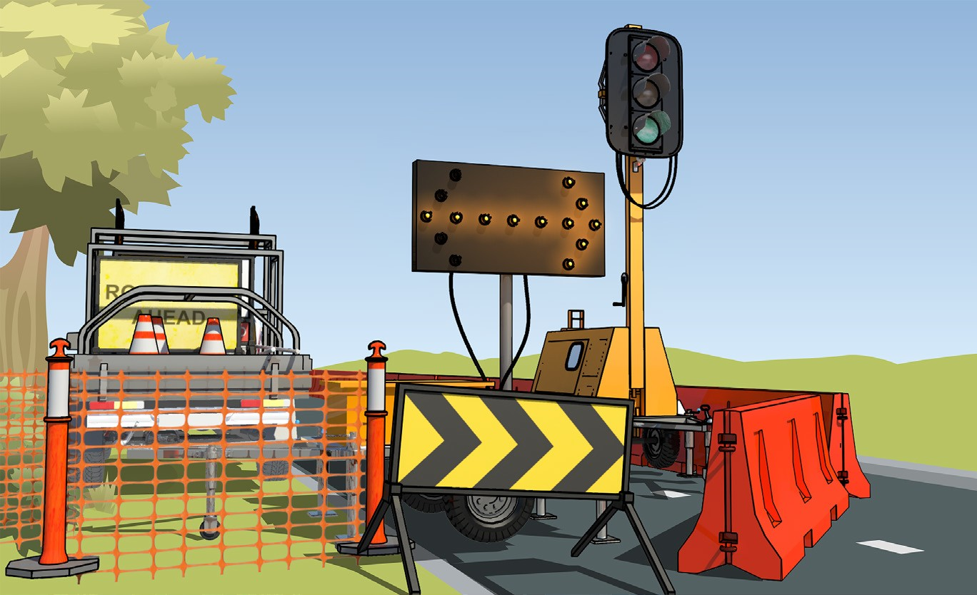

TRAFFIC MANAGEMENT LEARNER GUIDE
Training support material for:
RIIWHS302E –
Implement traffic
management plan
Produced by:

Slide 2


PREPARE TO IMPLEMENT TRAFFIC
MANAGEMENT PLAN
PREPARE TO IMPLEMENT TRAFFIC MANAGEMENT PLAN

Slide 3



Duty of Care Obligations under the WHS/OHS Act
PC 1.1 PREPARE TO IMPLEMENT TRAFFIC MANAGEMENT PLAN
Note:
The following information is based on the new WHS Act. If your state is not using the new Act, you should refer to the Occupational Health & Safety (OHS) Act.
‘The national WHS Act sets out the legal responsibilities that apply to persons conducting a business or undertaking (PCBU) and workers to make sure the workplace is as safe and healthy as possible.’
PCBUs (employer/workplace manager) and workers (employees) both have a duty of care responsibility to make sure the workplace is a healthy and safe place to be. A ‘worker’ includes people who are employees, contractors, sub-contractors, outworkers, employees of labour hire companies and volunteers.
The workplace must also not harm the health or safety of visitors or people nearby.

Slide 4
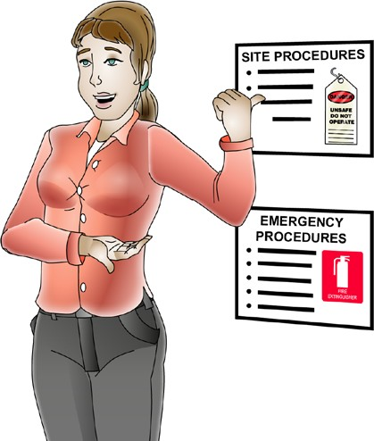

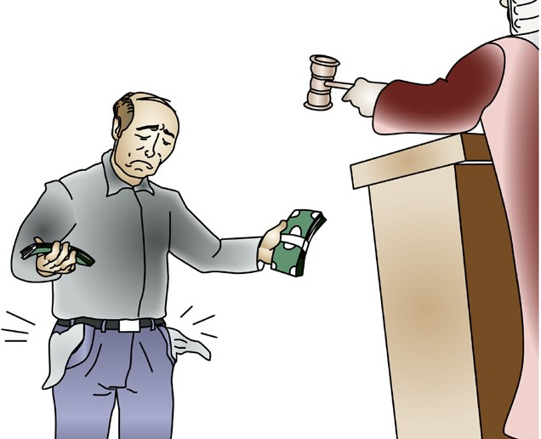

Worker’s (employee’s) duty of care
PC 1.1 PREPARE TO IMPLEMENT TRAFFIC MANAGEMENT PLAN
PCBU’s (employer’s) duty of care
By law, as a PCBU you must do everything reasonably practical to provide a workplace that is safe and without risk to health.
You must instruct and train your workers to work safely.
By law, as a worker you must take care of your own health and safety — and the health and safety of other people in the workplace.
You must also:
Do your best to follow reasonable safety instructions from your PCBU/ employer (boss)
Follow workplace health and safety procedures and policies
Do not do work if you believe a hazard would be a serious risk to your health or safety.
You must do so in
way that is easy for your employees to understand.
Penalties
If you are a PCBU/employer or worker, the government can fine or even imprison you for failing your duty of care.

Slide 5

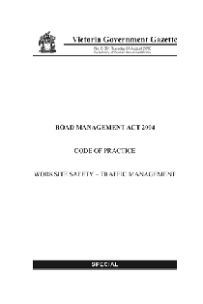
Compliance
PC 1.1 PREPARE TO IMPLEMENT TRAFFIC MANAGEMENT PLAN
There are documents called compliance documents that traffic controllers need to know about. These documents tell you what you must do to work safely and legally as a Traffic Controller.
The following are all examples of the types of compliance documents that are important for a Traffic Controller to know about:
Legislation
Road Management Act
Road Safety Act
Occupational Health and Safety Act or Work Health and Safety Act
Occupational Health and Safety Regulations or Work Health and Safety regulations
Road Safety (Traffic Management) Regulations
These documents can be found at www.comlaw.gov.au
Codes of practice (for example)
Code of Practice for Worksite Safety – Traffic Management
Traffic management for works on roads code of practice
Note: Check with the state/territory regulator for the relevant compliance documents in your state/territory.

Slide 6

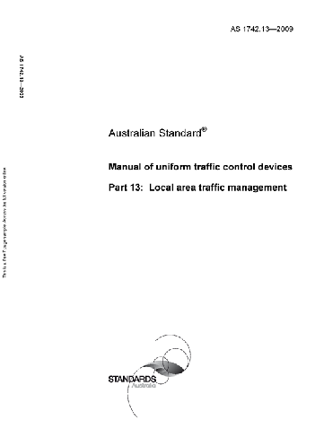
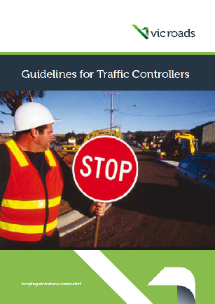
PC 1.1
PREPARE TO IMPLEMENT TRAFFIC MANAGEMENT PLAN
Compliance (continued)
Australian standards
Australian Standard AS1742: Manual of Uniform Traffic Control Devices
Australian Standard AS4602: High visibility safety garments
Australian Standard AS1906: Retroreflective materials and devices for road traffic control purposes.
These documents can be found at www.saiglobal.com
Worksite rules and procedures
The rules, procedures and policies of the company you are working for or the site you are working at should be made
available during site induction or from your supervisor.
Guidance notes
Guidelines for traffic controllers
Traffic controller handbook
(Check what’s available from your state or territory roads regulator).

Slide 7
Australian Standards
PC 1.1, 1.2 PREPARE TO IMPLEMENT TRAFFIC MANAGEMENT PLAN
The Australian Standard AS1742 Set-2014 Manual of uniform traffic control devices is a document you should be familiar with. There are 15 parts in the standard.
AS 1742.1
AS 1742.2
AS 1742.3
AS 1742.4
AS 1742.5
AS 1742.6
AS 1742.7
AS 1742.9
AS 1742.10
AS 1742.11
AS 1742.12
AS 1742.13
AS 1742.14
AS 1742.15
Manual of uniform traffic control devices - General introduction and index of signs Manual of uniform traffic control devices - Traffic control devices for general use Manual of uniform traffic control devices - Traffic control devices for works on roads Manual of uniform traffic control devices - Speed controls
Manual of uniform traffic control devices - Street name and community facility name signs Manual of uniform traffic control devices - Tourist and service signs
Manual of uniform traffic control devices - Railways crossings Manual of uniform traffic control devices - Bicycle facilities
Manual of uniform traffic control devices - Pedestrian control protection Manual of uniform traffic control devices - Parking controls
Manual of uniform traffic control devices - Bus, transit, tram and truck lanes Manual of uniform traffic control devices - Local area traffic management Manual of uniform traffic control devices - Traffic signals
Manual of uniform traffic control devices - Direction signs, information signs and route numbering
This standard gives information on the different devices that can be used to clarify and warn drivers, cyclists and pedestrians about road, traffic and path conditions.

Slide 8
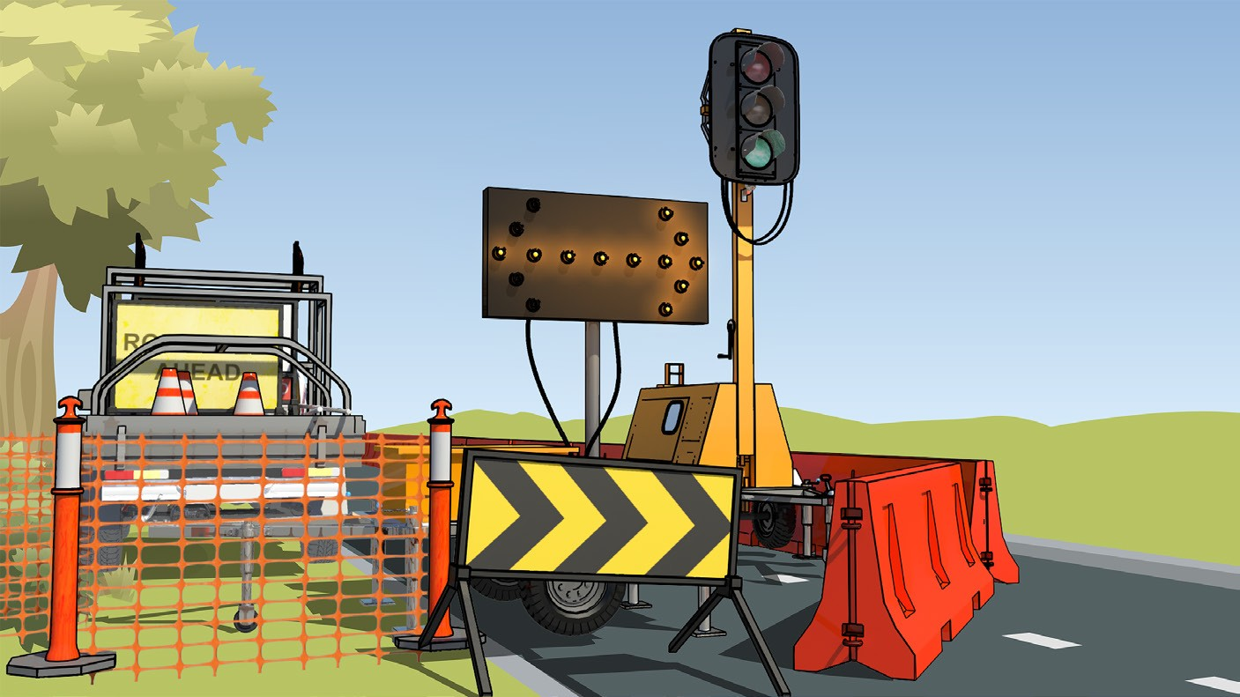
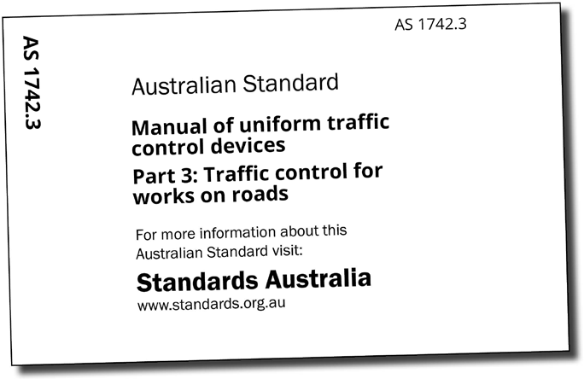
PC 1.1, 1.2
PREPARE TO IMPLEMENT TRAFFIC MANAGEMENT PLAN
Australian Standards (continued)
Australian Standard 1742.3 Manual of uniform traffic control devices. Part 3: Traffic control for works on roads.
This Standard is the main document that applies to traffic control and management.
“The objective of this Standard is to provide organizations carrying out works on roads with a set of uniform practices for the signing and delineation of construction and maintenance works which will promote the safety of both workers and road users at the work site.”
The Standard explains the devices and control measures to warn and guide road users in safely passing around or through a worksite on a road. It includes footpaths, shared paths and bicycle paths adjacent to the roadway.
The Standard is used when works obstructs the normal use of a road by a road user.
The Standard also gives guidance for traffic guidance schemes (TGS) which are used to guide traffic and keep workers safe.

Slide 9

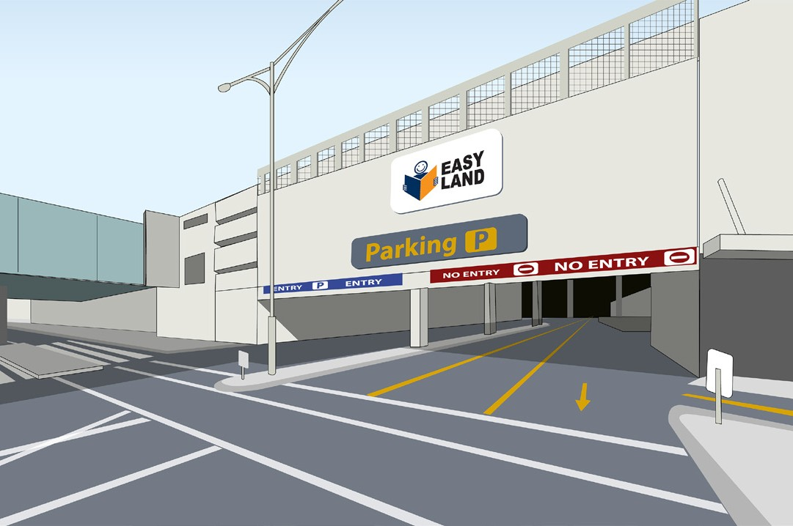

PC 1.1
PREPARE TO IMPLEMENT TRAFFIC MANAGEMENT PLAN
Traffic flow requirements
In making your traffic management plan you must know the approximate traffic flow of the affected road area. Your traffic flow data should include movement of light vehicles, heavy vehicles, pedestrians etc.Your plan and TGS should keep traffic flowing as smoothly as possible. Ideally, traffic delays should be a maximum of 15 minutes. Longer delays may require the use
of a detour or other modifications to your traffic management plan.
Your traffic flow assessment should include forecasted traffic flow data for roads and intersections of adjoining roads. If a detour is necessary, include streets where traffic is proposed to be detoured.
Your TMP must make sure that queues of waiting vehicles will not block intesections, railway crossings, schools, or entry and exit to nearby shopping centres.
If traffic volumes are high causing long queues it may be necessary to have a second traffic controller to slow or stop the traffic before the queue. If sprayed bitumen works are taking place the location of the traffic controller may need to be varied in keeping with traffic flows.

Slide 10
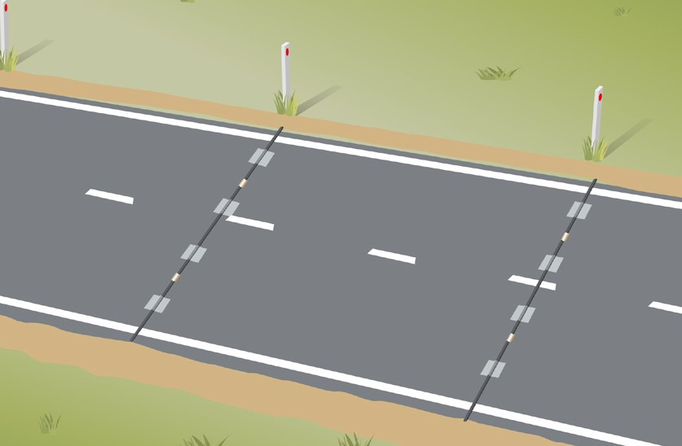


PC 1.1
PREPARE TO IMPLEMENT TRAFFIC MANAGEMENT PLAN
Traffic flow requirements (continued)
Traffic flow data helps you to know the traffic flow of the affected road area. This data is usually collected by the relevant road traffic authority in each state or territory. Mainroads Western Australia for example, undertakes traffic counting throughout Western Australia. Data is collected for both state road networks and local government roads.
The data is collected by installing counting equipment on the roads.The equipment is usually installed at night when traffic volumes are lower. Pneumatic road tubes are generally used for temporary studies to study a sample of traffic.
Traffic counters can also be used to count and classify vehicles. This will help in making the traffic control plan.
For example:
What traffic density is expected.
How long can delays in traffic be expected.
What percentage of the traffic is made up of heavy vehicles.
Will the traffic flow be one-way or two-way.
What speeds will the traffic need to move at.
Will any detours be needed.
What traffic warning signs and devices will be needed.
Will traffic controllers be needed and if so, how many.
Will a media communication plan be needed to let residents know what is happening.
A traffic impact engineering report may be needed.

Slide 11


When are traffic controllers used?
PC 1.1, 1.2 PREPARE TO IMPLEMENT TRAFFIC MANAGEMENT PLAN
Traffic controllers are used when signs alone are not enough. Following are examples of when traffic controllers would be used:
Situation | Reason to control traffic
In an emergency | To slow traffic down. For example, to go past a road accident.
Vehicles crossing the roadway. | This is to allow vehicles to cross the road safely at a designated crossing point.
A temporary total road closure. | A situation like blasting will require total closure of the road. Road users will need to be told the reason and time for the delay.
Low speed operation | This is used when a temporary speed sign has not been put in place and the traffic needs to be slowed.
Using a single lane | Traffic must be restricted to a single direction to alternate the flow of traffic.
Road being surfaced | Traffic will need to be slowed down or directed to take an alternative path as necessary.
Limited sight distance in a work site. | To warn road users of a hazard ahead.
Traffic controllers can only be used in areas where traffic speeds have been reduced to 60 km/h or less. Traffic controllers cannot direct traffic from a moving vehicle and must work from a static work position.

Slide 12

Check your work instructions
PC 1.1 PREPARE TO IMPLEMENT TRAFFIC MANAGEMENT PLAN
Your main work instructions will come in the form of a traffic management plan (TMP) and a traffic guidance scheme (TGS).
A traffic management plan is designed to keep all road users and workers safe when work is being done on or near a road. The plan makes sure that the road network and work at the site operates as smoothly as possible. The TMP sets out the placement of barricades, warning lights, or signs for the duration of the work impeding normal traffic flow.
A traffic management plan must be prepared by a qualified person whenever work is performed on or near roads. The TMP has all the details for the management of traffic during the conduct of works on roads. The TMP contains any relevant Traffic
Guidance Scheme (TGS) and standard operating procedures that relate to the management of traffic during the work. The traffic controller should review the TMP before starting work so they know what to do.
A traffic management plan should include the following:
Traffic demand
An acceptable level of service and convenience to road users must be maintained. This will determine how much road space must remain open or length of time for delays if traffic must be stopped. Plan for end of queue build up of traffic and risk of collisions.
Traffic routing
The TMP will show whether traffic will go through, around or past the work site or a combination of these.
Traffic control
Determine the amount of traffic control needed. This will be done by using traffic controllers, traffic signals, signs and other means.
Other road users
The TMP should include road users other than vehicles. This includes pedestrians, people with disabilities, bicycles, school children and emergency vehicles.

Slide 13
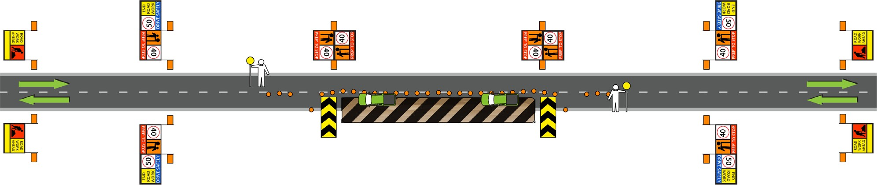
PC 1.1
PREPARE TO IMPLEMENT TRAFFIC MANAGEMENT PLAN
Traffic management plan (TMP)
The Road Safety Act requires any person conducting works on or near a road to have a traffic management plan in place. The traffic management plan must be prepared by a qualified person. The TMP contains the Traffic Guidance Scheme (TGS), worksite hazard assessment (eg: SWMS) and details of the location, nature and duration of the work. The traffic controller should review the TMP before starting work so they know what to do and how to do it.
The traffic management plan may include information about:
The safety of workers and the public
The overall strategy for the management of traffic
The arrangment of traffic control devices
The arrangment and number of traffic controllers
Emergency access (for workers and emergency services vehicles)
Unusual hazards or specific job requirements (eg: nearby schools, access to shops).

Slide 14
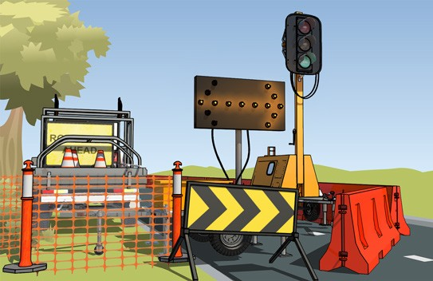

PC 1.1 PREPARE TO IMPLEMENT TRAFFIC MANAGEMENT PLAN
Traffic management plan (continued)
When should there be a traffic management plan?
You will need to have a traffic management plan when the work will:
affect traffic on public and private roads.
affect parking areas. • affect traffic on construction sites.
How big should the job be to have a traffic management plan?
You will need to have a traffic management plan for jobs large and small. This could include short term jobs such as road line marking or long term road construction work such as widening a bridge.
For long term work the TMP should show how the traffic will be managed outside of normal working hours.
Aims of a traffic management plan
A good traffic management plan will achieve the following:
Make sure the work activity is compliant.
Safely guide road users through, around or past the worksite.
Keep road users, pedestrians and workers safe.
Minimise the affect of the works on traffic and nearby land users. Access to adjacent properties must be provided.
Inform land users on the work that will be done.
Provide adequate warnings of the changed use of the road.
Minimise the affect of the works on public transport.
Minimise the affect on the environment.
Tools, signs, communication equipment etc that will be needed.
Times for controlling the traffic (day and night).

Slide 15

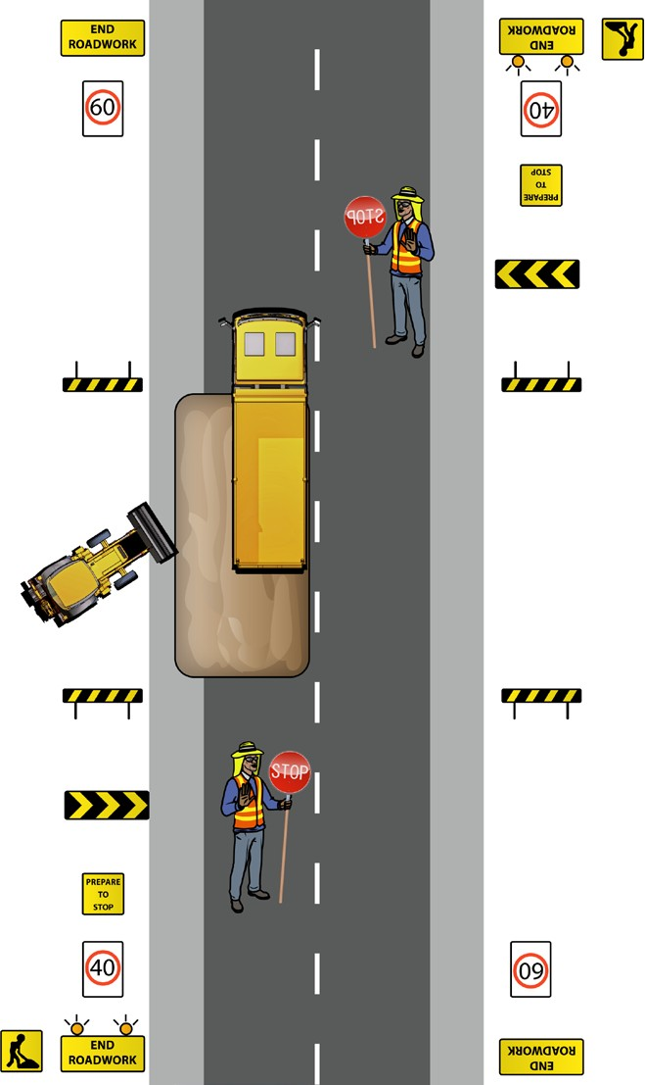

The traffic guidance scheme (TGS)
PC 1.1 PREPARE TO IMPLEMENT TRAFFIC MANAGEMENT PLAN
The TGS is the arrangement of temporary signs and devices to warn traffic and guide it through, past or around a work area or temporary hazard.
Any traffic guidance systems which need to be set up will be detailed in the TMP.
A TGS shows on a sketch or diagram the arrangement of signage and devices such as:
tempory warning signs
traffic cones
vehicle mounted signs and flashing lights
speed limit signs
guide signs
warning signs
warning lights
barriers
hazard markers
portable traffic signals
bollards
arrow boards
detours
traffic controllers.

Slide 16
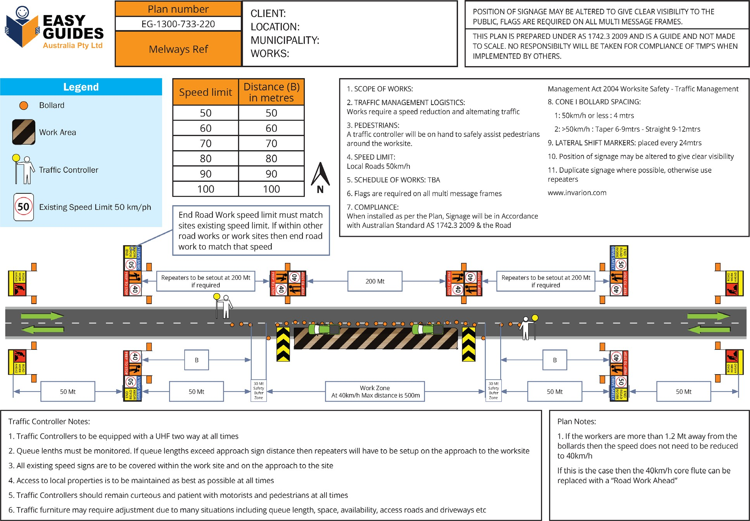
Sample information on a traffic guidance scheme (TGS)
PC 1.1 PREPARE TO IMPLEMENT TRAFFIC MANAGEMENT PLAN
You would expect to find some of the following information on a TGS:

Slide 17


Worksite hazard management process
PC 1.2 PREPARE TO IMPLEMENT TRAFFIC MANAGEMENT PLAN
The road environment is not free of risks and hazards, even without any works. The risk assessment should include the hazards likely to arise during the works in the various stages of (a) Planning; (b) Setting up; (c) Operating; (d) Changing; and (e) dismantling.
A systematic approach to managing risks needs to be taken. The likelyhood and the consequences of a risk occurring needs to be judged. The likelyhood and the consequences will determine the seriousness of the risk.
Hazard
A hazard is any thing or any situation which could injure or harm you.
In other words, it is anything that can hurt you.
Risk
A risk is the chance of a hazard causing injury or harm.
In other words, how likely it is that somebody or something may be harmed by the hazard.

Slide 18


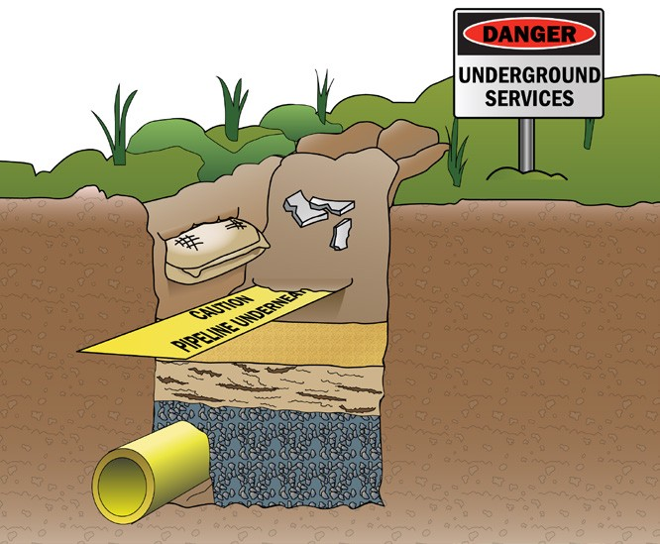

Hazard identification
PC 1.2 PREPARE TO IMPLEMENT TRAFFIC MANAGEMENT PLAN
There are a lot of hazards on construction sites that you need to be aware of. Hazards can cause accidents and injuries. Hazards need to be identified before you can start work so they can be controlled.
Hazards can include things like:
Uneven/unstable ground | Trees | Pits and underground services

Slide 19

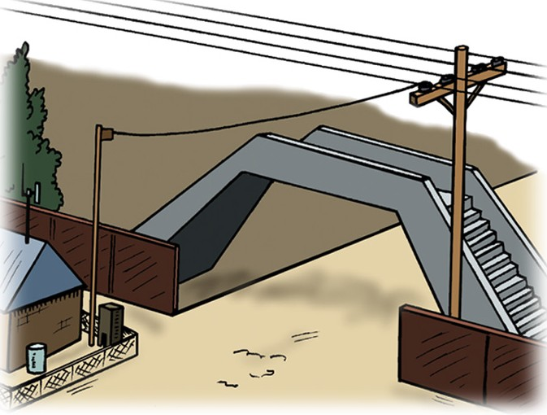
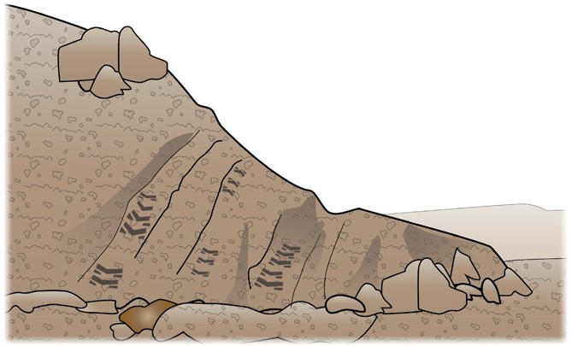



PC 1.2
PREPARE TO IMPLEMENT TRAFFIC MANAGEMENT PLAN
Hazard identification (continued)
Overhead services and bridges | Trip hazards and obstructions | Embankments and dirt mounds
Plant and machinery | Fire and hazardous materials | Cuttings

Slide 20
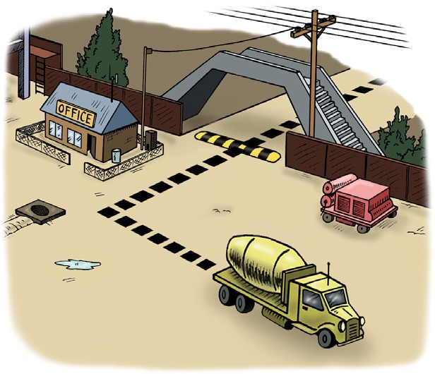
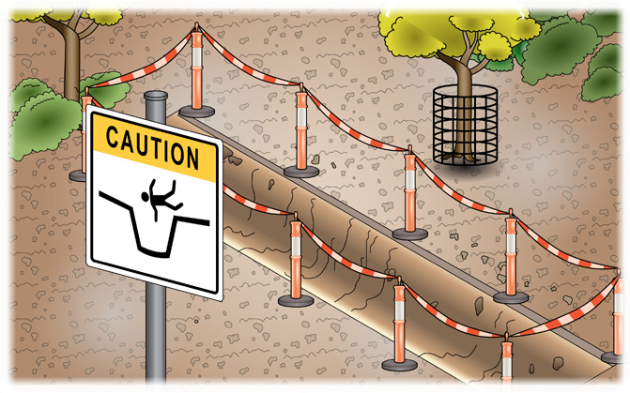
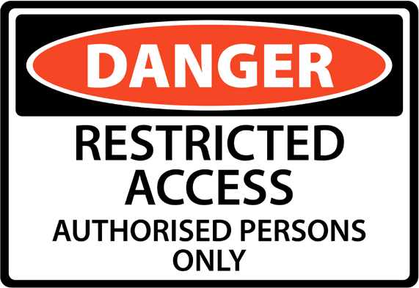
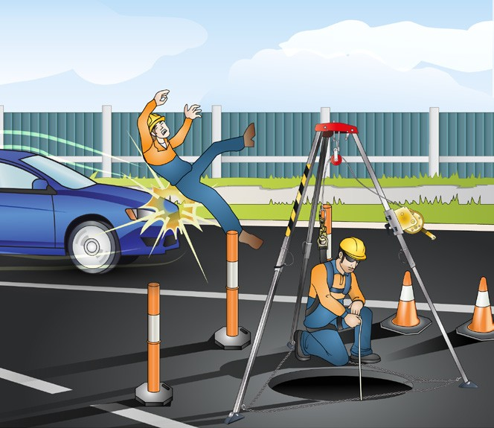

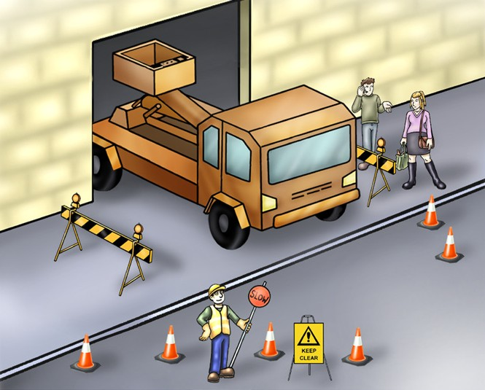
PC 1.2
PREPARE TO IMPLEMENT TRAFFIC MANAGEMENT PLAN
Hazard identification (continued)
Surrounding buildings, structures and facilities | Excavations and recently filled trenches | Restricted access barriers
Pedestrians and other personnel | Vehicle traffic | Weather conditions

Slide 21
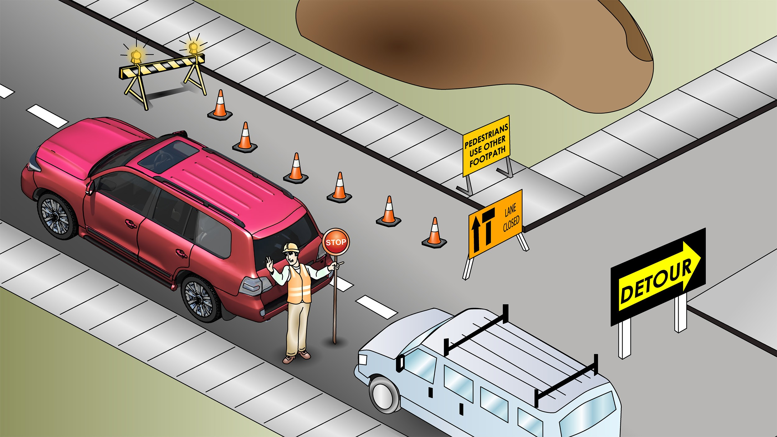
Major risks for worksite traffic management
PC 1.2 PREPARE TO IMPLEMENT TRAFFIC MANAGEMENT PLAN
For worksite traffic management the major risks are:
Speed of traffic next to or through the worksite
Space between moving traffic, workers, plant and equipment
Amount and type of traffic
Shape of the worksite and ways to approach it
How long the works will go for (short and long term)

