Slide 1
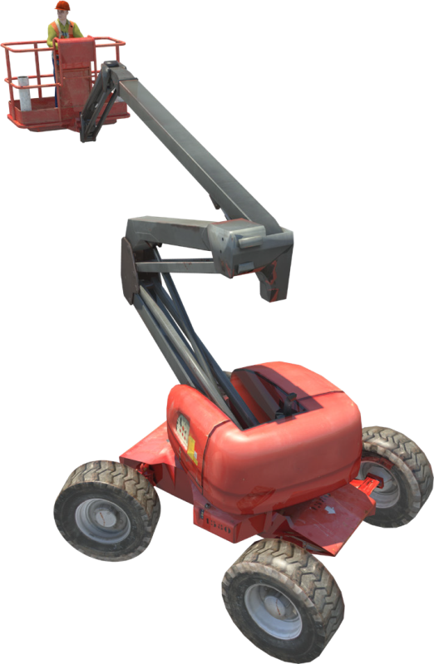
ELEVATING WORK
Training support material for:
TLILIC0005
Licence to operate a boom-type elevating work platform
(boom length 11 metres or more)
Produced by:

Slide 2
contents
About this guide
Introduction to elevating work platforms High risk licensing and the law
4
5
9
19
53
99
133
Element 1
Element 2
Element 3
Element 4
Plan work /task Prepare for work / task Perform work / task Pack up

Slide 3
About this guide
ABOUT THIS GUIDE
The guide is a follow-up to your formal training.
Like all Easy Guides, this one uses plain words and pictures to help you remember what you learned in your formal training. So you can pass your test — and get your licence.
Good luck from the team at Easy Guides Australia Pty Ltd.
Note: This guide does not use the same wording as the Safe Work Australia Assessment Instrument.
Easy Guides training materials have been developed around Language – Literacy – Numeracy (LLN) principles.
How to use this guide
Use it in hard copy
This guide helps you prepare for the test at the end of the course. Study it carefully, and then ask a friend to help you practise. They can ask you each question, and then you give the answer. Writing down the answers can also help you remember them. This also helps you see what you still need to learn. Good luck!
Or use it on screen
This guide also comes in a multimedia presentation, so you can use it on your computer or screen. The multimedia presentation
is just like the guide and has exactly the same questions with the same short words and easy-to-understand pictures.
Trainers can use the multimedia presentation in class to help learners discuss questions. The trainer first shows the question and asks if anyone knows the answer. Next, the trainer will show the answer and discuss it with the learners.
3

Slide 4
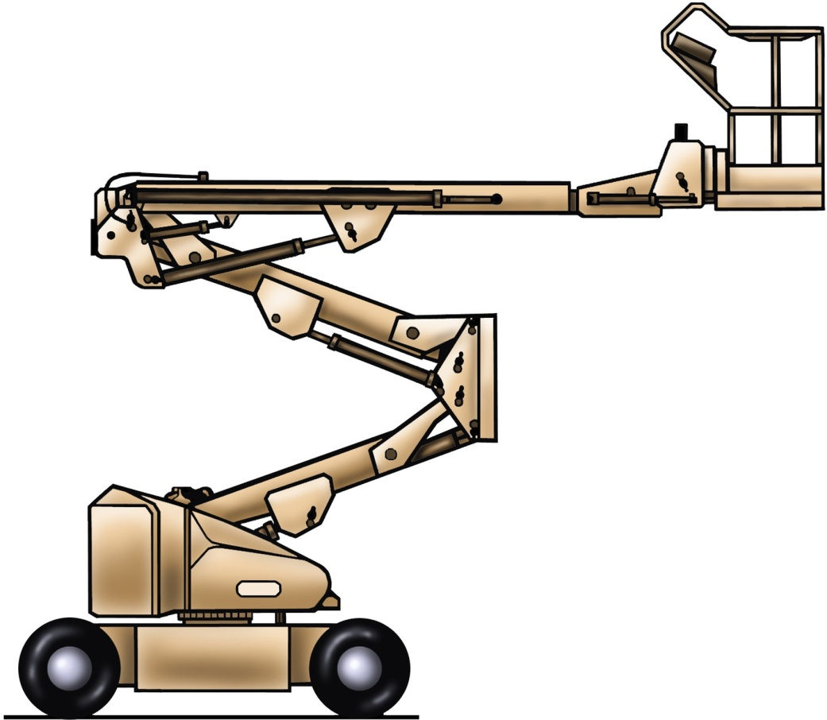
Parts of a boom-type elevating work platform
PC 1.3 INTRODUCTION TO ELEVATING WORK PLATFORMS
Level slave cylinder
Upper boom
Level master cylinder
Hinge
Basket/platform
Upper boom lift cylinder
Intermediate boom cylinder
Telescopic cylinder
Counter weight
Lower boom
Lower boom lift cylinder
Chassis
Slew ring
4

Slide 5
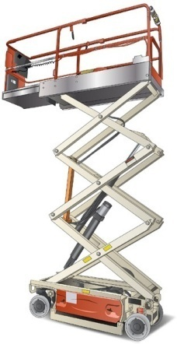
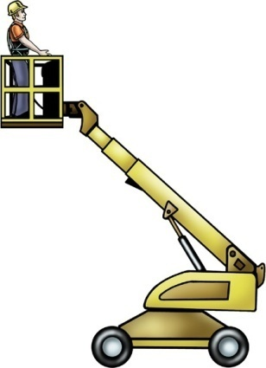
PC 1.3
INTRODUCTION TO ELEVATING WORK PLATFORMS
INTRODUCTION TO ELEVATING WORK PLATFORMS
Types of EWP
Elevating Work Platforms (or EWPs), are work platforms which can be raised to make working at heights much easier. EWPs are sometimes called cherry pickers, sky-workers, sky-cranes and boom lifts.
Scissor lifts are one type of EWP. These lifts have a platform which is hydraulically raised and lowered on linked, folding supports that draw together. | Boom-type EWPs have a platform which is raised on the end of a boom. There are many different types of boom-type EWPs.
Telescopic boom lifts. | Articulated boom lifts are often called
These are also called | ‘knuckle booms’. They have a feature
‘straight stick’ booms. | called ‘up and over reach’. This means
With these models, the | they have the ability to place operators
boom extends outwards, | in locations that require vertical height,
but does not articulate. | and horizontal reach.
5

Slide 6
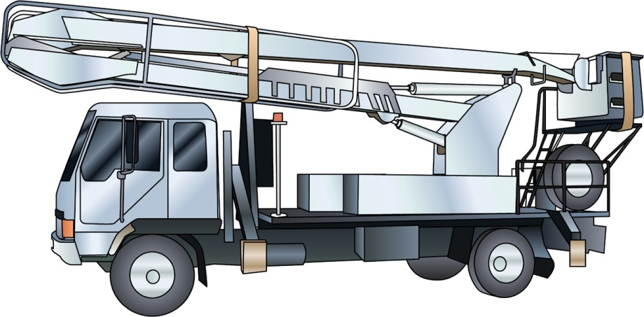
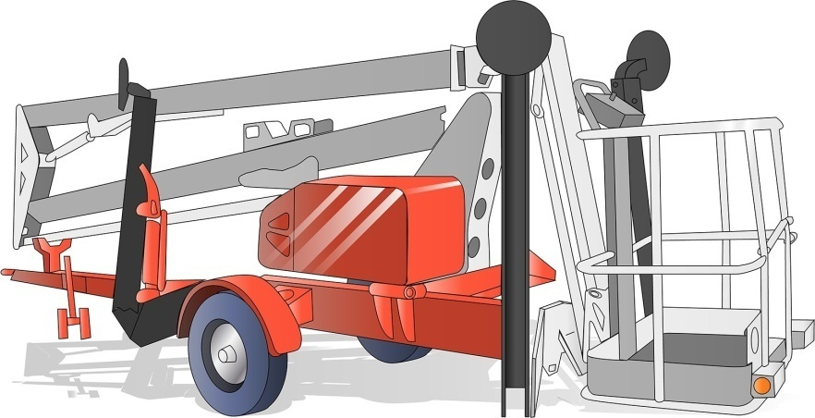
PC 1.3
INTRODUCTION TO ELEVATING WORK PLATFORMS
INTRODUCTION TO ELEVATING WORK PLATFORMS
Types of EWP (continued)
Truck-mounted EWPs offer a safe and easy way of working at heights with the flexibility of quick movement between sites. There are both articulating and telescopic versions of truck mounted EWPs available.
Trailer mounted EWPs have the ability to place operators at locations that require vertical height and horizontal reach.
They are available in varied sizes and
can be electric or engine powered.
A key feature of trailer mounts is ‘up and over reach’ with the flexibility of towing the trailer lift to the job sites using your own vehicle.
6

Slide 7
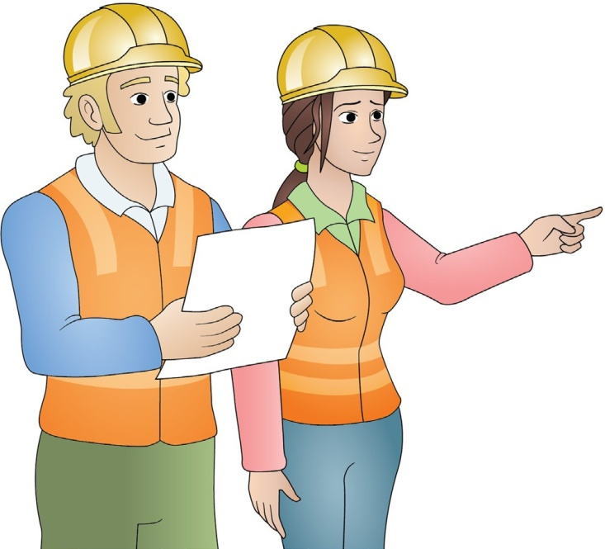
Plan work / task
Element 1
7

Slide 8
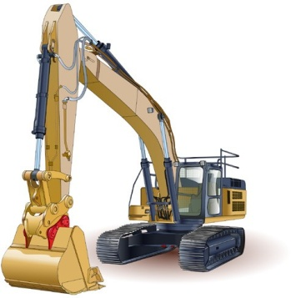
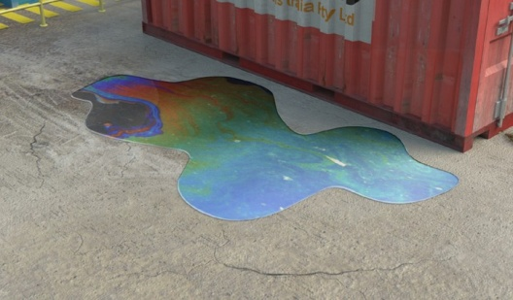
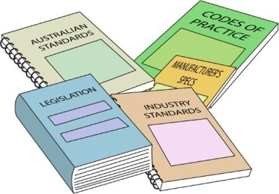
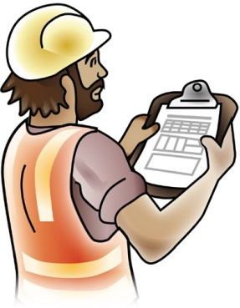
Work plan
PC 1.1 PLAN WORK / TASK
PLAN WORK
A work plan, sometimes called a job plan, helps to organise the way the job is carried out. Each worksite will have its own procedures for developing the work plan. When a work plan is developed it must take into account things like:
What plant or equipment is needed. | What hazards there are, and how these will be controlled. |  | Laws, Australian standards, or manufacturer’s instructions which must be followed.
Worksite rules and procedures. |  | The order of the tasks which need to be done.
8

Slide 9
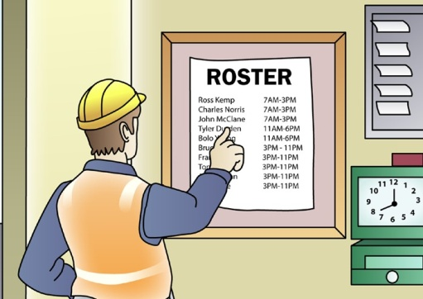
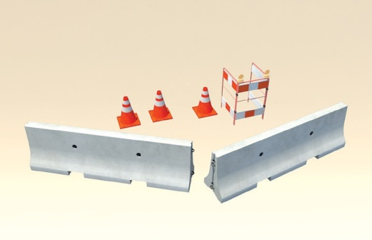
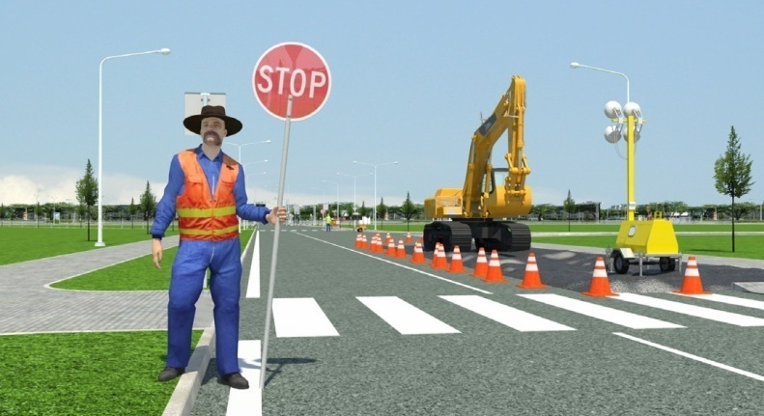
Job order
PC 1.1 PLAN WORK / TASK
PLAN WORK
Work plans also help put the tasks of a job in the order in which they need to be done. This helps to work out:
When certain plant or equipment will be on the site. | What staff are needed to do certain tasks at certain times. | The types of hazard controls you will need to set up before a particular type of work starts.
For example, the work plan might tell you that, in two days, traffic controllers will be needed. This way, you can be ready to do your job alongside the traffic controllers.
You should discuss the job plan with your supervisor and workmates. Talking and asking questions helps everyone understand what they have to do. It also helps everyone to understand the hazards involved in the job and how these hazards will be controlled.
9

Slide 10
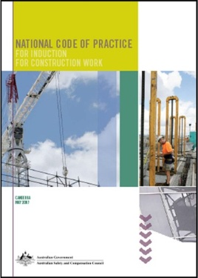
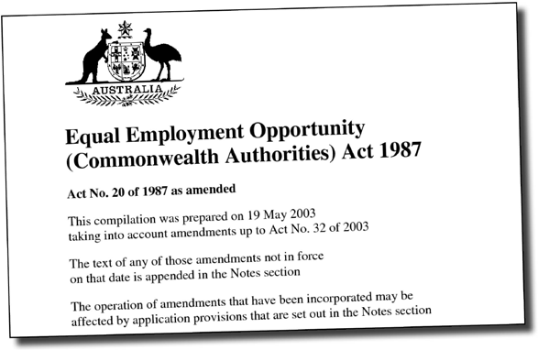
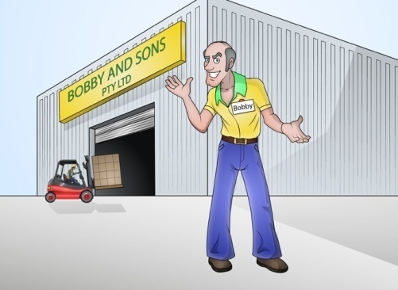
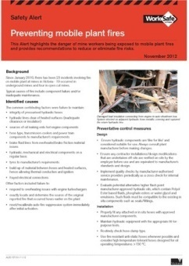
Safety information and work procedures
PC 1.1 PLAN WORK
You will also have to make sure you know about the safety information and procedures related to the job. Ways to find out this
information include:
Legislation and regulations | Australian standards | Worksite OHS/WHS policies
Codes of Practice | Instructions from manufacturers such as operation manuals. | Safe work procedures (SOPs).
10

Slide 11
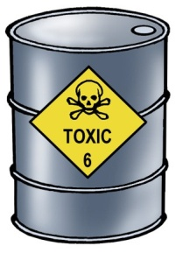
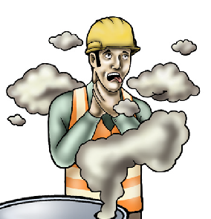
PC 1.5, 2.2
CHAPTER 1 – PLAN WORK/TASK
PLAN WORK
Hazard versus risk
What is the difference?
Different hazards and risks emerge constantly—sometimes instantly.
Hazard
A hazard is any thing or any situation which could injure or harm you.
In other words, it is anything that can hurt you.
Risk
A risk is the chance of a hazard causing harm such as injury, illness or even death.
In other words, how likely it is that somebody or something may be harmed by the hazard.
11

Slide 12
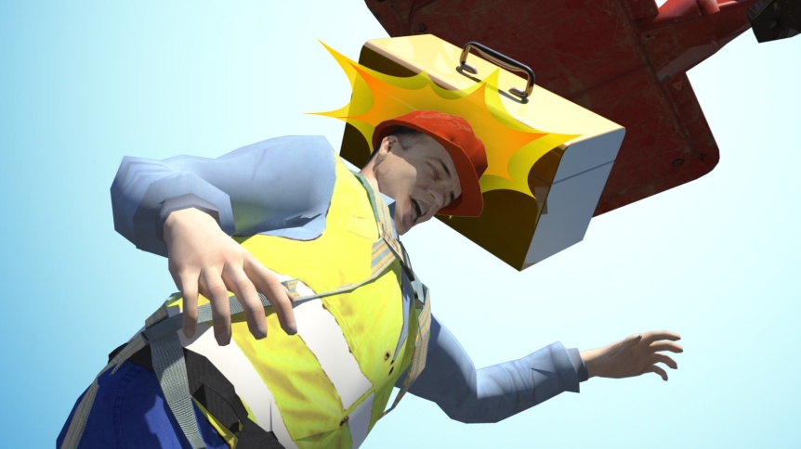
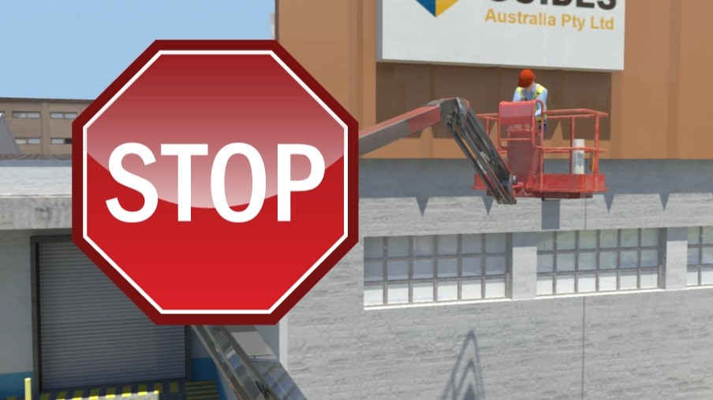
PC 2.13
PLAN WORK / TASK
Wind hazards
Wind is a common hazard when working on an elevating work platform. It can cause the boom to move uncontrollably, make objects fall from the platform or even make the EWP tip over.
Wind can also cause dust and debris to be blown around which can get into the operators eyes and affect vision.
If you are working and the wind speed exceeds the limit of the EWP – stop work immediately and bring the platform to the ground.
The wind speed rating of the EWP can be found by checking the data plate, operators manual or machines specifications.
12

Slide 13
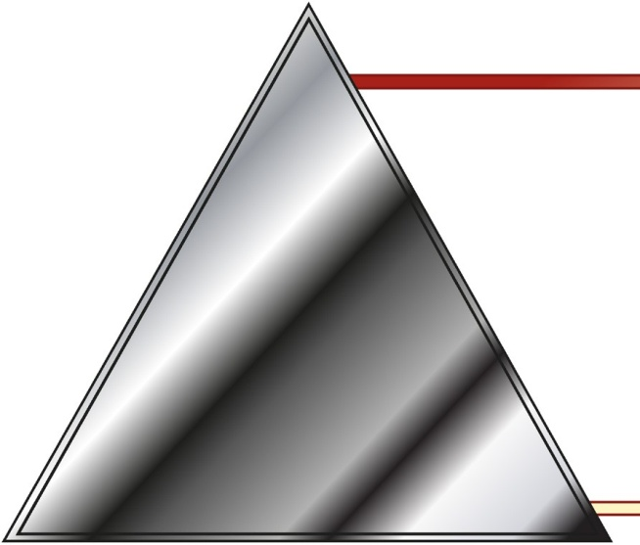
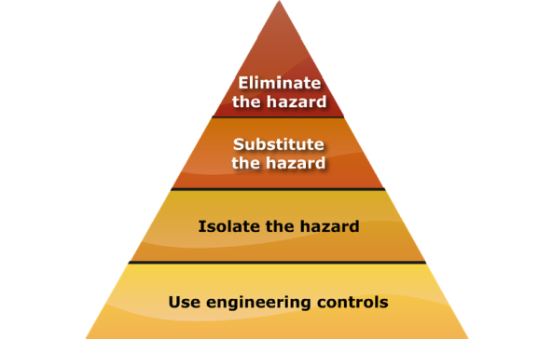
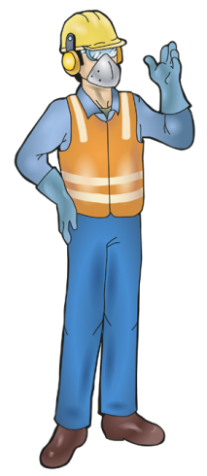
PC 1.5, 2.2, 3.1
PLAN WORK / TASK
QUESTION 17
The Hierarchy of Hazard Control is a list of controls that you can use to eliminate or lower the danger from a hazard in the workplace.
What are the six (6) levels in the hierarchy from the first choice to the
last choice?
1. Elimination: If possible,
remove (take away)
the hazard.
2. Substitution: Use a safer method if you can’t remove the hazard.
3. Isolation: Stop access to the hazardous (dangerous) area.
4. Engineering Control Measures:
Change the tools, equipment or environment to make it safer.
5. Administrative Practices: Reduce the time the worker is exposed to the hazards by using training, job rotation, the timing of jobs, etc.
6. Personal Protective Equipment (PPE): Use PPE as your last line of defence.
Memory aid: Every Saturday I Eat A Pie
13

Slide 14
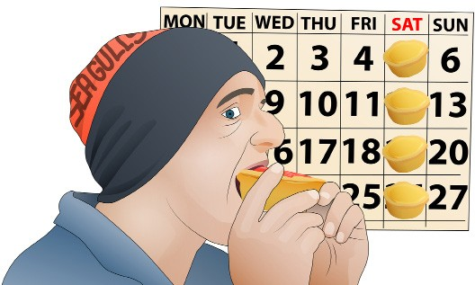
PC 1.5, 2.2, 3.1 PLAN WORK / TASK
How to remember the Hierarchy of Hazard Control
You can use the following acronym (an abbreviation formed from the initial components in a phrase) to help you remember
the steps in the hierarchy of hazard control.
Every Saturday I Eat a Pie
E Every
Eliminate
S Saturday
Substitute
I
I
Isolate
E Eat
Engineering
A a
Administration
P Pie
PPE
14

Slide 15
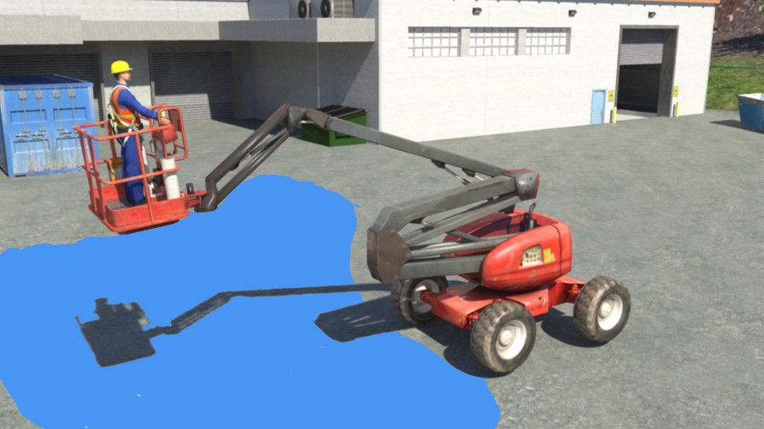
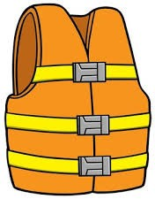
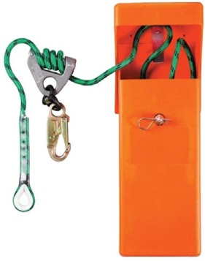
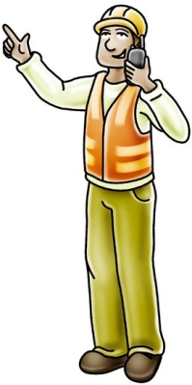
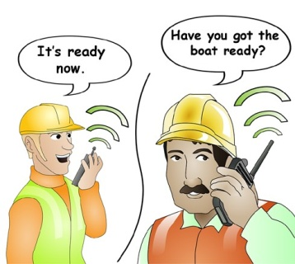
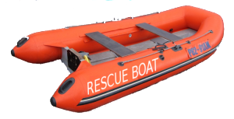
Working near or over water
PLAN WORK
When working over or near water, assess the hazards and risks to decide what personal protective equipment should be worn and what control measures should be in place.
Emergency retrieval system
Try not to be attached
to the EWP.
Wear a life jacket
Have a rescue boat
Have a rescue plan
Have a spotter
15

Slide 16
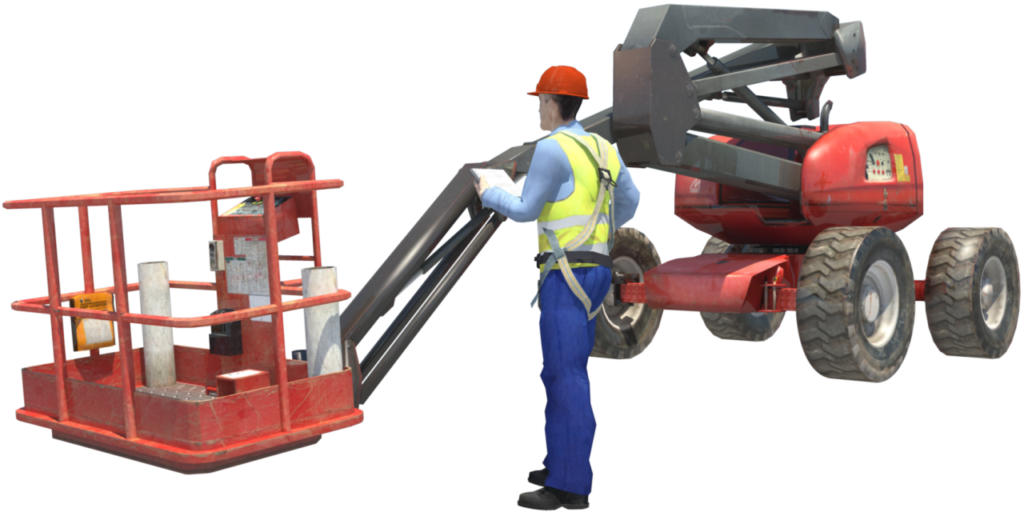
Prepare for work / task
Element 2

Slide 17
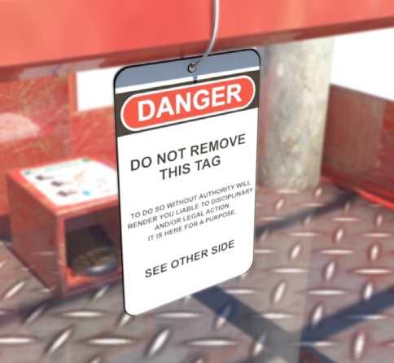
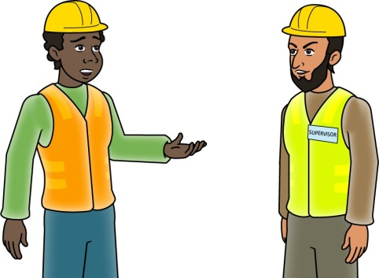
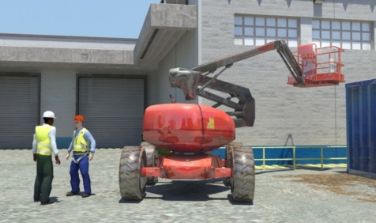
PC 2.11, 2.12
PREPARE FOR WORK / TASK
CONDUCT ROUTINE CHECKS
Check the service logbook
The EWP logbook is used to record details of when the EWP was operated and who the operator was. Any defects that are found and servicing and repairs carried out on the EWP are also recorded. You should check the EWP’s logbook to make sure it is the right logbook for the machine you are using. Check also if any defects have been reported, and if they have been fixed.
If you check the service logbook and find:
a defect that has not been fixed
the EWP hasn’t been tested
the EWP does not meet Australian Standards 2550.10
You should:
Tag out the machine | Do not use the EWP | Report the problem to your supervisor, and as per your site procedures.
If you find the EWP has a defect you must record it in the EWP logbook and the service
logbook.

Slide 18
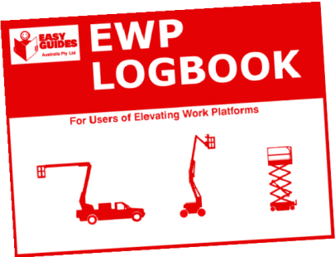
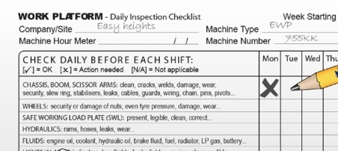
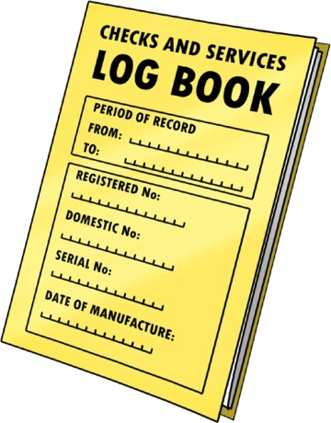
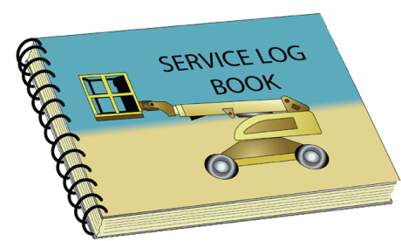
PC 2.11, 2.12
PREPARE FOR WORK TASK
QUESTION 25 What do you check the logbook for? | Some examples are: Is this the logbook that goes with this EWP? Is the logbook complete and up to date? Record EWP operation Enter daily safety checks Record defects Show that defects have been fixed Maintenance and inspections have been done.
QUESTION 26 What is the service logbook used for? | Some examples are: To record the date and time the EWP was used To record who operated the EWP To record daily safety checks To record defects and the repair of defects To record servicing, maintenance and inspections.

Slide 19
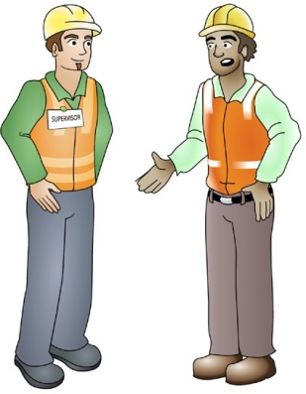
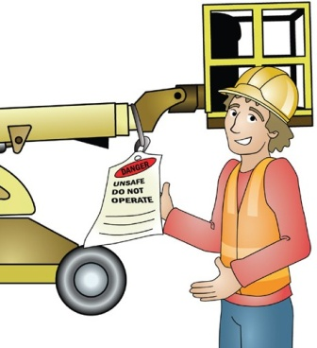
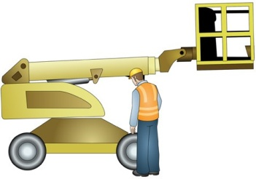
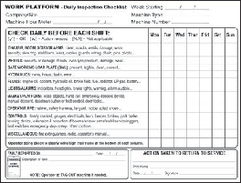
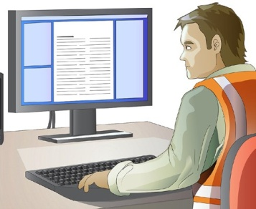
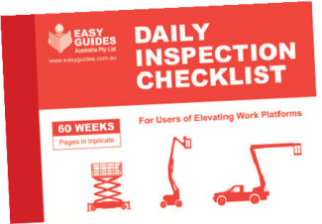
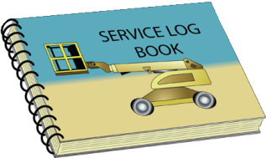
PC 2.11, 2.12
PREPARE FOR WORK TASK
QUESTION 27 You are checking the service logbook. You find the EWP wasn’t checked by following the Australian Standards (AS 2550.10). What must you do? | 1. Do not use the EWP until the problem is fixed. | 2. Put a danger tag on the EWP so no one else can use it. | 3. Tell a supervisor about the problem.
QUESTION 28 Where must you record all EWP defects (faults)? | EWP Daily inspection checklist book | Your site may also have it’s own procedures for recording defects | EWP service logbook

Slide 20
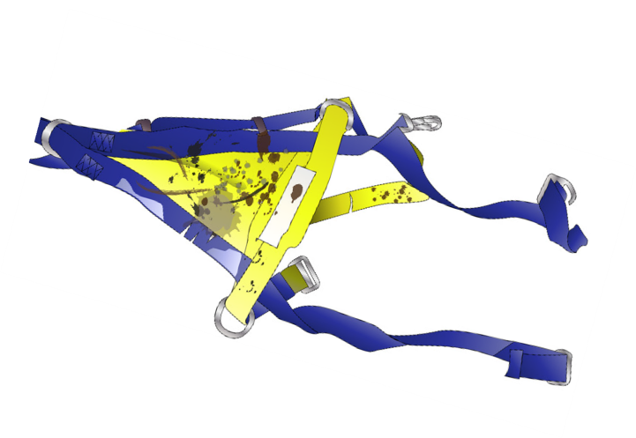
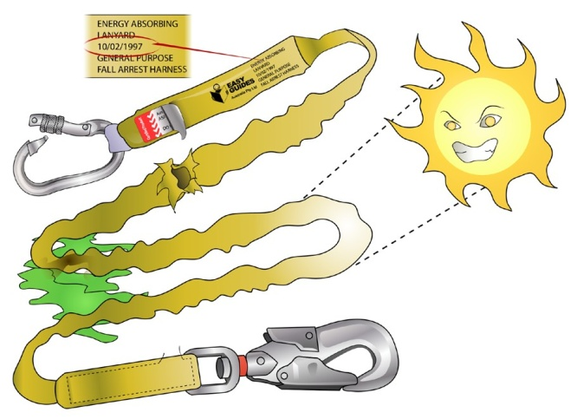
PC 2.3
PREPARE FOR WORK / TASK
CONDUCT ROUTINE CHECKS
Harness and lanyard defects
You must check the safety harness and lanyard to make sure it is in good working order.
Here are some of the checks you should do:
You must check the safety harness and lanyard to make sure it is
in good working order.
Here are some of the checks you should do:
If you find the harness has any defects, remove the ‘safe to use’ tag and apply an ‘out of service’ tag.
Separate the defective harness from the others and report it to
your supervisor.
Follow any other procedures for your worksite.
The lanyard must also be checked.
If you find the lanyard has defects or is out of date, remove the ‘safe to use’ tag and apply an ‘out of service’ tag.
Separate the defective lanyard from the others and report it
to your supervisor.
Follow any other procedures for your worksite.

Slide 21
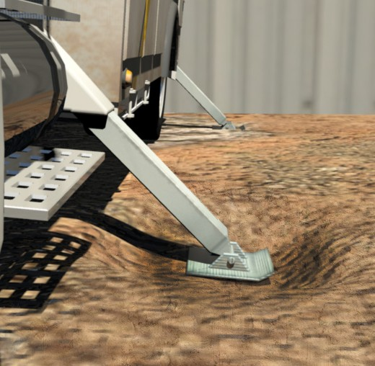
PC 1.2
PREPARE FOR WORK / TASK
Outrigger hazard controls
If you have set up the work platform, but one of the outriggers starts to sink you must stop immediately and lower the basket to the ground.
Fix the sinking problem by stabilising the
ground with packing.
If you cannot fix the ground conditions, move the EWP to another spot where the ground is more stable.

Slide 22
PC 1.2
PREPARE FOR WORK / TASK
C_{PC}h₁e.c₂k the ground
You must check ground conditions on the worksite before setting up the EWP.
This will help you work out if the ground can support the weight of the EWP and how much packing might be needed.
Soil conditions
Report on the condition of the soil. If your worksite has geological or survey reports you should check these reports.
The types of soil could affect how much weight the soil can support. For example, rock can support much more weight than wet clay. These reports will tell you things like:
Types of soil on the worksite | Layers of fill or backfilled trenches on the site | Pockets of weakness next to underground car parks

Slide 23
PC 1.2, 1.4
PREPARE FOR WORK / TASK
Planning the path of movement (continued)
When you move the boom, watch for things like trees, powerlines or any other obstructions.
Whenever you are moving the EWP itself, or the boom of the EWP, you need to think about all hazards and all

Slide 24
Small or confined spaces
PC 1.2, 1.4 PREPARE FOR WORK / TASK
If you are using an EWP in a small or confined space you have to look out for some particular hazards. For example:
Will the EWP fit into the area? | Are there pedestrian hazards to think about? |  | Are there any possible obstructions?
Do you need the help of a guide? |  | Is there enough room to slew safely?

Slide 25
Drive and position the EWP
PC 1.4, 1.8 PREPARE FOR WORK / TASK
You must think about where you will position the EWP to do the job. Some of the things to think about include:
Making sure the EWP is positioned to safely carry out the job. Check the ground conditions. | There is enough room for a safe working radius. Make sure the work area is within reach of the EWP. | That there is enough clearance from any hazards or obstructions. Beware of other vehicles and plant.

