Slide 1
LEARNER GUIDE
Training support material for:
CPCCWHS2001 –
Apply whs Requirements, Policies and Procedures in the Construction Industry
Includes test yourself questions
Industry Training Resources

Slide 2
Contents
Introduction
5
Element 1 — Identify and assess risks
11
Element 2 — Identify hazardous materials and other hazards on work sites 55
Element 3 — Plan and prepare for safe work practices
83
Element 4 — Apply safe work practices
99
Element 5 — Follow emergency procedures
133
Glossary
157
Test yourself — Questions
161

Slide 3
Introduction

Slide 4
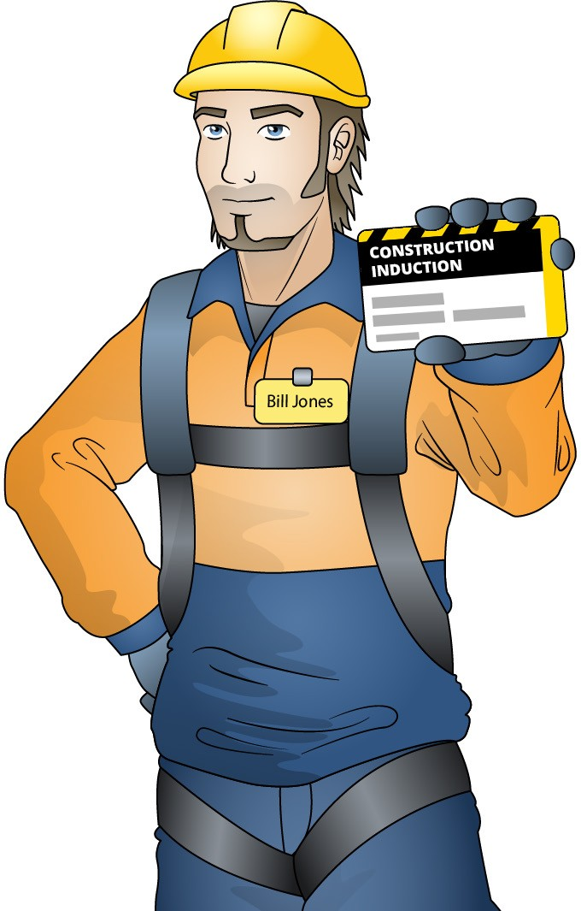
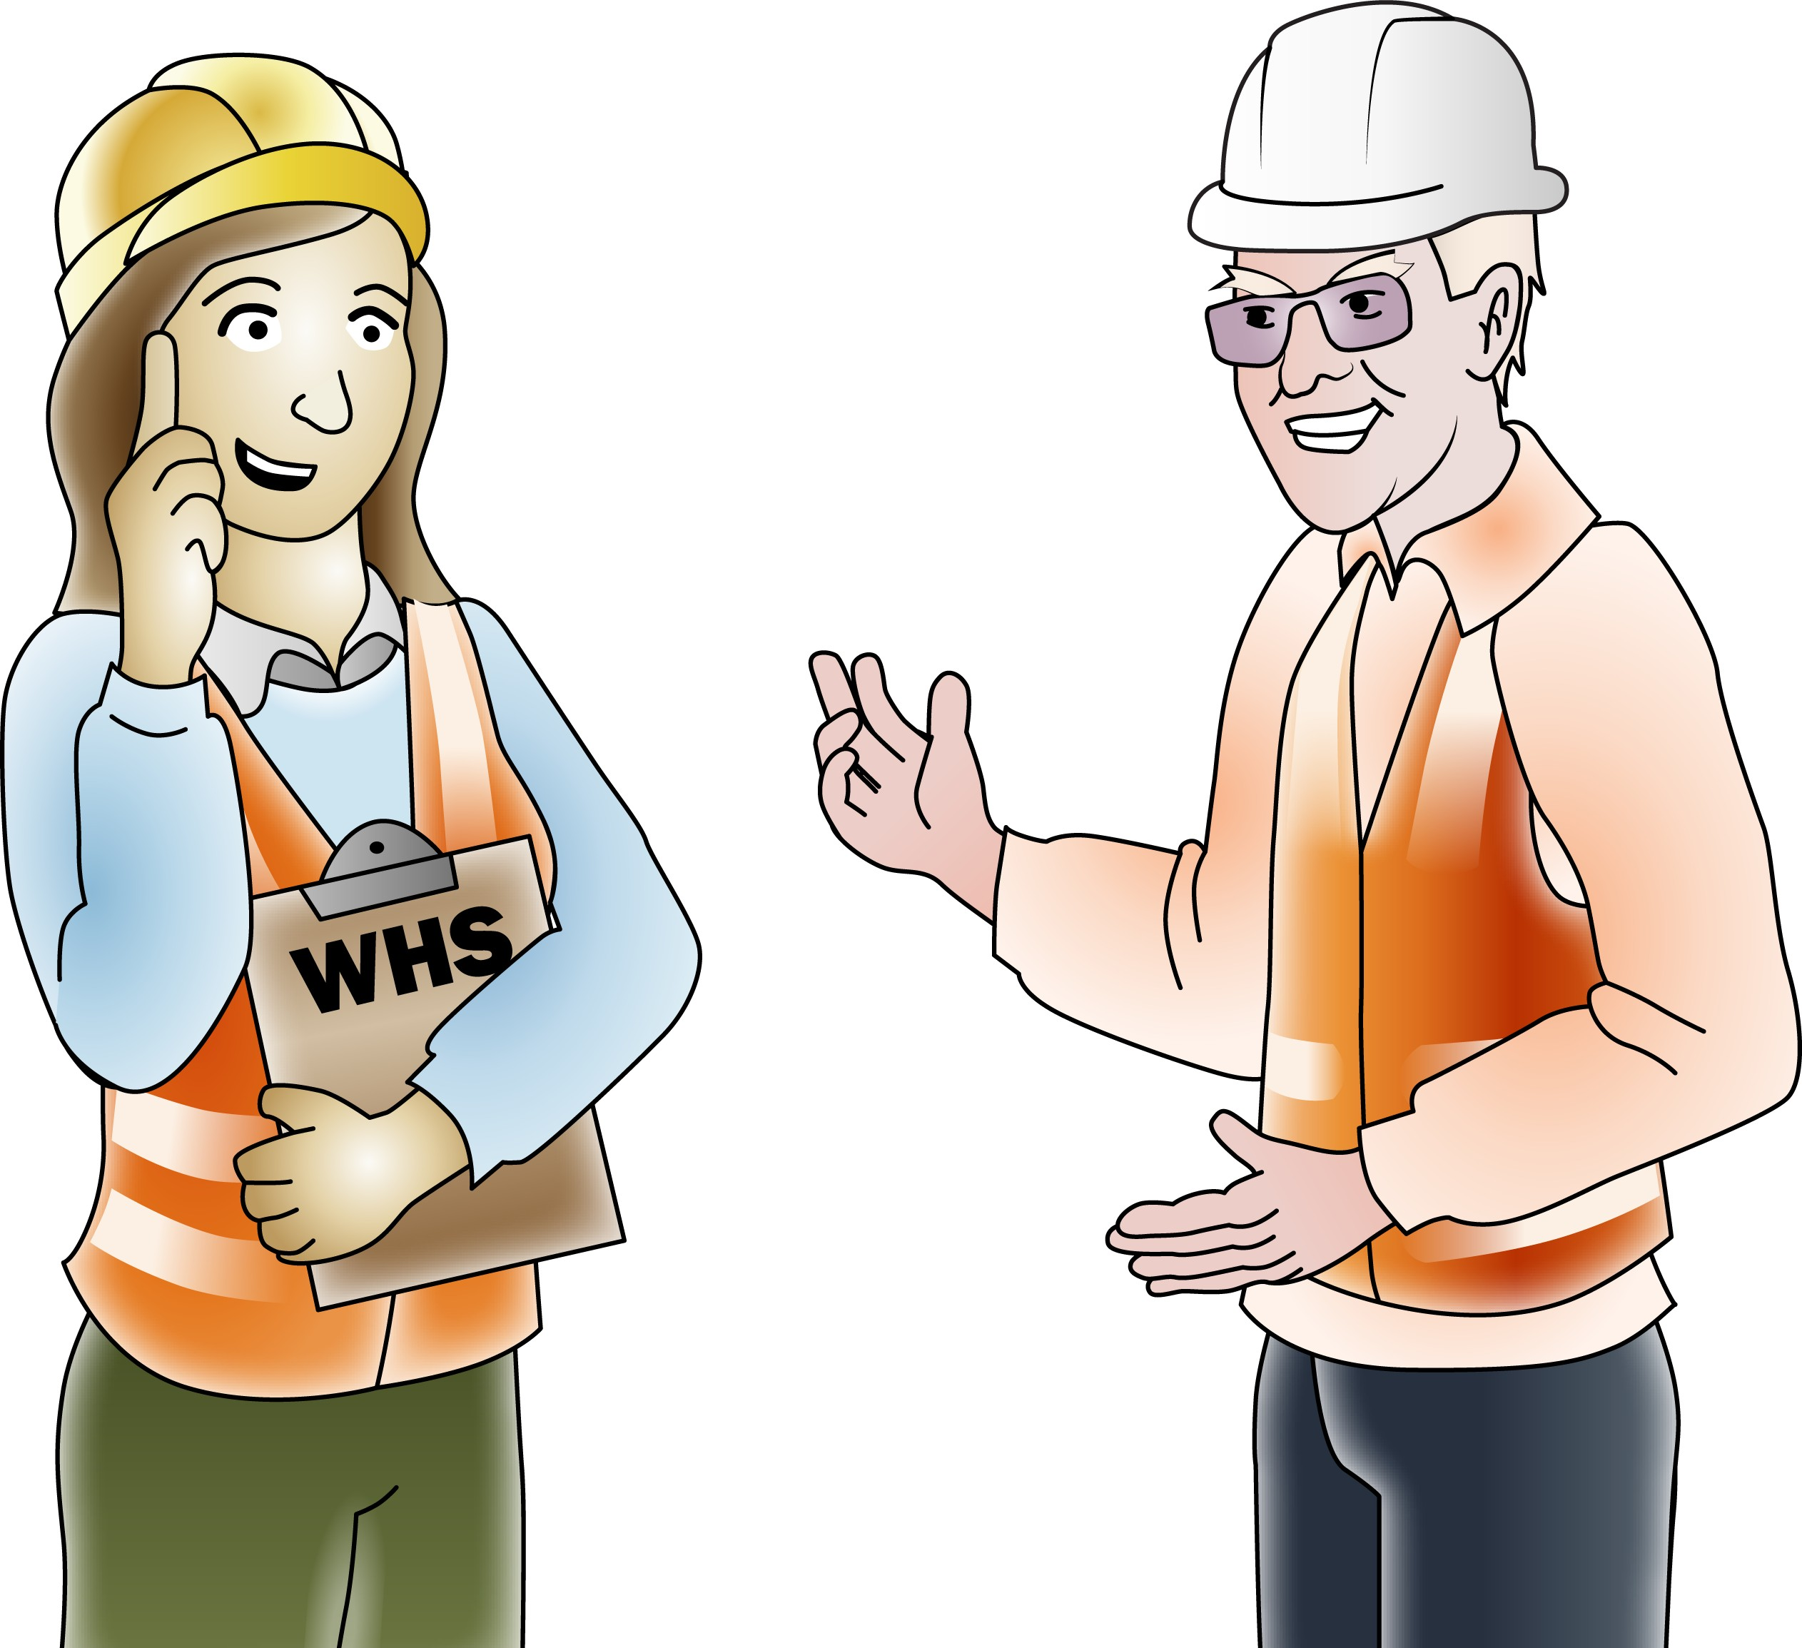
Induction training falls into three categories
INTRODUCTION
IDENTIFY OHS LEGISLATIVE REQUIREMENTS
General induction
Site specific induction
Task specific induction
An employer has a duty of care under the WHS/OHS Act to provide employees with information, instruction, training and supervision as is necessary to perform their work safely.

Slide 5
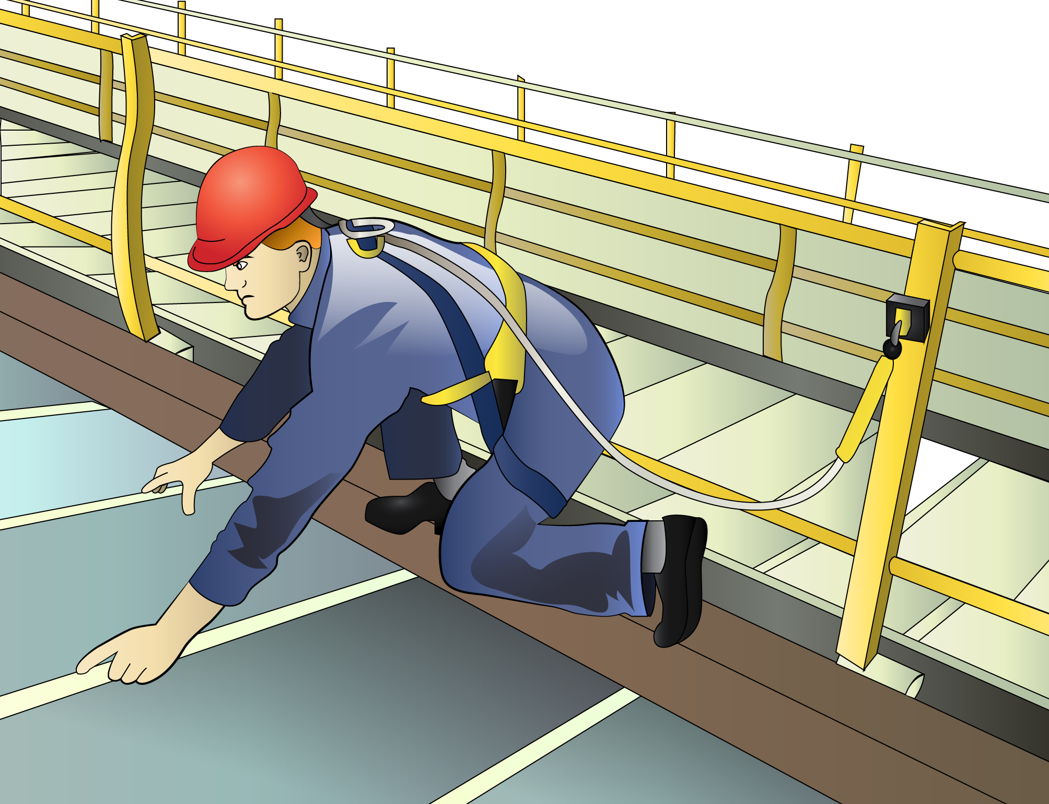
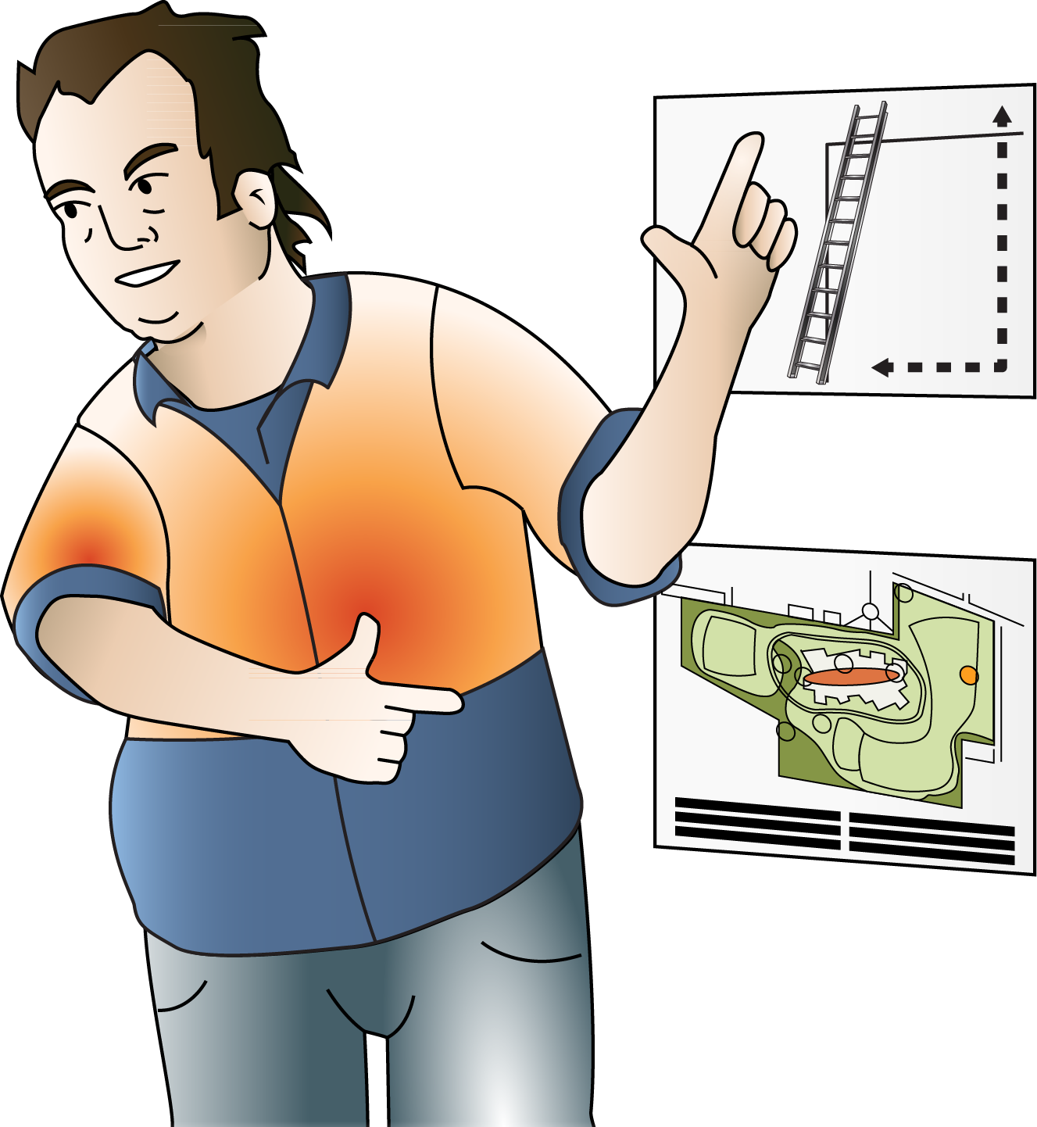
INTRODUCTION
IDENTIFY OHS LEGISLATIVE REQUIREMENTS
Aims of general induction training (continued)
General induction training is recommended for:
Anybody carrying out construction work including site managers, supervisors, surveyors, labourers and trades persons.
Anybody with access to operational construction zones unaccompanied or not directly supervised by an inducted person.
Anybody whose employment causes them to routinely enter operational construction zones.
General induction should be completed upon entry to the industry before commencing construction work.
However, general induction may be repeated when the person with control of the construction work decides that there is a need for additional training.
This can be determined through supervision, incidents that may occur, risk management, or when a person re-enters the industry after an extended absence; for example, two consecutive years.

Slide 6
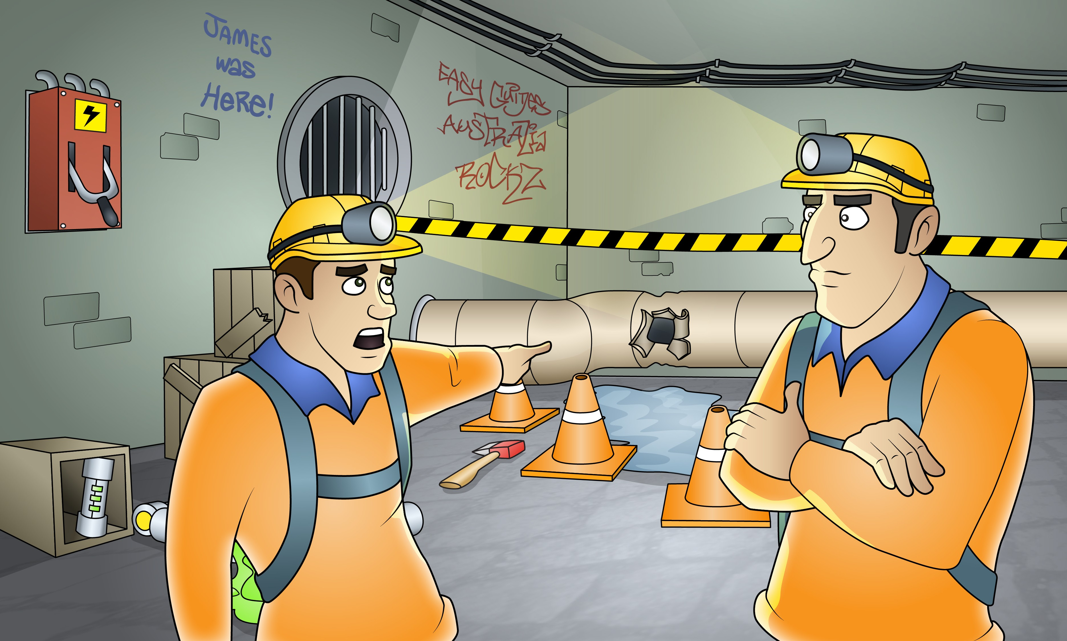
Element 1 -
Identify and assess risks
This element covers the following performance criteria:
Identify, assess and report hazards in the work area to designated personnel.
Report safety risks in the work area based on identified
hazards, to designated personnel.
Follow safe work practices, duty of care requirements and safe work instructions for controlling risks.
Contribute to WHS, hazard, accident or incident reports in accordance with workplace procedures, Australian government and state or territory WHS legislation, and relevant information.

Slide 7
2.1 1.1 Identify, assess and report hazards
PC 1.1 IDENTIFY AND ASSESS RISKS
IDENTIFY OHS LEGISLATIVE REQUIREMENTS
A hazard is anything that can harm you or others while you are working. The first thing you need to do is to identify these hazards before you start work.
Take a good look at your workplace and decide if anything could possibly cause injury to you or anyone else in the area.
Above head height
You should check above eye level for:
Powerlines
Buildings
Trees
Other obstructions
Objects that could fall from height.
Ground to eye height
You should check around eye height for:
Other equipment • Pedestrians
Machinery • Things in the path of travel
People • Other obstructions.
Ground level (and below)
You should check the ground to see:
If the surface is stable and level
If there are spills or wet surfaces
Is there debris/rubbish
Is the surface strong enough to support the weight of any equipment or materials
Are there trenches or recently backfilled trenches
Is the ground unstable.

Slide 8
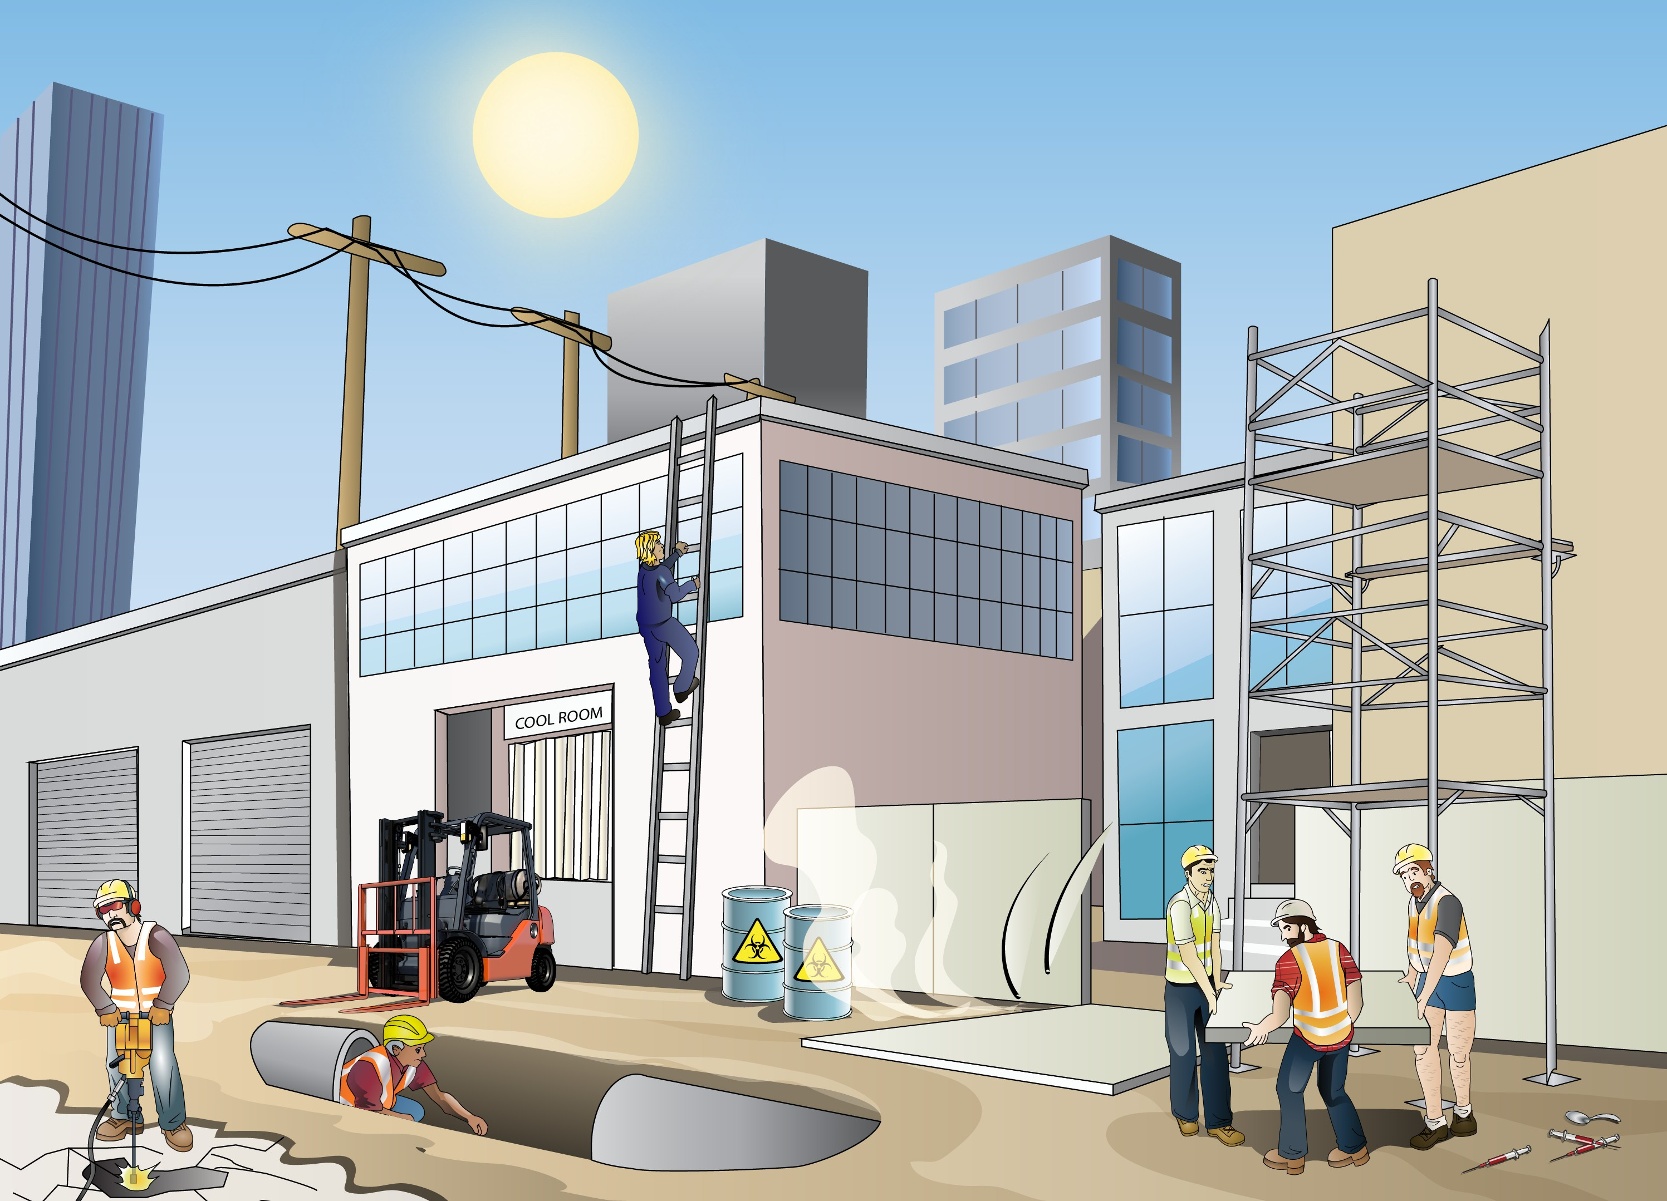
PC 1.1
IDENTIFY OHS LEGISLATIVE REQUIREMENTS
IDENTIFY AND ASSESS RISKS
Common construction hazards
What is a work area hazard?
Construction work is done in lots of different work environments such as on building sites, in confined spaces, in trenches, on rooftops, or inside buildings. These different work environments often have different hazards.
Hot working environment ultraviolet (UV) radiation
Electrical safety
Working at heights
Cold working environment
Unplanned collapse
Traffic and mobile plant
Manual handling
Noise
HIV and other infectious diseases
Plant and equipment
Hazardous substances
and dangerous goods

Slide 9
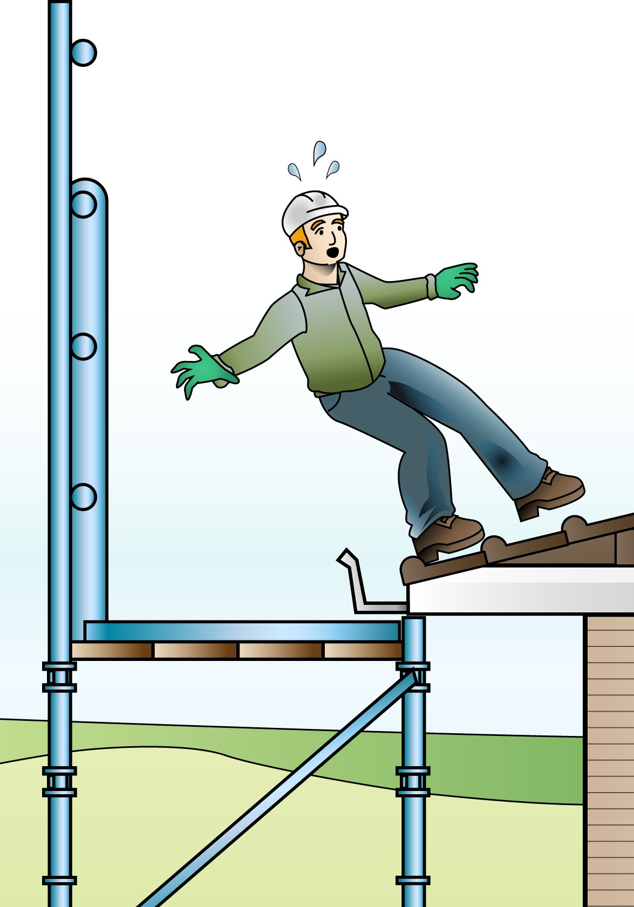
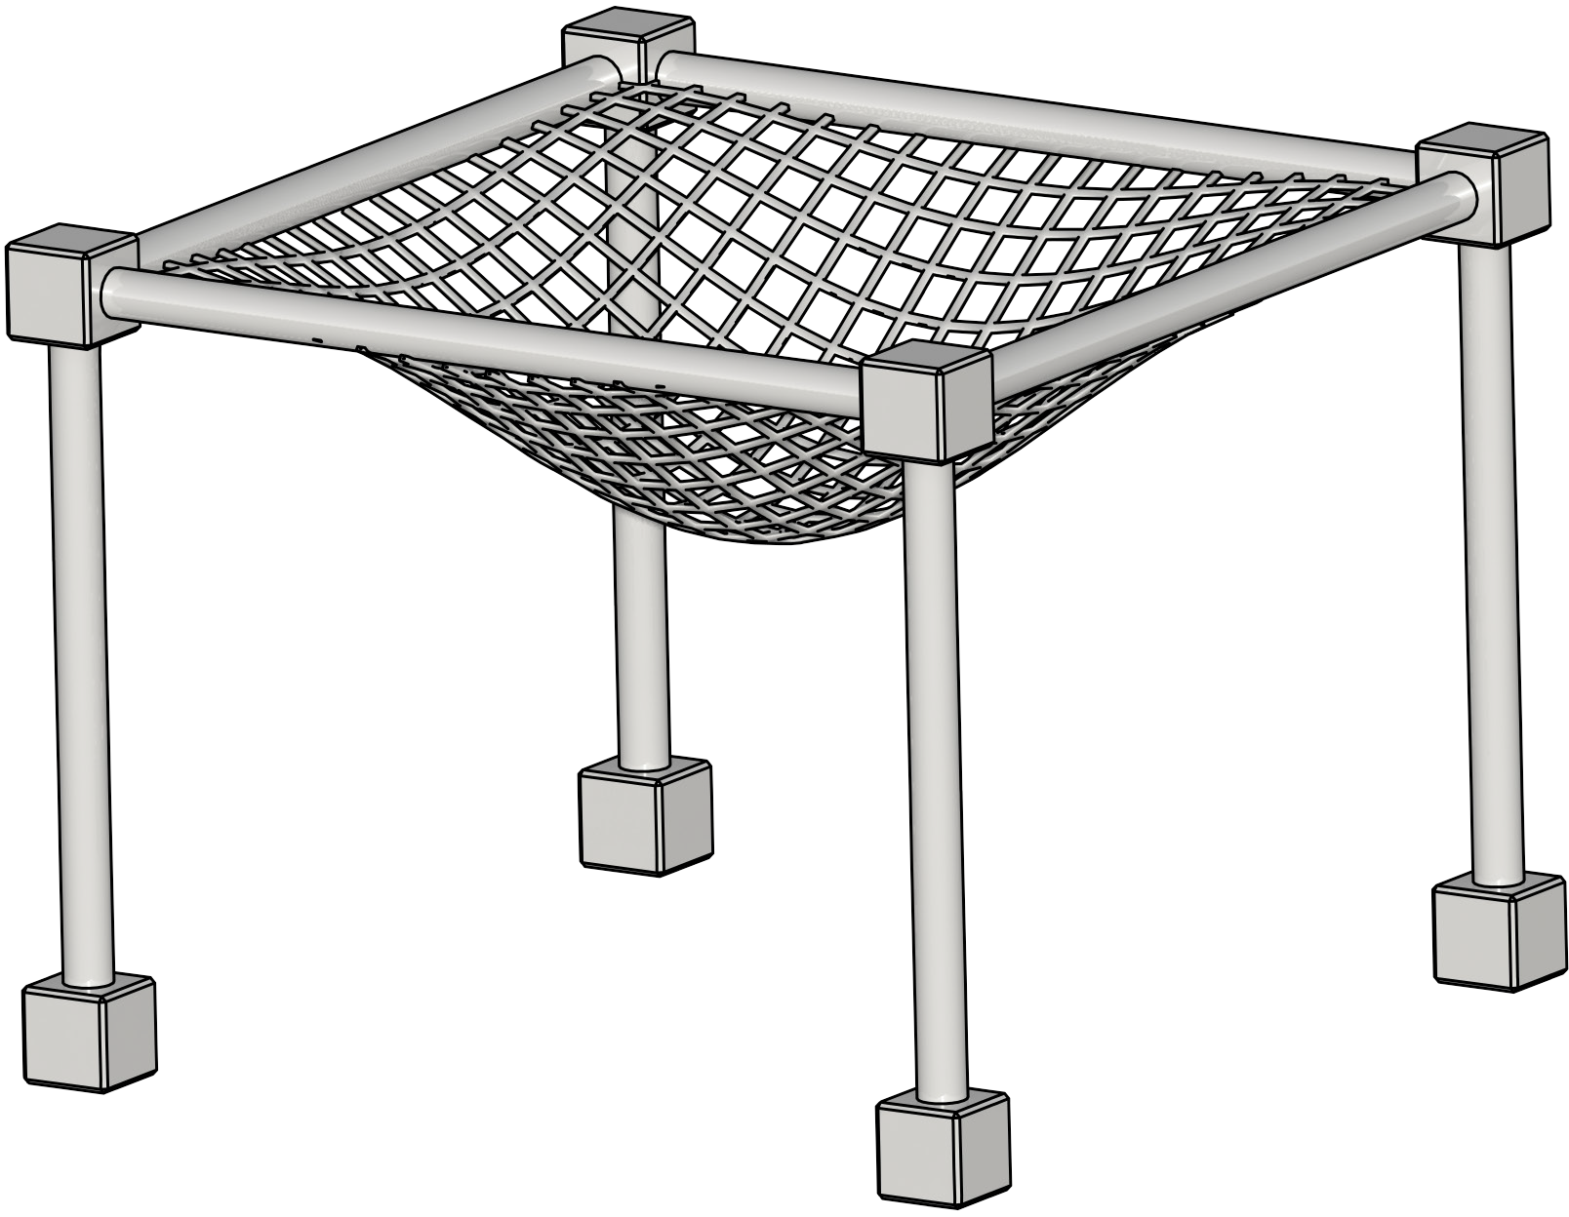
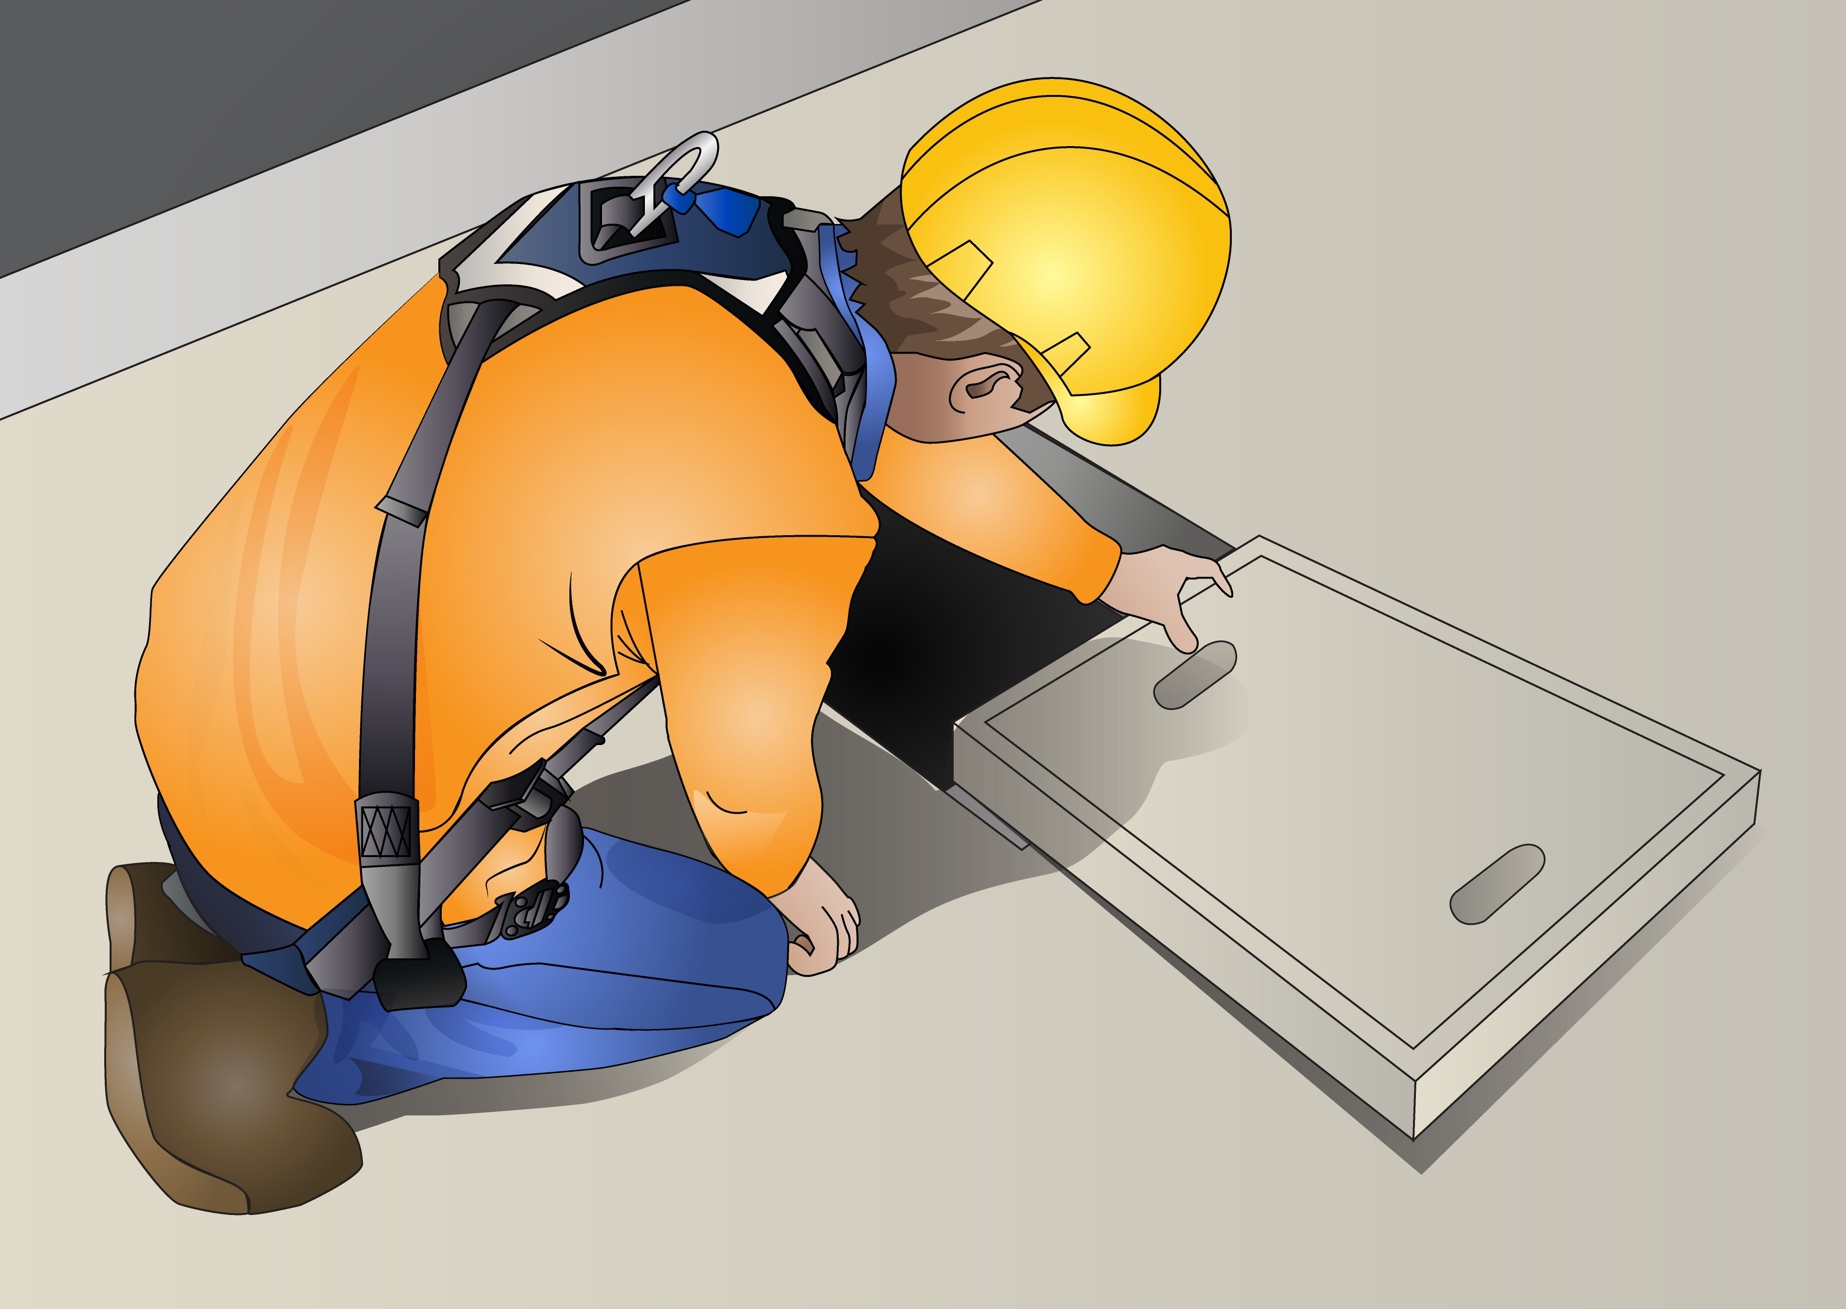
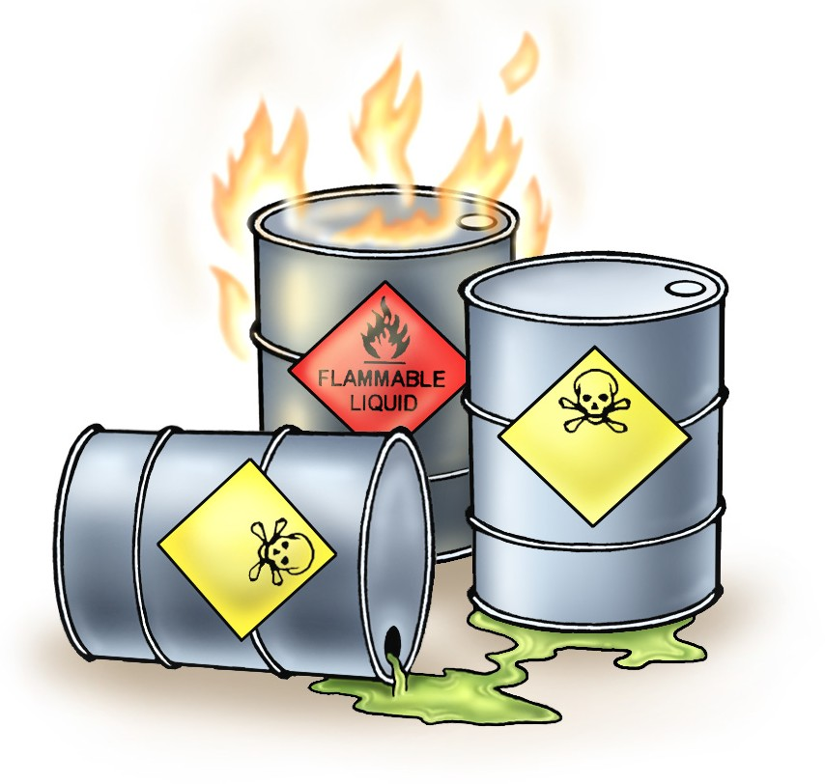
PC 1.1
IDENTIFY AND ASSESS RISKS
IDENTIFY OHS LEGISLATIVE REQUIREMENTS
Common construction hazards (continued)
Confined spaces Working in confined spaces requires special training and permits. Do not work in confined spaces unless you are properly trained. | Working at heights Always make sure you use the right safety equipment.
 | Chemicals Always check the Safety Data Sheet (SDS) before handling any chemicals.

Slide 10
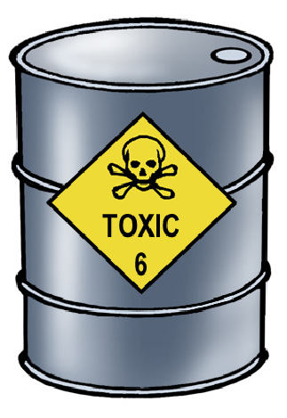
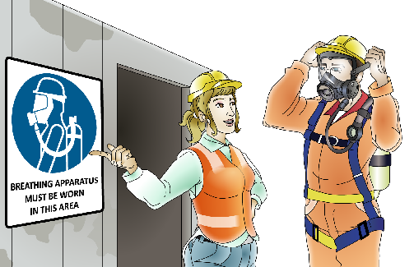
PC 1.1, 1.2
IDENTIFY OHS LEGISLATIVE REQUIREMENTS
IDENTIFY AND ASSESS RISKS
Assess the hazard
Once the hazards have been identified you must learn how to manage them. A risk assessment should be carried out to assess the chance of the hazard causing harm or an injury (the risk). Control measures can then be discussed and put in place.
Hazard
A hazard is any thing or any situation which could injure or harm you.
In other words, it is anything that can hurt you.
Risk
A risk is the chance of a hazard causing injury or harm.
In other words, how likely it is that somebody or something may be harmed by the hazard.
Control
Put controls in place to reduce the risk or eliminate the hazard.

Slide 11
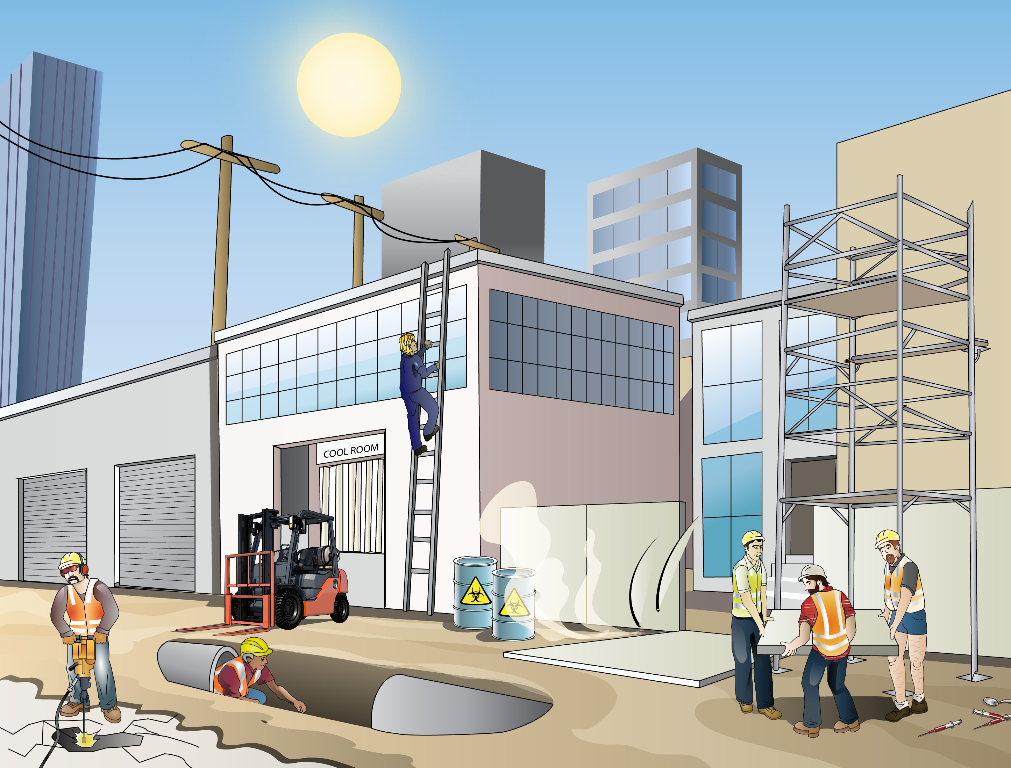
PC 1.2, 1.1
IDENTIFY AND ASSESS RISKS
What is risk management?
Risk management is lowering or removing the risk of a hazard harming you. Risk management is taking action to make sure you are safe.
IDENTIFY OHS LEGISLATIVE REQUIREMENTS
Risk management is made up of the following five steps:
Identify the hazards.
Assess the risk involved.
Talk and report to other workers.
Control the hazards to lower the risk.
Review the action you have taken.
1. Identify the hazards
For example:
Electrical safety
Traffic and mobile plant
Noise
Hazardous substances and dangerous goods
Plant and equipment
Manual handling
Trenches
Hot working environment ultraviolet (UV) radiation
Cold working environment.
The following pages show some examples of documents used to develop a strategy to identify, assess and control risks. The chapter "Risk assessment - putting it all together" shows how to use these documents.

Slide 12
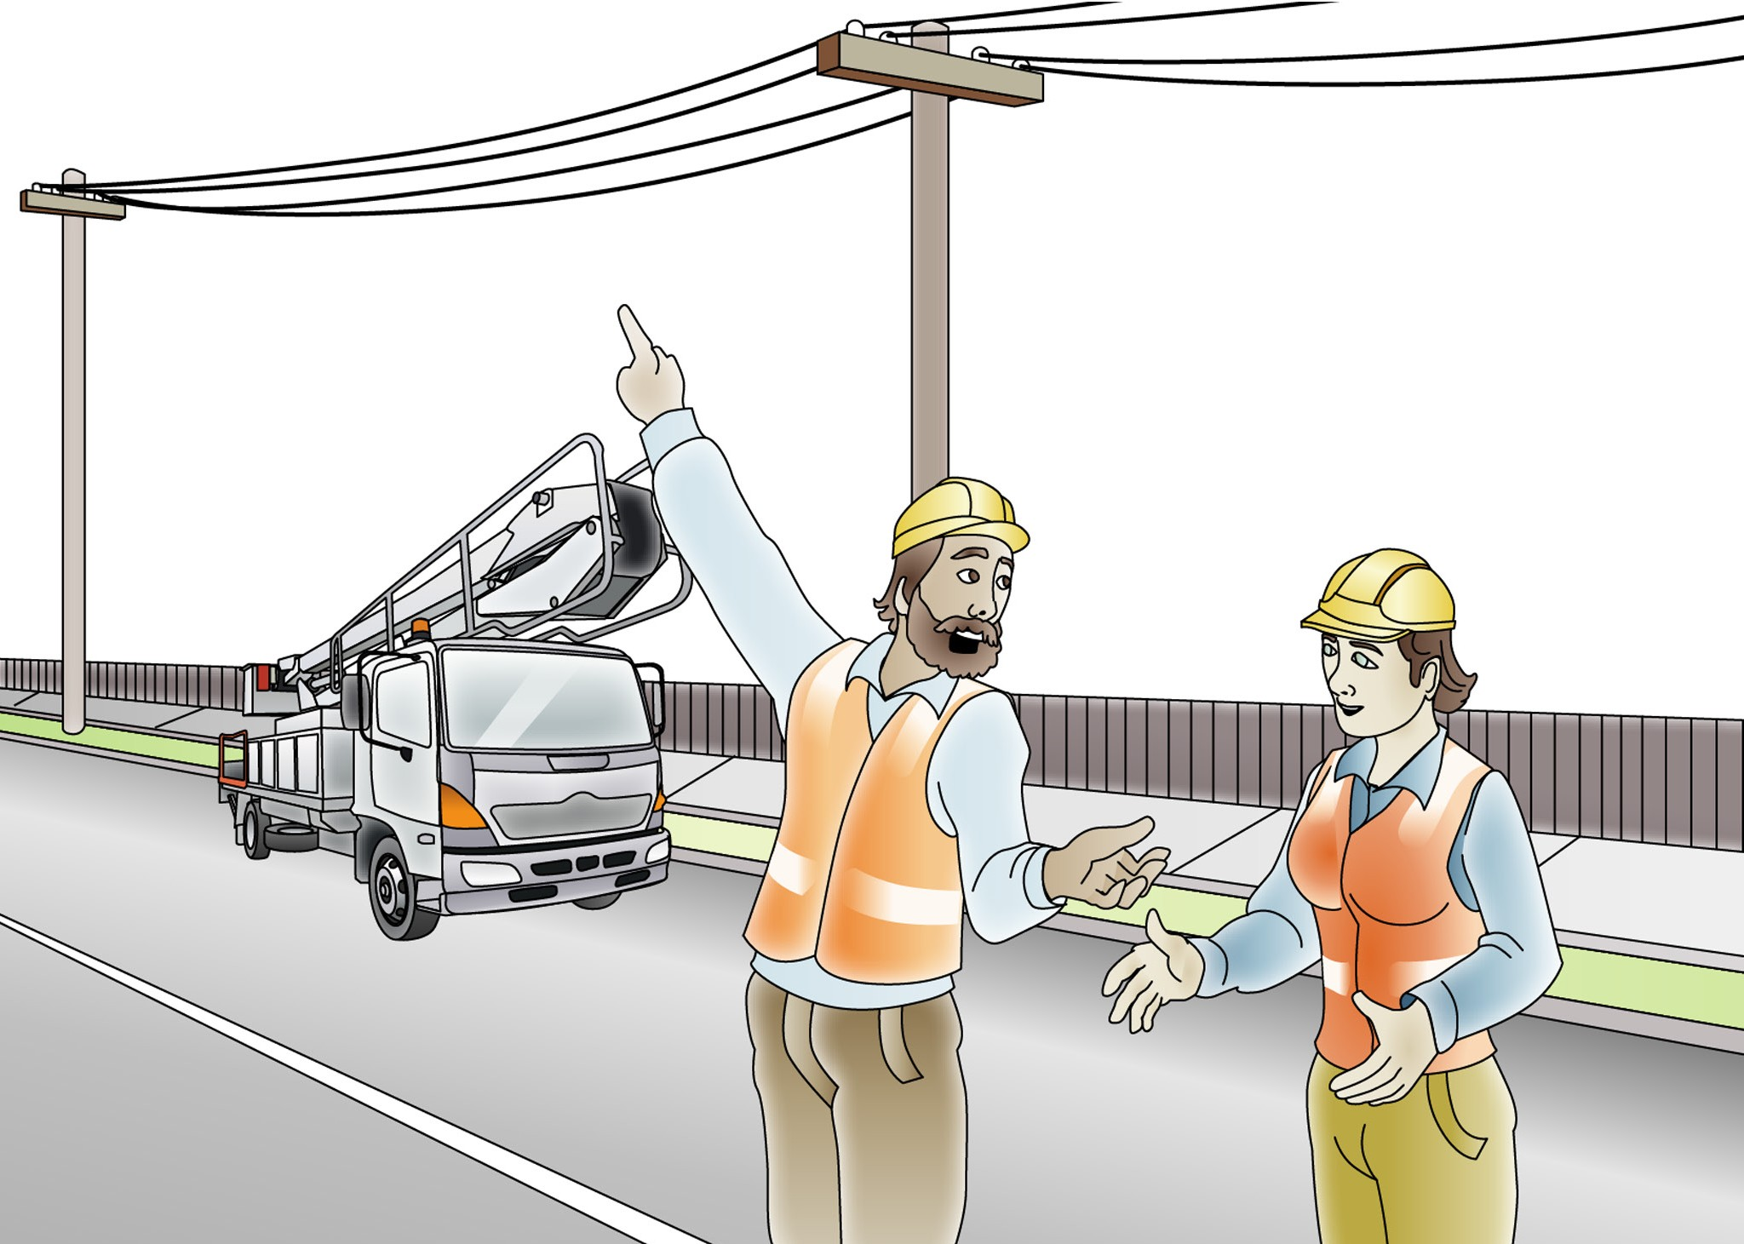
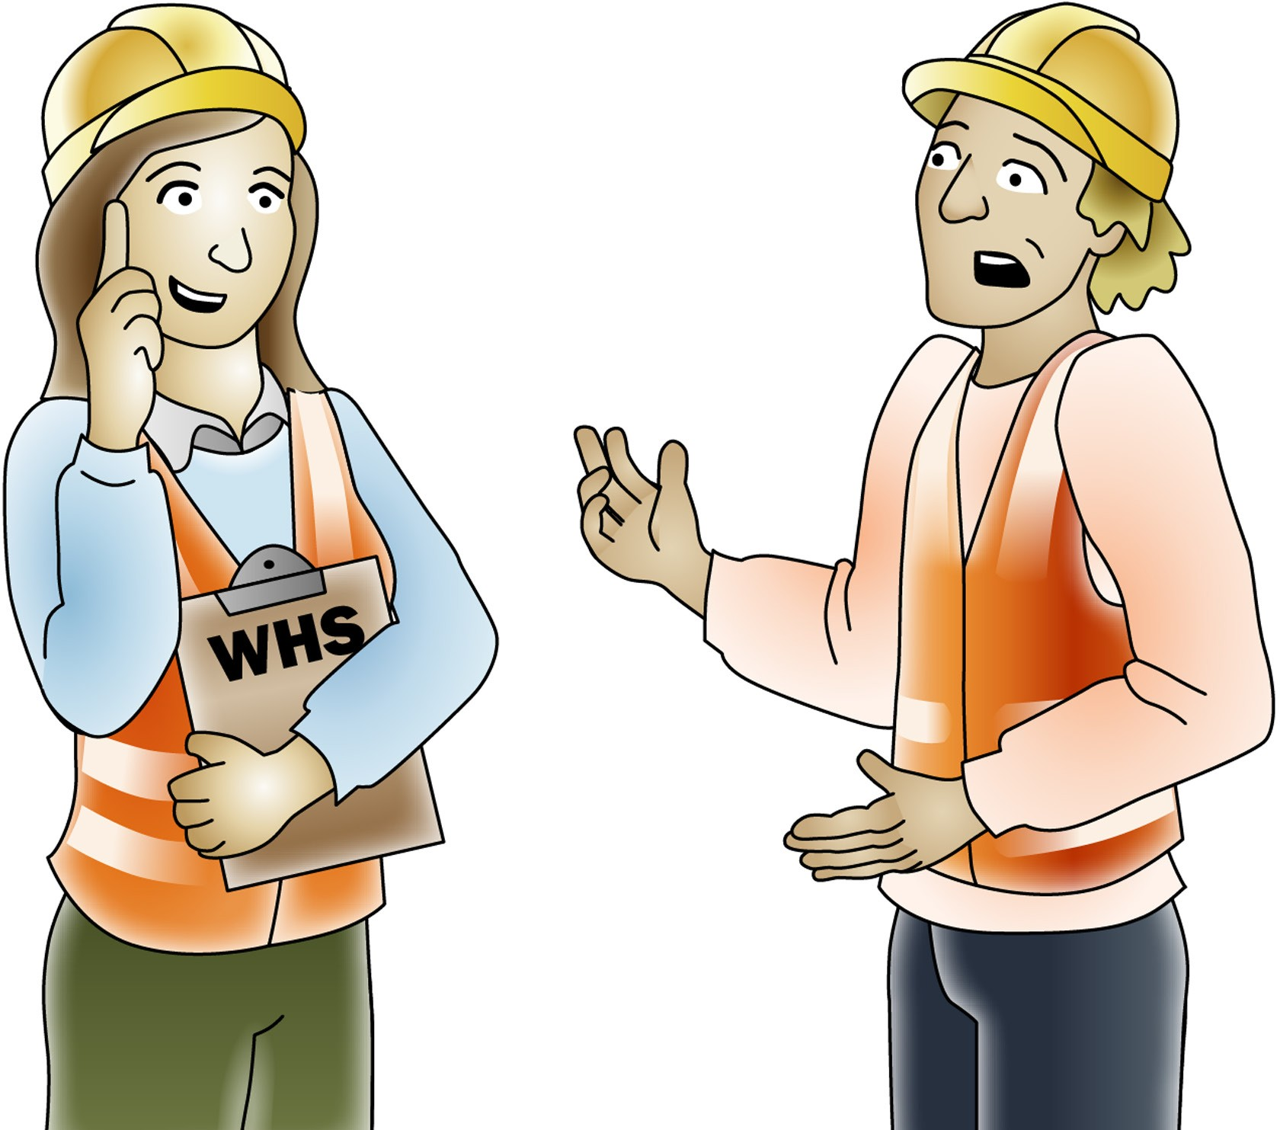
PC 1.2, 1.1
IDENTIFY AND ASSESS RISKS
IDENTIFY OHS LEGISLATIVE REQUIREMENTS
Risk management is made up of five steps (continued)
3. Talk and report to other workers
The hazard control measures you are planning to put into place may have an effect on the way other workers operate or the order of jobs being done.
Make sure you talk to any workers who may be affected.
Talk to your supervisor and WHS/OHS officer
or representative.
This is called consultation.

Slide 13
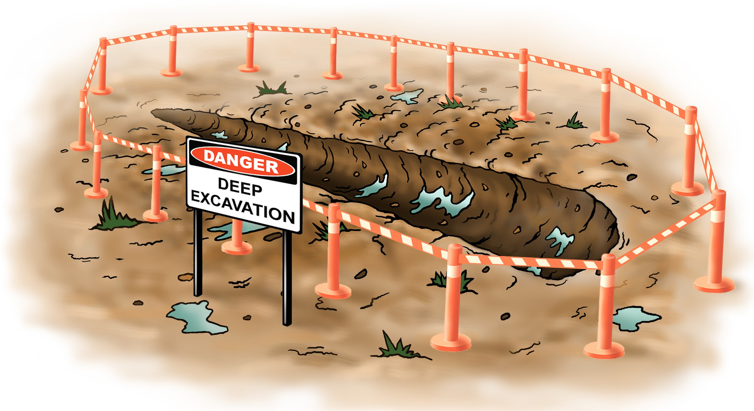
PC 1.2, 1.1
IDENTIFY OHS LEGISLATIVE REQUIREMENTS
IDENTIFY AND ASSESS RISKS
Risk management is made up of five steps (continued)
4. Control the hazards to lower the risk
5. Review the action you have taken
You use hazard controls to manage the risks caused by hazards.
For example:
Isolation of a trench –
This means putting up a fence around the hazard (the trench) to lower the risk of damage or harm.
Are control measures in place? | □ Yes | □
Why not?
No
Are controls preventing or minimising the risk? | □ Yes | □
Why not?
No
Are there any new problems with the risk? | □ Yes | □
What are they?
No

Slide 14
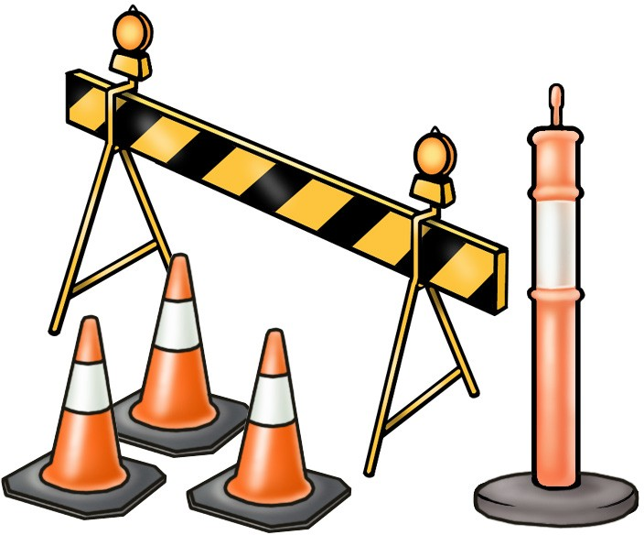
PC 1.2, 1.1
IDENTIFY AND ASSESS RISKS
IDENTIFY OHS LEGISLATIVE REQUIREMENTS
Assess the risk (risk assessment) — (continued)
Frequency
When assessing risk the frequency of the task also needs to be considered.
For example:
If the exposure to the risk is constant (all the time) a control measure must be permanently in place.
A control measure should be put in place and remain there for the duration of the exposure if the task is done:
Daily
Frequently
Weekly
Infrequently
Occasionally.

Slide 15
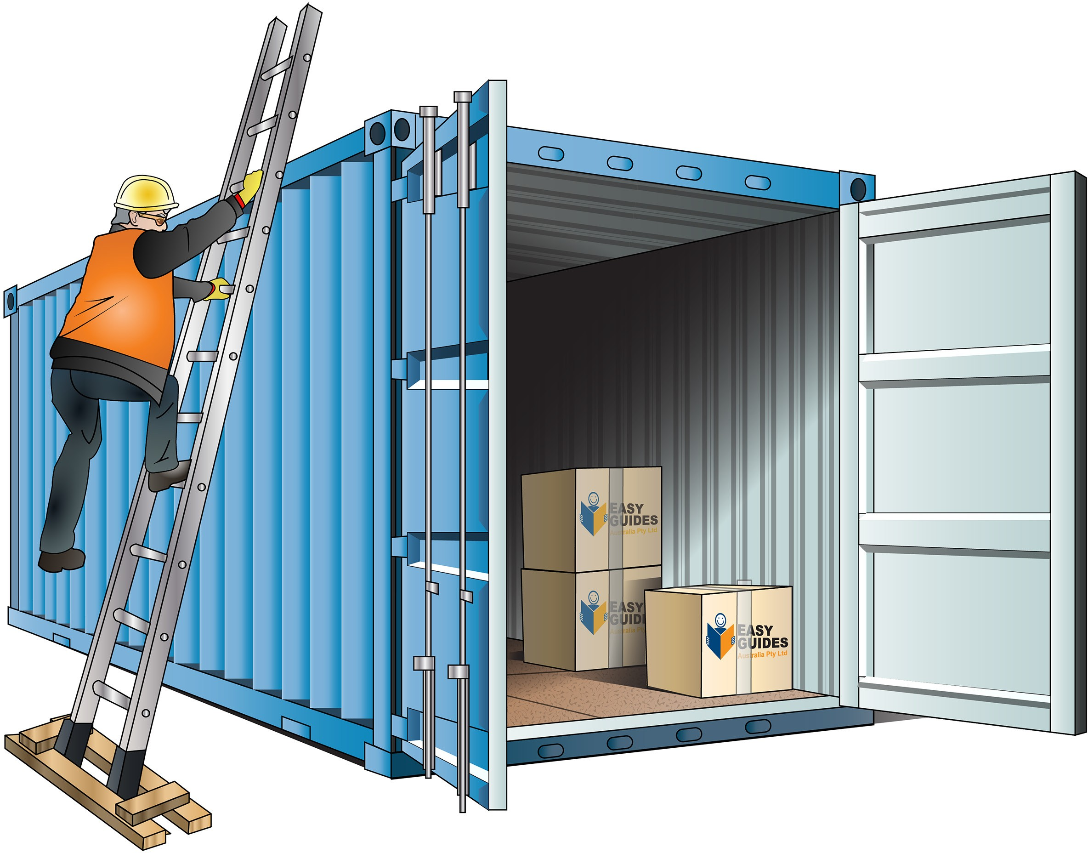
PC 1.2, 1.1
IDENTIFY OHS LEGISLATIVE REQUIREMENTS
IDENTIFY AND ASSESS RISKS
Risk assessment — putting it all together
The form represented in the following pages will help you decide how serious a risk is to you or other people. Use the form to decide if you need to do anything about the risk.
This form is an example of a risk assessment and control form. You can use it at your workplace to help with risk management. You can find out more about risk management in the Queensland Workplace Health and Safety codes of practice.
The following tables and form will show you how to do a risk assessment for the following workplace activity.
Workplace activity — Risk assessment
You need to access the top of a high load to attach lifting gear
The anchor point cannot be reached from ground level
The current process is to climb the load and attach the lifting gear
The current controls in place include using a ladder to access the top of the load and the dogger wears a hard hat and gloves.
The following Steps 1 to 5 give a guide to information needed for a risk assessment.
There are many different forms and tables used in industries but the process is always similar.
Lifting points

Slide 16
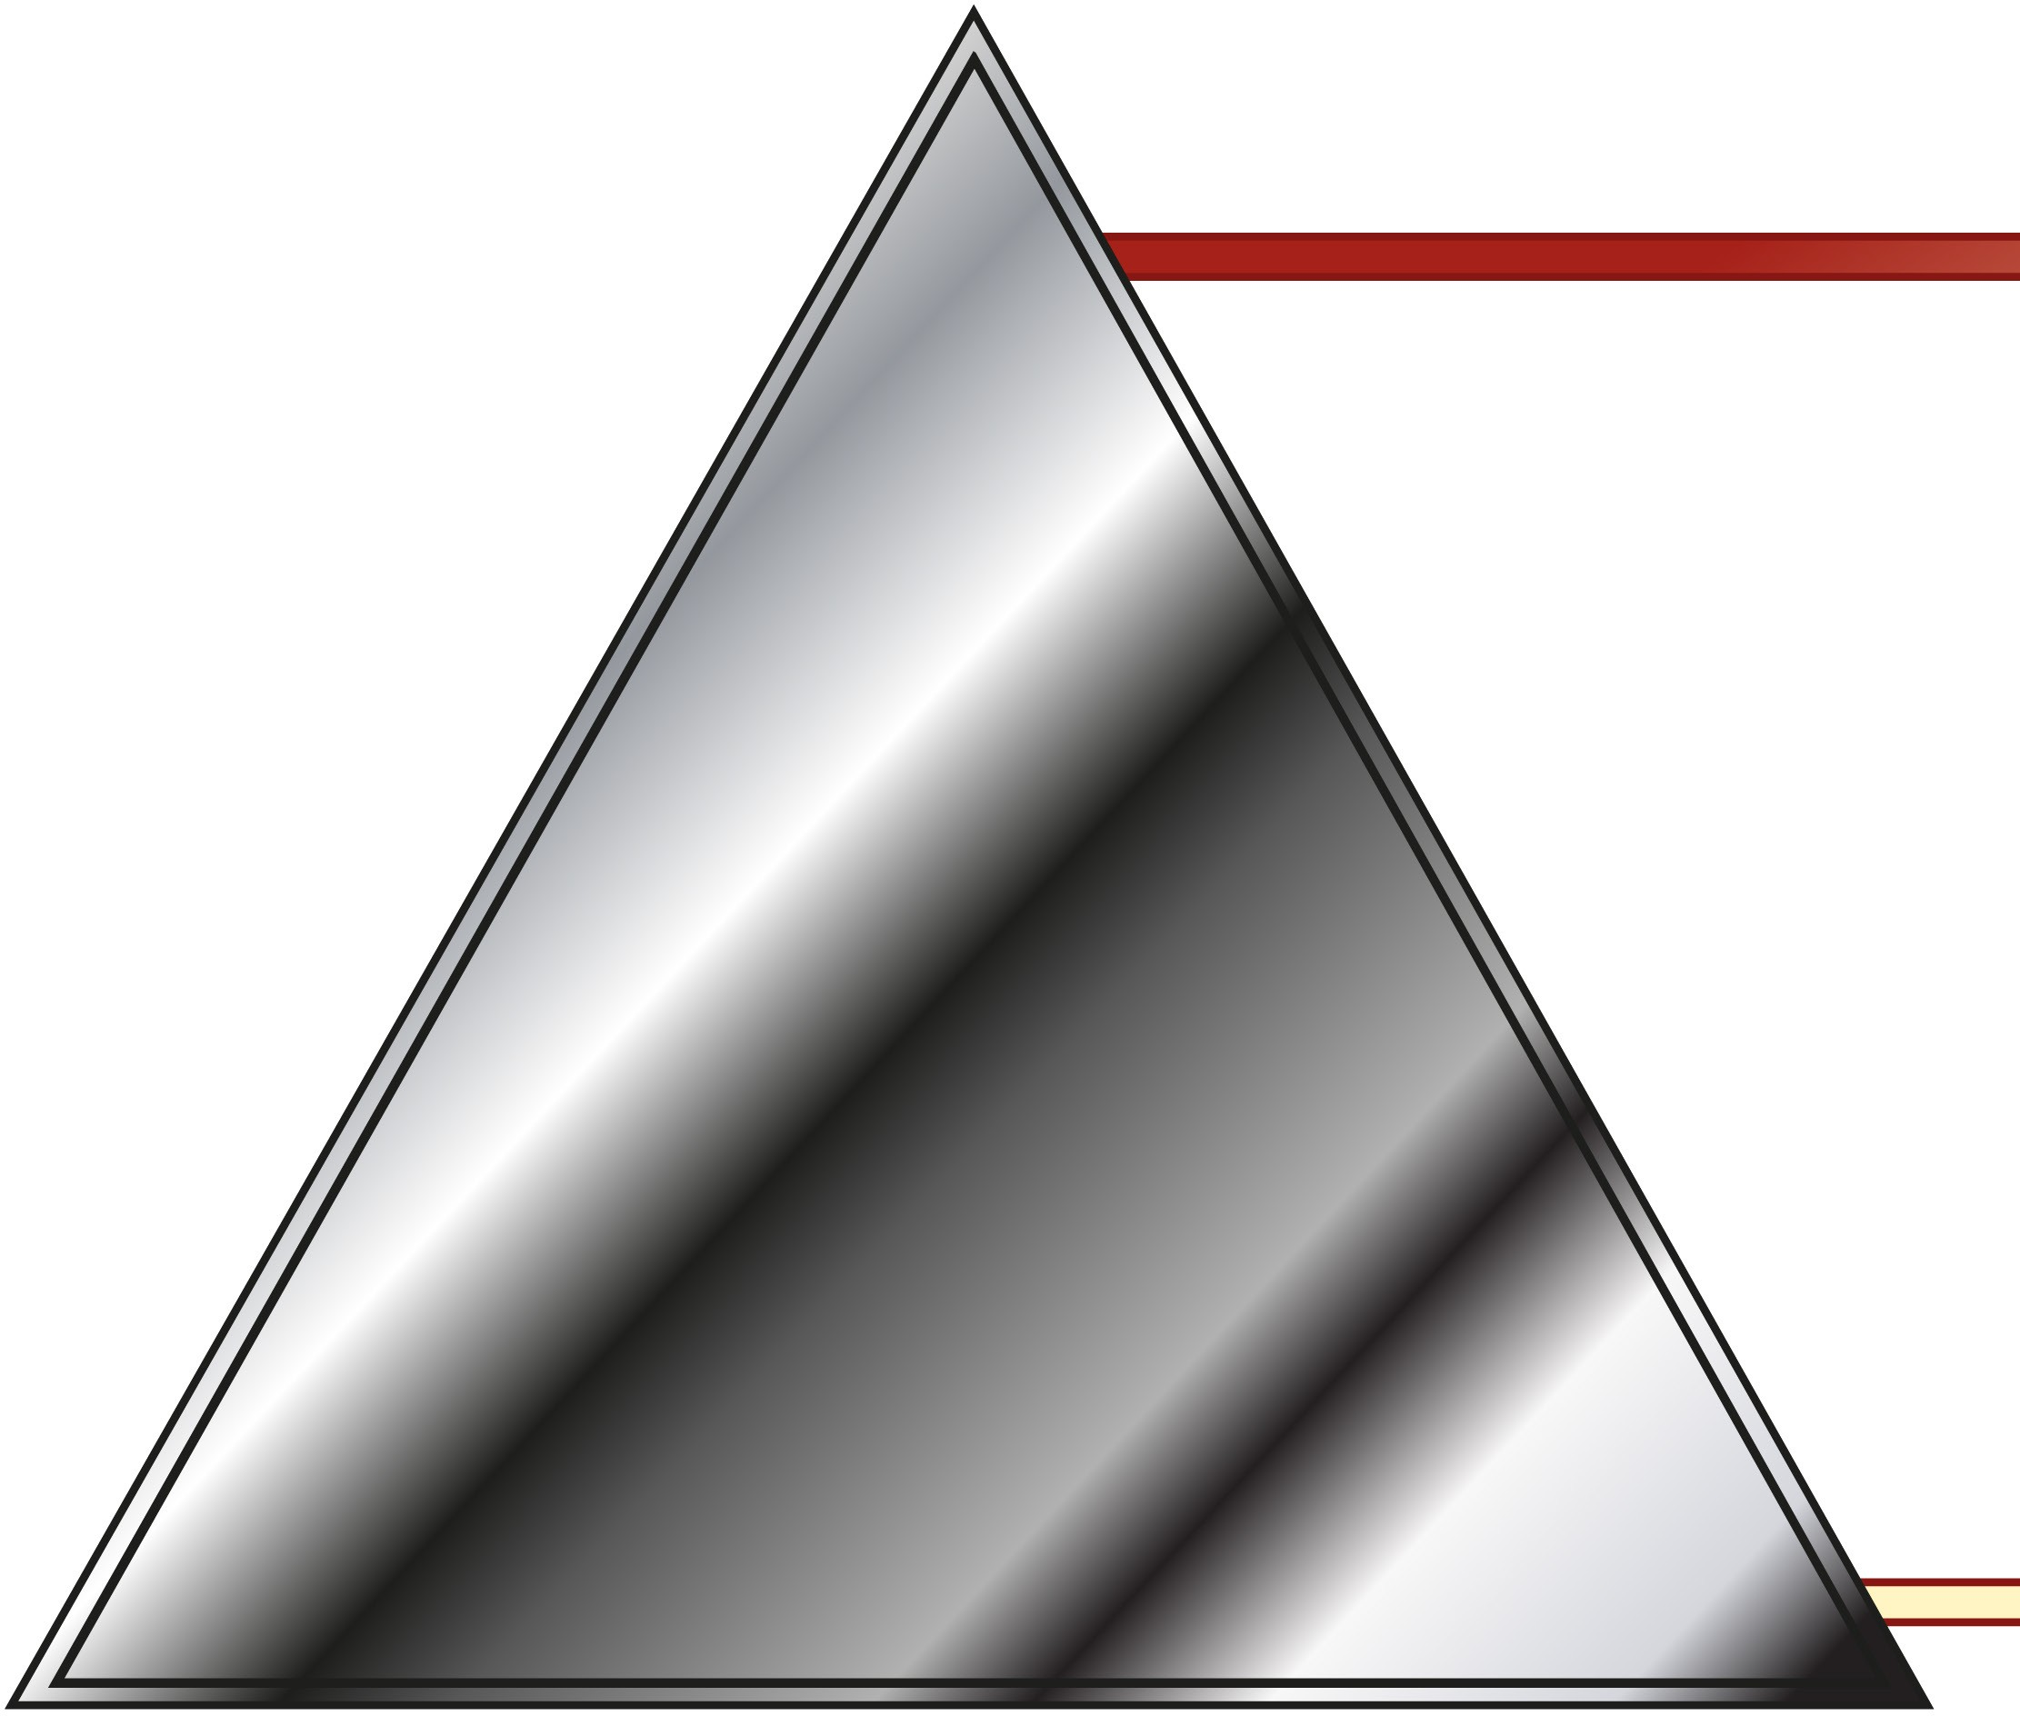
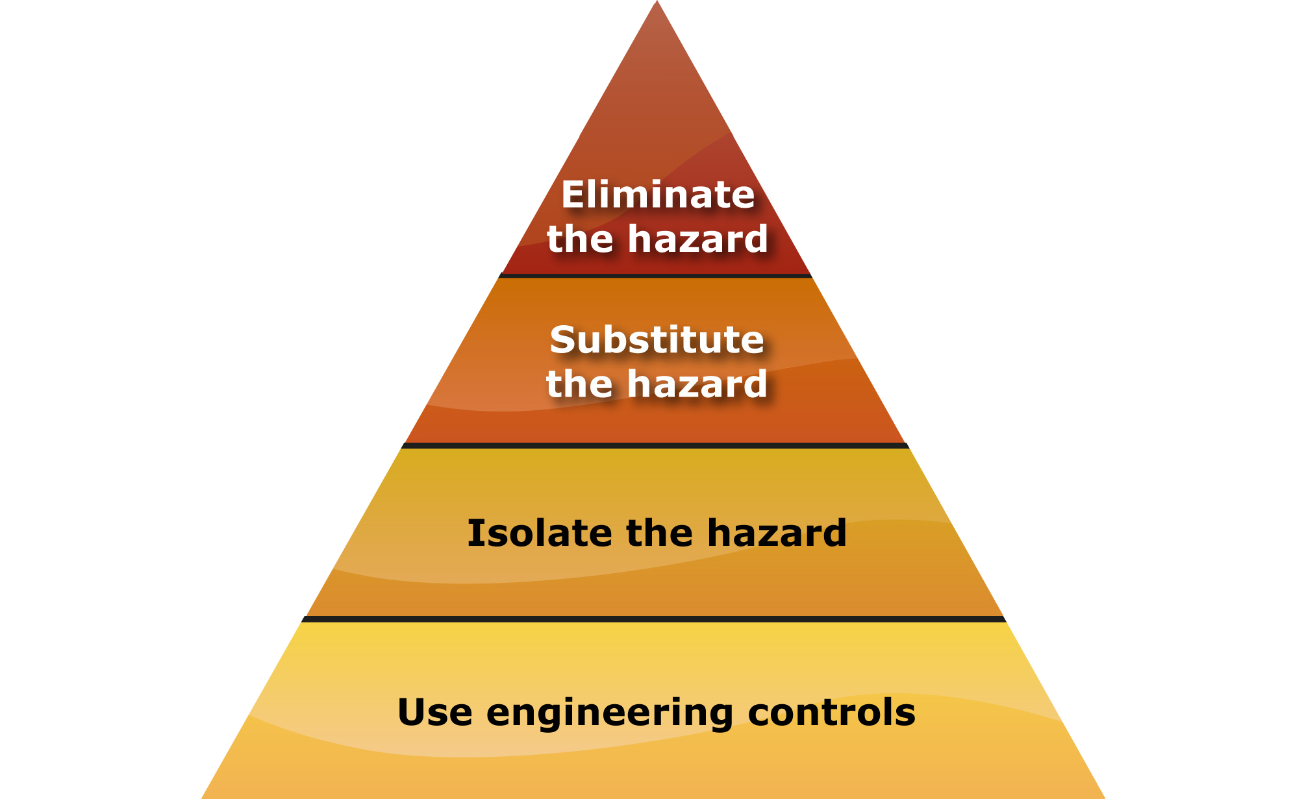
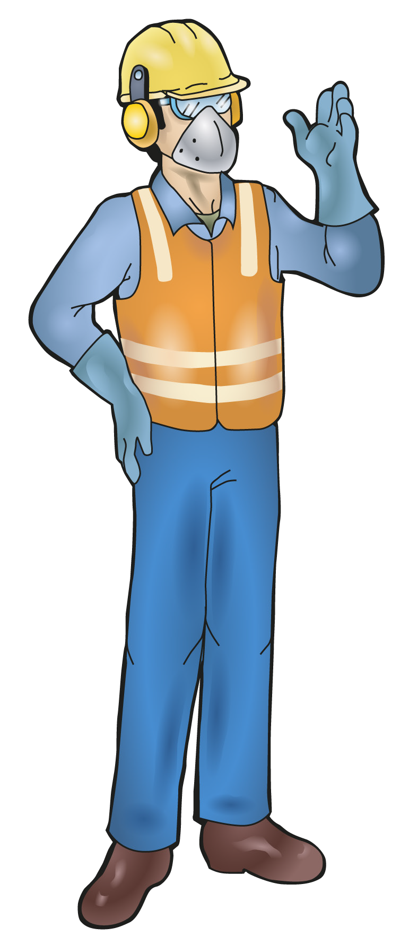
PC 1.2, 1.1
IDENTIFY OHS LEGISLATIVE REQUIREMENTS
IDENTIFY AND ASSESS RISKS
The Hierarchy of Hazard Control
The Hierarchy of Hazard Control is a list of controls that you can use to eliminate or lower the danger from a hazard in the
workplace. There are the six (6) levels in the hierarchy from the first choice to the last choice.
Elimination:
If possible, remove (take away) the hazard.
Substitution:
Use a safer method if you can’t remove the hazard.
Isolation:
Stop access to the hazardous (dangerous) area.
Engineering control measures:
Change the tools, equipment or environment to make it safer.
5. Administrative practices:
Reduce the time the worker is exposed to the hazards by using training, job rotation, the timing of jobs, etc.
6. Personal Protective Equipment (PPE):
Use PPE as your last line of defence.
Memory aid: Every Saturday I Eat A Pie

Slide 17
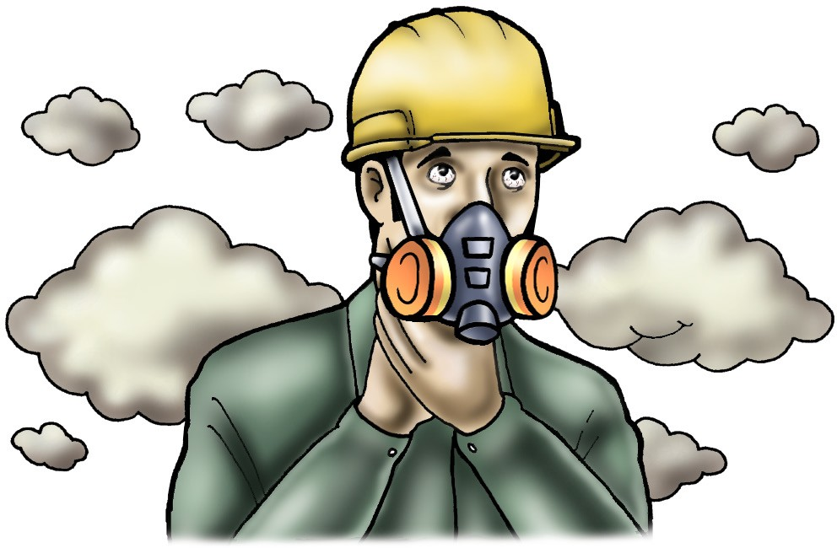
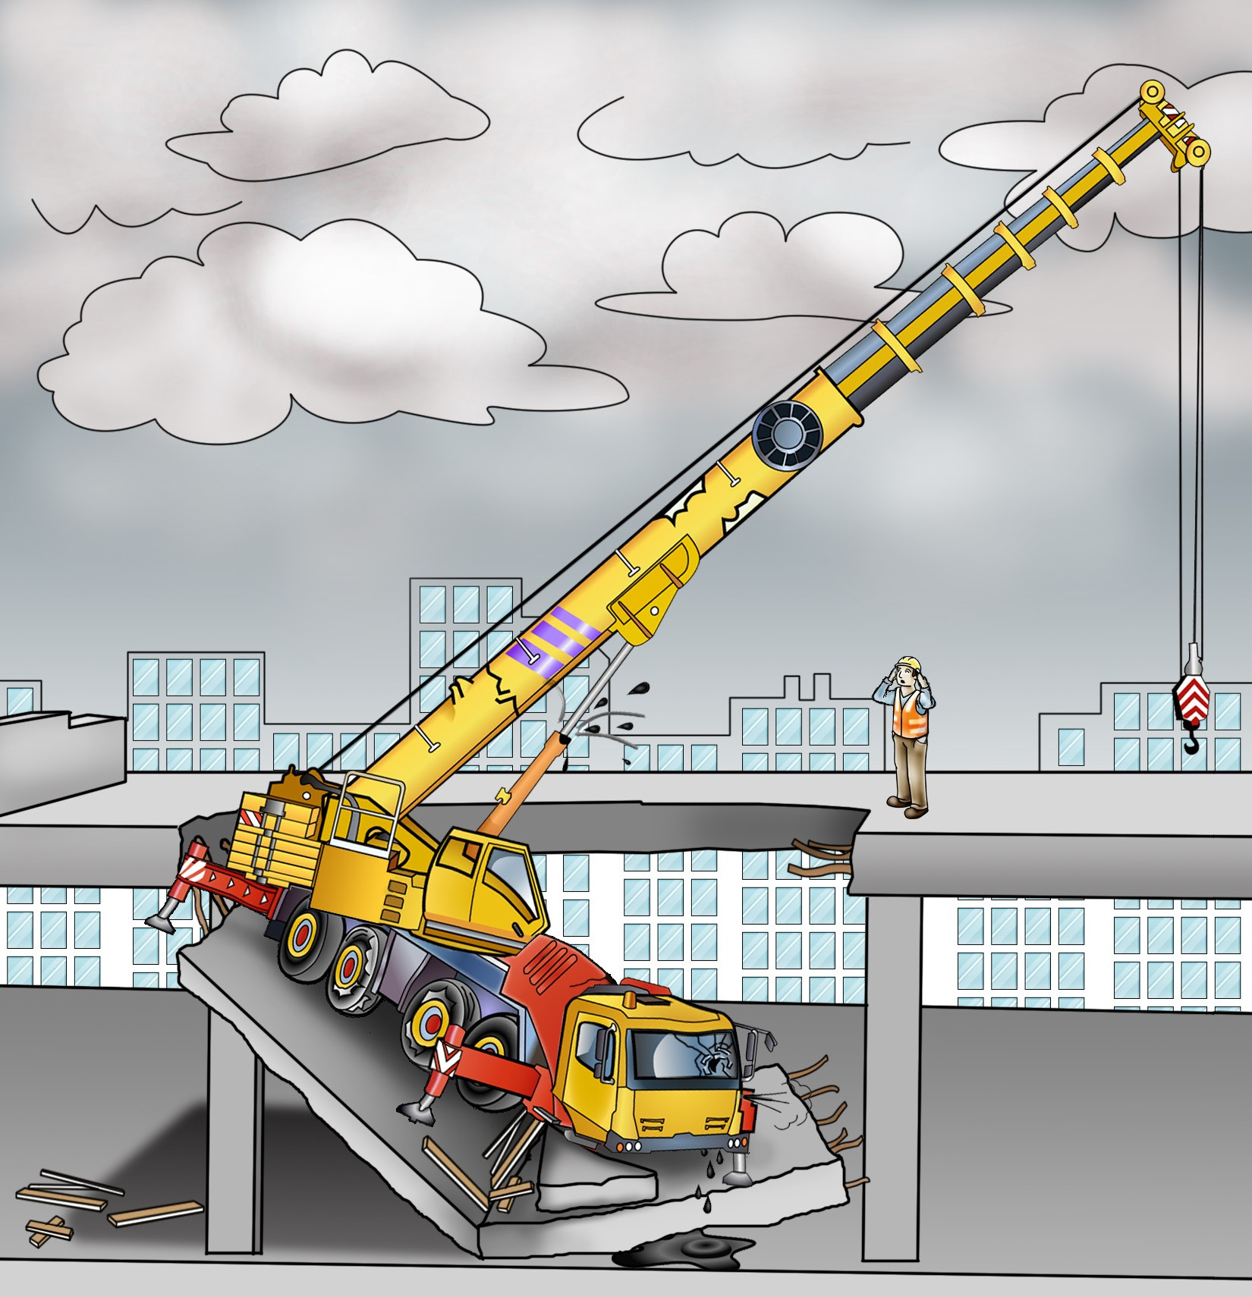
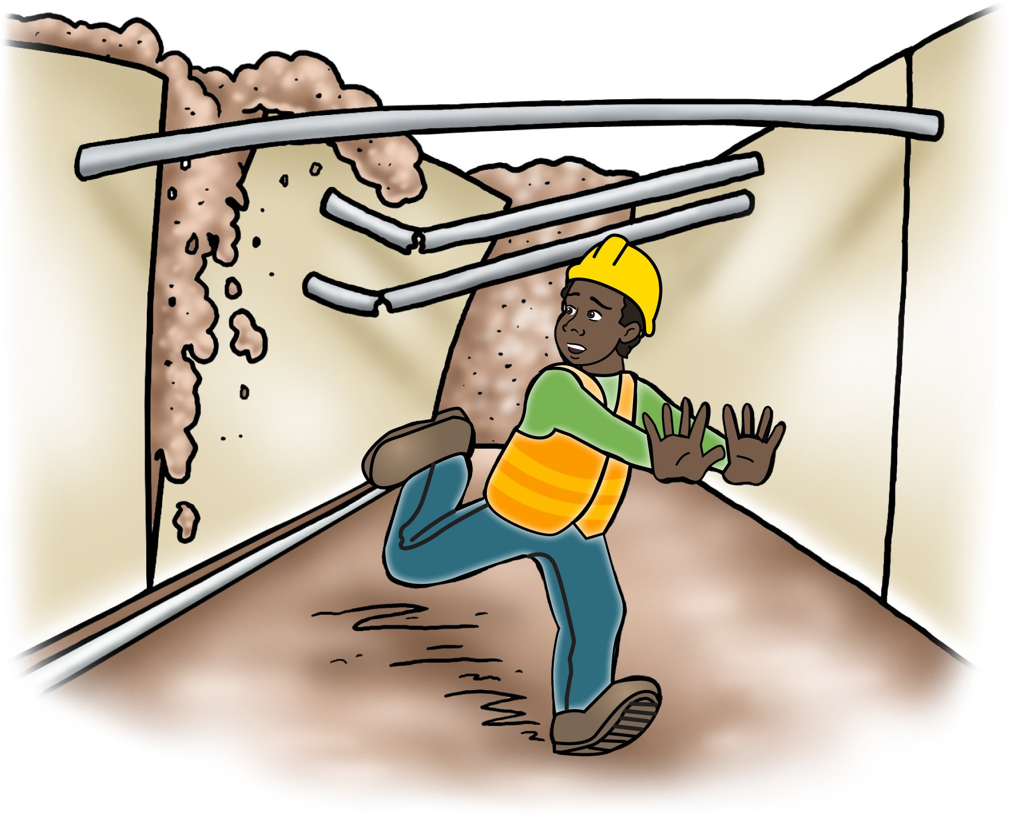
PC 1.4
IDENTIFY OHS LEGISLATIVE REQUIREMENTS
IDENTIFY AND ASSESS RISKS
Dangerous occurrences and near misses
Even if an accident is avoided you should still complete a report to raise any concerns and look at why the event occurred at all. All near misses should be reported so that action can be taken to prevent any possible accident in the future.
Shown here are some examples of incidents.
Breathing apparatus malfunctioning to the extent that the user’s health is in danger. | Collapse of the floor, wall or ceiling of a building being used as a workplace.
Collapse or failure of an excavation more than 1.5 metre deep.

Slide 18
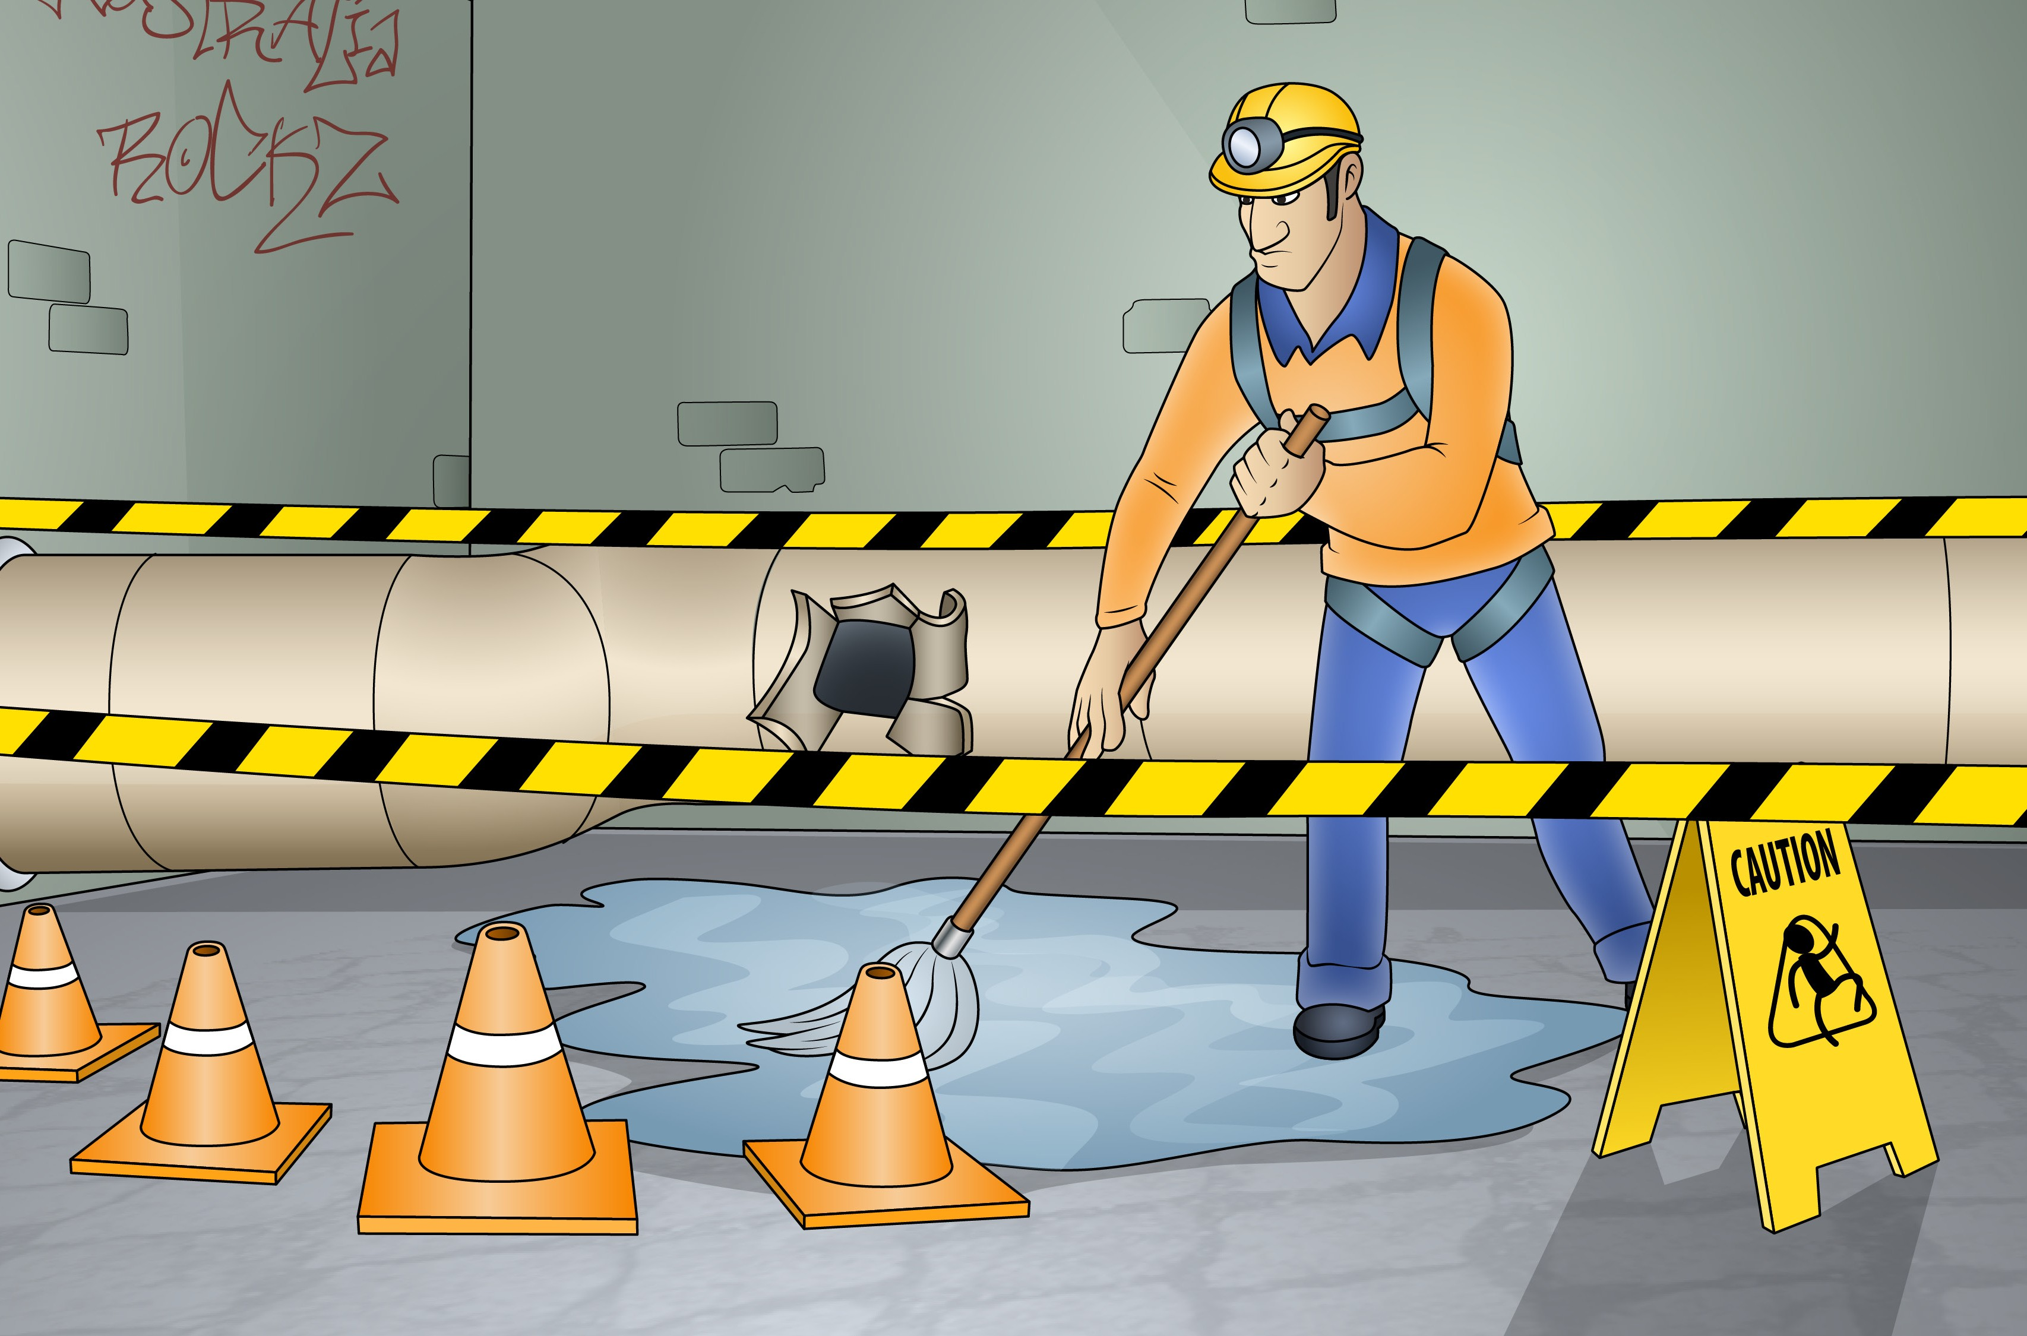
Element 2 - Identify hazardous materials and other hazards on work sites
This element covers the following performance criteria:
2.1 Correctly identify and, if appropriate, handle and use hazardous materials on a work site in accordance with legislative requirements, and workplace policies and procedures.
Apply measures for controlling risks and construction hazards
effectively and immediately.
Use appropriate signs and symbols to secure hazardous materials that have safety implications for self and other workers, immediately they are identified.
Identify asbestos-containing materials on a work site and report to designated personnel.

Slide 19
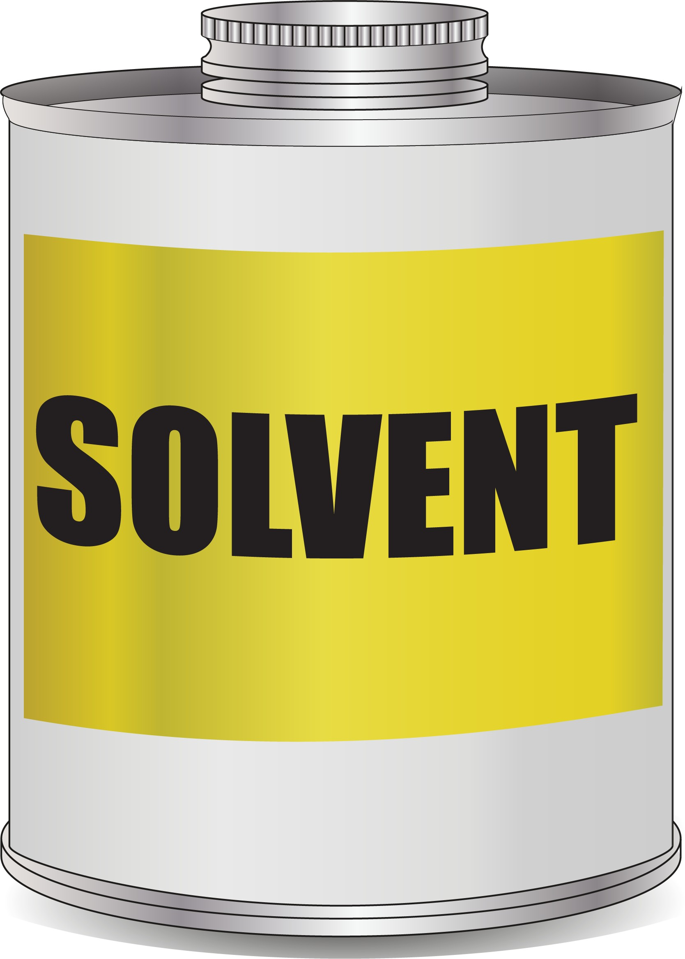
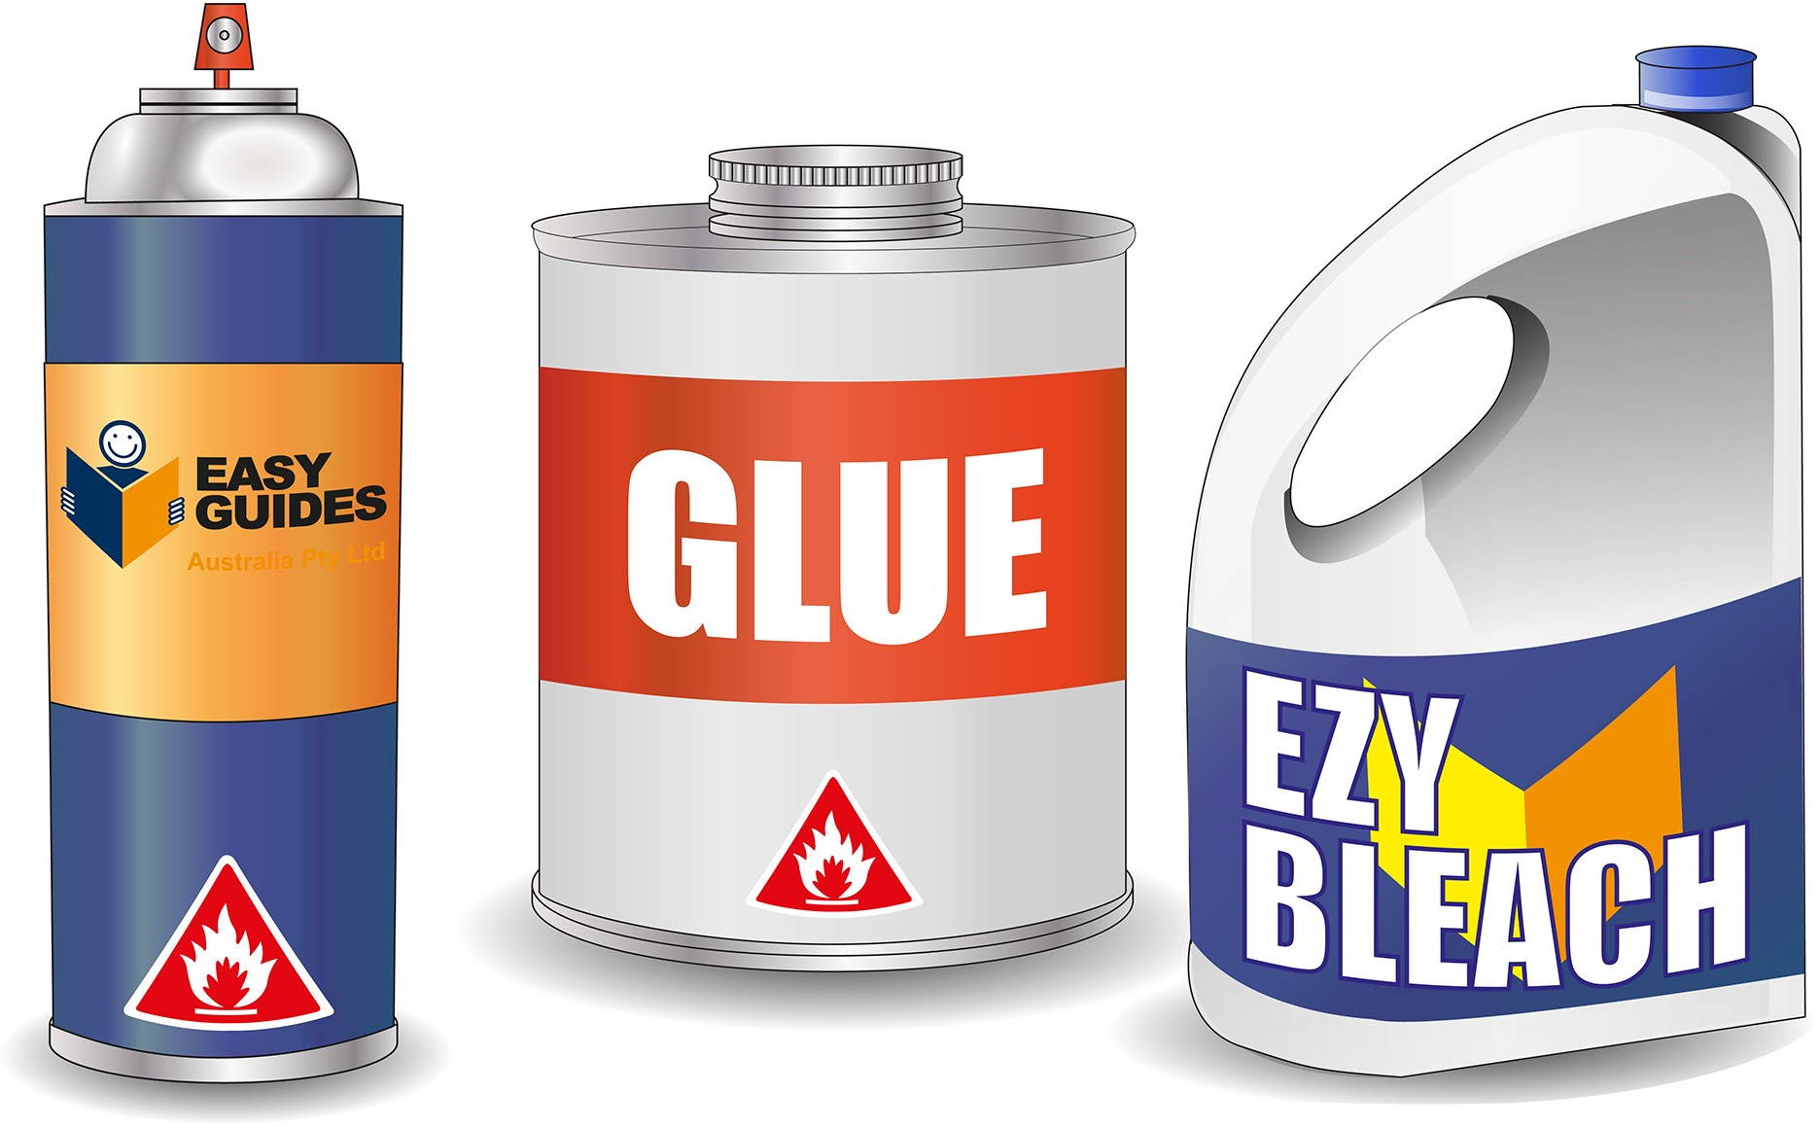
PC 2.1
IDENTIFY CONSTRUCTION HAZARDS AND CONTROL MEASURES
IDENTIFY HAZARDOUS MATERIALS AND OTHER HAZARDS ON WORK SITES
2.1 2.1 Identify hazardous materials
Construction worksites often contain materials that can harm you or others. Some hazardous materials commonly found on construction sites include:
Asbestos containing materials (ACM) - anything which contains asbestos. | Insulation materials | Solvents
Glues and cleaning chemicals | Treated timber products

Slide 20
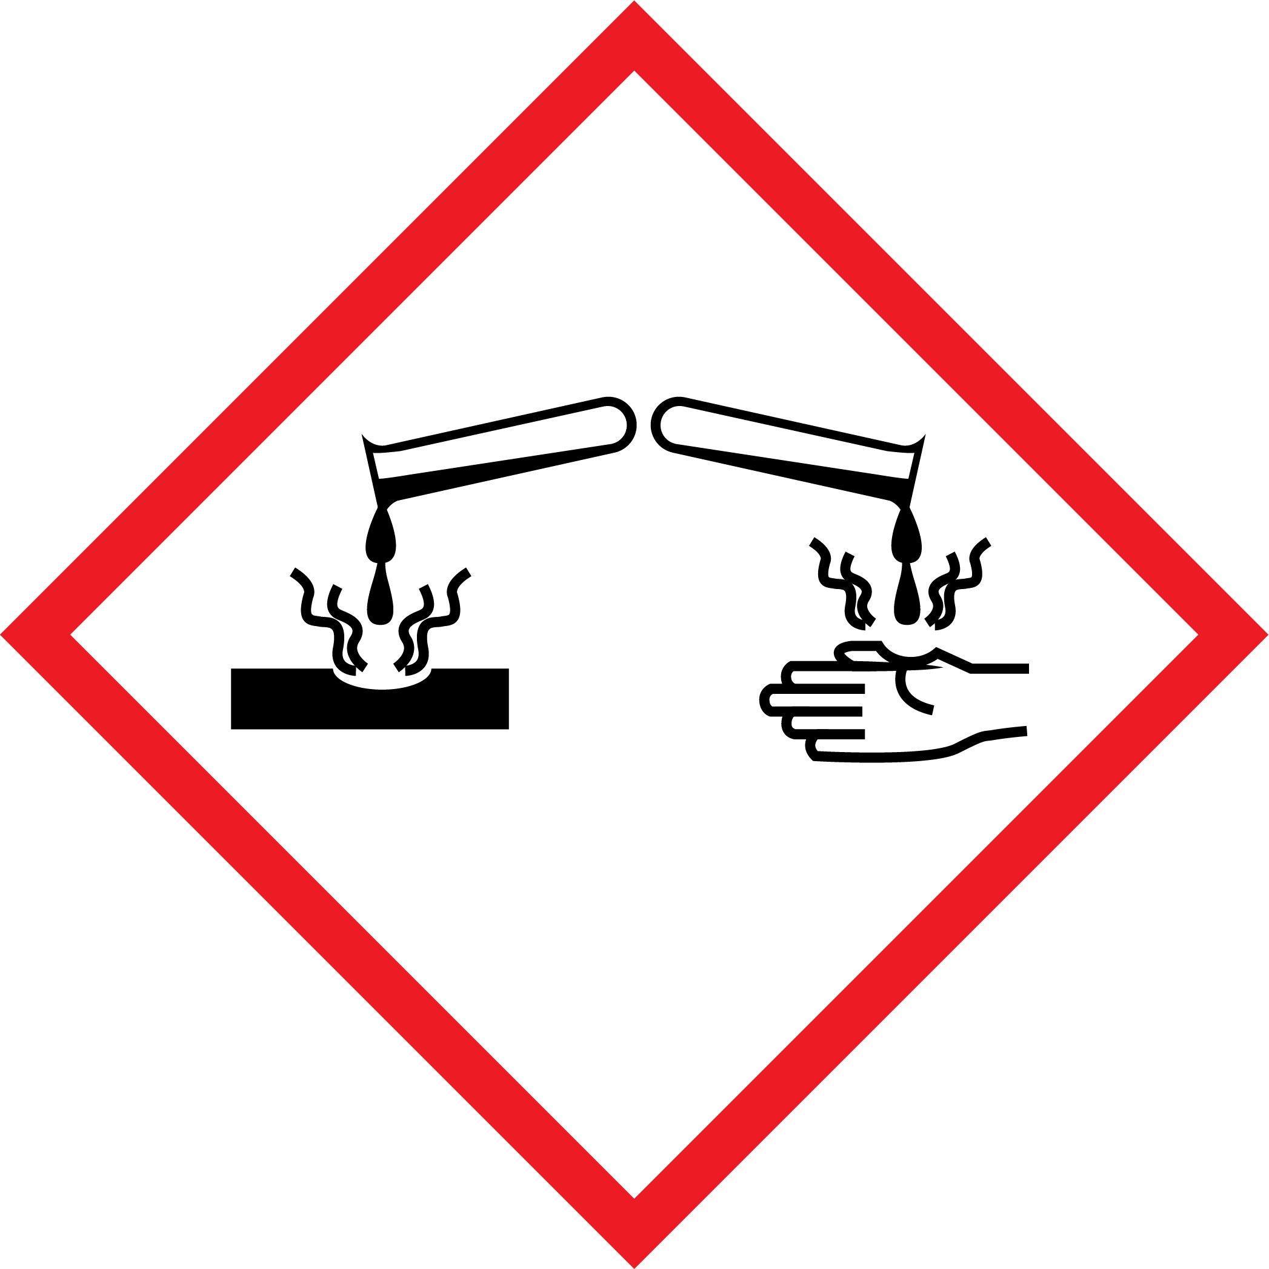
PC 2.1
IDENTIFY CONSTRUCTION HAZARDS AND CONTROL MEASURES
IDENTIFY HAZARDOUS MATERIALS AND OTHER HAZARDS ON WORK SITES
Identify hazardous materials (continued)
Hazardous chemicals and materials can usually be identified by looking at labels and Safety Data Sheets (SDS).
This information can tell you what is in the chemical or material that makes it hazardous.
Labels can have information on them like DANGER or WARNING or may have words that describe how a
chemical or material may affect you, for example:
May cause respiratory irritation (breathing problems)
May cause cancer
Fatal if inhaled
Flammable liquid and vapour
Causes severe skin burns and eye damage.
Symbols are also used so you can quickly identify them:
Flammability | Acute toxicity | Certain health hazards
Chronic health hazard | Corrosive | Explosive
Oxidising | Gases under pressure | Environmental hazard

Slide 21
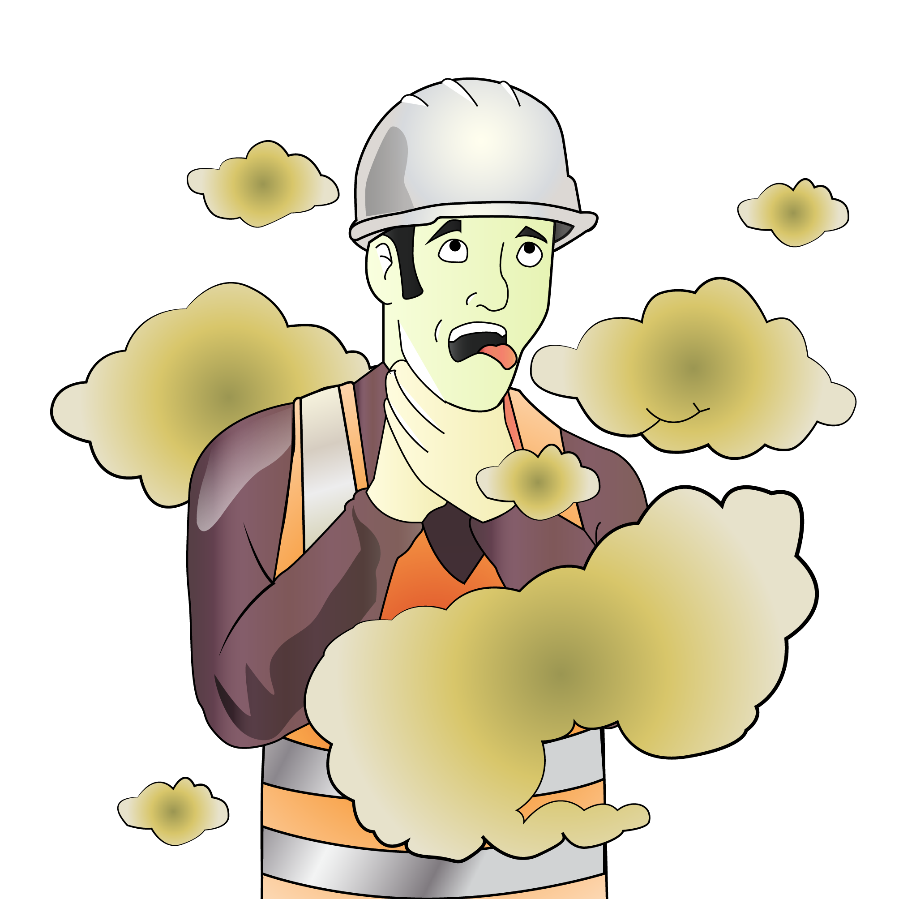
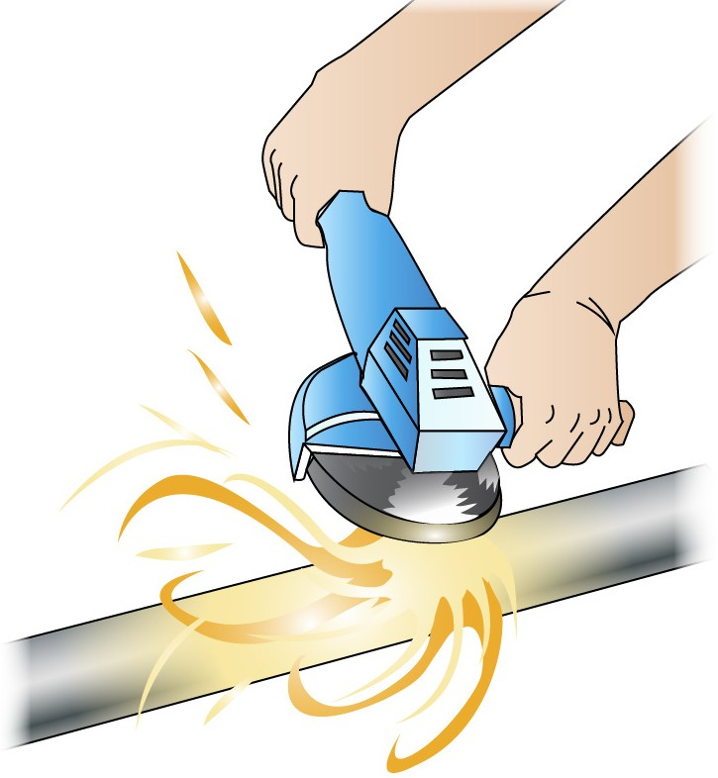
PC 2.1
IDENTIFY CONSTRUCTION HAZARDS AND CONTROL MEASURES
IDENTIFY HAZARDOUS MATERIALS AND OTHER HAZARDS ON WORK SITES
Identify hazardous materials (continued)
Some hazardous chemicals and materials can be produced by jobs you do on the work site. These are harder to identify because they do not have labels or may not have a SDS. For example:
Exhaust fumes from plant and machinery produce harmful gases | Welding can cause toxic fumes and vapours
When grinding metals toxic dust or fumes may be released | Chemicals used to make timber products like Medium Density Fibre (MDF), and dusts released from cutting and sanding timbers are hazardous to health or can present a dust explosion risk.
If hazardous chemicals or materials are created in the workplace, you must manage the risks.

Slide 22
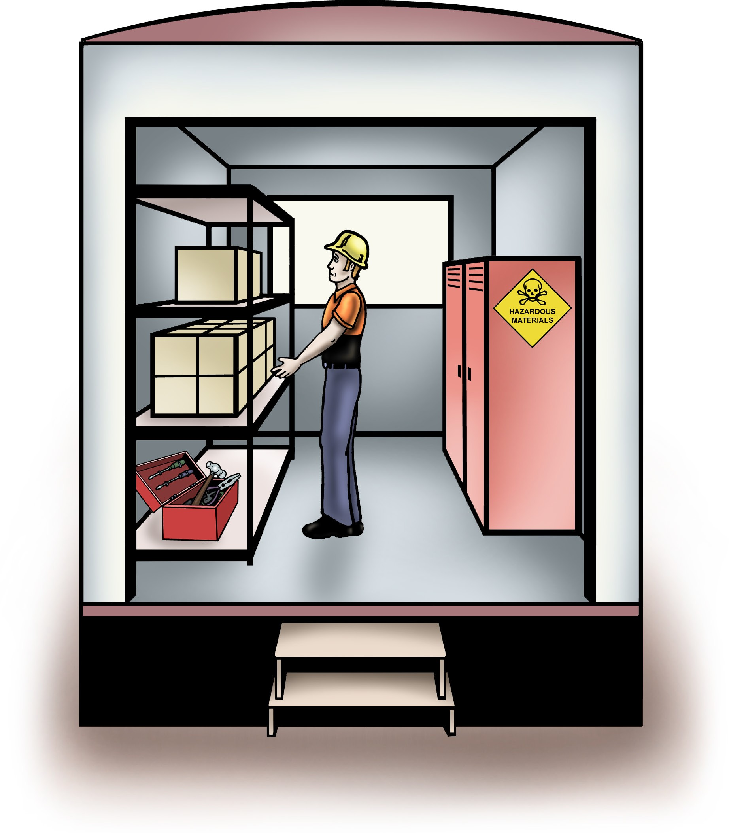
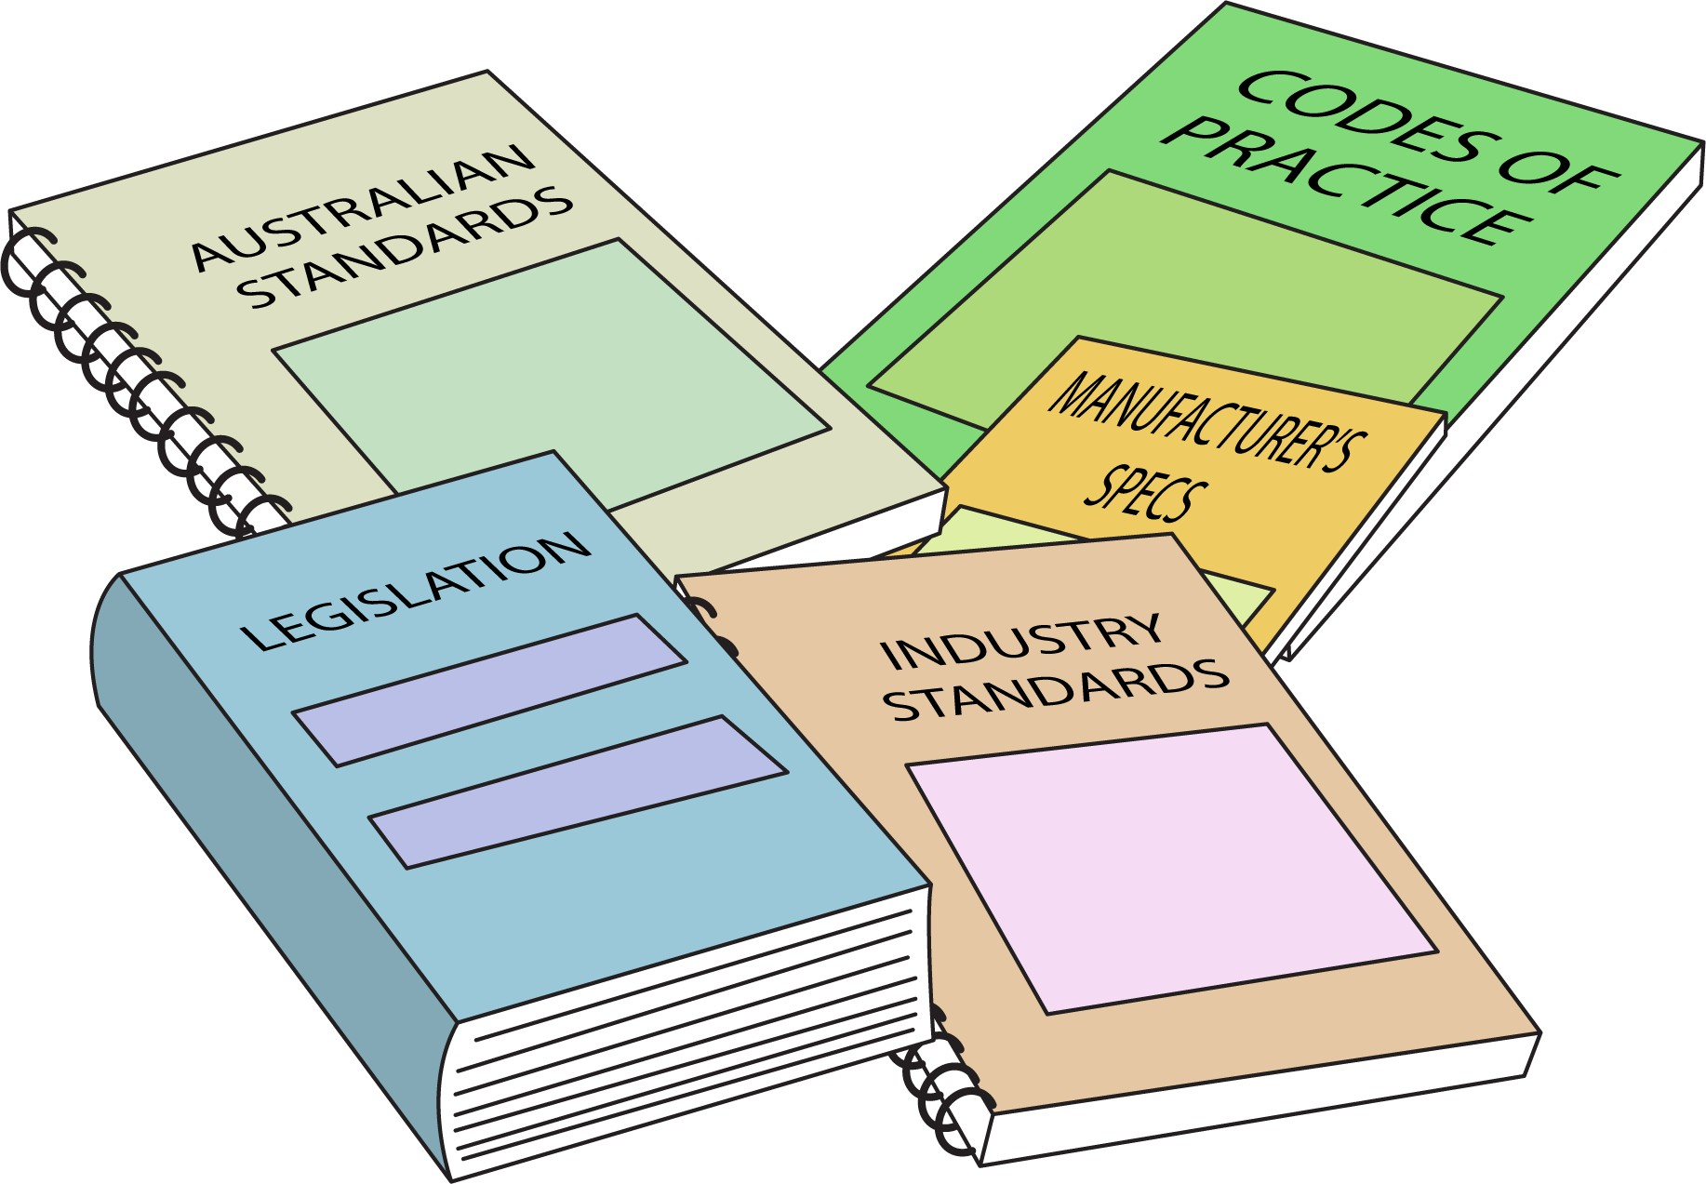
PC 2.3
IDENTIFY CONSTRUCTION HAZARDS AND CONTROL MEASURES
IDENTIFY HAZARDOUS MATERIALS AND OTHER HAZARDS ON WORK SITES
Securing hazardous materials (continued)
Storage of hazardous materials
Check your worksite procedures to find out how hazardous materials should be stored.
Some things to remember are:
Hazardous materials should be stored in a designated area | All hazardous materials should be clearly labelled and kept in their original containers if possible
If there are large quantities there may be certain rules you need to follow | There should be a SDS available for all hazardous materials.

Slide 23
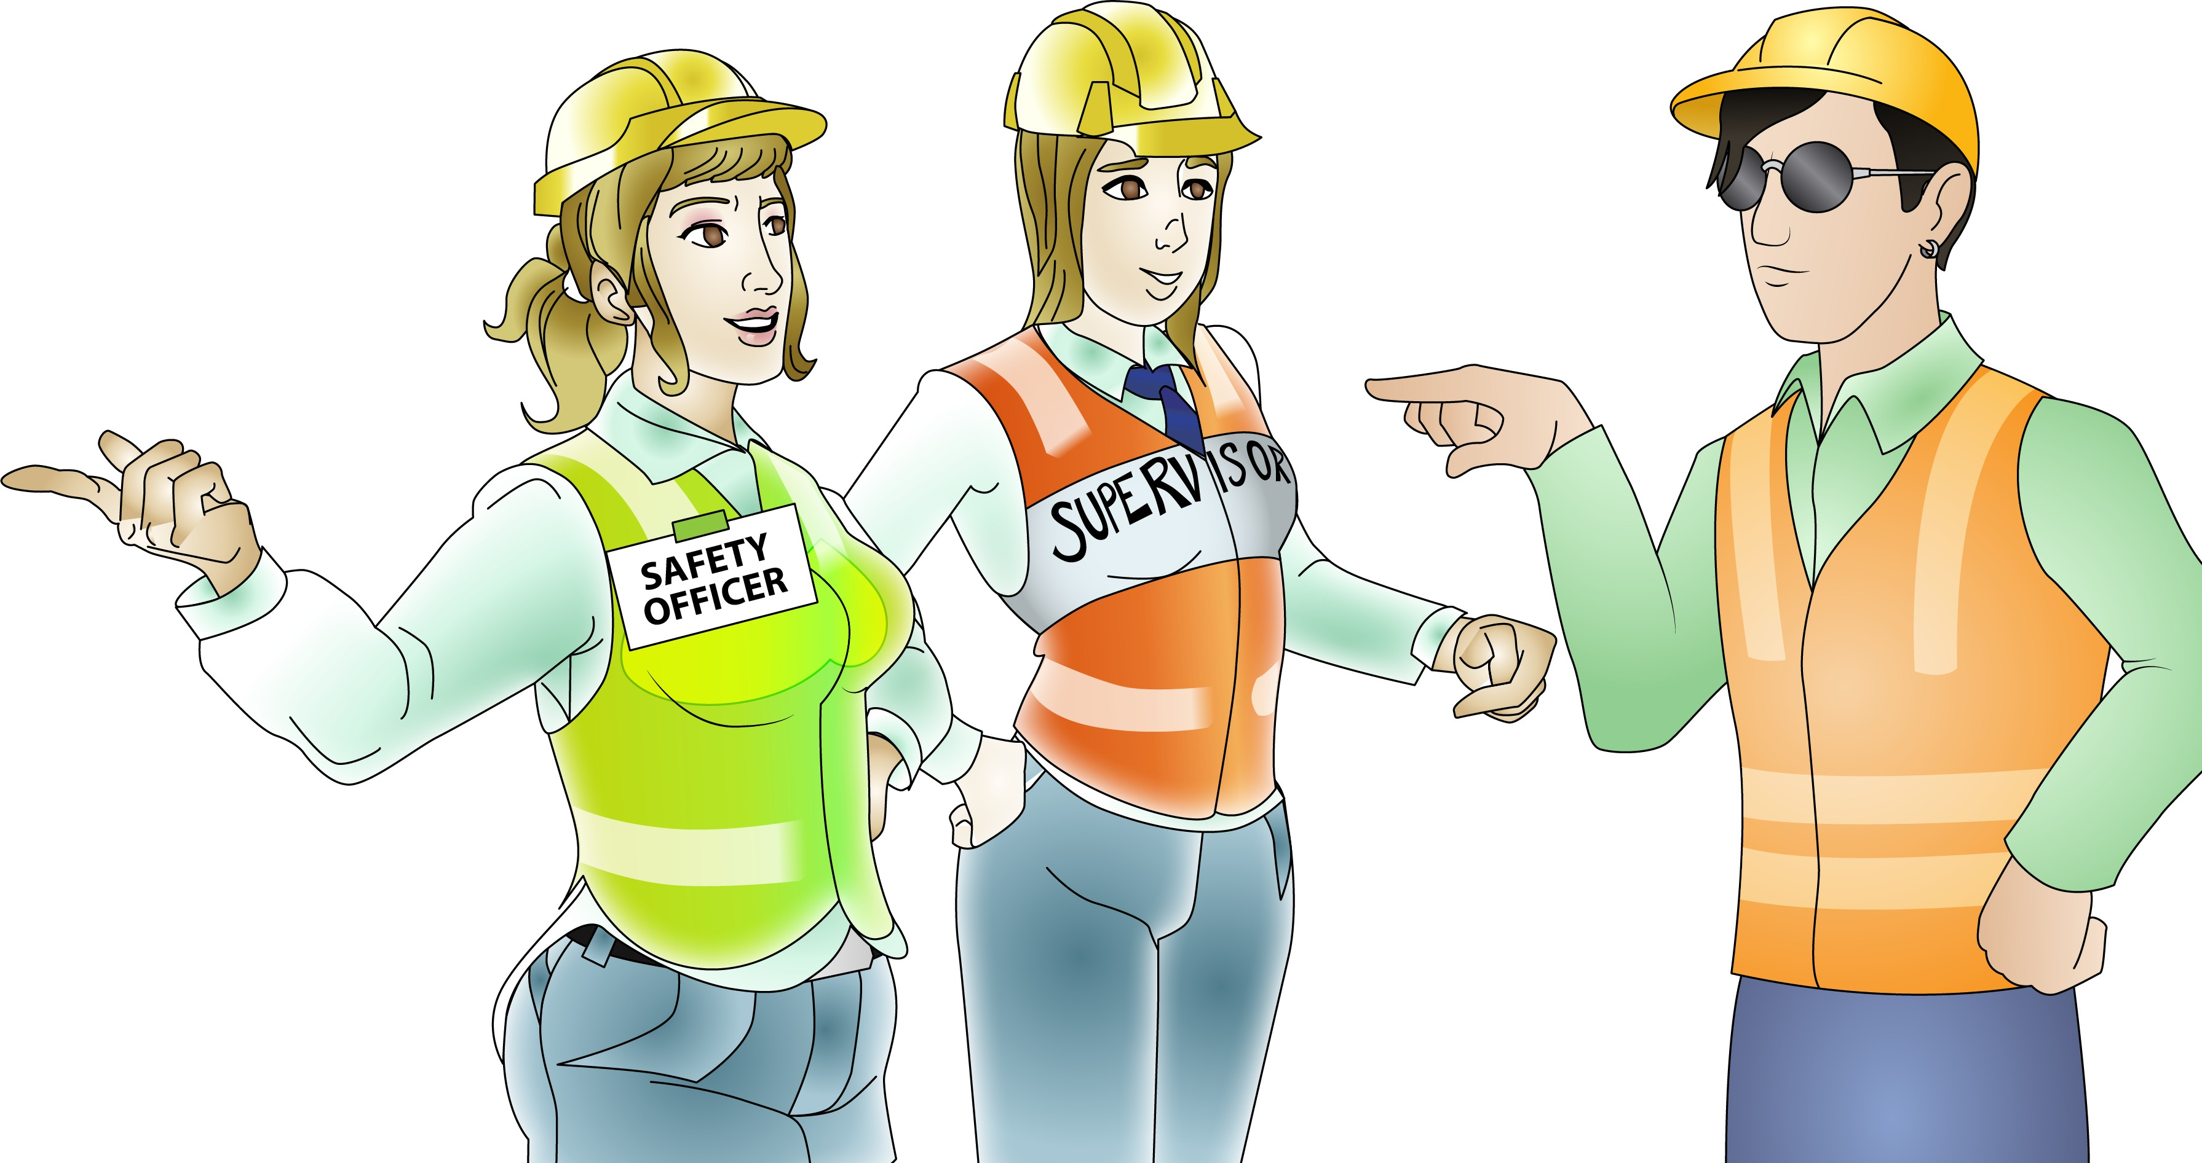
Element 3 - Plan and prepare for safe work practices
This element covers the following performance criteria:
Identify, wear, correctly fit, use and store correct personal protective equipment and clothing for each area of construction work in accordance with workplace procedures.
Select tools, equipment and materials, and organise tasks in conjunction with other personnel on site and in accordance with workplace procedures.
Determine required barricades and signage, and erect at the appropriate site location.
Apply material safety data sheets (MSDSs), job safety analyses (JSAs) and safe work method statements (SWMSs) relevant to the work to be performed.

Slide 24
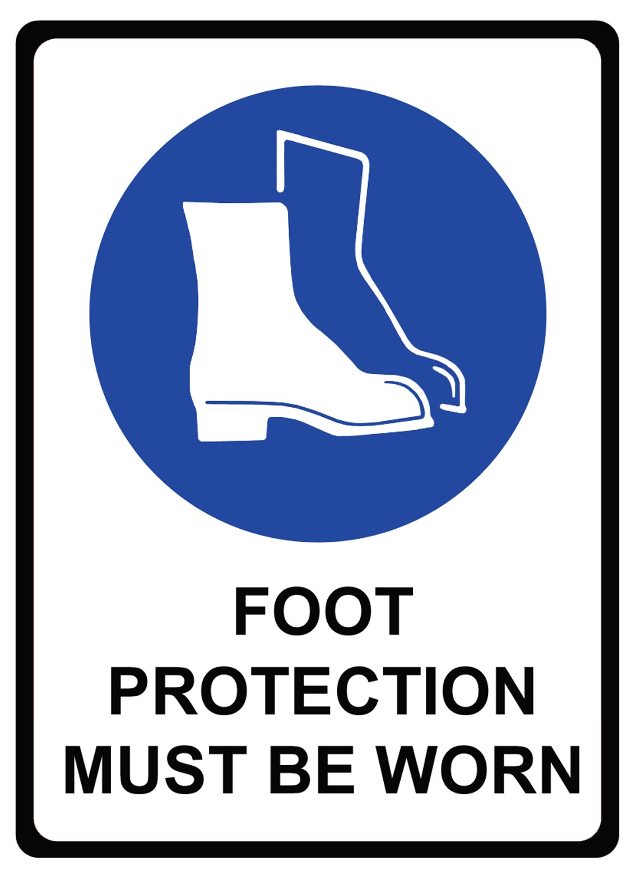
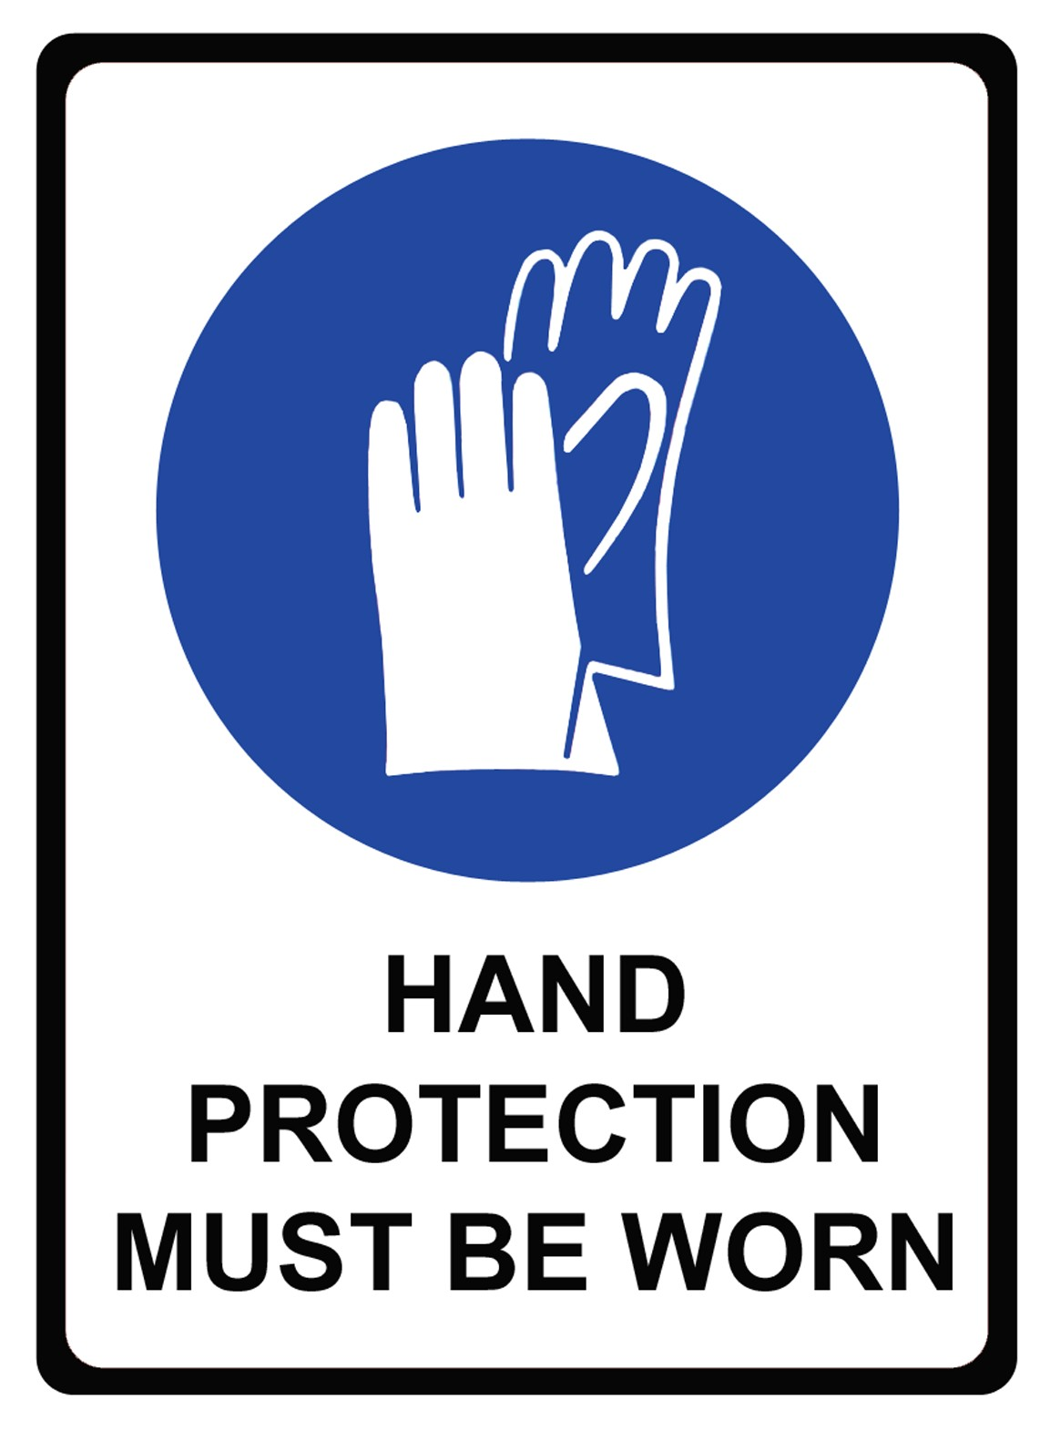
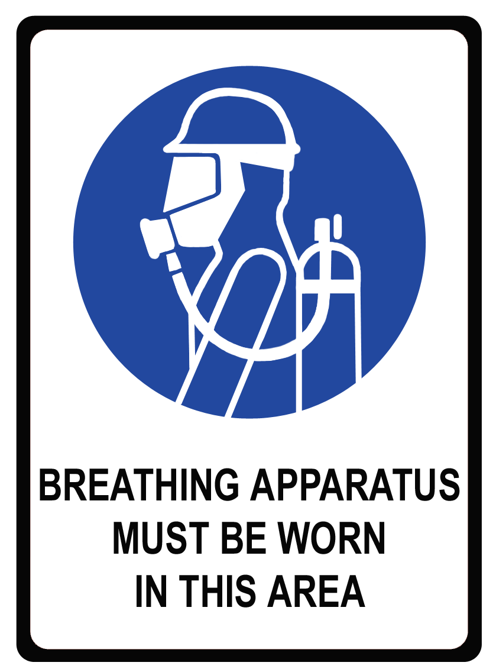
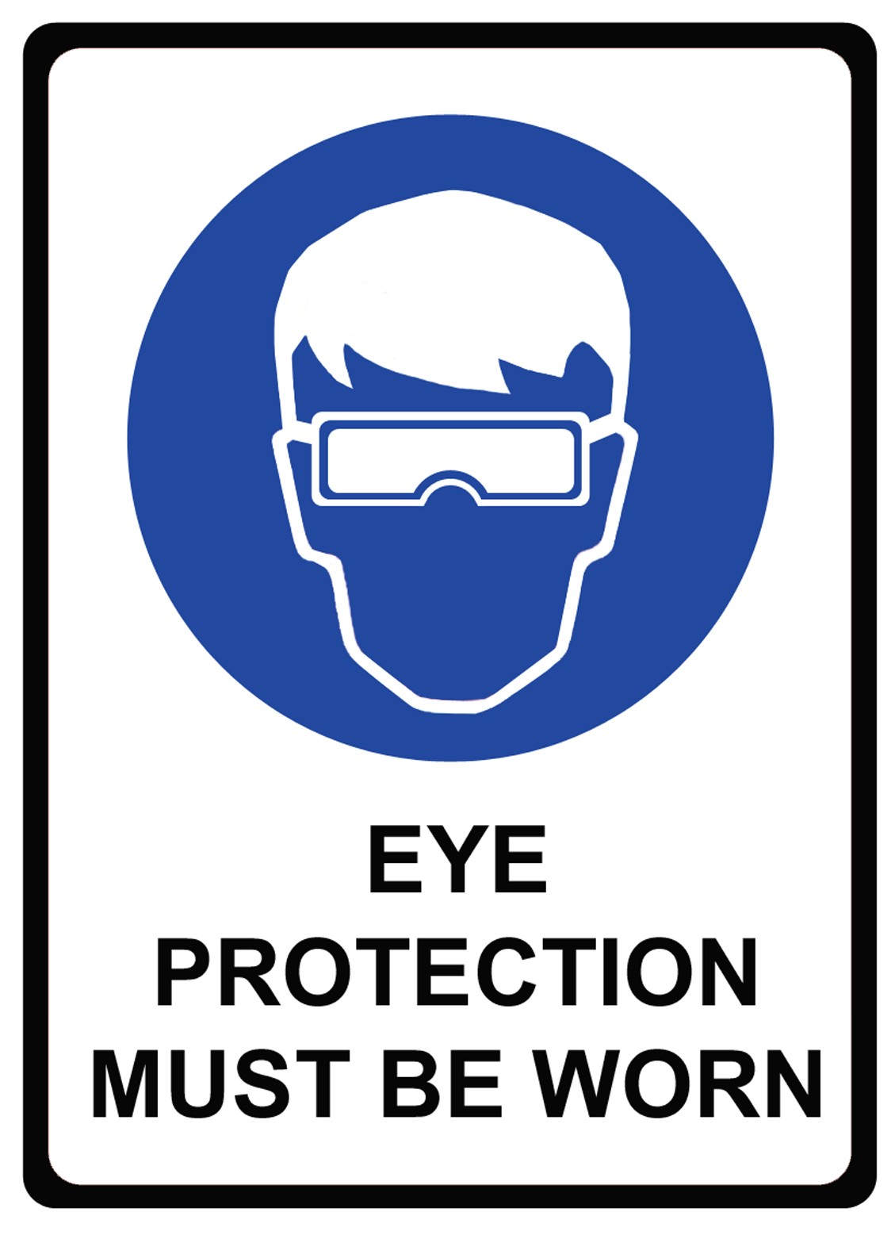
PC 3.1
IDENTIFY CONSTRUCTION HAZARDS AND CONTROL MEASURES
PLAN AND PREPARE FOR SAFE WORK PRACTICES
3.1 Personal Protective Equipment (PPE)
Personal protective equipment (PPE) is worn by a person to provide a barrier between themselves and a hazard. PPE will help to minimise the risk to a person’s health and safety but it is not guaranteed to prevent injury. PPE is best used along with other hazard control measures.
The employer (PCBU) must provide PPE or an allowance for the employee to purchase PPE
Training should be done to learn how to correctly fit and use PPE
PPE needs to be kept clean, hygienic and in good working order
PPE must comply with Australian Standards, for example: AS/NZS 1337 Personal eye protection
PPE should be stored so it is kept dry, clean and undamaged
Check your workplace procedures to find out what PPE has to be worn.
Look for safety signs around your worksite to show you when you need to wear different types of PPE. PPE signs are mandatory; this means you MUST do what they say.

Slide 25
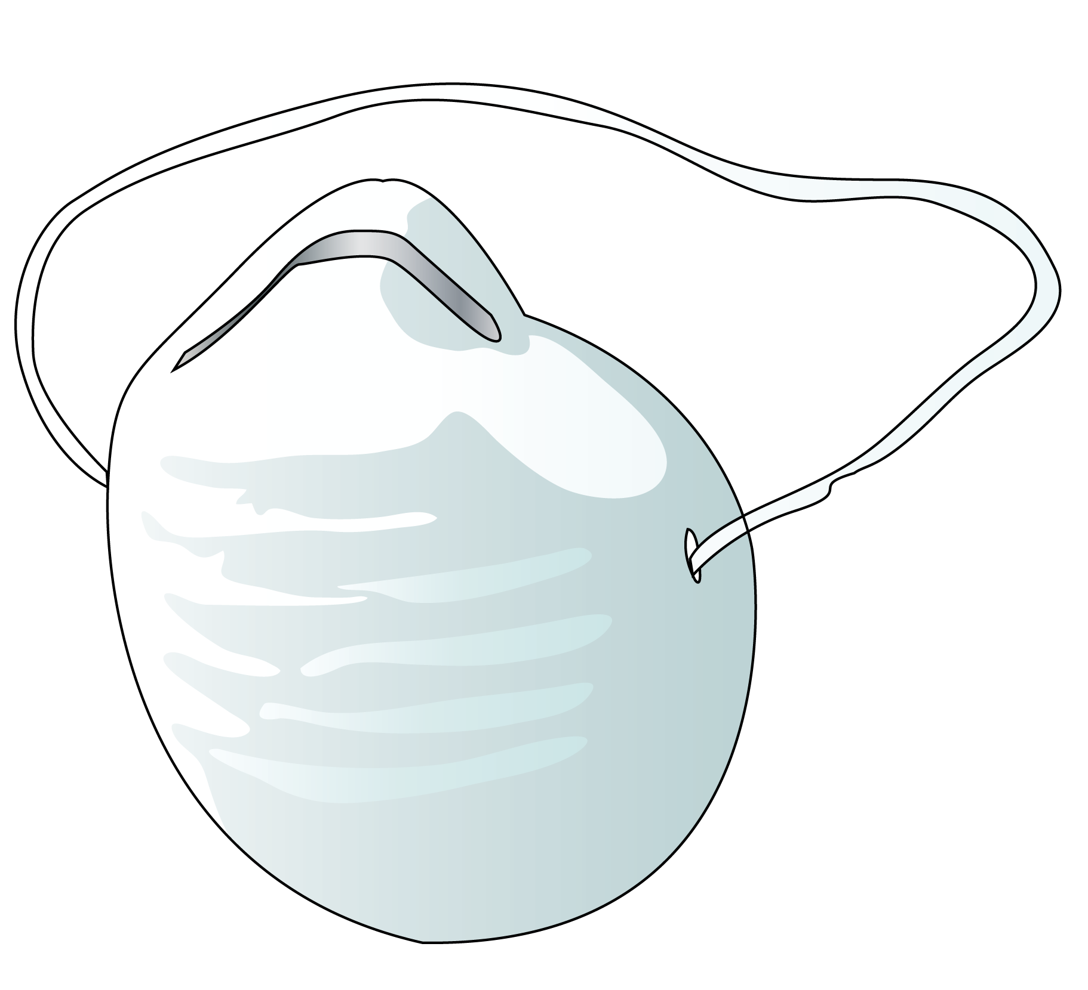
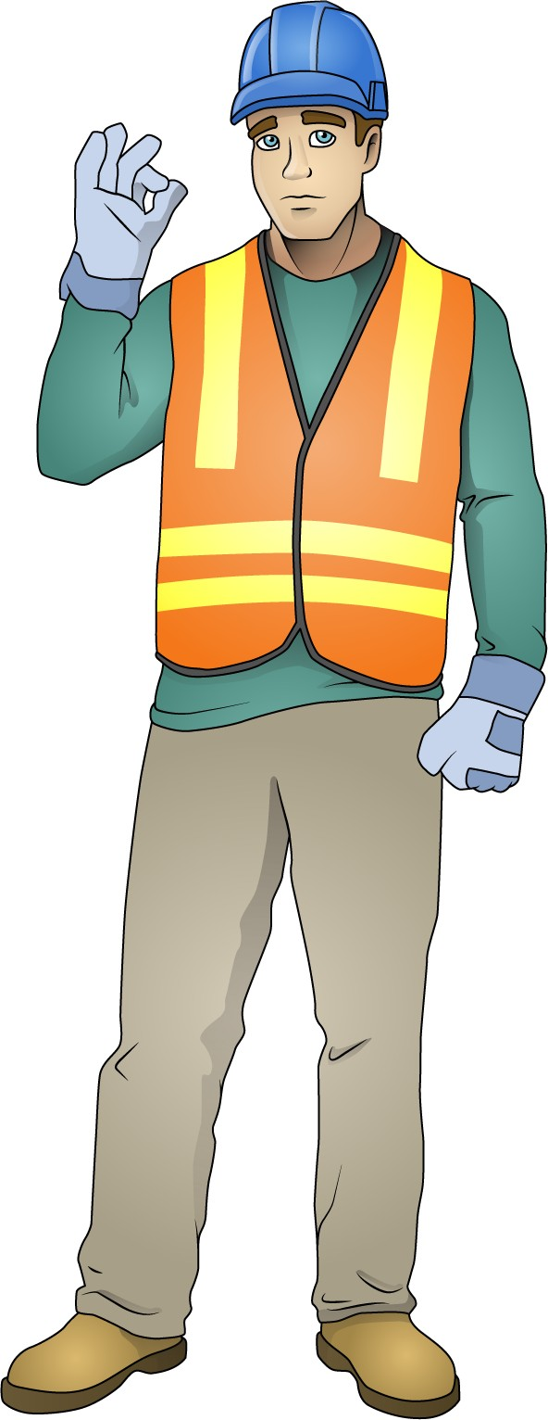
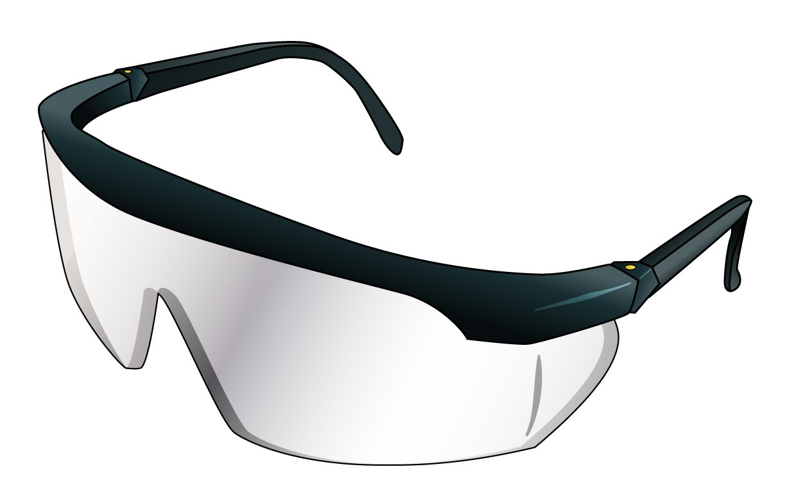
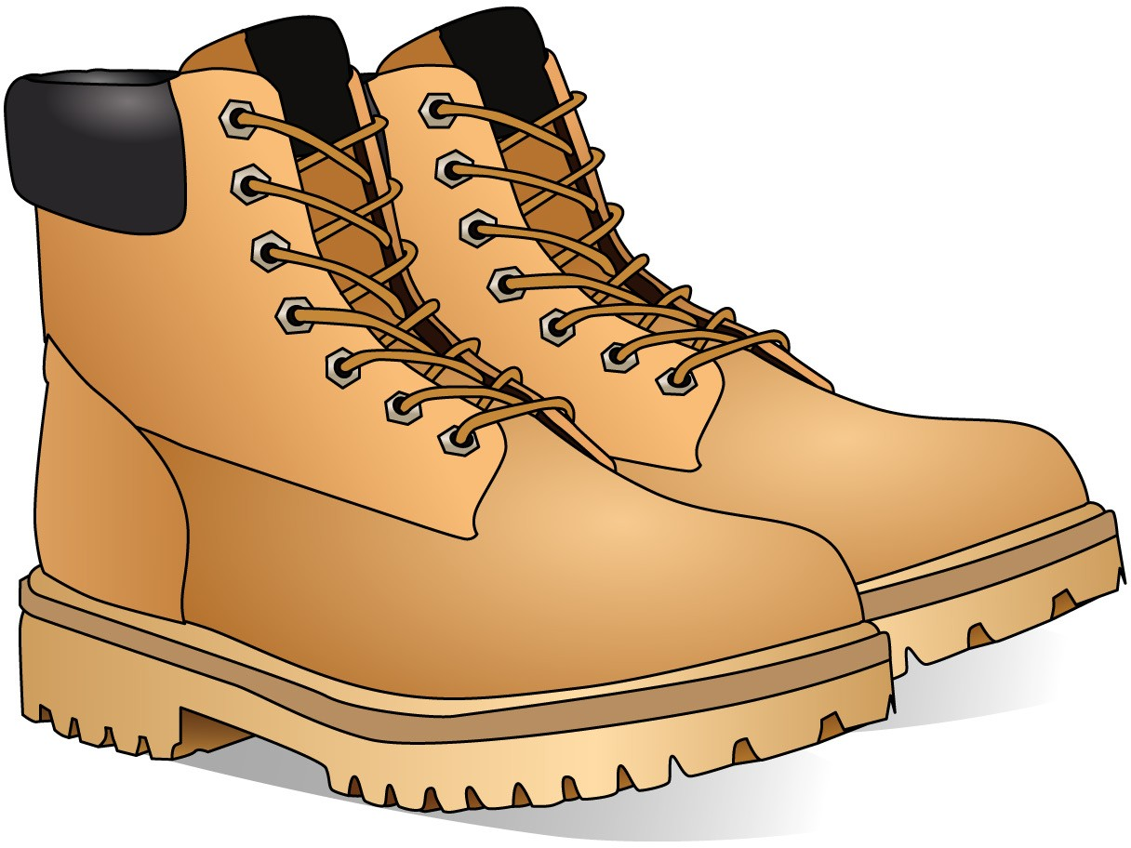
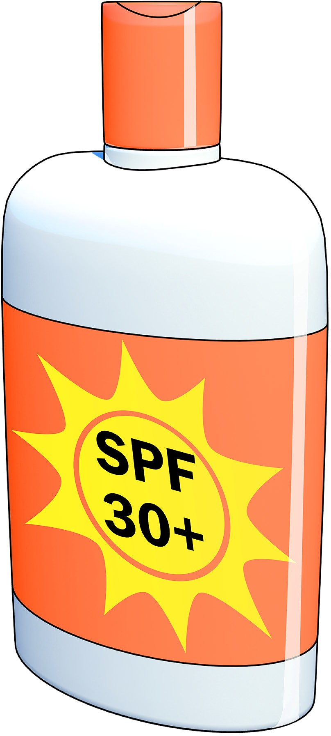
PC 3.1
PLAN AND PREPARE FOR SAFE WORK PRACTICES
IDENTIFY CONSTRUCTION HAZARDS AND CONTROL MEASURES
Personal Protective Equipment (PPE) (continued)
Below are some examples of PPE that is worn at different times on a construction site. The PPE that is required will
depend on the job being done.
Safety vest
Dust mask
Hard hat
Safety gloves
Long sleeved top
Ear muffs
Safety glasses/goggles
Boots that cover the whole foot
Long pants
Sunscreen

Slide 26
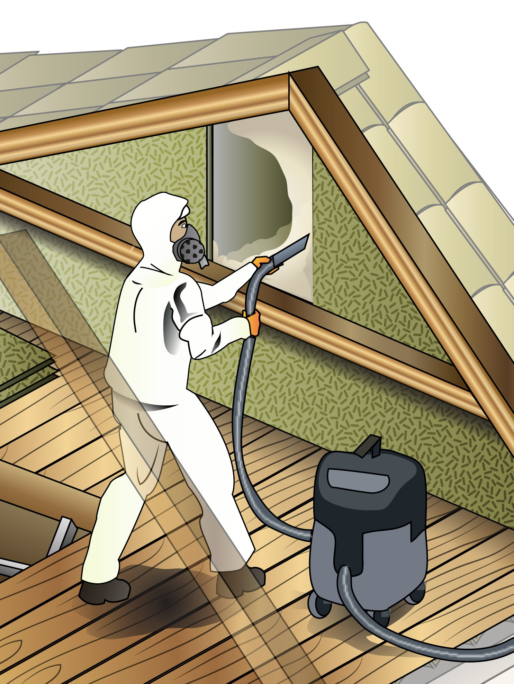
Element 4 -
Apply safe work practices
This element covers the following performance criteria:
Carry out tasks in a manner that is safe for operators, other personnel and the general community, in accordance with legislative requirements, and workplace policies and procedures.
Use plant and equipment guards in accordance with manufacturers’ specifications, work site
regulations and Australian Standards.
Follow procedures and report hazards, incidents and injuries to relevant authorities.
Recognise and do not use prohibited tools and equipment in areas containing identified
asbestos..
Identify and follow requirements of work site safety signs and symbols.
Clear and maintain work site area to prevent and protect self and others from incidents and accidents, and to meet environmental requirements.

Slide 27
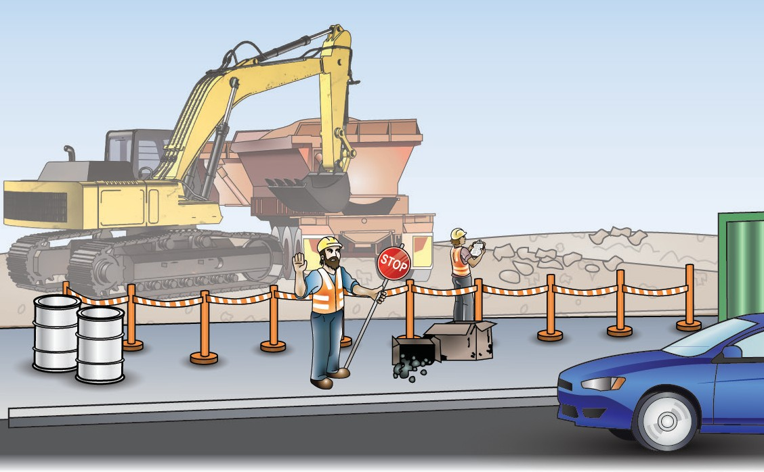
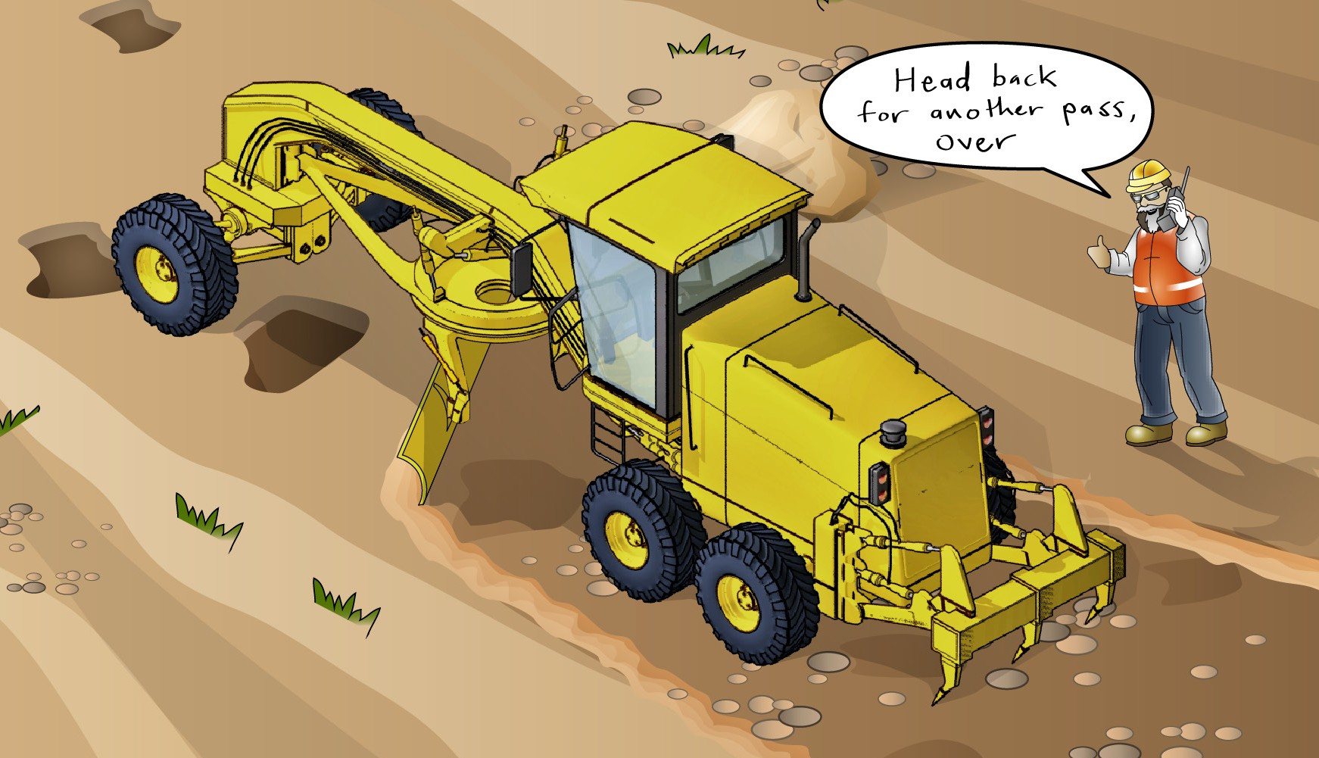
PC 4.1
IDENTIFYIDENTIFY CONSTRCONSTRUCTIONUCTION
APPLY SAFE WORK PRACTICES
Follow employer policies and procedures
When doing your job at the worksite, always be aware of company policies and procedures – and follow them. If you are ever unsure about a policy or procedure, ask your supervisor or other responsible person. Tell other workers about what you have found out so that everyone is doing the same thing.
One example of an employer’s safety procedure is a traffic management plan. It tells you how to control vehicles in and around the worksite. It helps keep the site safe for you and others.
You may need a traffic control licence in your state or territory, before you can actually control traffic.
Communication
You need to communicate effectively on a construction site.
This may involve using:
Hand signals – if the other worker cannot hear you
Fixed channel two-way radio – if the other worker cannot see you.
Two-way radio
Make sure you know how to use the two-way radio properly. Test the equipment before you start the job.
Keep your mind on the job and quickly tell the other worker anything he needs to know. Use the terms that are commonly used at your worksite.

Slide 28
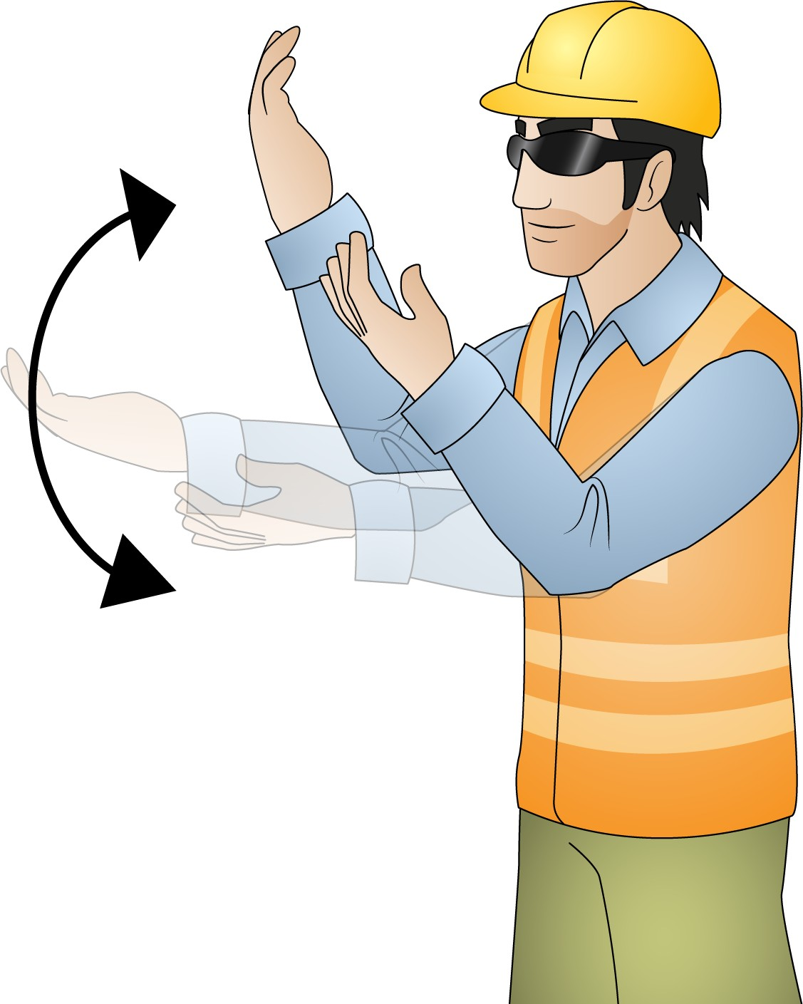
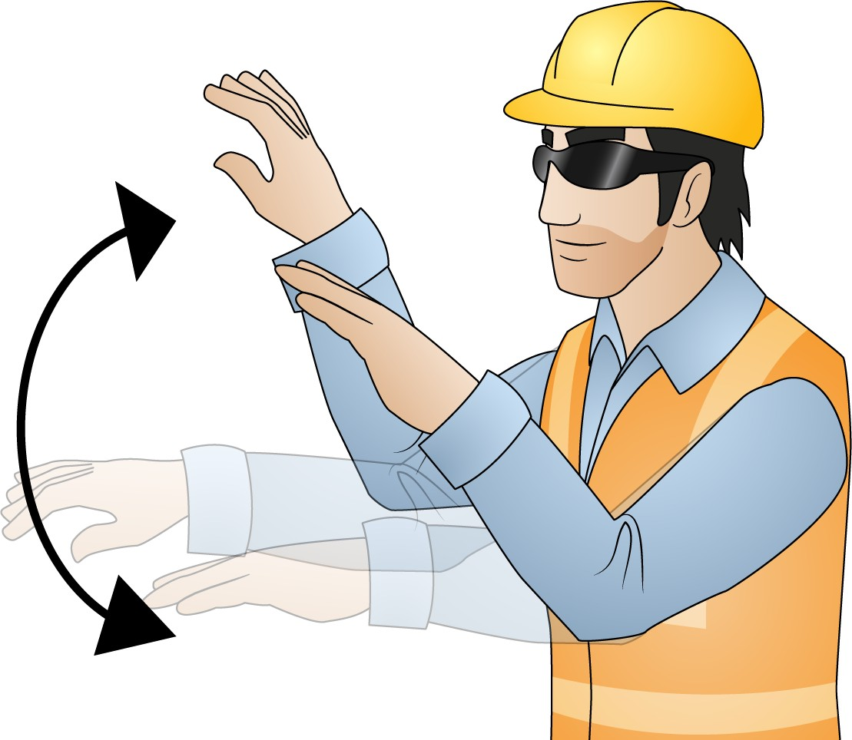
PC 4.1
APPLY SAFE WORK PRACTICES
Communication (continued)
The hand signals below are examples of signals that could be used as a communication method on a construction site. They are not part of a standard and are not related to the hand signals used to direct load shifting equipment (e.g cranes).
Start | Stop | Move forwards Both arms are bent with the palms facing upwards, and the forearms make slow movements towards the body.
Both arms are extended | The right arm
horizontally with the palms | points upwards
facing forwards. | with the palm
 | facing forwards.
Move backwards | Danger
Both arms are bent with the palms | Both arms point upwards with the
facingn downwards, and the | palms facing forwards.
forearms make slow movements away from the body.

Slide 29
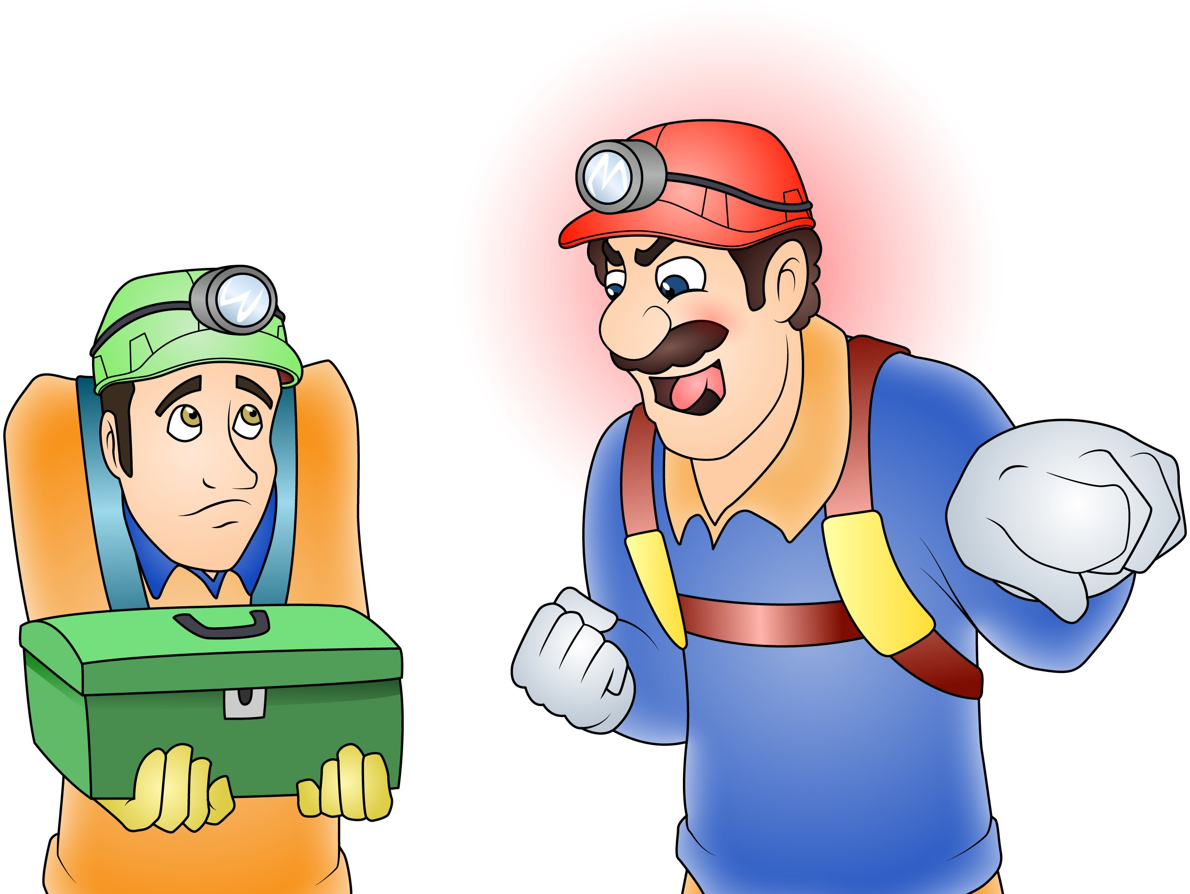
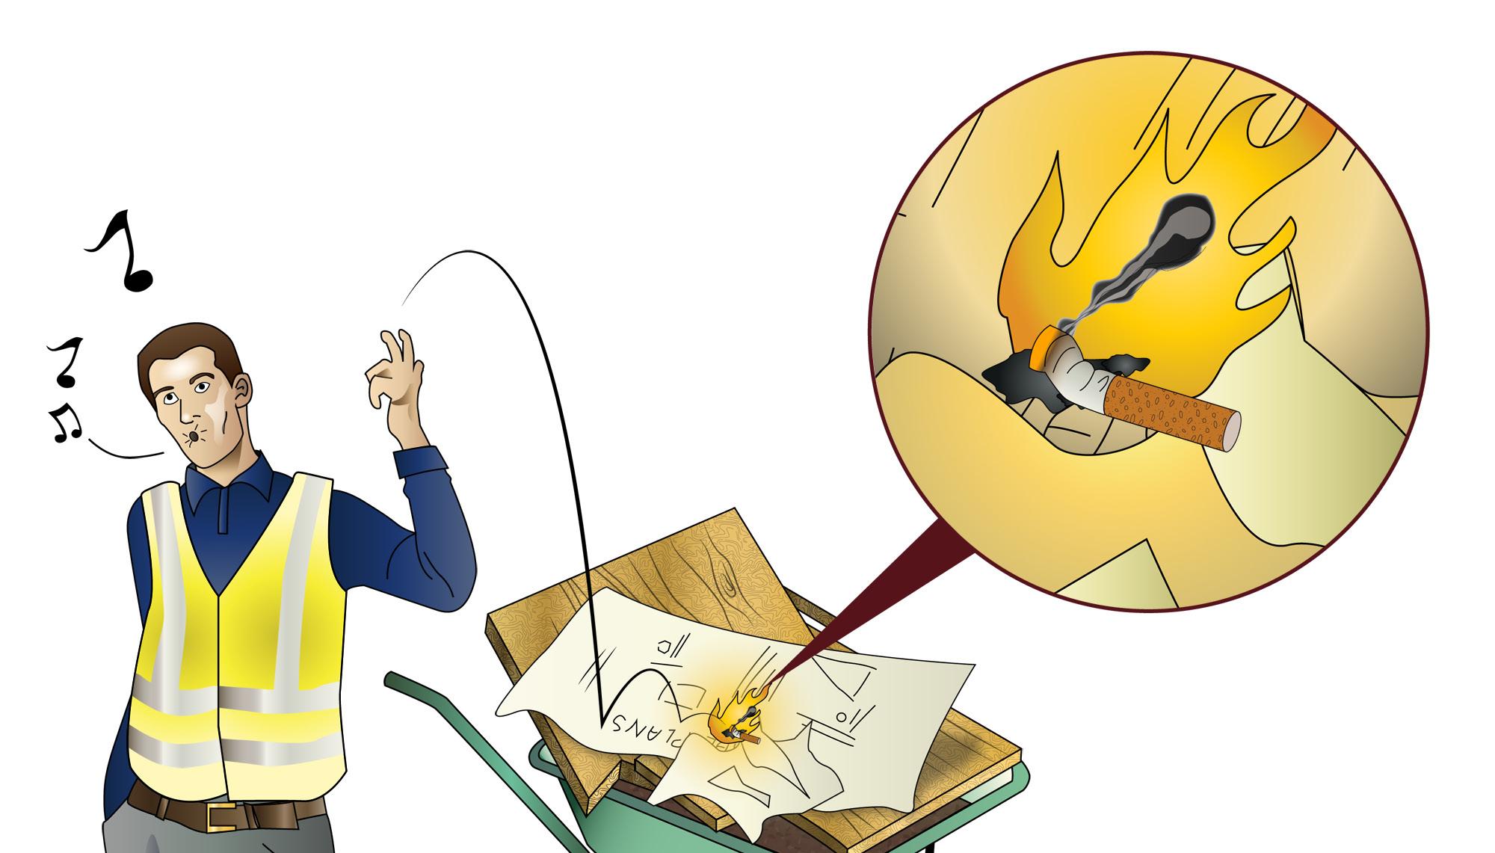
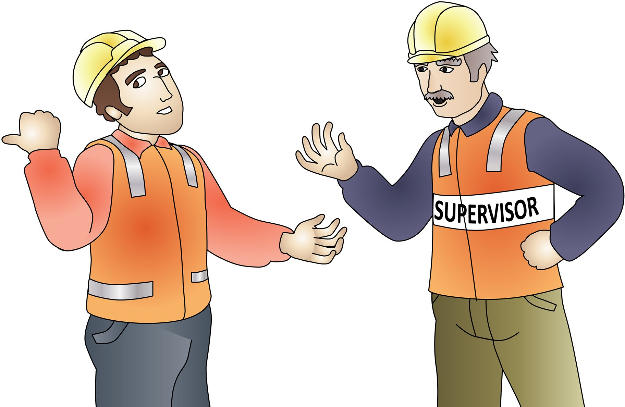
PC 4.1
APPLY SAFE WORK PRACTICES
Bullying and harassment
Take care of yourselves and each other.
Bullying and harassment do not belong in the workplace. Report any bullying or harassment to your supervisor or other relevant person.
Smoking in the workplace
Some workplaces have special places for people who smoke. If you smoke, you must use these places to prevent a risk to others who do not smoke. It also removes the risk of a flame near flammable liquids.
Some sites may also have set smoking times.

Slide 30
PC 4.1
APPLY SAFE WORK PRACTICES
Site disturbance and dust (continued)
Control dust by wetting roads and stockpiles (water restrictions permitting). | Make sure stormwater drains in the area have been set up with a gravel sausage or gravel inlet filter to stop mud making its way into the stormwater system.
 | Clean truck tyres with a broom or water to prevent mud spreading onto the road.

Slide 31
PC 4.5
APPLY SAFE WORK PRACTICES
2.1 4.5 Identify and follow worksite safety signs and symbols
Safety signs and symbols
There are a lot of signs and symbols that are placed around work sites. It is important that the meaning of these signs is understood and the directions they give are followed.
Safety signs are made to an Australian standard which means their colour, design, shape and size all have to meet the standard.
Safety signs sit in Four (4) different categories:
1. Regulatory signs
Description | Prohibition signs White with a red circle with a line through it. These signs tell you what you MUST NOT do. | Mandatory signs White with a blue circle containing an image. These signs tell you what you MUST do. | Limitation or restriction signs White with a red circle around a black image or number. These signs let you know of any restrictions in place.
Example: | No smoking | Safety helmet must be worn | Speed limit is 50 kilometres per hour
White
White
WhiteWhite

Slide 32
PC 4.5
APPLY SAFE WORK PRACTICES
Safety signs and symbols (continued)
2. Emergency information
Description | Green in colour These signs identify directions to find exits, first aid facilities and equipment.
Example: | First Aid facility
3. Fire signs
Description | Red in colour These signs identify where to find fire-fighting equipment, alarms and exits.
Example: | Fire extinguisher

Slide 33
Element 5 -
Follow emergency procedures
This element covers the following performance criteria:
Identify designated personnel in the event of an emergency for communication purposes.
Follow safe workplace procedures for dealing with accidents, fire and other emergencies, including identification and use, if appropriate, of fire equipment within scope of own responsibilities.
Describe, practice and effectively carry out emergency response and
evacuation procedures when required.
Carry out emergency first aid treatment of minor injuries and, as soon as possible, accurately report treatment details to designated personnel.

Slide 34
PC 5.1
IDENTIFY CONSTRUCTION HAZARDS AND CONTROL MEASURES
FOLLOW EMERGENCY PROCEDURES
2.1 5.1 Tell your supervisor or other key person about an emergency
An emergency is when something serious, unexpected and dangerous happens. When there is an emergency certain things need to be done immediately so people can be kept safe.
If an emergency happens at work, you must decide who needs to know about it and tell them straight away. The people you may need to tell when there is an emergency can include:
Managers
Supervisors
Fire wardens
OHS/WHS representatives
First aid officers
Team leaders
Other workers.
Know key emergency people
The people you need to tell about an emergency should be listed in emergency procedures kept at the workplace, and put on noticeboards in different areas of the workplace for everyone
to see. When the right people are aware of the emergency, they can make sure emergency plans are put into practice so the situation can be controlled.

Slide 35
PC 5.2
IDENTIFY CONSTRUCTION HAZARDS AND CONTROL MEASURES
FOLLOW EMERGENCY PROCEDURES
2.1 5.2 Follow your workplace procedures during an emergency
Employers (PCBU) must make sure that the workplace has an emergency plan. An emergency plan is written instructions about what workers should do when there is an emergency. The emergency plan or a summary of the main points in the emergency plan should be displayed on a noticeboard and/or be easy for employees to find.
The emergency plan should cover:
Fire and explosion
Medical emergencies
Rescues
Incidents with hazardous chemicals
Bomb threats
Violence
Natural disasters.
The plan should include information about:
Emergency procedures (how to respond to an emergency)
Evacuation procedures
How and when to notify emergency services
Medical treatment and assistance
Communicating the emergency response
Testing emergency procedures (drills)
Information, training and instruction to workers about emergency procedures.

Slide 36
PC 5.2
IDENTIFY CONSTRUCTION HAZARDS AND CONTROL MEASURES
FOLLOW EMERGENCY PROCEDURES
Fire blankets
Examples of when to use a fire blanket are:
On fires caused by cooking oils and fats
To control a fire in clothes being worn by a person.
Fire blankets will also have a limited affect on class A and B fires.
An example of a fire
blanket sign
Breathing apparatus
Breathing apparatus sets are breathing kits designed to give you clean, breathable air (from a tank).
They are designed for use in poor air due to low oxygen, smoke, gasses or contaminants.
An example of a breathing apparatus sign

Slide 37
PC 5.3
IDENTIFY CONSTRUCTION HAZARDS AND CONTROL MEASURES
FOLLOW EMERGENCY PROCEDURES
Evacuation
You may be required to evacuate the area. There will be set areas for you to assemble around your worksite. Workplaces should have site emergency plans and documentation clearly displayed.
Talk to your health and safety representative for more information on emergency procedures at your workplace.

Slide 38
PC 5.4
IDENTIFY CONSTRUCTION HAZARDS AND CONTROL MEASURES
FOLLOW EMERGENCY PROCEDURES
Basic first aid - Severe bleeding
For severe external bleeding:
Always wear gloves to protect yourself from the patient’s blood
DO NOT put a tourniquet on the patient
If there is something stuck in the wound (e.g: a piece of metal) DO NOT REMOVE IT. Apply pressure on both sides of the wound and put pads around it before you bandage
DO NOT give the patient anything to eat or drink.
For an unconscious patient:
Follow DRSABCD procedure
For a conscious patient:
Follow DRSABCD procedure
Lie the patient down and expose their wound
Apply pressure directly to the wound using a pad or your hands (wear gloves). The patient can do this themselves if possible
Squeeze the edges of the wound together
Raise the injured part above the level of the heart. Be careful in case there are other injuries (e.g: a broken bone)
Put a pad over the wound and bandage over it
If bleeding is not under control, place a second pad over the top and bandage in place
Check blood circulation below the wound
Make sure an ambulance has been called.

Slide 39
START- UP PACKS
1300 733 220
www.easyguides.com.au
A full set of training resources for each unit of competency
RII Earthmoving Training Materials
Each Start-up Pack includes: 1 × Trainer’s Resource
(with editable resources)
5 × Learner Guides
1 × Multimedia Presentation
1 × Record of Training Logbook
High Risk Training Materials
Each Start-up Pack includes:
1 × Information Book
1 × Information Multimedia Presentation 1 × Final Review Study Guide
1 × Final Review Multimedia Presentation 1 × Record of Training Logbook
1 × Trainer’s Resource (with editable resources) 1 × Learner Workbook
1 × Trainer’s Marking Guide
Each Start-up Pack gives you a full suite of training materials to get the unit on your RTO’s scope.
The materials are thoroughly mapped to help you pass audit.
To view the full range of Start-up Packs visit our website
www.easyguides.com.au
– Go to individual links for further details
© Easy Guides Australia Pty. Ltd.
183 May not be reproduced

