Slide 1
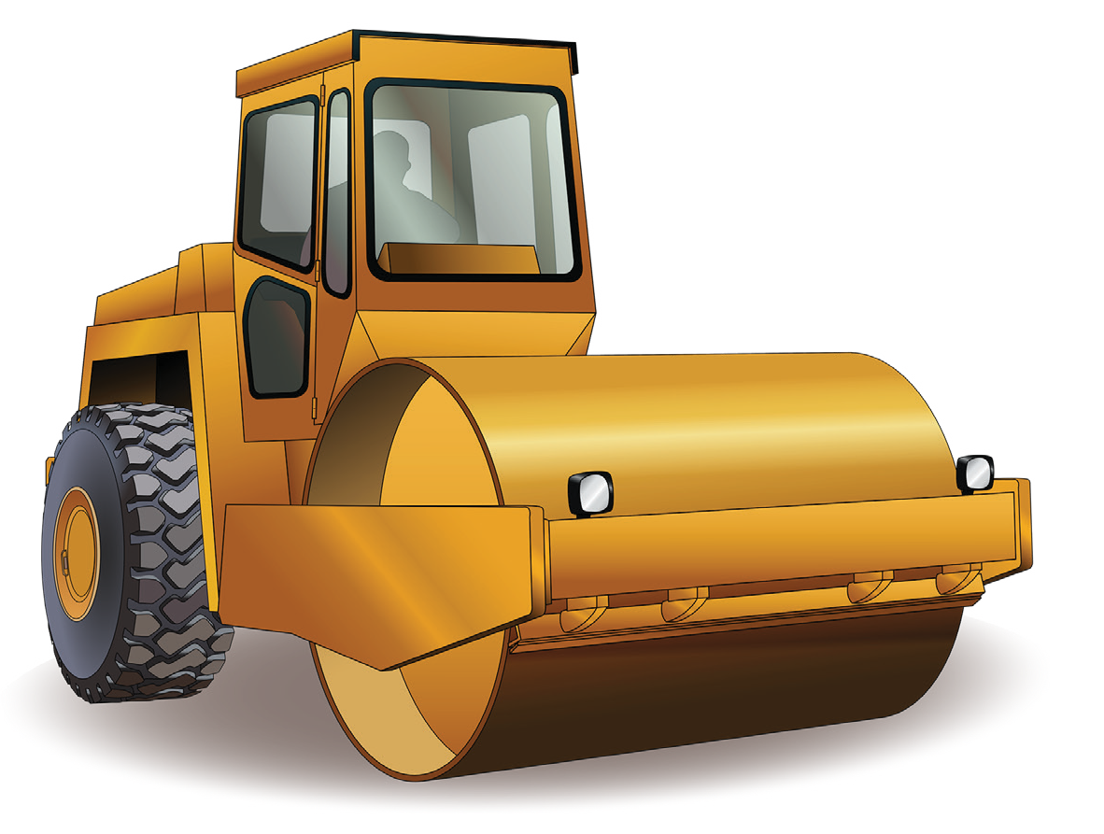

LEARNER GUIDE
RIIMPO317F Conduct civil construction roller operations
RollerTICKET
Introduction to roller
General Information
1. Plan and prepare for work
2. Identify and control hazards
3. Check and monitor equipment
4. Opreate /use equipment
5. Shutdown and store equipment
6. Maintain equipment
7. Housekeeping
8. Record keeping
9. Relocate equipment

Slide 2
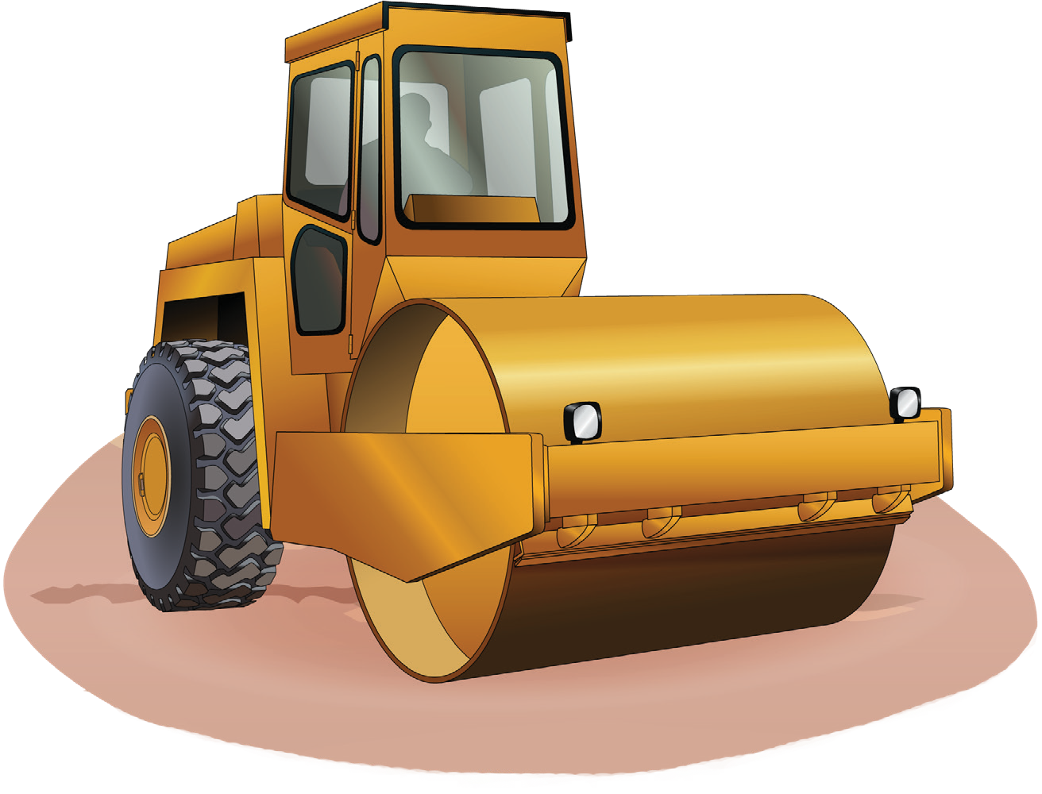
Introduction to Roller

Slide 3
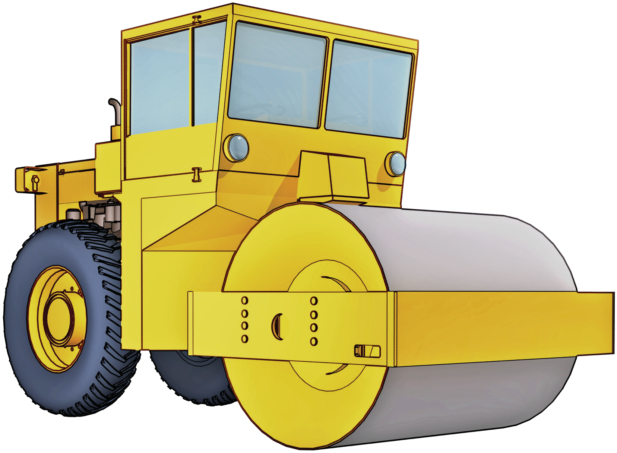
An example of a roller
INTRODUCTION TO ROLLER
Rollover protective structure (ROPS)
Cab
Engine
Drum
Vibratory hydraulics

Slide 4
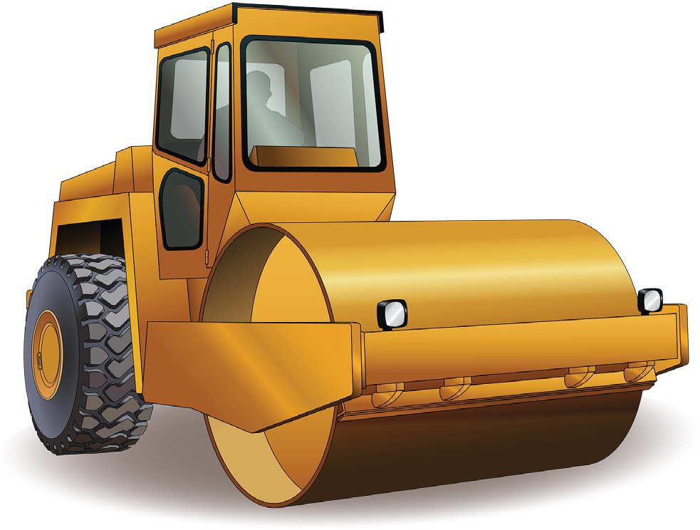
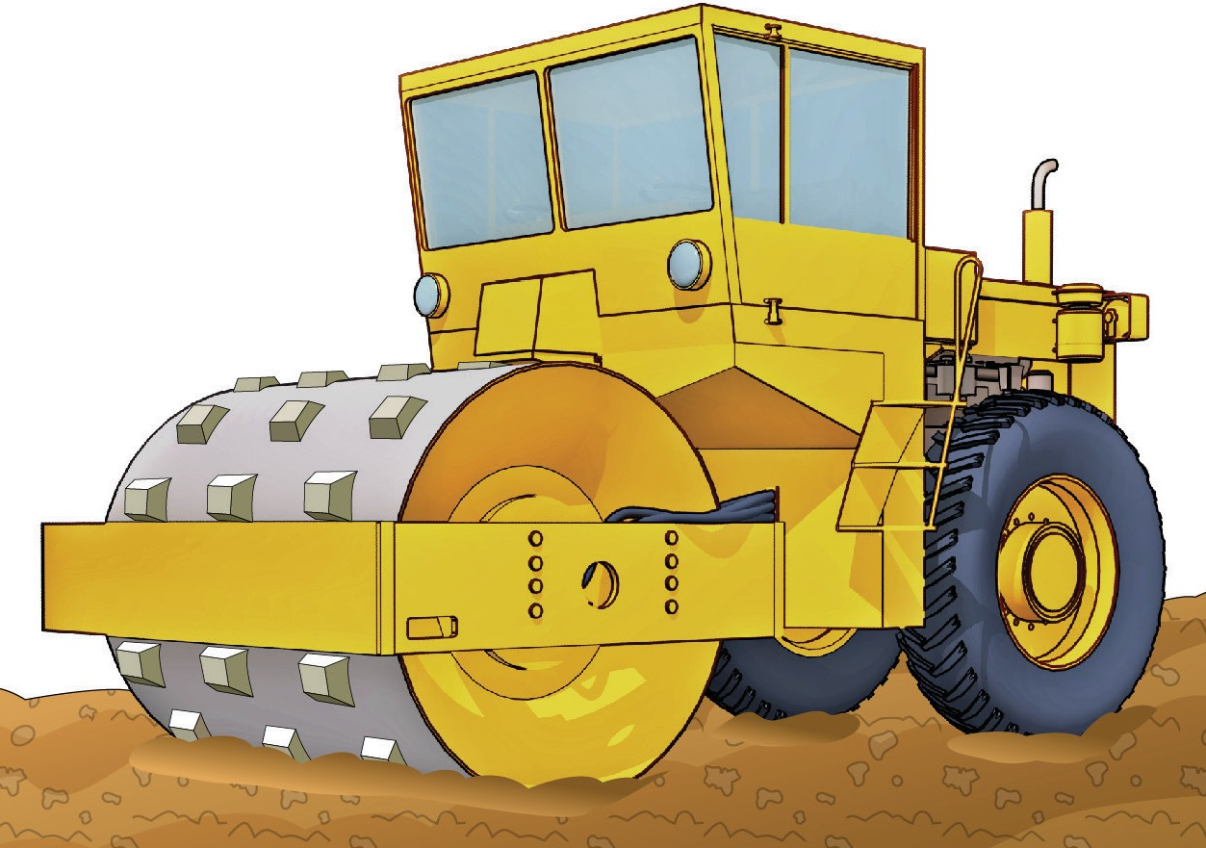
Types of rollers/compactors
PC 1.6 INTRODUCTION TO ROLLER
Self propelled rollers
These rollers have their own engine, steering and drive system. There are many types available to do a range of different tasks.
For example:
Two sets of rubber tyres and a plain steel roller drum
Two sets of rubber tyres and a sheepsfoot steel roller drum

Slide 5
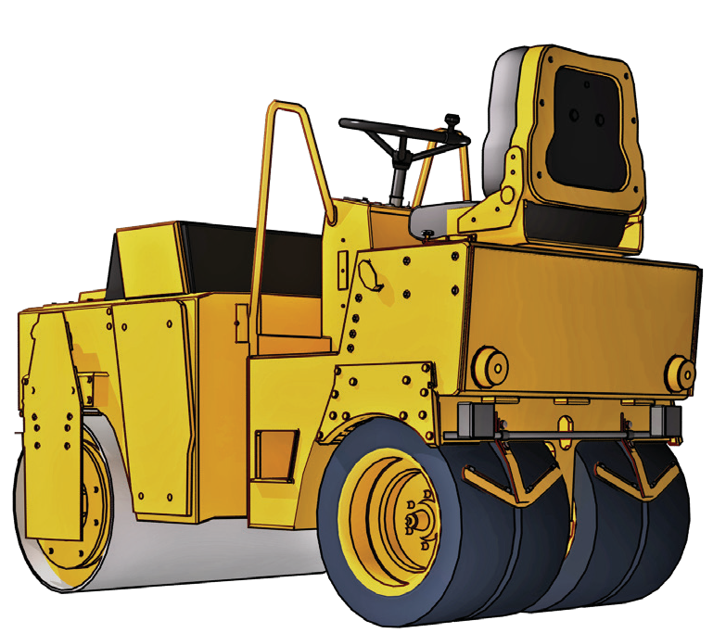
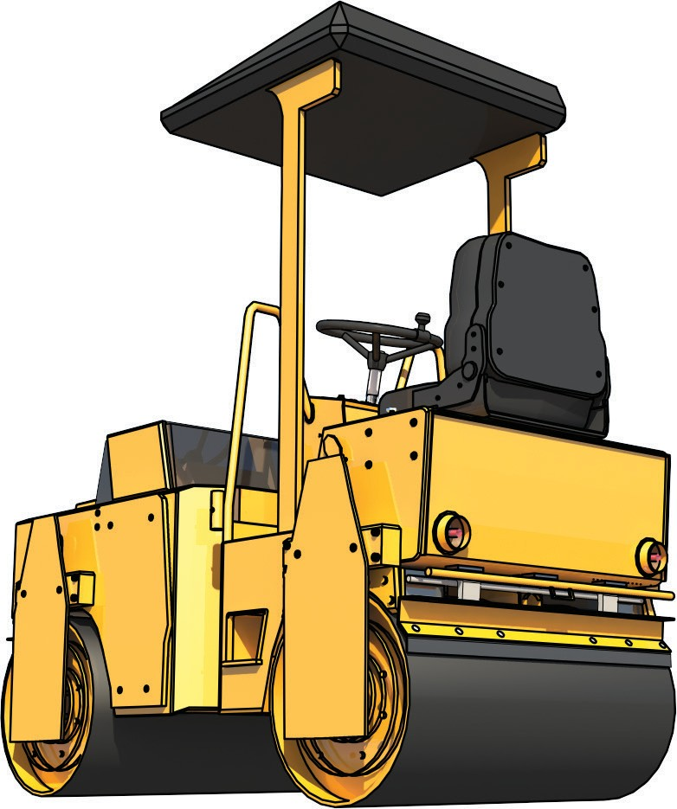
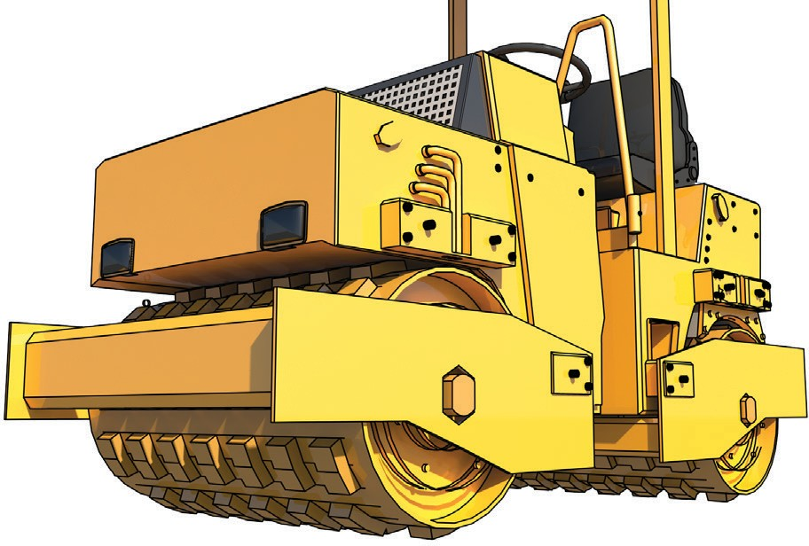
PC 1.6
INTRODUCTION TO ROLLER
Self propelled rollers (continued)
Multi wheel and steel drum
Two plain steel drums
Two sheepsfoot steel drums

Slide 6
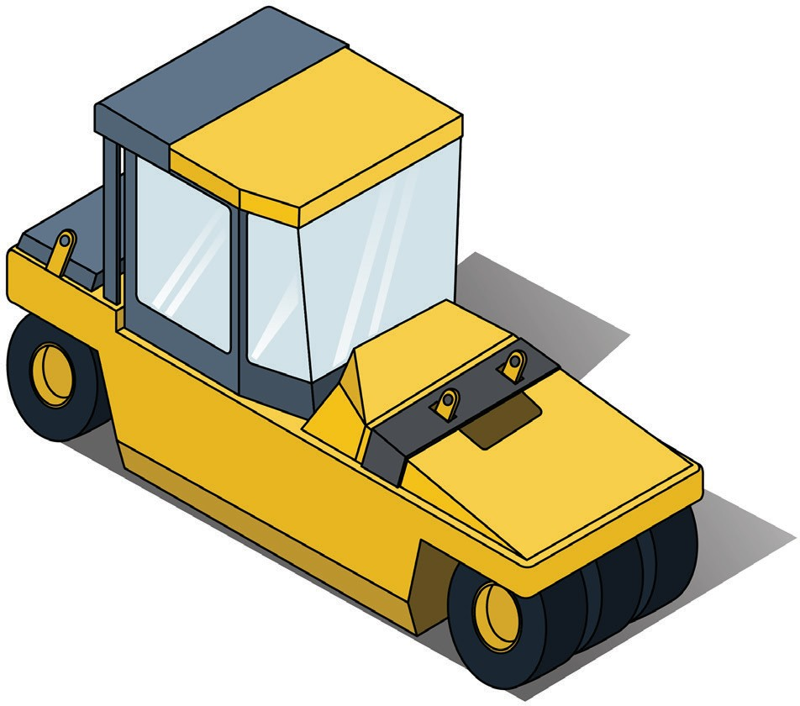
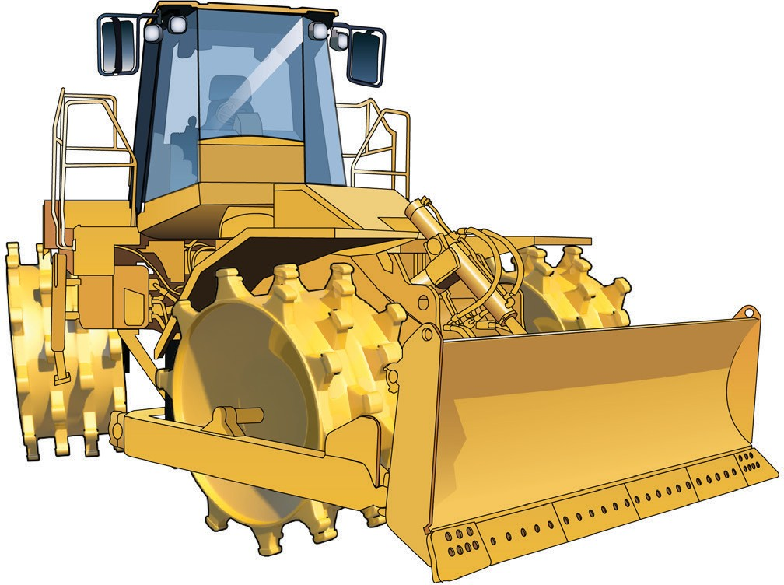
PC 1.6
INTRODUCTION TO ROLLER
Self propelled rollers (continued)
Four wheel (steel drum) articulated roller with dozer blade
Multi wheeled rubber tyred rollers

Slide 7

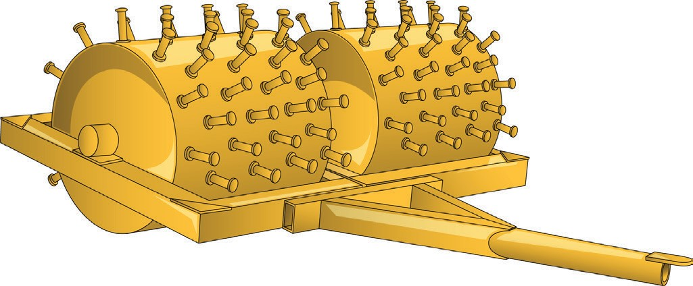
PC 1.6
INTRODUCTION TO ROLLER
Towed rollers
Single plain drum roller
Single sheepsfoot drum roller
Combination towed rollers
There are also many types of combination towed type rollers such as:
Multi wheeled on single axle and single steel drum towed combination roller
Multi wheeled on single axle and single sheepsfoot drum towed combination roller
Multi wheeled on two axle and single steel drum towed combination roller
Multi wheeled two axle and single sheepsfoot drum towed combination roller.

Slide 8
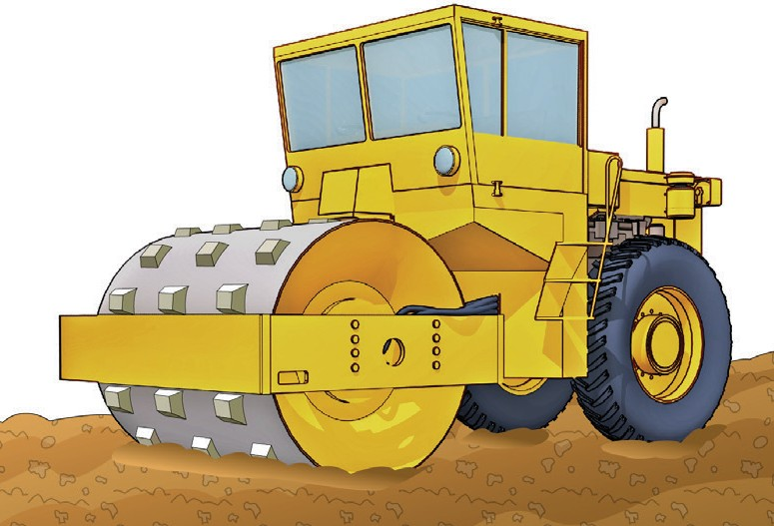
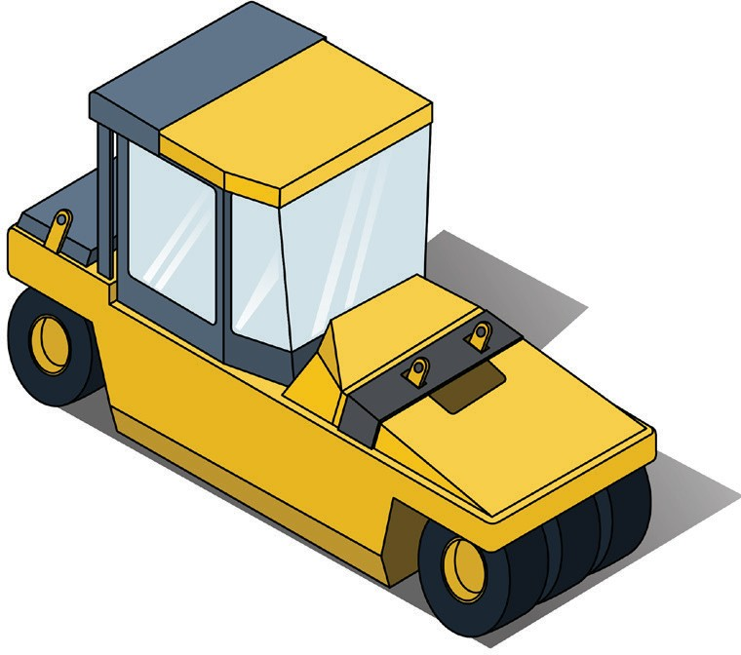
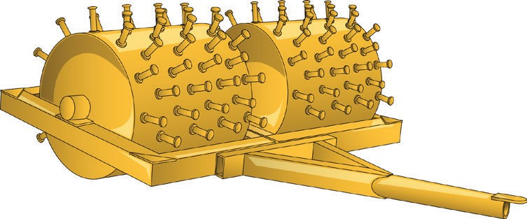
PC 1.6
INTRODUCTION TO ROLLER
QUESTION 1
What kinds of rollers are there?
Multi-rubber-tyred roller | Sheeps foot or padded roller
 | A roller can be self-propelled, towed or attached to another kind of machine such as a loader. Towed rollers include grid rollers and sheepsfoot rollers.
 | ...CONTINUES ON NEXT PAGE

Slide 9
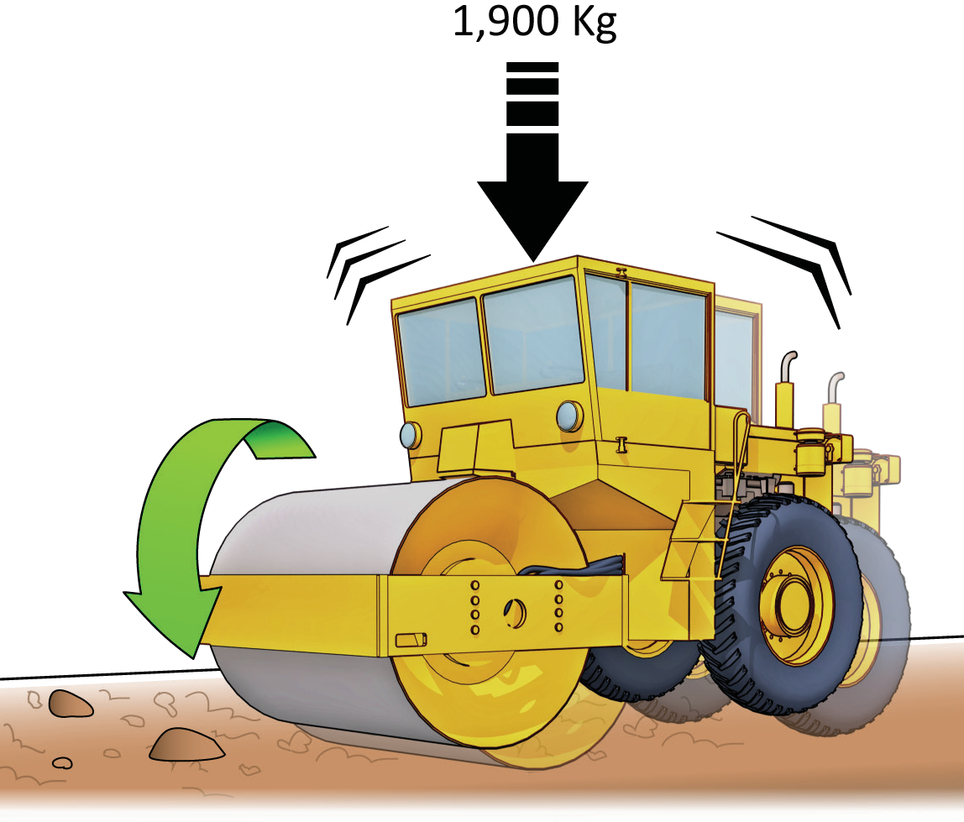
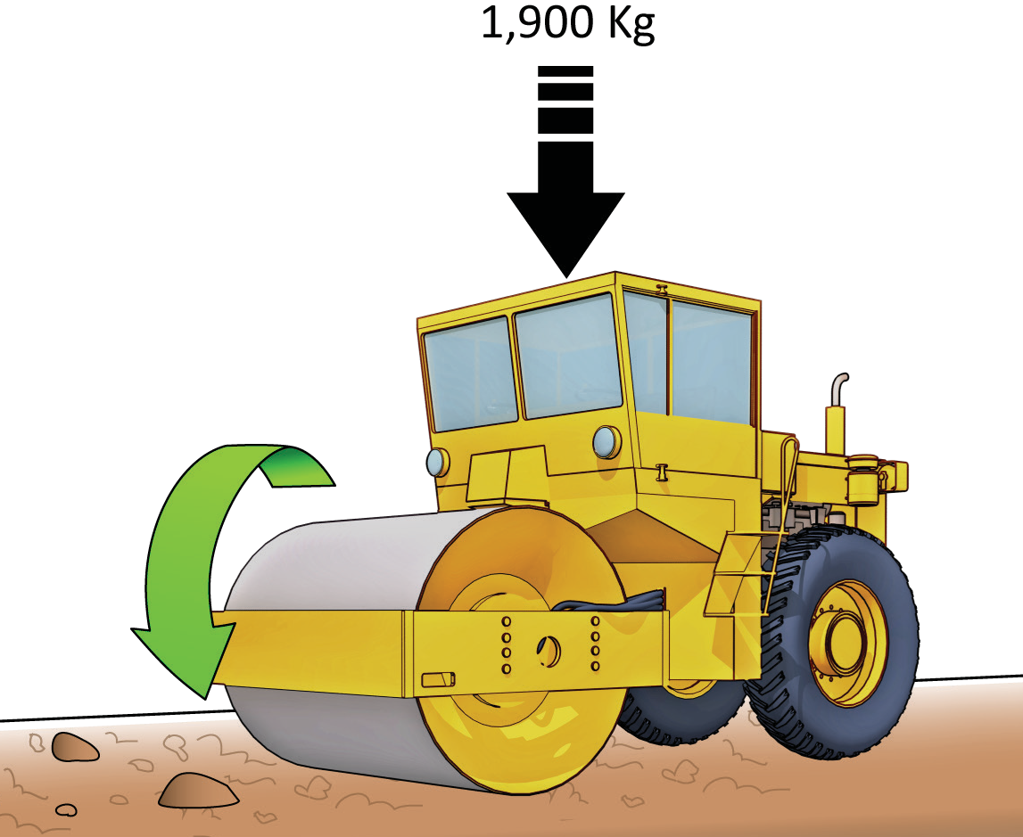
PC 1.6
INTRODUCTION TO ROLLER
QUESTION 1
Vibrating roller
...CONTINUED FROM PREVIOUS PAGE
What kinds of rollers are there?
Static/smooth roller

Slide 10

Plan and prepare for work
Chapter 1

Slide 11
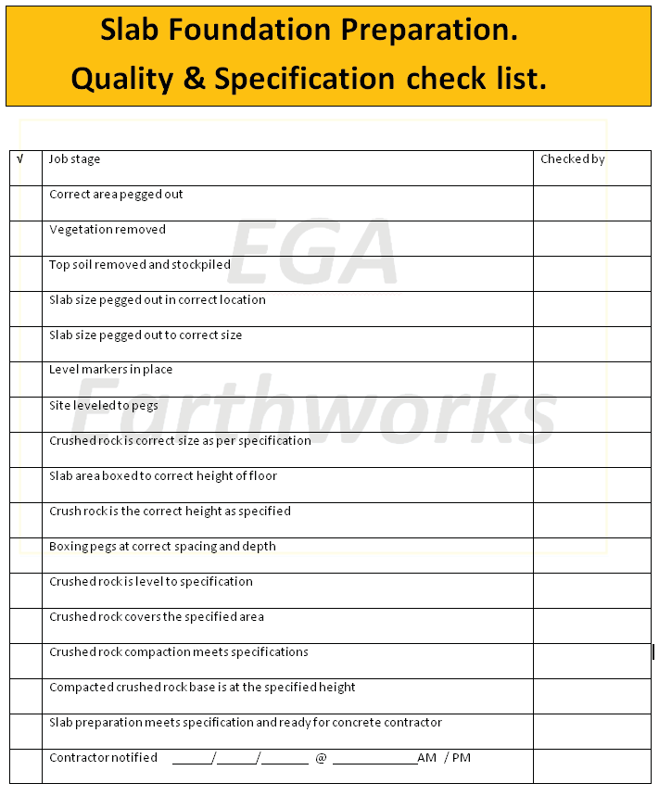

PC 1.2
PLAN AND PREPARE FOR WORK
QUESTION 2 What are quality requirements? | The quality requirements tell you the standards you must meet when doing earthmoving work. They tell you what you need to do and how to do it to satisfy the customer. You may need to follow Codes of Practice, regulations, national standards etc.

Slide 12
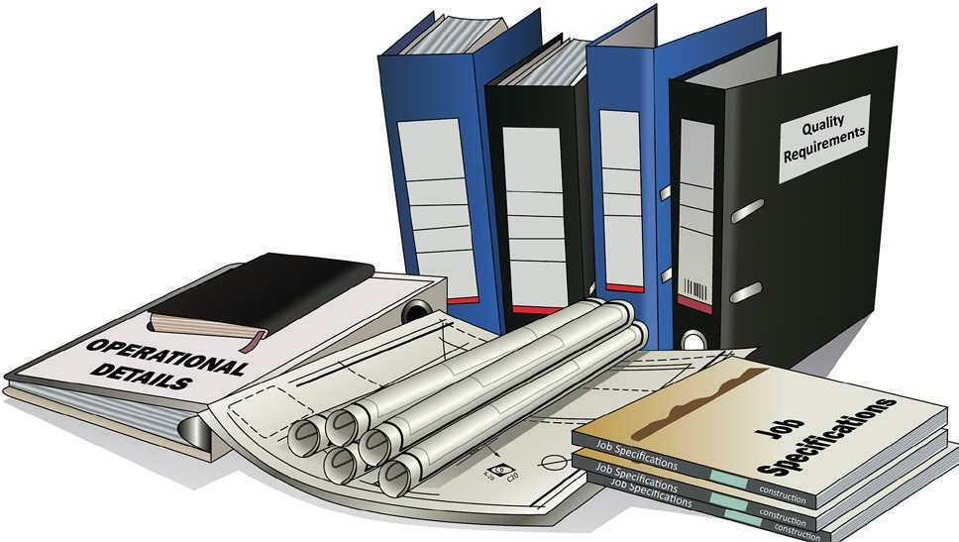
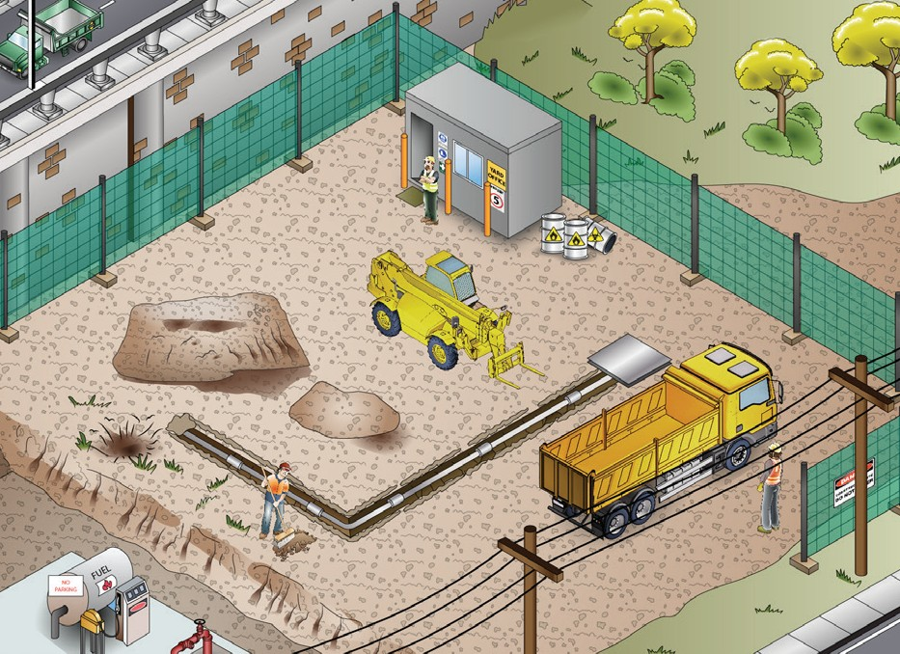
PC 1.2, 1.8
PLAN AND PREPARE FOR WORK
QUESTION 3 What kinds of information do you need before starting work? | Plans – Drawings and sketches that tell you what you need to do Specifications – rules and details about the job Operational details – how you will do the job Quality requirements of the job – the standards you are expected to meet.
QUESTION 4 When planning your job, why do you need to know what other people are doing on site? | To make sure you will not get in the way of other jobs being done To make sure you know what others are doing near where you must work.

Slide 13
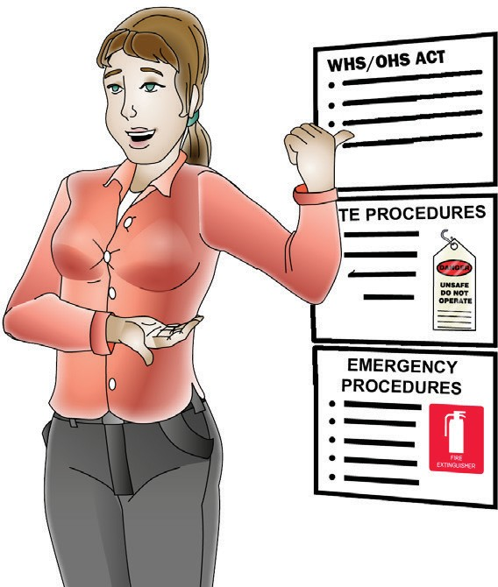
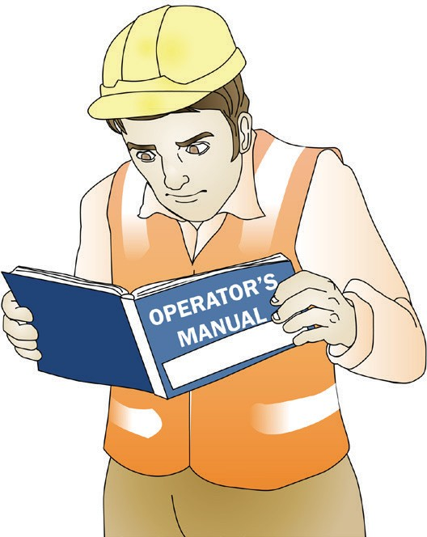
PC 1.1, 1.2
PLAN AND PREPARE FOR WORK
QUESTION 5 What are some examples of documentation you should read before doing earthmoving work? | Health and Safety Acts and Regulations Codes of Practice Standards (Eg: AS 2958 Earthmoving machinery) Manufacturer’s specifications Operator’s manuals Site requirements and procedures Work or quality requirements Drawings and sketches of the work to be done Company policies and procedures for Employment and workplace relations, Equal opportunity and disability.
QUESTION 6 Why should you check the operator’s manual before using earthmoving equipment? | The operator’s manual tells you how to operate your machine. The manual also tells you about maintenance (how to keep your machine working well).

Slide 14
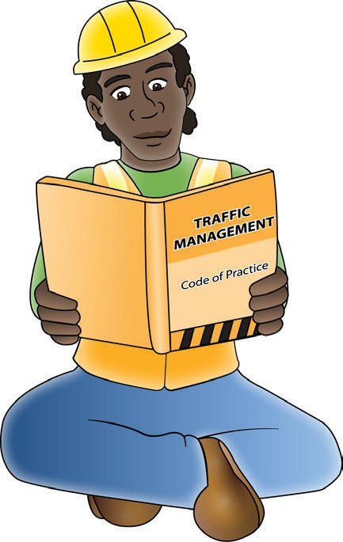
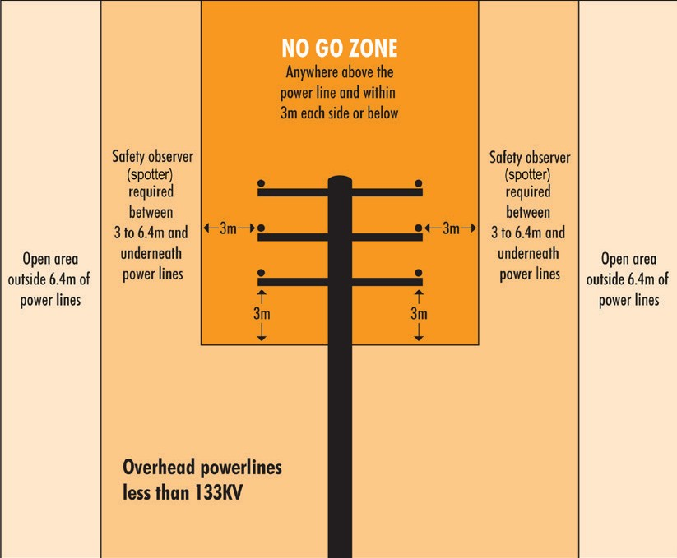
PC 1.1
PLAN AND PREPARE FOR WORK
QUESTION 7
What do codes of practice explain?
Codes of practice are practical guidelines on how to comply or follow the rules in legislation/laws.
For example:
A traffic management code of practice will tell you all the rules a traffic controller must follow. For example, a traffic controller must have a zero percent blood/ alcohol concentration/reading while performing traffic control duties.
QUESTION 8
What do Australian Standards explain?
Australian standards are work guidelines that set the minimum accepted performance or quality for a specific hazard process or product.
For example:
AS2550.1 — Powerline distances This standard tells you the distances
you can safely work near powerlines on poles and towers.

Slide 15
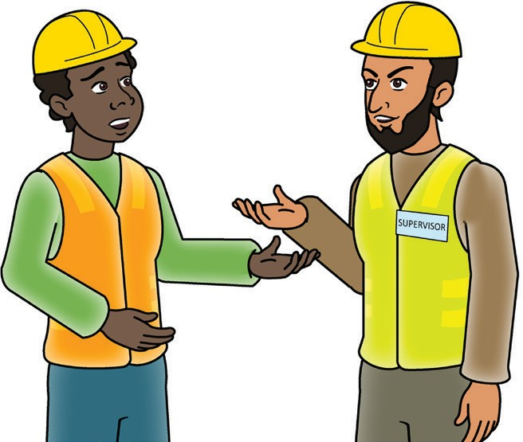

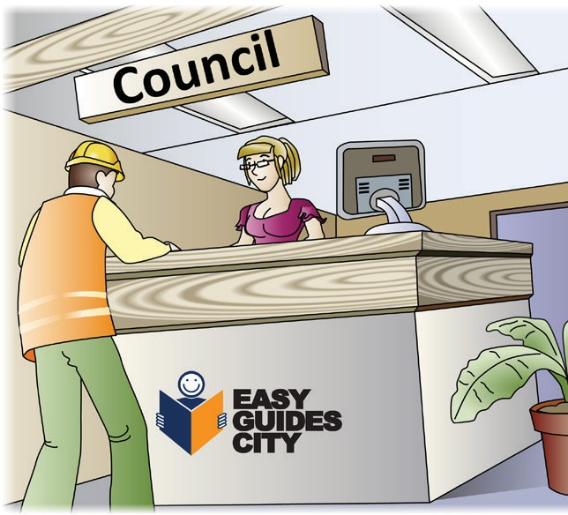
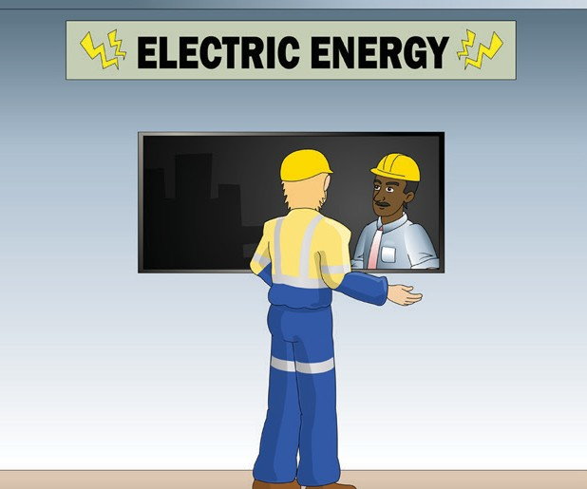
PC 1.8
PLAN AND PREPARE FOR WORK
QUESTION 9
Who can you ask about underground services on the worksite?
Ask your site supervisor | Call 'Dial Before You Dig' on 1100 as a guide to services location only. Ask a specialist consultant to check the site.
Ask the local supply authority (for example, the electricity, gas or water company). | Check the council maps for the site.

Slide 16
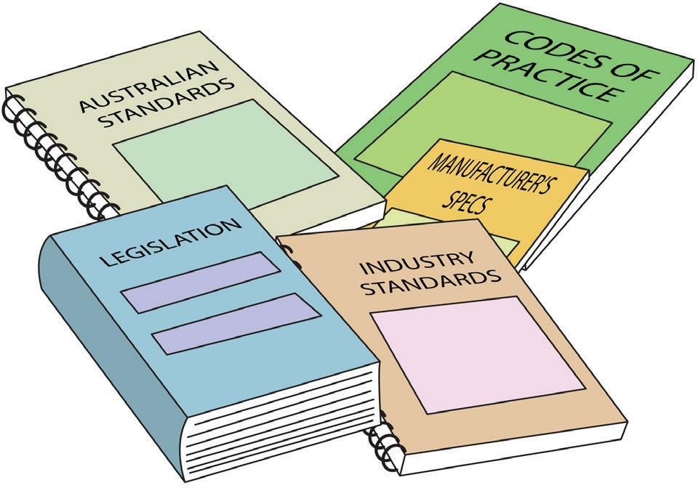
PC 1.1
PLAN AND PREPARE FOR WORK
QUESTION 10
What are the National Work Health (WHS) and Occupational Health and Safety (OHS) Acts about?
The Acts explain how to keep your workplace safe and healthy. They explain what you need to do to meet your duty of care.
For example:
You must make sure you do earthmoving work in a way that won’t put yourself or others at risk. You must use earthmoving equipment according to instructions.
Note: Check your state requirements as Acts may vary from state to state

Slide 17
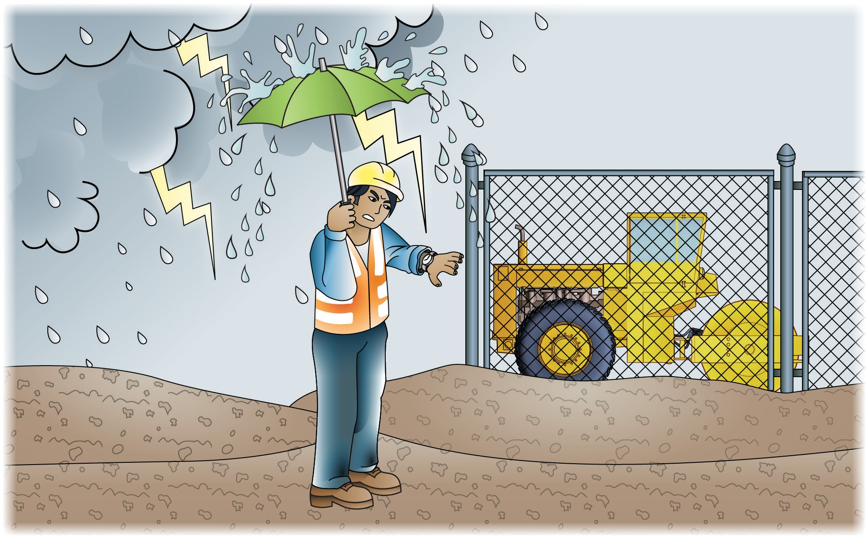
PC 1.2
PLAN AND PREPARE FOR WORK
QUESTION 11
What do the job’s work instructions explain?
Work instructions explain:
What to do in unexpected situations like bad weather
What the job is
Where the job is
How to do the job safely
How long the job will take
What tools and equipment you need
How to do the job from start to finish

Slide 18
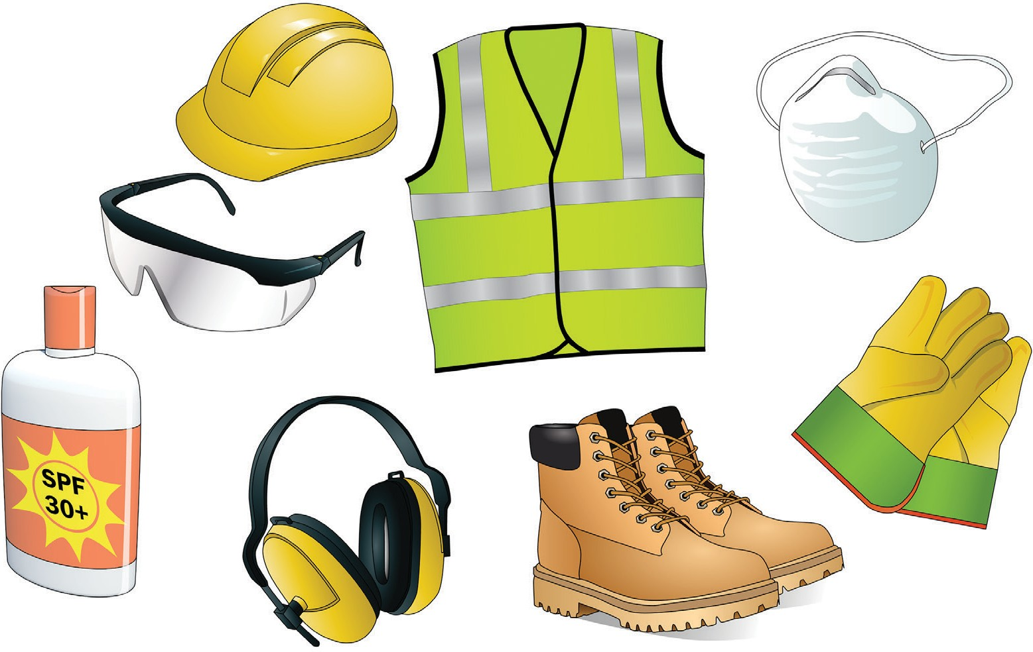
PC 1.1
PLAN AND PREPARE FOR WORK
QUESTION 12
What does the safety plan tell you?
The safety plan tells you how the worksite intends to meet all the safety rules. It tells you:
What personal protective equipment (PPE) to wear
...CONTINUES ON NEXT PAGE

Slide 19
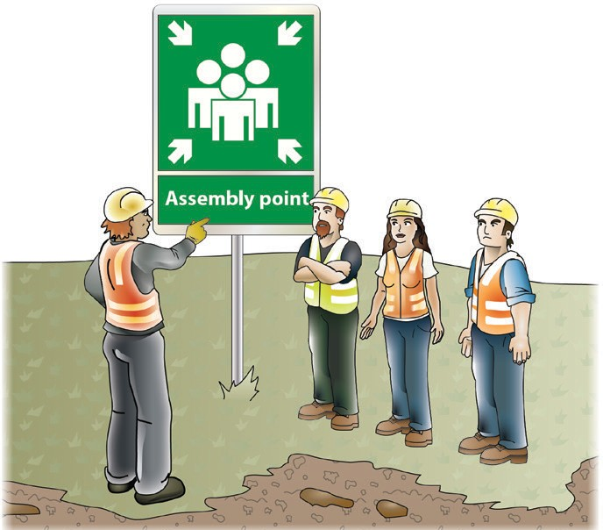
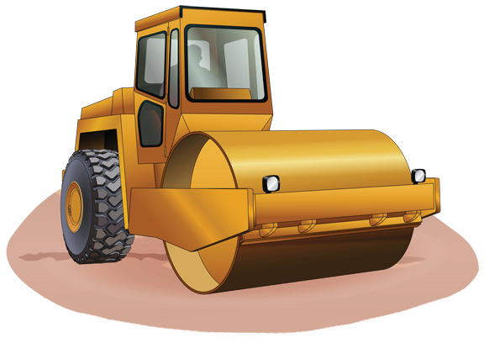
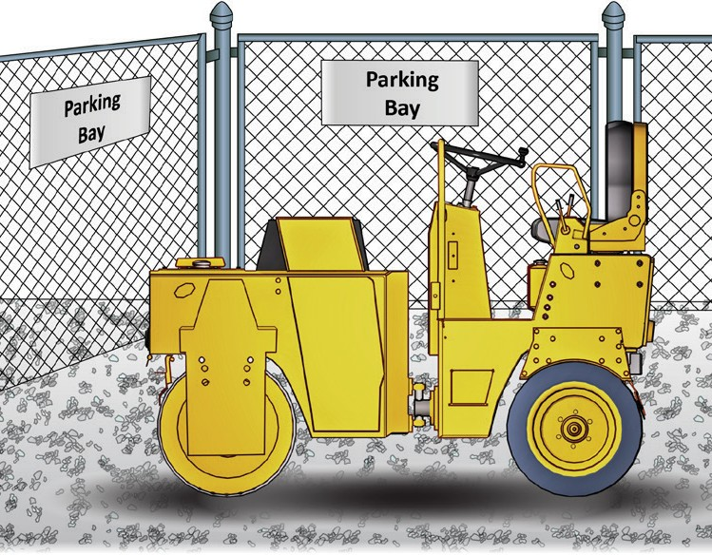
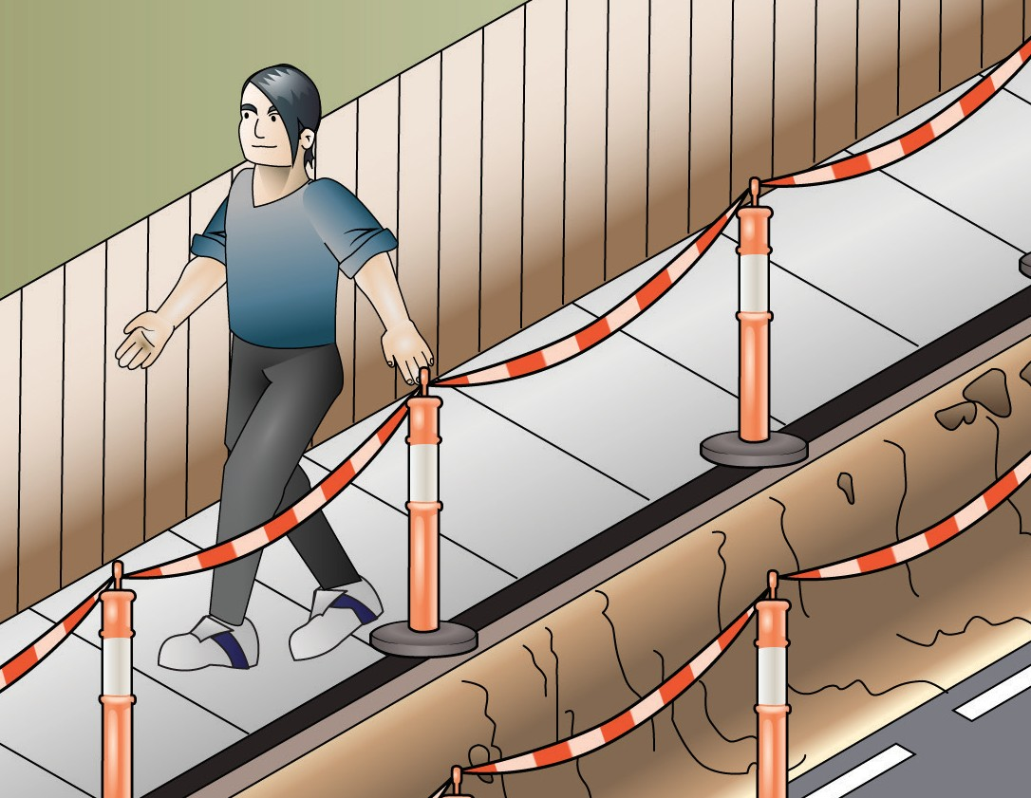
PC 1.1
PLAN AND PREPARE FOR WORK
QUESTION 12
How to use tools, plant and equipment safely | Emergency procedures and exits
How to park safely and where to park | Control hazards and risks
...CONTI
NUED FROM PREVIOUS PAGE
What does the safety plan tell you?

Slide 20
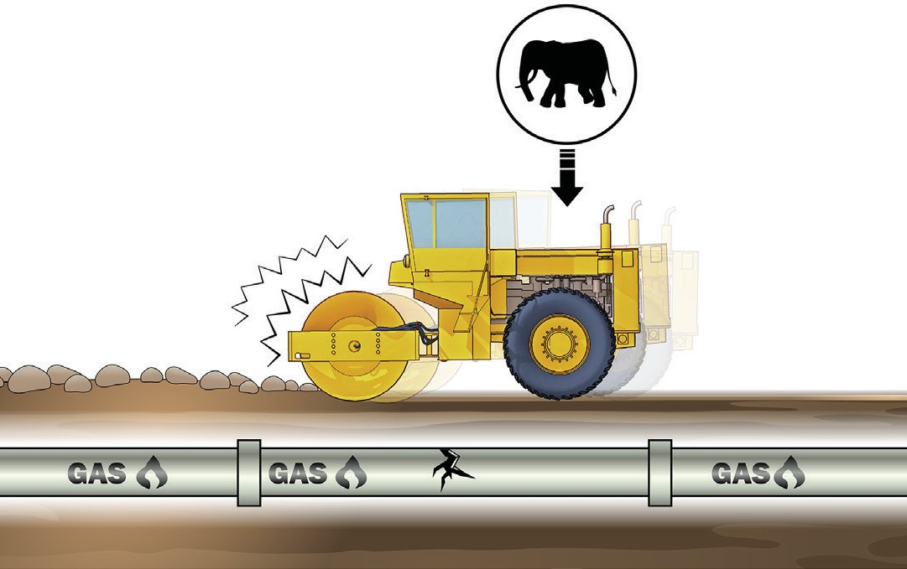
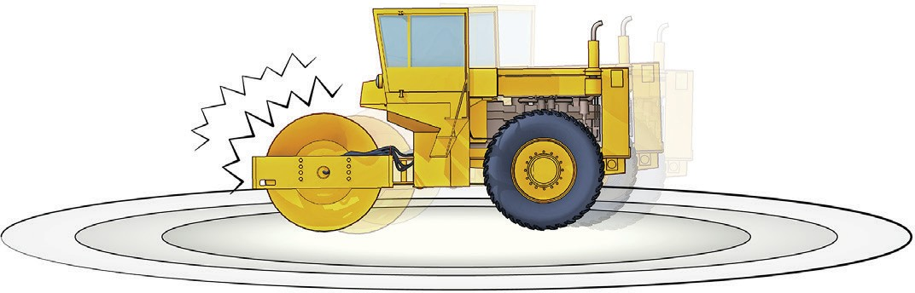
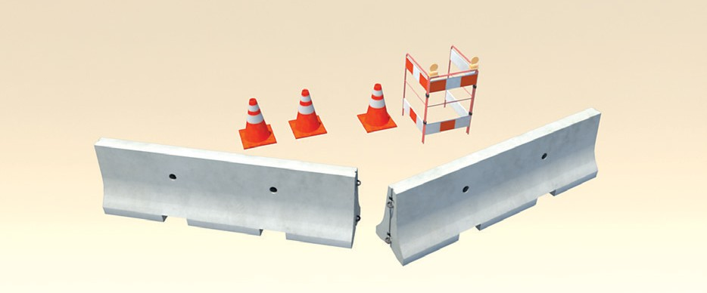
PC 1.3
PLAN AND PREPARE FOR WORK
Risks of using a roller near infrastructure
A roller passing over, beside or near underground infrastructure can cause damage, this damage may not be immediately visible and not cause a problem until sometime after the job is complete.
An example is the cracking of a water pipe which leaks and the water erodes away the soil supporting a road or foot path causing a cave in.
The vibrating effect of a roller greatly increases the tremor in the soil surrounding the roller drum.
The ground tremor can damage underground services such as water and gas pipes and can cause collapsing of trenches etc.
Ask the site engineer about the distance you should keep your roller away from services when using the vibrating system.
Place markers such as pegs, cones or barriers at a safe distance from the underground services. This will help remind you of the services.

Slide 21
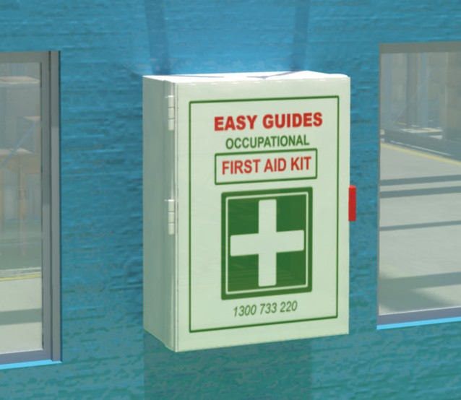

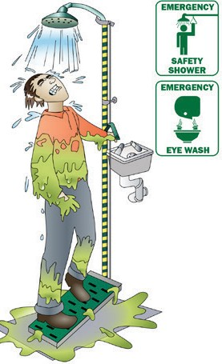
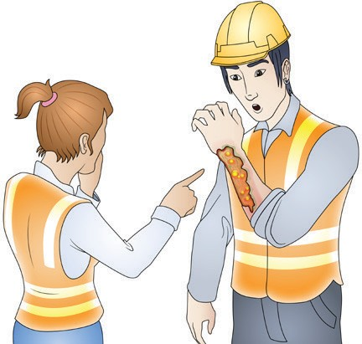
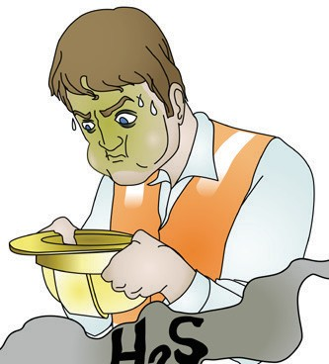
PC 1.7
PLAN AND PREPARE FOR WORK
First aid and emergencies
Employers should make sure there are trained first aiders and first aid kits available.
The employer should make sure:
The first aid kits are checked, maintained and kept in a clean dry place
There are clear signs indicating the location of first aid kits
They have recorded and displayed the numbers and location for emergency services (or local doctors or hospitals).
Reporting incidents
As a PCBU, employer or self-employed person you must report serious incidents to the SafeWork authority in your state.
You must give a written report within 48 hours if any of the following happen on a site you are controlling:
A death | An injury that requires medical treatment | Exposure to a substance that requires treatment | Other injuries or health issues caused from a workplace incident.
The authorities may send an inspector to come and examine the site. You must leave the site as it is, unless you need to; protect people, help an injured worker, make the site safe, or stop other incidents happening. The inspector will tell you when you can continue working normally.

Slide 22
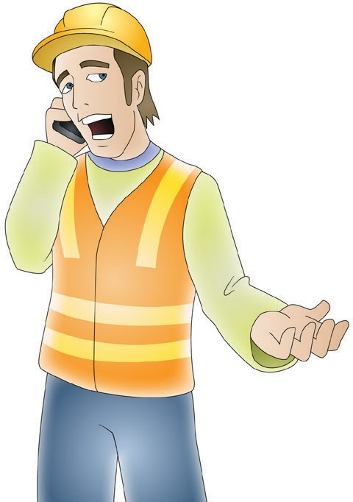
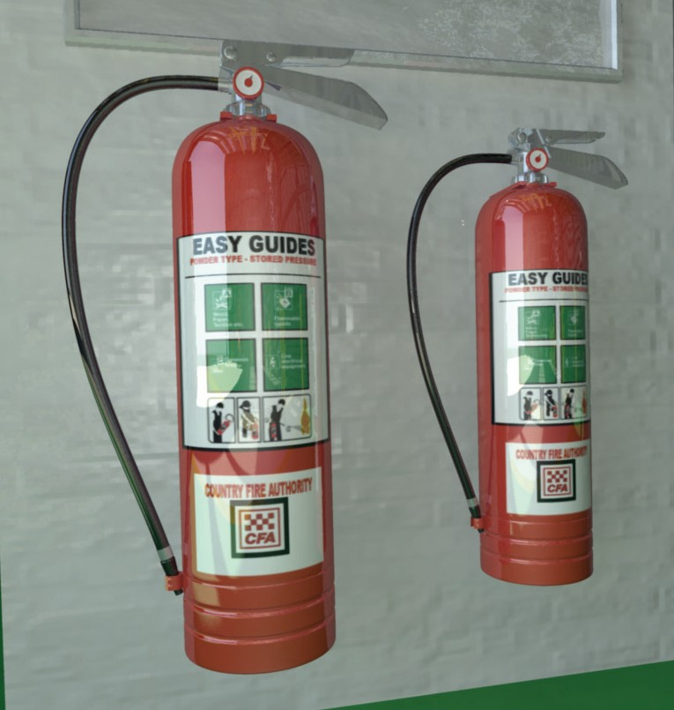
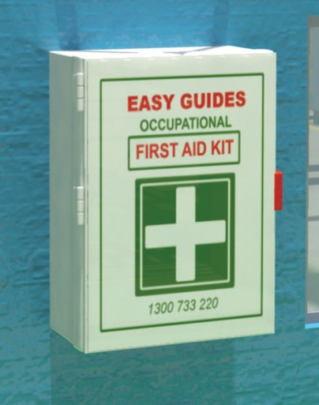
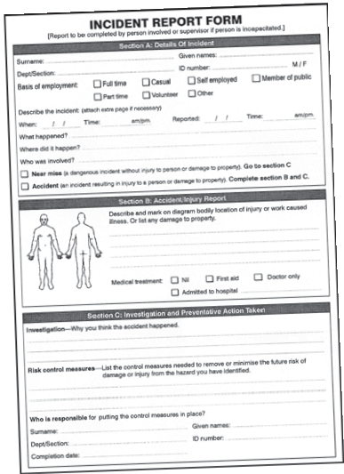
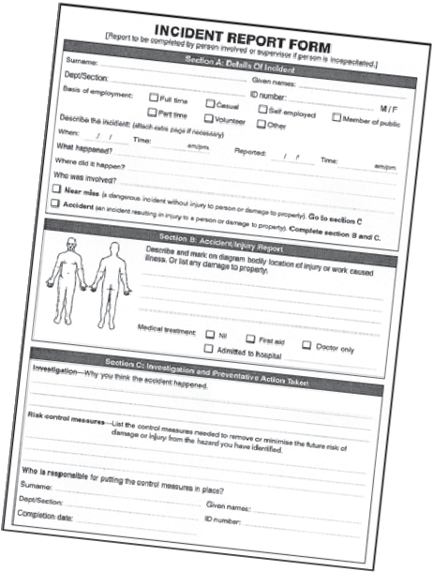
PC 1.7
PLAN AND PREPARE FOR WORK
QUESTION 13
What equipment should be on site to deal with an emergency?
Telephone | Fire extinguishers
First aid kit | Incident reporting form

