Slide 1
EASY
Making Safety Simple
GUIDES www.easyguides.com.au
Australia Pty Ltd

Slide 2
The Easy Guides Series
Safety & Licence Guide
OH&S National Certificate of Competency
RIDE ON MOWER
www.easyguides.com.au

Slide 3
EMPLOYEES
An employee must take care of his/her own health and safety and the health and safety of others in the workplace.
Employees must not place themselves or others at risk.
Employees must carry out tasks or use equipment according to any safety instruction.
Employees must cooperate with employer and follow all systems or procedures in the workplace to the extent necessary to allow compliance with the Act.
3

Slide 4
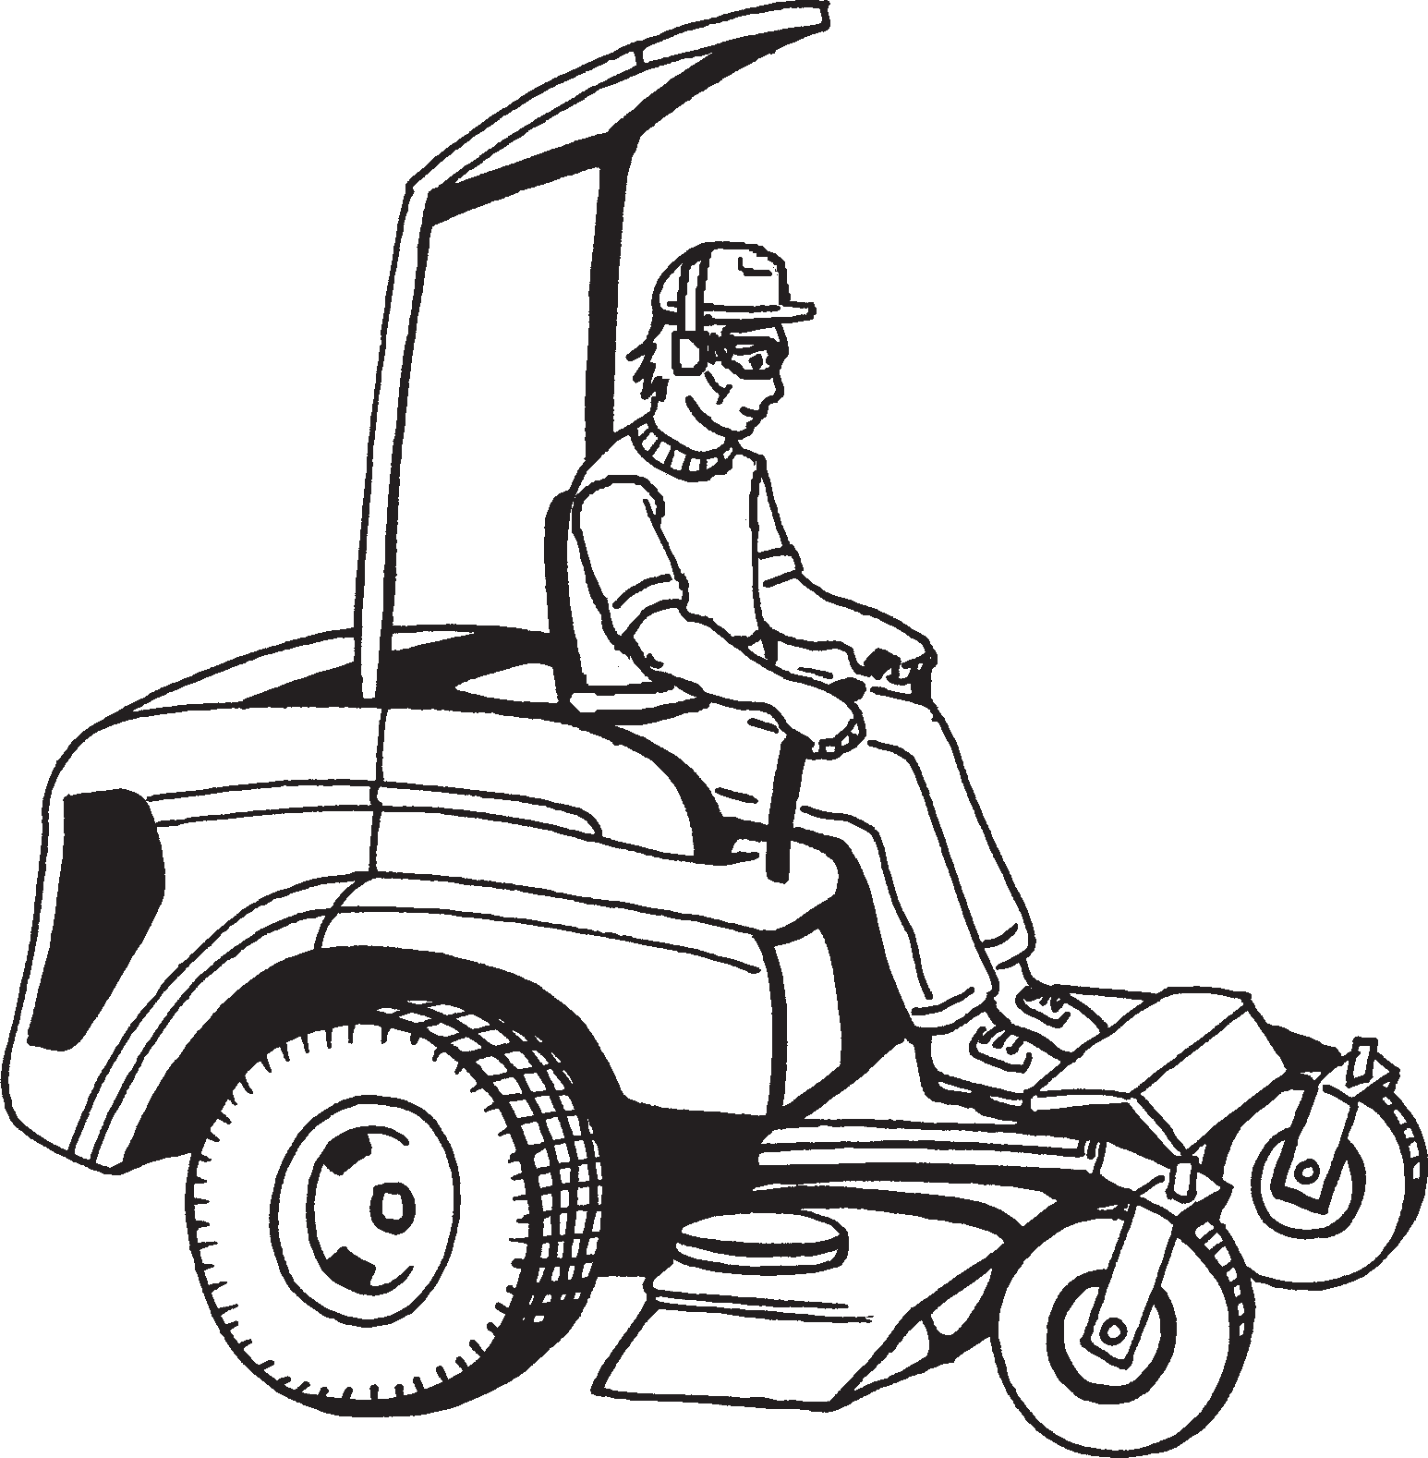
This book is for operating a ride-on mower
A ride-on mower is:
A powered mower where you sit at the controls. It looks like a small tractor,
with the cutting deck mounted between the front and rear axles.
Another type of ride-on mower has
a rear-mounted engine with rear-wheel steering and a front-mounted deck.
It steers better around tight corners than the tractor-style but is more expensive. Most of these machines cut with horizontal rotating blades.
4

Slide 5
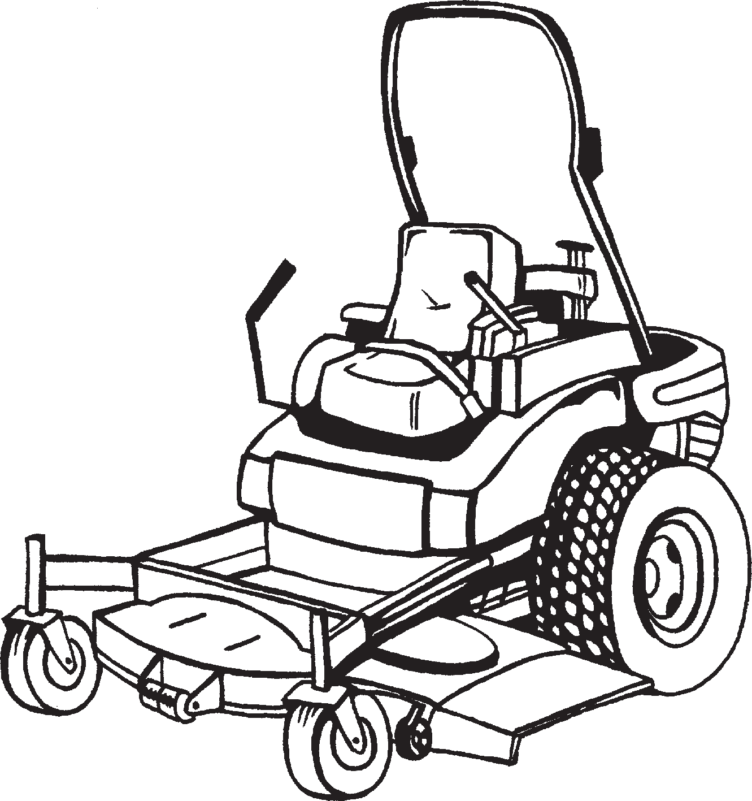
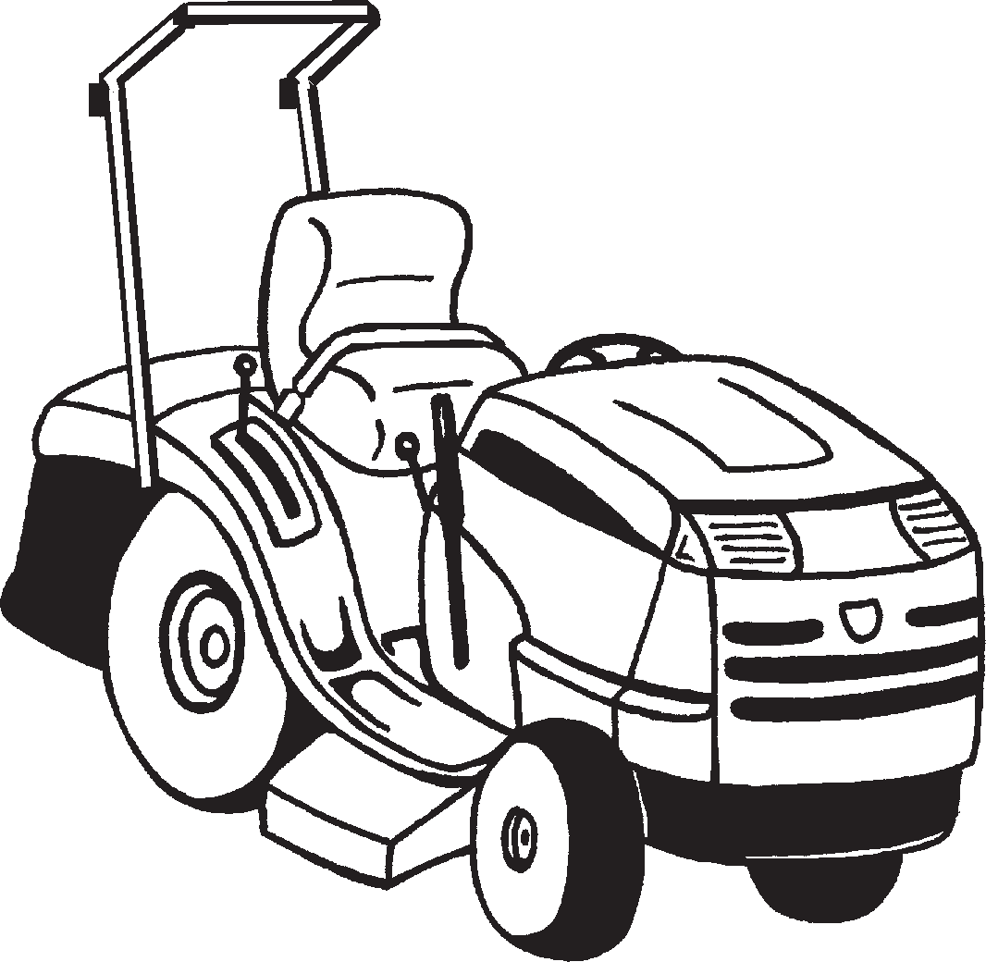
Example of a ride-on mower
Zero turn mower
Rollover protective
Tractor-style mower
Rollover protective structure (ROPS)
structure (ROPS)
Safety light
Seatbelt (must be fitted and worn)
Power take- off (PTO) covers (must be on at all times)
Seatbelt (must be fitted and worn)
Chute guard
Cutting deck
5

Slide 6
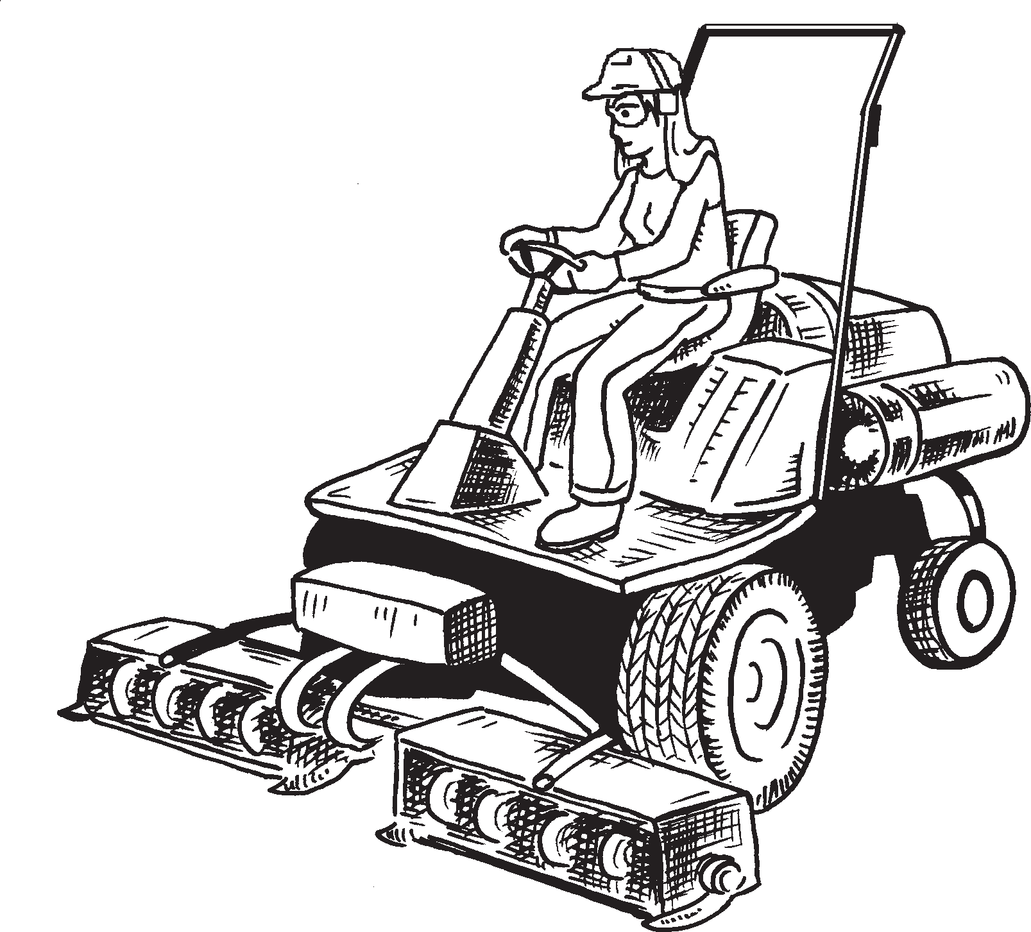
PART 1
KNOWLEDGE TRAINING ACTIVITIES
to operate a ride-on mower safely
6

Slide 7
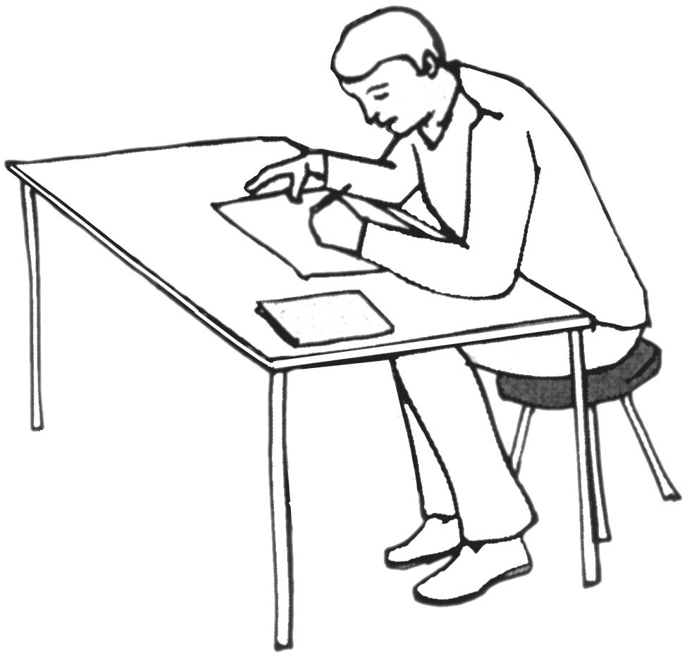
Training ideas KNOWLEDGE QUESTIONS
Introduction to training tasks
There are lots of ways you can use this book as a training tool.
The following ideas are suggestions only. You and/or your trainer can decide which ones are best for you.
Training Idea 1
LOOK - COVER - WRITE - CHECK
First, read all of the questions in the knowledge section of this guide. When you have read and understood the information, try the following:
Carefully LOOK at each question and answer. COVER the answer. WRITE the answer on a pad. CHECK your answer. If not right, try again.
7

Slide 8
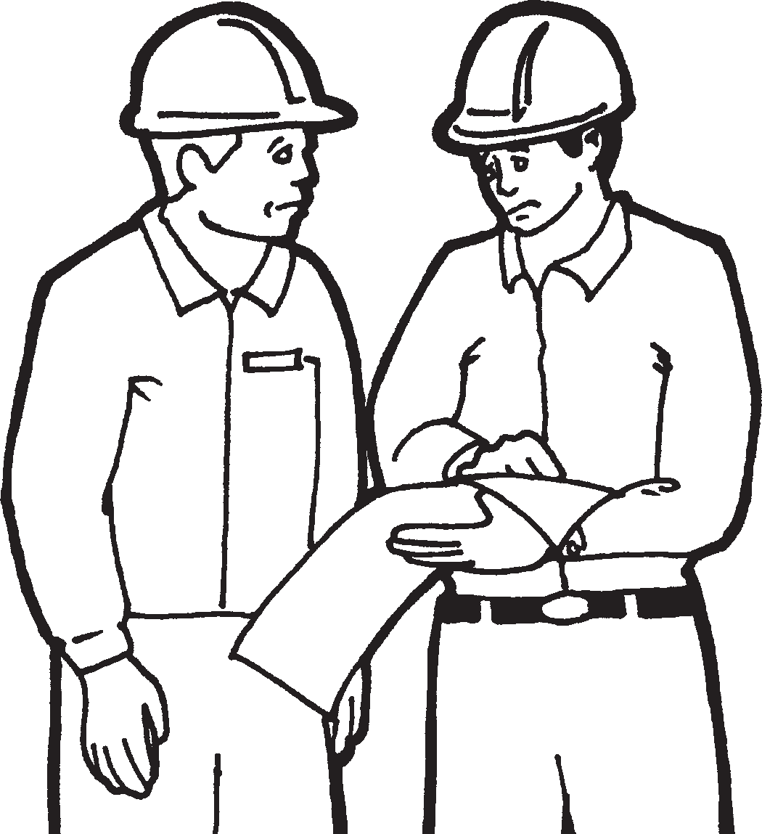
Training idea 2
Get a workmate to test you on each question.
☑
Read all of the knowledge questions and answers. Make sure you understand each one. If you do not understand a question, ask someone who is an experienced ride on mower operator - they may be able to explain the answer to you. When you feel ready, ask someone to ask you each question. Tick ✓ the ones you get right. Keep learning until you know and understand all of the questions and answers.
Training idea 3
Use the ride-on mower PowerPoint presentation
This training task can be done individually or as a class training activity.
Put the PowerPoint CD into the computer. Click the mouse until the first question comes onto the screen. Write down what you think the answer is (don’t cheat and look ahead!). Click the mouse again and the picture and answer will come onto the screen. Check your answer to see if it is right. Add extra details you may have missed.
8

Slide 9
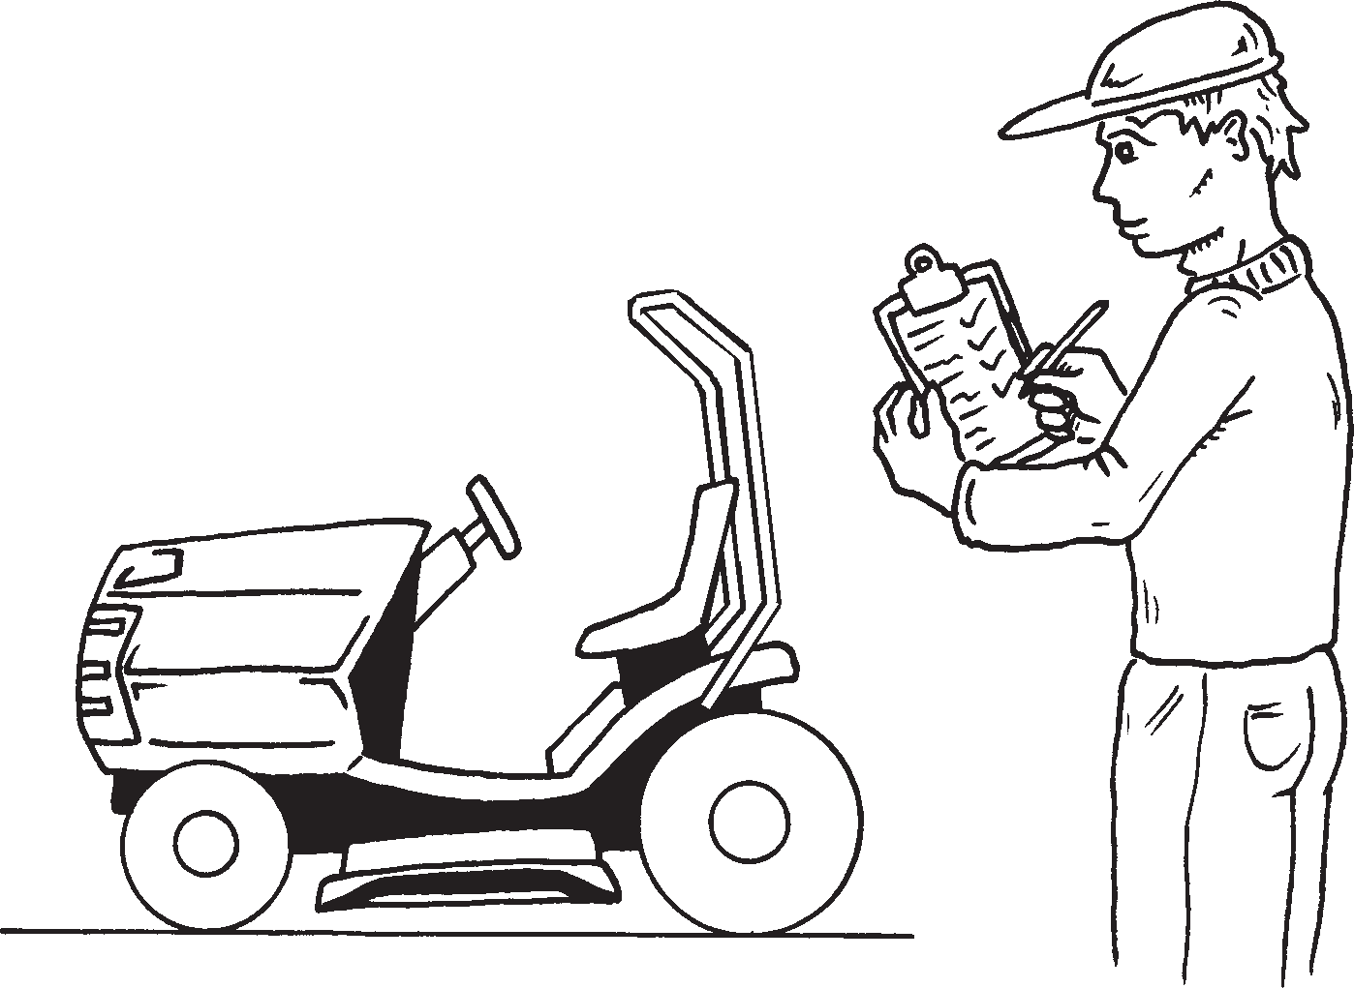
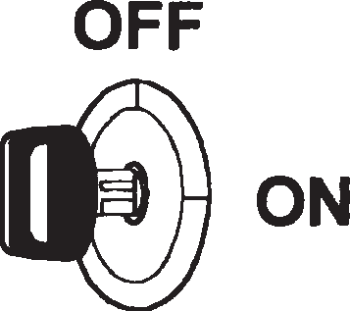
PART 1 - A GUIDE TO THE KNOWLEDGE QUESTIONS
To know how to operate a ride-on mower safely, you will need to show a good knowledge of the following:
UNIT 1 - CONDUCT ROUTINE CHECKS AND PLAN WORK
UNIT 2 - OPERATE MOWER
UNIT 3 - SHUT DOWN EQUIPMENT
9

Slide 10
UNIT 1
CONDUCT ROUTINE CHECKS AND PLAN WORK
When planning to use your ride-on mower it is important to have the knowledge needed to operate safely. The information in Unit 1 will help to give you this knowledge.
10

Slide 11
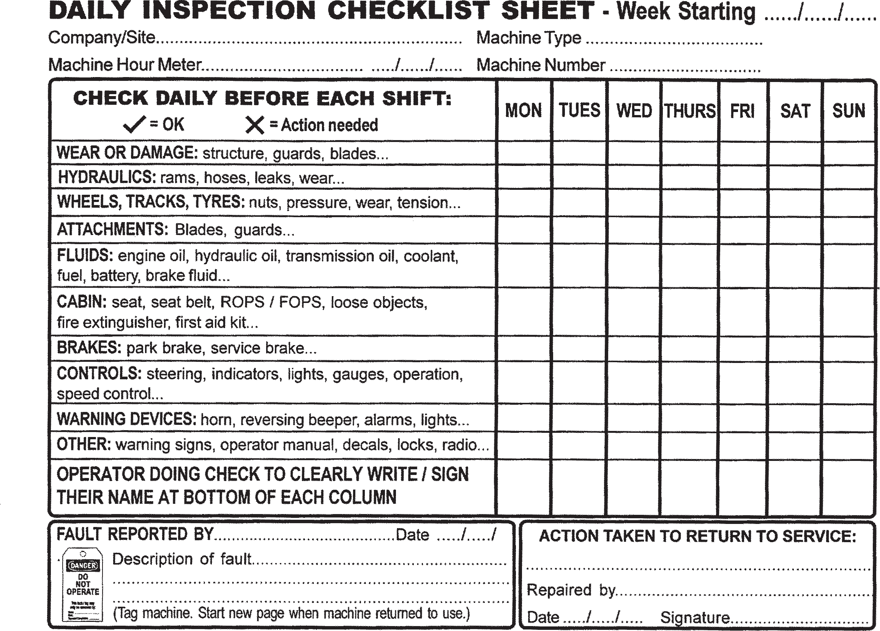
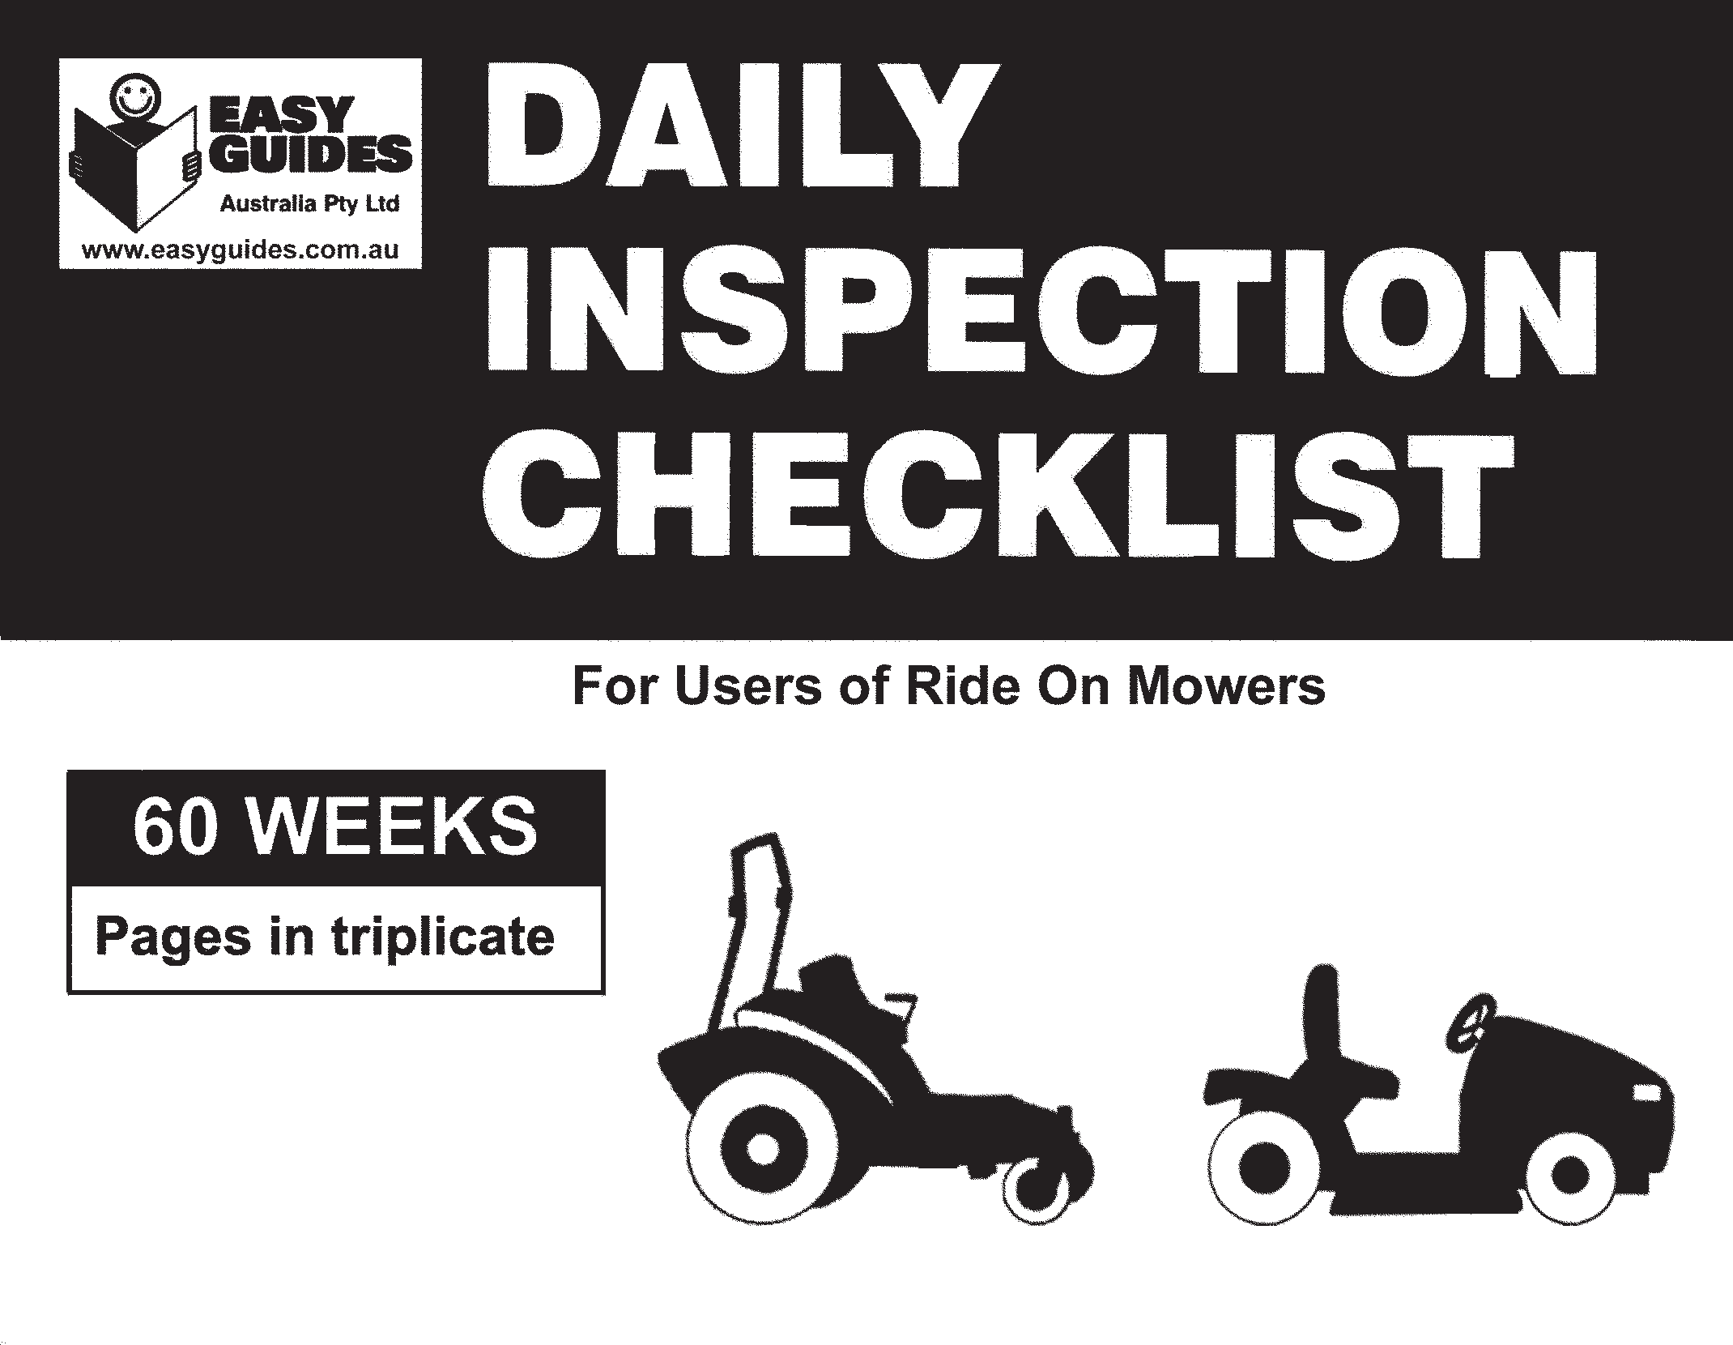
DAILY INSPECTION CHECKLIST
A checklist may be kept on your machine. It can be used to record defects, routine maintenance and other work that needs to be done.
PRE-CHECKS are necessary before operating a ride-on mower. Pre-checks are used to identify DAMAGE, PREVENT ACCIDENTS and to make sure the ride-on mower is SAFE TO USE.
11

Slide 12
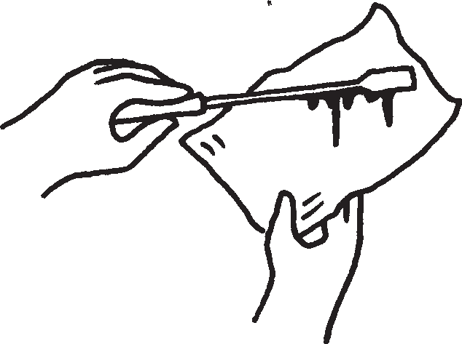
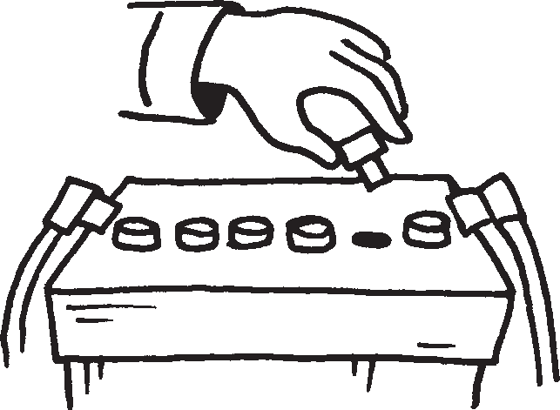
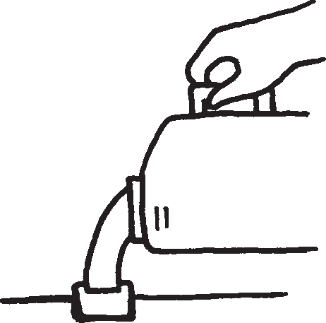
Question 1. Inspect your mower before using it. Name at least four liquid levels you inspect.
Answer: (Choose from the following.)
Hydraulic oil
Engine oil
Transmission oil
Brake fluid
Battery security, water level and cleanliness
(Extra information not in assessment:
Unless a maintenance-free battery)
Fuel
Cooling water
12

Slide 13
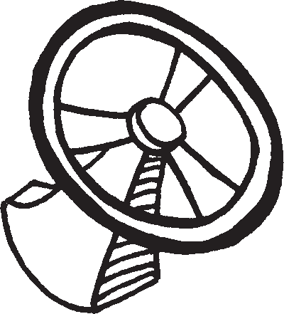
Question 2. Inspect your mower before using it. Name at least four parts you inspect.
Answer: (Choose from the following.)
Brakes
Controls
Steering
Lights
(NOTE: Continued on next page)
13

Slide 14
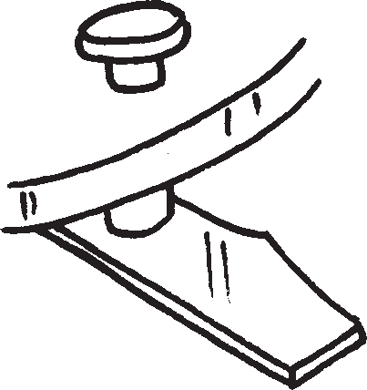
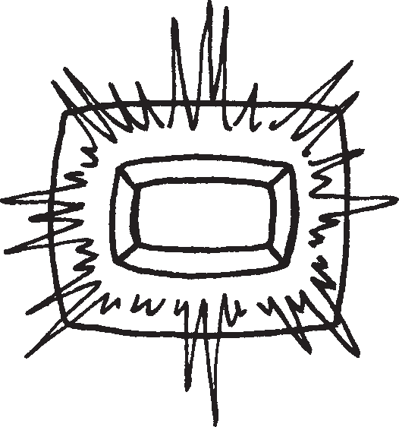
Question 2 (continued)
Warning devices
Attachments (blades)
Security of attachments
ROPS
Rollover protective structure
Tyres
14

Slide 15
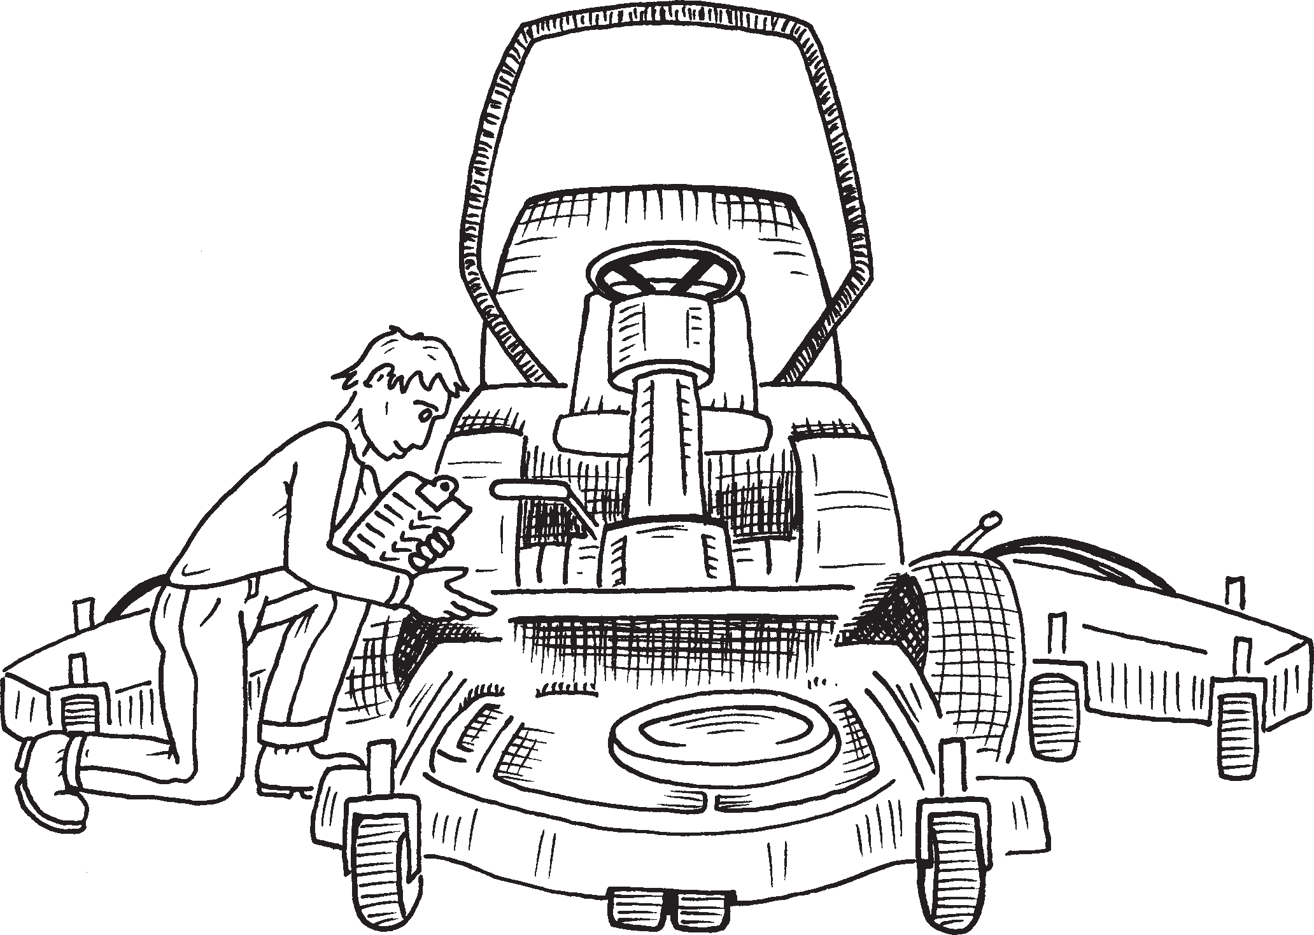
Question 3. Why are pre-start operational checks necessary?
Answer: To identify damage, prevent accidents and to make sure the mower will work safely.
15

Slide 16
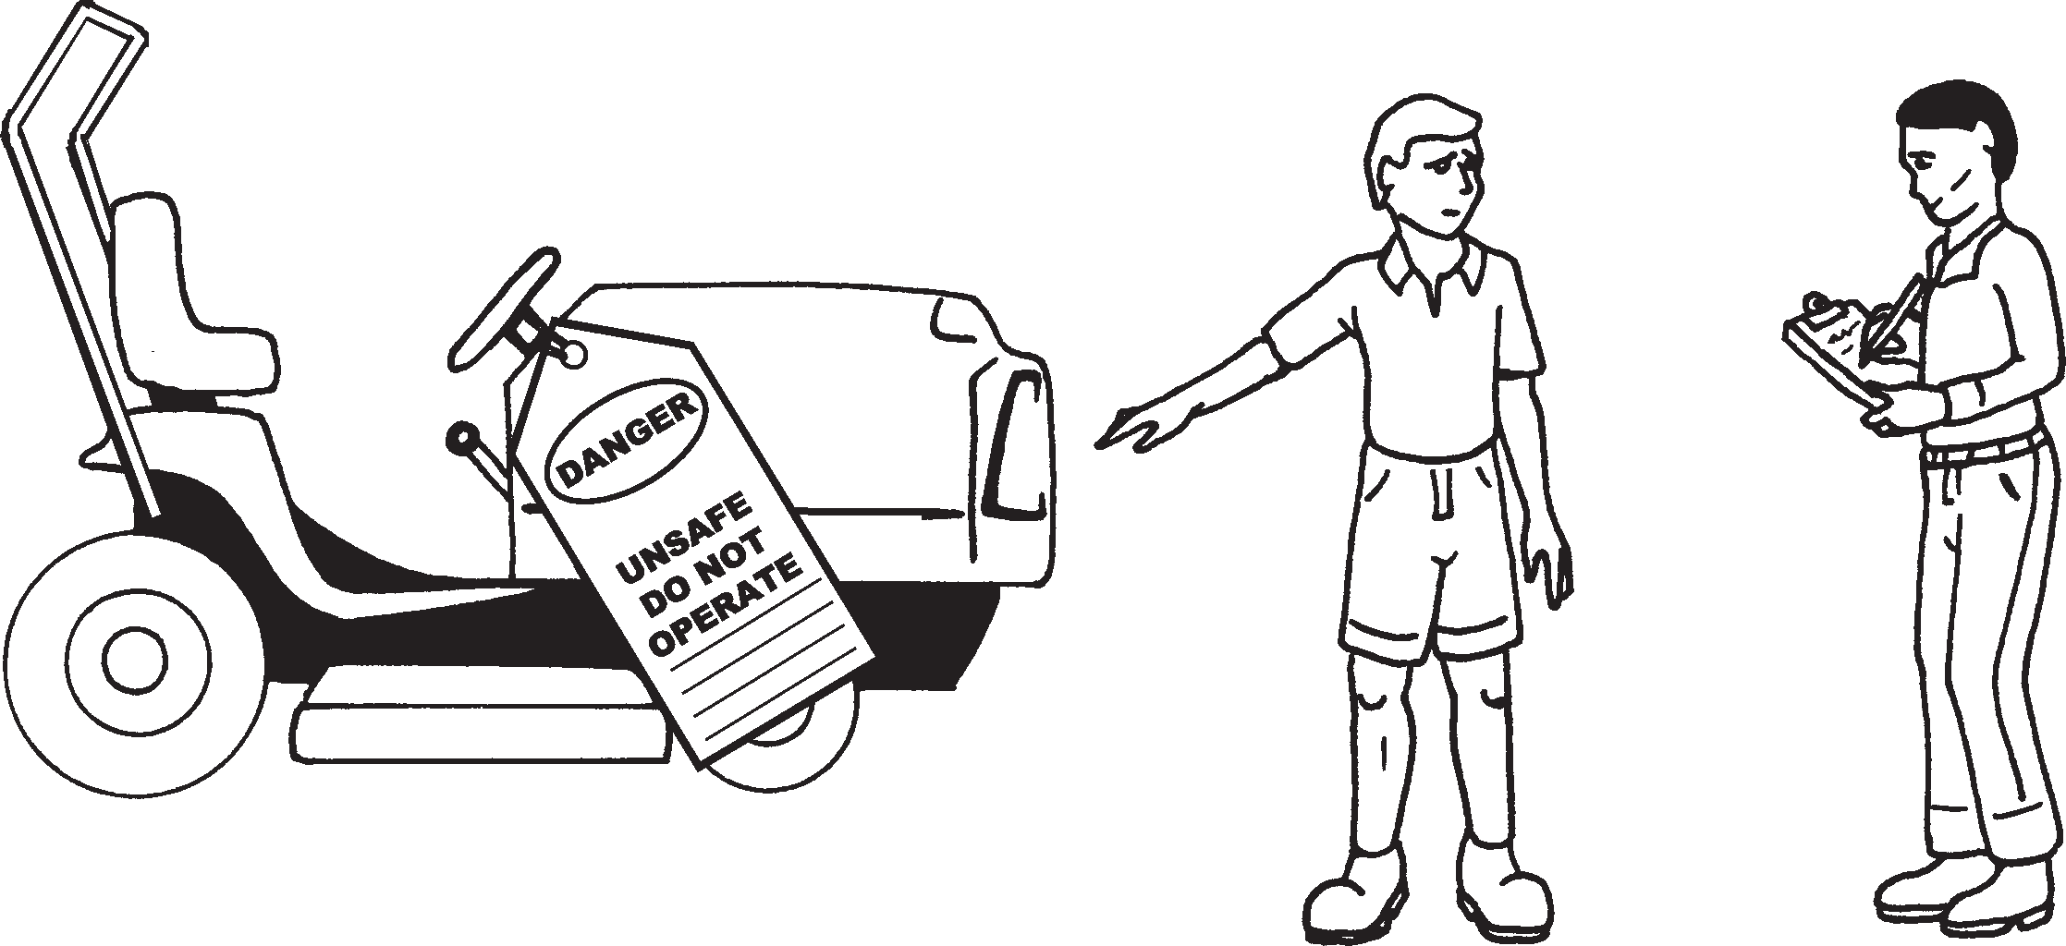
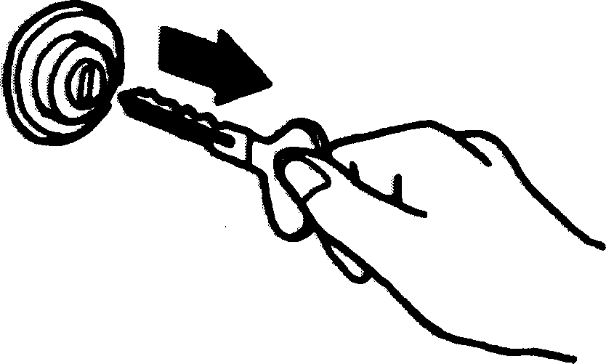
Question 4. If you find any defects what must you do?
Remove the keys
Answer: Report the defect to an authorised person in charge and tag the mower.
16

Slide 17
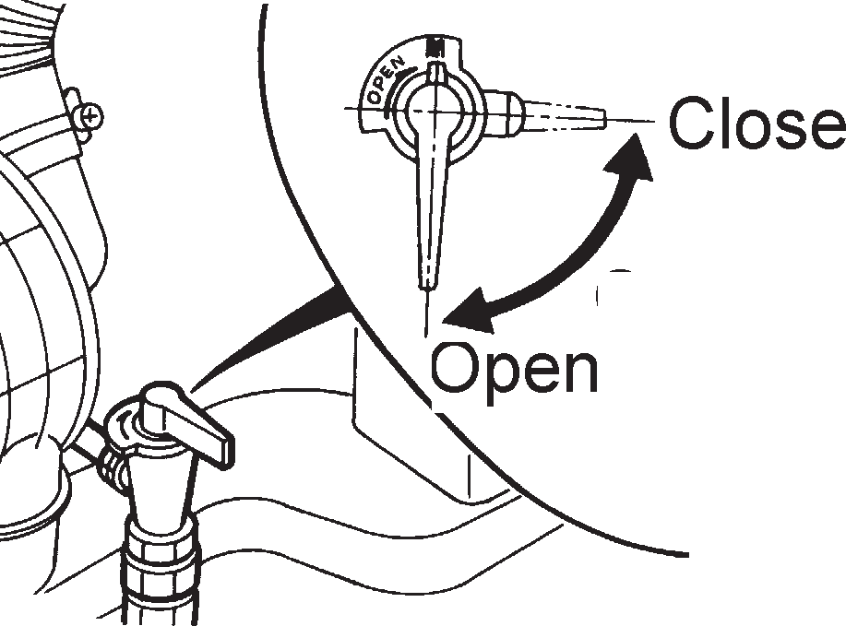
Question 5. What should you do if you find a leak in the fuel system?
Answer:
Remove the keys
1. Stop the machine immediately!
2. Isolate the fuel supply if possible
3. Put a danger do not use tag on the mower showing that the mower must not be used.
4. Report the leak to an authorised person.
17

Slide 18
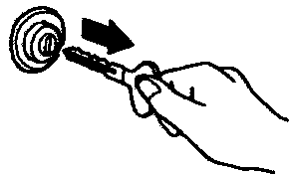
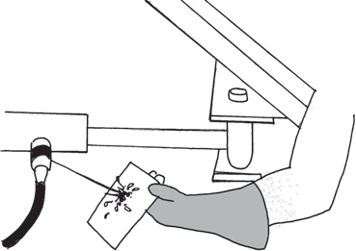
Question 6. What should you do if you find a hydraulic leak during your pre-start operational check?
Answer:
Remove the keys
1. Put a danger do not use tag warning on the mower showing the mower must not be used.
2. Report it to an authorised person
18

Slide 19
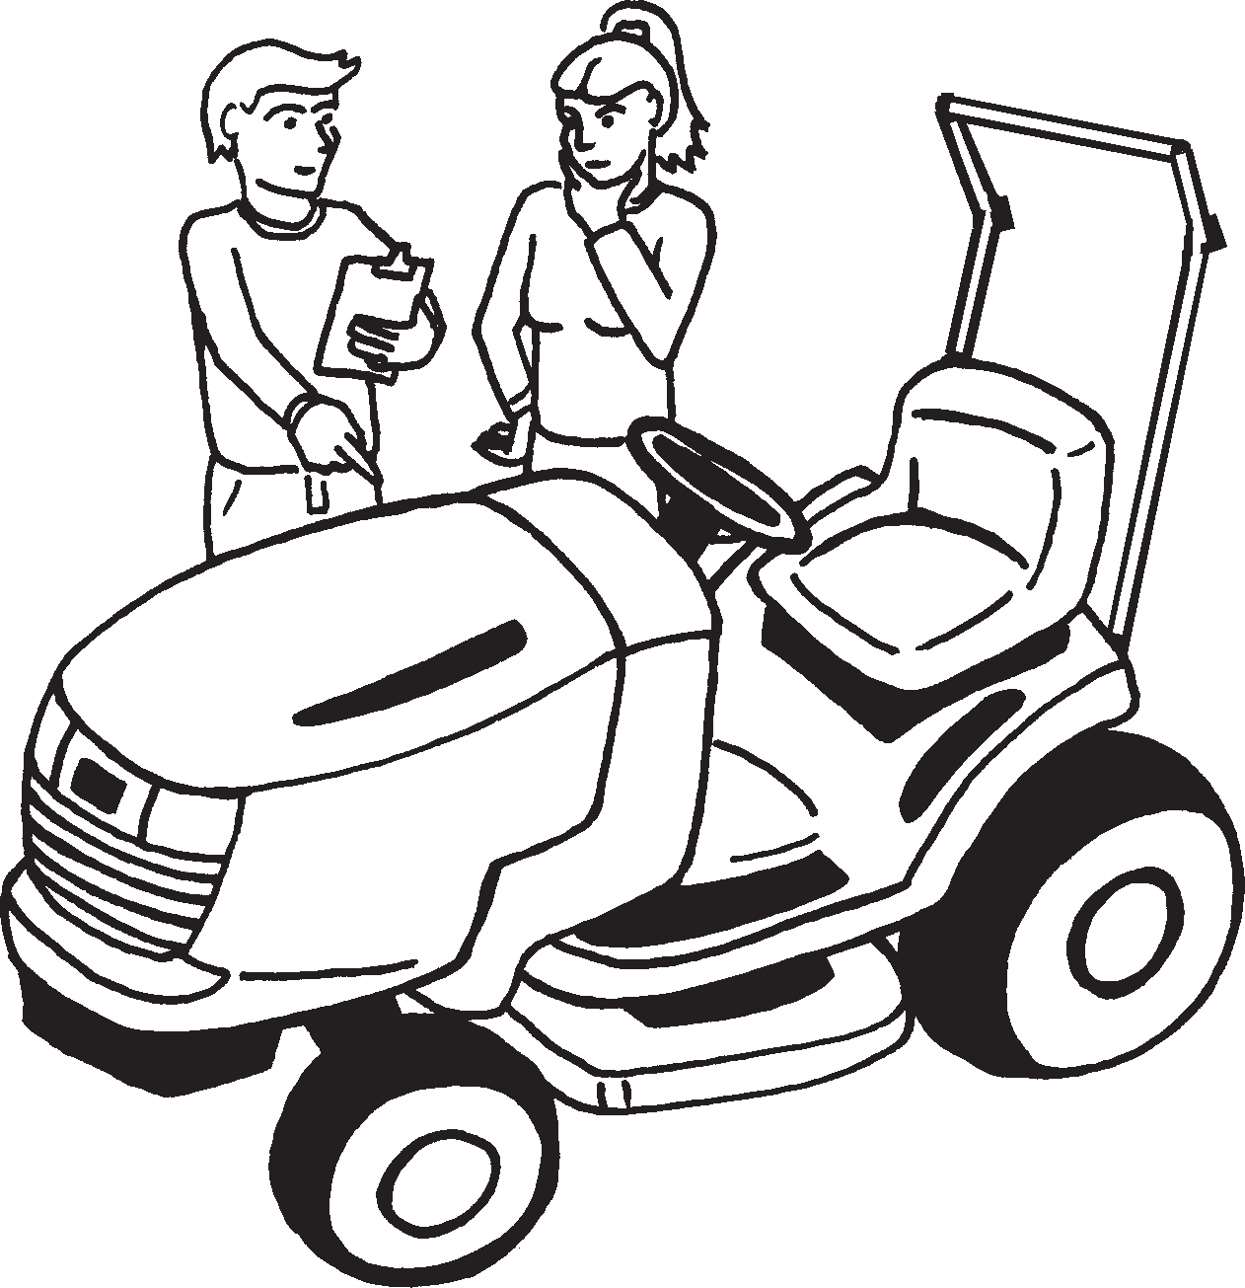
Question 7. Is an untrained person allowed to operate a ride-on mower without supervision (explain your answer)?
Answer: NO! The operator must be supervised and trained before being allowed to use the mower on their own.
19

Slide 20
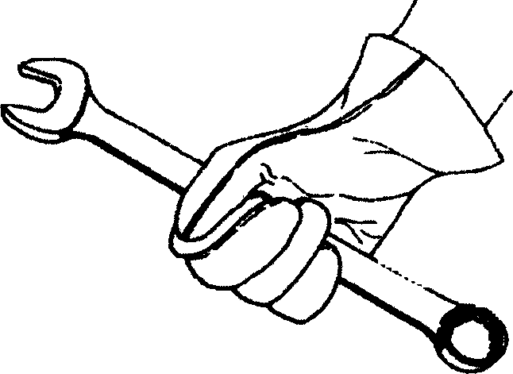
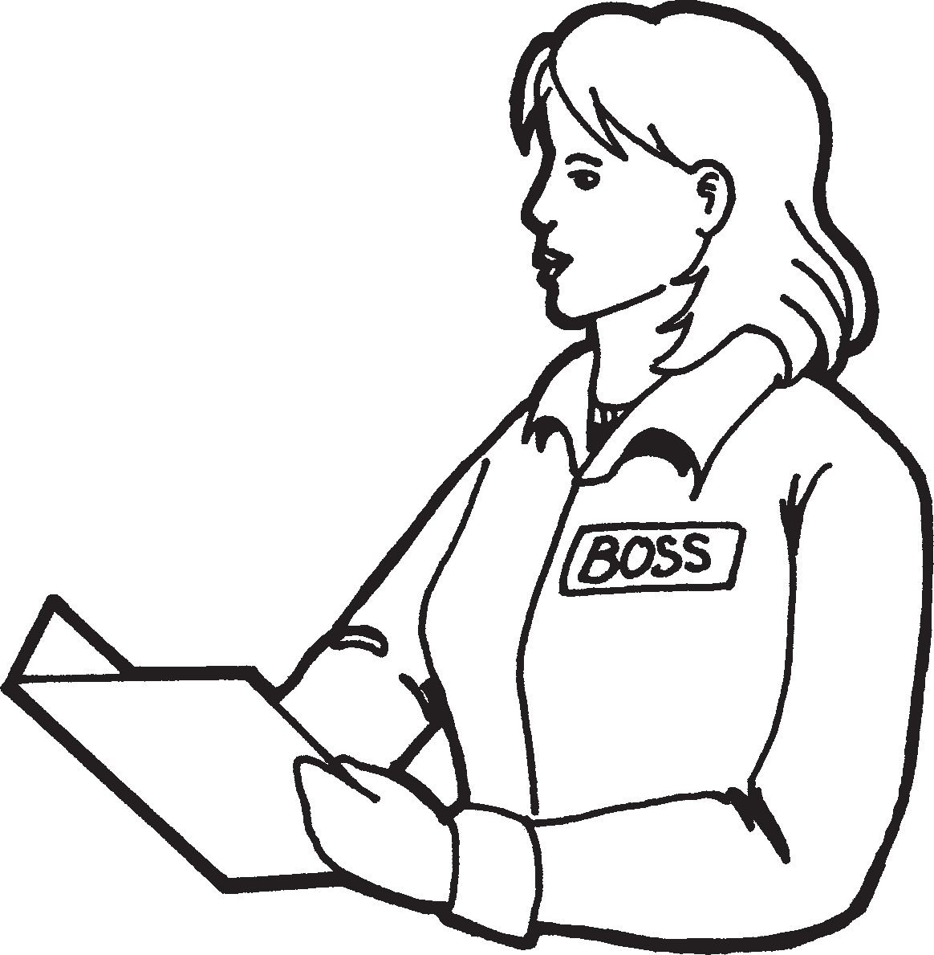
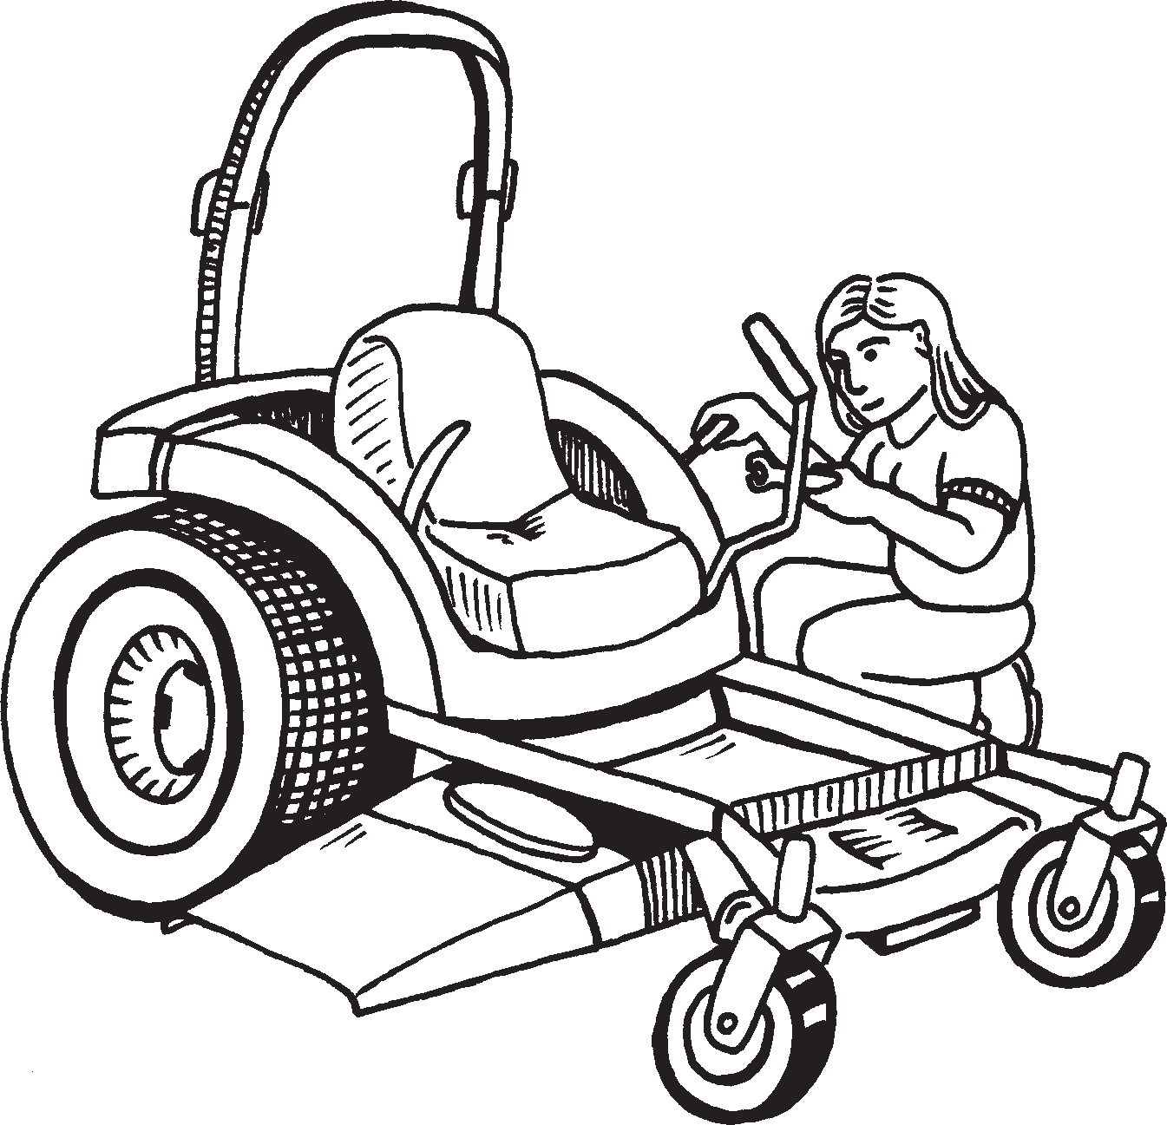
MINOR REPAIRS
Question 8. Is an operator allowed to make minor repairs, alterations or adjustments to a mower?
Answer: You must not go ahead unless:
Go ahead and fix it.
1. You are competent and have the skills to carry out the work.
AND
2. Your employer has given you permission / authorisation.
20

Slide 21
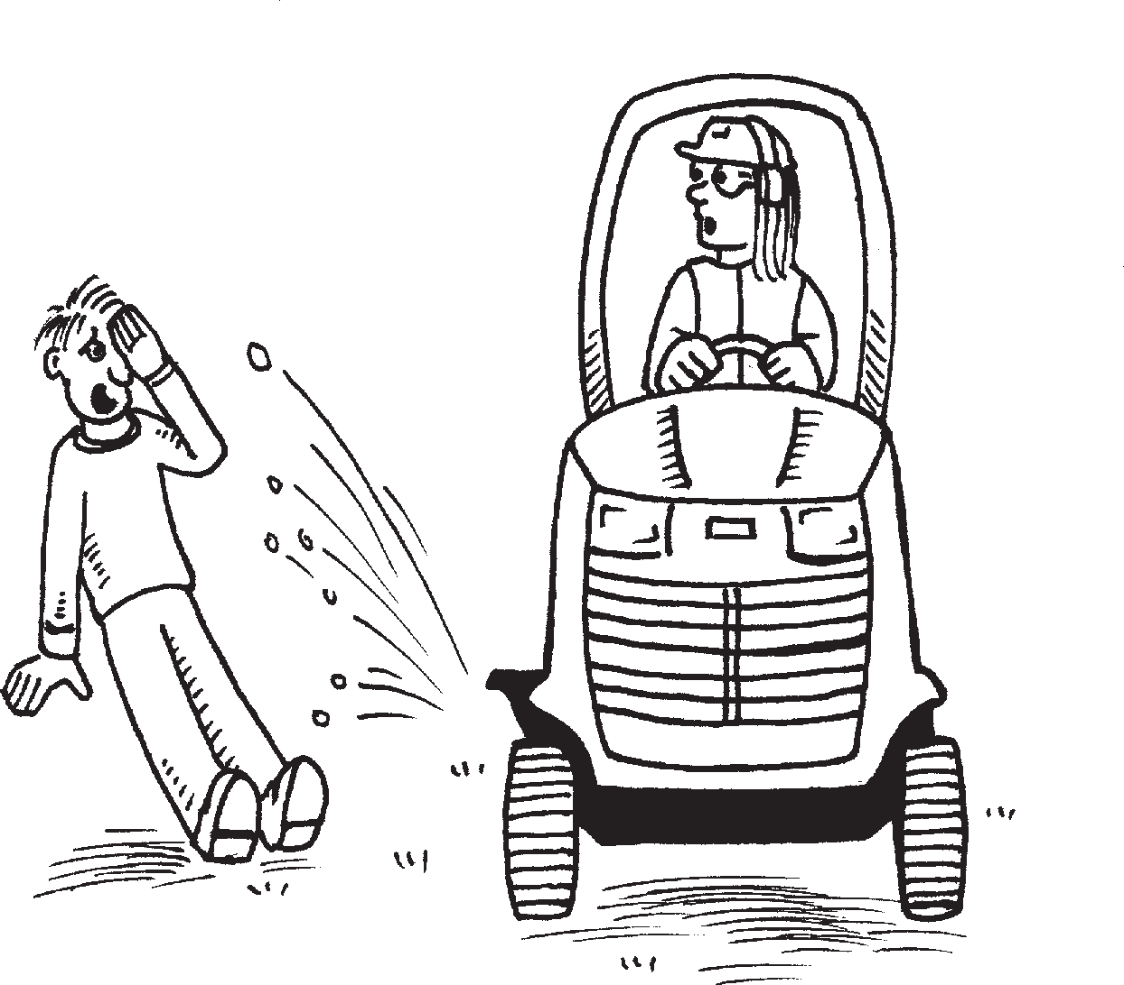
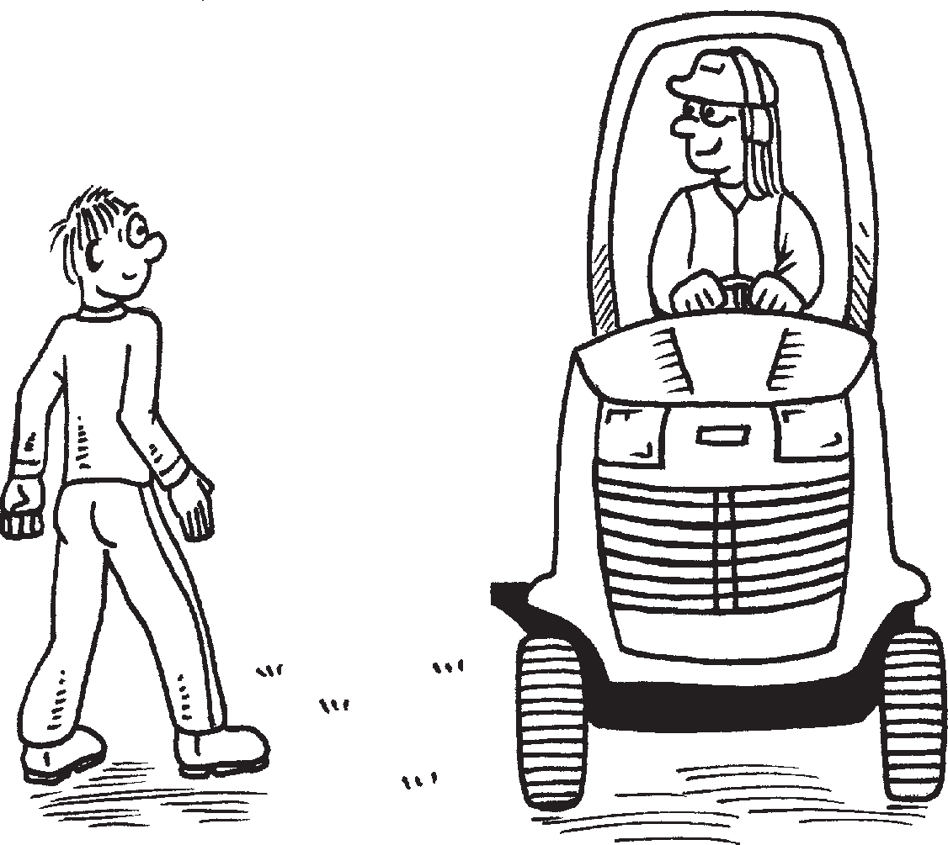
WARNING
STOP & DISENGAGE BLADES | WHEN PEOPLE GO PAST
YOUR MOWER. GUARDS MUST BE DOWN AT ALL TIMES.
21

Slide 22
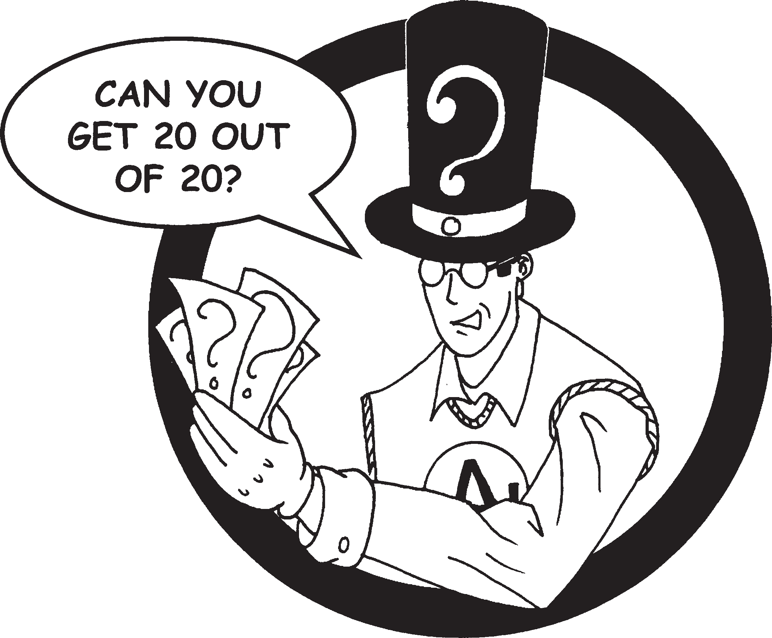
Think your an expert now?
Try the quiz and see!!!

Slide 23
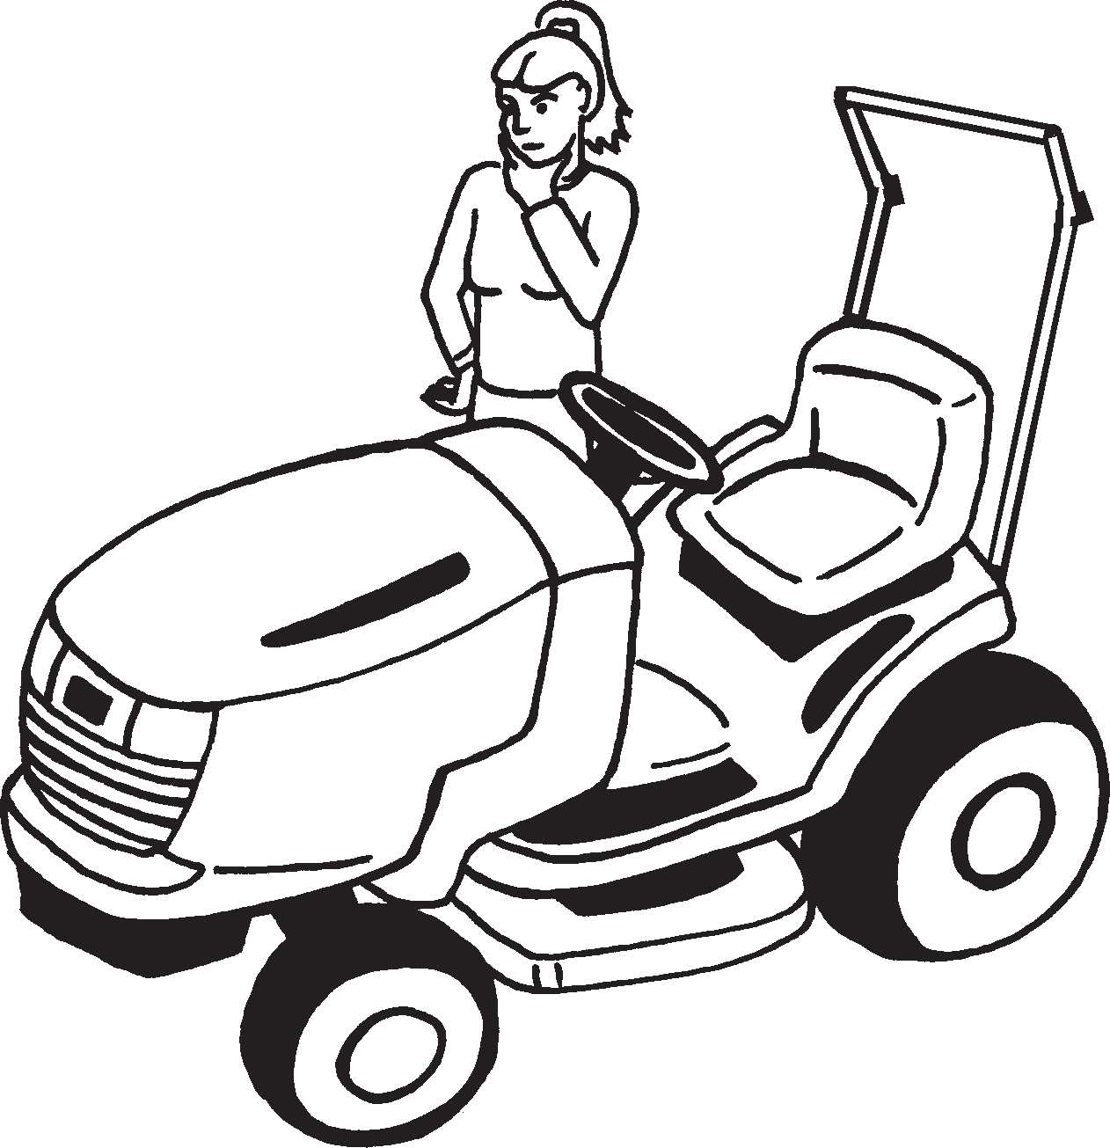
Welcome to Easy Guides ride- on mower quiz
(answers on page 135)
The aim of this quiz is to test your knowledge and understanding of this guide.
There are 20 questions. Each question is multiple choice and you’l find the correct answers at the back of the book.
Good luck.

Slide 24
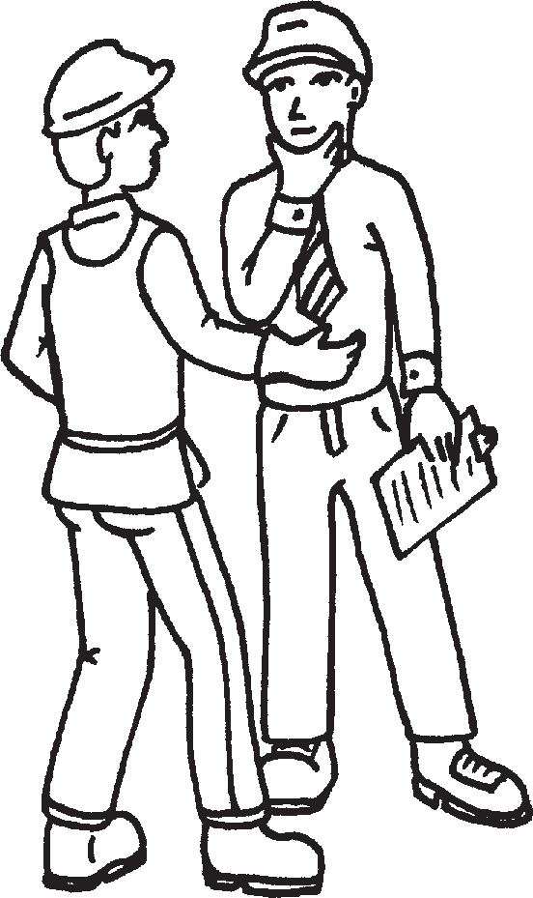
Who is allowed to use a ride-on mower?
Question 1:
Anyone who wants to.
Management.
Workers who are trained and authorised.
Your mum.

Slide 25
REMEMBER: A safe workplace begins with you?

Slide 26
QUIZ ANSWERS
Q1: (c) | Q11: ()
Q2: (b) | Q12: ()
Q3: (d) | Q13: ()
Q4: () | Q14: ()
Q5: () | Q15: ()
Q6: () | Q16: ()
Q7: () | Q17: ()
Q8: () | Q18: ()
Q9: () | Q19: ()
Q10: () | Q20: ()

