Slide 1


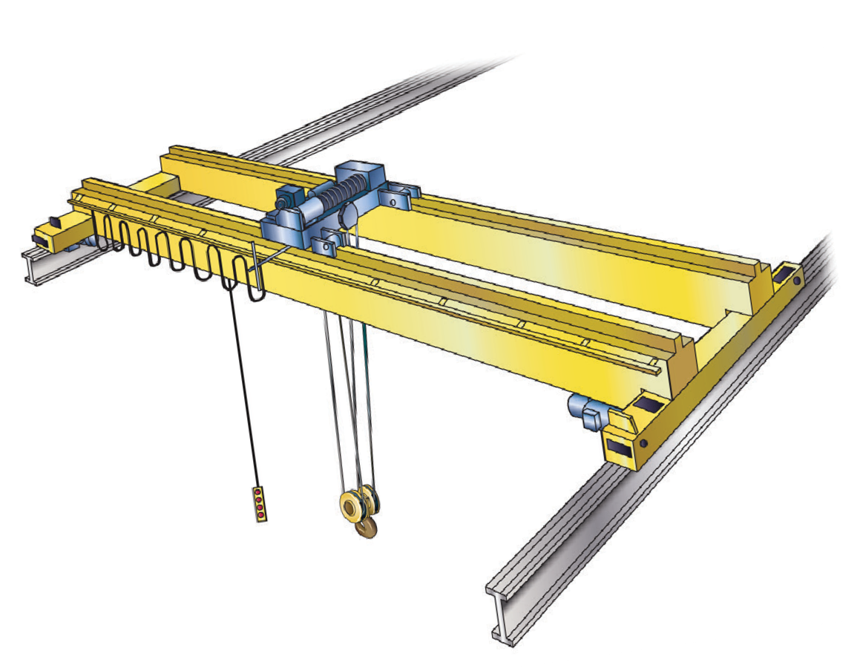

LEARNER GUIDE
Overhead Crane (Remote operated)
RII COMPETENCY
Training support material for:
RIIHAN305D –
Operate a gantry or overhead crane
(Remote operated)
Produced by:
Includes question/answer and practical training records

Slide 2
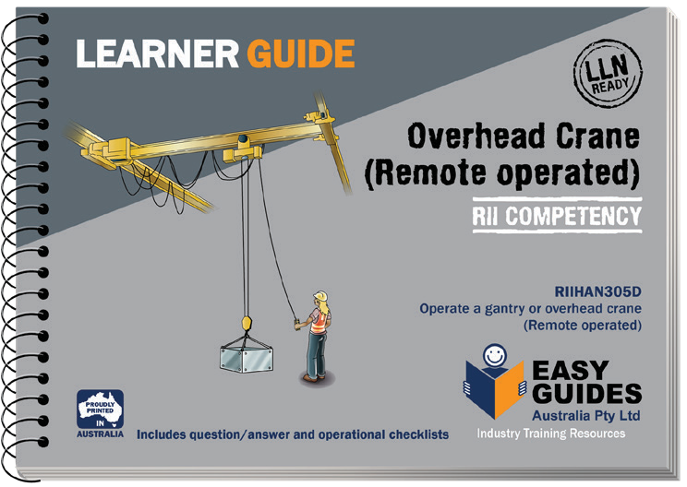
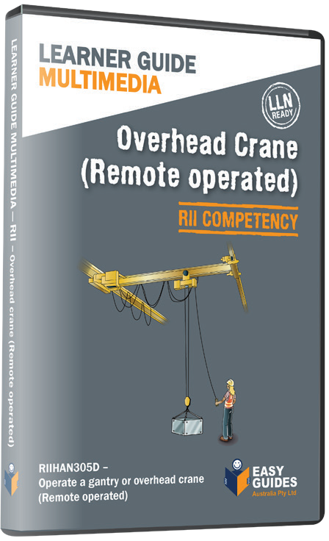
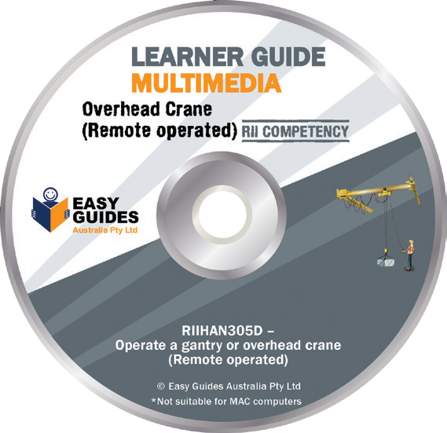
How to use this guide
HOW TO USE THIS GUIDE
Use it in hard copy
This guide helps you prepare for the test at the end of the course. Study it carefully, and then ask a friend to help you practise. They can ask you each question, and then you give the answer. Writing down the answers can also help you remember them. This also helps you see what you still need to learn. Good luck!
Or use it on screen
This guide also comes in a multimedia presentation, so you can use it on your computer or screen. The multimedia presentation is just like the guide and has exactly the same questions with the same short words and easy-to-understand pictures.
Trainers can use the multimedia presentation in class to help learners discuss questions. The trainer first shows the question and asks if anyone knows the answer. Next, the trainer will show the answer and discuss it with the learners.

Slide 3
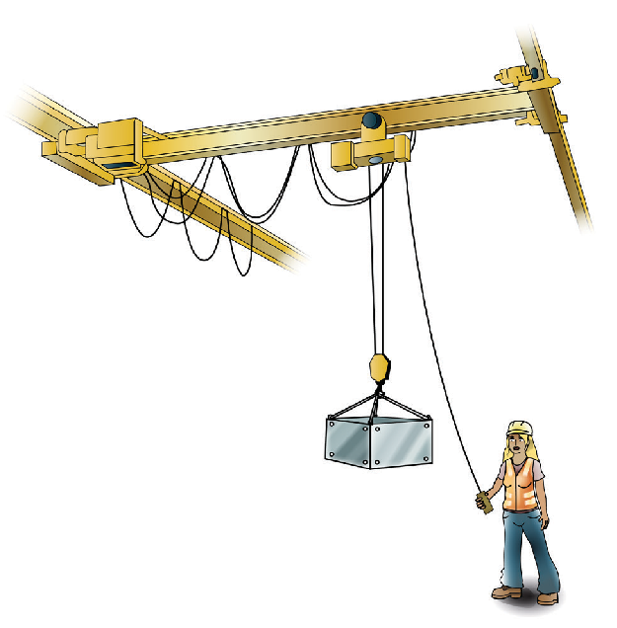
Introduction to Operate a Gantry/Overhead Crane
(Remote operated)

Slide 4
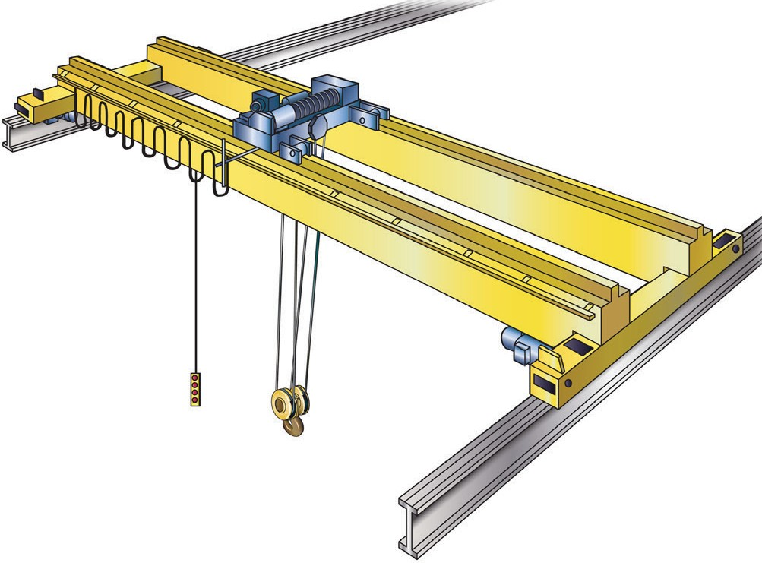
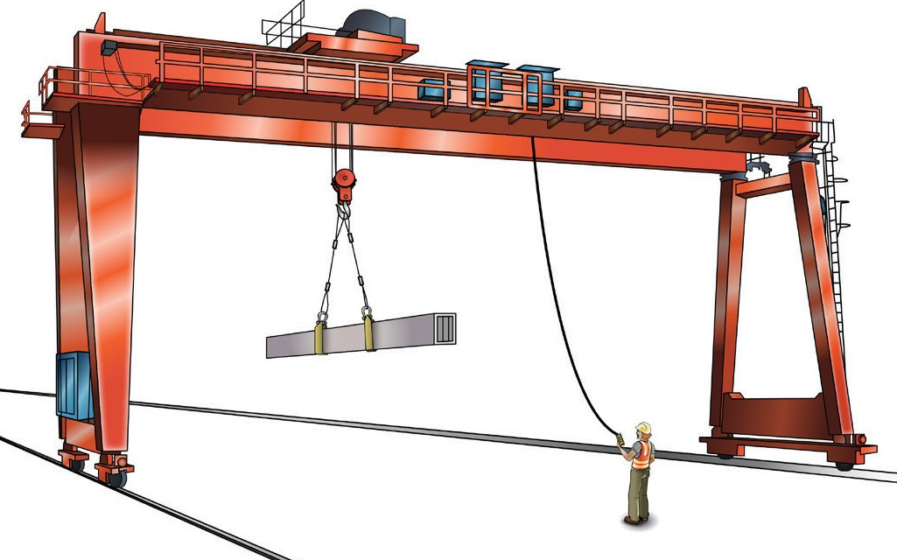
Example of a remote operated bridge and gantry crane
INTRODUCTION TO OPERATE A GANTRY/OVERHEAD CRANE (REMOTE OPERATED)
Bridge crane
A bridge crane (or overhead travelling crane) is defined as a crane compromising a bridge beam or beams, which are supported at each end, capable of travelling along elevated runways and having one or more hoisting mechanisms arranged across the bridge.
Gantry crane
A gantry crane comprises a bridge beam or beams, which are supported at one or both ends by legs mounted to end carriages, capable of travelling along runways and has one or more hoisting mechanisms.

Slide 5
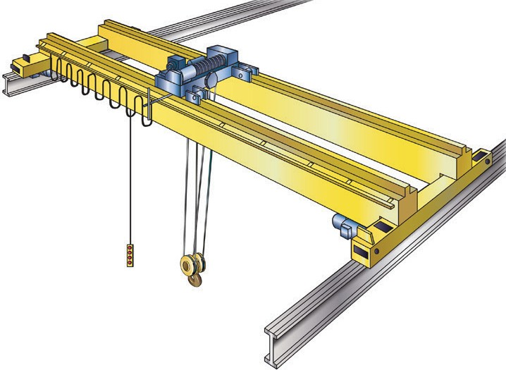
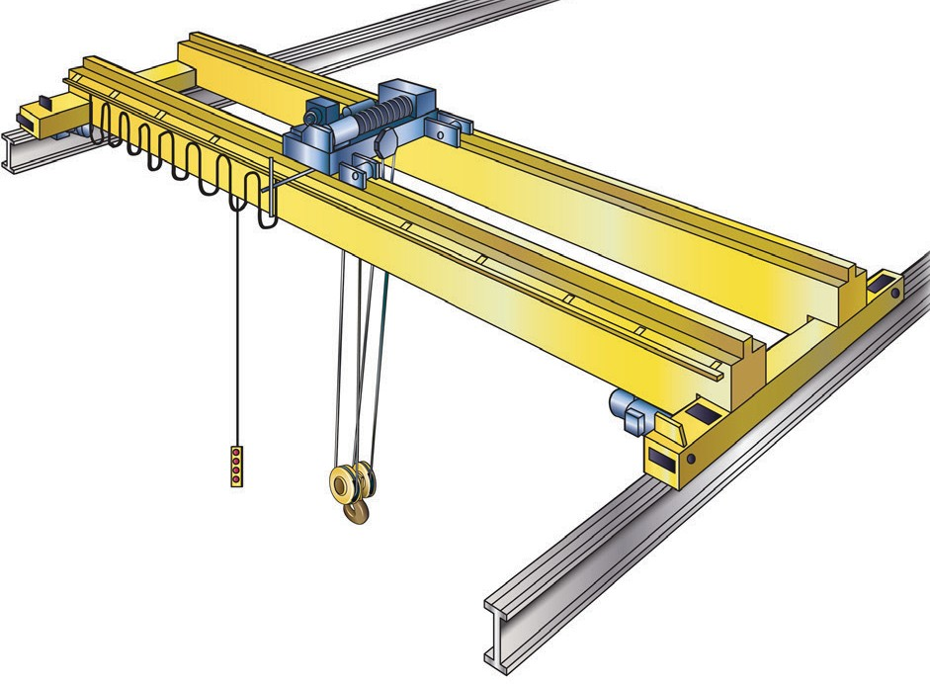

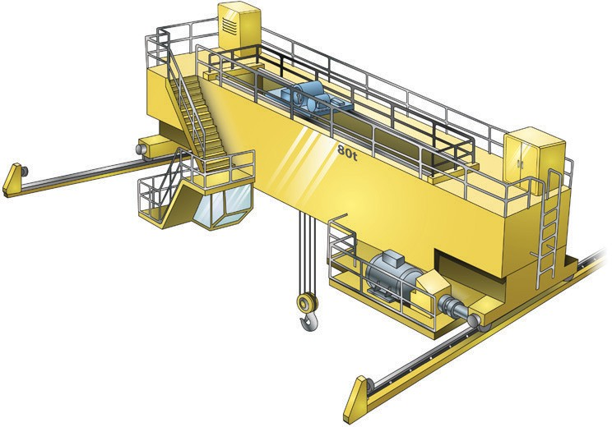


About this learner guide
INTRODUCTION TO OPERATE A GANTRY/OVERHEAD CRANE (REMOTE OPERATED)
This guide is not intended for use with a cabin controlled bridge and gantry crane. To operate a cabin controlled bridge and gantry crane or a remote/pendant operated crane with more than three movements you must complete “TLILIC3003A Licence to operate a bridge and gantry crane”. Consult your State/Territory OHS/WHS regulator for more information about the National Standards for High Risk Work.
Three or less movements
Three or more movements
Cabin operated

Slide 6
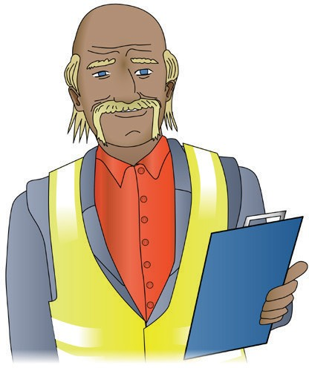

Who has a duty of care?
INTRODUCTION TO OPERATE A GANTRY/OVERHEAD CRANE (REMOTE OPERATED)
PCBU’s/Employer’s duty of care
By law, as an employer you must:
provide a workplace that is safe
provide a workplace without risk to people’s health
instruct, train and supervise employees to work safely
train workers in a way that is easy to understand.
You have a duty of care. Duty of care applies to: Employers/persons conducting a business or undertaking (PCBU)
‘Workers’ which includes people who are:
  employees
  contractors
  sub-contractors
  outworkers
  employees of labour hire companies
  volunteers
Managers
Designers
Importers
Suppliers
Inspectors.
Can a PCBU/employer (boss) let you operate a gantry or overhead crane if you are not fully trained?
No. By law, your PCBU/employer must make sure you are trained and competent to do high risk work.
Except. If you are enrolled in a course of high risk work (HRW) and supervised by a person with that HRW licence.
Your employer may ask you to show them evidence of competency before they will allow you to do any high risk work. You must be able to show them your high risk work licence or evidence (proof) that you are enrolled in a course and training with an RTO for the relevant licence class.

Slide 7
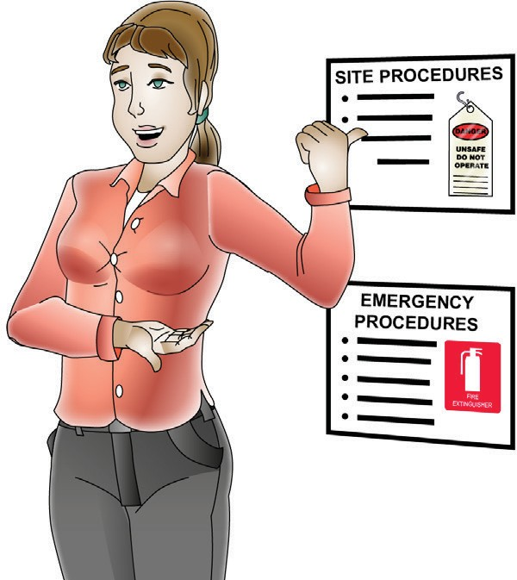
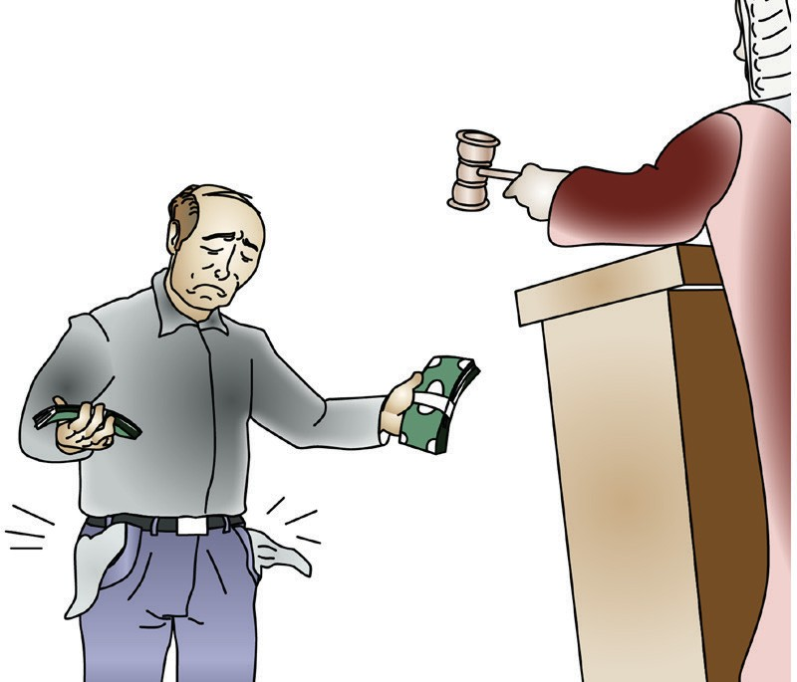
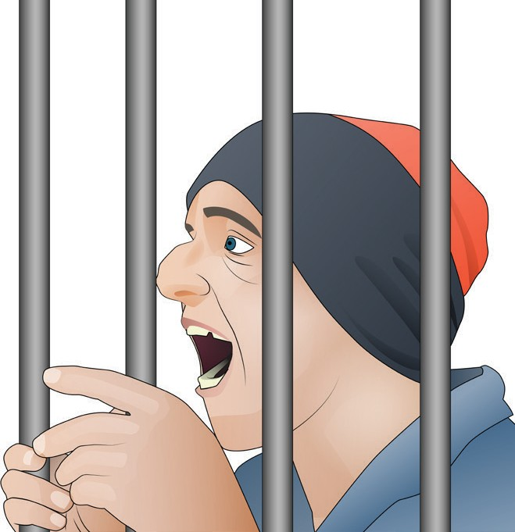
Worker’s duty of care
INTRODUCTION TO OPERATE A GANTRY/OVERHEAD CRANE (REMOTE OPERATED)
By law, as a worker you must take care of your own health and safety — and the health and safety of other people in the workplace.
You must also:
do your best to follow reasonable safety instructions from your PCBU/employer (boss)
follow workplace health and safety procedures and policies
do not do work if you believe a hazard would be a serious risk to your health or safety.
Penalties
If you are a PCBU/employer or worker, the government can fine or even imprison you for failing your duty of care.

Slide 8

Plan and prepare for gantry/overhead crane operation
Element 1

Slide 9



Compliance documents
PC 1.1 PLAN AND PREPARE FOR GANTRY/OVERHEAD CRANE OPERATIONS
When working in the civil construction industry there are documents called compliance documents that you need to know about. These documents tell you what you must do to work safely and legally.
The following are all types of compliance documents.
Legislation: such as the OHS/WHS Act
Codes of Practice: such as Preventing Falls in Housing Construction
Australian Standards: such as AS 2550.10.
Cranes, hoists and winches – Safe use – Part 10: Mobile elevating work platforms
Manufacturer’s manuals and specifications
Worksite rules and procedures
Equal Employment Opportunity and Disability Discrimination Legislation

Slide 10
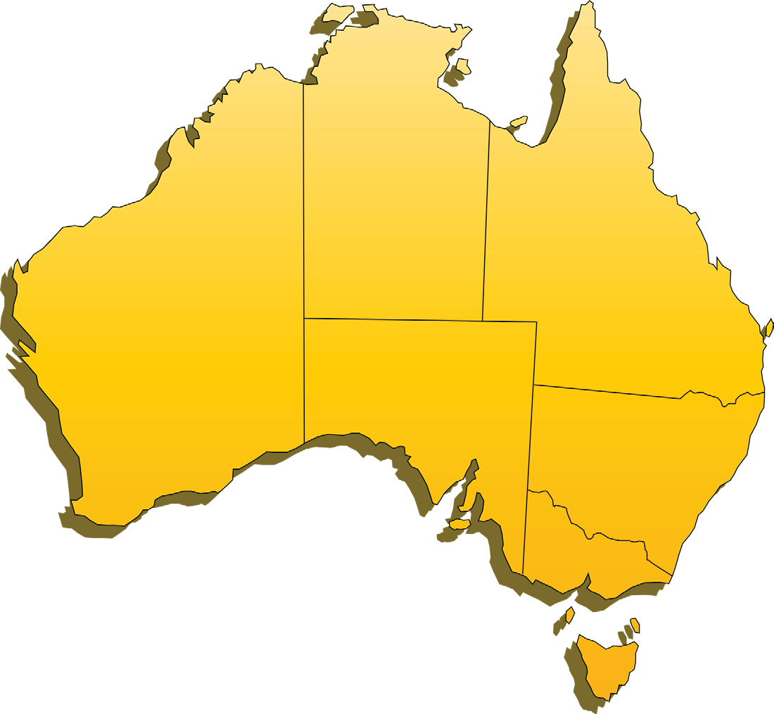
WHERE TO FIND WHS/OHS INFORMATION
PC 1.1 PLAN AND PREPARE FOR GANTRY/OVERHEAD CRANE OPERATIONS
You can check these websites for more information about workplace health and safety.
NT WorkSafe
www.worksafe.nt.gov.au
QLD Workplace Health and Safety
www.justice.qld.gov.au
WA WorkSafe
www.commerce.wa.gov.au/WorkSafe
NSW WorkCover
www.workcover.nsw.gov.au
SA SafeWork
www.safework.sa.gov.au
ACT WorkCover
www.worksafe.act.gov.au
VIC WorkSafe
www.worksafe.vic.gov.au
You can read more about the new WHS/OHS Act at:
www.safeworkaustralia.gov.au
TAS WorkSafe
www.worksafe.tas.gov.au/home

Slide 11

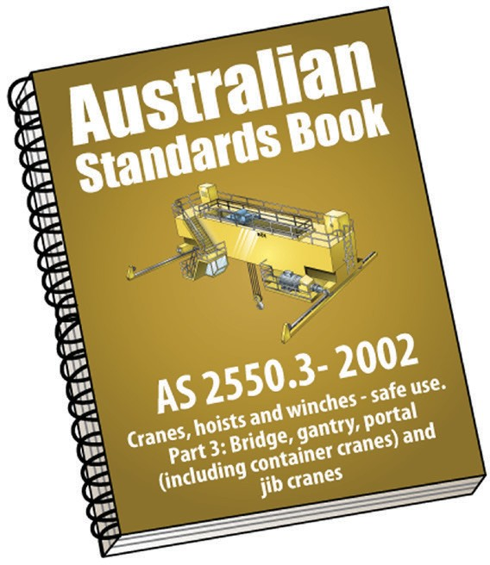

PC 1.1
PLAN AND PREPARE FOR GANTRY/OVERHEAD CRANE OPERATIONS
QUESTION 1 Where can you find information about the gantry or overhead crane you are about to use? | Information can be found in manufacturer’s manuals, guidelines and specifications.
QUESTION 2 What is a standard? | Standards are documents which set out specifications and procedures designed to ensure products, services and systems are safe, reliable and consistently perform the way they were intended to. They establish a common language which defines quality and safety criteria. (source: Standards Australia)

Slide 12
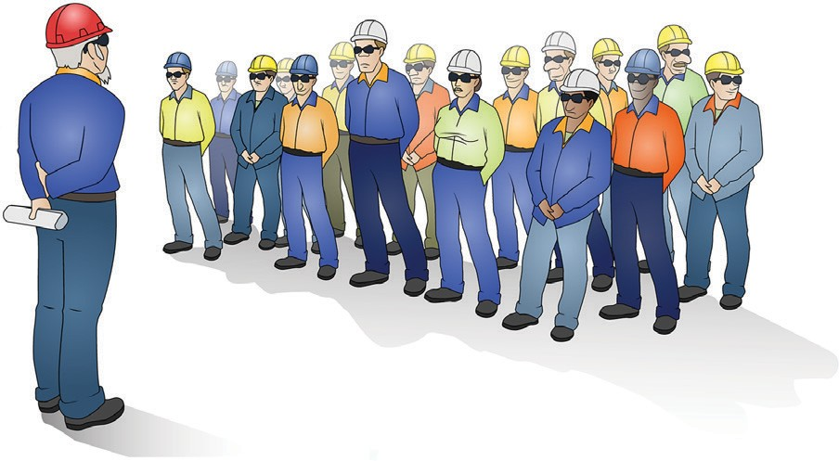
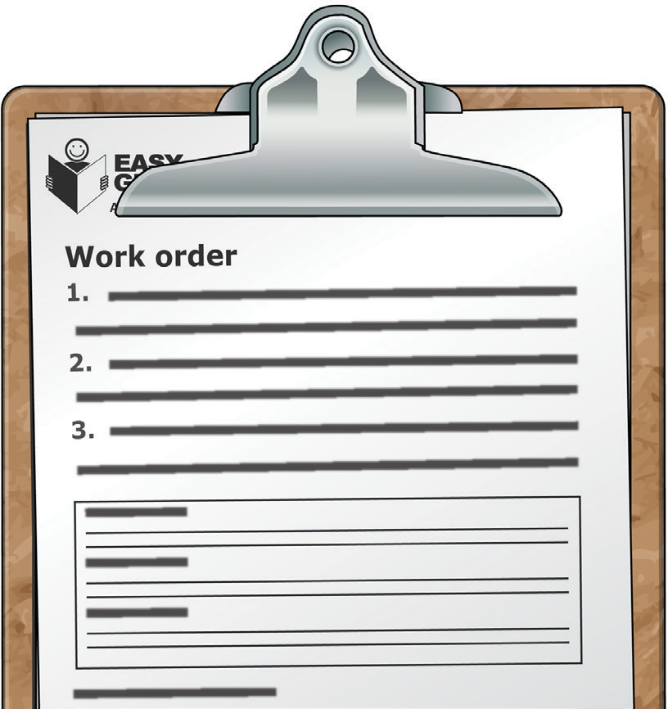
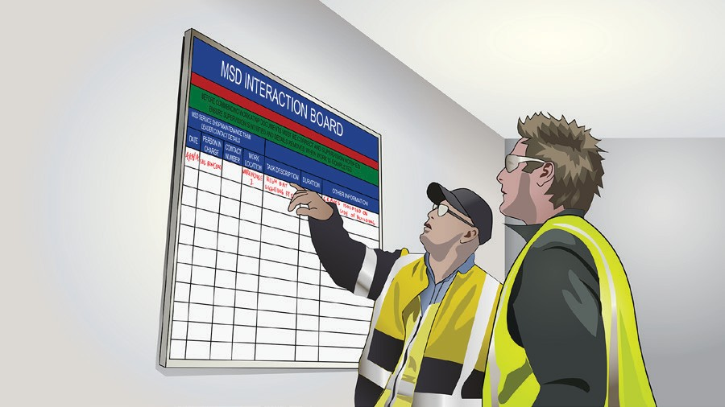
Work requirements
You will have to make sure you know about the work requirements for the job and the work site. Ways to find out this information include:
PC 1.2 PLAN AND PREPARE FOR GANTRY/OVERHEAD CRANE OPERATIONS
Shift briefings/inductions Work orders
Handover details

Slide 13
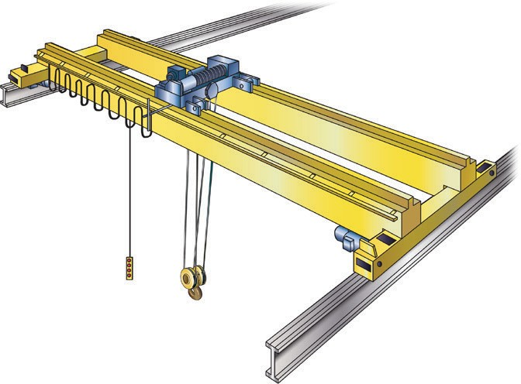

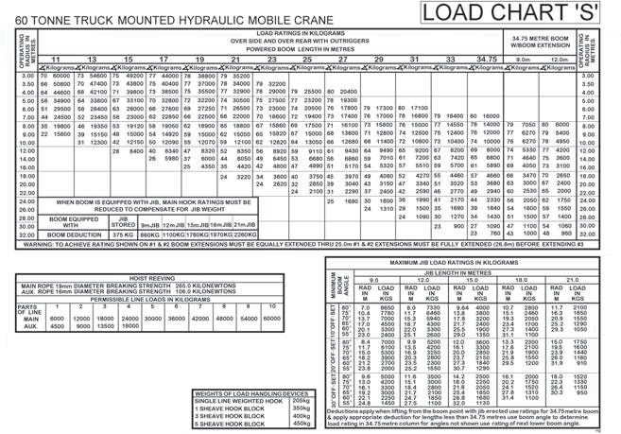
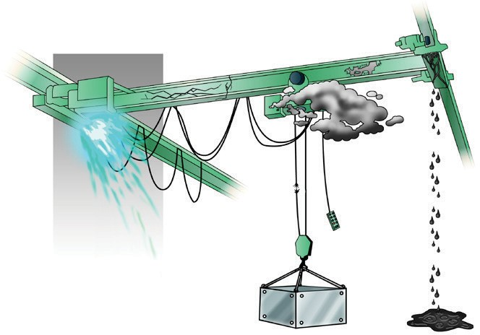
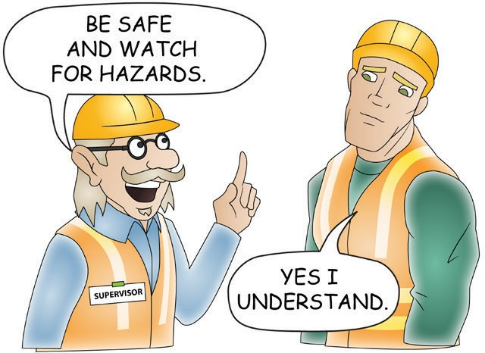

PC 1.2
PLAN AND PREPARE FOR GANTRY/OVERHEAD CRANE OPERATIONS
Work requirements (continued)
Some of the things you may need to find out about include:
Crane/equipment to be used | What needs to be done | Load charts and factors
Defects on equipment | Hazards and potential hazards | Co-ordination requirments

Slide 14
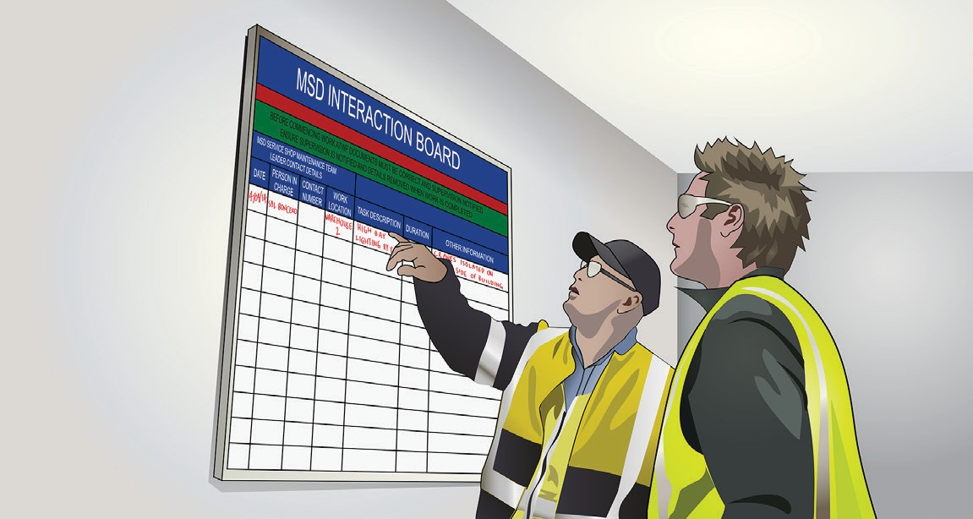
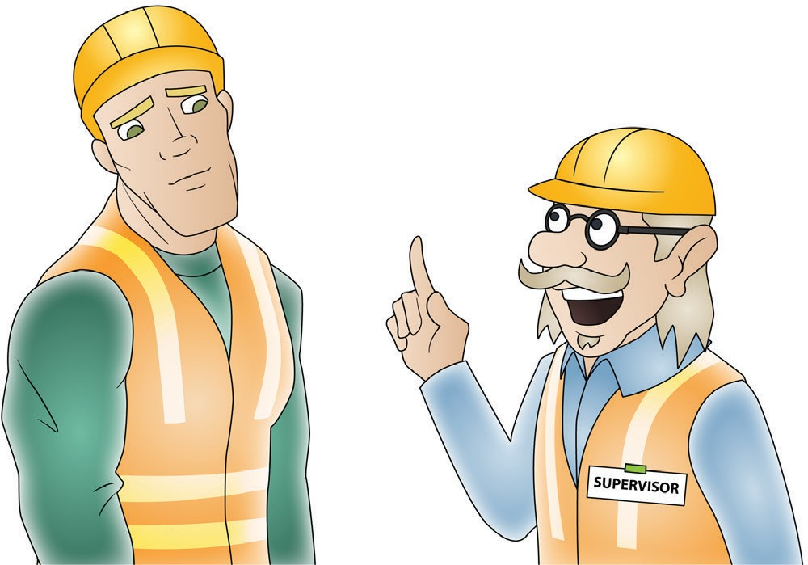
PC 1.2
PLAN AND PREPARE FOR GANTRY/OVERHEAD CRANE OPERATIONS
QUESTION 3 Shift briefings, handovers and work orders are all ways you can find out about work requirements, if you are still unsure about what to do who should you speak to? | You should speak to your supervisor.
QUESTION 4 Why is it important to find out information about work requirements before starting? | This will help you to be able to complete the job safely, efficiently and within the rules and regulations.

Slide 15
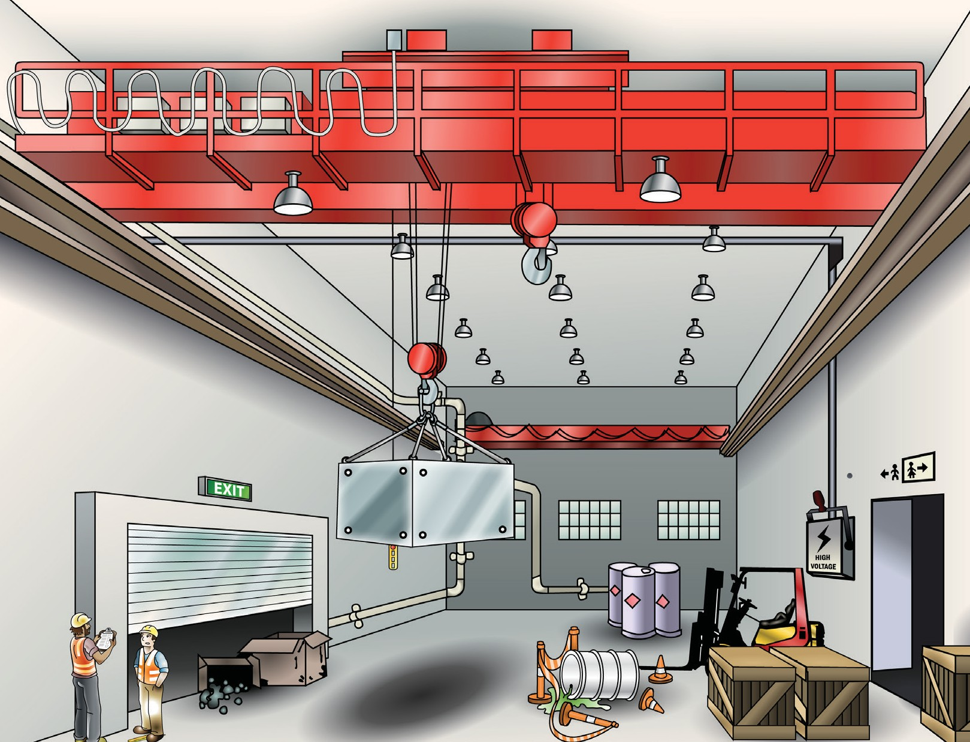
Indoor hazards
PC 1.3 PLAN AND PREPARE FOR GANTRY/OVERHEAD CRANE OPERATIONS
Before operating the crane you must make sure that any potential risks, hazards and environmental issues have been identified. You should check ground level, ground to eye level and above head height.
Some hazards you might find indoors can include:
Bad lighting
Hazardous materials
Doorways
Pedestrians
Other plant and machinery
Trip hazards
Spills
Obstructions

Slide 16
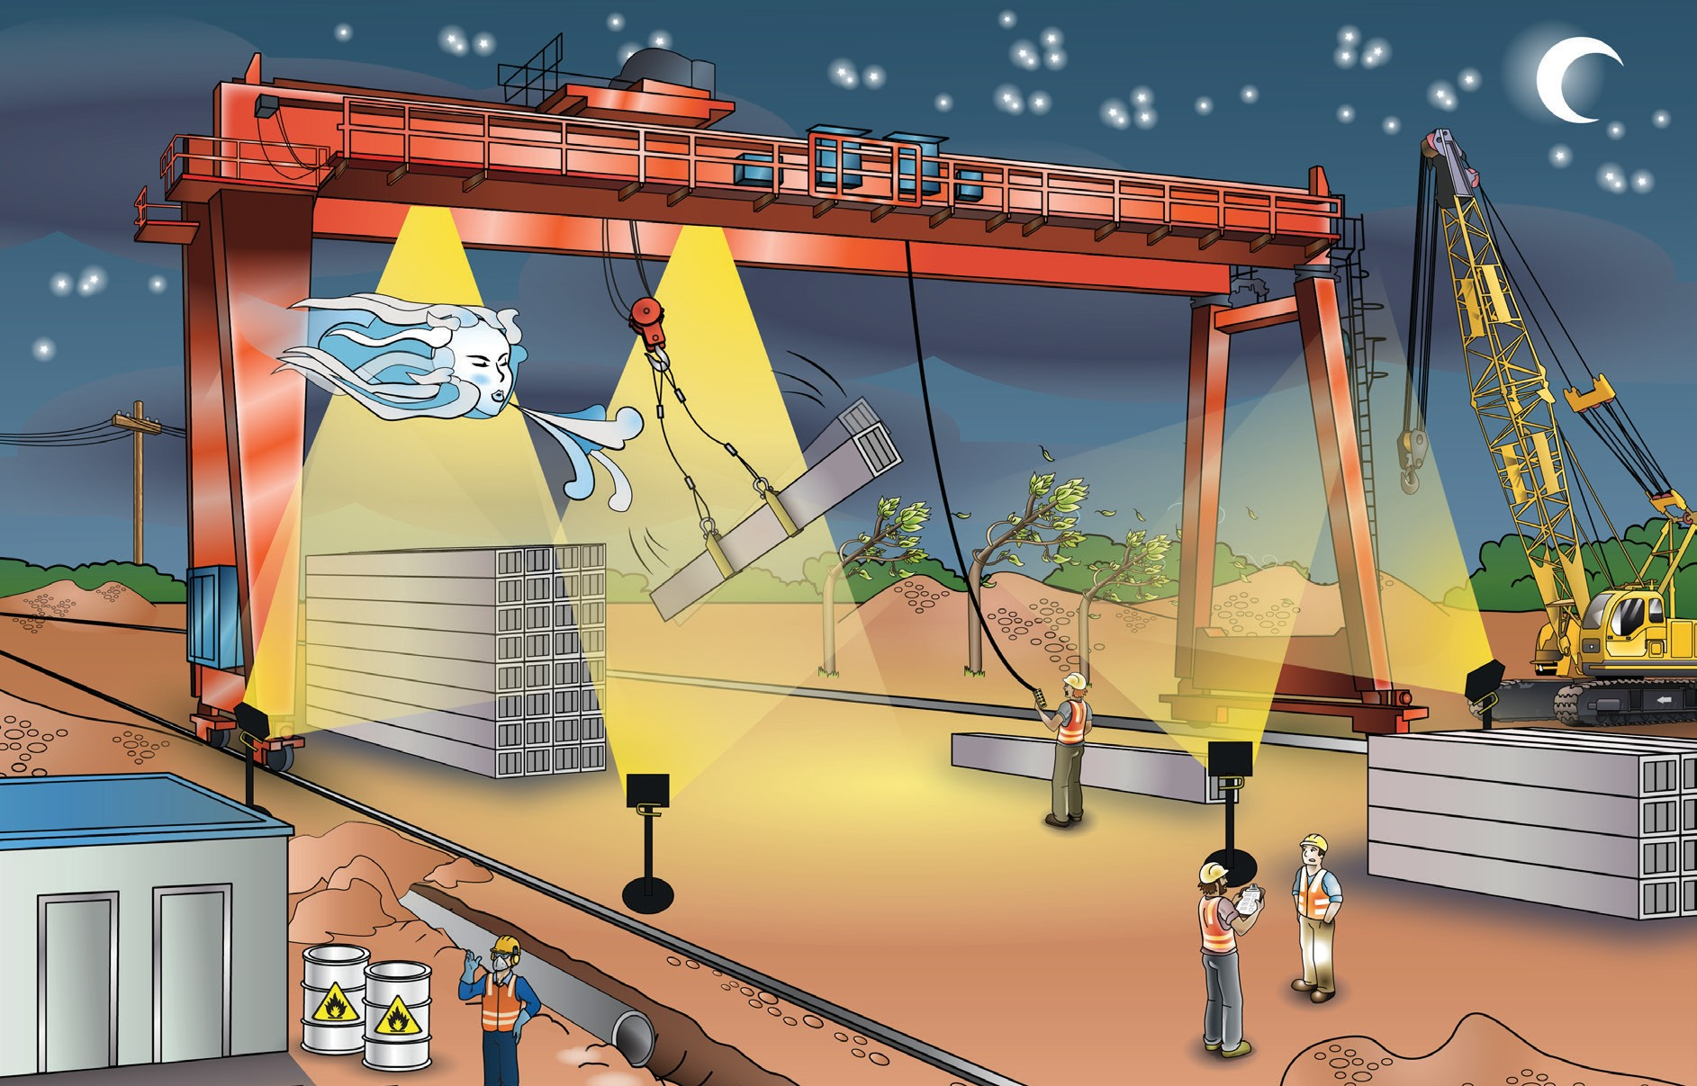
Outdoor hazards
PC 1.3 PLAN AND PREPARE FOR GANTRY/OVERHEAD CRANE OPERATIONS
Some hazards you might find outdoors can include:
Wind
Lighting
Other equipment
Facilities
Dangerous materials
Trip hazards
Pedestrians

Slide 17
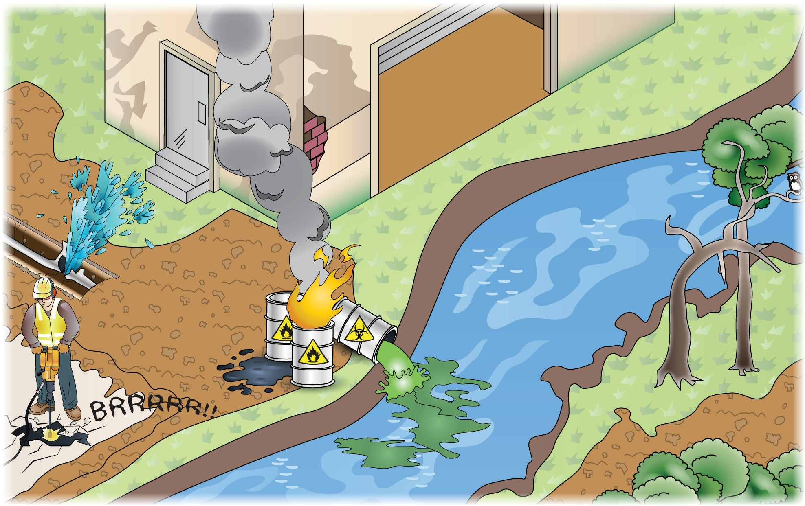
Environmental hazards
When you are working you also have to think about how your work might affect the environment. Some examples of things you should be careful of include:
PC 1.3 PLAN AND PREPARE FOR GANTRY/OVERHEAD CRANE OPERATIONS
Air pollution
Asbestos from old buildings
Confined spaces
Damage to underground services
Fire
Damage to plants and trees
Noise
Waste management
Soil damage and erosion
Leaking fuels

