Slide 1

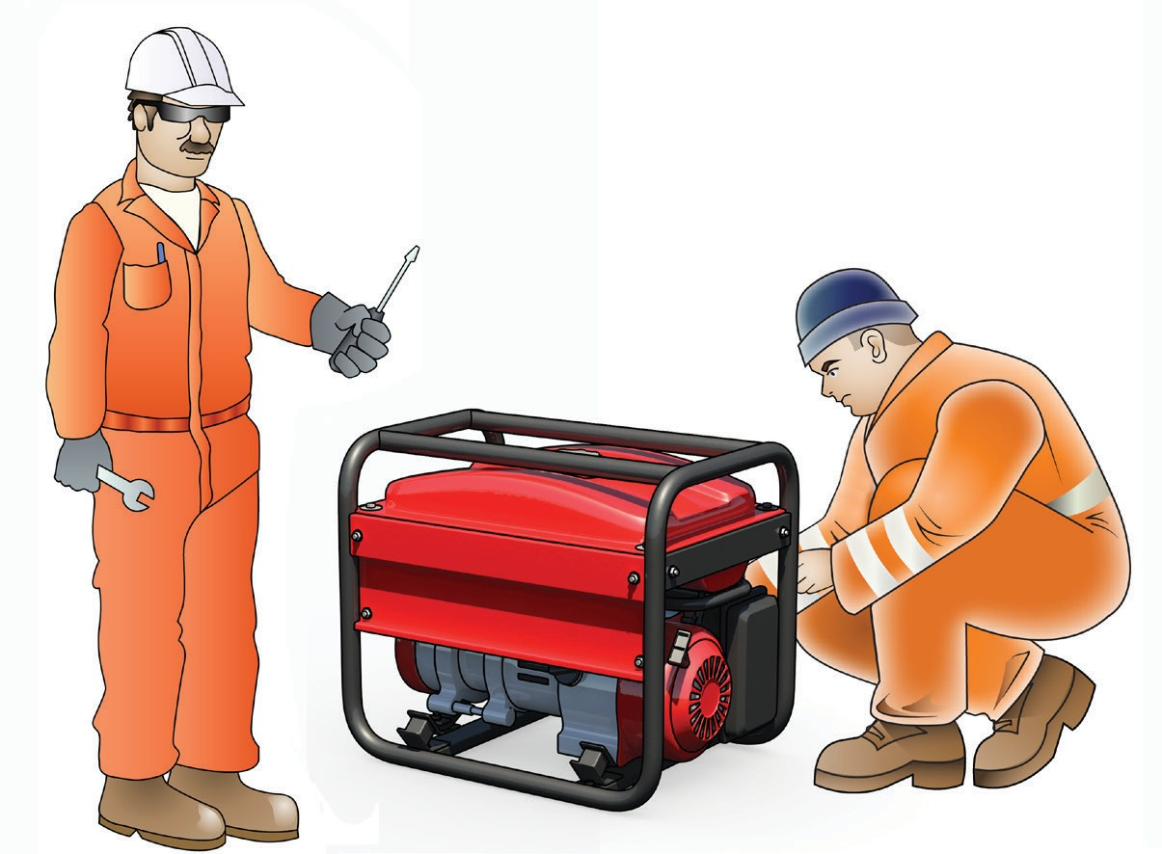

LEARNER GUIDE
Training support material for:
RIISAM204E
Operate small plant and equipment
Produced by:
Picture based. Plain English. Learning made easy.

Slide 2
CONTENTS
About this guide
4
Language – Literacy – Numeracy (LLN)
5
LLN core skills – customising training
6
Prepare for operating small plant and equipment 7
Conduct pre-operational checks
39
Use small plant and equipment
47
Carry out operator maintenance
59
Conduct housekeeping activities
67

Slide 3
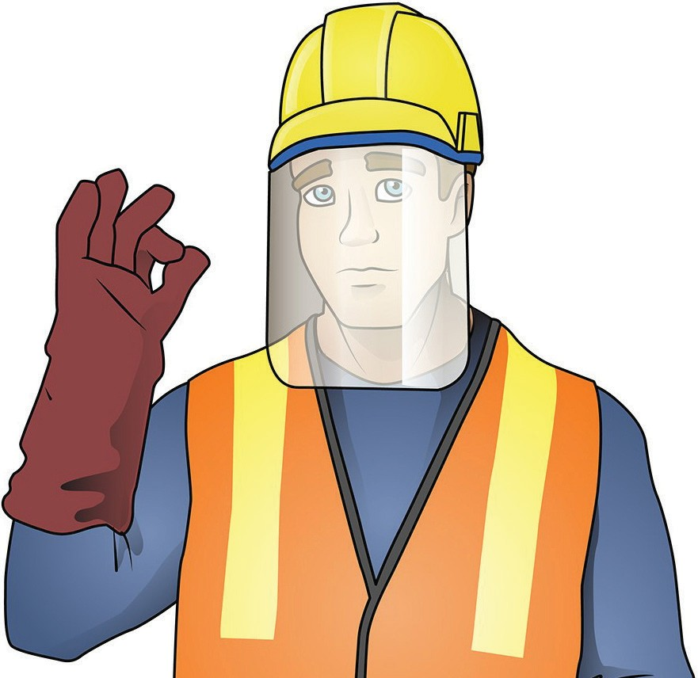
PLAN AND PREPARE TO USE HAND AND POWER TOOLS
prepare for operating small plant
and equipment
Element 1

Slide 4
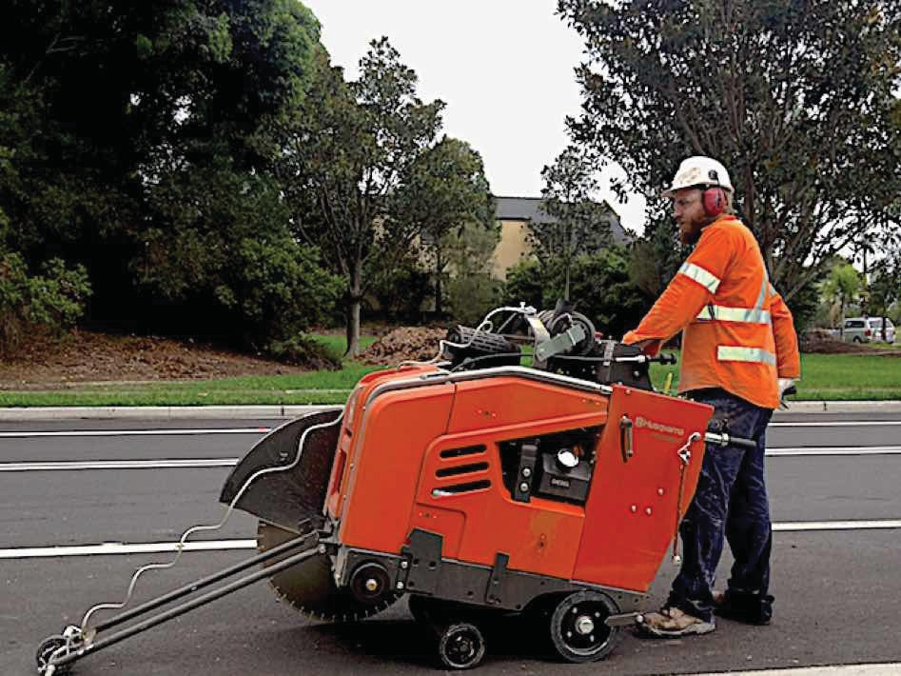
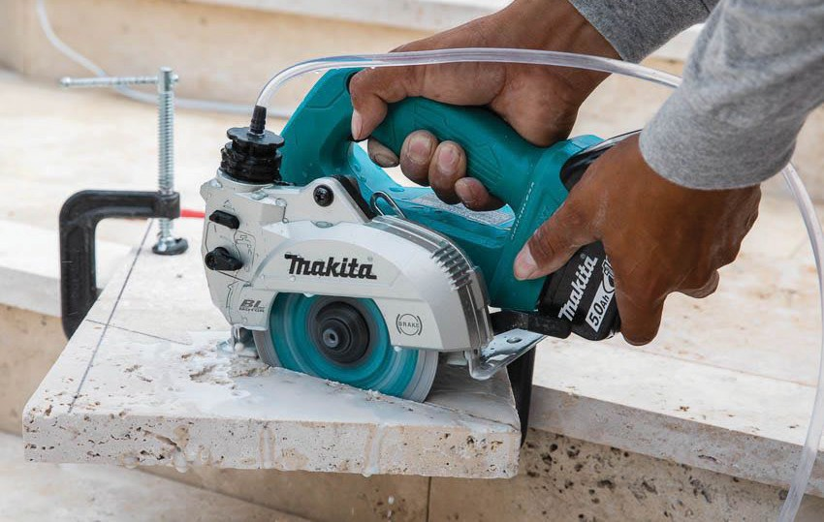
PC 1.1, 1.5 PREPARE FOR OPERATING SMALL PLANT AND EQUIPMENT
1. What types of small plant and equipment are used in this unit of competency?
Generally, 2-3 pieces of small plant and equipment will be used in training. On-site training can be customised
to specific items of small plant and equipment. Training can include but is not limited to:
Brick / masonry saws: Brick or masonry saws are specialized cutting tools used for precision
cutting of bricks, blocks, tiles, and other masonry materials. These saws typically have a diamond blade specifically designed for cutting through hard materials like concrete, stone, and ceramics. They are commonly used in construction, masonry work, and tile installation to achieve accurate cuts for fitting bricks or blocks in various applications. Brick or masonry saws may come in different sizes and configurations, including handheld models or larger, stationary saws for more heavy-duty cutting tasks.
Continued next page...
Road saws: Road saws, also known as concrete saws or asphalt saws, are powerful cutting machines
used in construction and road maintenance. They are typically equipped with a large circular blade with diamond or abrasive teeth and are designed to cut through concrete, asphalt, and other hard surfaces. Road saws are commonly employed to
create expansion joints, remove damaged sections of pavement, or cut trenches for installing utility lines.

Slide 5
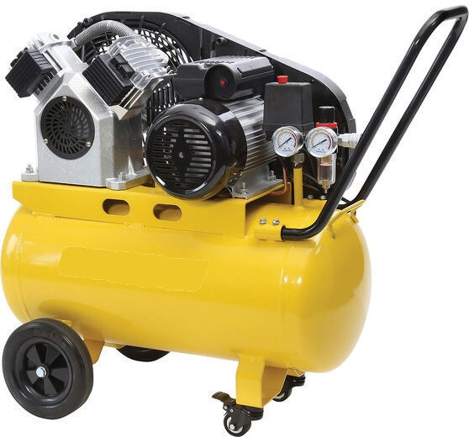
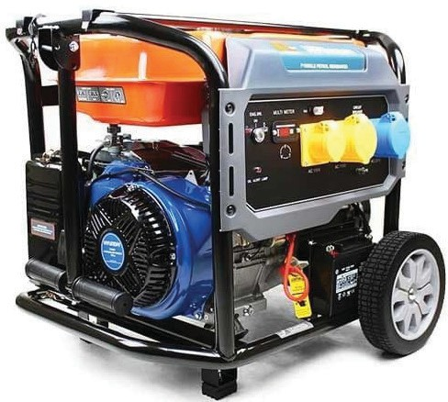
PC 1.1, 1.5 PREPARE FOR OPERATING SMALL PLANT AND EQUIPMENT
(Continued from last page...)
Compressors: A compressor is a device or machine used to increase the pressure of a gas or air by reducing its volume. It is commonly used in various industries, including manufacturing, refrigeration, air conditioning, and power generation. Compressors are essential components in systems where the compression of gases is required for different purposes.
Generators: A generator is a device that converts mechanical energy into electrical energy. It is commonly used to produce electricity when a reliable power source is unavailable or as a backup power supply in case of power outages. Generators are widely used in various applications, including residential, commercial, and industrial settings.
Continued next page...

Slide 6
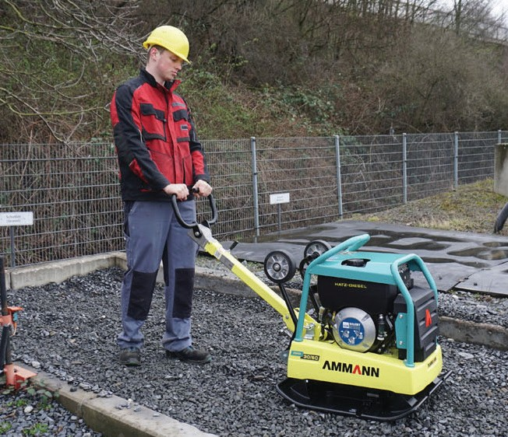
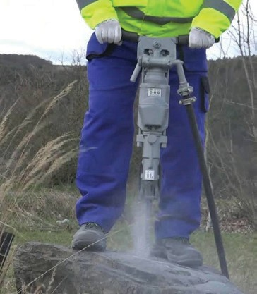
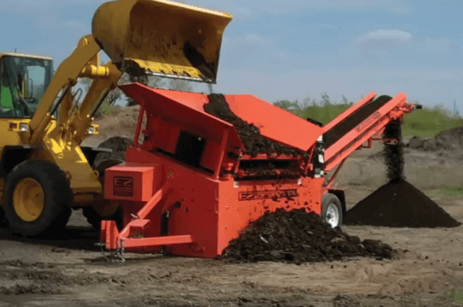
PC 1.1 PREPARE FOR OPERATING SMALL PLANT AND EQUIPMENT
(Continued from last page...)
Gravel: Vibratory Plate Compactor
A vibratory plate compactor is a small machine used to compact gravel and other granular materials, creating a more stable and solid surface. It’s commonly used in road construction, landscaping, and other applications where compacted gravel is needed.
Mud: Mud Mixer
A mud mixer is a small device used to mix mud, which typically consists of soil, water, and sometimes additives, to create a slurry-like substance. This mixture is used in various applications, including construction, drilling, and even in some agricultural practices.
Rock: Rock Drill
A handheld rock drill is a small, portable drilling machine used for drilling holes in rock, such as for mining, quarrying, or geological exploration. It’s an essential tool for working with hard rock surfaces.
Topsoil: Topsoil Screener
A topsoil screener is a small machine designed to sift and separate topsoil from larger debris like rocks and sticks. It’s commonly used in landscaping and construction to ensure that the topsoil used for planting is free of unwanted materials.

Slide 7
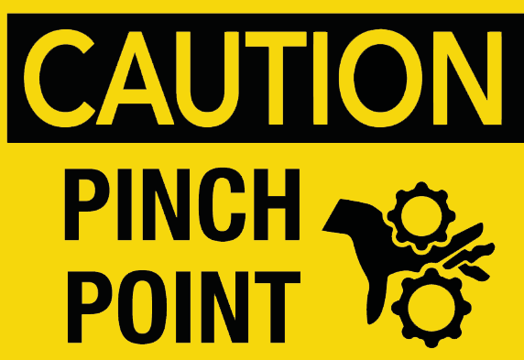
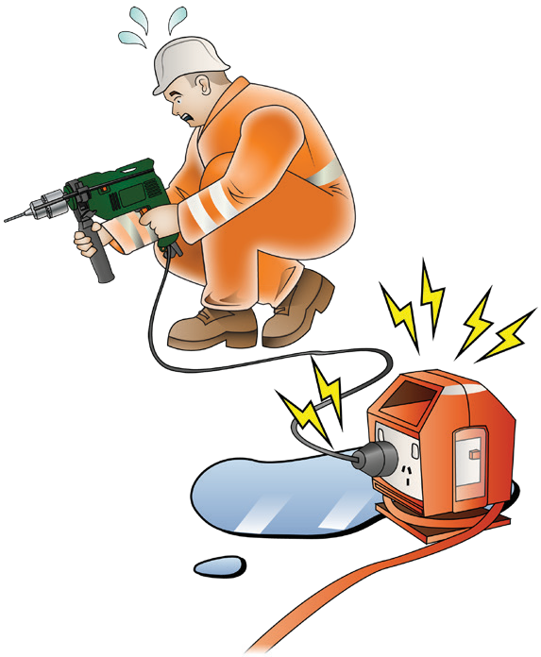
Identify and control risks and hazards (continued...)
PC 1.3 PLAN AND PREPARE TO USE HAND AND POWER TOOLS
Hazard: Struck-By or Pinch Points (accidental contact)
Control Measures:
Maintain a clear work area: Keep the work area free of clutter and obstructions that could cause tripping or create hazards.
Use tools with safety features: Choose hand tools that have built-in safety mechanisms, such as retractable blades or guards, to minimize the risk of pinch points or accidental contact.
Safe handling techniques: Use proper hand placement on tools, keeping fingers
away from potential pinch points. Avoid using excessive force or using tools in
Hazard: Electrical Shock Control Measures:
Grounding and electrical safety: Ensure that power tools are properly grounded or double-insulated to minimise the risk of electrical shock. Inspect power cords for damage before each use and replace any frayed or worn cords.
GFCI (Ground Fault Circuit Interrupter): Utilise GFCI-protected outlets or portable GFCI devices when using power tools in wet or damp environments to quickly interrupt electrical current in case of a fault.
Training and qualification: Ensure that workers are adequately trained in the safe use of power tools, including electrical safety practices, and that only qualified individuals operate the tools.
Continued on next page...

Slide 8
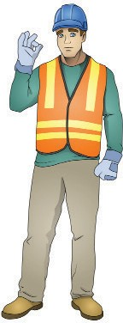
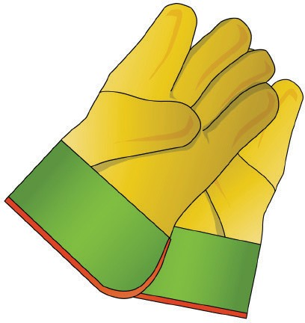

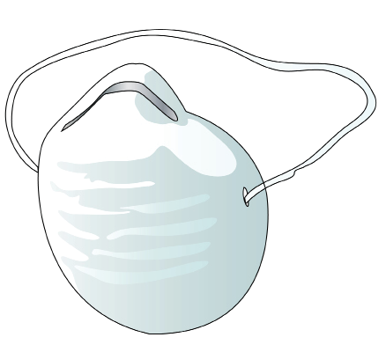


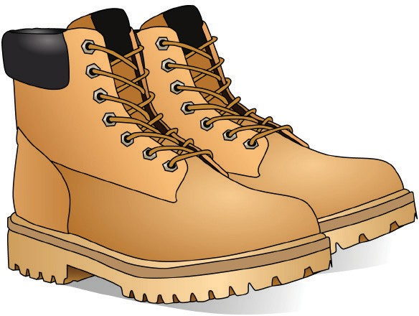


Choose and wear personal protective equipment (PPE)
PC 1.4 PLAN AND PREPARE TO USE HAND AND POWER TOOLS
It is important to wear the correct PPE to keep you safe and protected. Here are some examples:
Here are some typical tools and equipment you might need.
Hard hat
Safety vest
Dust mask
Safety gloves
Long sleeved top
Ear muffs
Bootsthatcoverthe whole foot
Safety glasses/goggles, Sunglasses
Long pants
Sunscreen

Slide 9
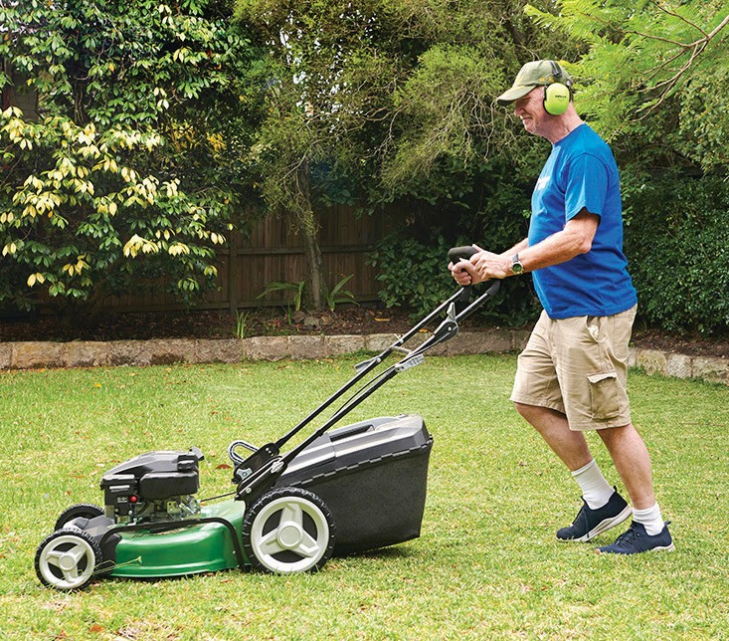
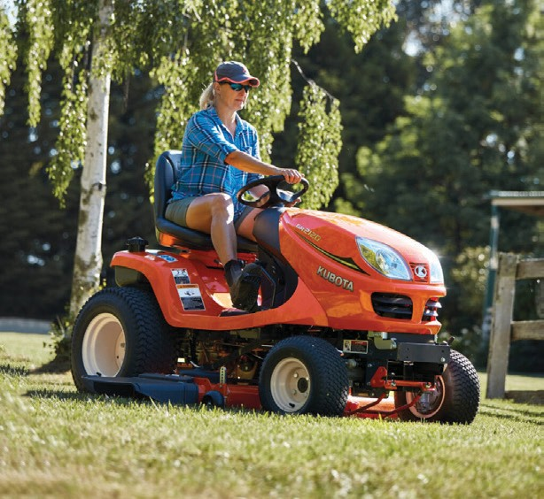
PC 1.5 PLAN AND PREPARE TO USE HAND AND POWER TOOLS
12. How do you make sure you have the right equipment for the activity?
Understand clearly what task or job needs to be done.
Look at the information about the equipment to see what it can do and what it can’t do. Think about things like how much power it needs, how much it can hold, how big it is, how fast it is, how precise it is, and what safety features it has.
Find out and compare different options for equipment. Think about how well they work, how efficient they are, how reliable and durable they are, and if they are suitable for the task.
or
Think about how much money you can spend and how it will affect your budget. Balance the cost with the benefits and long-term value the equipment will give you.
If possible, try out the equipment before you use it for the job. This
will help you find any problems or limits that could affect the task.
Make sure the people who will use the equipment know how to use it right, take care of it, and keep everyone safe.

Slide 10
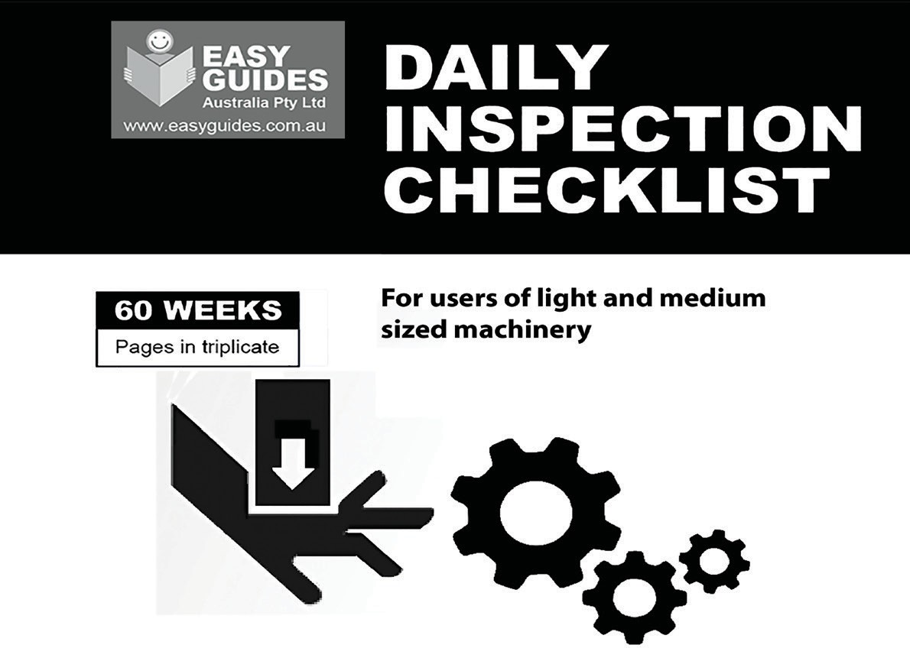
conduct pre-operational checks
CONDUCT PRE-OPERATIONAL CHECKS
Element 2

Slide 11

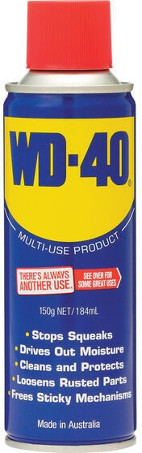
PC 2.1 CONDUCT PRE-OPERATIONAL CHECKS
14. What fuel and lubricants might you use to operate small plant and equipment?
using it.
Fuel: Fuel is what powers the equipment and makes it work. Common fuels for small plants and equipment include petrol and diesel.
Petrol is often used for smaller engines, like those found in lawnmowers or chainsaws.
Diesel fuel is commonly used for larger equipment, such as generators or construction machinery. These fuels are flammable liquids that burn inside the engine to produce the energy needed for the equipment to function.
Lubricants: Lubricants are substances that reduce friction and wear between moving parts in the equipment. They help the components move smoothly and prevent them from overheating or getting damaged.
The specific lubricants used depend on the type of equipment, but some common ones include motor oil, grease, and hydraulic fluids.
Motor oil is used in engines to lubricate the internal parts. Grease is a thicker lubricant that is applied to joints and bearings. Hydraulic fluids are used in hydraulic systems to transmit force and provide lubrication.

Slide 12
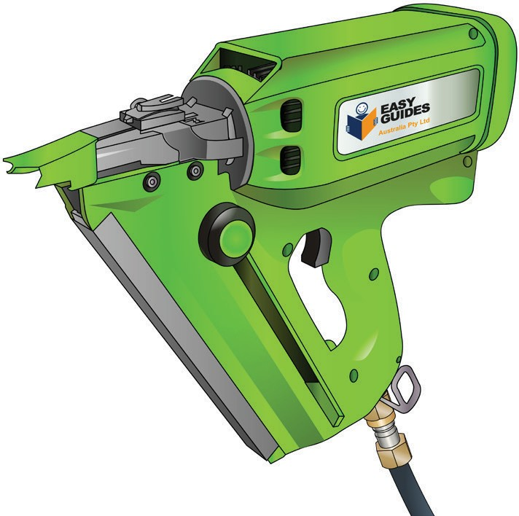
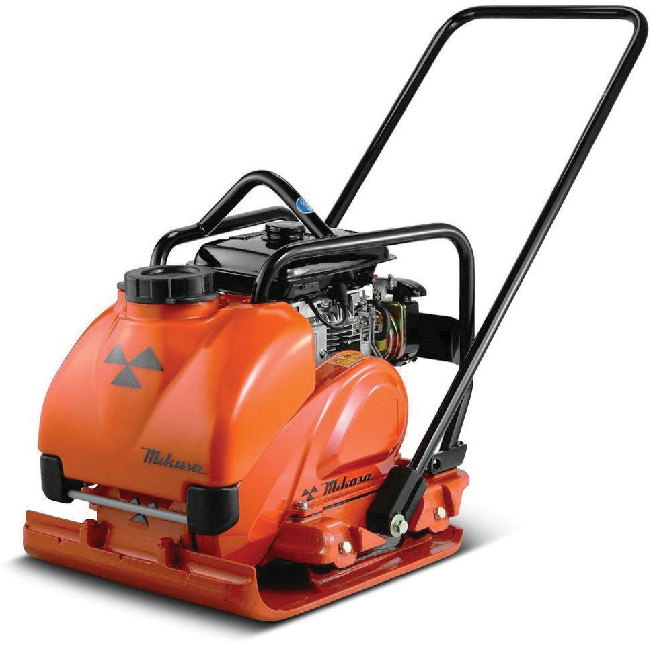
uSe small plant and equipment
Element 3

Slide 13
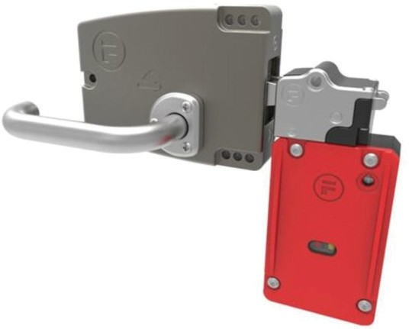
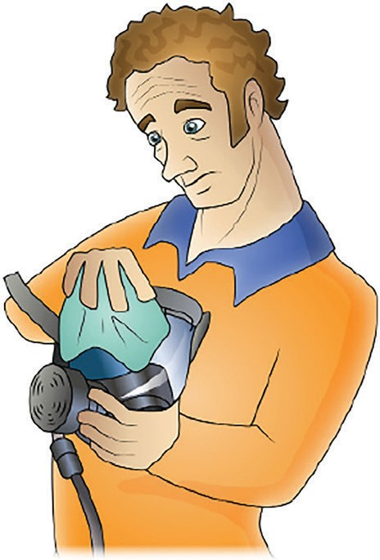
PC 3.1 USE SMALL PLANT AND EQUIPMENT
20. How can you identify and control risks when operating small plant and equipment?
using it.
Familiarise yourself with operating procedures: Understand the standard operating procedures (SOPs) for the equipment you’re using. This will help you recognize any deviations or gaps in the control measures.
Check the effectiveness of safety controls: Evaluate the existing safety controls, such as emergency stops, guards, or safety interlocks. Check if they are functional and properly maintained..
Evaluate operator training and competency: Determine if operators have received adequate training on the equipment and its safe operation.
Consider the maintenance and inspection routines: Review the maintenance and inspection protocols for the equipment. Check if they are being followed consistently. Inadequate maintenance can increase the risk of control failures.
Assess the availability and adequacy of warning signs and labels: Check if the equipment has appropriate warning signs and labels to communicate potential risks or required safety precautions. Ensure they are visible, legible, and located in relevant areas.
Continued on next page...

Slide 14
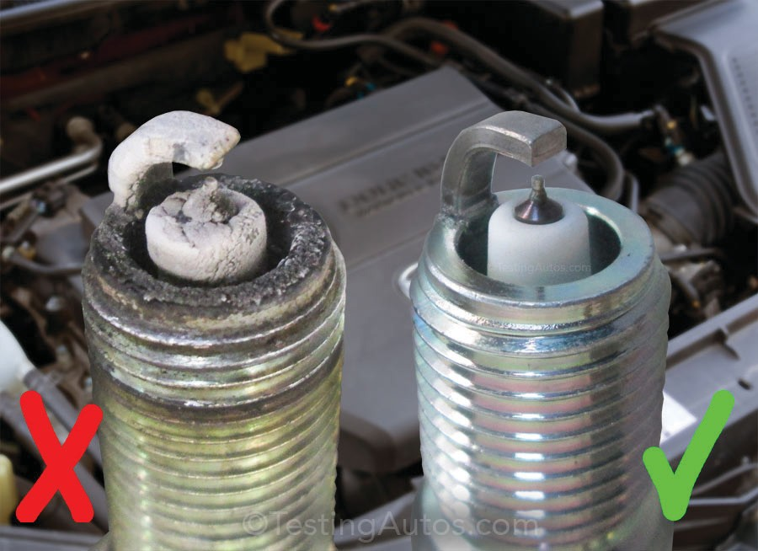
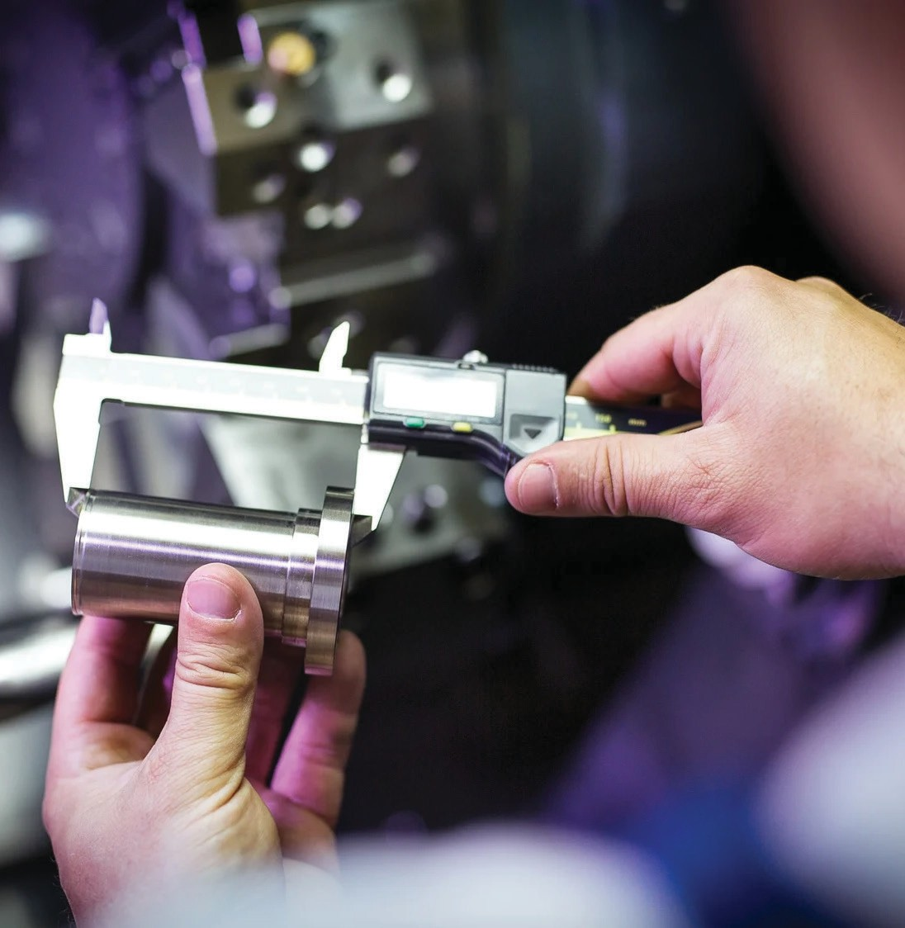
PC 3.2 USE SMALL PLANT AND EQUIPMENT
...Continued from previous page
Implement quality control measures: Do quality control checks during the production process. Inspect samples or conduct tests to verify that the output meets the specified tolerances. Identify and fix any deviations at once.
Train operators effectively: Provide proper training to operators on the correct operation of the equipment. Ensure they understand the specified tolerances, the impact of their actions on output quality, and how to make necessary adjustments.
Document and analyse performance data: Keep records of the equipment’s performance, including output measurements,
adjustments made, and any deviations from the specified tolerances.
Communicate and collaborate with stakeholders: Maintain open communication with supervisors, quality control personnel, and other relevant stakeholders. Share feedback, discuss challenges, and work together to optimise output while staying within specified tolerances.
By following these guidelines, you can maximise the output of small plant and equipment while ensuring that the final results meet the specified tolerances and quality requirements.

Slide 15

CARRY OUT OPERATOR MAINTENANCE
CARRY OUT OPERATOR MAINTENANCE

Slide 16
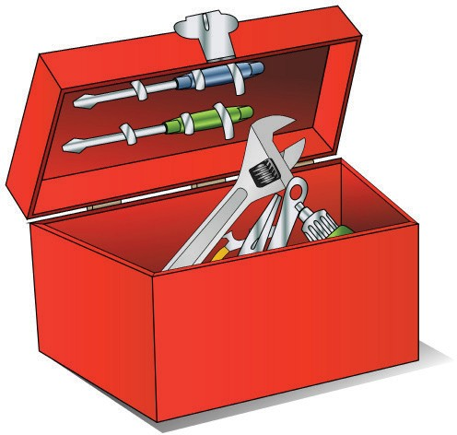
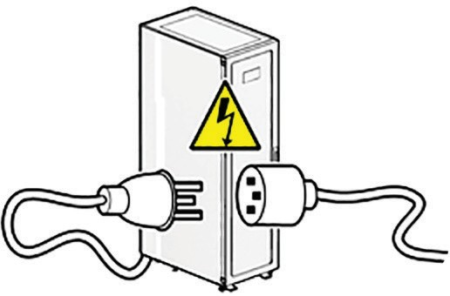
PC 4.1 CARRY OUT OPERATOR MAINTENANCE
24. How can you get small plant and equipment ready for maintenance?
using it.
Notify Relevant Personnel: Inform the maintenance team and relevant personnel about the scheduled maintenance. Communicate the date, time, and duration of the maintenance activity.
Schedule Downtime: Choose a suitable time to perform maintenance when the equipment is not in use. This prevents disruptions to regular operations.
Secure Necessary Resources: Gather all the tools, equipment, and materials needed for the maintenance tasks.
Arrange Spare Parts: Ensure that you have the necessary spare parts available in case any components need replacement during maintenance.
Prepare Work Area: Clear the area around the equipment and create a safe and organized workspace for the maintenance team.
Isolate Equipment: If possible, disconnect the equipment from its power source and any connected systems to ensure safety during maintenance.
Continued on next page...

Slide 17
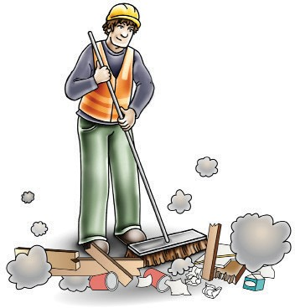
CoNDUCT HOUSEKEEPING ACTIVITIES
CONDUCT HOUSEKEEPING ACTIVITIES

Slide 18

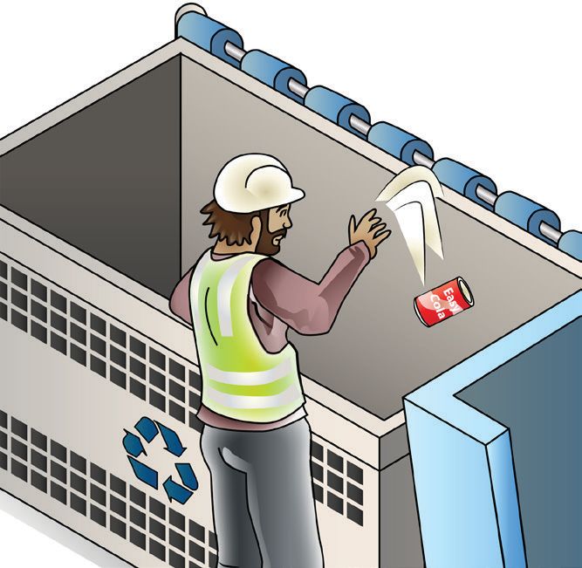
PC 5.1 CONDUCT HOUSEKEEPING ACTIVITIES
27. How do you clear the work area and dispose of materials?
using it.
Put Away Tools and Equipment: After using the small plant and equipment, make sure to put them away in their designated storage areas. This prevents accidents and keeps the workspace tidy.
Clean Up Debris: Remove any debris, waste, or leftover materials from the work area. Use a broom or a vacuum to sweep the floor and ensure it is clean and safe.
Collect and Sort Waste: Separate any waste materials generated during the work process. Sort them into different containers or bags based on their type, such as recyclables, general waste, or hazardous materials.
Follow Local Regulations: Check with your local authorities or waste management guidelines on how to properly dispose of the collected waste. Adhere to any specific instructions for recycling, proper disposal, or hazardous materials handling.
Dispose of Waste Responsibly: Take the sorted waste to the appropriate disposal facilities, recycling centers, or collection points. If there are hazardous materials, ensure they are handled according to safety regulations.
Continued on next page...

