Slide 1
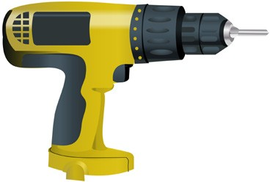
LEARNER GUIDE
Training support material for:
RIISAM203E
Use hand and power tools
Produced by:
Picture based. Plain English. Learning made easy.

Slide 2
CONTENTS
Plan and prepare to use hand and power tools
7
Select and use hand tools
21
Select and use power tools
37
Conduct housekeeping activities
55

Slide 3
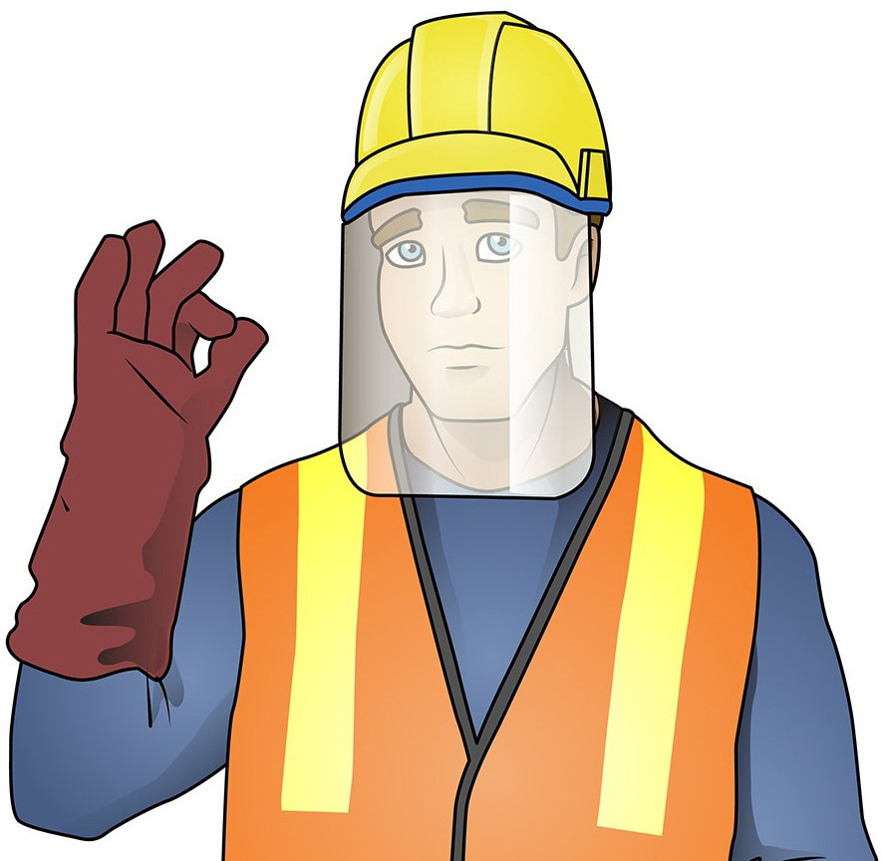
PLAN AND PREPARE TO USE HAND AND POWER TOOLS
PLAN AND PREPARE TO USE HAND AND
POWER TOOLS
Element 1

Slide 4
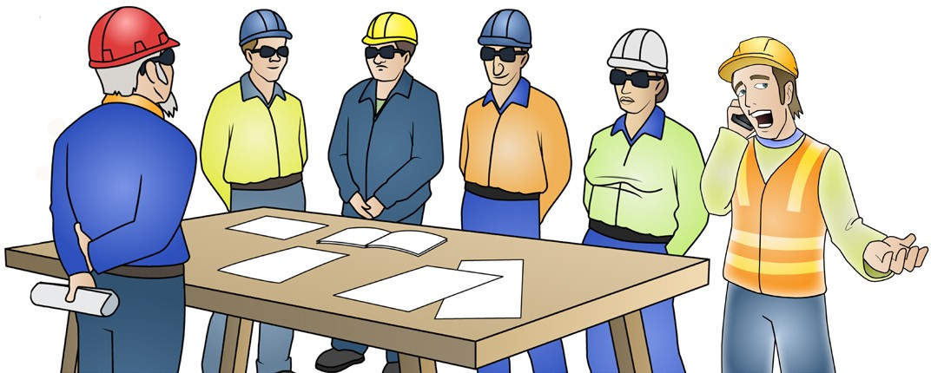
Get, interpret and confirm work needs
PC 1.1 PLAN AND PREPARE TO USE HAND AND POWER TOOLS
Getting, interpreting, and confirming work needs when using hand and power tools is an essential step to make sure safety and achieve the desired outcome. Here’s a general ways you can get and confirm your work needs:
Supervisors/Managers: In many work settings, supervisors or managers assign job tasks and provide work requirements to
employees directly. They may communicate instructions verbally or provide written documents outlining the tasks to be performed and any safety guidelines to follow.
Work Orders/Job Sheets: Work orders or job sheets are used to detail the specific tasks and requirements for a particular job. These documents can include instructions, diagrams, specifications, materials needed, and any safety precautions. Employees refer to these documents to understand their tasks and complete the work accordingly.
Work Planning Meetings: In collaborative work environments, teams may hold planning meetings to discuss upcoming projects or tasks. During these meetings, supervisors or project managers explain the work requirements, assign tasks to team members, and provide any necessary instructions. This approach allows for clarification and discussion among team members.
Digital Systems/Task Management Software: Some workplaces utilise digital systems or task management software to assign and track job tasks. Employees may receive notifications or access an online platform where they can view their assigned tasks, read instructions, and update the status of their work.
It’s important to note that workplace practices can vary significantly depending on the industry and organization. Following established safety protocols and seeking guidance from supervisors or trainers is crucial when working with hand and power tools to ensure proper understanding of job tasks and requirements.

Slide 5
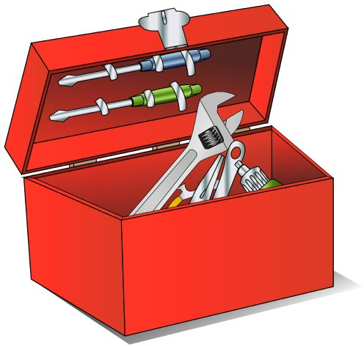
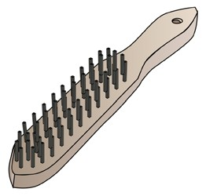
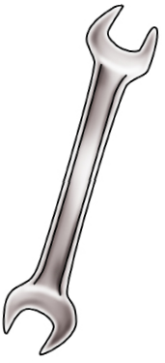
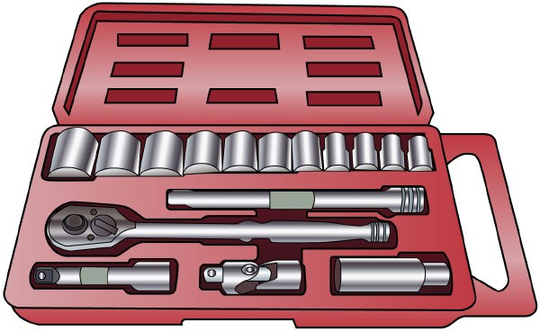
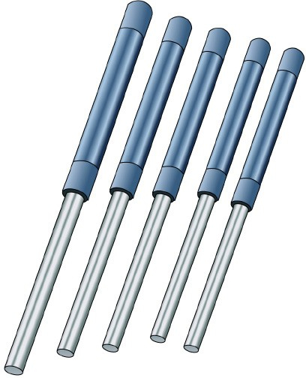
SELECT AND USE HAND TOOLS
SELECT AND USE HAND TOOLS
Element 2

Slide 6
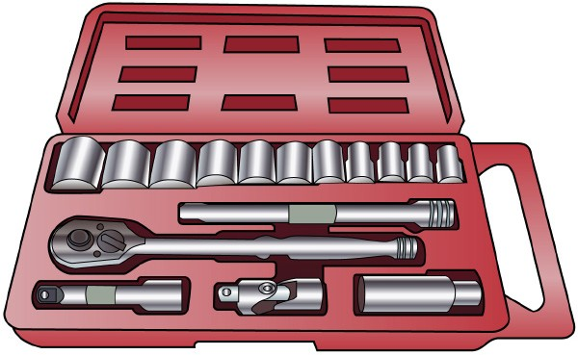
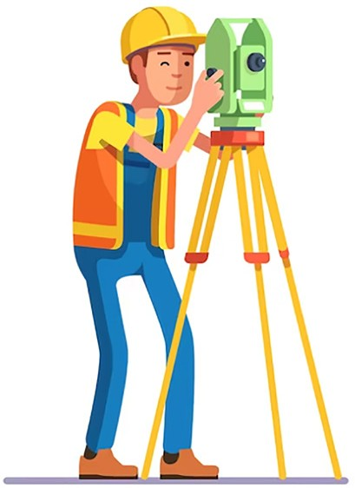
Choose the right tools for the job
PC 2.1 SELECT AND USE HAND TOOLS
Following are examples of jobs where hand tools are used:
Equipment Maintenance and Repair: Hand tools are frequently used for maintenance and repair tasks in resources and infrastructure industries.
This can include activities like servicing machinery, inspecting equipment, tightening or loosening fasteners, replacing components, or adjusting settings using tools such as wrenches, screwdrivers, pliers, or socket sets.
Construction and Assembly: Hand tools are essential for construction and assembly tasks in infrastructure development. This can involve activities like carpentry, where tools such as hammers, saws, chisels, or levels are used to cut and shape materials, drive nails, or assemble wooden structures. Other hand tools like wrenches, drills, or pipe cutters may be used in plumbing or electrical installations.
Field Surveying and Measurement: Hand tools play a role in surveying and measurement tasks within resources and infrastructure industries. Tools like tape measures, levels, compasses, or surveying equipment are used to measure distances, angles, and elevations for tasks such as land surveying, site layout, or infrastructure positioning.

Slide 7
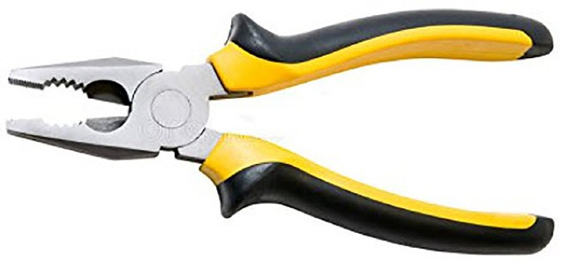
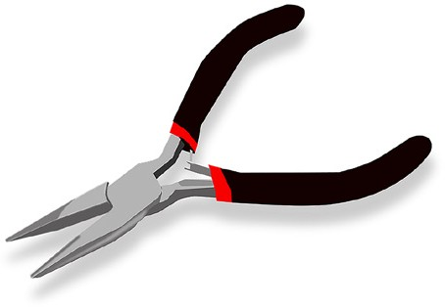
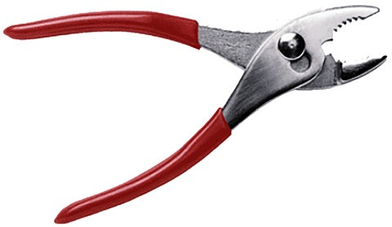
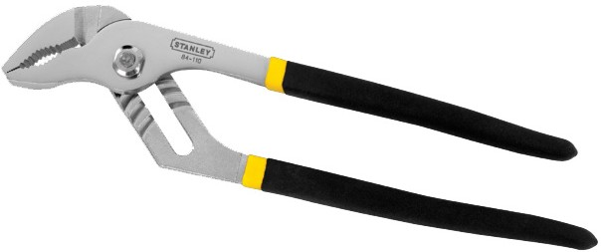
Choose the right tools for the job (continued...)
PC 2.1 SELECT AND USE HAND TOOLS
Equipment maintenance and repair
Pliers:
Combination Pliers:
These pliers have jaws that can be used for gripping, bending, cutting, and holding objects. They often have a wire cutter near the pivot point.
Needle-Nose Pliers: These pliers have long, thin jaws with a pointed tip, allowing for reaching into tight spaces or gripping small objects.
Slip-Joint Pliers:
Slip-joint pliers have an adjustable pivot point that allows for two or more jaw opening positions, providing versatility for different gripping sizes.
Locking Pliers (Vise-Grips):
Locking pliers have a mechanism that allows them to lock onto an object and maintain a secure grip. They are useful for holding or clamping objects in place.

Slide 8
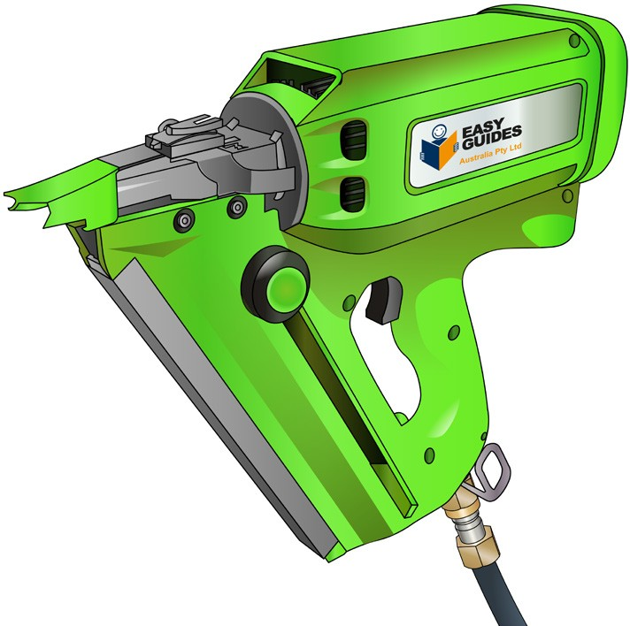
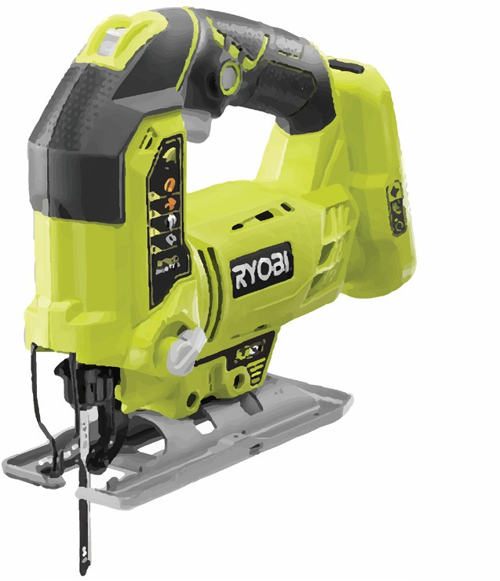
SELECT AND USE POWER TOOLS
Element 3

Slide 9
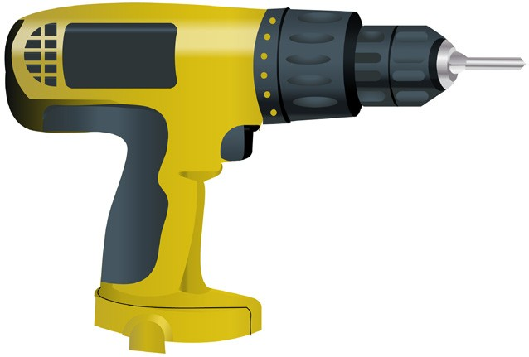
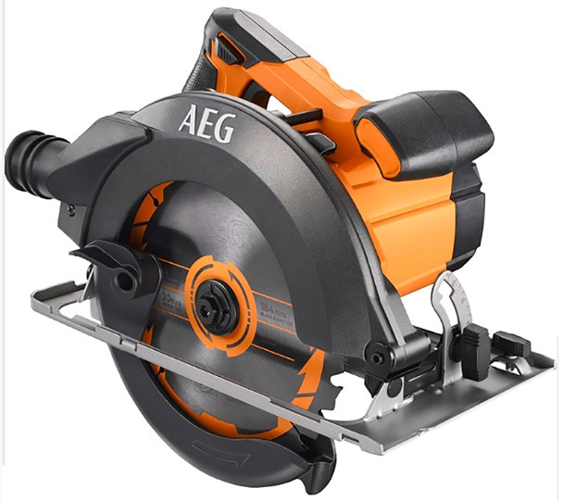
Choose the right power tools for the job
PC 3.1 SELECT AND USE POWER TOOLS
Tasks that commonly require the use of power tools within the resources and infrastructure industries include:
Drilling and Fastening:
Power drills are commonly used in resources and infrastructure industries for tasks such as drilling holes and fastening materials together. This can involve drilling holes for installation, attaching components, or securing fixtures using screws, bolts, or other fasteners.
Cutting and Grinding:
Power tools like angle grinders or circular saws are often used for cutting and grinding tasks in these industries. They can be used to cut through various materials such as metal, wood, or concrete, as well as for shaping or smoothing surfaces.
Material Removal and Surface Preparation:
Power tools such as sanders, grinders, or planers are employed for tasks involving material removal and surface preparation. They can be used to remove old paint or coatings, smooth rough surfaces, or prepare materials for further processing or finishing.
Continued on next page...

Slide 10
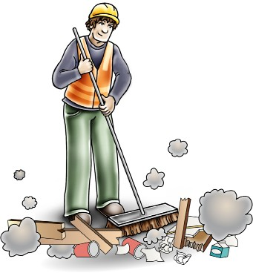
CoNDUCT HOUSEKEEPING ACTIVITIES
CONDUCT HOUSEKEEPING ACTIVITIES

Slide 11
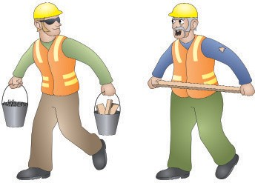
Clear work area and dispose of materials
PC 4.1 CONDUCT HOUSEKEEPING ACTIVITIES
After completing work with hand and power tools it is important to perform various housekeeping duties to
maintain a safe and organized work environment. Here are some housekeeping tasks to consider:
Remove any unused materials, debris, or waste generated during the work process.
Dispose of waste materials in designated containers or follow proper waste management protocols.
Sweep or vacuum the work area to remove dust, dirt, or other particles.
Securely store hazardous materials, chemicals, or flammable substances following safety protocols and guidelines.
Check and replenish stock levels of consumable items as needed.
Clear Pathways and Exits:
Ensure that pathways, walkways, and exits are clear of tools, equipment, or obstructions.
Remove any trip hazards, such as loose cords or materials, from the floor. Maintain clear access to emergency exits and fire extinguishers.
Continued on next page...
May not be reproduced

