Slide 1
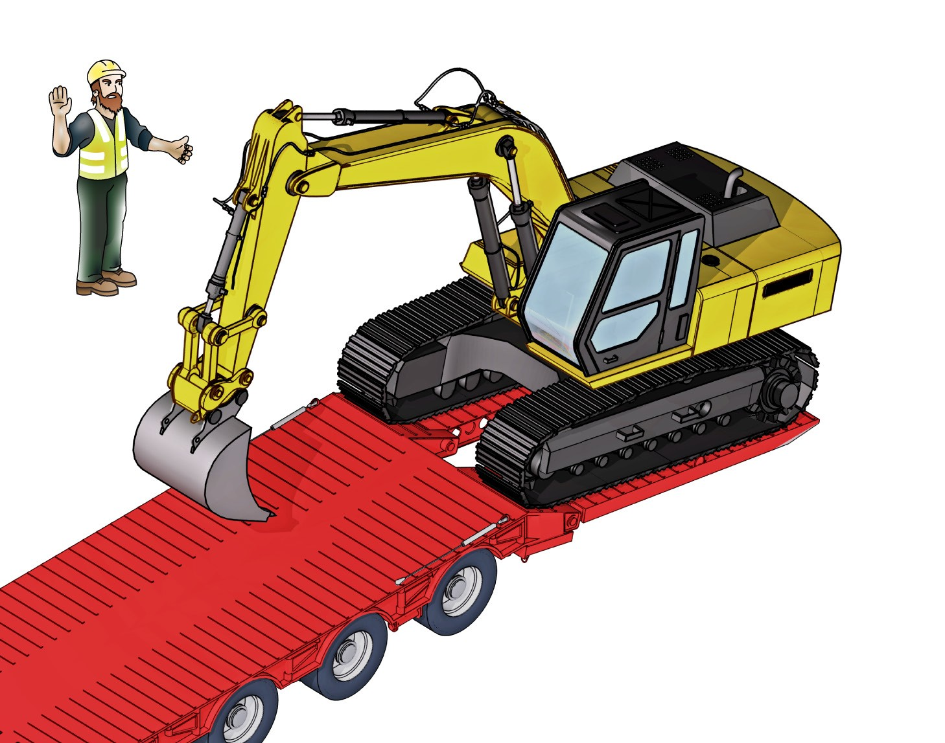
LEARNER GUIDE
Load and
Unload Plant
RII COMPETENCY
Training support material for:
RIIHAN308F
Load and unload plant

Slide 2
CONTENTS
About this guide
6
Introduction
7
High risk licensing and the law
Element 1 Prepare to load and unload plant
Element 2 Load the plant in line with established requirements Element 3 Unload the plant in line with established requirements Thank you - Subject matter experts
11
15
55
111
121

Slide 3
Introduction

Slide 4
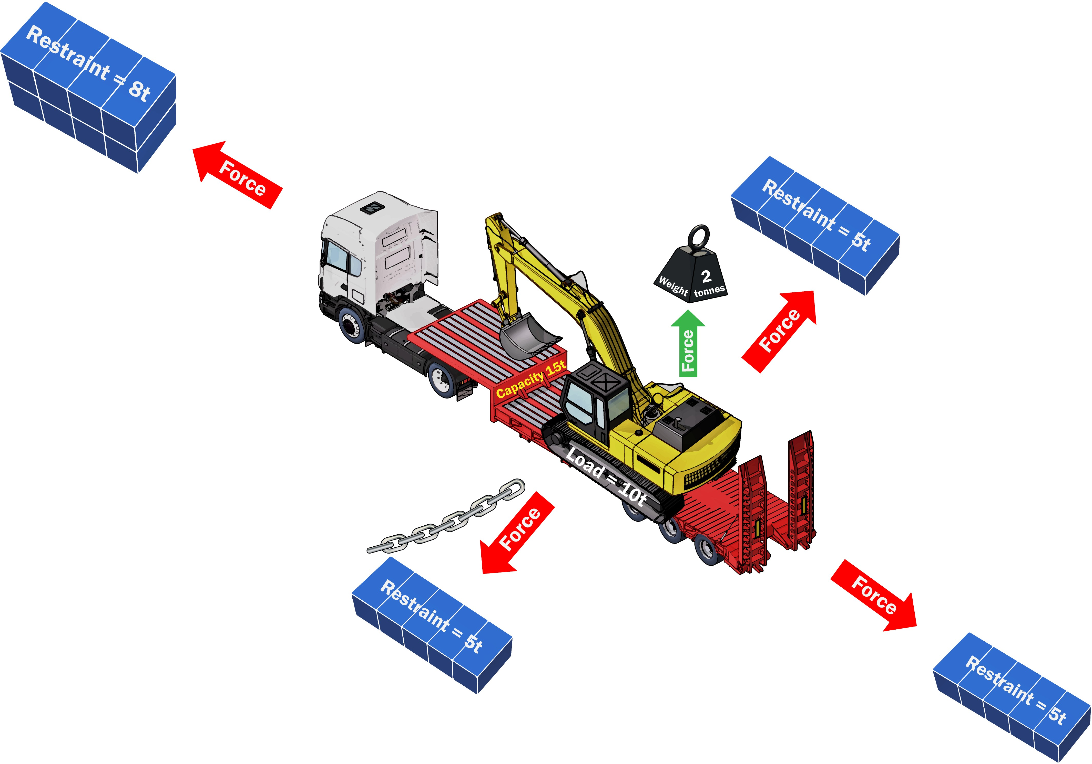
What you need to know to carry plant on a transport vehicle
LOAD AND UNLOAD PLANT
CAPACITY - How much weight can the transport vehicle carry? How heavy is the plant you want to carry?
MASS - What is the size of the plant you want to carry? You may need to go through a tunnel or travel on a narrow road.
LOAD RESTRAINTS - What type and how many load restraints do you need to hold the plant down securely?

Slide 5
LOAD AND UNLOAD PLANT
Prepare to load and unload plant
Element 1

Slide 6
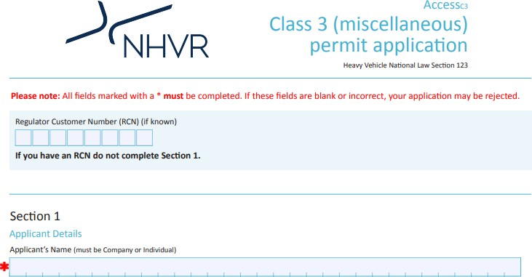
Documentation needed to load and unload plant
PC 1.1 LOAD AND UNLOAD PLANT
To load and unload plant correctly you need to know how to get, read and apply load handling documentation. The following pages will give you examples of the types of load documentation and information you are likely to use.
Some of the documentation will be online such as the permits on the National Heavy Vehicle Regulator (NHVR) website.

Slide 7
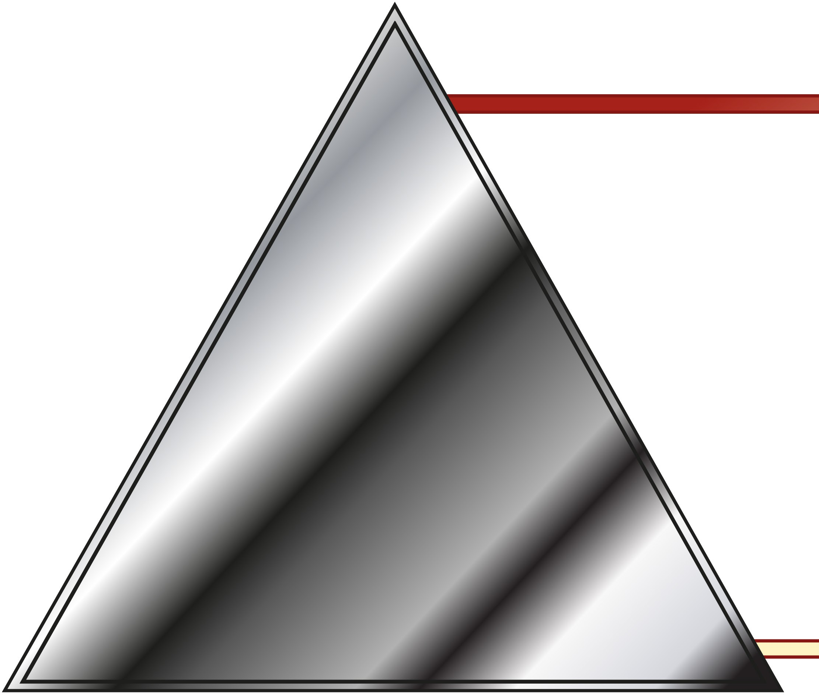
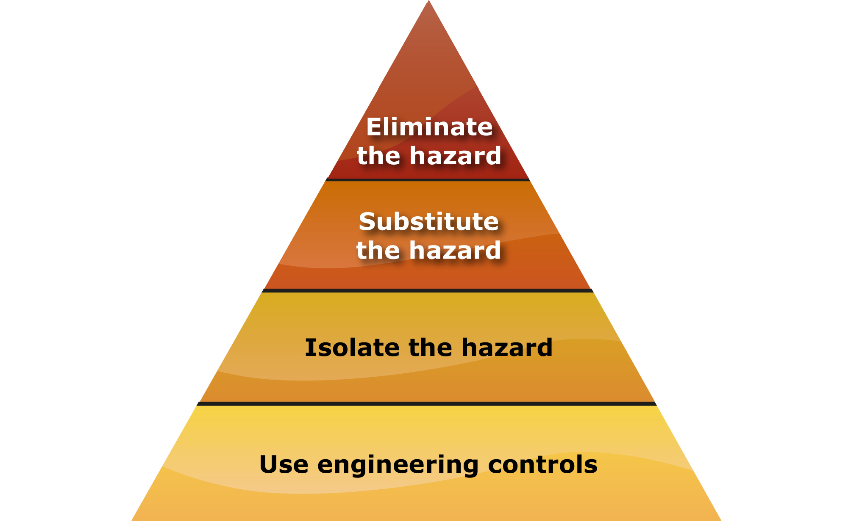
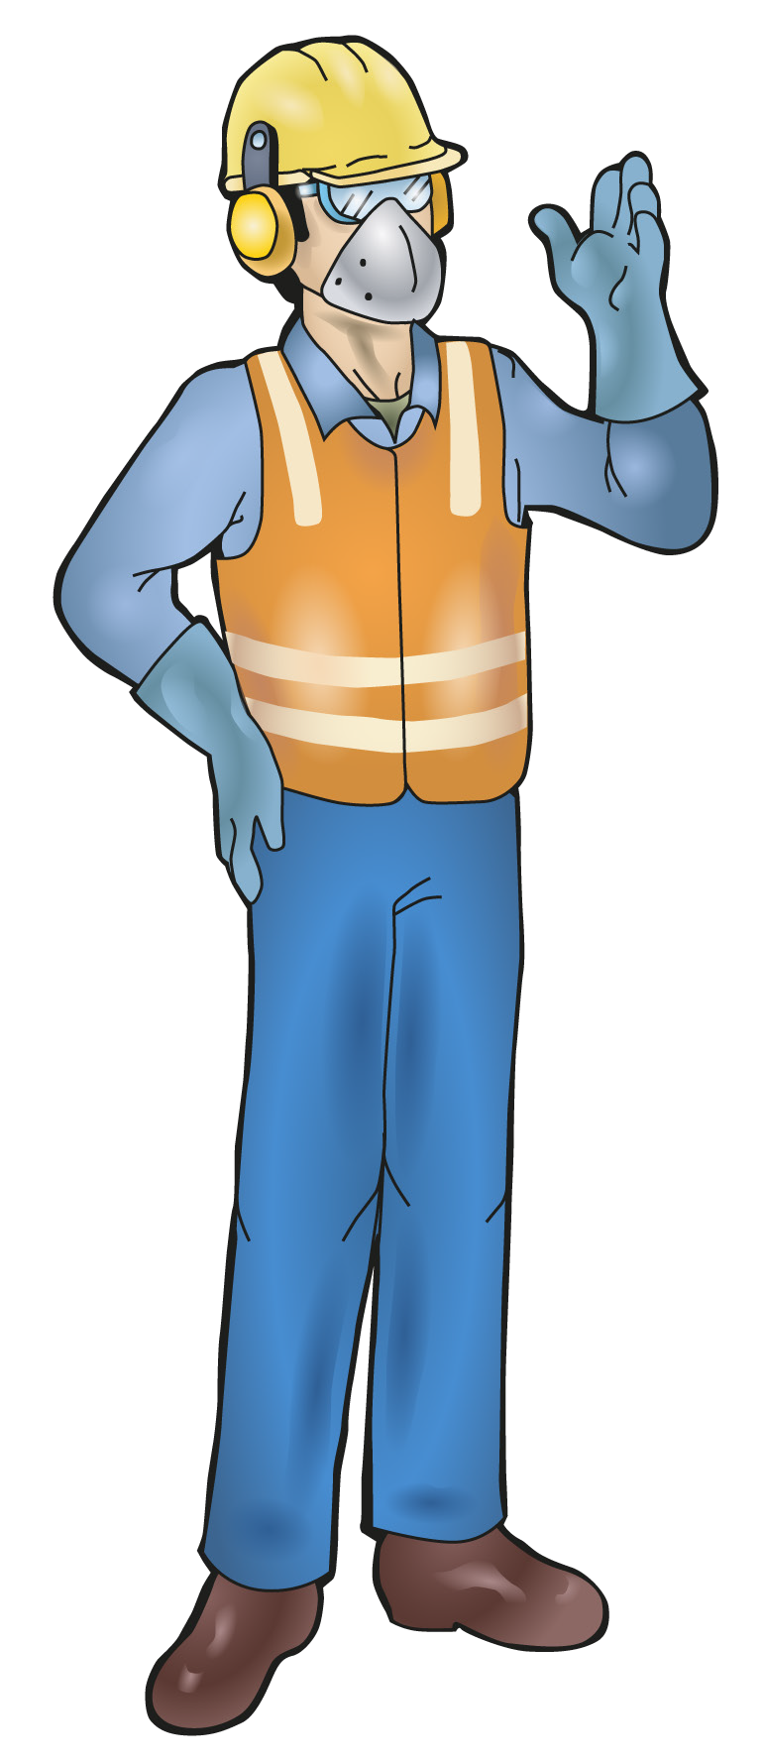
PC 1.3
LOAD AND UNLOAD PLANT
The Hierarchy of Hazard Control
The Hierarchy of Hazard Control is a list of controls that you can use to eliminate or lower the danger from a hazard in the workplace.
There are the six (6) levels in the hierarchy from the first choice to the last choice.
Elimination:
If possible, remove (take away) the hazard.
Substitution:
Use a safer method if you can’t remove the hazard.
Isolation:
Stop access to the hazardous (dangerous) area.
Engineering control measures:
Change the tools, equipment or environment to make it safer.
Administrative practices:
Reduce the time the worker is exposed to the hazards by using training, job rotation, the timing of jobs, etc.
Personal Protective Equipment (PPE):
Use PPE as your last line of defence.
Memory aid: Every Saturday I Eat A Pie

Slide 8
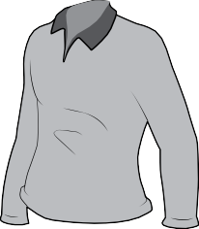
Personal protective equipment (PPE)
PC 1.4 LOAD AND UNLOAD PLANT
Question 2. What personal protective equipment (PPE) should you wear when loading and unloading a machine in hot weather
Answer may include but not limited to:
hard hat
hi viz vest
gloves
sunscreen
long sleeved shirt with a collar
safety glasses
hard nosed boots
Pants

Slide 9
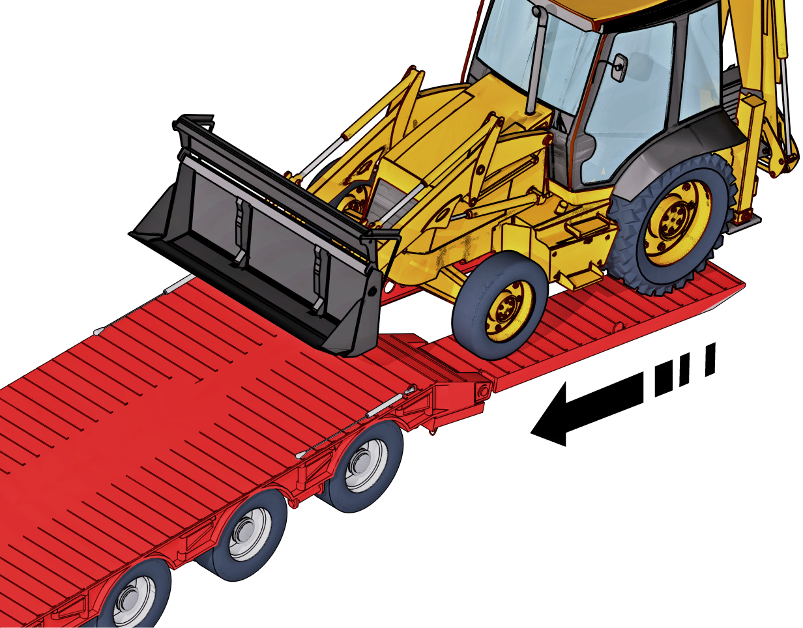
LOAD AND UNLOAD PLANT
LOAD THE PLANT CORRECTLY
Element 2

Slide 10
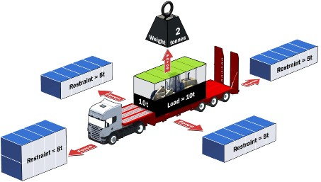
What you need to know to carry plant on a transport vehicle
PC 2.1 LOAD AND UNLOAD PLANT
CAPACITY - How much weight can the transport vehicle carry? How heavy is the plant you want to carry?
MASS - What is the size of the plant you want to carry? You may need to go through a tunnel or travel on a narrow road.
LOAD RESTRAINTS - What type and how many load restraints do you need to hold the plant down securely?

Slide 11
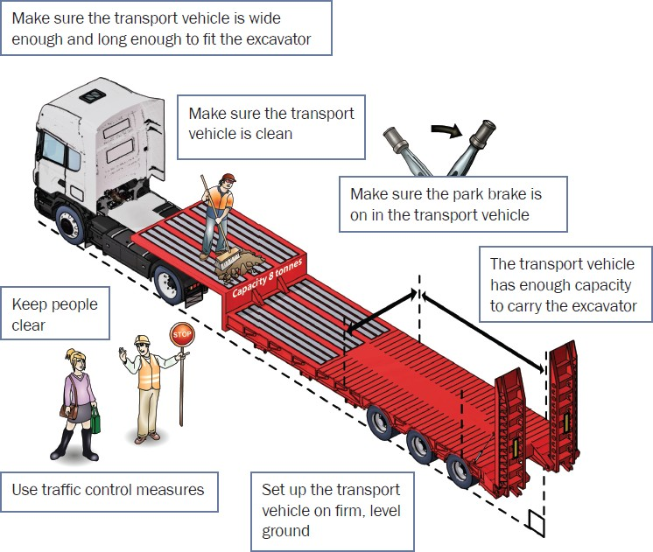
PC 2.1 LOAD AND UNLOAD PLANT
Set up the transport vehicle to carry an excavator
Example of moving plant:
[Continued on next page.]

Slide 12
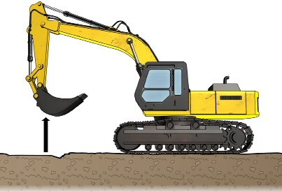
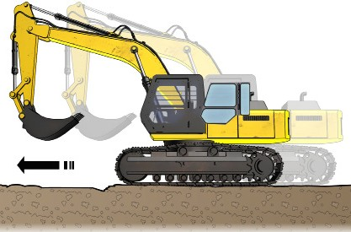
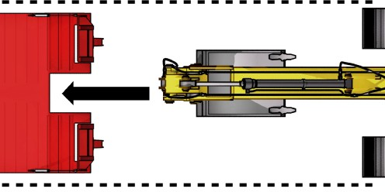
PC 2.4, 2.5
LOAD AND UNLOAD PLANT
After the transport vehicle and the excavator have been prepared, what steps are taken?
1. Raise the bucket to clear the ground.
2. Drive to the loading area.
3. Line the machine up with the ramps.
[Continued on next page.]

Slide 13
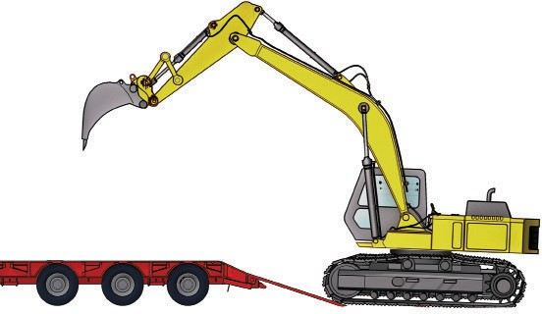
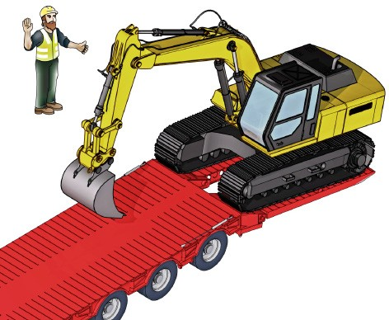
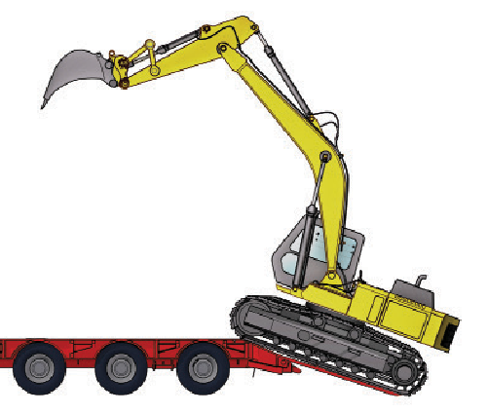
PC 2.2, 2.4, 2.5
4. Drive slowly forward until the tracks or wheels start to climb the ramp.
LOAD AND UNLOAD PLANT
If visibility is restricted a guide may be required.
5. Move the bucket or attachment away from the machine to help balance the machine while climbing ramps.
[Continued on next page.]

Slide 14
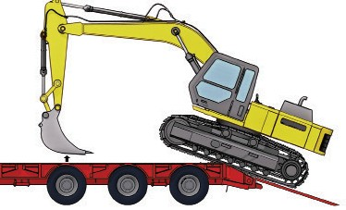
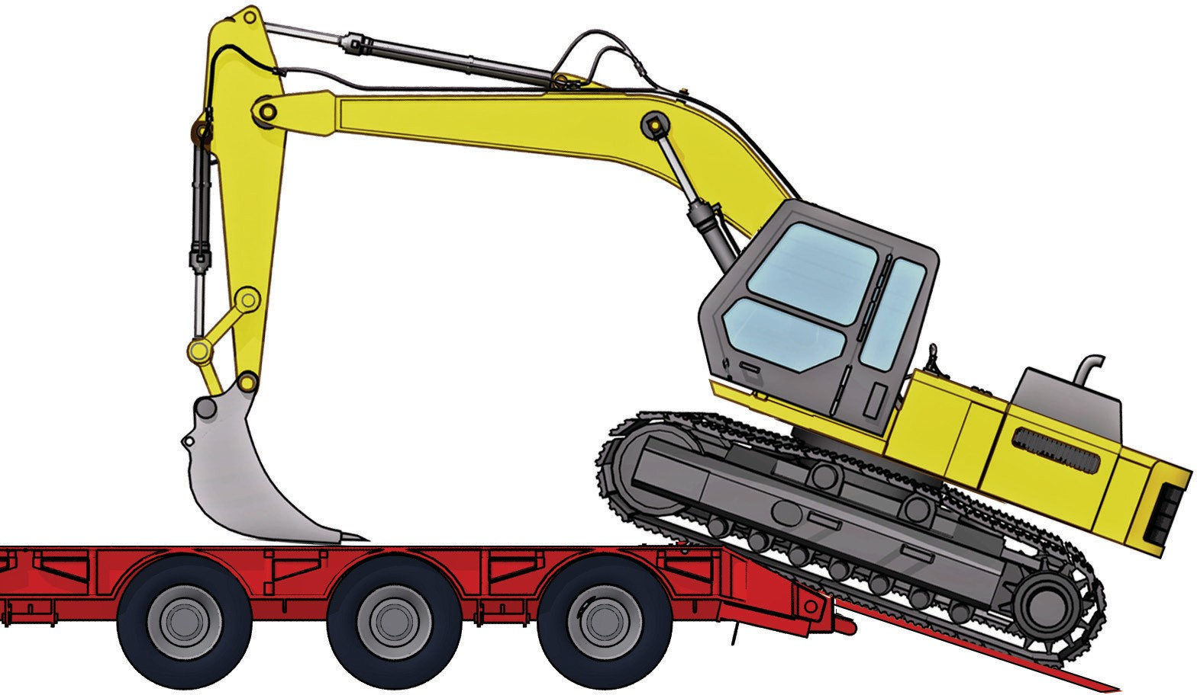
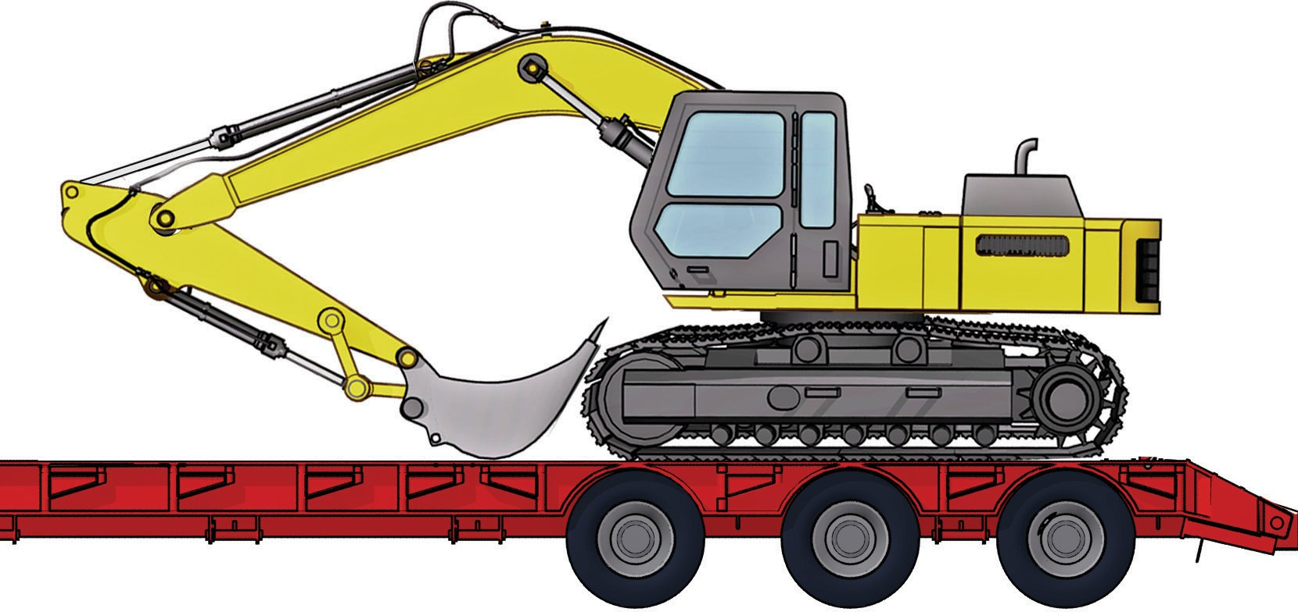
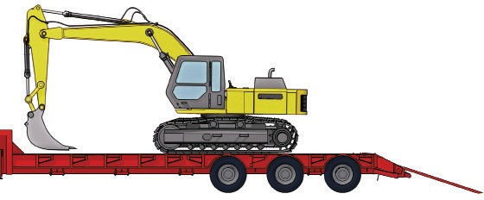
PC 2.5, 2.7
LOAD AND UNLOAD PLANT
6. Lower the bucket to the vehicle deck and drive slowly forward while moving the attachment closer to the cab and supporting the front of the machine.
7. As the machine rocks over onto the deck raise the bucket slowly to prevent the machine coming down hard onto the deck.
8. Raise the bucket until it just clears the deck and position the machine on the vehicle to make sure the load is correctly shared by the wheels.
9. Move the bucket close to the operator's platform and lower the boom down until the boom weight is resting on the deck.
[Continued on next page.]

Slide 15
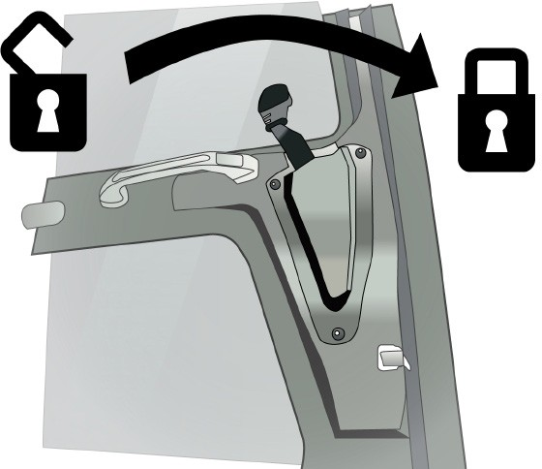
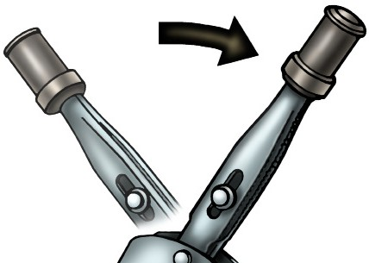
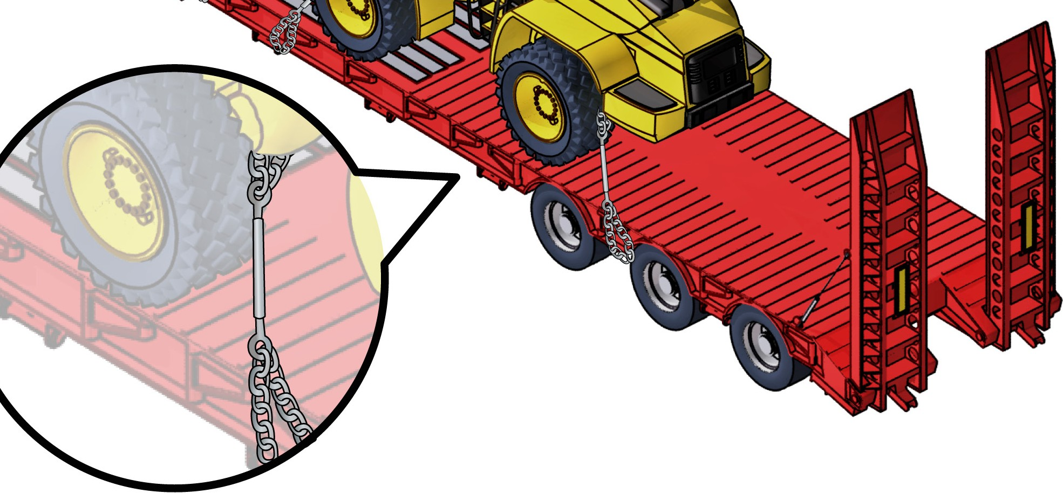
PC 2.8
LOAD AND UNLOAD PLANT
10. Switch off the machine and apply the park brake.
11. Secure the cabin.
12. Secure the machine to the vehicle.

Slide 16
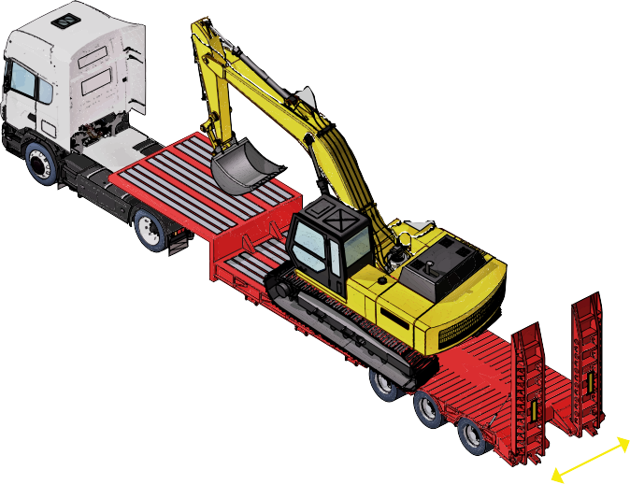
PC 2.1 LOAD AND UNLOAD PLANT
Machinery dimensions
You need to know the weight and dimensions of the float or trailer to safely carry the plant. This will help you to know
that you have the right transport vehicle to do the job.
For example: Which float would you use?
Barry Smith has been asked to transport an excavator weighing 52 tonne with a track width of 3.2 meters, the
company Barry works for has two floats in the transport pool.
1 Drake widening 4x4 float timber deck and drake 2x4 dolly non widening
1 Lusty 4x8 axle steel deck widening float and 2x8 dolly widening.
1 Which float would be used?
Answer:
Barry should use the 4x8 Lusty float. A 4x4 even with the dolly is only good for 50 tonne. Legal compliance build plates on the float and will have details including gross vehicle mass (GVM) and tare weight.
Weight
tonnes
[Note: Gross Vehicle Mass (GVM) is the maximum total weight that a truck can apply to the ground.]
length
width

