Slide 1
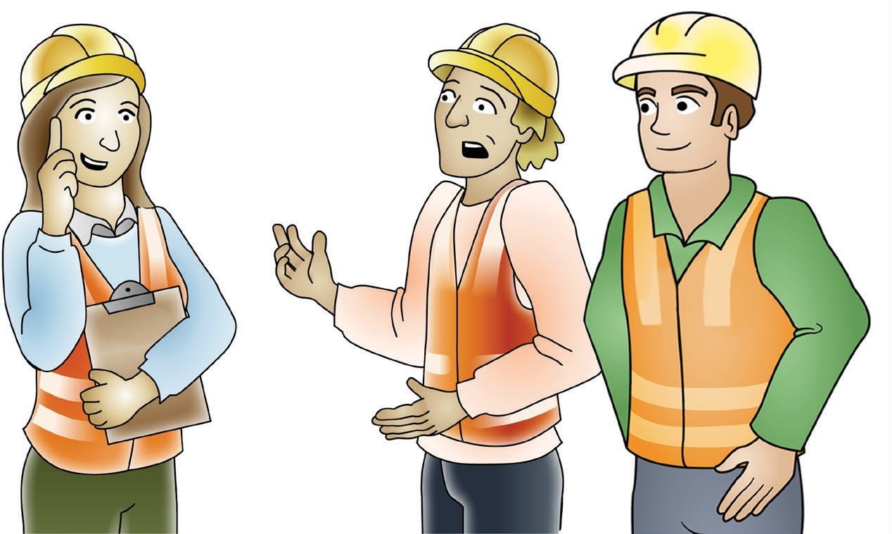
LEARNER GUIDE
Training support material for:
RIICOM201E
Communicate in the workplace
Produced by:
Picture based. Plain English. Learning made easy.

Slide 2
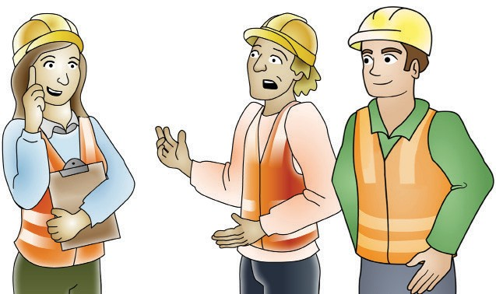
Introduction
INTRODUCTION

Slide 3
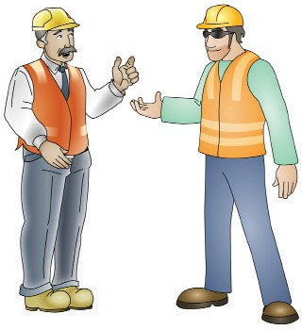
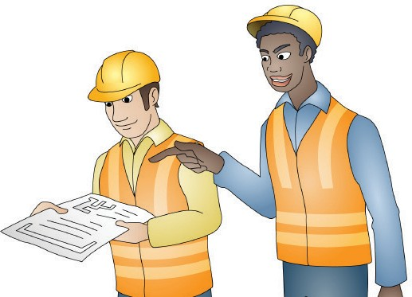
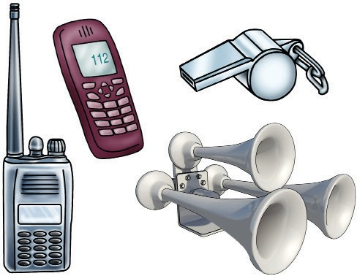
Communicate in the workplace
The purpose of communication is to exchange information with another person or a group of people. There are a number of ways to communicate. For example:
PC 2.5 INTRODUCTION
Speaking | Writing | By using communication equipment and systems
Communication is vital in the workplace. Effective communication is important to ensure a safe, efficient and happy working environment. Clear and correct information is necessary to pass on messages.
In this learners guide you will learn about:
Planning and preparing for workplace communication using equipment and systems
Communicating using communication equipment and systems
Carrying out face-to-face routine communication
Completing written documentation.

Slide 4
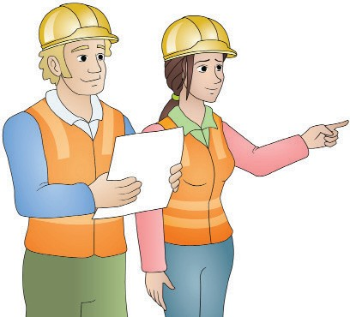
Plan and prepare for workplace communication using equipment and systems
PLAN AND PREPARE FOR WORKPLACE COMMUNICATION USING EQUIPMENT AND SYSTEMS
Element 1

Slide 5
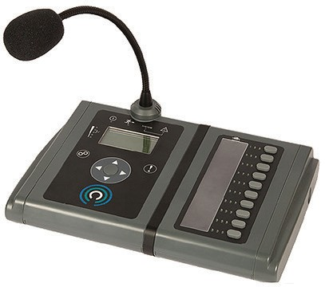
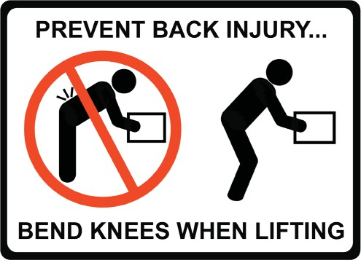
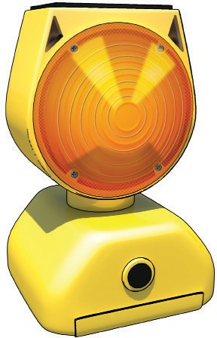
PC 1.3 PLAN AND PREPARE FOR WORKPLACE COMMUNICATION USING EQUIPMENT AND SYSTEMS
Communication equipment (continued)
Computer system Monitor, keyboard, hard drive, mouse, speakers. |  | Tablets |  | Public address (PA) systems and megaphones
Sirens and bells | Whistles |  | Lights |  | Signs
 |  |  |  |  | Tags

Slide 6
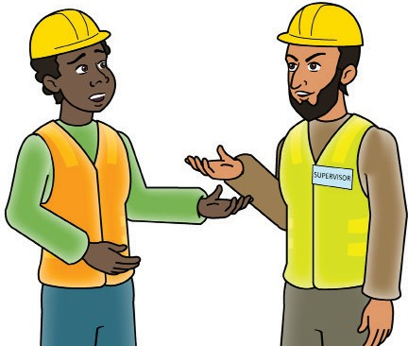
PC 1.4 PLAN AND PREPARE FOR WORKPLACE COMMUNICATION USING EQUIPMENT AND SYSTEMS
Establishing communication (continued)
When establishing communication with others it is important to approach them in the correct way. The success of further communications can often rely on how well the initial (first) communication goes.
Some things to remember include:
Be respectful and friendly Introduce yourself Smile Offer a handshake Make eye contact Know the persons name Do not talk down to people Respect the persons position in the company. For example the manager or supervisor. | Be culturally sensitive Consider the persons cultural background Consider different religions The person may have an accent or find it hard to understand yours Certain hand gestures and words have different meanings in some cultures. | Use language the audience understands English might be a second language for the person Try not to use ‘jargon’. Jargon is language that is only relevant to a particular trade, profession or group). Try not to use ‘acronyms’. An acronym is a set of letters that represent a phrase, name or organisation. For example: ASAP = As Soon As Possible EGA = Easy Guides Australia FEL = Front End Loader

Slide 7
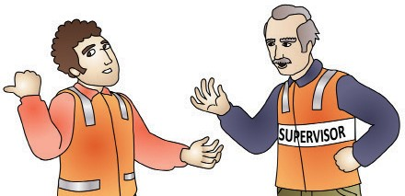
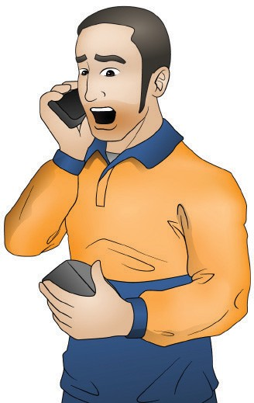
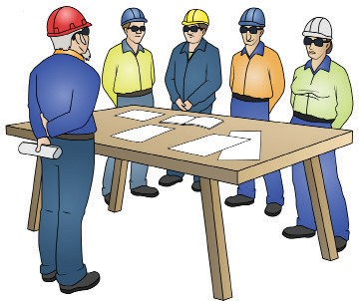
Maintaining communication
PC 1.4 PLAN AND PREPARE FOR WORKPLACE COMMUNICATION USING EQUIPMENT AND SYSTEMS
Once communication has been established with the audience it is important to maintain the communication until the message gets across.
Some tips for maintaining the communication include:
Keep it simple Do not use complicated or academic language. People may not understand and could lose interest. | Keep communication moving Make sure every bit of information builds on the information before it, this will make the subject flow and help with understanding. |  | Get to the point Get to the main point or points quickly. People may become frustrated or confused if the communication gets off track.
Interact with the audience If there is interaction between the speaker and the audience it will help to maintain interest and might also help the audience to understand. |  | Follow up After the initial communication it is a good idea to follow up to see how things are going. A phone call, text message or an email is a good way to do this.

Slide 8
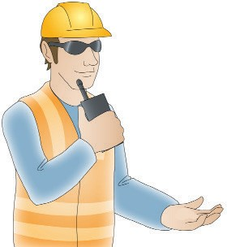
COMMUNICATE USING COMMUNICATION EQUIPMENT AND SYSTEMS
Communicate using communication
equipment and systems
Element 2

Slide 9
Use communication equipment and systems
PC 2.2 COMMUNICATE USING COMMUNICATION EQUIPMENT AND SYSTEMS
Two-way radio
Two-way radio systems usually operate in a half-duplex mode. This means that the operator can either talk or listen but cannot do both at the same time.
To send a message the operator must press a ‘push-to-talk’ button which activates the transmitter (allows a message to be sent).
When the button is released the receiver is active (allows a message to be received).
https://new-acc-space-9702.ispring.com/app/preview/b5f62eb4-ce8a-11ed-a821-ee0b4c9d17aa
Aerial
Volume
Speaker
Volume
LCD display
Push to talk
Channel up/down
Channel up/down
Push to talk
LCD display
Speaker
https://new-acc-space-9702.ispring.com/app/preview/b5f62eb4-ce8a-11ed-a821-ee0b4c9d17aa
Always refer to the operators manual for information on the radios controls

Slide 10
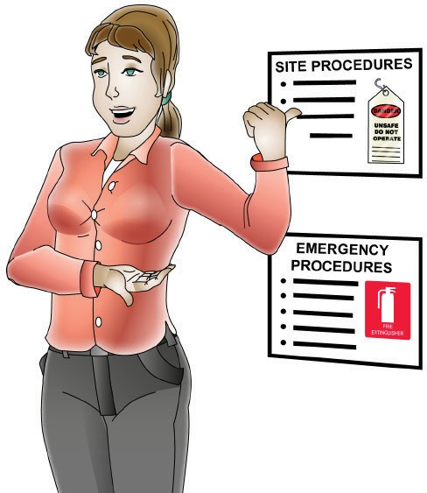
PC 2.5 COMMUNICATE USING COMMUNICATION EQUIPMENT AND SYSTEMS
Follow safety procedures (continued)
Observance of local communications and emergency procedures
Always refer to workplace policies and procedures to learn what is expected when a workplace emergency occurs. Observing local communications for emergencies on your work site means that you:
https://new-acc-space-9702.ispring.com/app/preview/b5f62eb4-ce8a-11ed-a821-ee0b4c9d17aa
Know who you need to communicate with in an emergency. This could be internal people like: Managers Supervisors Other workers First aid officers | Know what you need to communicate in an emergency: The type of emergency Location of the emergency Injuries Emergency services needed.
 | Know how to communicate in an emergency:
Or external people like: Emergency services Health and safety regulators Environmental protection authority. | Sound the alarm to warn everyone What type of communication equipment is safe to use? Keep calls brief. Do not tie up phone lines.
 | Know what documentation and reporting needs to be done:
 | All incidents, accidents and near misses must be reported and investigated Any incident that results in death, serious injury/illness or is dangerous must be reported to the state/territory health and safety regulator.
https://new-acc-space-9702.ispring.com/app/preview/b5f62eb4-ce8a-11ed-a821-ee0b4c9d17aa
https://new-acc-space-9702.ispring.com/app/preview/b5f62eb4-ce8a-11ed-a821-ee0b4c9d17aa
https://new-acc-space-9702.ispring.com/app/preview/b5f62eb4-ce8a-11ed-a821-ee0b4c9d17aa
https://new-acc-space-9702.ispring.com/app/preview/b5f62eb4-ce8a-11ed-a821-ee0b4c9d17aa

Slide 11
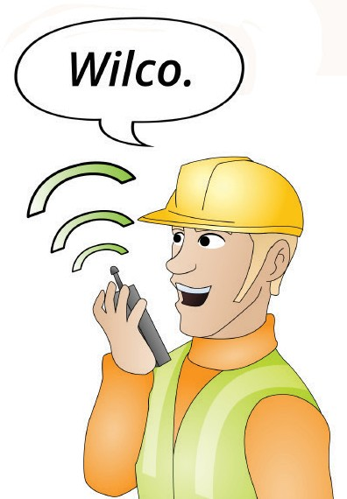
PC 2.2 COMMUNICATE USING COMMUNICATION EQUIPMENT AND SYSTEMS
QUESTION 15
When communicating on a two-way radio.
What term do you use to tell someone you will comply with their instructions?
Wilco
QUESTION 16
How do you write the word ‘dog’ using the phonetic alphabet?
Delta Oscar Golf
A | ALPHA
B | BRAVO
C | CHARLIE
D | DELTA
E | ECHO
F | FOXTROT
G | GOLF
H | HOTEL
I | INDIA
J | JULIET
K | KILO
L | LIMA
M | MIKE
N | NOVEMBER
O | OSCAR
P | PAPA
Q | QUEBEC
R | ROMEO
S | SIERRA
T | TANGO
U | UNIFORM
V | VICTOR
W | WHISKEY
X | X-RAY
Y | YANKEE
Z | ZULU

Slide 12
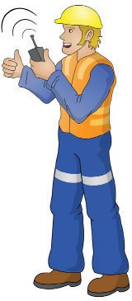
PC 2.2 COMMUNICATE USING COMMUNICATION EQUIPMENT AND SYSTEMS
QUESTION 17 There are basic protocols (rules) that a two-way radio user should understand and follow. Identify three of the rules. | Never transmit sensitive, private or confidential information Perform radio checks Do not interrupt Do not reply to messages that are not for you Think before you speak.
QUESTION 18 What are the four basic steps to transmitting a message on a two-way radio? | Listen to make sure that the channel is clear for you to speak. Press the push-to-talk (PTT) button. Wait for two seconds: Say — ‘Message recipients call sign... twice’. Next say — ‘This is... followed by your call sign’. When the person you want to talk to answers, you can pass on your message.

Slide 13
Carry out face-to-face routine communication
Element 3

Slide 14
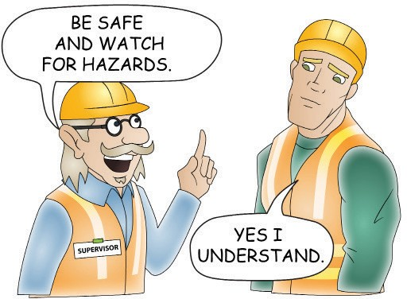
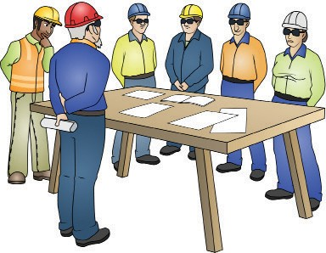
PC 3.1 CARRY OUT FACE-TO-FACE ROUTINE COMMUNICATION
QUESTION 35 Why is it important to speak clearly when communicating a message? | If you do not speak clearly when communicating a message it can cause errors and safety issues.
QUESTION 36 | Answer may include but is not limited to:
You need to communicate a message to a group of workers. | Do not mumble Do not talk too fast Do not talk too softly
What are some things you should remember when talking to them so the message is clear? | Do not talk too loudly Do not use slang Do not use acronyms.

Slide 15
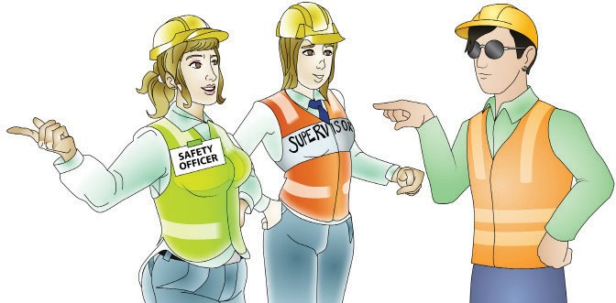
PC 3.5 CARRY OUT FACE-TO-FACE ROUTINE COMMUNICATION
QUESTION 51 What does it mean to communicate co-operatively. | To communicate co-operatively means to use a technique that encourages people to work together, or co-operate with each other. When you communicate co-operatively your communication will be more effective.
QUESTION 52 Who would be the more co-operative communicator — Someone who is assertive, aggressive or passive? | A person who is assertive would be the most co-operative communicator.

Slide 16
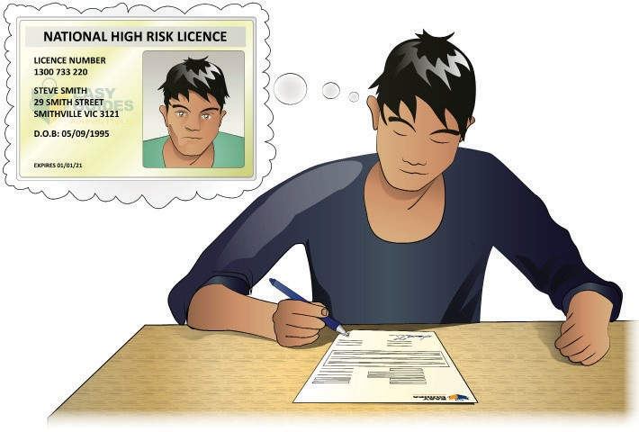
Complete written documentation
COMPLETE WRITTEN DOCUMENTATION

Slide 17
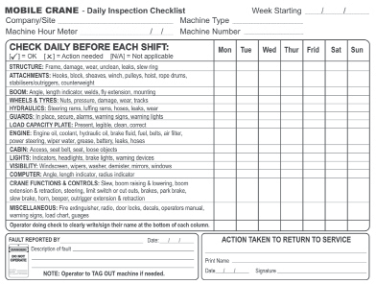
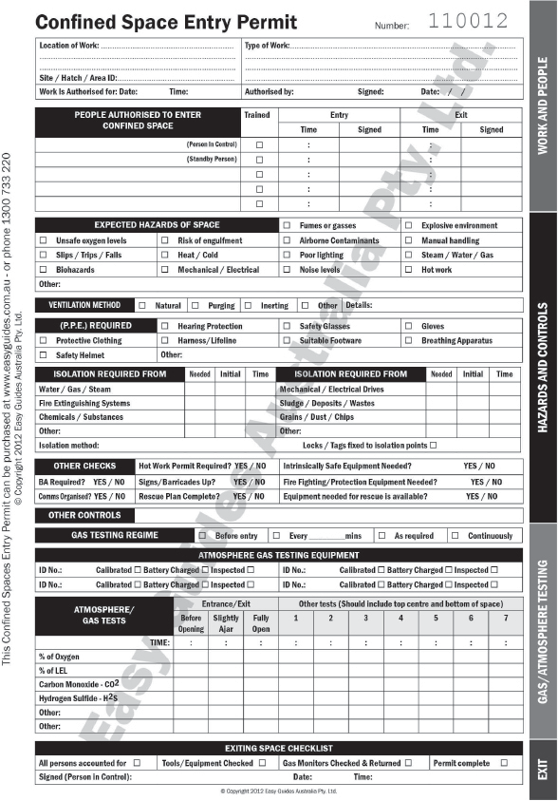
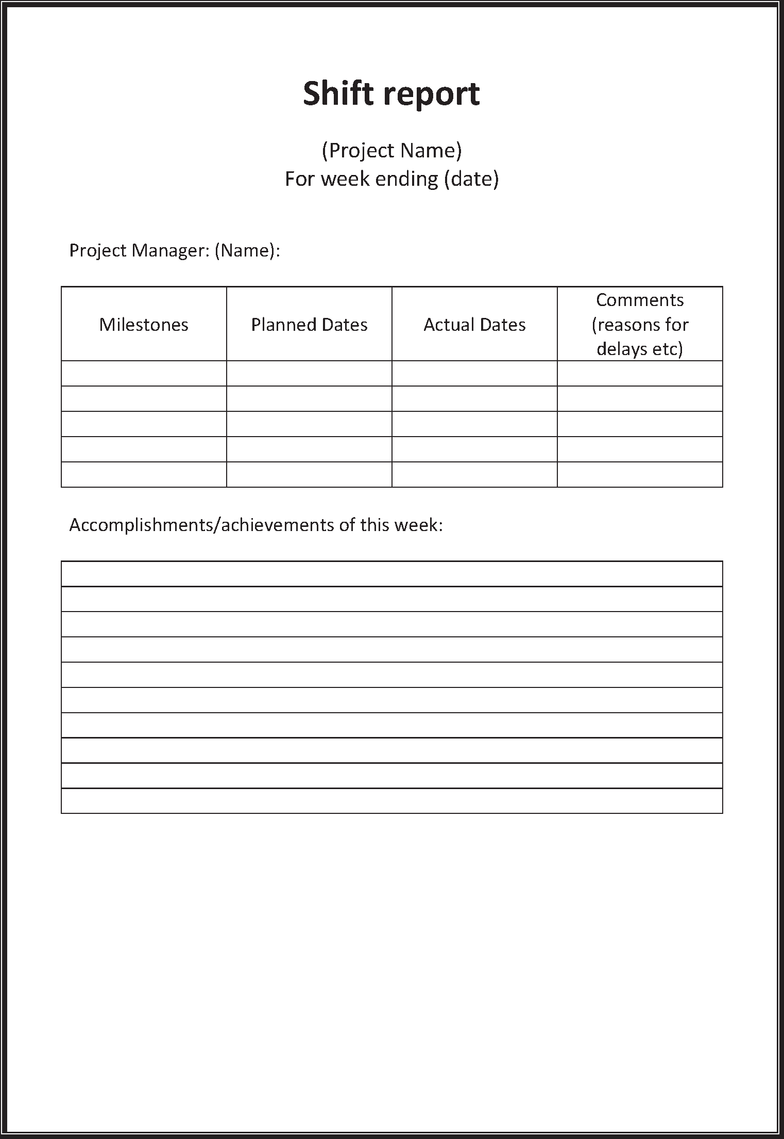
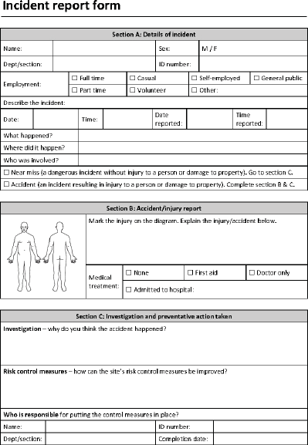
Complete written documentation
The types of written documentation used on worksites can vary between workplaces. Some common examples include:
PC 4.1 COMPLETE WRITTEN DOCUMENTATION
Checklists | Work permits
End of shift documentation | Incident reports

