Slide 1
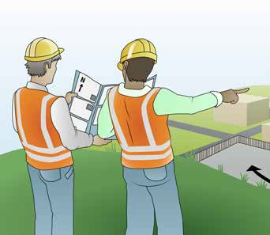
LEARNER GUIDE
Training support material for:
RIIBEF201E
Plan and organise work
Produced by:

Slide 2
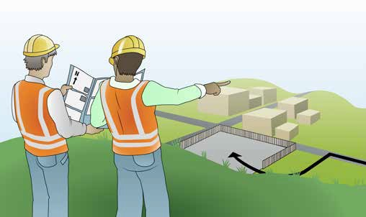
Plan and prepare for work

Slide 3
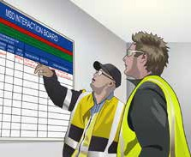
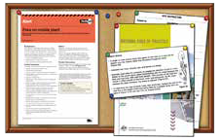
PC 1.3
PLAN AND PREPARE FOR WORK
Work instructions (continued)
Verbal, written and graphical (visual) instructions | Signage, work schedules and plans | Work bulletins, memos and maps
Safety data sheets (SDS) | Quality requirements | Instructions issued by authorised organisation or external personnel.

Slide 4
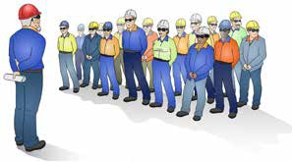
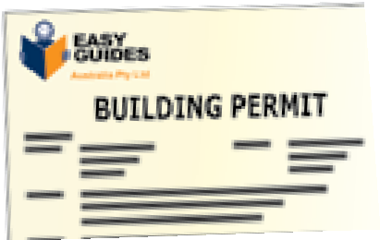
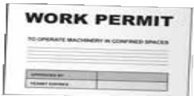
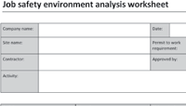
Plan work
PC 1.4 PLAN AND PREPARE FOR WORK
When planning the job it is important that you analyse (examine in detail) the required outcome (what needs to be done). This means that you carefully look at all the steps that are involved in completing the task so you can plan and organise
everything. This will help to make sure the task is done in a safe and efficient way and nothing is forgotten.
When analysing the task you should consider the following things:
Work procedures (work process) Work procedures are clear and precise instructions that outline how a job should be done. Work procedures are written by a person or group selected by the employer, they contain information like:
Who is responsible for what. | What steps need to be taken to complete the task. For example: Step 1 – Measure and mark fence post positions as per plans Step 2 – Check area for underground hazards Step 3 – Dig post holes using post hole digger Step 4 – Remove excess dirt from holes using spade Step 5 – Place one fence post in each hole Step 6 – Level and brace each post, fill holes with dirt/cement mix and compact area around post.
What forms or documents need to be completed. What permits are needed.

Slide 5
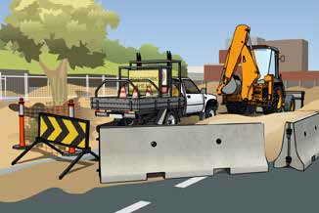
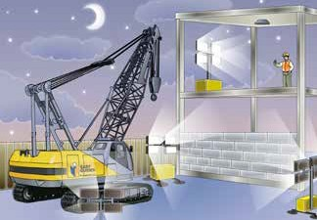
PC 1.4
PLAN AND PREPARE FOR WORK
Plan work (continued)
Traffic
If the job affects traffic, you may only be able to work at times when traffic is light (not peak hours).
Time of day
Some jobs can only be done during daylight hours, others may have to be done at night only.

Slide 6
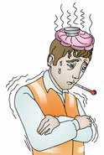
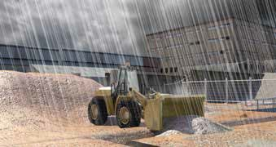
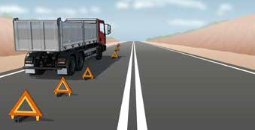
PC 1.4 PLAN AND PREPARE FOR WORK
Plan work (continued)
Some things that affect the time it takes to do the job are difficult to plan for because you don’t know they are going to happen
until they happen. For example:
Sick days | Problems with plans
Bad weather | Equipment problems and breakdowns.

Slide 7
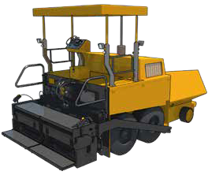
PC 1.4
PLAN AND PREPARE FOR WORK
Plan work (continued)
Calculating the time to complete a task
When planning a task it is important to calculate how long it will take. It can be difficult
to get this exactly right but a close estimate will be helpful.
Knowing how long the task will take helps to plan things like:
When the next part of the task can commence
When the next trades person might be required
When materials need to be delivered
How long disruptions might last, for example traffic delays.
Consider the following scenario:
150 m² of asphalt needs to be laid
30 m² can be laid in 60 minutes
The job takes 30 minutes to set up
The job takes 30 minutes to pack up
Workers have:
2 × 15 minute break, and
1 × 45 minute break during the day.
How long will it take to complete the job?
If work commences at 8:00 am —
What time could we expect to finish the job?

Slide 8
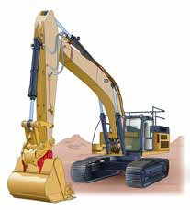
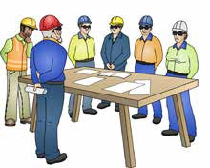
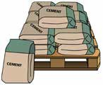
PC 1.4 PLAN AND PREPARE FOR WORK
Plan work (continued)
Resource requirements
Resources include all the things you need to do the job. When planning a job you must know what resources will be required and when. Make sure all resources are organised and available when you need them so work is not delayed.
Resources are things like:
People, workers (human resources) | Plant and equipment | Materials

Slide 9
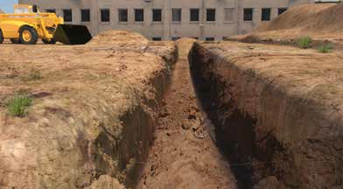
PC 1.4
PLAN AND PREPARE FOR WORK
Plan work (continued)
Volume
Volume is the amount we need to know if we want to fill a three dimensional (3-D) space. For example if we wanted to know how much dirt will be required to fill a trench.
The formula used to calculate volume can be different depending on the shape. The basic formula for a cube or rectangular shape is Length × Width × Height. Volume is expressed in cubic metres (m³).
For example:
To calculate the amount of dirt required to fill the trench below:
Length (L) = 10 metres
Width (W) = 2 metres Height (H) = 1.5 metres 10 × 2 × 1.5 = 30 metres
The quantity of dirt required is 30 m³
Width - 2 metres
Height - 1.5 metres
Length - 10 metres

Slide 10
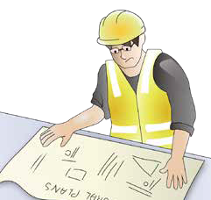
PC 1.4
PLAN AND PREPARE FOR WORK
Plan work (continued)
Priorities
When planning and organising work you must know if there are any priorities (things that need to be done first).
If there is, the job must be planned so these things are done without delay.
Check the work instructions for any priorities.

