Slide 1




QUEENSLAND
LEARNER WORKBOOK
Marking Guide with answers
Construction Induction
White card
CPCWHS1001 -
Prepare to work safely in the construction industry
Produced by:

Slide 2
Contents
About construction induction
5
Health and safety legislation
7
Identify construction hazards and risk control measures
19
Speaking (Oral communication)
33
Personal protective equipment
47

Slide 3
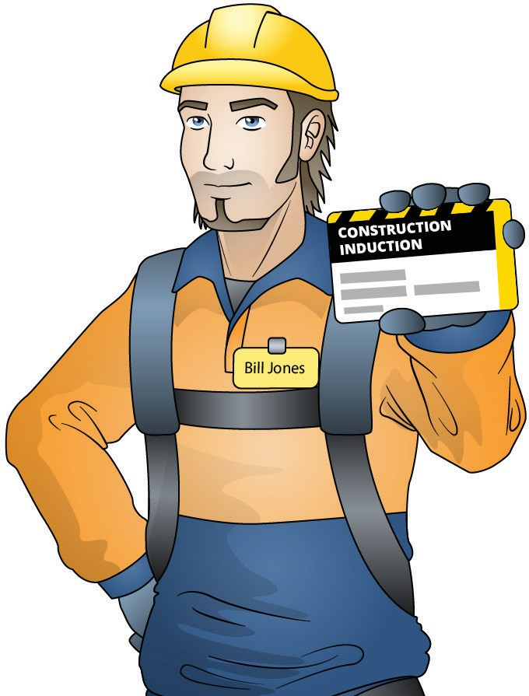
About construction induction

Slide 4

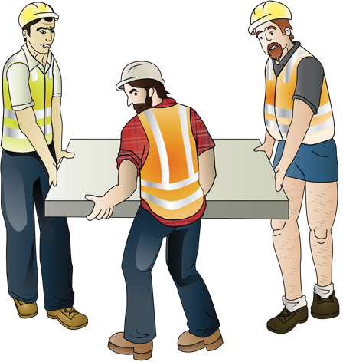
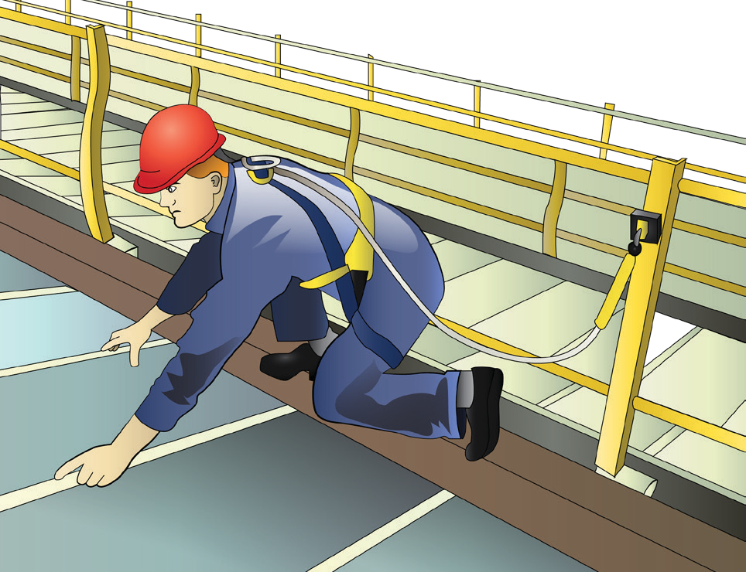
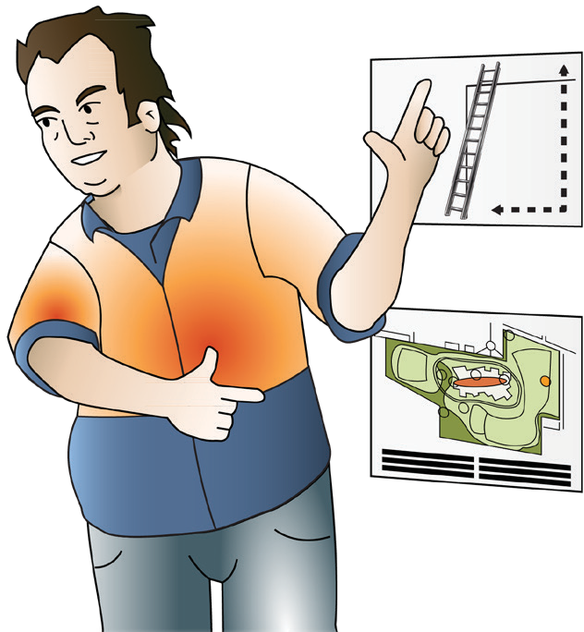
ABOUT CONSTRUCTION INDUCTION
Aims of general induction training
General induction training aims to provide persons with a basic knowledge of workplace health and safety legislative requirements, principles of risk management and the prevention of injury and illness in the construction industry.
General induction training should be undertaken by anybody working in general construction (commercial and civil) as well as those in the residential construction sector.
General induction training should include a formal training program that provides workers in the construction industry with an awareness and understanding of:
their rights and responsibilities under health and safety law
common hazards and risks that are in the construction industry
basic risk management principles
the standard of behaviour expected of workers on construction sites.
General induction training is recommended for:
Anybody carrying out construction work including site managers, supervisors, surveyors, labourers and trades persons.
Anybody with access to operational construction zones unaccompanied or not directly supervised by an inducted person.
Anybody whose employment causes them to routinely enter operational construction zones.
General induction should be completed upon entry to the industry before commencing construction work.
However, general induction may be repeated when the person with control of the construction work decides that there is a need for additional training.
This can be determined through supervision, incidents that may occur, risk management, or when a person re-enters the industry after an extended absence; for example, two consecutive years.

Slide 5

health and safety legislation

Slide 6
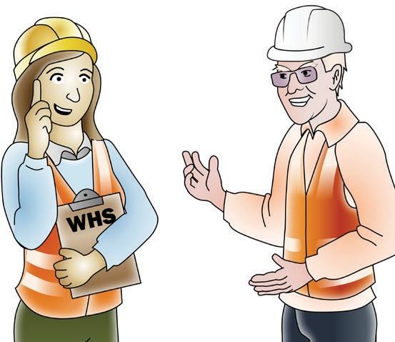
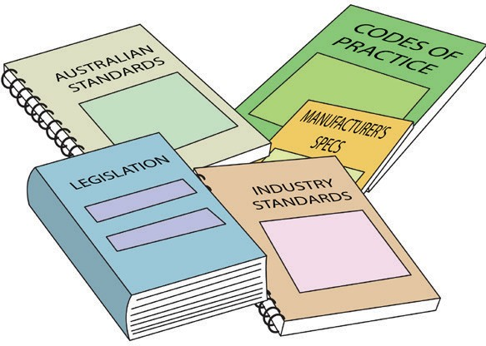
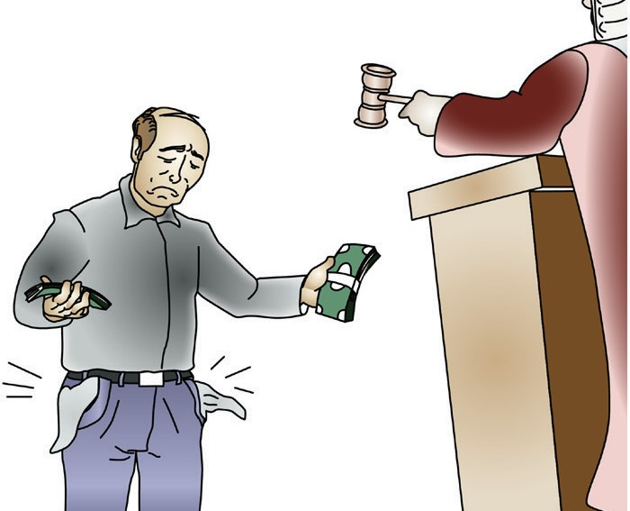
IDENTIFY HEALTH AND SAFETY LEGISLATIVE REQUIREMENTS OF CONSTRUCTION WORK
Laws to keep your workplace safe
Health and safety requirements are outlined in Acts, Regulations, Codes of Practice and Australian Standards.
Acts
Acts are laws that explain how to improve health and safety in the workplace. Queensland has the Work Health and Safety Act 2011.
Regulations
Regulations explain specific parts of the Act. For example, Queensland has the Workplace Health and Safety Regulations 2002.
Codes of Practice/Compliance Codes
Codes of Practice are practical guidelines on how to comply with (meet the rules of) legislation. For example: HAZARDOUS MANUAL TASKS Code of Practice
Australian Standards
Australian Standards are work guidelines that set the minimum accepted performance or quality for a specific hazard, process or product. For example: AS 2550 – Cranes, hoists and winches – safe use set.
Question: The laws in Queensland come under what Act?
Answer: .^{W}...º..^{r}.^{k}...^{H}..^{e}..ª..^{l}.^{t}.^{h}...ª..^{n}..^{d}...^{S}..ª..^{f}.^{e}..^{t}.^{y}...^{A}..^{c}..^{t}..²..⁰..¹..¹..................................
Question: What is the name of the regulation in Queensland that gives you more information about the Act?
The Workplace Health and Safety Regulation 2002.
Answer: .....................................................................................
Duty of care under the OHS Act
Everyone employed by a company/PCBU (Person Conducting a Business or Undertaking) on a construction site has a ‘duty of care’. The workplace must be a healthy and safe place to be.
Managers, supervisors, team leaders and all workers in general have a duty of care. A work-experience student or sub-contractor on site would also come under the ‘duty of care’.
If you do not look out for the health and safety of others you can be fined or
punished.
Someone not employed by the PCBU operating a construction site does not have a ‘duty of care’ for that site.

Slide 7
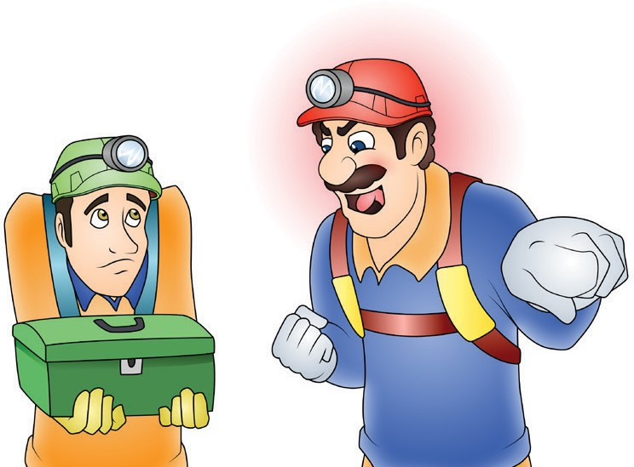

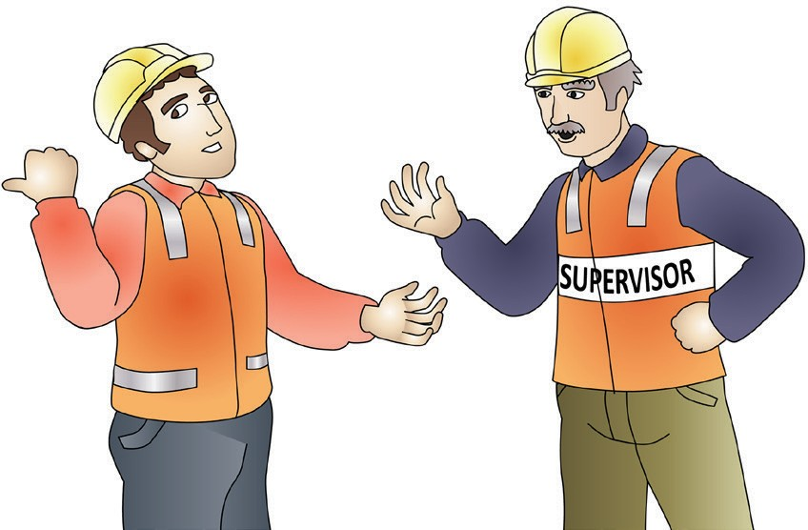


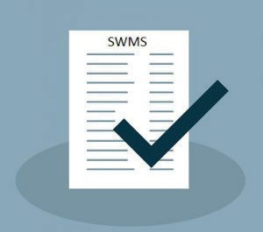

IDENTIFY HEALTH AND SAFETY LEGISLATIVE REQUIREMENTS OF CONSTRUCTION WORK
Bullying and harassment
Take care of yourselves and each other.
Bullying and harassment do not belong in the workplace. Do not be abusive, insulting or offensive towards others.
Report any bullying or harassment to your supervisor or other relevant person.
If necessary, supervisors should give constructive feedback on someone’s job performance. Make sure you give other workers the information they need to get the job done.
Question: Can you be abusive and insulting if someone is not doing the job properly?
Answer: ^{N}...º........................................................................................................................................................................
Question: What should a supervisor do if someone is not doing the job properly?
Answer: ^{G}...^{iv}..^{e}...^{t}.^{h}..^{e}...^{p}..^{e}..^{r}..^{s}.º..^{n}...^{c}..º..^{n}..^{s}..^{t}.^{r}.^{u}..^{c}..^{t}.^{i}.^{v}..^{e}...^{f}.^{e}..^{e}..^{d}..^{b}..ª..^{c}.^{k}.................................................................................................................
There are a number of documents that help to keep a workplace healthy and safe. These include:
Chemicals and solvents
Always check the Safety Data Sheet (SDS) before handling any chemicals.
An SDS must be provided to, and understood by, a person using chemicals in the workplace.
The SDS will tell you how to safely
handle the chemicals.
If you are not sure, put the chemicals in a safe, isolated area and talk to your supervisor.
Safe Work Method Statement (SWMS)
A Safe Work Method Statement is a site specific statement that must be prepared before any high-risk construction work is commenced.
It covers the job and safety responsibilities of each member of a work group. Workers should be involved in discussions of tasks, associated hazards, risks and controls.
Job Safety Analysis (JSA)
A Job Safety Analysis (JSA) is a way to make jobs safer. It involves looking at each step of a job, finding things that could be dangerous, and figuring out how to stop accidents
from happening. This keeps workers safe and helps companies follow safety rules.

Slide 8
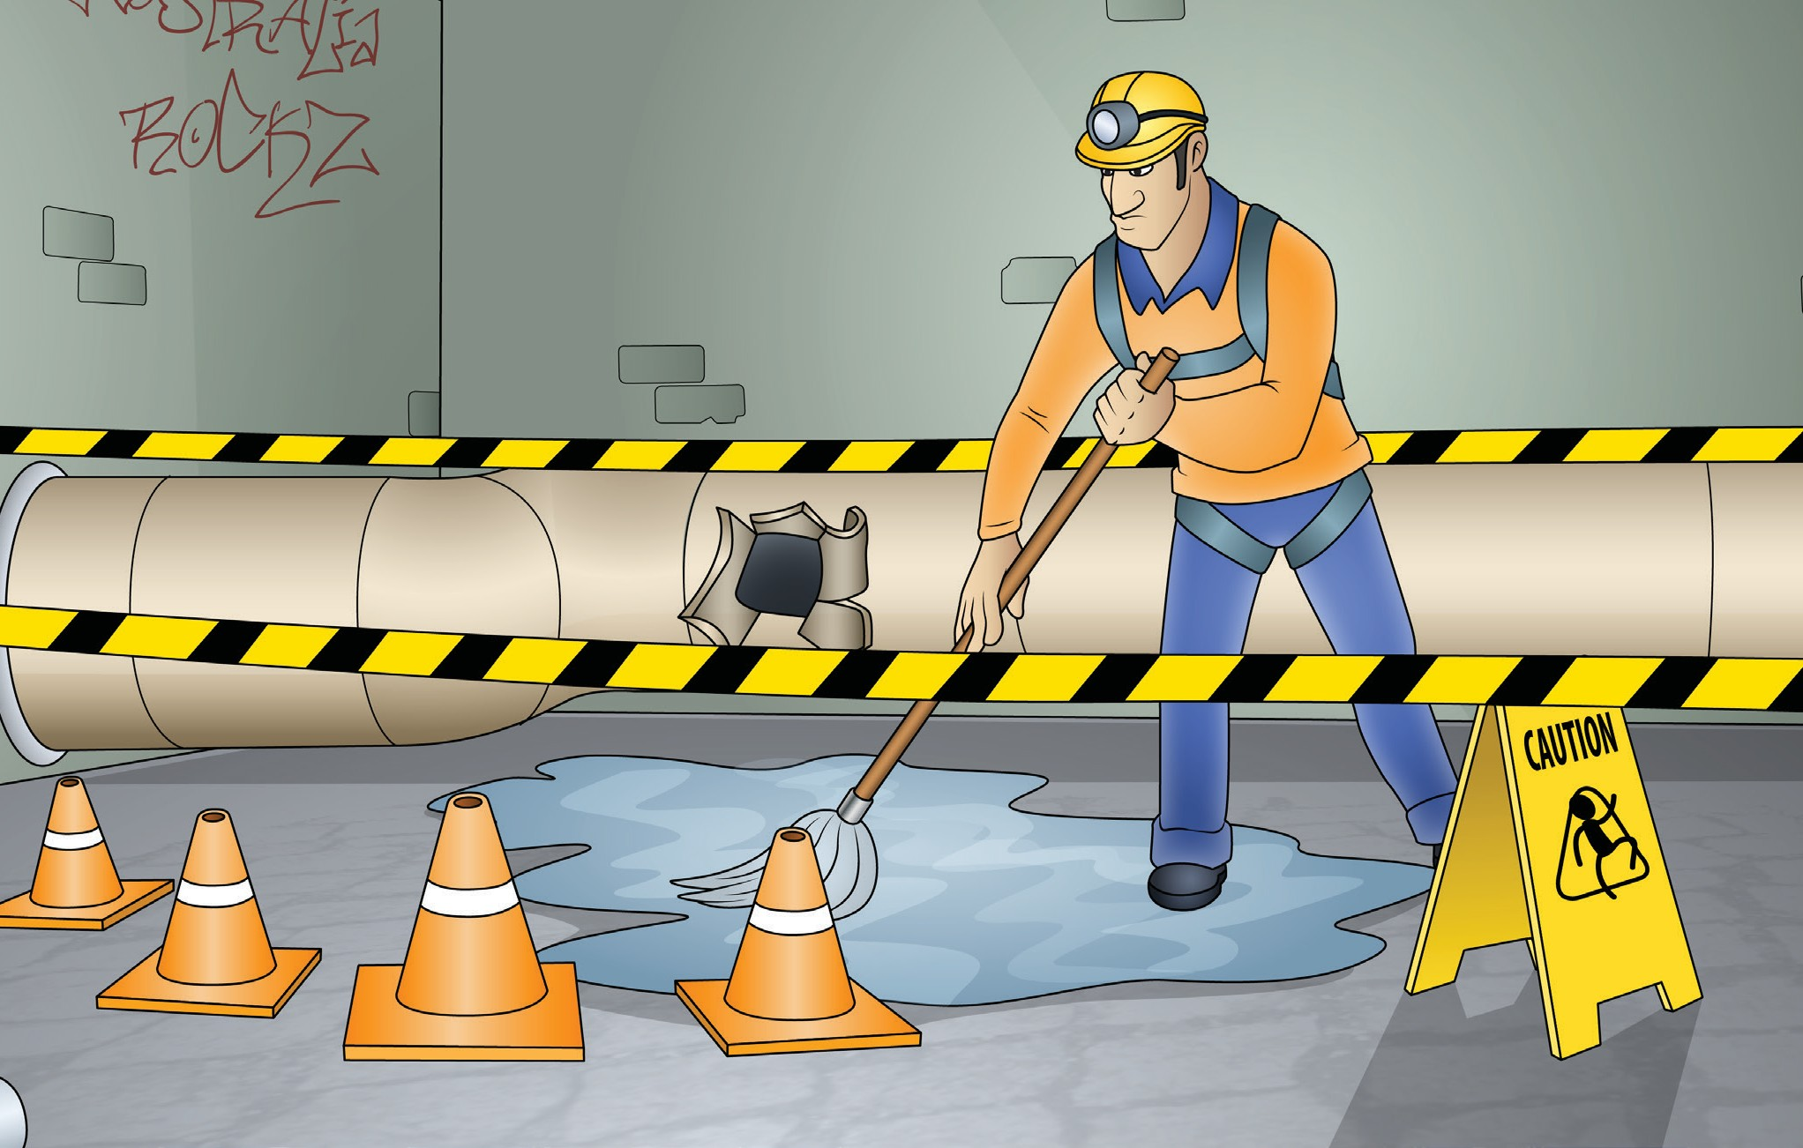
Identify construction hazards and risk control measures

Slide 9
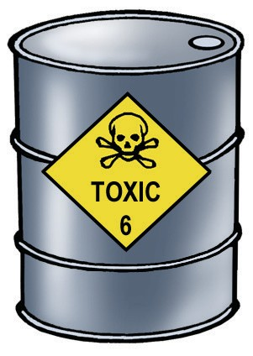
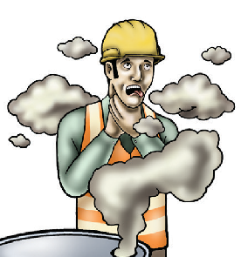
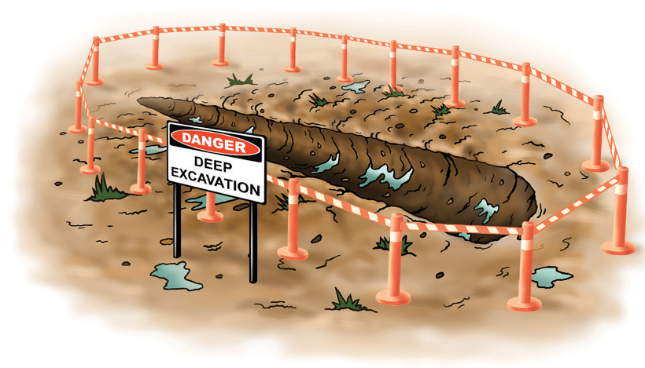
IDENTIFY CONSTRUCTION HAZARDS AND RISK CONTROL MEASURES
Hazard versus risk
What is the difference?
The constantly changing nature of construction work sets it apart from other types of work. Different hazards and
risks emerge constantly—sometimes instantly.
Co-ordinating risk management is made more difficult by the stop and start nature of a construction project, high
turnover of workers and temporary workplaces. These features contribute to the high levels of risk in the industry.
Hazard
A hazard is any thing or any situation which could injure or harm you.
In other words, it is anything that can hurt you.
Risk
A risk is the chance of a hazard causing injury or harm.
In other words, how likely it is that somebody or something may be harmed by the hazard.
Managing a risk
There are 5 steps you should take to manage a risk. They are:
Step 1 - Identify / find the risk.
Step 2 - Assess the risk. How likely is the risk and what serious would it be?
Step 3 - Report the risk.
Step 4 - Control the hazard to lower the risk. Step 5 - Review the action you have taken.
The best way to manage a risk is to eliminate (get rid of) it.
Question: What is a hazard?
Answer: ^{A}..^{n}...^{y}.^{t}.^{h}...^{in}...^{g}..º..^{r}...^{s}.^{i}.^{t}.^{u}..ª..^{t}..^{io}..^{n}...^{t}..^{h}..ª..^{t}..^{c}.º..^{u}...^{ld}...^{h}..ª..^{r}..^{m}....^{y}..º..^{u}..........................................................................................................
Question: What is a risk?
Answer: ^{T}..^{h}..^{e}...^{p}..º..^{s}..^{s}.^{i}.^{b}..^{i}.^{l}.^{i}.^{t}.^{y}...º..^{f}..ª...^{h}..ª..^{z}.ª..^{r}..^{d}...^{c}.ª..^{u}..^{s}..^{i}.^{n}..^{g}...^{in}..^{j}.^{u}..^{r}..^{y}..º...^{r}..^{h}..ª..^{r}.^{m}.................................................................................................
Question: Use one or two words to describe each of the 5 steps to manage a risk?
Answer: ..^{S}..^{t}.^{e}..^{p}...¹...⁻..^{I}.^{d}..^{e}..^{n}..^{t}.^{i}.^{f}.^{y}..,..^{S}..^{t}.^{e}..^{p}...²..⁻..^{A}..^{s}.^{s}..^{e}..^{s}..^{s}..^{r}.^{i}.^{s}..^{k}..,.^{S}..^{t}..^{e}.^{p}...³...⁻..^{R}..^{e}..^{p}..º..^{r}..^{t}..^{r}.^{i}.^{s}..^{k}..,.^{S}..^{t}.^{e}..^{p}...⁴...⁻..^{C}..º..^{n}..^{t}..^{r}.º..^{l}..^{r}.^{i}.^{s}..^{k}..ª..^{n}..^{d}...^{S}..^{t}..^{e}.^{p}...⁵...⁻..^{R}..^{e}..^{v}..^{i}.^{e}..^{w}...ª..^{c}..^{t}.^{i}.º..^{n}.........
Question: What is the best way to manage a risk?
Answer: .E.l.i.m...i.n..a..t.e...(.g..e..t..r.i.d...o..f..).i.t..........................................................................................................................................

Slide 10
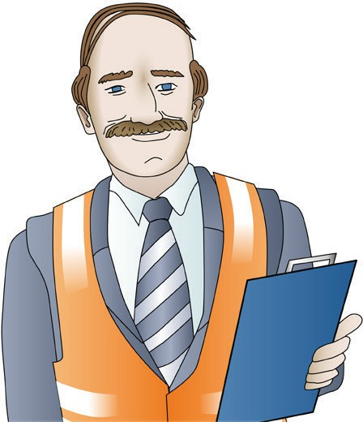
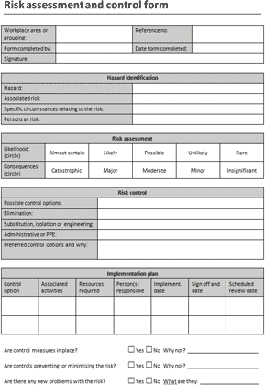
IDENTIFY CONSTRUCTION HAZARDS AND RISK CONTROL MEASURES
Reviewing the action you have taken
Once you have applied hazard controls to lower the risk of harm, you need to review how effective the control is and if more needs to be (or can be) done to lower the risk further.
Reasons you may need to review the risk controls control could be:
when a notifiable incident happens
when checking shows that the risk control is not working
when a health and safety representative asks that the review be done (per the Queensland legislation).
You may need to apply more than one control measure to reduce the risk to a minimal level.
Risk assessment management plan
In making a risk assessment management plan you should include the following:
Identify the hazard
Assess how likely it is that the hazard will cause harm
Talk to other workers or health and safety people to find ways to control
the hazard
Talk to other workers or health and safety people to lower the risk
Finally, are there ways to improve things for the future?
Always re-assess the level of risk after you introduce a control measure. If you are unsure about what other hazard controls can be applied, talk to your health and safety representative or your supervisor.
Question: Should you review the controls you have made to manage a risk?
Answer: ..^{Y}.^{e}..^{s}.......................................................................................................................................................................
Question: Can a health and safety representative ask that a risk control be reviewed?
Answer: .^{Yes}........................................................................................................................................................................
Question: Do you only need to check on (monitor) a risk control every month?
Answer: .^{N}..º........................................................................................................................................................................
Question: What is the last thing you should do in your risk management plan?
Answer: ..^{S}..^{e}..^{e}...^{i}.^{f}..^{t}.^{h}..^{e}..^{r}.^{e}...ª..^{r}.^{e}...^{w}...ª..^{y}.^{s}...^{t}.º...^{i}.^{m}...^{p}..^{r}..º..^{v}.^{e}...^{t}.^{h}..^{i}.^{n}..^{g}..^{s}...^{f}.º..^{r}..^{t}..^{h}..^{e}..^{f}..^{u}..^{t}.^{u}..^{r}.^{e}........................................................................................
Question: Should you re-assess the level of a risk after you introduce a control measure?
Answer: .^{Yes}........................................................................................................................................................................

Slide 11
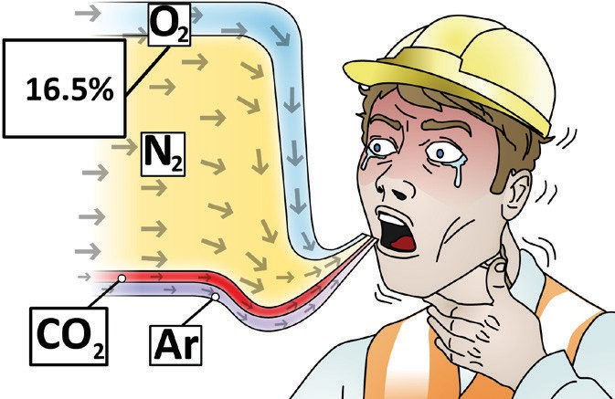
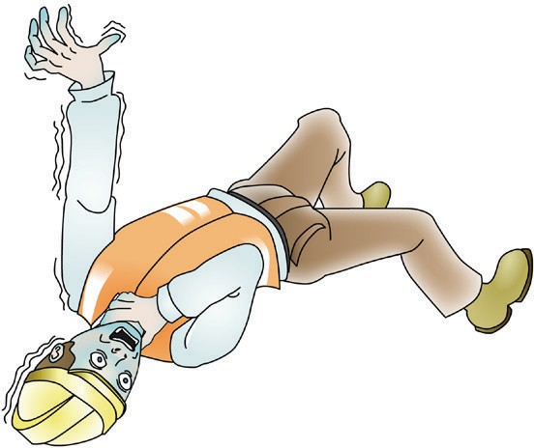
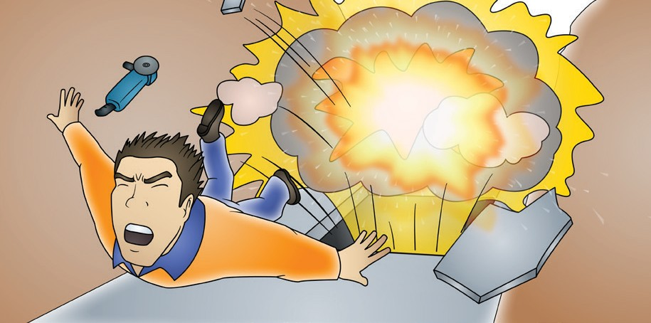
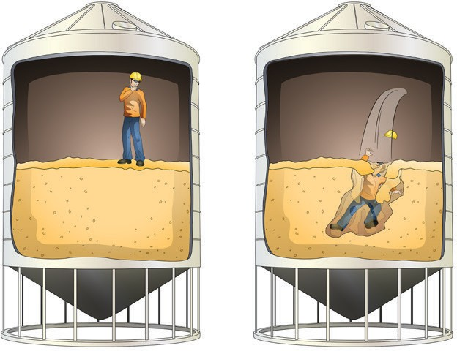
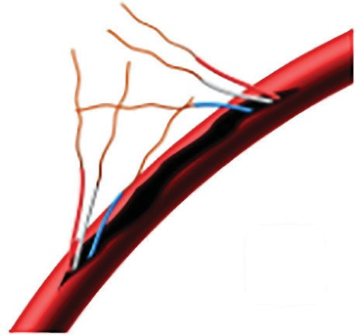
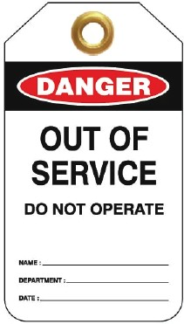
IDENTIFY CONSTRUCTION HAZARDS AND RISK CONTROL MEASURES
How to identify a confined space
A confined space is an area which is enclosed. It is not designed for people to go into. It may be hard to get in and out of because of a small or blocked entry/exit.
There is a risk in a confined space with one or more of these dangers:
A dangerous level of oxygen concentration outside the safe oxygen range. | A concentration of airborne contaminant (such as gasses, vapours or dust) that may cause impairment, loss of consciousness or asphyxiation.
A concentration of flammable airborne contaminant that may cause injury from fire or explosion. | Engulfment in a stored free-flowing solid or a rising level of liquid that may cause suffocation or drowning.
35. Question: What is a confined space?
An area that is enclosed and not designed for people to go into. It may be hard to get in and out.
Answer:........................................................................................................................................................................
Question: Can you go into a confined space if there is a confined space sign nearby?
Answer:..^{N}...º.....................................................................................................................................................................
Question: You don’t need training to enter a confined space. Is this true or false?
Answer: ..^{F}.ª..^{l}.^{s}..^{e}....................................................................................................................................................................
Electric power tools
Take action if you find a power tool with a damaged lead.
You should:
  remove it from use
  report the damage to your supervisor
  place an ‘out of service’ tag on it.
​Question: If you found an electrical power tool with a damaged lead should you leave it where it is?
Answer: .^{N}..º.........................................................................................................................................................................

Slide 12
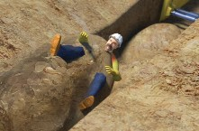

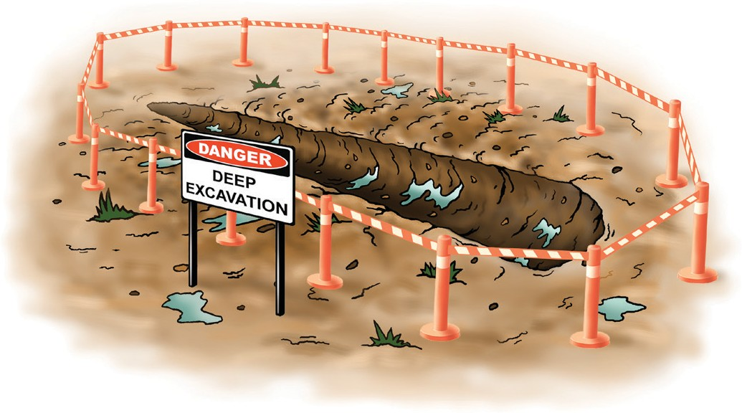
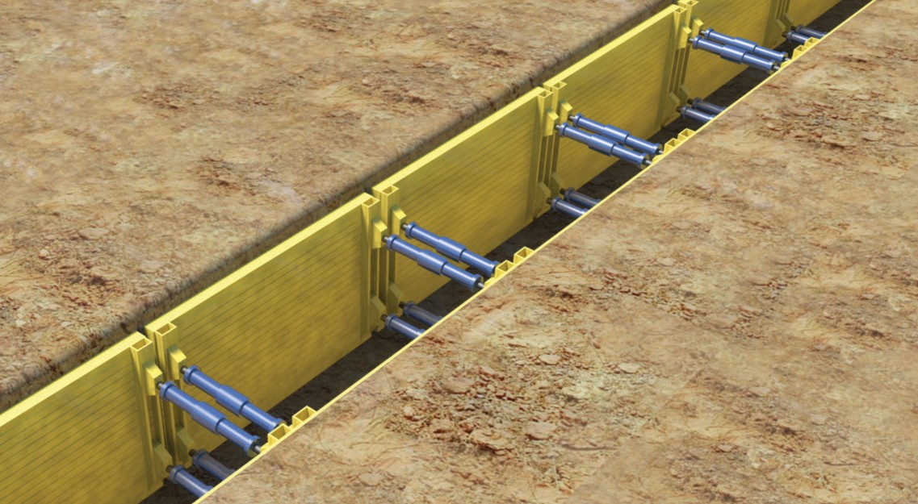
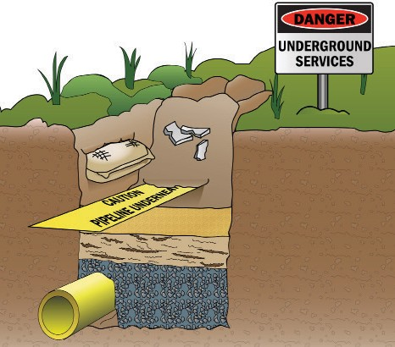
IDENTIFY CONSTRUCTION HAZARDS AND RISK CONTROL MEASURES
Excavations including trenches
Barricades, guardrails or fencing should be used to prevent access to excavations and to stop people accidentally falling in. Signs should also be put in place warning of the dangers.
There are some cases where an excavation or a trench will need to be shored.
Shoring an excavation or using trench shields should be done whenever:
the trench is more than 1.5 metres deep
workers need to enter the excavation
the ground is unstable and there is a likelihood the trench may collapse.
What should you use to excavate if you think there’s an underground service nearby?
Stop. Use a non conductive hand tool to expose the service lines. Dig carefully so you will not cause any damage.
Look for:
Danger signs
Sand bags
Broken tiles
Used tape
Clean sand
Loose soil
Question: Is ground collapse a hazard of trenches?
Answer:^{Y}.^{e}..^{s}........................................................................................................................................................................
Question: Is the possibility of falling into a trench a hazard?
Answer: .^{Y}..^{e}.^{s}........................................................................................................................................................................
Question: You do not need to worry about underground services when working near a trench. Is this true or false?
Answer: ..^{F}..ª..^{l}.^{s}.^{e}....................................................................................................................................................................

Slide 13
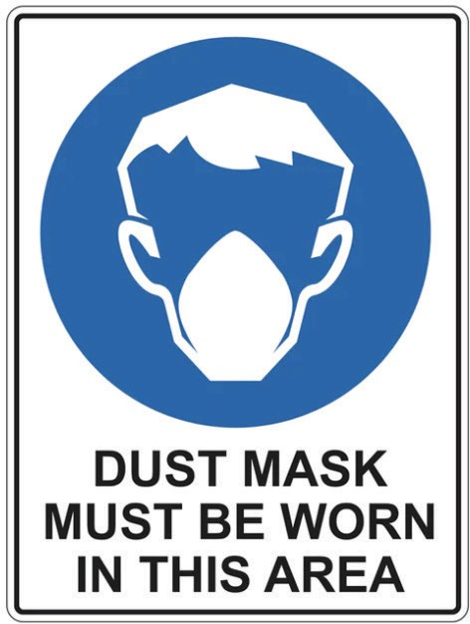
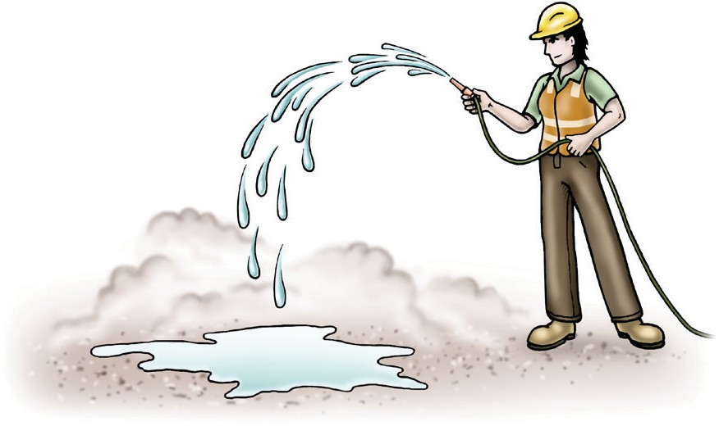
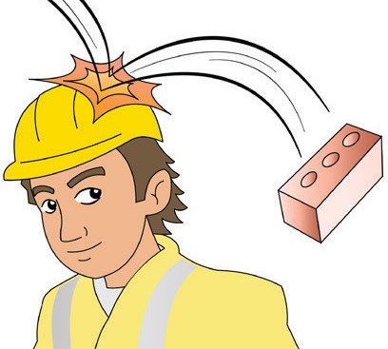
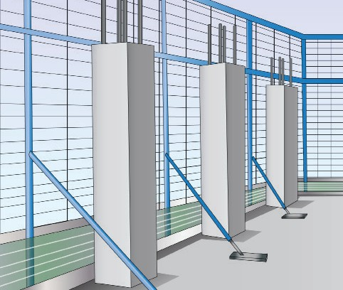
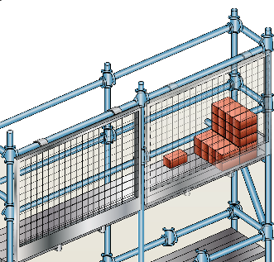
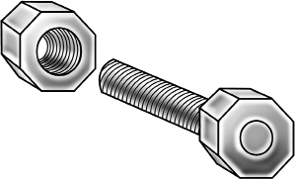
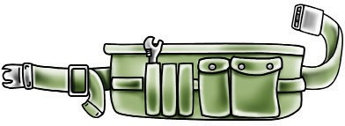
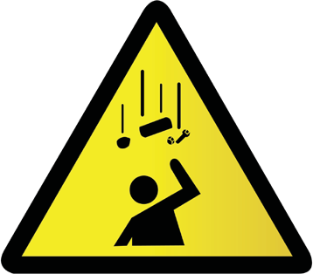
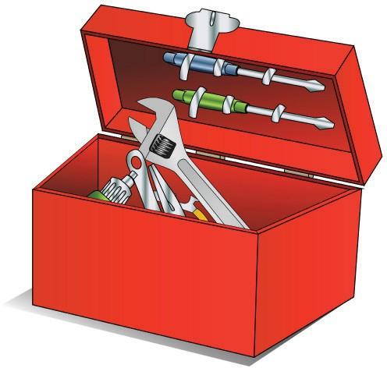
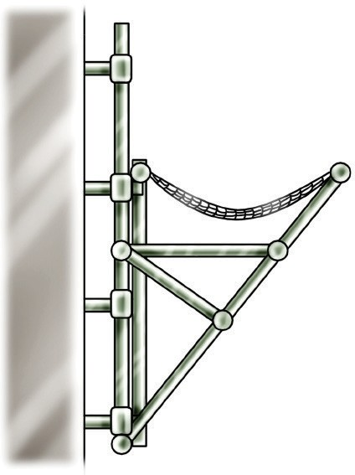
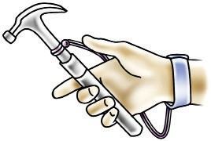
IDENTIFY CONSTRUCTION HAZARDS AND RISK CONTROL MEASURES
Dust (cement and wood)
Dust can be dangerous to breathe in. Dust can be made from many activities. These include:
polishing concrete
cutting bricks
sawing fibre-cement sheeting.
Protect yourself with gloves, eye protection (goggles, glasses or a mask).
Wet down dusty areas to prevent the spread of dust in the air.
Question: How can you help prevent the spread of dust in the air?
Answer: .^{W}....^{e}..^{t}..^{d}..º..^{w}..^{n}...^{d}...^{u}..^{s}.^{t}.^{y}...ª..^{r}.^{e}..ª..^{s}.........................................................................................................................................
Question: Look at the information above. What are three activities that cause dust?
Answer: .^{P}...º..^{li}.^{s}..^{h}..^{i}.^{n}..^{g}...^{c}.º..^{n}...^{c}.^{r}..^{e}.^{t}..^{e}..,.^{c}..^{u}..^{t}.^{t}.^{i}.^{n}..^{g}...^{b}..^{r}..^{i}.^{c}.^{k}..^{s}..ª..^{n}..^{d}...^{s}..ª..^{w}...^{i}.^{n}..^{g}..^{fi}..^{b}..^{r}..^{e}..⁻.^{c}..^{e}.^{m}....^{e}..^{n}..^{t}..^{s}.^{h}..^{e}..^{e}..^{t}..^{in}..^{g}..................................................................
Falling objects
People can be hurt or killed from objects falling from above. Here are some ways to stop things like tools from falling.
Use a safety helmet or hard hat.
Use perimeter containment screens
Store materials on overhead gantries.
Use a tool belt for small pieces of equipment such as bolts, nuts and
WARNING
Falling objects
Erect and place appropriate signs warning of the
Use wrist straps for larger tools like hammers
Keep any tools in a toolbox when you are not using them
Use netting to catch objects if you are working from height.
47. Question: Does a fall restraint system stop objects from falling on people below?
No.
Answer: ...........................................................................................................................................................................

Slide 14
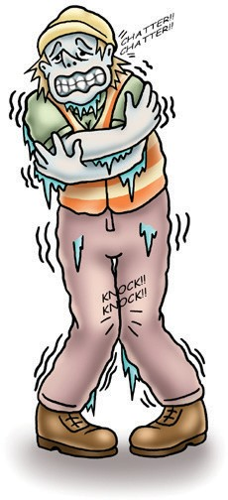
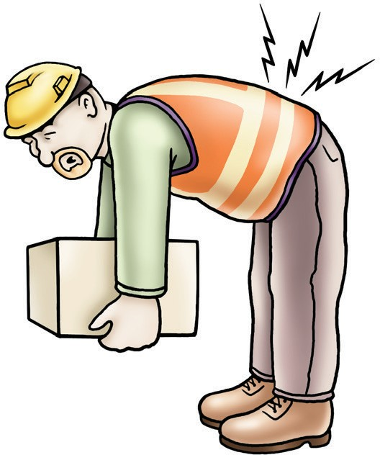
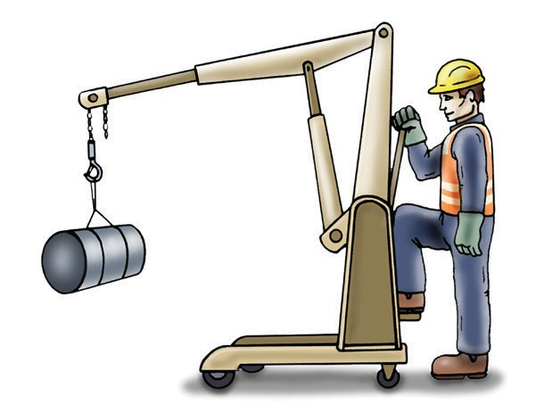
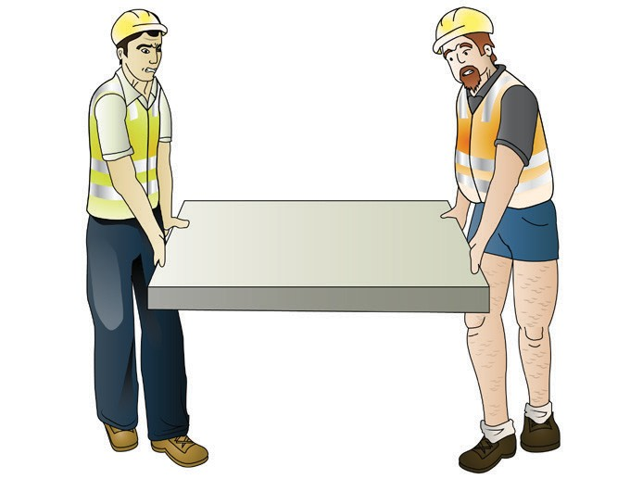
IDENTIFY CONSTRUCTION HAZARDS AND RISK CONTROL MEASURES
Cold environment
Working in a cold environment can also lead to serious medical conditions like hypothermia.
Hypothermia is when the body’s core temperature drops below 35° The normal body temperature for a healthy adult typically ranges from 97°F (36.1°C) to 99°F (37.2°C).
Wear appropriate warm clothing for the environmental conditions and talk to your supervisor if you feel you may be at risk.
Question: Should you keep hydrated or dehydrated when working in the sun?
Answer: ..^{H}...^{y}.^{d}...^{r}.ª..^{t}.^{e}..^{d}............................................................................................................................................................
Question: Would it be dangerous if a person’s core body temperature was 33°C?
Answer: .^{Y}.^{e}..^{s}.......................................................................................................................................................................
Manual handling
Manual handling can be hazardous. It is any activity where you use force to:
  lift
  lower
  push
  pull
  carry or
  move a load.
Any manual handling activity that is done incorrectly can result in injuries such as muscle strain and back and neck injuries.
If you do the same movement over and over you can suffer from a manual handling strain. Inactivity (eg. sleeping on the job) won’t give you a manual handling injury but you won’t get much work done! Using handheld power tools and equipment, such as jackhammers, chainsaws, and pneumatic drills can give you a manual handling injury. This is called Hand-Arm Vibration (HAV)
Before you start any manual handling activity check to see if there are any mechanical aids or equipment that you can use to make the job safer and easier.
If the load is big, heavy or an awkward shape get someone to help you move it.
51. Question: What is the name of the injury you might get from using a power tool for long periods of time?
Answer: ^{H}...ª..^{n}..^{d}..⁻.^{A}..^{r}..^{m}....^{V}..^{i}.^{b}..^{r}.ª...^{t}.^{i}.º..^{n}...⁽.^{H}...^{A}..^{V}..⁾.................................................................................................................................

Slide 15
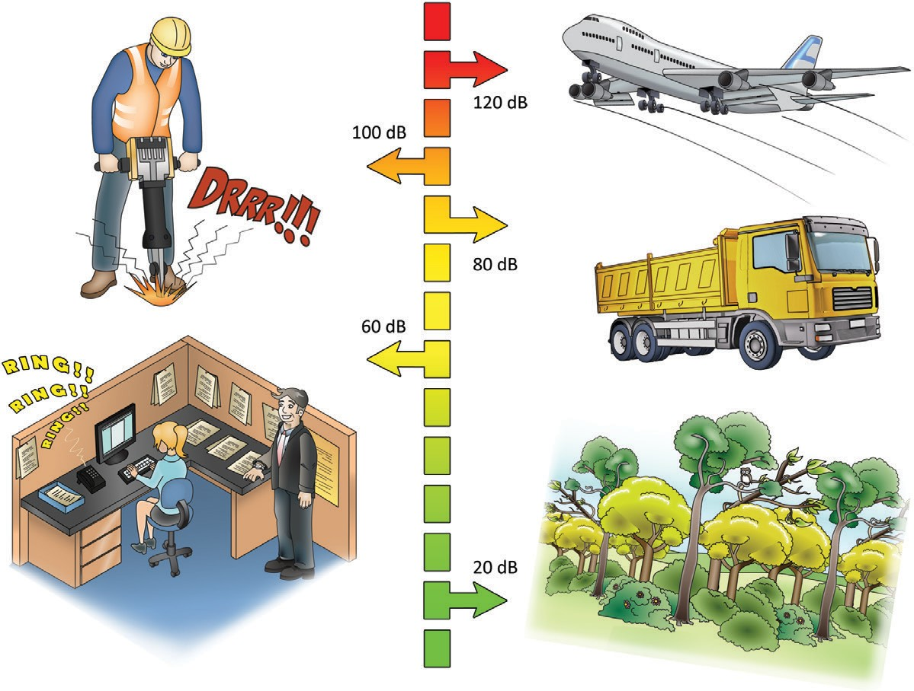
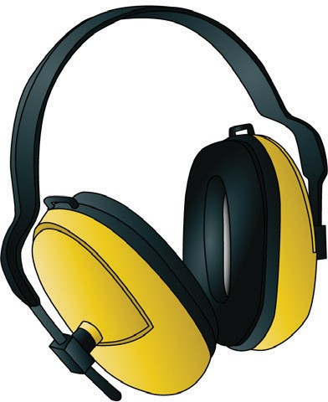
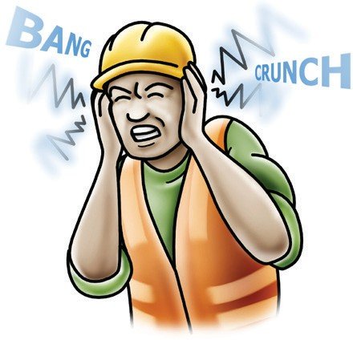
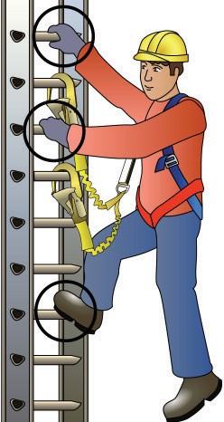
IDENTIFY CONSTRUCTION HAZARDS AND RISK CONTROL MEASURES
Noise
Noise which is usually caused by heavy vehicles and equipment can damage your hearing permanently.
Decibel levels of common sounds
8 hours of noise at 85db or noise levels of 140db even briefly can permanently damage your hearing.
Hearing loss is:
Hearing protection
You should wear hearing protection like ear plugs or ear muffs whenever there is noise that could contribute to the loss of hearing.
slow
painless
irreversible.
If possible, stay out of areas where noisy work is being done. When deciding which tool to use, choose the quieter one.
Question: Can hearing loss be reversed?
Answer: .^{N}...º........................................................................................................................................................................
Question: What PPE should you use when there is noise that could contribute to the loss of hearing?
Ear plugs or ear muffs.
Answer: ...........................................................................................................................................................................
Using ladders
Maintain three (3) points of contact on a ladder at all times.
54. Question: Should you have one, two or three points of contact when using a ladder?
Three.
Answer: ...........................................................................................................................................................................

Slide 16
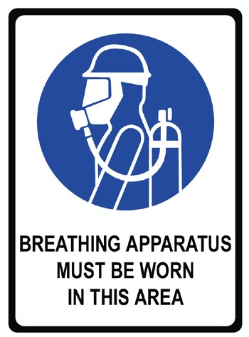
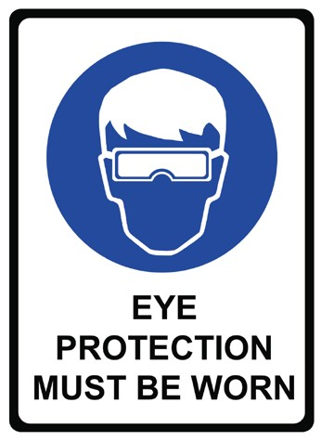
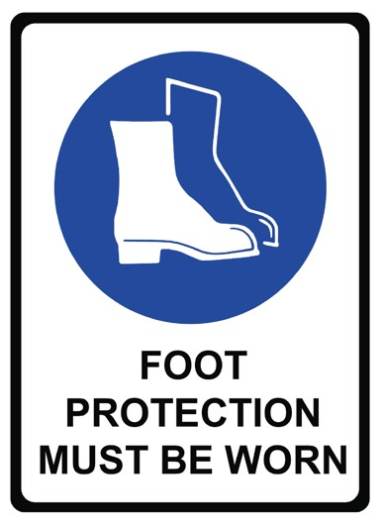
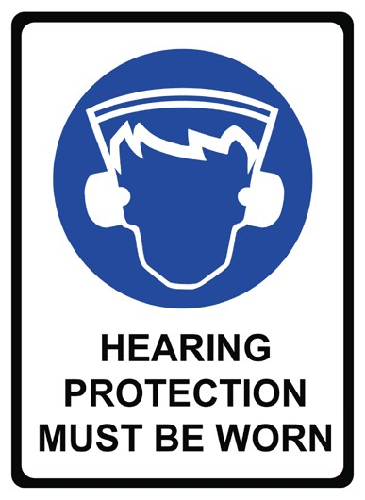
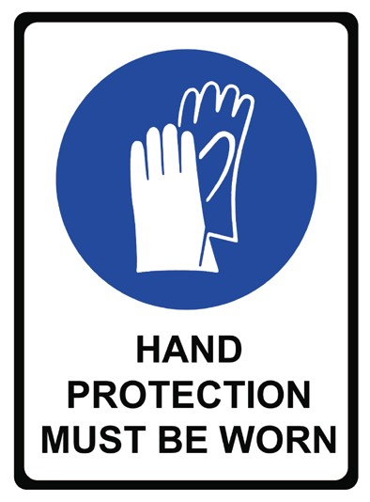











IDENTIFY CONSTRUCTION HAZARDS AND RISK CONTROL MEASURES
Personal protective equipment (PPE)
Personal protective equipment (PPE) provides you with basic protection from hazards. It is not a guarantee that it will prevent injury, but it should help.
It is up to your employer to provide the necessary PPE for you to operate safely and also to make sure that you are trained to fit and use it properly. Look for safety signs around your worksite to show you when you need to wear different types of PPE.
It is a condition of entry on some construction sites that you wear
specific PPE.
The best way to make the workplace safe is to take away hazards altogether. But often you can’t do this. This is where Personal Protective Equipment (PPE) can help.
PPE is clothing or equipment worn on the body to help protect you from hazards. PPE will not take away the risk of harm altogether, but it will help keep you safe.
Here are some examples of PPE:
Safety vest
Dust mask
Hard hat
Safety gloves
Long sleeved top
Ear muffs
Boots that cover the whole foot
Safety glasses/goggles
Long pants
Sunscreen
70. Question: What is the main purpose of PPE?
To protect you from hazards.
Answer: ...........................................................................................................................................................................

Slide 17
IDENTIFY CONSTRUCTION HAZARDS AND RISK CONTROL MEASURES
Knowing the right PPE to use
71. Question: Draw a line to match the right PPE with the hazard it can help protect you from. Answer:
Falling objects on your foot.
Object hitting or falling on your head.
When there is a chance of noise causing a loss of hearing.
When exposed parts of your skin might get sunburn.
To prevent cuts or burns on your hands.

Slide 18

SPEAKING - ORAL COMMUNICATION

Slide 19


SPEAKING (ORAL COMMUNICATION)
(c) If you found a hazard on a worksite who would you report this to?
Your supervisor.
Answer: ............................................................................................................................
..............................................
Workplace health and safety (WHS) personnel
. People in the workplace have different responsibilities for health and safety. Here are ^{some of them:}
First aid officers are trained to provide first aid on site.
WHS representatives
Fellow workers elect health and safety representatives to:
look into workplace health and safety issues
get input from other workers on health and safety
be a member of the health and safety committee.
WHS Committee members
To be a member you must be employed by the workplace.
A committee tells the PCBU (employer) about workplace health and safety.
The PCBU can choose to set up a health and safety committee or must do so
if the health and safety representative asks them to.
There are a number of different people that you can talk to about various health and safety issues – not just your health and safety
representative.
Supervisors may be members of the WHS committee. They are responsible for management and safety on site. Workers can ask them questions to check on instructions.
Question 2
.
(a) Can workers be members of the WHS committee?
Answer: Yes
(b) What is the job of the WHS representative?
Answer: A person elected by a work group to represent them on health and safety concerns.
(c) What is the job of a supervisor to do with health and safety?
Answer:........................................................................................................................................................................
(e) What is the job of first aid officers?
Answer:........................................................................................................................................................................
A supervisor is responsible for health and safety on site.
^{F}.^{i}.^{r}..^{s}.^{t}..ª..^{i}.^{d}...º..^{ffi}...^{c}..^{e}..^{r}.^{s}...ª..^{r}.^{e}...^{t}.^{r}.ª..^{i}.^{n}..^{e}..^{d}...^{t}.º...^{g}..^{i}.^{v}..^{e}...^{fi}..^{r}.^{s}..^{t}..ª..^{id}...º...^{n}...^{s}.^{i}.^{t}.^{e}.............................................................................................

Slide 20







SPEAKING (ORAL COMMUNICATION)
Fire hose reels
Fire hose reels are designed to provide an accessible and controlled supply of water to fight a fire. The length of a fully extended fire hose is 36 metres with a diameter of 19 mm (outside diameter).
These appliances are designed to deliver at least 0.33 litres of water per second.
A control nozzle attached to the end of the hose enables the operator to control the direction and
flow of water to the fire.
Australian Standards nominate installation and maintenance requirements.
These are some examples of fire hose reel signs:
Fire blankets
Fire blankets are fire-resistant sheets of glass-fibre material.
They are used to cover a fire to cut off the supply of oxygen or to wrap a person whose clothes are on fire.
An example of a
fire blanket sign
Breathing apparatus
Breathing apparatus sets are breathing kits designed to give you clean, breathable air (from a tank).
They are designed for use in poor air due to low oxygen, smoke, gasses or contaminants.
An example of a breathing apparatus sign

Slide 21






SPEAKING (ORAL COMMUNICATION)
Fire safety equipment
Question 4. Name the type of safety equipment in each picture and name its purpose.
Equipment Name / type
Purpose
Put out fires from cooking fats or oil.
Fire blanket
Used for large fires that need high pressure water.
Hose reel
Put out fires involving wood, paper, cloth, plastic, rubber, grass, oils, petrol, paint, flammable or combustible liquids, Class A and Class B fires.
Foam fire extinguisher
Put out fires involving electrical, oils, petrol, paint, flammable or combustible liquids, Class B and Class E fires.
Powder fire extinguisher
Put out fires involving electrical, oils, petrol, paint, flammable or combustible liquids, Class B and Class E fires.
Carbon dioxide fire
Put out fires involving paper, wood, cloth, plastic, rubber, grass and Class A fires.
Water fire extinguisher

Slide 22




SPEAKING (ORAL COMMUNICATION)
Sign
Type of sign Meaning of sign
This sign the location of the fire alarm.
Fire
Emergency
This sign shows the location of the emergency eye wash.
Emergency
This sign shows the location of the emergency exit.
This sign tells you the PPE that you must wear on the site.
Mandatory

Slide 23
personal protective equipment - ppe

Slide 24





PERSONAL PROTECTIVE EQUIPMENT (PPE)
Fitting PPE
Personal protective equipment (PPE) provides you with basic protection from hazards. It is not a guarantee that it will prevent injury, but it should help.
Your trainer will demonstrate the correct fitting of PPE. It will then be your turn to practise until you get it right.
You will be asked to demonstrate the correct fitting of the following:
If using safety glasses or goggles they must cover the eyes. They must sit on the bridge of the nose and the bent arms must fit around the ears.
eye protection (safety goggles or glasses)
If using ear plugs, the student must put an ear plug in each ear according to the manufacturer’s instructions (e.g. roll ear plug in fingers; pull ear up and back; place ear plug in ear and release so that it expands). If using ear muffs, the student must place the muffs over their ears so that they are fully covered by the muffs and adjust the head piece where needed so that it sits close to the head.
hearing protection (ear plugs or earmuffs)
Fit and adjust the head harness where needed so that the hat is positioned comfortably, ie. it should not sit too high, it should be on straight and not backwards.
hard hat
The vest, shirt or jacket must be sized correctly, for example, not too tight or too loose. If using a vest it must be secured at the front.
high visibility vest, shirt or jacket.

