Slide 1
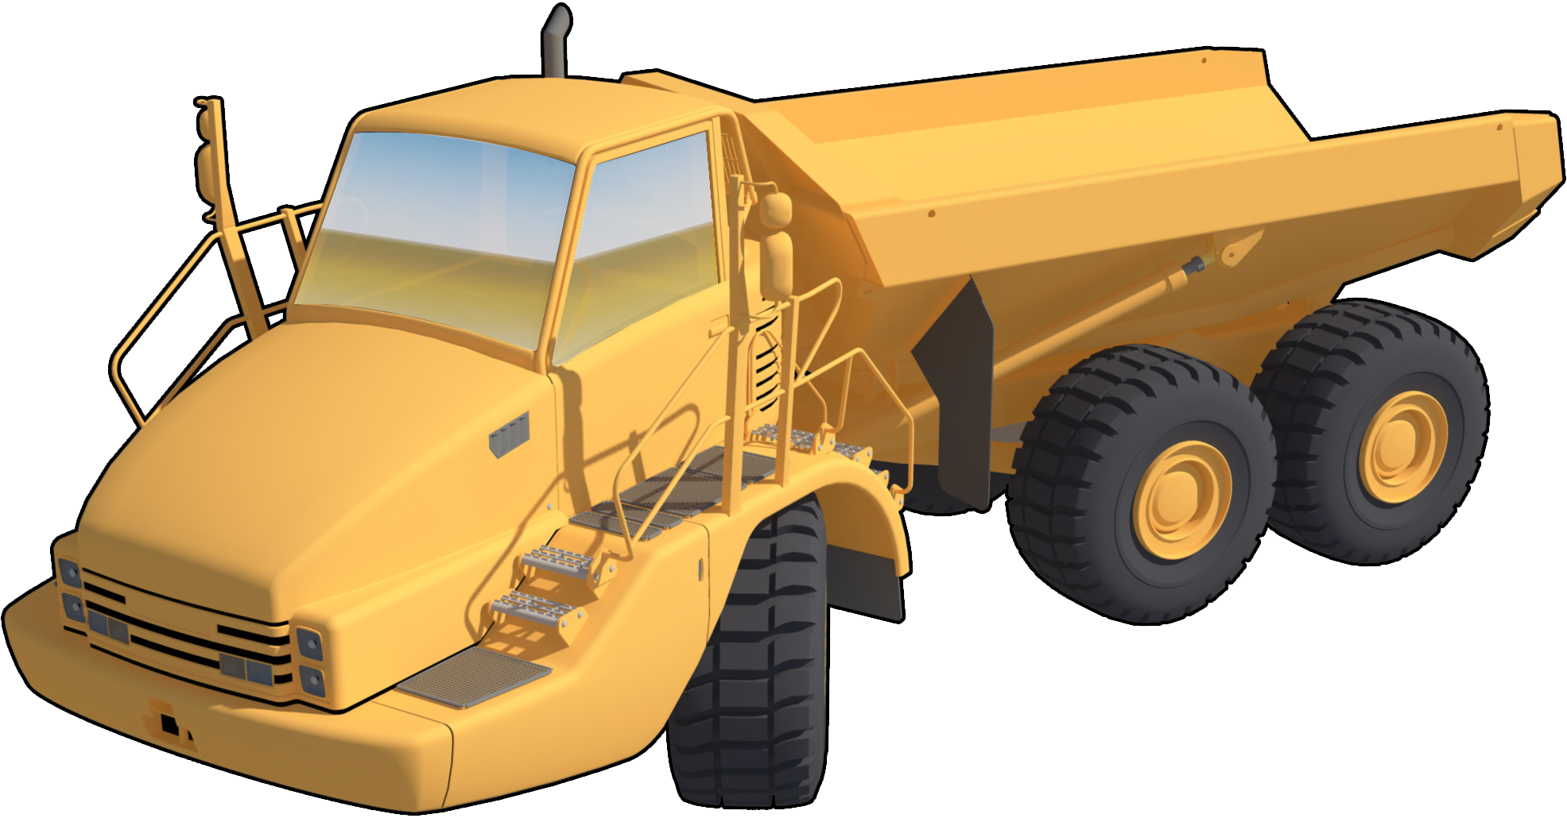
Learner Workbook Marking Guide
Articulated
Haul Truck
TICKET
Training support material for:
RIIMPO337E
Conduct articulated haul truck operations
Produced by:

Slide 2
Contents
Introduction to articulated haul trucks 5
The basics of road construction 9
Chapter 1 Plan and prepare for articulated haul truck operations 17 Chapter 2 Operate articulated haul truck 67
Chapter 3 Load, haul and dump materials 105
Chapter 4 Carry out housekeeping activities 120

Slide 3
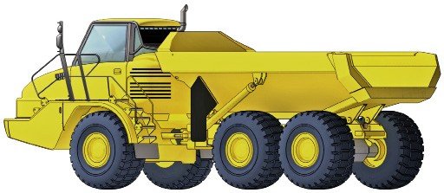
Introduction to Articulated Haul Truck
5

Slide 4
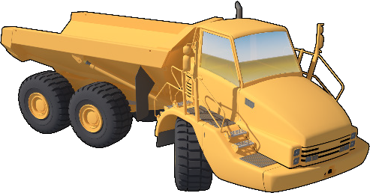
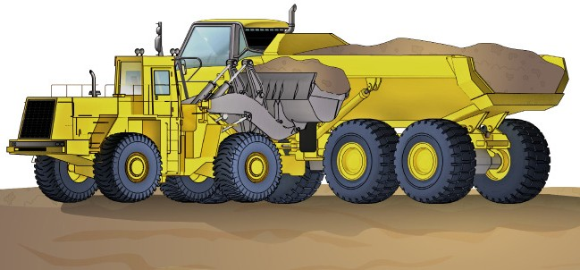
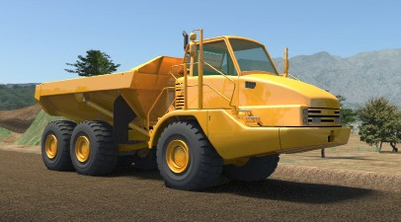
INTRODUCTION TO ARTICULATED HAUL TRUCK
Introduction to articulated haul truck
An articulated haul truck is a large heavy duty type of haul truck used to transport loads over rough terrain and carry materials from one place to another.
The haul truck is built to handle rough slopes and slippery conditions. It has four-wheel or all-wheel drive and the truck steers by the cab and front axle pivoting separate from the load body and rear wheels. For example, to steer to the right, the engine, cab and front axle would pivot to the right.
You can load a haul truck with a number of machines including excavators and loaders.
Articulated haul trucks covered in this guide are off-highway trucks and diesel-powered mechanical drive.
Notes
1. Question: What is a haul truck used for? Answer:
An articulated haul truck is a large heavy duty type of haul truck used to transport loads over rough terrain and carry materials from one place to another.
.

Slide 5
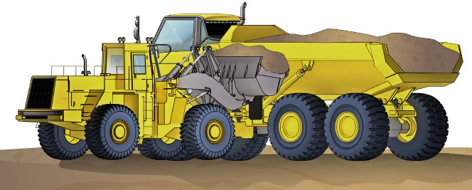
Operate articulated haul truck
Chapter 2

Slide 6
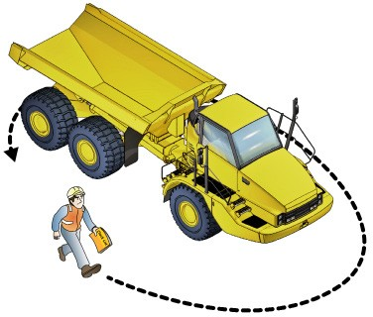
PC 2.1
OPERATE ARTICULATED HAUL TRUCK
QUESTION
What is the first check you
do on the machine?
Walk around it and check for obvious problems you can easily see.
Notes
65. Question: What is the first check you should do on a machine?
Answer:
Walk around the haul truck and see any obvious problems.
.

Slide 7
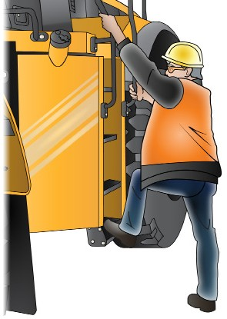
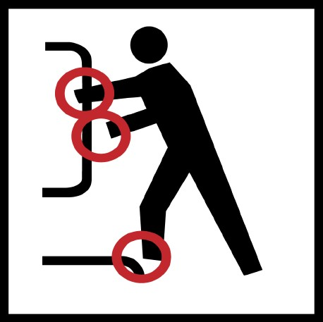
PC 2.4
OPERATE ARTICULATED HAUL TRUCK
QUESTION
How do you safely get in and out
of the loader’s cabin?
Always use three (3) points of contact facing the machine.
For example, use two hands and one foot or two feet and one hand.
3 point contact (both hands and foot)
74. Question: How many points of contact should you have if you get in or out a front end loader? Answer: You should have 3 points of contact.
.

Slide 8
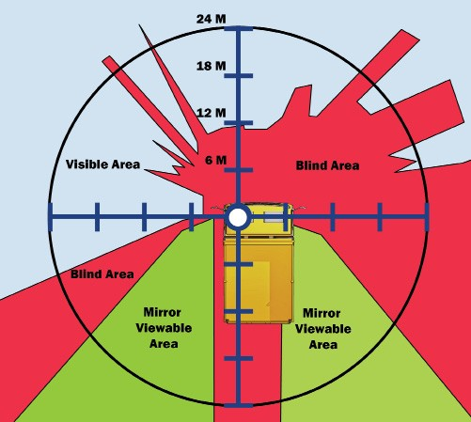
PC 2.3, 2.5 OPERATE ARTICULATED HAUL TRUCK
Blind spots
Be aware your machine will have blind spots. You won't be able to see all of the road. This is a blind spot.
Take extra care especially when reversing or when the path is rough. Look ahead and check the path of travel for hazards.
Notes
81. Question: What is a blind spot on your machine? Answer:
You won't be able to see all the road. This is a blind spot.
.

Slide 9
Load, haul and dump materials
Chapter 3

Slide 10
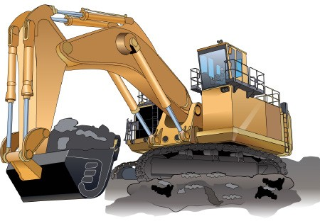
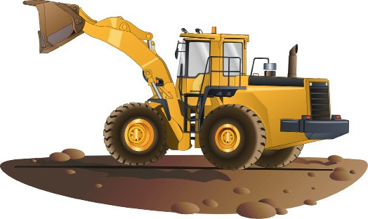
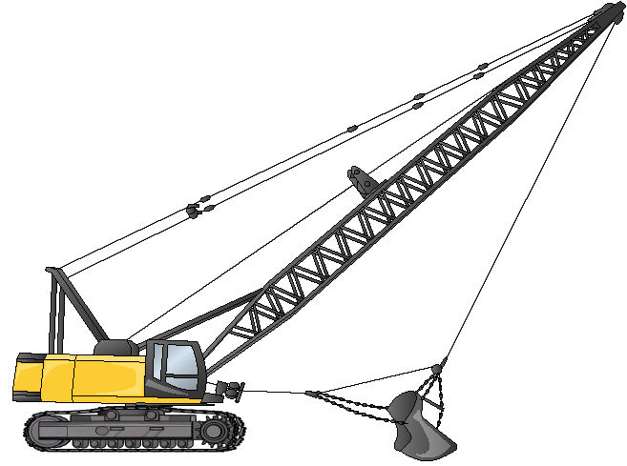
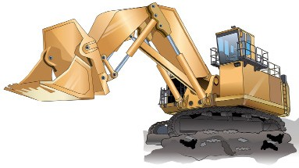
PC 3.2
LOAD, HAUL AND DUMP MATERIALS
QUESTION
What kinds of loading equipment might be used to load a haul truck?
A haul truck may be loaded with:
Excavators | Loaders
Face shovels | Draglines
Notes
103. Question: What kinds of loading equipment might be used to load a haul truck?
Answer:
Excavators
Loaders
Face shovels.
Draglines

Slide 11
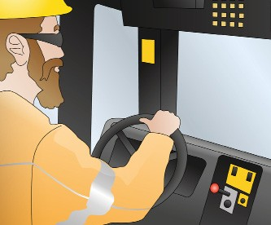
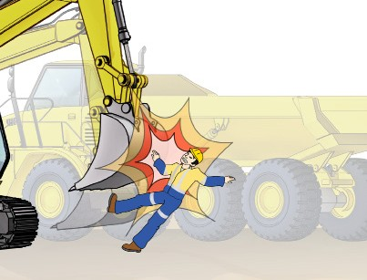
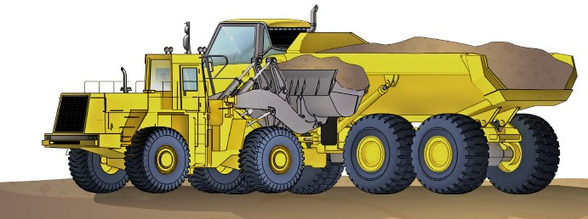
PC 3.1
LOAD, HAUL AND DUMP MATERIALS
QUESTION Why should you stay in the haul truck’s cabin while it’s being loaded? | You must stay in the cabin so the person loading the truck knows where you are. If you stand outside the truck, you could be hit and injured if the load spills on to you, or you could be hit by the loading machine.
QUESTION Why is it important to position the haul truck as directed by the loader for loading? | So the loading equipment can load the haul truck as quickly as possible. It is also safer.
Notes
104. Question: Why should you stay in the haul truck’s cabin while it’s being loaded? Answer:
If you stand outside the truck you could be hit by the load.
.

