Slide 1
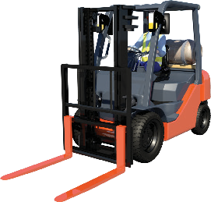
FORKLIFT TRUCK
LEARNER WORKBOOK
TRAINER’S MARKING GUIDE WITH MODEL ANSWERS
TLILIC0003
Licence to operate a forklift truck
www.easyguides.com.au
National Licence RTO-VET Learning Materials

Slide 2
Chapter 1
Plan Work
Trainers please note:
The answers in this book are in no way conclusive and are to be used as a guide only. Use your own knowledge and experience to correct the variation of answers that may be given by learners.
May not be reproduced
23

Slide 3
Performance Criterion: 1.5
Identify workplace hazards
A hazard is anything that can hurt you or others while you work.
You need to know (identify) workplace hazards before you start work. Look for hazards.
Look above you, look around you, and check the ground below you.
24
© Easy Guides Australia Pty Ltd

Slide 4
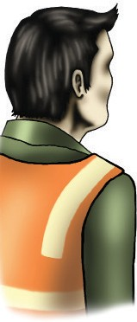
Theory Training Task 1
Performance Criterion: 1.5
a) Give examples of hazards you should look for before you begin work.
Above head height
Answer my include:
powerlines
overhead pipes
trees
buildings
clearance height
other obstructions
Ground level to eye level
other equipment
machines
people and pedestrians
things in the path of travel
blind corners
enclosed or poorly ventilated spaces
dimly lit areas
other obstructions
Ground level (and below)
if the surface is stable and level
if the surface is strong enough to support the weight of the forklift and loads
if cables have been left lying around
for spills or wet surfaces
for any debris or rubbish
drain/pit lids
service covers/trenches
loading dock edges
b) Tick any of these hazards you may have come across in past or present workplaces.
Trainers: encourage your learners to place a tick beside hazards they have seen in their past or present places of employment.
May not be reproduced
25

Slide 5
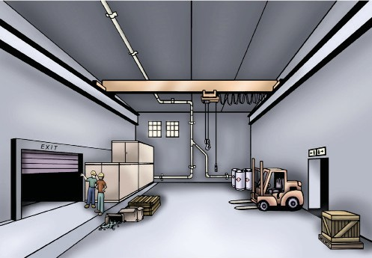
Theory Training Task 2
Performance Criterion: 1.5
a) Circle all the hazards (dangers) you can find in the picture below.
b) How could the people in this picture be a hazard if you were using a
forklift near them?
They could be hit by the forklift truck.
They could end up too close to a load being moved or even end up underneath if the load is raised.
c) Can you think of ways to ensure these people do not get in the way
of the forklift?
Answer may include:
You could tell them you are planning to drive the forklift.
You could put up signs or barriers to stop them from entering the area where you will be working.
You could use the forklift horn and flashing lights to alert them of your
movements.
26
© Easy Guides Australia Pty Ltd

Slide 6
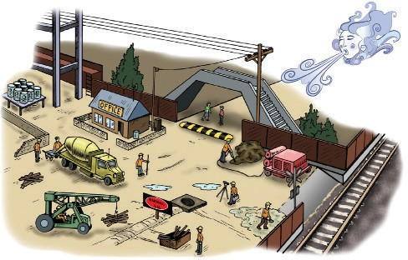
Theory Training Task 3
Performance Criterion: 2.3
a) Circle all the hazards (dangers) you can find in the picture below.
b) Can you explain why the ground conditions would be a hazard?
Answer may include:
The ground could be uneven which will make the forklift unstable and it could tip over.
The ground could be wet or muddy which could cause the forklift to slide or tip over.
c) Why might other vehicles be a hazard if you are driving a forklift?
Answer may include:
The other vehicles may not see you operating the forklift and an accident could occur.
May not be reproduced
27

Slide 7
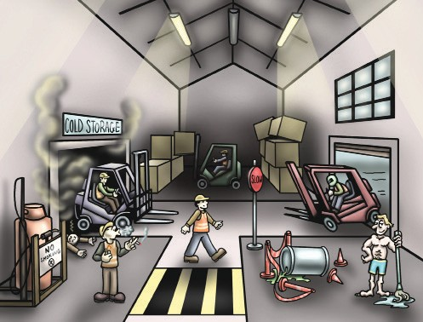
Theory Training Task 4
Performance Criterion: 1.4, 1.5
a) Circle the eight (8) hazardous work practices you can see in the worksite picture below.
b) If you notice these hazards (or others) taking place what should you do?
Answer may include:
You should tell the person to stop what they are doing immediately.
You should report the hazard to your supervisor or other relevant person.
28
© Easy Guides Australia Pty Ltd

Slide 8
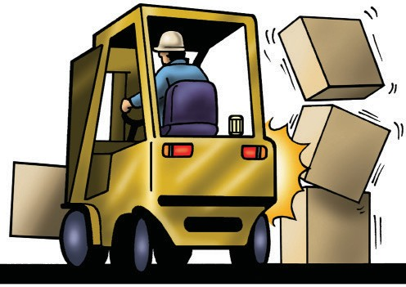
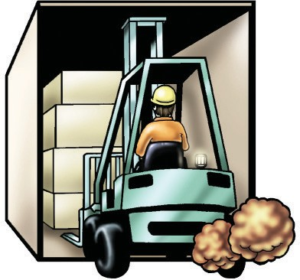
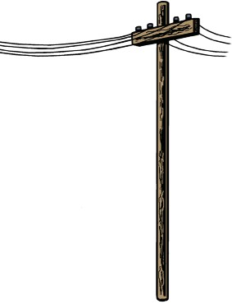
Theory Training Task 5
Performance Criterion: 1.5
What is rear-end swing?
Rear-end swing is the rapid sideways movement of the back of a forklift truck.
Who do you think is most at risk from forklift rear-end swing?
Pedestrians near the forklift.
Theory Training Task 6
Performance Criterion: 1.5
Circle which would be considered an enclosed or poorly-ventilated area. freezer carpark
shed cold storage room
Why do you think you shouldn’t use a petrol forklift truck in a small freezer room?
You could be overcome by the fumes (carbon monoxide poisoning) which could kill you.
Theory Training Task 7
Performance Criterion: 1.5, 2.3
Check the safe working distances for powerlines in your state or territory. How many metres is the NO GO zone for distribution lines on poles in your state or territory?
The NO GO zone for
(state/territory)
is metres.
* Trainers please check YOUR state or territory
May not be reproduced
29

Slide 9
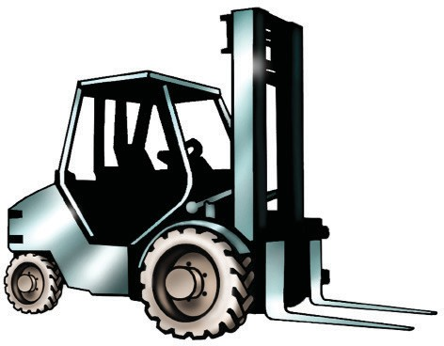
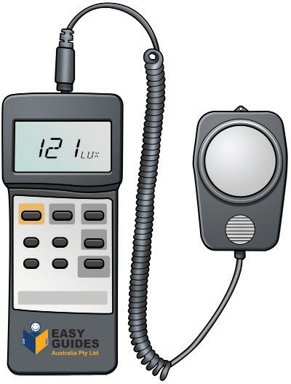
Theory Training Task 8
Performance Criterion: 1.2, 1.5, 2.3
What kind of forklift truck do you use on rough ground?
A rough-terrain forklift truck.
Where can you find out more information about the right forklift to use?
AS 2359 – 1995
Theory Training Task 9
Performance Criterion: 1.5, 2.3
What is the recommended Lux (light level) for safe forklift work in a warehouse?
80 - 160 Lux
30
© Easy Guides Australia Pty Ltd

Slide 10
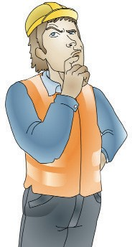
Theory Training Task 10
Performance Criterion: 2.3
What kinds of things should you plan for before using a forklift? List three.
Answer may include:
Hazards
Unusual loads
Load destination and racking
Light levels
Hazardous materials
Theory Training Task 11
Performance Criterion: 2.3
What are some examples of information that a Safety data sheet (SDS) previously called a Materials safety data sheet (MSDA) tells you?
Answer may include:
What the materials are
Why they are hazardous
How to handle them safely
What to do if there is a spill
May not be reproduced
31

Slide 11
Element 1 — Plan Work
TLILIC2001 – Licence to operate a forklift truck
Performance Criterion: 1.5
Hazard control measures
What are hazard control measures?
They are actions you take to control or prevent a danger that can injure (hurt) you. Use controls to reduce the risk to workmates and property. Set up the hazard controls before you start the task. The hierarchy of hazard control tells you the steps to take so you can reduce the danger from hazards.
A risk is the chance of a hazard injuring a person. In other words, what is the chance of the hazard hurting you?
Theory Training Task 12
Performance Criterion: 2.3, 2.9
What is a Safe Work Method Statement (SWMS) used for?
A SWMS is used to record hazards and how they will be controlled.
What other forms could you use to show how you will control a hazard?
Job Safety Analysis Worksheet (JSA)
Safe work method statement
This SWMS is site-specific statement that must be prepared before any high-risk construction work is commenced.
Person responsible for ensuring compliance with this SWMS: |  |  | Date:
High-risk job: |  |  | Location:
What are the tasks involved? |  | What are the hazards and risks? |  | How will hazards and risks be controlled? (describe the control measures and how they will be used)
Think about the worksite and each stage of the project, including preparation and clean-up.
32
© Easy Guides Australia Pty Ltd

Slide 12
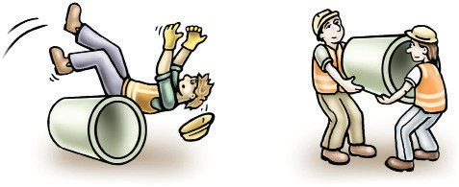
TLILIC2001 – Licence to operate a forklift truck
Element 1 — Plan Work
Theory Training Task 13
Performance Criterion: 2.3
a) List the six levels of the Hierarchy of Hazard Control.
Elimination
Substitution
Isolation
Engineering Control Measures
Administrative Controls
Personal Protective Equipment (PPE)
b) What is the first thing you should try if you find a hazard?
Elimination - you should try to remove the hazard entirely.
May not be reproduced
33

