Slide 1
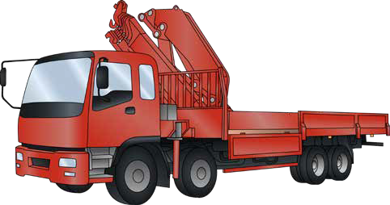
VEHICLE LOADING CRANE
SAFETY AND LICENCE GUIDE
Training support material for:
TLILIC0024
Licence to operate a vehicle loading crane
(capacity 10 metre tonnes and above)
Produced by:

Slide 2
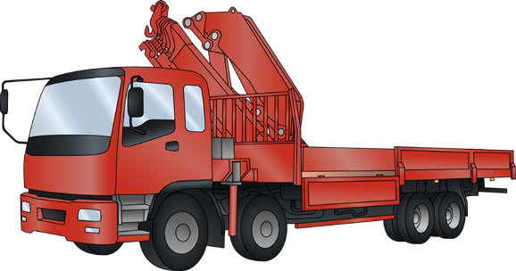
INTRODUCTION TO VEHICLE LOADING CRANE
2

Slide 3
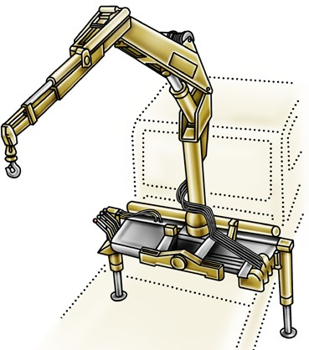
What is a vehicle loading crane?
INTRODUCTION TO VEHICLE LOADING CRANE
A vehicle loading crane is a crane which is mounted to a vehicle for loading and unloading. Vehicle loading cranes have hydraulic booms with power supplied from the vehicles engine through a PTO (power take off).
Winch
Extension cylinder
Lift cylinder
Booms
Hook
Mast
Slewing base
Controls
Outrigger/stabiliser legs
3

Slide 4
10 metre tonnes
INTRODUCTION TO VEHICLE LOADING CRANE
A High Risk Work licence is needed when the vehicle loading crane has a capacity of 10 metre tonnes or more. The metre tonnage of a vehicle loading crane is a number which is worked out by multiplying the lifting capacity by the working radius of the boom for that lifting capacity.
To calculate 10 metre tonnes
MULTIPLY THE SWL × THE WORKING RADIUS FOR THAT SWL = METRE TONNES
from the centre line of slew to the centre line of hook. This calculation must be done for each Safe working load (SWL) on the load chart.
If any one calculation amounts to 10 metre tonnes lifting capacity or greater, the crane operator will require the appropriate High Risk Work Licence.
For example
The load chart below indicates the crane can lift 1300 kilograms at 8.5 metres. 1300 kg × 8.5 m = 11,050
— as this is greater than 10,000 a HRW Licence is required to operate the crane.
4

Slide 5
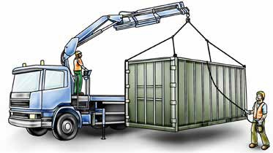
Does the operator of a VLC need a dogging licence?
INTRODUCTION TO VEHICLE LOADING CRANE
A dogging HRW Licence or one of the three rigging HRW Licences is required by:
Any person, other than a licenced VLC operator, who exercises judgment in the estimation of a load or selection of the slinging method and lifting gear when slinging a load on any VLC, or
Any person who directs any VLC operator in the movement of the load when the load is out of view of the crane operator.
To exercise judgment means:
Selecting the slinging method by considering the shape of the load
Selecting the lifting gear by determining the weight (its mass) and centre of gravity of the load, and
Inspecting the lifting gear to ensure it is not defective by considering its condition.
The vehicle loading crane HRW licence includes the application of load estimation and slinging techniques to move a load competently. Holders of a vehicle loading crane HRW licence can exercise judgment on the load and slinging method and select and inspect the lifting equipment when operating a vehicle loading crane.
The holder of a vehicle loading crane HRW licence cannot:
Exercise judgement or inspect lifting gear for any other class of crane unless they hold the relevant HRW licence
Operate the VLC if the load is out of view
Direct another VLC operator in the movement of a load when the load is out of the operators view.
For further information see the Safe Work Australia website – www.swa.gov.au
5

Slide 6
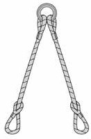
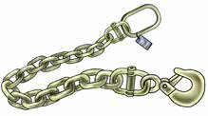
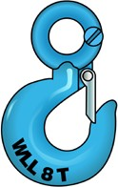
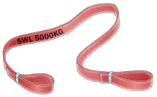
Lifting gear
INTRODUCTION TO VEHICLE LOADING CRANE
As a VLC operator you will need to make use of many types of lifting gear including:
Fibre ropes | Wire ropes | Chain
Synthetic webbing slings | Multi-leg slings | Hooks
6

Slide 7
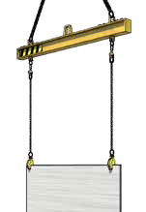
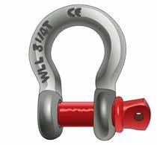
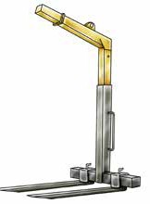
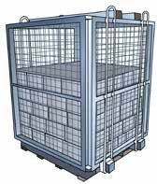
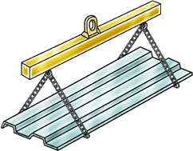
INTRODUCTION TO VEHICLE LOADING CRANE
Lifting gear (continued)
Lifting rings, shackles and eyebolts | Beam and plate clamps
Pallet forks and cages | Spreader and lifting beams
SWL
7

Slide 8
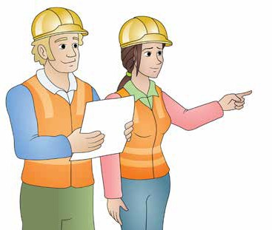
Plan work
Element 1
8

Slide 9
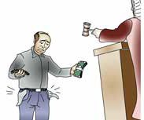
PC 1.1
PLAN WORK
Duty of care
Duty of care means your legal responsibility to ensure the safety and well being of others who could be affected by your actions.
Duty of care applies to:
Worker’s duty of care
By law, as a worker you must:
take care of your own health and safety
take care of the health and safety of other people in the workplace because of the things you do or forget to do
Do your best to follow workplace, health and safety (WHS) / Occupational health and safety (OHS) requirement from your PCBU/employer
Don’t misuse anything provided at the workplace for WHS / OHS either deliberately or recklessly.
Employers/persons conducting a business or undertaking (PCBU)
‘Workers’ which includes people who are:
– employees
contractors
sub-contractors
outworkers
employees of labour hire companies
volunteers
Managers
Designers
Importers
Suppliers
Inspectors.
Penalties
If you are a PCBU/employer or worker, the government can
fine or even imprison you for failing your duty of care.
PCBU’s/Employer’s duty of care
By law, as an employer you must:
provide a workplace that is safe and without risk to health or safety to people
provide information and training so that work will be done safely
provide safe plant, equipment and structures
put systems in place to work safely
provide ways to make sure plant, structures and substances are used, handled and stored safely.
make sure facilities are in good condition
Note: PCBU means employer in this publication
9

Slide 10
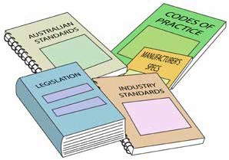
OHS / WHS Guidelines, instructions and people
PC 1.1 PLAN WORK
Before operating the crane you must be aware of any guidelines, instructions and people for the crane you will be operating and for crane operation in general at the workplace.
The types of documents you may need to refer to include:
Manufacturers instructions such as an operator’s manual
Safe work or job procedures
Specific workplace policies and procedures
OHS / WHS workplace representatives
Plans by managers
Codes of practice
WHS /OHS policy
Health and Safety Acts and Regulations (OHS/WHS)
These can be found at www.safeworkaustralia.com or
on your state/territory Health and Safety Regulators website.
Australian and industry standards
You can search for standards at www.standards.org.
10

Slide 11
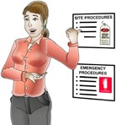
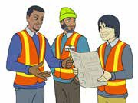
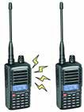
Communicate clearly
PC 1.7 PLAN WORK
Communicating clearly is an important part of working safely. You should discuss communication methods with the people you need to work with and agree on the best way to communicate. Choose the method at the planning stage or before starting work.
Some examples are:
Speaking, listening and asking questions Talk with your workmates. They might be able to give you information about the job or make you aware of hazards you don’t know about. | Site rules The site rules tell you the rules and procedures for the worksite you are on. You might read about these on noticeboards or be told about them in an induction.
Toolbox meetings Toolbox meetings are like _{Hand gesters} small staff meetings. or yelling. | Two-way radios You can use a two-way radio when you can’t see your workmate. If you are using them, always make sure they are working properly before you start the job. Check the batteries have enough charge and check you have the right channel to communicate with your workmates.
11

