Slide 1

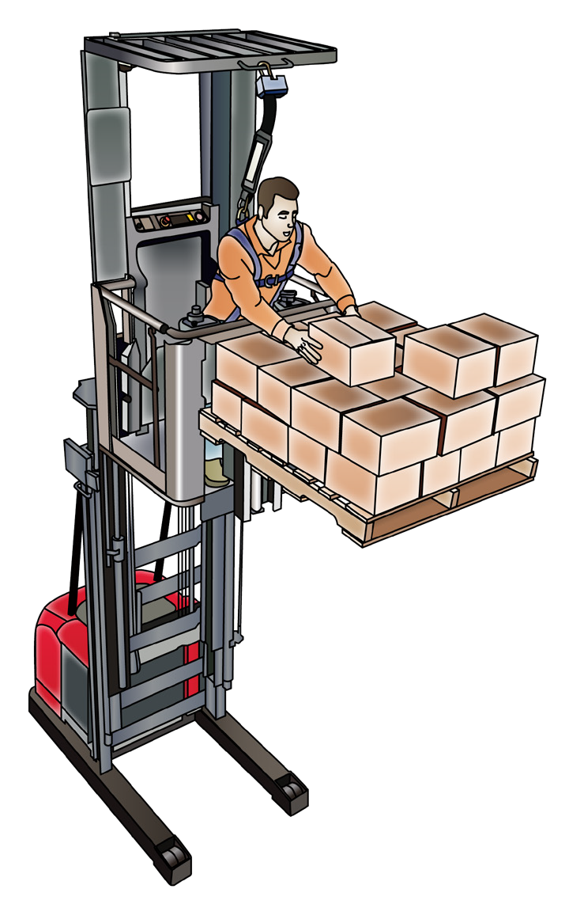

ORDER PICKING FORKLIFT
SAFETY AND LICENCE GUIDE
Training support material for:
TLILIC0004
Licence to operate an order picking forklift truck
Produced by:

Slide 2
Contents
About this guide
Acknowledgements
Introduction to order picking forklift truck
High risk licensing and the law
4
5
7
11
17
37
58
91
Element 1
Element 2
Element 3
Element 4
Plan work / task Prepare for work / task Perform work / task Pack up

Slide 3


About this guide
ABOUT THIS GUIDE
The guide is a follow-up to your formal training.
Like all Easy Guides, this one uses plain words and pictures to help you remember what you learned in your formal training. So you can pass your test — and get your licence.
Good luck from the team at Easy Guides Australia Pty Ltd.
Note: This guide does not use the same wording as the Safe Work Australia Assessment Instrument.
Easy Guides training materials have been developed around Language – Literacy – Numeracy (LLN) principles.
How to use this guide
Use it in hard copy
This guide helps you prepare for the test at the end of the course. Study it carefully, and then ask a friend to help you practise. They can ask you each question, and then you give the answer. Writing down the answers can also help you remember them. This also helps you see what you still need to learn. Good luck!
Or use it on screen
This guide also comes in a multimedia presentation, so you can use it on your computer or screen. The multimedia presentation is just like the guide and has exactly the same questions with the same short words and easy-to-understand pictures.
Trainers can use the multimedia presentation in class to help learners discuss questions. The trainer first shows the question and asks if anyone knows the answer. Next, the trainer will show the answer and discuss it with the learners.

Slide 4
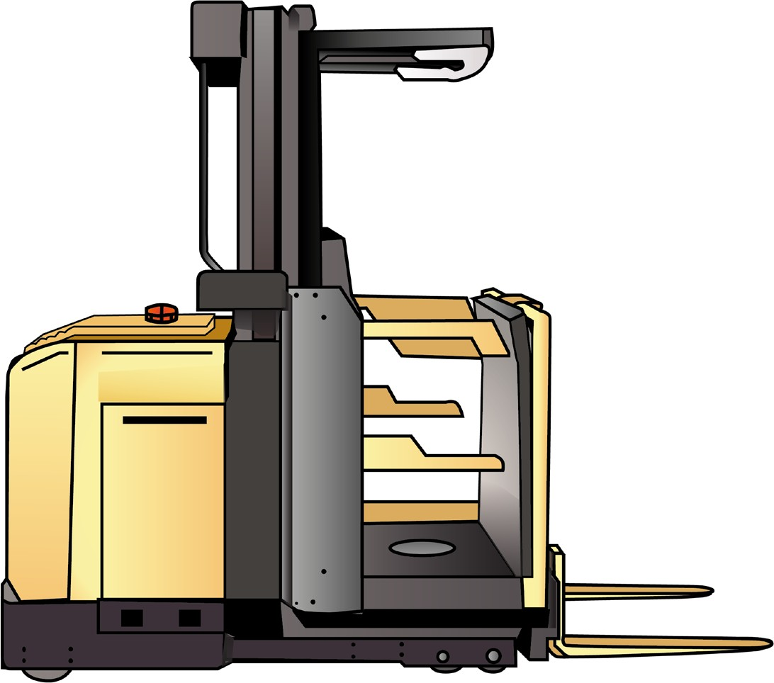

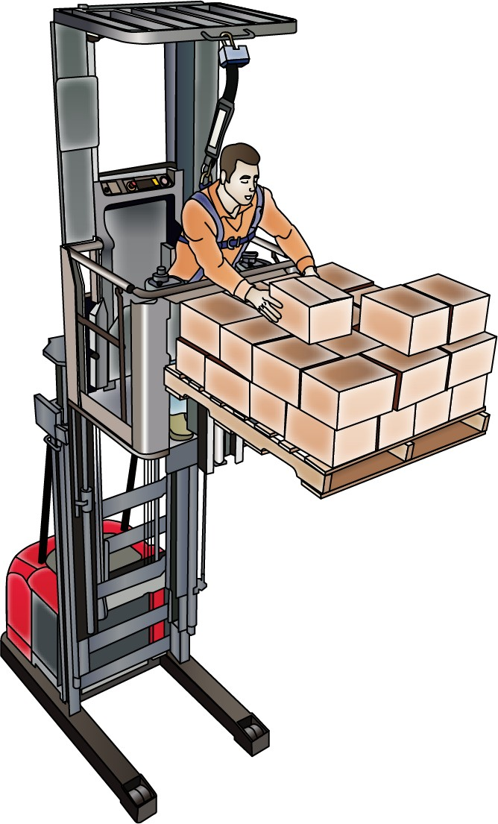

What is an order picking forklift truck?
PC 1.3 INTRODUCTION TO ORDER PICKING FORKLIFT TRUCK
An order picking forklift truck (also known as a stock picker) is different from other forklifts.
On an order picking forklift the mast is fixed and cannot tilt
An order picking forklift lifts and lowers the operator with the load
The controls travel with the operator.
Controls travel with operator
Operator is lifted and lowered with the load
Tether bar
Mast is fixed
Auxiliary lift controls
Three-bar sidegate
Dead man’s pedal

Slide 5
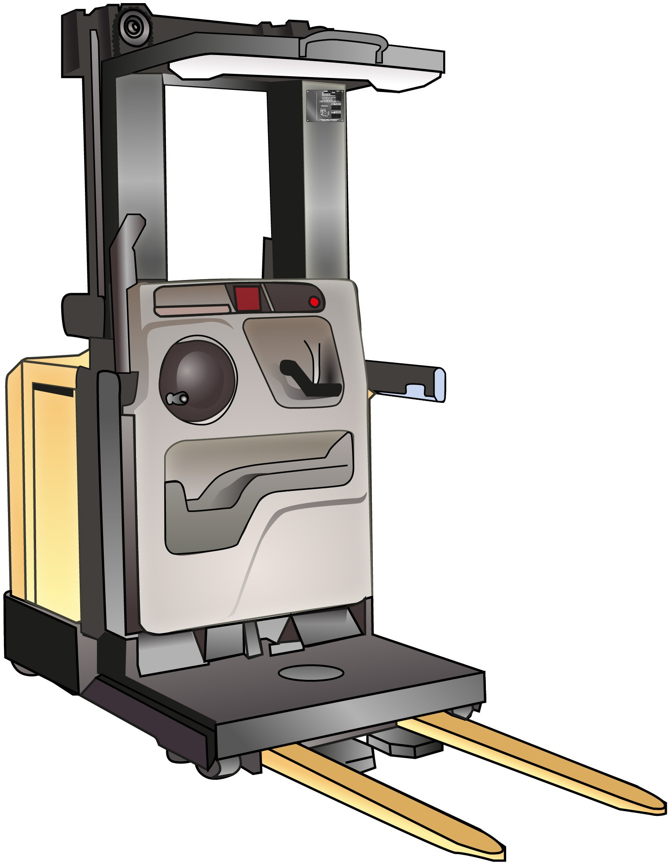
PC 1.3
INTRODUCTION TO ORDER PICKING FORKLIFT TRUCK
Parts of an order picking forklift truck
Overhead guard
Location of tether mounting bar
Location of operational fire extinguisher (location optional)
Work-lights, fan and control switches
Card slot
Operator’s display
Steering wheel
Key switch
Emergency power disconnect button
Upper louvered cover
Standard sidegate
Battery cover
Operator’s storage area
Simulaneous-function
control handle
Optional wire or rail guidance on/off switch
Lower cover
Battery gate
Pallet clamp release pedal
Dead man’s pedal
Note: This order picking forklift has lock-down bars. Some order picking forklifts have a cage.
Pallet clamp
Forks (tynes)

Slide 6
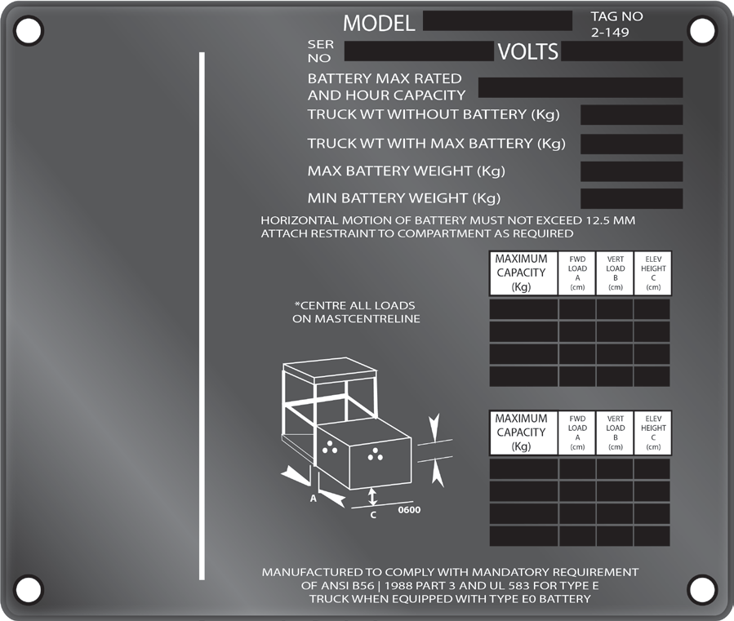
Data plate
PC 1.3 INTRODUCTION TO ORDER PICKING FORKLIFT TRUCK
Your order picking forklift and any attachments you use with it will have a data plate.
This plate shows you how much weight the forklift or attachments can lift
Trying to lift more than the data plate allows will damage the forklift or the load.
It can cause the forklift to become unstable and it may even tip over
If the data plate on the forklift is missing or unreadable, do not use the order picking forklift.
Power rating of battery
Serial number assigned
to this truck by factory
Model designation
Approximate weight of truck minus battery, load and operator
Nominal battery voltage
Approximate weight of truck with battery installed, minus load and operator
Maximum battery weight
for this truck
Minimum battery weight
for this truck.
(Battery weight must be between the minimum and maximum weight)
Maximum load capacity of the truck

Slide 7

Plan work / task
Element 1

Slide 8
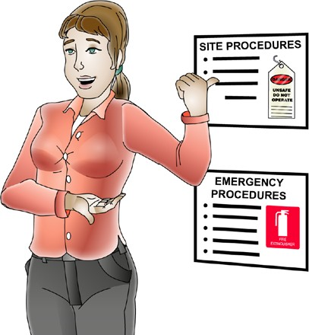
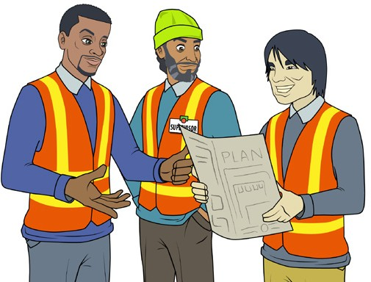
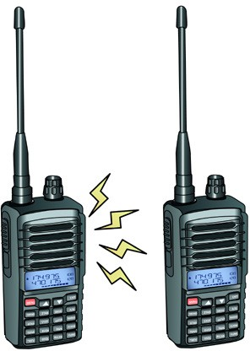
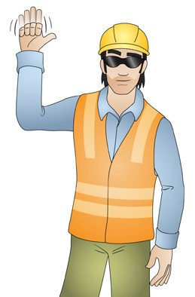
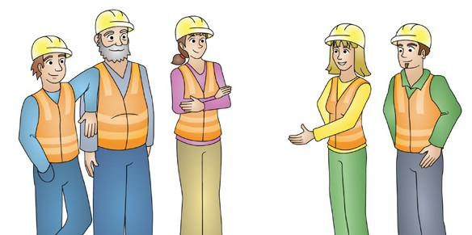
Communicate clearly
PC 1.1, 1.2, 2.1 PLAN WORK
Communicating clearly is an important part of working safely. You should discuss communication methods with the people you need to work with and agree on the best way to communicate. Choose the method at the planning stage or before starting work.
Some examples are:
Speaking, listening and asking questions Talk with your workmates. They might be able to give you information about the job or make you aware of hazards you don’t know about. | Site rules The site rules tell you the rules and procedures for the worksite you are on. You might read about these on noticeboards or be told about them in an induction.
Toolbox meetings Toolbox meetings are like _{Hand gesters} small staff meetings. or yelling. | Two-way radios You can use a two-way radio when you can’t see your workmate. If you are using them, always make sure they are working properly before you start the job. Check the batteries have enough charge and check you have the right channel to communicate with your workmates.

Slide 9


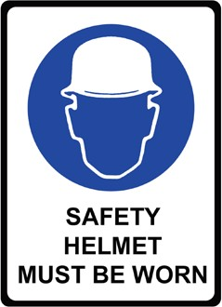

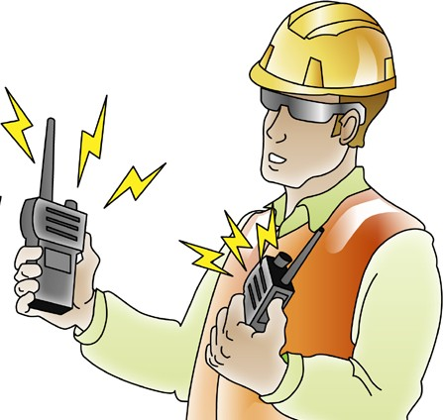
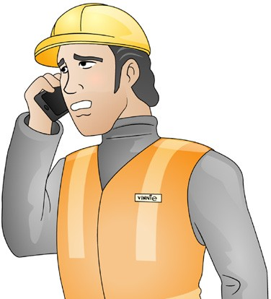
PC 1.1, 1.2, 2.1
PLAN WORK
Communicate clearly (continued)
Signage A sign at the worksite may warn you of a hazard or danger you need to avoid. Always follow the information given on these signs. Signage can be used to give instructions and directions. Ensure you can read and write enough to understand the safety signs. If you find it difficult to understand any written instructions or signs, ask a workmate to help you. | Written instructions Read the written instructions about the job or the worksite. Check the job plans and Safe work method statements (SWMS).
Make sure the equipment works | Mobile phones
Before you use any communications equipment, always test it first. Test radios by trying to speak to a workmate. | You can use a mobile phone when you can’t see your workmates.
If you find any equipment that doesn’t work, do not use it.
End of Plan work section. Check your knowledge by answering the questions at the end of the book. Your trainer will check your answers.

Slide 10

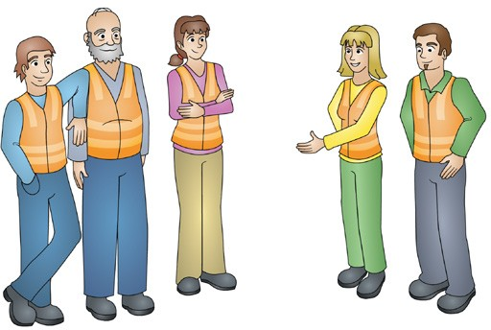
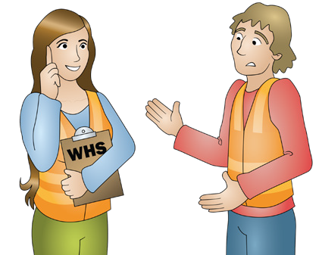
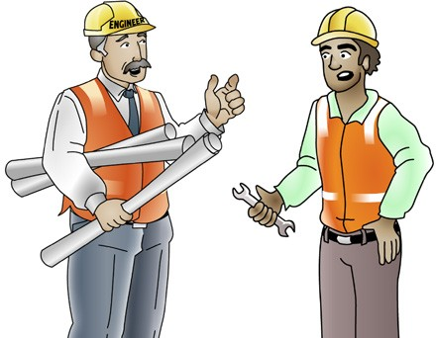

PC 1.1, 1.2, 2.1
PLAN WORK/TASK
QUESTION 9 You are starting work on a new site today. Who should you talk to about site hazards before you start work? | Managers and supervisors who are in charge. | Workmates
 | Safety officers and workplace, health and safety (WHS) representatives. WHS committee members. | Engineers (if there is one).
QUESTION 10 Why is it important to talk to people in the workplace (such as workplace health and safety representatives) about hazards before you start work. Why do you think it is important to do this? | You will find out what the hazards are and how to control them. You will find out about any ground conditions that are a hazard. To make sure that you follow workplace policies and procedures.

Slide 11

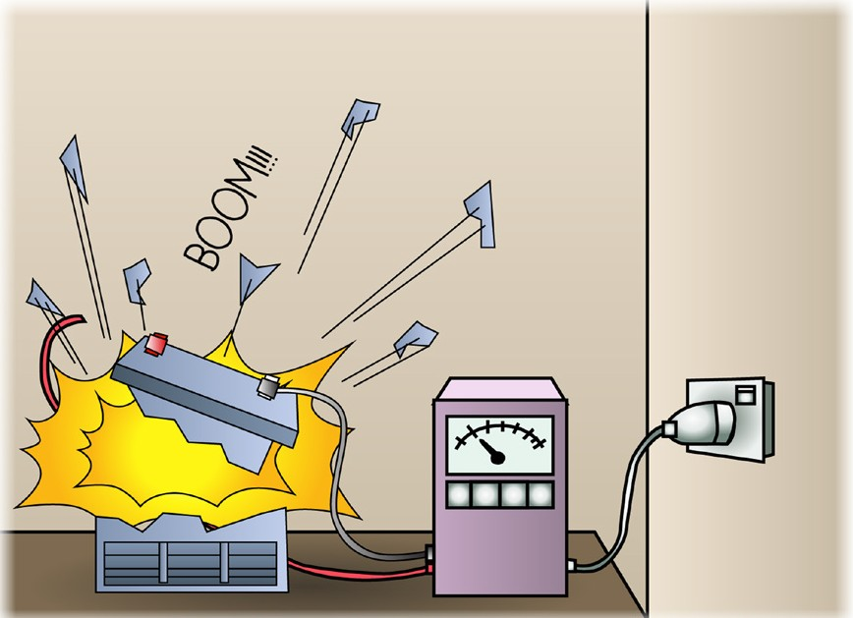
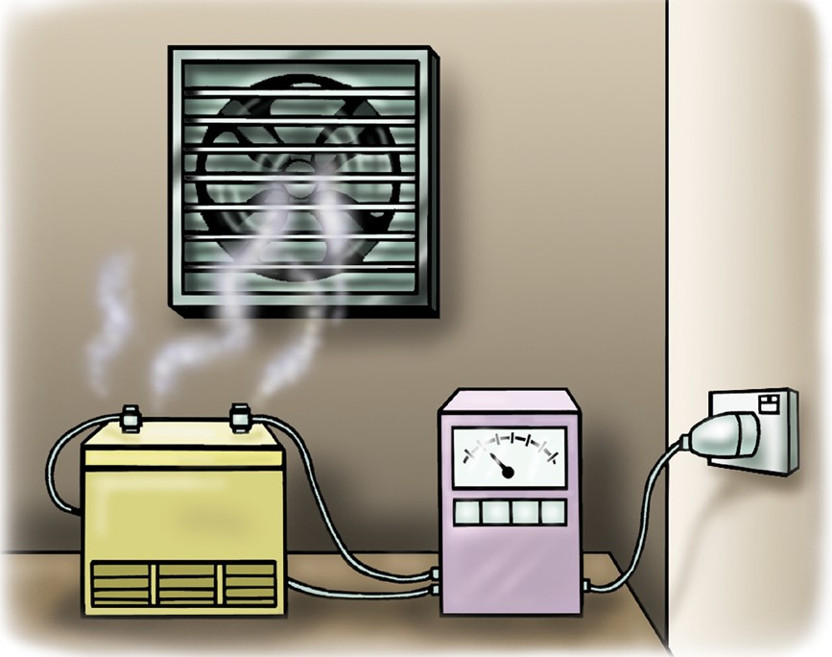

PC 2.2, 2.3
PLAN WORK/TASK
QUESTION 11 | Batteries give off gasses (Hydrogen gas) which can explode. Good air flow helps to remove the gasses.
Why must you charge
batteries in a well-aired
(ventilated) area?

Slide 12

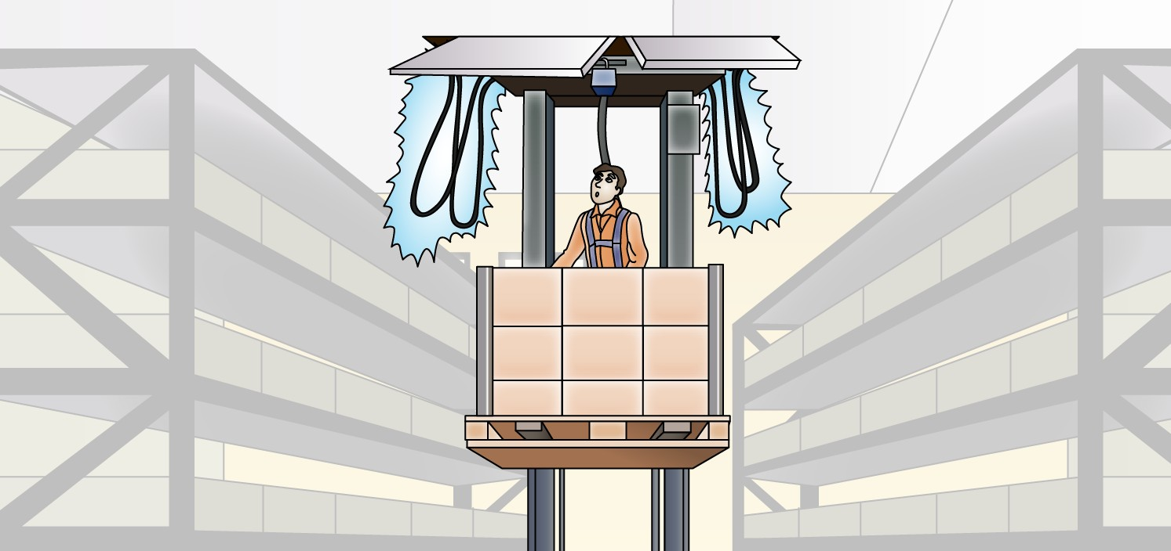
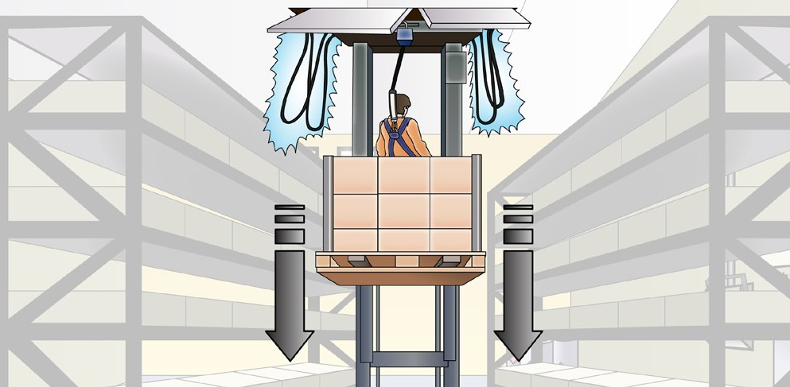

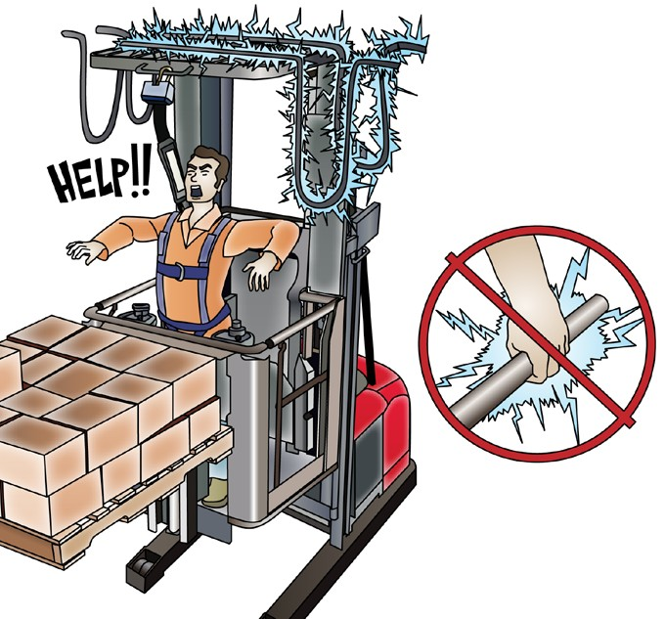

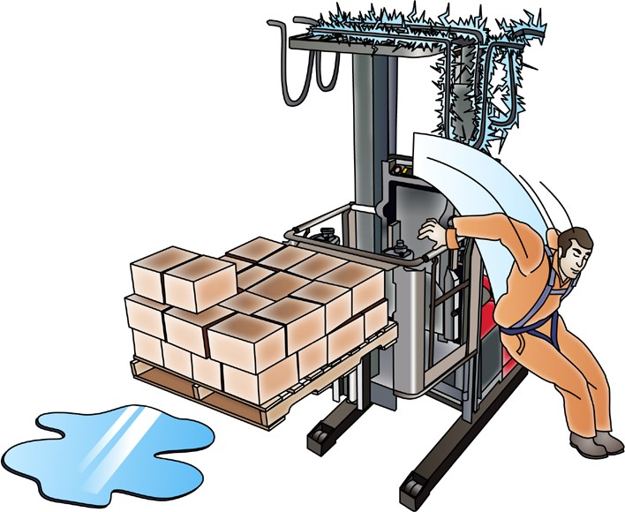

PC 2.3
PLAN WORK
Contact with electrical or live service lines
If your order picker accidentally hits the electrical or live service wires, there are a number of steps to take.
1. If possible, break contact with the wires. | 2. If you can’t break contact, stay on the order picker. Lower the platform if you can or move the order picker away from the power line.
3. Do not touch any metal parts. Call out for help. | 4. If you can’t stay in the order picker because it is not safe, for example, there is a fire, you must jump clear.
 | Make sure there are no obstacles

Slide 13
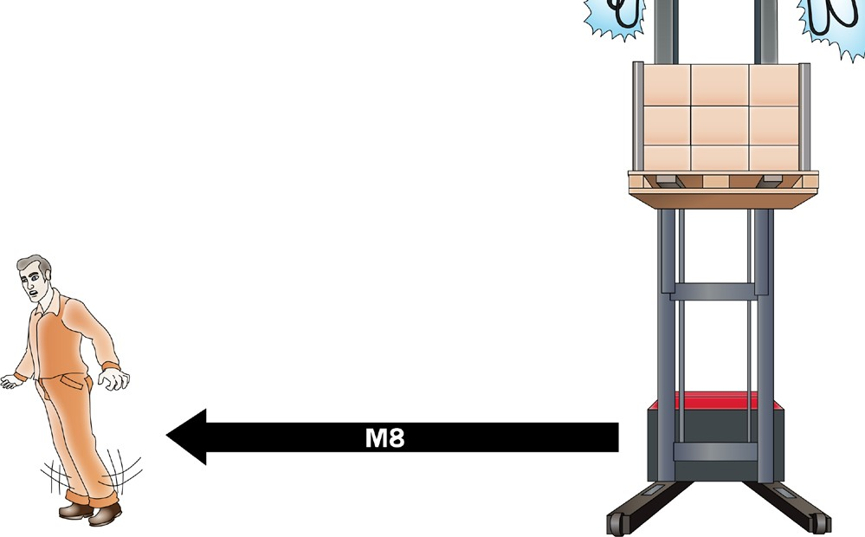
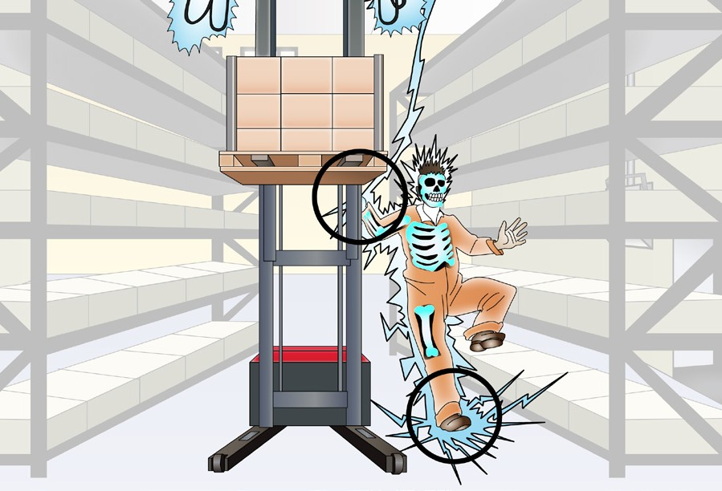

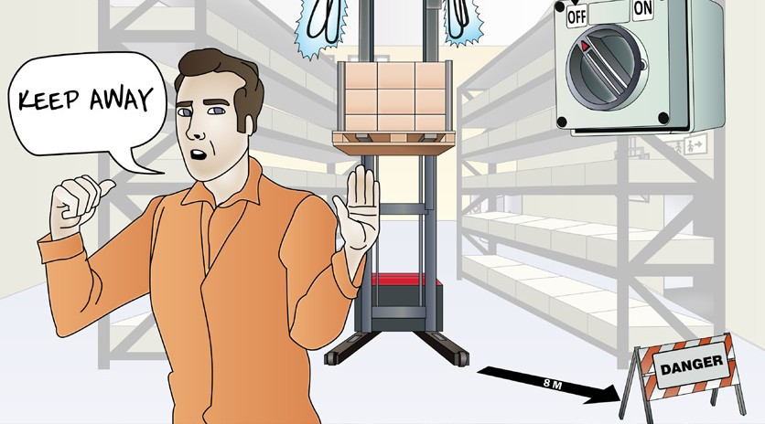

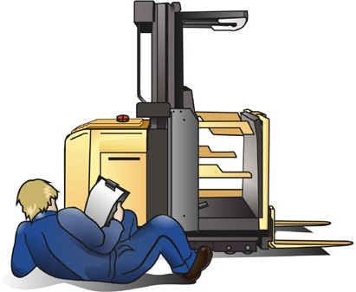
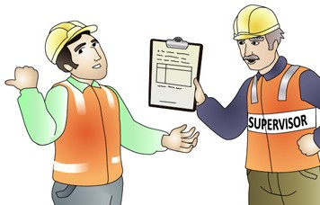
PC 2.3
PLAN WORK
Contact with electrical or live service lines (continued)
5. When you hit the ground, do not touch the ground and the order picker at the same time. | 6. Keep both feet together and hop or shuffle away from the order picker. Hop or shuffle 8 metres Get at least 8 metres away from the order picker
7. Warn other people to stay at least 8 metres away until the power has been turned off. | 8. Your work site will have rules to follow. You should tell management, the power company and the safety regulator. | 9. Do not use the order picker until it has been checked by a competent person.

Slide 14
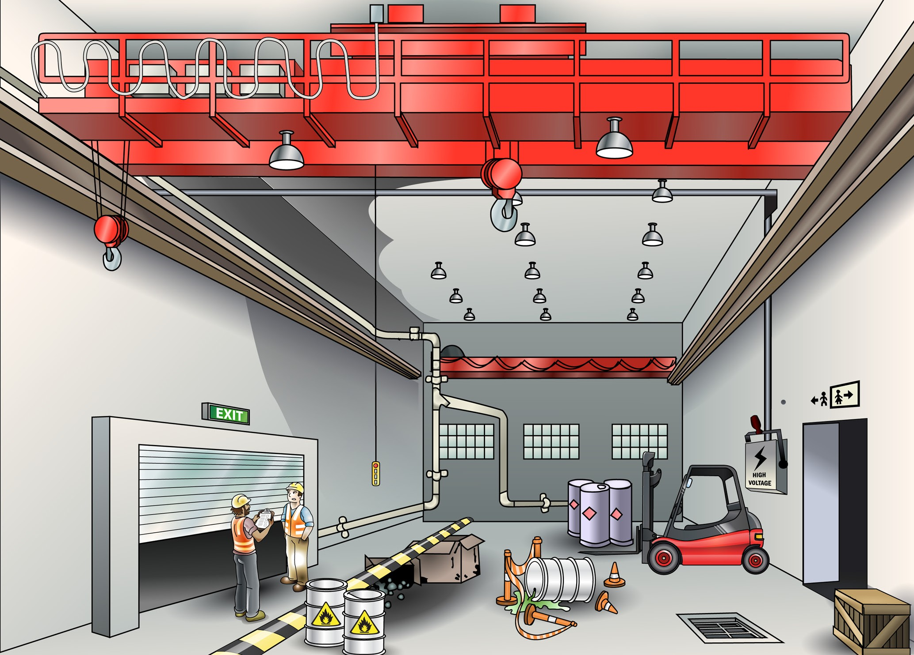
PC 2.3
PLAN WORK/TASK
QUESTION 12
You are about to use the order picking forklift.
What are some hazards you need to think about and plan for?
Overhead services such as electricity lines or fire sprinklers
There may not be enough lighting
Structures
Other hazards unique to your workplace
Other plant, equipment and vehicle traffic.
People
Obstructions
Doorways
Dangerous materials such as chemicals
Underground services
...CONTINUES ON NEXT PAGE

Slide 15
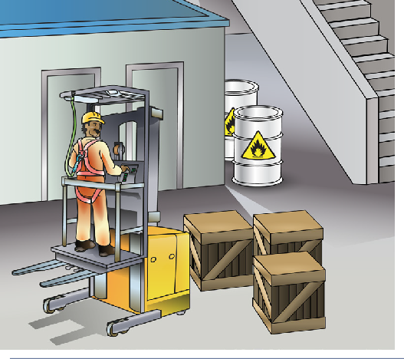
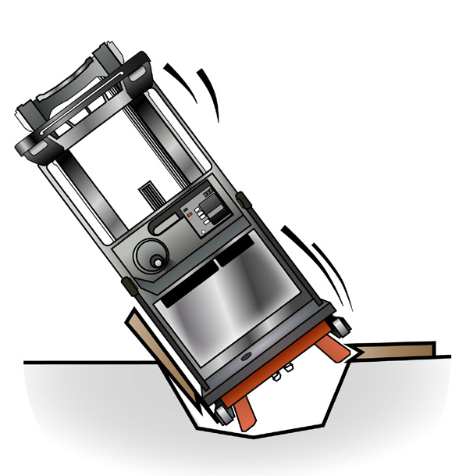

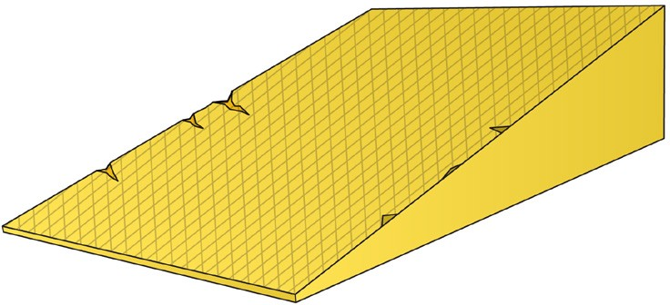
PC 2.3, 1.7
PLAN WORK/TASK
QUESTION 12
...CONTINUED FROM PREVIOUS PAGE
You are about to use the order picking forklift.
What are some hazards you need to think about and plan for?
Structures such as buildings that other order pickers are working in.
Surfaces that won’t take the weight of your vehicle | Different surfaces such as ramps, slopes and rough or damaged flooring.
CRACK!

Slide 16



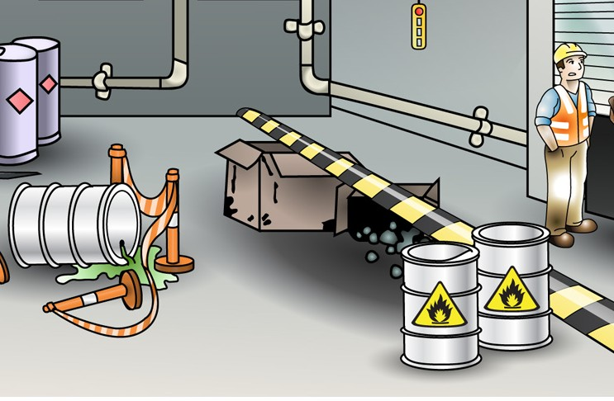
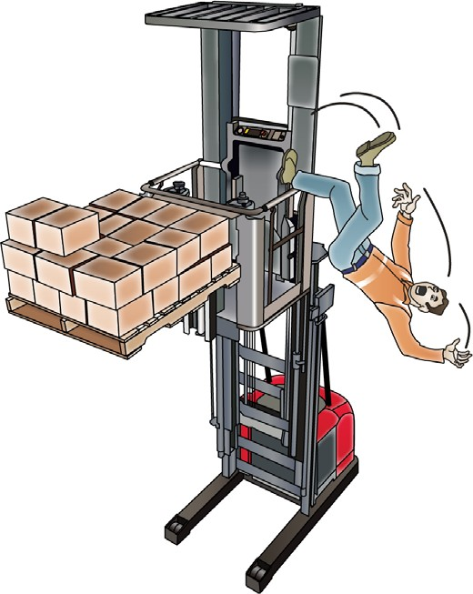
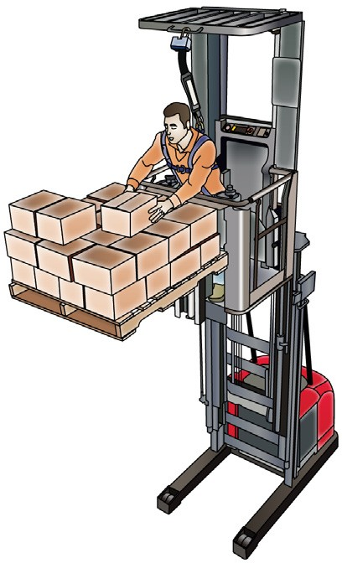
PC 2.3
PLAN WORK
Hazardous materials
Hazard
Hazardous materials are things that could harm or kill you. Hazardous materials include things like chemicals and gasses.
Control
Read the Safety data sheet (SDS) before you work with hazardous materials. The SDS tells you what the hazardous materials are, and what to do if there’s a spill.
Your employer must give you an SDS and must train you to work safely with hazardous materials.
Working from heights
Hazard
You’re working at height in an order picking forklift. What safety equipment would you wear and use to do it safely?
Control
A full body harness and safety lanyard which is attached to the overhead structure. A safety harness stops the operator from falling or being thrown from the order picker or into its structure if it tips over or there is a collision.

Slide 17



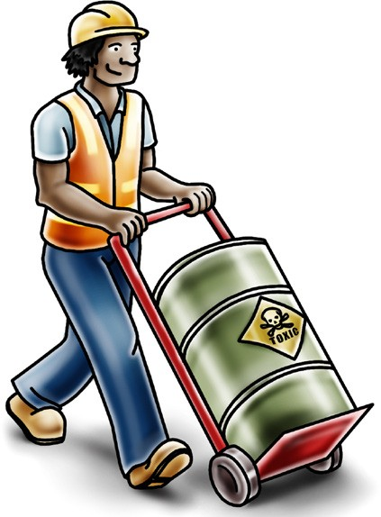



PC 2.3
PLAN WORK
Hazard, risk and control
Hazard | Risk | Control
A hazard is anything that can harm you or others while you work. | A risk is the chance of a hazard injuring or hurting a person. | A control is what you can do to stop the hazard from hurting or killing someone.
 | In other words, what is the chance of the hazard hurting you?

Slide 18
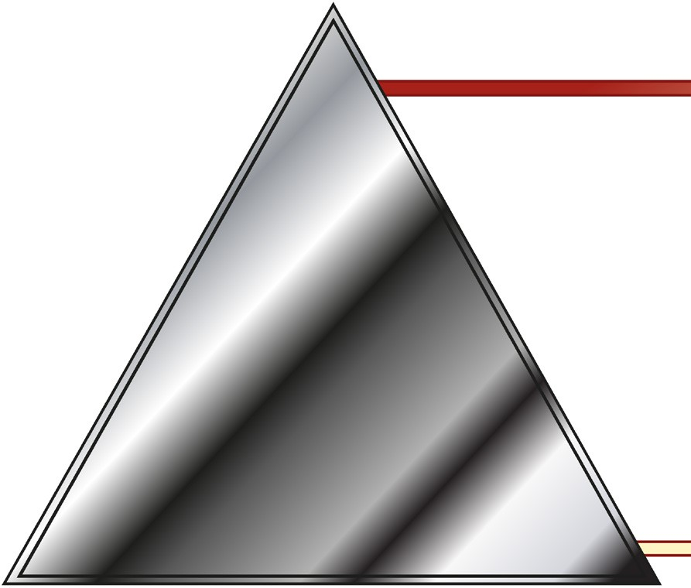
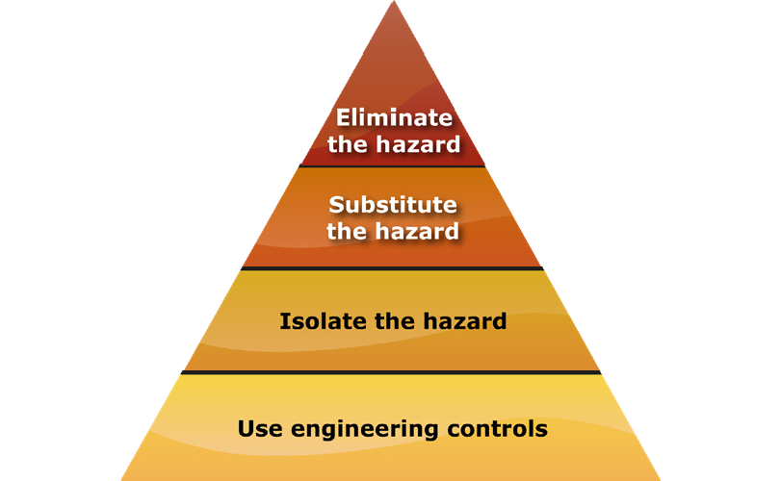
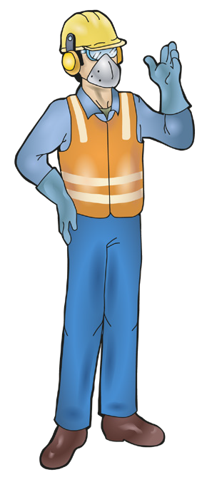

PC 2.3
PLAN WORK/TASK
QUESTION 13
The Hierarchy of Hazard Control is a list of controls that you can use to eliminate or lower the danger from a hazard in the workplace.
What are the six (6) levels in the hierarchy from the first choice to the last choice?
1. Elimination: If possible, remove (take away)
the hazard.
2. Substitution: Use a safer method if you can’t remove the hazard.
3. Isolation: Stop access to the hazardous (dangerous) area.
4. Engineering Control Measures:
Change the tools, equipment or environment to make it safer.
5. Administrative Practices: Reduce the time the worker is exposed to the hazards by using training, job rotation, the timing of jobs, etc.
6. Personal Protective Equipment (PPE): Use PPE as your last line of defence.
Memory aid: Every Saturday I Eat A Pie

Slide 19
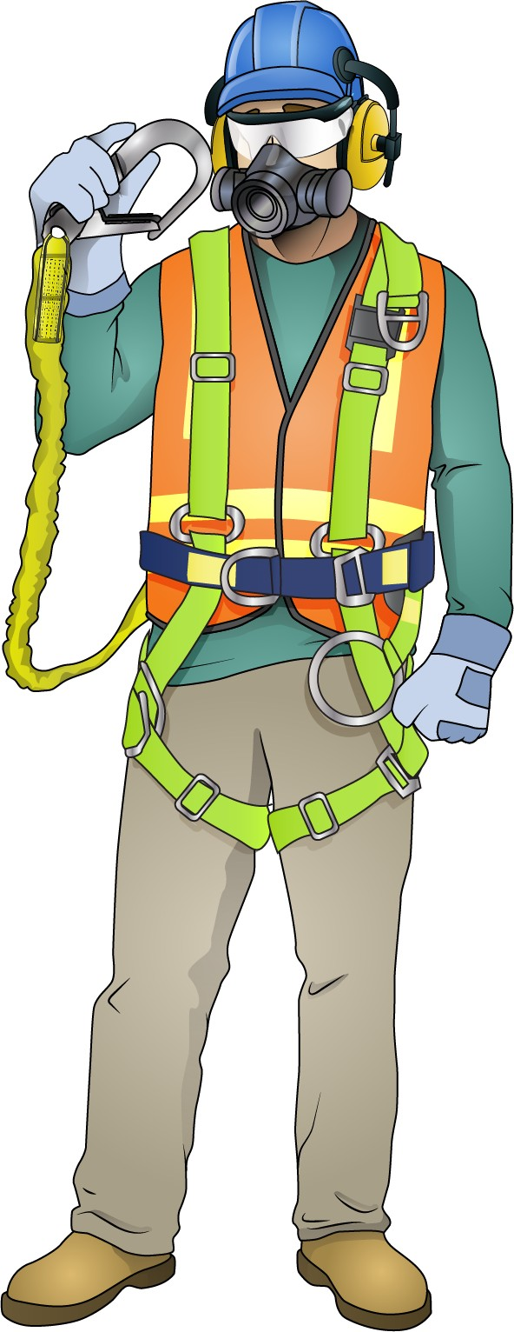
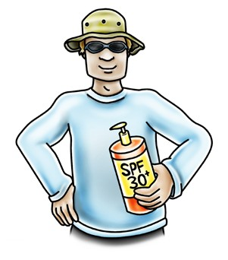
PC 2.7
PLAN WORK
Personal protective equipment (PPE)
Safety glasses or goggles
PPE is clothing or equipment worn on the body to protect you from hazards.
PPE will not take away the risk of harm altogether, but it will help keep you safe.
There are different types
Safety helmet
or hard hat
Ear muffs or ear plugs
Respiratory equipment
Dust mask, half face respirator
or full face respirator
of safety equipment.
Depending on the job and the work area, you may need to use a certain type of safety
equipment. Be sure you choose the right safety equipment when you’re planning the job.
High visibility clothing Safety vest, hi-vis shirt or hi-vis jumpsuit
Long sleeved shirt
Lanyard
Safety harness
Safety gloves
Insulated
Skin cancer is a major hazard for people working outdoors.
The best action to take when working out in the sun or other hot environments is to SLIP on a shirt, SLOP on some sunscreen and SLAP on a hat.
Sunglasses will also help to
Long pants
Safety shoes
Rubber soled, fully enclosed foot, may be steel capped to protect the toes

Slide 20
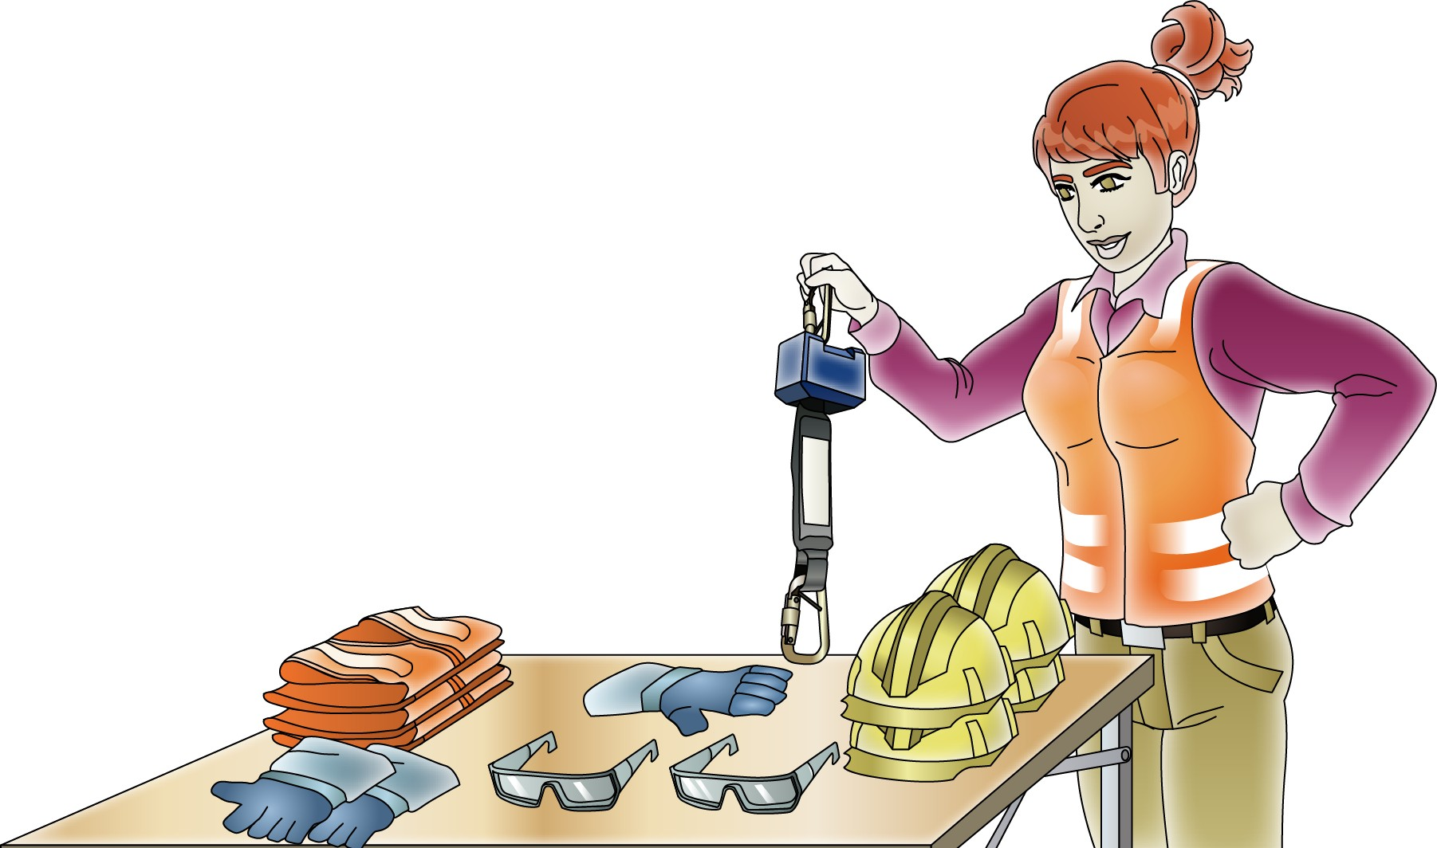
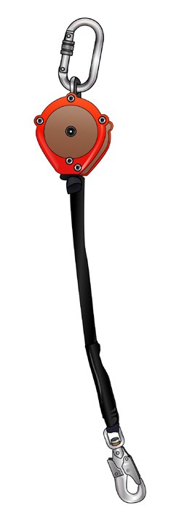
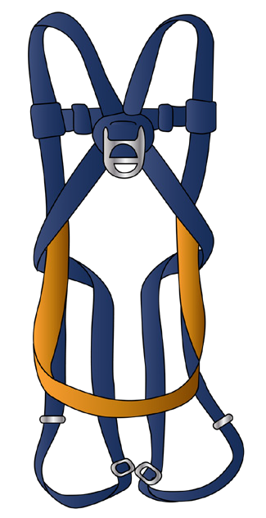
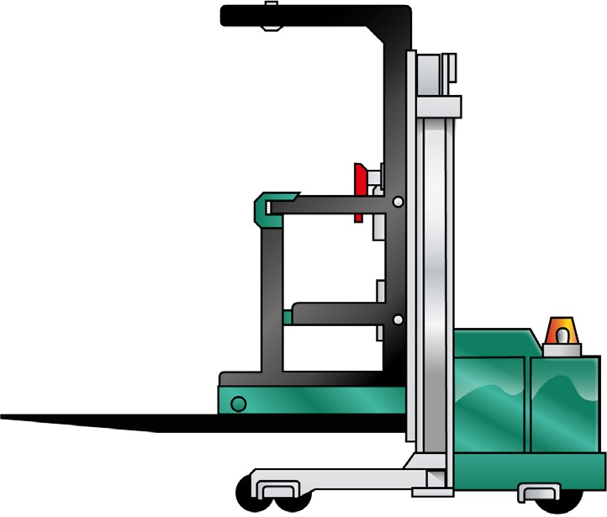
PC 2.7
PLAN WORK/TASK
QUESTION 14 When is the best time to choose your personal protective equipment (PPE) and other safety equipment? | When you are planning the job.
QUESTION 15 What is the most important items of safety equipment you need to use when using an order picking forklift truck? | A full body harness | Overhead guard Lanyard (has retractable anchor point lanyard fitted). Retractable lanyard

Slide 21
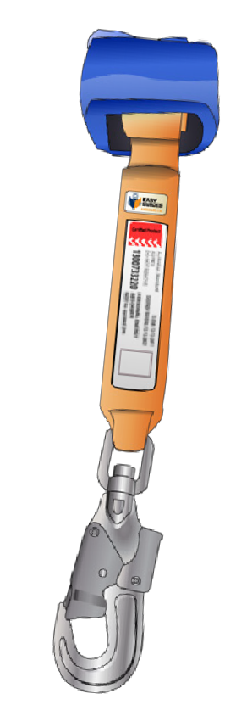
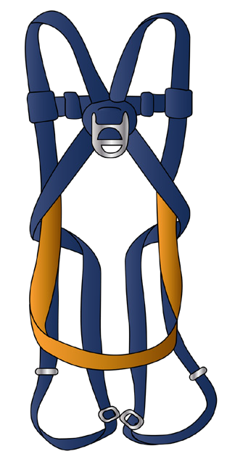
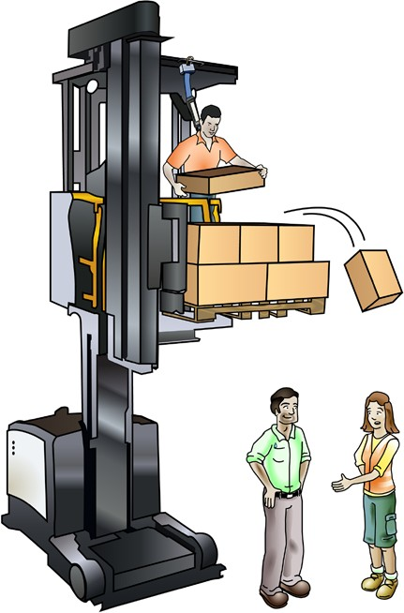

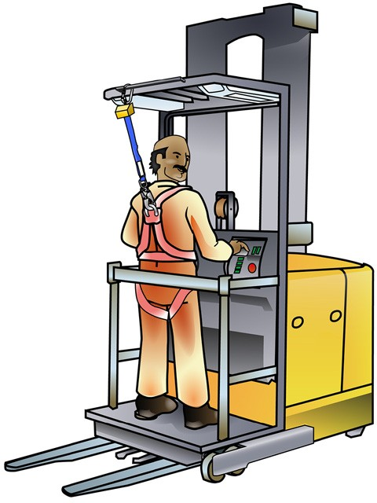

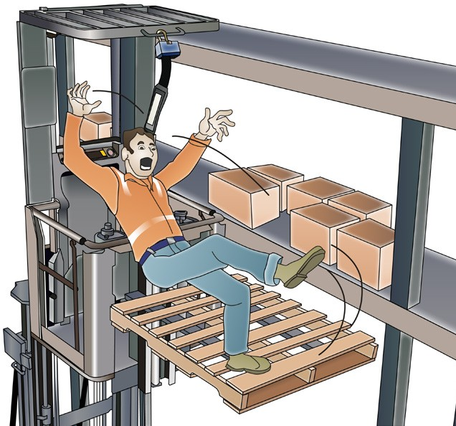
PC 3.1
PLAN WORK
Working safely at heights
If you can’t find a safety harness or a lanyard, do not use the order picker. | You should never raise a load on the order picker when there are people around. This is dangerous because something in the load might fall and hit someone.
You must make sure the platform handrails are closed. If you can’t close the platform handrail do not use the order picker. | Never leave the order picker’s platform when it is off the ground. This is very dangerous with the serious risk of a fall from heights.

Slide 22


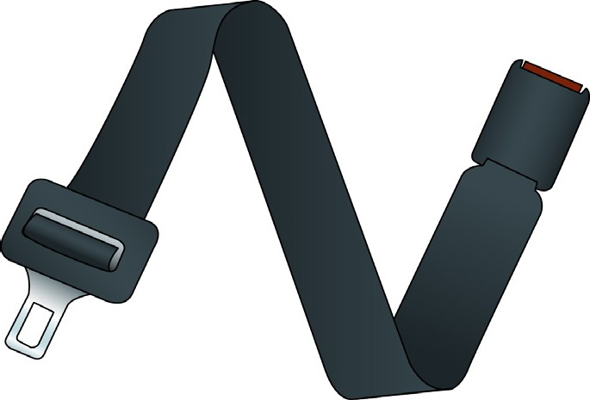
PC 3.1
PLAN WORK/TASK
QUESTION 16 Why do you wear a full body harness with retractable lanyard? | It stops the operator from falling or being thrown from the order picker or into its structure if it tips over or there is a collision.
QUESTION 17 What important job does a seat belt do (if fitted)? | The seatbelt stops the operator falling out if there is a rollover or crash. The seatbelt protects the operator from being thrown around and hurt inside the order picking forklift. Note: Most models of order picking forklifts do not have a seatbelt.

Slide 23




PC 1.1
PLAN WORK/TASK
QUESTION 18
You are about to start order picking.
What are some things you must plan for (other than site hazards)?
Type of load to be picked | Communication. Who do you need to talk to? Can you talk to them safely and when you need to?
How will you attach the load to the platform? | What is your task and where is it?
 |  | ...CONTINUES ON NEXT PAGE

Slide 24



PC 1.1
PLAN WORK /TASK
QUESTION 18
Do you have the equipment
you need to do the job?
Do you need any permits to do the job?
...CONTINUED FROM PREVIOUS PAGE
You are about to start order picking.
What are some things you must plan for (other than site hazards)?
Is the rated capacity of the order picking
forklift suitable for the job.

Slide 25






PC 1.4, 1.6, 3.4
PLAN WORK/TASK
QUESTION 19 You are planning your travel path. What do you look and plan for? | Check your path for hazards. If you find some, decide how you will control them.
QUESTION 20 How can you communicate with fellow workers on site? Hand gesters or yelling. | Verbal. Listen and ask questions to make sure you understand. Communicate in an appropriate way. | Use signs Use two-way radio | Use written instructions.

Slide 26







PC 3.6
PLAN WORK/TASK
QUESTION 21
There is an emergency. Who do you need to tell? What should you tell them?
You need to tell:
Supervisor Safety officer Manager | Other workers | Emergency services.
You should tell them:
There is an emergency
What the emergency is.
Where it is
not safe to go

