Slide 1


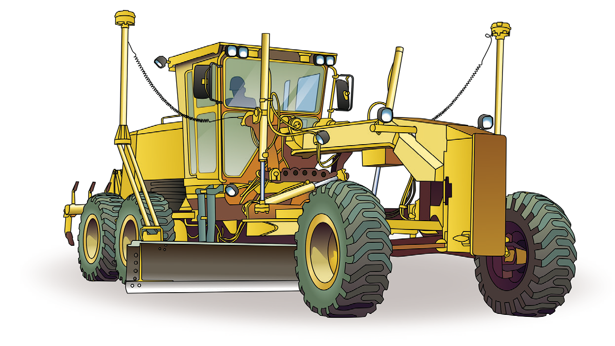

LEARNER GUIDE
Grader
Training support material for:
RIIMPO324F
Conduct civil construction grader operations
Produced by:
TICKET

Slide 2
Contents
Language – Literacy – Numeracy (LLN) Acknowledgements
Introduction to grader General information
4
6
7
10
13
21
46
88
115
147
155
174
179
181
188
Chapter 1
Chapter 2
Chapter 3
Chapter 4
Chapter 5
Chapter 6
Chapter 7
Chapter 8
Chapter 9
Chapter 10
Plan and prepare for work Identify and control hazards Check and monitor equipment Operate/use equipment
Shut down and store equipment Maintain equipment Housekeeping
Record keeping Relocate equipment Attachments

Slide 3
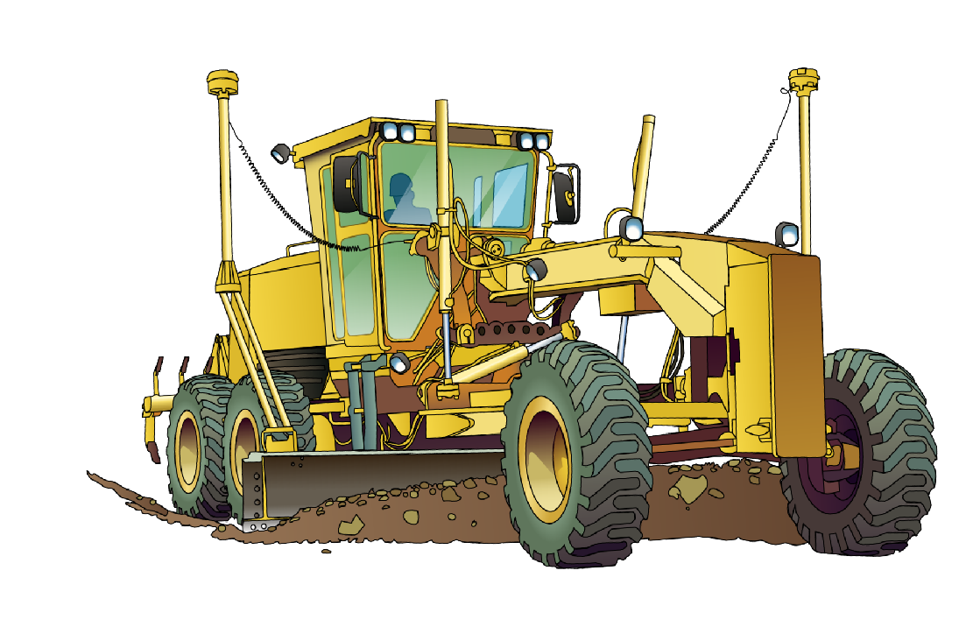
Introduction to Grader

Slide 4
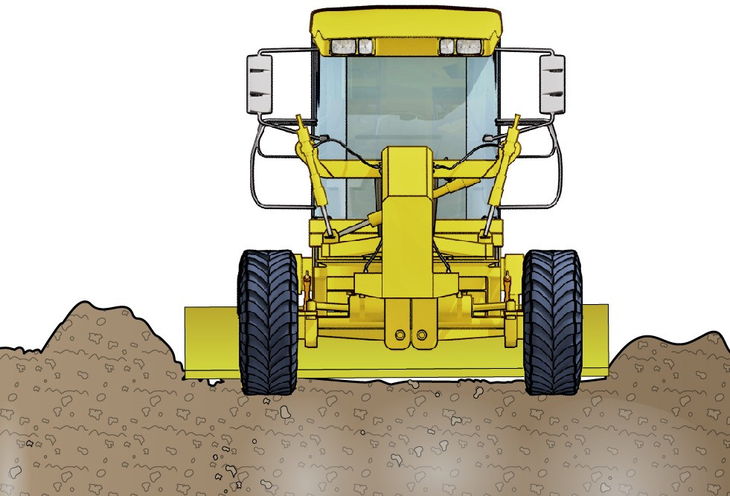
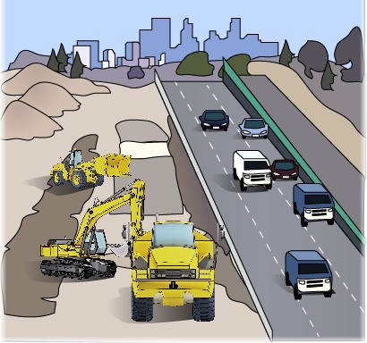
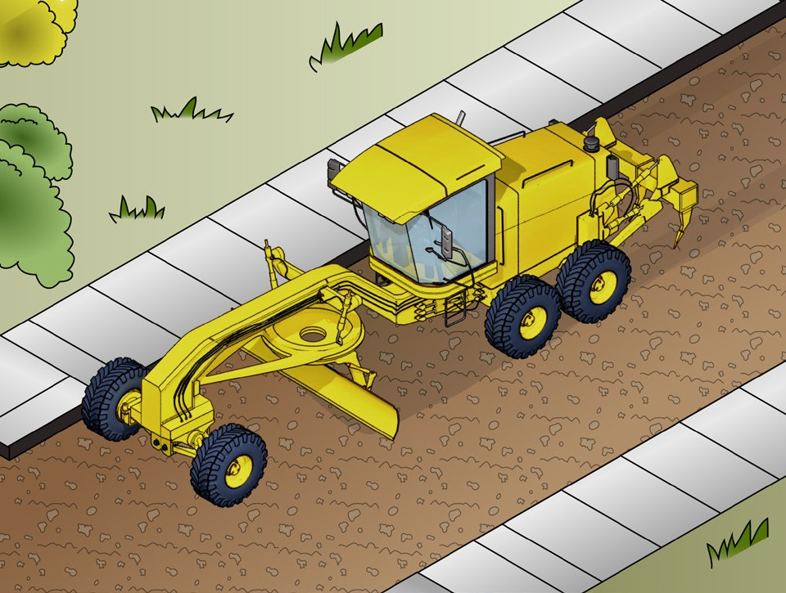
Introduction to grader
INTRODUCTION TO GRADER
A grader is a self-propelled articulating or rigid framed wheeled machine, designed to cut, move and place construction materials using a centrally mounted blade and may include forward and/or rear mounted rippers/scarifiers.
The blade and attachment controls are normally hydraulic; however, they may be mechanical.
What industries do you use a grader in?
Civil construction

Slide 5
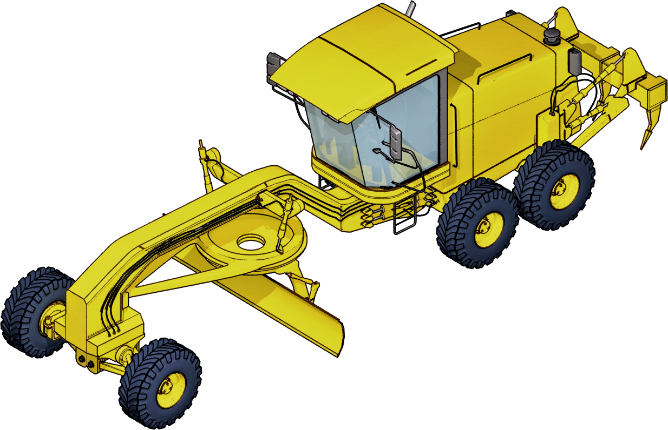
An example of a grader
INTRODUCTION TO GRADER
Engine
Rollover protective structure
Cab
Lift cylinder
Ripper
Frame
Circle
Tandem drive housing
Circle drawbar
Mold board
Steering cylinder
Cutting edge

Slide 6

PLAN AND PREPARE FOR WORK
Plan and prepare for work
Chapter 1

Slide 7
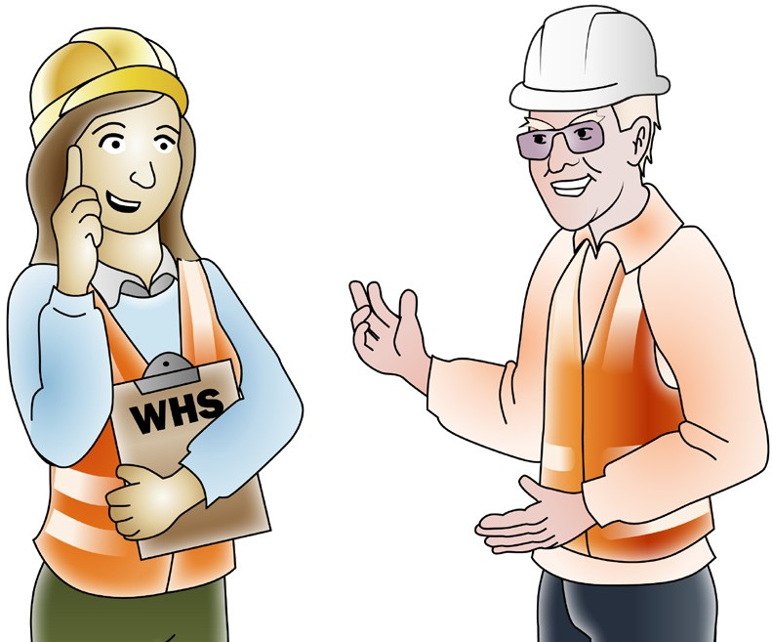
PC 1.1
PLAN AND PREPARE FOR WORK
Work Health & Safety Legislative Requirements
‘Laws to keep your workplace safe’
WHS/OHS requirements are outlined in Acts, Regulations, Codes of Practice and Australian Standards.
WHS/OHS Acts
‘WHS/OHS Acts’ are laws that explain how to improve health and safety in the workplace.
For example: Model National WHS Act.
WHS has the same meaning as OHS in this document.
Regulations
‘Regulations’ explain specific parts of the Act.
For example: Part 4.3 – Confined spaces, Part 4.4 – Falls.
Codes of Practice/Compliance Codes
‘Codes of Practice’ are practical guidelines on how to comply with (meet the rules of) legislation. For example: HAZARDOUS MANUAL TASKS Code of Practice.
Australian Standards
‘Australian Standards’ are work guidelines that set the minimum accepted performance or quality
for a specific hazard, process or product.
For example: AS 2550 – Cranes, hoists and winches – safe use set.

Slide 8
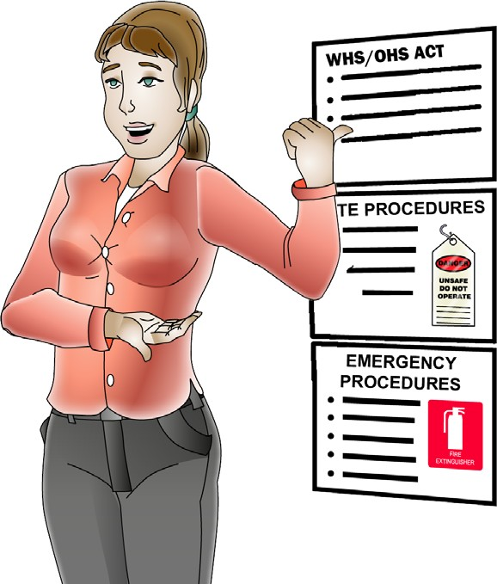
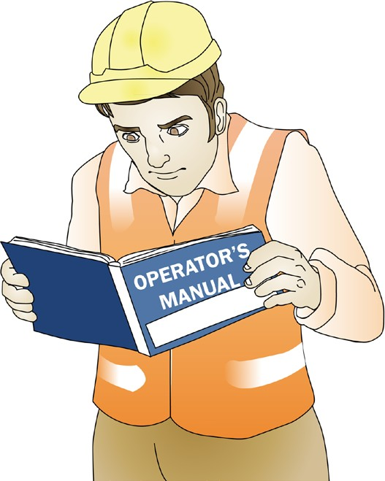
PC 1.1
PLAN AND PREPARE FOR WORK
QUESTION 2 What are some examples of documentation you should read before doing earthmoving work? | WHS/OHS Act Regulations Codes of Practice Australian Standards (AS 2958 Earthmoving machinery) Manufacturer’s specifications Operator’s manual for your machine Site requirements and procedures Company policies and procedures for Employment and workplace relations, Equal opportunity and disability.
QUESTION 3 | The operator’s manual tells you how to operate your machine.
Why should you check the operator’s | The manual also tells you about maintenance (how to keep your machine working well).
manual before using
earthmoving equipment?

Slide 9
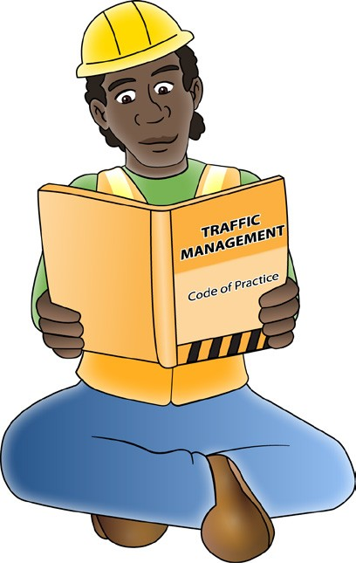
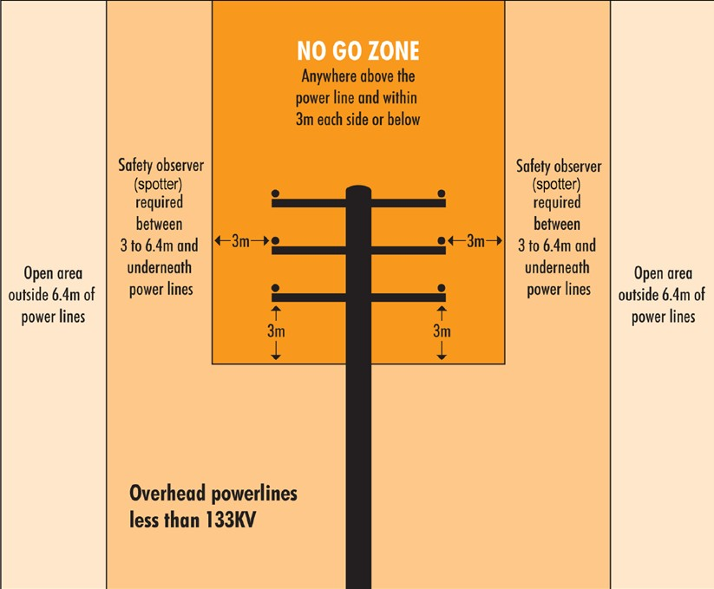
PC 1.1
PLAN AND PREPARE FOR WORK
QUESTION 4
What do codes of practice explain?
Codes of practice are practical guidelines on how to comply or follow the rules in legislation/laws.
For example:
A traffic management code of practice will tell you all the rules a traffic controller must follow. Such as a traffic controller must have a zero percent blood/alcohol concentration/reading while performing traffic control duties.
QUESTION 5
What do Australian Standards explain?
Australian standards are work guidelines that set the minimum accepted performance or quality for a specific hazard process or product.
For example: AS2550.1—Powerline distances
This standard tells you the distances you can safely work near powerlines on poles and towers.

Slide 10

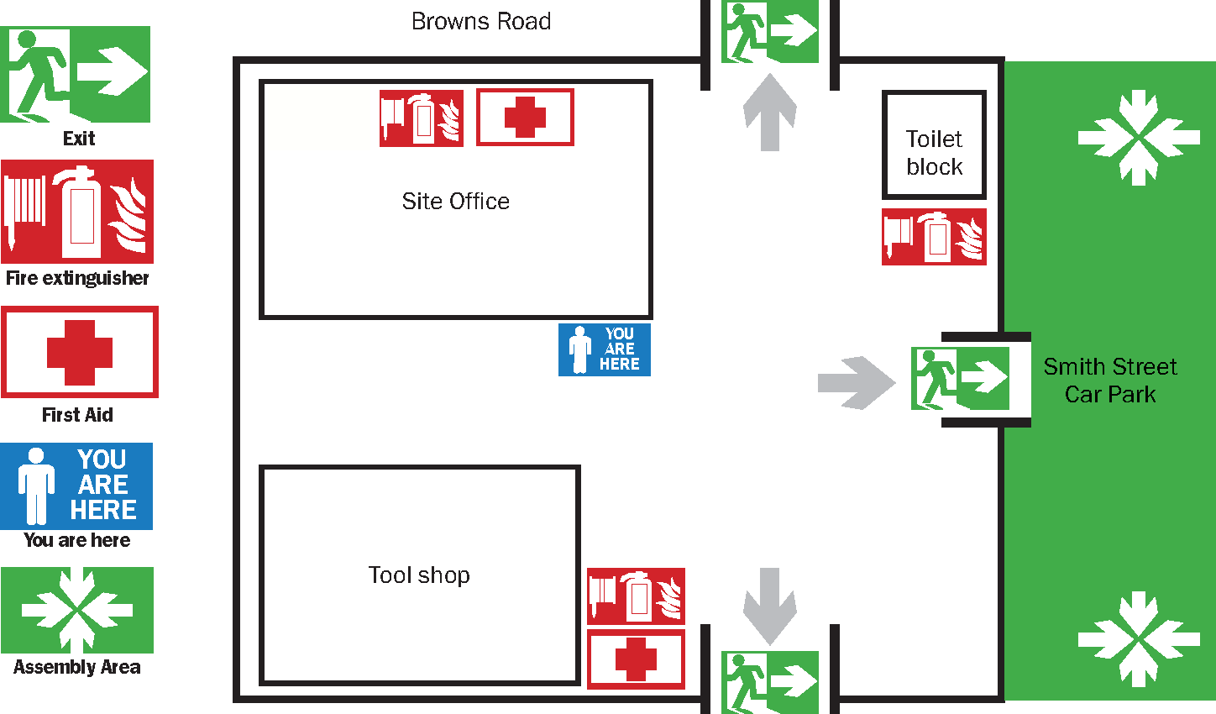
PC 1.2
PLAN AND PREPARE FOR WORK
Worksite requirements
Examples of documents your employer should provide include:
Safety plan for the site
Emergency procedures, for example a site evacuation plan
Environmental management plan for the job.
Emergency evacuation plan
Many worksites have an emergency evacuation plan which is displayed on the notice board.
You should make sure you know how to interpret this plan. For example, start by looking for a ‘You are here’ sticker on the plan drawing. Note how nearby areas are shown on the plan. Then work out where the emergency exit is – on the plan and in real life.

Slide 11
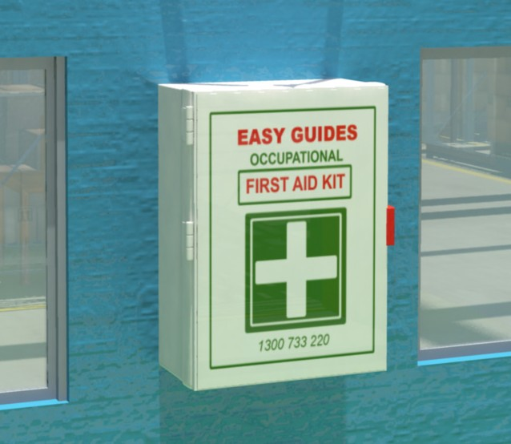

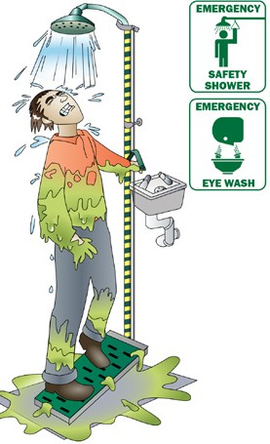
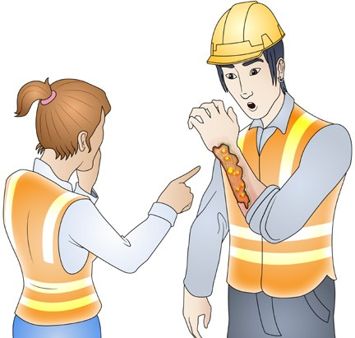
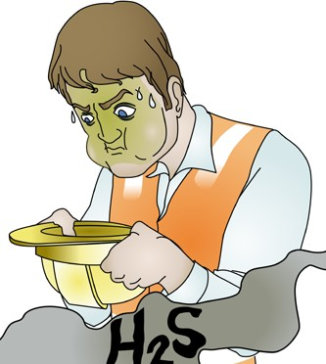
PC 1.7
PLAN AND PREPARE FOR WORK
First aid and emergencies
Employers should make sure there are trained first aiders and first aid kits available.
The employer should make sure:
The first aid kits are checked, maintained and kept in a clean dry place
There are clear signs indicating the location of first aid kits
They have recorded and displayed the numbers and location for emergency services (or local doctors or hospitals).
Reporting incidents
As a PCBU, employer or self-employed person you must report serious incidents to the SafeWork authority in your state.
You must give a written report within 48 hours if any of the following happen on a site you are controlling:
A death | An injury that requires medical treatment | Exposure to a substance that requires treatment | Other injuries or health issues caused from a workplace incident.
The authorities may send an inspector to come and examine the site. You must leave the site as it is, unless you need to; protect people, help an injured worker, make the site safe, or stop other incidents happening. The inspector will tell you when you can continue working normally.

Slide 12
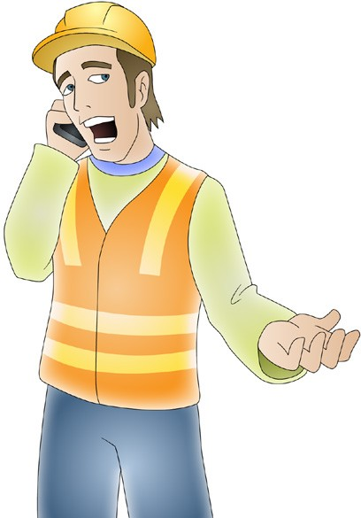
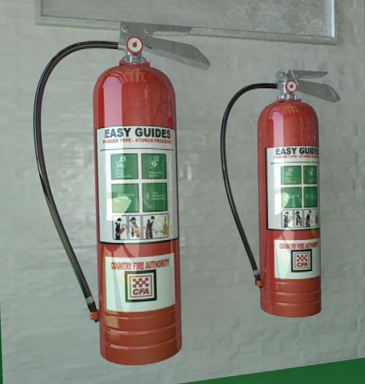
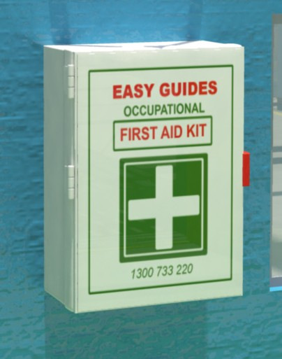
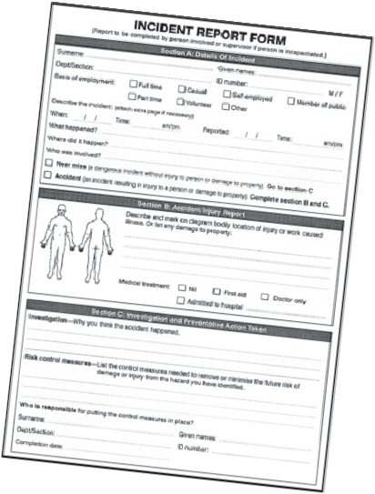
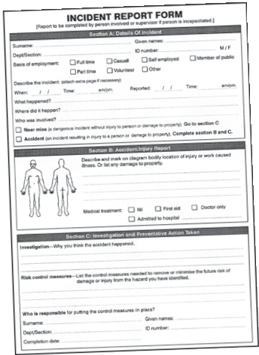
PC 1.7
PLAN AND PREPARE FOR WORK
QUESTION 6
What equipment should be on site to deal with an emergency?
Telephone | Fire extinguishers
First aid kit | Incident reporting forms

Slide 13

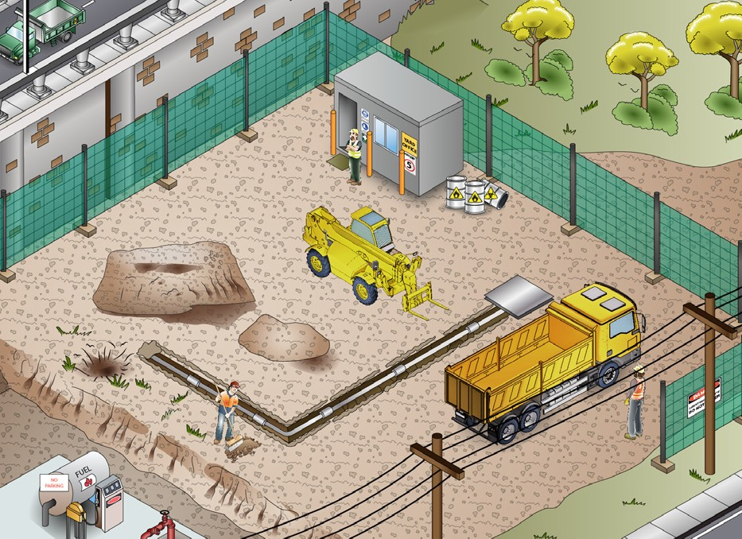
PC 1.1, 1.2, 1.8
PLAN AND PREPARE FOR WORK
QUESTION 8 What kinds of information do you need before starting work? | Plans – what you need to do Specifications – rules and details about the job Operational details – how you will do the job Quality requirements of the job – the standards you are expected to meet.
QUESTION 9 When planning your job, why do you need to know what other people are doing on site? | To make sure you will not get in the way of other jobs being done To make sure you know what others are doing near where you must work.

Slide 14
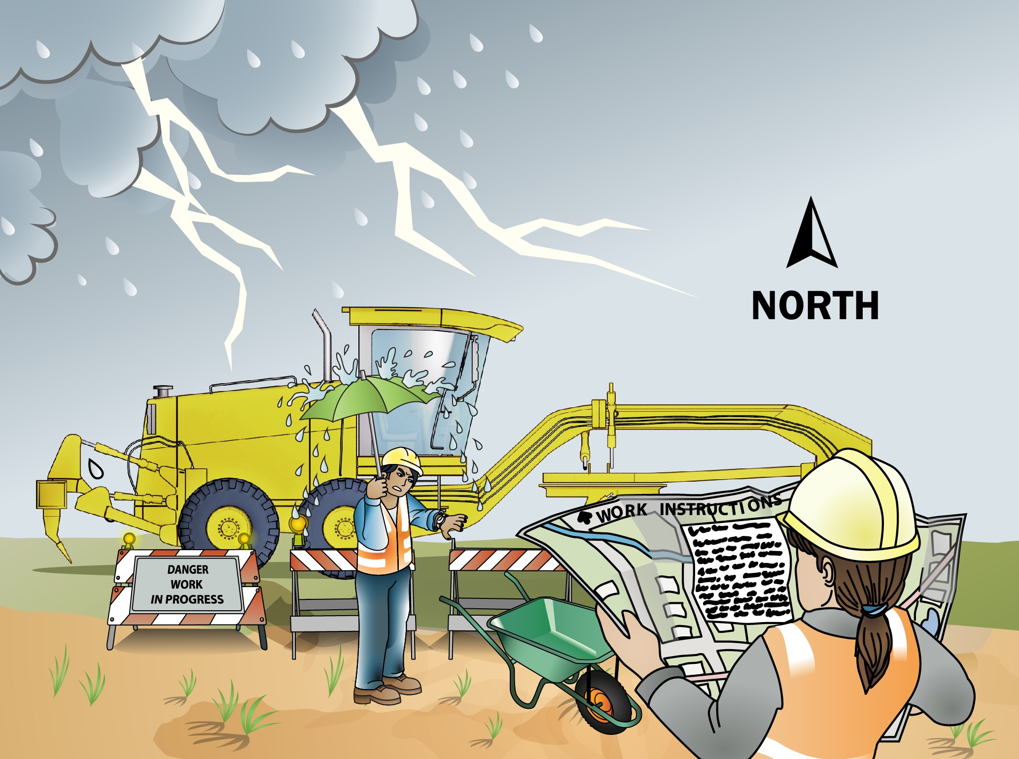
PC 1.2
PLAN AND PREPARE FOR WORK
QUESTION 10
What do the job’s work instructions explain?
Work instructions explain:
What to do in unexpected situations like bad weather
What the job is
Where the job is
How to do the job safely
How long the job will take
What tools and equipment you need
How to do the job from start to finish

Slide 15




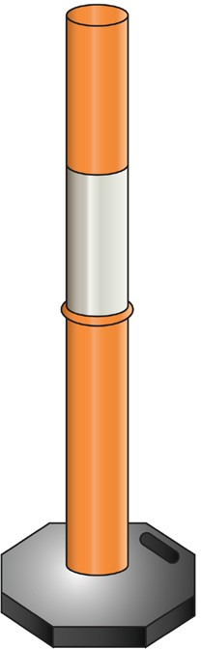

PC 1.5, 4.2
PLAN AND PREPARE FOR WORK
QUESTION 11
What equipment may be used in a traffic control plan?
Stop/slow bats | High visibility vests | Radios
Barricades | Cones | Bollards

Slide 16
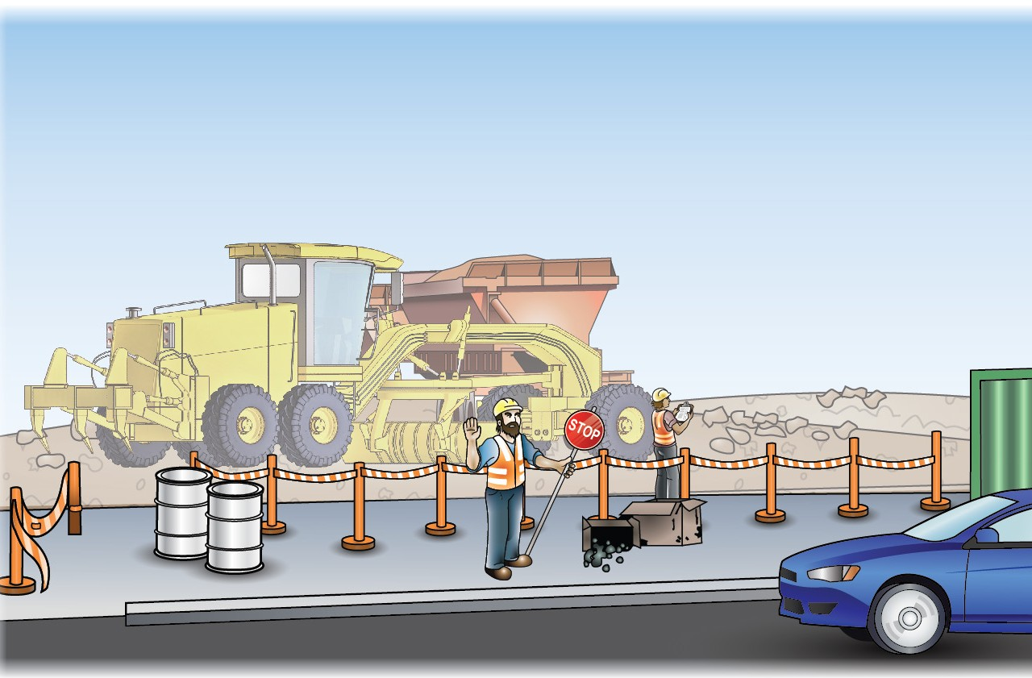
PC 1.5, 4.2
PLAN AND PREPARE FOR WORK
QUESTION 12 | It tells you how to control vehicles in and around the worksite. It helps keep the site safe for
What does the traffic management plan (TMP) | you and others. You may require a traffic control licence in your state or territory.
tell you?

Slide 17
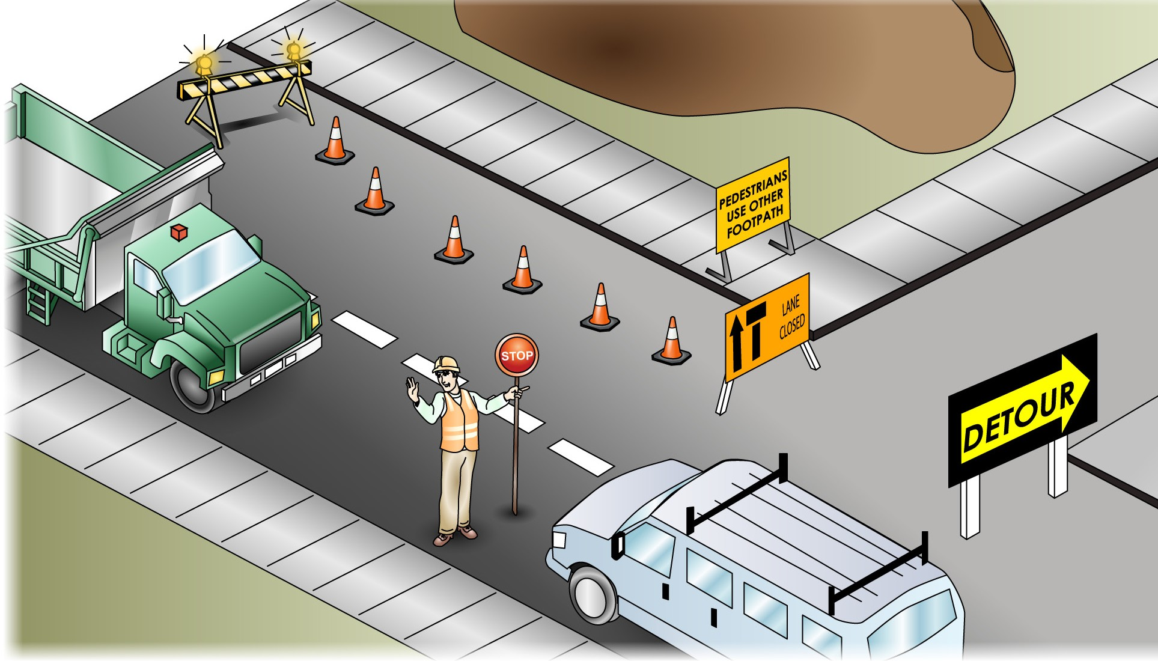
PC 1.5, 4.2
PLAN AND PREPARE FOR WORK
QUESTION 13
What can you do to control
traffic in and around
a worksite?
You can:
Use flashing lights
Close footpaths nearby
Put up barricades or witches hats
Close roads or one or two lanes of a road
Put up warning signs
Set up detours
Use a traffic control person (to control traffic on a public road, you must be a qualified traffic controller)

Slide 18
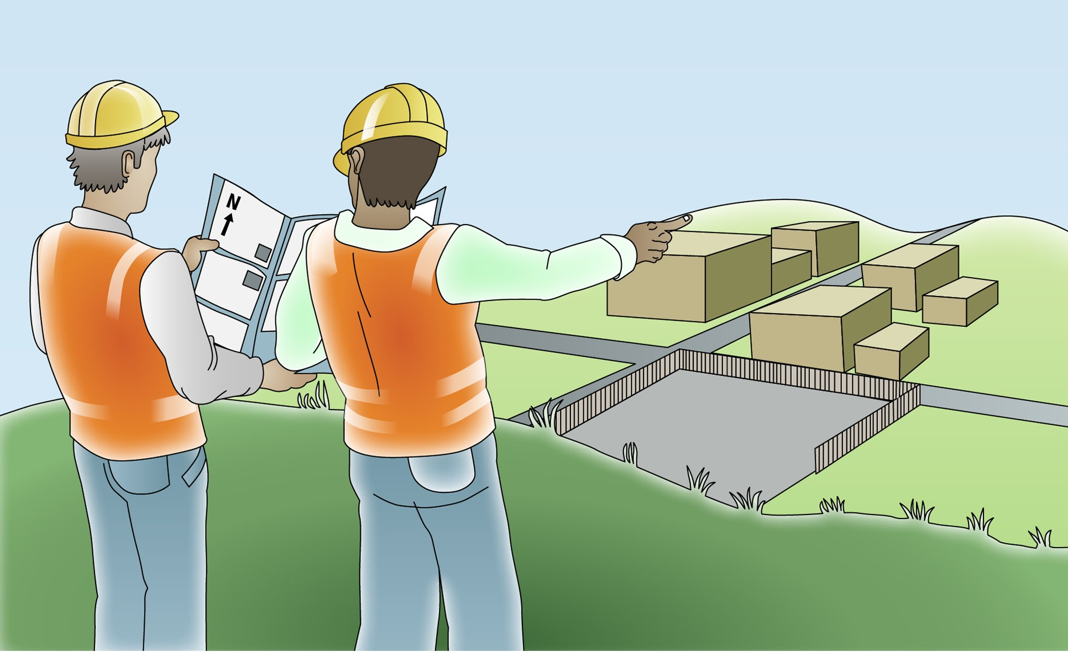
PC 1.8
PLAN AND PREPARE FOR WORK
Communication
You need to communicate with people on a work site before you start work. This is important to help you follow the rules and work procedures for the site.

Slide 19


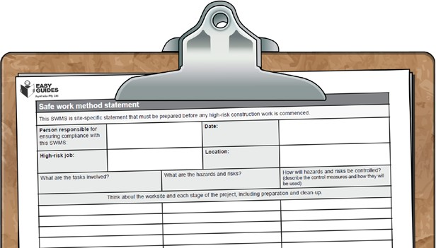
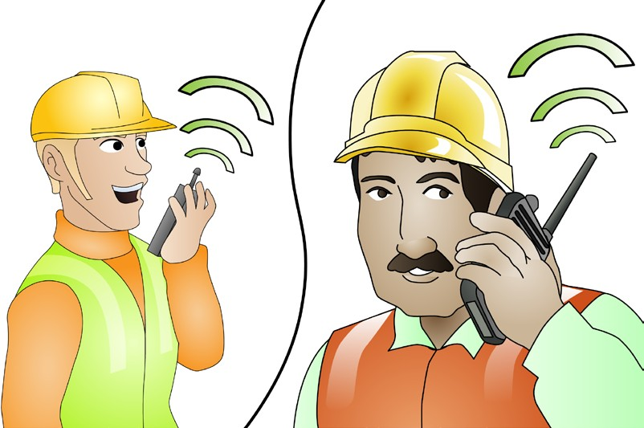
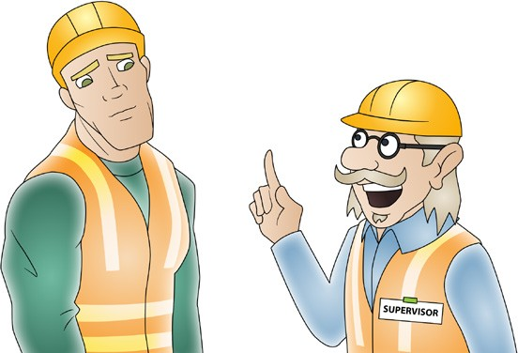
PC 1.8
PLAN AND PREPARE FOR WORK
Choosing the right communication method
When you work with a grader, you will often have to work with other people. Communication is important to make sure you get the job done. There are some different ways of communicating. Some of these are:
Written instructions For example, job plans and Safe Work Method Statements | Signs These can include warning signs | Hand signals
Asking questions and listening This is very important because it helps you understand how to do your job safely. | Two-way radios These are common on worksites. If you are using them, always make sure they are working properly before you start the job. Check the batteries have enough charge and check you have the right channel to communicate with your workmates.
You need to choose the best way to communicate on the job you are doing. Do this when you are planning the job.

Slide 20
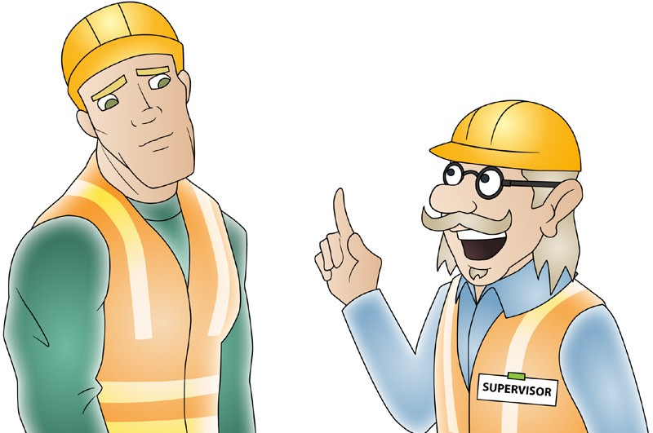
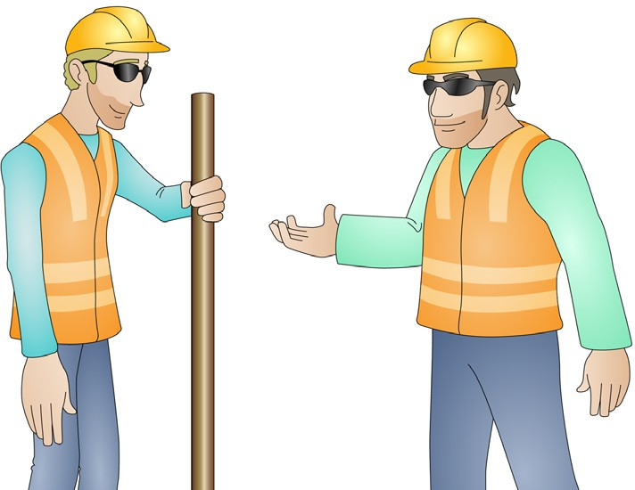
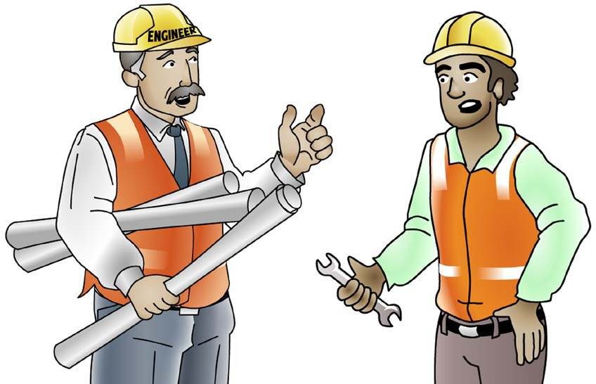
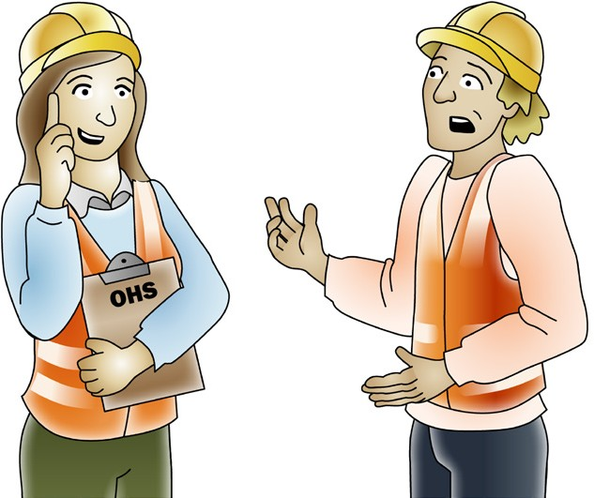
PC 1.8
PLAN AND PREPARE FOR WORK
Communicating with people
By communicating, you will also find out what hazards to watch for. This will help keep you and others to stay safe. Some of the
people you might talk to about site hazards are:
Your supervisor or team leader | Workmates
Site engineers | OHS representatives or safety officers

Slide 21
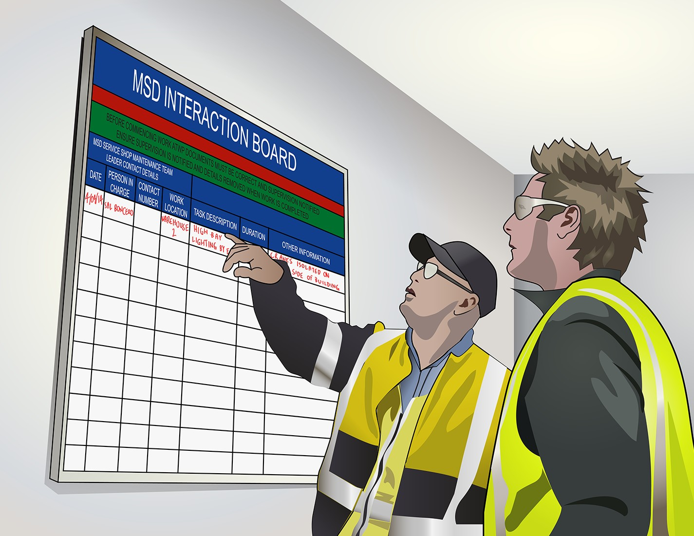
PC 1.8
PLAN AND PREPARE FOR WORK
Communication – shift handovers
Handovers happen anytime one worker (or team of workers) takes over the job from another. For example, when one shift ends and another one starts. During the handover, the worker, or workers, leaving the job must give details about the job to the worker, or workers, taking over.
Some of the things that should be talked about during a handover include:
Hazard and hazard controls; for this you might use the JSA or SWMS
Any problems with the job
How complete the job is; for this you might use the job plan
What part of the job has to be done next?
During handovers, keep in mind cultural differences.
For example, someone might have English as their second language. Take extra care to make sure they understand what you are telling them. Always follow the handover procedures for your worksite.

Slide 22
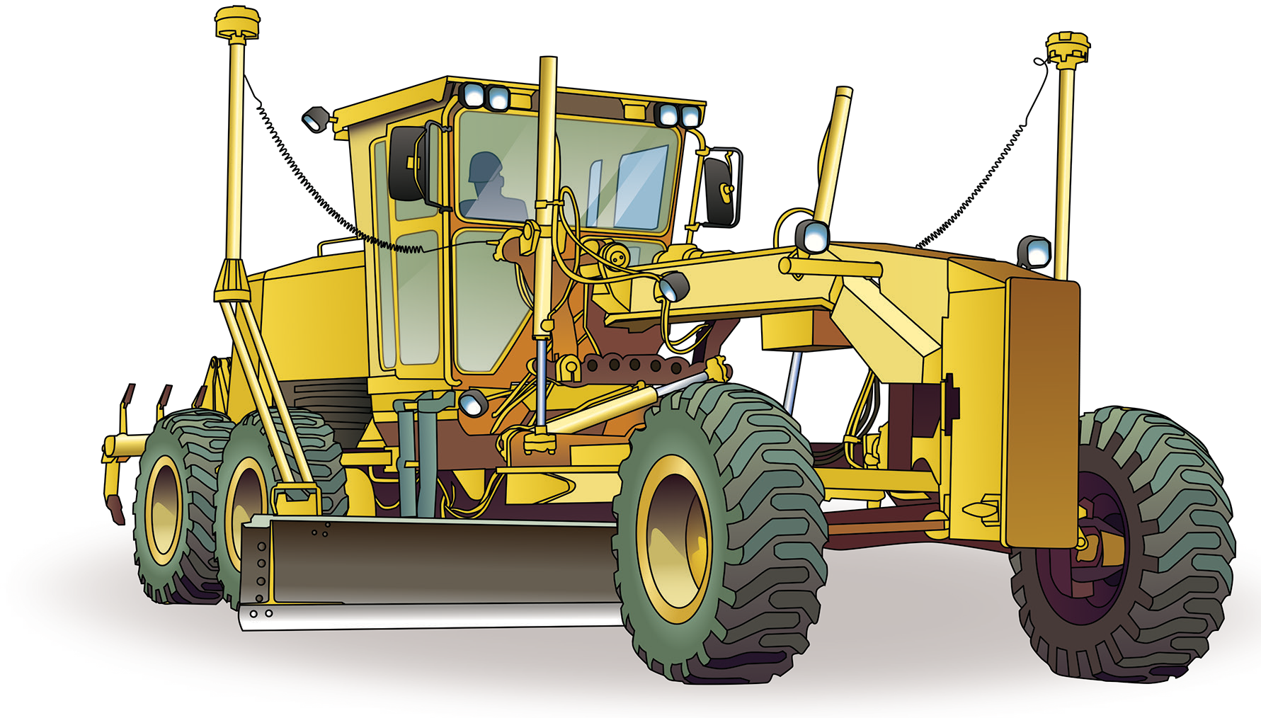
Identify and control hazards
Chapter 2

