Slide 1
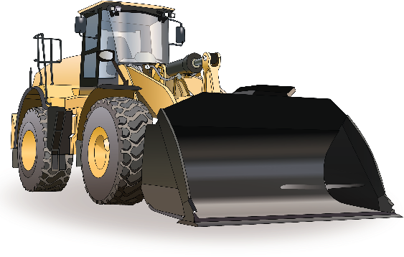
Learner Workbook PowerPoint
Front End Loader -
Wheeled
TICKET
Training support material for:
RIIMPO321F
Conduct civil construction wheeled front end loader operations

Slide 2
Contents
How to use this guide | 4
Acknowledgements | 6
Introduction to wheeled front end loader | 4
General information | 12
Chapter 1 Plan and prepare for work | 37
Chapter 2 Identify and control hazards | 47
Chapter 3 Check and monitor equipment | 73
Chapter 4 Operate/use equipment | 85
Chapter 5 Shut down and store equipment | 111
Chapter 6 Housekeeping | 117
Chapter 7 Record keeping | 123
Chapter 8 Relocate equipment | 125

Slide 3
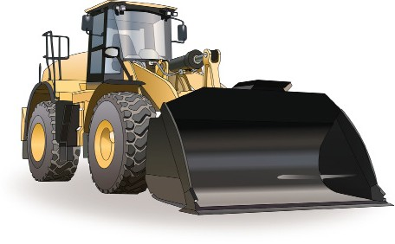
Introduction to Wheeled Front End Loader

Slide 4
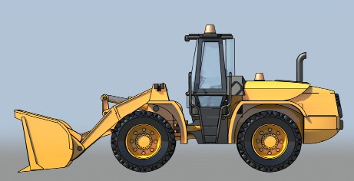
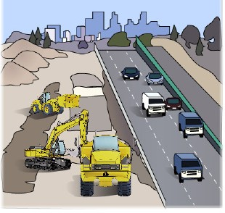
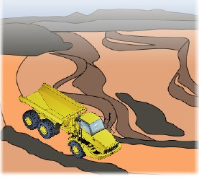
What do you use a front end loader for?
Agriculture – farming
Construction
Clean up
Moving dirt/rocks etc
Can use for lifting purposes
What industries do you use a front end loader in?
Civil construction • Mining
Notes
1. Question: What industries do you use a front end loader in? Answer:
Civil construction
Mining
.

Slide 5
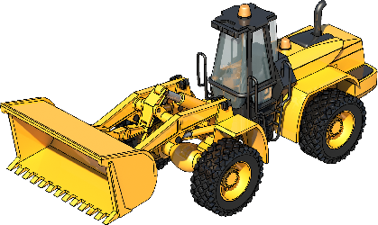
An example of a wheeled front end loader
A wheeled front end loader is a type of machine, that has a front-mounted square wide bucket connected to the end of two booms (arms) to scoop up loose material such as dirt, sand or gravel and move it from one place to another without pushing the material across the ground.
A wheeled front end loader is commonly used to move material from ground level and deposit it into an awaiting dump truck, stockpile or into an open trench excavation.
Front end loaders can also come in tracked models (refer RIIMPO322 Conduct civil construction tracked front end loader operations).
Dump cylinder
Tilt link
Bucket
Rear wheel
Lift cylinder
Lift arm
Front wheel
Notes
2. Question: What is a front end loader commonly used for?
Answer: A wheeled front end loader is commonly used to move material from ground level and deposit it into an awaiting dump truck, stockpile or into an open trench excavation.
.

Slide 6
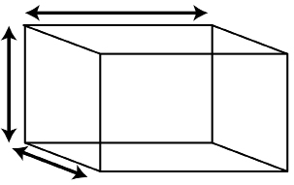
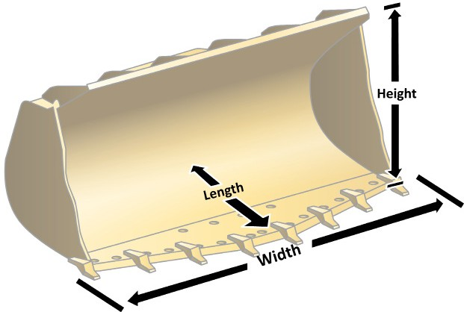
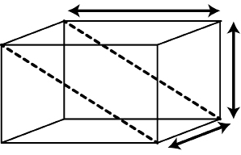
PC 1.2, 3.1
Calculations (continued)
How to find the cubic capacity of a bucket
The planner must know the capacity of the loader bucket to be able to plan the job. For example, a machine with a larger bucket will move more material than a smaller bucket in the same number of loads.
Length
Capacity = L × W × H
Height
2
Width
Cubic capacity of cube
= L × W × H
Length
Height Width
Cubic capacity of bucket
= L × W × H ÷ 2
Cubic capacity is ÷ 2 because of the shape of the bucket (a triangular prism)
Notes
33. Question: What is the formula for finding the cubic metre capacity of a bucket? Answer: Multiply lenth x width x height divided by divided by 2.
.

Slide 7
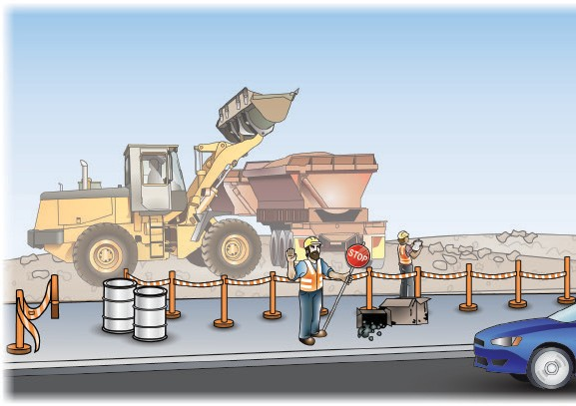
PC 1.5
QUESTION 30 | It tells you how to control vehicles in and around the worksite. It helps keep the site safe for
What does the traffic management plan (TMP) | you and others. You may require a traffic control licence in your state or territory.
tell you?
56. Question: What does the traffic management plan (TMP) tell you?
Answer: It tells you how to control vehicles in and around the worksite.
.

Slide 8
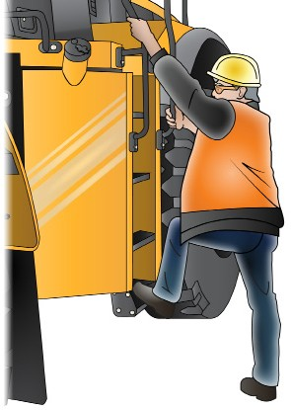
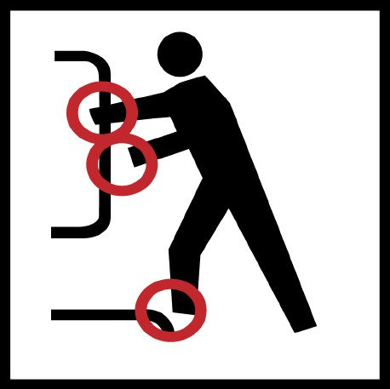
PC 2.4
QUESTION 34
How do you safely get in and out of the loader’s cabin?
Always use three (3) points of contact facing the machine.
For example, use two hands and one foot or two feet and one hand.
3 point contact (both hands and foot)
58. Question: How many points of contact should you have if you get in or out a front end loader? Answer: You should have 3 points of contact.
.

Slide 9
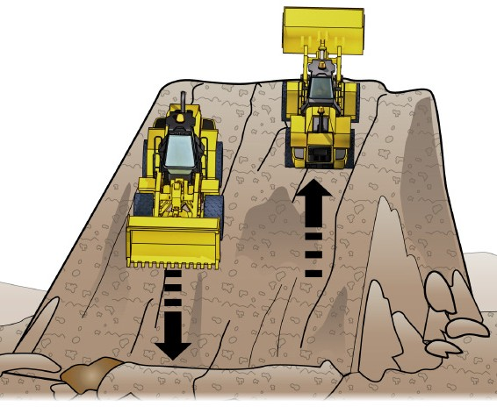
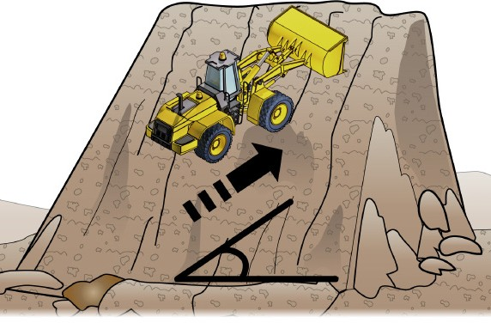
PC 2.3, 2.4
QUESTION 35
Which way should you travel when driving on sloping ground?
Go straight up or down the hill, not at an angle.
59. Question: Which way should you travel when driving on sloping ground?
Answer: Go straight up or down the hill, not at an angle.
.

Slide 10
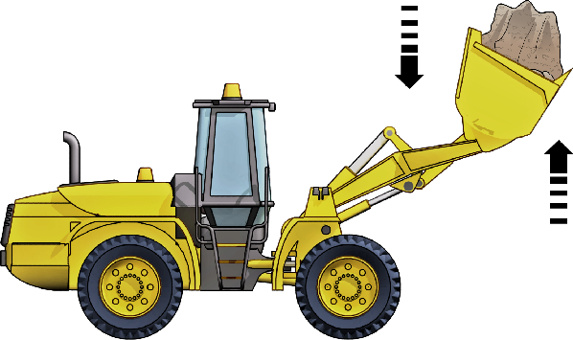
Operate/use equipment
Chapter 4

Slide 11
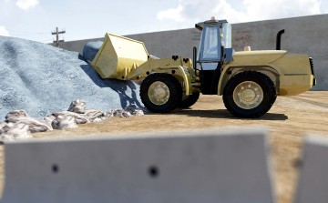
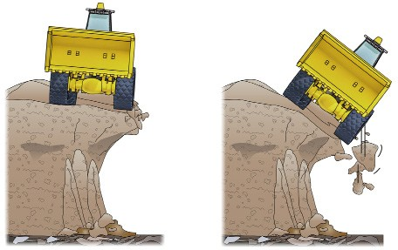
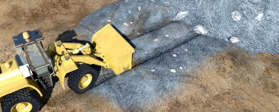
PC 2.3, 2.4
QUESTION 72
How do you safely fill
out a stockpile?
1. Start by filling the area closest to the back of the stockpile area. | 2. Try not to fill too close to the edge. The edge of the stockpile could give way.
3. Keep filling out the stockpile one row at a time.
Question: How do you safely fill out a stockpile?
Answer:
Start by filling out area closest to the back of the stockpile.
Try not to fill too close to the edge.
Keep filling out the stockpile one row at a time.

Slide 12
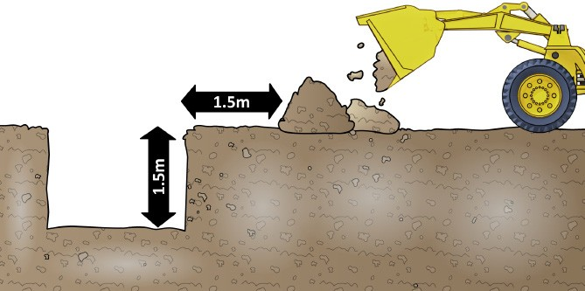
PC 2.4, 3.3
QUESTION 73
When dumping materials
near an excavation, how far away from the excavation must you dump the load?
As a general rule of thumb, you should dump the load the same distance away as the depth of the hole.
For example:
89. Question: How far should you dump the materials away from an excavation?
Answer:
As a general rule of thumb, you should dump the load the same distance away as the depth of the hole.
.

