Slide 1
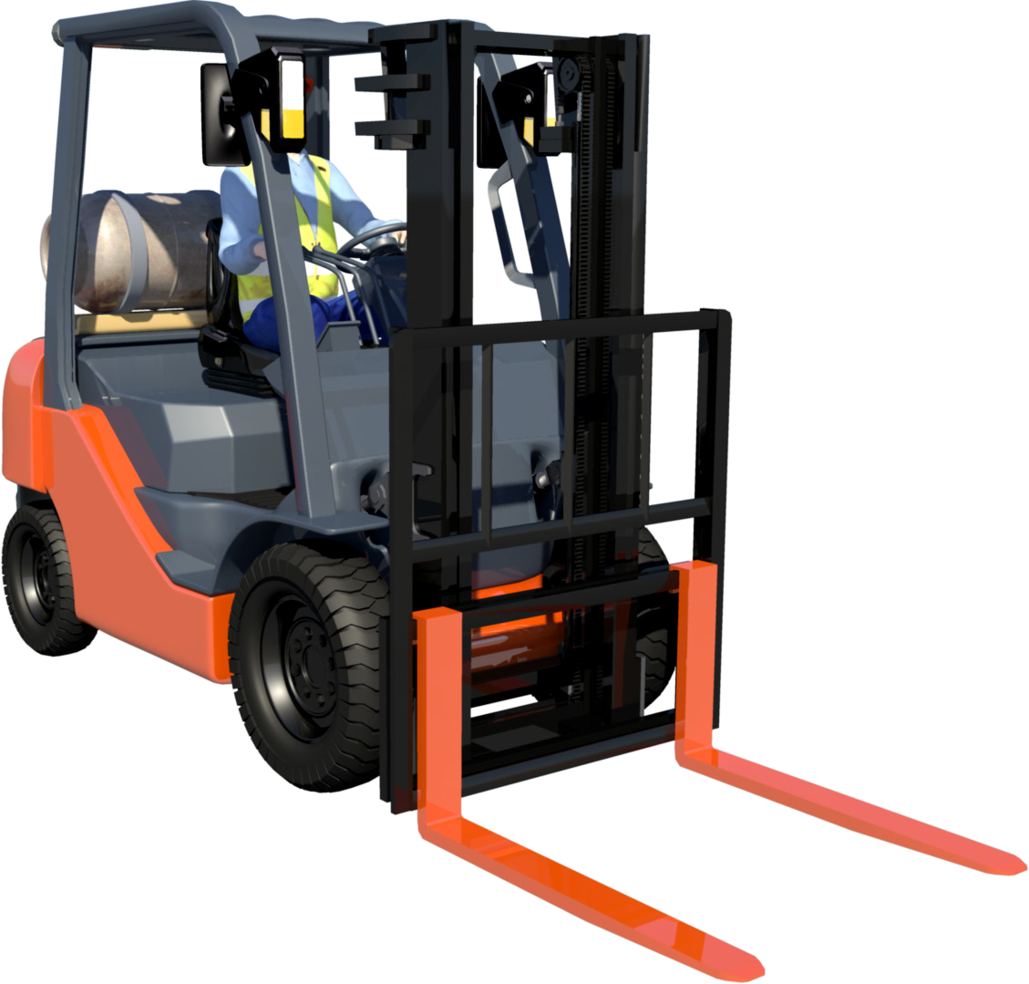

FORKLIFT TRUCK
SAFETY AND LICENCE GUIDE
Training support material for:
TLILIC0003
Licence to operate a forklift truck
Produced by:
Picture based. Plain English. Learning made easy.

Slide 2
CHAPTER 1
Plan work/task
2

Slide 3
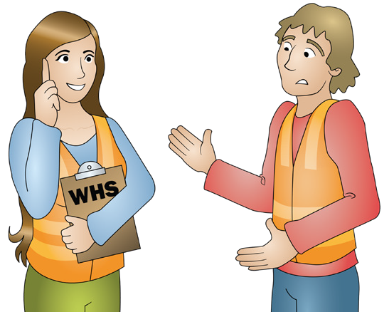
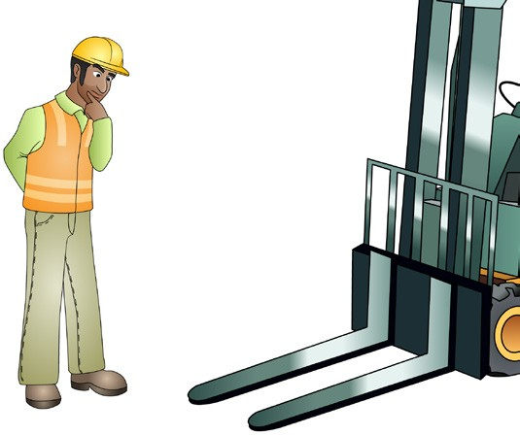
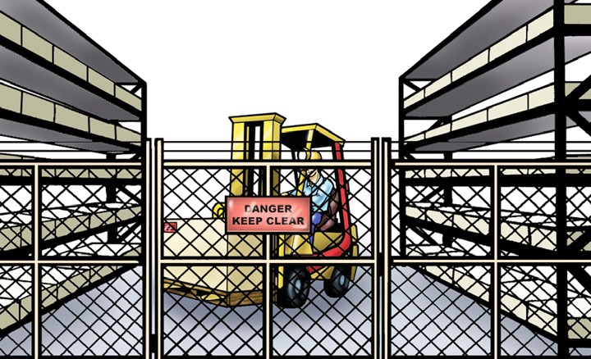
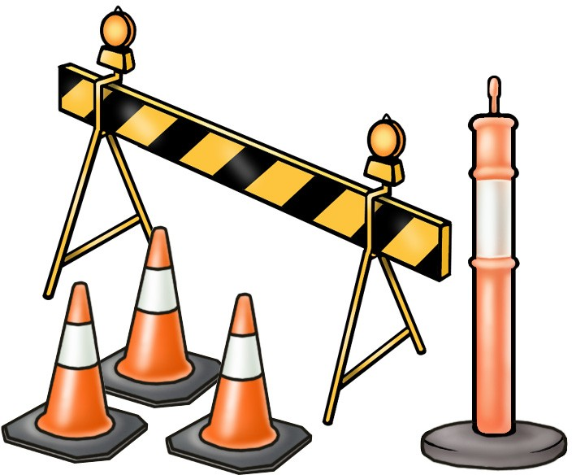
PC 1.1
CHAPTER 1 – PLAN WORK/TASK
Task requirements
Before operating the forklift you must know what the work task requires you to do.
Task requirements may be given to you verbally, in writing or electronically. They may be called work orders or something similar. If you are unclear about the requirements you should always speak to a supervisor or relevant person.
When the task requirements are known, you will be able to consider and plan for other important things such as:
Communication | Attachment method (for the load)
Where will you do the lift? What do you need to do? | What equipment do you need? Is the equipment available?
3

Slide 4
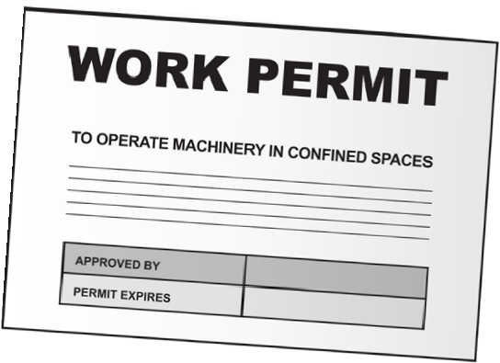
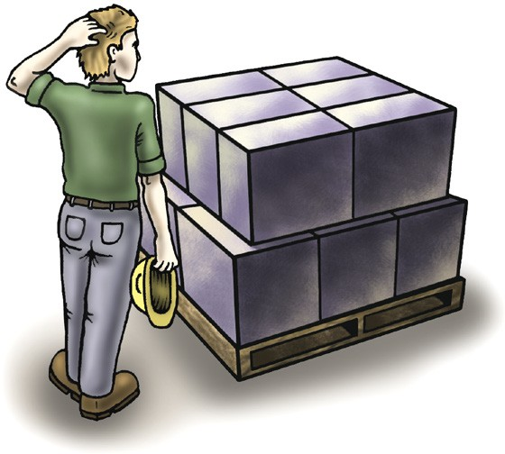

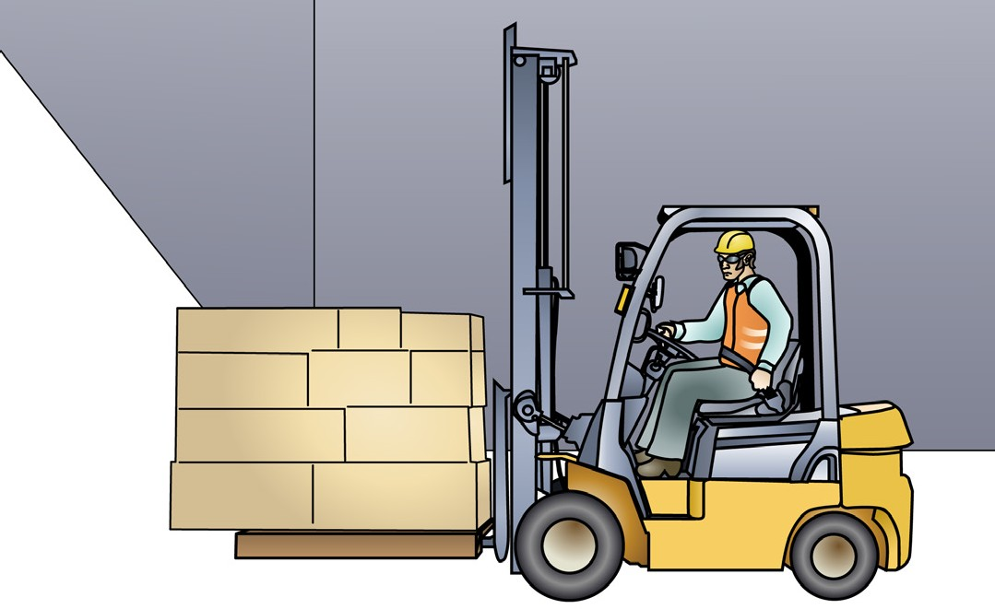
PC 1.1
CHAPTER 1 – PLAN WORK/TASK
Task requirements (continued)
Do you need any permits? | Does the load have any special features? | Does the forklift have enough capacity to carry the load? Check the data plate.
 |  | FORK TRUCK LOAD AND WARNING NOTICE Operators must be trained and authorised. Do not operate the lift truck if it is in need of repair. This capacity plate is not transferable and is invalidated by any change to specifications. MODEL: A12345A S/NO: 123456 MAST: 2W370 MAST/CARRIAGE TILT DEGREES: TYRE PRESSURES KPA: FORWARD/DOWN: 6 FRONT: 686 BACK/UP: 12 REAR: 686 DRIVE WHEELS: SINGLE TYRE TYPE: PNEUMATIC TRACTION BATTERY WEIGHT (KG) MIN: N.A. MAX: N.A. VOLT: N.A. TARE WEIGHT WITHOUT TRACTION BATTERY (KG): 2745 HIRE 921 RATED CAPACITIES - SIDESHIFT & LOAD IN CENTRE POSITION LOAD CENTRE LIFT/LOAD HEIGHT MAST VERTICAL MAST FORWARD (MM) (MM) CAPACITY(KG) CAPACITY (KG) SIDESHIFT 600 3700 1575 900 PLATE I.D.: 12345 DEALER: EASY GUIDES PTY LTD
Blind spots caused by: Corners The mast The load.
4

Slide 5

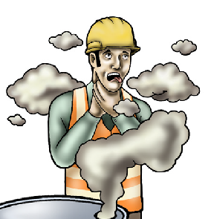
PC 2.1
CHAPTER 1 – PLAN WORK/TASK
Hazard versus risk
What is the difference?
Different hazards and risks emerge constantly—sometimes instantly.
Hazard
A hazard is any thing or any situation which could injure or harm you.
In other words, it is anything that can hurt you.
Risk
A risk is the chance of a hazard causing harm such as injury, illness or even death.
In other words, how likely it is that somebody or something may be harmed by the hazard.
5

Slide 6
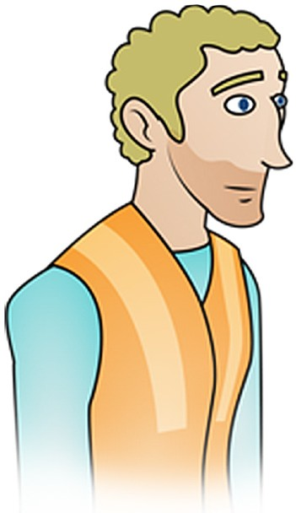
PC 1.1
CHAPTER 1 – PLAN WORK/TASK
Site inspection
There are a lot of hazards and risks on work sites that you need to be aware of. Hazards can cause accidents, injuries and even death.
Hazards and hazard controls need to be considered when planning work. The work site should be inspected by looking for hazards and risks that exist:
Above eye level (in the air)
At eye level
Below eye level (on the ground).
You should always follow workplace procedures for conducting site inspections.
Above eye level (in the air)
At eye level
Below eye level (on the ground)
6

Slide 7
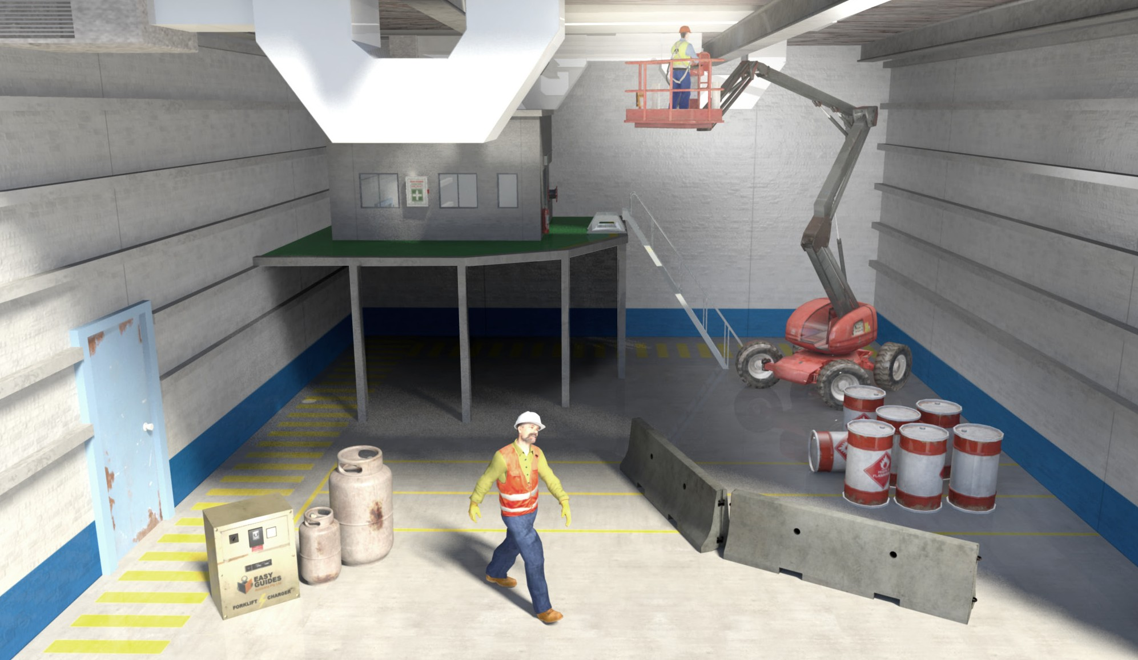
PC 1.1
CHAPTER 1 – PLAN WORK/TASK
Hazards – indoors
Before you begin work, you must be aware of hazards. A hazard is any thing or situation with the potential to cause injury or harm. In other words it is any ‘thing’ or ‘action’ that can hurt you or other workers.
If you are working indoors you must think about things like:
Other equipment
working in the area
Overhead services lines
Possible non weight
bearing surfaces
Areas with poor lighting
Dangerous materials in the work area
Pedestrians
Doorways
Obstructions
Ground bearing pressure
Blind corners
surface conditions
7

Slide 8
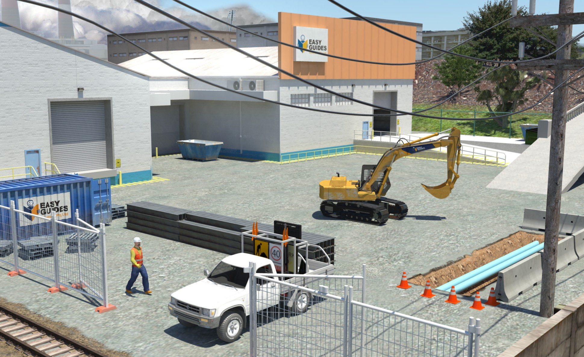
PC 1.1
CHAPTER 1 – PLAN WORK/TASK
Hazards – outdoors
If you are working outdoors there may be hazards such as:
Poor weather conditions and wind
Powerlines or overhead service lines
Trees
Surrounding structures like buildings
Loading docks
Ramps or slopes
Bridges
Other plant and equipment
ground conditions,
eg. wet surfaces
Pedestrians and
workers
Underground services
Railway crossings and other hazards unique to your workplace
Vehicle traffic
8

Slide 9
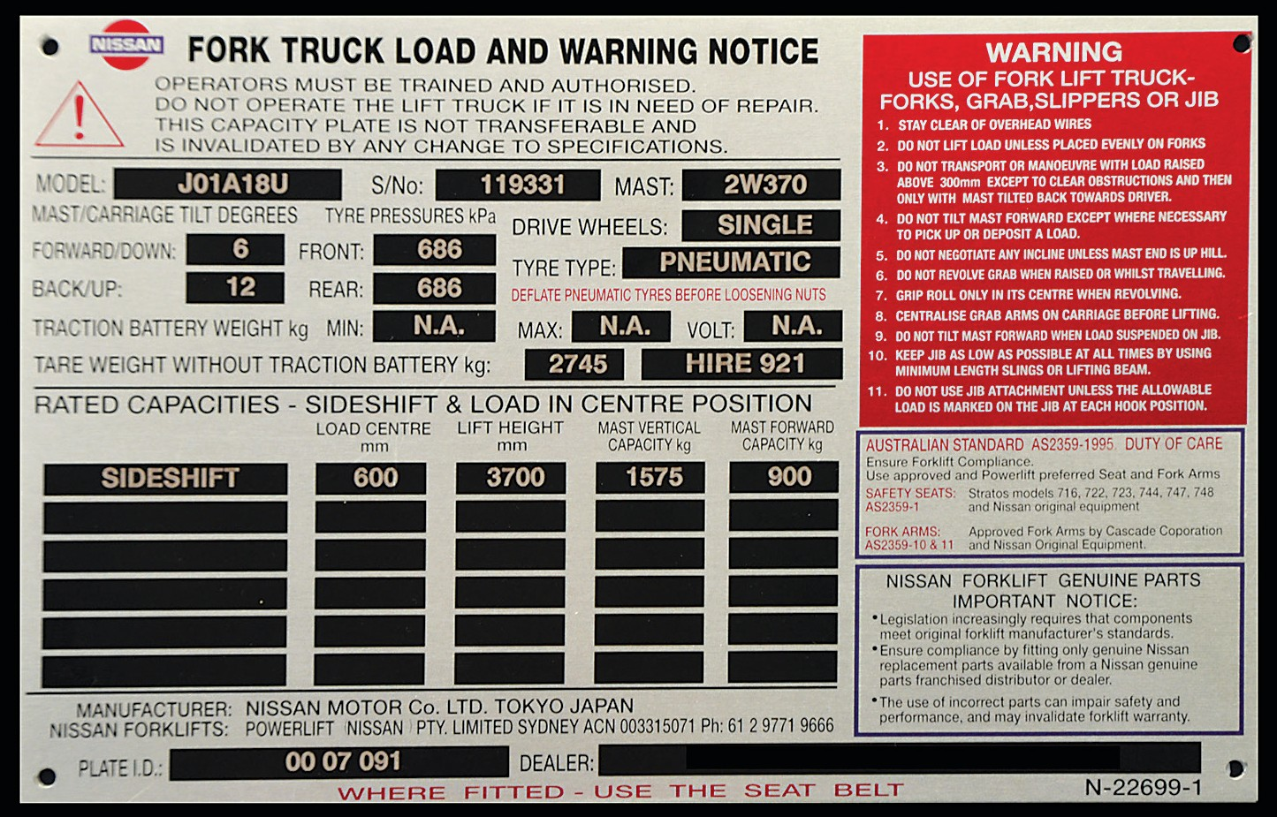
PC 1.3
CHAPTER 1 – PLAN WORK/TASK
Suitability of forklift and attachment
Every forklift has a data plate. You must check the data plate before using the forklift. The data plate tells you important things about the forklift. This includes telling you how much the forklift can safely lift and what attachments you can use.
The data plate helps you work out if the forklift and attachment are suitable for the load.
Make and model of the forklift
Serial number
Attachment type
Forklift weight
Load centre distance
Maximum lift height
Rated capacity – both vertical and tilt
9

Slide 10



PC 1.3
CHAPTER 1 – PLAN WORK/TASK
Checking the rated capacity
Check the data plate to find the rated capacity.
The forklift with the following data plate attached has the rated capacity of:
1575 kg with a sideshift attachment lifting a load to a 3700 mm height with vertical mast and a 600 mm load centre
OR
900 kg with a sideshift attachment lifting a load to a 3700 mm height with forward tilted mast and a
600 mm load centre
FORK TRUCK LOAD AND WARNING NOTICE
Operators must be trained and authorised. Do not operate the lift truck if it is in need of repair. This capacity plate is not transferable and is invalidated by any change to specifications.
MODEL:
A12345A
S/NO: MAST:
123456
2W370
MAST/CARRIAGE TILT DEGREES:
TYRE PRESSURES KPA:
FORWARD/DOWN: BACK/UP:
DRIVE WHEELS:
6
FRONT: REAR:
 | 686
 | 686
 | PNEUMATIC
MAX: |  | N.A. | VO
2745
12
SINGLE
TYRE TYPE:
TRACTION BATTERY WEIGHT (KG) MIN:
N.A.
LT:
N.A.
TARE WEIGHT WITHOUT TRACTION BATTERY (KG):
HIRE 921
RATED CAPACITIES - SIDESHIFT & LOAD IN CENTRE POSITION
LOAD CENTRE LIFT/LOAD HEIGHT MAST VERTICAL (MM) (MM) CAPACITY (KG)
MAST FORWARD CAPACITY (KG)
SIDESHIFT | 600 | 3700 | 1575 | 900
PLATE I.D.:
12345
DEALER:
EASY GUIDES PTY LTD
10

Slide 11
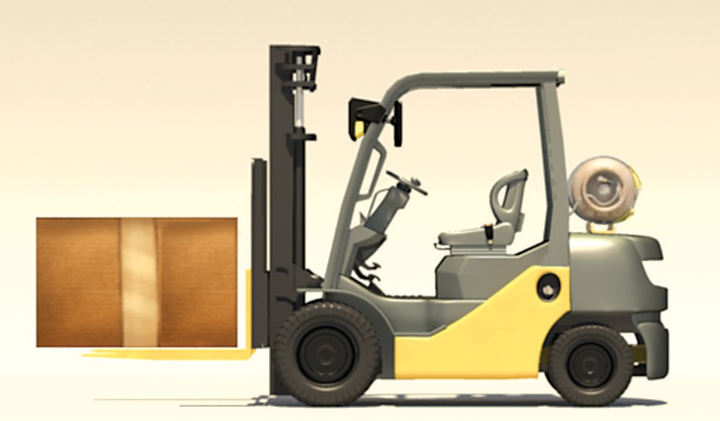
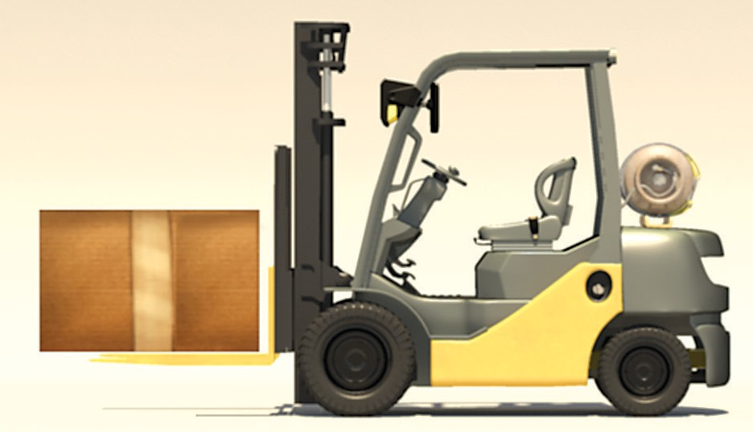
PC 1.3
CHAPTER 1 – PLAN WORK/TASK
Load centre distance
Load centre distance is the distance measured from the vertical face of the forks to the centre of
gravity of the load.
Vertical face
The load centre distance affects how much weight
the forklift can lift.
The load centre distance will be marked on your
forklift’s data plate.
Load centre distance
For example, this forklift is lifting a 1500 kg load.
The forklift rated capacity is 1575 kg at a 600 mm load centre distance.
It’s okay to lift this weight.
But the load centre distance must be checked to make sure it is 600 mm or less first. 600mm is the most common load centre distance in millimetres.
600
mm
1500 kg
11

Slide 12


PC 1.3
CHAPTER 1 – PLAN WORK/TASK
Calculating the load centre distance
Measure from the vertical face of the forks to the front of the load.
For this load the measurement is 1 metre (or 1000 mm).
Halve this measurement and you get the load centre distance. With this load it’s 500 mm.
This forklift can safely lift and carry this load if:
The load centre distance on the data plate is greater than 500 mm
The weight of the load is within capacity
The load is against the face of the forks.
1000 mm
500 mm
But watch what happens when we change the load
centre distance of the same 1500 kg load.
The distance from the vertical face of the forks to the front of the load is now one and a half metres (or 1500 mm).
This makes the load centre distance 750 mm. The maximum load centre distance for this forklift is 600 mm.
This forklift cannot safely lift this load.
The forklift would be unstable and the lifting capacity reduced. This might cause it to tip over.
 | 1500 mm
750 mm
12

Slide 13
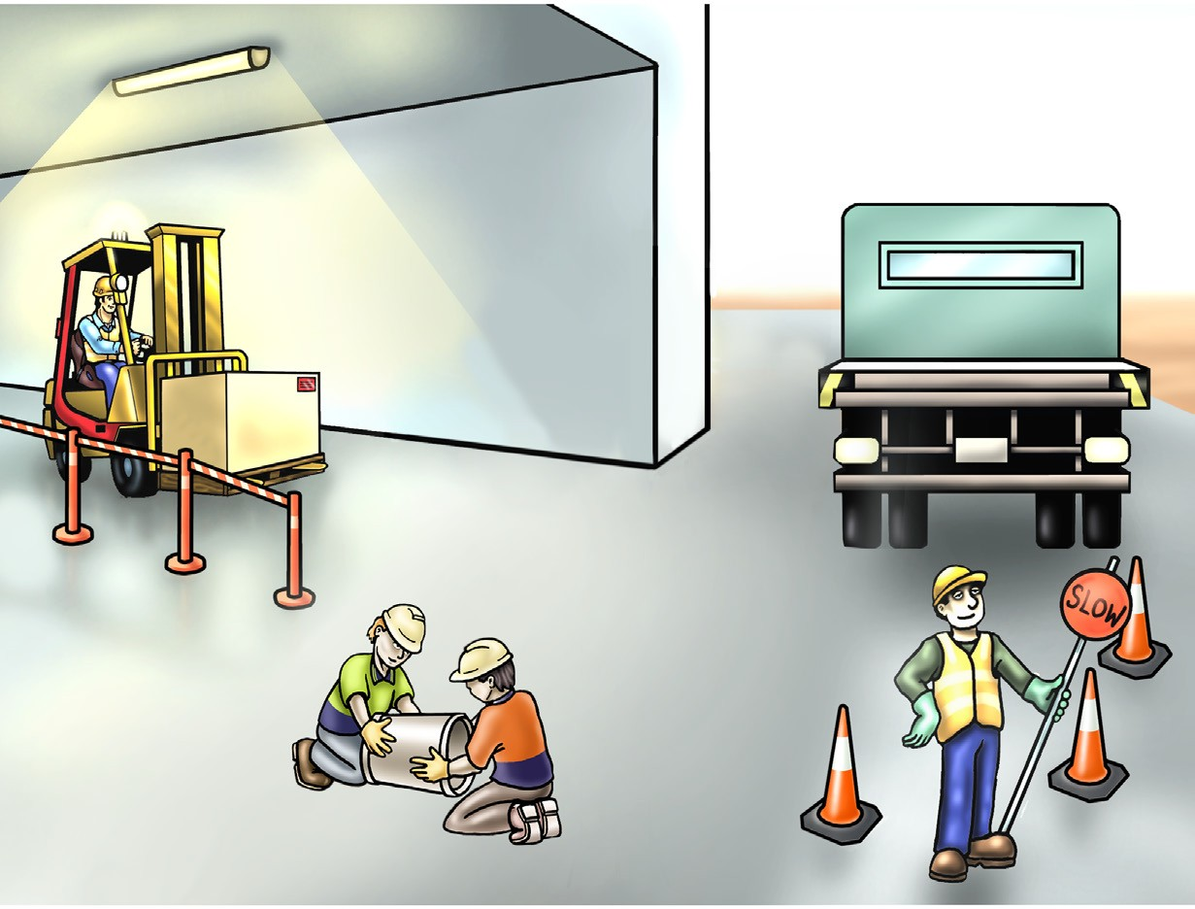
PC 1.4
CHAPTER 1 – PLAN WORK/TASK
Path of travel
Inspecting the work area also helps you to determine the most appropriate pathways for operating the forklift and for moving and placing loads.
When planning your path of travel you should consider some of the following things:
Is there enough ventilation and fresh air?
When should you sound the horn?
Will you need to reverse?
Are there any ramps or slopes?
Where will you have to stop?
Where should you slow down?
What is the speed limit?
Are there places the forklift can’t go?
Where will there be pedestrians?
Is there a suitable area to place the load?
13

Slide 14

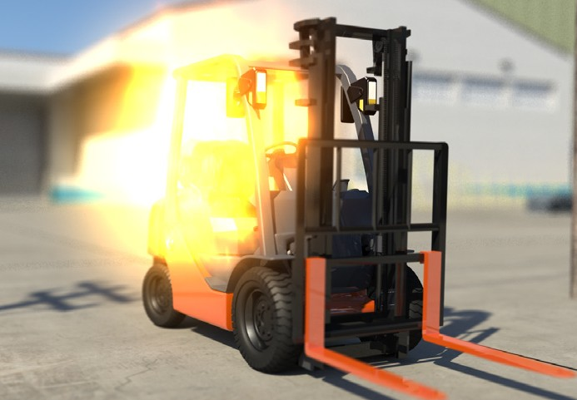

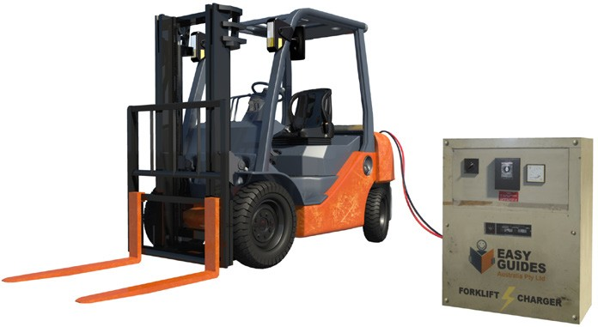
PC 1.5
CHAPTER 1 – PLAN WORK/TASK
Hazard control (continued)
Refuelling and charging
Forklifts can be powered by either a combustion engine fuelled by gas, diesel or petrol or an electric motor run by a battery. No matter which type you operate you will need to refuel or recharge the power source at some stage.
There are hazards you need to consider when refuelling or recharging your forklift and
measures you can take to control the hazards.
Refuelling
Refer to workplace policies and procedures and manufacturer’s instructions for refuelling
Wear the appropriate personal protective equipment
There is a risk of fuel igniting and catching fire if you leave the forklift running. Always turn the forklift off while you are refuelling.
Recharging
Refer to workplace policies and procedures and manufacturer’s instructions for recharging
Wear the appropriate personal protective equipment
Make sure the battery charger is switched off before
connecting or disconnecting the battery
When charging, batteries give off explosive gasses. Always charge batteries in an area with good air flow to prevent the build-up of gasses.
14

Slide 15
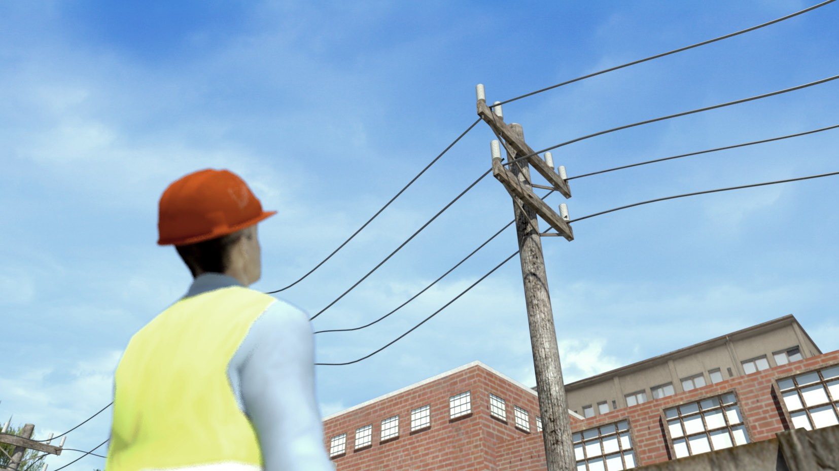
PC 1.5
CHAPTER 1 – PLAN WORK/TASK
Hazard control (continued)
Overhead powerlines
Always check for overhead powerlines. Make sure your forklift and anything you are carrying does not come into contact with powerlines.
There is a National Australian Standard number AS 2550.1 – which outlines the distances you need to work from powerlines. If you need to know the voltage of powerlines, you should contact the local power supply company.
Note:
Some states have their own rules.
You must always check the distances for your state or territory as they may be different.
15

Slide 16
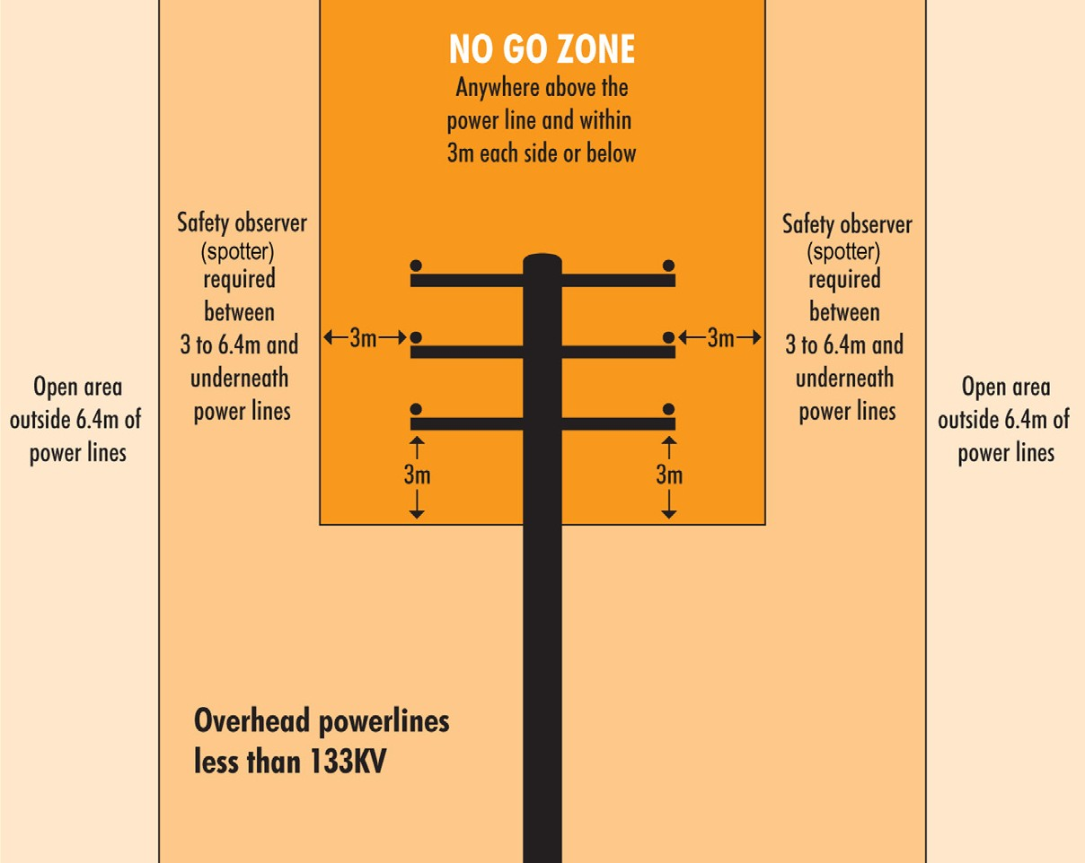
PC 1.5
CHAPTER 1 – PLAN WORK/TASK
Overhead powerlines on poles (National Standard)
These are usually ‘Low Voltage’. This means powerlines of less than 133KV.
The information below is taken from the National Standard.
Always check the distances for your state or territory, as they may be different.
AS2550.1
Powerline distances
Powerline distances “Look up and live!”
Always check overhead for powerlines and make sure you and any equipment or materials you are using do not come into contact with them.
The safe operating distances for working near powerlines are outlined on the following pages.
A spotter is required if you are working between
3 to 6.4 metres from distribution lines on poles.
The term ‘spotter’ is defined as a safety observer who is a person competent for the sole task of observing and warning against unsafe approach to overhead powerlines and other electrical apparatus.
In some states or territories a spotter must be
qualified.
Above is the National Standard. Always check the distances for your state or territory, as they may be different.
16

