Slide 1
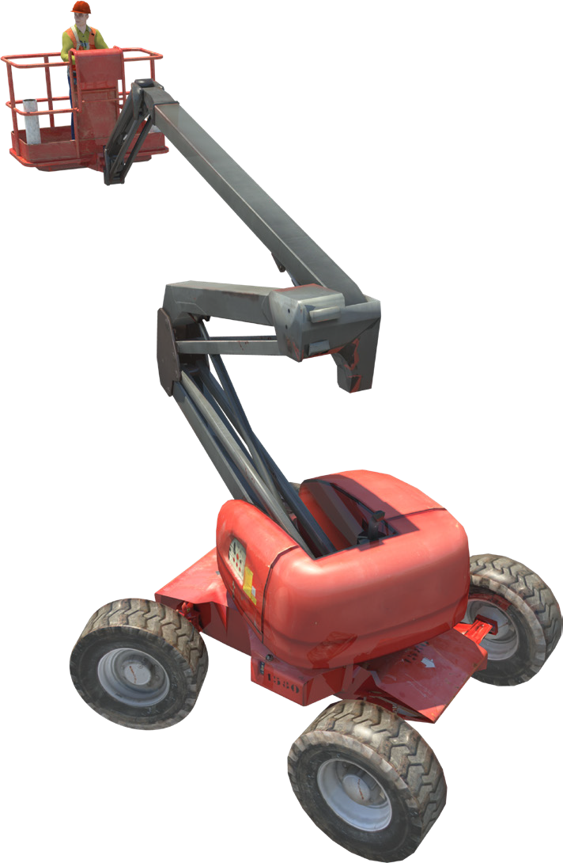

ELEVATING WORK PLATFORM SAFETY & LICENCE GUIDE
Training support material for:
TLILIC0005
Licence to operate a boom-type elevating work platform
(boom length 11 metres or more)
Produced by:

Slide 2
contents
About this guide
Acknowledgements
Introduction to elevating work platforms High risk licensing and the law
4
7
9
11
19
49
93
127
Element 1
Element 2
Element 3
Element 4
Plan work /task Prepare for work / task Perform work / task Pack up

Slide 3


About this guide
ABOUT THIS GUIDE
The guide is a follow-up to your formal training.
Like all Easy Guides, this one uses plain words and pictures to help you remember what you learned in your formal training. So you can pass your test — and get your licence.
Good luck from the team at Easy Guides Australia Pty Ltd.
Note: This guide does not use the same wording as the Safe Work Australia Assessment Instrument.
Easy Guides training materials have been developed around Language – Literacy – Numeracy (LLN) principles.
How to use this guide
Use it in hard copy
This guide helps you prepare for the test at the end of the course. Study it carefully, and then ask a friend to help you practise. They can ask you each question, and then you give the answer. Writing down the answers can also help you remember them. This also helps you see what you still need to learn. Good luck!
Or use it on screen
This guide also comes in a multimedia presentation, so you can use it on your computer or screen. The multimedia presentation
is just like the guide and has exactly the same questions with the same short words and easy-to-understand pictures.
Trainers can use the multimedia presentation in class to help learners discuss questions. The trainer first shows the question and asks if anyone knows the answer. Next, the trainer will show the answer and discuss it with the learners.
3

Slide 4
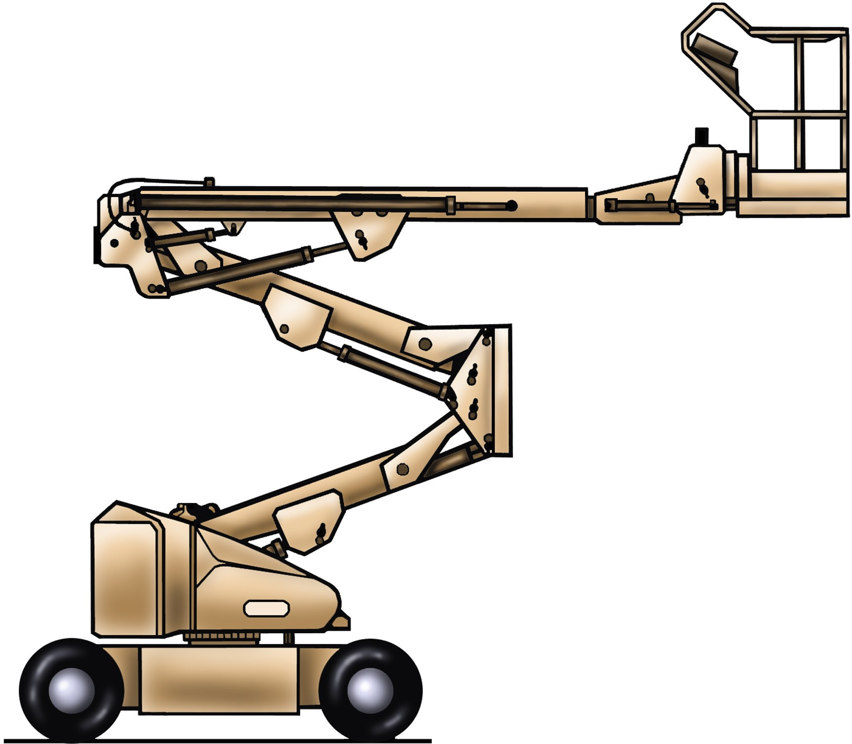
Parts of a boom-type elevating work platform
INTRODUCTION TO ELEVATING WORK PLATFORMS
Level slave cylinder
Upper boom
Level master cylinder
Hinge
Basket/platform
Upper boom lift cylinder
Intermediate boom cylinder
Telescopic cylinder
Counter weight
Lower boom
Lower boom lift cylinder
Chassis
Slew ring
4

Slide 5
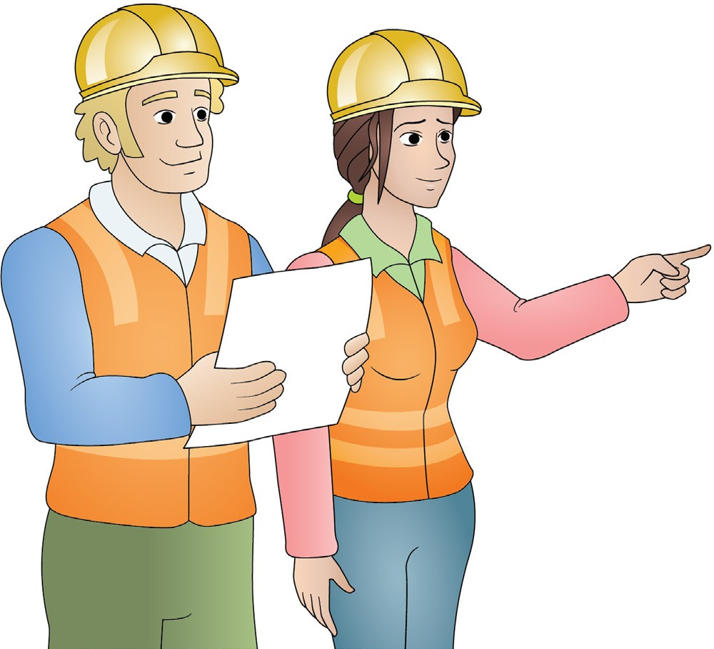
Plan work / task
Element 1

Slide 6
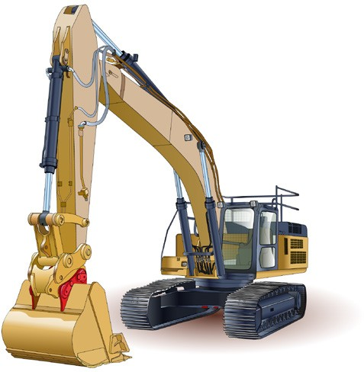
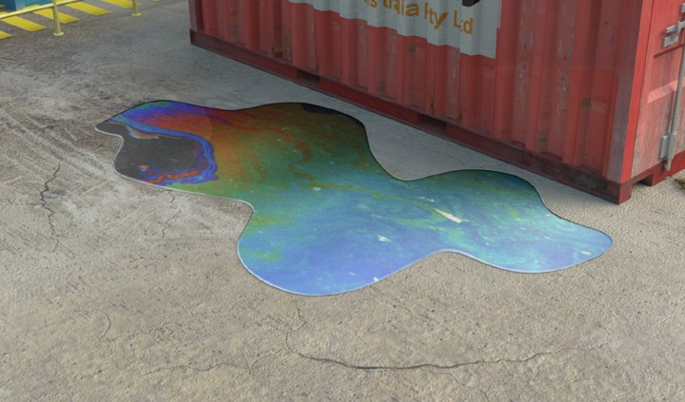
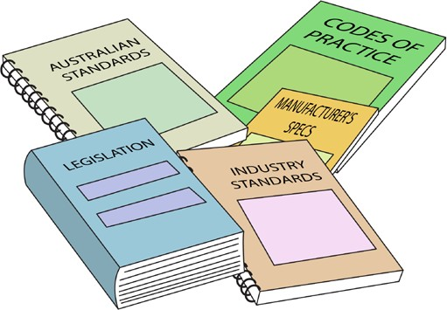

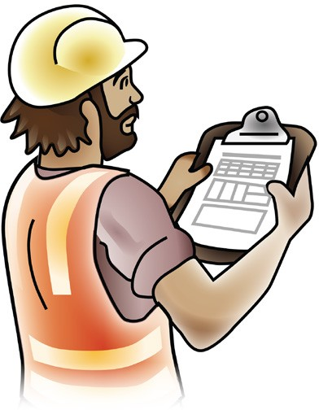
Work plan
PC 1.1 PLAN WORK / TASK
PLAN WORK
A work plan, sometimes called a job plan, helps to organise the way the job is carried out. Each worksite will have its own procedures for developing the work plan. When a work plan is developed it must take into account things like:
What plant or equipment is needed. | What hazards there are, and how these will be controlled. |  | Laws, Australian standards, or manufacturer’s instructions which must be followed.
Worksite rules and procedures. |  | The order of the tasks which need to be done.

Slide 7
Work plan
PC 1.1 PLAN WORK / TASK
PLAN WORK
A work plan, sometimes called a job plan, helps to organise the way the job is carried out. Each worksite will have its own procedures for developing the work plan. When a work plan is developed it must take into account things like:
What plant or equipment is needed. | What hazards there are, and how these will be controlled. |  | Laws, Australian standards, or manufacturer’s instructions which must be followed.
Worksite rules and procedures. |  | The order of the tasks which need to be done.

Slide 8

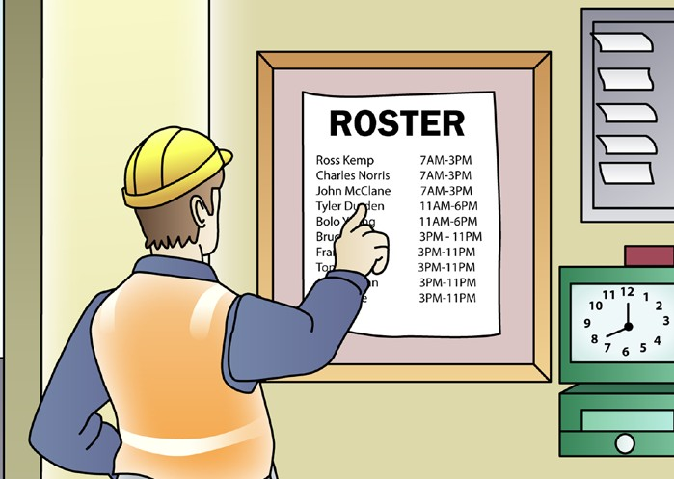
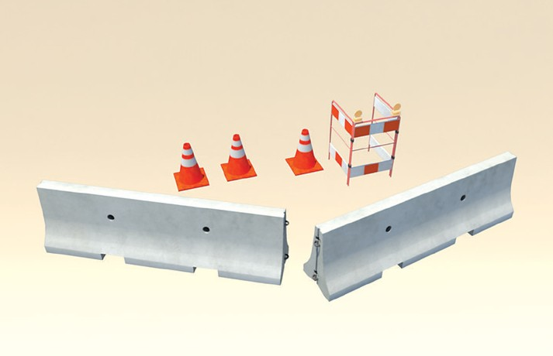
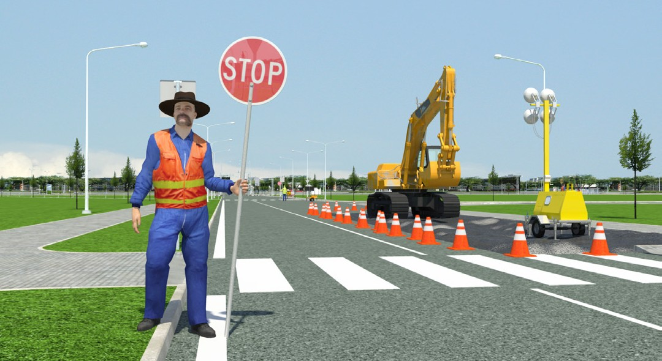
Job order
PC 1.1 PLAN WORK / TASK
PLAN WORK
Work plans also help put the tasks of a job in the order in which they need to be done. This helps to work out:
When certain plant or equipment will be on the site. | What staff are needed to do certain tasks at certain times. | The types of hazard controls you will need to set up before a particular type of work starts.
For example, the work plan might tell you that, in two days, traffic controllers will be needed. This way, you can be ready to do your job alongside the traffic controllers.
You should discuss the job plan with your supervisor and workmates. Talking and asking questions helps everyone understand what they have to do. It also helps everyone to understand the hazards involved in the job and how these hazards will be controlled.

Slide 9
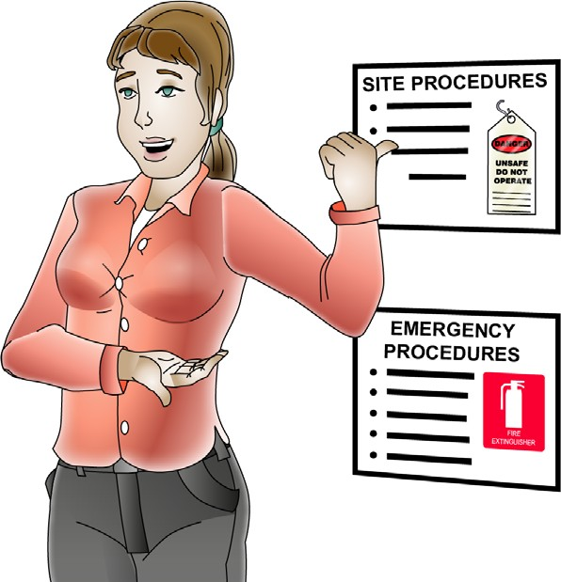
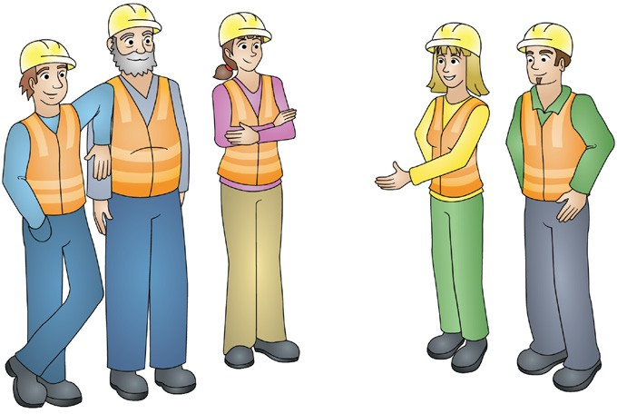
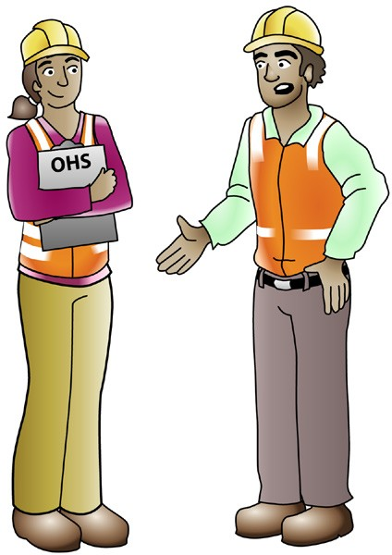
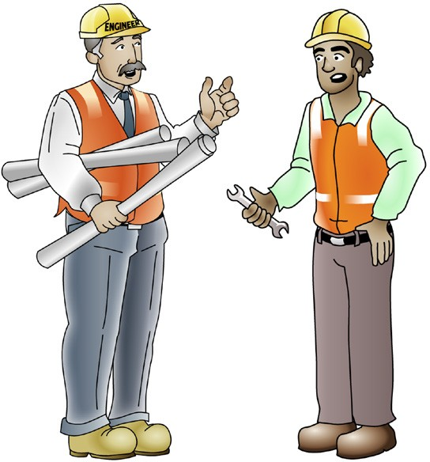
PC 1.1, 1.5,
PLAN WORK / TASK
QUESTION 9
Who might you talk to about workplace hazards before you start the job?
Your supervisor or manager | Workmates
WHS/OHS representatives or safety officer | Workplace engineers

Slide 10
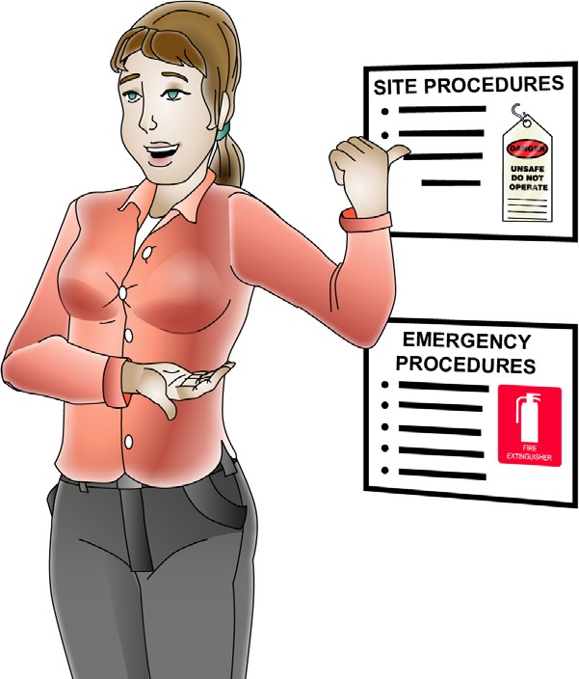
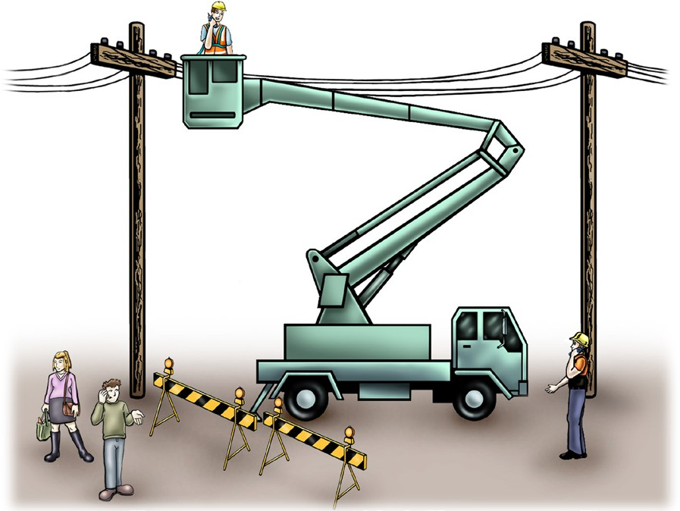
PC 1.7, 1.5
PLAN WORK / TASK
QUESTION 10 You need to communicate with people (such as workplace health and safety representatives) about hazards before you start work. Why do you think it is important to do this? | So you are able to identify hazards and know which workplace policies and procedures need to be followed.
QUESTION 11 You are using an elevating work platform (EWP) near uninsulated powerlines. Working near powerlines is very dangerous and can kill you. There are important rules that must be followed. What are the minimum safe distance rules you must follow? | The minimum safe distance rules you must follow can be different for each state/territory. A spotter may be used in some states to help you work closer to uninsulated powerlines. Uninsulated means the powerlines have no cover. If you touch them you could be hurt or killed. Spotter

Slide 11
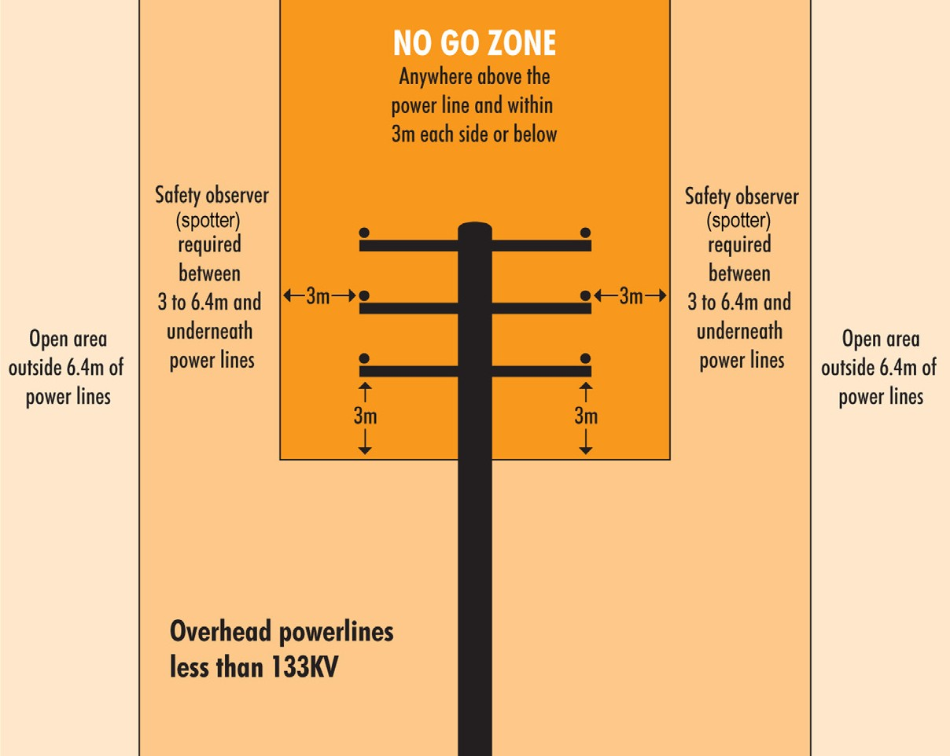
PC 1.5
PLAN WORK
Overhead powerlines on poles (National Standard)
These are usually ‘Low Voltage’. This means powerlines of less than 133KV.
The information below is taken from the National Standard.
Always check the distances for your state or territory, as they may be different.
AS2550.1
Powerline distances
Powerline distances “Look up and live!”
Always check overhead for powerlines and make sure you and any equipment or materials you are using do not come into contact with them.
The safe operating distances for working near powerlines are outlined on the following pages.
A spotter is required if you are working between
3 to 6.4 metres from distribution lines on poles.
The term ‘spotter’ is defined as a safety observer who is a person competent for the sole task of observing and warning against unsafe approach to overhead powerlines and other electrical apparatus.
In some states or territories a spotter must be qualified.

Slide 12
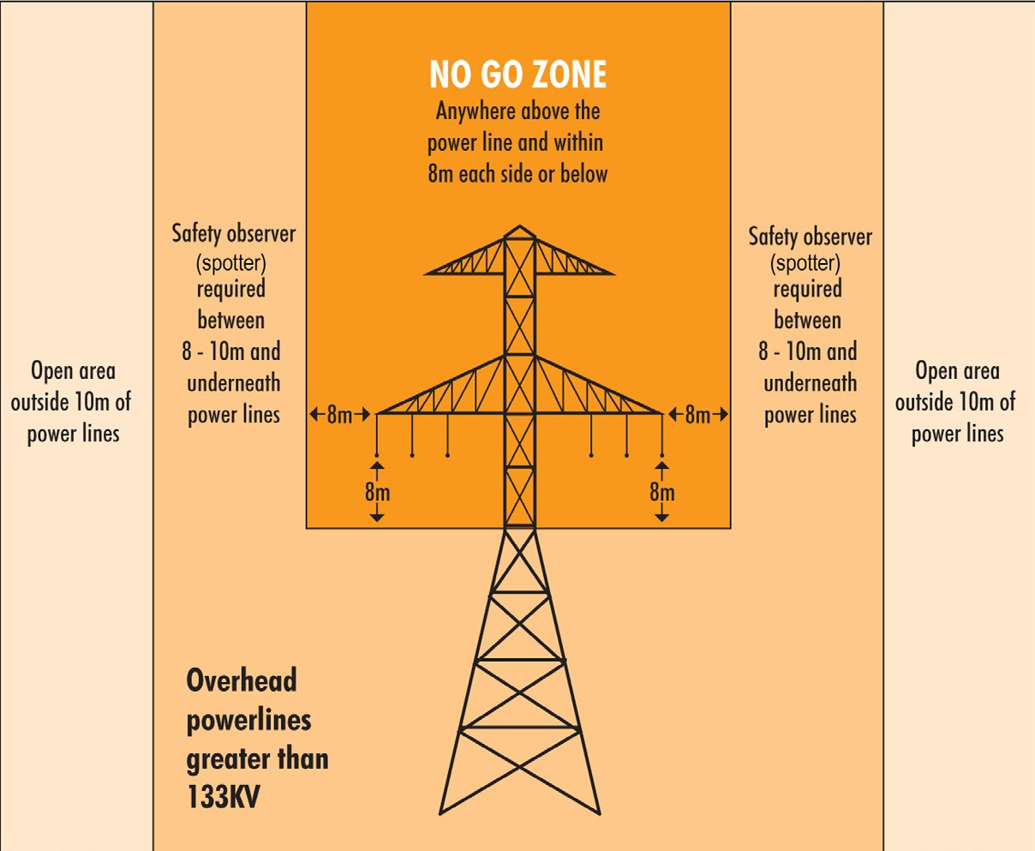
PC 1.5
PLAN WORK
Overhead powerlines on towers (National Standard)
These are usually ‘High Voltage’. This means powerlines of more than 133KV.
The information below is taken from the National Standard.
Always check the distances for your state or territory, as they may be different.
AS2550.1
Powerline distances
A spotter is required if you are working between
8 to 10 metres from transmission lines on towers.
The term ‘spotter’ is defined as a safety observer who is a person competent for the sole task of observing and warning against unsafe approach to overhead powerlines and other electrical apparatus.

Slide 13
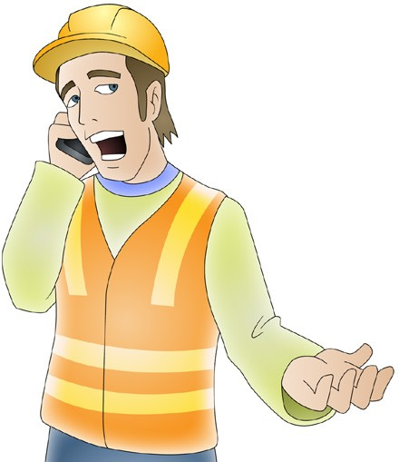
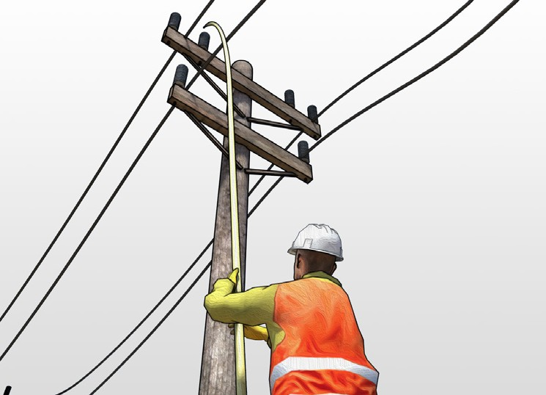
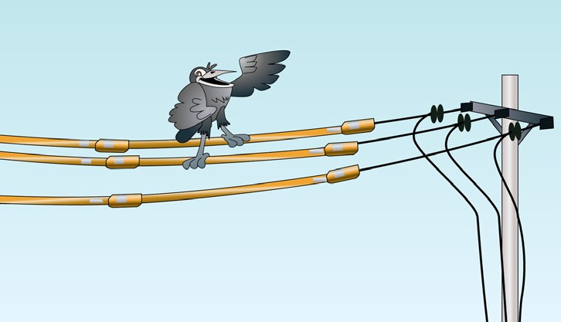
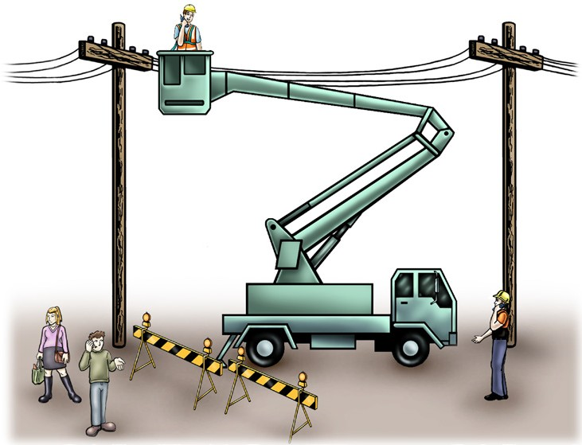
PC 1.5
PLAN WORK / TASK
QUESTION 12
What are some ways you can work closer to powerlines than the minimum
distances allowed?
You might be able to get permission from the electricity supply authority. They will provide help with working safely. | The power company may be able to turn off (disconnect) the power supply.
If you can’t turn the power off, the power lines will need to be covered by insulation. These powerlines have been insulated | Use a spotter in the exclusion zone if you are allowed to in your state/territory. Spotter

Slide 14
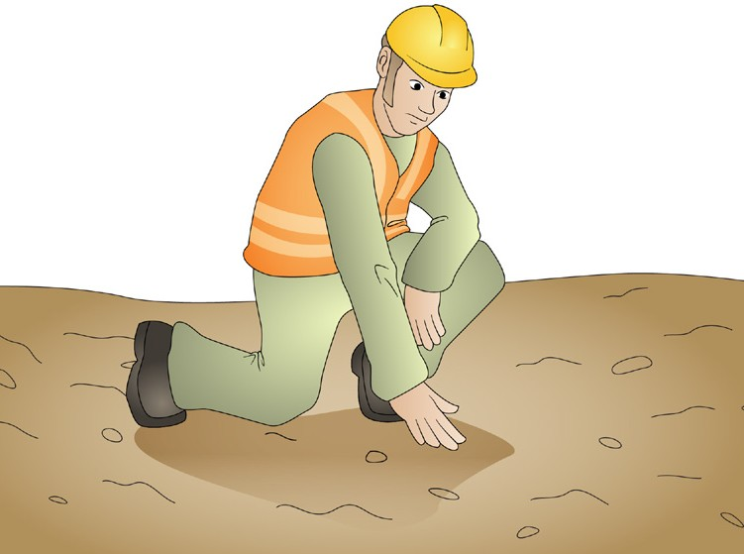
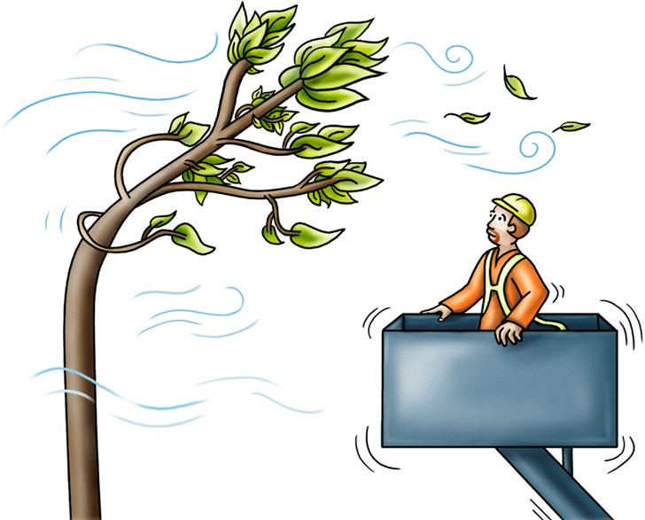
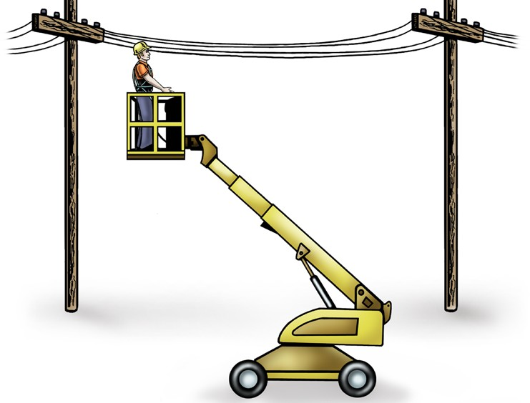
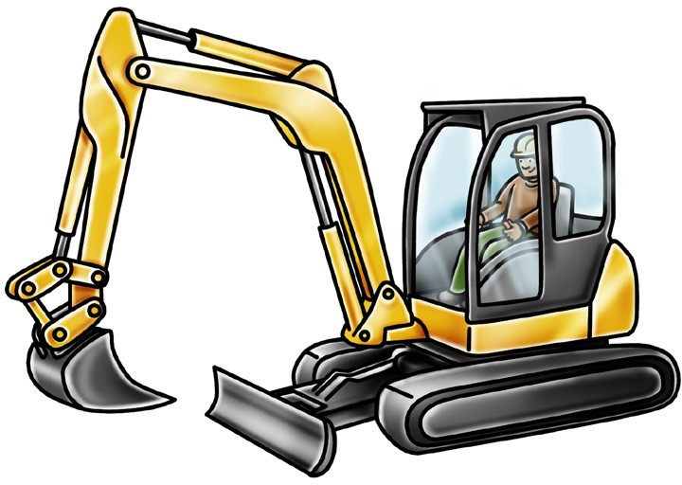
PC 1.1
PLAN WORK / TASK
QUESTION 13
You need to mobile (move) an EWP with the platform raised for a short distance.
What do you need to check first?
Ground conditions, hills and slopes | Wind speed
Vehicles, other equipment and people | Powerlines and other things near the EWP

Slide 15
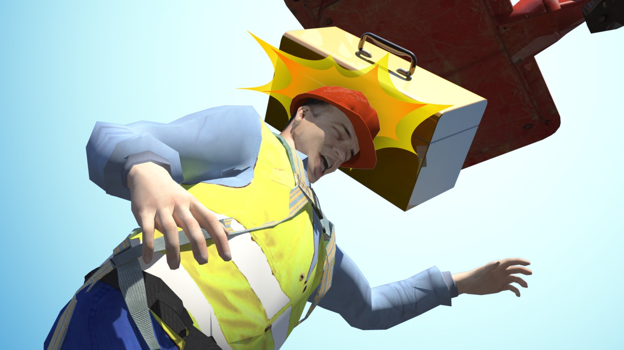
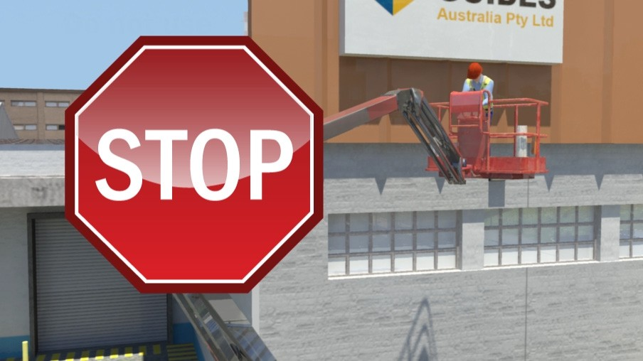
PC 2.13
PLAN WORK / TASK
Wind hazards
Wind is a common hazard when working on an elevating work platform. It can cause the boom to move uncontrollably, make objects fall from the platform or even make the EWP tip over.
Wind can also cause dust and debris to be blown around which can get into the operators eyes and affect vision.
If you are working and the wind speed exceeds the limit of the EWP – stop work immediately and bring the platform to the ground.
The wind speed rating of the EWP can be found by checking the data plate, operators manual or machines specifications.

Slide 16
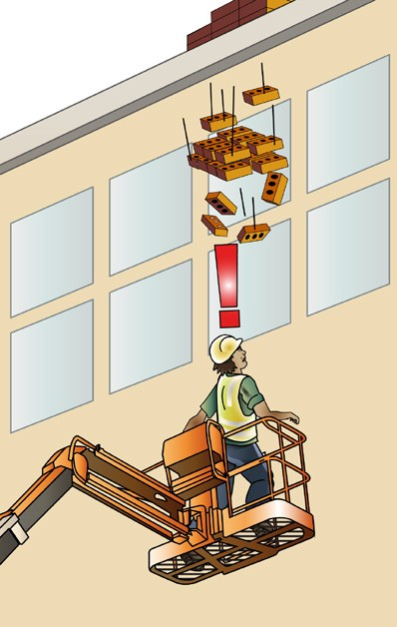
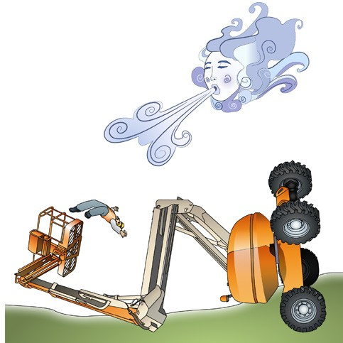
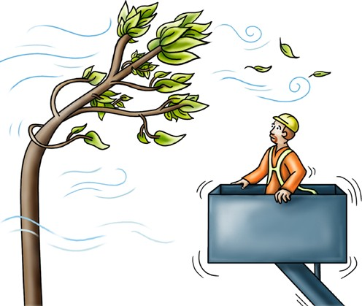
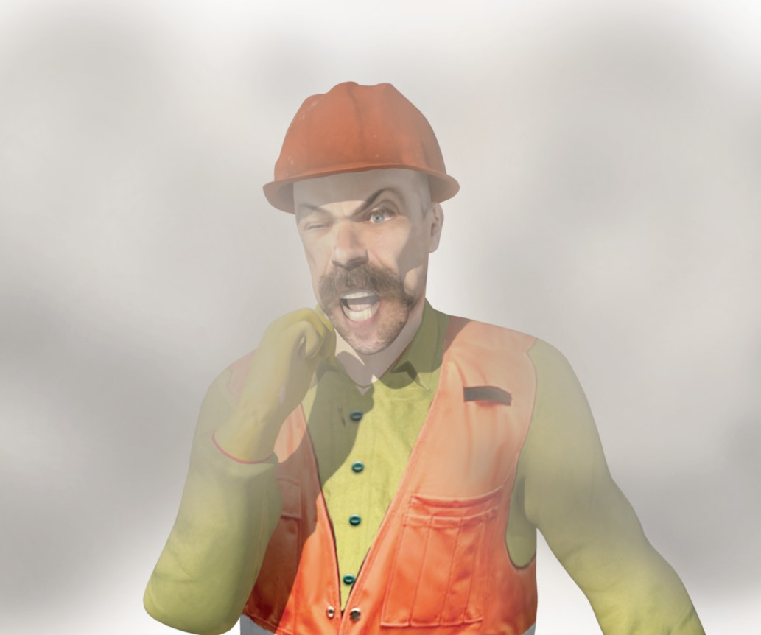
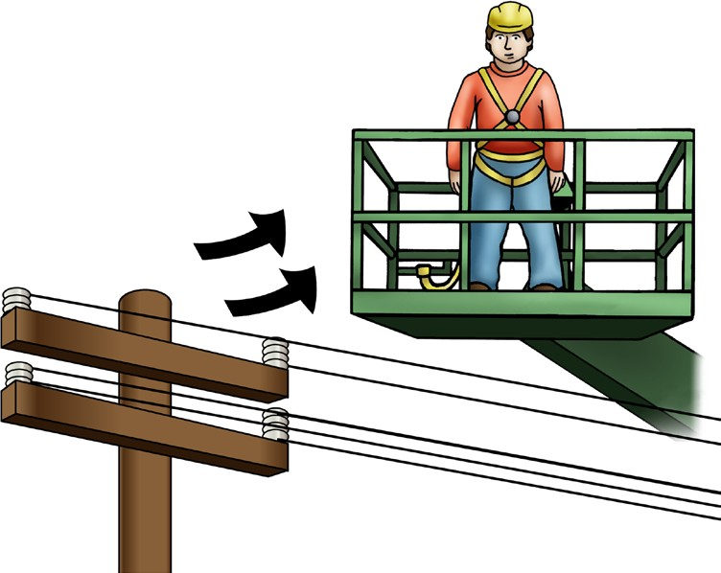
PC 2.13
PLAN WORK / TASK
QUESTION 14
What hazards (dangers) can happen when it
is windy?
Uncontrollable boom movement
Tip over
Falling objects
Reduced visibility caused by dust and debris
Power lines can sway and cables
could dislodge.

Slide 17
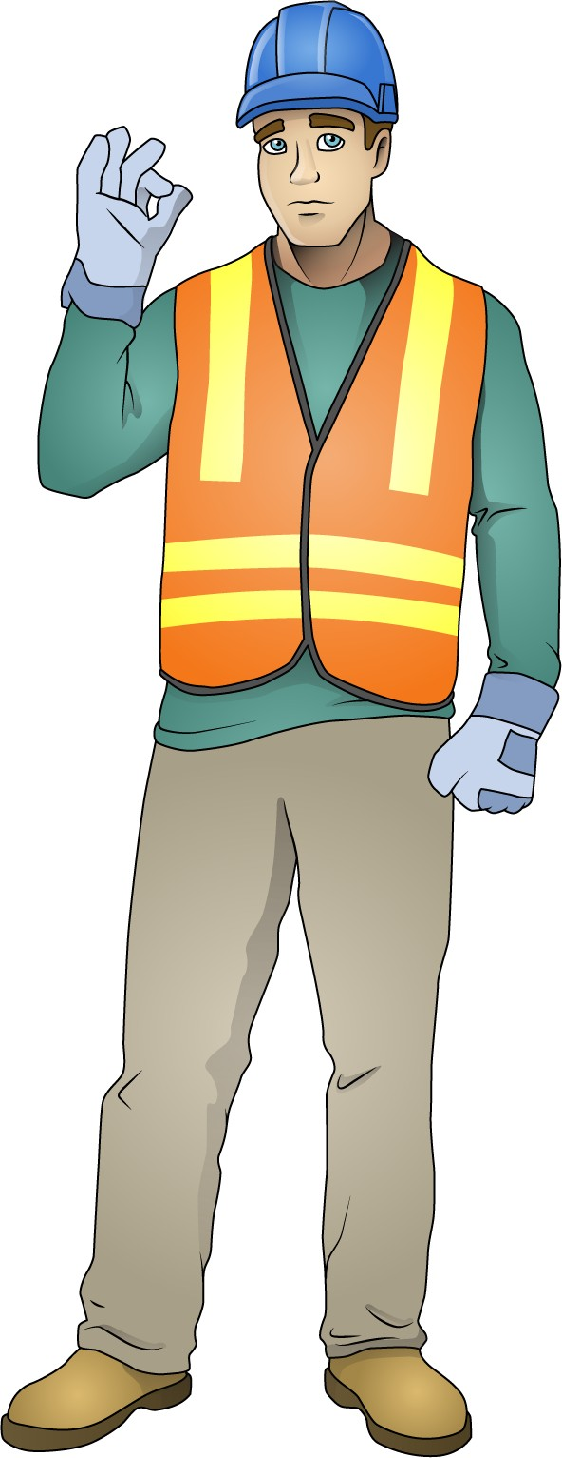
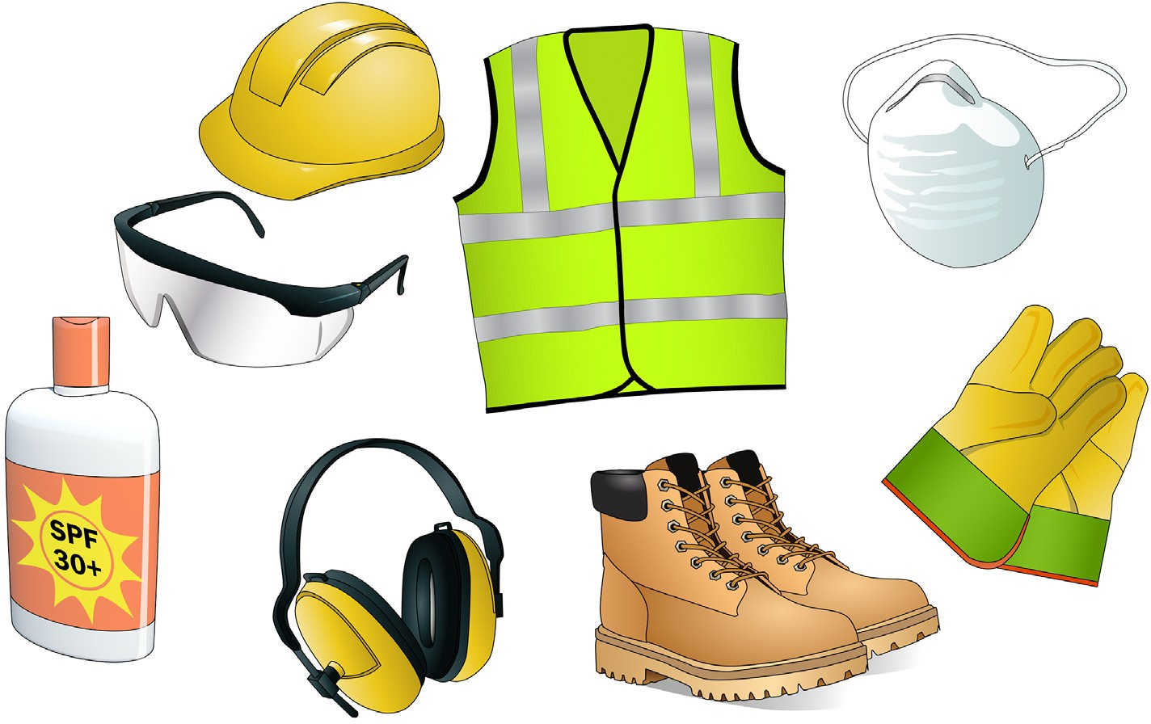
PC 2.3
PLAN WORK / TASK
Personal Protective Equipment (PPE)
The best way to make the workplace safe is to take away hazards altogether. But often you can’t do this. This is where Personal Protective Equipment (or PPE) can help.
PPE is clothing or equipment worn on the body to protect you from hazards. PPE will not take away the risk of harm altogether, but it will help keep you safe. Below are some examples of PPE.
Hard hat
High visibility clothing
Dust mask
Safety glasses
Long sleeved top
Long pants
Safety gloves
Sunscreen
Ear muffs
Safety shoes
Note: Before starting any work all PPE should be checked to make sure it is in good working order.

Slide 18
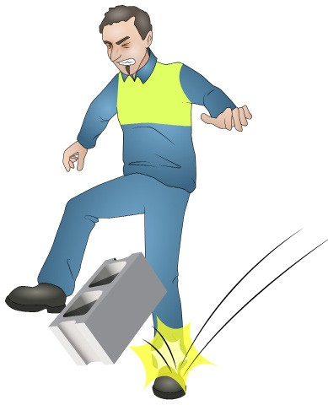
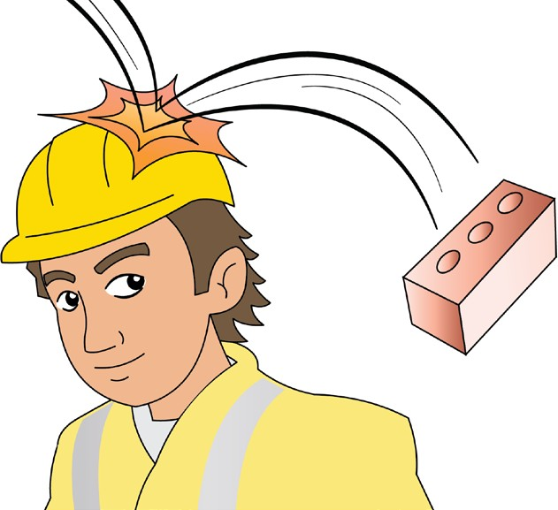
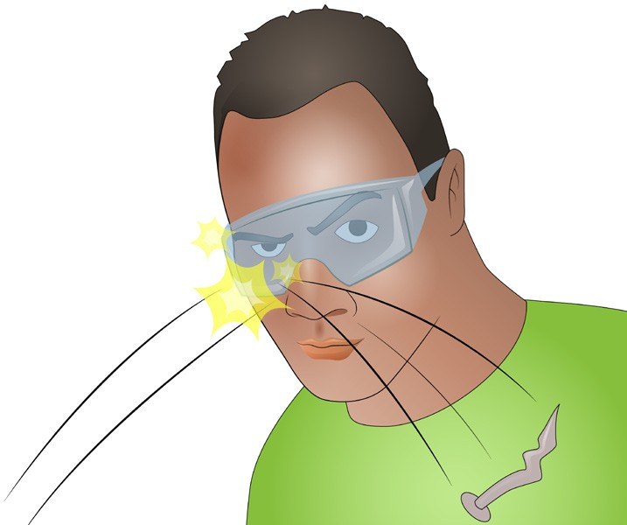
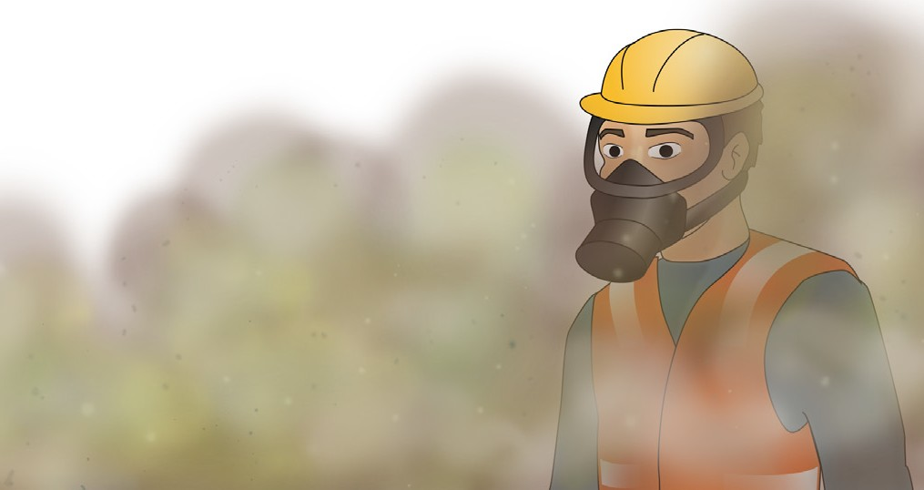
PC 2.3
PLAN WORK / TASK
PPE Examples
Here are examples of how personal protective equipment can protect you and your work mates.
Safety shoes can protect your feet. | Safety helmet or hard hat can protect your head from falling objects.
Safety glasses or goggles can protect your eyes from harmful objects. | Dust masks can stop you from breathing in harmful substances such as gasses.

Slide 19
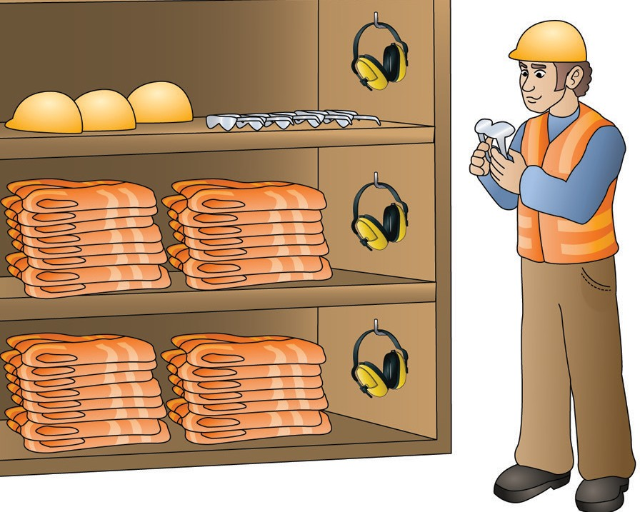
PC 2.3
PLAN WORK / TASK
QUESTION 15
You must select all safety equipment. This includes Personal Protective Equipment (PPE).
When must you do this?
Before you start work

Slide 20
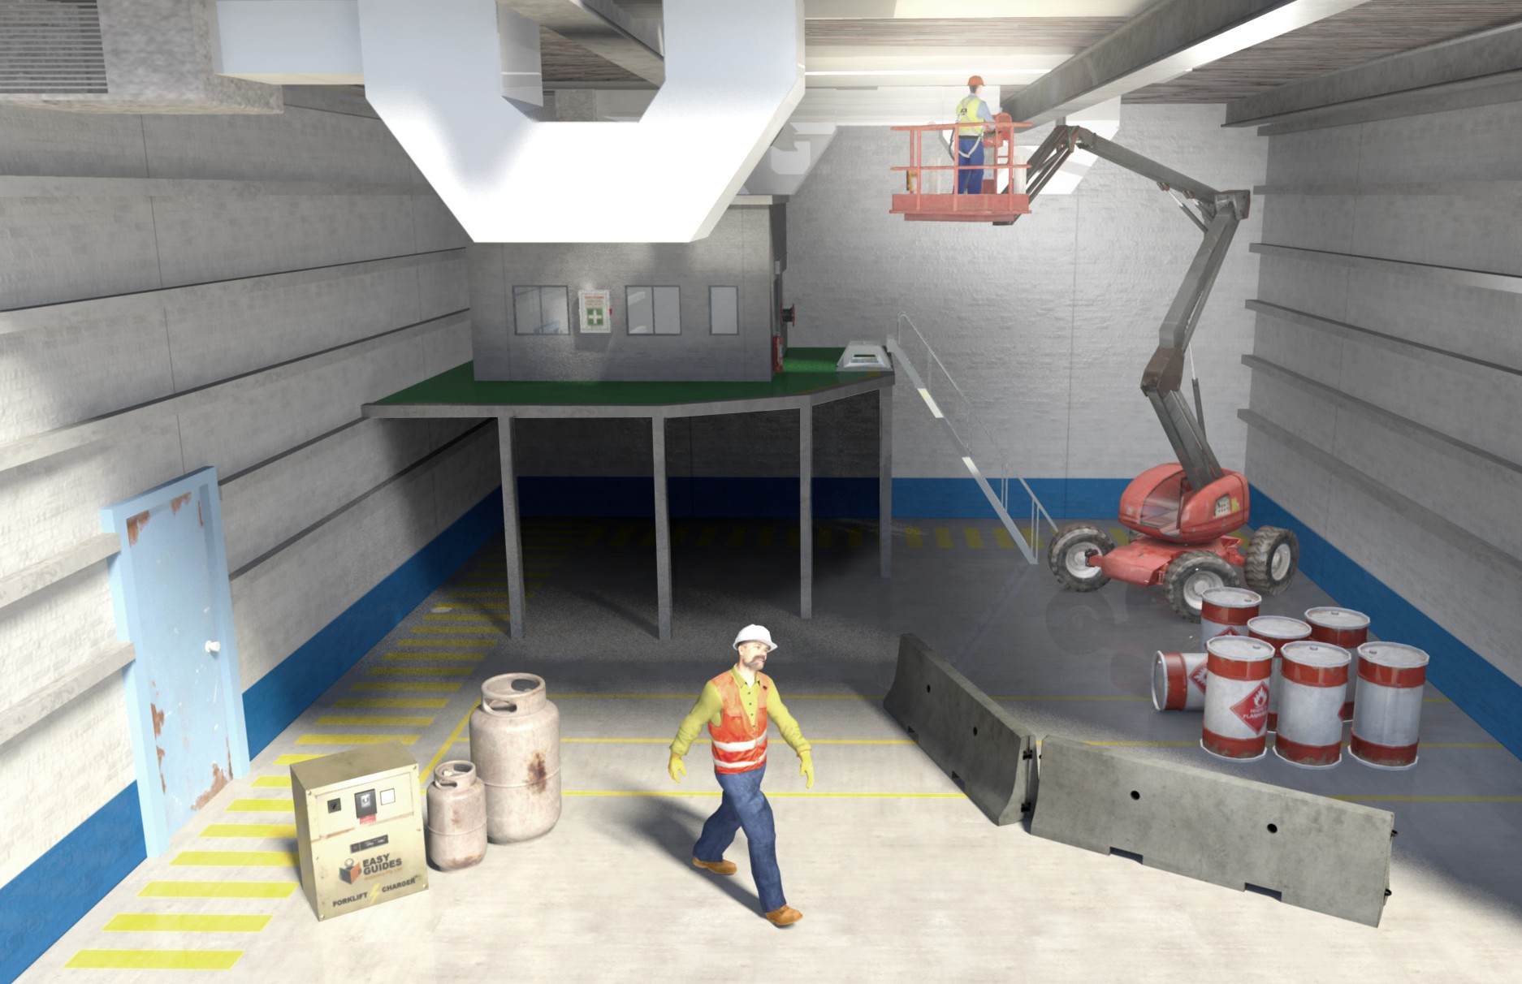
PC 1.5
PLAN WORK / TASK
QUESTION 16
You have arrived on site and you are about to start using the EWP. There are hazards (dangers) you might run into when using the EWP.
What are some examples of hazards that you must plan for indoors?
Indoor hazards
Overhead services such as
electricity or phone lines
There may not be enough lighting
Non-weight
bearing surfaces
Entry and exit points
Structures
Dangerous materials such as chemicals
Poor ‘housekeeping’
causing obstructions
People
Facilities such as toilets

Slide 21
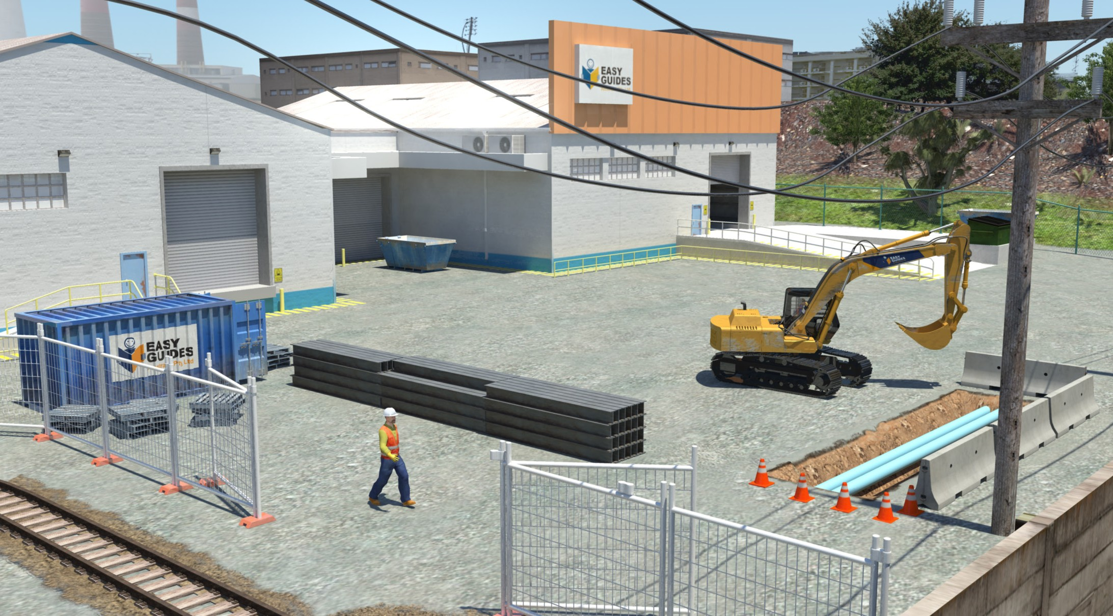
PC 1.5
PLAN WORK / TASK
QUESTION 17
You have arrived on site and you are about to start using the EWP.
There are hazards (dangers) you might run into when using the EWP.
What are some examples of hazards that you must plan for outdoors?
Outdoor hazards
Wind, lightning or rain
Overhead service lines
Trees
Surrounding
buildings
Powerlines
Hazards unique to the workplace
Other vehicles/
equipment
Ground conditions
Underground services
Pedestrians
Railway crossings
Pavement obstructions
(speed humps)
Bridges

