Slide 1


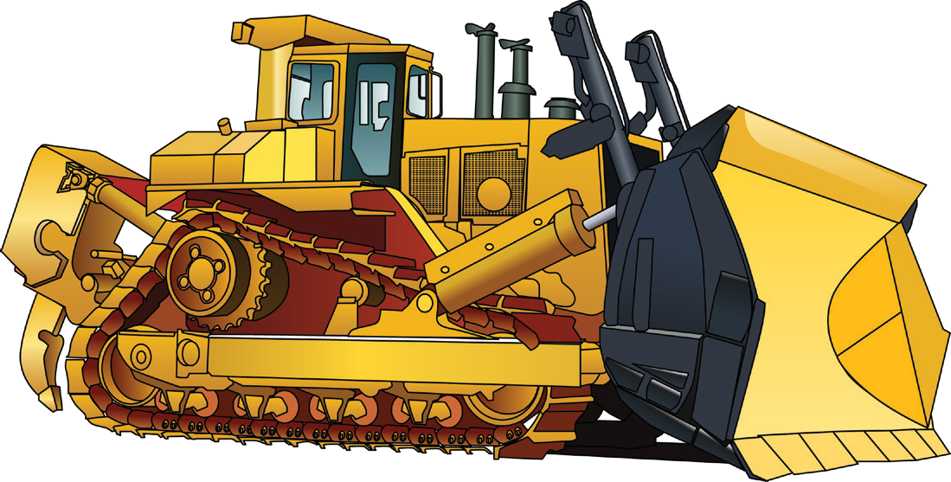

LEARNER GUIDE
Dozer
TICKET
Training support material for:
RIIMPO323E
Conduct civil construction dozer operations
Produced by:

Slide 2

Introduction to Dozers

Slide 3
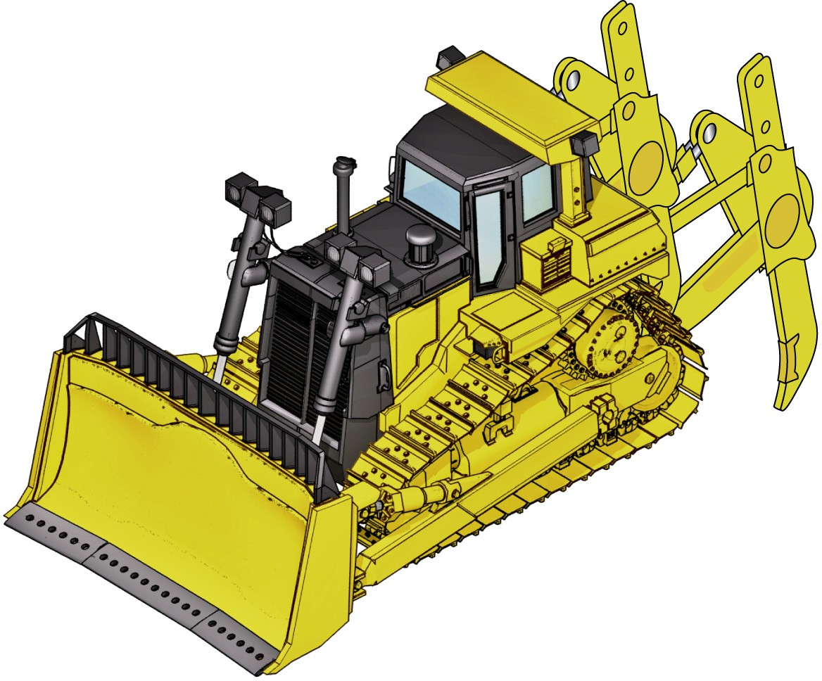
An example of a dozer
INTRODUCTION TO DOZERS
A dozer, also called a bulldozer, is a tractor with a blade at the front. The blade can lift up or down, tilt and rotate. You use a bulldozer to move rocks, tree stumps and earth.
Cab (with overhead protective structure)
Ripper attachment
Lift cylinder
Radiator
Drive sprocket
Rear idler
Tilt cylinder
Track frame
Frame
Blade
Grouser plate
Cutting edge
Corner tips
Front idler

Slide 4
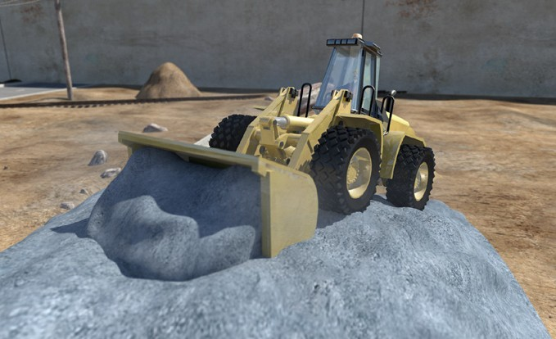
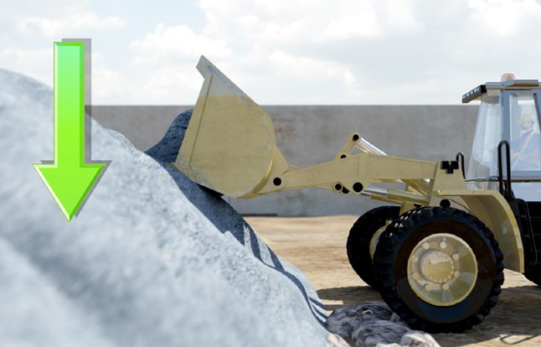
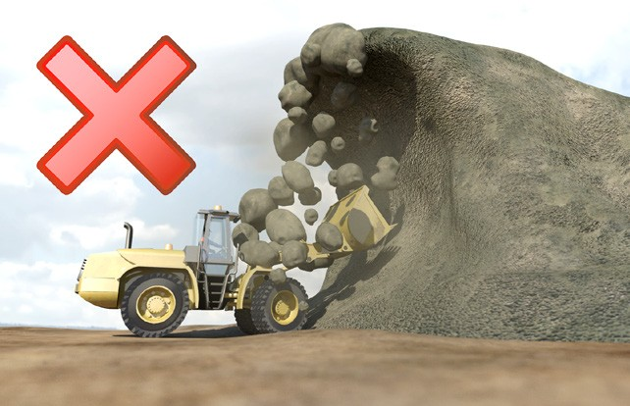
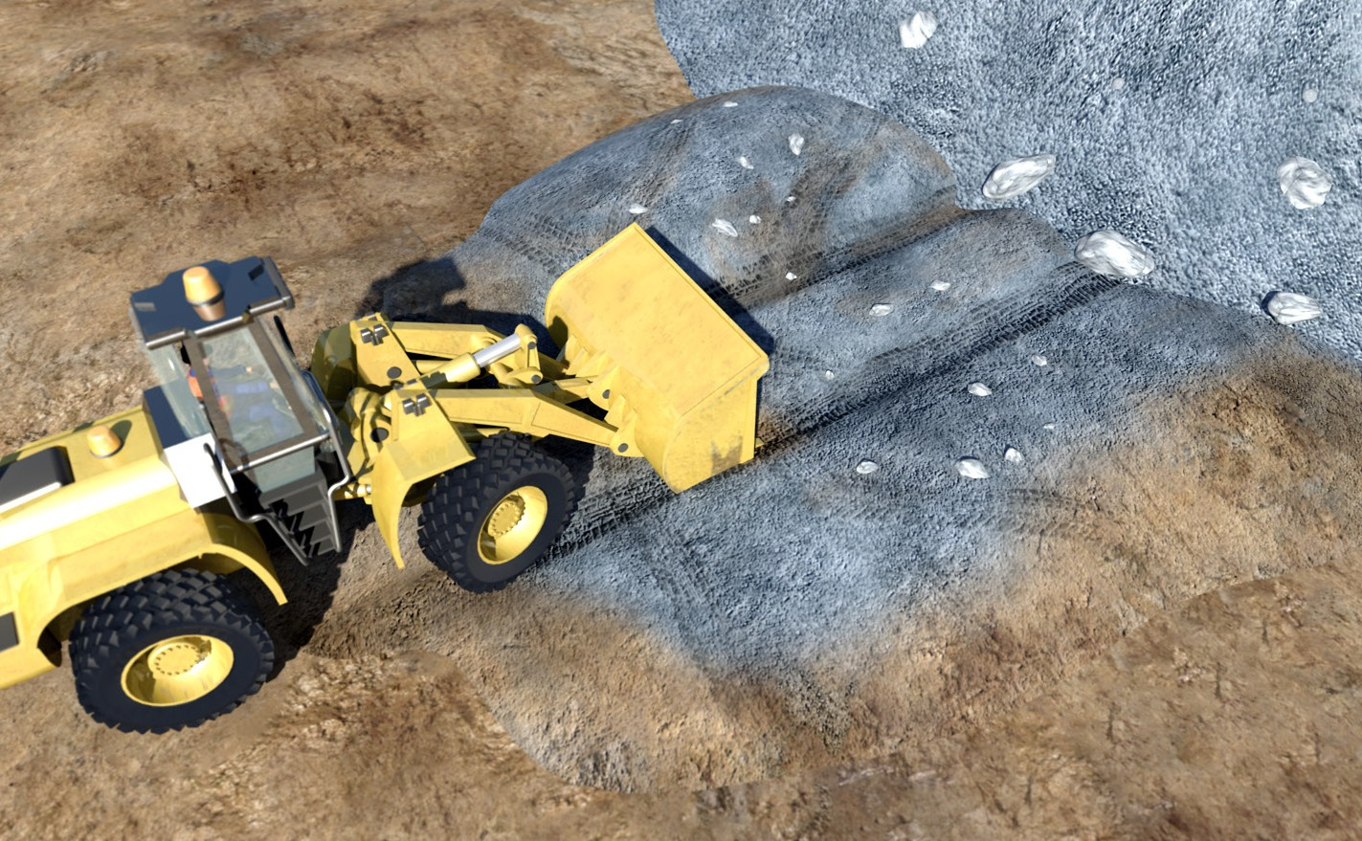
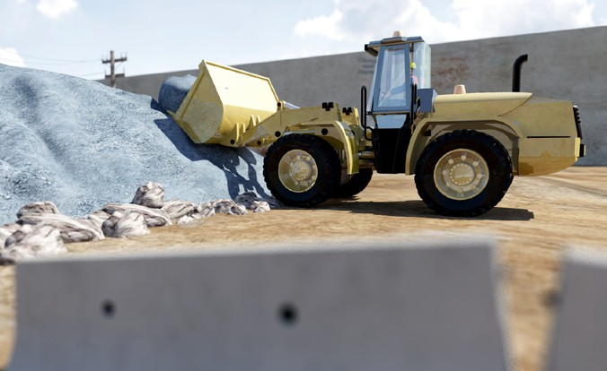
PC 2.5
THE BASICS OF ROAD CONSTRUCTION
Operating techniques
Taking from a stockpile
When you take from a stockpile, try and work neatly. | Take from the top, working down in layers. | Do not undercut the stockpile. It might collapse on you.
You may need to maintain the | To do this, you push
stockpile by neatening it up. | material up that has
 | been spread out.
 | Keep the loading area clean and level.

Slide 5
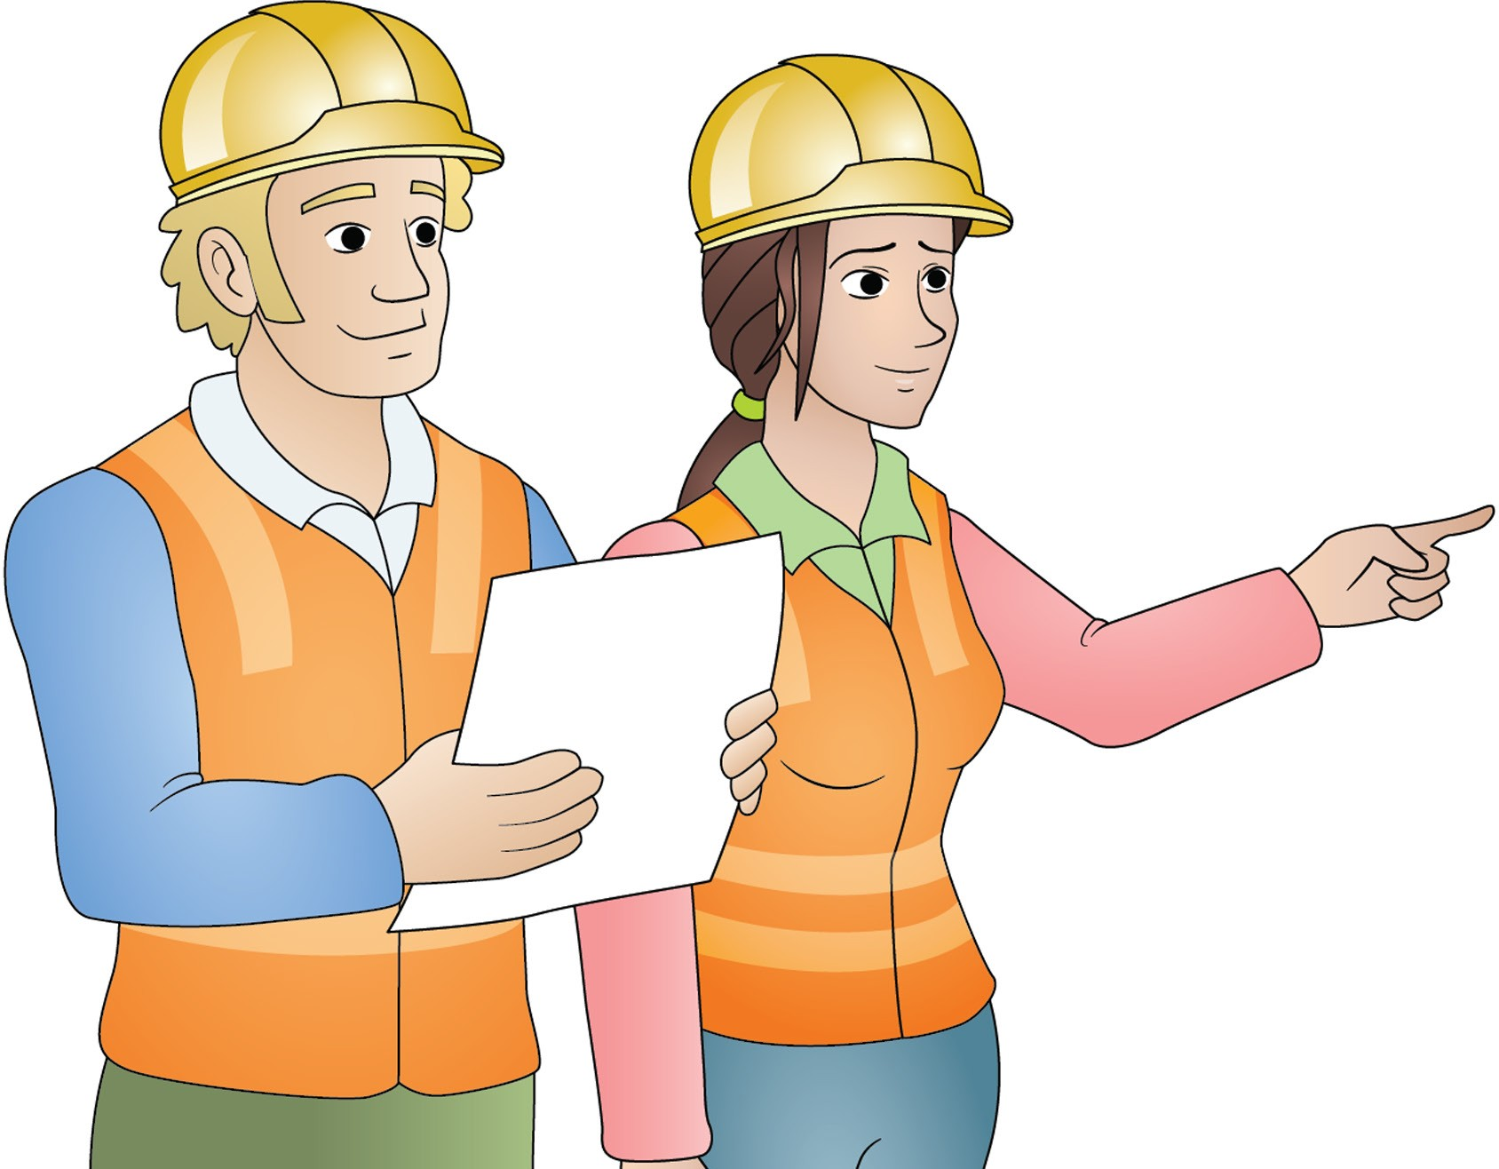
Plan and prepare for dozer operations
Element 1

Slide 6
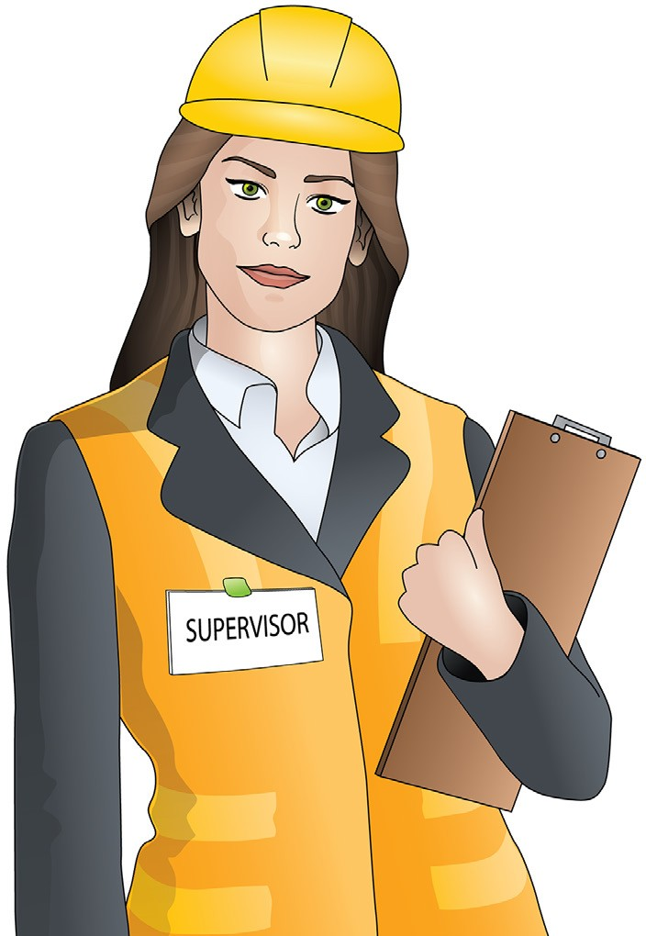
Who has duty of care?
You have a duty of care. So does anyone who has something to do with the worksite. Duty of care applies to:
PC 1.1 PLAN AND PREPARE FOR DOZER OPERATIONS
Employers/persons conducting a business or undertaking (PCBU). This includes managers, manufacturers/suppliers, importers, designers, inspectors, etc.
Workers. This includes employees, contractors and sub-contractors, employees of labour hire companies, outworkers, volunteers, etc.

Slide 7
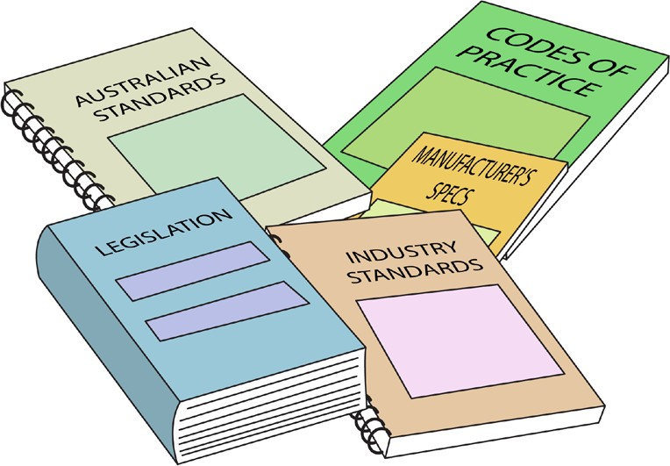

PC 1.1
PLAN AND PREPARE FOR DOZER OPERATIONS
QUESTION 1
What are the National Work Health (WHS) and Occupational Health and Safety (OHS) Acts about?
Health and Safety Acts explain how to keep your workplace safe and
healthy. They explain what you need to do to meet your duty of care.
For example:
You must make sure you do earthmoving work in a way that won’t put yourself or others at risk. You must use earthmoving equipment according to instructions.
Note: Check your state/Territory requirements as Acts may vary.
QUESTION 2
Under Health and Safety laws, what are your responsibilities while working?
You must work in a way that is safe. You must not risk the health and safety of yourself or others.

Slide 8
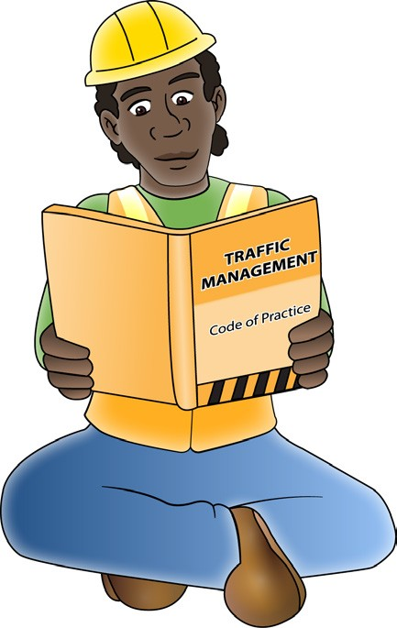
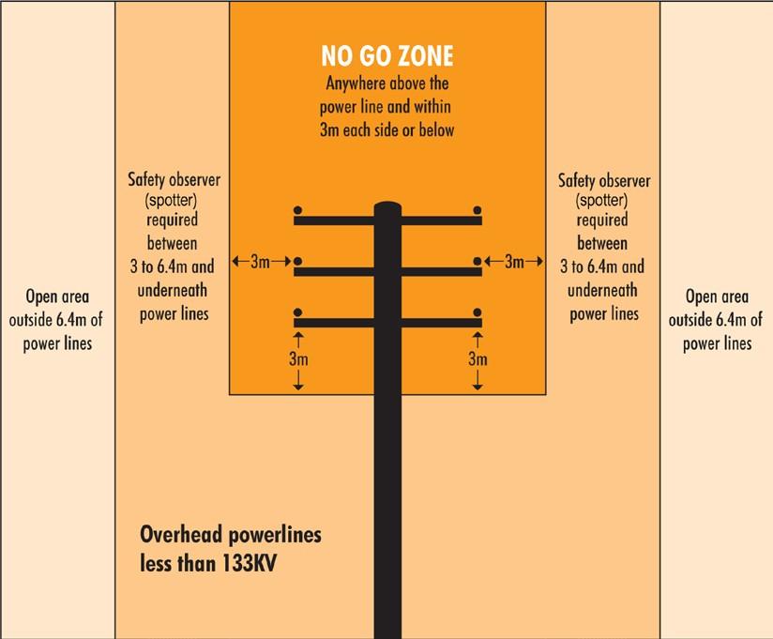
PC 1.1
PLAN AND PREPARE FOR DOZER OPERATIONS
QUESTION 3
What do codes of practice explain?
Codes of practice are practical guidelines on how to comply or follow the rules in legislation/laws.
For example:
A traffic management code of practice will tell you all the rules a traffic controller must follow. For example, a traffic controller must have a zero percent blood/alcohol concentration/reading while performing traffic control duties.
QUESTION 4
What do Australian Standards explain?
Australian standards are work guidelines that set the minimum accepted performance or quality for a specific hazard process or product.
For example:
AS2550.1-2011
Powerline distances
This standard tells you the distances you can safely work near powerlines on poles and towers.

Slide 9
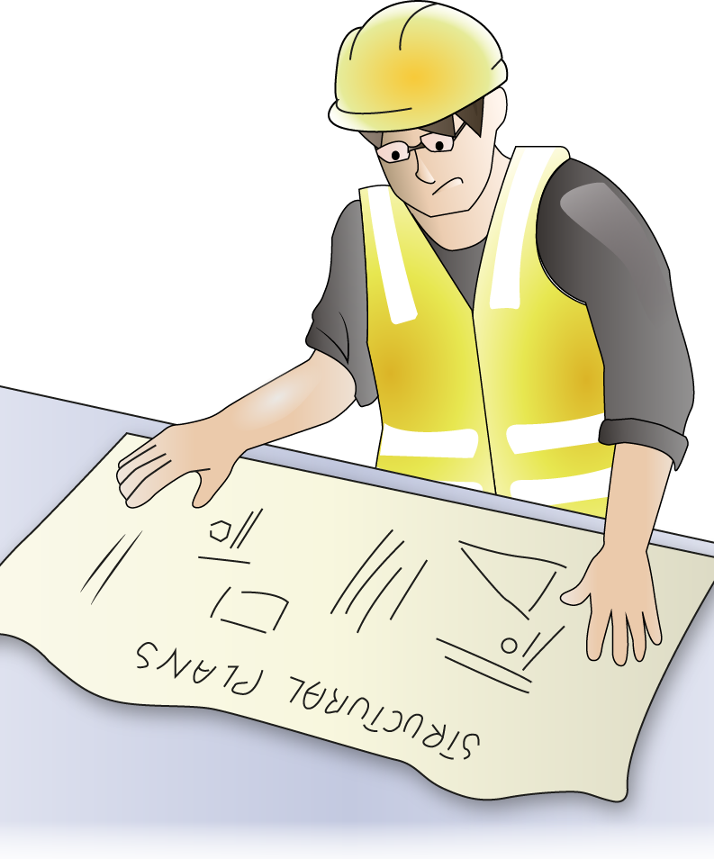
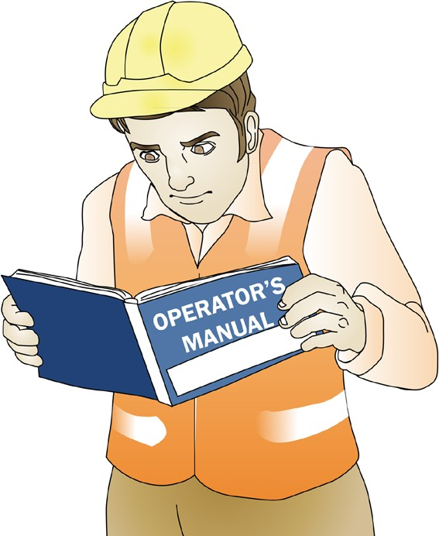
PC 1.1
PLAN AND PREPARE FOR DOZER OPERATIONS
QUESTION 5 What are some examples of documentation you should read before doing earthmoving work? | Health and Safety Acts and Regulations Codes of practice Manufacturers specifications Operators manuals Site requirements and procedures Work or quality requirements Drawings and sketches of the work to be done Company policies and procedures for Employment and workplace relations, Equal opportunity and disability Standards, for example AS2958 Earthmoving machinery.
QUESTION 6 Why should you check the operator’s manual before using earthmoving equipment? | The operator’s manual tells you how to operate your machine. The manual also tells you about maintenance (how to keep your machine working well).

Slide 10
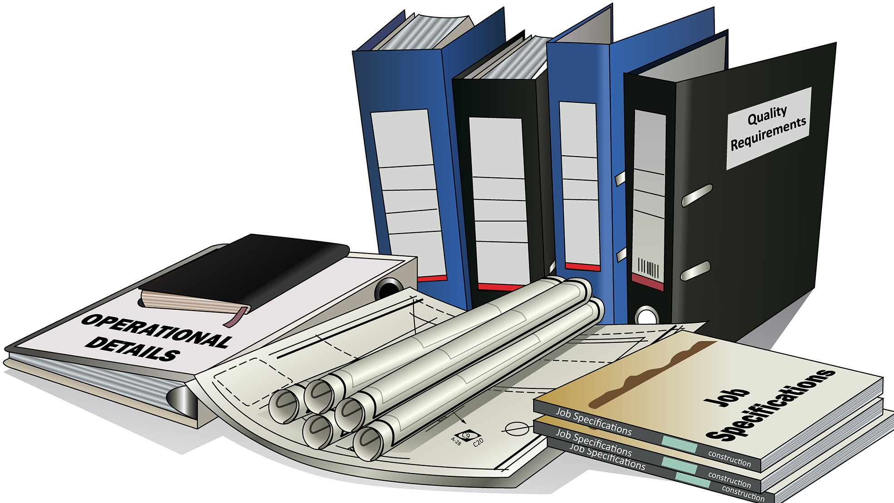
PC 1.2
PLAN AND PREPARE FOR DOZER OPERATIONS
QUESTION 7
What kinds of information do you need before starting work?
Plans – Drawings and sketches detailing what you need to do
Specifications – rules and details about the job
Operational details – how you will do the job
Quality requirements of the job – the standards you are expected to meet.

Slide 11
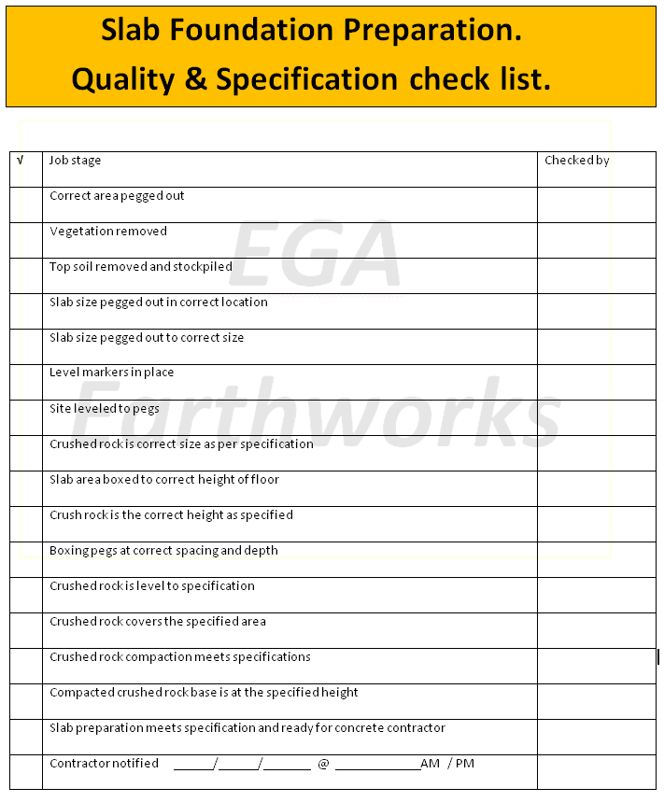

PC 1.2
PLAN AND PREPARE FOR DOZER OPERATIONS
QUESTION 8 What are quality requirements? | The quality requirements tell you the standards you must meet when doing earthmoving work. They tell you what you need to do and how to do it to satisfy the customer. You may need to follow codes of practice, regulations, national standards etc.

Slide 12
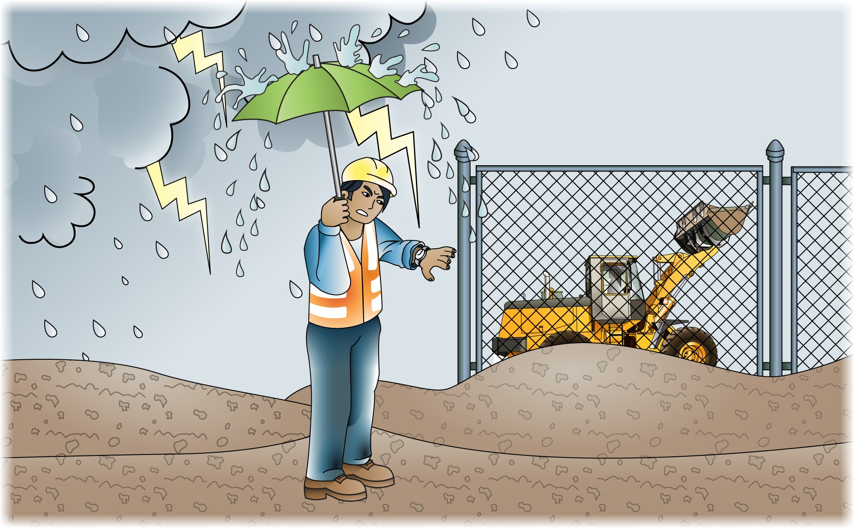
PC 1.2
PLAN AND PREPARE FOR DOZER OPERATIONS
QUESTION 9
What do the job’s work instructions explain?
Work instructions explain:
What to do in unexpected situations like bad weather
Where the job is
What the job is
How to do the job safely
How long the job will take
What tools and equipment you need
How to do the job from start to finish

Slide 13
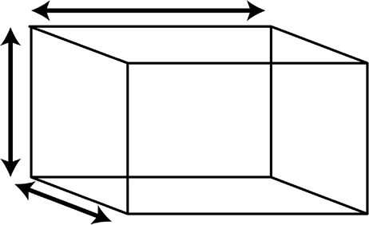
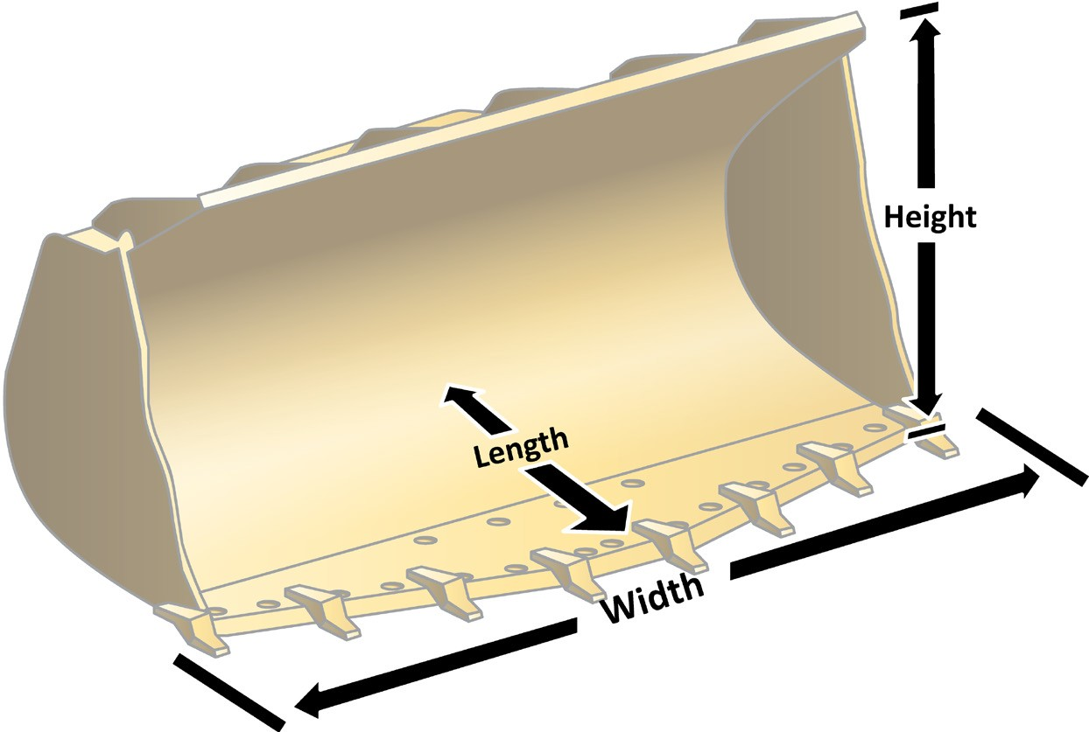
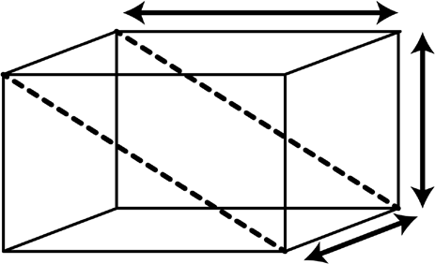
PC 1.2
PLAN AND PREPARE FOR DOZER OPERATIONS
Calculations (continued)
How to find the cubic capacity of a bucket
Length
Capacity = L × W × H
2
Height
Width
Cubic capacity of cube
= L × W × H
Length
Height
Width
Cubic capacity of bucket
= L × W × H ÷ 2
Cubic capacity is ÷ 2 because of the shape of the bucket (a triangular prism)

Slide 14
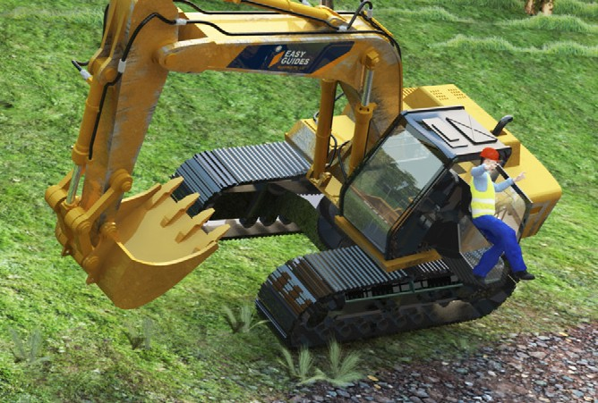
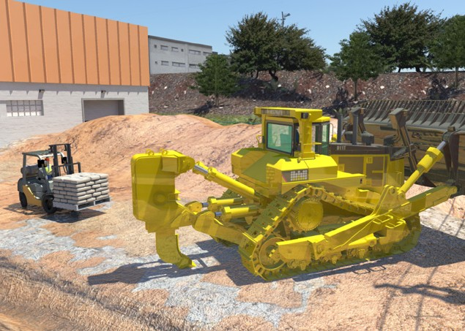
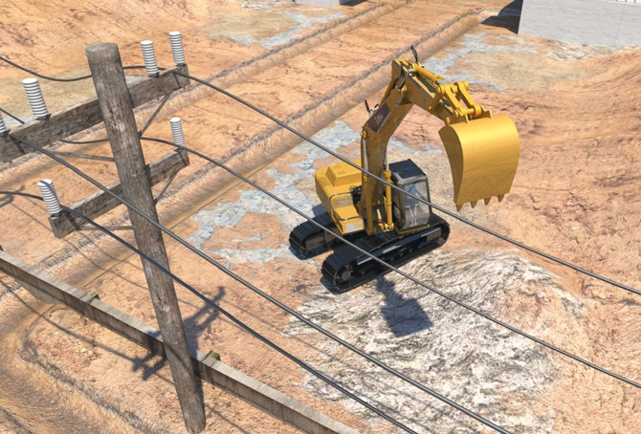
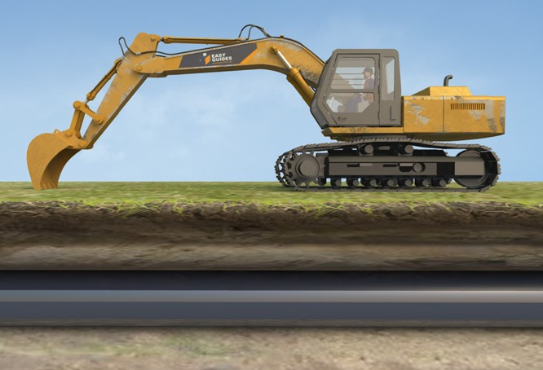
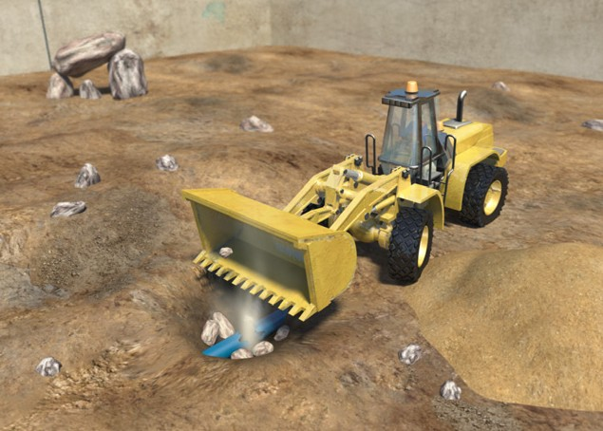
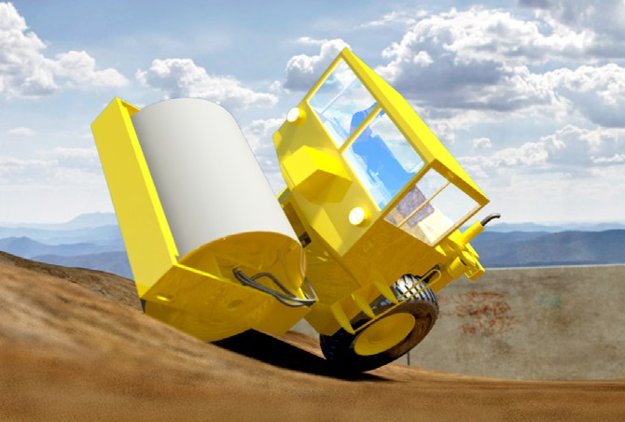
PC 1.3
PLAN AND PREPARE FOR DOZER OPERATIONS
Earthmoving hazards and risks
The most common hazards and risks with earthmoving work are:
Falls from plant or machinery | Traffic and other mobile plant | Overhead or underground power
Underground gas lines | Water and sewage piping | Rollovers

Slide 15
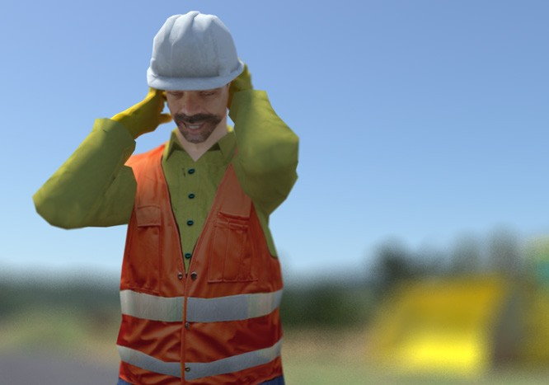
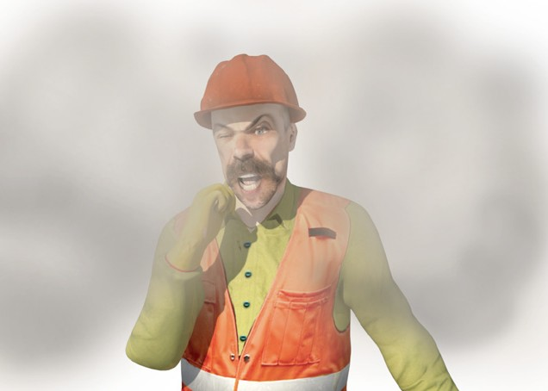
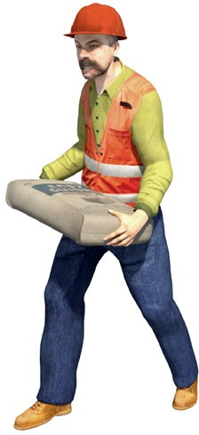
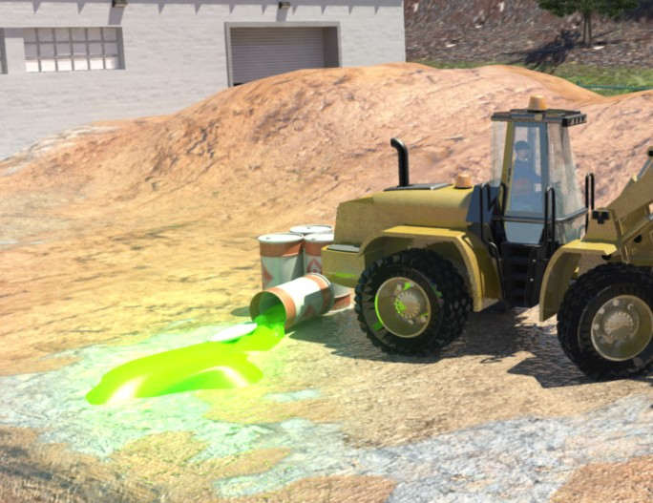
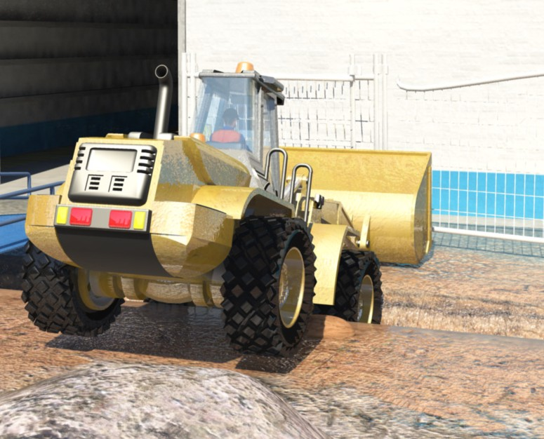
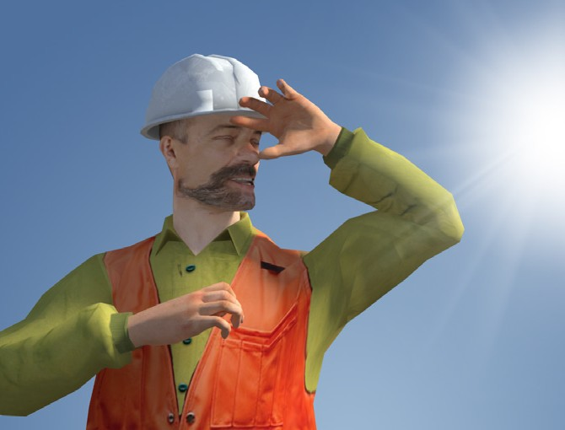
PC 1.3
PLAN AND PREPARE FOR DOZER OPERATIONS
Earthmoving hazards and risks (continued)
Noise | Dust | Manual handling
Contaminated soil | Falling into trenches or excavations | UV rays (radiation) from working in the sun

Slide 16
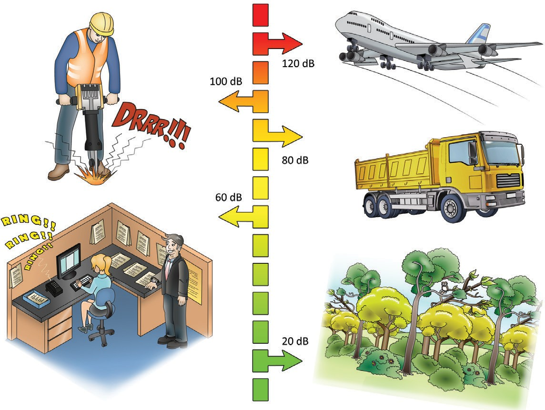
Decibel levels of common sounds
PC 1.3 PLAN AND PREPARE FOR DOZER OPERATIONS
You must wear hearing protection when operating earthmoving equipment.
This is important because 8 hours of noise at 85 db (decibels), or noise levels of 140 db even briefly can permanently damage
your hearing.
Hearing loss is:
slow
painless
irreversible.
Here are some examples of levels of noise in different environments.
A forest has about 20 db of noise
In an office there might be around 60 db
Standing outside a truck generates about 80 db
A jackhammer generates around 100 db
A jet taking off generates about 120 db

Slide 17
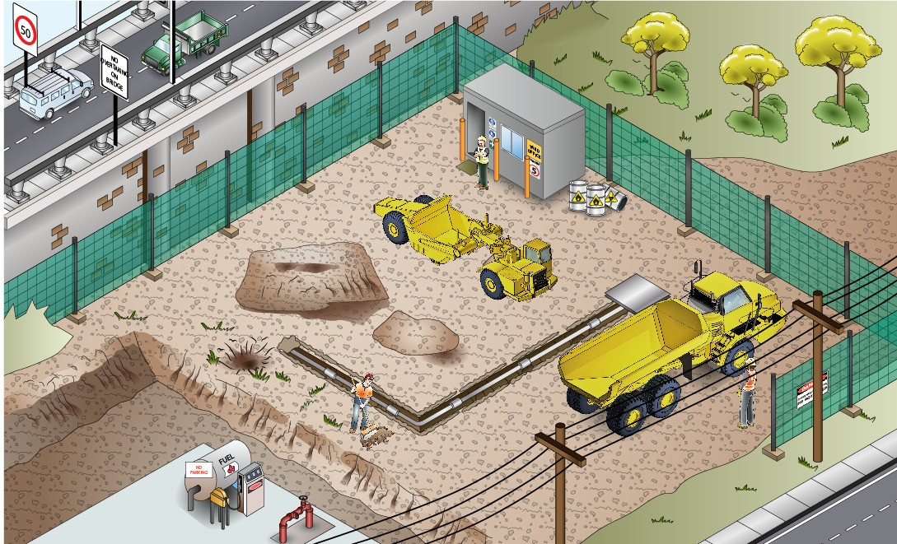
PC 1.3
PLAN AND PREPARE FOR DOZER OPERATIONS
QUESTION 10
What are some hazards you must look for before starting work?
Buildings
Other people
Dangerous materials (chemicals, gasses, acids, explosives)
Bridges
Trees
Uneven or unstable ground
Other vehicles, machines or equipment
Embankments
Hidden holes
Trenches
Powerlines
Things that might get in your way
Drop offs
Underground services (gas, water, electricity, communications)

Slide 18
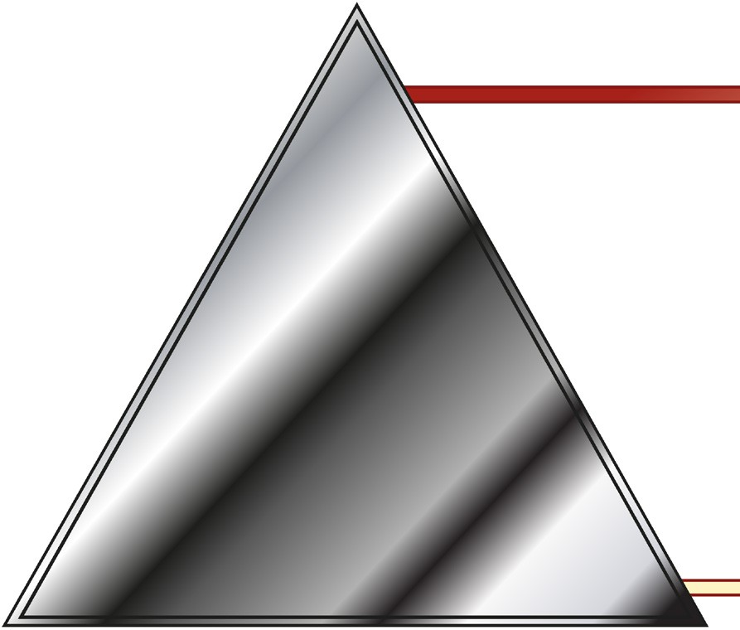
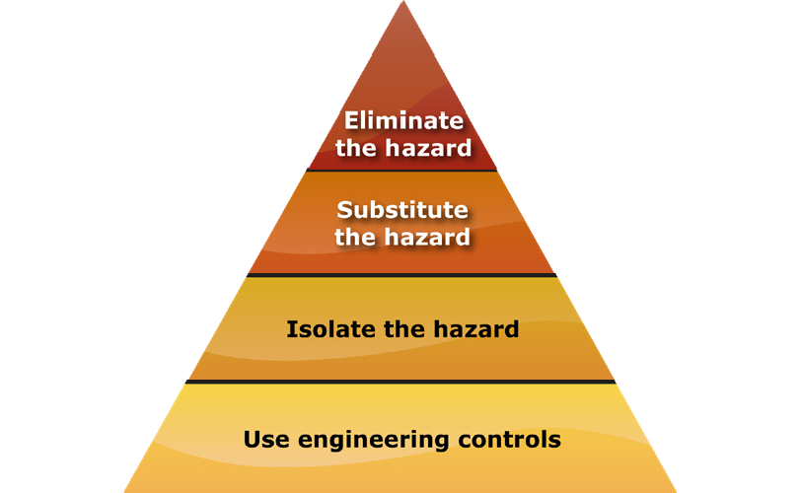
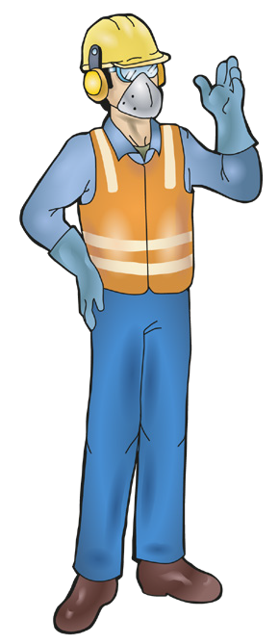
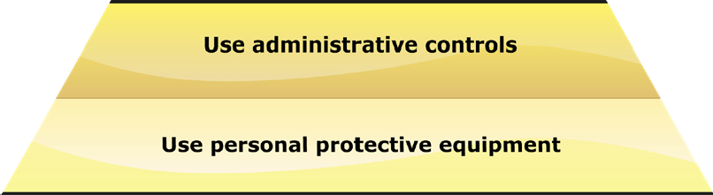
PC 1.3, 5.2
PLAN AND PREPARE FOR DOZER OPERATIONS
QUESTION 11
The Hierarchy of Hazard Control is a list of controls that you can use to eliminate or lower the danger from a hazard in the workplace.
What are the six (6) levels in the hierarchy from the first choice to the last choice?
1. Elimination: If possible, remove (take away)
the hazard.
2. Substitution: Use a safer method if you can’t remove the hazard.
3. Isolation: Stop access to the hazardous (dangerous) area.
4. Engineering Control Measures:
Change the tools, equipment or environment to make it safer.
5. Administrative Practices: Reduce the time the worker is exposed to the hazards by using training, job rotation, the timing of jobs, etc.
6. Personal Protective Equipment (PPE): Use PPE as your last line of defence.
Memory aid: Every Saturday I Eat A Pie

Slide 19
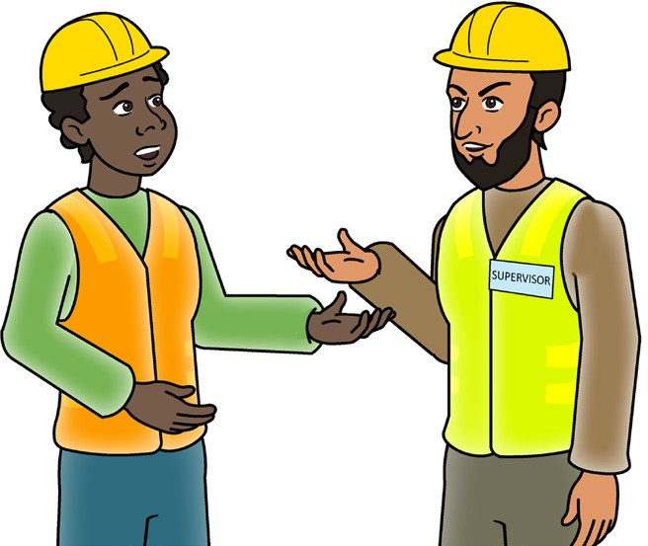

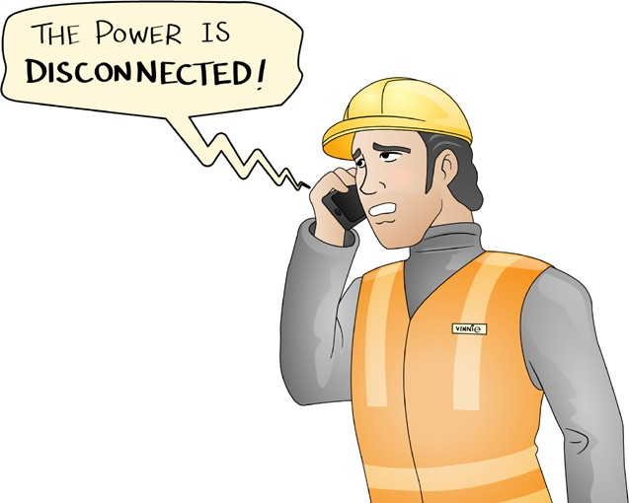
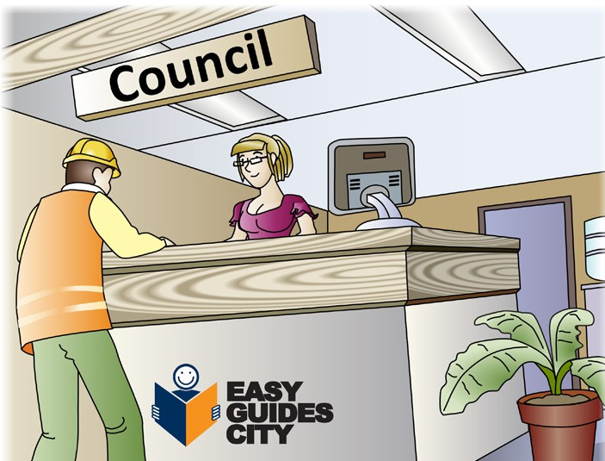
PC 1.3, 1.8
PLAN AND PREPARE FOR DOZER OPERATIONS
QUESTION 12
Who can you ask about underground services on the worksite?
You can:
Ask your site supervisor | Call 'Dial Before You Dig' on 1100 as a guide to services location only. Ask a specialist consultant to check the site.
Ask the local supply authority (for example, the electricity, gas or water company). | Check the council maps for the site

Slide 20
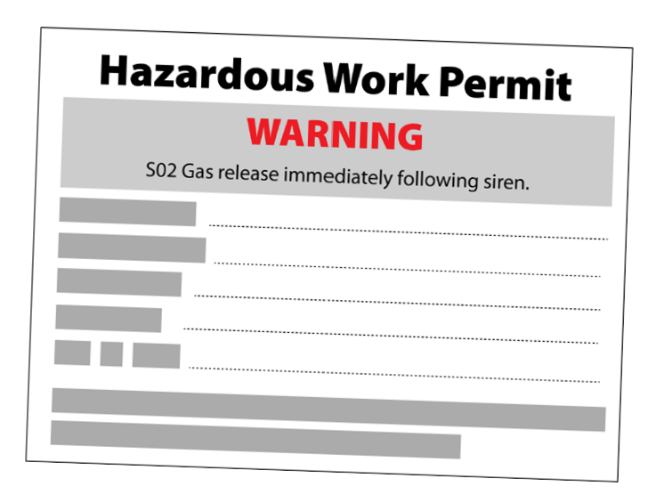
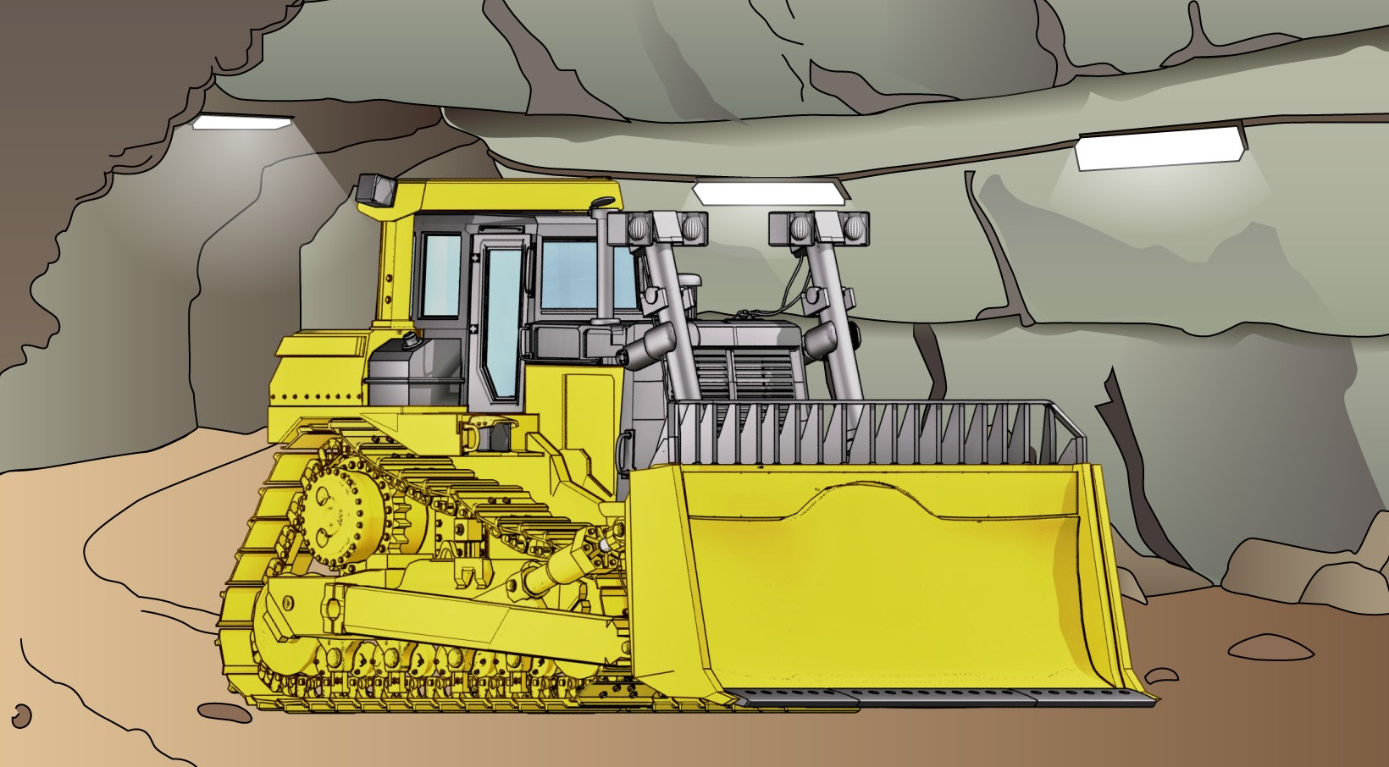
PC 1.2, 1.3
PLAN AND PREPARE FOR DOZER OPERATIONS
QUESTION 13
You will work in a hazardous area, for example, a confined space.
What type of permit might you need to get?
You may need to get a hazardous work permit.

