Slide 1

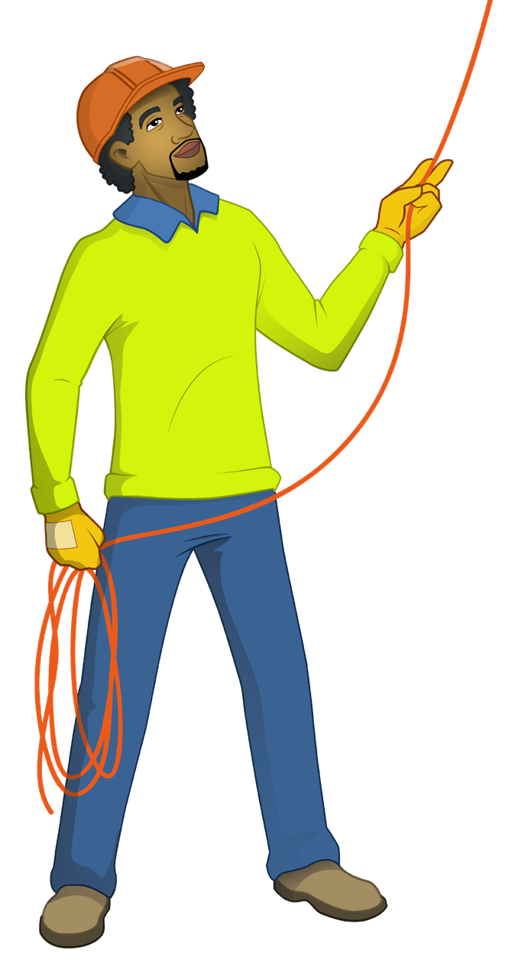

DOGGING
SAFETY & LICENCE GUIDE
Dogging
LICENCE
Training support material for:
CPCCLDG3001
Licence to perform dogging
Produced by:

Slide 2
Contents
How to use this guide
Language – Literacy – Numeracy (LLN) Introduction to dogging
High risk licensing and the law
4
6
8
18
24
84
116
134
181
193
Element 1
Element 2
Element 3
Element 4
Element 5
Plan task
Select and inspect equipment Set up task
Perform task
Pack up and clean up
Practical training

Slide 3
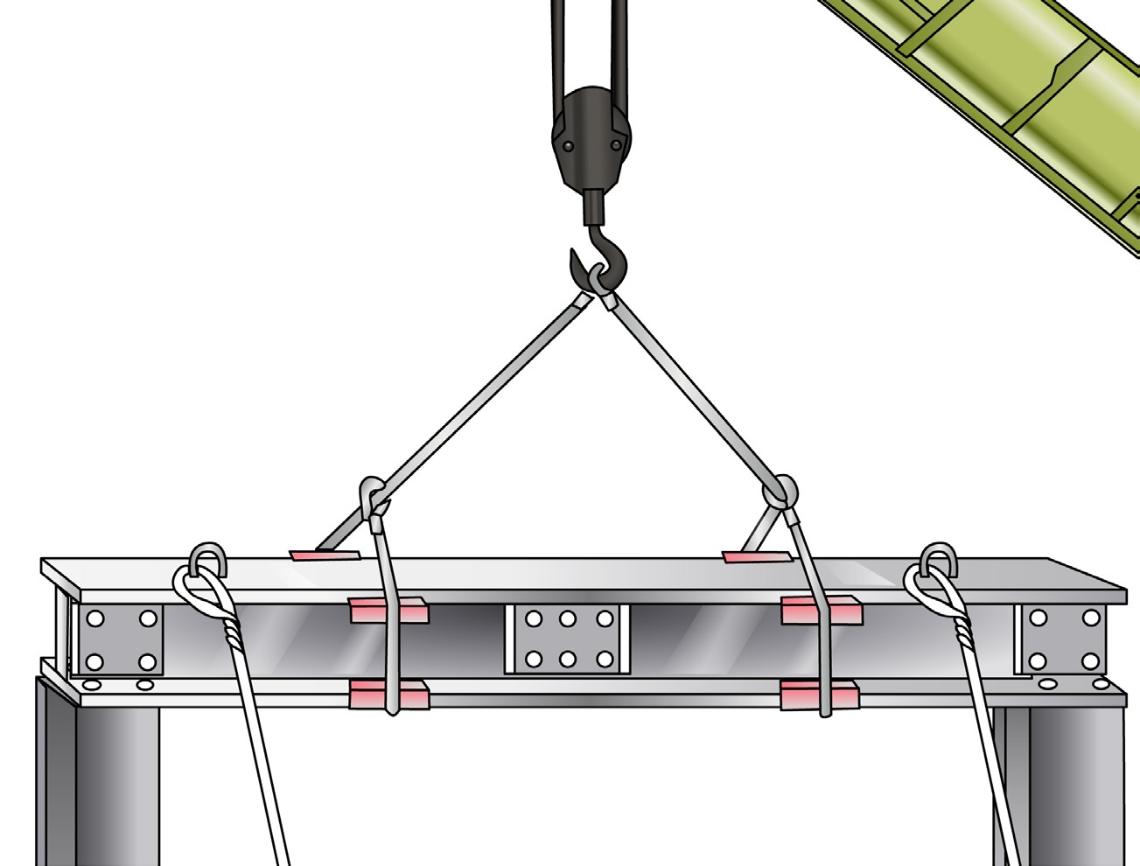
Introduction to Dogging
3

Slide 4
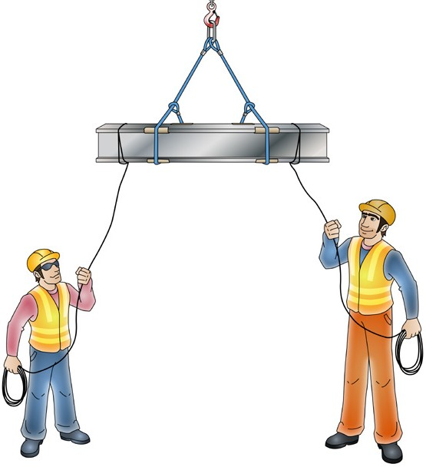
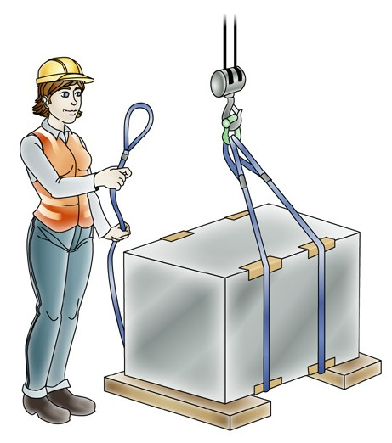
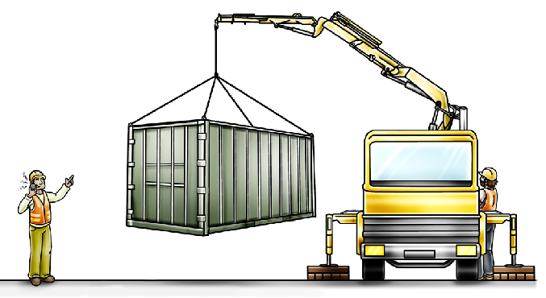
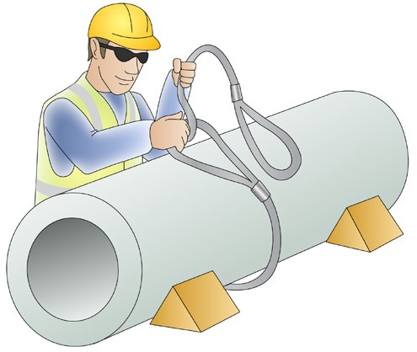
What is dogging?
INTRODUCTION TO DOGGING
A dogman is responsible for:
Selecting the correct lifting equipment for the job and inspecting it for damage and defects
Working out the weight of loads
Determining and using the correct technique to sling loads
Communicating with the crane operator about the crane and the load
Guiding the crane operator in the lifting, movement and placement (landing) of loads.
When selecting the correct slings and slinging technique, inspecting slings and directing the crane operator in the load movement (particularly when it is out of view to them) you must:
hold a dogging licence
or
be enrolled in a dogging course with an RTO and under the supervision of a licenced dogman.
4

Slide 5
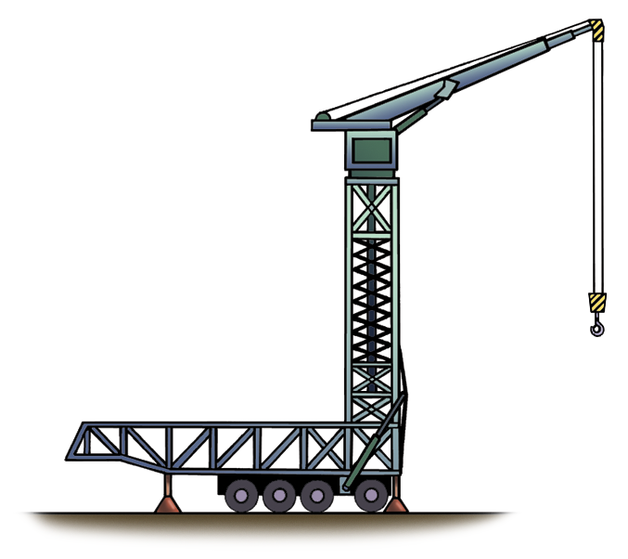
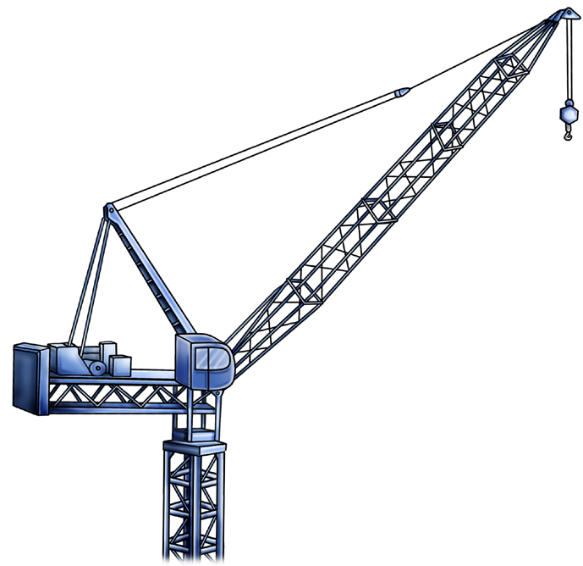
Types of cranes
INTRODUCTION TO DOGGING
As a dogger it is likely that you will work with many different types of cranes.
The dogger must talk with the crane operator to find out the cranes rated capacities under all configurations.
These are some examples of the types of cranes that you may work with.
Self-erecting tower crane
The self-erecting tower crane is commonly used on building construction sites for lifting a wide range of construction materials to elevated locations on the jobsite.
Luffing boom tower crane
The luffing boom tower crane is commonly used on building construction sites for lifting a wide range of construction materials to high-elevated locations on the jobsite.
Some self-erecting tower cranes can hydraulically climb in height.
The self-erecting tower crane can be packed up and transported from site to
site.
These types of crane can be installed on a number of bases such as a fixed
outriggered base, a travelling rail mounted base or mounted on a tower in a fixed position.
These tower cranes can hydraulically climb in height.
Erection of the tower crane is performed by an auxiliary crane.
These types of crane can be installed on a number of bases such as a fixed counterweighted base, an
anchored base, a travelling rail mounted base or mounted in a fixed position.
5

Slide 6
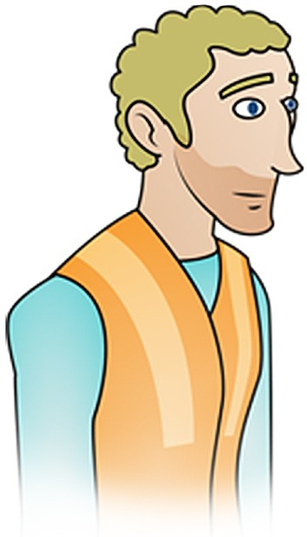
PC 1.2
PLAN TASK
Identifying workplace hazards
Workplace hazards need to be notified before you start work.
Take a good look at your workplace and decide if anything could possibly cause injury to you or anyone else in the area.
Above eye level
You should check above eye level for:
Powerlines
Buildings
Trees
Clearance heights
Other obstructions
Other overhead services
Bridges.
Zones/areas to check for hazards:
Ground to eye level
You should check around eye height for:
Other equipment
Machinery
People
Pedestrians
Things in the path of travel
Other obstructions
Facilities.
Ground level (and below)
You should check the ground to see if:
There is debris or rubbish in the way
The surface is strong enough to support the
weight of any equipment or materials
If there are any open trenches or recently
filled trenches
Underground services.

Slide 7
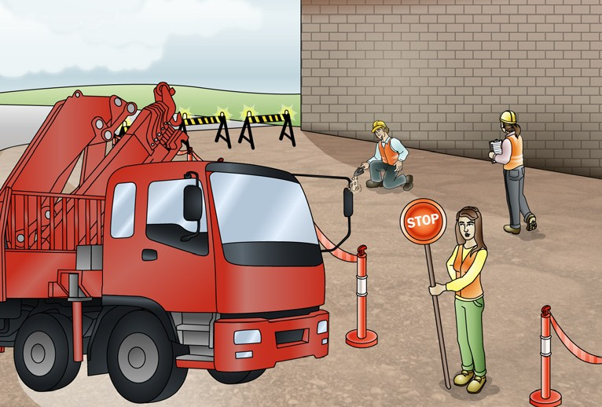
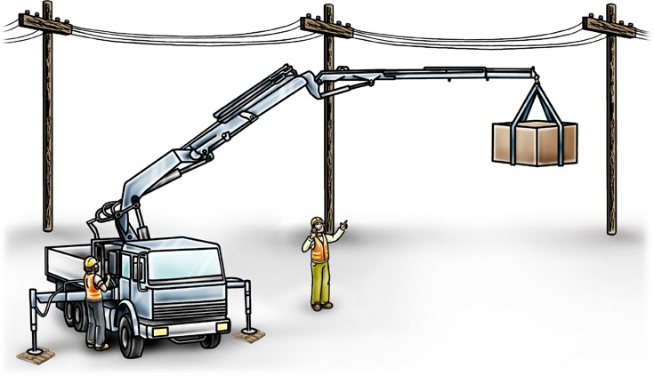
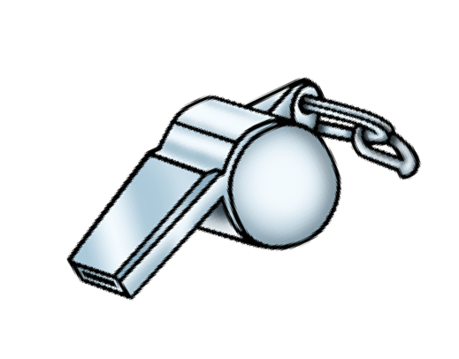
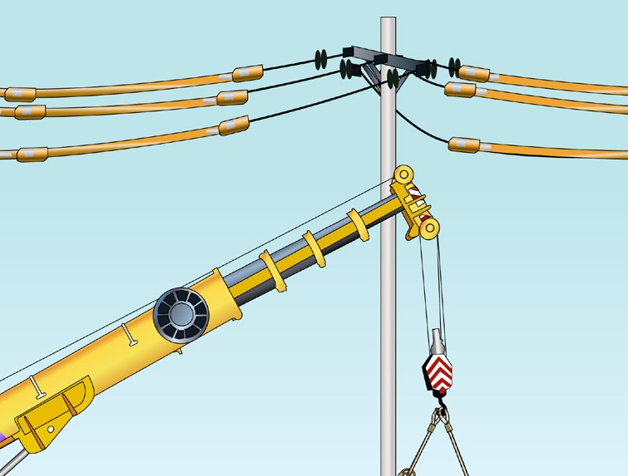
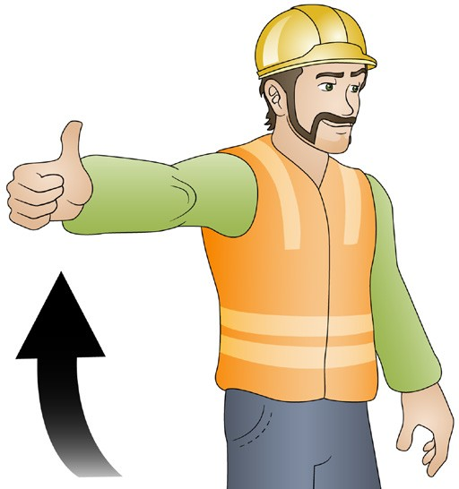
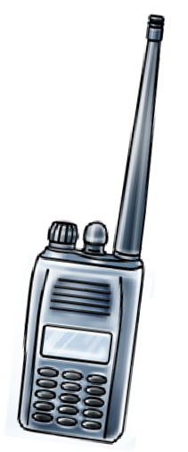
PC 1.2
PLAN TASK
QUESTION 11
You need to plan the path for the crane and load.
What do you need to think about?
Keeping people out of the path way.
Do you need a spotter?
How will you communicate with the crane operator?
Are there any powerlines overhead?
...CONTINUES ON NEXT PAGE

Slide 8
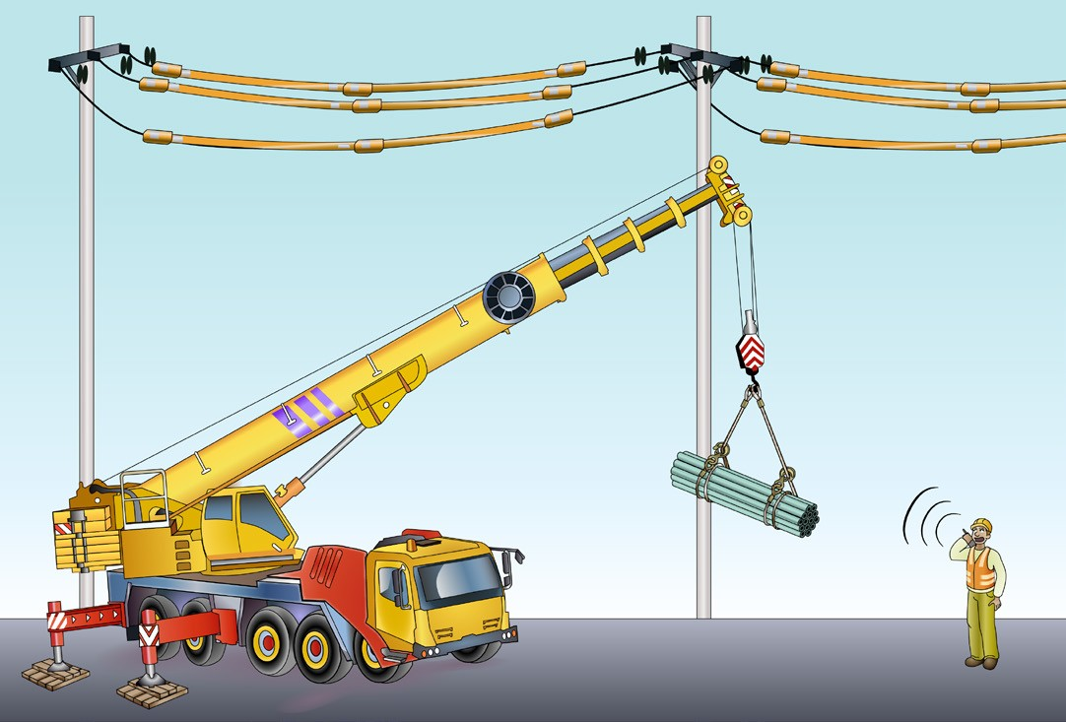
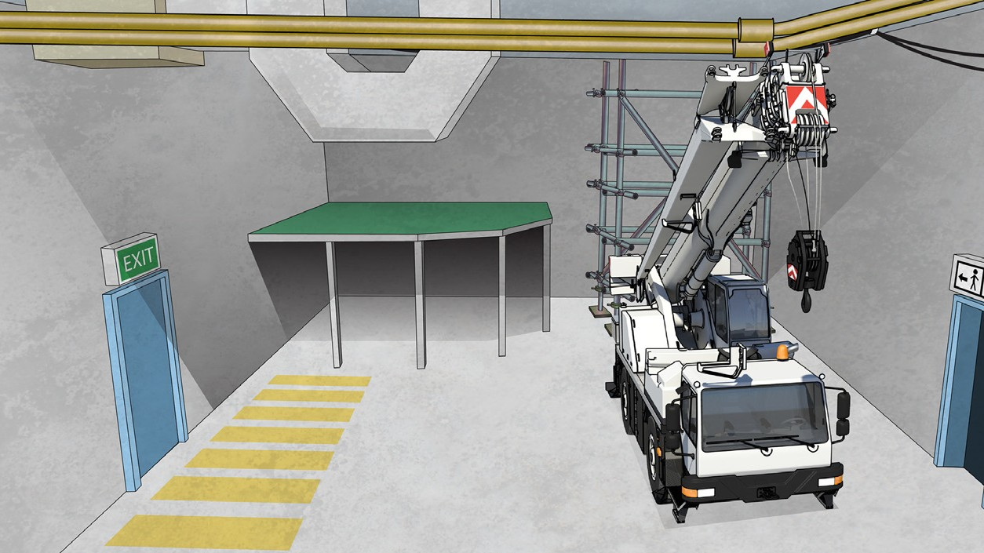
PC 1.4
PLAN TASK
Overhead hazards
Powerlines
Always check the site for overhead powerlines.
You must keep the crane at a safe distance from powerlines at all times.
A crane boom and load can become electrically charged when working near radio, TV or microwave transmitters.
Overhead services
You should check for service pipes for gas, water or electrical cables and direct the crane operator to avoid making contact with any of these with the crane boom or the load.

Slide 9
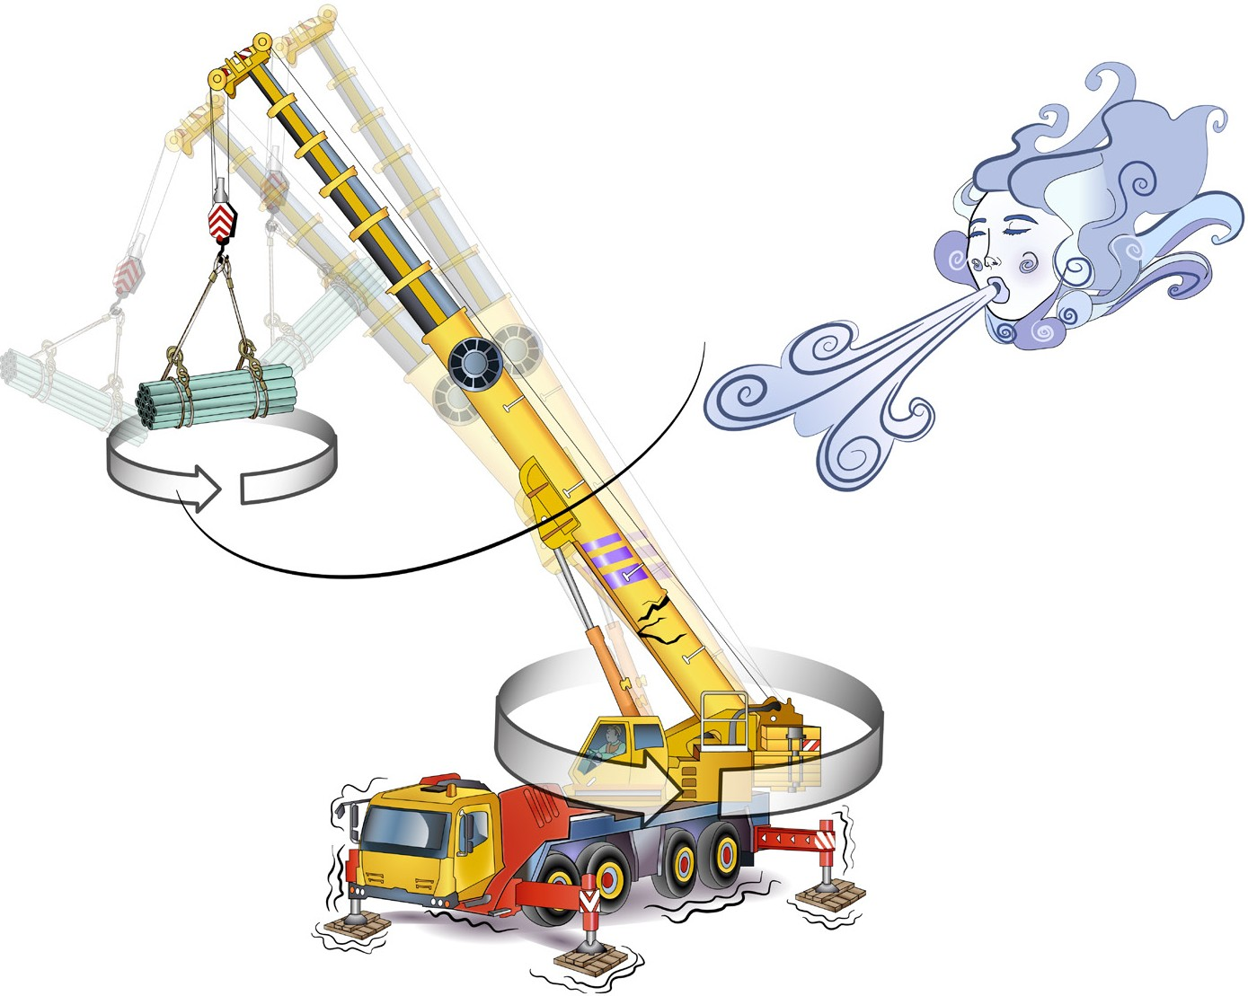
PC 1.4
PLAN TASK
QUESTION 16
A crane is moving a load on a windy day.
What hazards can the wind cause and what controls can be put in place to minimise the risk?
Controls:
Check the crane operator is using slew brakes (if the crane has them)
Use guy ropes and braces
If the wind gets too strong, stop working.
The load could swing
The load could spin
The crane could slew out of control
The crane could become unstable or damaged

Slide 10
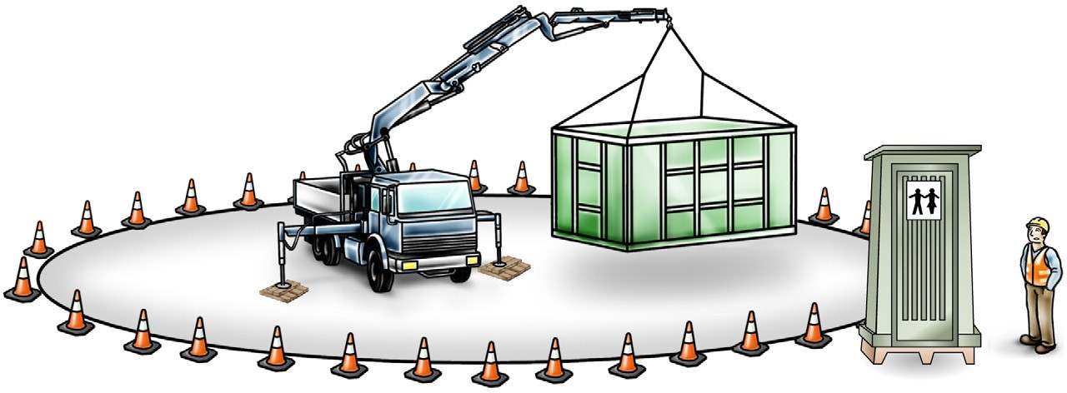
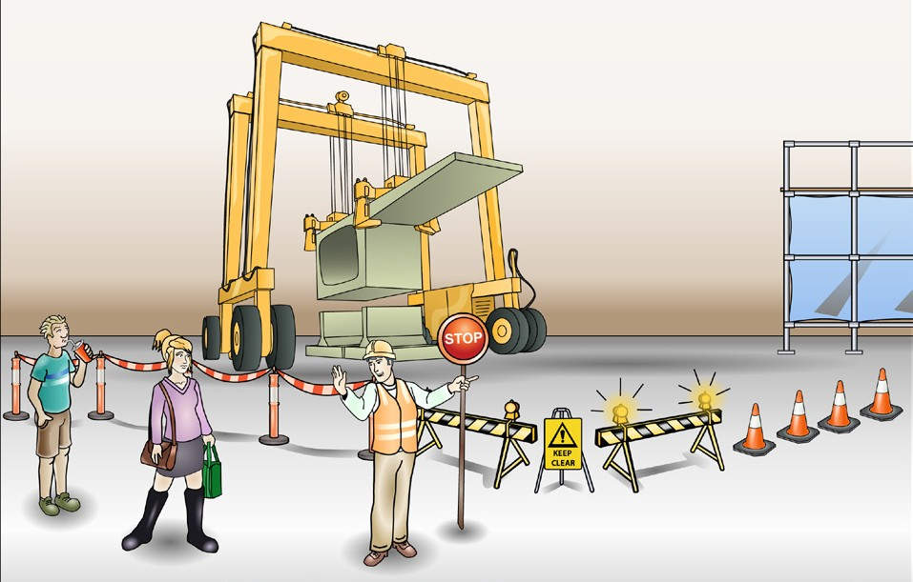

PC 1.4
PLAN TASK
QUESTION 24
What are the hazard and control methods for workmates and things
close to a slewing crane?
The control is to use exclusion zones
– areas where people and unwanted things are kept out
The hazard is that someone or something might get hit by the crane when it is slewing
Exclusion zone
QUESTION 25
How will you keep workers and pedestrians out of the pathway of the crane
and load?
Some methods are:
Flashing yellow hazard lights to warn people
Barricades (safety fences) to protect people
Scaffolding, hoarding or gantry
A flag person to control the traffic. (You might need to be a licensed traffic controller.)
Traffic control such
as witches hats
Warning signs

Slide 11
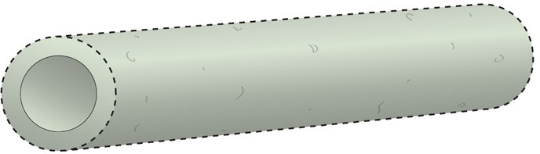
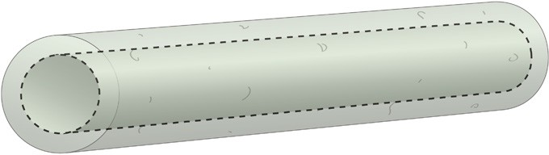

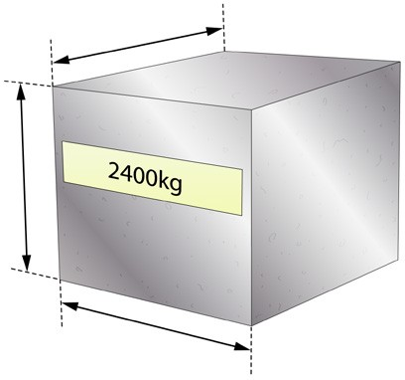


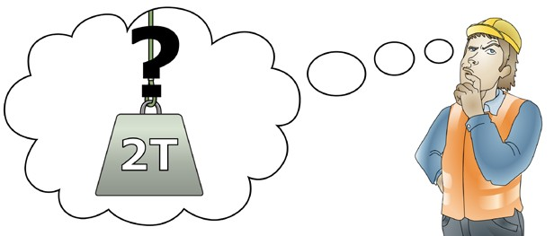
PC 1.5
PLAN TASK
Calculate the volume using Pi as the formula  = 3.14
R = 0.6 m
To work out the volume of the cylinder:
1. Work out the volume of the outer cylinder. R in (m) × R in (m) × 3.14 × L in (m) 3.14 m × 0.6 m × 0.6 m × 5 m = 5.652 cubic metres
2. Work out the volume of the inner cylinder. R in (m) × R in (m) × 3.14 × L in (m) 3.14 m × 0.4 m × 0.4 m × 5 m = 2.512 cubic metres
3. Take the inner circle volume away from the outer circle volume. 5.652 cubic metres − 2.512 cubic metres = 3.14 cubic metres
4. Multiply the volume by the weight of material. 3.14 cubic metres × 2400 kg = 7.536 kg (7.6 t)
R = 0.4 m
1 m
1 m
1 m
Concrete 2400 kg per cubic metres (m³)
Rule of thumb formulas
You can use rule of thumb formulas to work out how much weight a sling can hold, or what size sling you need to lift a certain weight.

Slide 12
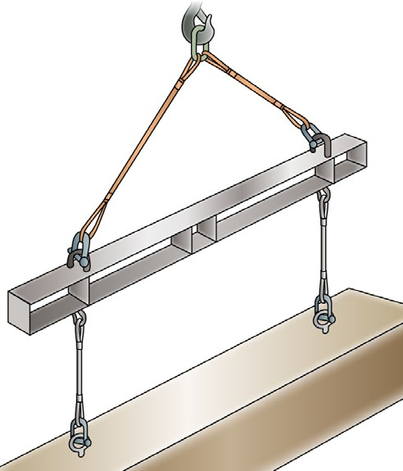
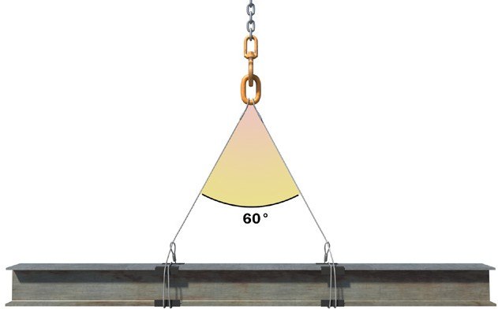
PC 1.5
PLAN TASK
Calculate
Formula = √ Load ÷ Number of slings ÷ 8 2000 kg ÷ 2 = 1000 kg
1000 kg ÷ 8 = 125 kg
√ 125 = 11.180 mm
(Rounded up to 12 mm)
Weight of beam 400 kg
2000 kg (2 T)
Using this total load – Calculate
What is the minimum diameter FSWR required for the slings?
5 metre beam at 85 kg per metre
Part 1
Calculate the weight of the beam
5 m × 85 kg per metre = 425 kg
Calculate the minimum slings required to lift the beam
425 kgs ÷ 8 ÷ 0.5 ÷ 1.73 = √ 61.416 = 7.83 mm
(Rounded up to 8 mm)
FSWR
60°
5 m

Slide 13
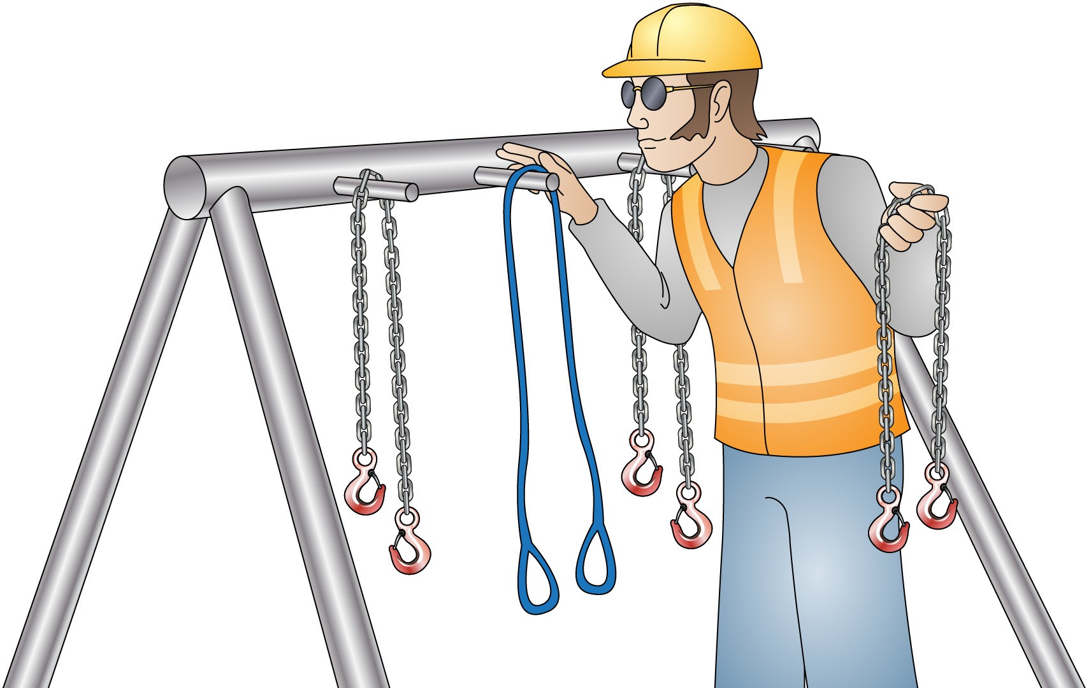
Select and inspect equipment
Element 2

Slide 14
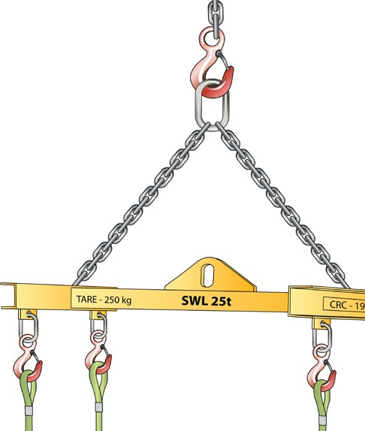
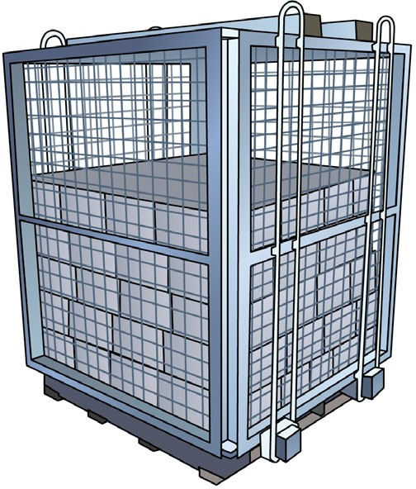
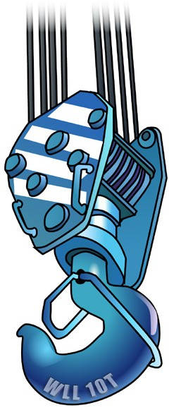
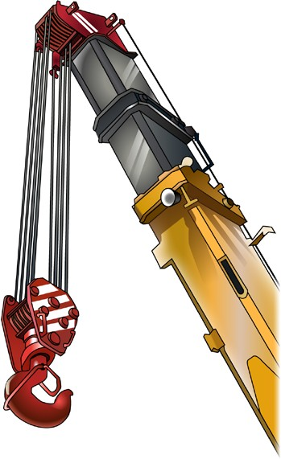
Selecting lifting equipment
PC 2.1 SELECT AND INSPECT EQUIPMENT
Depending on the type, weight and dimensions of the load, different lifting equipment may be needed to move it safely. For example, synthetic slings or FSWR for timber trusses. A pallet cage for a pallet of loose objects.
Check that all the equipment is available before you start the job | The dogger is responsible for inspecting the lifting equipment
All lifting gear that you are using under the hook needs to be added to the weight of the load and checked against the hook and crane that will be used. | All lifting gear you are using below the head of the crane boom is part of load the crane has to lift. Most cranes have multiple hook blocks; each hook block will have its own mass and safe working load.

Slide 15
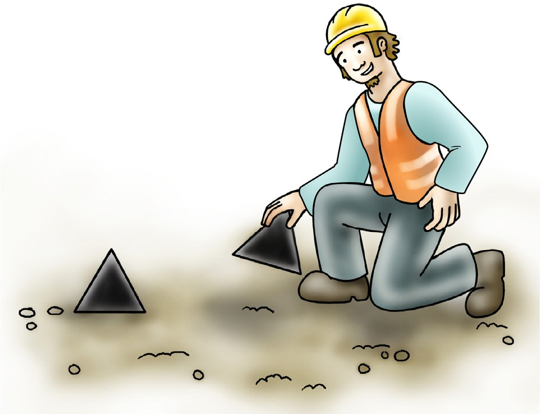
Set up task
Element 3

Slide 16
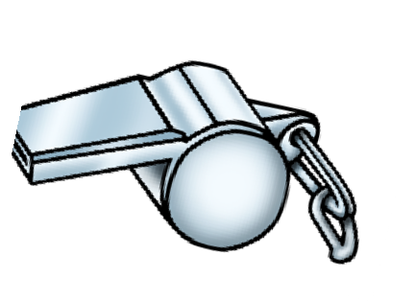
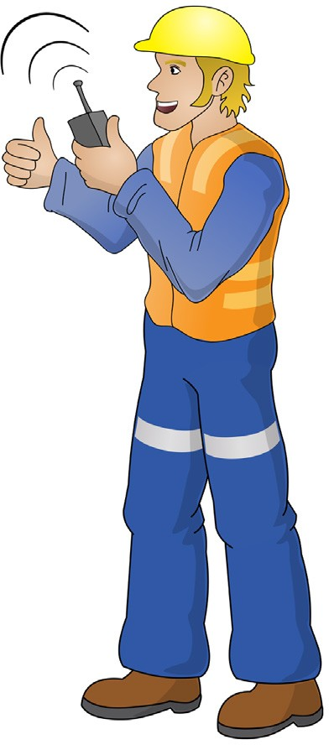
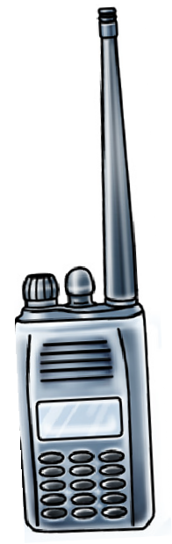
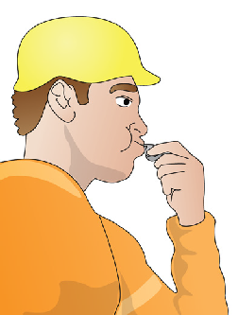
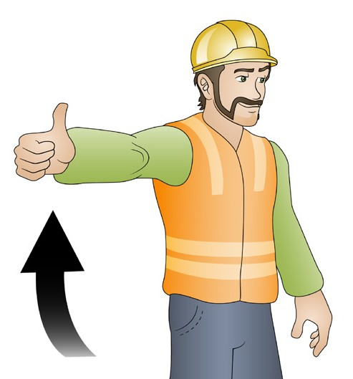
PC 3.1
SET UP TASK
Communication
When planning a job, you will need to think about how you are going to communicate with the crane operator during the lift. There are a number of ways that you can communicate directions or instructions to the driver.
Sometimes the type of communication method depends on the crane that you will be working with and the worksite.
Make sure you listen to information and ask questions if you do not understand what you have been told.
v
v
v
Crane operators and doggers can communicate by two way radio, whistles, horns or hooters when they are out of sight from the person dogging the load.
Doggers can use hand signals if they are in plain view of the crane operator.

Slide 17
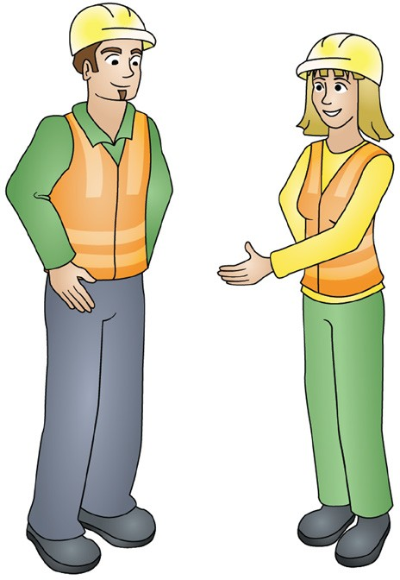
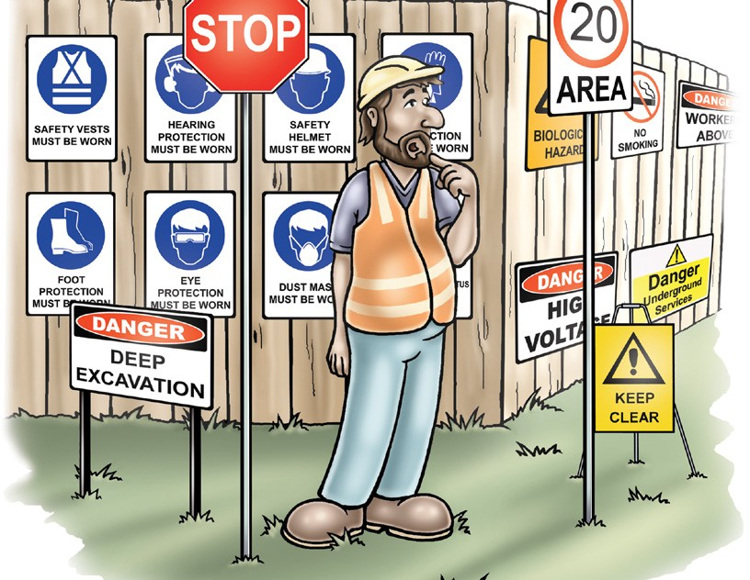
PC 3.1
SET UP TASK
Other personnel
It is important that you include any other people who will be working with you during the lift or who are responsible for the work happening on the worksite.
When planning the job and the methods of communication you are going to use you may need to talk to:
Other doggers
Riggers
Crane operator
Site supervisor
Authorised managers
Other personnel working in the area who may be affected by the crane movement
Any other personnel shown on the Safe work method statement.
Signage
Signage can be used to warn of danger and give instructions or directions.
v
v

Slide 18
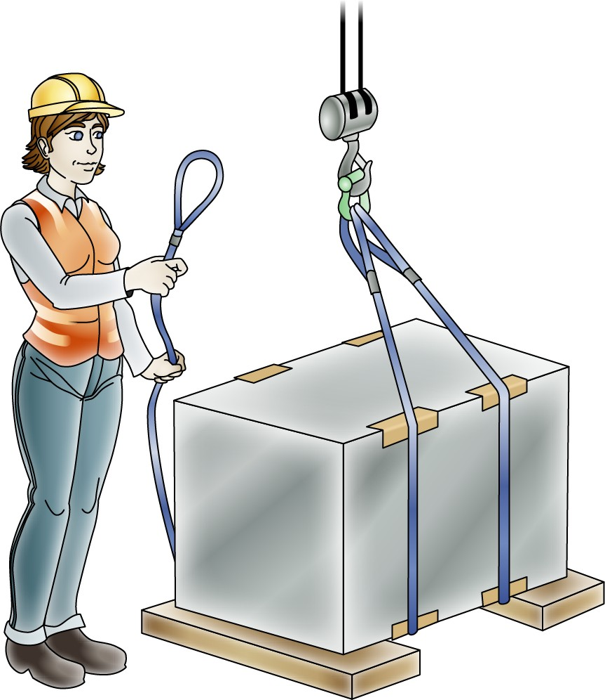
Perform task
Element 4

Slide 19


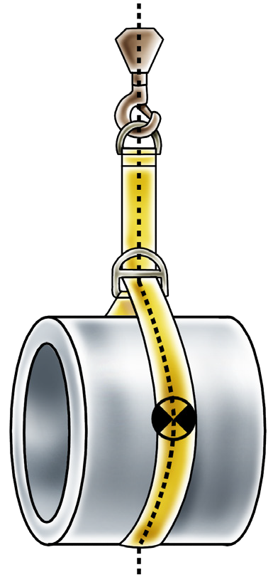
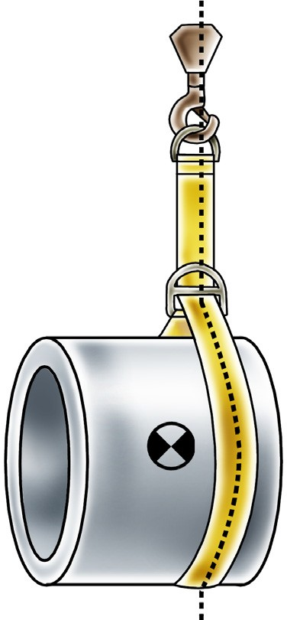
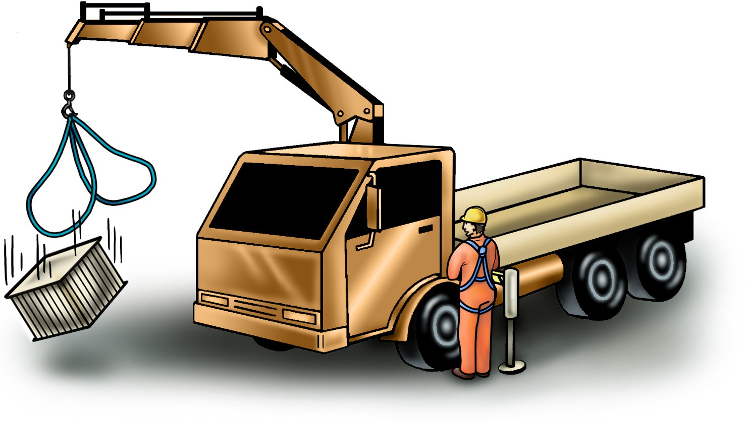

PC 4.1
SET UP TASK
Position the hook above the load
The crane hook needs to be positioned directly above the load centre of gravity and the lifting gear connected.
If the load is not over the centre of gravity the load may try to tip, be snigged (dragged) or swing when lifted clear of the ground.
Do a test lift to make sure the load is balanced, the slings are connected correctly and the load is safe to lift.
v

Slide 20
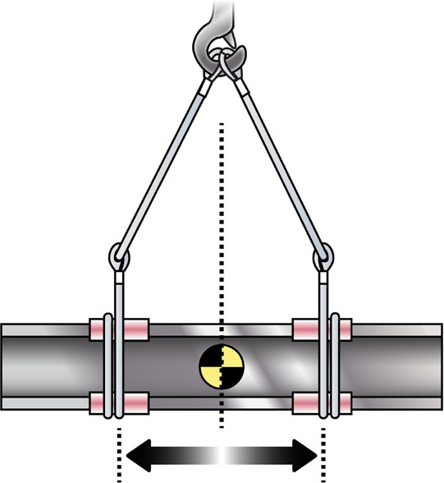
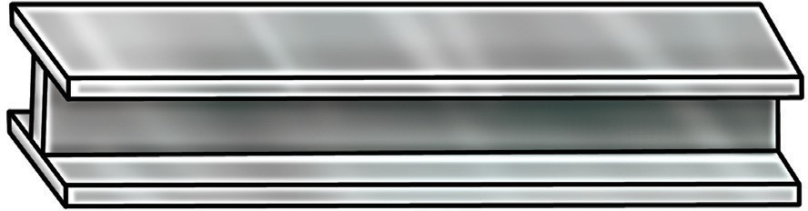


Finding the centre of gravity
PC 4.1 SET UP TASK
Finding the centre of gravity is simple with a regular shaped load. If it is not marked on the load you can measure and/or
calculate to find it.
Measure the length of the beam and halve the measurement to find the centre | Place the slings equal distances from the centre. Make sure the hook is above the centre of gravity.
You can also measure from corner to corner. | The point where the two measurements cross will be the centre.
v
v
v
v

Slide 21


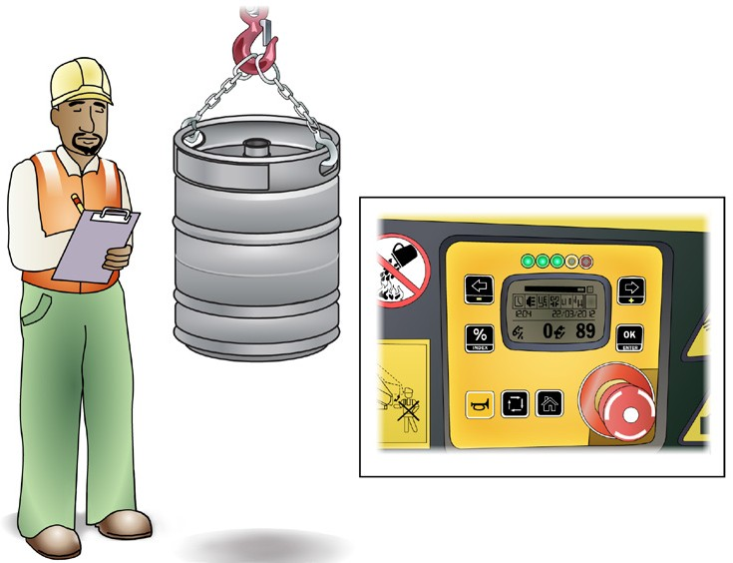
PC 4.1
SET UP TASK
Finding the centre of gravity (continued)
Irregular shaped loads can be more difficult.
This load is an irregular shape and the centre of gravity can be more difficult to find. | It may require an experienced person to find the centre of gravity.
You will need to do a test lift before moving a load to check the balance of the load. This will allow you to make adjustments if the load is unstable.
v
v
v

Slide 22
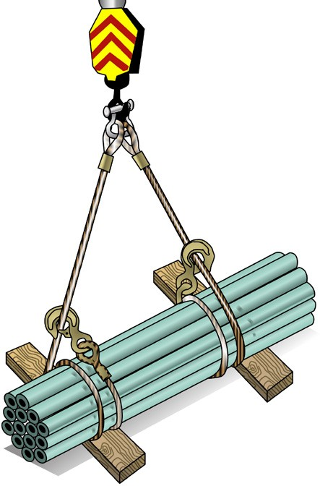
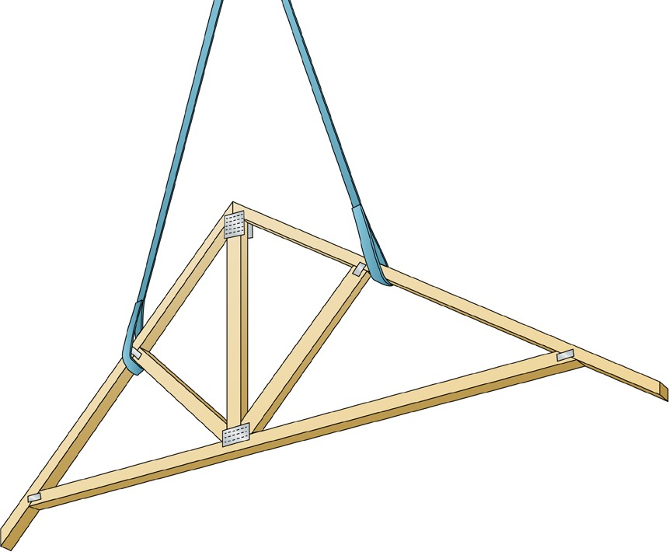
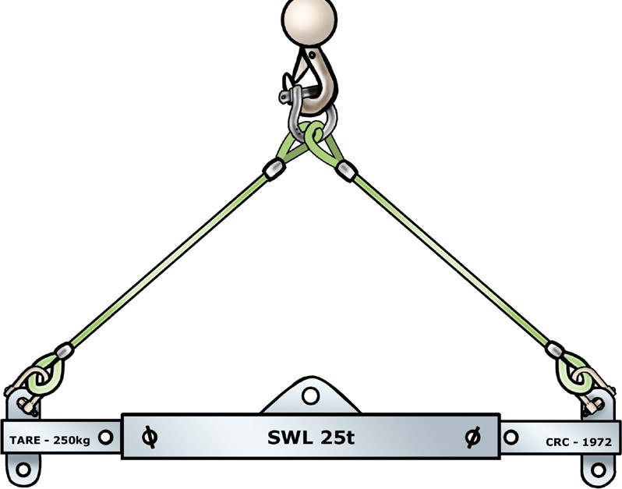
PC 4.2
SET UP TASK
Lifting loads
When lifting loads that can slip or be damaged if not correctly lifted, special equipment or slinging methods should be used.
A load which has parts that can slip should be double wrapped with the sling.
Loads such as roof trusses or air conditioning duct work can be easily damaged by compression forces or unsupported sections bending.
These should be lifted using special equipment such as spreader bars or long slings to reduce the compression forces as slings try to move to directly under the hook.
v
Double wrapped sling
Spreader bar
v
v
Long slings

Slide 23
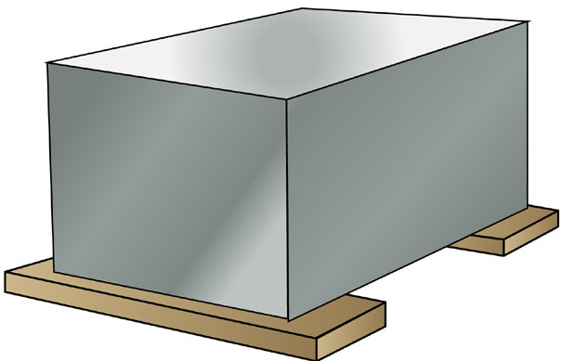




PC 4.6
PERFORM TASK
Prepare load destination
You may be moving a load to a spot on the ground, a loading platform, a suspended
floor or onto a vehicle.
Before you start to move a load you need to make sure the load destination
(the place where you are moving the load to) is ready for the load. The load may need to be landed on supports if the slings can be crushed or jammed preventing easy removal. Loads will need to be chocked if there is any chance of the load rolling.
v
Ground | Loading dock
Suspended floor | Loading onto a vehicle
v
v
v
v

Slide 24

PC 4.7
PERFORM TASK
Releasing a heavy load from the crane hook
You need to control boom deflection when you are releasing a heavy load from the crane hook.
Cranes using a hoist rope
To release the tension from the boom and hoist rope:
Lower the load with the hoist rope until it is resting on the ground.
Lower the boom to release the tension on the hoist rope and sling.
Cranes not using a hoist rope
1. Lower the boom to release the tension on the hoist rope slings. The boom will not be under tension so it will not spring up.
v
v

Slide 25




PC 4.7
PERFORM TASK
Remove the lifting equipment
Disconnect the lifting gear from the load and the crane hook.
v
The hook should be positioned at a suitable height to disconnect the lifting gear.
v
Make sure you do not damage the load or the lifting gear while you are removing or disconnecting it.
Placing the load on dunnage can mean the slings can be removed without damaging them.
If the lifting gear is needed to lift another load, start to re-assemble the lifting gear, otherwise inspect and store the equipment.

Slide 26



Pack up and clean up
Element 5
26

Slide 27




PC 5.1
PACK UP AND CLEAN UP
QUESTION 118
You have finished in the
work area.
What are some examples of cleaning and packing up you might have to do?
Pack up and clean any tools | Pack up extra equipment
Pack up the crane and lifting gear | Clean up any mess
v
v
v
v
27

Slide 28


PC 5.1, 5.2
PACK UP AND CLEAN UP
QUESTION 119
When is the best time to get rid of extra materials around the work area?
v
As soon as you can
v
QUESTION 120
Why must you report any faulty equipment to
your supervisor?
v
Your supervisor will know the site rules (procedures) you must follow when you find a fault with your equipment.
If you ignore faulty equipment, you or one of your workmates could be badly injured or killed.
28

