Slide 1




I
Construction Induction
(White card)
CPCWHS1001
Prepare to work safely in the construction industry
Includes training tasks
Industry Training Resources
Front Cover

Slide 2

Element 1 - Identify health and safety legislative requirements of construction work
This element covers the following performance criteria:
  Basic roles, responsibilities and rights of duty holders are identified and explained according to jurisdictional health and safety legislative requirements.
  Duty of care requirements are identified.
  Construction safe work practices are identified
and explained.

Slide 3
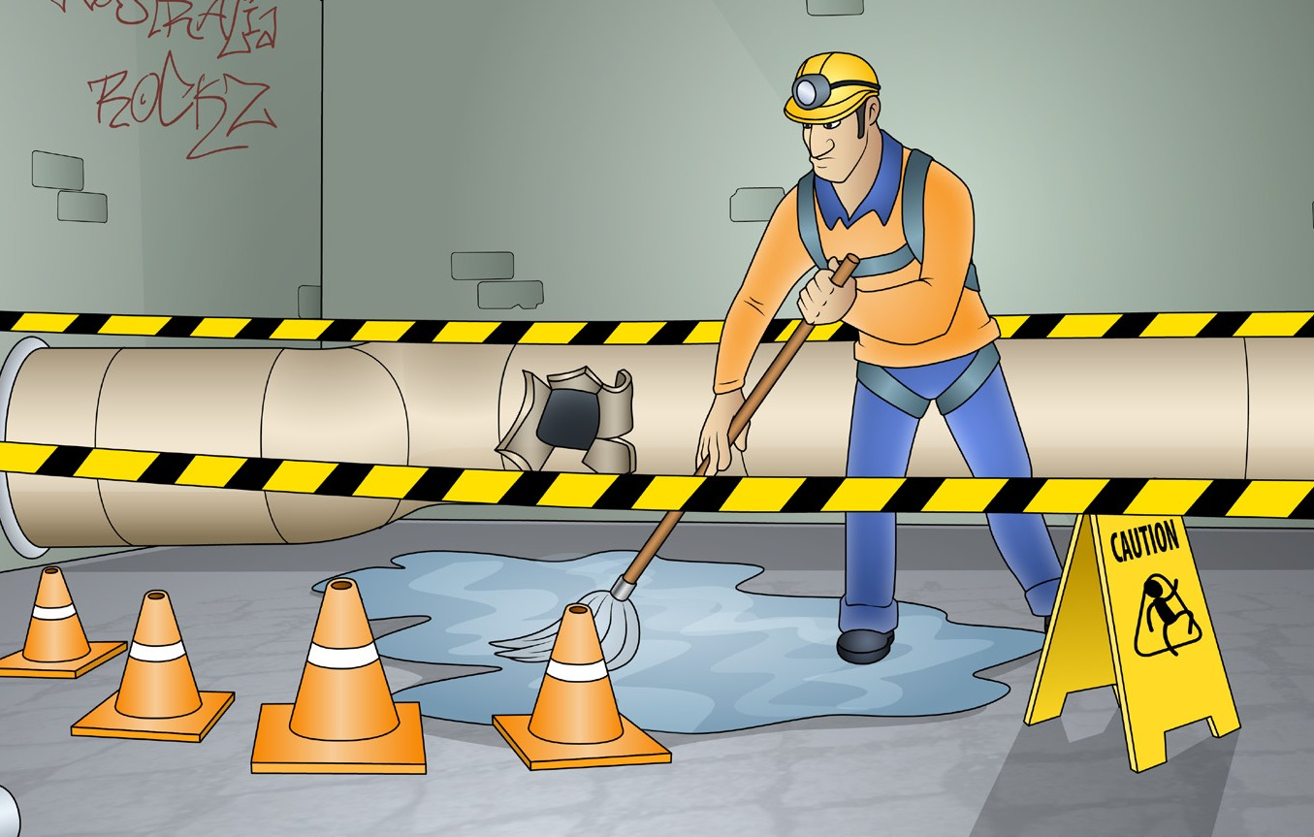
Element 2 - Identify construction hazards and risk control measures
This element covers the following performance criteria:
  Basic principles of risk
management are identified.
  Construction hazards are identified
and discussed.
  Purpose and use of PPE are
identified and demonstrated.
  Measures for controlling hazards
are identified.

Slide 4

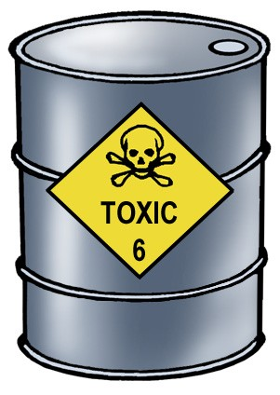
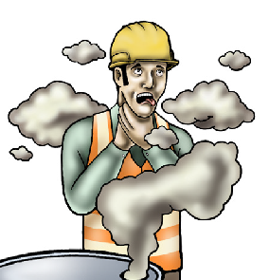
PC 2.1
IDENTIFY CONSTRUCTION HAZARDS AND RISK CONTROL MEASURES
2.1 – Basic principles of risk management
Hazard versus risk
What is the difference?
The constantly changing nature of construction work sets it apart from other types of work. Different hazards and
risks emerge constantly—sometimes instantly.
Co-ordinating risk management is made more difficult by the stop and start nature of a construction project, high
turnover of workers and temporary workplaces. These features contribute to the high levels of risk in the industry.
Hazard
A hazard is any thing or any situation which could injure or harm you.
In other words, it is anything that can hurt you.
Risk
A risk is the chance of a hazard causing injury or harm.
In other words, how likely it is that somebody or something may be harmed by the hazard.

Slide 5
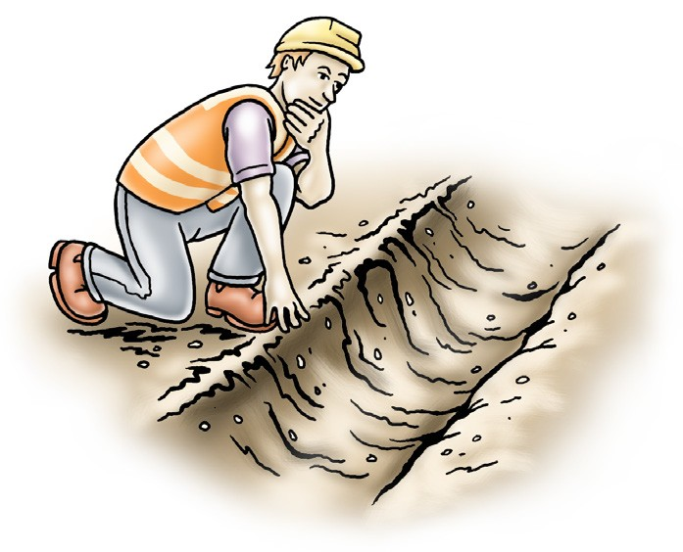
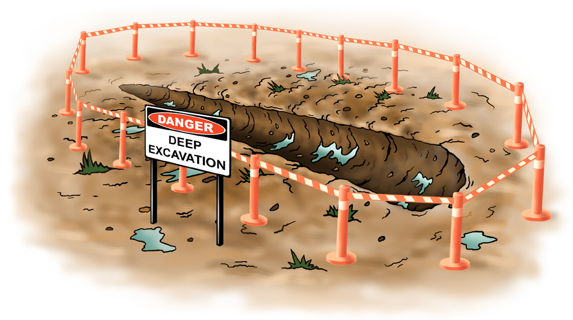
PC 2.1
IDENTIFY CONSTRUCTION HAZARDS AND RISK CONTROL MEASURES
Risk management
Risk management is taking action to make sure you are safe.
Risk management is made up of the following five steps.
Identifying hazards.
Assessing the risk involved.
Talking and reporting to other workers.
Controlling the hazards to lower the risk.
Reviewing the action you have taken.
You can manage the risks caused by hazards by using ‘hazard controls’. For example, the isolation of a trench hazard.

Slide 6

PC 2.1
IDENTIFY CONSTRUCTION HAZARDS AND RISK CONTROL MEASURES
Identifying workplace hazards
A hazard is anything that can harm you or others while you are working. The first thing you need to do is to identify these hazards before you start work.
Take a good look at your workplace and decide if anything could possibly cause injury to you or anyone else in the area.
Above head height
You should check above eye level for:
Powerlines
Buildings
Trees
Other obstructions.
Ground to eye height
You should check around eye height for:
Other equipment
Machinery
People
Pedestrians
Things in the path of travel
Other obstructions.
Ground level (and below)
You should check the ground to see:
If the surface is stable and level
If there are spills or wet surfaces
Is there debris/rubbish
Is the surface strong enough to support the weight of any equipment or materials
Are there trenches or recently backfilled trenches
Is the ground unstable.

Slide 7
PC 2.1
IDENTIFY CONSTRUCTION HAZARDS AND RISK CONTROL MEASURES
Assessing the risk involved — risk assessment
After you have identified a hazard you need to assess the level of risk associated with the hazard.
You may need to talk to other workers or health and safety consultants to get enough information to assess and lower the risk.
Risk assessment is made up of three elements
Probability –
How likely is it that the hazard will cause harm?
Consequence –
How much harm could it do?
Frequency –
How often could people be harmed by it?
 |  | CONSEQUENCES: How severely it hurts someone (if it happens)
Likelihood How likely is it to happen? |  | Insignificant (no injuries) | Minor (first aid treatment only; spillage contained at site) |  | Moderate (medical treatment; spillage contained but with outside help) | Major (extensive injuries; loss of production) |  | Catastrophic (death; toxic release of chemicals)
Almost certain — expected in most circumstances |  | 3 High | 3 High |  | 4 Acute | 4 Acute |  | 4 Acute
Likely — will probably occur in most circumstances |  | 2 Moderate | 3 High |  | 3 High | 4 Acute |  | 4 Acute
Possible — might occur at some time |  | 1 Low | 2 Moderate |  | 3 High | 4 Acute |  | 4 Acute
Unlikely — could occur at some time |  | 1 Low | 1 Low |  | 2 Moderate | 3 High |  | 4 Acute
Rare — may occur, only in exceptional circumstances |  | 1 Low | 1 Low |  | 2 Moderate | 3 High |  | 3 High
Risk Score and Statement
4 |  | 3 |  |  | 2 |  |  | 1
Acute |  | High |  |  | Moderate |  |  | ow
Act now — URGENT | Highest management |  |  | Follow management |  |  | OK for now. Record and
 |  |  |  |  |  |  | review if any equipment/ people/materials/ work process or
Do something about the risks immediately. Requires immediate | decision is required urgently. |  |  | instructions.
attention. |  |  |  |  |  |  | procedure changes.

Slide 8
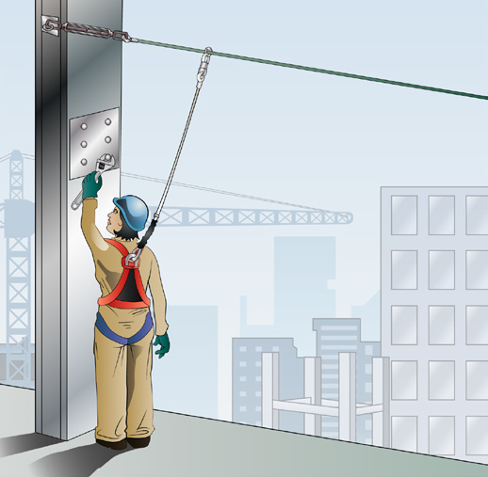
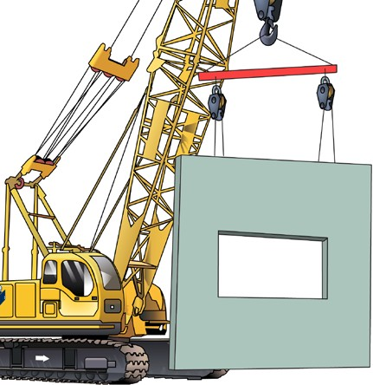
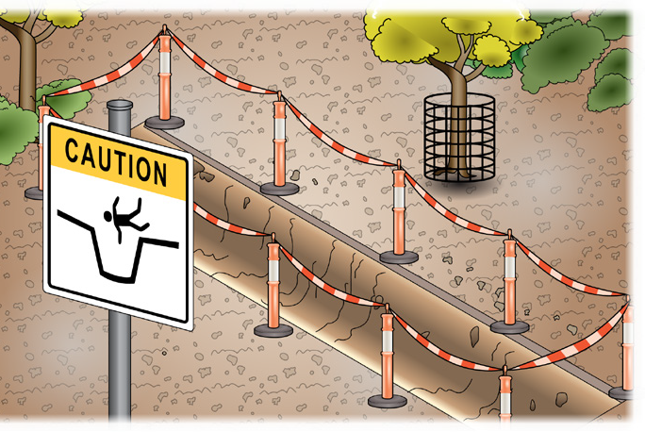
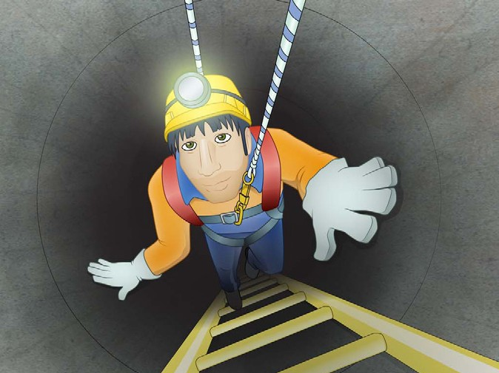
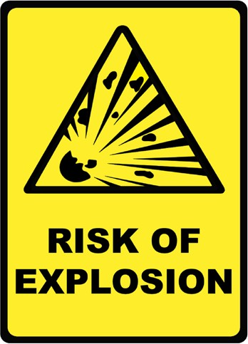
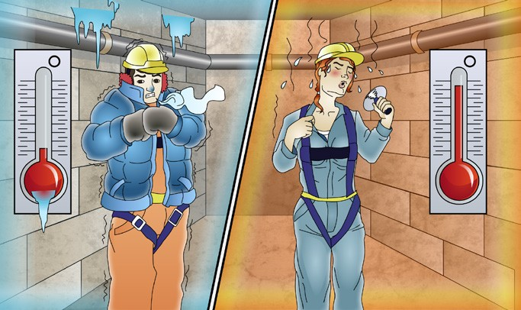
PC 2.1
IDENTIFY CONSTRUCTION HAZARDS AND RISK CONTROL MEASURES
Safe Work Method Statement (SWMS)
One way to identify construction workplace hazards is to use a Safe work method statement (SWMS).
Safe work method statements are required to be completed by employers for high risk construction work such as:
Working at heights | Construction involving tilt-up or precast panels | Trenching
Working in a confined space | Work involving explosives | Working in areas of extreme heat or cold

Slide 9
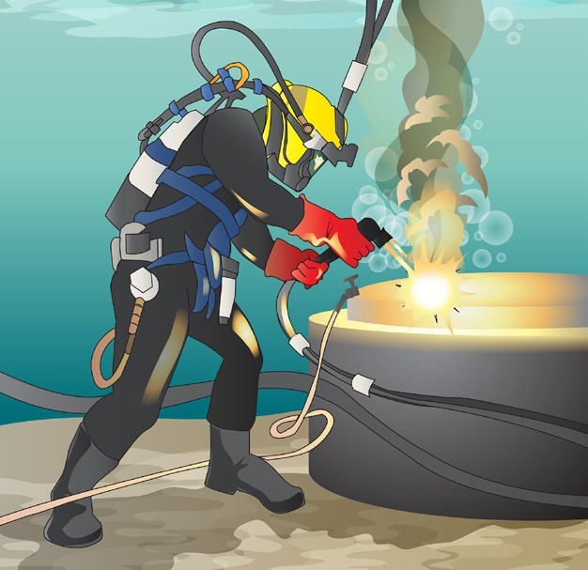

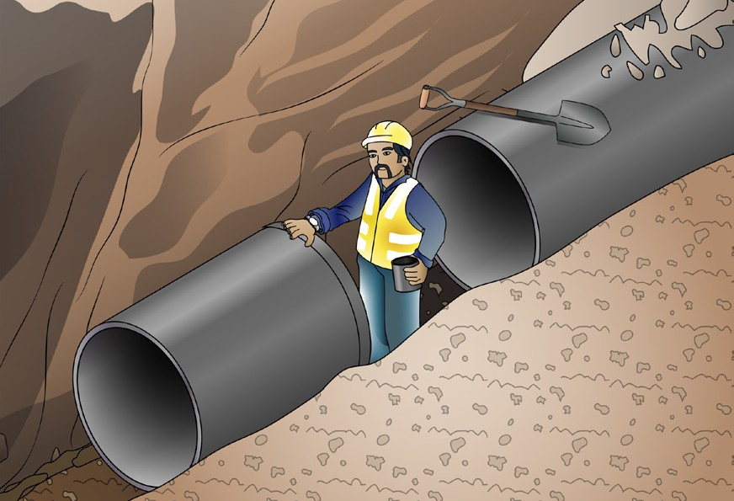
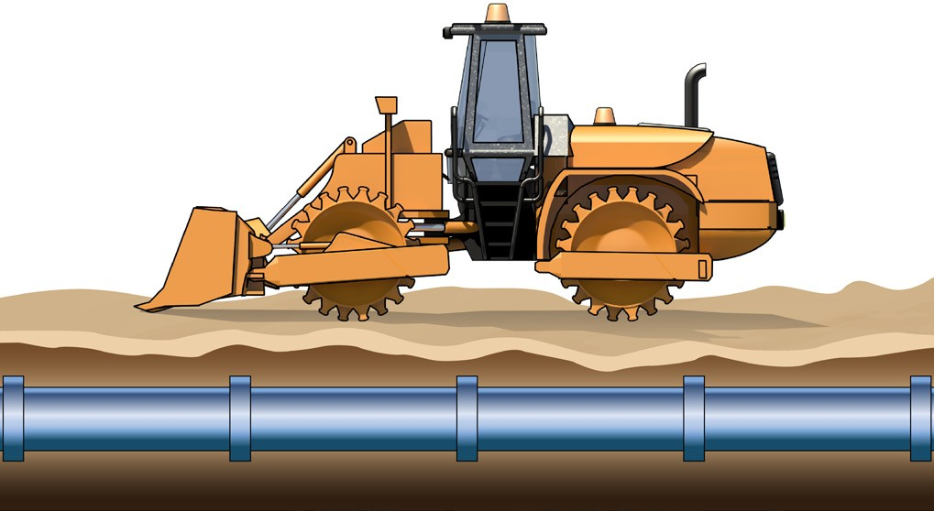
PC 2.1
IDENTIFY CONSTRUCTION HAZARDS AND RISK CONTROL MEASURES
Safe Work Method Statement (continued)
Construction work involving diving | Working adjacent to roadways or railways
Work involving excavation deeper than 1.5 metres | Work on or near chemical, fuel or refrigerant lines

Slide 10
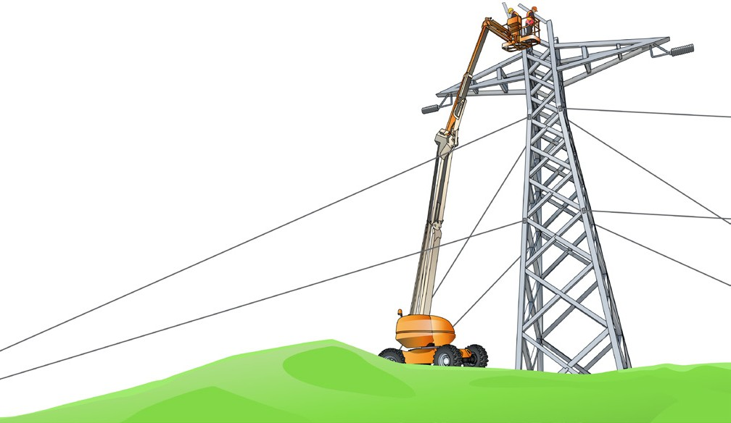
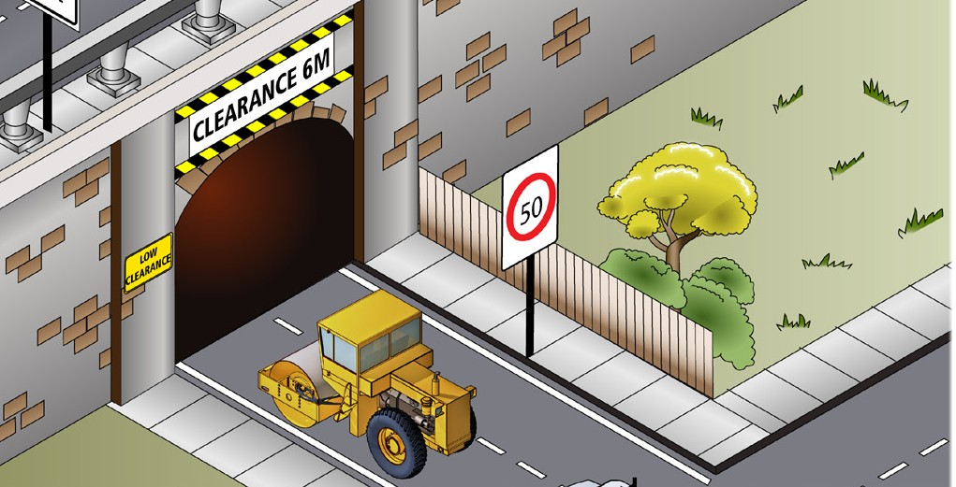
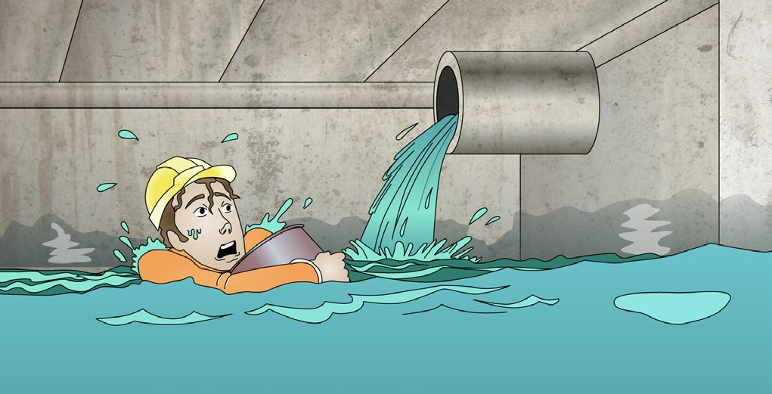
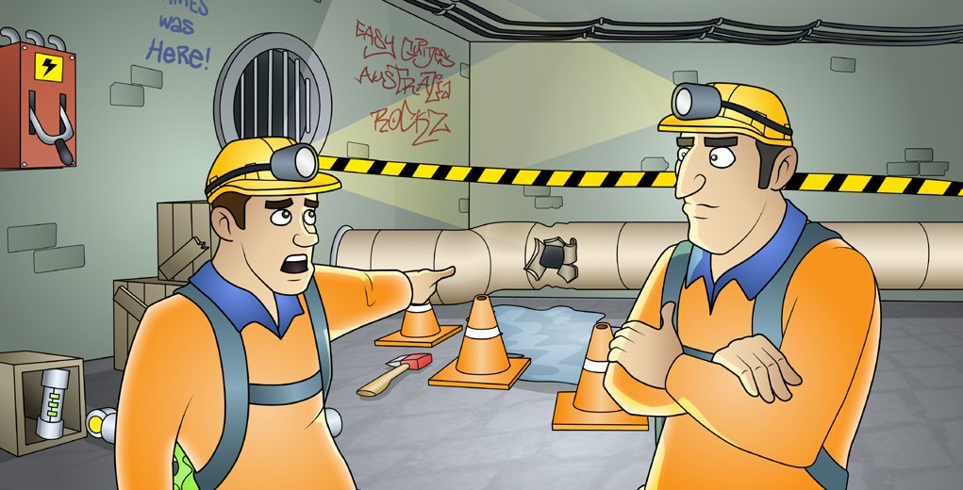
PC 2.1
IDENTIFY CONSTRUCTION HAZARDS AND RISK CONTROL MEASURES
Safe Work Method Statement (continued)
Construction of tunnels | Construction work on telecommunications towers
Working where there is a risk of drowning | Working in an area that may be contaminated.
Safe work method statements must contain certain information but can be as short or complex as they need to be to control the hazard or risk.

