Slide 1

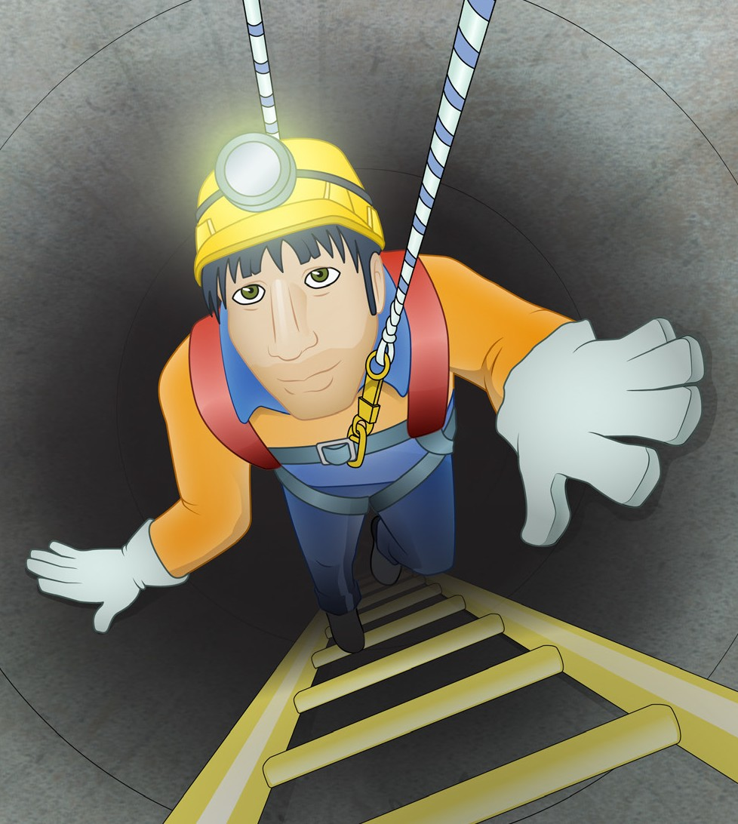


Confined Spaces Learner Guide
Training support material for:
RIIWHS202D
Enter and work in confined spaces
Produced by:
Industry Training Resources
Picture based. Plain English. Learning made

Slide 2
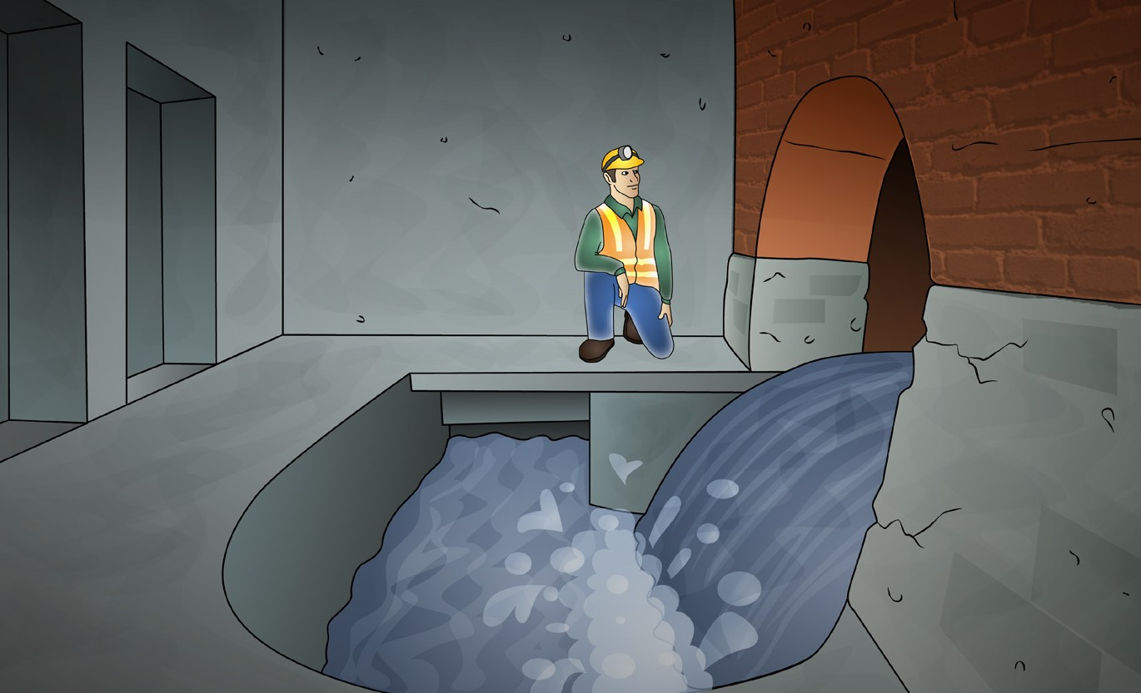
Introduction to confined
spaces
2

Slide 3
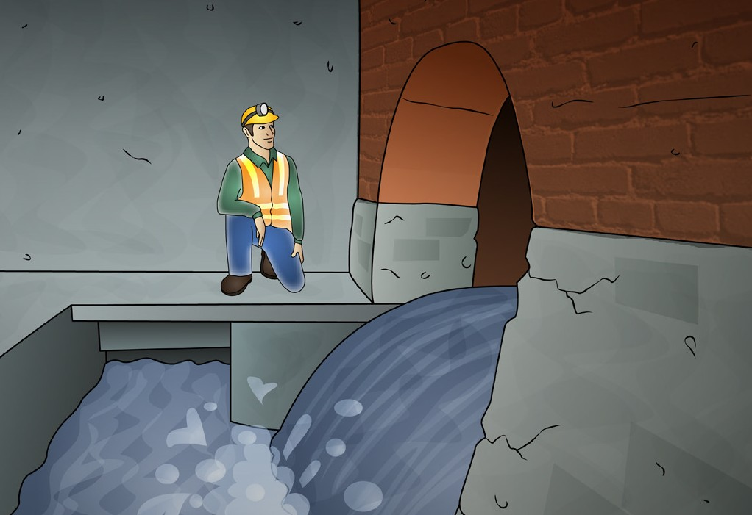
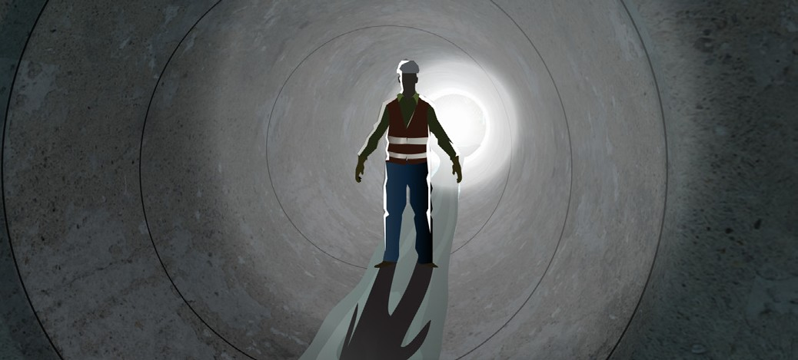
What ‘enter and work in a confined space’ means
INTRODUCTION TO CONFINED SPACES
A confined space is an area which is enclosed. It is not designed for people to go into. It may be hard to get in and out of because of a small or blocked entry/exit.
A confined space has one or more of these dangers:
Entering a confined space means your head or upper body go into the space.
Confined spaces may include:
A dangerous level of oxygen
Something in it (like a gas) that could cause a fire or explode
Contaminants such as gasses, vapours or dust
Something that could engulf (surround) you and
make it hard to breathe.
Storage tanks, tank cars, process vessels, boilers, pressure vessels, silos and other tank-like compartments
Open-topped spaces such as pits or degreasers
Pipes, sewers, shafts, ducts and similar structures
Shipboard spaces entered through a small hatchway or access point, cargo tanks, cellular double bottom tanks, duct keels, ballast and oil tanks and void spaces (but not including dry cargo holds).
3

Slide 4
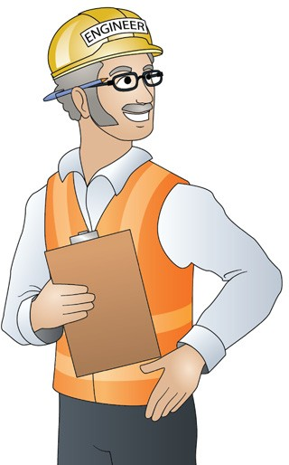
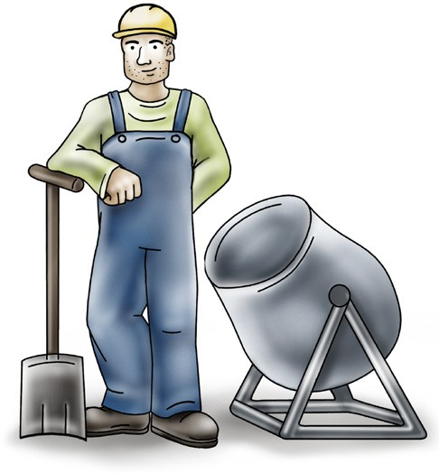
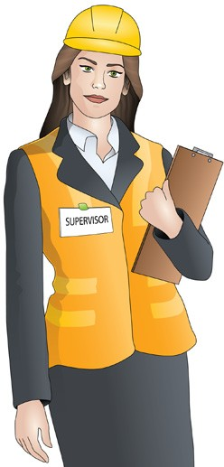
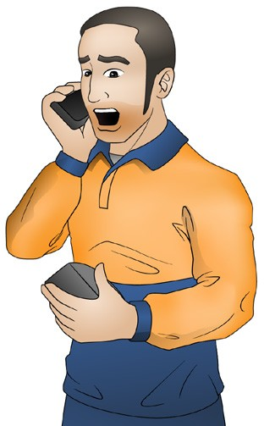
PC 1.1
INTRODUCTION TO CONFINED SPACES
Confined spaces and the law (continued)
Health and Safety regulations
The Health and Safety regulations have special rules for confined spaces. There are different rules for:
Employers/PCBUs – Person conducting a business or undertaking | Workers/employees
Officers – People like company directors | Designers, manufacturers and suppliers
4

Slide 5
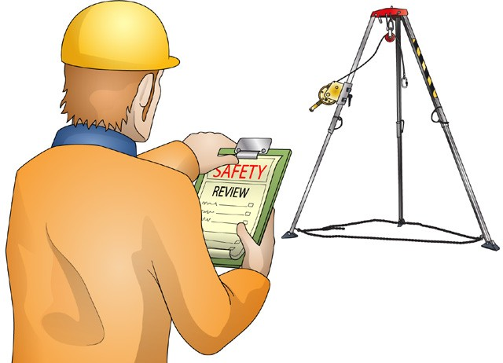
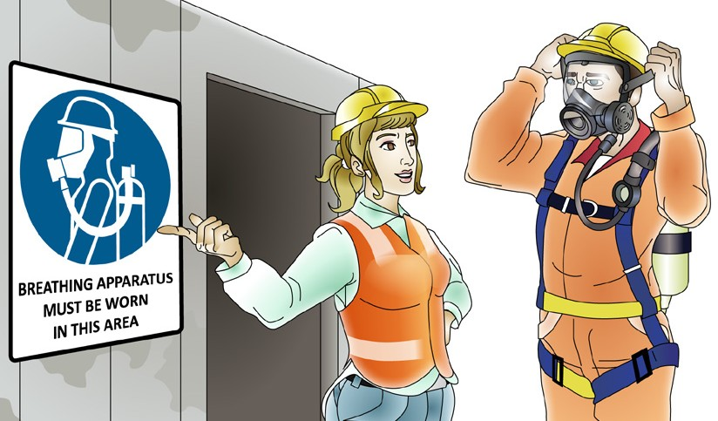

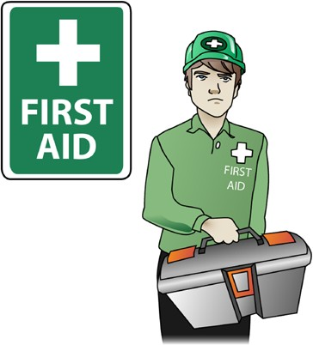
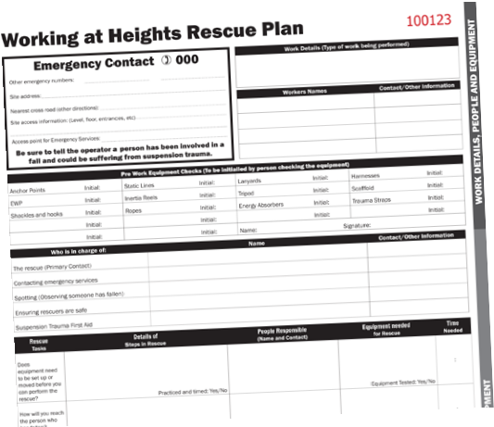
PC 1.1, 1.5
INTRODUCTION TO CONFINED SPACES
Employers/PCBUs
As an employer or a person conducting a business or undertaking (PCBU) you must:
Find the hazards and risks with work in confined spaces at your workplace | Try and get rid of the risks. If you cannot get rid of the risk, then find a way to lower the risk.
Make sure people who enter a confined space follow the safety rules. They must use safe equipment They must work safely They must fill out and follow the entry permit. | Have a first aid plan and a rescue plan in case of an emergency. Your workers should practice the plan. This makes it quicker to rescue someone in an emergency.
5

Slide 6
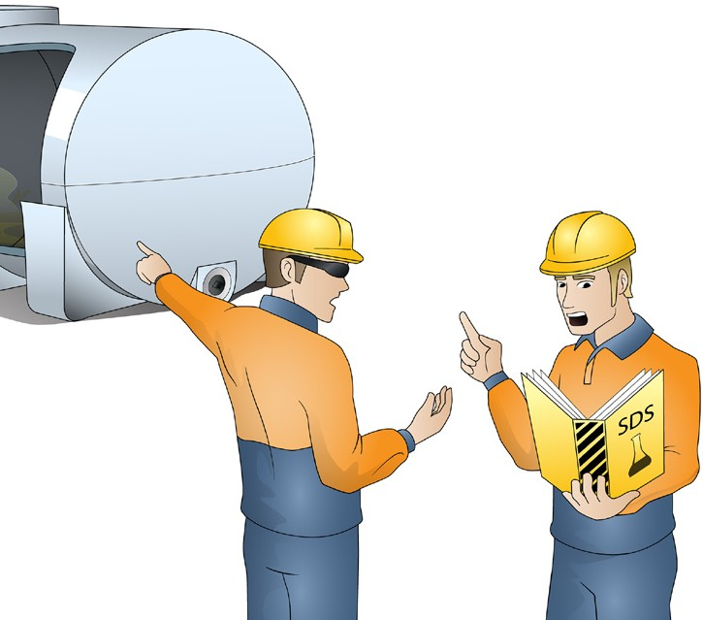
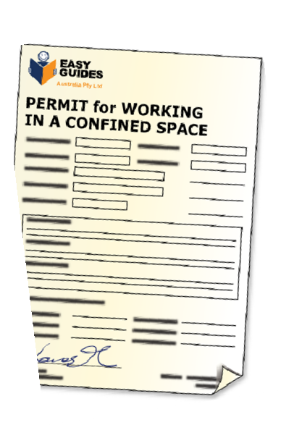
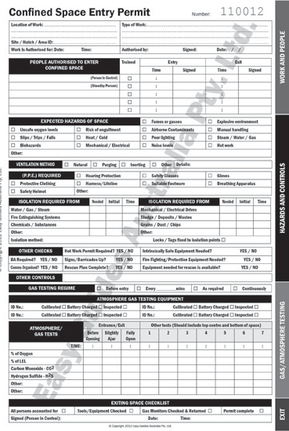
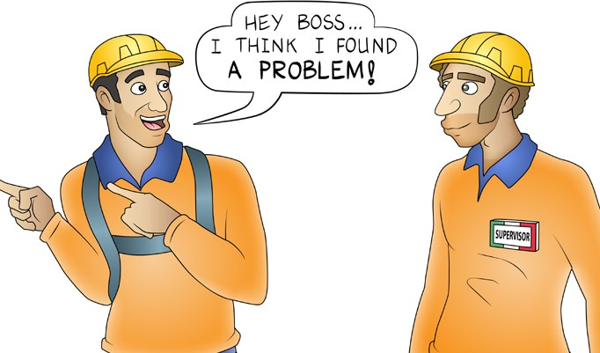
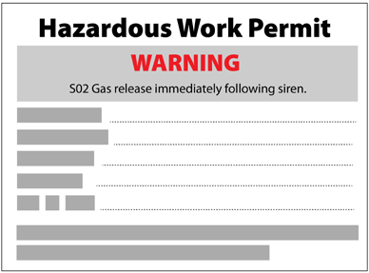
PC 1.1, 1.5
INTRODUCTION TO CONFINED SPACES
Employers/PCBUs (continued)
Train your workers and instruct them on what to do. You must tell them about any hazards, risks and control measures They must know the procedure (what to do) if there is an emergency You must tell them about any special rules they need to know You need these rules on the confined space entry permit
Review the way you control risks and find hazards. See if you can find a better or safer way If you find a way to make the work safer, you must update your risk control measures. | Keep records about the work you do in confined spaces.
6

Slide 7
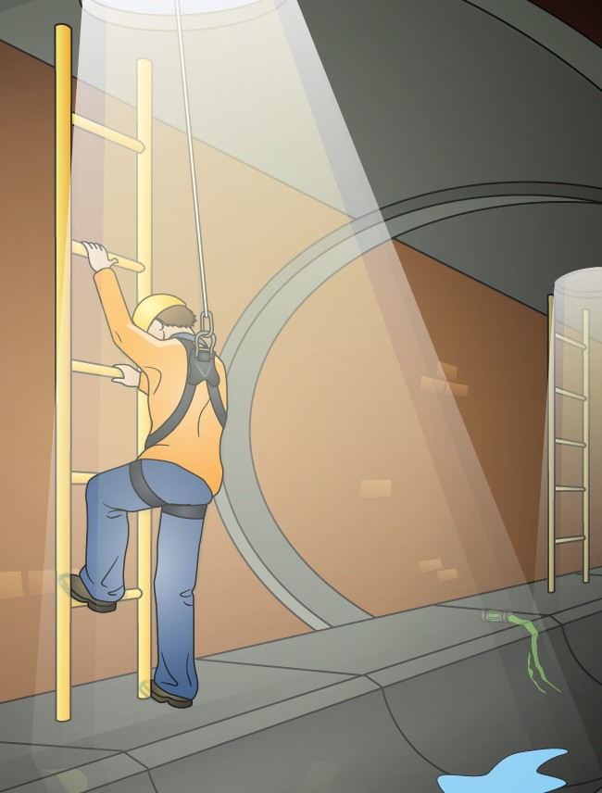
PC 1.1, 1.5
INTRODUCTION TO CONFINED SPACES
Designers, manufacturers and suppliers
You must follow rules if you design, manufacture (build) or sell something.
You must try to make it so that people do not need to go into a confined space. For example, some silo’s will have a device that tells you how much grain is in it. This stops people needing to go into the silo to check.
If you must go into a confined space make sure:
Nobody can accidently go into the space. Place warning signs.
There is a safe way to get in and out of the confined space. For example, you might need handrails, walkways, ladders etc.
You reduce the health and safety risks with the space if you can. For example, you might put in extra ventilation.
The entrances and exits are large enough so it is easy for people to get in and out. You must think about equipment people might need to wear or carry into the space. The entrances and exits must be large enough to allow for a rescue in case of an emergency.
Fittings do not block the entrance or exit. This can make it hard to rescue someone in an emergency.
There are plenty of entrances and exits. For examples, a gas main or sewer might need many access points. This helps for rescues, and allows better airflow.
7

Slide 8
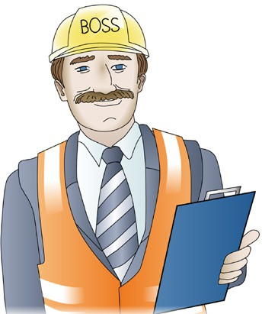
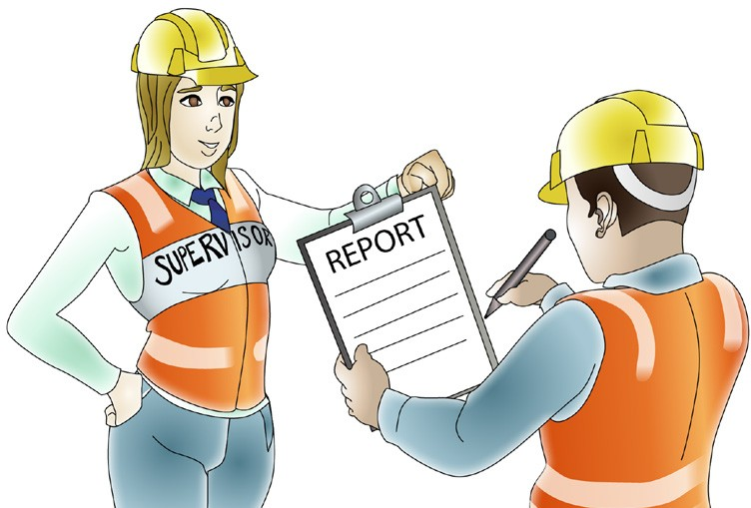
PC 1.1
INTRODUCTION TO CONFINED SPACES
Officers
Officers mean people who run companies, for example company directors. They must:
Make sure their business meets the health and safety laws
Try to reduce risks with confined spaces
Use a process (a way to do the work) or equipment to help reduce risks
Make sure their workers follow the process.
Workers
Workers must take care of their own health and safety. They must also take care of the health and safety of others. When you work in a confined space, you must also:
Follow any safe work practices and safety instructions
Follow the instructions on the entry permit
Follow the risk control and emergency plan
Follow your confined space training.
8

Slide 9
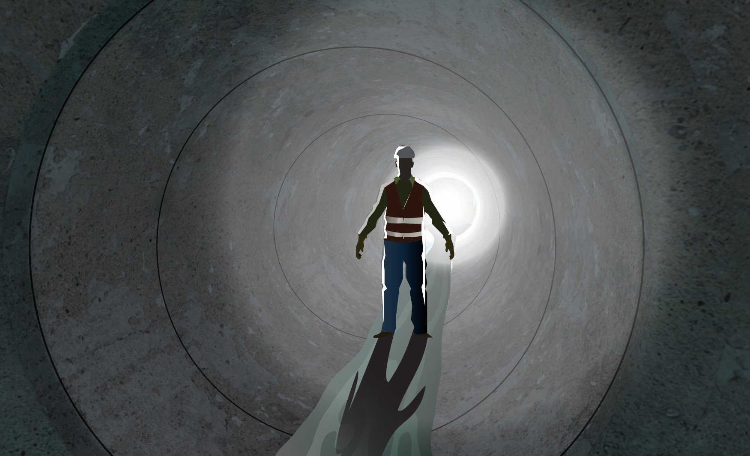
About confined spaces
9

Slide 10
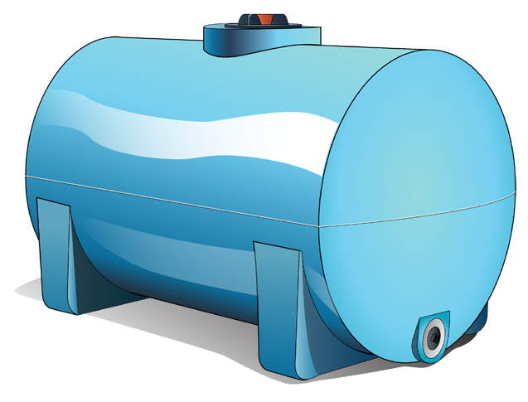
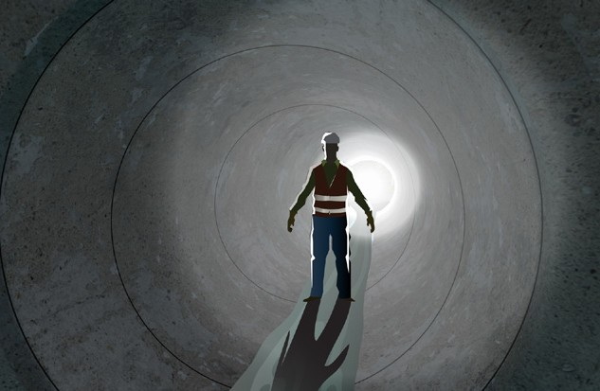
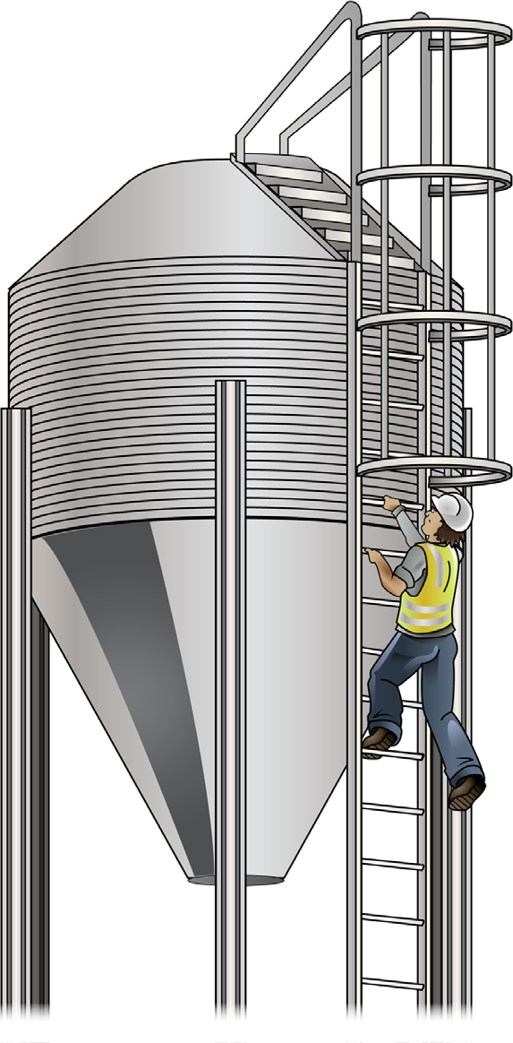
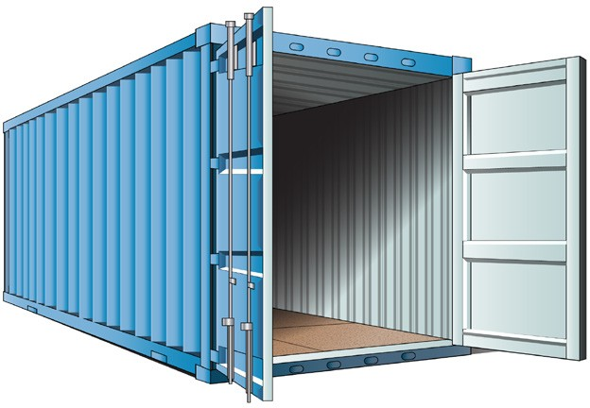
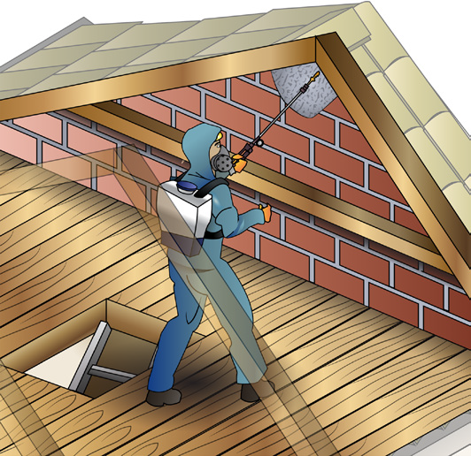
PC 2.1
ABOUT CONFINED SPACES
What are some examples of confined spaces?
Water or storage tanks
Ducts
Silos
Shipping containers
Roof or floor cavity
10

Slide 11
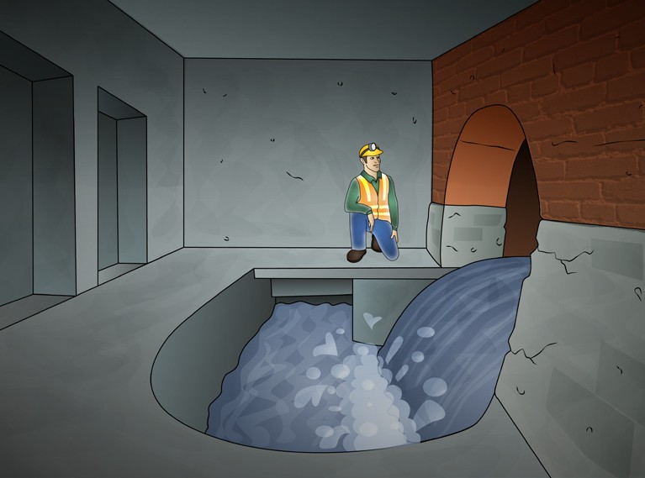
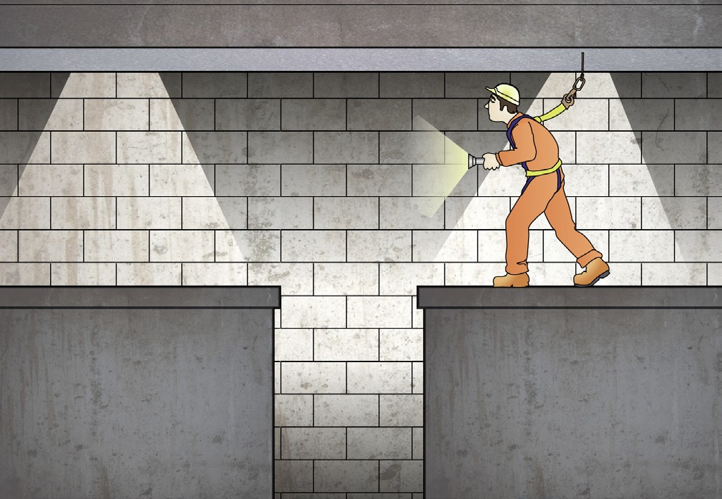
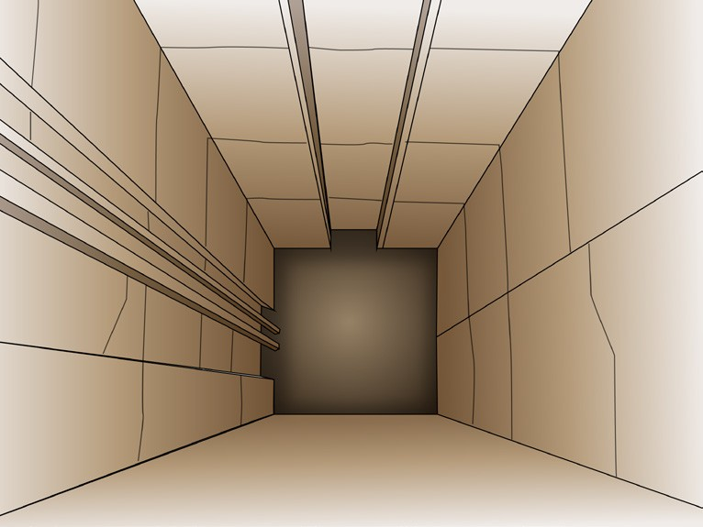
PC 2.1
ABOUT CONFINED SPACES
Examples of confined spaces (continued)
Underground sewer
Trenches, tunnels or pipes
Shafts or wells
11

Slide 12
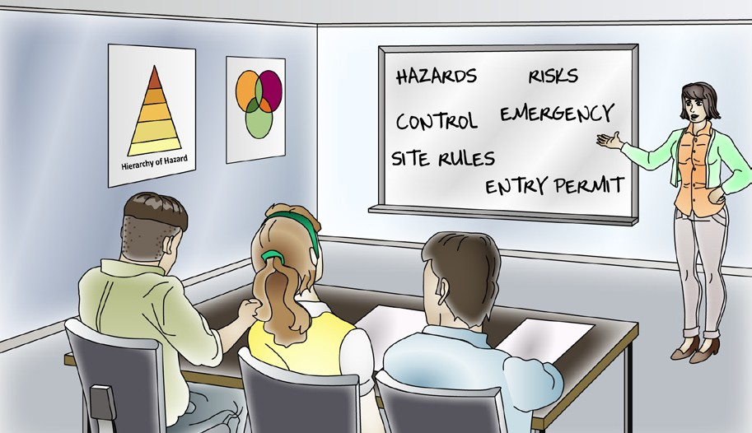
PC 2.1
ABOUT CONFINED SPACES
How can you tell if a space is a ‘confined space’?
To work out if a space is a confined space you should use a Confined space identification checklist. This form will help you work out if the space is a confined space.
For example:
 | Confined Space Criteria |  |  |  |  |  | Confined space?
 | For the work area to be considered a ‘confined space’,
 | you must answer ‘YES’ to all 3 of the following, and, |  |  | any one of the following
Description of the space and work | A | B | C | D |  |  | If you answer yes to A, B, C and at least one of D, then the space is a confined space.
 | Is the space enclosed or partically enclosed? | Is the space not designed or intended to be occupied by a person? | Is the space designed or intended to be, at normal atmospheric pressure while any person is in the space? | Does the space represent a risk from:
 |  |  |  | Harmful airborne contaminants | An unsafe oxygen level | Engulfment
Entering a silo to clear a
Inspecting a sewer
Workers must take care of their own health and safety. They must also take care of the health and safety of others.
When you work in a confined space you must:
Follow any safe work practices and safety instructions
Follow the instructions on the entry permit
Follow the risk control and emergency plan
Follow your confined space training.
12

Slide 13
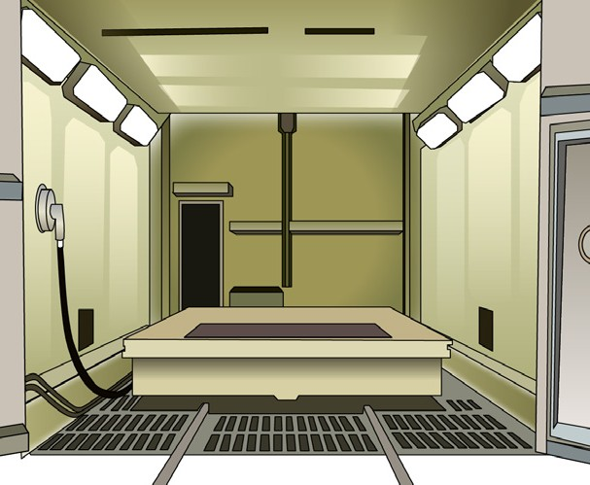
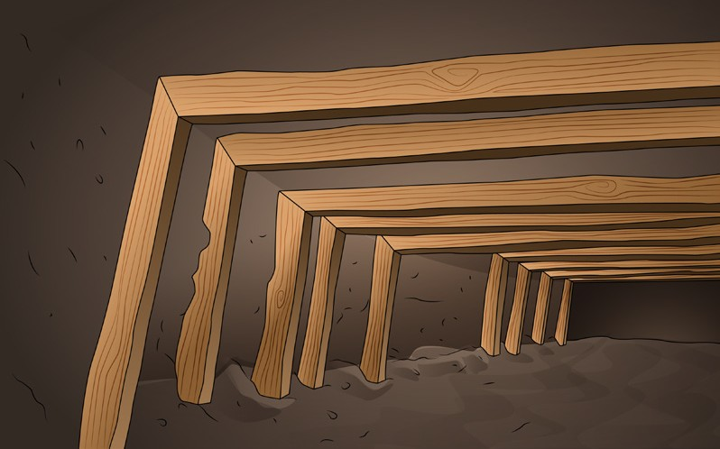
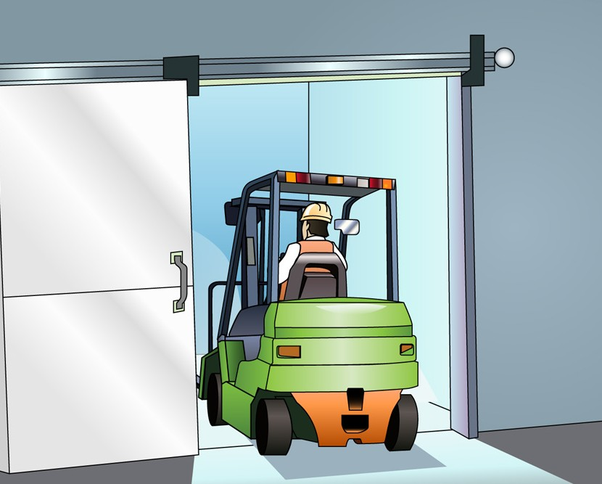
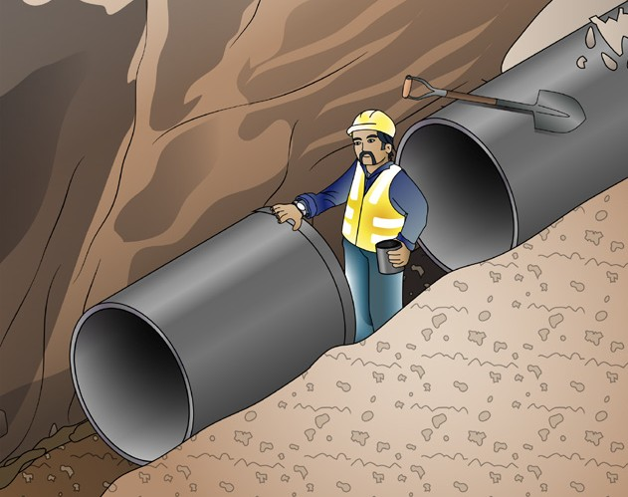
PC 2.1
ABOUT CONFINED SPACES
Some spaces are NOT considered confined spaces
If a space is supposed to have people go into it, it is not always a confined space under the WHS act. The space must have safe entrances, exits, good lighting and airflow.
Some examples are:
Spray booths or sand blasting booths | Mines
Cool stores (that have large doors for access) | Trenches As long as they do not have any dangerous gasses or fumes.
Sometimes you may not be sure if a space is a confined space or not. If you are not sure, it is safer to treat the space as a confined space.
13

Slide 14

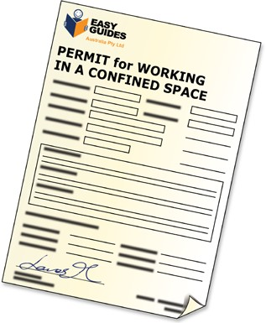
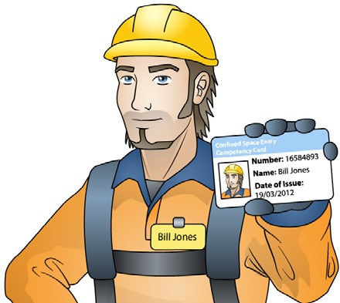
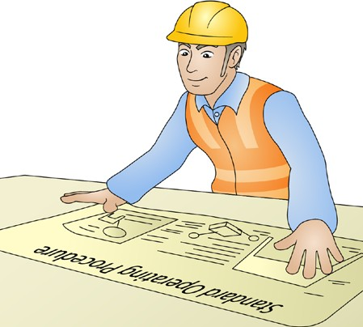
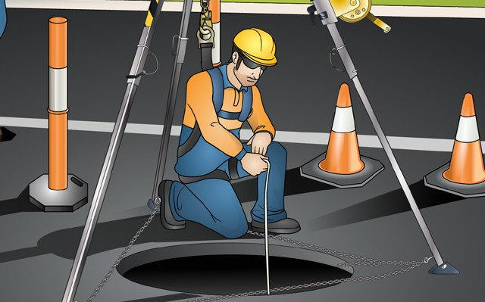
PC 1.1, 1.2,
ABOUT CONFINED SPACES
If you decide a space is a confined space
If you decide that a space is a confined space there are rules you must follow.
You need to put up signs and barricades warning of the danger | You need an entry permit system
You need to make sure people have the right training to work in the space. | Your company might have Standard operating procedures (SOPs). The SOPs will tell you what you need to do if you decide a work area is a confined space.
Who can enter a confined space? You can only enter a confined space if your name is on the entry permit. Before someone can put you on the entry permit you must be competent (experienced and trained).
14

Slide 15
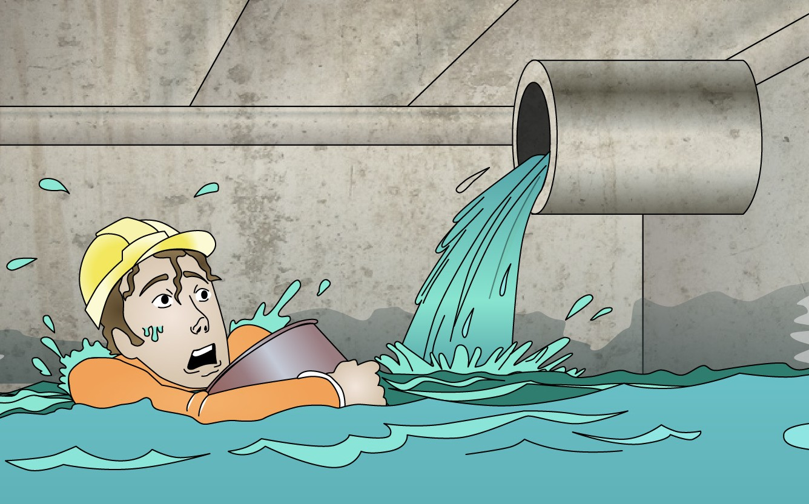
Confined space hazards
15

Slide 16
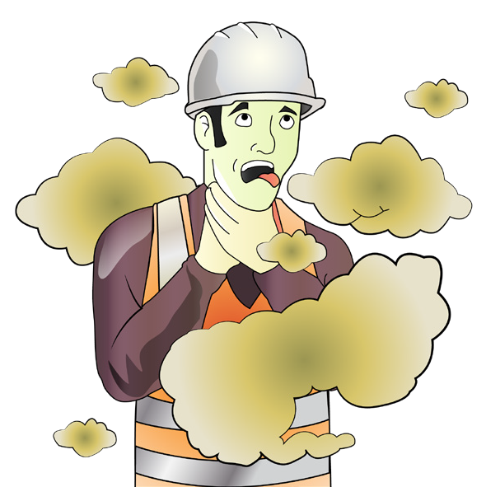
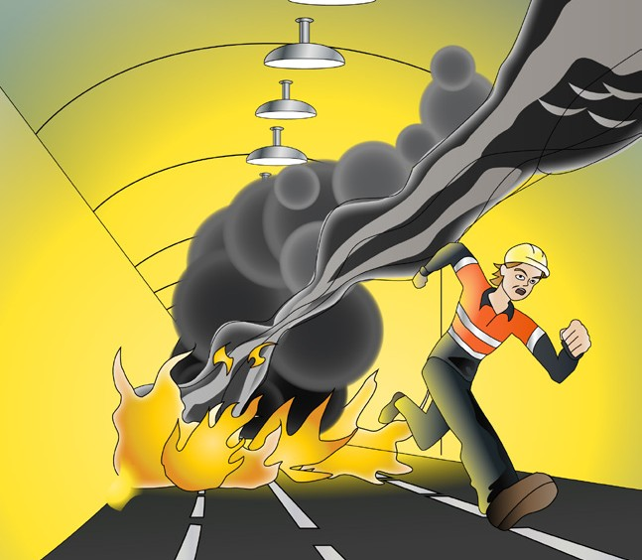
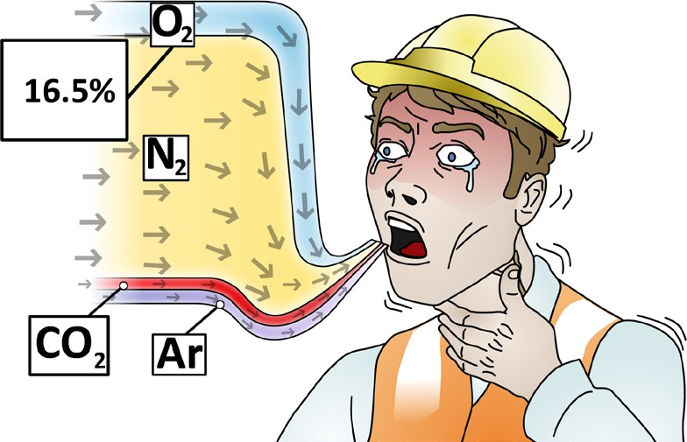
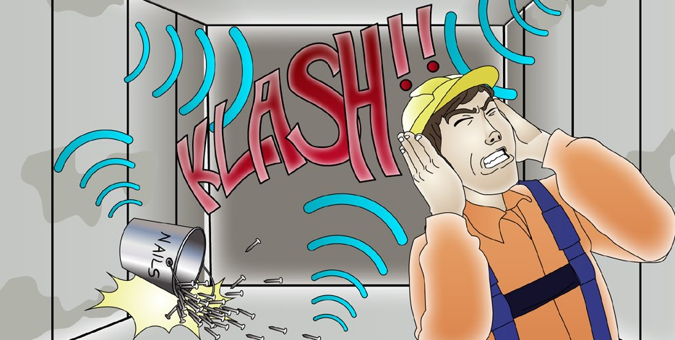
PC 1.3
CONFINED SPACE HAZARDS
Hazards of working in a confined space
Fumes or gasses can make you unconscious (put you to sleep) or kill you | Fire or explosion from gasses
Not enough oxygen in the air to breathe properly | Noise levels can be higher in a confined space. You may damage your hearing if you do not wear hearing protection.
16

Slide 17

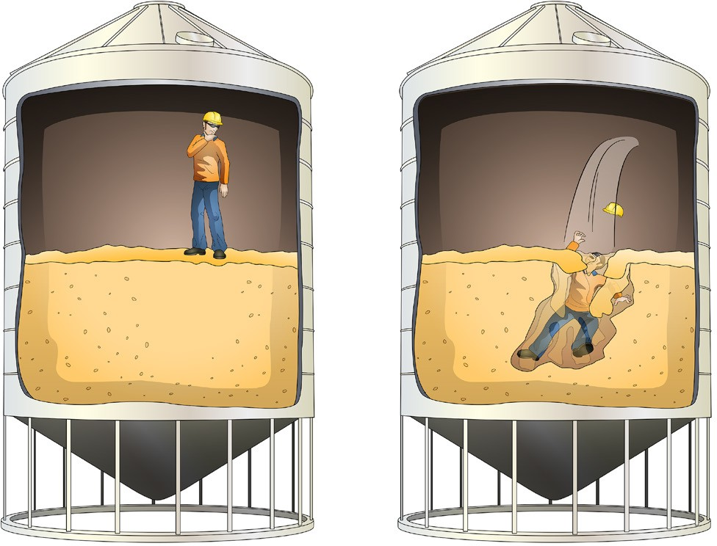
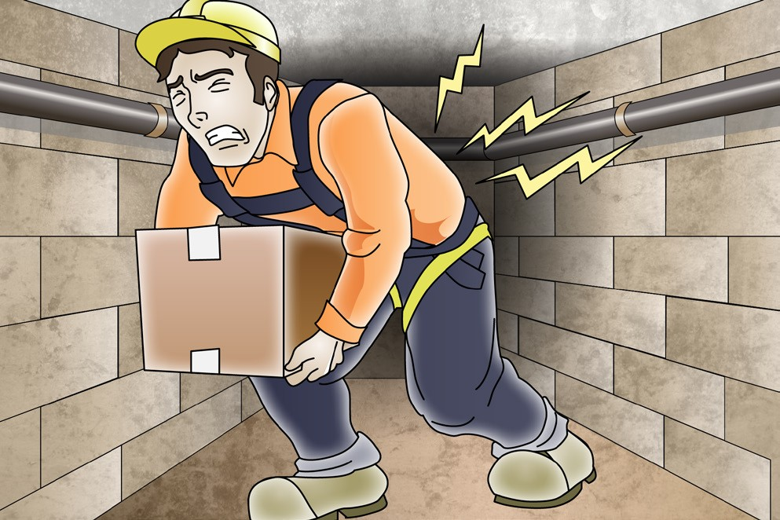
PC 1.3
CONFINED SPACE HAZARDS
Hazards of working in a confined space (continued)
Loose materials could engulf (smother) you.
For example, if you are working in a wheat silo, the wheat you are standing on is a loose material.
It is easily displaced (moved) allowing you to sink and be trapped under the wheat.
You will not be able to breathe.
You may need to wear PPE such as a harness, which makes it hard to lift or carry tools or equipment.
You could strain a muscle or drop something.
17

Slide 18
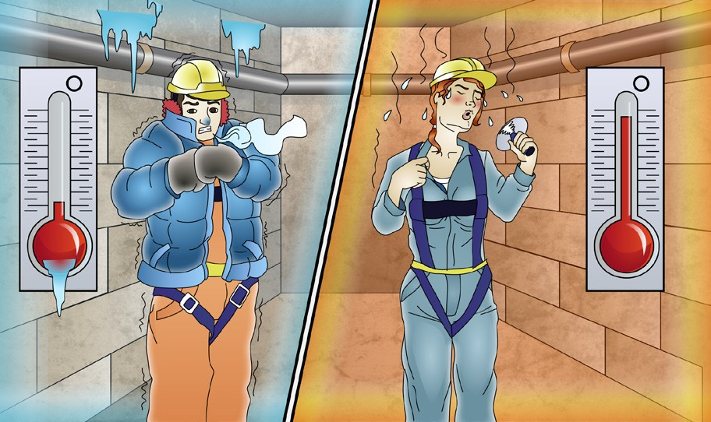
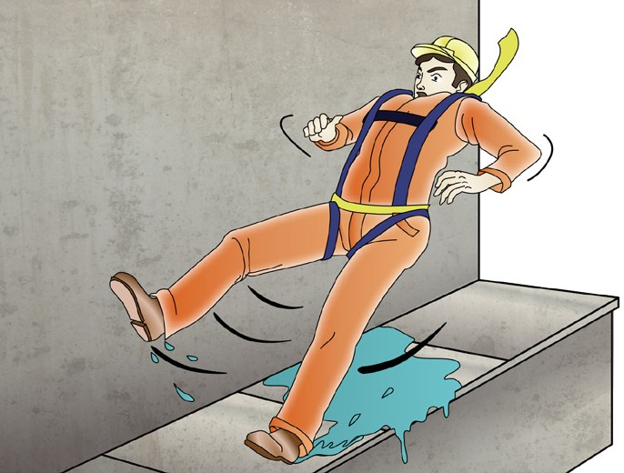
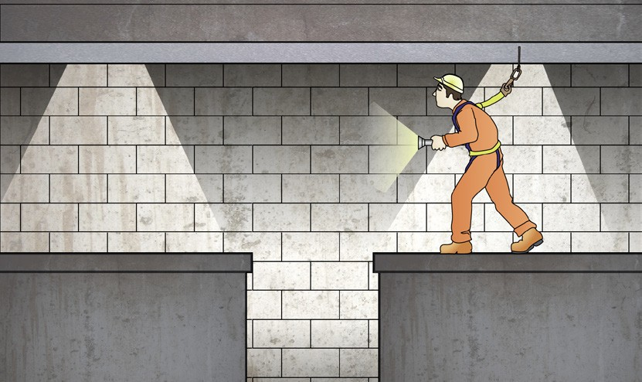
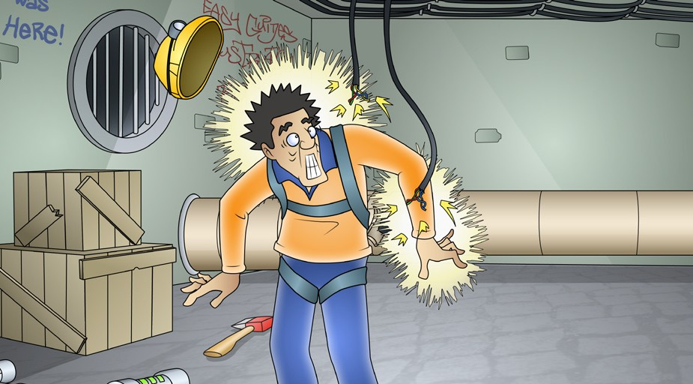
PC 1.3
CONFINED SPACE HAZARDS
Hazards of working in a confined space (continued)
The space might be too cold or too hot | You could slip, trip or fall because of hazards like rough ground or wet floor
There could be hazards you cannot see because of poor lighting | Cables or pipes could electrocute or burn you
18

Slide 19
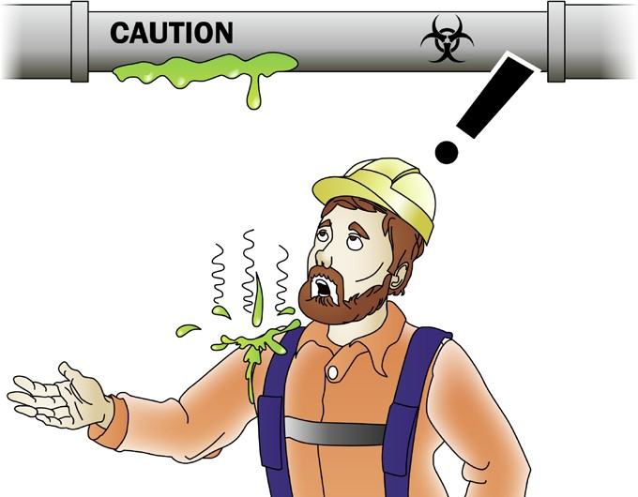


PC 1.3
CONFINED SPACE HAZARDS
Hazards of working in a confined space (continued)
A machine could entangle or crush you. You should always isolate the danger when doing maintenance on machinery. | Your skin could touch a dangerous chemical. This could cause a skin allergy, irritation, burns or worse.
 | Biohazards Moulds, germs, or animals (such as insects, rats or snakes) may live in the space.
19

Slide 20




PC 1.3
CONFINED SPACE HAZARDS
Hazards of working in a confined space (continued)
Something entering the space that you did not plan for. For example, steam, water or gasses flow into a space you are working in from another pipe. | Rescuing a person who is injured or unconscious is very difficult in a confined space. It may be dangerous to enter the confined space.
If the entry to a confined space is on a road or footpath, a car could hit you.
20

