Slide 1
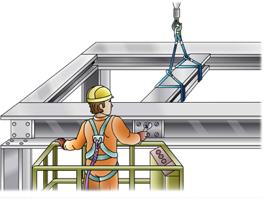
RIGGING – BASIC
SAFETY AND LICENCE GUIDE
Training support material for:
CPCCLRG3001
Licence to perform
basic rigging

Slide 2
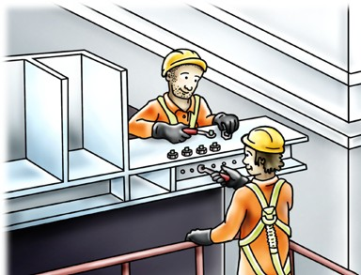
Introduction to Rigging – Basic
5

Slide 3
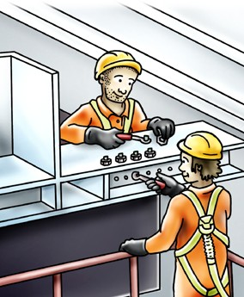
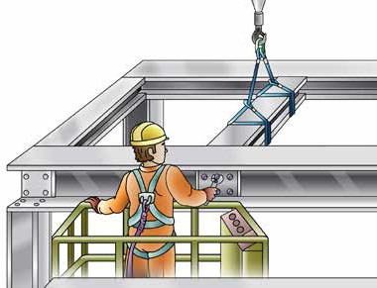
What is rigging?
INTRODUCTION TO RIGGING – BASIC
Rigging work means the use of mechanical load shifting equipment (and associated gear) to:
Move, place or secure a load using plant, equipment or members of a building or structures to ensure the stability of those members
The setting up or dismantling of cranes or hoists.
6

Slide 4
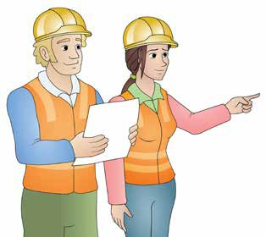
PLAN TASK
Plan task
Element 1
19

Slide 5
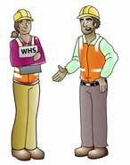
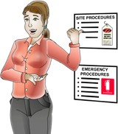
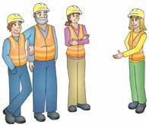
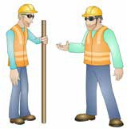
Talk with others about site hazards
PC 1.4 PLAN TASK
Before starting any job on a worksite it is important you talk to the site supervisor or WHS/OHS officer or representative to find out about any site rules, procedures or policies that may affect the way you carry out the work.
Some people you may check with about site hazards may include:
WHS/OHS representative or safety officer |  | Site supervisors
Workmates | Site engineers |  | Authorised managers
24

Slide 6
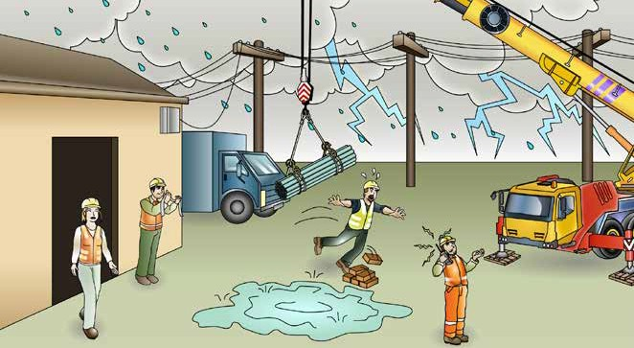
Identify workplace hazards
PC 1.4 PLAN TASK
A hazard is anything that can hurt you or others while you work. The government classes rigging as high risk. By law, only a licensed person can do rigging work. The licence includes knowing what workplace hazards to look for — and the causes.
While there is no substitute for experience, this book shows you the hazards you need to know about while you do rigging work.
Slinging hazards
Powerlines
Weather conditions
Buildings/obstructions
Other traffic
Poor lighting
Pedestrians
Tripping hazards
Ground stability
Radio interference
25

Slide 7
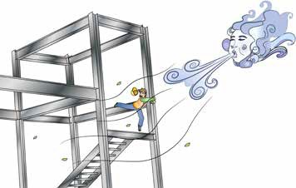
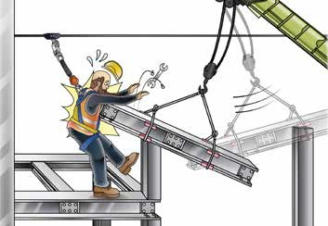
PC 1.4
PLAN TASK
Working in high winds
Working in high winds on steel structures is very dangerous.
There is a risk you could be knocked over
There is also a risk you might be blown
off the structure.
Lifting a beam that won’t move
You must always take care if a crane is lifting a beam near you. But if the crane’s boom is being lifted and the beam doesn’t move, stand clear.
The beam might suddenly move.
This could damage the crane
It might also injure you.
29

Slide 8
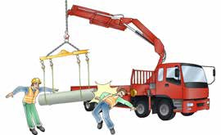
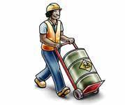
PC 1.4
PLAN TASK
Risk control and safety measures
What are risk/hazard controls?
They are actions you take to control, reduce the chance, or prevent a danger that can injure or hurt you.
You use the actions to do away with or to reduce risk to workmates and property
Take these actions before you start the task.
Hazard, risk and control
What is a hazard? | What is a risk? | What is control?
A hazard is anything that can harm you or others while you work. | A risk is the chance of a hazard injuring or hurting a person. In other words, what is the chance of the hazard hurting you? | A control is what you can do to stop the hazard from hurting or killing someone.
40

Slide 9
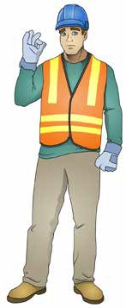
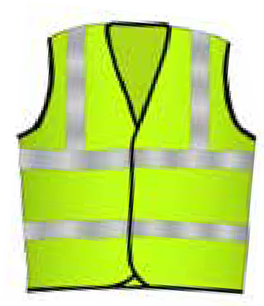
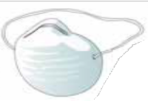
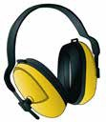
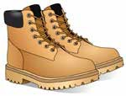
PC 1.4 PLAN TASK
6. Use personal protective equipment (PPE) (wear safety clothing)
Wear safety clothing and PPE to control hazards. Avoid relying on these as the only way to control hazards. Make sure the PPE is right for you and the company has trained you in how to use it.
For example, wear high-visibility clothing so workmates can see you more easily.
Hard hat
Safety vest
Dust mask
Safety gloves
Long sleeved top
Ear muffs
Boots that cover the whole foot
Safety glasses/goggles, Sunglasses
Long pants
Sunscreen
As a minimum, a rigger should wear a safety helmet, rubber-soled boots, a hi-vis vest/clothing and gloves.
50

Slide 10
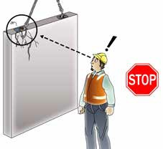
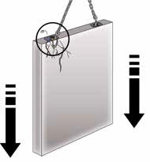
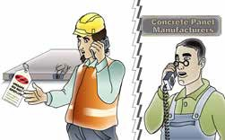
PC 1.5
PLAN TASK
QUESTION 3
You are using a lifting insert and it breaks.
What do you do?
Stop working | Safely lower or support the load if possible
Tag the equipment out of service | Do not use the lifting insert. Report the defect to the manufacturer of the panel. They might fix or replace it.
52

Slide 11
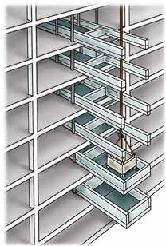
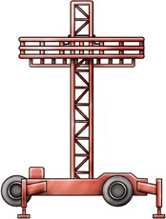
Associated plant
PC 1.7 PLAN TASK
You will also need to think about any associated plant and the forces applied to them. This may include:
Mast climbers A mast climber is a platform raised for temporary access to heights. A dead load is a mast climber weight on the ground with no elevation or movement. A dynamic load is a mast climber being elevated with workers, tools and materials on it. | Cantilevered crane loading platform A temporary loading bay cantilevered from the face of a building or structure to land or lift crane-handled loads. | Materials hoist A materials hoist is a powered elevator you use to move materials up and down a building. A wind load is the wind force on the materials hoist. A dynamic load is a barrow hoist with a wheelbarrow of sand.

Slide 12
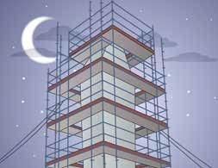
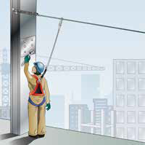
Identify rigging equipment
PC 1.6 PLAN TASK
You need to know a wide range of rigging and associated plant and equipment to carry out rigging work.
Associated equipment – Part 1
Scaffolds
Scaffolds are temporary frames used to support people and materials
in the construction or repair of buildings and other large structures.
Any scaffold higher than 4 metres needs to be designed and built by a licensed scaffolder.
Static line
A wire line used to anchor you to the building, but still offering the
freedom to walk around and work freely.

Slide 13
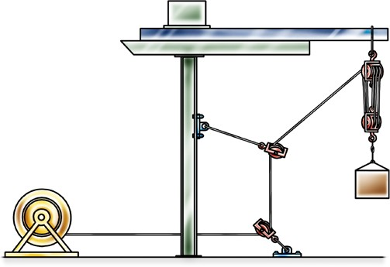
PC 1.6
PLAN TASK
QUESTION 4
Look at the picture.
The winch and the head sling are shown already.
What are the other parts?
See next page for answer
Counterbalance
Needle
Head sling
Top block
Lead rope
Lower block
Lead rope
Winch
Lead block
...CONTINUES ON NEXT PAGE
77

