Slide 1
LEARNER GUIDE
Training support material for:
CPCCWHS2001 –
Apply whs Requirements, Policies and Procedures in the Construction Industry
Includes test yourself questions
Industry Training Resources

Slide 2
Contents
Introduction
5
Element 1 — Identify and assess risks
11
Element 2 — Identify hazardous materials and other hazards on work sites 55
Element 3 — Plan and prepare for safe work practices
83
Element 4 — Apply safe work practices
99
Element 5 — Follow emergency procedures
133
Glossary
157
Test yourself — Questions
161

Slide 3
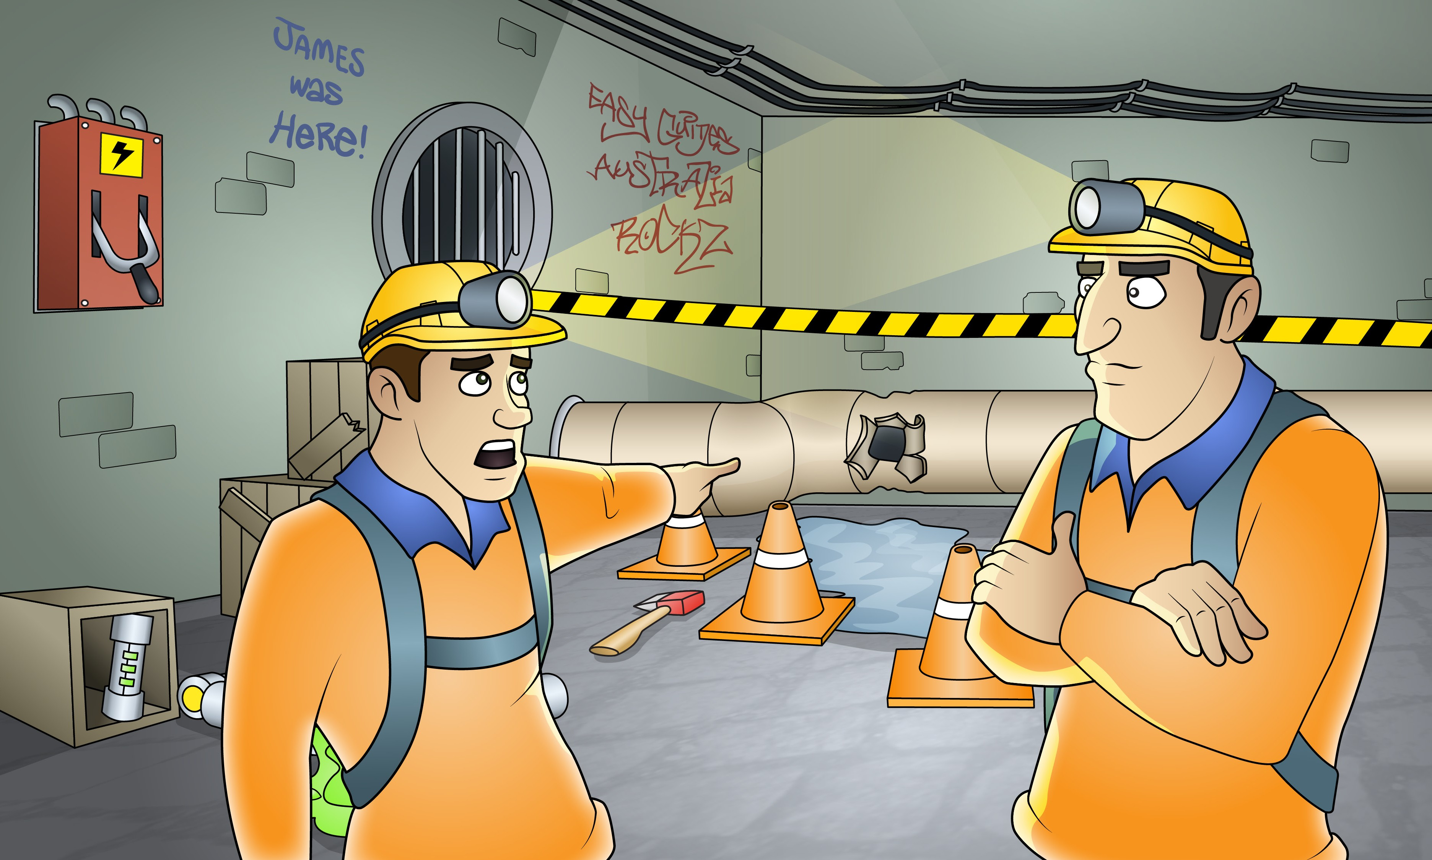
Element 1 -
Identify and assess risks
This element covers the following performance criteria:
Identify, assess and report hazards in the work area to designated personnel.
Report safety risks in the work area based on identified
hazards, to designated personnel.
Follow safe work practices, duty of care requirements and safe work instructions for controlling risks.
Contribute to WHS, hazard, accident or incident reports in accordance with workplace procedures, Australian government and state or territory WHS legislation, and relevant information.

Slide 4
2.1 1.1 Identify, assess and report hazards
PC 1.1 IDENTIFY AND ASSESS RISKS
IDENTIFY OHS LEGISLATIVE REQUIREMENTS
A hazard is anything that can harm you or others while you are working. The first thing you need to do is to identify these hazards before you start work.
Take a good look at your workplace and decide if anything could possibly cause injury to you or anyone else in the area.
Above head height
You should check above eye level for:
Powerlines
Buildings
Trees
Other obstructions
Objects that could fall from height.
Ground to eye height
You should check around eye height for:
Other equipment • Pedestrians
Machinery • Things in the path of travel
People • Other obstructions.
Ground level (and below)
You should check the ground to see:
If the surface is stable and level
If there are spills or wet surfaces
Is there debris/rubbish
Is the surface strong enough to support the weight of any equipment or materials
Are there trenches or recently backfilled trenches
Is the ground unstable.

Slide 5
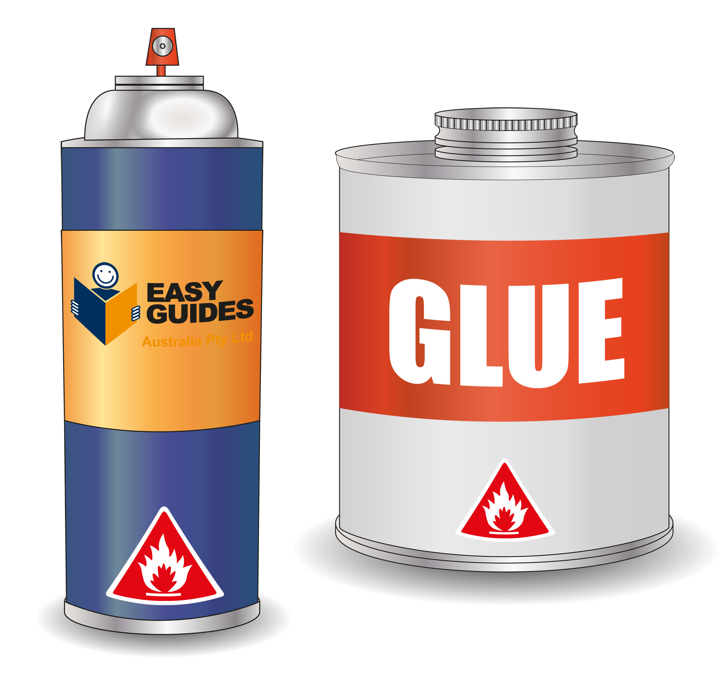
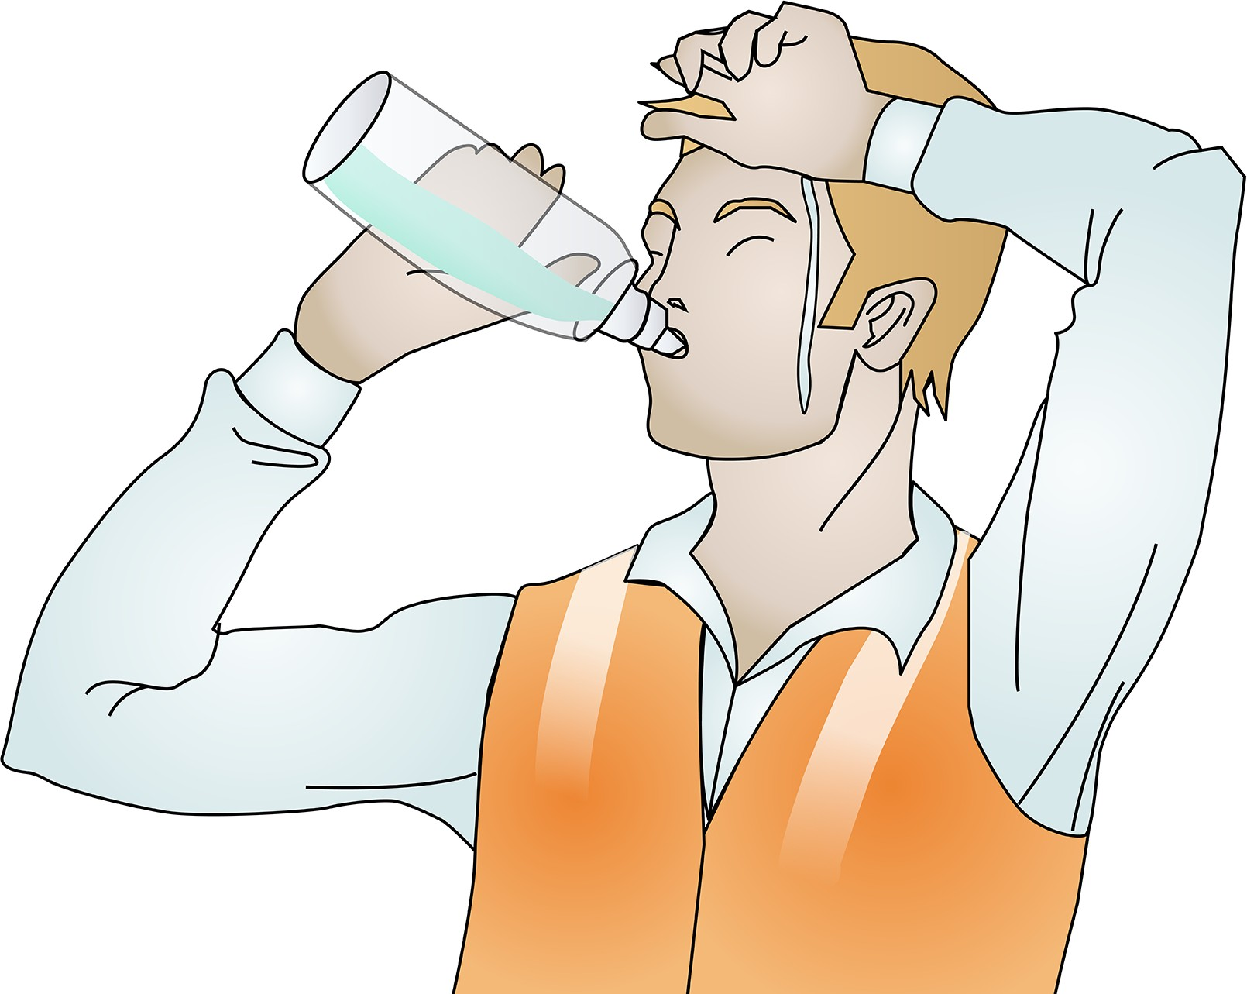
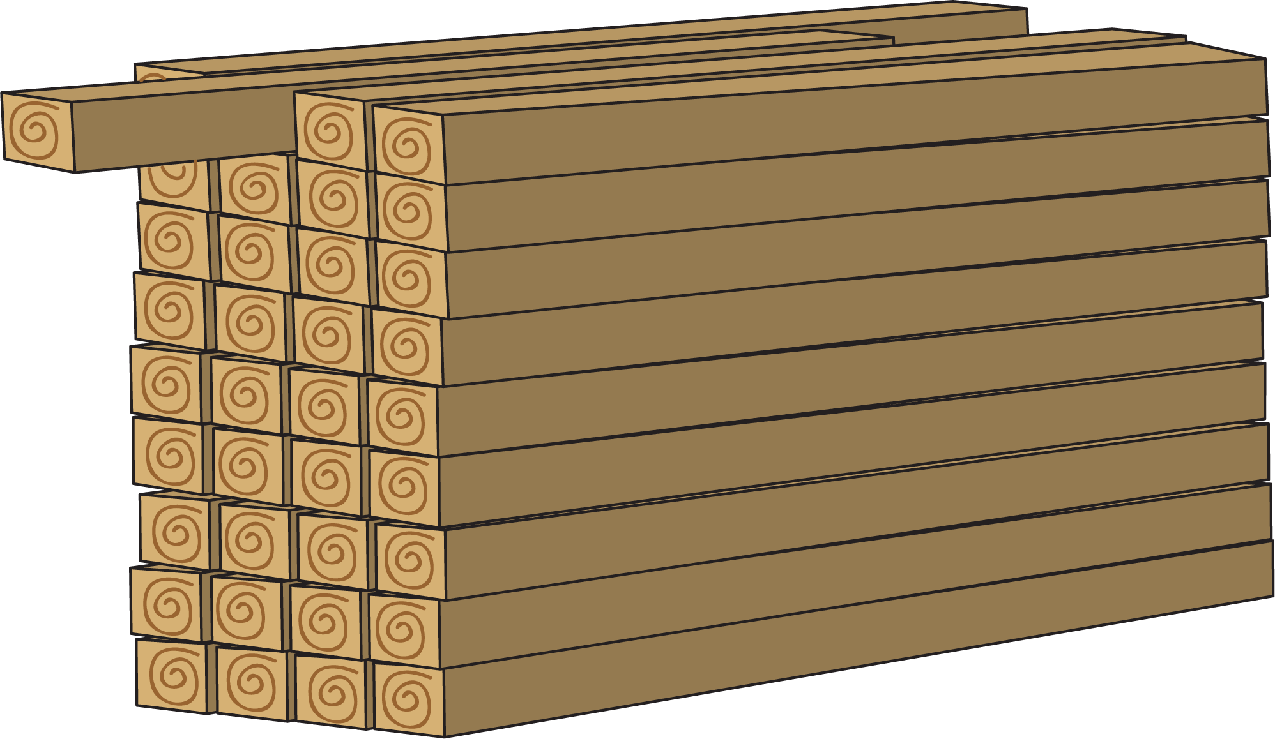
PC 1.1
IDENTIFY OHS LEGISLATIVE REQUIREMENTS
IDENTIFY AND ASSESS RISKS
Common construction hazards (continued)
Fires Decide if your work could cause a fire. | Very hot or cold temperatures or ultraviolet (UV) radiation When working in a hot environment (out in the sun or near hot equipment) take steps to prevent heat- related illnesses, such as heat stroke (which is life threatening). Drink plenty of water. Wear long sleeves and sunscreen.
 | Overhanging beams or anything that sticks out and could hit workers in the head Remove these hazards if possible. Otherwise tag them so workers can quickly see where they are.

Slide 6
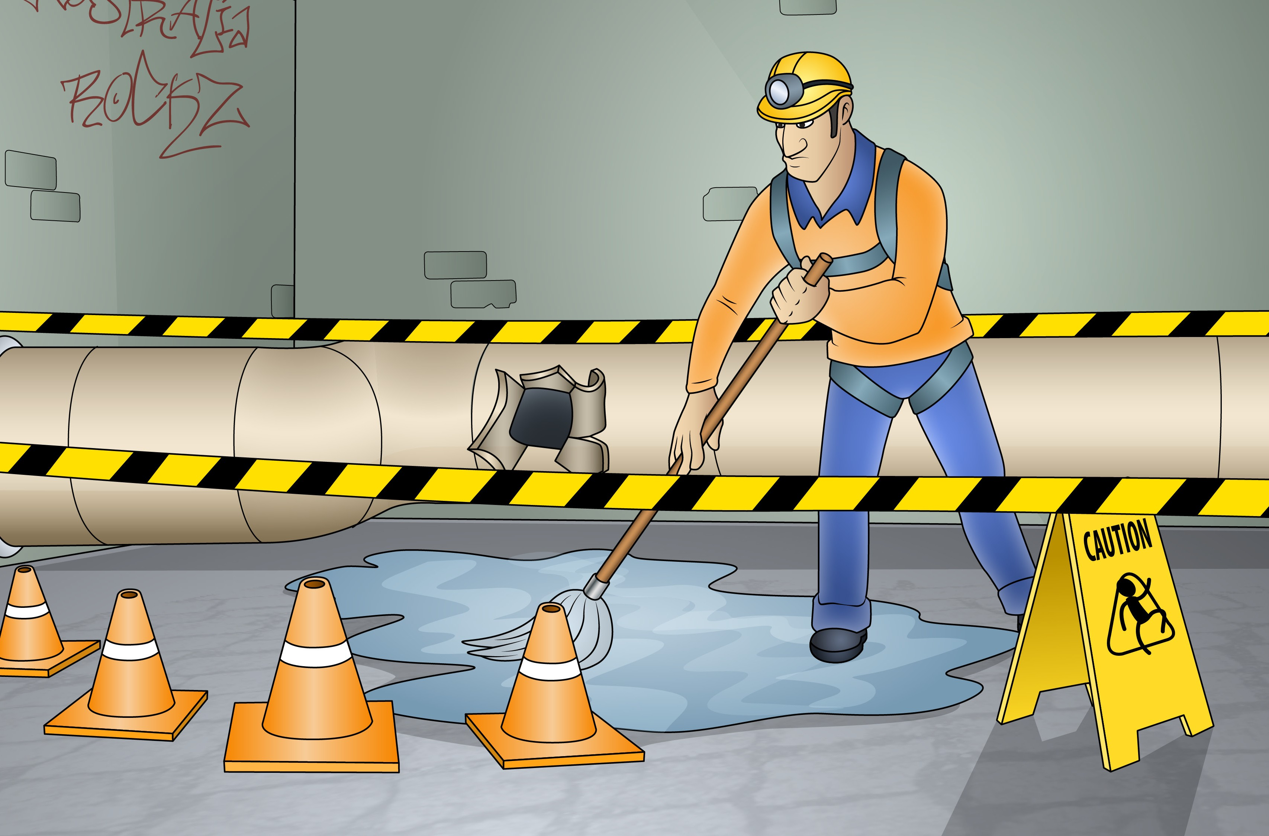
Element 2 - Identify hazardous materials and other hazards on work sites
This element covers the following performance criteria:
2.1 Correctly identify and, if appropriate, handle and use hazardous materials on a work site in accordance with legislative requirements, and workplace policies and procedures.
Apply measures for controlling risks and construction hazards
effectively and immediately.
Use appropriate signs and symbols to secure hazardous materials that have safety implications for self and other workers, immediately they are identified.
Identify asbestos-containing materials on a work site and report to designated personnel.

Slide 7
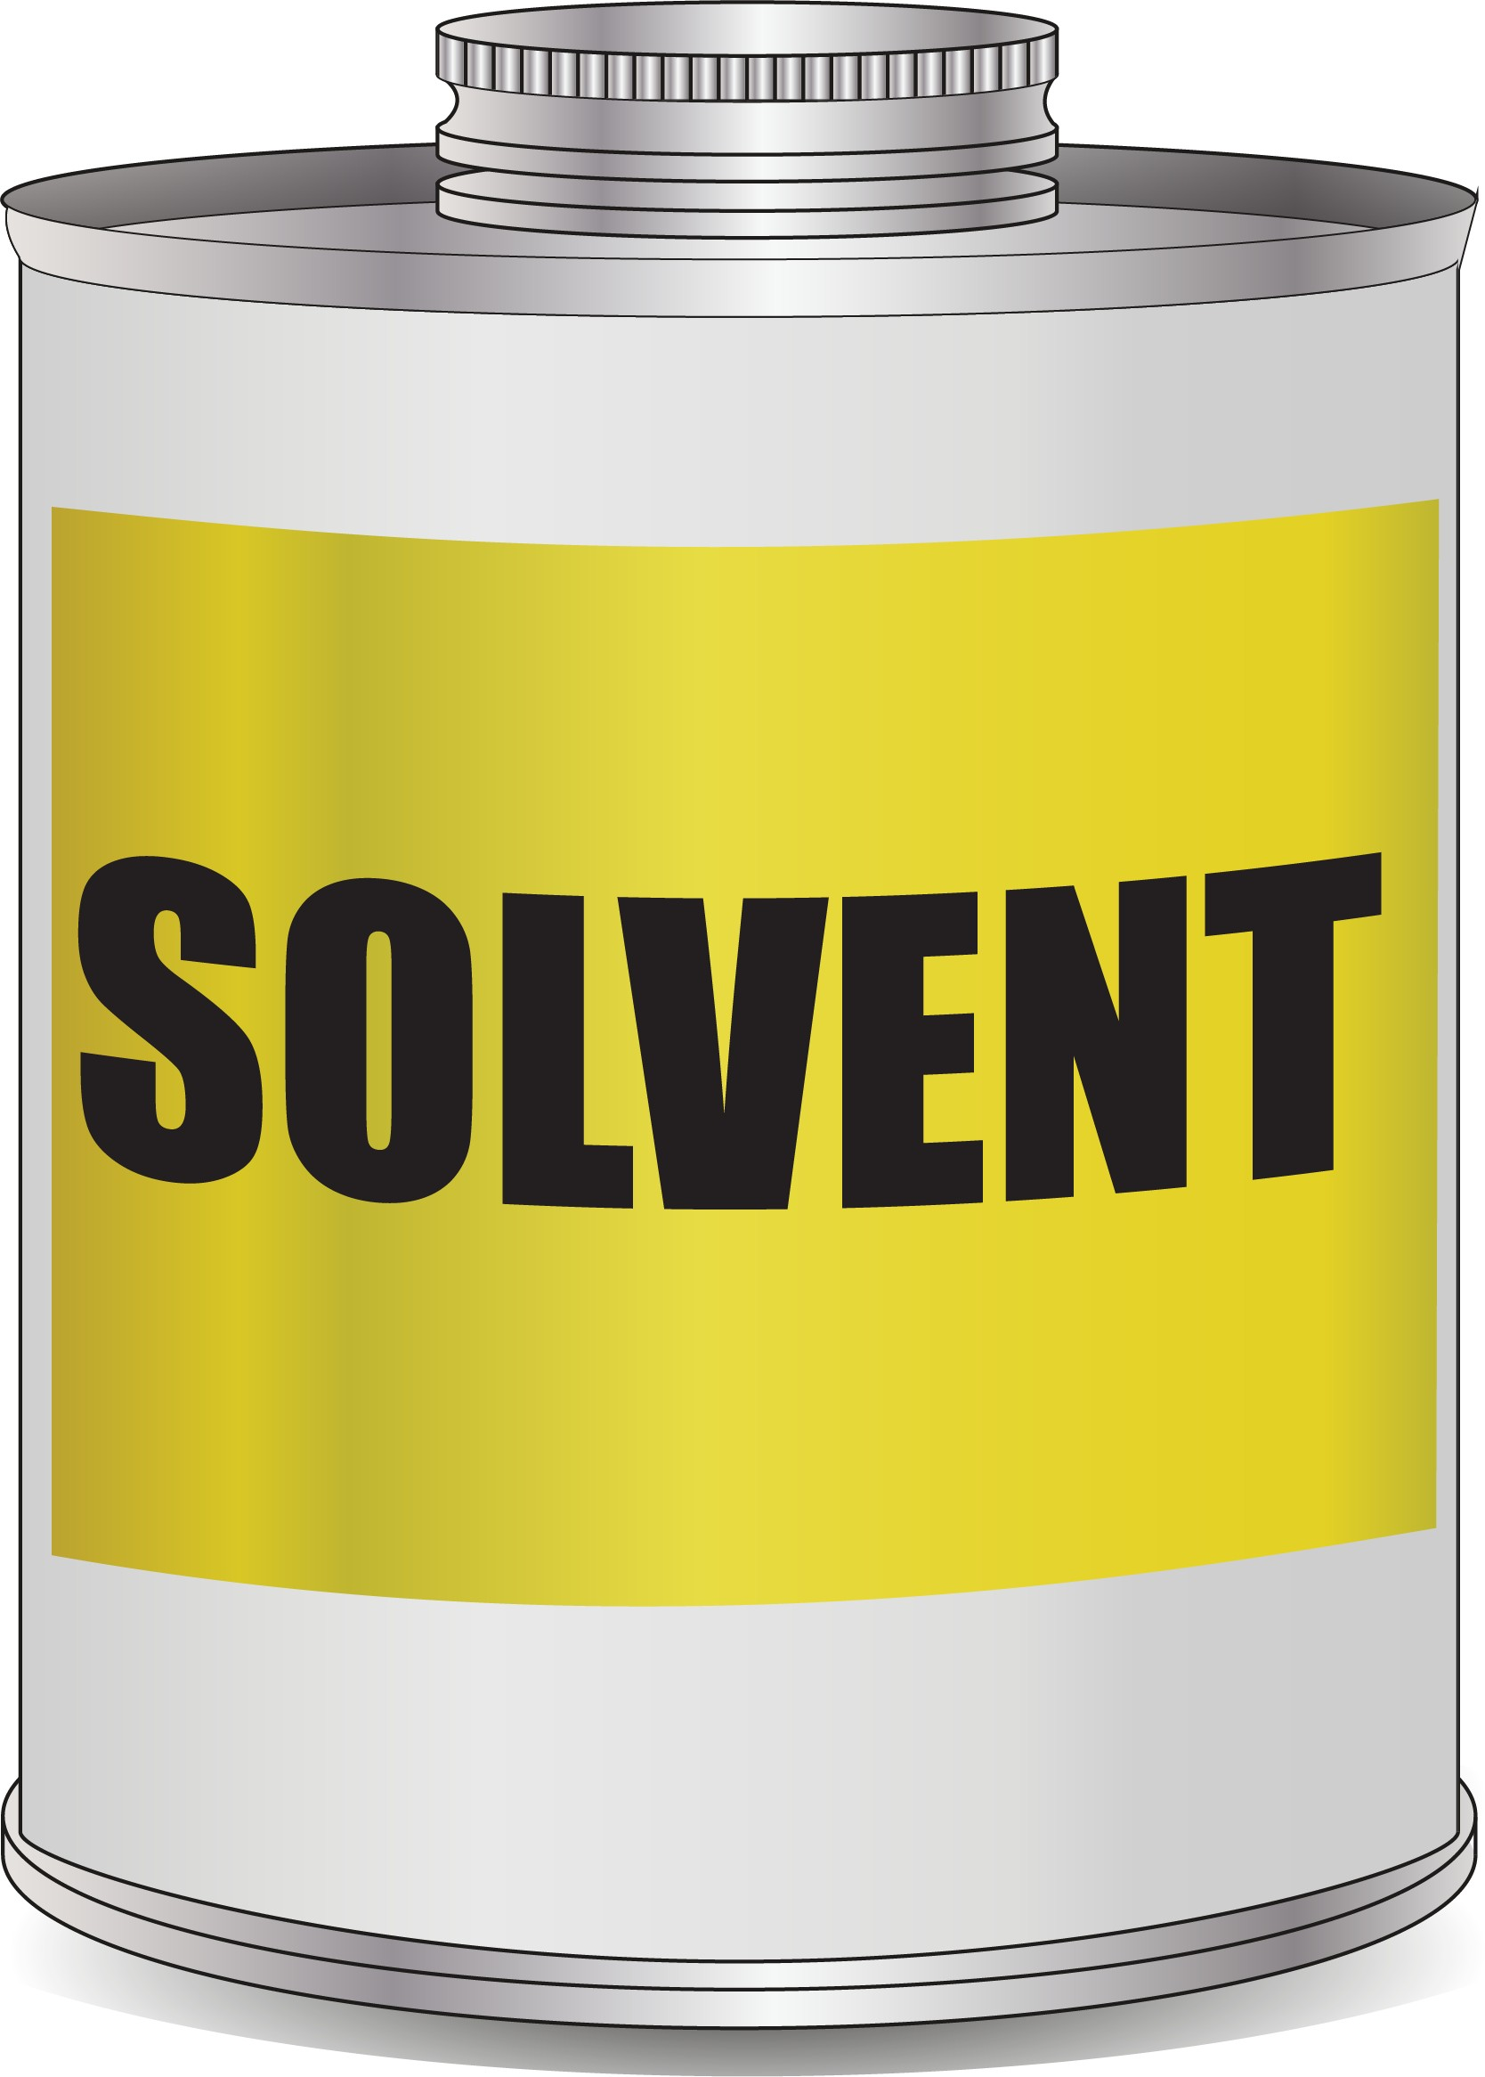
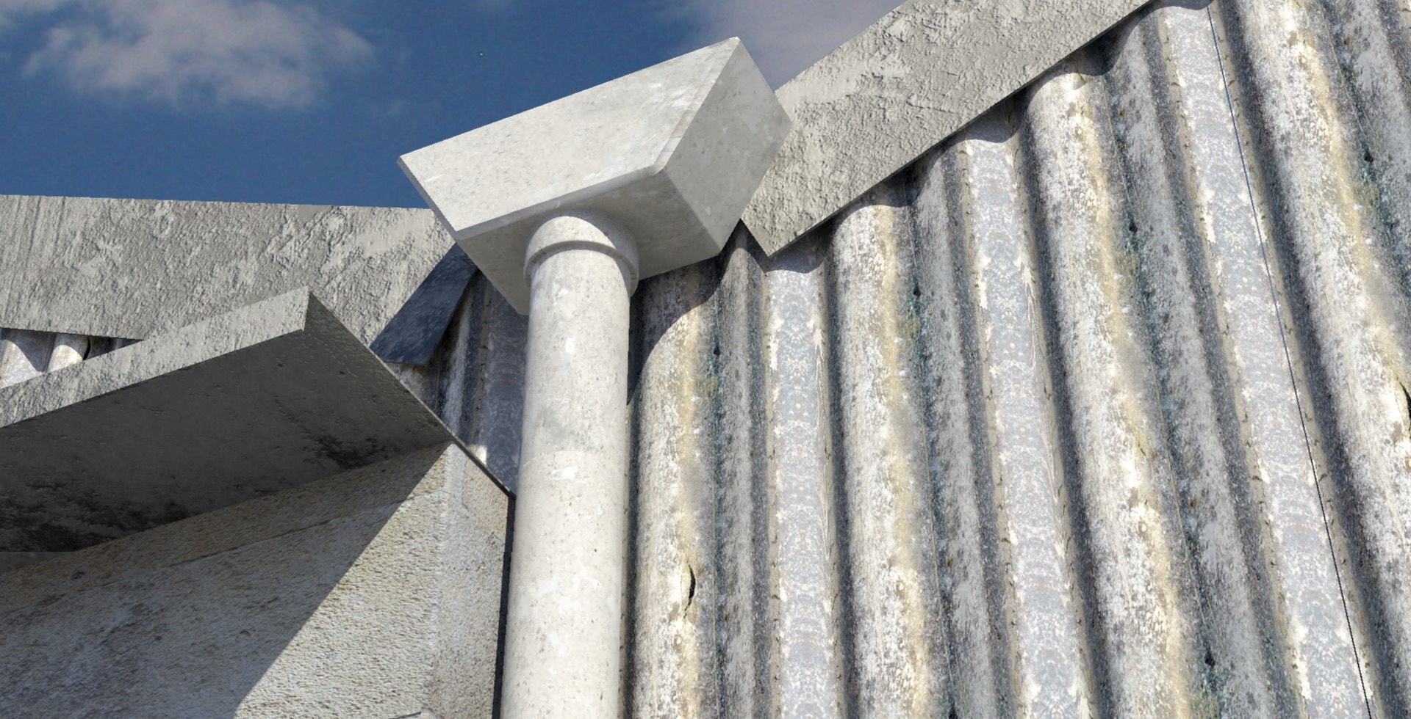
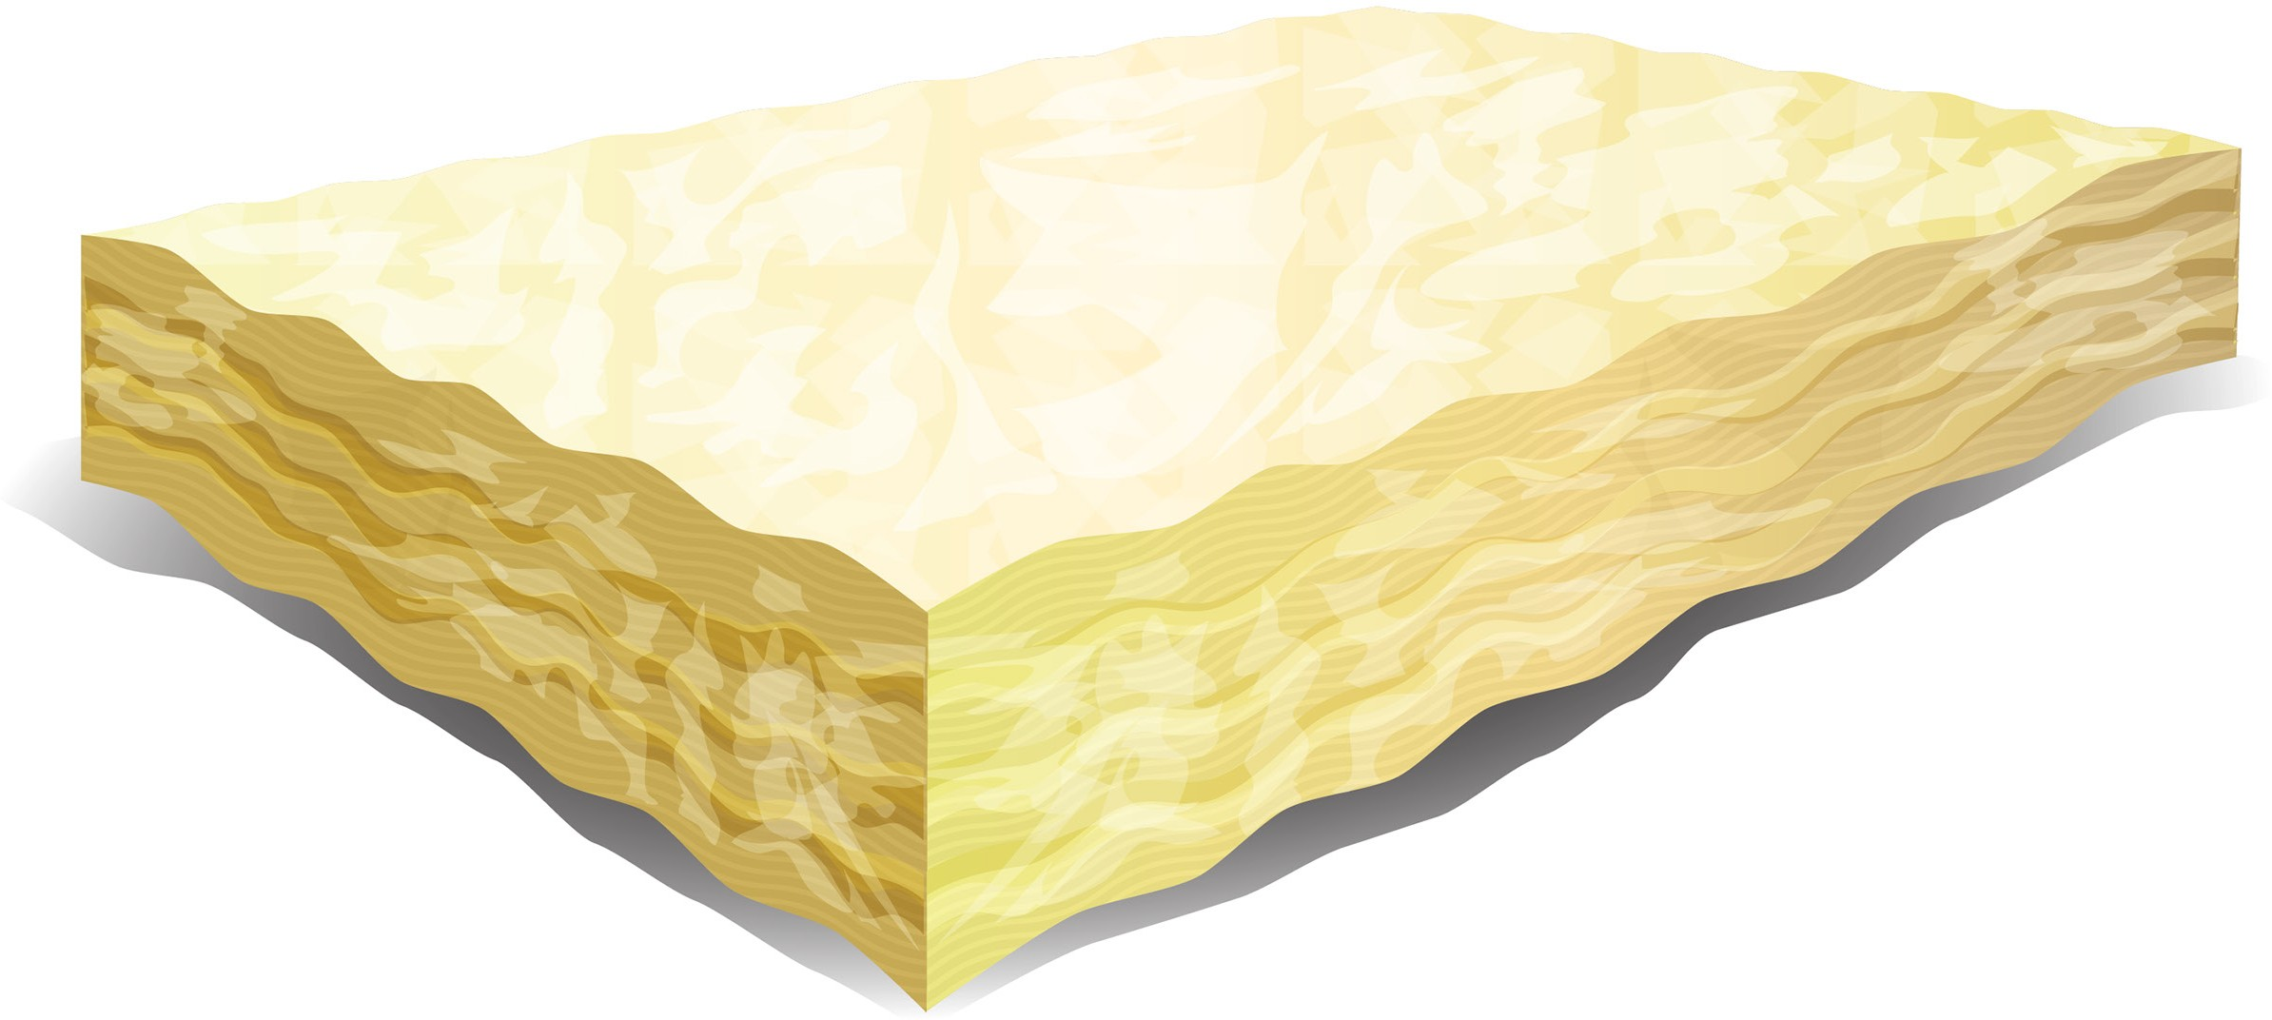
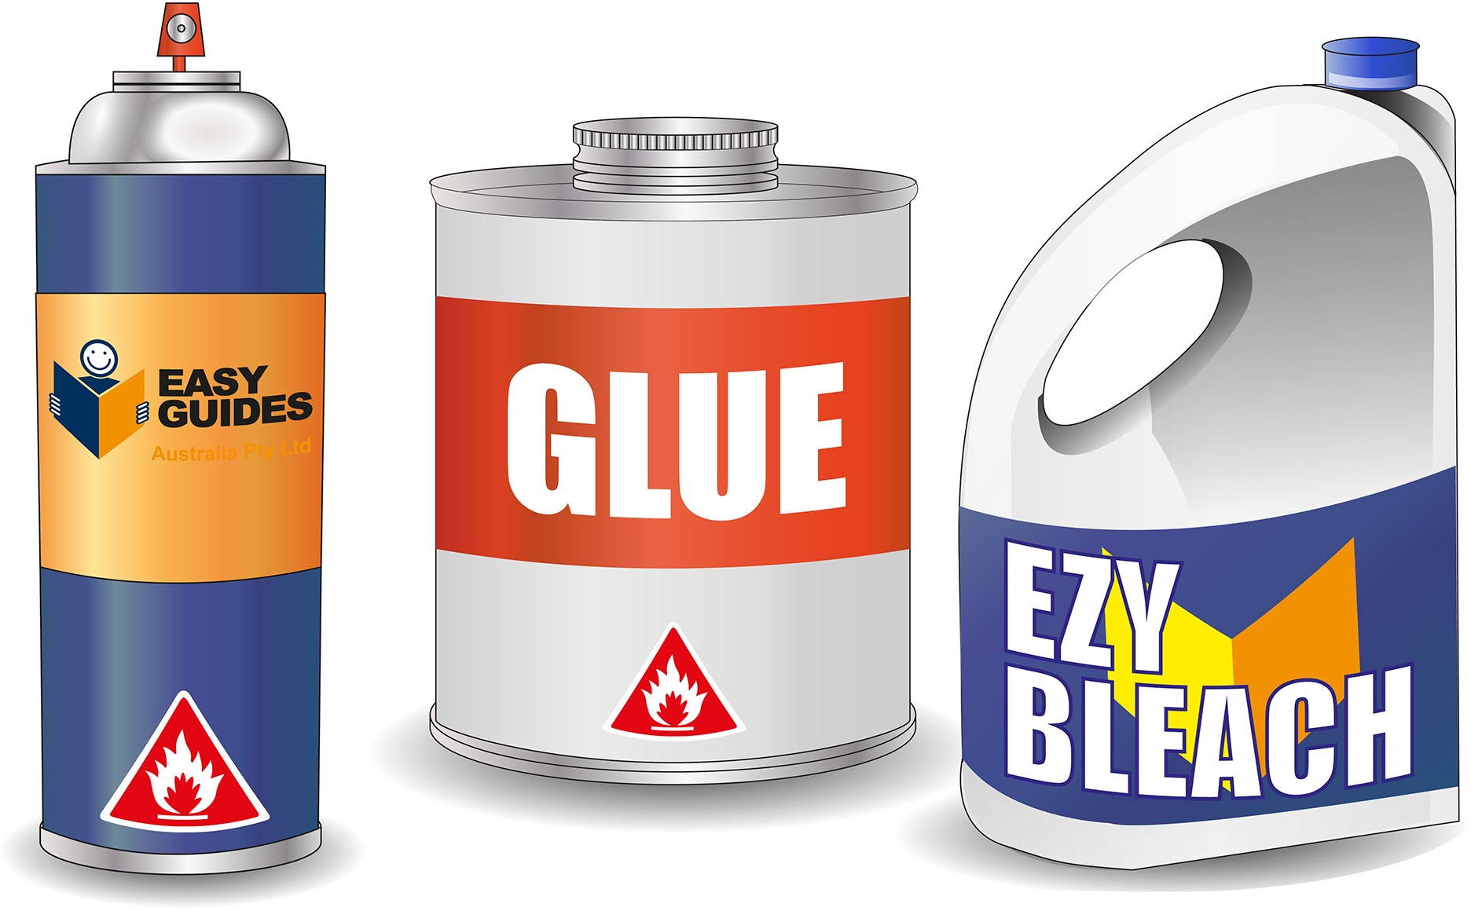
PC 2.1
IDENTIFY CONSTRUCTION HAZARDS AND CONTROL MEASURES
IDENTIFY HAZARDOUS MATERIALS AND OTHER HAZARDS ON WORK SITES
2.1 2.1 Identify hazardous materials
Construction worksites often contain materials that can harm you or others. Some hazardous materials commonly found on construction sites include:
Asbestos containing materials (ACM) - anything which contains asbestos. | Insulation materials | Solvents
Glues and cleaning chemicals | Treated timber products

Slide 8
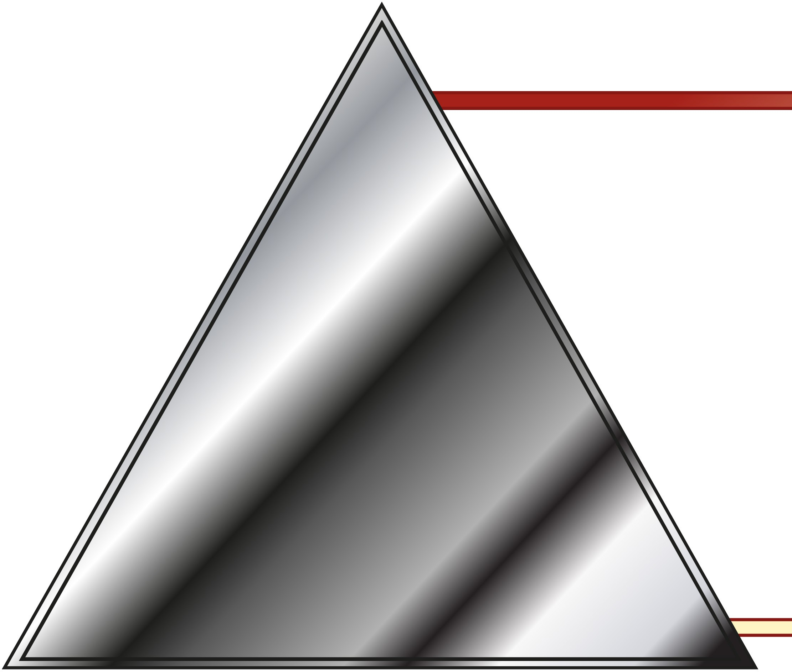
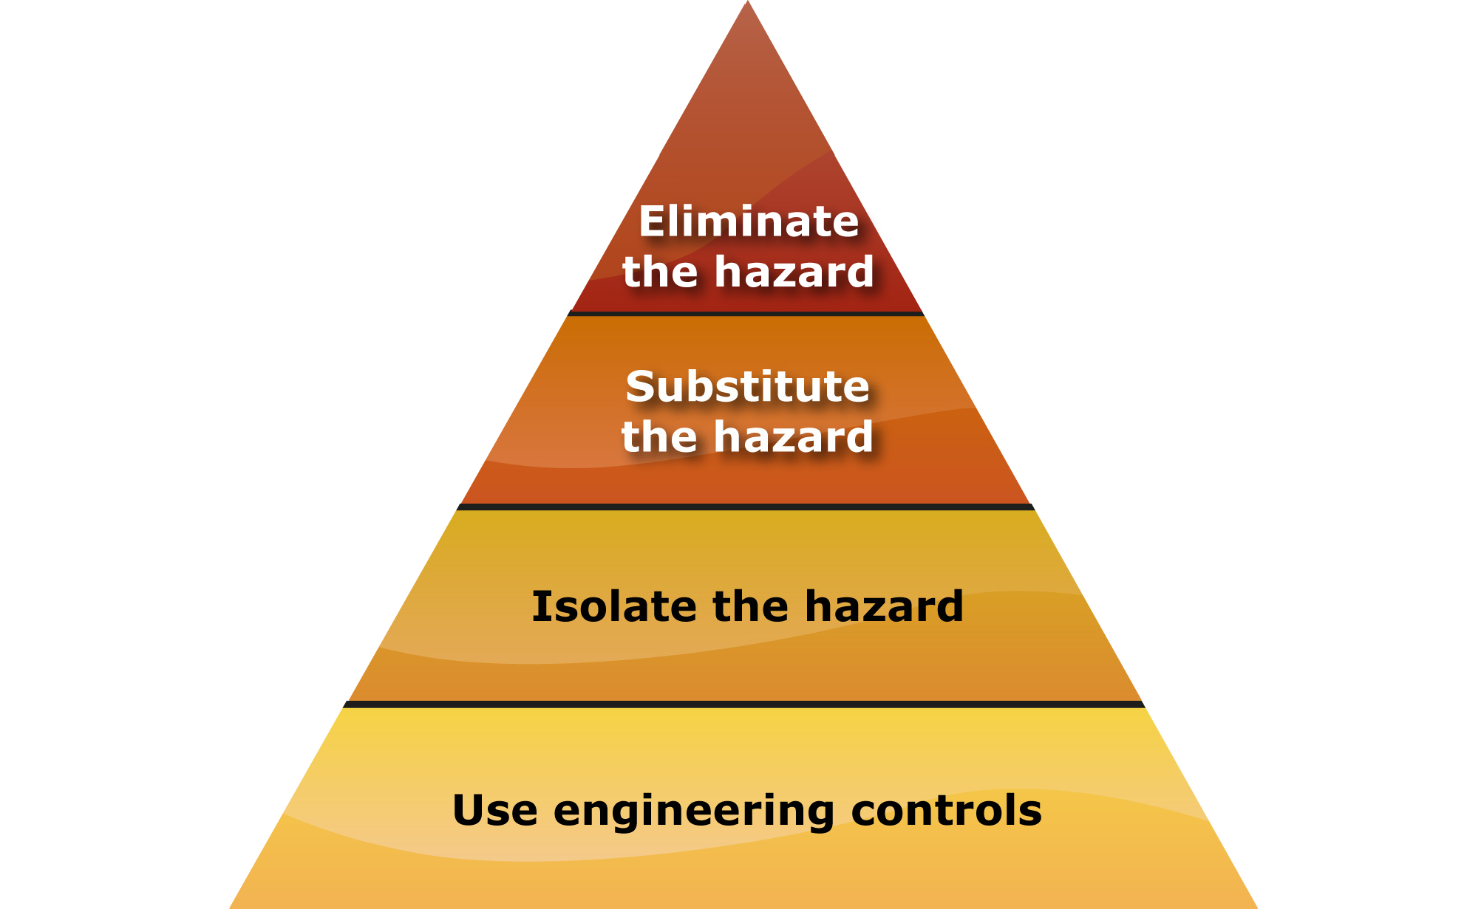
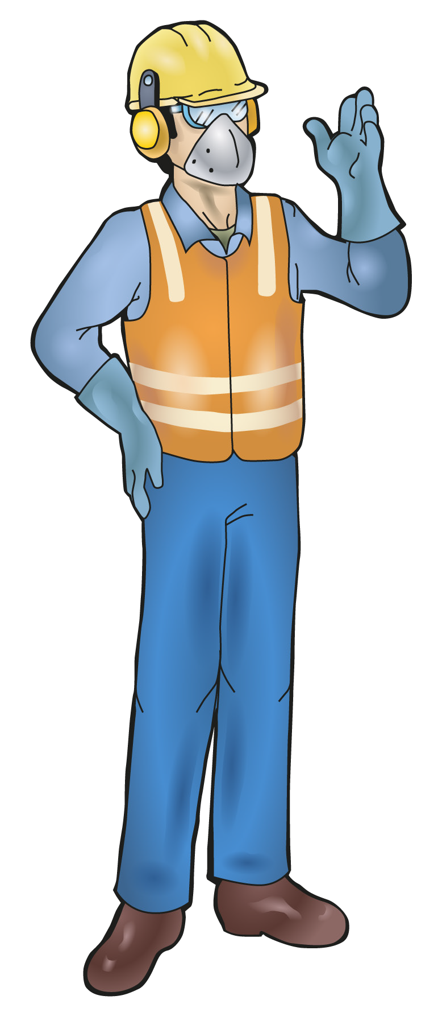
2.2 Measures for controlling risks and construction hazards
PC 2.2 IDENTIFY HAZARDOUS MATERIALS AND OTHER HAZARDS ON WORK SITES
IDENTIFY CONSTRUCTION HAZARDS AND CONTROL MEASURES
To identify and manage workplace hazards requires a simple process.
1
2.
3.
Look around the workplace. List all hazards.
Then using the Hierarchy of hazard control ‘triangle’ shown here,
find the most effective method to control the hazards.
What does each level of the Hierarchy of hazard control triangle mean?
Hazard control | How to use the control
Eliminate the hazard (Most effective control) | Get rid of the hazard from the area or get rid of the dangerous machine
Substitute the hazard | Use a different process, material or piece of equipment
Isolate the hazard | Put a barrier or fence around the hazard to keep workers away from the hazard.
Use engineering controls | For example – attach guards to the machine to protect users.
Use administrative controls | Put up signs, train workers how to use the machine safely, write procedures to tell workers how to do the job
Use personal protective equipment (Least effective control) | Wear gloves and goggles when doing the work

